Slide 1
Physics and Perspectives of the ATLAS Experiment at the LHC
Andreas Hoecker (CERN)
CERN TE Graduate Workshop 2025

Slide 2
It’s all made of a handful of particles and forces
The sub-atomic structure of matter (a very simplified picture)
The universe, as we describe it, is a strange place*
Elementary particles are point-like — with no spatial extent at all
Without some remarkable mechanism at play, elementary particle would have no mass
*Frank Wilczek in physics/0511067

Slide 3
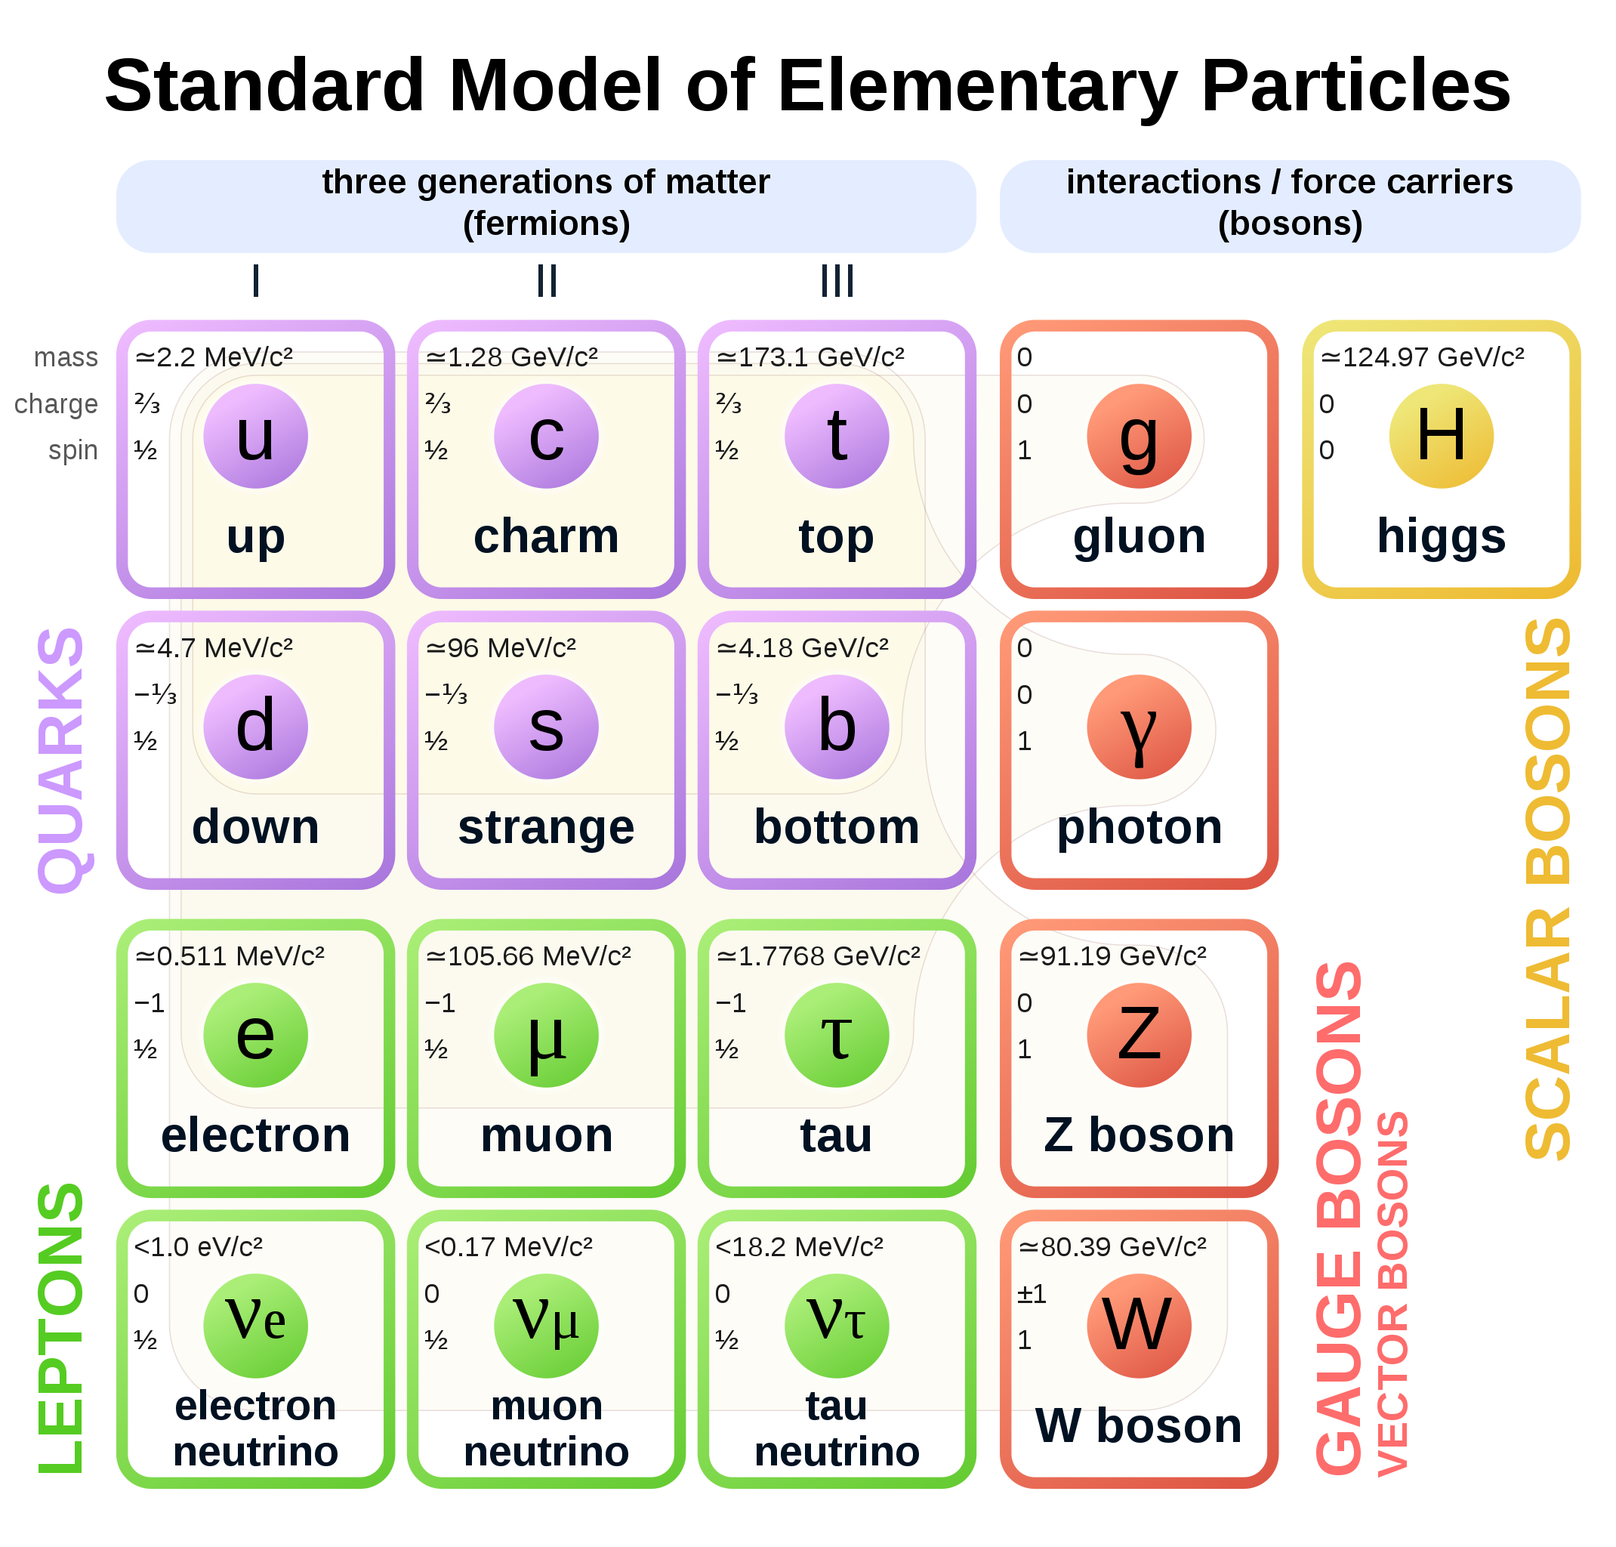
It’s all made of a handful of particles and forces
The sub-atomic structure of matter and its interactions is described by the Standard Model
In mathematical terms, particles are local excitations of quantum fields. There are matter fields (fermions) and force fields (bosons)
Completely new type of non-universal interactions, nothing to do with known forces
Spin 1/2
Spin 1
Spin 0

Slide 4
It’s all made of a handful of particles and forces
The sub-atomic structure of matter and its interactions is described by the Standard Model
Decades of international high-technology accelerator-based research gave us these insights
Completely new type of non-universal interactions, nothing to do with known forces
Spin 1/2
Spin 1
Spin 0

Slide 5
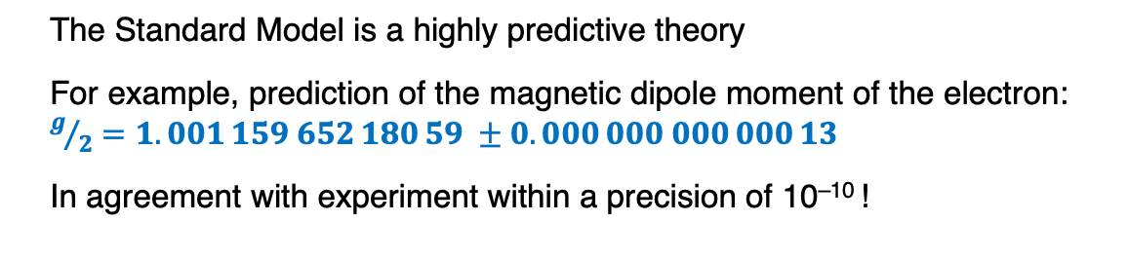
It’s all made of a handful of particles and forces
The sub-atomic structure of matter and its interactions is described by the Standard Model
The Standard Model is a highly predictive theory
For example, prediction of the magnetic dipole moment of the electron: $g/2=1.001 159 652 180 59 ±0.000 000 000 000 13$
In agreement with experiment within a precision of 10^{–10} !

Slide 6
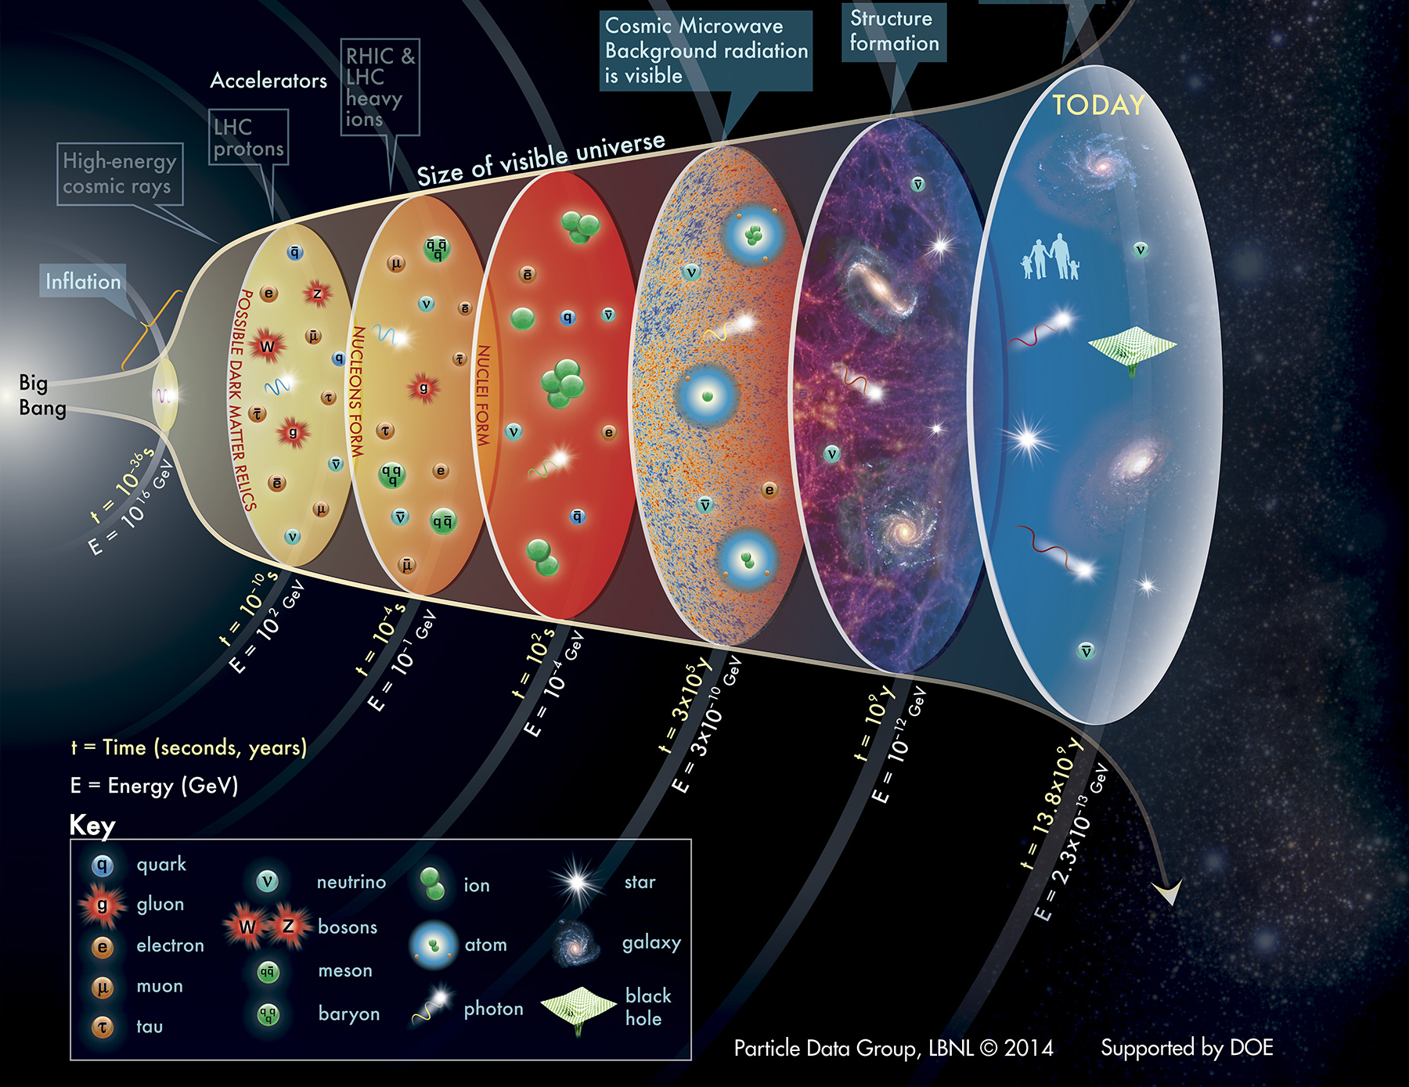
The Standard Model
… should not only work today, but also describe the history of the universe since the Big Bang 13.8 billion years ago
–12
T = 10¹⁵ K
T = 10¹² K
T = 10⁹ K
T = 4000 K
T = 60 K
T = 2.7 K

Slide 7
The Standard Model
… should not only work today, but also describe the history of the universe since the Big Bang 13.8 billion years ago
Matter ~ Antimatter
→ Annihilation
(very little) matter
But something is odd: why is there only matter left in the universe?
–12
T = 10¹⁵ K
T = 10¹² K
T = 10⁹ K
T = 4000 K
T = 60 K
T = 2.7 K

Slide 8
The Standard Model
… should not only work today, but also describe the history of the universe since the Big Bang 13.8 billion years ago
Matter ~ Antimatter
→ Annihilation
(very little) matter
But something is odd: why is there only matter left in the universe?
And what is the origin of the huge quantity of dark matter?
–12
invisible “dark” matter
T = 10¹⁵ K
T = 10¹² K
T = 10⁹ K
T = 4000 K
T = 60 K
T = 2.7 K

Slide 9
The Standard Model
… should not only work today, but also describe the history of the universe since the Big Bang 13.8 billion years ago
Matter ~ Antimatter
→ Annihilation
(very little) matter
But something is odd: why is there only matter left in the universe?
And what is the origin of the huge quantity of dark matter?
–12
invisible “dark” matter
T = 10¹⁵ K
T = 10¹² K
T = 10⁹ K
T = 4000 K
And why do elementary particles have mass at all? (Simply sticking masses onto particles has disastrous effects, causing certain predictions to diverge to infinity and creating mathematical inconsistencies)
A simple, though very profound question: how and when did mass occur?
T = 60 K
T = 2.7 K

Slide 10
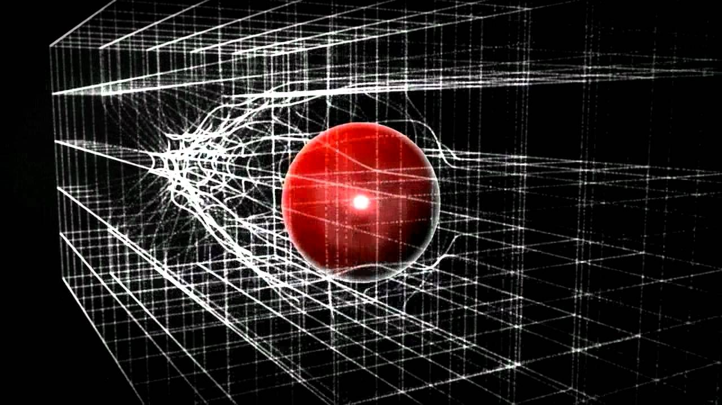
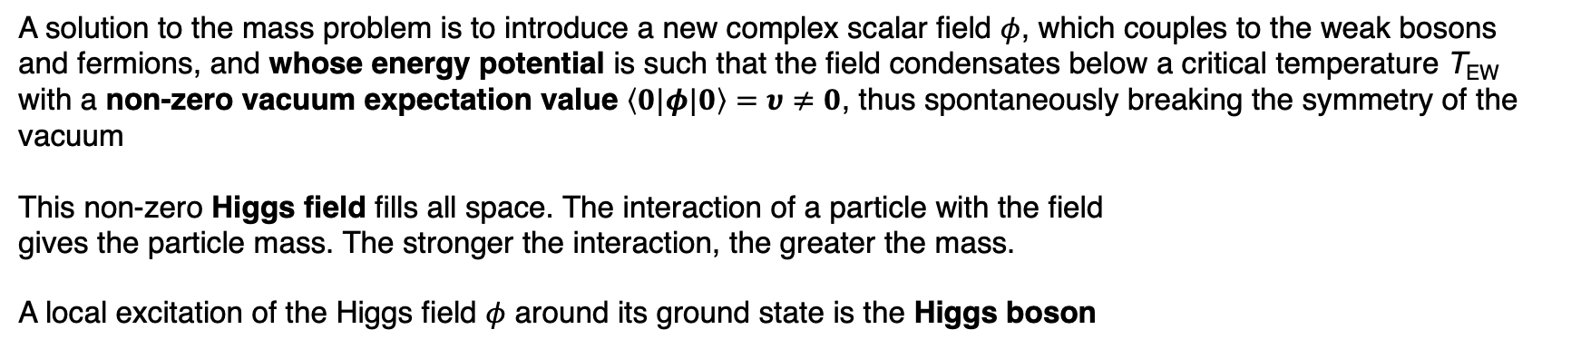
Gauge symmetry and the Higgs mechanism
A solution to the mass problem is to introduce a new complex scalar field $φ$, which couples to the weak bosons and fermions, and whose energy potential is such that the field condensates below a critical temperature T_{EW} with a non-zero vacuum expectation value $\left\langle 0|φ|0\right\rangle =υ≠0$, thus spontaneously breaking the symmetry of the vacuum
This non-zero Higgs field fills all space. The interaction of a particle with the field gives the particle mass. The stronger the interaction, the greater the mass.
A local excitation of the Higgs field $φ$ around its ground state is the Higgs boson

Slide 11




Gauge symmetry and the Higgs mechanism
A solution to the mass problem is to introduce a new complex scalar field $φ$, which couples to the weak bosons and fermions, and whose energy potential is such that the field condensates below a critical temperature T_{EW} with a non-zero vacuum expectation value $\left\langle 0|φ|0\right\rangle =υ≠0$, thus spontaneously breaking the symmetry of the vacuum
This non-zero Higgs field fills all space. The interaction of a particle with the field gives the particle mass. The stronger the interaction, the greater the mass.
A local excitation of the Higgs field $φ$ around its ground state is the Higgs boson
V$(φ)$
T > T_{EW}
The Higgs potential energy:
$$V\left(φ\right)=−μ^{2}{\left|φ\right|}^{2}+λ{\left|φ\right|}^{4}$$
At lowest order (tree level)
T = T_{EW}
T < T_{EW}
$$|φ|$$
$$υ$$

Slide 12
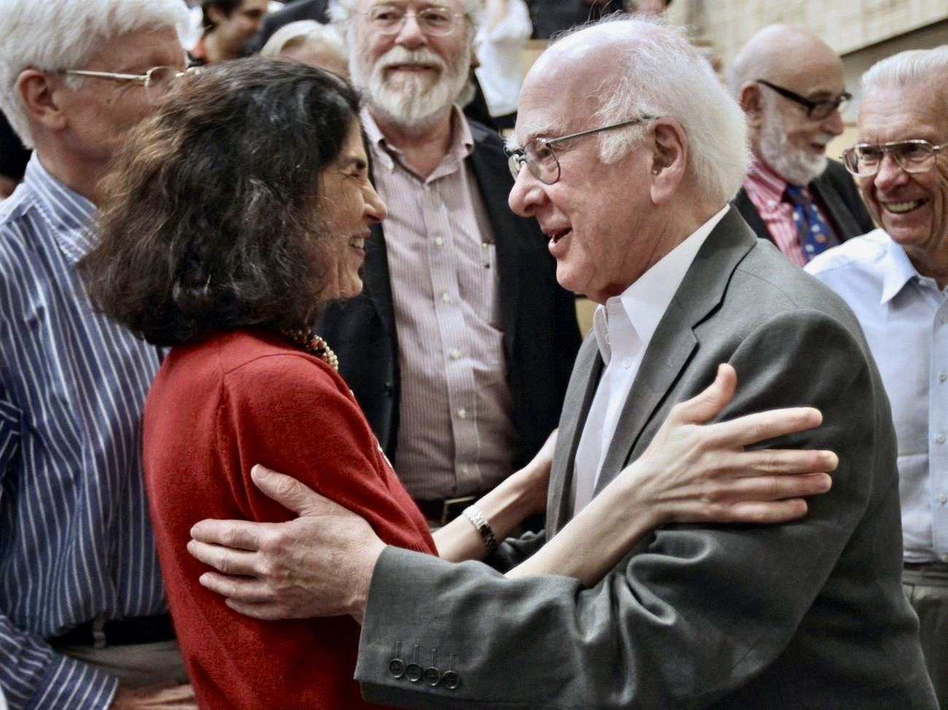
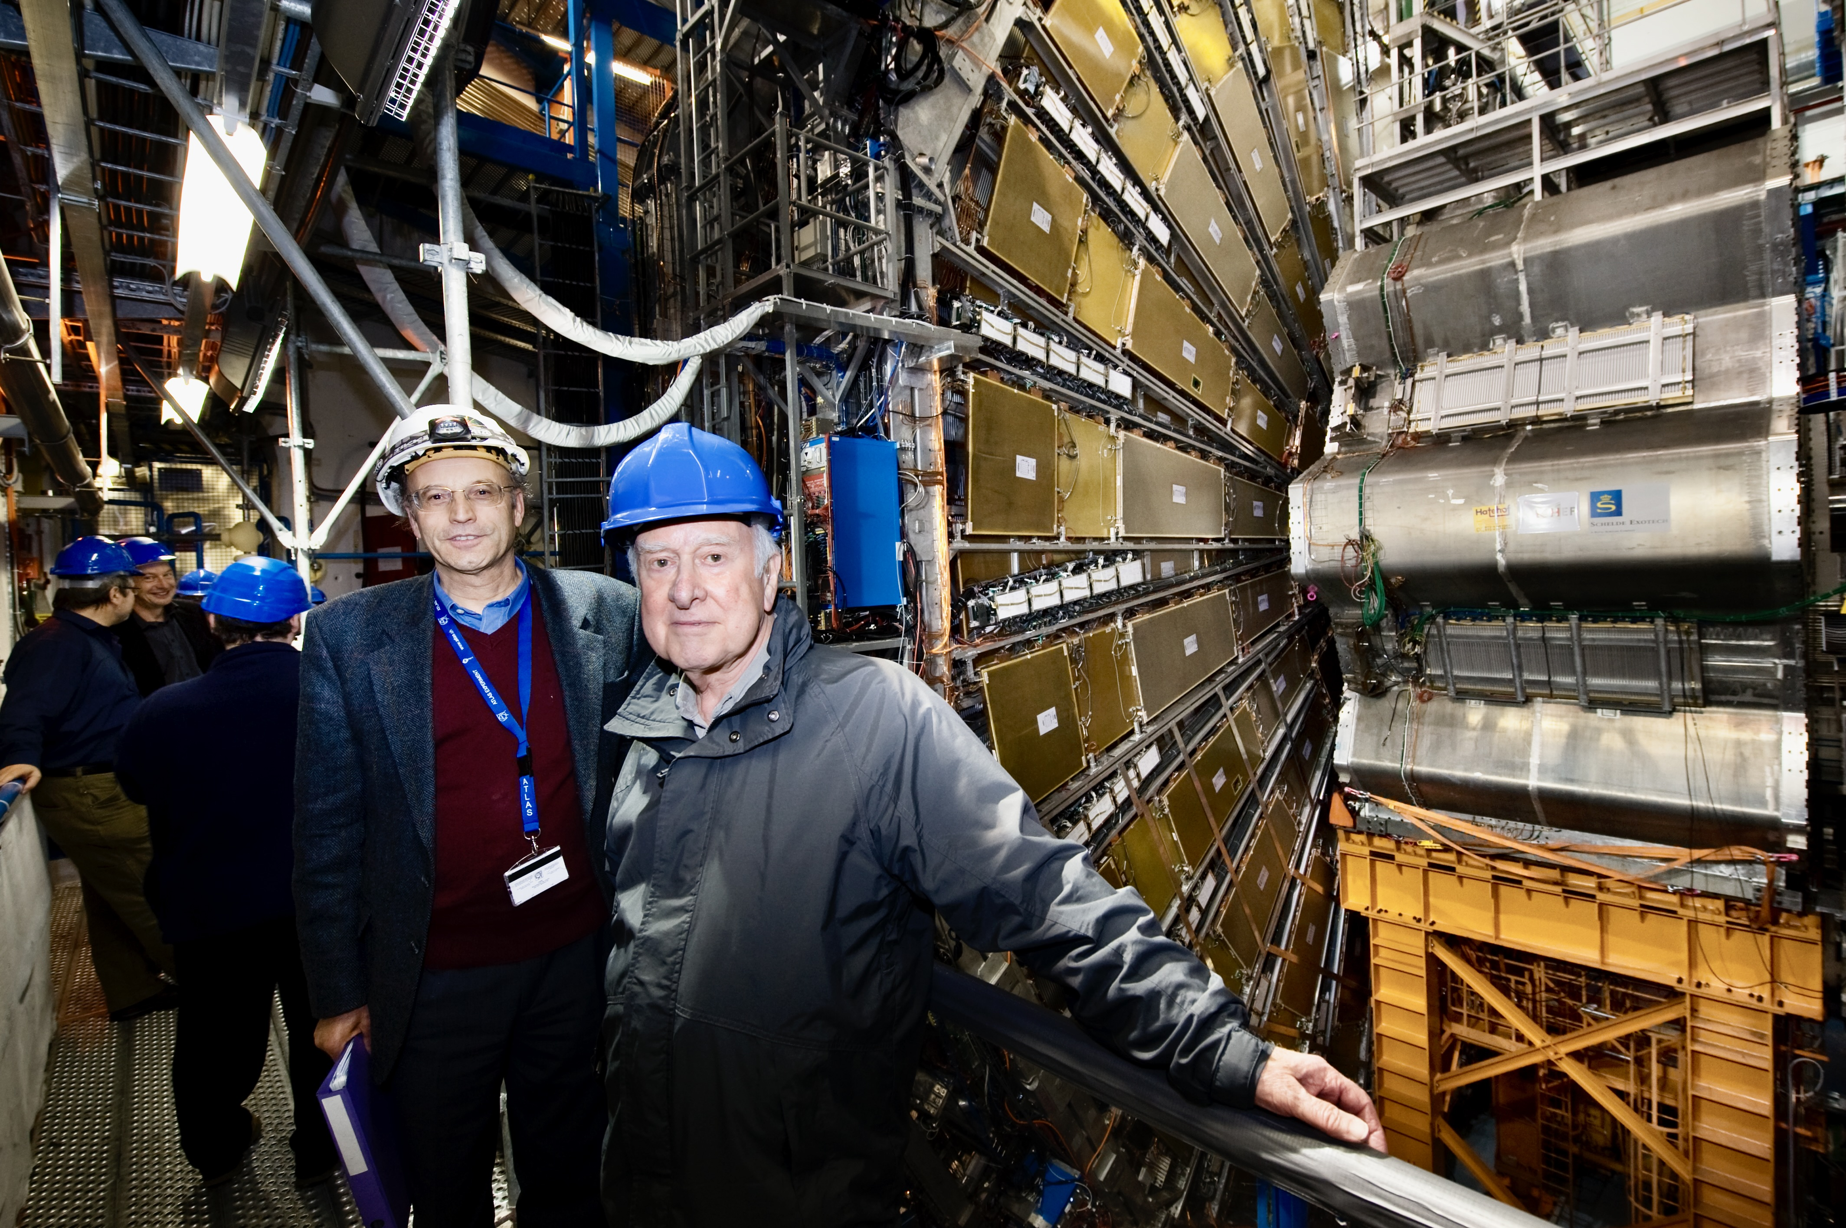
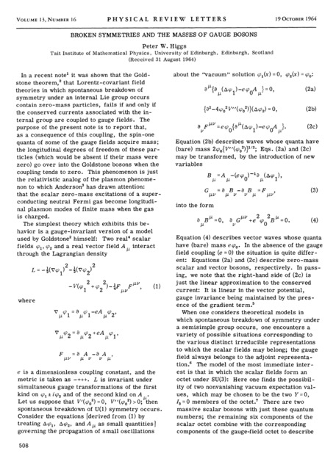
Gauge symmetry and the Higgs mechanism
A solution to the mass problem is to introduce a new complex scalar field $φ$, which couples to the weak bosons and fermions, and whose energy potential is such that the field condensates below a critical temperature T_{EW} with a non-zero vacuum expectation value $\left\langle 0|φ|0\right\rangle =υ≠0$, thus spontaneously breaking the symmetry of the vacuum
This non-zero Higgs field fills all space. The interaction of a particle with the field gives the particle mass. The stronger the interaction, the greater the mass.
A local excitation of the Higgs field $φ$ around its ground state is the Higgs boson
Peter Ware Higgs (1929 – 2024)
Broken Symmetries and the Masses of Gauge Bosons –– or how to change the course of physics with a good idea on two pages — together with the other famous works from his colleagues in 1964
[My life as a boson, 2010]
Peter Higgs with Peter Jenni visiting ATLAS on 4 April 2008
Peter Higgs and Fabiola on 4 July 2012

Slide 13
Gauge symmetry and the Higgs mechanism
A few further comments:
The mass values govern the history of the universe (incl. complex chemistry and life) → what would happen had we (or nature) a dial to change the particle masses? [see R. Cahn, 1996*]
The vacuum energy density of the Higgs field is about 10⁵⁵ times larger than the dark energy observed → “It would curve the universe into an object roughly the size of a football” (Veltman, 1986)
The remarkable similarity between the Higgs mechanism and the Bardeen–Cooper–Schrieffer (BCS) theory of superconductivity, where the Bose condensation of a Cooper pair of two electrons plays the role of the Higgs field (note: T_{crit} = T_{EW} ~ 10¹⁵ K!), raises the question whether the Higgs boson might not be elementary after all

Slide 14
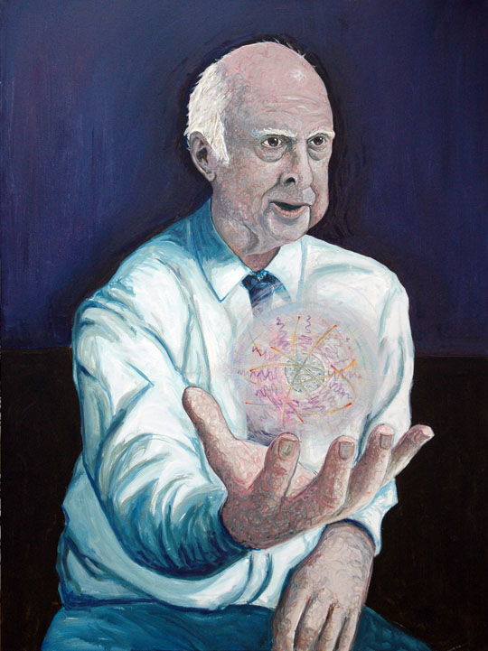
The Higgs mechanism was only a hypothesis before the start of the LHC
To prove it one had to find and measure a new particle: the mysterious Higgs boson
http://www.shardcore.org/

Slide 15
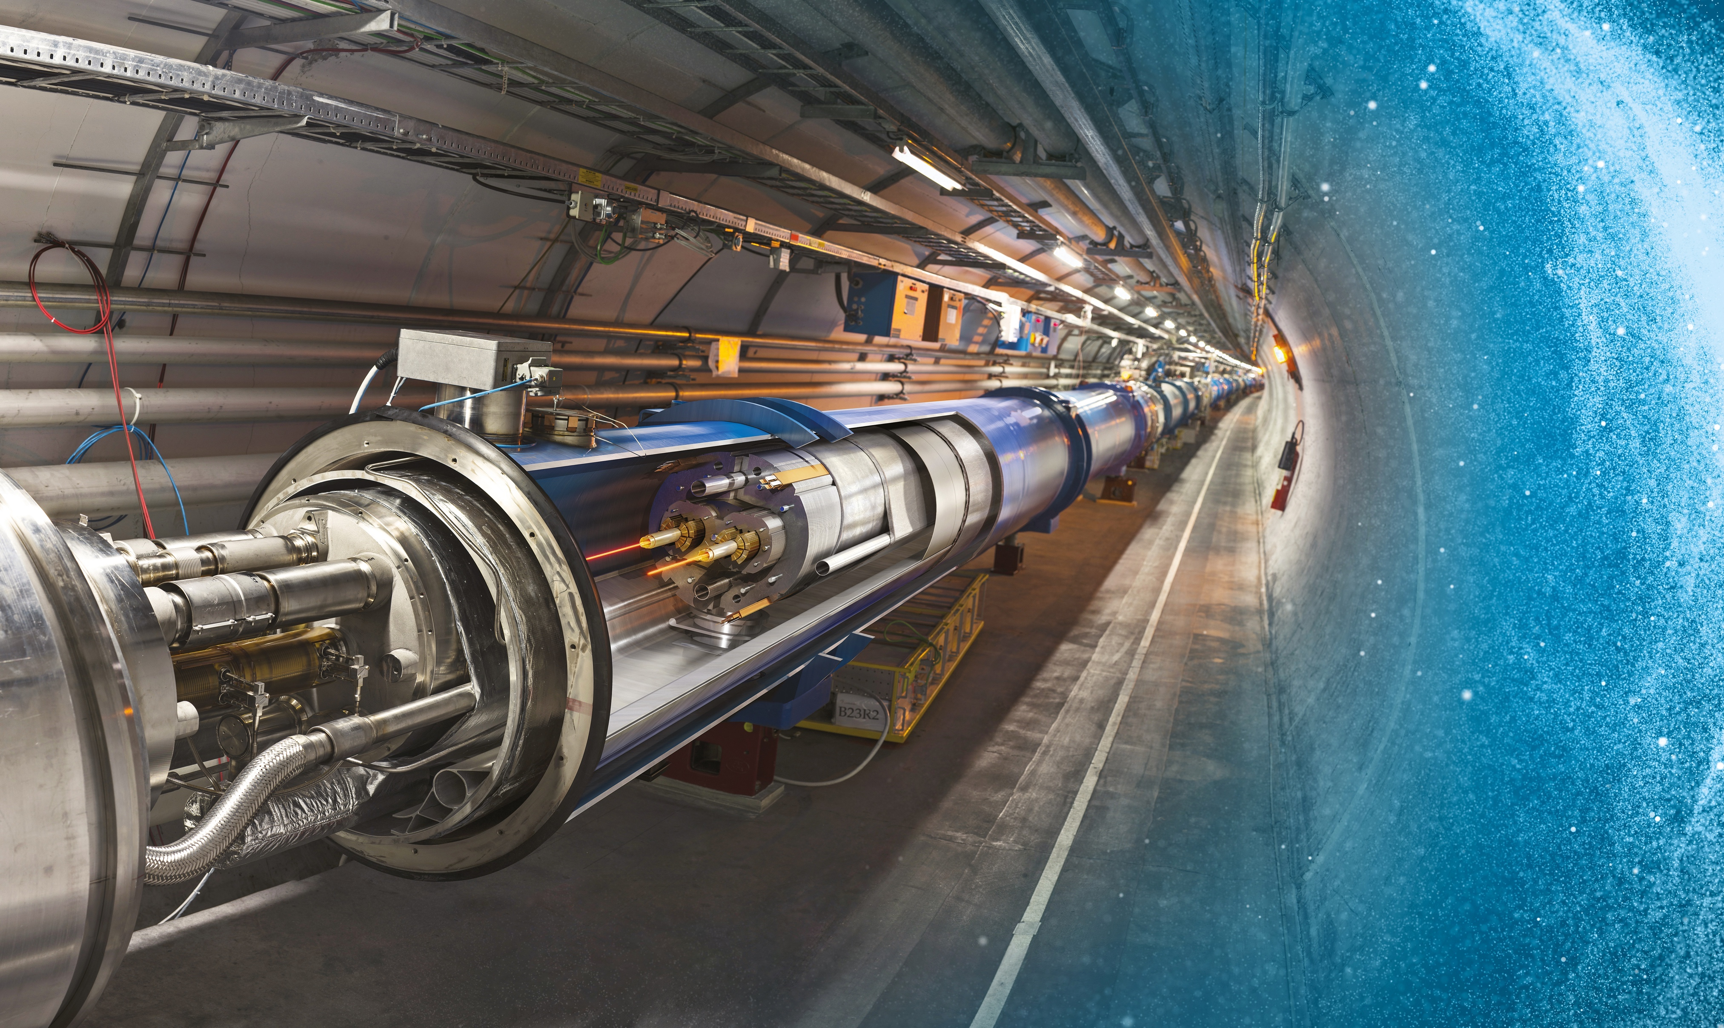

Producing and studying the Higgs boson requires a huge machine
Large Hadron Collider (LHC)
27 km underground accelerator and collider
Superconducting magnets (1.9 K = –271.3 °C) steer the particles around the ring
Proton and ions are accelerated to multi-TeV scale energies before they collide
The LHC has a total of 9300 magnets for beam bending, beam focusing and orbit corrections

Slide 16
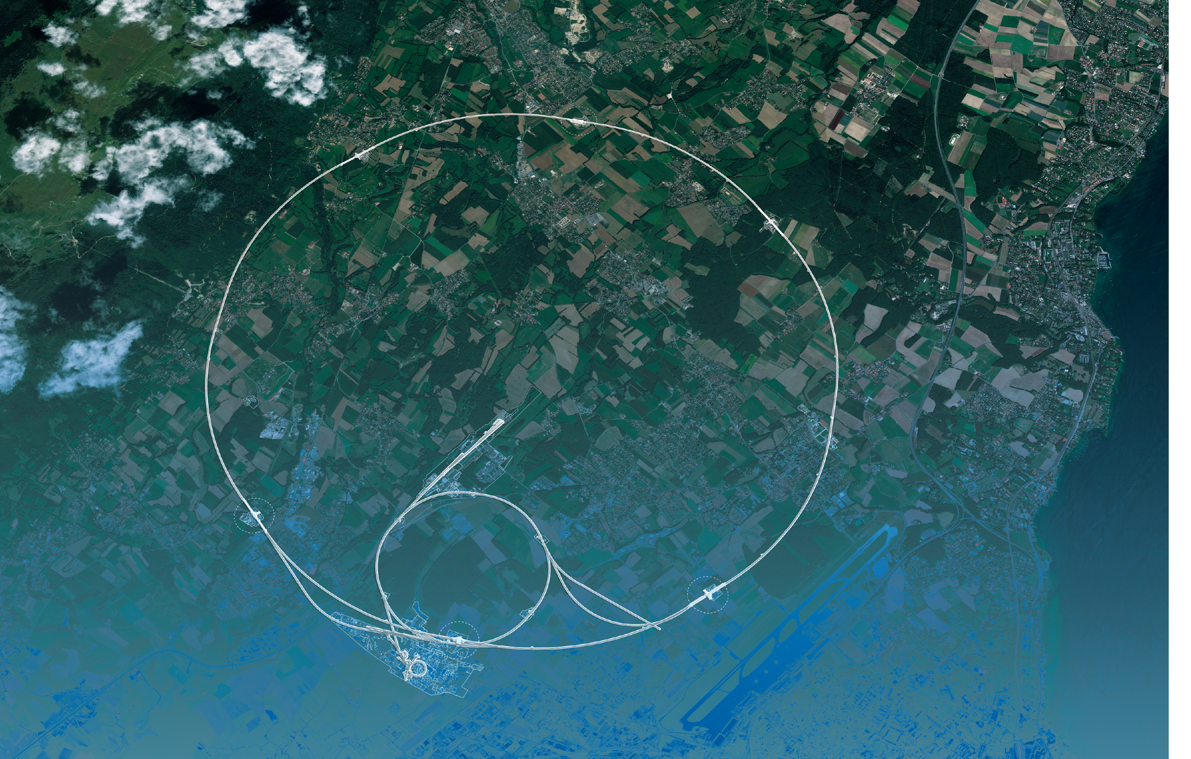
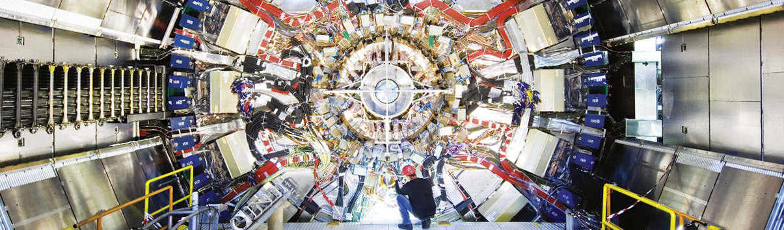
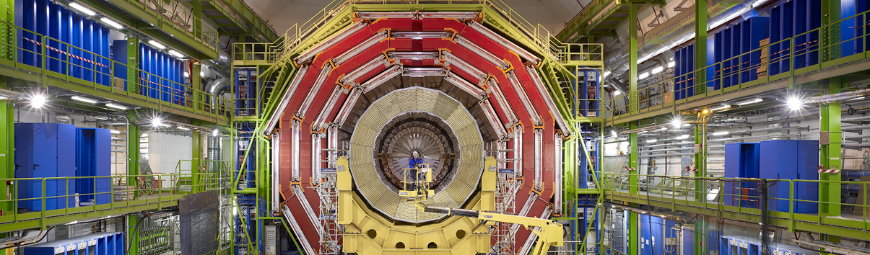
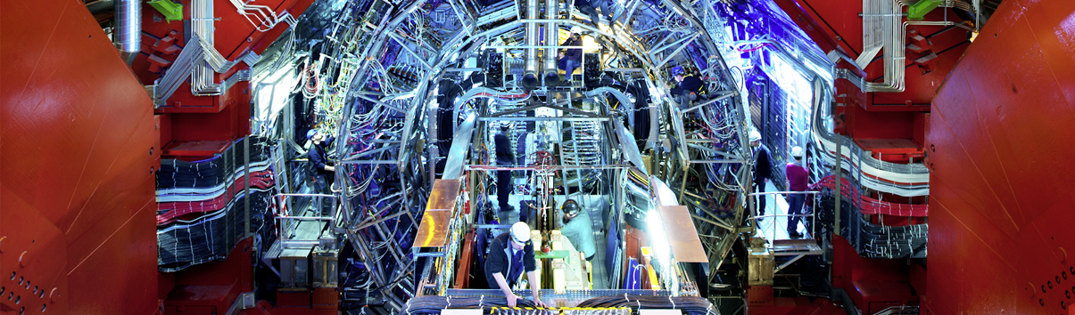
LHC Experiments
CMS
ATLAS
LHC
CMS
ALICE
SPS
ALICE
ATLAS
LHCb
LHCb
PS
Areal view
Presentation

Slide 17
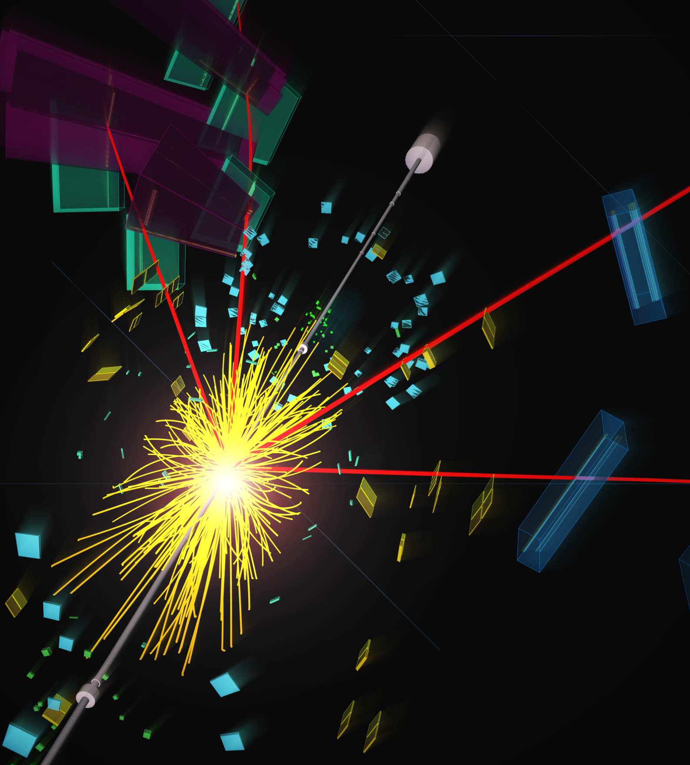
What happens in a high-energy proton–proton collision?
Its constituents fuse and transform into new, sometimes heavy particles with rates depending on the strength of their interaction with the proton and on their mass:
Light quarks, gluons (“jets”) ≫ W, Z ≫ top quark ≫ Higgs boson
Heavy particles decay instantaneously to light, stable particles (quarks/hadrons, leptons, photons)
A particle detector precisely neasures these decay particles, which allows to deduce the properties of the mother particle
An online filter (“trigger”) reduces the huge rate of particle interactions by a factor of 20,000 focusing on the most interesting processes
Data reconstruction and analysis is done in computing centers worldwide

Slide 18

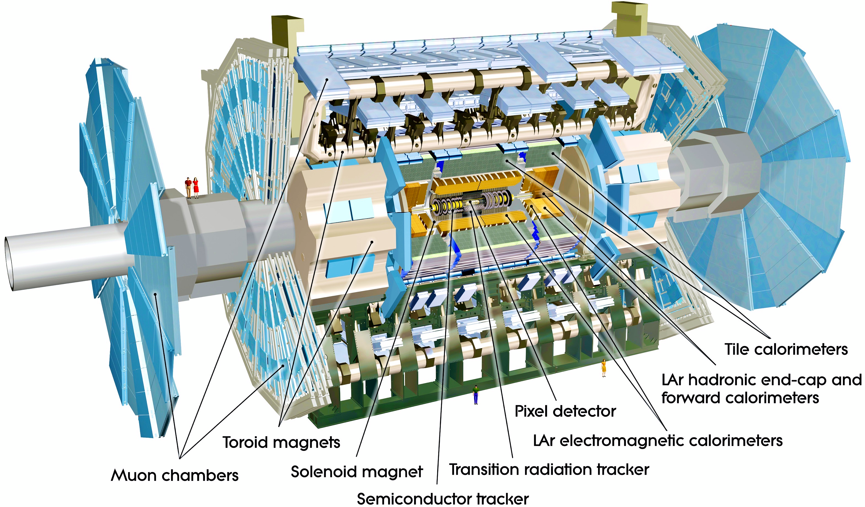
The ATLAS Detector
High resolution silicon detectors:
100 Mio. channels (50 µm x 250 µm)
6 Mio. channels (80 µm x 12 cm)
spatial resolution ~15 µm (in azimuth). Complemented by gaseous transition radiation tracker at large radius
Axial field provided by solenoid (2 T) in central region (momentum measurement)
Energy measurement down to 1º to the beam line with a calorimeter system
Independent muon spectrometer (superconducting toroid magnet system)
Trigger based on ultra-fast custom electronics and high-performance computers
25 m diameter, 44 m long, 7000 tons weight

Slide 19
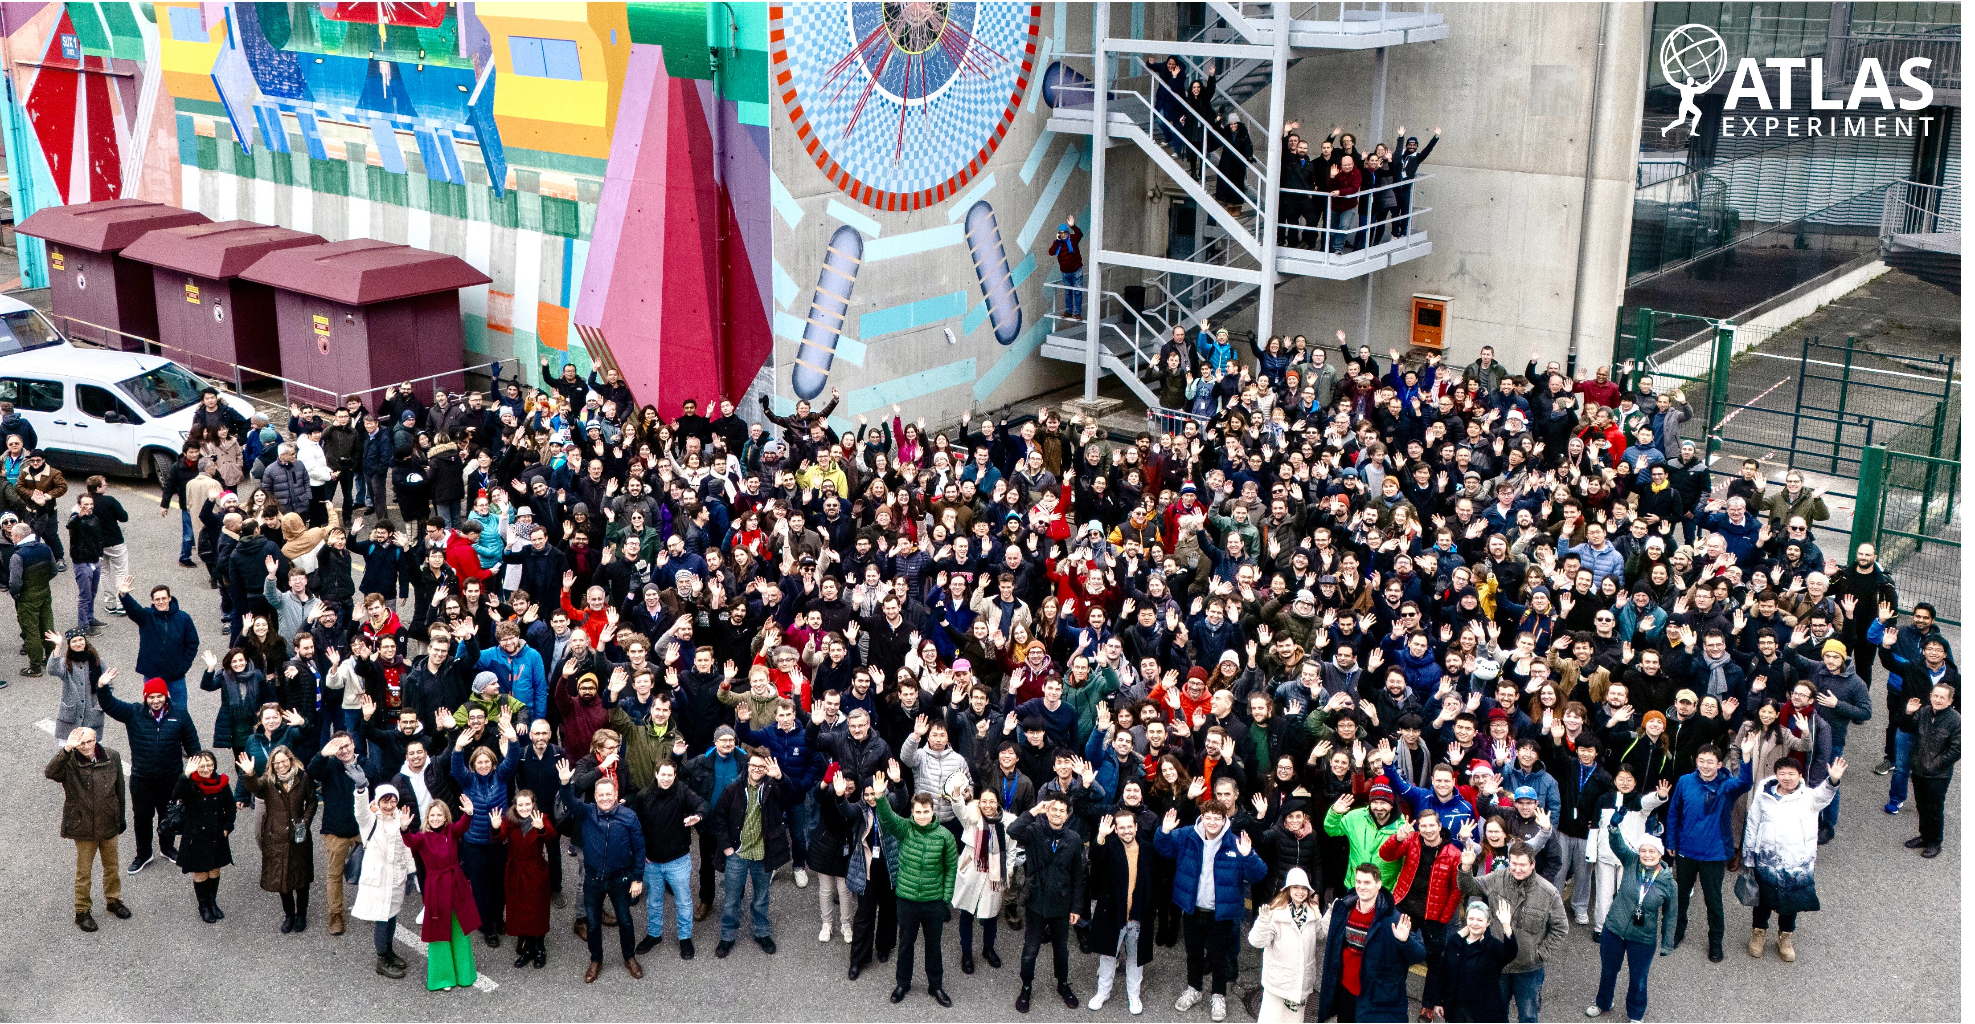
The ATLAS Collaboration
ATLAS is a multi-decade international experimental programme involving:
242 institutes from 40 countries + 16 Technical Associate Institutes
2900 Scientific authors
1200 Physics PhD students
1300 Engineers or technicians
100 Engineering students
6000 Active members
Links: ATLAS public home page, Physics results, Interactive ATLAS world map, Static world maps, List of ATLAS institutes
Photo taken in Dec 2024 at the ATLAS detector site at CERN

Slide 20
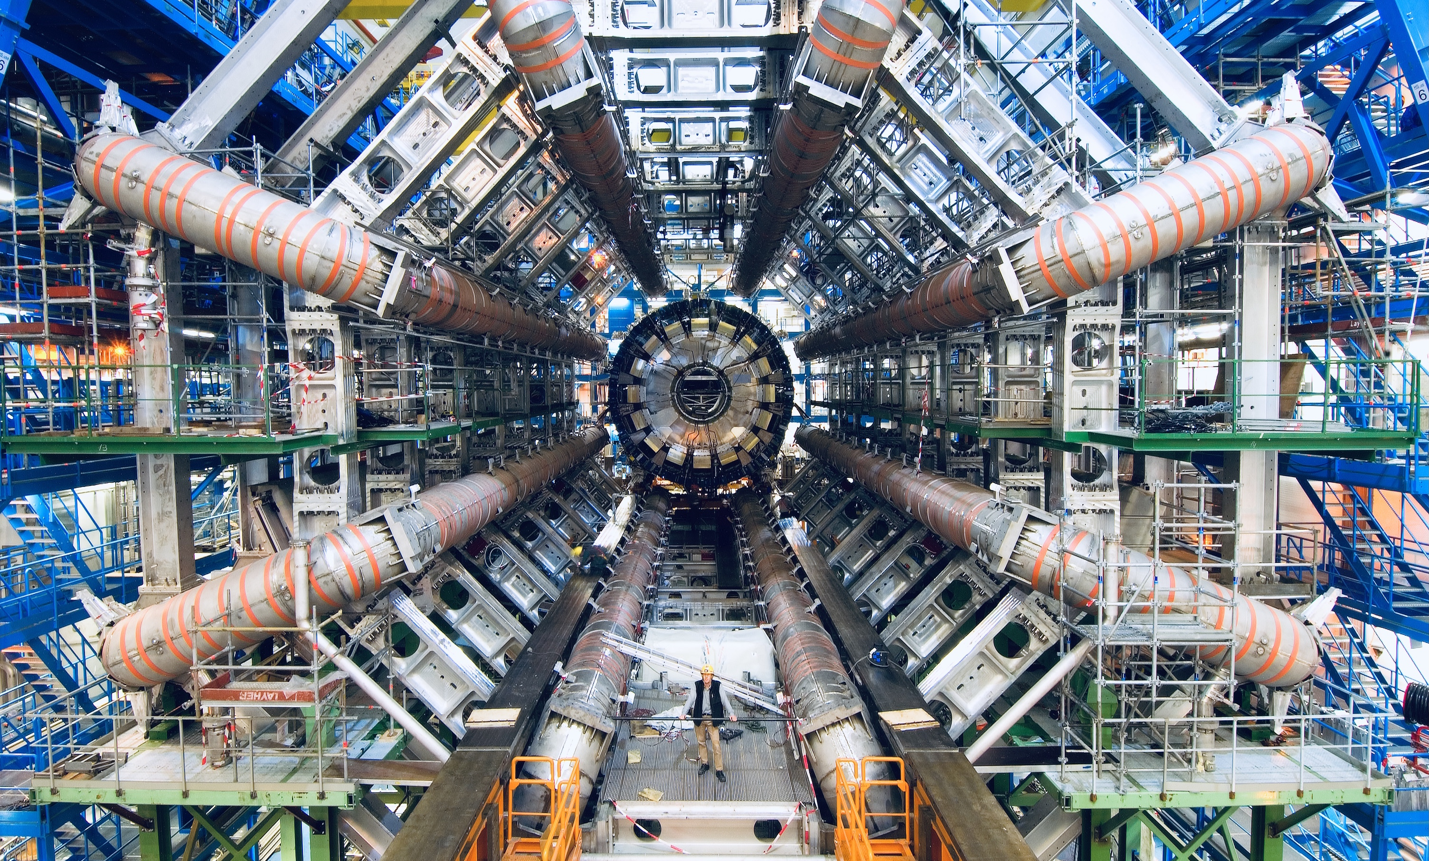

Slide 21
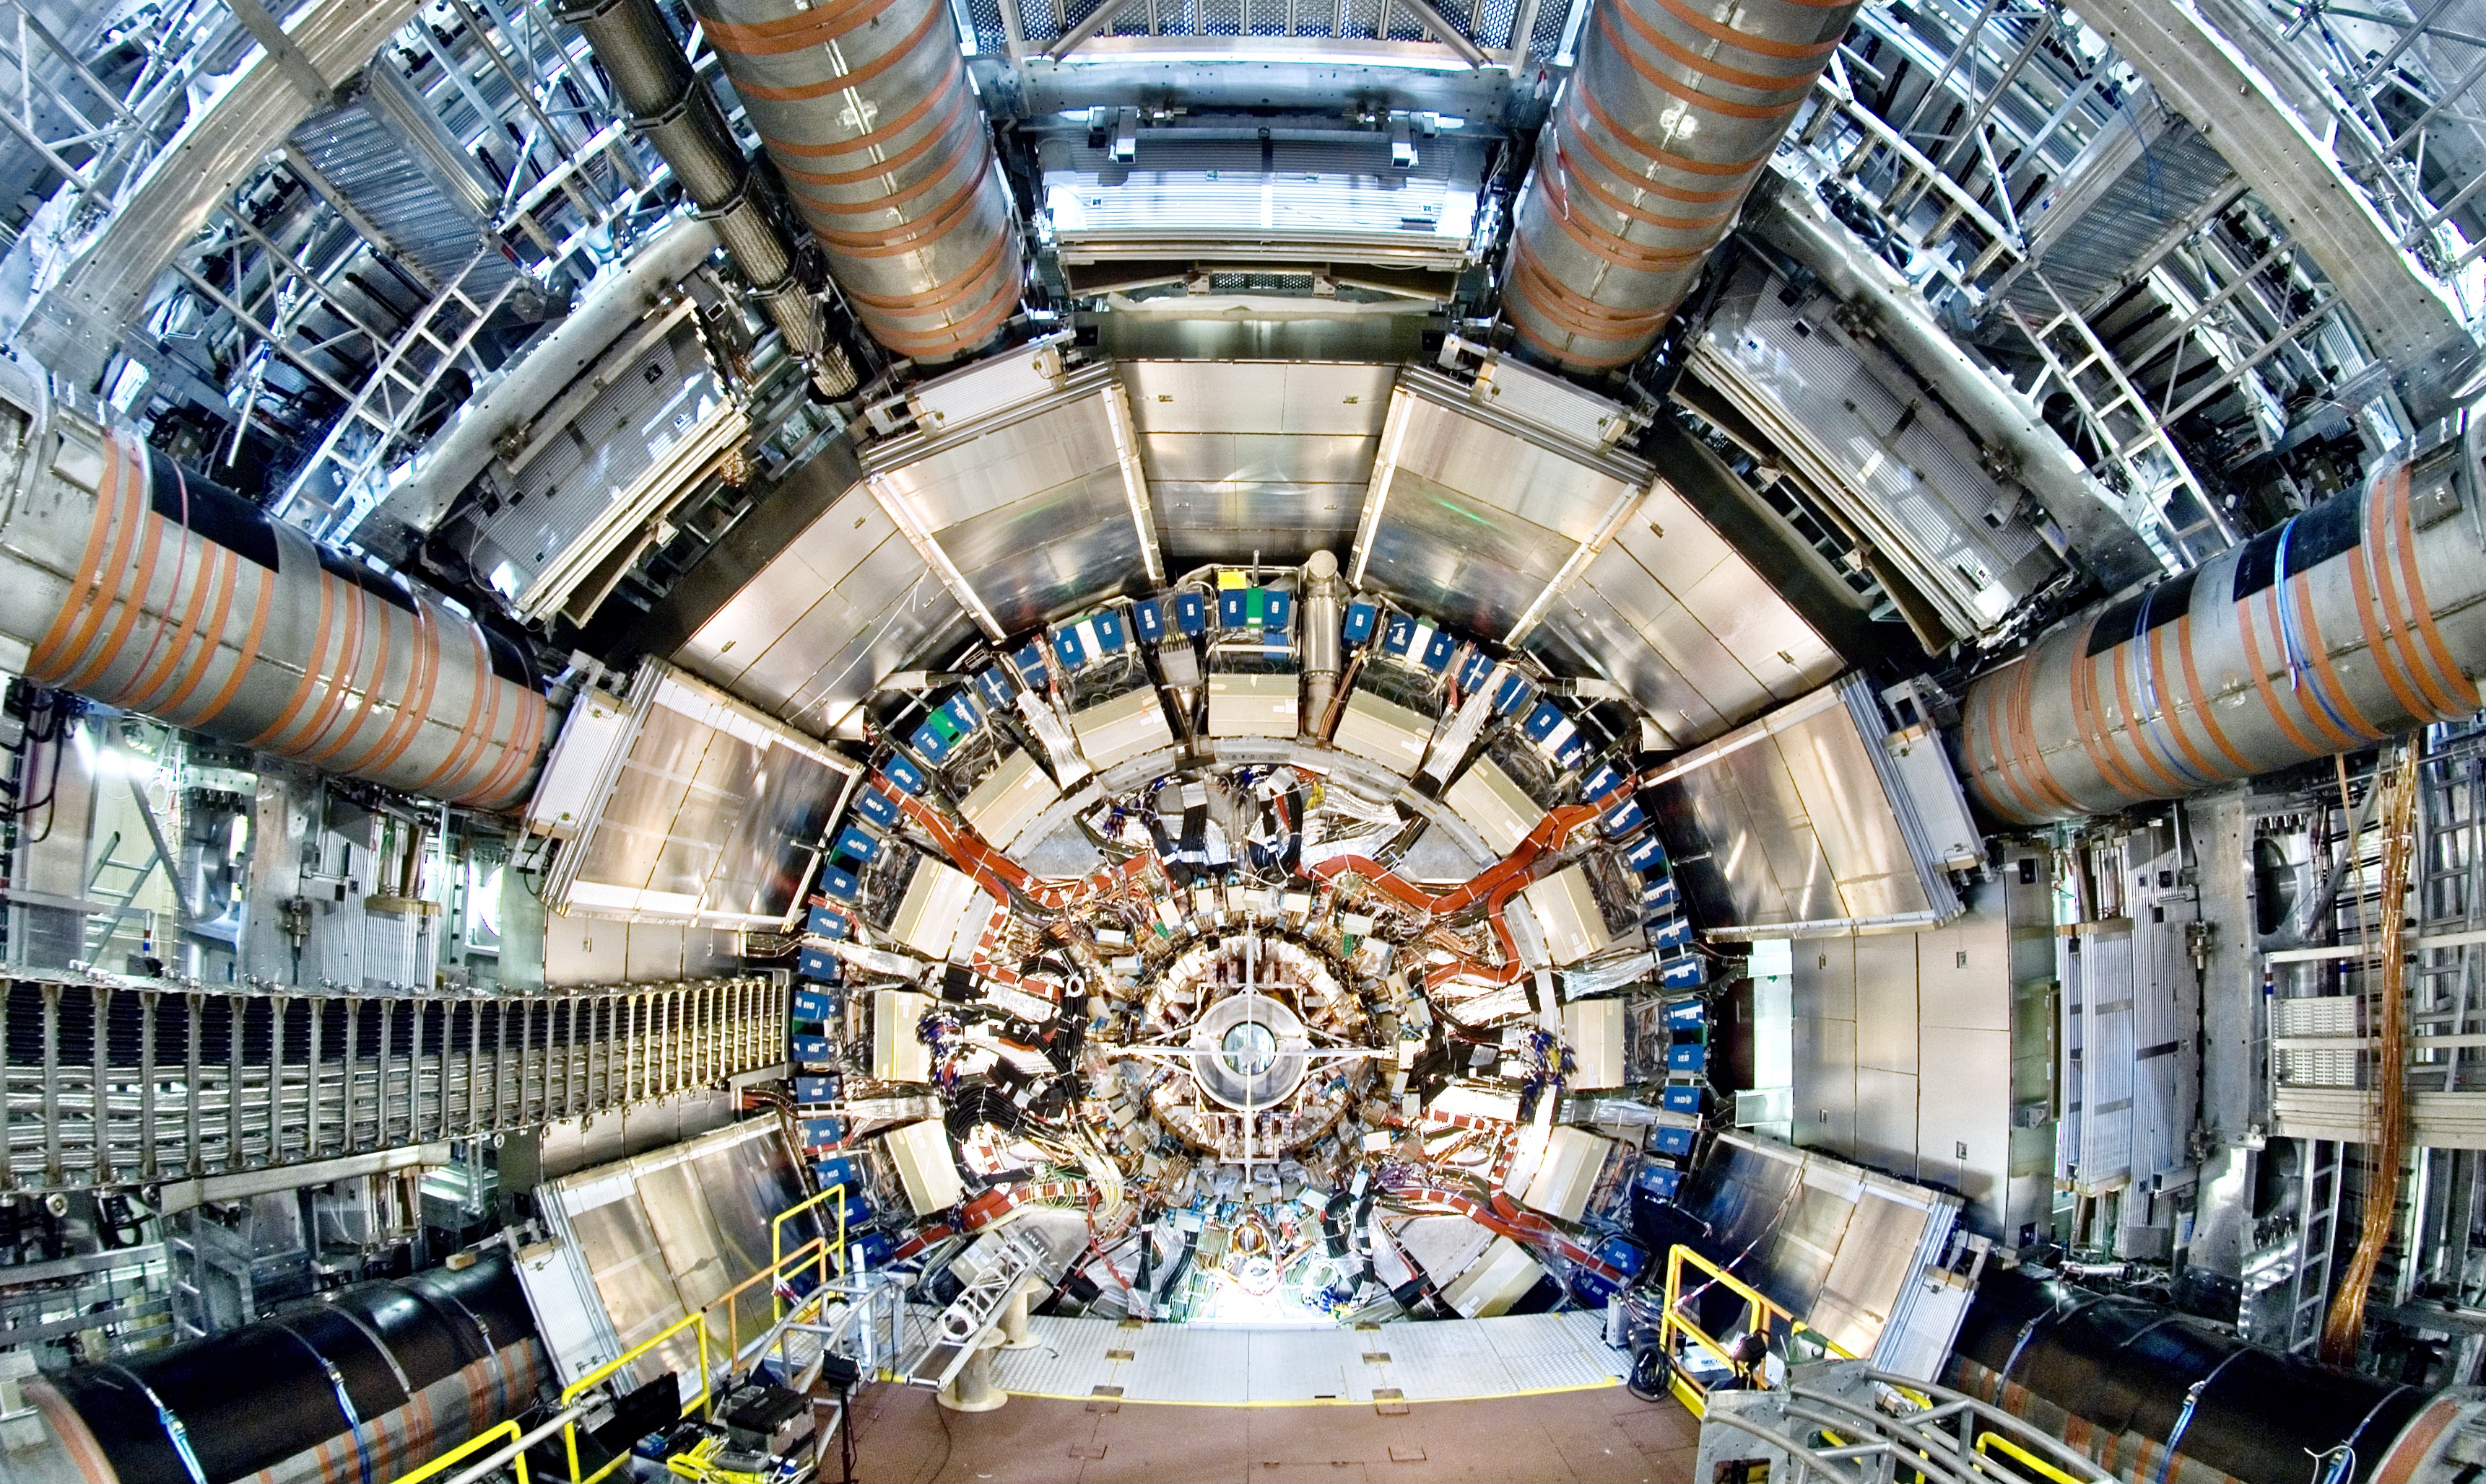
View on the ATLAS inner detectors. At the centre, the inner tracking detector with a radius of about 1m. It is surrounded by the inner solenoid producing a uniform 2-Tesla field throughout the volume of the tracker. The magnet itself is located inside the cryostat of the liquid argon electromagnetic calorimeter, whose electronic read-out boxes are visible, covering in part the hadronic calorimeter located at larger radius. On the outer part, the first layers of muon chambers, part of the muon spectrometer, subdivided into sixteen azimuthal sectors, are seen

Slide 22
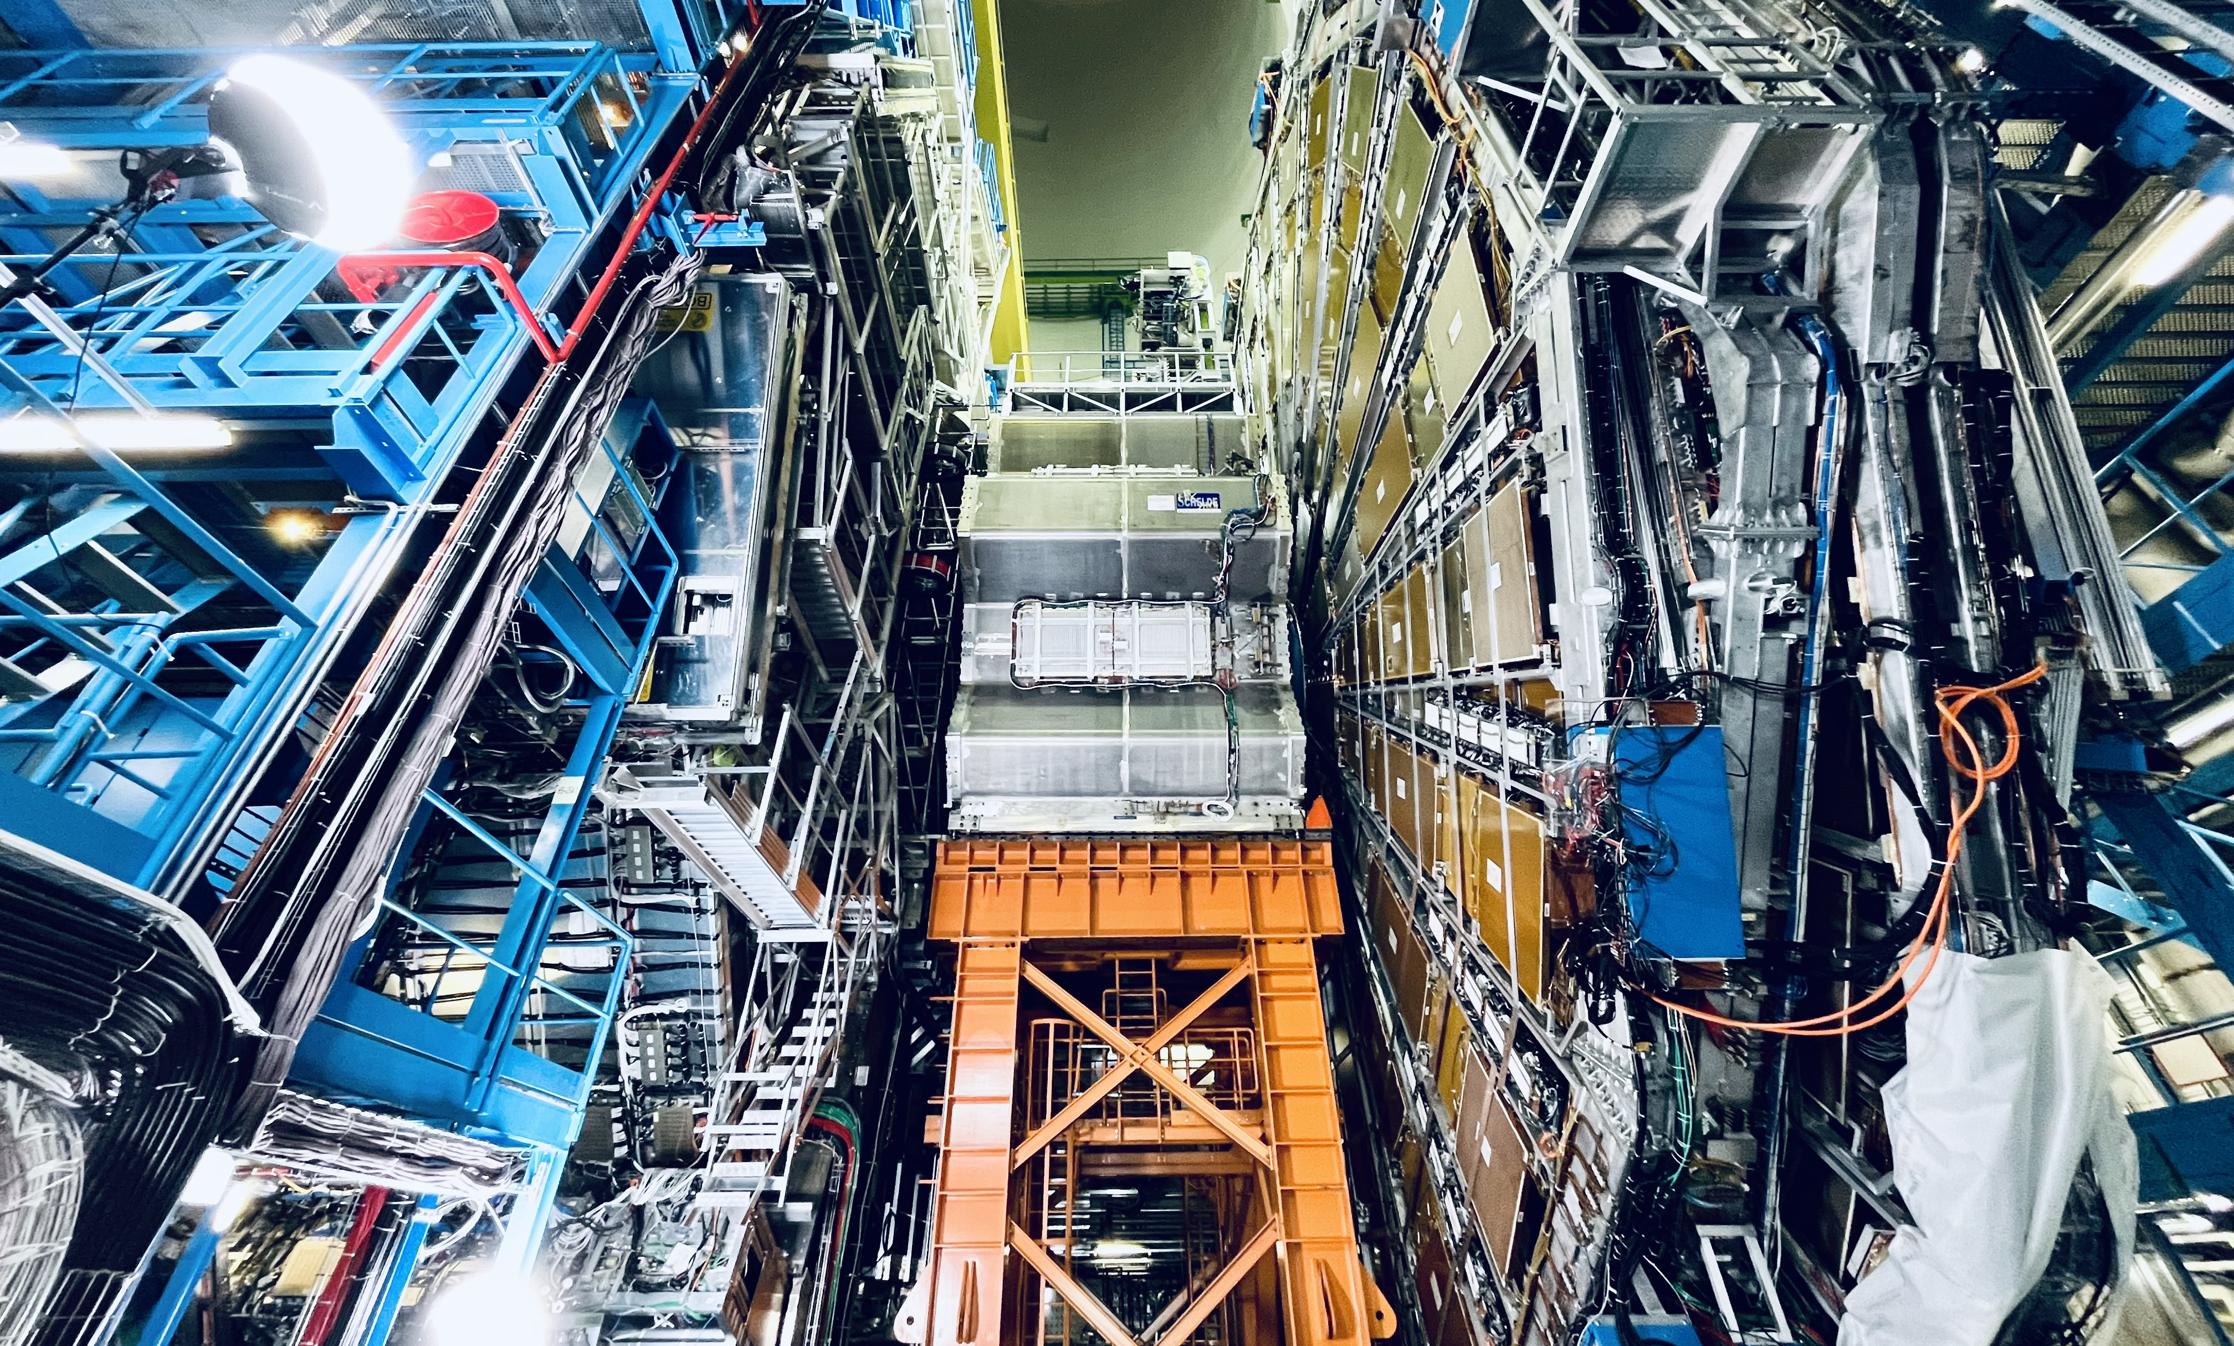
ATLAS endcap in open position during year-end technical stop 2023/2024

Slide 23



Higgs boson production and decay at the LHC
About 1 Higgs boson per second is produced in ATLAS at the LHC (about 20M total by today)
It decays within 10^{–22} s
0.010% (e,µ)
f
H
$$∝\frac{m_{f}}{υ}$$
0.012% (e,µ)
f
W/Z
1.1% (e,µ)
H
$$∝\frac{2m_{W/Z}^{2}}{υ}$$
W/Z
H → 𝛾𝛾, Z𝛾 occur through virtual top or W loops (no direct Higgs coupling to massless particles)

Slide 24
A Higgs boson to 4 muons candidate

Slide 25
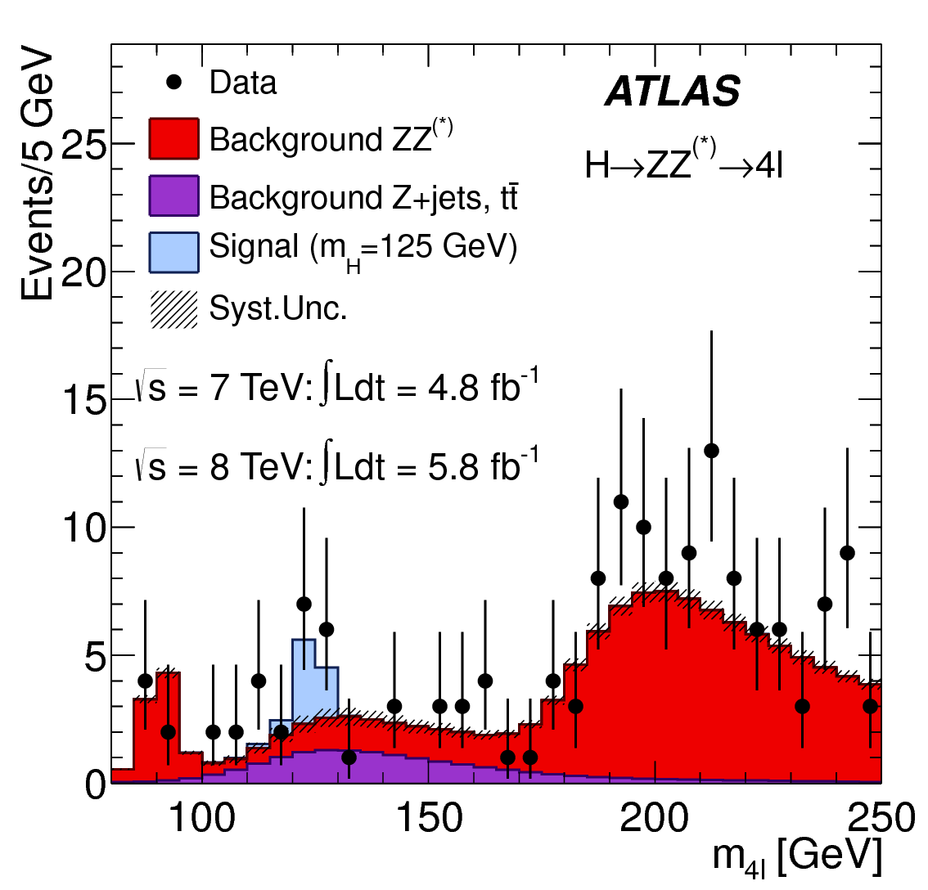
The Higgs boson discovery
2012
Phys. Lett. B 716 (2012) 1-29
A Higgs boson to 4 muons candidate

Slide 26
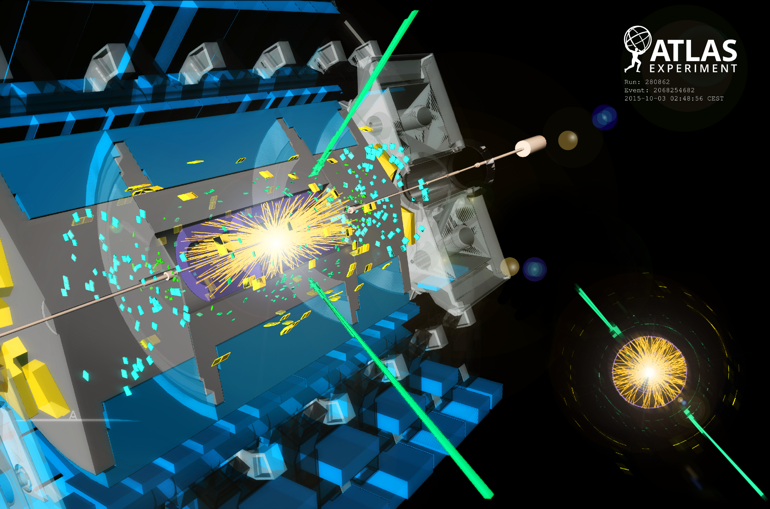
A Higgs boson to 2 photons candidate

Slide 27
A Higgs boson to 2 photons candidate
2012
Phys. Lett. B 716 (2012) 1-29

Slide 28
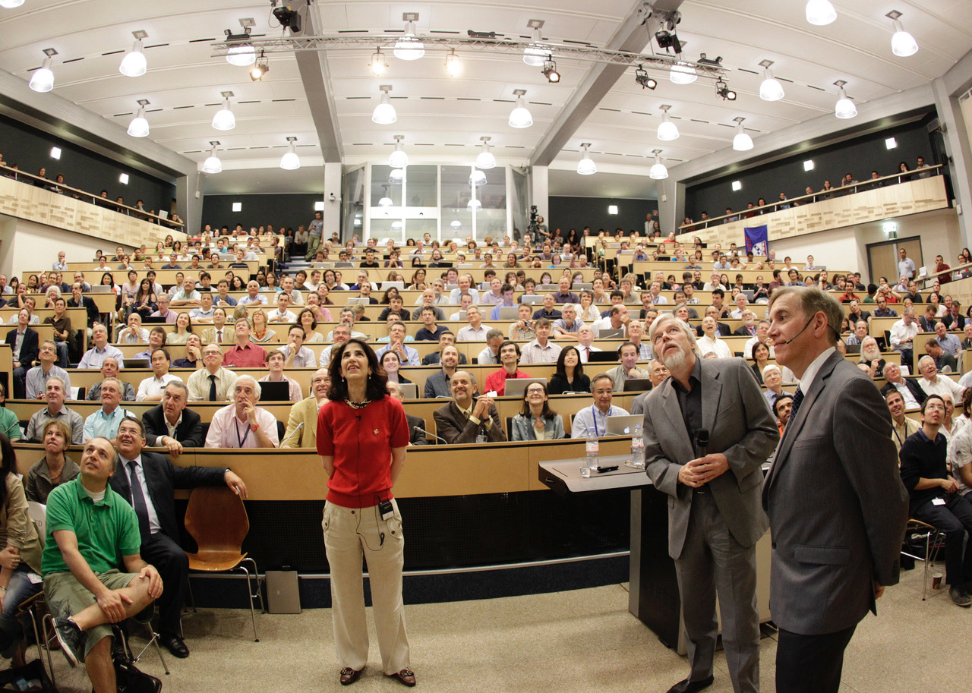
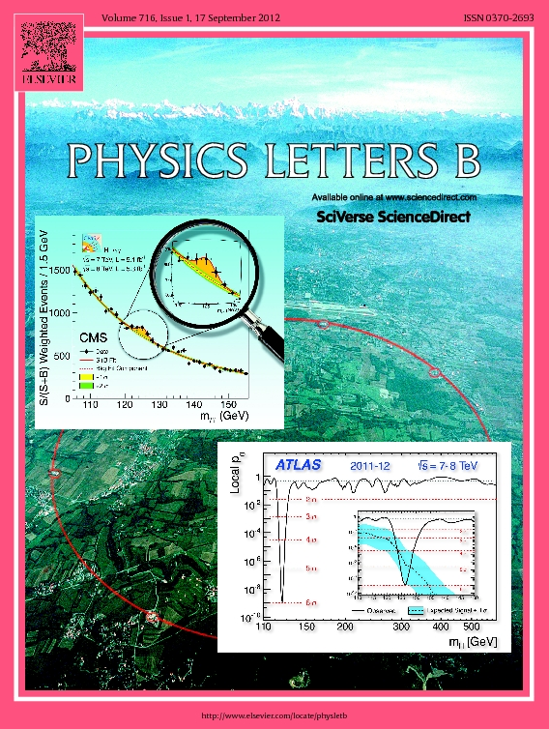
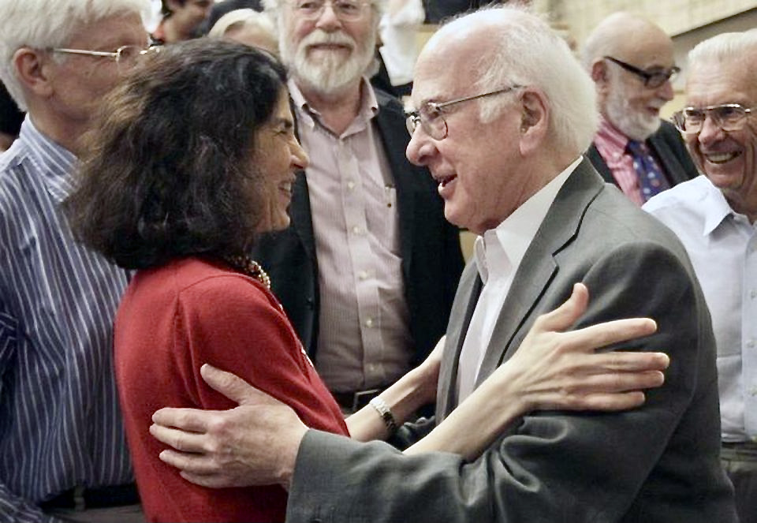
The Higgs boson discovery
Fabiola Gianotti and Peter Higgs, 4 July 2012
Phys. Lett.B 716 (2012)
Cited almost 15,000 times
4 July 2012: ATLAS (Fabiola Gianotti) und CMS (Joseph Incandela) announce the Higgs boson discovery before a packed auditorium

Slide 29
The Higgs boson discovery
The LHC’s magnum opus
A very special particle… whose discovery allows us to access a totally new sector of the Standard Model:
Higgs–matter interactions
Higgs–force particle interactions
Higgs potential and Higgs self-interaction
Fabiola Gianotti and Peter Higgs, 4 July 2012
Phys. Lett.B 716 (2012)
Cited almost 15,000 times (today)

Slide 30
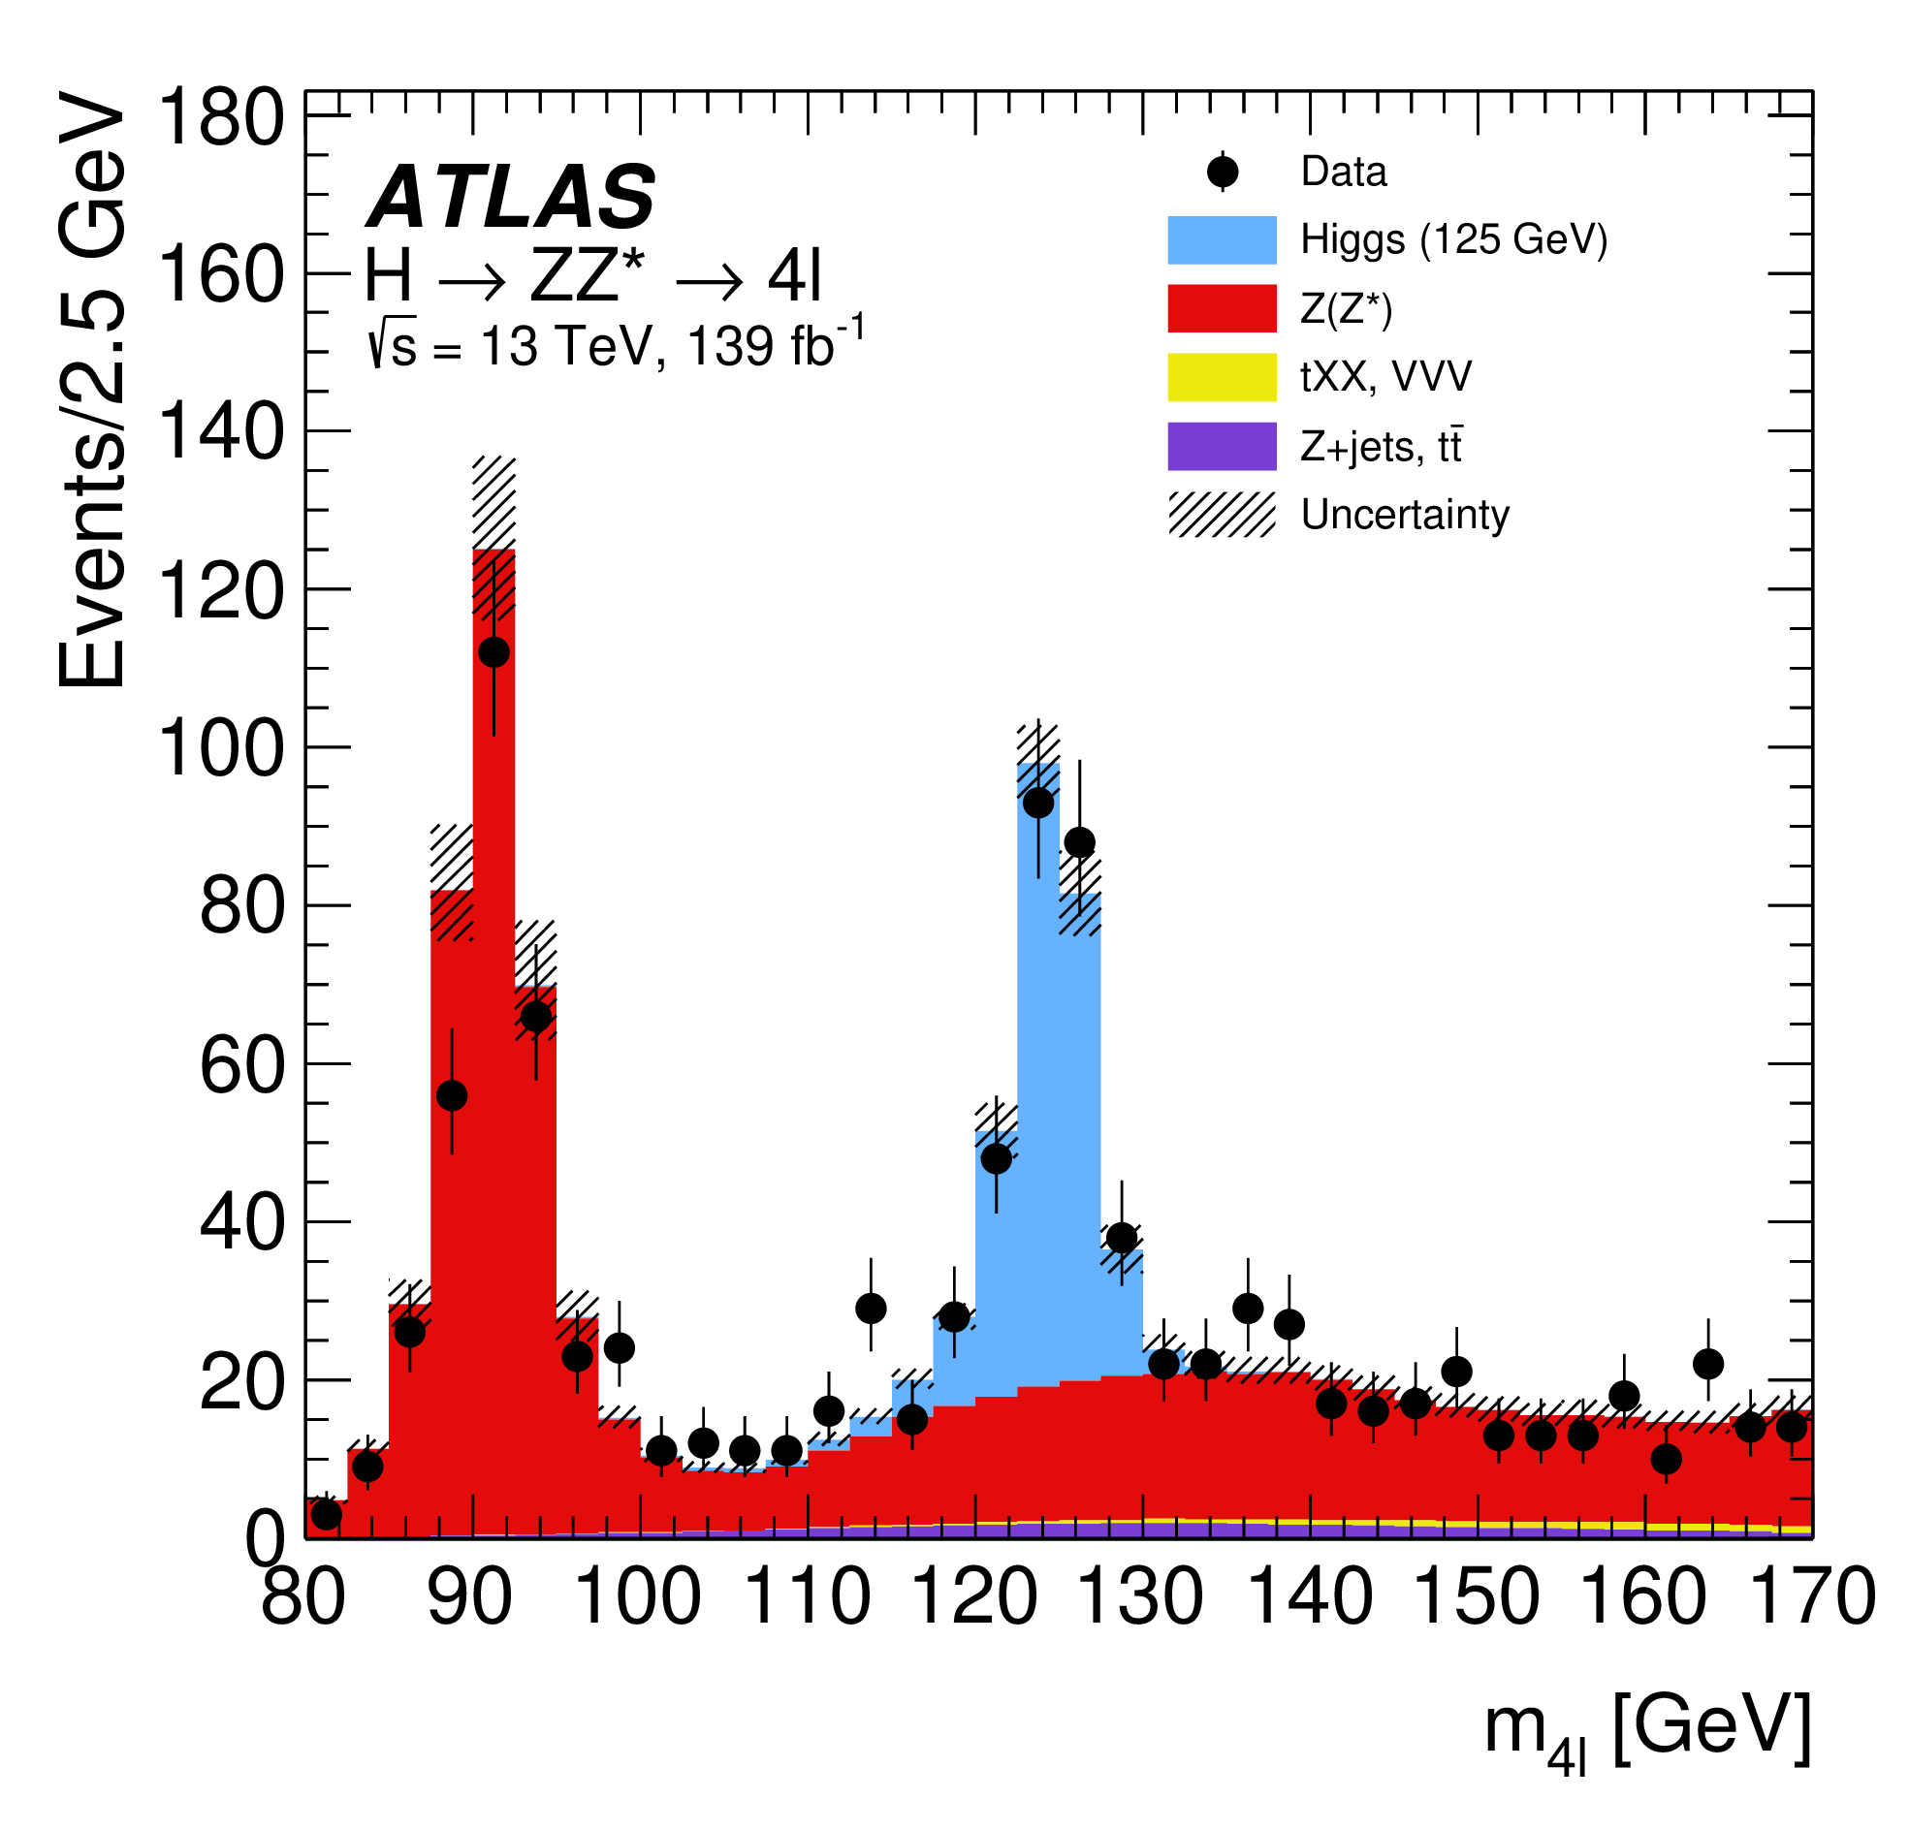
The Higgs boson — At 10
2020
JHEP 07 (2023) 088
Eur. Phys. J. C 80 (2020) 942
H → 𝛾𝛾
H → ZZ* → 4𝓁

Slide 31
Higgs boson mass
2020
Eur. Phys. J. C 80 (2020) 942
The Higgs mass is peculiar
m_{H} = 125.11 ± 0.11 GeV (0.09%)
arXiv:2308.04775

Slide 32
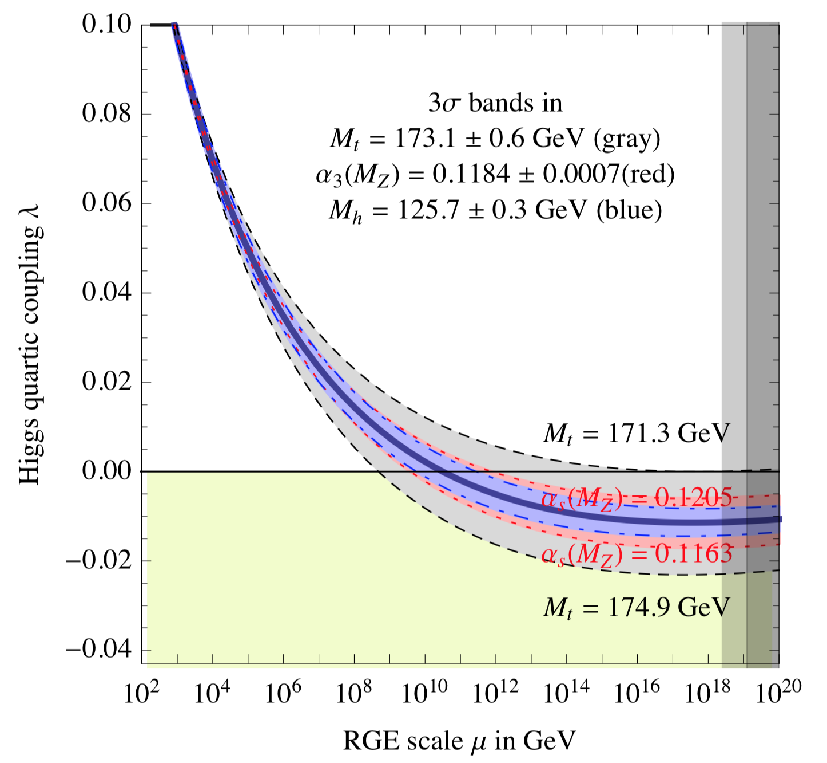
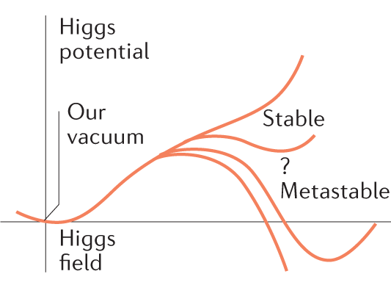

Higgs boson mass
Evolution of the Higgs quartic coupling, assuming SM (only)
The Higgs mass is peculiar
It is consistent with the global electroweak fit
But the electroweak vacuum seems to be metastable
$$V\left(φ\right)=−μ^{2}{\left|φ\right|}^{2}+λ{\left|φ\right|}^{4}$$
λ may become zero and even negative at high energy
arXiv:1205.6497

Slide 33
Higgs boson couplings
Huge experimental programme, some channels suffer from large backgrounds, huge improvements from smart analysis techniques and machine learning
The Higgs boson couplings to the SM particles are experimentally determined by measuring cross-sections of all accessible Higgs boson production and decay modes
Channel categories |  | BR | ggF | VBF | VH | ttH
Cross Section (13 TeV) |  |  | 48.6 pb | 3.8 pb | 2.3 pb | 0.5 pb
γγ | 0.2 % | 0.2 % | ✓ | ✓ | ✓ | ✓
ZZ | 2.6% | 3% | ✓ | ✓ | ✓ | ✓
WW | 21% | 22% | ✓ | ✓ | ✓ | ✓
ττ | 6.3 % | 6.3 % | ✓ | ✓ | ✓ | ✓
bb | 58% | 55% | ✓ | ✓ | ✓ | ✓
Zγ (& γγ∗) | 0.2 % | 0.2 % | ✓ | ✓ | ✓ | ✓
μμ | 0.02 % | 0.02 % | ✓ | ✓ | ✓ | ✓
In grey: evidence for decays, but not observed yet

Slide 34
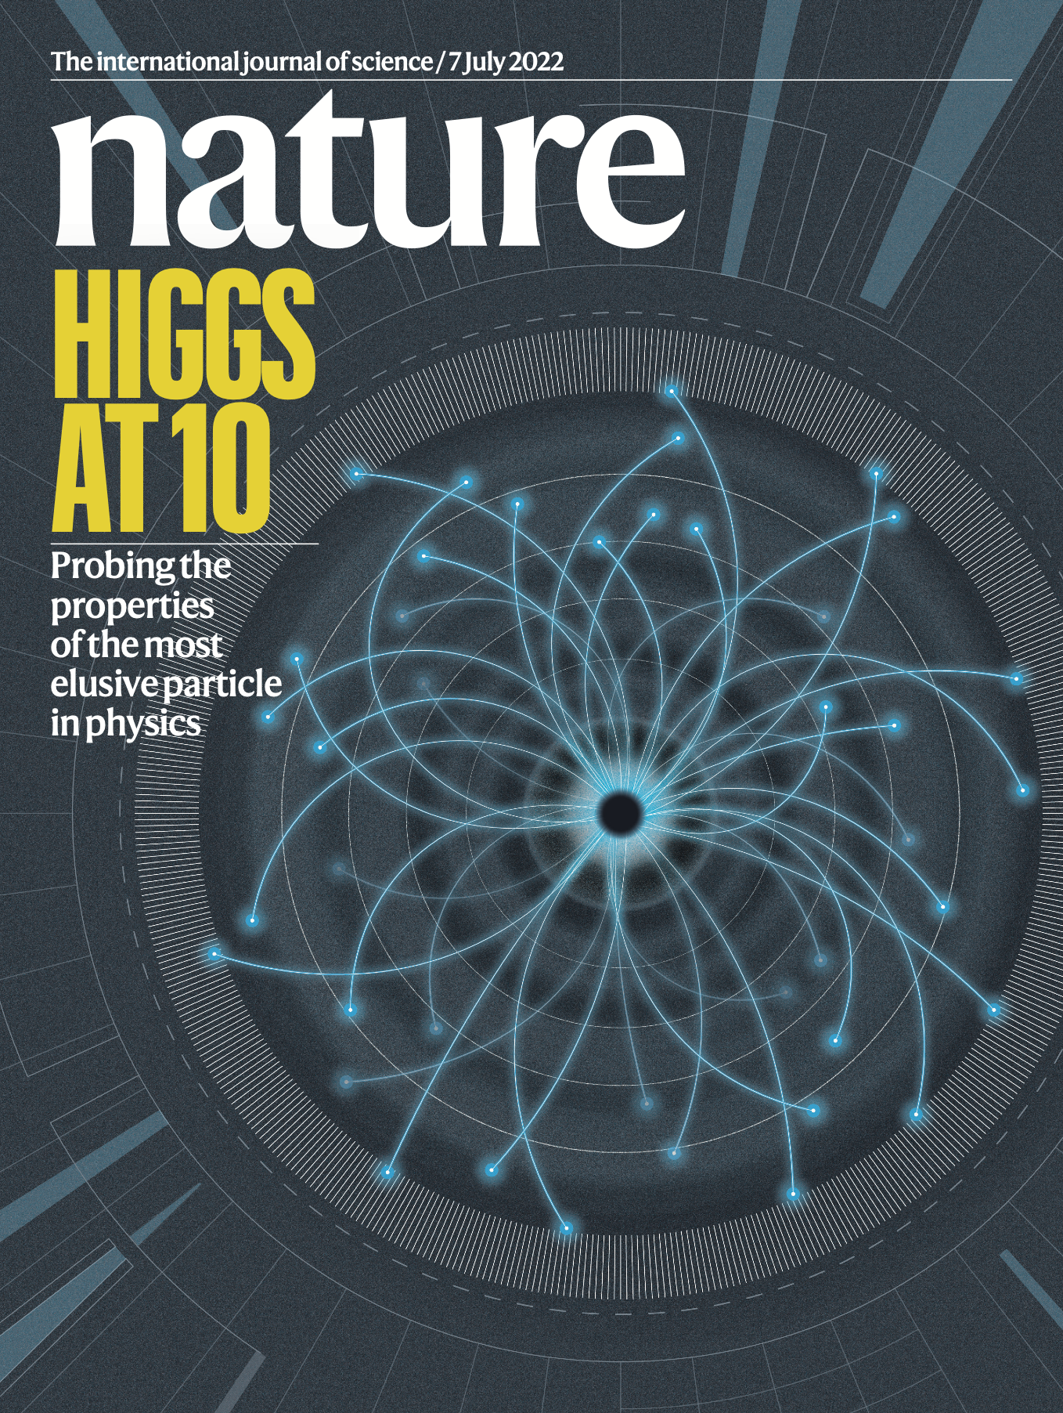
The Higgs mechanism is real !
Nature 607, 52 (2022)

Slide 35
The Higgs mechanism is real !
The Higgs boson and open questions in particle physics and cosmology
Why is the Higgs boson so light?
Is the Higgs boson elementary or composite ?
Do Higgs interactions violate matter-antimatter symmetry?
Is the Higgs boson unique?
Does the Higgs boson couple to dark matter?
What is the origin of the large mass hierarchy in the Standard Model?
Is the vacuum metastable?
Is the Higgs field connected with cosmic inflation?
Why is the dark energy in the universe so much smaller than the Higgs vacuum energy?
The Higgs sector is directly connected with very profound and crucial questions

Slide 36
The Higgs mechanism is real !
The Higgs boson and open questions in particle physics and cosmology
Why is the Higgs boson so light?
Is the Higgs boson elementary or composite ?
Do Higgs interactions violate matter-antimatter symmetry?
Is the Higgs boson unique?
Does the Higgs boson couple to dark matter?
What is the origin of the large mass hierarchy in the Standard Model?
Is the vacuum metastable?
Is the Higgs field connected with cosmic inflation?
Why is the dark energy in the universe so much smaller than the Higgs vacuum energy?
The Higgs sector is directly connected with very profound and crucial questions
The Higgs boson discovery allows us to directly study this sector, requiring a broad experimental programme that will extend over decades

Slide 37
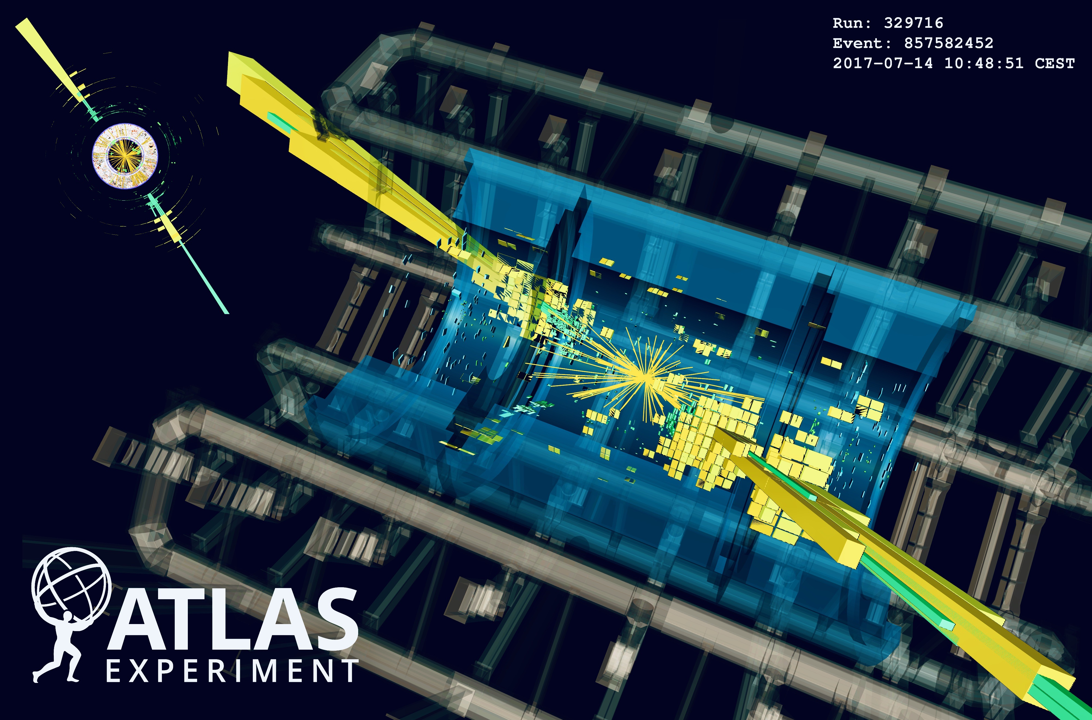
Deep searches for new phenomena

Slide 38
Are quarks elementary particles?
?
substructure ?

Slide 39
Are quarks elementary particles?

Slide 40
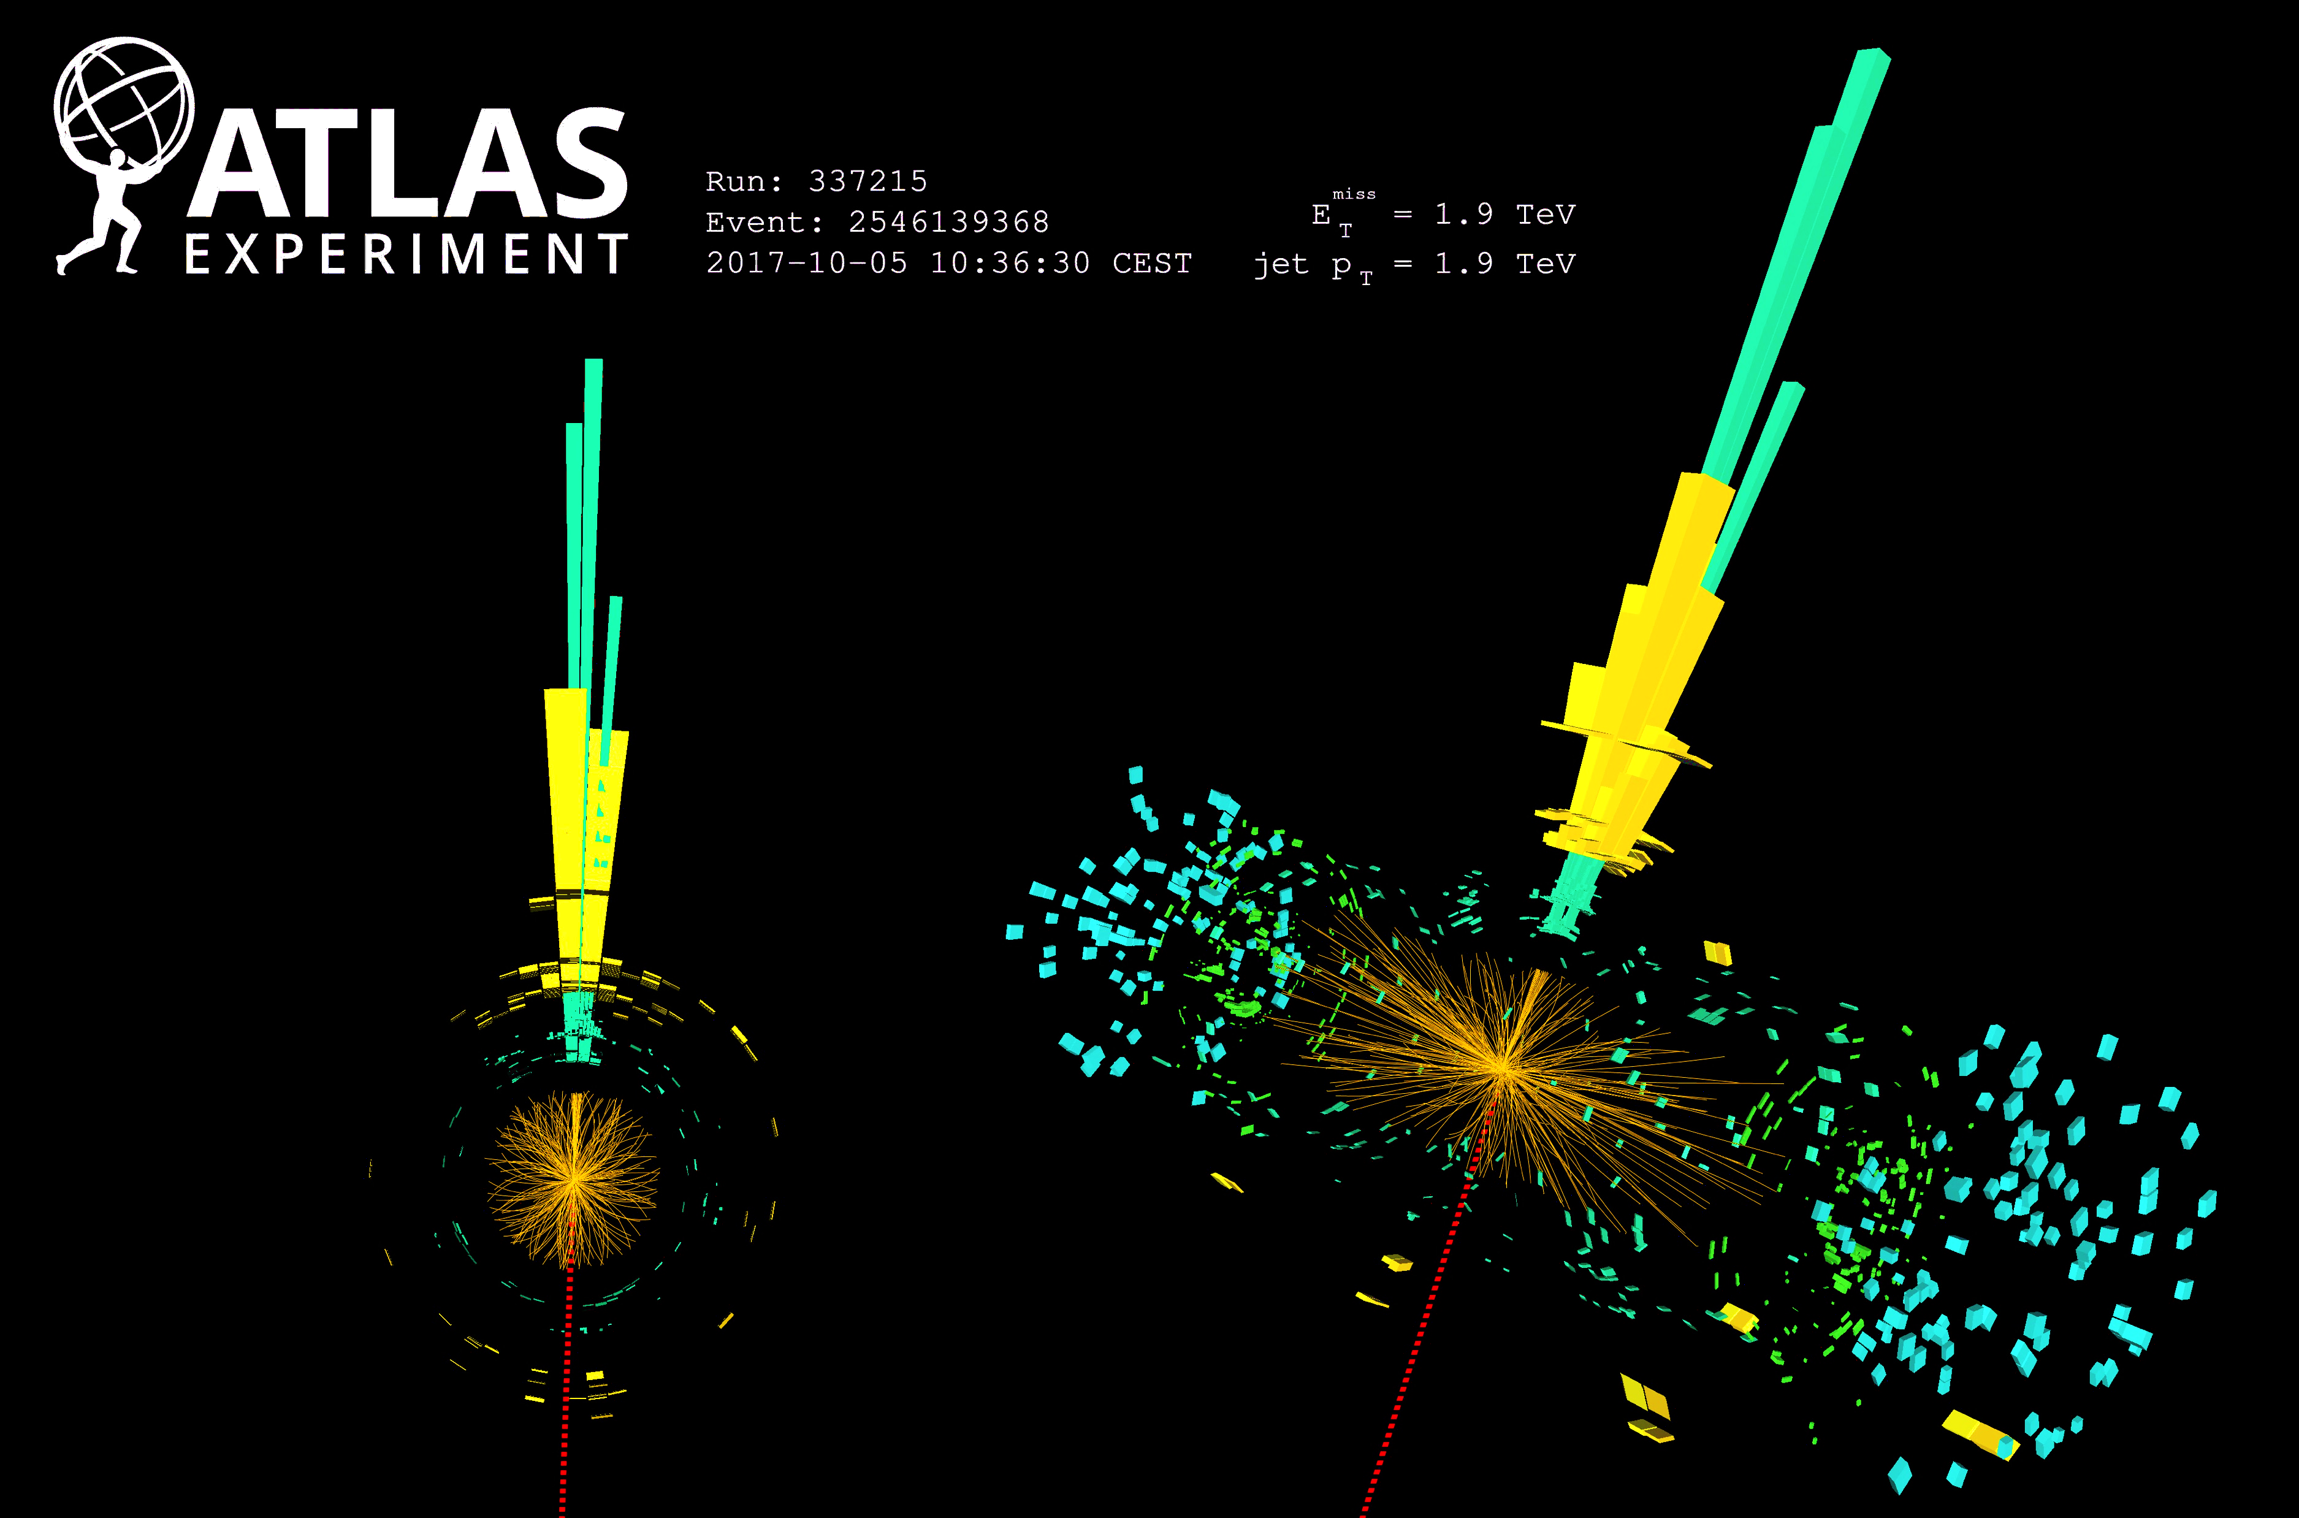
Searches for Dark Matter
Are dark matter particles produced in proton collisions or in Higgs-boson decays?

Slide 41
Studies of physics in extreme electromagnetic fields

Slide 42
And a detailed mapping of the properties of the quark-gluon plasma with soft and hard probes
In collisions of heavy ions, the LHC creates for a very brief moment a quark-gluon plasma of up to 6 trillion degrees, almost half a million times hotter than the core of the sun

Slide 43
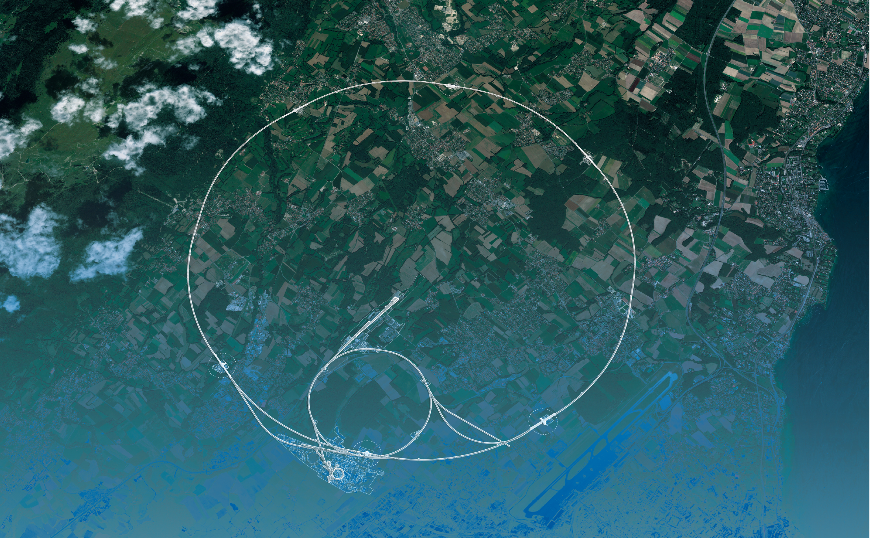
The next steps

Slide 44
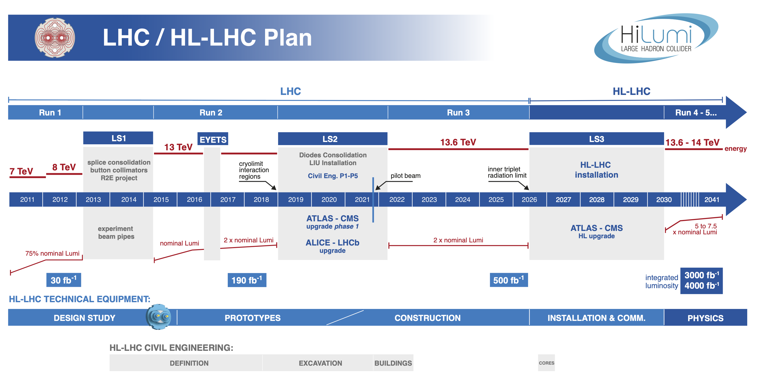
LHC and High-Luminosity-LHC project timeline
HL-LHC is the world’s flagship collider project during the next decade

Slide 45
LHC and High-Luminosity-LHC project timeline
HL-LHC is the world’s flagship collider project during the next decade
HL-LHC
10 times more data than currently recorded: particle factory (ATLAS & CMS: 360M H, 240k HH, 13.4B top, 130B (12B) W (Z) → e/µ, 720M WW) for precise and rare Higgs coupling measurements, access to Higgs self interaction and longitudinal vector boson scattering, and increased overall rare & new physics sensitivity
Complementary in many ways to a future e⁺e– collider at CERN (→ Michael Benedikt)

Slide 46
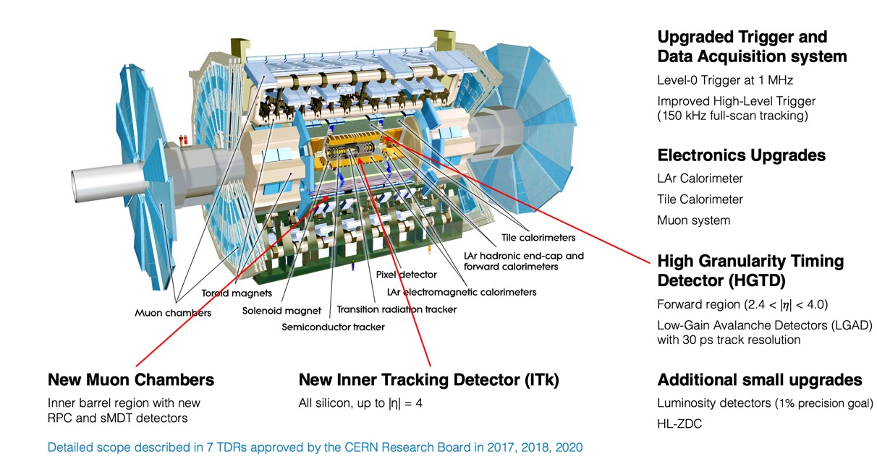
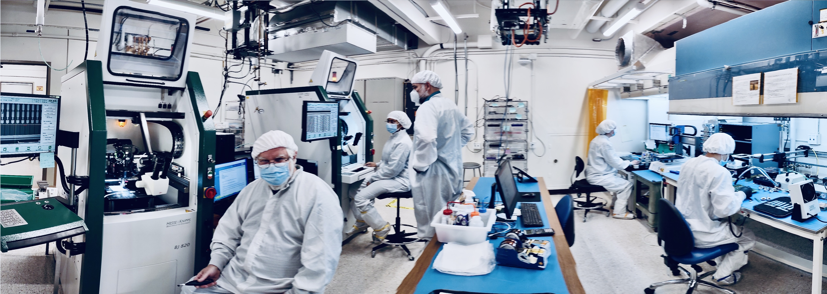
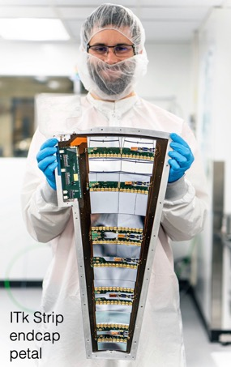
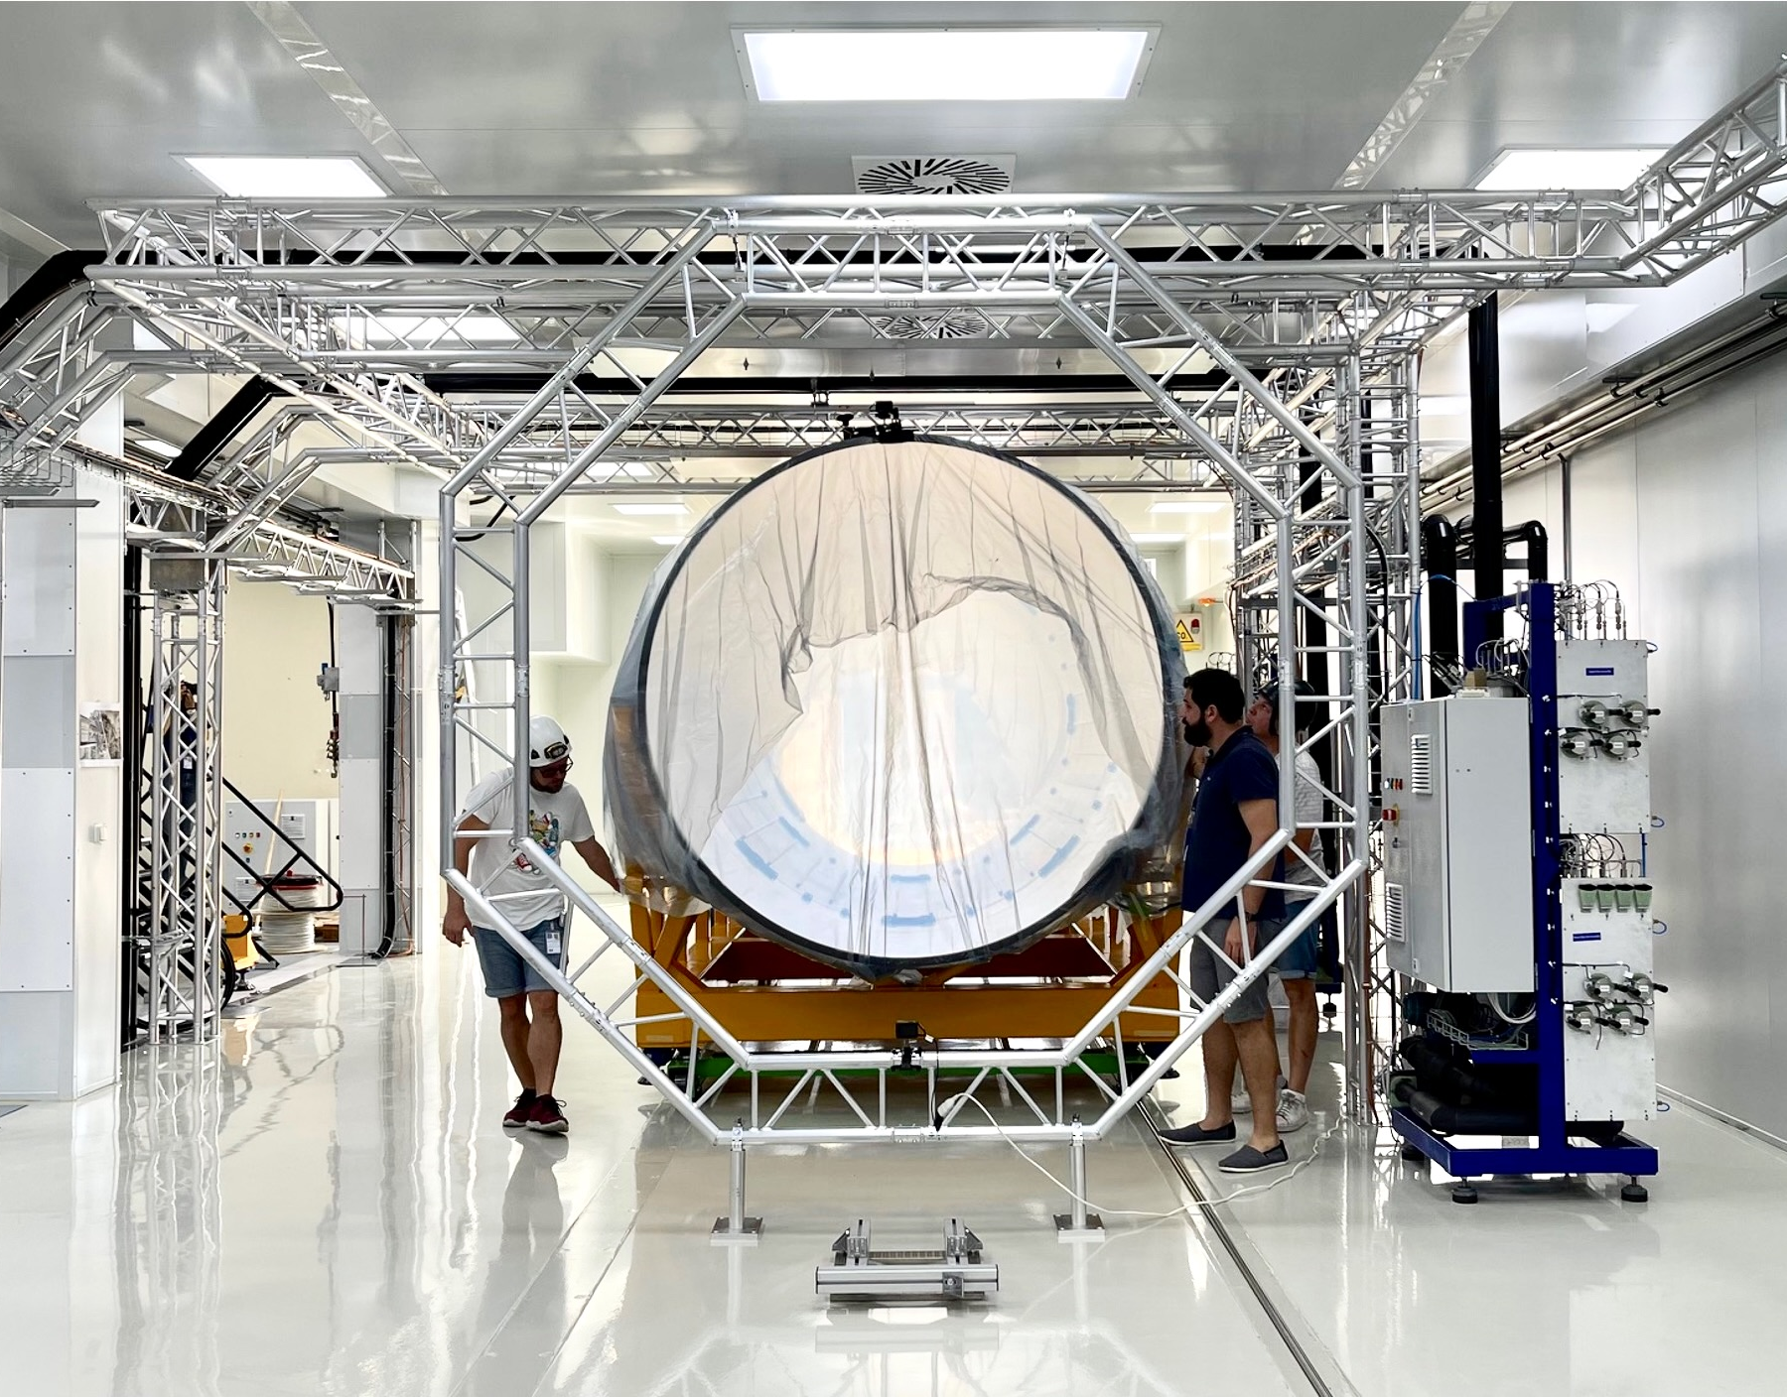
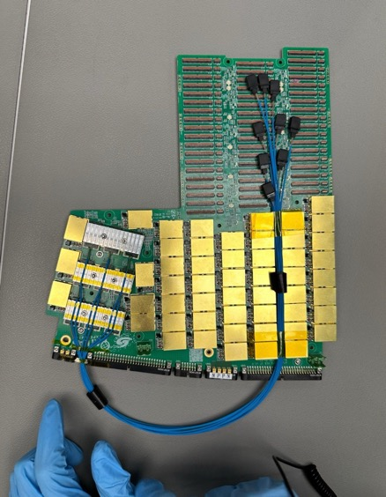
Upgrade to the High-Luminosity LHC (HL-LHC)
The HL-LHC’s intensity requires unprecedented detector and computing technologies:
Radiation hardness
High detection granularity and resolution
Precise timing detectors
More powerful triggers
Deeply embedded ML & AI
High-performance software & computing
Substantial upgrades for ATLAS & CMS
HGTD electronics board
Cleanroom at Santa Cruz UC
ITk Outer cylinder at CERN
200 pileup event simulated in ATLAS

Slide 47
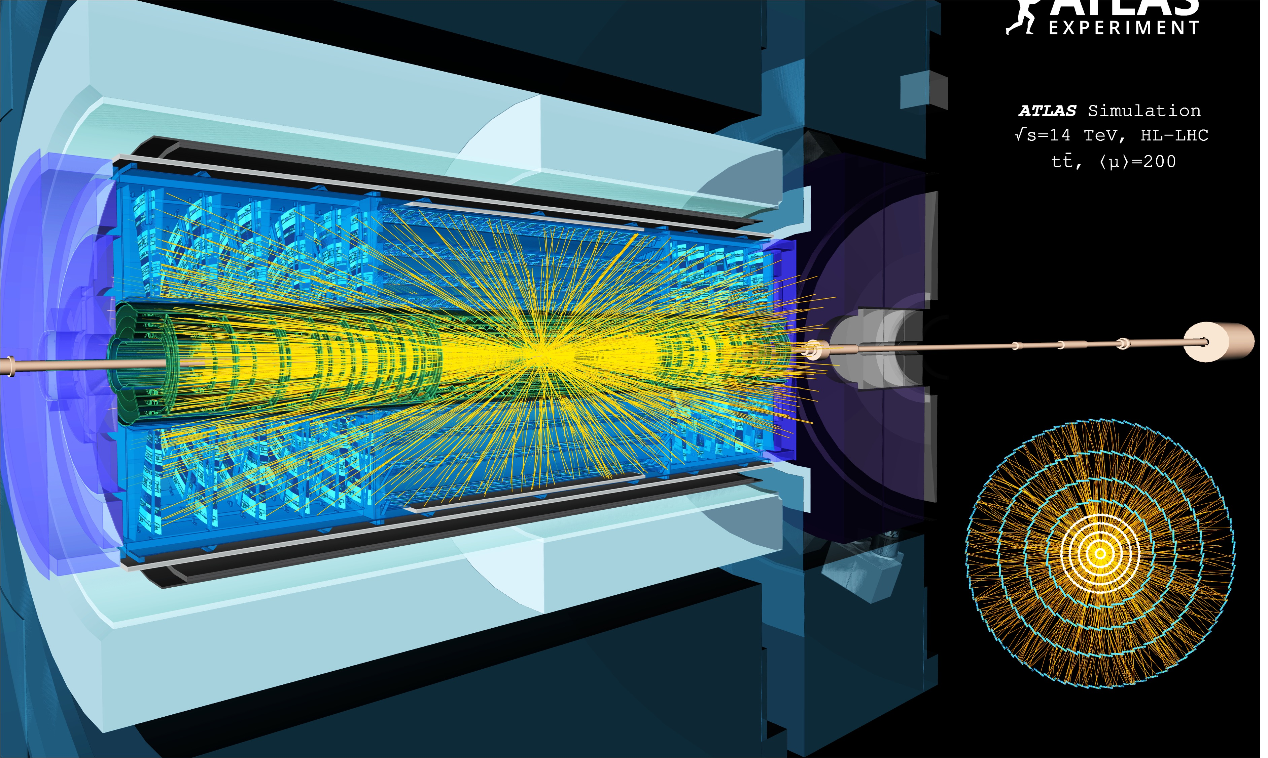
The all-new ATLAS Inner Tracker
ATLAS new silicon inner tracker (simulation)

Slide 48




Measuring Higgs self-coupling
ATL-PHYS-PUB-2025-018
$Z_{HH[SM]}=7.6σ,$ $κ_{λ[SM]}=1_{−0.26}^{+0.29}$
H
H
$$∝6λυ$$
H
$$V\left(φ\right)=−μ^{2}{\left|φ\right|}^{2}+λ{\left|φ\right|}^{4}$$

Slide 49
We’ve come a long way in our quest for the ultimate laws of Nature
Yet many secrets remain hidden from us
ATLAS' voyage of discovery at the LHC continues at pace!

Slide 50

Extra slides

Slide 51

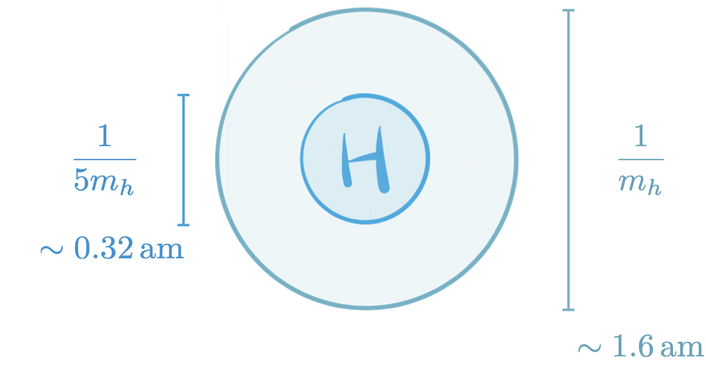
An analogy to the Higgs mechanism
Superconductivity
SC (BCS) theory Higgs mechanism
Cooper pair Bose condensation Condensed Higgs field
Electrically charged (2e) Weak charge
Mass of the photon Mass of W & Z bosons
T_{crit} ~ mK – several 10s of K T_{crit} = T_{EW} ~ 10¹⁵ K
Our universe
→ Is the Higgs boson elementary or composite?
A superconductor is locked mid-air in different orientations above a permanent magnet — superconductive levitation due to the expulsion of the static magnetic field (Meissner effect) [Source]
In response to an externally applied magnetic field, perpetual eddy currents circulate in the superconductor, producing an internal magnetic field that exactly cancels the externally applied one
Further reading, eg: L. Dixon, “From superconductors to supercolliders”

Slide 52
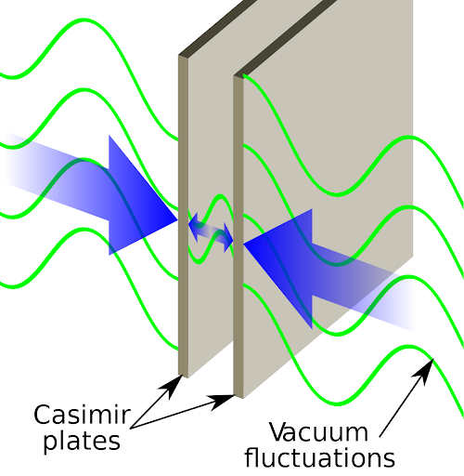
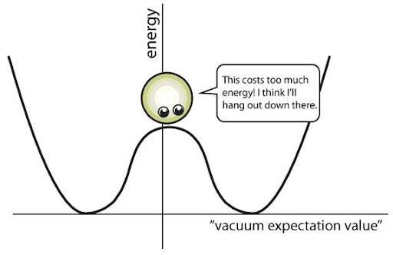
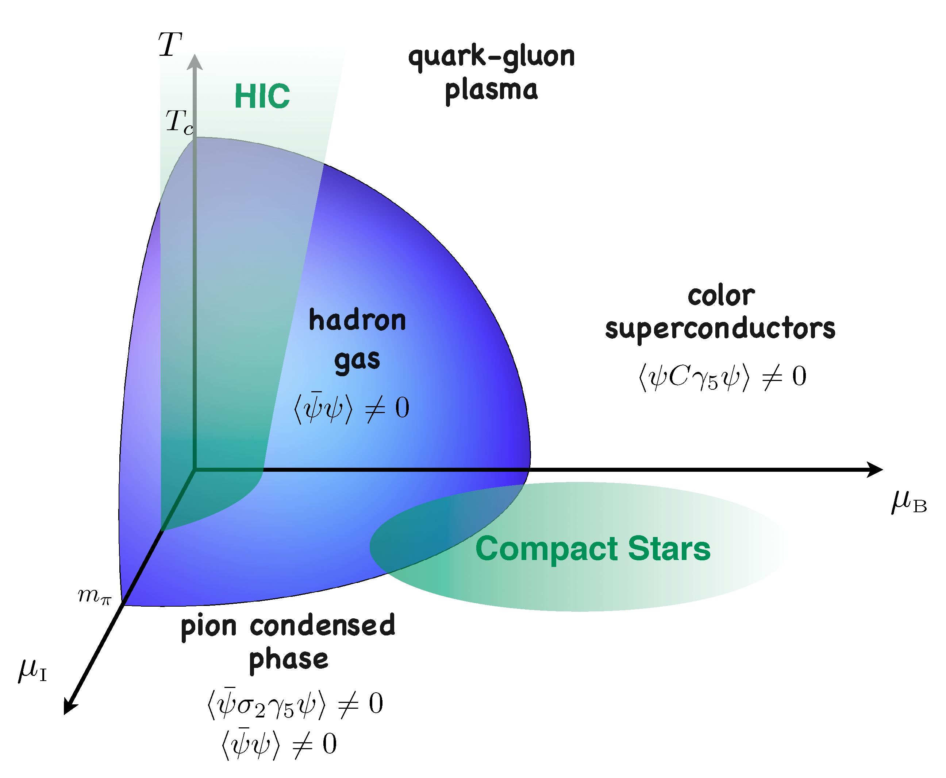
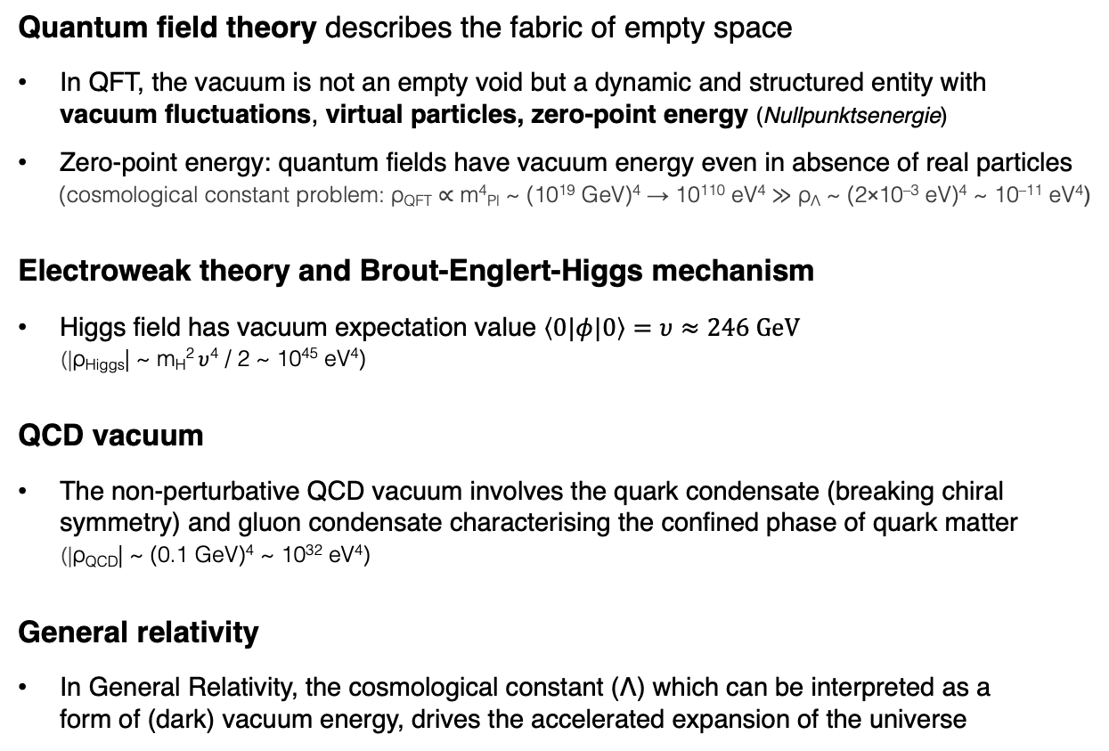

Vacuum energy
Quantum field theory describes the fabric of empty space
In QFT, the vacuum is not an empty void but a dynamic and structured entity with vacuum fluctuations, virtual particles, zero-point energy (Nullpunktsenergie)
Zero-point energy: quantum fields have vacuum energy even in absence of real particles
(cosmological constant problem: ρ_{QFT} ∝ m⁴_{Pl} ~ (10¹⁹ GeV)⁴ → 10¹¹⁰ eV⁴ ≫ ρ_{Λ} ~ (2×10^{–3} eV)⁴ ~ 10^{–11} eV⁴)
Electroweak theory and Brout-Englert-Higgs mechanism
Higgs field has vacuum expectation value $\left\langle 0|φ|0\right\rangle =υ≈246 GeV$
(|ρ_{Higgs}| ~ m_{H}² $υ$⁴ / 2 ~ 10⁴⁵ eV⁴)
QCD vacuum
The non-perturbative QCD vacuum involves the quark condensate (breaking chiral symmetry) and gluon condensate characterising the confined phase of quark matter
(|ρ_{QCD}| ~ (0.1 GeV)⁴ ~ 10³² eV⁴)
General relativity
In General Relativity, the cosmological constant (Λ) which can be interpreted as a form of (dark) vacuum energy, drives the accelerated expansion of the universe
Harnessing the zero-point energy
Non-zero ground state of the Higgs field
$$υ$$
Phase diagram of hadronic matter

Slide 53
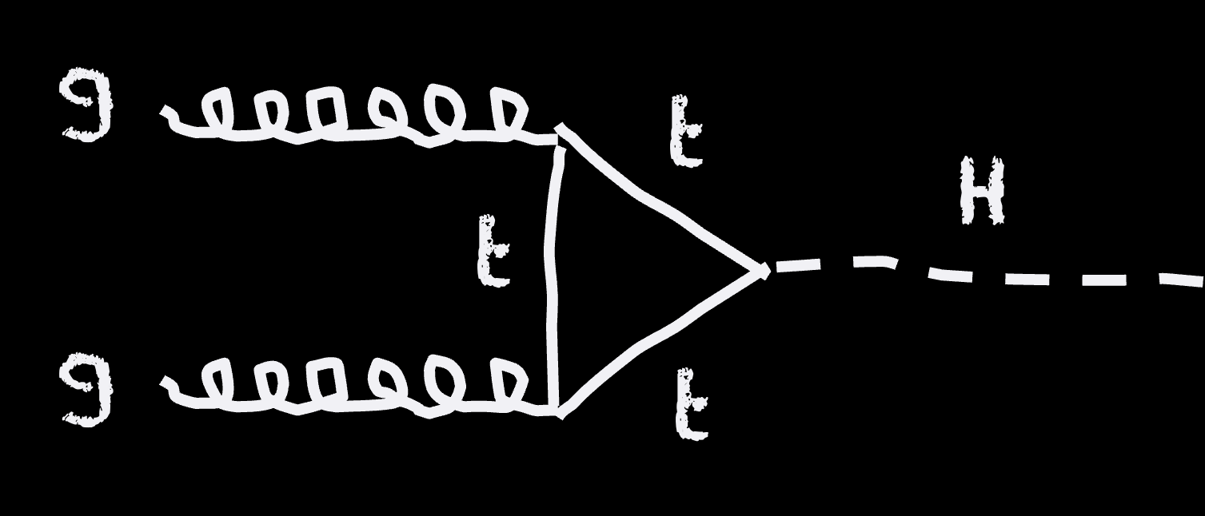
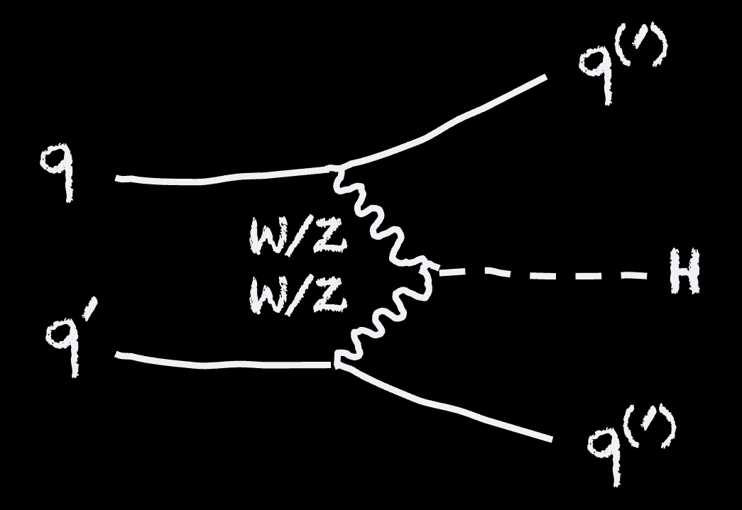

Higgs boson production at the LHC
About 1 Higgs boson per second is produced in ATLAS at the LHC (about 20M total by today)
tt → eµ + jets candidate event in 2016 8.16 TeV p-Pb collisions
(88% of H production)
Sensitivity to heavy new particles
(7%)
(0.9%)
(4%)

