Slide 1
ATLAS and the LHC
Andreas Hoecker (CERN)
HKUST, 15 January 2026

Slide 2
It’s all made of a handful of particles and forces
The sub-atomic structure of matter (a very simplified picture)
The universe is a strange place
Elementary particles are point-like — with no spatial extent at all (this is likely not true)
Without some remarkable mechanism at play, elementary particles would have no mass (except for spin-zero particles)
Bare fermion masses are forbidden by chiral structure of weak interaction

Slide 3
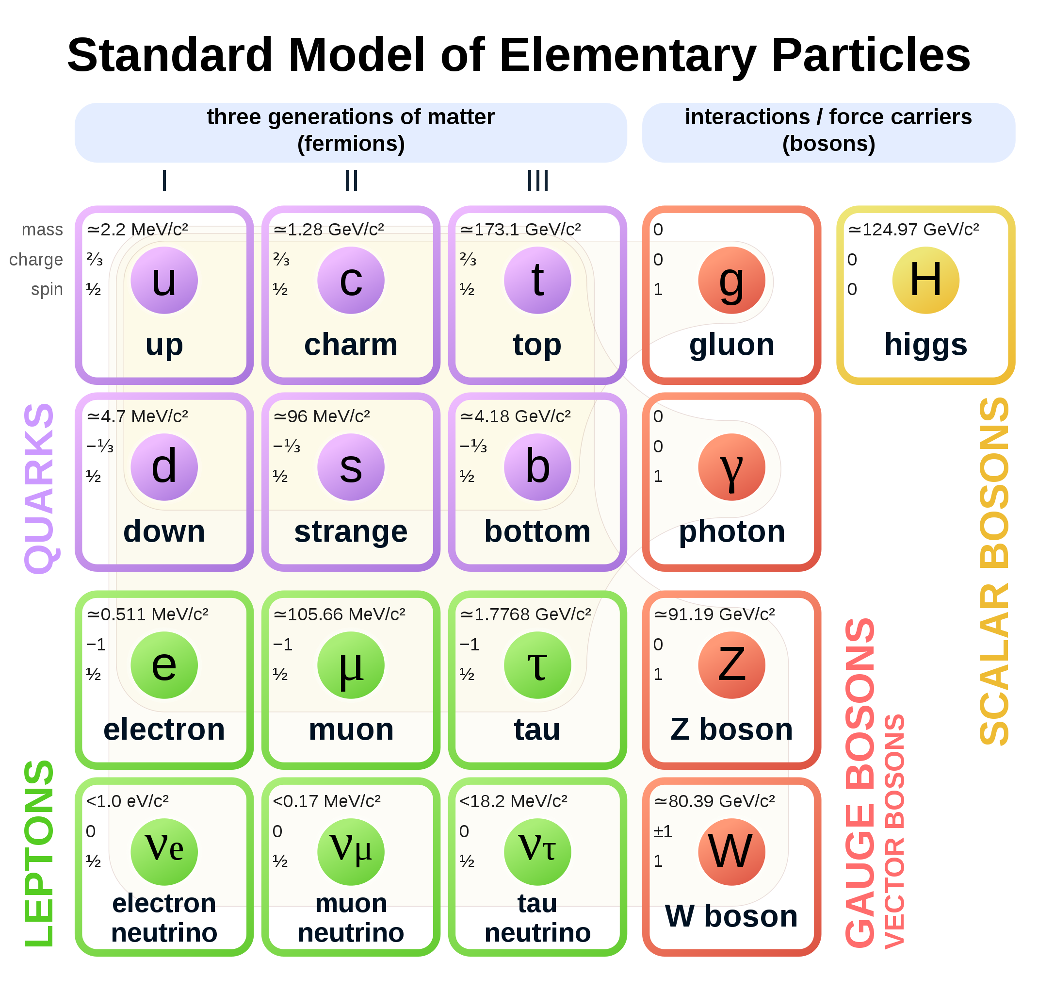
It’s all made of a handful of particles and forces
The sub-atomic structure of matter and its interactions is described by the Standard Model
In mathematical terms, particles are local excitations of quantum fields. There are matter fields (fermions) and force fields (bosons)
Completely new type of non-universal interactions, nothing to do with known forces
Spin 1/2
Spin 1
Spin 0

Slide 4
It’s all made of a handful of particles and forces
The sub-atomic structure of matter and its interactions is described by the Standard Model
Decades of international high-technology accelerator-based research gave us these insights
Completely new type of non-universal interactions, nothing to do with known forces
Spin 1/2
Spin 1
Spin 0

Slide 5
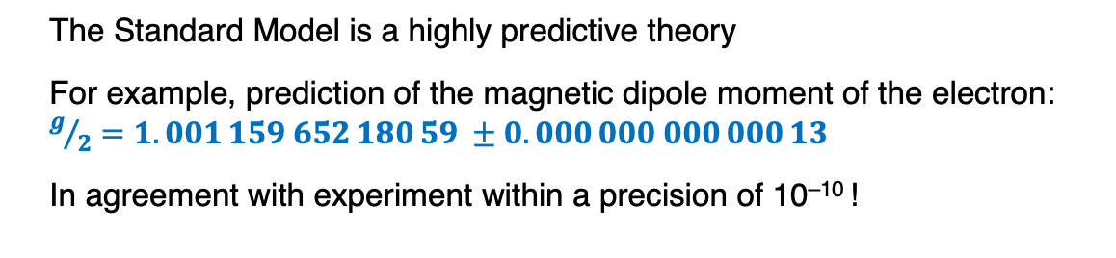
It’s all made of a handful of particles and forces
The sub-atomic structure of matter and its interactions is described by the Standard Model
The Standard Model is a highly predictive theory
For example, prediction of the magnetic dipole moment of the electron: $g/2=1.001 159 652 180 59 ±0.000 000 000 000 13$
In agreement with experiment within a precision of 10^{–10} !
Spin 1/2
Spin 1
Spin 0

Slide 6
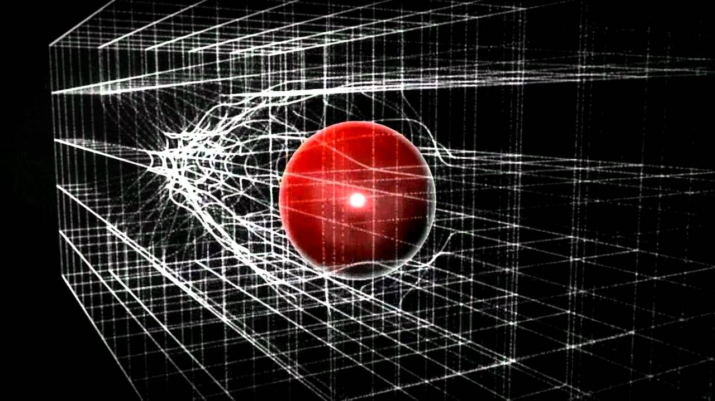
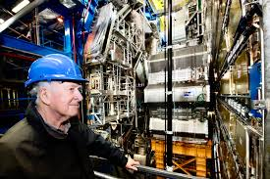
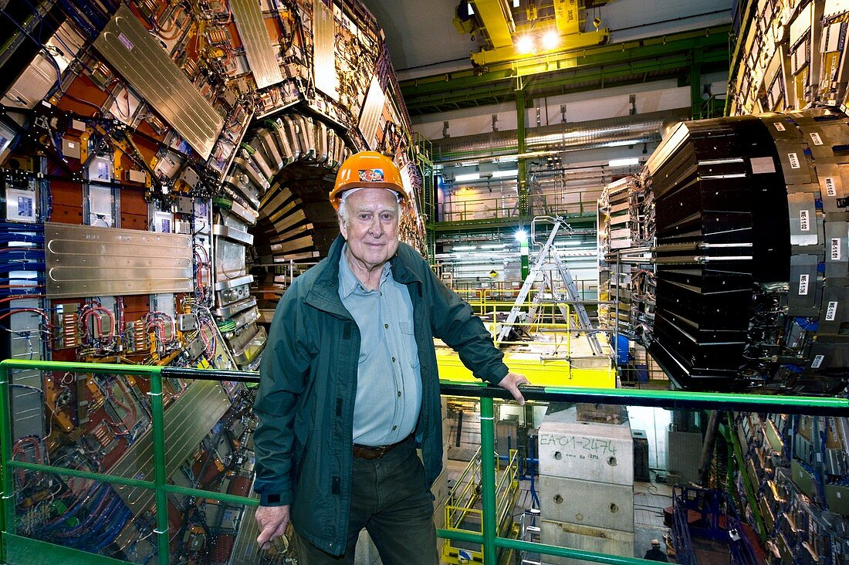
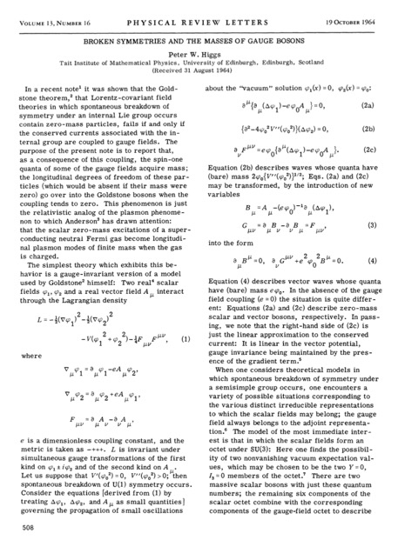
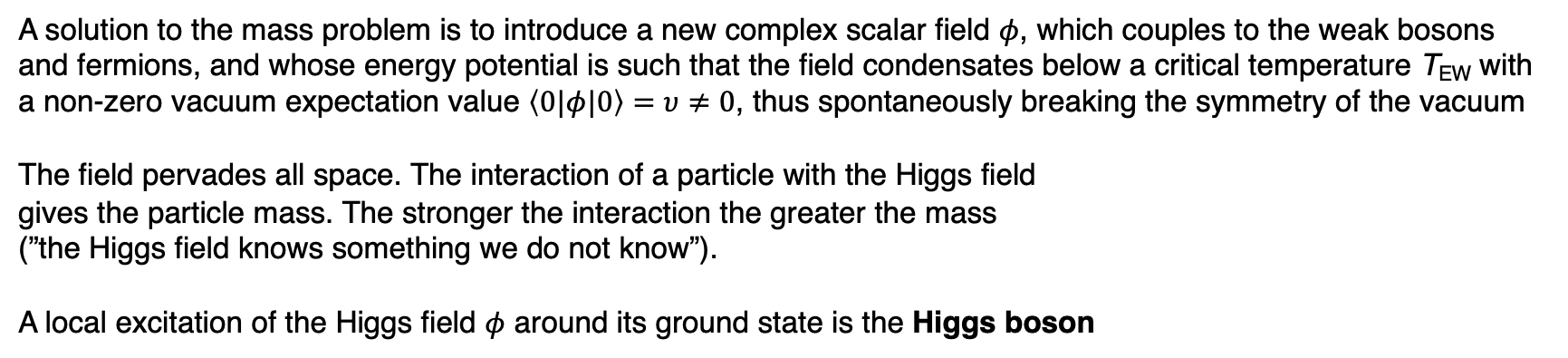
Gauge symmetry and the Brout-Englert-Higgs mechanism
A solution to the mass problem is to introduce a new complex scalar field $φ$, which couples to the weak bosons and fermions, and whose energy potential is such that the field condensates below a critical temperature T_{EW} with a non-zero vacuum expectation value $\left\langle 0|φ|0\right\rangle =υ≠0$, thus spontaneously breaking the symmetry of the vacuum
The field pervades all space. The interaction of a particle with the Higgs field gives the particle mass. The stronger the interaction the greater the mass (”the Higgs field knows something we do not know”).
A local excitation of the Higgs field $φ$ around its ground state is the Higgs boson
Peter Ware Higgs (1929 – 2024)
Broken Symmetries and the Masses of Gauge Bosons –– or how to change the course of physics with a good idea on two pages — together with the other famous works from his colleagues in 1964
Superconductivity (BCS theory) was key in the development of the BEH mechanism [My life as a boson, 2010]
Peter Higgs at ATLAS
Peter Higgs at CMS

Slide 7
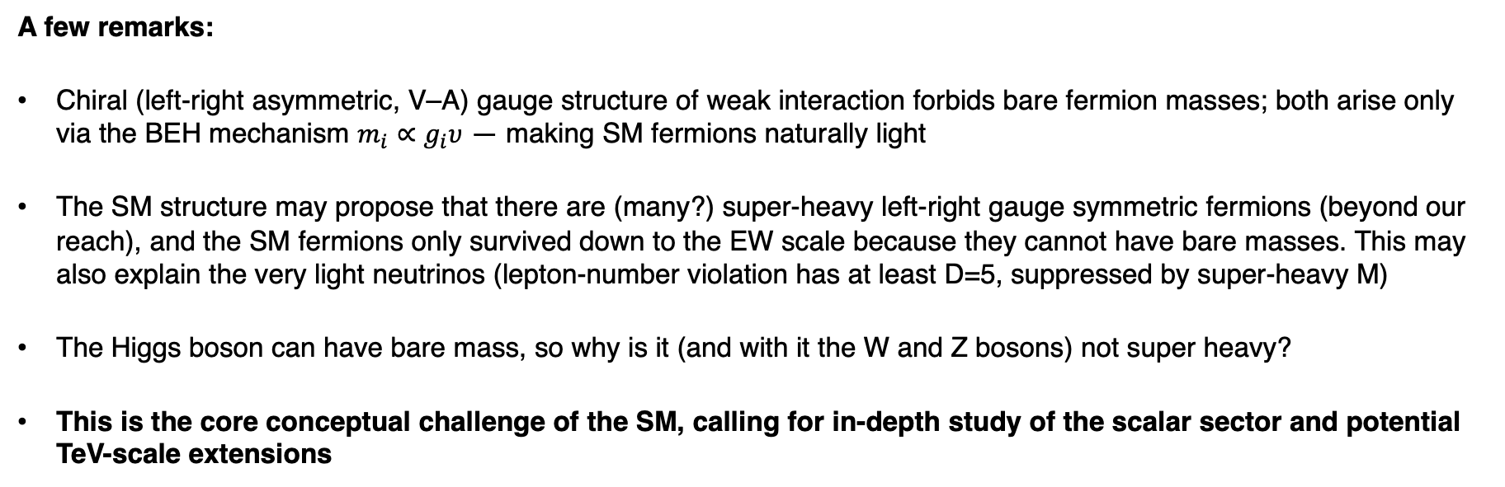
The Brout-Englert-Higgs mechanism
A few remarks:
Chiral (left-right asymmetric, V–A) gauge structure of weak interaction forbids bare fermion masses; both arise only via the BEH mechanism $m_{i}∝g_{i}υ$ — making SM fermions naturally light
The SM structure may propose that there are (many?) super-heavy left-right gauge symmetric fermions (beyond our reach), and the SM fermions only survived down to the EW scale because they cannot have bare masses. This may also explain the very light neutrinos (lepton-number violation has at least D=5, suppressed by super-heavy M)
The Higgs boson can have bare mass, so why is it (and with it the W and Z bosons) not super heavy?
This is the core conceptual challenge of the SM, calling for in-depth study of the scalar sector and potential TeV-scale extensions

Slide 8
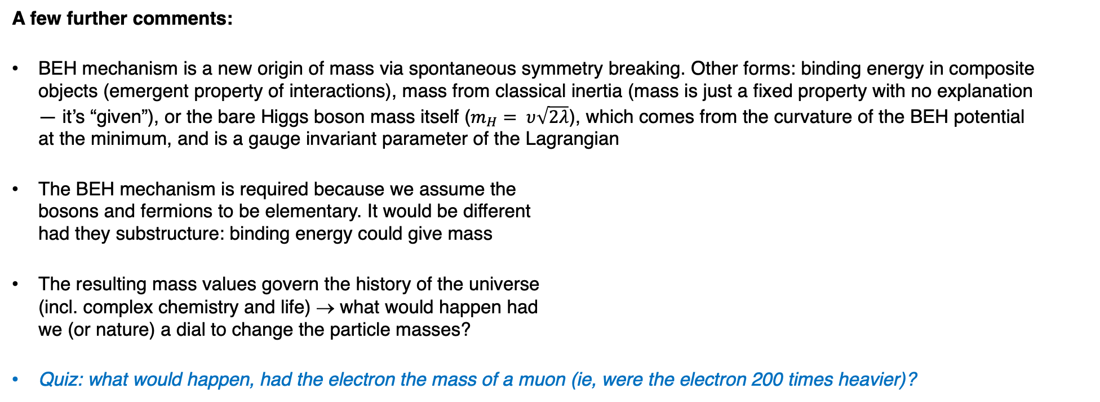
The Brout-Englert-Higgs mechanism
A few further comments:
BEH mechanism is a new origin of mass via spontaneous symmetry breaking. Other forms: binding energy in composite objects (emergent property of interactions), mass from classical inertia (mass is just a fixed property with no explanation — it’s “given”), or the bare Higgs boson mass itself ($m_{H}= υ\sqrt{2λ}$), which comes from the curvature of the BEH potential at the minimum, and is a gauge invariant parameter of the Lagrangian
The BEH mechanism is required because we assume the bosons and fermions to be elementary. It would be different had they substructure: binding energy could give mass
The resulting mass values govern the history of the universe (incl. complex chemistry and life) → what would happen had we (or nature) a dial to change the particle masses?
Quiz: what would happen, had the electron the mass of a muon (ie, were the electron 200 times heavier)?
[see R. Cahn, 1996]

Slide 9

Completing the Standard Model
The scalar Higgs sector completes the Standard Model
These terms describe interactions among force particles (top) and among matter and force particles (bottom)
The SM Lagrangian
Beauty: interactions governed by gauge symmetries with only 3 (EW) and 2 (QCD, θ_{strong} tiny → strong CP problem) parameters
This term is related
to the Higgs sector
$$+ …$$
Key to many mysteries
Unpleasant: not governed by symmetries, 23 free parameters*, large hierarchy among masses
*Assuming neutrinos are Majorana particles (total of 9 neutrino related parameteres)

Slide 10
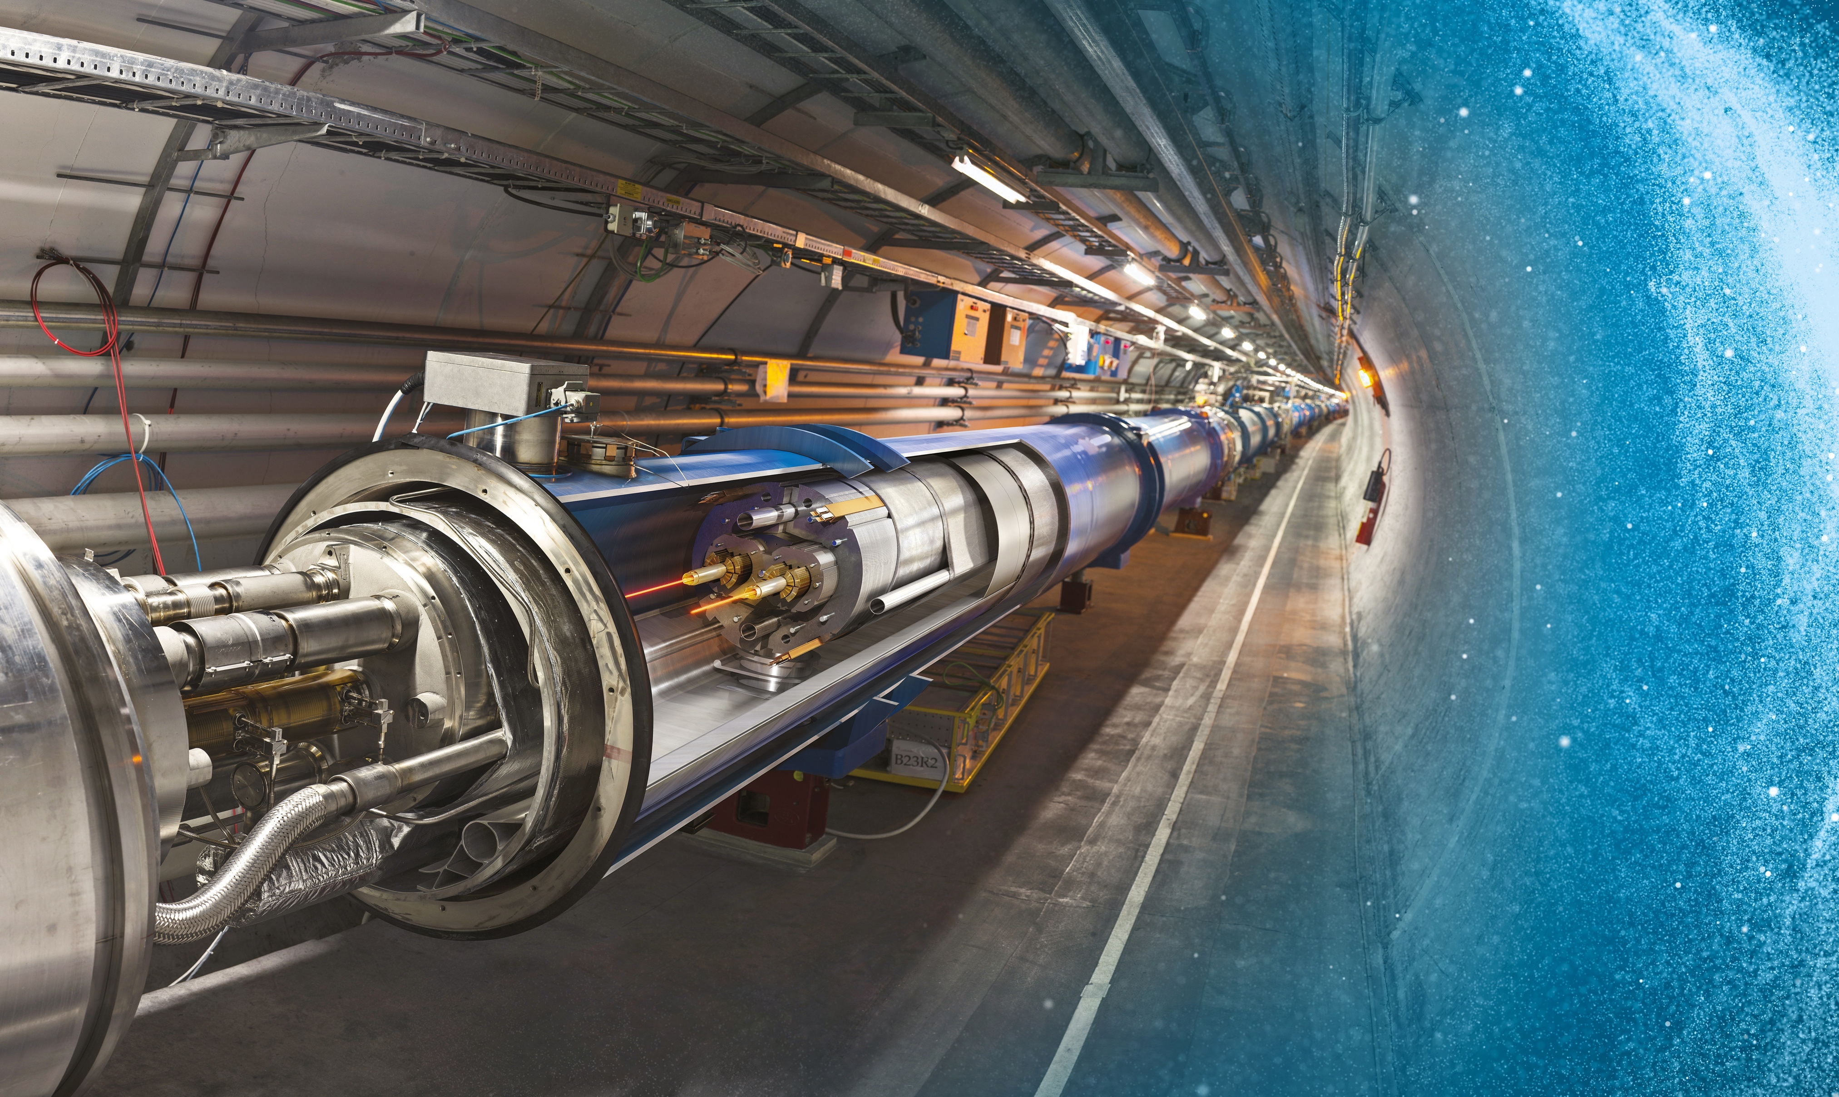
Producing and studying the Higgs boson requires a huge machine
Large Hadron Collider (LHC)
27 km underground accelerator and collider
Superconducting magnets (1.9 K = –271.3 °C) steer the particles around the ring (the strength of the magnets determines the maximum reachable beam energy)
Proton and ions are accelerated to multi-TeV scale energies before they collide
The LHC has a total of 9,300 magnets for beam bending, beam focusing and orbit corrections

Slide 11

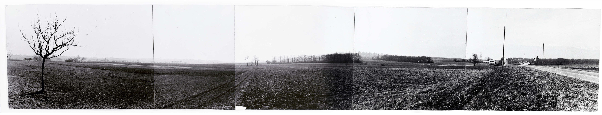
CERN — Science for peace
Objective: Creation of a powerful and competitive infrastructure for fundamental research in nuclear / particle physics in Europe
1952: Creation of a Council: "Conseil Européen pour la Recherche Nucléaire“
  Belgium, Denmark, France, West Germany, Greece, Italy, The Netherlands, Norway, Sweden, Switzerland, United Kingdom, Yugoslavia
Coming into force of the convention on 29 September 1954: Foundation as "Organisation Européenne pour la Recherche Nucléaire“
“Panorama” photograph taken around 1954 of the site that would become the CERN laboratory
Find more on CERN’s history here: https://timeline.web.cern.ch/timeline-header/89

Slide 12
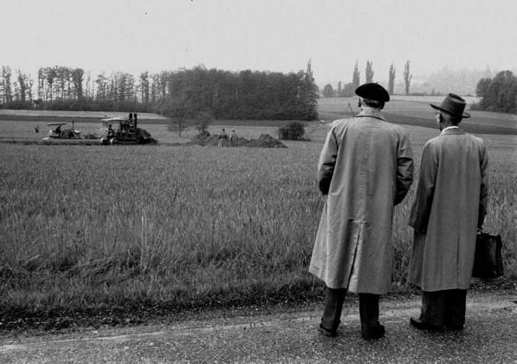
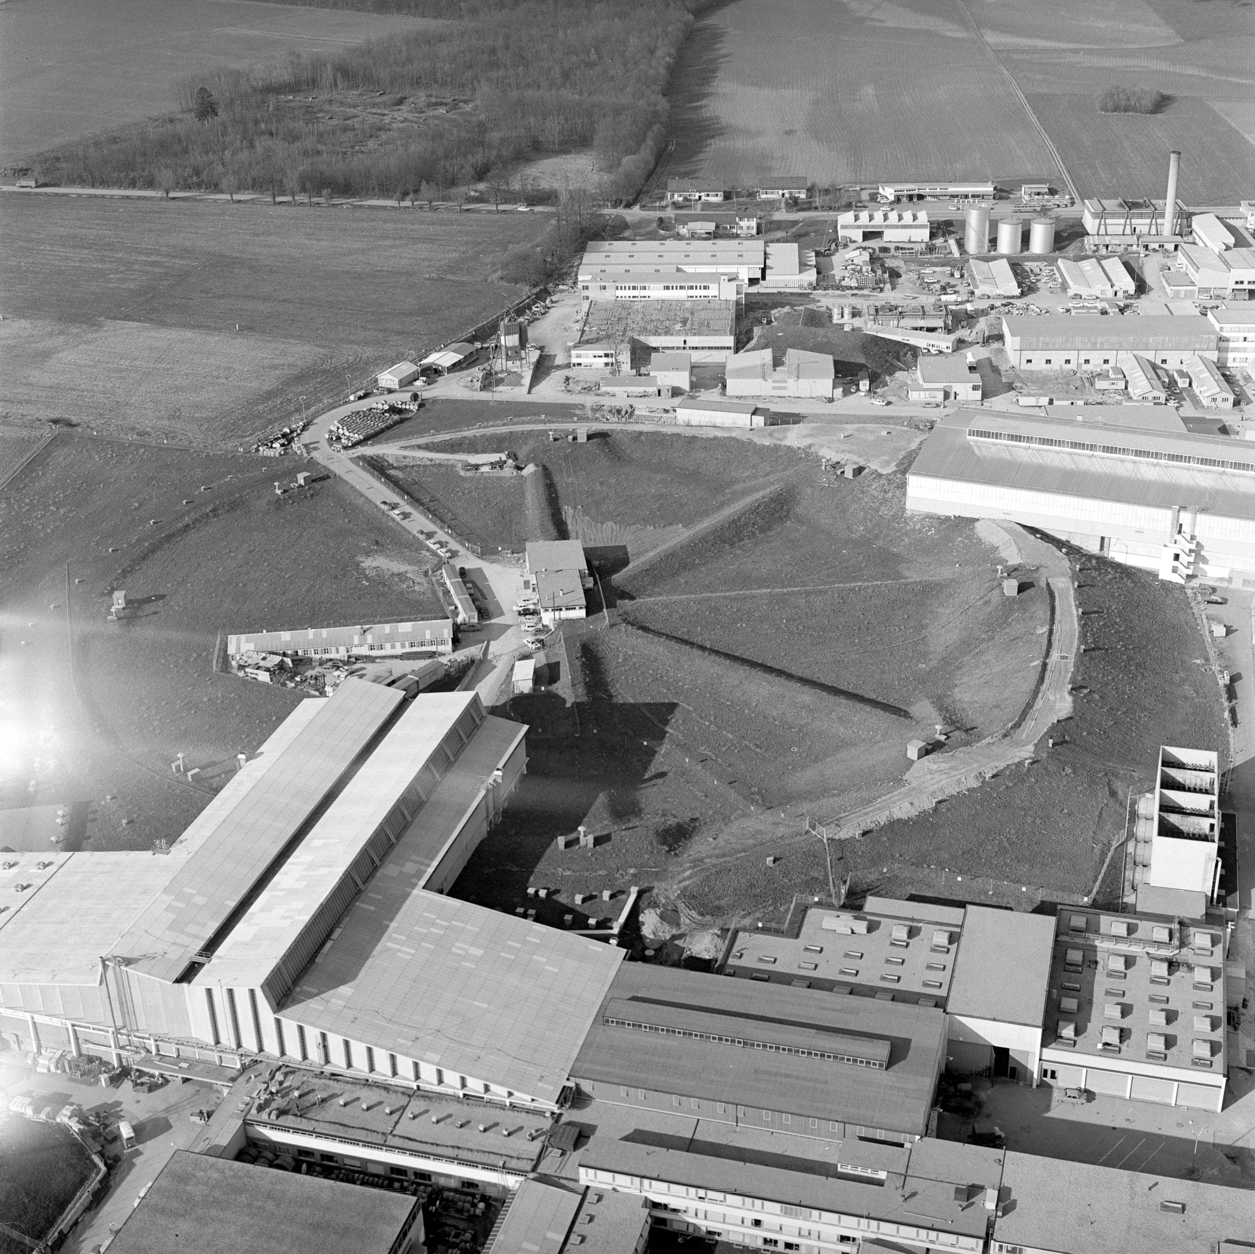
On 17 May 1954, the first shovel of earth was dug on the Meyrin site in Switzerland under the eyes of Geneva officials and members of CERN staff
Aerial view of the 25 GeV Protron Synchrotron at CERN in 1965

Slide 13
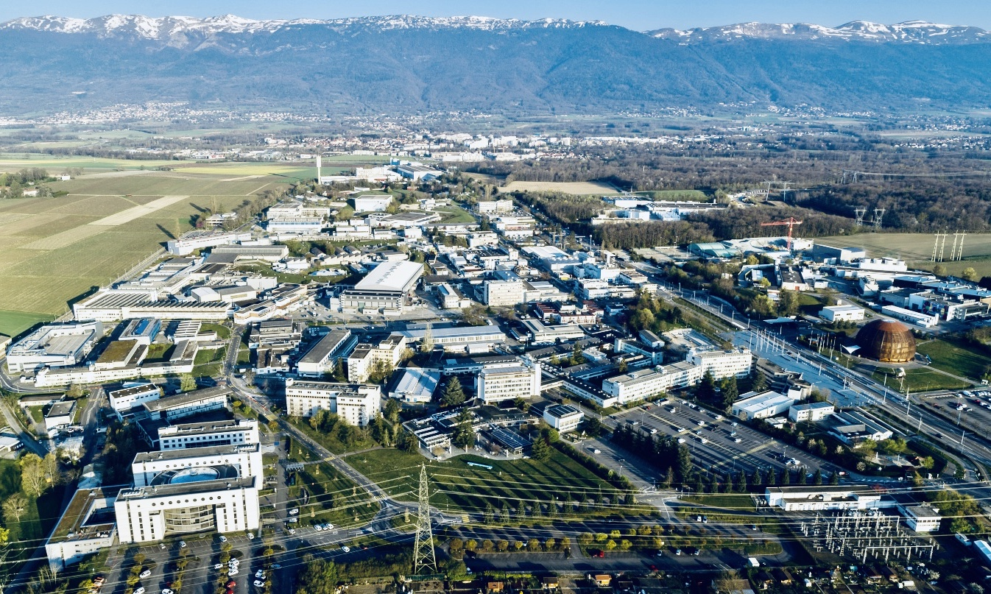
CERN today

Slide 14
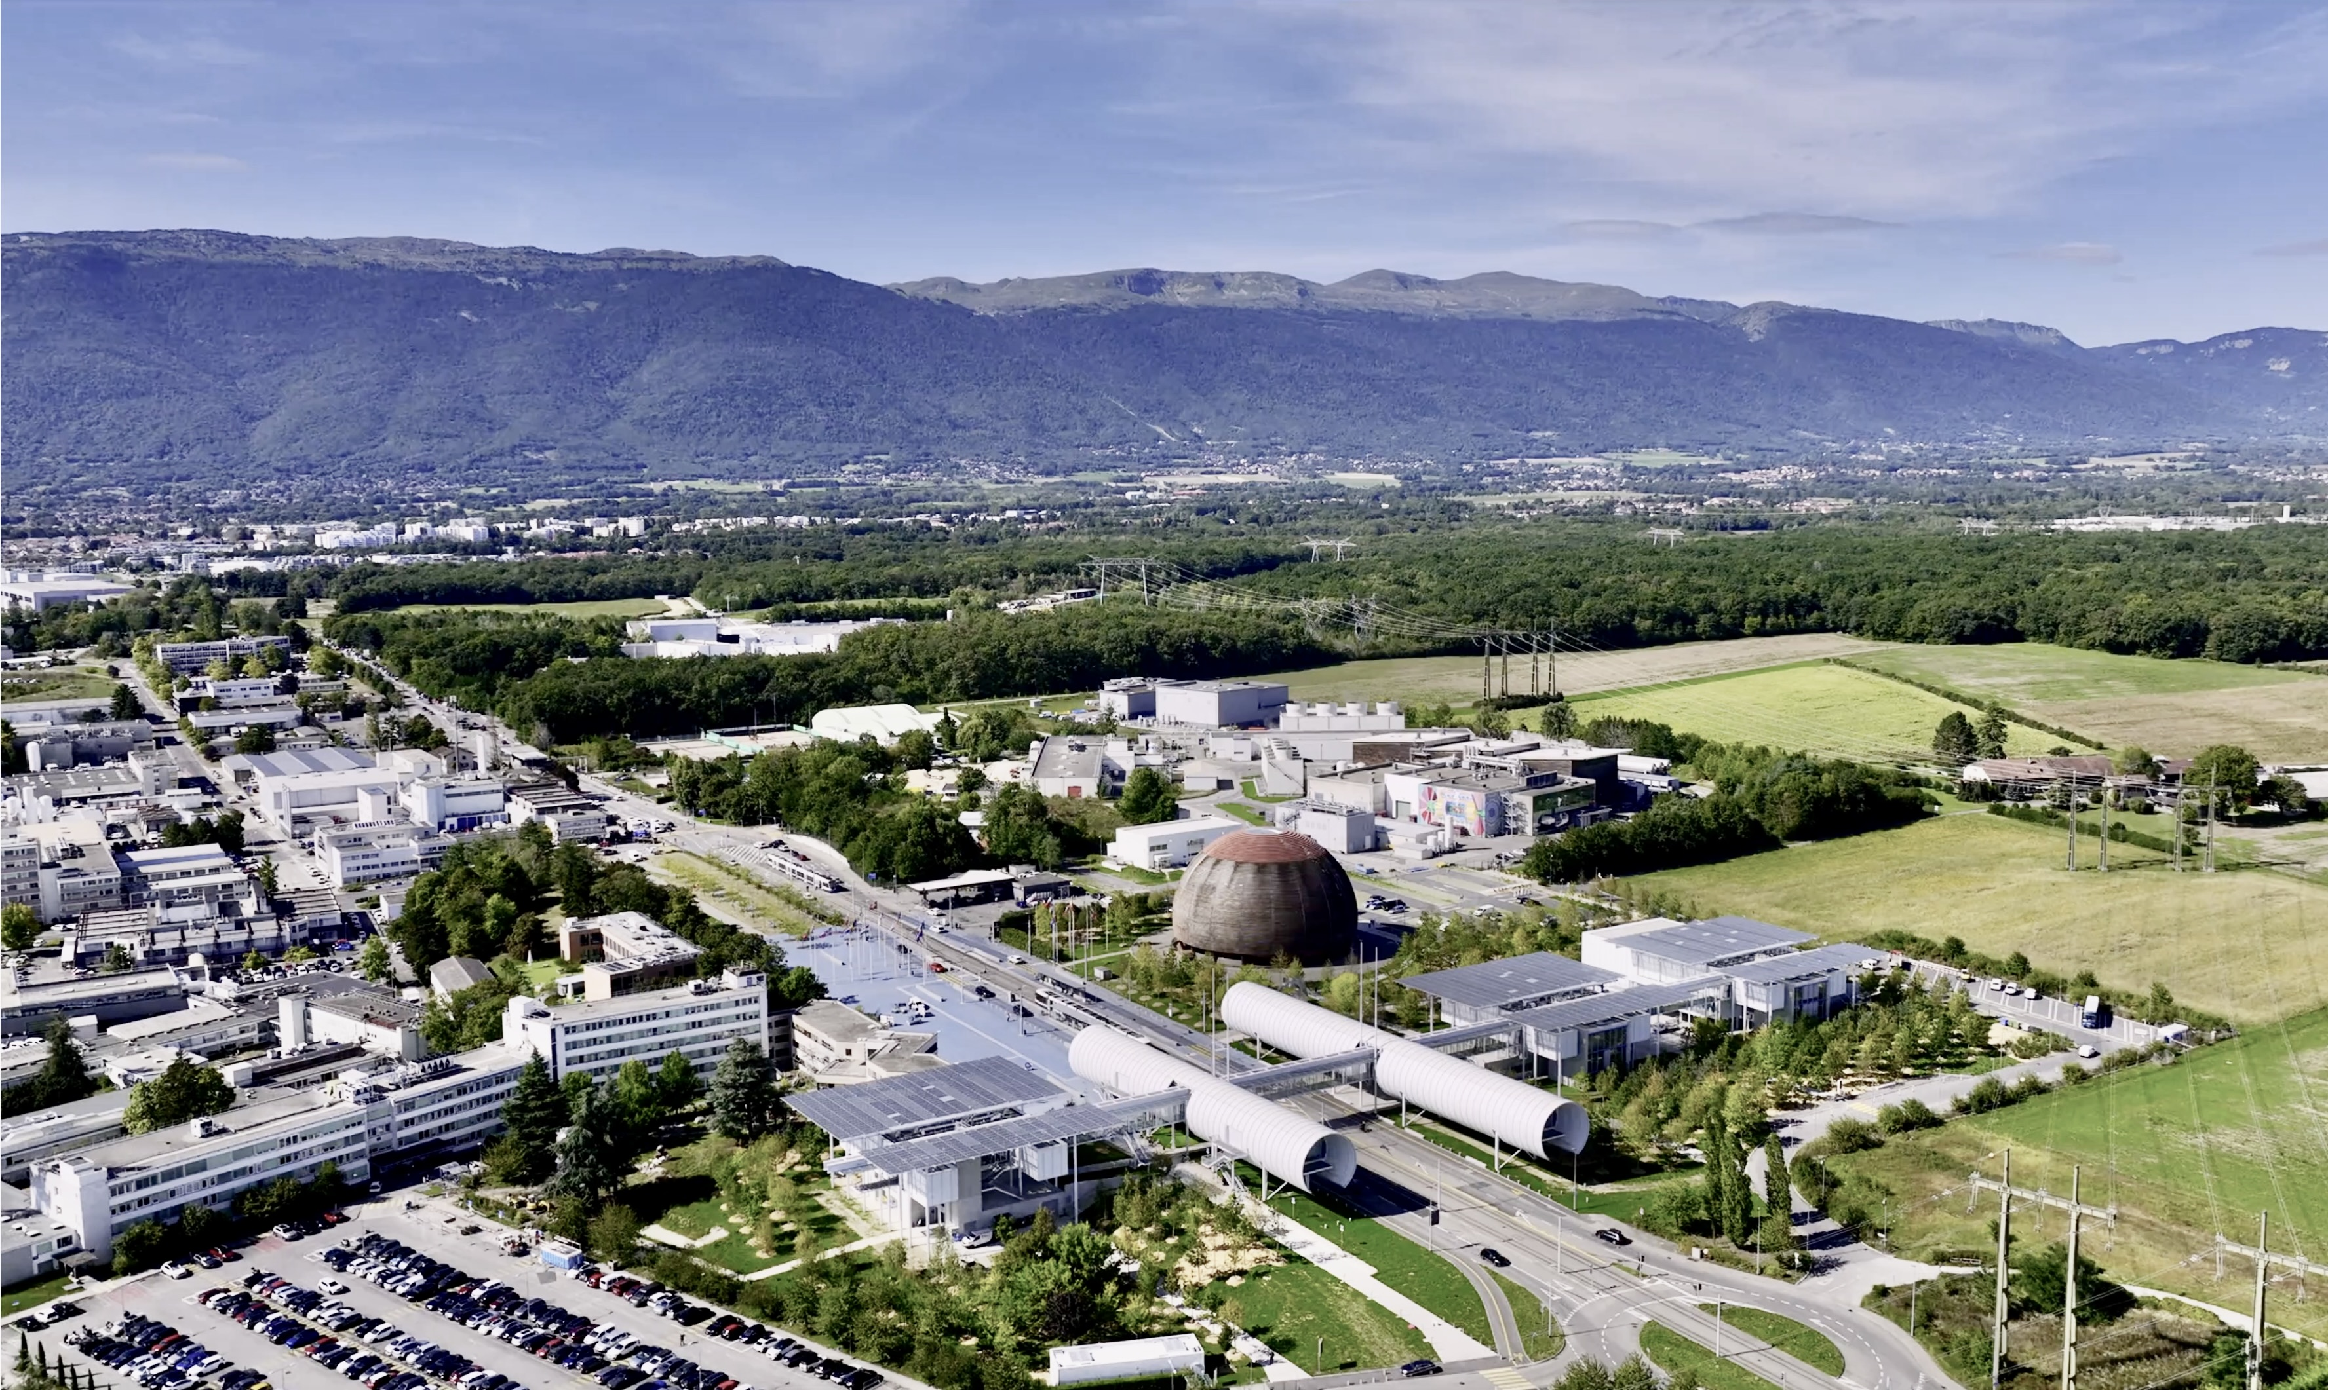
CERN today
ATLAS Experiment

Slide 15

CERN today — the world’s largest centre for particle physics
24 Member States
Austria – Belgium – Bulgaria – Czech Republic
Denmark – Estonia – Finland – France – Germany Greece Hungary – Israel – Italy – Netherlands Norway – Poland – Portugal – Romania – Serbia Slovakia Spain – Sweden – Switzerland – United Kingdom
CERN – Science for Peace
3 Associates Member States
in the pre-stage to membership
Cyprus – Slovenia
8 Associate Member States
Brazil – Croatia – India – Latvia – Lithuania – Pakistan Turkey – Ukraine
6 Observers
Japan – Russia (suspended) – USA
European Union – JINR (suspended) – UNESCO
As of 31 December 2023
Employees:
2,666 staff, 1,002 graduates
Associates:
12,370 users, 1,513 others
Around 50 Cooperation Agreements with non-Member States and Territories
Albania – Algeria – Argentina – Armenia – Australia – Azerbaijan – Bangladesh – Belarus – Bolivia
Bosnia and Herzegovina – Brazil – Canada – Chile – Colombia – Costa Rica – Ecuador – Egypt – Georgia – Iceland
Iran – Jordan – Kazakhstan – Latvia – Lebanon – Malta – Mexico – Mongolia – Montenegro – Morocco – Nepal
New Zealand – North Macedonia – Palestine – Paraguay – People's Republic of China – Peru – Philippines – Qatar
Republic of Korea – Saudi Arabia – Sri Lanka – South Africa – Thailand – Tunisia – United Arab Emirates – Vietnam
Very successful: CERN
Summer Student
Programme, open to Non-
Member States

Slide 16
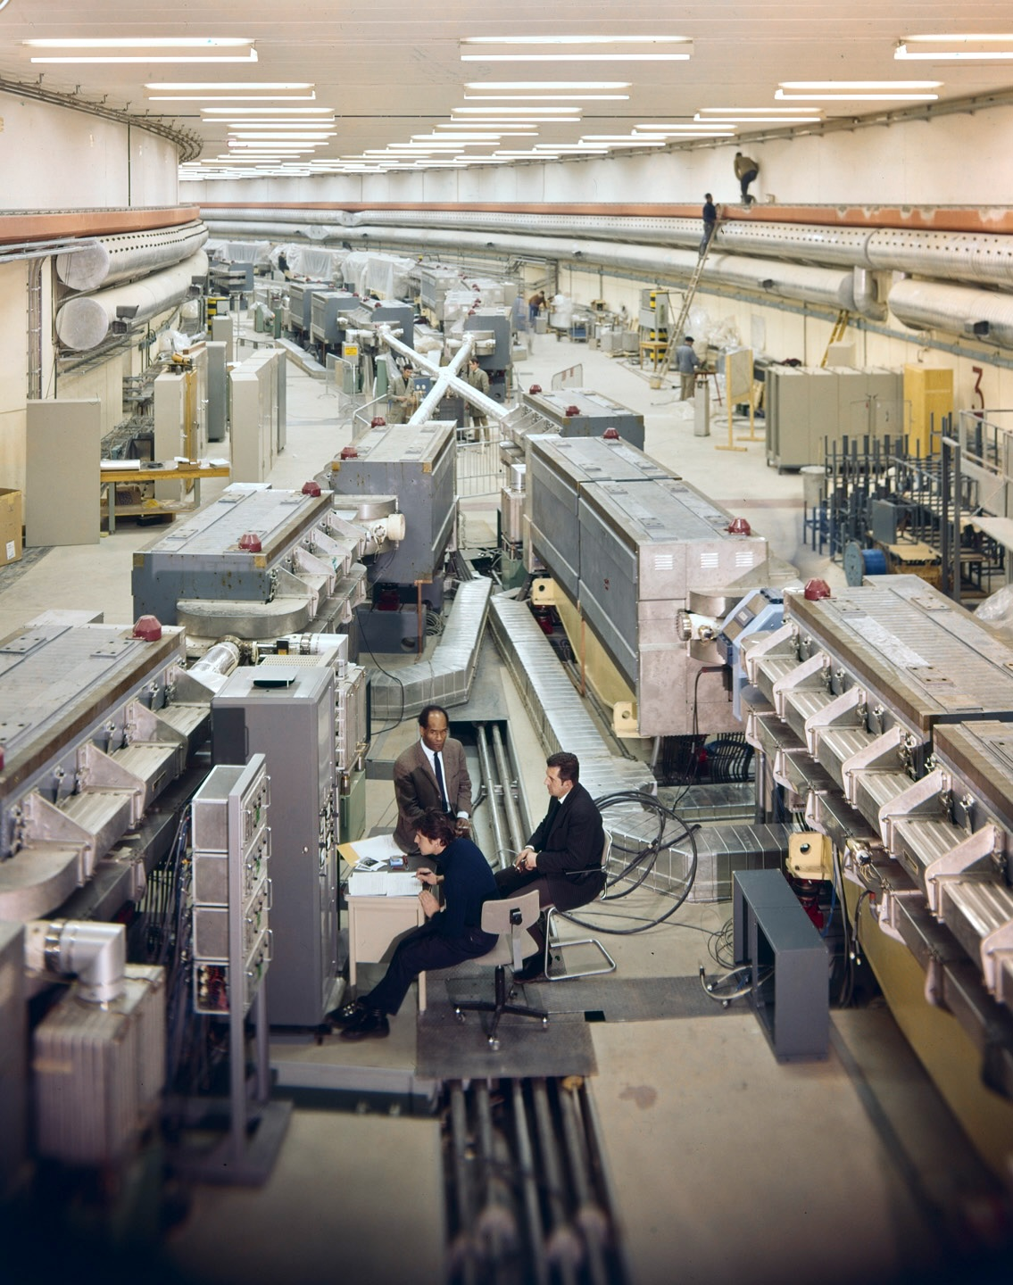
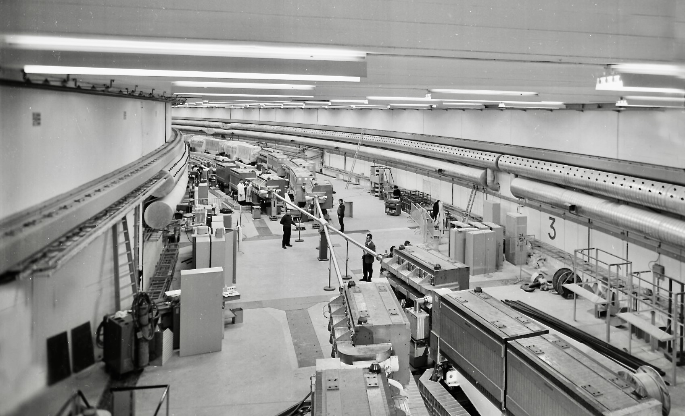
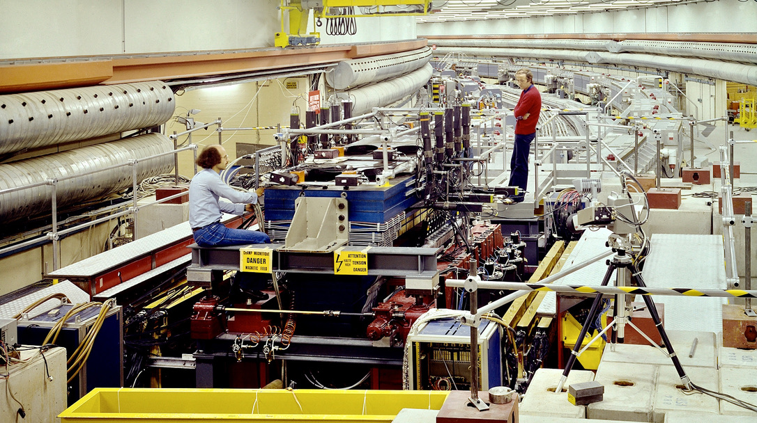
IP5
1971 — the first Hadron-Collider
Intersecting Storage Rings at CERN operated as a proton, proton–antiproton and ion collider for physics between 1971 and 1983. 943 m circumference, 1.3 T dipole field, CM energy up to 63 GeV, holding luminosity record for hadron machines until 2004
IP7: R702 in 1977

Slide 17
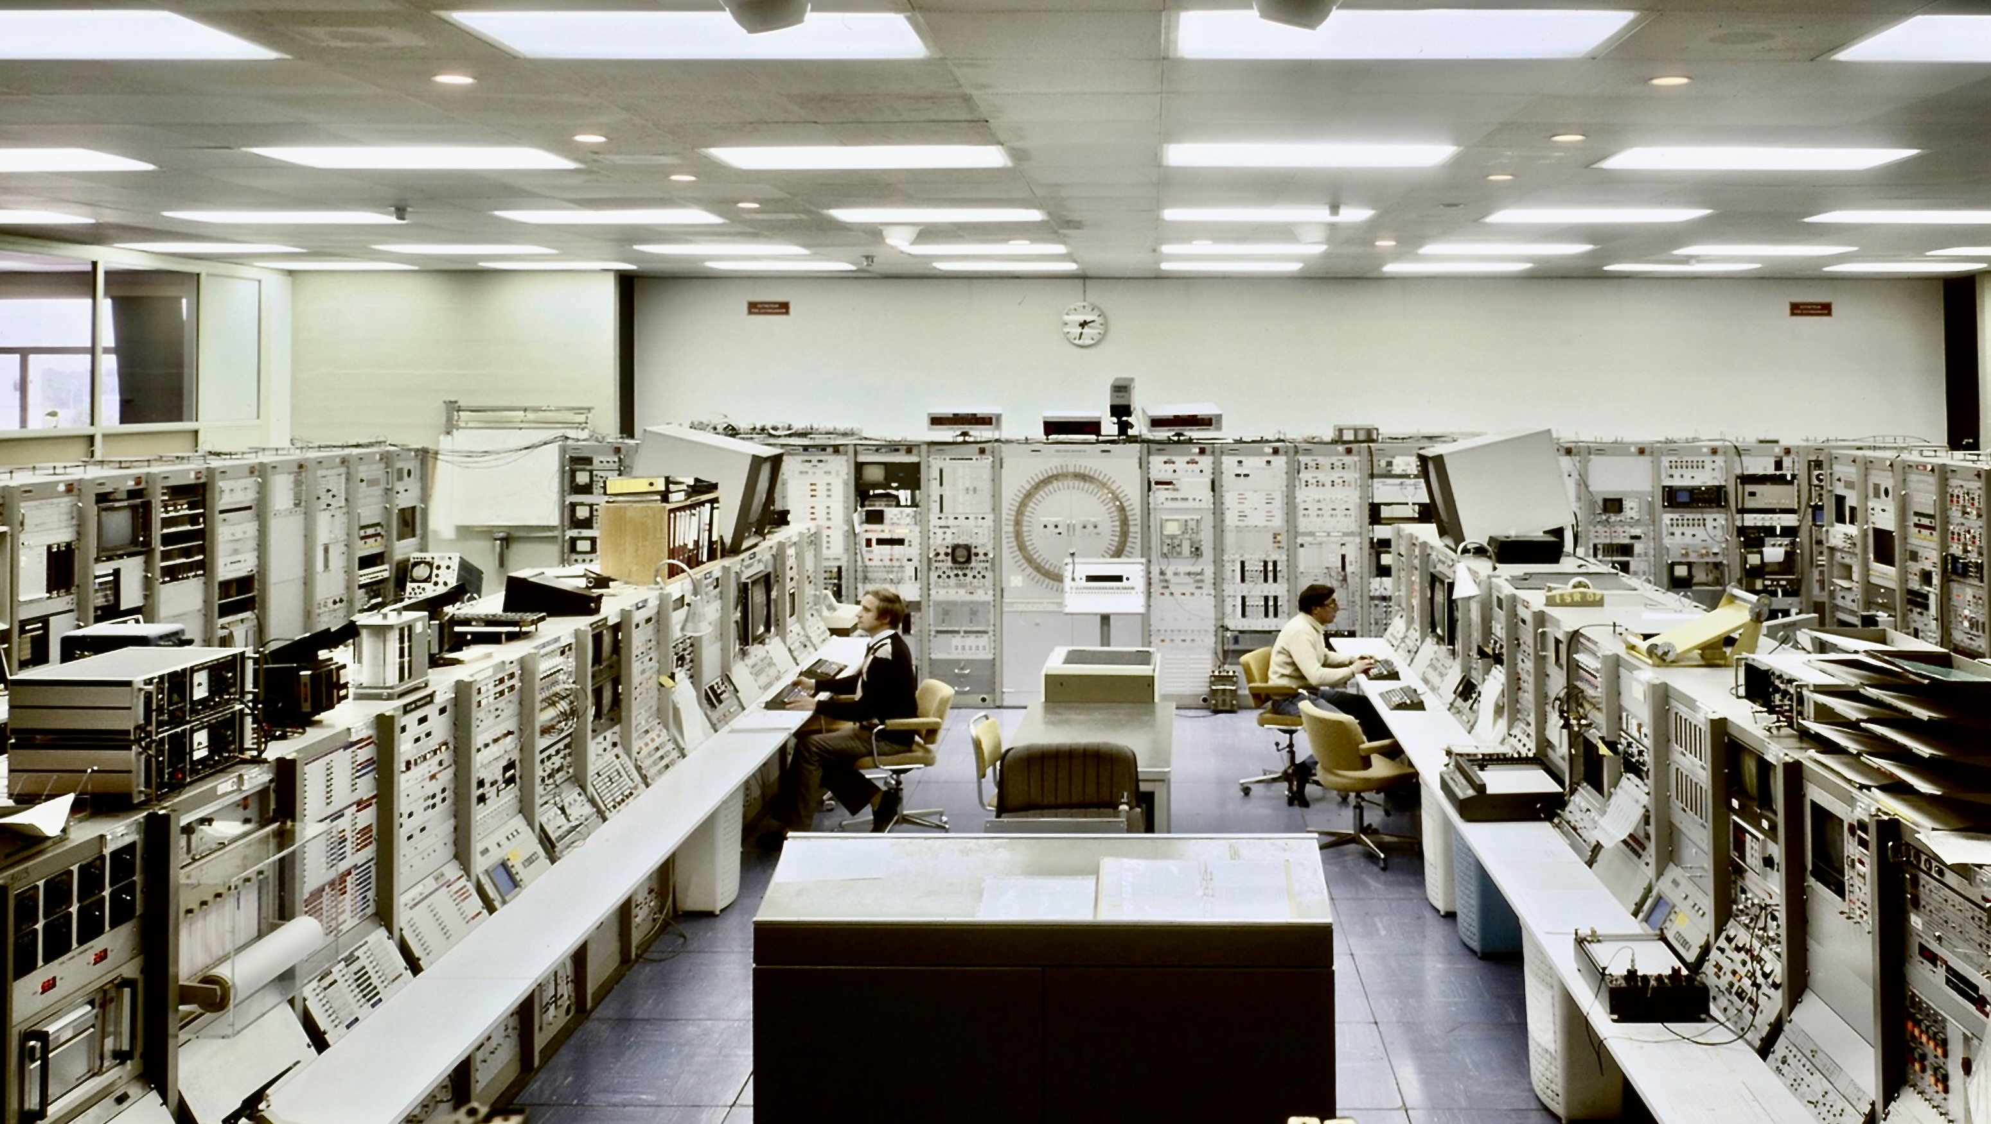
ISR Control Room (early 70s)

Slide 18
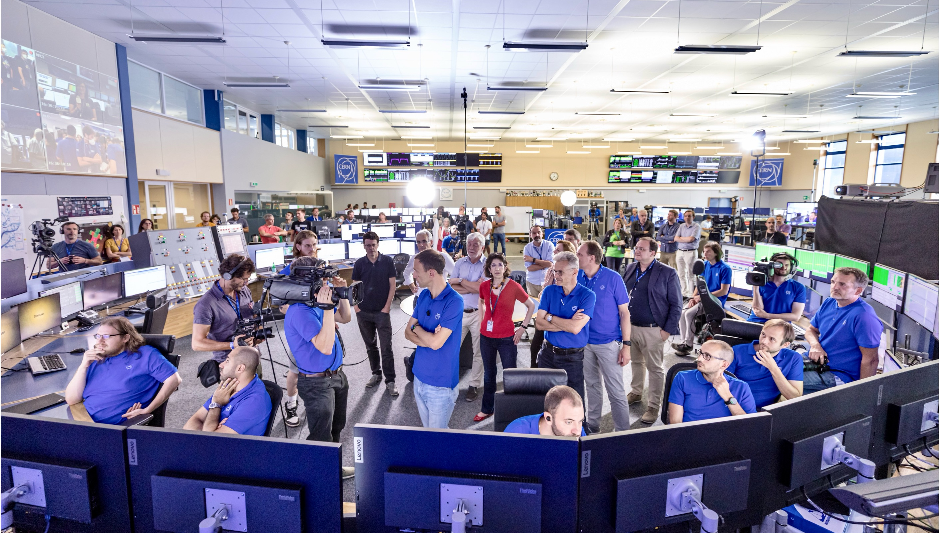
LHC Control Room (July 2022)

Slide 19
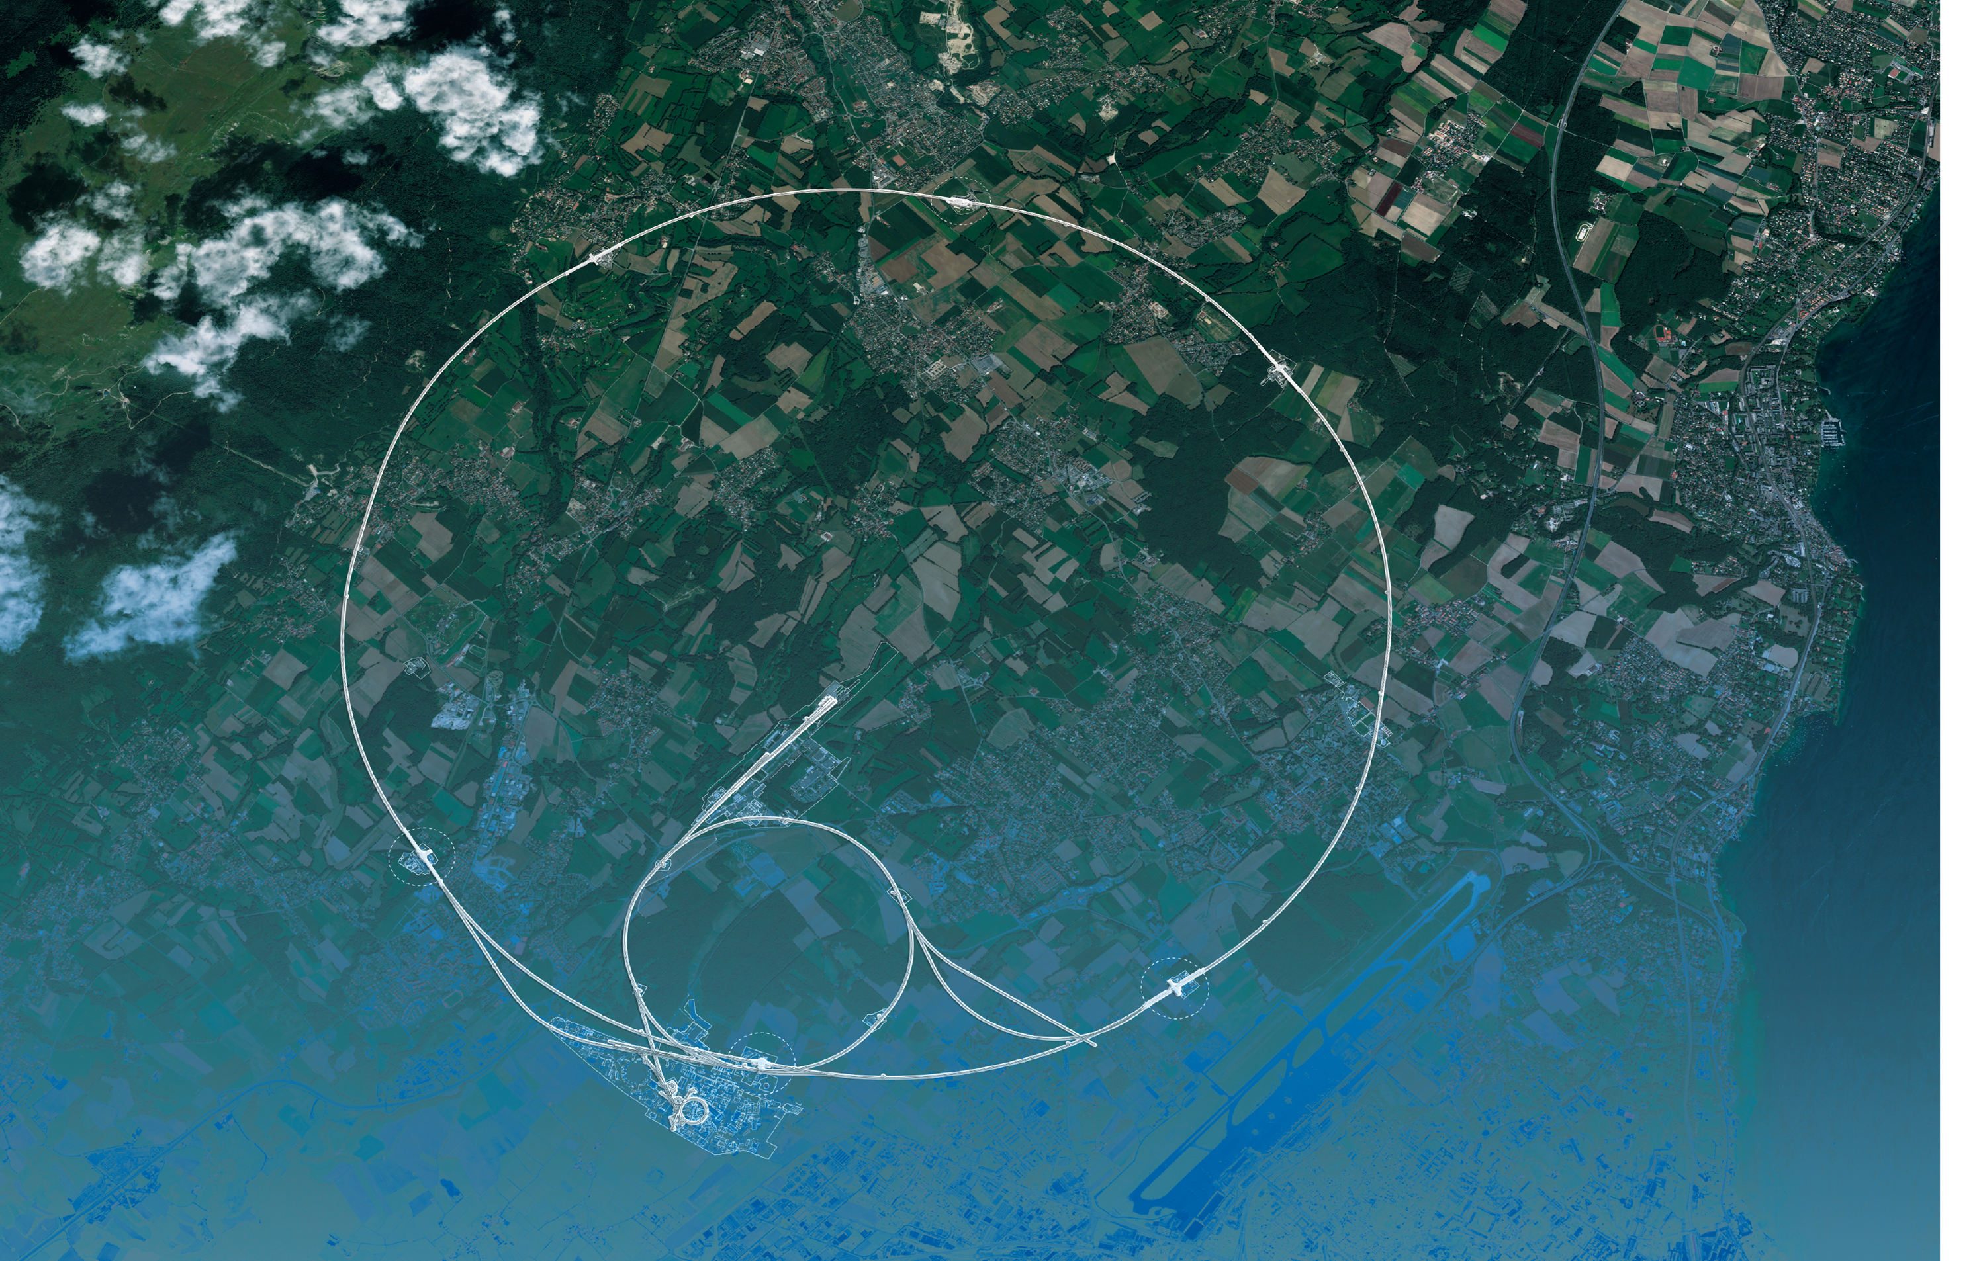

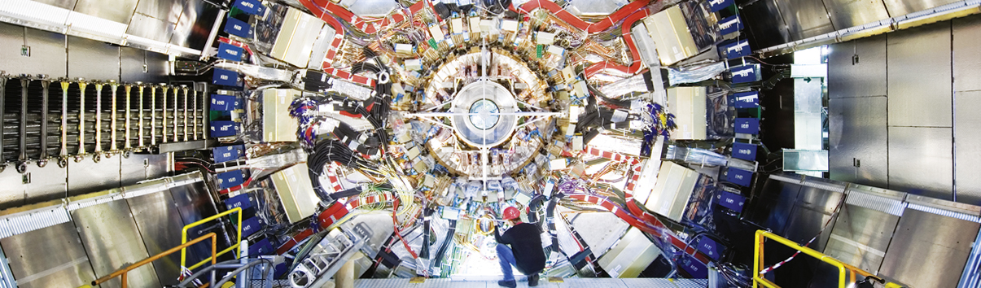
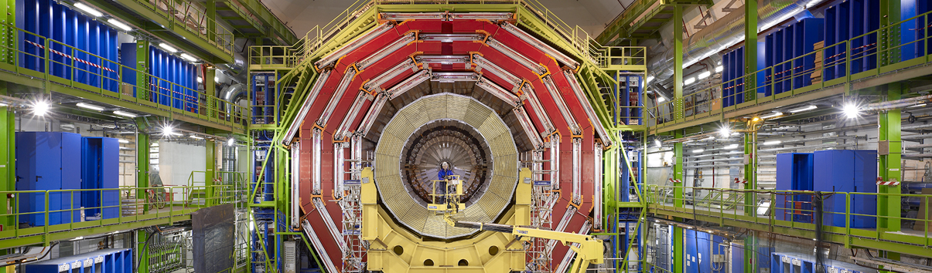
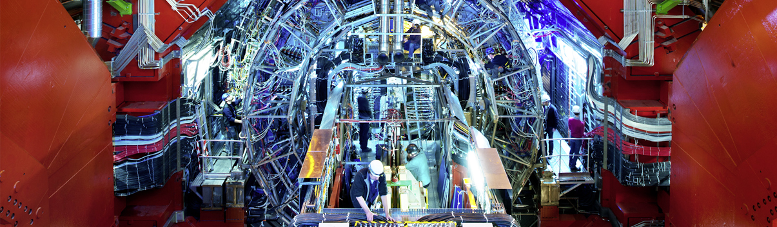
LHC Experiments
CMS
joined ATLAS in 2014
MilliQan
ATLAS
LHC
CMS
ALICE
SPS
ALICE
LHCb
ATLAS
LHCf
LHCb
SND
FASER
MoEDAL
PS
Aerial view
Presentation

Slide 20
Important design considerations for the LHC (around 1990)
  The new machine must be capable of exploring the full mass range up to the TeV mass scale. The question of the existence of the Higgs boson must be clarified, i.e. the detectors must have a discovery potential over the full mass range up to 1 TeV
To reach this goal with the given ring of 27 km and the centre-of-mass energy in the range of 14–16 TeV, required very high luminosities of the order of 10³⁴ cm^{–2} s^{–1}
This required a huge programme on detector and accelerator research and development
Theoretical view at the time: No-Loose theorem:
  → The LHC will either discover the Higgs boson, or new physics, or both

Slide 21
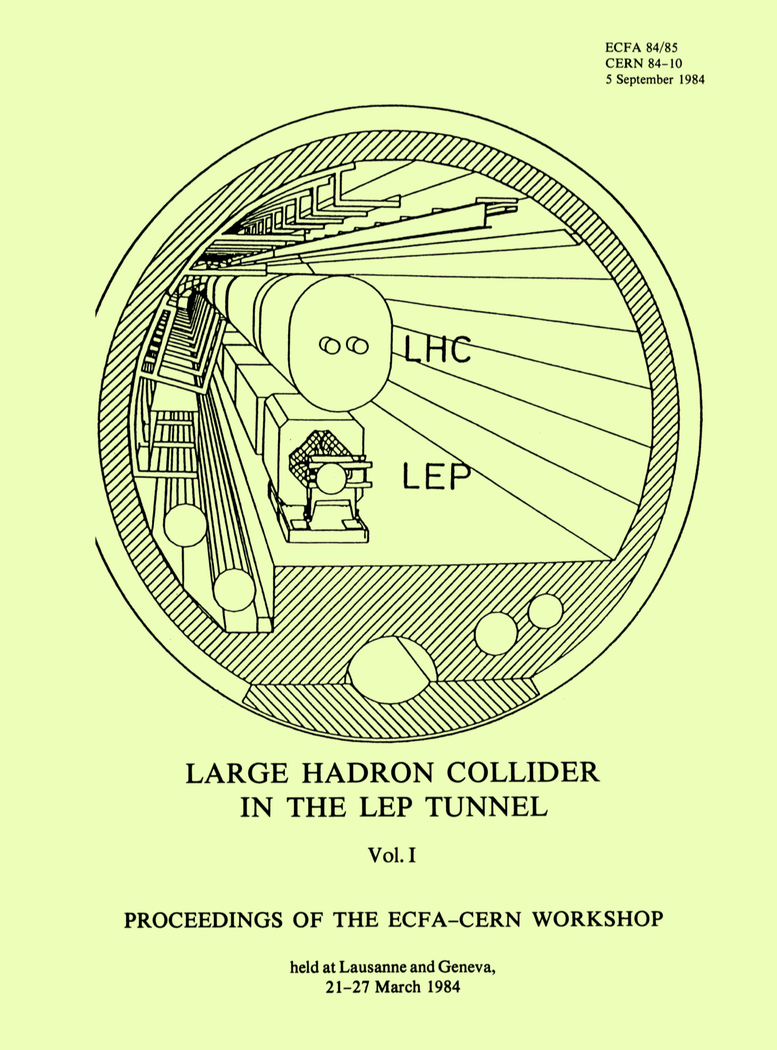
History of the LHC
1984: For the community it all started with the CERN-ECFA Workshop in Lausanne on the feasibility of a hadron collider in the future LEP tunnel
1986: LAA (Italian project) R&D on new detector technologies started, later followed by the DRDC (Detector Research & Development Committee)
1987: La Thuile Workshop: many LHC colleagues were already involved in this workshop set up by Carlo Rubbia as part of CERN’s Long Range Planning Committee
1989: ECFA Study Week in Barcelona for LHC instrumentation
1990: Large Hadron Collider Workshop Aachen (CERN-ECFA)
1992: CERN – ECFA meeting “Towards the LHC Experimental Programme” in Evian

Slide 22
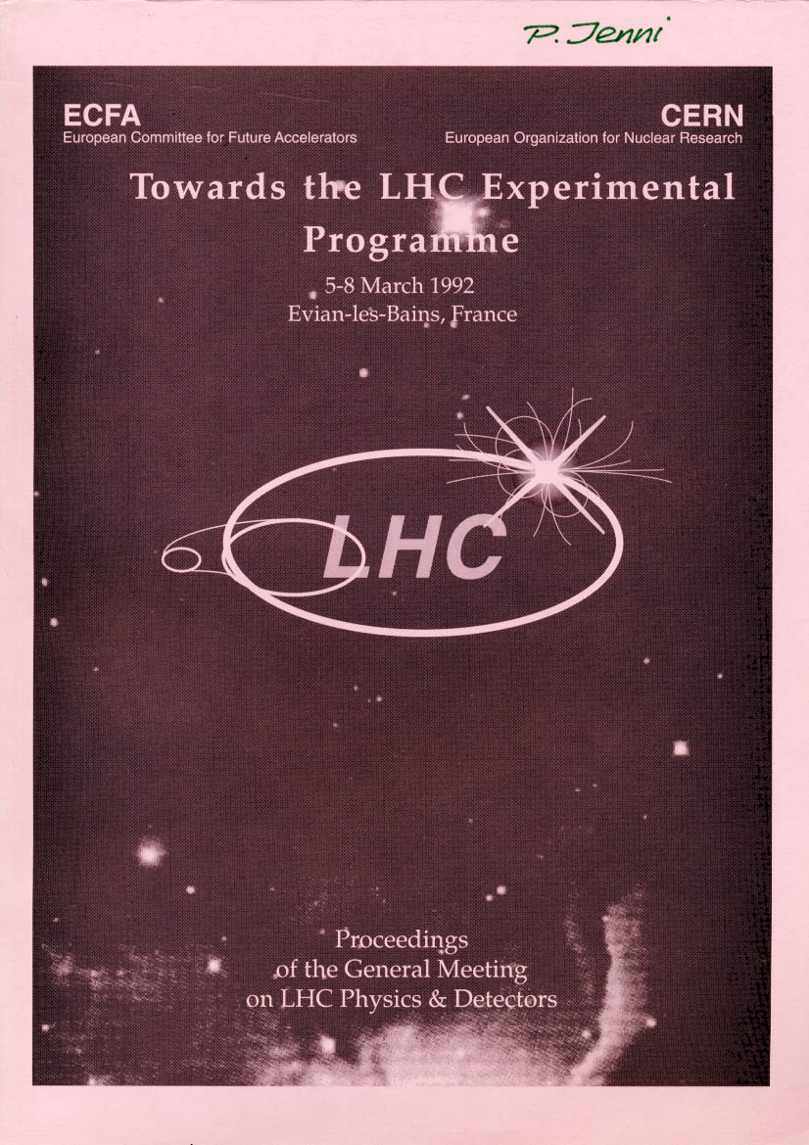
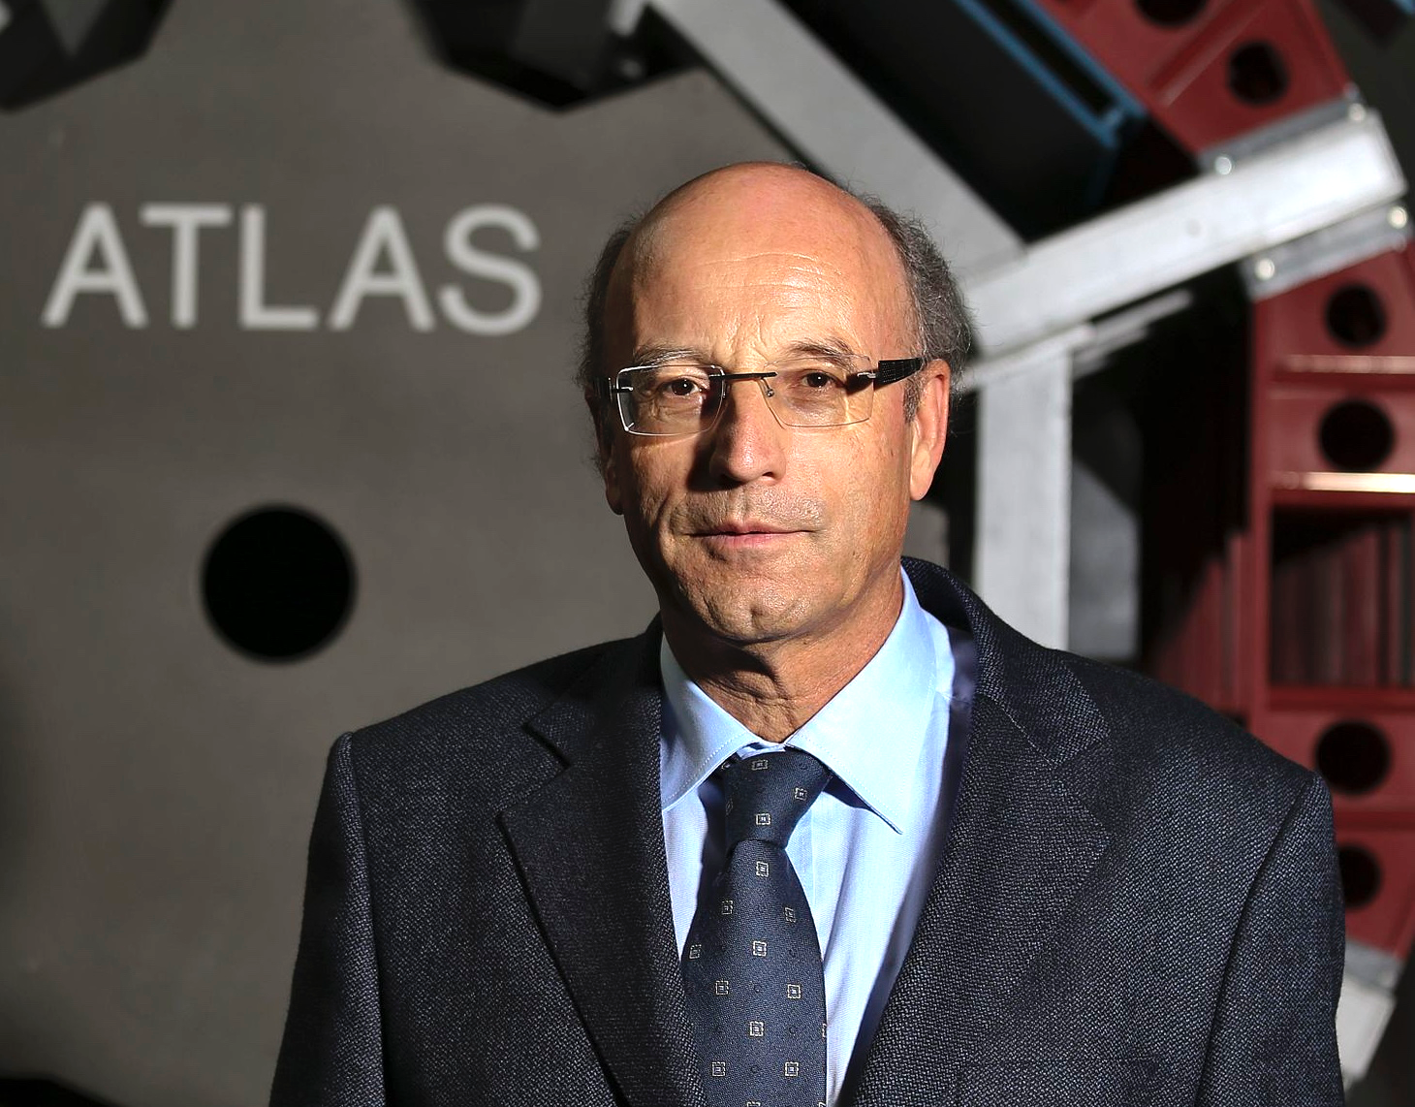
History of the LHC experiments
March 1992: Evian Meeting with presentations of the Expressions of Interest (EoI)
For proton–proton:
  ASCOT P. Norton
  CMS M. Della Negra / H. Desportes
  EAGLE P. Jenni
  L3P S. Ting, F. Pauss
In addition:
  LHC Beauty Collider P. Schlein
  B extracted beam G. Carboni
  B gas jet T. Nakada
  Neutrino at LHC F. Vannucci
  LHC HI J. Schukraft
  DELPHI LHC HI G. Jarlskog
Peter Jenni (CERN)

Slide 23
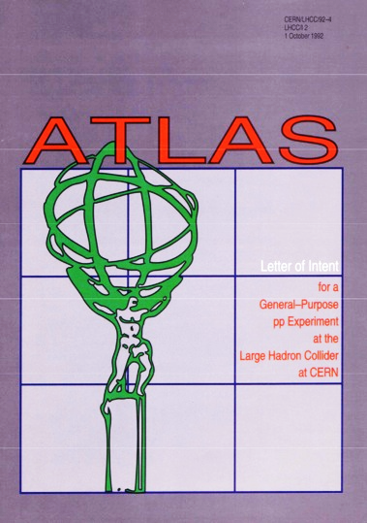
History of ATLAS
March 1992 – Summer 1992: merging of EAGLE and ASCOT
September 1992: the new baby needs a name, decision:
1st round: 2nd round:
ATLAS 31 ATLAS 40
ALICE 12 ALICE 13
ACE 5
ALEX 5
LHD 0
1st October 1992: ATLAS Letter of Intend (LoI) submitted to the LHCC
Official birth of the ATLAS* Collaboration
*A Toroidal LHC ApparatuS

Slide 24


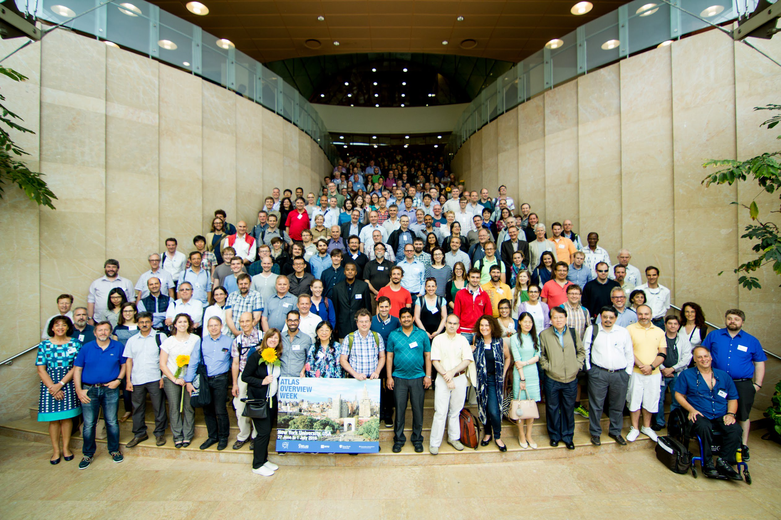
177 Institutions (248 Institutes) from 41 countries (>100 nationalities) + 13 Technical Associate Institutes
2900 scientific authors
1950 with PhD contributing to M&O share
1200 physics PhD students
1300 engineers and technicians
6000 members
177 institutions (248 institutes) from 41 countries
Try the intereactive ATLAS map: http://atlas.web.cern.ch/Atlas/Management/Map.html
Status: January 2026

Slide 25
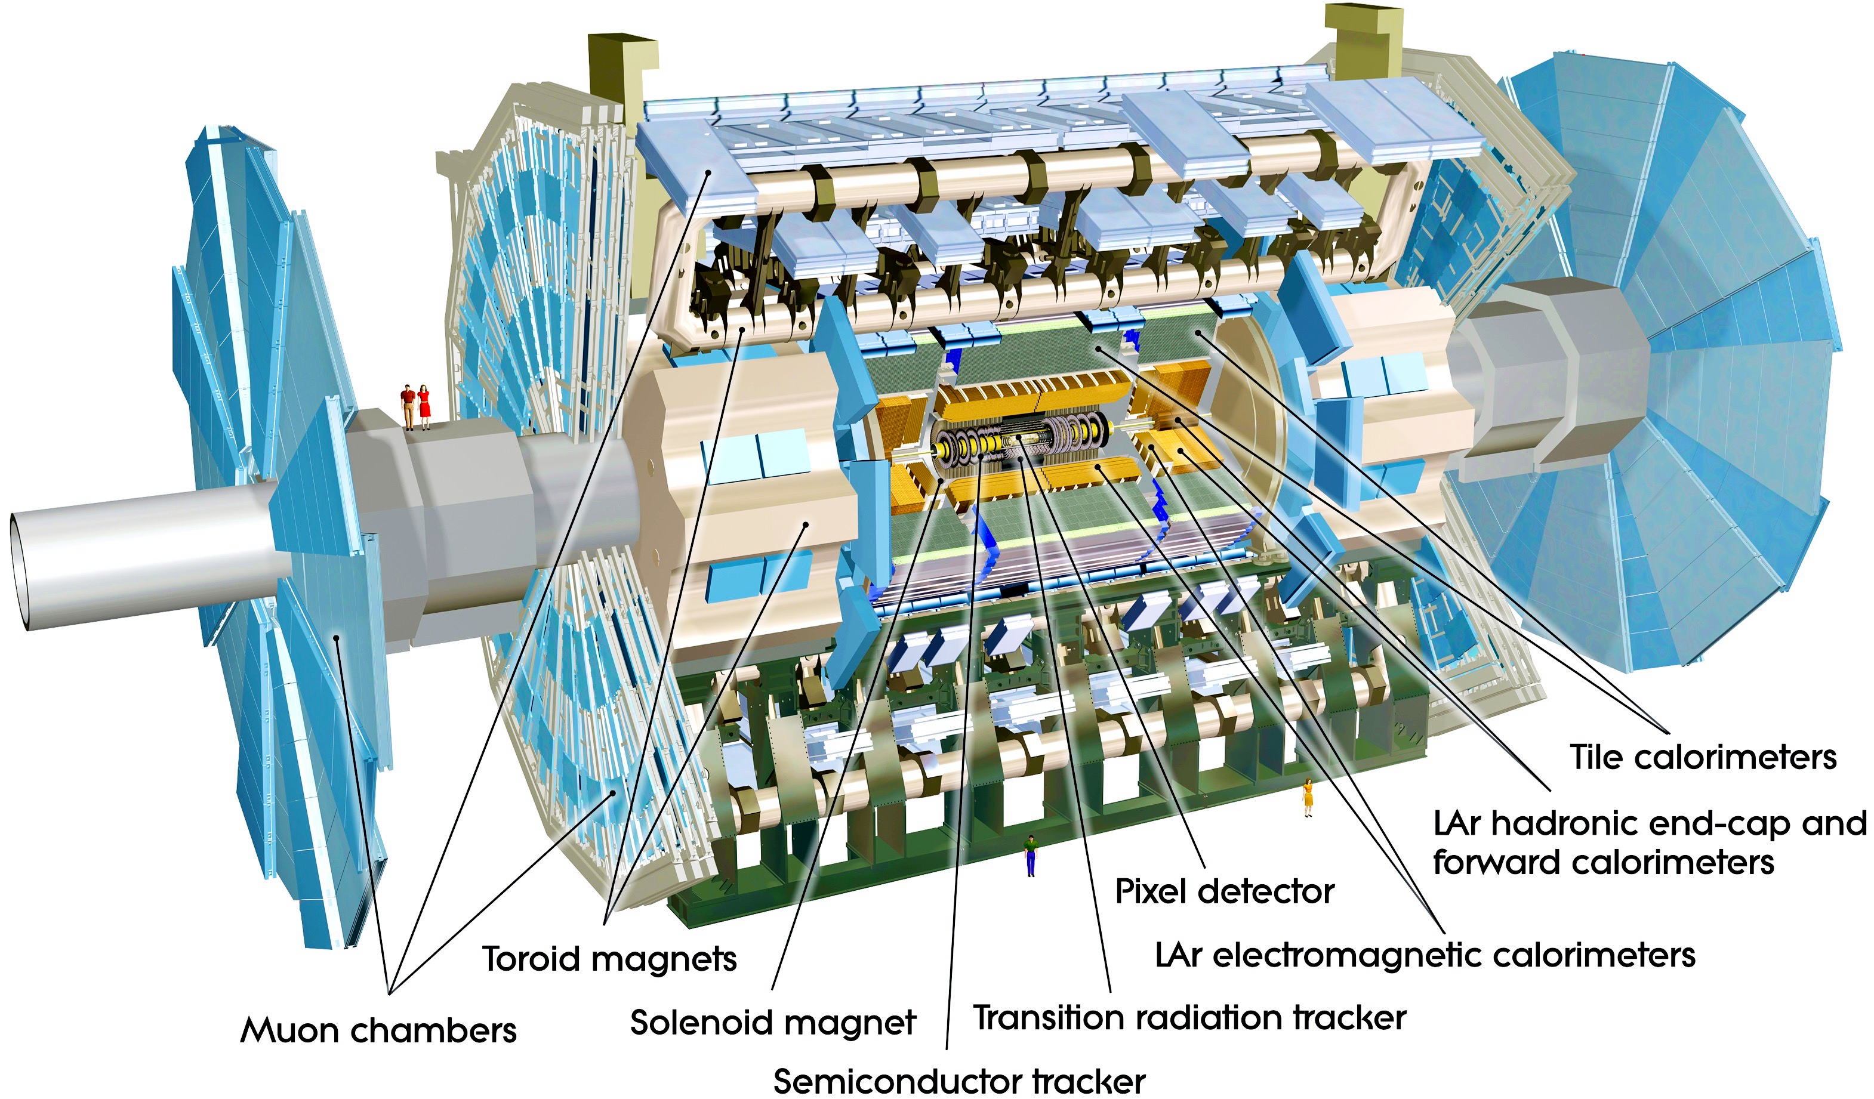
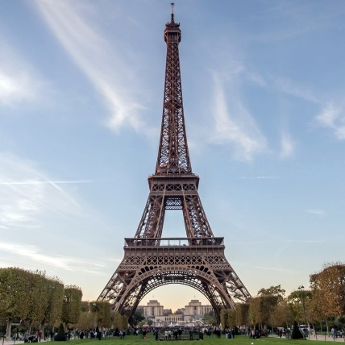
The ATLAS Detector
Axial field provided by solenoid
(2 T) in central region (momentum measurement)
High resolution silicon detectors:
100 Mio. channels (50 µm x 250 µm)
6 Mio. channels (80 µm x 12 cm)
spatial resolution ~15 µm (in azimuthal direction)
Energy measurement down to 1º to the beam line with a calorimeter system
Independent muon spectrometer (superconducting toroidal magnet system)
Ultra-fast custom electronics and high-performance computers filter the collisions: only 1 out of 20,000 collisions is kept
25 m diameter, 44 m long, 7000 tons weight ~

Slide 26
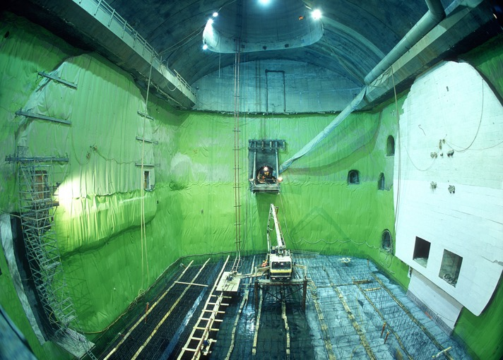
ATLAS Detector construction and installation
ATLAS cavern after excavation in July 2002
53 m long
35 m high (10-storey building)
30 m wide

Slide 27
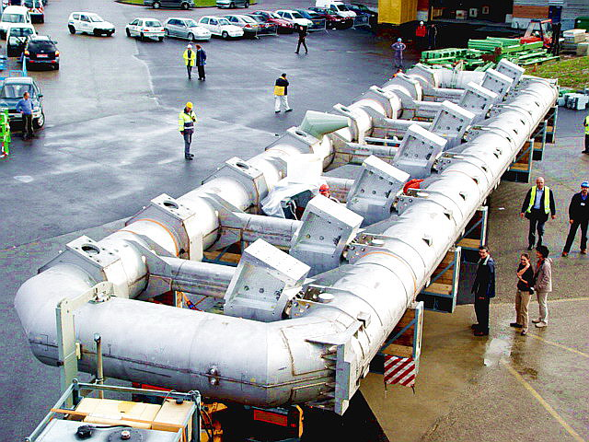
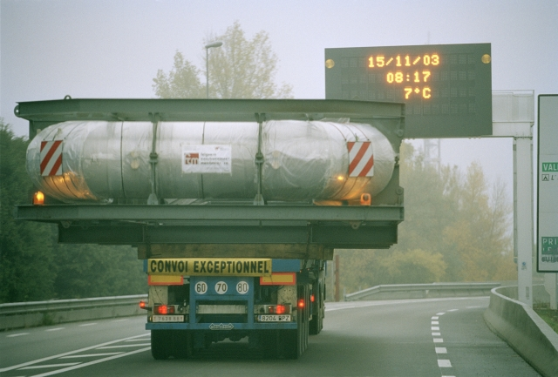
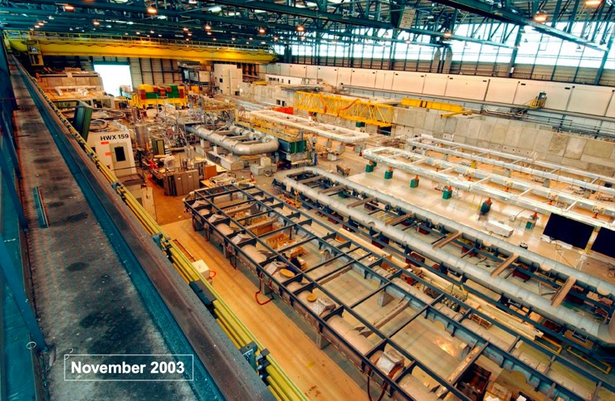
ATLAS Detector construction and installation
Transport from Spain to CERN of one of the eight vacuum vessels for the barrel toroid (2003)
Barrel Toroid coil integration and testing in Hall 180 (CERN)

Slide 28
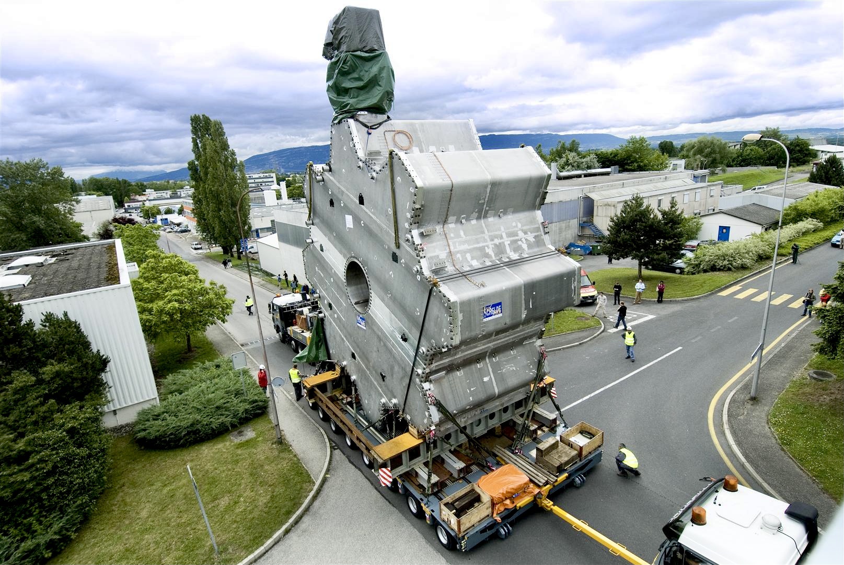
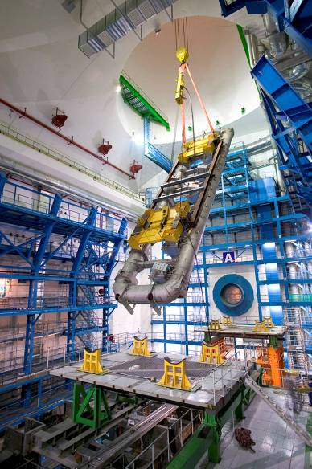
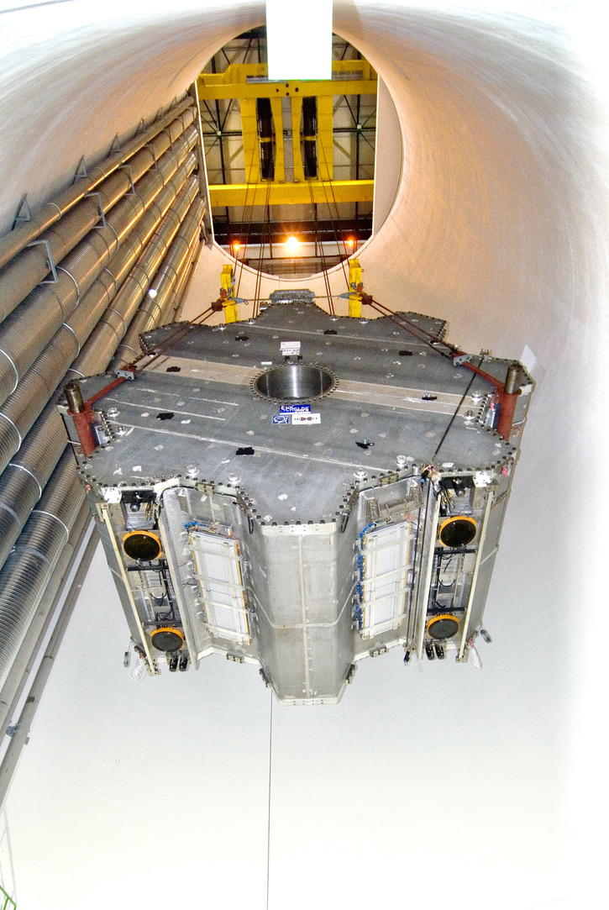
ATLAS Detector construction and installation

Slide 29
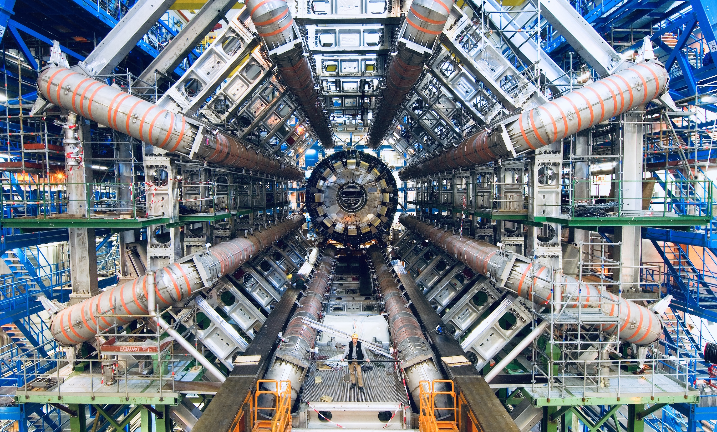

Slide 30
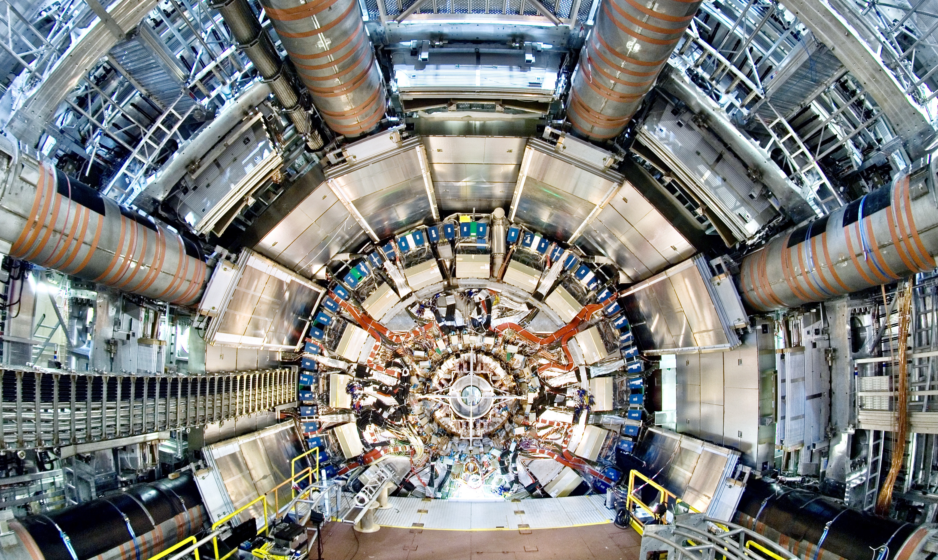
View on the ATLAS inner detectors. At the centre, the inner tracking detector with a radius of about 1m. It is surrounded by the inner solenoid producing a uniform 2-Tesla field throughout the volume of the tracker. The magnet itself is located inside the cryostat of the liquid argon electromagnetic calorimeter, whose electronic read-out boxes are visible, covering in part the hadronic calorimeter located at larger radius. On the outer part, the first layers of muon chambers, part of the muon spectrometer, subdivided into sixteen azimuthal sectors, are seen

Slide 31
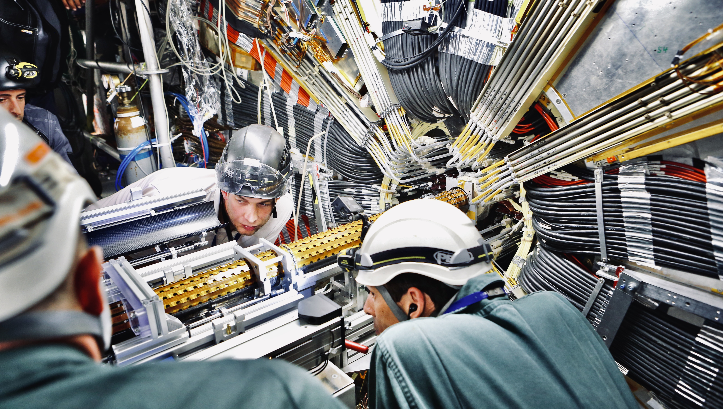
Installation of ATLAS Insertable B-layer on 15 May 2014

Slide 32
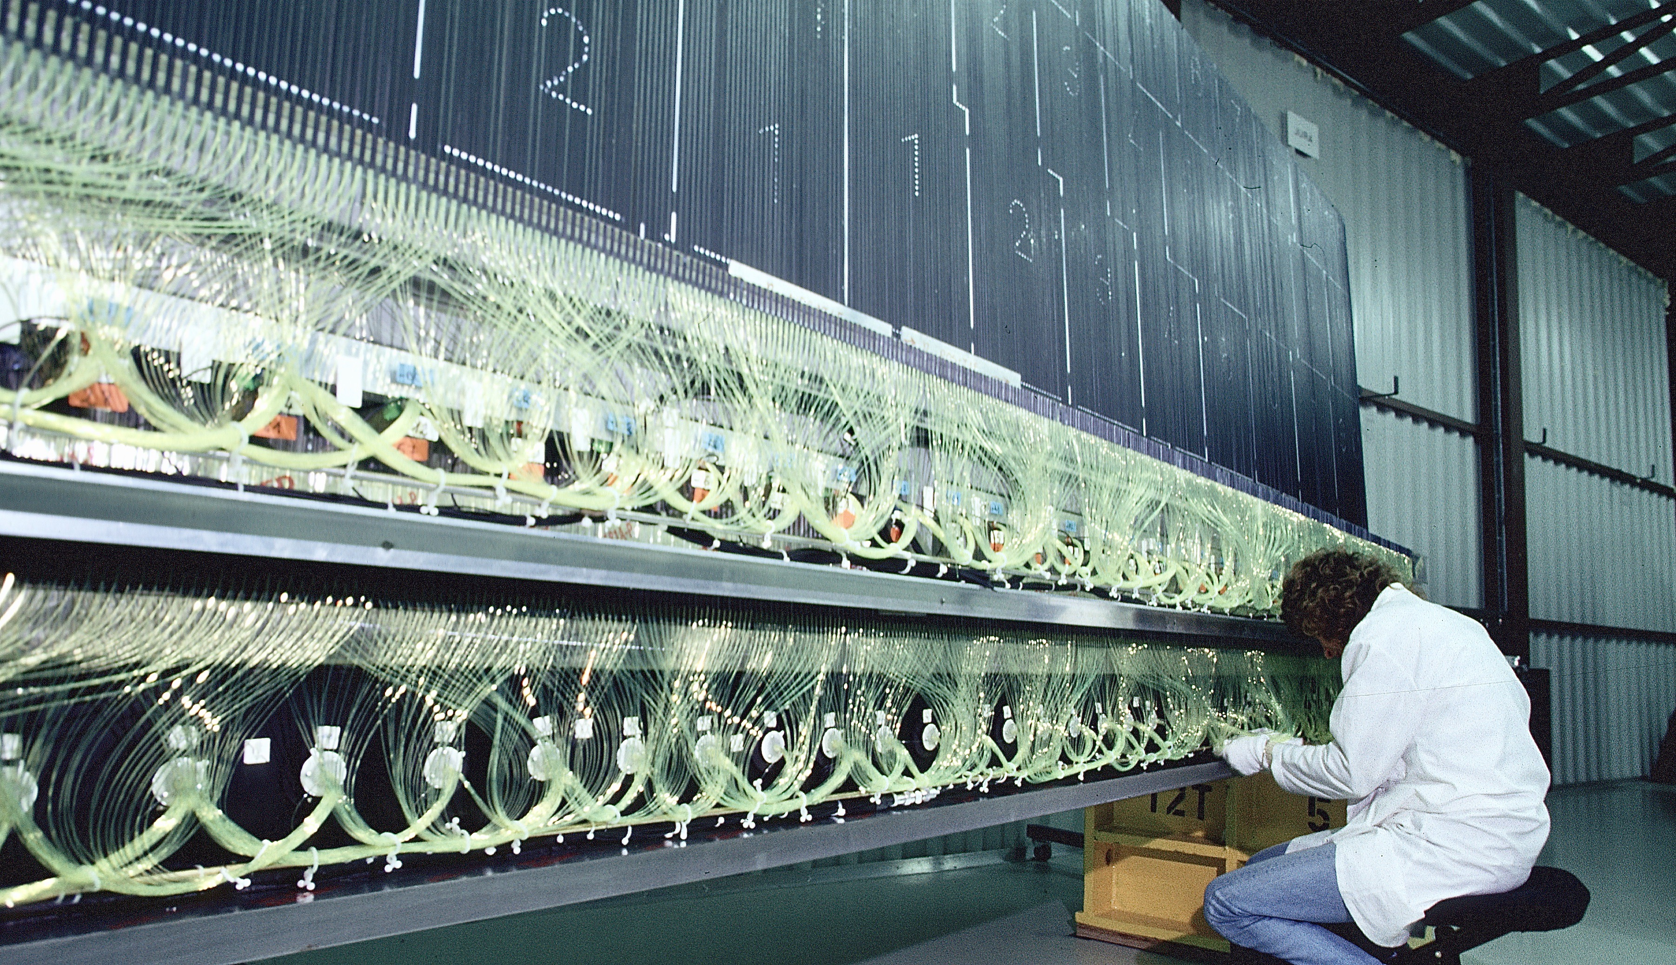
A complete ATLAS tile calorimeter module covering 1/64 of the full azimuth

Slide 33
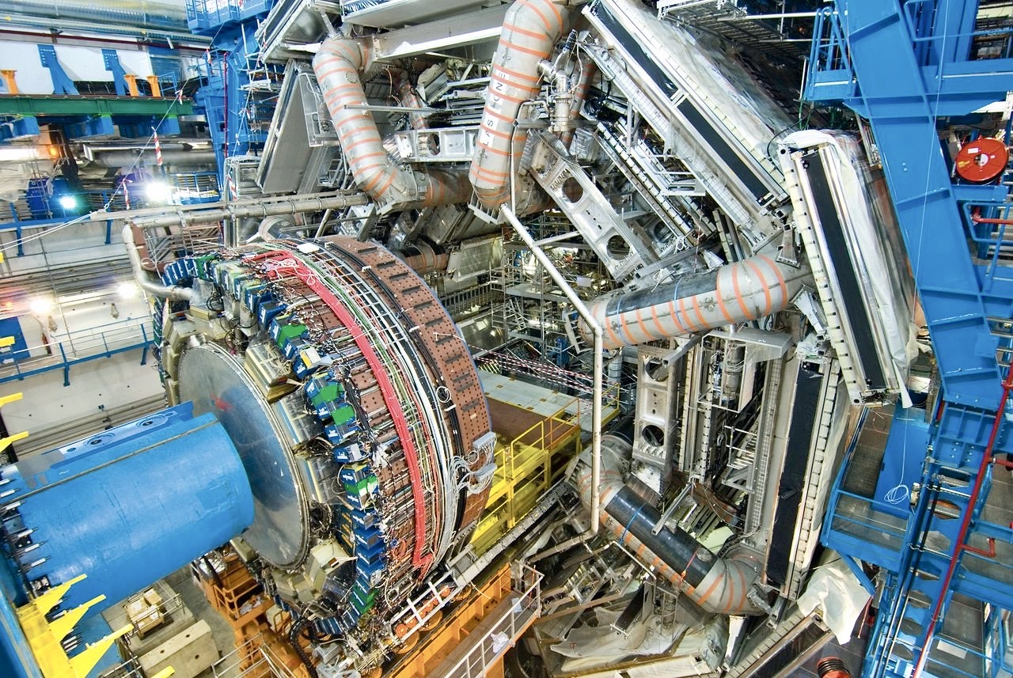
ATLAS Detector construction and installation — Calorimeters
View of the central part of ATLAS during final assembly stages. The wire chambers mounted inside and around the toroid magnet cryostats are well visible, as is part of the end-cap hadronic calorimeter before its insertion inside the magnet

Slide 34
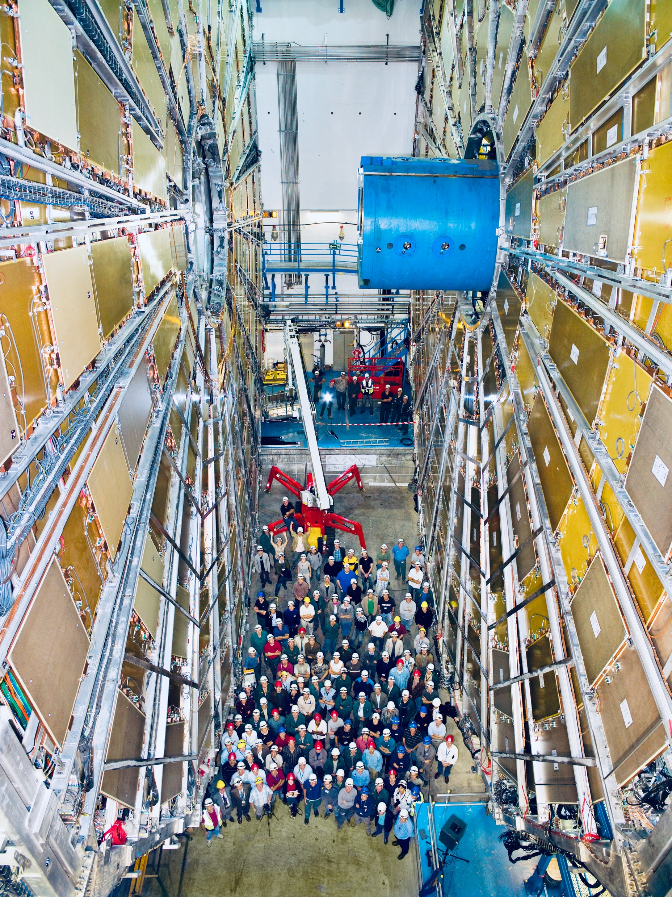
ATLAS Detector construction and installation — Muon Spectrometer
View on the Big Wheels, intermediate muon stations with four 25 m diameter wheels on each forward side

Slide 35
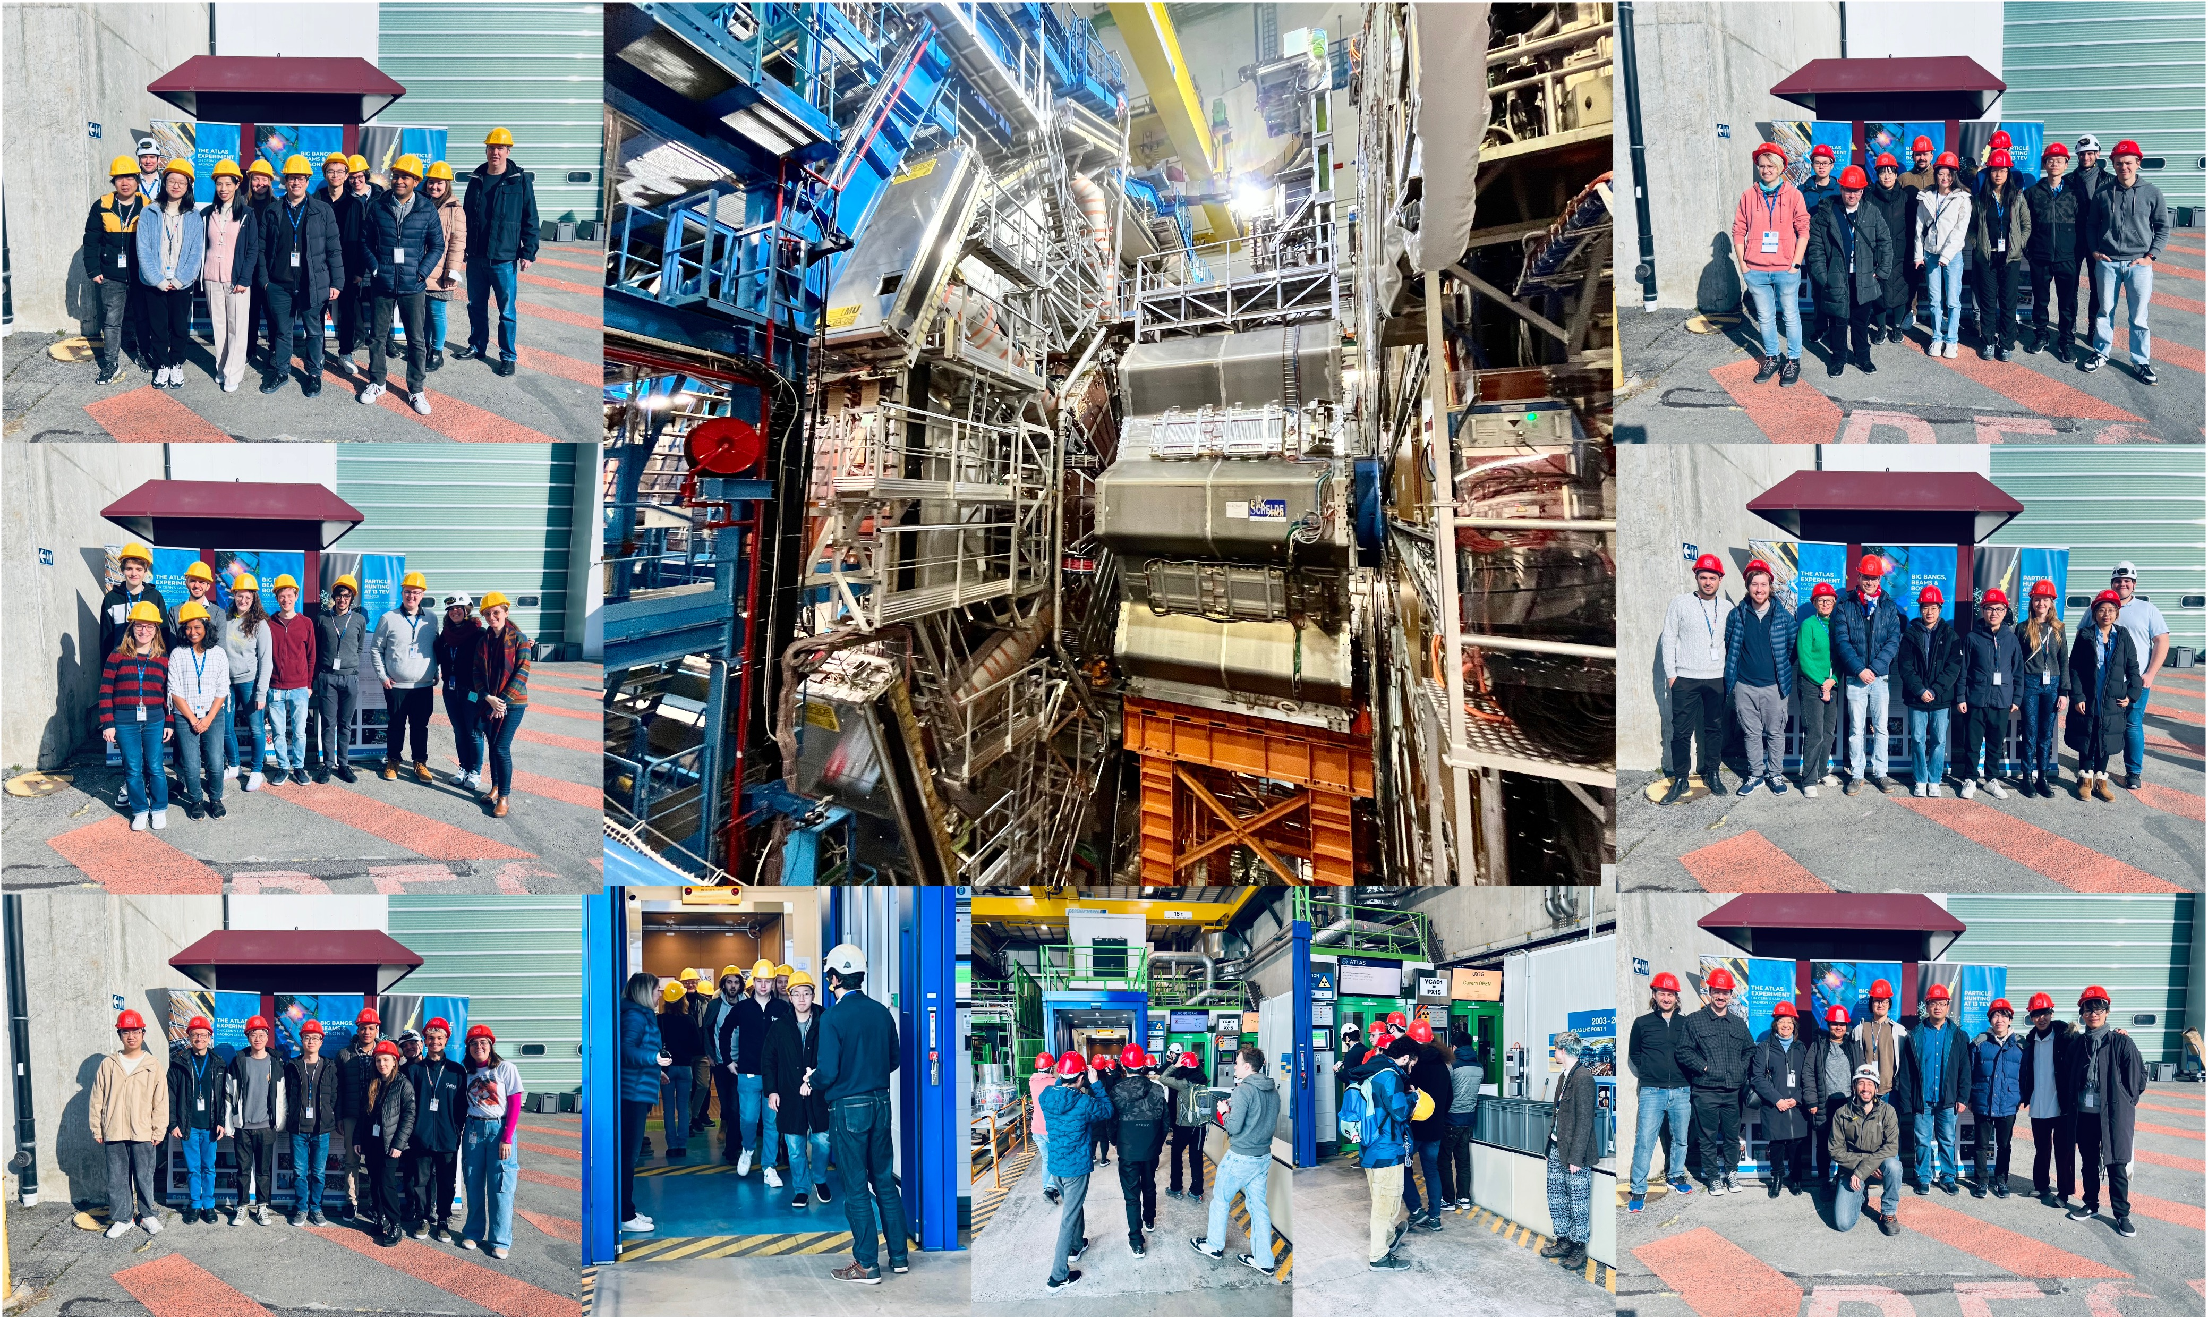
The ATLAS Detector
ATLAS Vists during Feb 2023 Collaboration Week
Axial field provided by solenoid
(2 T) in central region (momentum measurement)
High resolution silicon detectors:
100 Mio. channels (50 µm x 250 µm)
6 Mio. channels (80 µm x 12 cm)
spatial resolution ~15 µm (in azimuthal direction)
Energy measurement down to 1º to the beam line with a calorimeter system
Independent muon spectrometer (superconducting toroid system)
Ultra-fast custom electronics filters the collisions: only 1 out of 30,000 bunch collisions is kept!
25 m diameter, 46 m long, 7000 tons weight ~

Slide 36

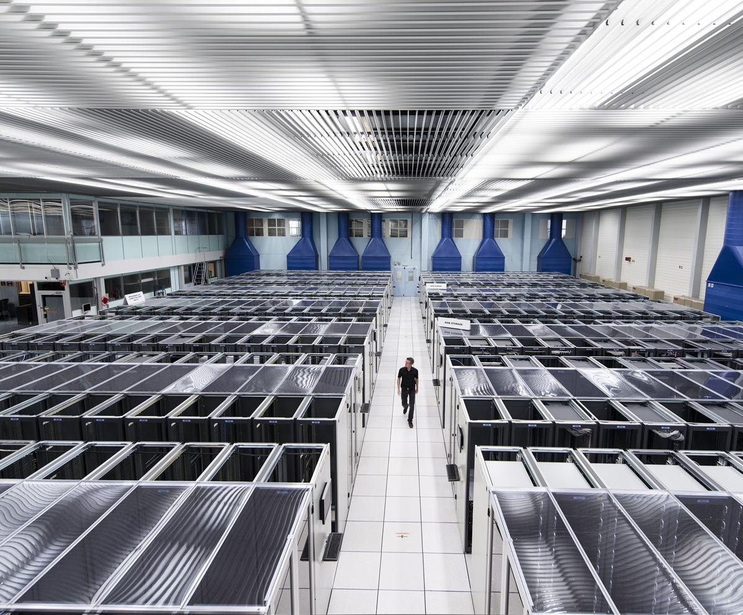
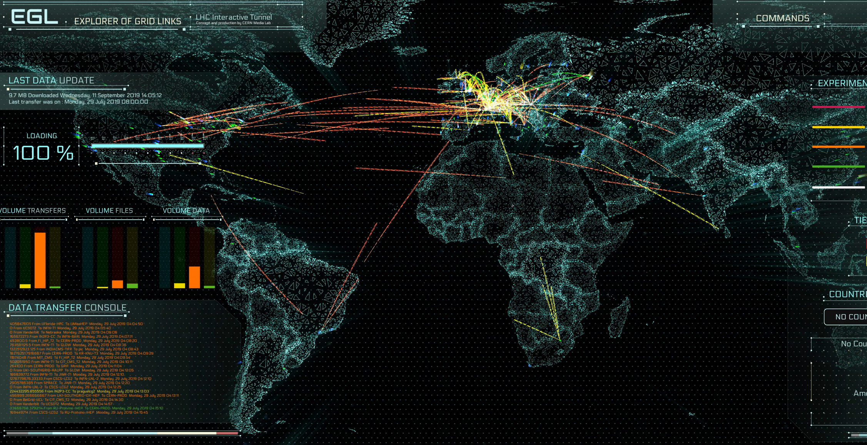

The Worldwide LHC Computing Grid (WLCG)
WLCG stores, distributes, processes and analyses LHC experiments’ data
1.4 million processing cores in 170 data centres and more than 40 countries
1500 Petabytes (1.5 Exabytes) of CERN data stored worldwide

Slide 37
Most successful LHC Runs 1, 2, 3
Superb LHC performance in 2024 and 2025 — on track for a strong Run-3 finish
Total delivered luminosity (ATLAS, CMS): 515 fb^{–1} (> 3 × Run-2, 164 fb^{–1})
Reference
2025
2024
LHC design lumi per experiment 300 fb^{–1}
2023
2022
2018
2017
2016
~8h luminosity levelling
2015
2011
2012
Long shutdown 1
Long shutdown 2
Mid 2026: Begin of Long shutdown 3
2010
ALICE
LHCb
Run 1 (2010–2012)
LS1 (2013–2015)
Run 2 (2015–2018)
LS2 (2019–2022)
Run 3 (2022–2026)
Treasure trove: ATLAS & CMS can each expect > 450 fb^{–1} of good-for-physics data from LHC Runs 2 + 3

Slide 38
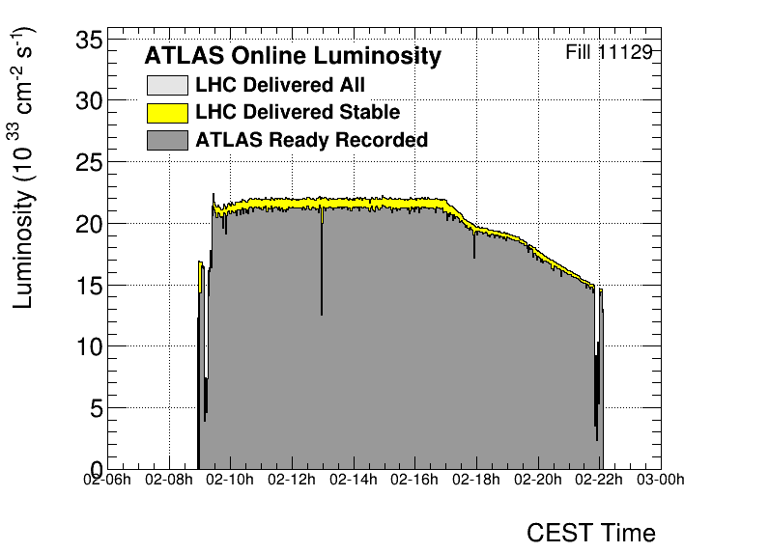
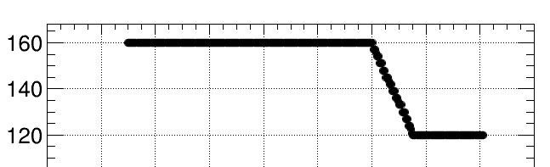
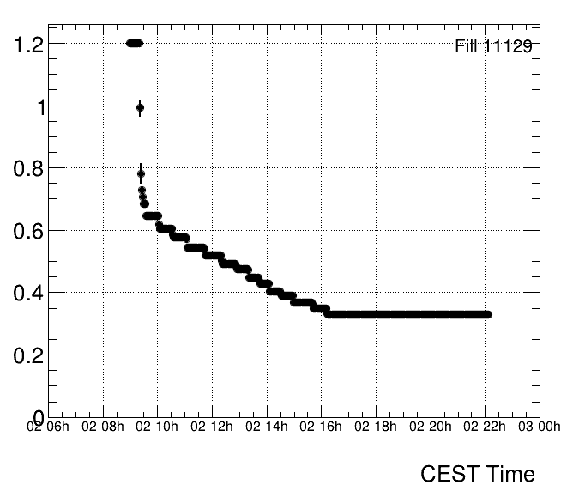
Most successful LHC Runs 1, 2, 3
Luminosity profile in ATLAS & CMS during a 15h28 fill (13h07 in stable beams), 2 Oct 2025
Luminosity profile of a typical run (6 September 2024)
Luminosity: 2.2×10³⁴ cm^{–2}s^{–1}
64 pileup collisions per bunch crossing
Intensity: 1.7 × 10¹¹ p / bunch
θ (μrad)
Crossing angle levelling: 160 → 120 μrad
β* (m)
β* levelling 120 → 60 / 18 cm (shown is average)
Delivered integrated luminosity in this fill: 947 pb^{–1}
ATLAS recorded luminosity : 917 pb^{–1} (96.9%)

Slide 39
What have we learned from the LHC so far — a bold summary
Performance of accelerator and ATLAS experiment
LHC, ATLAS detector, software & computing, object reconstruction and physics analysis all perform(ed) beyond design
EPJ C 85 (2025) 927
Public plots, arXiv:2505.19689
Combined JES uncertainty of 2.5 / 0.3 / 0.6% at 20 / 300 / 4000 GeV
Detailed jet energy calibration using in-situ processes enables, among others, high-precision top mass measurements (0.2%)
Efficient and pure jet-flavour tagging and further ML based performance and analysis improvements enhance physics reach

Slide 40

What have we learned from the LHC so far — a bold summary
Discovery and characterization of the Higgs boson
Discovery of scalar Higgs boson enables for the first time direct study of electroweak symmetry breaking and the process of mass generation
Higgs couplings to bosons and fermions match SM expectations within 5–20%. Γ_{H} is as SM within ~50% uncertainty. B(H → inv) < 11%
ATLAS-CONF-2025-006, Nature 607, 52–59 (2022)
Fabiola Gianotti and Peter Higgs, 4 July 2012
Phys. Lett. B 716 (2012) 1-29
Eur. Phys. J. C 80 (2020) 942
Left: at moment of discovery. Right: after Run 2

Slide 41
What have we learned from the LHC so far — a bold summary
Discovery and characterization of the Higgs boson
Discovery of scalar Higgs boson enables for the first time direct study of electroweak symmetry breaking and the process of mass generation
Higgs couplings to bosons and fermions match SM expectations within 5–20%. Γ_{H} is as SM within ~50% uncertainty. B(H → inv) < 11%
ATLAS-CONF-2025-006, Nature 607, 52–59 (2022)
Fabiola Gianotti and Peter Higgs, 4 July 2012
The scalar sector is directly connected with very profound questions: naturalness, vacuum stability & energy, flavour. Also: is the Higgs boson actually elementary?
The Higgs boson is a completely new type of particle whose detailed study requires a broad experimental programme that will extend over decades
Phys. Lett. B 716 (2012) 1-29
Eur. Phys. J. C 80 (2020) 942
Left: at moment of discovery. Right: after Run 2

Slide 42

What have we learned from the LHC so far — a bold summary
Scrutinising the Standard Model
A plethora of unique measurements probing new forms of particle interactions and very rare processes, and (so far) confirming the predictive power of the Standard Model
Theory developments and computations are key to this progress
EPJ C 83 (2023) 496

Slide 43

Deep searches for new phenomena

Slide 44

Searches for Dark Matter

Slide 45
Studies of physics in extreme electromagnetic fields

Slide 46
And a detailed mapping of the properties of the quark-gluon plasma with soft and hard probes
In collisions of heavy ions, the LHC creates for a very brief moment a quark-gluon plasma of up to 6 trillion degrees, almost half a million times hotter than the core of the sun

Slide 47
CMS
ATLAS
LHC
CMS
LHC: the next phase
ALICE
SPS
ALICE
LHCb
ATLAS
LHCb
PS
Not shown: additional smaller experiments
Areal view
Presentation

Slide 48

LHC and High-Luminosity-LHC (HL-LHC) project timeline
Huge effort ongoing to construct HL-LHC and experiment upgrades – a bright future
World’s flagship collider project during next decade — 10 times currently analysed dataset (350M H, 240k HH, 13B top, …, BSM reach +2 TeV)
Large-scale ATLAS & CMS upgrades under construction, ALICE & LHCb plan significant upgrades for Run 5
550 fb^{–1} pp
We are here
ATLAS & CMS upgrades
HL-LHC →
ALICE & LHCb upgrades
3000 fb^{–1} pp
Power of HL-LHC together with upgraded detectors & ML/AI: huge scientific opportunity for our field — complementary in many ways to a future e⁺e– collider

Slide 49

LHC machine upgrade to HL-LHC
Ambitious goal: L_{int} > 2500 fb^{–1} in 9 years of operation (for a total delivered luminosity of 3 ab^{–1})
 | Bunch intensity [protons / bunch] | β* [cm] | Peak lumi [cm^{–2}s^{–1}] | Pileup ⟨μ⟩ | Int. lumi / year [fb^{–1}]
LHC design | 1.15 $∙$10¹¹ | 55 | 1 $∙$ 10³⁴ | 23 | 30
LHC today | 1.6 $∙$10¹¹ | 60/18 | 2.2 $∙$ 10³⁴ | 64 | 120
HL-LHC | 2.2 $∙$10¹¹ | 15 | 5–7 $∙$ 10³⁴ | 140–200 | up to 300
Improved crygenic cooling and collimators, make all systems more radiation hard
RF crab cavities to restore effective head-on collisions, LIU high-brightness upgrade during LS2
Stronger focussing: 12 new Nb₃Sn “inner triplet” quadrupoles at ATLAS & CMS (aperture: 70 → 150 mm, B-field: 8 → 11.5 T)
Civil engineering for two 300-metre new service tunnels next to ATLAS & CMS

Slide 50




LHC machine upgrade to HL-LHC
New Nb₃Sn “inner triplet” quadrupoles
Fully realistic inner triplet string test facility at CERN, from left to right: installation of superconducting link, installation of D1 and Q2a cryo-assemblies, tests to start in Oct 2025
Nb₃Sn technology for new high-field superconducting quadrupole magnets successfully demonstrated for HL-LHC!

Slide 51






Upgrade to the High-Luminosity LHC (HL-LHC)
The HL-LHC’s intensity requires unprecedented detector and computing technologies:
Radiation hardness
High detection granularity and resolution
Precise timing detectors
More powerful triggers
Deeply embedded ML & AI
High-performance software & computing
HGTD electronics board
Cleanroom at Santa Cruz UC
ITk Outer cylinder at CERN

Slide 52

The all-new ATLAS Inner Tracker (ITk)
Pixel sensor size (z–ϕ)
Outer layers:
ITk Pixel
Current Pixel
Innermost barrel layer:
ITk Pixel (L0)
Current IBL
Current SCT active layers
[4,088 modules → 17,888 (ITk)]
[61 m² silicon → 165 m² (ITk)]
Current Pixel active layers
[2,024 modules → 8,372 (ITk)]
[1.7 m² silicon → 13 m² (ITk)]
New Inner Tracking Detector (ITk)
All silicon, up to |η| = 4
ITk: ~13 hits in barrel (incl. 2 hits per Strip module), minimum ~9 Pixel hits in forward region

Slide 53

The all-new ATLAS Inner Tracker
ATLAS new silicon inner tracker (simulation)

Slide 54




The all-new ATLAS Inner Tracker
ATL-PHYS-PUB-2025-018
$Z_{HH[SM]}=7.6σ,$ $κ_{λ[SM]}=1_{−0.26}^{+0.29}$
H
H
$$∝6λυ$$
H
$$V\left(φ\right)=−μ^{2}{\left|φ\right|}^{2}+λ{\left|φ\right|}^{4}$$

Slide 55
Conclusions
The LHC is the most powerful and versatile particle collider ever built, enabling deep Higgs, EW, top, QCD, flavour, BSM, and quark-gluon plasma studies
Its results have been transformative for particle physics
Runs 3–5 will provide 95% of the full LHC dataset
We will do better than any of our extrapolations
The HL-LHC and upgraded detectors offer immense opportunities, we are in the midst of a storm of innovation

Slide 56
Extra slides

Slide 57





The Brout-Englert-Higgs (BEH) mechanism
*Note that in the SM, this phase transition is a smooth crossover, ie, of 2nd order with no Higgs bubble creation
The BEH potential energy:
$$V\left(φ\right)=−μ^{2}{\left|φ\right|}^{2}+λ{\left|φ\right|}^{4}$$
At lowest order (tree level)
The early universe, at T > T_{EW}, was in a symmetric phase (|$φ$_{min}| = $υ_{T}=0$), a phase transition at ~T_{EW} (~10¹⁵ K, 10^{–12} s after the big bang) led to ${\text{|}φ\text{min}\text{|}=υ}_{T_{EW}}$ > 0
At T = 0, $V\left(φ\right)$has a minimum at:
${υ=υ}_{T=0}=\sqrt{\frac{μ^{2}}{2λ}}$ $(υ=\frac{1}{\sqrt{\sqrt{2}G_{F}}}≈246 GeV)$
where was used: $g/m_{W}∝\sqrt{G_{F}}$
Developing $φ(x)∝(0, υ+H\left(x\right))$ around the minimum and inserting it into the SM Lagrangian expanded by particle interactions with $φ(x)$, determines the particle spectrum
$m_{γ}=0$, $m_{W}=\frac{1}{2}gυ$, $m_{Z}=\frac{1}{2}\sqrt{g^{2}+g^{′2}}∙υ$, $m_{W}/m_{Z}=\cos{θ_{W}}$
$m_{f}=\frac{1}{\sqrt{2}}y_{f}υ$, ($y_{f}$(Yukawa couplings) not predicted by Higgs mechanism, note that $y_{top}≈1$, but $ye≈0.3∙{10}^{–5}$)
$m_{H}= μ=υ\sqrt{2λ}$ + $Δλ$(energy-dependent quantum corrections)

Slide 58

Huge progress also in theoretical calculations and modelling
And more needed: theory uncertainties will dominate many HL-LHC measurements and their interpretation
High-precision top–antitop diff. cross section measurement in the e–μ channel
Powheg+MiNNLO: differential NNLO+PS (tt + 1 jet NLO) accuracy + small-q_{T} resummation
Interpretation relies on theory: calculations of Higgs boson production via gluon fusion versus time
M. Kado
arXiv:2509.15066

