Slide 1
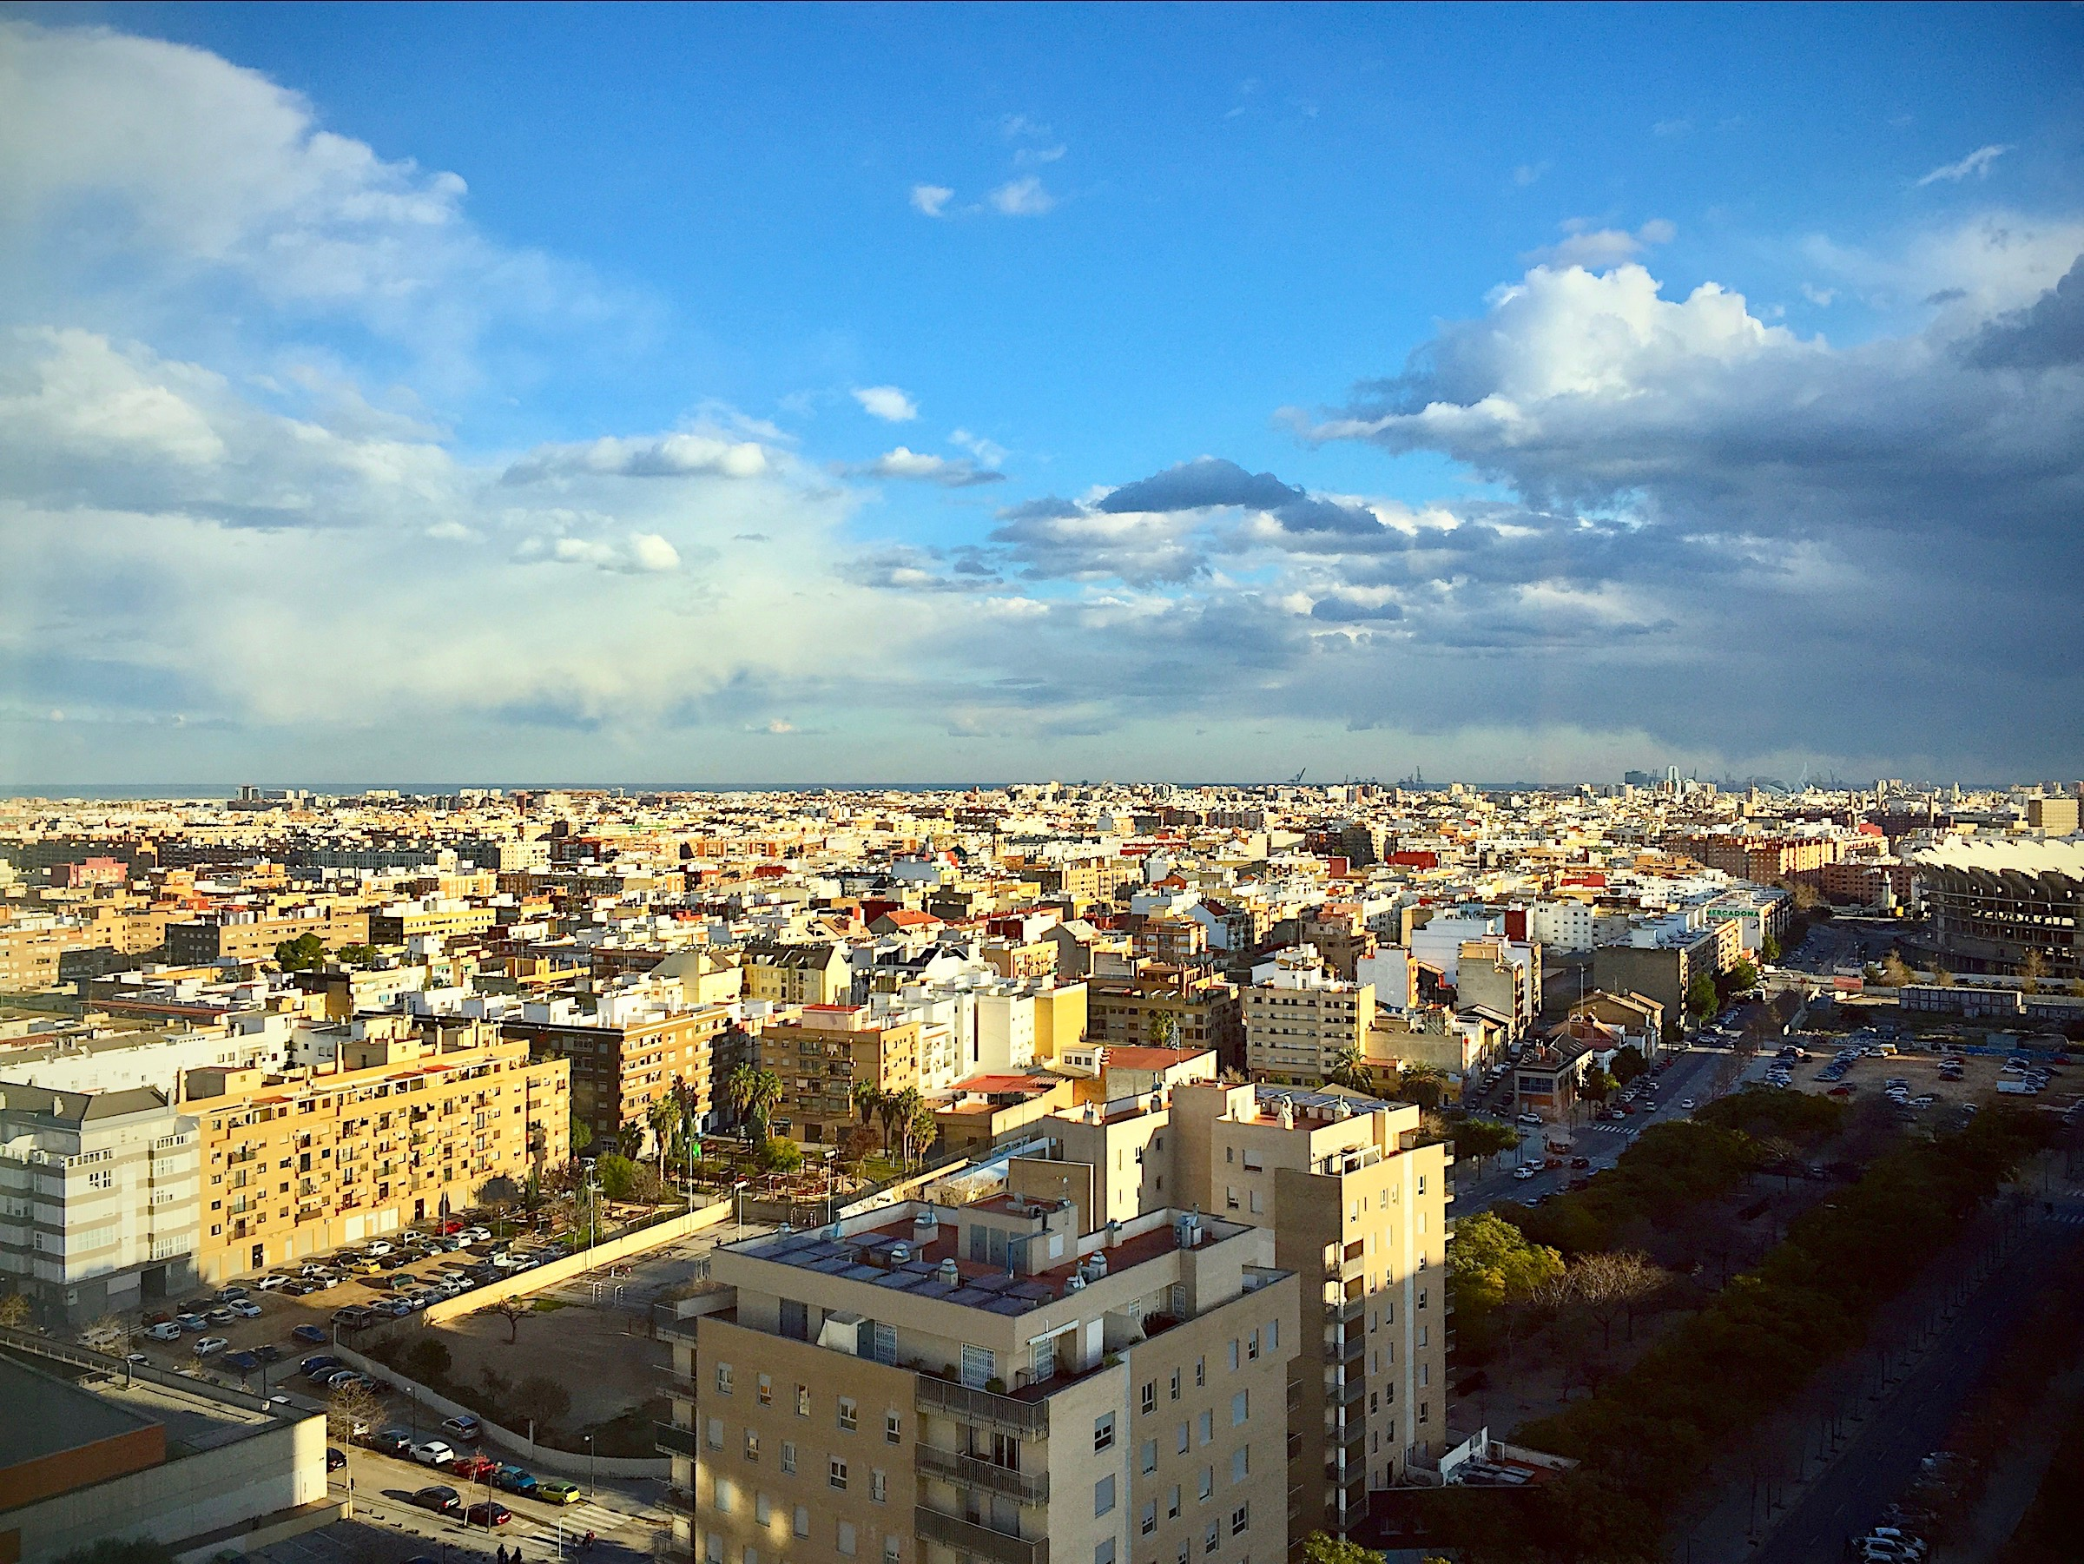
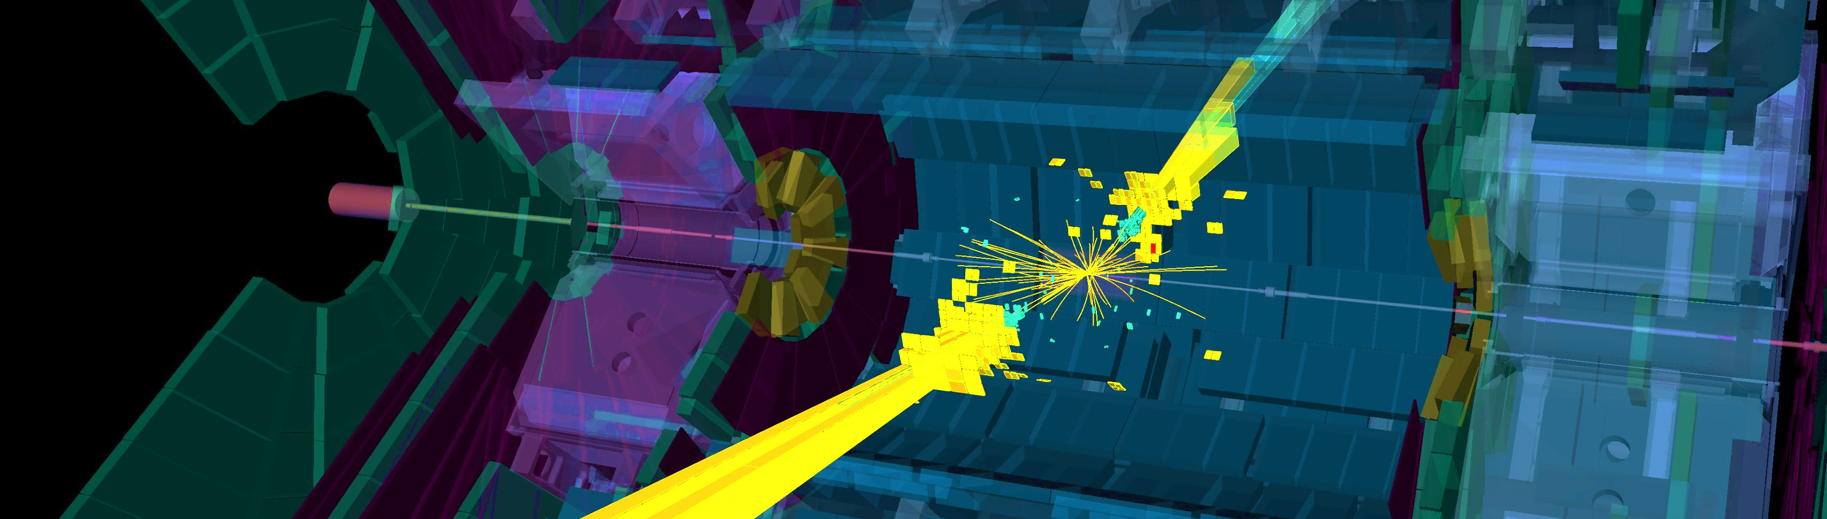
Particle Physics at the dawn of a new high-energy frontier
Valencia seen from the hotel room
Andreas Hoecker (CERN)
Colloquium at IFIC, Valencia, January 18th, 2017

Slide 2

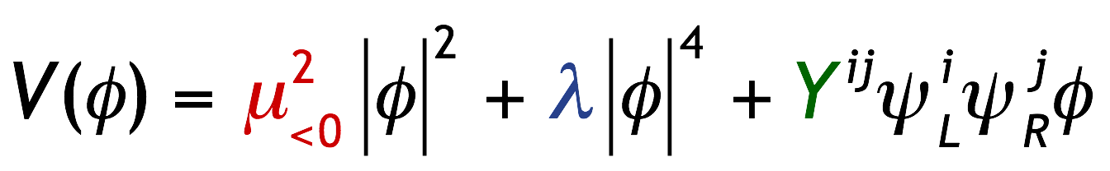
The LHC at CERN probes nature at the smallest distances ever explored on Earth to study and improve our current knowledge of matter and force as it is encoded in the SM of particle physics.
Quite special — only known elementary scalar particle. Product of BEH mechanism required by gauge symmetry and massive bosons and fermions
Matter particles (S=1/2)
Force quanta (S=1)
The Standard Model is the legacy of 20th century particle physics
It unifies quantum mechanics, special relativity and field theory
It unifies electromagnetic and weak interactions
It describes ~ all laboratory data
Tree-level BEH potential at zero temperature:
( |µ| = 89 GeV, λ = 0.13 for m_{H} = 125 GeV )

Slide 3
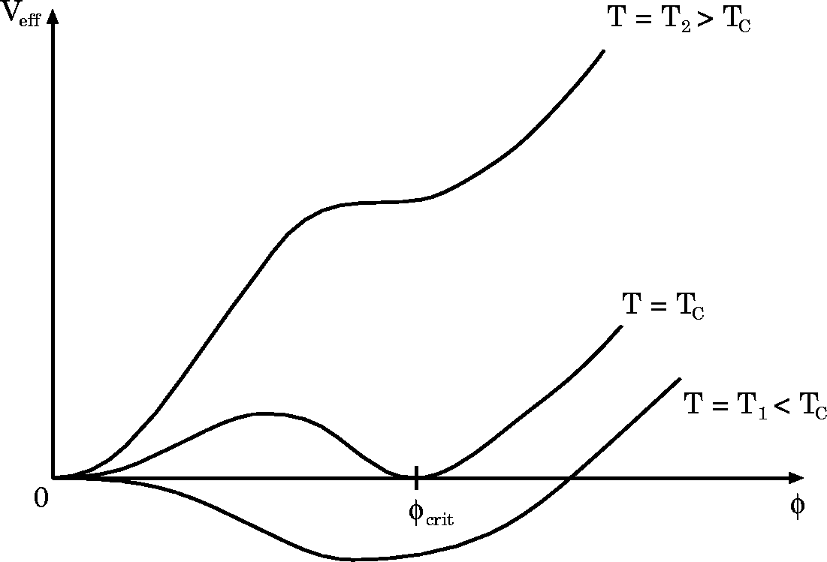



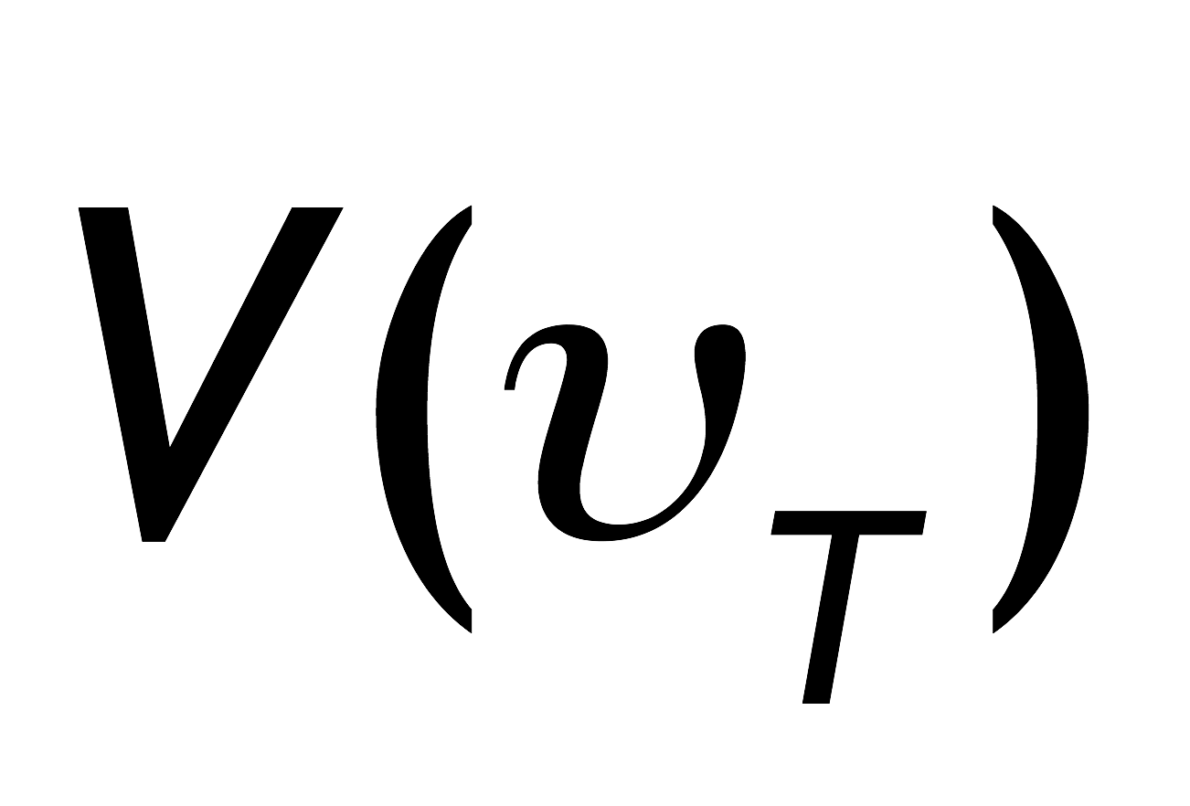

BEH Potential
The early universe, at temperature T > T_{EW}, was in a symmetric phase (|φ_{min}| = 0)
V(T) dependence mainly governed by top loop, adding a cubic 𝜙³ term
Drawings from W. Bernreuther, hep-ph/0205279

Slide 4
BEH Potential
The early universe, at temperature T > T_{EW}, was in a symmetric phase (|φ_{min}| = 0)
A phase transition at ~T_{EW} (~several 10⁻¹¹ s after big bang, causal domain of few cm) led to |φ_{min}| > 0
Phase transition
Potential barrier
BEH bubble expansion
Picture describes a 1st order phase transition that would require light Higgs, or new physics → currently disfavoured
Drawings from W. Bernreuther, hep-ph/0205279

Slide 5

BEH Potential
The early universe, at temperature T > T_{EW}, was in a symmetric phase (|φ_{min}| = 0)
A phase transition at ~T_{EW} (~several 10⁻¹¹ s after big bang, causal domain of few cm) led to |φ_{min}| > 0
Phase transition
Potential barrier
BEH bubble expansion
The condensed field fills all space and time but without orientation as it has no spin. (One might view it as a Lorentz-invariant ether creating a vacuum viscosity)
Condensation of BEH field
v
“spontaneous” phase transition
Drawings from W. Bernreuther, hep-ph/0205279
5

Slide 6
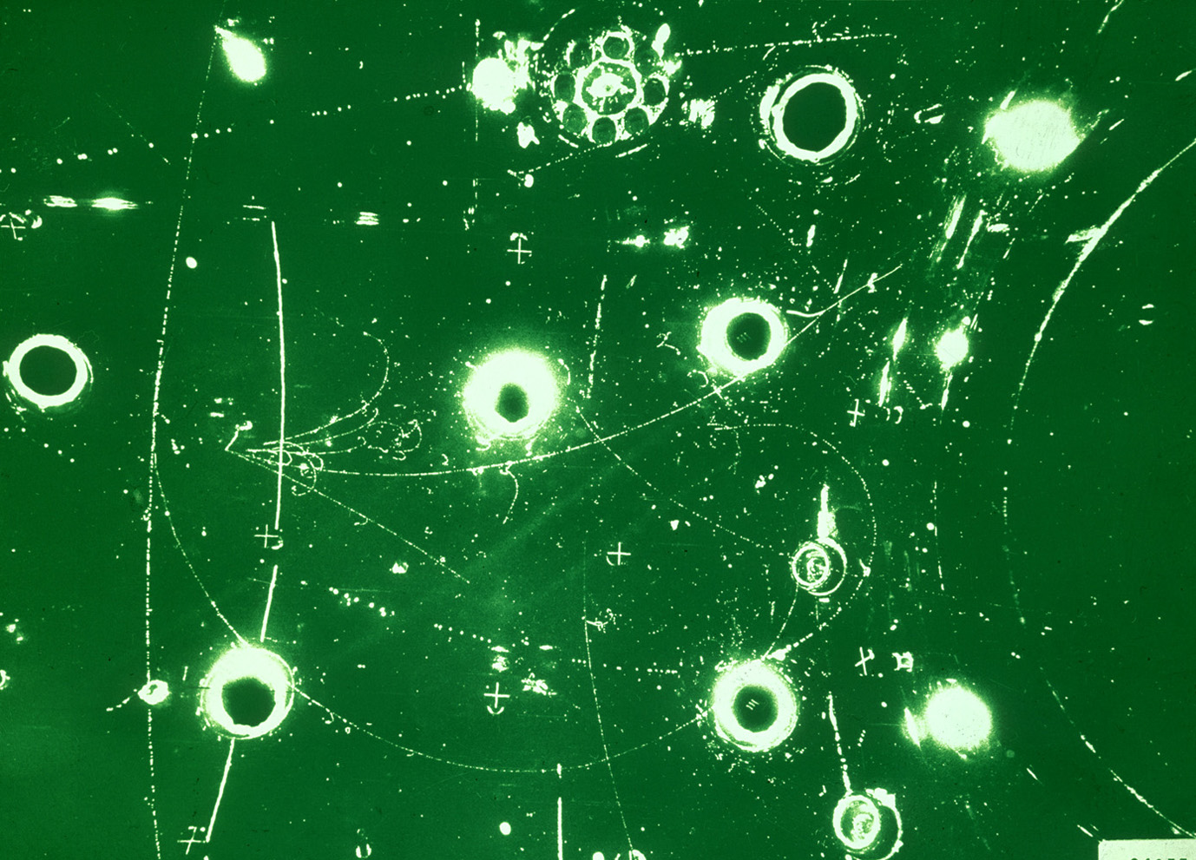
The Standard Model
BEH mechanism
Early universe: symmetric phase, fundamental particles are massless → gauge symmetry is respected
Symmetric phase – early universe
Gravity
Photon
Weak boson
Neutrinos
Electrons
Top quark
H. Murayama

Slide 7
The Standard Model
BEH mechanism
Early universe: symmetric phase, fundamental particles are massless → gauge symmetry is respected
Higgs quantum liquid in broken phase
Gravity
A Higgs field displaces ground state breaking gauge symmetry
Photon
×
×
It fills all space time (but without orientation as it has no spin)
Weak boson
×
×
×
×
Particles interact with Higgs field and effectively reduce their velocity. Acquired mass proportional to interaction strength
×
Neutrinos
ν_{L}
Λ⁻¹
ν_{L}
Electrons
×
e_{L}
e_{R}
×
e_{L}
→ Action of the Higgs field creates “vacuum viscosity”
×
×
×
_{L}
_{R}
Interaction with Higgs field alters chirality of massive Dirac fermion
×
×
Top quark
_{R}
_{R}
×
_{R}
×
×
_{L}
_{L}
t_{L}
_{L}
×
×
H. Murayama

Slide 8

The Higgs boson
The SM predicts all its properties, except for its mass
What was known about the Higgs before its discovery ?
Full references for mechanism:
F. Englert and R. Brout, PRL 13 (1964) 321.
P.W. Higgs, PRL 13 (1964) 508.
G. Guralnik, C. Hagen, and T.W.B. Kibble, PRL 13 (1964) 585.
It should be noted that Landau and Ginzburg had proposed a field giving the photon a mass in a superconductor, the mathematics of which is identical to the “Higgs mechanism” and predates it by several years.
http://www.shardcore.org/shardpress

Slide 9

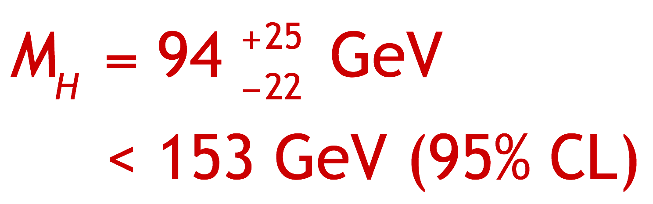
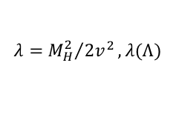
What was known about the Higgs (mass) before the LHC ?
Direct searches at LEP excluded: m_{H} < 114.4 GeV | Tevatron: excluded m_{H} ~ 160 GeV
Today’s Tevatron exclusion (2013): 149 < m_{H} < 182 GeV
Constraint from SM fit to EW precision data:
  Perturbativity and stability bounds versus SM cut-off scale Λ:
$$λ={M_{H}^{2}}/{2v^{2}}, λ(Λ)$$

Slide 10
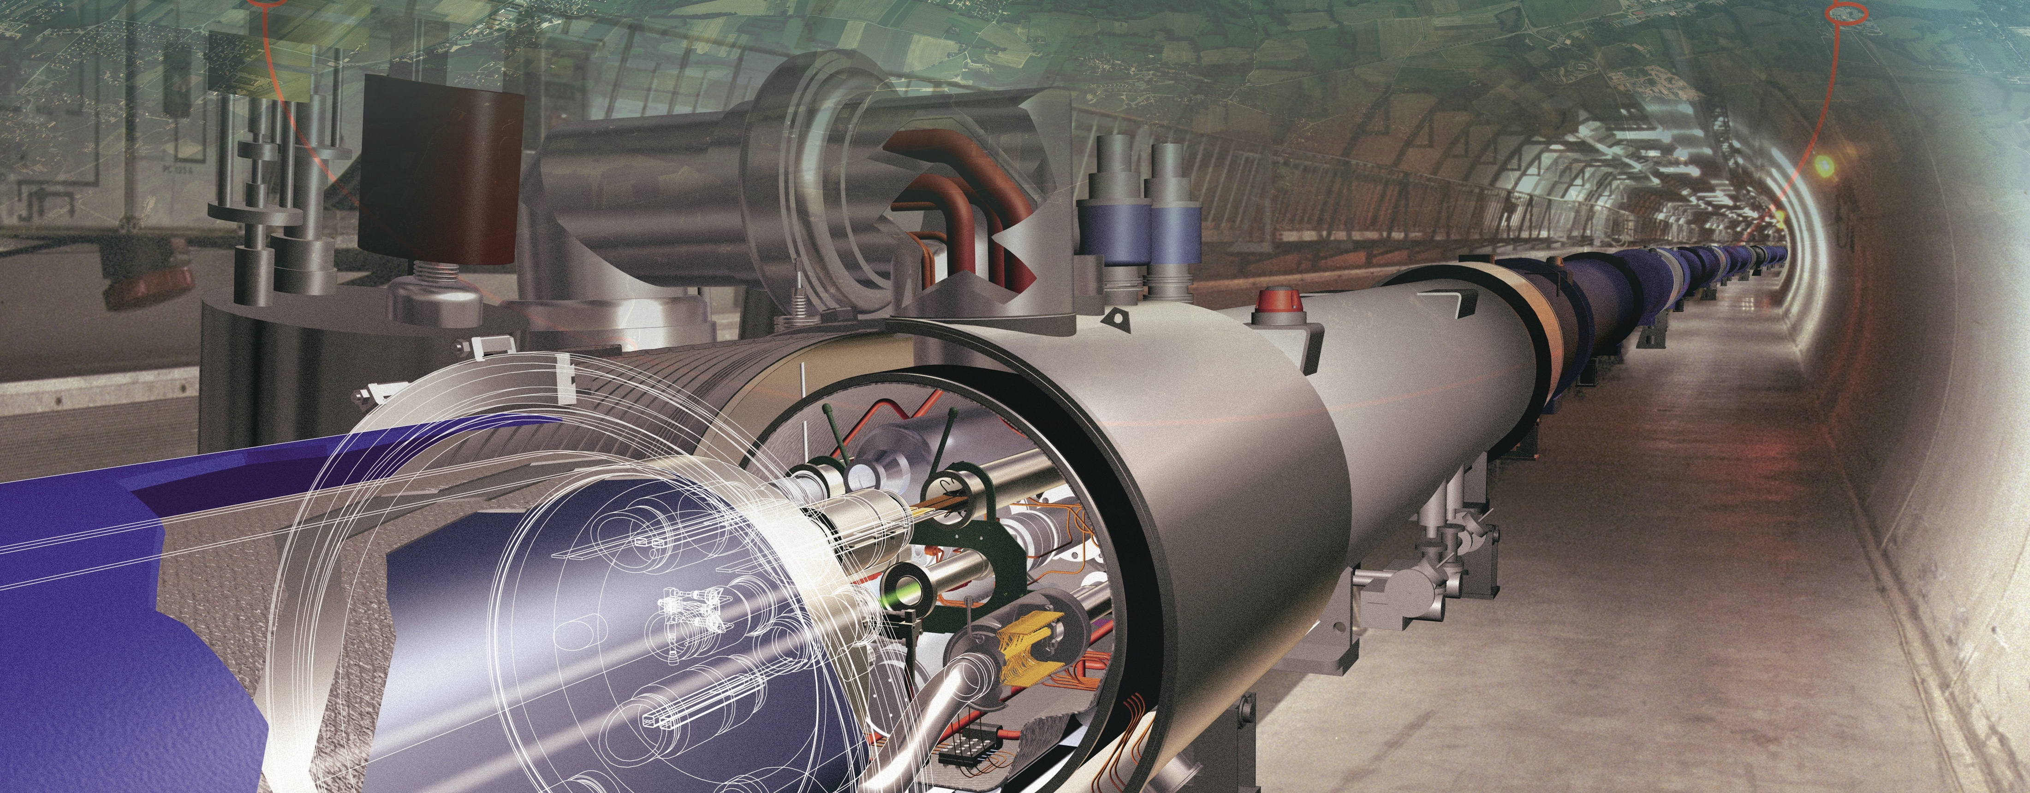
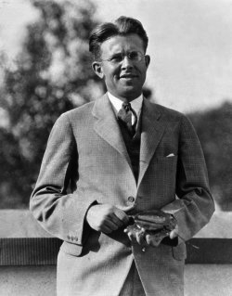
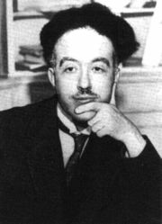
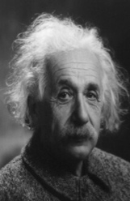
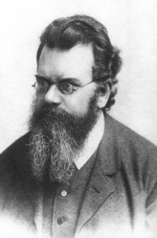
Producing the Higgs Boson and Searching for New Physics at the TeV Scale Requires a Huge Machine
de Broglie
Particles accelerators:
Look deeper into matter (size ~ 1/E ) (“powerful microscopes”)
Discover new heavier particles (E = mc ² )
Probe conditions of the early universe (E = kT )
Einstein
Lawrence
(First cyclotron provided 80 keV proton acceleration)
Boltzmann

Slide 11

Superconducting proton/ion accelerator and collider installed in a 27 km circumference underground tunnel (4 m tunnel cross-section diameter )
LHC ring at CERN:
27 km circumference
70 — 140 m depth
LHC
control room
CERN (Prévessin site)
SPS ring:
7 km circumference
CERN (Meyrin site)
~20 minutes are required to accelerate the protons in the LHC from 450 GeV to 7 TeV

Slide 12

7 TeV
LHC
450 GeV
LHC ring at CERN:
27 km circumference
SPS
70 — 140 m depth
26 GeV
PS
1.4 GeV
LHC
control room
CERN (Prévessin site)
BOO-
STER
SPS ring:
7 km circumference
50 MeV
LIN-
AC2
PROTONS
CERN (Meyrin site)
~20 minutes are required to accelerate the protons in the LHC from 450 GeV to 7 TeV

Slide 13
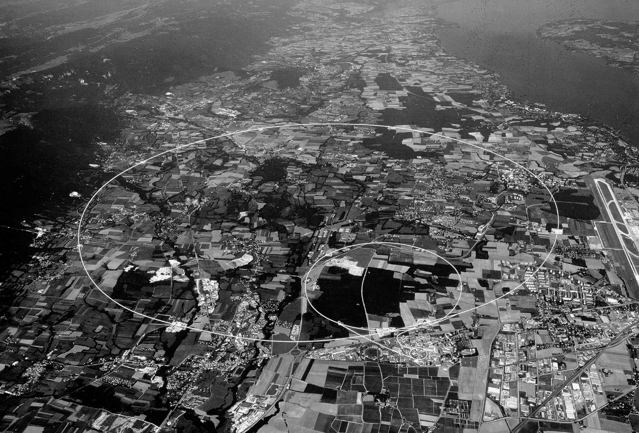

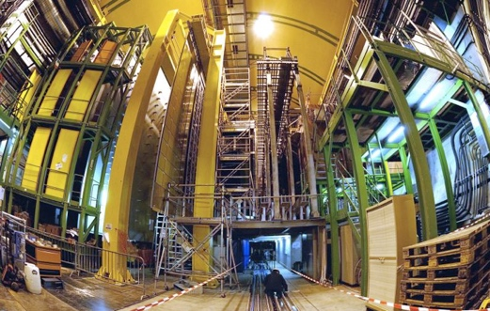

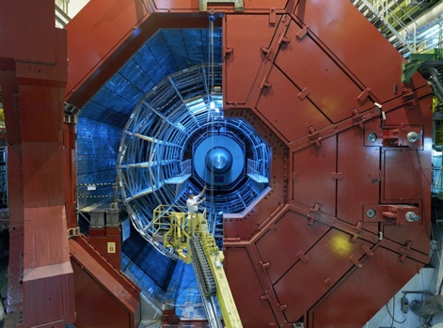
CMS
LHCb
ALICE
ATLAS

Slide 14
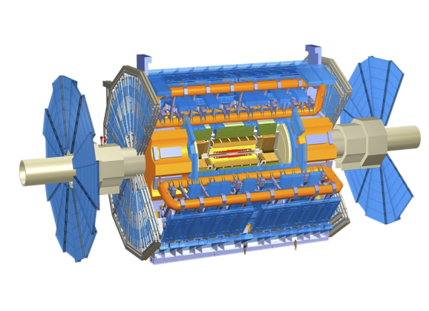

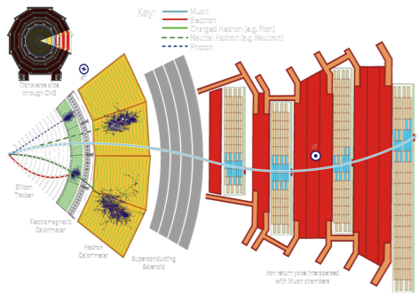
ATLAS & CMS: giant, ultra sophisticated particle detectors
ATLAS: emphasis on excellent jet and missing-E_{T} resolution, particle identification, flavour tagging, and standalone muon measurement
CMS: emphasis on excellent electron/photon energy & track (muon) momentum resolution, and flavour tagging
Both: excellent hermeticity – very few “cracks”

Slide 15
LHC computing is big data
LHC experiments started more than a decade ago with large scale computing — now big data is everywhere
Note: LHC has a public science budget, unlike Google or Facebook
Business email sent per year
2,986 PB
Google search index
98 PB
US climate database
6 PB
Content uploaded to Facebook each year
182 PB
Video upload to YouTube / year: 15 PB
ATLAS managed data volume
230 PB
US Congress library
6 PB
Largest data volume from simulated events, not from real collision data !
ATLAS annual data volume
~40 PB
Source: http://www.wired.com/2013/04/bigdata
http://www.wired.com/2013/04/bigdata
15

Slide 16

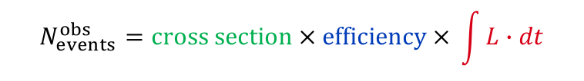
Luminosity — single most important quantity
Luminosity drives our ability to detect low cross-section processes
“Cross section” given by Nature
“Efficiency” of detection optimised by experimentalist
Integrated luminosity delivered by LHC
$$N_{events}^{obs}=cross section × efficiency × \int{L∙dt}$$
Luminosity is a function of the LHC beam parameters
$$L=\frac{f_{rev}n_{bunch}N_{p}^{2}}{4πσ_{x}σ_{y}}∙R\left(θ_{c},ε,β^{∗},σ_{z}\right)=\frac{1}{4π}{∙f}_{rev}n_{bunch}N_{p}∙\frac{N_{p}}{ε_{n}}∙\frac{γ}{β^{∗}}∙R\left(θ_{c},ε,β^{∗},σ_{z}\right)$$
Reduction factor
Crossing angle (0.3 mrad) and “hourglass effect” (σ_{z} ~ 4–6 cm)
crossing angle
hour glass

Slide 17
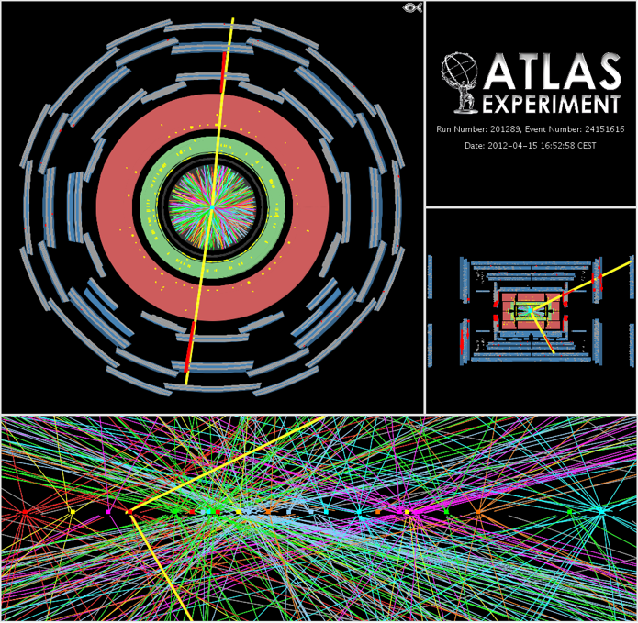

High luminosity comes at price of pileup interactions
Pileup interactions
  Average of 21 (peak: 40) interactions per crossing in 2012. Similar in 2016. LHC design value:
  Most analyses quite insensitive to pileup at this rate, several mitigation methods used
  However: higher trigger thresholds → low-p_{T} physics suffers
$$μ=\frac{σ_{inel}∙L}{f_{rev}∙n_{bunch}}≈\frac{80 mb∙10 {nb}^{−1}s^{−1}}{11245 s^{−1}∙2808}=25$$

Slide 18
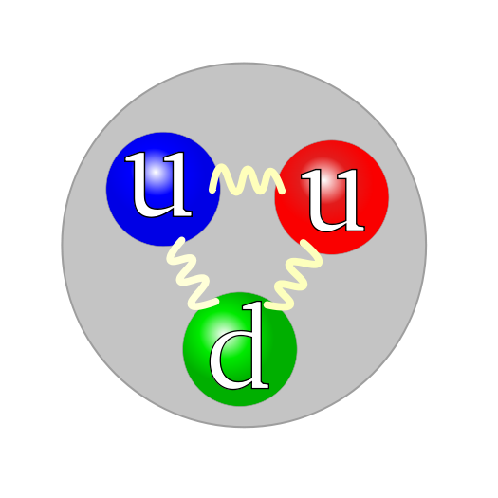
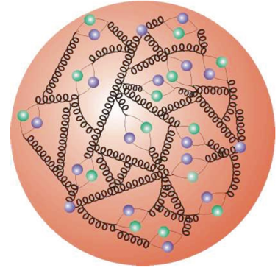
Proton–Proton Collisions
For proton–proton collisions, cross section is convolution of Parton Density Functions (PDF) with parton scattering Matrix Element
Parton distribution functions
Representing structure of proton, extracted using experimental data and QCD properties

Slide 19
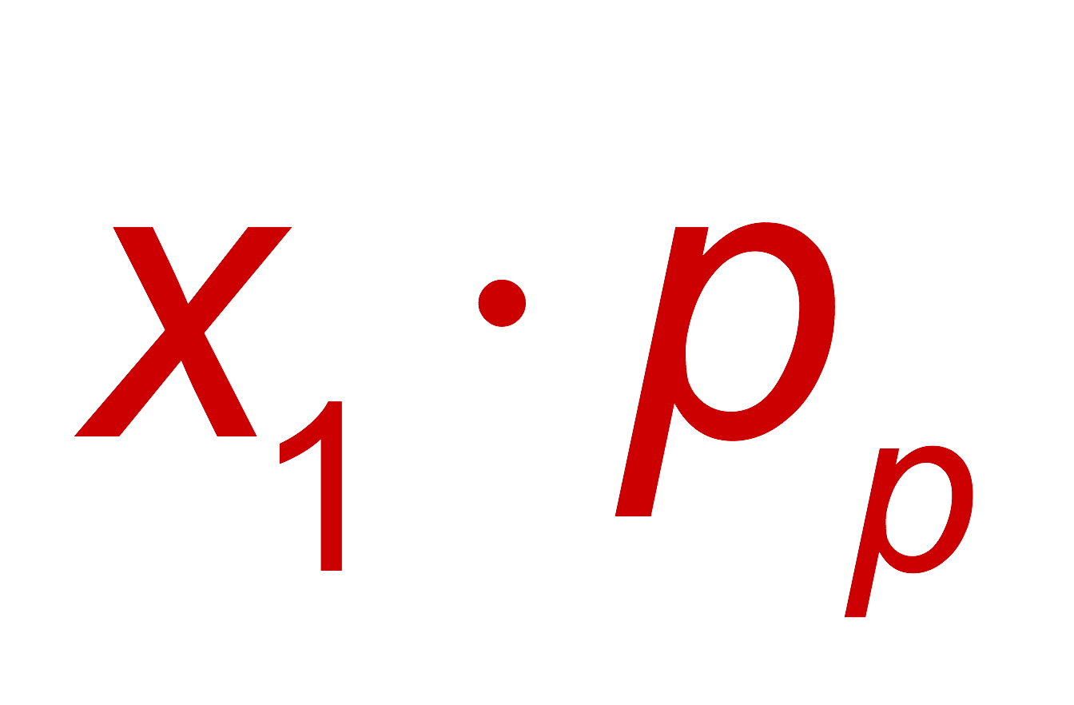
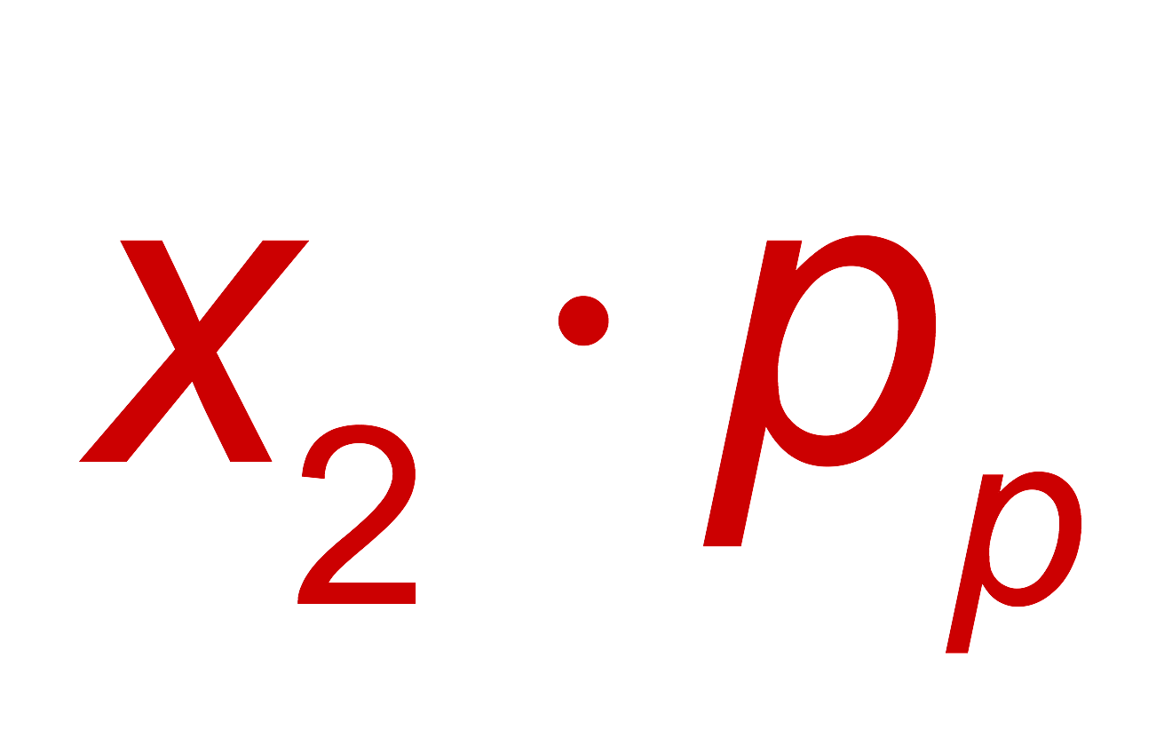

Proton–Proton Collisions
For proton–proton collisions, cross section is convolution of Parton Density Functions (PDF) with parton scattering Matrix Element
Parton distribution functions
Representing structure of proton, extracted using experimental data and QCD properties
Hard scatter parton cross section
Higher order pQCD correction; accompanying radiation, jets, …
p
Q ² = M_{X}²
X = jets, W, Z, top, Higgs, SUSY, …
p
Underlying event
CM energy-squared of parton collision:
The PDFs rise dramatically towards low x:
  Higher cross section at higher proton−proton collision energy
  More luminosity also achieves higher achievable energy
  Low-x regime (eg, Higgs production) dominated by gluon−gluon collisions: “gluon collider”

Slide 20
Proton–Proton Collisions
Cross-section fully dominated by inelastic strong interaction “minimum bias” events
Detectors cannot record 40 MHz event rate* (each event ~2 MB size → 80 TB / second)
Online custom hardware and software “triggers” reduce rate to filter out events with a million & more times smaller cross-sections than minimum bias events
*The LHCb phase-1 upgrade is preparing for exactly that!

Slide 21
Theoretical predictions based on perturbation theory
Progress in theoretical calculations — NNLO revolution
Figure by Gavin Salam at LHCP 2016
Also experimental knowledge of PDFs limits precision in many LHC analyses !

Slide 22
The LHC Run-1: 7 & 8 TeV pp, 5 & 20 fb^{–1}
A brief history of selected highlights

Slide 23
Theory so far agrees with all measured cross-sections
Across widely different processes
Standard Model cross-section measurements
Harvest of cross-section measure-ments from LHC experiments (> 500 papers / exp) confirmed the predictive power of the Standard Model
Run-1 is not over yet: high-quality, extremely well understood data sample for precision measurements

Slide 24
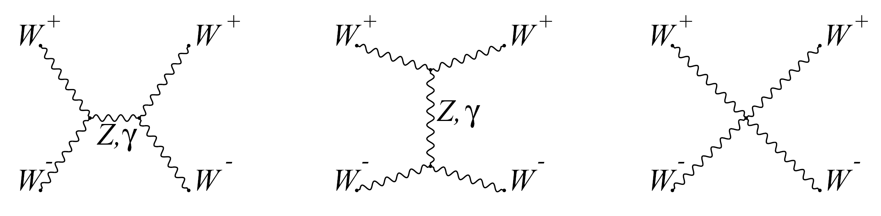
Run-1 allowed critical first electroweak studies
Higgs boson acts as “moderator” to unitarise high-energy longitudinal vector boson scattering
Unitarity: if only Z and W are exchanged, the amplitude of (longitudinal) W_{L}W_{L} scattering violates unitarity
Higgs boson restores unitarity of total amplitude:
H
m_{H} must not be too large (which is fulfilled)
H
Same-sign WW selection greatly reduces strong production. Removes s-channel Higgs process:
Look for VBS scattering in high dijet invariant mass distributions
EW VBS production
Non-VBS production
Strong production

Slide 25
Run-1 allowed critical first electroweak studies
Higgs boson acts as “moderator” to unitarise high-energy longitudinal vector boson scattering
Unitarity: if only Z and W are exchanged, the amplitude of (longitudinal) W_{L}W_{L} scattering violates unitarity
1405.6241, 1611.02428
Higgs boson restores unitarity of total amplitude:
Same-sign WW selection greatly reduces strong production. Removes s-channel Higgs process:
Look for VBS scattering in high dijet invariant mass distributions
ATLAS finds 3.6σ evidence for EW production (2.3σ expected)
EW VBS production
Non-VBS production
Strong production

Slide 26

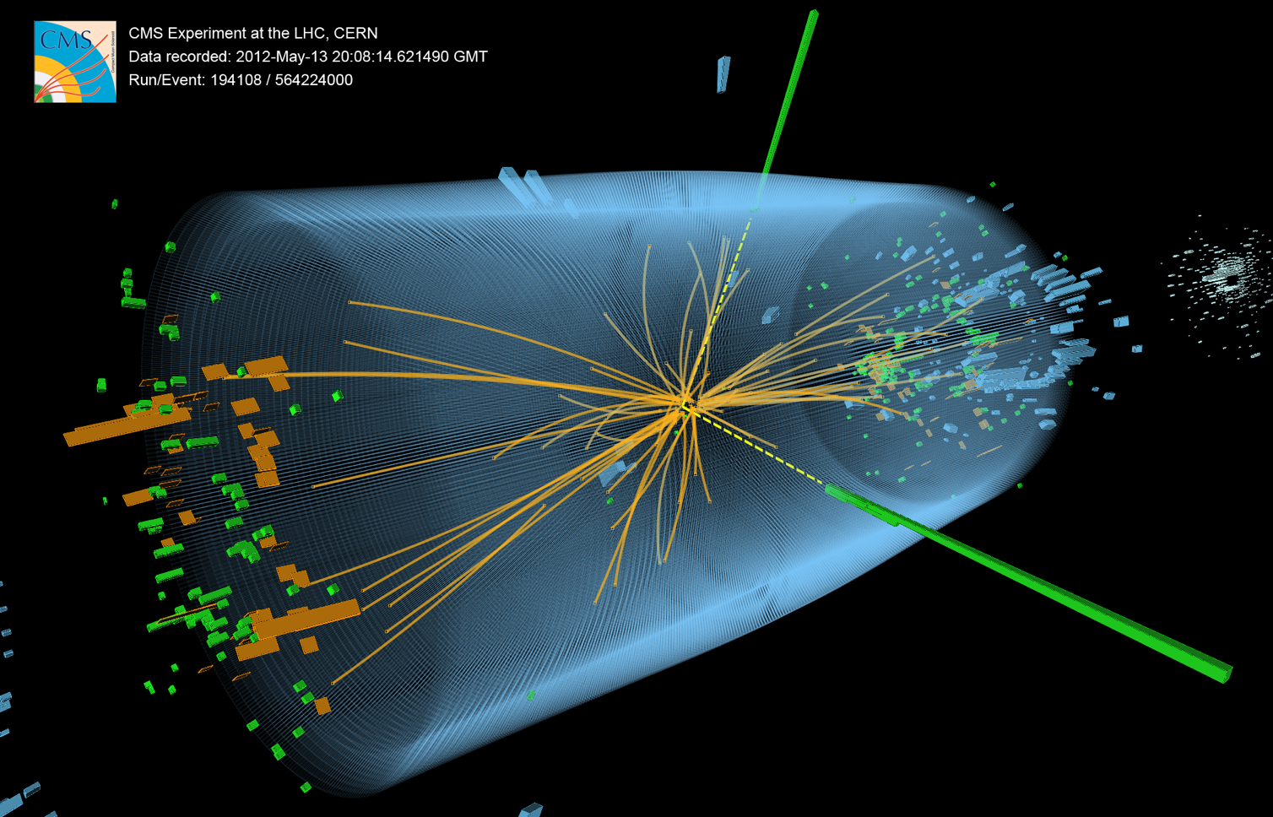
Higgs Boson — Run-1 magnum opus

Slide 27

Higgs boson production at the LHC
At the LHC, the Higgs boson is dominantly produced via gluon fusion for σ_{H,total} ~22 pb at 8 TeV for m_{H} = 125 GeV
Cross section steeply falling with Higgs mass
Vector boson fusion (σ_{W/Z+H} ~ 1.6 pb):
g
t
t
H
Higgs-strahlung (σ_{W/Z+H} ~ 0.7/0.4 pb):
g
t
σ_{H,ggF} ~ 19 pb
“ttH” production (σ_{ttH} ~ 0.13 pb):
Total production of ~470 thousand SM Higgs bosons of 125 GeV in 2012 in each ATLAS and CMS

Slide 28
Higgs boson production at the LHC
H(125 GeV) branching fractions:
Because of the coupling to the mass of the decay particles:
  … the Higgs will decay with preference to the heaviest particles allowed
  … the Higgs does not couple directly to photons and gluons, but only via “loops” involving preferentially heavy particles (e.g., top, W )
0.012% (e,µ)
1.1% (e,µ)
Uncertainties 3∼12%

Slide 29
No doubt on H₁₂₅ discovery in the bosonic channels
H → γγ
H → ZZ⁽*⁾ → 4𝓁
H → WW ⁽*⁾ → 2𝓁2ν
σ(m) ~ 1–2%
σ(m) ~ 1–2%
σ(m) ~ 20%
0
Very different experimental challenges in each of these discovery channels.
All analyses significantly improved since July 2012. Resulting yields agree with SM predictions

Slide 30
Combined ATLAS & CMS Higgs analysis and flurry of Higgs property measurements
ATLAS & CMS Combinations of Higgs mass and coupling measurements
[ 1503.07589, 1606.02266 ]
Agreement among experiments
Overall comparison: µ = 1.09 ± 0.11
Combined observation of H → ττ channel & VBF production
ttH channel a bit large: 4.4σ (2.0 exp), µ = 2.3
Precise mass combination (0.2%):
m_{H} = 125.09
± 0.21_{stat}
± 0.11_{syst} GeV
Higgs production processes
Higgs decay processes
Note that the least model-dependent observables at the LHC are ratios of couplings

Slide 31
Combined ATLAS & CMS Higgs analysis and flurry of Higgs property measurements
ATLAS & CMS Combinations of Higgs mass and coupling measurements
[ 1503.07589, 1606.02266 ]
t
t
t
W
W
W
t
t
t
Couplings to massless particles mediated by loops involving heavy particles
Powerful test for new physics (eg, excludes SM-like heavy 4th fermion generation)

Slide 32
The Higgs boson as a portal to beyond the SM physics
Higgs is narrow: 4.1 MeV
For comparison:
Γ_{W} = 2.1 GeV
Γ_{Z} = 2.5 GeV
Γ_{top} = 1.3 GeV
Invisible dark matter?
?
Even small couplings to new light states can measurably distort branching fractions
Γ_{H} = 4.1 MeV

Slide 33
What was known about the Higgs (mass) before the LHC ?
Direct searches at LEP excluded: m_{H} < 114.4 GeV | Tevatron: excluded m_{H} ~ 160 GeV
Today’s Tevatron exclusion (2013): 149 < m_{H} < 182 GeV
Constraint from SM fit to EW precision data:
  Perturbativity and stability bounds for high SM cut-off scale Λ:
$$λ={M_{H}^{2}}/{2v^{2}}, λ(Λ)$$

Slide 34
Agreement of observation with prior constraints
Direct searches at LEP excluded: m_{H} < 114.4 GeV | Tevatron: excluded m_{H} ~ 160 GeV
Today’s Tevatron exclusion (2013): 149 < m_{H} < 182 GeV
Constraint from SM fit to EW precision data:
ATLAS & CMS:
m_{H} = 125.09 ± 0.21_{stat} ± 0.11_{syst} GeV
  Perturbativity and stability bounds for high SM cut-off scale Λ:
ATLAS & CMS
ATLAS & CMS

Slide 35


Global fit to electroweak precision data
Global electroweak fit was masterpiece of LEP/SLD era.
Discovery of Higgs over-constrains the fit and dramatically improves predictability
No W mass measurement at LHC until last December …
Competitive top mass results from the LHC
Best current results: 172.44 ± 0.13 ± 0.47 GeV (CMS, 1509.04044),
172.84 ± 0.34 ± 0.61 GeV (ATLAS, 1606.02179, not yet all 8 TeV)

Slide 36

Measurement of the W mass at the LHC (using low-pileup 7 TeV dataset)
Measurement uses W → e𝜈, µ𝜈 events; competitive measurement needs < 0.03 % uncertainty
Current best single measurement (CDF): m_{W} = 80389 ± 19 MeV, world average: 80385 ± 15 MeV
W mass measurement relies on excellent understanding of selection efficiency and backgrounds, momentum/energy calibration, physics modelling (particularly challenging at LHC)
ATLAS-CONF-2016-113
$$m_{T}=\sqrt{2p_{T,ℓ}E_{T}^{miss}\left(1−cosΔφ_{ℓν}\right)}$$
W mass from fit of MC template to data

Slide 37
Measurement of the W mass at the LHC (using low-pileup 7 TeV dataset)
Measurement uses W → e𝜈, µ𝜈 events; competitive measurement needs < 0.03 % uncertainty
Current best single measurement (CDF): m_{W} = 80389 ± 19 MeV, world average: 80385 ± 15 MeV
Excellent agreement of measurements between e,µ channels, W⁺ and W– and p_{T,𝓁} and m_{T}
Combined result:
m _{W} (ATLAS) = 80370 ± 7(stat.) ± 11(exp. syst.) ± 14(mod. syst.) MeV
= 80370 ± 19 MeV
ATLAS-CONF-2016-113

Slide 38
The Higgs boson discovery
The Higgs-boson discovery and property measurements confirmed BEH picture of mass generation through spontaneous symmetry breaking. Scalar sector SM-like so far…
However, apart from the mass, none of these measurements are yet very precise and leave room for significant deviations. Also, important modes are still unseen (bb, ttH, µµ, Zγ, HH)
The (mysterious) scalar sector of the SM is directly connected with profound questions of the SM: naturalness, vacuum stability & energy, flavour
The Higgs discovery finally allows us to directly study this sector, requiring a broad experimental programme that will extend for decades

Slide 39
Highly important flavour measurements
Flurry of results from LHCb [ ~300 papers to date ]
Does the Higgs boson has brothers and sisters?
h, H, A
H ±
?
B_{s} → µµ is loop process (no tree-level FCNC) that is in addition CKM & helicity suppressed
SM: 3.7 ± 0.2 × 10^{–9}
CMS & LHCb: observation of B_{s} → µµ
[ Nat. 522 (2015) 68 ]
Lower ATLAS Run-1 result
[1604.04263, consistency with SM at 2σ ]

Slide 40
Highly important flavour measurements
Flurry of results from LHCb [ ~300 papers to date ]
Does the Higgs boson has brothers and sisters?
h, H, A
H ±
?
B_{s} → µµ is loop process (no tree-level FCNC) that is in addition CKM & helicity suppressed
SM: 3.7 ± 0.2 × 10^{–9}
CMS & LHCb: observation of B_{s} → µµ
[ Nat. 522 (2015) 68 ]
Lower ATLAS Run-1 result
[1604.04263, consistency with SM at 2σ ]
Precision measurement of 𝜙_{s}
[ PRL 114, 041801 (2015): φ_{s} = –0.010 ± 0.039 ]
A few anomalies in b → s and lepton universality in semileptonic B decays are to be followed up

Slide 41
Two beautiful, extremely precise theories
The Standard Model of EW and strong interactions
Predicting, e.g., the anomalous magnetic moment of the electron to a relative precision of better than 10^{–9} in agreement with experiment
General relativity — theory of gravitation
Tested up to an accuracy of order 10^{–5} (Cassini probe [B Bertotti et al., Nature 425, 2003])
Unfortunately, the SM and general relativity don’t work in regimes where both are important (ie, at very small scales)

Slide 42
Many open questions remain…
Scalar sector
Single doublet or more
Elementary or composite
Form of potential
Origin of Yukawa couplings
Quarks and leptons
Origin of families, mass, mixing, CPV
Matter–antimatter asymmetry
Baryon and lepton number conservation (proton decay)
Dark matter
Composition: WIMP, axions, sterile neutrinos, hidden sector particles, gravitational effect only
Single or multiple sources
Neutrinos
Origin and values of neutrino masses
Nature: Majorana or Dirac
CP violation
Sterile neutrinos
Expansion of Universe
Primordial expansion via inflation; which fields, role of quantum gravity?
Accelerated expansion today: cosmological constant problem
High-scale physics
Hierarchy problem and new physics at TeV scale
Grand unification of forces
Unification with gravity
Quantum gravity, string theory
Strong CP problem

Slide 43
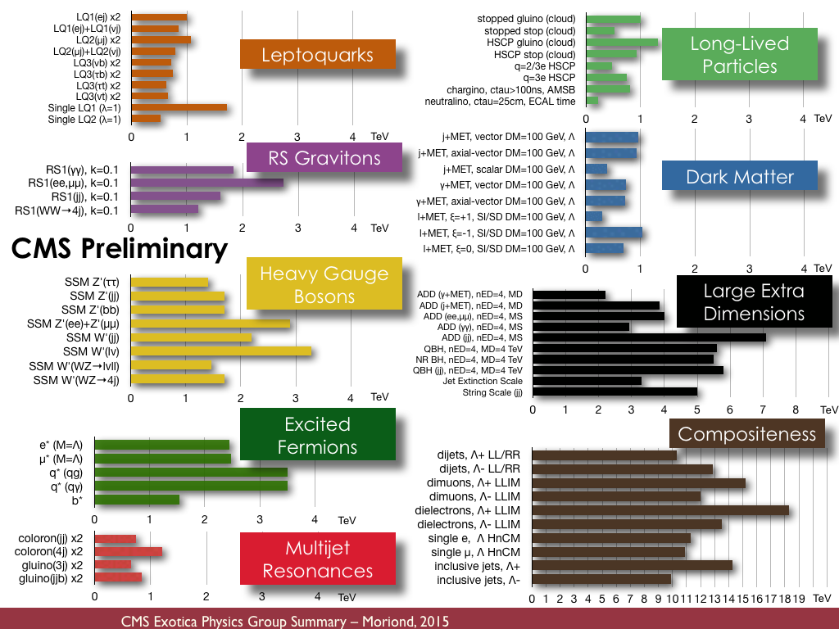
It therefore seems that the SM isn’t all there is
Vast amount of BSM searches
Theory-agnostic, signature based searches, as well as highly targeted model-dependent ones
No significant anomaly seen so far

Slide 44
The LHC Run-2 at 13 TeV
— terra incognita —

Slide 45
The LHC Run-2: 13 TeV / 8 TeV inclusive “parton luminosity” ratio
PDFs
Strong interaction dominated processes
Electroweak processes
4 TeV
Larger cross section increase for gluon induced than for quark induced processes
Early Run-2 puts emphasis on searches
45

Slide 46
2015 LHC proton–proton luminosities
Most results reported by ATLAS & CMS use total 2015 and summer 2016 dataset
ICHEP 2016
Peak luminosity (> design):
L_{max} = 1.2 × 10³⁴ cm^{–2} s^{–1}
12–16 fb^{–1} for results so far
Total of 39 fb^{–1} delivered in 2016
2015 and 2016 pileup profile in ATLAS & CMS
(LHCb mean pileup of ~1.7 due to levelling)
LHCb after luminosity levelling: 1.7 (1.9) fb^{–1} recorded (delivered)
Current luminosity precision from van-der Meer scans: 2.9% (ATLAS), 6.2% (CMS 2016), 3.8% (LHCb)

Slide 47
Selected physics at 13 TeV proton–proton collisions

Slide 48
Measurement of jet cross section at 13 TeV
Primary test of QCD at highest collision energy
CMS 1605.04436, 1609.05331
Double differential cross section measured by CMS
Comparison with 8 TeV plot (right) shows effect of increased parton luminosities at high jet p_{T}

Slide 49
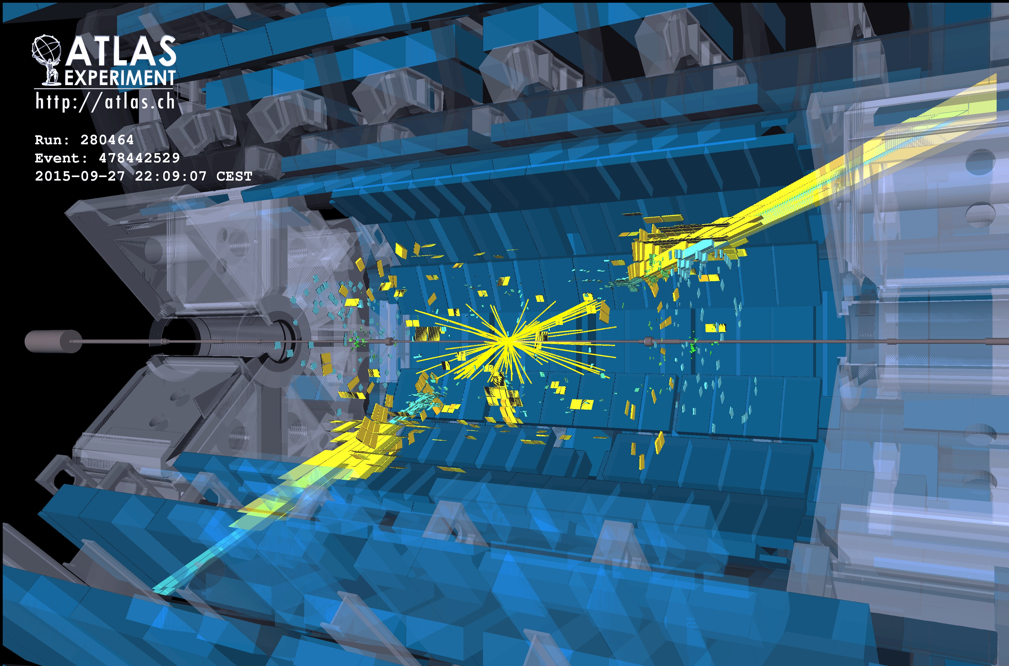
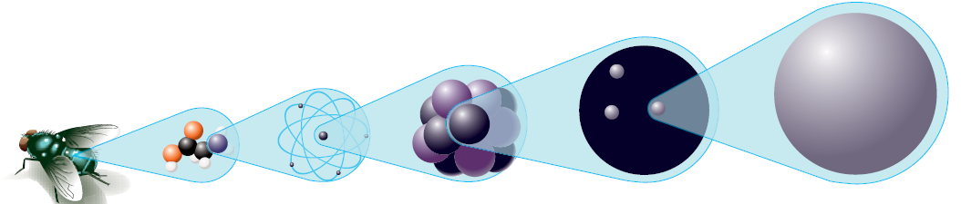

New physics in events with jets ?
< 10 ^{–19} m
10^{–15} m
Several 10^{–15} m
O(10^{–10} m)
O(10^{–9} m)
quark
Do quarks have substructure? Can they be excited?

Slide 50
Searches in high-p_{T} multijet final states at 13 TeV
Processes with large cross-sections, sensitivity to highest new physics scales
Among the high priority early 13 TeV searches
ATLAS-CONF-2016-069
Dijet resonance and angular distribution (incl. lower mass via ISR)
High-p_{T} multijets produced, eg, by strong gravity
Fit of empirical function to data
No anomaly seen in these or similar searches
Limits on excited quarks (for example) at 5.6 TeV

Slide 51
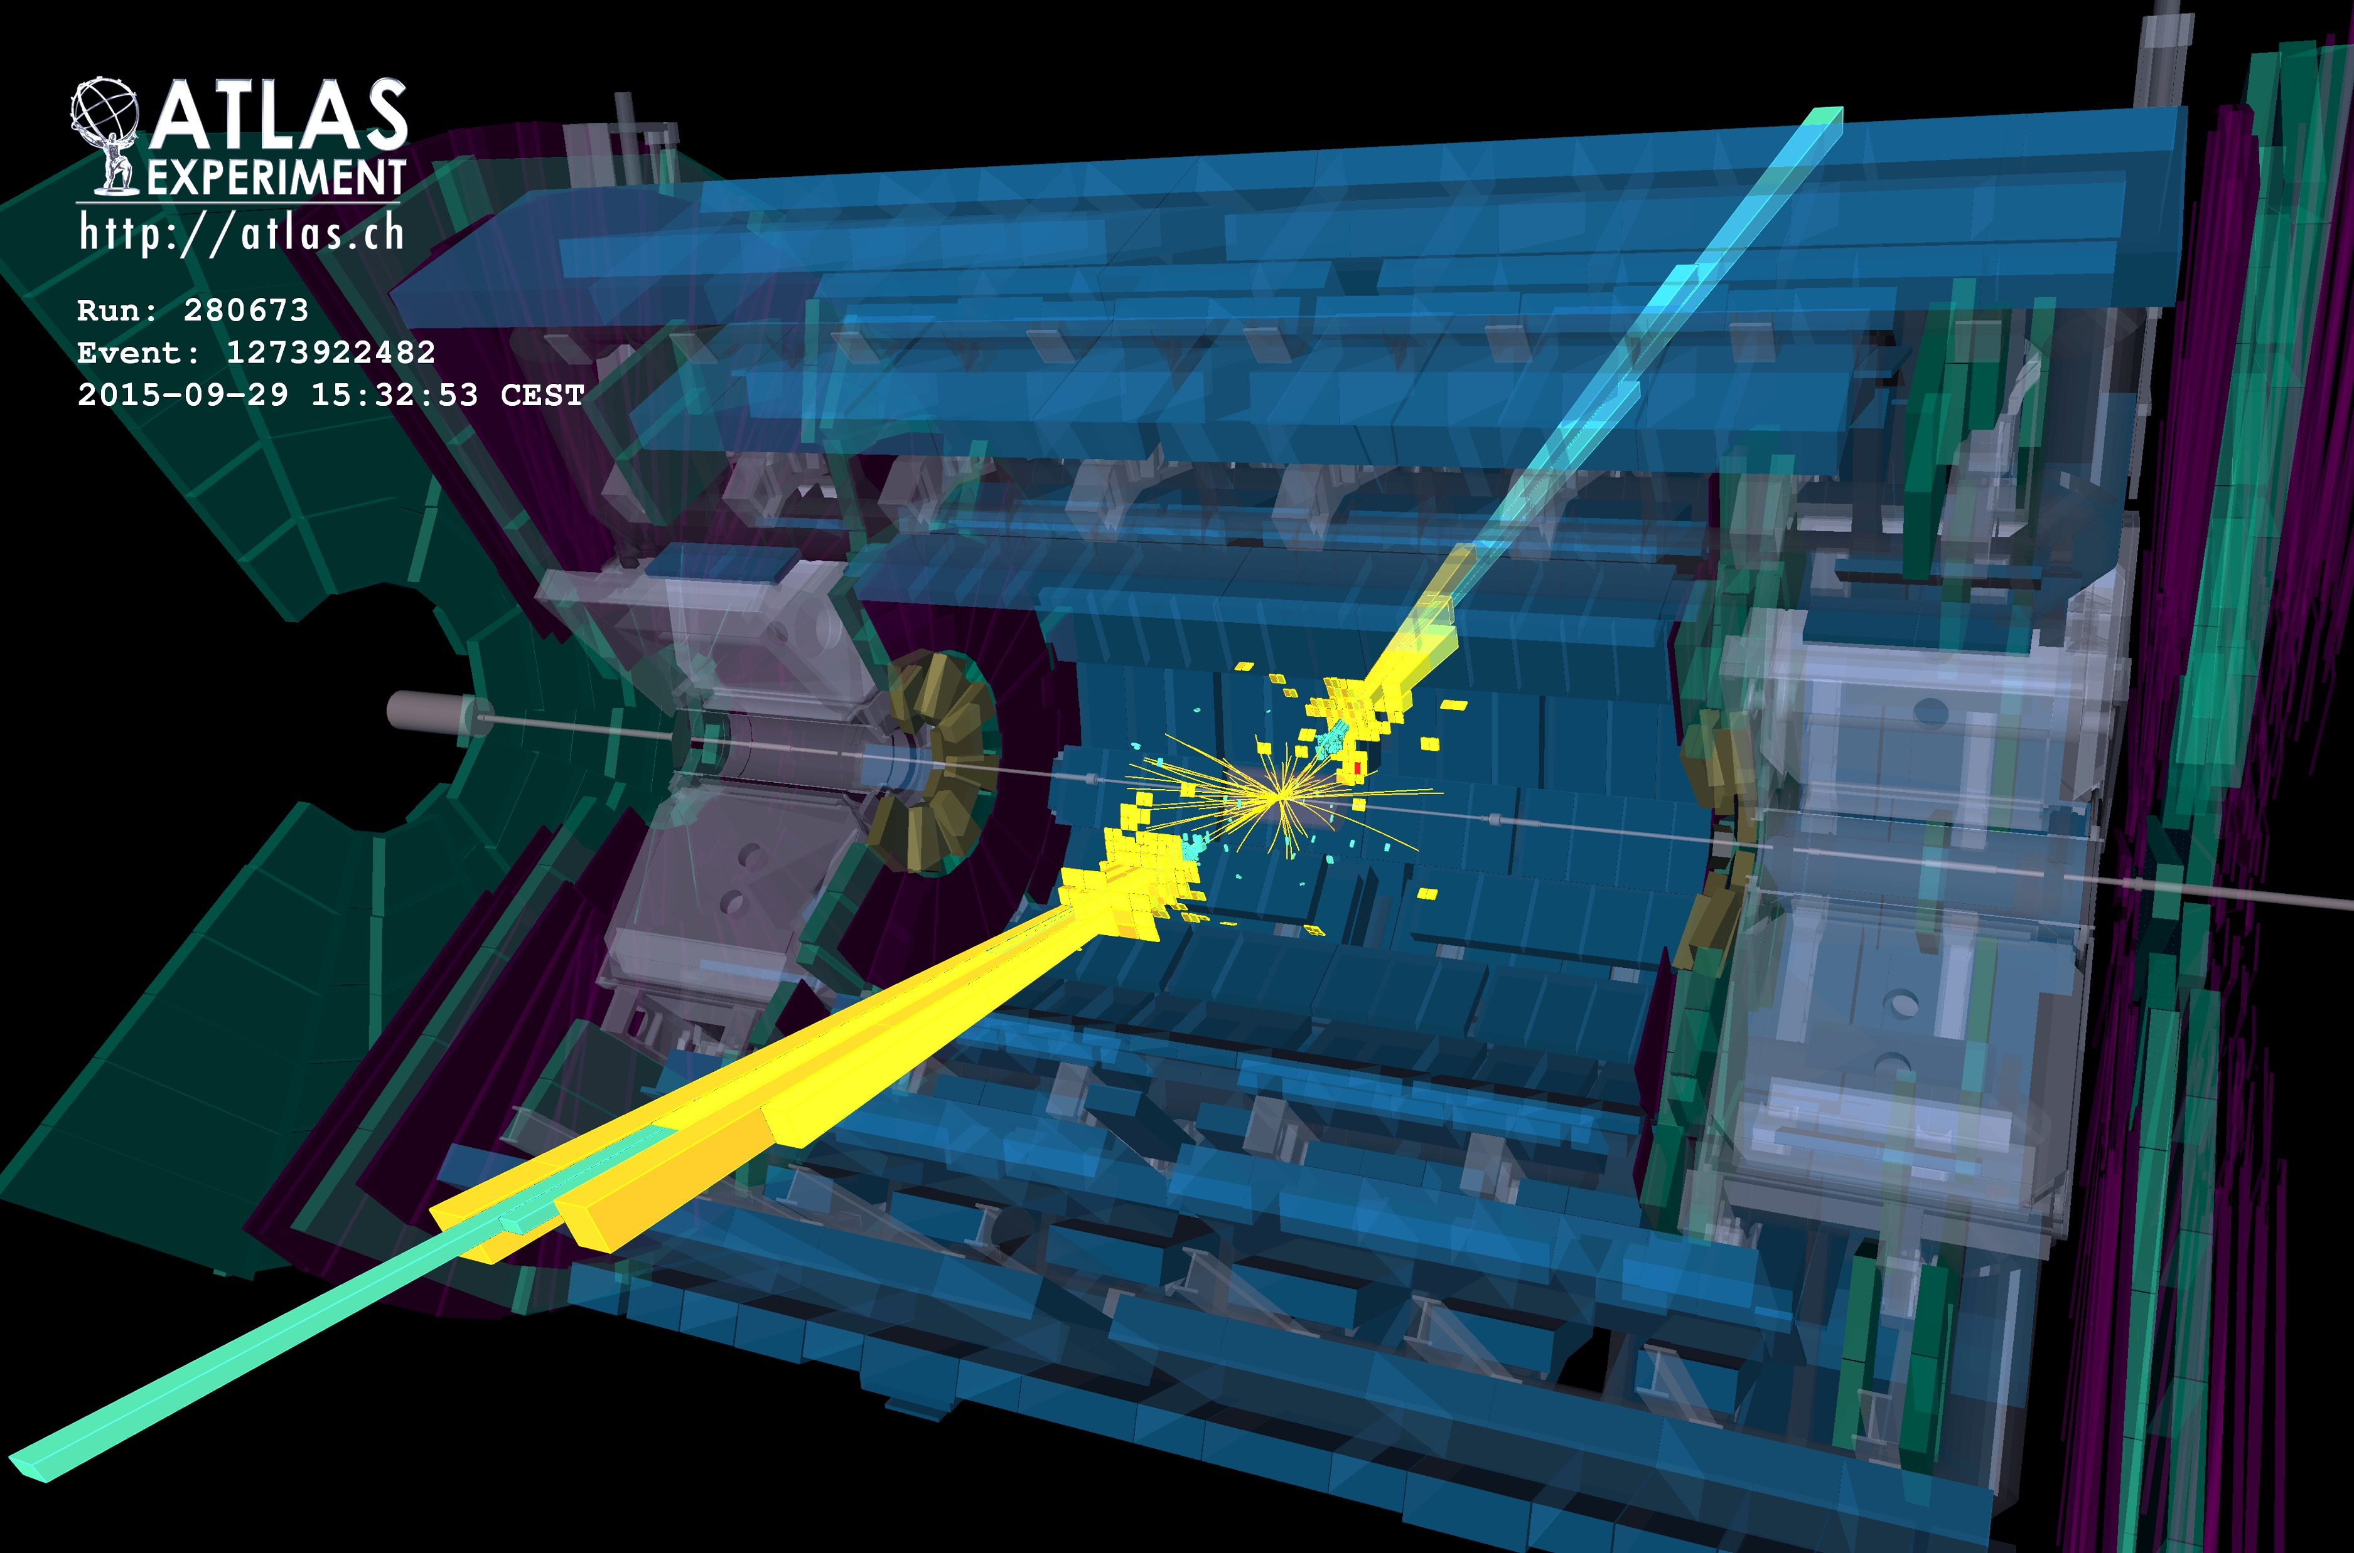
Highest mass central dijet event measured by ATLAS in 2015 (√s = 13 TeV): m_{jj} = 6.9 TeV

Slide 52
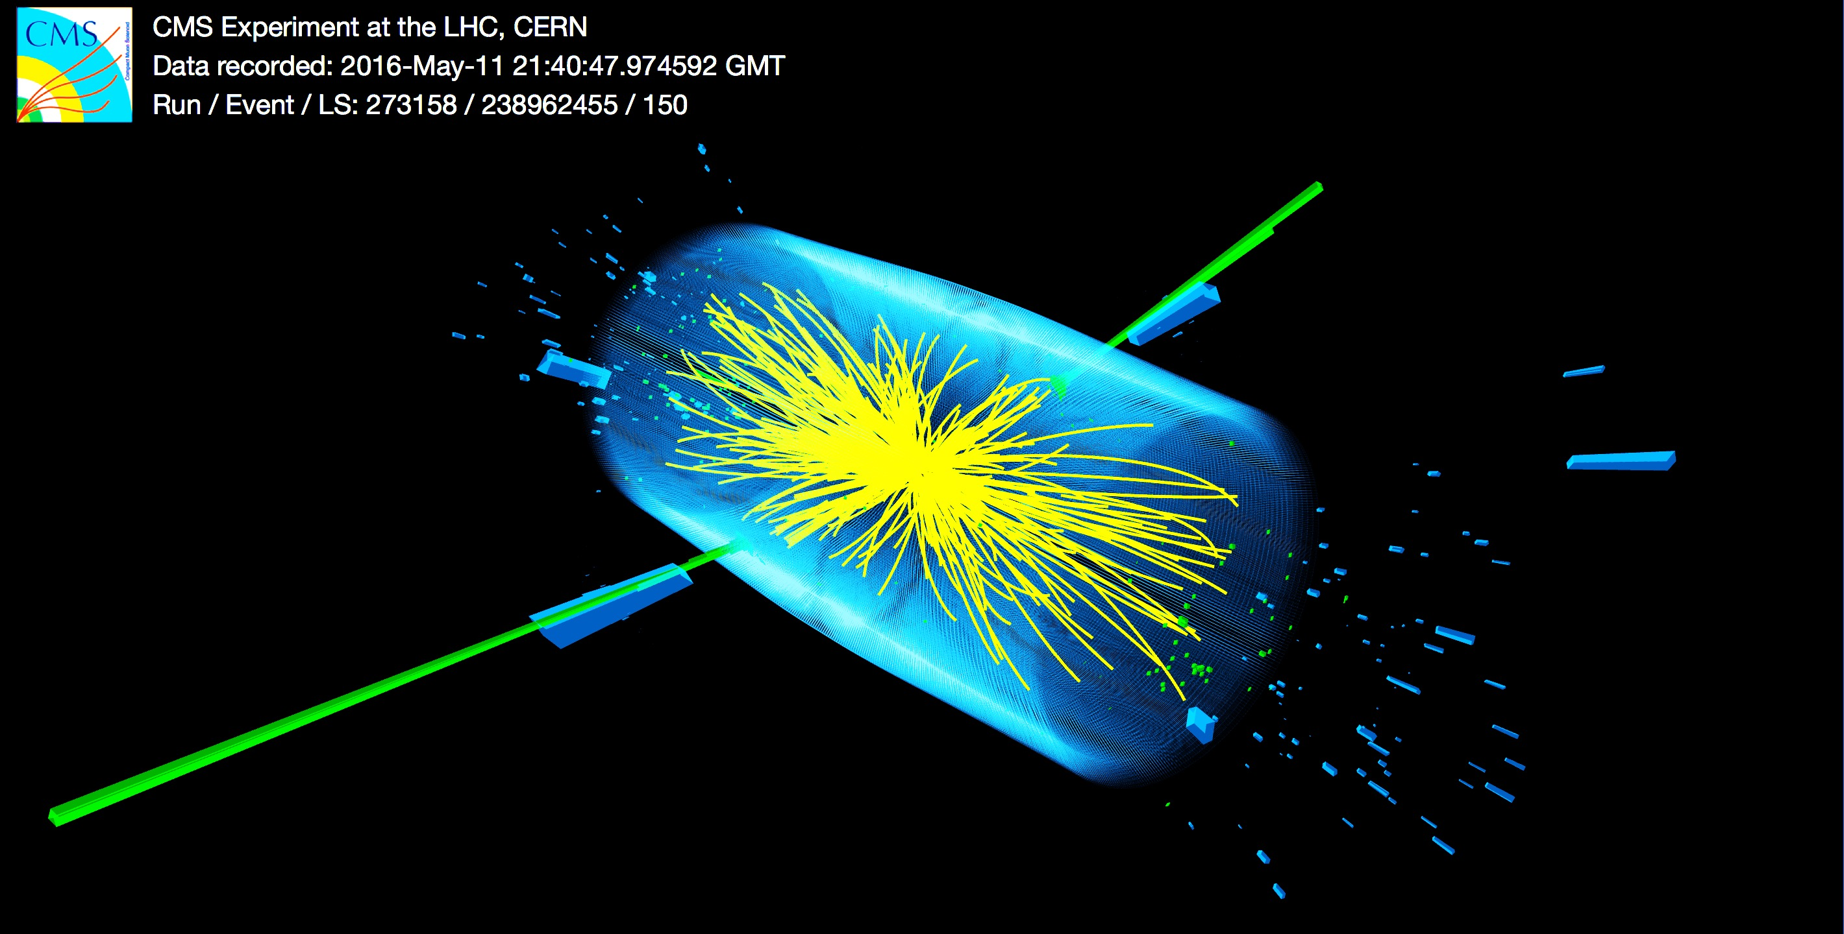
Highest mass dijet event measured by CMS in 2016 (√s = 13 TeV): m_{jj} = 7.7 TeV

Slide 53
Z and W production at 13 TeV
Expect increase of cross section by factors of 1.7 and 1.6, respectively
Inclusive cross sections shown, also fiducial cross sections measured
Comparison of measured cross-sections with NNLO QCD & NLO EW Drell-Yan predictions (FEWZ 3.1): good agreement found within uncertainties
Also: LHCb σ_{Z} (2.0 < η < 4.5) in agreement with SM

Slide 54
Searches in leptonic final states
Canonical searches for new physics in high-mass Drell-Yan production (Z’, W’)
Measured mass spectra are compared with SM prediction
No anomaly found. SSM Z’ / W’ benchmark limits set at 4.0 / 4.7 TeV (2.9 / 3.3 TeV at 8 TeV)
ATLAS-CONF-2016-045, CMS-PAS-EXO-16-031
< 2% resolution
~15% resolution
ATLAS & CMS also looked into high-mass eµ (LFV) production. Main background here: top-antitop.

Slide 55
Display of rare colossal e⁺e– candidate event with 2.9 TeV invariant mass
Each electron candidate has 1.3 TeV E_{T}
Back-to-back in φ
Highest-mass Run-1 events: 1.8 TeV (ee), 1.9 TeV (µµ)

Slide 56
Diboson production — example: σ_{WW, no Higgs} (13 TeV) ~ 120 pb
Highly important sector of LHC physics, intimately related to electroweak symmetry breaking
ATLAS & CMS performed detailed inclusive, fiducial and differential cross-section analyses at 8 TeV. First 13 TeV results for all modes available.
Example: pp → WZ → 𝓁𝜈 𝓁𝓁
Theoretical predictions at NNLO accuracy needed to describe the data !
(+ NNLL soft gluon resummation in WW case because of jet veto)

Slide 57
Searches for diboson resonances (hh, Vh, VV)
High-p_{T} of bosons boosts hadronic decay products into merged jets
Hadronic decay modes use jet substructure analysis to reconstruct bosons. Important strong interaction backgrounds
Some excess of events around 2 TeV (globally 2.5σ for ATLAS) seen at 8 TeV in VV in fully hadronic channel, not seen in the other decay channels (eg, l𝜈qq)
ATLAS-CONF-2016-05, fully hadronic5
CMS-PAS-B2G-16-020, semileptonic

Slide 58
Summary of cross-section measurements by ATLAS
Data agree with the expected rise of the cross section at 13 TeV
Agreement with expected factor 3.3

Slide 59
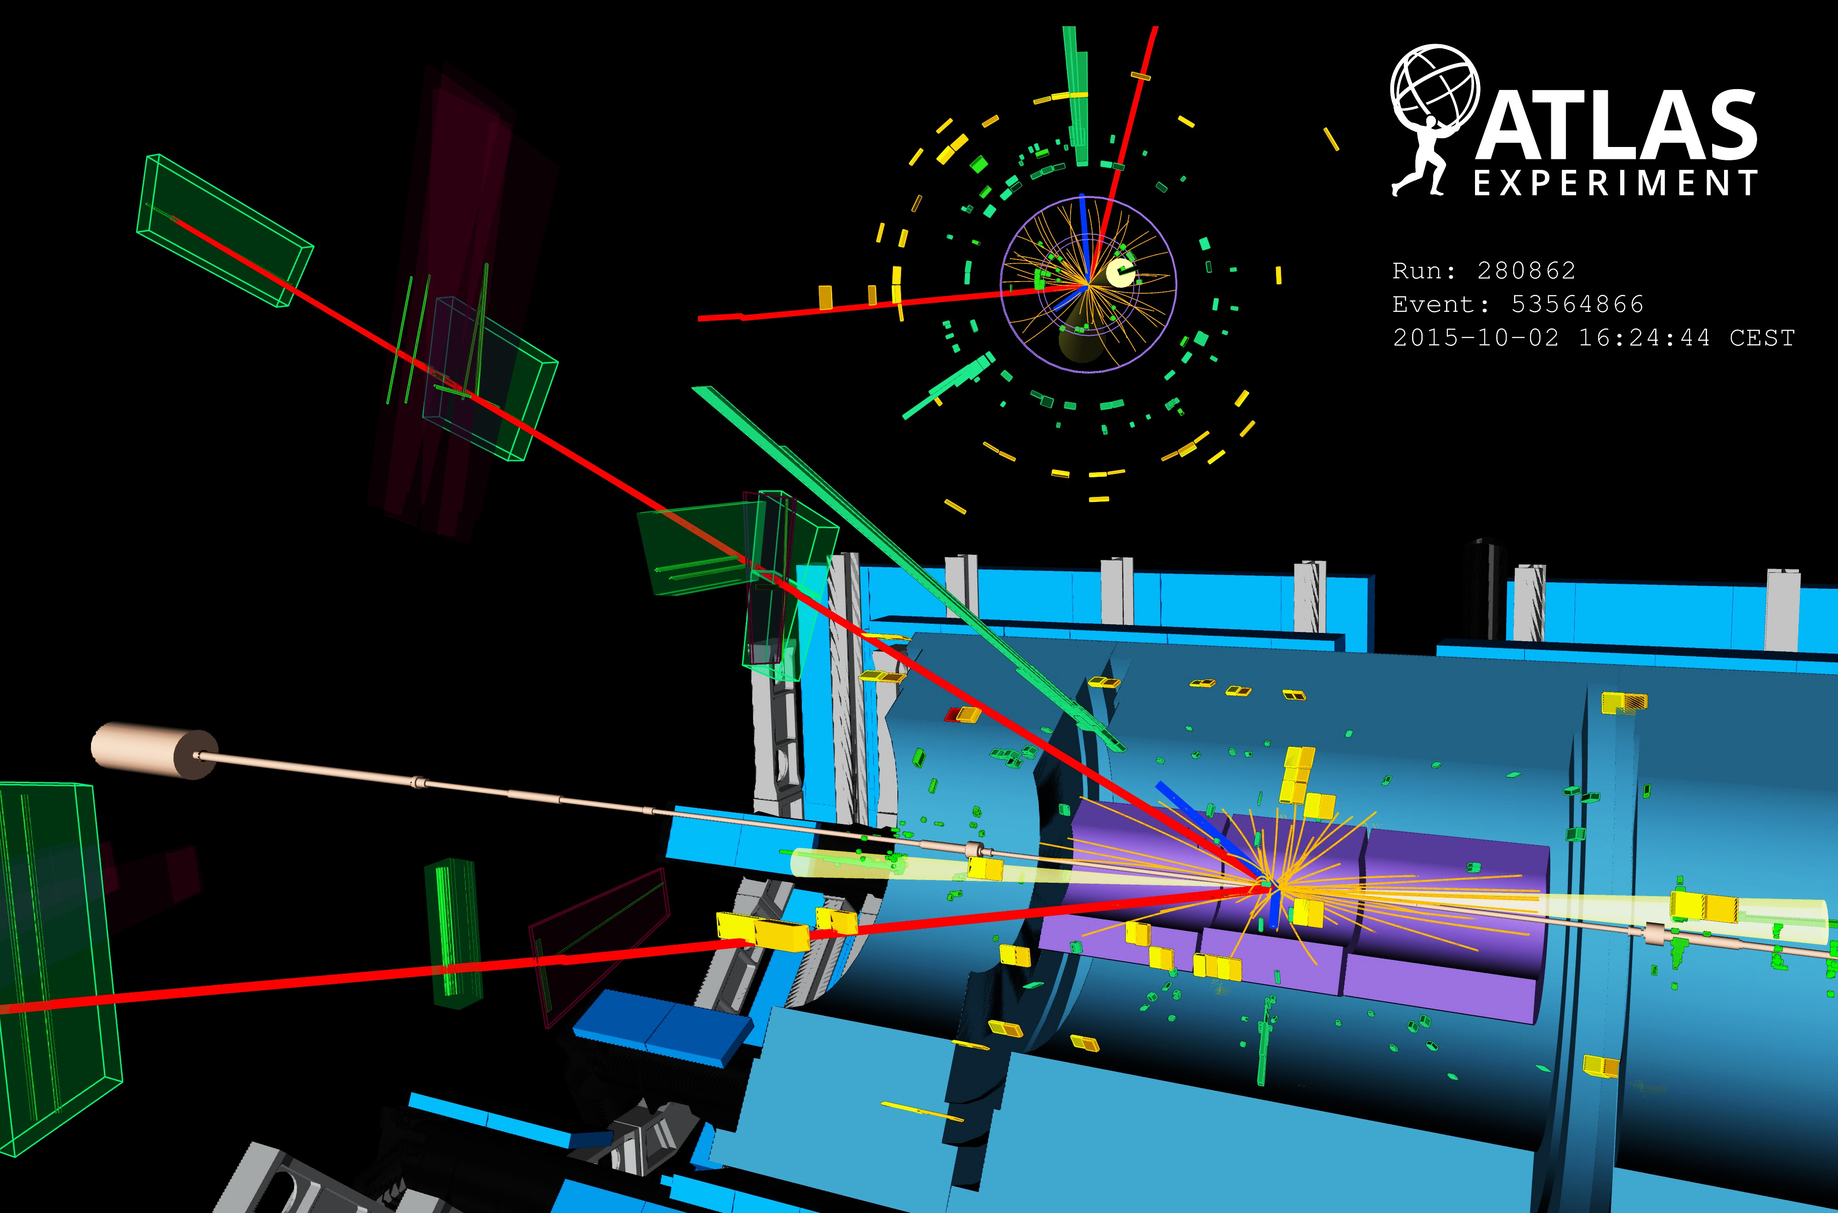
Higgs reobservation at 13 TeV
13/8 TeV cross section ratios of 2~2.4 for VH, ggH, VBF, and 3.9 for ttH
2015 & 2016 statistics combined achieves better significance and precision than in Run-1
Display of VBF H → eeµµ + 2jets candidate from 13 TeV pp collisions. The electrons have a transverse momentum of 111 and 16 GeV, the muons 18 and 17 GeV, and the jets 118 and 54 GeV. The invariant mass of the four lepton system is 129 GeV, the dielectron (dimuon) invariant mass is 91 (29) GeV, the pseudorapidity difference between the two jets is 6.4 and the dijet invariant mass is 2 TeV.

Slide 60
ATLAS and CMS studied H₁₂₅ in bosonic channels
Preliminary fiducial and total cross-section and coupling measurements (ggF and VBF significant)
H → ZZ* → 4𝓁
ATLAS-CONF-2016-079
CMS-PAS-HIG-16-033
+18
– 16
µ = σ_{data} / σ_{SM} = 0.99
+0.33
– 0.26
σ_{tot,data} = 81 pb
σ_{tot,SM} = 55 ± 4 pb
Expected significance (SM): 6.5σ
+0.48
– 0.44
CMS also measured: m_{H} = 124.50 GeV
(dominated by statistical uncertainty, compare to 125.09 ± 0.24 GeV from ATLAS & CMS Run-1 combination)

Slide 61
ATLAS and CMS studied H₁₂₅ in bosonic channels
Preliminary fiducial and total cross-section and coupling measurements (ggF and VBF significant)
H → γγ
ATLAS-CONF-2016-067
CMS-PAS-HIG-16-020
µ = 0.85
+0.22
– 0.20
µ = 0.91 ± 0.20
Expected significance (SM): 5.4σ
Expected significance (SM): 6.2σ

Slide 62
ATLAS and CMS studied H₁₂₅ in bosonic channels
Cross section versus centre-of-mass energy
H → γγ and H → ZZ* → 4𝓁 combined (left)
Combined H → 4𝓁, γγ
H → 4𝓁, fiducial cross section
ATLAS-CONF-2016-081
CMS-PAS-HIG-16-033
Expected rise of cross-section observed in data

Slide 63
ATLAS studied H₁₂₅ in bb decay channel
Associated production, challenging final states
H → W / Z + H → 𝓁𝜈 / 𝓁⁺𝓁–, 𝜈𝜈 + bb
ATLAS-CONF-2016-091
Slightly lower yield than SM, similar for Run-1
(µ = 0.7 ± 0.3 for ATLAS & CMS, µ = 0.5 ± 0.4 for ATLAS)

Slide 64
Searches for rare Higgs decays
Beyond SM reach at present, but could have new physics contributions ?
Strongly resolution dependent, improve sensitivity by categorising events (low/high p_{T}, central/forward, VBF)
H → µµ [expected branching fraction: 0.02%]
ATLAS-CONF-2016-041
Observed limit 4.4 times SM (3.5 combined with Run-1). Need about 300 fb^{–1} of data to reach SM
Can already exclude universal Higgs coupling to fermions !
(Would have observed H → µµ, if same BR as H → ττ)
64

Slide 65
First search for ttH production at 13 TeV by ATLAS
Direct measurement of Higgs–top coupling
ATLAS & CMS showed preliminary results for ttH in all major channels at ICHEP 2016
Individual channels and combination
ATLAS-CONF-2016-068
CMS finds:
H → γγ,
tt → 0 & 1 leptons
CMS-PAS HIG-15-005
µ = 3.8
+4.5
– 3.6
ttH → multi-leptons,
2 same charge (+ 𝜏) / 3 leptons
CMS-PAS-HIG-16-022
µ = 2.0
+0.8
– 0.7
H → bb,
tt → 1 & 2 leptons
CMS-PAS HIG-16-004
µ = –2.0 ±1.8 < 2.6 (95% CL)
Improved sensitivity over Run-1

Slide 66
Beyond the Standard Model Higgs physics
Higgs sector may be non-minimal and/or Higgs boson may couple to new physics
Diverse search programme:
Light or heavy neutral Higgs bosons
Charged Higgs boson
Lepton flavour violating Higgs decays
BSM
Higgs
searches
Di-Higgs production (resonant or not)
Exotic Higgs decays
No sensitivity yet for SM di-Higgs production
Higgs as portal to hidden sector
Higgs in BSM decay chains
BSM constraint from coupling measurements
No deviation from SM found in any of these searches
Taken from: Thibault Guillemin @ SEARCH 2016

Slide 67
Supersymmetry
Offers elegant solution to: naturalness problem, unification, dark matter
Very diverse signatures. Highest cross-section events produce gluino / squark pairs with decays to jets and missing transverse momentum

Slide 68
Naturalness driven SUSY searches
Searches for direct production of stop/sbottom & charginos/neutralinos
SUSY stop and sbottom, or “Electroweak-inos” may be the lightest SUSY particles. Low-cross section searches requiring dedicated optimisation. Long-term search effort
“Compressed” regions

Slide 69
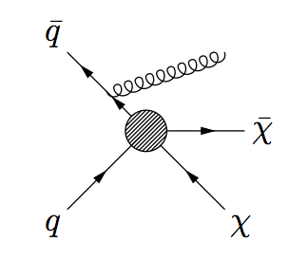
May not be able to prove at LHC that a signal is dark matter
Searches for dark matter production at the LHC
Canonical signature is ‘X+MET’ with large variety of ‘X’
Direct dark matter production at the LHC requires boost for triggering. Depending on coupling it can be made by different objects.
Experimentally challenging to control Z/W+jets background. Theory input needed.
ATLAS 1604.07773
Energetic gluon/photon radiation in the initial sate
Many other 13 TeV results available:
jets + MET
γ + MET
V + MET
H + MET
tt + MET
Can also directly search for mediator in, eg, dijet events
No anomaly seen so far

Slide 70
The next steps

Slide 71
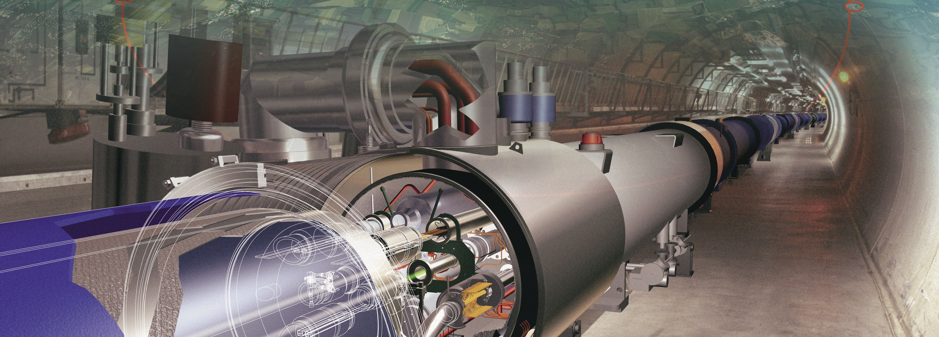
The road to the future
The LHC Run-2 and beyond
We are here

Slide 72
Expected integrated luminosity of LHC & HL-LHC
3000
2500
We will be going here
2000
LHC physics will hardly look the same again…
Run-5
1500
HL-LHC
1000
Run-4
500
We are here
Run-2
Run-3
0
2015
2019
2023
2027
2031
2035
© P. Ferreira da Silva at Moriond EW, 2016

Slide 73
Challenges and opportunities
Particle physics has entered an era of uncertainty: we have a beautiful theory, and many indications that it is incomplete, possibly the SM is only the tip of the iceberg.
Contrary to Fermi, who knew the TeV scale, we do not know the next new physics scale. Naturalness suggests it should be O(TeV), but we do not know how much Nature cares about naturalness.

Slide 74
Challenges and opportunities
Particle physics has entered an era of uncertainty: we have a beautiful theory, and many indications that it is incomplete, possibly the SM is only the tip of the iceberg.
Contrary to Fermi, who knew the TeV scale, we do not know the next new physics scale. Naturalness suggests it should be O(TeV), but we do not know how much Nature cares about naturalness.
We live in data-driven times, experiment must guide us to the next stage. That means we need a very broad and diverse research programme (“no stone unturned”).
We need a flagship collider programme at the energy frontier (LHC, HL-LHC, HE-LHC, FCC, …)
We need a lepton collider for precision Higgs, electroweak and top physics
We need to develop high-field magnets and compact high-gradient accelerators for the long-term future
We need to continue and further extend the intensity and precision programme: rare B & kaon physics, g–2, lepton flavour violation, n/p/e/µEDM, neutrino physics with all that belongs to it, proton decay
We need to search for dark matter particles/WIMPs, we need direct DM experiments, indirect searches in space, fixed target searches, axion searches

Slide 75
Extra slides

Slide 76
Prospects for the LHC Run-2/3 and beyond (HL-LHC)
Three examples only !
Of course: any detection of new physics till then would likely be a game changer !

Slide 77
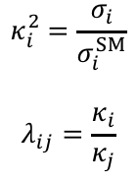
Higgs boson physics
(Conservative) extrapolation of Higgs coupling measurements
Higgs signal strengths (left) and ratios of coupling modifiers (right), compared to current precision (orange)
Run-1
(ATLAS & CMS,
expected uncertainties)
$$κ_{i}^{2}=\frac{σ_{i}}{σ_{i}^{SM}}$$
$$λ_{ij}=\frac{κ_{i}}{κ_{j}}$$
~0.33
Hatched areas indicate impact of theoretical uncertainties on expected cross-sections
Theory uncertainty limiting in several cases
Some uncertainties cancel in ratios
2.4

Slide 78
Higgs boson physics
Constraining the Higgs off-shell coupling
Both CMS and ATLAS have measured the Higgs off-shell coupling and through this constrained Γ_{H}
Method uses the independence of off-shell cross section on Γ_{H} and relies on identical on-shell and off-shell Higgs couplings. One can then determine Γ_{H} (=4.1 MeV in SM) from the measurements of µ_{off-shell} and µ_{on-shell}
on-shell
off-shell
CMS: 1405.3455
With Run-1, limits of the order of 5 × Γ_{H}SM obtained
With L₂ = 3000 fb^{–1} expect:
ATLAS: ATL-PHYS-PUB-2015-024

Slide 79
Great potential for rare SM and flavour physics processes
Example: B_{(s)} → µµ
Remember: Run-1 observation of B_{(s)} → µµ
by CMS and LHCb (ATLAS finds lower value)
Prospective study by CMS for LHC Phase 1 & Phase 2
300 fb^{–1}
3000 fb^{–1}
Complementary to SuperKEKB/Belle-II physics programme !
CMS-PAS-FTR-13-022

Slide 80
Beyond the HL-LHC
Only a very brief enumeration of projects

Slide 81
Future hadron collider projects in a nutshell
The next discovery machine
HL-LHC: E_{CM} = 14 TeV, 3 ab^{–1}, 2026~2035… (formally approved as project by CERN council last week)
Future Circular Collider FCC-hh (CERN):
E_{CM} ~ 100 TeV in 100 km ring, L ~ 2 × 10³⁵ s^{–1}cm^{–2}
~16 T magnets, possibly HE-LHC (E_{CM} ~ 28 TeV) as intermediate stage
Huge detectors needed for muon p_{T} measurement
Possible start of physics ~ 2035
SppC (China):
E_{CM} ~ 71 TeV in 55 km ring, L ~ 1 × 10³⁵ s^{–1}cm^{–2}
Requires very high gradient dipole magnets ~ 20 T
Possible start of physics ~ 2042

Slide 82
Future e–e⁺ collider projects in a nutshell
Measure EW & EWSB sector to highest precision
International Linear Collider ILC (host candidate: Japan)
20 years of R&D, mature technology, ~32 MV/m accelerating gradient ~ xFEL at DESY (45 MV/m for 1 TeV)
E_{CM} ~ 500–1000 GeV in 31–45 km total length, L ~ 1.8 × 10³⁴ s^{–1}cm^{–2}, only one interaction region
nm beam size, possible start of physics ~ 2030
*A low energy, high current, “drive” beam is decelerated in power extraction structures and the RF power is transferred to the cavities that accelerate the main beam
Compact Linear Collider CLIC (CERN)
High-gradient 2-beam scheme*: 100 MV/m gradient
E_{CM} ~ 380–3000 GeV, 11–50 km total length, L ~ a few × 10³⁴ s^{–1}cm^{–2}, only one interaction region
0.5 ns bunch distance, nm beam size, large beamstrahlung, physics ~ 2035
Future Circular Collider FCC-ee (CERN):
E_{CM} ~ 90–350 GeV in 2 rings (90k bunches), L ~ 70–1.3 × 10³⁴ s^{–1}cm^{–2}
Synchrotron power (E ⁴/R up to 7.5 GeV/turn): 100 MW (LEP-2: 22 MW)
Circular EP collider CEPC (China):
E_{CM} ~ 240 GeV, L ~ 2 × 10³⁴ s^{–1}cm^{–2}
Single ring, 50 bunches
Possible start of physics ~ 2028

Slide 83
More Standard Model and Flavour physics
Complementary to SuperKEKB / Belle II programme !
Expect ~40 times luminosity of 1st generation asymmetric B-factories: up to 50 ab^{–1}
Among the physics highlights:
Rare decays: B → τν (< 5%), R_{D*}, detailed b → s studies (incl. B → K⁽*⁾νν penguin+box to ~20%)
Lepton flavour violation, universality tests
CP violation in bottom and charm systems

Slide 84
How can these LHC luminosity improvements be achieved ?
We are here

Slide 85
Scales in particle physics
Year when energy reached in labs
L_{gravitation} ~ 10⁻³⁵ m
10¹⁹ GeV
The scales of particle physics …
Planck scale (M_{Pl})
10¹⁶ GeV
GUT ?
10¹⁴ GeV
ν_{R} ?
~ 2010
L_{weak} ~ 10⁻¹⁸ m
100 GeV
t, Z, W, H, EWSB
10 GeV
ψ, b, Υ, B
1 GeV
τ, c, n, p, ρ, φ
~ 1970
L_{strong} ~ 10⁻¹⁵ m
100 MeV
μ, s, π, QCD
10 MeV
u, d, nuclear binding E
1 MeV
e
100 keV
10 keV
1 keV
core of Sun
100 eV
10 eV
atomic binding E
~ 1900
L_{atomic} ~ 10⁻¹⁰ m
1 eV
ν’s
100 meV
?
10 meV
0
γ, g

Slide 86
Scales in particle physics
Year when energy reached in labs
L_{gravitation} ~ 10⁻³⁵ m
10¹⁹ GeV
The scales of particle physics …
Planck scale (M_{Pl})
10¹⁶ GeV
GUT ?
10¹⁴ GeV
ν_{R} ?
LHC reach
10 TeV
New Physics ?
~ 2010
1 TeV
…probing attometre scales
L_{weak} ~ 10⁻¹⁸ m
100 GeV
t, Z, W, H, EWSB
10 GeV
ψ, b, Υ, B
1 GeV
τ, c, n, p, ρ, φ
~ 1970
L_{strong} ~ 10⁻¹⁵ m
100 MeV
μ, s, π, QCD
10 MeV
u, d, nuclear binding E
1 MeV
e
100 keV
10 keV
1 keV
core of Sun
100 eV
10 eV
atomic binding E
~ 1900
L_{atomic} ~ 10⁻¹⁰ m
1 eV
ν’s
100 meV
?
10 meV
0
γ, g

Slide 87
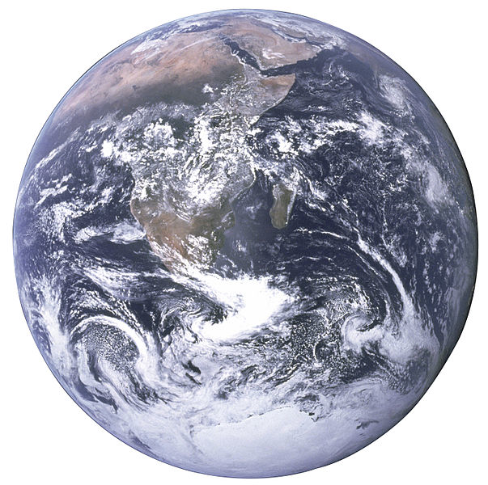

Scales in particle physics
A 1 TeV-frequency microscope looks at really, really tiny objects…
Nanoscience
Particle physics today
(TeV scale)
Siphonaptera (flea)
Earth

Slide 88
The LHC at CERN probes nature at the smallest distances ever explored on Earth to study and improve our current knowledge of space and time, matter and force as it is encoded in the SM of particle physics.
HERA data from electron–quark scattering into e+q (NC = γ,Z) or 𝜈+q (CC = W ±)
The SM is the legacy of 20th century particle physics
It unifies quantum mechanics, special relativity and field theory
It unifies electromagnetic and weak interactions
It describes ~ all laboratory data
Neutral current
Charged current
EW unification reduces 20 SM parameters to 19 (if 𝜈 = 0)

Slide 89
Inclusive and differential jet cross section vs. jet p_{T} and rapidity
Agreement with theory over many orders of magnitude
[ 1609.05331 ]
Precision measurements & theory developments (includes non-perturbative and electroweak corrections)
→ new quality of QCD tests at hadron colliders

Slide 90
Measurement of the W mass at the LHC (using low-pileup 7 TeV dataset)
Summary of systematic uncertainties:
ATLAS-CONF-2016-113

Slide 91
Particle physics at the dawn of the LHC Run-2
No new physics in direct searches
or study of quantum fluctuations
QED tested to parts per million accuracy (slight anomaly in muon g–2)
Asymptotic freedom in strong interactions verified at % level
Electroweak unification tested to high precision
Quark sector: CKM picture for quark mixing & CP violation confirmed
Lepton sector: massive neutrinos, unknown nature, masses, CP violation, sterile 𝜈’s ? No flavour violation in charged lepton sector. Lepton universality tested to per-mil level
No compelling sign of new physics found at high mass scales, or anywhere else, eg: no electric dipole moments (EDM), no dark matter particles (gravitational hints only), no axions, no proton decay
?

Slide 92
The LHC Run-2: 13 TeV / 8 TeV inclusive pp cross-section ratio

Slide 93
Searches in high-p_{T} multijet final states at 13 TeV
Processes with large cross-sections, sensitivity to highest new physics scales
ATLAS-CONF-2016-069
Among the high priority early 13 TeV searches
Dijet resonance and angular distribution (incl. lower mass via ISR)
High-p_{T} multijets produced, eg, by strong gravity
Fit of empirical function to data
ATLAS-CONF-2016-070
No anomaly seen in these or similar searches
Limits on excited quarks (for example) at 5.6 TeV

Slide 94
Searches in high-p_{T} multijet final states at 13 TeV
Processes with large cross-sections, sensitivity to highest new physics scales
ATLAS bounds in the coupling-vs-mass plane for leptophobic Z’ model from dijet searches

Slide 95
Top-antitop production at 13 TeV
Extraction of top-pair cross section (expect: 13 TeV / 8 TeV ~ 3.3)
ATLAS & CMS studied top production in many ways at 13 TeV → very prompt analyses turn around
Agreement with expected factor of 3.3
Differential cross-section measurements at 13 TeV show reasonable modelling, though some deviations at large jet multiplicity. Known modelling problems from Run-1 not all solved!
Also first results on t-channel single top production — found in agreement with SM

Slide 96
Top-antitop production and a vector boson at 13 TeV
First results on important ttV process, in it’s own right, and as background to ttH and searches
ATLAS & CMS have preliminary 13 TeV results
Analyses combine several multilepton final states, difficult mis-ID background
At 8 TeV, both processes observed, and found to agree with SM prediction (ttW ~1σ up in both ATLAS & CMS)
Different production processes and thus 13/8 TeV cross-section ratios for ttZ & ttW: 3.6 & 2.4
13 TeV tt+W/Z results from ATLAS and CMS in agreement with SM:
ATLAS: 1609.01599, CMS-PAS-TOP-16-017
ATLAS (3.2 fb^{–1}, 2015):
ttW: 1.5 ± 0.8 pb
ttZ: 0.9 ± 0.3 pb
CMS (12.9 fb^{–1}, 2016):
ttW: 0.98 pb
ttZ: 0.70 pb
SM (NLO):
ttW: 0.60 ± 0.08 pb
ttZ: 0.84 ± 0.09 pb
+0.23
– 0.22
+0.22
– 0.18
+0.16
– 0.15
+0.14
– 0.12

Slide 97
First search for ttH production at 13 TeV by CMS
Direct measurement of Higgs–top coupling
CMS showed preliminary results for ttH in all major Higgs decay channels: H → γγ, multi-leptons, bb
Highly complex analyses, huge effort to get these done so quickly after data taking (already by Moriond 2016)
H → γγ,
tt → 0 & 1 leptons
ttH → multi-leptons
2 same charge (+ 𝜏) / 3 leptons
H → bb
tt → 1 & 2 leptons
µ = 3.8
+4.5
– 3.6
µ = 2.0
+0.8
– 0.7
µ = –2.0 ±1.8 < 2.6 (95% CL)
CMS-PAS HIG-15-005
CMS-PAS-HIG-16-022
CMS-PAS HIG-16-004

Slide 98
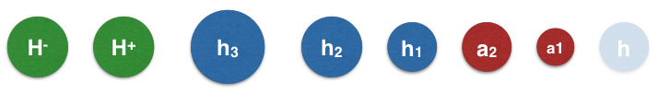
BSM Higgs boson searches
Single BEH doublet and form of potential simple but Nature may be more complex (eg, SUSY)
Beyond the SM “Higgs zoo”
[ Will Davey, LHCP 2014 ]
Higgs coupling to mass, look for decays to tau leptons or weak bosons, for example:
ATLAS-CONF-2016-088
H⁺ → τ𝜈
ATLAS-CONF-2016-085
H / A → ττ

Slide 99
One word on lepton flavour violation in Higgs decays
Both experiments have finalised their Run-1 LFV analyses
While H → µe is severely constrained from flavour physics, H → τµ, τe are not (~10% limits)
CMS released early 2015 a H → τµ search finding a slight (2.4σ) excess
Not confirmed by ATLAS in the full Run-1 analysis
H → τµ:
ATLAS:
BR = 0.53 ± 0.51% < 1.43% (95% CL)
CMS:
BR = 0.84 % < 1.51% (95% CL)
H → τe:
ATLAS:
BR = –0.3 ± 0.6% < 1.04% (95% CL)
+0.39
– 0.37

Slide 100
One word on lepton flavour violation in Higgs decays
Both experiments have finalised their Run-1 LFV analyses
New preliminary result with 13 TeV from CMS [ CMS-PAS-HIG-16-005 ]
Six categories considered: (µτ_{h}, µτ_{e}) × (0,1,2 jets)
No significant excess, combined limit: BR = –0.8 ± 0.8 % (<1.2% at 95%CL)
Limit on non-diagonal Yukawa couplings:

Slide 101
Naturalness driven searches
Searches for direct production of stop/sbottom and charginos/neutralinos
SUSY stop and sbottom may be the lightest sfermions. They have low cross-sections, so Run-2 luminosity just enough to increase sensitivity
Vector-like quarks* (VLQ) singly or pair produced decay to bW, tZ or tH. Also exotic X_{5/3} → tW possible
Signatures are b-jets, jets, possibly leptons and MET
No anomaly seen
Sensitivity improved over Run-1
Similar for VLQ searches
*Hypothetical fermions that transform as triplets under colour and who have left- and right-handed components with same colour and EW quantum numbers

Slide 102
Electroweak supersymmetry production
Searches for direct production
“Electroweak-inos” may be the lightest fermions. They also have low cross-sections, so Run-2 luminosity just enough to increase sensitivity
Signatures are leptons, few or no jets, MET
Example diagrams
Compressed region (“higgsino” case)

Slide 103
Exclusion regions for simplified models with heavy particle mediating interaction between initial state quarks and final state WIMPs
Since the mediator is produced via quark annihilation (g_{q}), it can also decay to quarks
For full explanation, see: https://atlas.web.cern.ch/Atlas/GROUPS/PHYSICS/CombinedSummaryPlots/EXOTICS/index.html#ATLAS_DarkMatter_Summary

Slide 104
Digression: machine learning in high-energy physics
Rare background-heavy channels like ttH need MVA support. But ML offers much more.
Huge experience with MVA in HEP since the 90’s. Likelihood methods and fits still in heavy use. Classification and, more recently, regression methods used everywhere at the LHC and in HEP.
Most common methods: Boosted Decision Trees (very robust) and Neural Networks
ATLAS-CONF-2016-058
CMS: 1506.01010
Build multidimensional (“multiclass”) MVA to simultaneously discriminate against all backgrounds
Multivariate (BDT) regression to improve m(bb) resolution in H → bb: better calibration and 18% improved resolution

Slide 105


Flavour anomalies ?
B-factories and LHCb measure ratios of semileptonic B decays. Robust SM predictions
$$R_{D^{(∗)}}=\frac{BR(B^{0}→D^{\left(∗\right)}τν)}{BR(B^{0}→D^{\left(∗\right)}ℓν)}$$
$$R_{K}=\frac{BR(B^{+}→K^{+}μμ)}{BR(B^{+}→K^{+}ee)}$$
World average HFAG: R_{D*} = 0.316 ± 0.016 ± 0.010 (3.3σ from SM 0.252 ± 0.003, combined R_{D*} & R_{D} is 4.0σ)
http://www.slac.stanford.edu/xorg/hfag/semi/winter16/winter16_dtaunu.html
New Belle measurement using hadronic t decays gives: R_{D*} = 0.276 ± 0.034_{stat} ± 0.028_{syst} [1608.06391]

Slide 106
ATLAS and CMS studied H₁₂₅ in bosonic channels
Preliminary fiducial and total cross-section and coupling measurements (ggF and VBF significant)
H → γγ and H → ZZ* → 4𝓁 (right combined)
ATLAS-CONF-2016-067
Combination of
H → γγ and H → 4𝓁
ATLAS-CONF-2016-081
Differential fiducial cross-section measurement in H → 4𝓁 compared to NNLO+PS theoretical prediction

Slide 107
The LHC is also a high-precision machine
Electroweak sector requires precise measurements of m_{top}, M_{W}, sin²θ_{w}
Newest top mass combination from CMS features total uncertainty of 480 MeV
Best top mass from LHC:
172.44 ± 0.13 ± 0.47 GeV (CMS)
172.84 ± 0.34 ± 0.61 GeV (ATLAS, not yet all 8 TeV results available)
640 MeV for Tevatron combination
Reaching systematic limit from b-quark fragmentation
Alternative m_{top} determinations

Slide 108
The LHC Run-2: 13 TeV / 8 TeV inclusive “parton luminosity” ratio
PDFs
Strong interaction dominated processes
Electroweak processes
4 TeV
Larger cross section increase for gluon induced than for quark induced processes
Early Run-2 puts emphasis on searches

Slide 109
Inclusive inelastic cross-section measurement at 13 TeV
Fundamental initial measurement, based on forward scintillators
Measurement in fiducial region ξ = M_{X}² / s > 10^{–6} (M_{X} largest mass of two proton-dissociation systems)
Use Minimum Bias Trigger Scintillators (MBTS) with acceptance 2.07 < |η | < 3.86, 4.2M selected events
Systematic uncertainty fully dominated by luminosity
ATLAS: 1606.02625
Measured inclusive inelastic cross section:
σ_{13 TeV} = 79.3 ± 0.8 ± 1.3 (lumi) ± 2.5 (extr) mb
Best measurement of total cross section via elastic scattering and optical theorem:
σ_{tot} ∝Im f_{elastic}(t → 0)
using dedicated forward devices (up to 1.4% precision in Run-1, dominated by luminosity error)

Slide 110
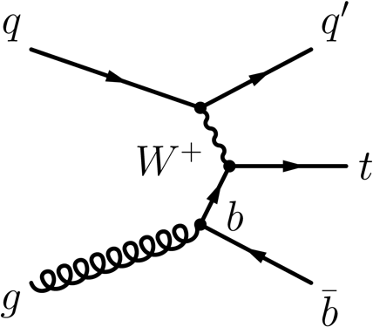
Single top quark production
Increase of cross section by factor of 2.5 (t-channel) over 8 TeV, roughly 1/3rd of tt cross section
ATLAS & CMS have so far released preliminary t-channel measurements at 13 TeV
“t-channel”
(“4 flavour scheme”)
13 TeV: ATLAS-CONF-2015-079, CMS-PAS-TOP-16-003
“Wt-channel”
“s-channel”
(not easier at 13 TeV)
Tevatron: 6.3σ, ATLAS Run-1: 3.2σ

Slide 111
Diphoton resonance searches, the 2015 data
Dedicated searches for a spin-0 and a spin-2 diphoton resonance
Photons are tightly identified and isolated. Typical purity ~94%, background modelling empirical in spin-0 (theoretical in spin-2 case for ATLAS)
ATLAS 1606.03833
CMS 1606.04093
Also: EBEE and B-field off categories
Lowest p-value at ~750 GeV, Γ ~ 45 GeV (6%)
Local / global Z = 3.9 / 2.1σ
Lowest p-value at ~750 GeV, narrow width
Local / global Z = 3.4σ / 1.6σ (Run-1+2 combination)

Slide 112
Diphoton resonance searches, the 2016 results
Repeated ~unchanged analyses with 2016 data
Photons are tightly identified and isolated. Typical purity ~94%, background modelling empirical in spin-0 (theoretical in spin-2 case for ATLAS)
ATLAS-CONF-2016-059
CMS 1609.02507
Also: EBEE categories
Also: significance of 2015 result reduced after re-calibration
No noticeable excess in 2016 data

Slide 113
Diphoton resonance searches, the 2016 results
Comparison of 2015 and 2016 p-values
Resulting background-only p-values
ATLAS-CONF-2016-059
CMS 1609.02507
Lesson? Statistical fluctuation. Can happen, nothing wrong.
Actual trials factor larger than global factor quoted, as very many signatures probed by experiments (hard to estimate, but keep in mind!). Having a second experiment with a similar non-significant excess does not remove trials factor if you keep both. Removing 2015 data, and looking at 750 GeV in 2016 does remove trials factor.

Slide 114
Nathanial Craig @ SEARCH 2016: PICK TWO
Good idea ?

Slide 115
Long-lived particles predicted in many new physics models
Reason: large virtuality in decay, low coupling, or mass degeneracy
Multitude of signatures depending on lifetime, charge, decay: highly ionising, slow, out-of-time decay, displaced vertex, kinked or disappearing track, lepton-jets, …
Some signatures require dedicated triggers, most requiring dedicated analysis strategies.
Standard searches sometimes sensitive to signatures with long-lived particles as well

Slide 116
Exclusion regions for simplified models with heavy particle mediating interaction between initial state quarks and final state WIMPs
Since the mediator is produced via quark annihilation (g_{q}), it can also decay to quarks
For full explanation, see: https://atlas.web.cern.ch/Atlas/GROUPS/PHYSICS/CombinedSummaryPlots/EXOTICS/index.html#ATLAS_DarkMatter_Summary

Slide 117
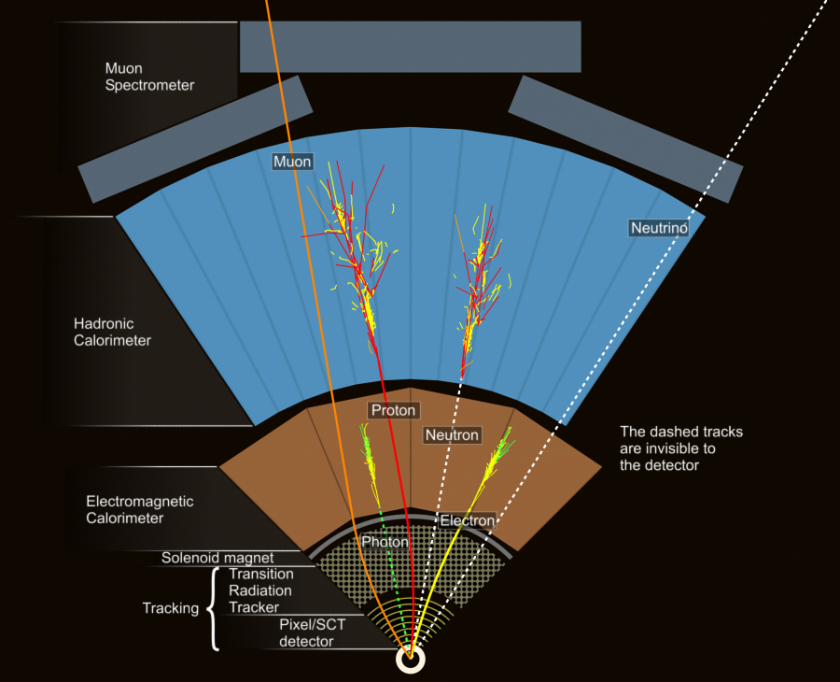
The detectors measure interaction of particles with active material
Ensemble of measured interactions in a given proton–proton bunch crossing makes up an “event”

