Slide 1
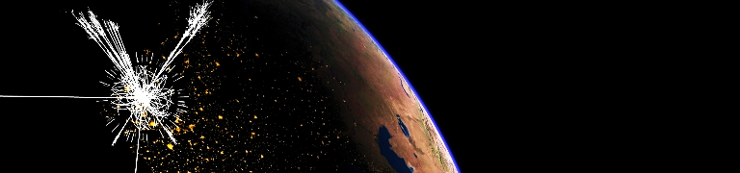

The H(125) boson at the LHC
Andreas Hoecker (CERN)
Pierre Fayet Fest, December 8–9, 2016, ENS, Paris

Slide 2
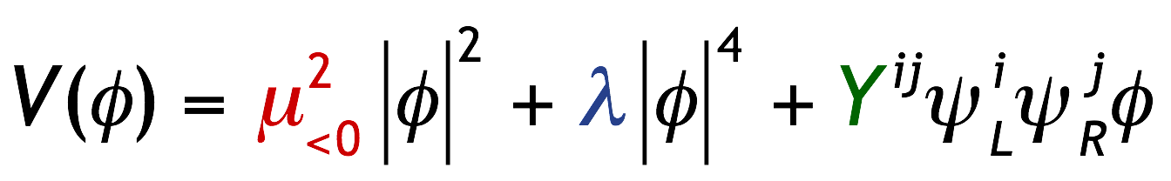
The Standard Model
Quite special — only known elementary scalar particle. Product of BEH mechanism required by gauge symmetry and massive bosons and fermions
Matter particles (S=1/2)
Force quanta (S=1)
Tree-level BEH potential at zero temperature:
( µ, λ determined once Higgs mass known )

Slide 3
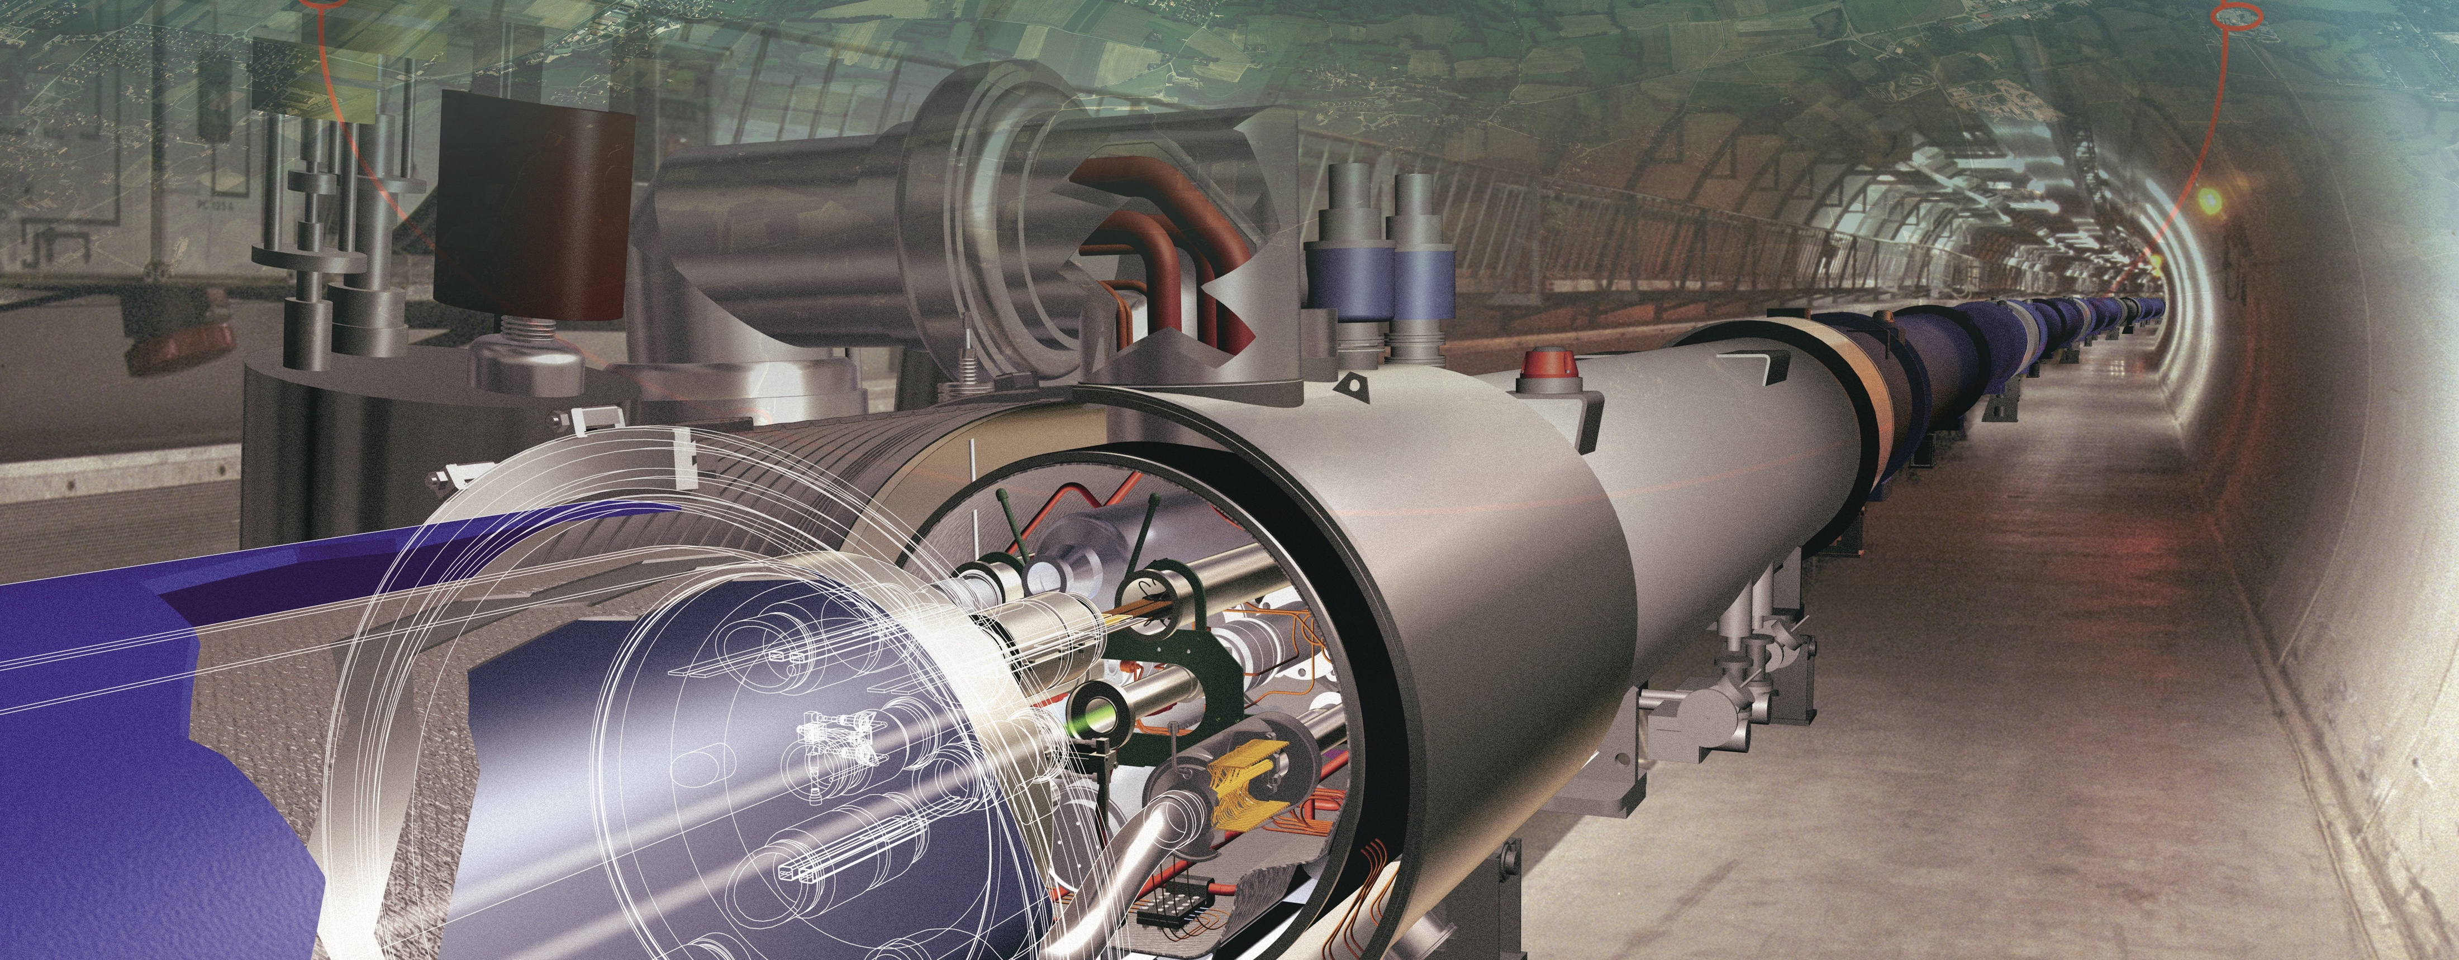
Producing the Higgs boson and searching for new physics at the TeV scale requires a huge machine

Slide 4

The LHC is a superconducting proton/ion accelerator and collider
installed in a 27 km circumference underground tunnel
LHC ring at CERN:
27 km circumference
70 — 140 m depth
LHC
control room
CERN (Prévessin site)
CERN (Meyrin site)

Slide 5
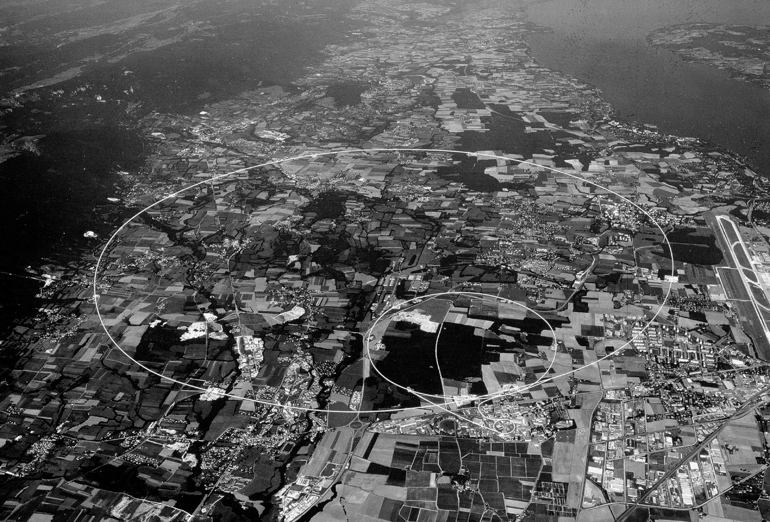

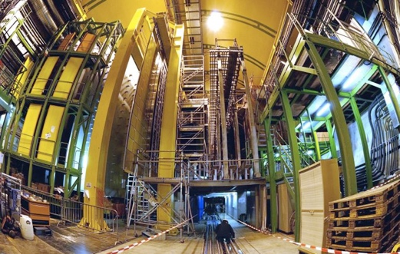

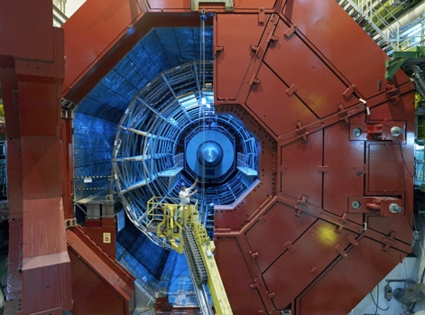
CMS
LHCb
ALICE
ATLAS

Slide 6

The LHC Run-1: 7 & 8 TeV pp, 5 & 20 fb^{–1}
Higgs boson discovery and first property measurements

Slide 7
Proton–Proton Collisions
Harvest of cross-section measure-ments from LHC experiments (> 500 papers / exp) confirmed the predictive power of the Standard Model

Slide 8
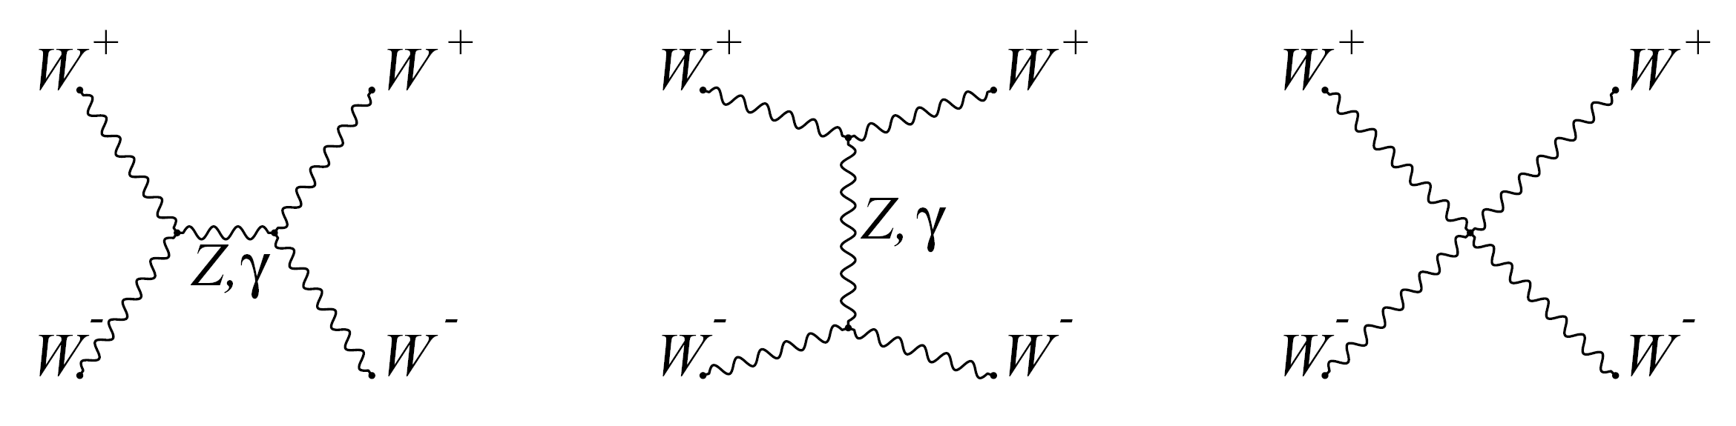
The Higgs boson as moderator
Unitarity: if only Z and W are exchanged, the amplitude of (longitudinal) W_{L}W_{L} scattering violates unitarity
Higgs boson restores unitarity of total amplitude:
H
m_{H} must not be too large (which is fulfilled)
H
Same-sign WW selection greatly reduces strong production. Removes s-channel Higgs process:
Look for VBS scattering in high dijet invariant mass distributions
EW VBS production
Non-VBS production
Strong production

Slide 9
The Higgs boson as moderator
Unitarity: if only Z and W are exchanged, the amplitude of (longitudinal) W_{L}W_{L} scattering violates unitarity
1405.6241, 1611.02428
Higgs boson restores unitarity of total amplitude:
Same-sign WW selection greatly reduces strong production. Removes s-channel Higgs process:
Look for VBS scattering in high dijet invariant mass distributions
ATLAS finds 3.6σ evidence for EW production (2.3σ expected)
EW VBS production
Non-VBS production
Strong production

Slide 10

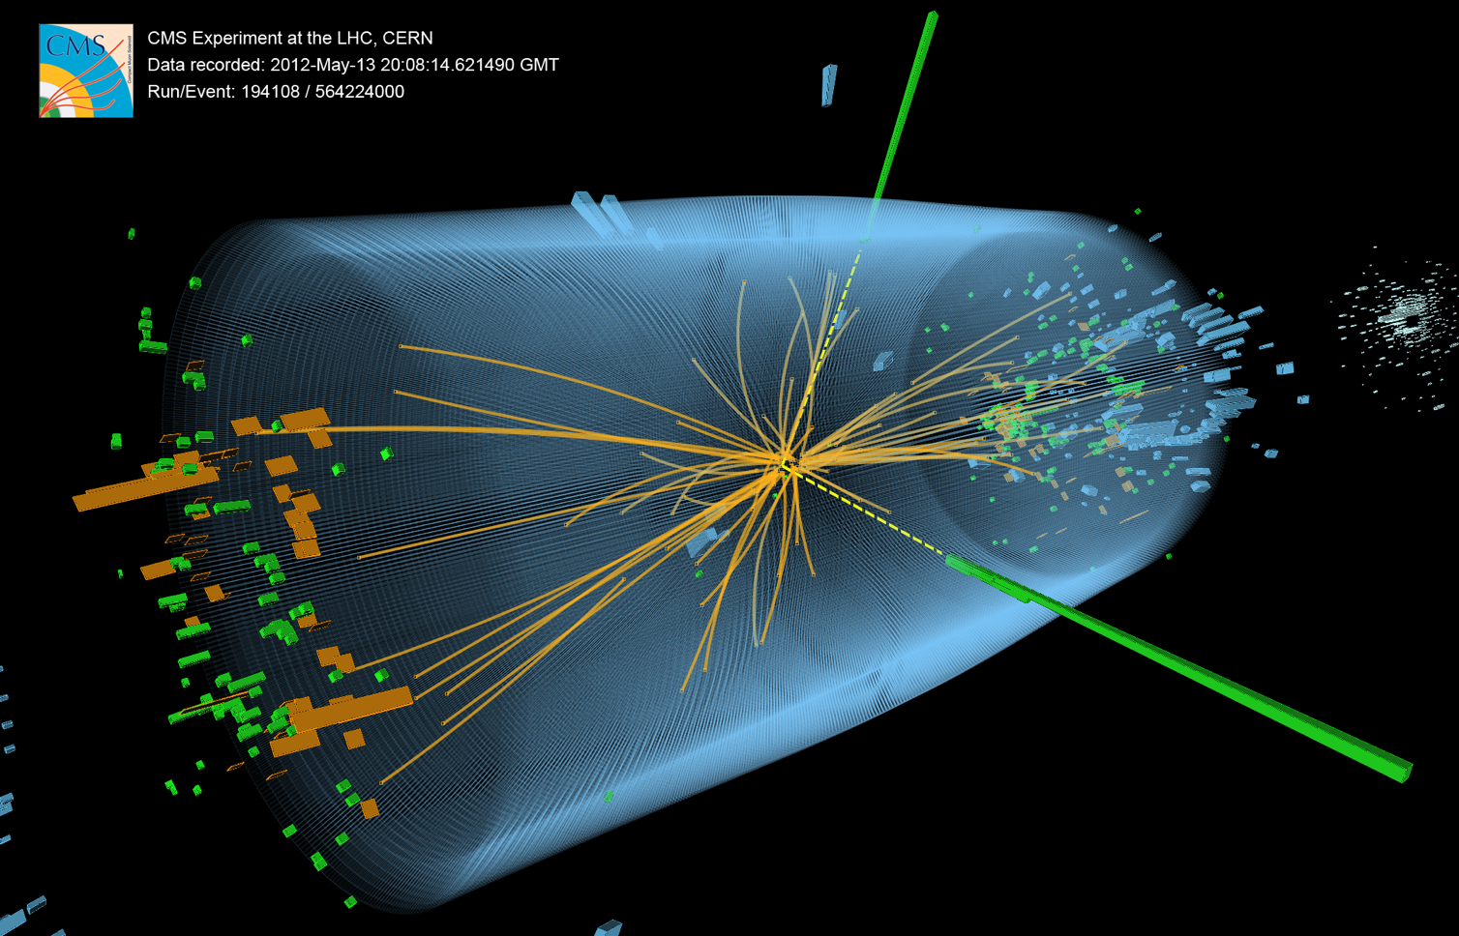
Higgs Boson discovery — Run-1 magnum opus

Slide 11

Higgs boson production at the LHC
At the LHC, the Higgs boson is dominantly produced via gluon fusion for σ_{H,total} ~22 pb at 8 TeV for m_{H} = 125 GeV
Cross section steeply falling with Higgs mass
Vector boson fusion (σ_{W/Z+H} ~ 1.6 pb):
g
t
H
Higgs-strahlung (σ_{W/Z+H} ~ 0.7/0.4 pb):
t
g
t
σ_{H,ggF} ~ 19 pb
“ttH” production (σ_{ttH} ~ 0.13 pb):
Total production of ~470 thousand SM Higgs bosons of 125 GeV in 2012 in each ATLAS and CMS

Slide 12
Higgs boson production at the LHC
H(125 GeV) branching fractions:
Because of the coupling to the mass of the decay particles:
  … the Higgs will decay with preference to the heaviest particles allowed
  … the Higgs does not couple directly to photons and gluons, but only via “loops” involving preferentially heavy particles (e.g., top, W )
0.012% (e,µ)
1.1% (e,µ)
Uncertainties 3∼12%

Slide 13
No doubt on H(125) discovery in the bosonic channels
H → γγ
H → ZZ⁽*⁾ → 4𝓁
H → WW ⁽*⁾ → 2𝓁2ν
σ(m) ~ 1–2%
σ(m) ~ 1–2%
σ(m) ~ 20%
0
Very different experimental challenges in each of these discovery channels.
All analyses significantly improved since July 2012. Resulting yields agree with SM predictions

Slide 14
Fermionic modes more challenging / use of multivariate methods and complex fits
H → ττ
σ(m) ~ 10%
V(Z/W) + H(→ bb)
σ(m) ~ 15%
tt + H(→ γγ, bb, leptons)
1501.04943
ttH — multilepton channel
1409.6212
1506.05988
4.5_{obs} (3.4_{exp})σ
1310.3687
1409.6212
1401.5041
µ = 0.70 ± 0.27
3.4_{obs} (3.6_{exp})σ
µ = 0.8 ± 0.5
No individual observation yet

Slide 15
Many additional H(125) analyses and searches / examples only
VBF + H(→ bb)
VBF + H(→ invisible)
H → τ µ
1508.07869
While H → µe is severely constrained from flavour physics, H → τµ, τe are not (~10% limits)
CMS released early 2015 a H → τµ search finding a slight (2.4σ) excess:
E_{T,miss} > 150 GeV
Dedicated hadronic VBF triggers (~2% signal efficiency)
BDT + m_{bb} mass fit (bump search). Verification with Z → bb
Largest background from Z(→ νν) + 2 jets (strong and EW)
Limit: BR(H → invisible) < 28%
1506.01010
The Higgs is narrow: 4.1 MeV
For comparison:
Γ_{W} = 2.1 GeV
Γ_{Z} = 2.5 GeV
Γ_{top} = 1.3 GeV
Even small couplings to new light states can measurably distort branching fractions
µ = 2.8
+ 1.6
– 1.4
Excess not confirmed by ATLAS in Run-1, neither by CMS at 13 TeV

Slide 16
Properties of the new H(125)
First Higgs property measurements using Run-1 data
Spin-parity and CP, FCNC tests
Constraint on Γ_{H} via off-shell coupling measurement
Total, fiducial and differential cross sections
Combination of H → γγ, 4l
1504.05833
H → WW * (fiducial)
1604.02997
HRES: NNLO + NNLO fixed order calculation

Slide 17
Combined ATLAS & CMS Higgs analysis
ATLAS & CMS Combinations of Higgs mass and coupling measurements
[ 1503.07589, 1606.02266 ]
Agreement among experiments
Overall comparison: µ = 1.09 ± 0.11
Combined observation of H → ττ channel & VBF production
Precise mass combination (0.2%):
m_{H} = 125.09
± 0.21_{stat}
± 0.11_{syst} GeV
Higgs production processes
Higgs decay processes
Note that the least model-dependent observables at the LHC are ratios of couplings

Slide 18
Combined Higgs analysis and a flurry of property measurements
ATLAS & CMS Combinations of Higgs mass and coupling measurements
[ 1503.07589, 1606.02266 ]
t
t
t
W
W
W
t
t
t
Couplings to massless particles mediated by loops involving heavy particles
Powerful test for new physics (eg, excludes SM-like heavy 4th fermion generation)

Slide 19

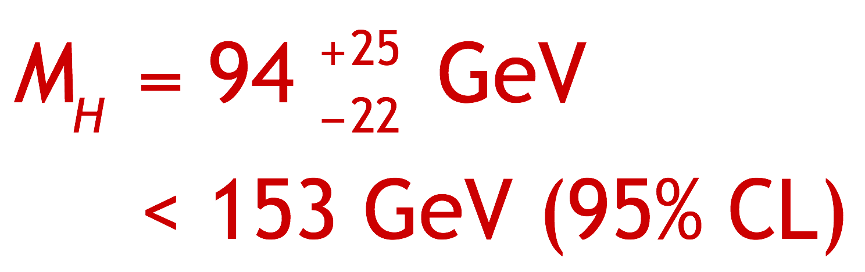
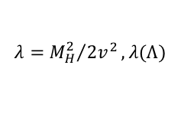
What was known about the Higgs (mass) before the LHC ?
Direct searches at LEP excluded: m_{H} < 114.4 GeV | Tevatron: excluded m_{H} ~ 160 GeV
Today’s Tevatron exclusion (2013): 149 < m_{H} < 182 GeV
Constraint from SM fit to EW precision data:
  Perturbativity and stability bounds for high SM cut-off scale Λ:
$$λ={M_{H}^{2}}/{2v^{2}}, λ(Λ)$$

Slide 20
Agreement of observation with prior constraints
Direct searches at LEP excluded: m_{H} < 114.4 GeV | Tevatron: excluded m_{H} ~ 160 GeV
Today’s Tevatron exclusion (2013): 149 < m_{H} < 182 GeV
Constraint from SM fit to EW precision data:
ATLAS & CMS:
m_{H} = 125.09 ± 0.21_{stat} ± 0.11_{syst} GeV
  Perturbativity and stability bounds for high SM cut-off scale Λ:
ATLAS & CMS
ATLAS & CMS

Slide 21


Global fit to electroweak precision data
Global electroweak fit was masterpiece of LEP/SLD era.
Discovery of Higgs over-constrains the fit and dramatically improves predictability
No W mass measurement from LHC just yet …
But please follow the CERN seminar by ALTAS coming Tuesday, 11:00
https://indico.cern.ch/event/593538
Competitive top mass results from the LHC
Best current results: 172.44 ± 0.13 ± 0.47 GeV (CMS, 1509.04044),
172.84 ± 0.34 ± 0.61 GeV (ATLAS, 1606.02179, not yet all 8 TeV)

Slide 22
The LHC Run-2: 13 TeV pp collisions
Higgs boson re-observation and much more to come

Slide 23
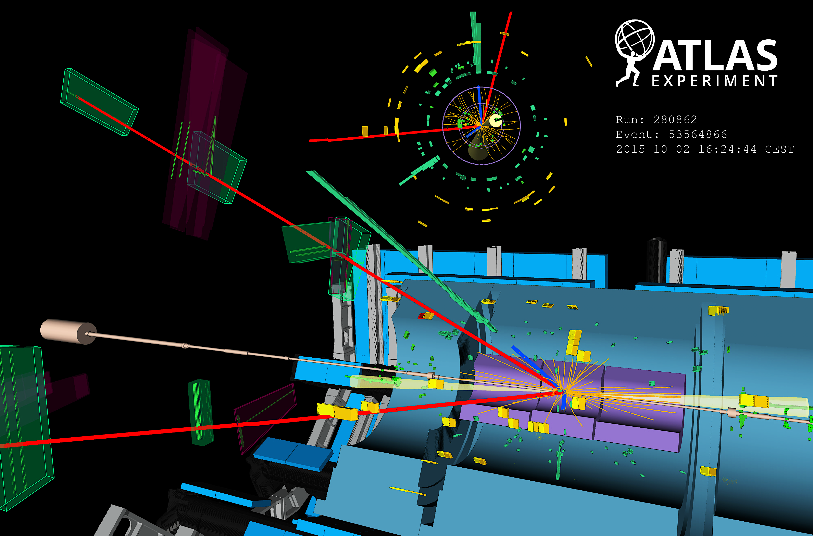
Higgs re-observation at 13 TeV
13/8 TeV cross section ratios of 2~2.4 for VH, ggH, VBF, and 3.9 for ttH
2015 & 2016 (ICHEP) statistics combined (13~15 fb^{–1}) achieves similar precision as Run-1
Display of VBF H → eeµµ + 2jets candidate from 13 TeV pp collisions. The electrons have a transverse momentum of 111 and 16 GeV, the muons 18 and 17 GeV, and the jets 118 and 54 GeV. The invariant mass of the four lepton system is 129 GeV, the dielectron (dimuon) invariant mass is 91 (29) GeV, the pseudorapidity difference between the two jets is 6.4 and the dijet invariant mass is 2 TeV.

Slide 24
Clear Higgs observation of at 13 TeV in bosonic channels
Preliminary fiducial and total cross-section and coupling measurements (ggF and VBF significant)
H → ZZ* → 4𝓁
ATLAS-CONF-2016-079
CMS-PAS-HIG-16-033
+18
– 16
µ = σ_{data} / σ_{SM} = 0.99
+0.33
– 0.26
σ_{tot,data} = 81 pb
σ_{tot,SM} = 55 ± 4 pb
Expected significance (SM): 6.5σ
+0.48
– 0.44
CMS also measured: m_{H} = 124.50 GeV
(dominated by statistical uncertainty, compare to 125.09 ± 0.24 GeV from ATLAS & CMS Run-1 combination)

Slide 25
Clear Higgs observation of at 13 TeV in bosonic channels
Preliminary fiducial and total cross-section and coupling measurements (ggF and VBF significant)
H → γγ
ATLAS-CONF-2016-067
CMS-PAS-HIG-16-020
µ = 0.85
+0.22
– 0.20
µ = 0.91 ± 0.20
Expected significance (SM): 5.4σ
Expected significance (SM): 6.2σ

Slide 26
ATLAS and CMS studied H(125) in bosonic channels
Cross section versus centre-of-mass energy
H → γγ and H → ZZ* → 4𝓁 (left)
Combined H → 4𝓁, γγ
H → 4𝓁, fiducial cross section
ATLAS-CONF-2016-081
CMS-PAS-HIG-16-033
Assuming SM branching fractions and acceptance (left)
Expected rise of cross-section observed in data

Slide 27
ATLAS studied H(125) in bb decay channel
Associated production, challenging final states
W / Z + H → 𝓁𝜈 / 𝓁⁺𝓁–, 𝜈𝜈 + bb
ATLAS-CONF-2016-091
Slightly lower yield than SM, similar for Run-1
(µ = 0.7 ± 0.3 for ATLAS & CMS, µ = 0.5 ± 0.4 for ATLAS)
Powerful cross-check
with V+Z(→ bb):
µ = 0.91 ± 0.17
+0.32
–0.27

Slide 28
ATLAS studied H(125) in bb decay channel
Looked also for VBF + H(bb) events with high-energetic photon!
Following idea by E. Gabrielle et a;, hep-ph/0702119
VBF + H (→ bb) + γ _{(E > 30 GeV)}
_{T}
Uses dedicated photon+VBF trigger. Background reduction by >10 over α_{QED} owing to suppression of gluon production of bbqqγ and destructive interference between continuum ISR/FSR γ amplitudes
ATLAS-CONF-2016-063
(fit)
µ = –3.9
+ 2.8
– 2.7
Interfere destructively
µ < 4.0 (expected: < 6.3) at 95% CL

Slide 29
Searches for rare Higgs decays
Beyond SM reach at present, but could have new physics contributions ?
Strongly resolution dependent, improve sensitivity by categorising events (low/high p_{T}, central/forward, VBF)
H → µµ [expected branching fraction: 0.02%]
ATLAS-CONF-2016-041
Observed limit 4.4 times SM (3.5 combined with Run-1). Need about 300 fb^{–1} of data to reach SM
Can already exclude universal Higgs coupling to fermions !
(Would have observed H → µµ, if same BR as H → ττ)
29

Slide 30
First search for ttH production at 13 TeV by CMS
Direct measurement of Higgs–top coupling
CMS showed preliminary results for ttH in all major Higgs decay channels: H → γγ, multi-leptons, bb
Highly complex analyses, huge effort to get these done so quickly after data taking (already by Moriond 2016)
H → γγ,
tt → 0 & 1 leptons
ttH → multi-leptons
2 same charge (+ 𝜏) / 3 leptons
H → bb
tt → 1 & 2 leptons
µ = 3.8
+4.5
– 3.6
µ = 2.0
+0.8
– 0.7
µ = –2.0 ±1.8 < 2.6 (95% CL)
CMS-PAS HIG-15-005
CMS-PAS-HIG-16-022
CMS-PAS HIG-16-004

Slide 31
First search for ttH production at 13 TeV by ATLAS
Direct measurement of Higgs–top coupling
ATLAS showed preliminary results for ttH in all major channels and their combination at ICHEP 2016
Individual channels and combination
ATLAS-CONF-2016-068
Improved sensitivity over Run-1

Slide 32
Beyond the Standard Model Higgs physics
Higgs sector may be non-minimal and/or Higgs boson may couple to new physics
Diverse search programme:
Light or heavy neutral Higgs bosons
Charged Higgs boson
Lepton flavour violating Higgs decays
BSM
Higgs
searches
Di-Higgs production (resonant or not)
Exotic Higgs decays
No sensitivity yet for SM di-Higgs production
Higgs as portal to hidden sector
Higgs in BSM decay chains
BSM constraint from coupling measurements
No deviation from SM found in any of these searches
Taken from: Thibault Guillemin @ SEARCH 2016

Slide 33
Conclusions
The Higgs-boson discovery and a flurry of property measurements proved true the BEH mechanism to break gauge symmetry
However, apart from the mass, none of these measurements are yet very precise and leave room for significant deviations. Also, important modes are still unseen (bb, ttH, µµ, Zγ, HH)
And then, the reasons for new physics are all still valid, as is the beauty of SUSY…

Slide 34
Conclusions
The Higgs-boson discovery and a flurry of property measurements proved true the BEH mechanism to break gauge symmetry
However, apart from the mass, none of these measurements are yet very precise and leave room for significant deviations. Also, important modes are still unseen (bb, ttH, µµ, Zγ, HH)
And then, the reasons for new physics are all still valid, as is the beauty of SUSY… …so we may still hope Pierre was right !

Slide 35
Extra slides

Slide 36
A brief look into the future

Slide 37
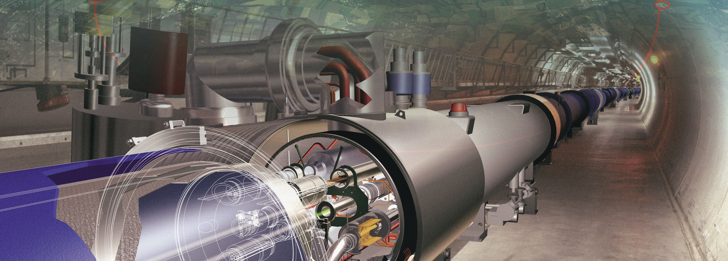
The road to the future
The LHC Run-2 and beyond
We are here

Slide 38
How can these LHC luminosity improvements be achieved ?
We are here

Slide 39
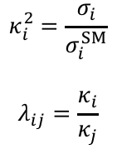
Higgs boson physics
(Conservative) extrapolation of Higgs coupling measurements
Higgs signal strengths (left) and ratios of coupling modifiers (right), compared to current precision (orange)
Run-1
(ATLAS & CMS,
expected uncertainties)
$$κ_{i}^{2}=\frac{σ_{i}}{σ_{i}^{SM}}$$
$$λ_{ij}=\frac{κ_{i}}{κ_{j}}$$
~0.33
Hatched areas indicate impact of theoretical uncertainties on expected cross-sections
Theory uncertainty limiting in several cases
Some uncertainties cancel in ratios
2.4

Slide 40
Higgs boson physics
Constraining the Higgs off-shell coupling
Both CMS and ATLAS have constrained the Higgs off-shell coupling and through this obtained upper limits on the Higgs total width Γ_{H}
The method uses the independence of off-shell cross section on Γ_{H} and relies on identical on-shell and off-shell Higgs couplings. One can then determine Γ_{H} (=4.2 MeV in SM) from the measurements of µ_{off-shell} and µ_{on-shell}
on-shell
off-shell
CMS: 1405.3455
With Run-1, limits of the order of 5 × Γ_{H}SM obtained
With L₂ = 3000 fb^{–1} expect:
ATLAS: ATL-PHYS-PUB-2015-024

Slide 41
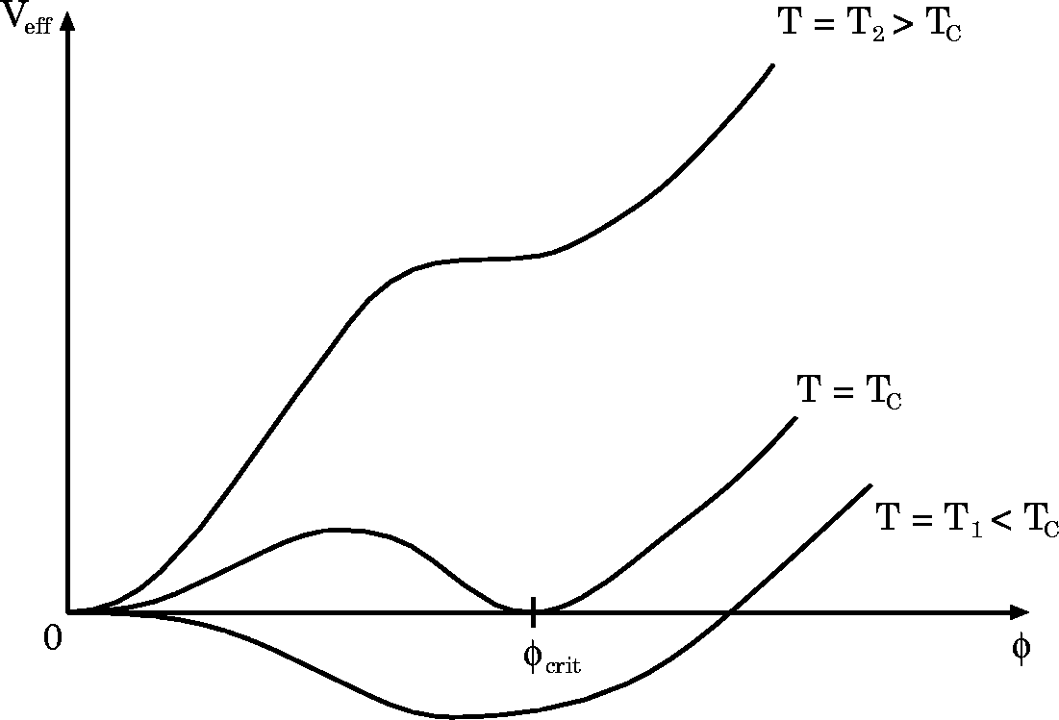



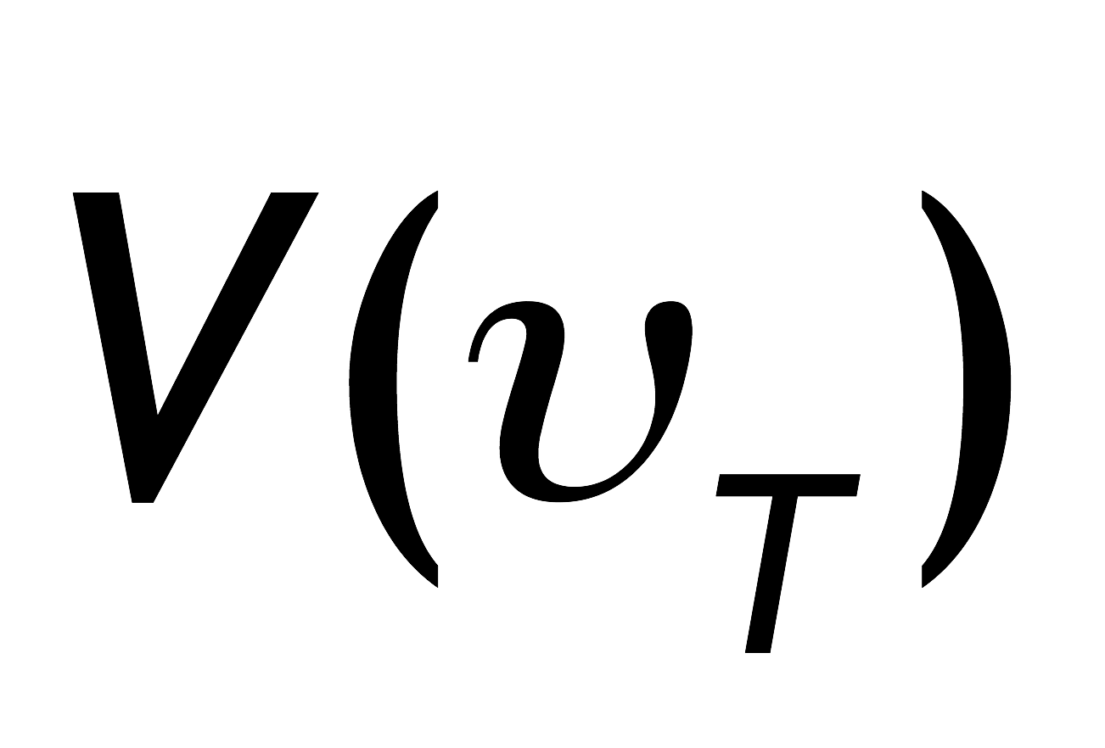

BEH Potential
The early universe, at temperature T > T_{EW}, was in a symmetric phase (|φ_{min}| = 0)
V(T) dependence mainly governed by top loop, adding a cubic 𝜙³ term
Pictures from W. Bernreuther, hep-ph/0205279

Slide 42
BEH Potential
The early universe, at temperature T > T_{EW}, was in a symmetric phase (|φ_{min}| = 0)
A phase transition at ~T_{EW} (~several 10⁻¹¹ s after big bang, causal domain of few cm) led to |φ_{min}| > 0
Phase transition
Potential barrier
BEH bubble expansion
Picture describes a 1st order phase transition that would require light Higgs, or new physics → currently disfavoured
Pictures from W. Bernreuther, hep-ph/0205279

Slide 43

BEH Potential
The early universe, at temperature T > T_{EW}, was in a symmetric phase (|φ_{min}| = 0)
A phase transition at ~T_{EW} (~several 10⁻¹¹ s after big bang, causal domain of few cm) led to |φ_{min}| > 0
Phase transition
Potential barrier
BEH bubble expansion
The condensed field fills all space and time but without orientation as it has no spin. (One might view it as a Lorentz-invariant ether creating a vacuum viscosity)
Condensation of BEH field
v
“spontaneous” phase transition
Tree-level BEH potential at T=0:
Simplest scalar potential that breaks ground state symmetry. Does what we need, but bears fundamental problems.
Carries the seeds of new physics …
( µ, λ determined once Higgs mass known )

Slide 44
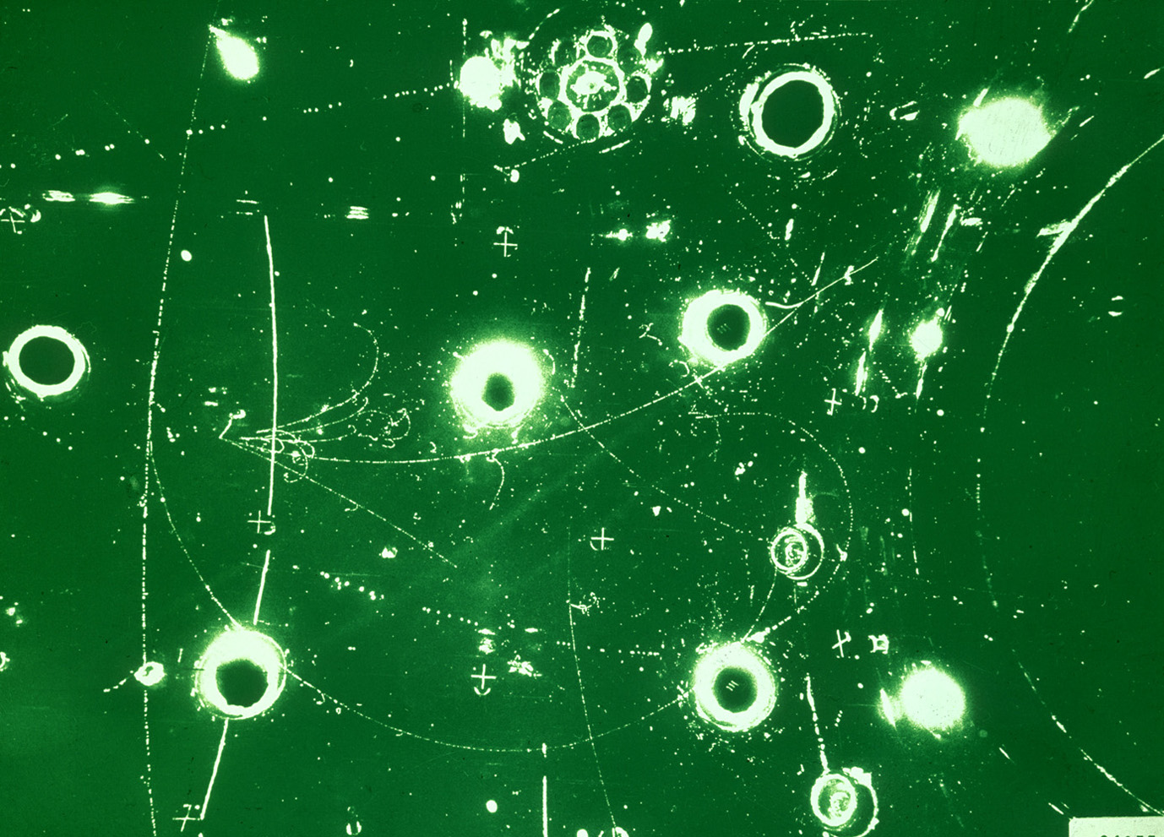
The Standard Model
BEH mechanism
Early universe: symmetric phase, fundamental particles are massless → gauge symmetry is respected
Symmetric phase – early universe
Gravity
Photon
Weak boson
Neutrinos
Electrons
Top quark
H. Murayama

Slide 45
The Standard Model
BEH mechanism
Early universe: symmetric phase, fundamental particles are massless → gauge symmetry is respected
Higgs quantum liquid in broken phase
Gravity
A Higgs field displaces ground state breaking gauge symmetry
Photon
×
×
It fills all space time (but without orientation as it has no spin)
Weak boson
×
×
×
×
Particles interact with Higgs field and effectively reduce their velocity. Acquired mass proportional to interaction strength
×
Neutrinos
ν_{L}
Λ⁻¹
ν_{L}
Electrons
×
e_{L}
e_{R}
×
e_{L}
×
×
×
_{L}
_{R}
Interaction with Higgs field alters chirality of massive Dirac fermion
×
×
→ Action of the Higgs field creates “vacuum viscosity”
Top quark
_{R}
_{R}
×
_{R}
×
×
_{L}
_{L}
t_{L}
_{L}
×
×
H. Murayama

Slide 46
ATLAS and CMS studied H(125) in bosonic channels
Preliminary fiducial and total cross-section and coupling measurements (ggF and VBF significant)
H → γγ and H → ZZ* → 4𝓁 (right combined)
ATLAS-CONF-2016-067
Combination of
H → γγ and H → 4𝓁
ATLAS-CONF-2016-081
Differential fiducial cross-section measurement in H → 4𝓁 compared to NNLO+PS theoretical prediction

Slide 47
Theoretical cross-sections and uncertainties
Progress in theoretical calculations*
NNLO revolution
Also experimental knowledge of PDFs is limiting precision in many LHC analyses !
*Gavin Salam at LHCP 2016

Slide 48
The LHC Run-2: 13 TeV / 8 TeV inclusive “parton luminosity” ratio
PDFs
Strong interaction dominated processes
Electroweak processes
4 TeV
Larger cross section increase for gluon induced than for quark induced processes
Early Run-2 puts emphasis on searches

Slide 49
The LHC Run-2: 13 TeV / 8 TeV inclusive pp cross-section ratio
Heavy flavour cross section scales ≈ linearly with √s

Slide 50
2015 LHC proton–proton luminosities
Most results reported by ATLAS & CMS use total 2015 and summer 2016 dataset
ICHEP 2016
Peak luminosity (> design):
L_{max} = 1.2 × 10³⁴ cm^{–2} s^{–1}
12–16 fb^{–1} for results so far
2015 and 2016 pileup profile in ATLAS & CMS
(LHCb mean pileup of ~1.7 due to levelling)
LHCb after luminosity levelling: 1.7 (1.9) fb^{–1} recorded (delivered)
Current luminosity precision from van-der Meer scans: 2.9% (ATLAS), 6.2% (CMS 2016), 3.8% (LHCb)

Slide 51
One word on lepton flavour violation in Higgs decays
Both experiments have finalised their Run-1 LFV analyses
While H → µe is severely constrained from flavour physics, H → τµ, τe are not (~10% limits)
CMS released early 2015 a H → τµ search finding a slight (2.4σ) excess
Not confirmed by ATLAS in the full Run-1 analysis
H → τµ:
ATLAS:
BR = 0.53 ± 0.51% < 1.43% (95% CL)
CMS:
BR = 0.84 % < 1.51% (95% CL)
H → τe:
ATLAS:
BR = –0.3 ± 0.6% < 1.04% (95% CL)
+0.39
– 0.37

Slide 52
One word on lepton flavour violation in Higgs decays
Both experiments have finalised their Run-1 LFV analyses
New preliminary result with 13 TeV from CMS [ CMS-PAS-HIG-16-005 ]
Six categories considered: (µτ_{h}, µτ_{e}) × (0,1,2 jets)
No significant excess, combined limit: BR = –0.8 ± 0.8 % (<1.2% at 95%CL)
Limit on non-diagonal Yukawa couplings:

Slide 53
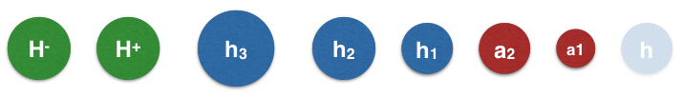
BSM Higgs boson searches
Single BEH doublet and form of potential simple but Nature may be more complex (eg, SUSY)
Beyond the SM “Higgs zoo”
[ Will Davey, LHCP 2014 ]
Higgs coupling to mass, look for decays to tau leptons or weak bosons, for example:
ATLAS-CONF-2016-085
H / A → ττ
ATLAS-CONF-2016-088
H⁺ → τ𝜈

Slide 54
Limits on 2HDM / MSSM Higgs
Many final states studies. Here: H /A → ττ (left) and H ± → τ𝜈 (right)
Limits on production of neutral (left) and charged (right) Higgs bosons
CMS-PAS-HIG-16-037
CMS-PAS-HIG-16-031
Interpretation in m_{h}^{mod+} scenario
(fit top-squark mixing to obtain m_{h} 1302.7033)

Slide 55
Beyond the HL-LHC

Slide 56
Future hadron collider projects in a nutshell
The next discovery machine
HL-LHC: E_{CM} = 14 TeV, 3 ab^{–1}, 2026~2035… (formally approved as project by CERN council last week)
Future Circular Collider FCC-hh (CERN):
E_{CM} ~ 100 TeV in 100 km ring, L ~ 2 × 10³⁵ s^{–1}cm^{–2}
~16 T magnets, possibly HE-LHC (E_{CM} ~ 28 TeV) as intermediate stage
Huge detectors for muon p_{T} measurement
Possible start of physics ~ 2035
SppC (China):
E_{CM} ~ 71 TeV in 55 km ring, L ~ 1 × 10³⁵ s^{–1}cm^{–2}
Requires very high gradient dipole magnets ~ 20 T
Possible start of physics ~ 2042

Slide 57
Future e–e⁺ collider projects in a nutshell
Measure EW & EWSB sector to highest precision
International Linear Collider ILC (host candidate: Japan)
20 years of R&D, mature technology, ~32 MV/m accelerating gradient ~ xFEL at DESY (45 MV/m for 1 TeV)
E_{CM} ~ 500–1000 GeV in 31–45 km total length, L ~ 1.8 × 10³⁴ s^{–1}cm^{–2}, only one interaction region
nm beam size, possible start of physics ~ 2030
*A low energy, high current, “drive” beam is decelerated in power extraction structures and the RF power is transferred to the cavities that accelerate the main beam
Compact Linear Collider CLIC (CERN)
High-gradient 2-beam scheme*: 100 MV/m gradient
E_{CM} ~ 380–3000 GeV, 11–50 km total length, L ~ a few × 10³⁴ s^{–1}cm^{–2}, only one interaction region
0.5 ns bunch distance, nm beam size, large beamstrahlung, physics ~ 2035
Future Circular Collider FCC-ee (CERN):
E_{CM} ~ 90–350 GeV in 2 rings (90k bunches), L ~ 70–1.3 × 10³⁴ s^{–1}cm^{–2}
Synchrotron power (E ⁴/R up to 7.5 GeV/turn): 100 MW (LEP-2: 22 MW)
Circular EP collider CEPC (China):
E_{CM} ~ 240 GeV, L ~ 2 × 10³⁴ s^{–1}cm^{–2}
Single ring, 50 bunches
Possible start of physics ~ 2028

