Slide 1
Status and prospects of the LHC —
Physics at the High-Energy Frontier
Andreas Hoecker (CERN)
KMI2025 — 6th KMI International Symposium
Nagoya, March 5th, 2025

Slide 2
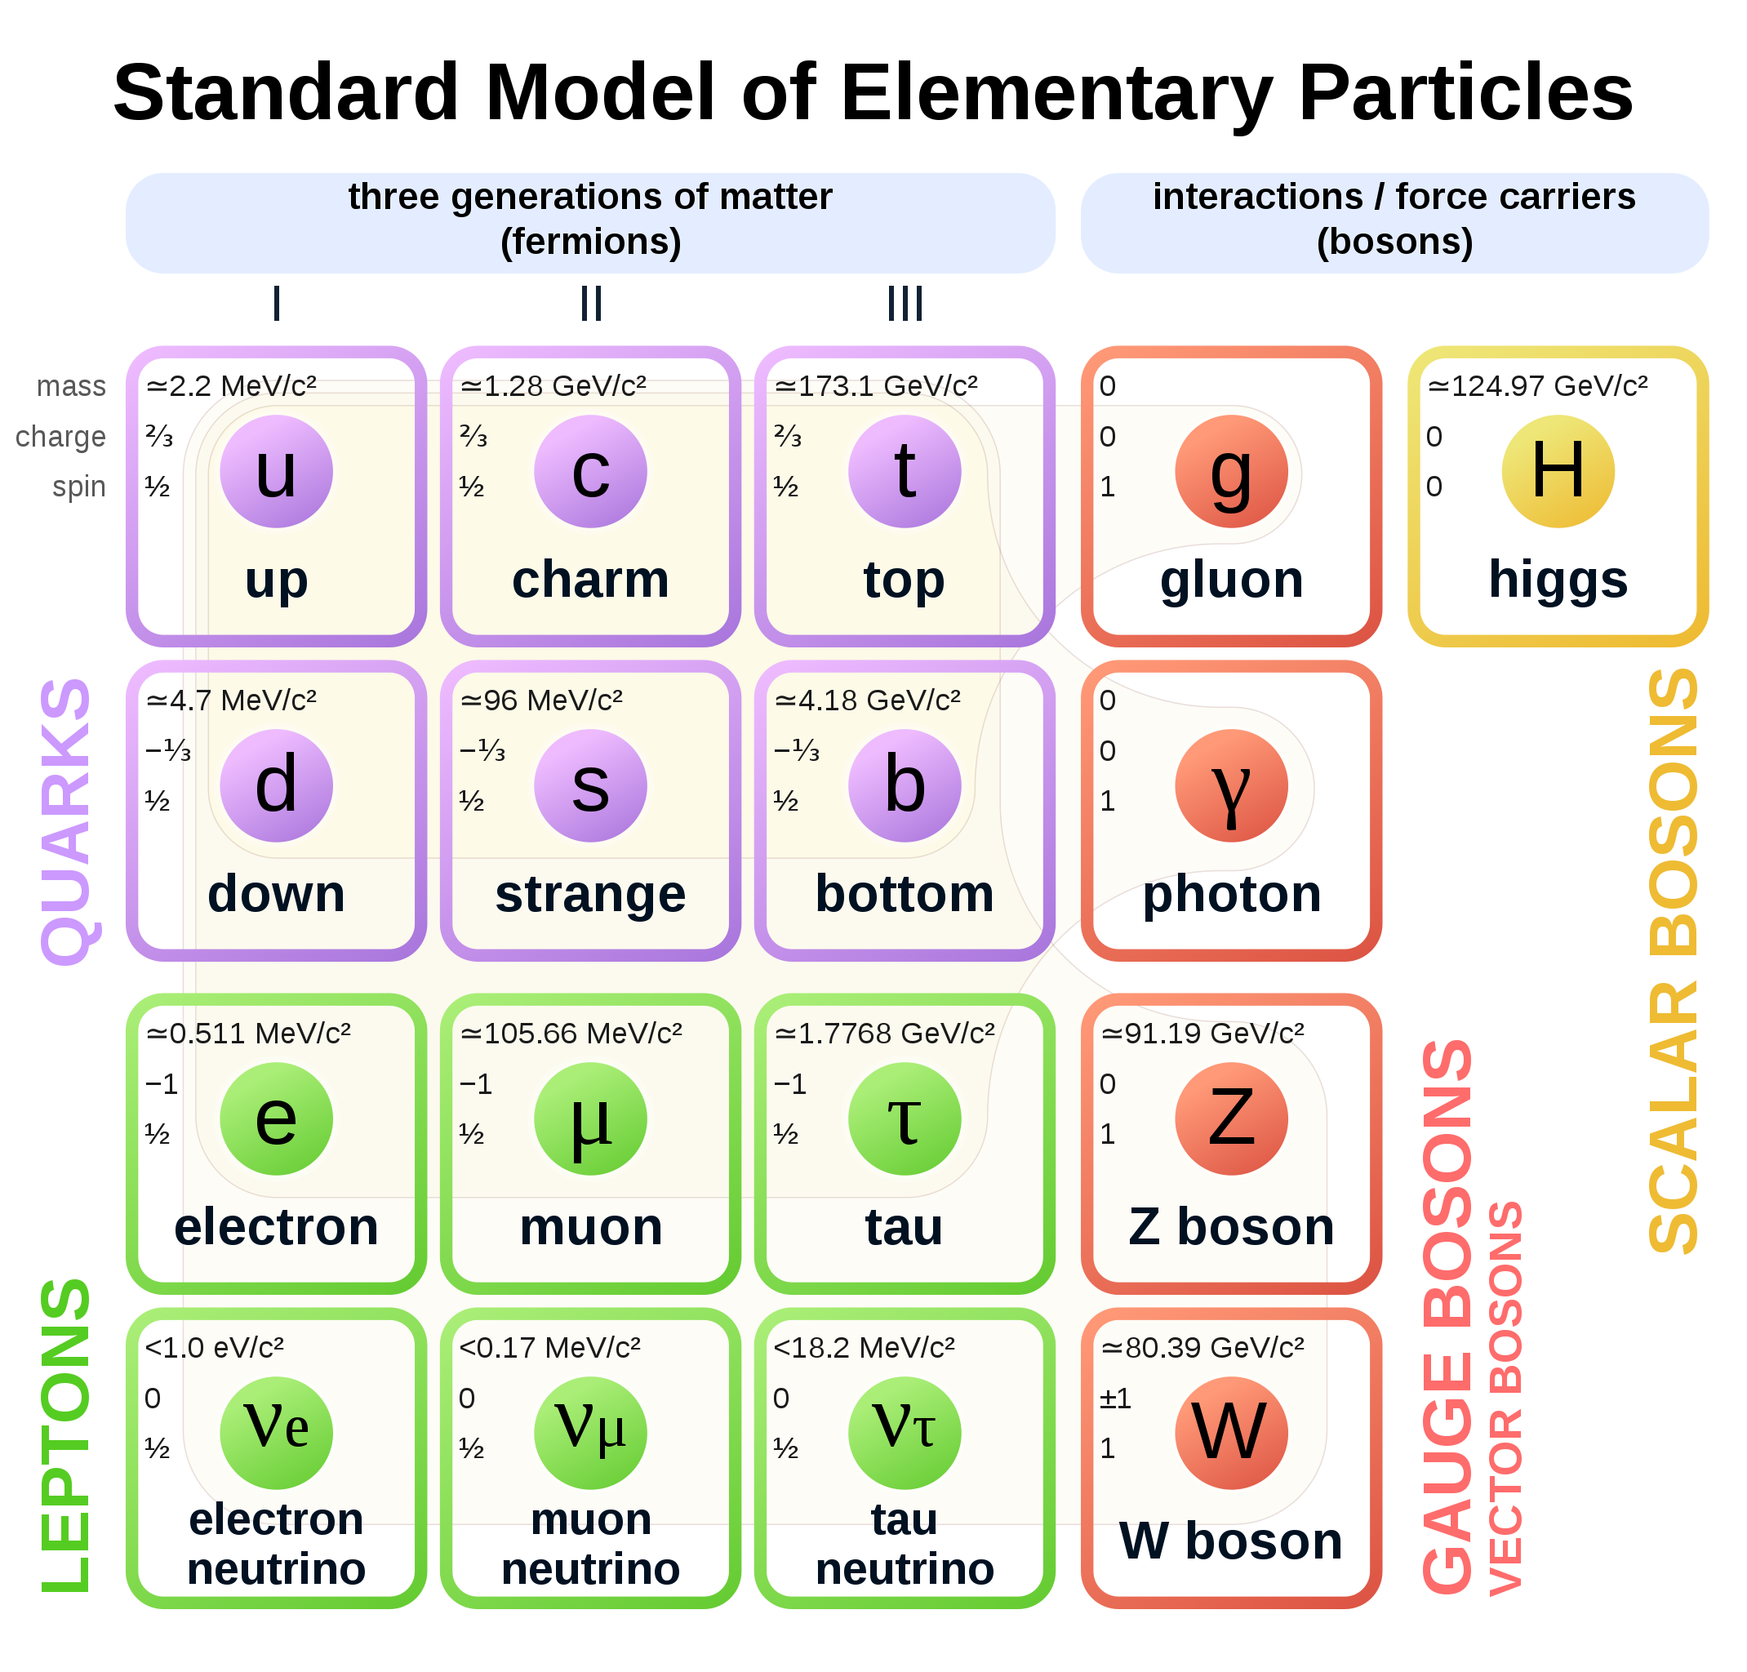

It’s all made of a handful of particles and forces
The sub-atomic structure of matter and its interactions is described by the Standard Model
Completely new type of non-universal interactions, nothing to do with known forces
Potential energy of the Higgs field:
$$V\left(φ\right)=−μ^{2}{\left|φ\right|}^{2}+λ{\left|φ\right|}^{4}$$
At lowest order (tree level)

Slide 3
It’s all made of a handful of particles and forces
The sub-atomic structure of matter and its interactions is described by the Standard Model
Decades of international high-technology accelerator-based research brought us thus far

Slide 4
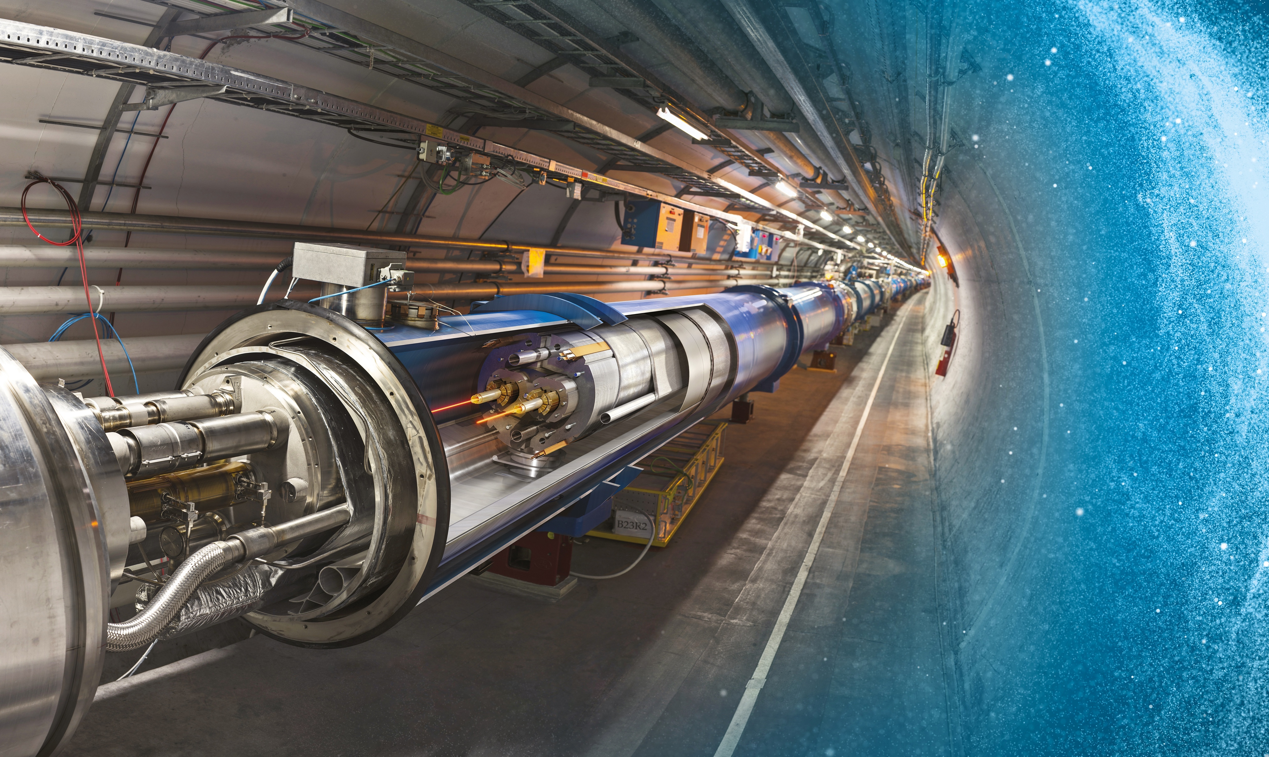

Producing and studying the Higgs boson and searching for new phenomena at the energy frontier requires a huge machine
Large Hadron Collider (LHC)
This machine was realized at CERN
27 km underground accelerator and collider
Superconducting magnets (1.9 K = –271.3 °C) steer the particles around the ring
Proton and ions are accelerated to multi-TeV scale energies before they collide
The LHC has a total of 9300 magnets for beam bending, beam focusing and orbit corrections

Slide 5
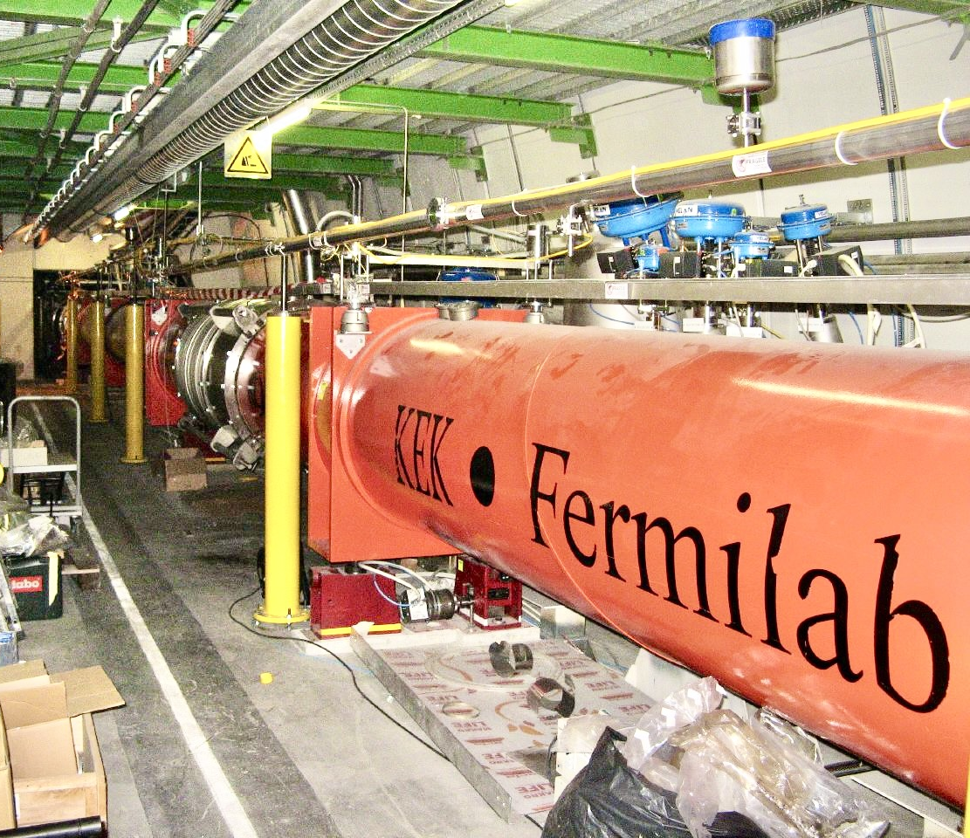
With strong Japanese contributions for the final focusing superconducting quadrupole magnets
Large Hadron Collider (LHC)
27 km underground accelerator and collider
Superconducting magnets (1.9 K = –271.3 °C) steer the particles around the ring
Proton and ions are accelerated to multi-TeV scale energies before they collide
The LHC has a total of 9300 magnets for beam bending, beam focusing and orbit corrections

Slide 6
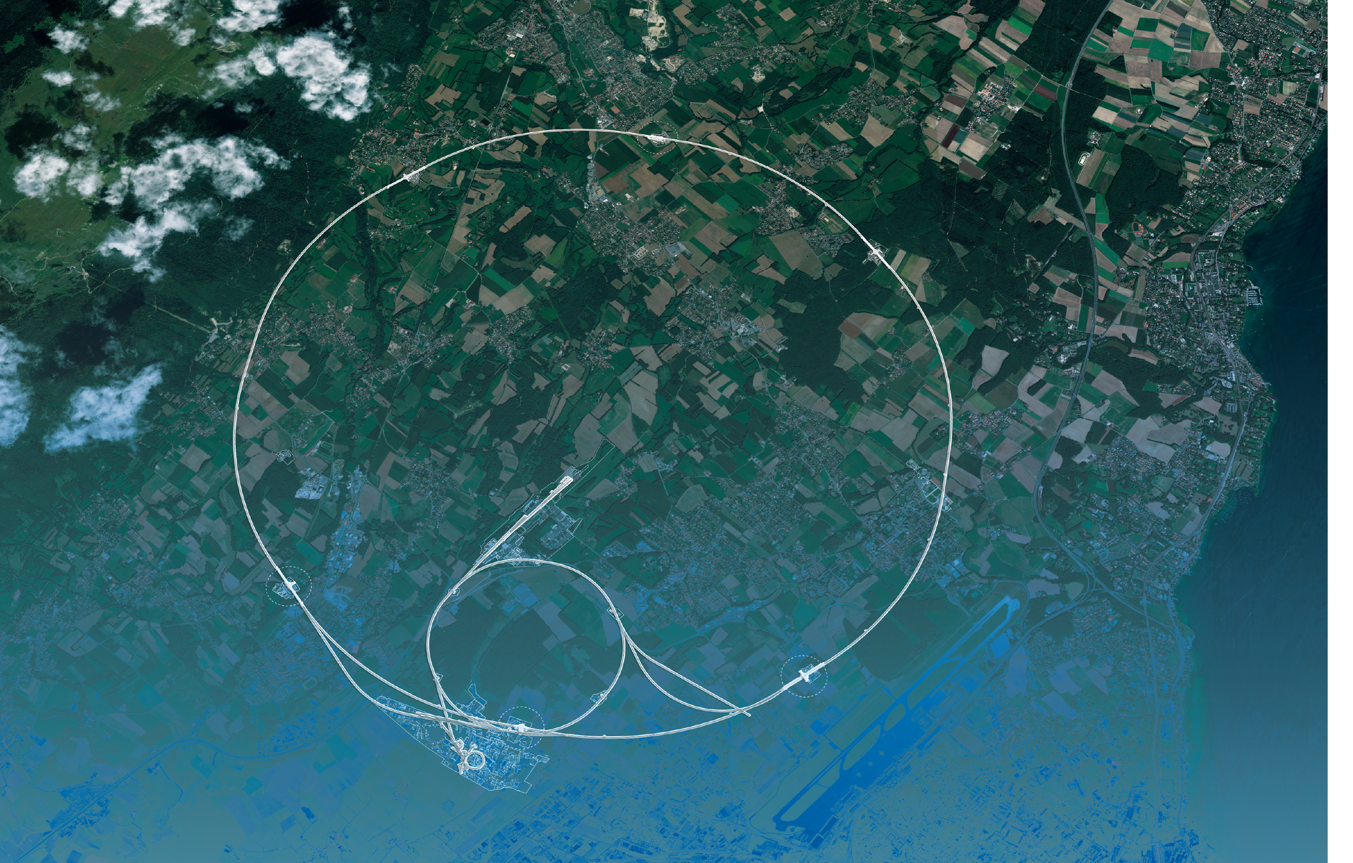
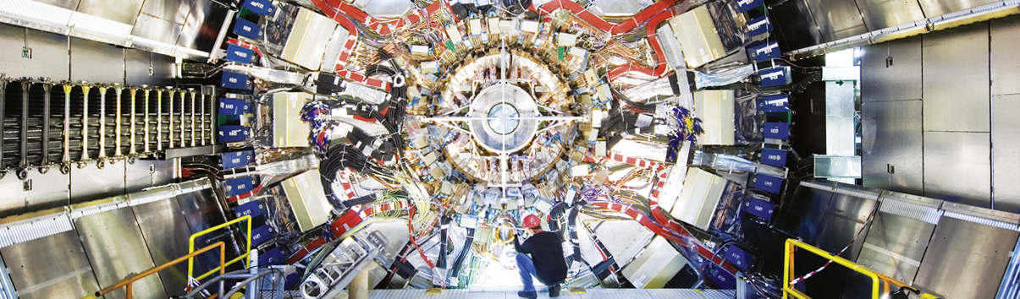
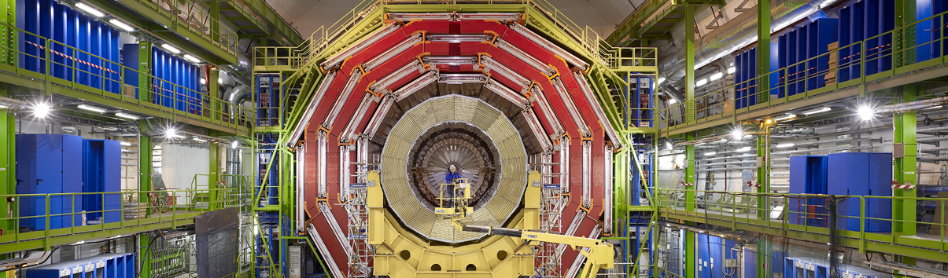
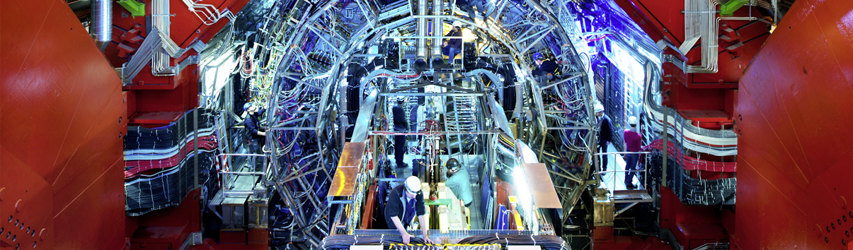
The Large Hadron Collider
CMS
ATLAS
LHC
CMS
ALICE
SPS
ALICE
LHCb
ATLAS
LHCb
PS
Areal view
Presentation

Slide 7
The Large Hadron Collider
CMS
Superb performance of the LHC
Peak luminosity in 2024: 2.1 × 10³⁴ cm^{–2}s^{–1}, pileup of 63, total delivered luminosity: 389 fb^{–1}
LHC
2024
2023
2022
2018
2017
SPS
2016
~8h luminosity levelling
2015
2011
2012
Long shutdown
Long shutdown
2010
ALICE
14h 21m stable beams
ATLAS
LHCb
Run 1 (2010–2012)
LS1 (2013–2015)
Run 2 (2015–2018)
LS2 (2019–2022)
Run 3 (2022–2026)
PS
Areal view
Presentation

Slide 8
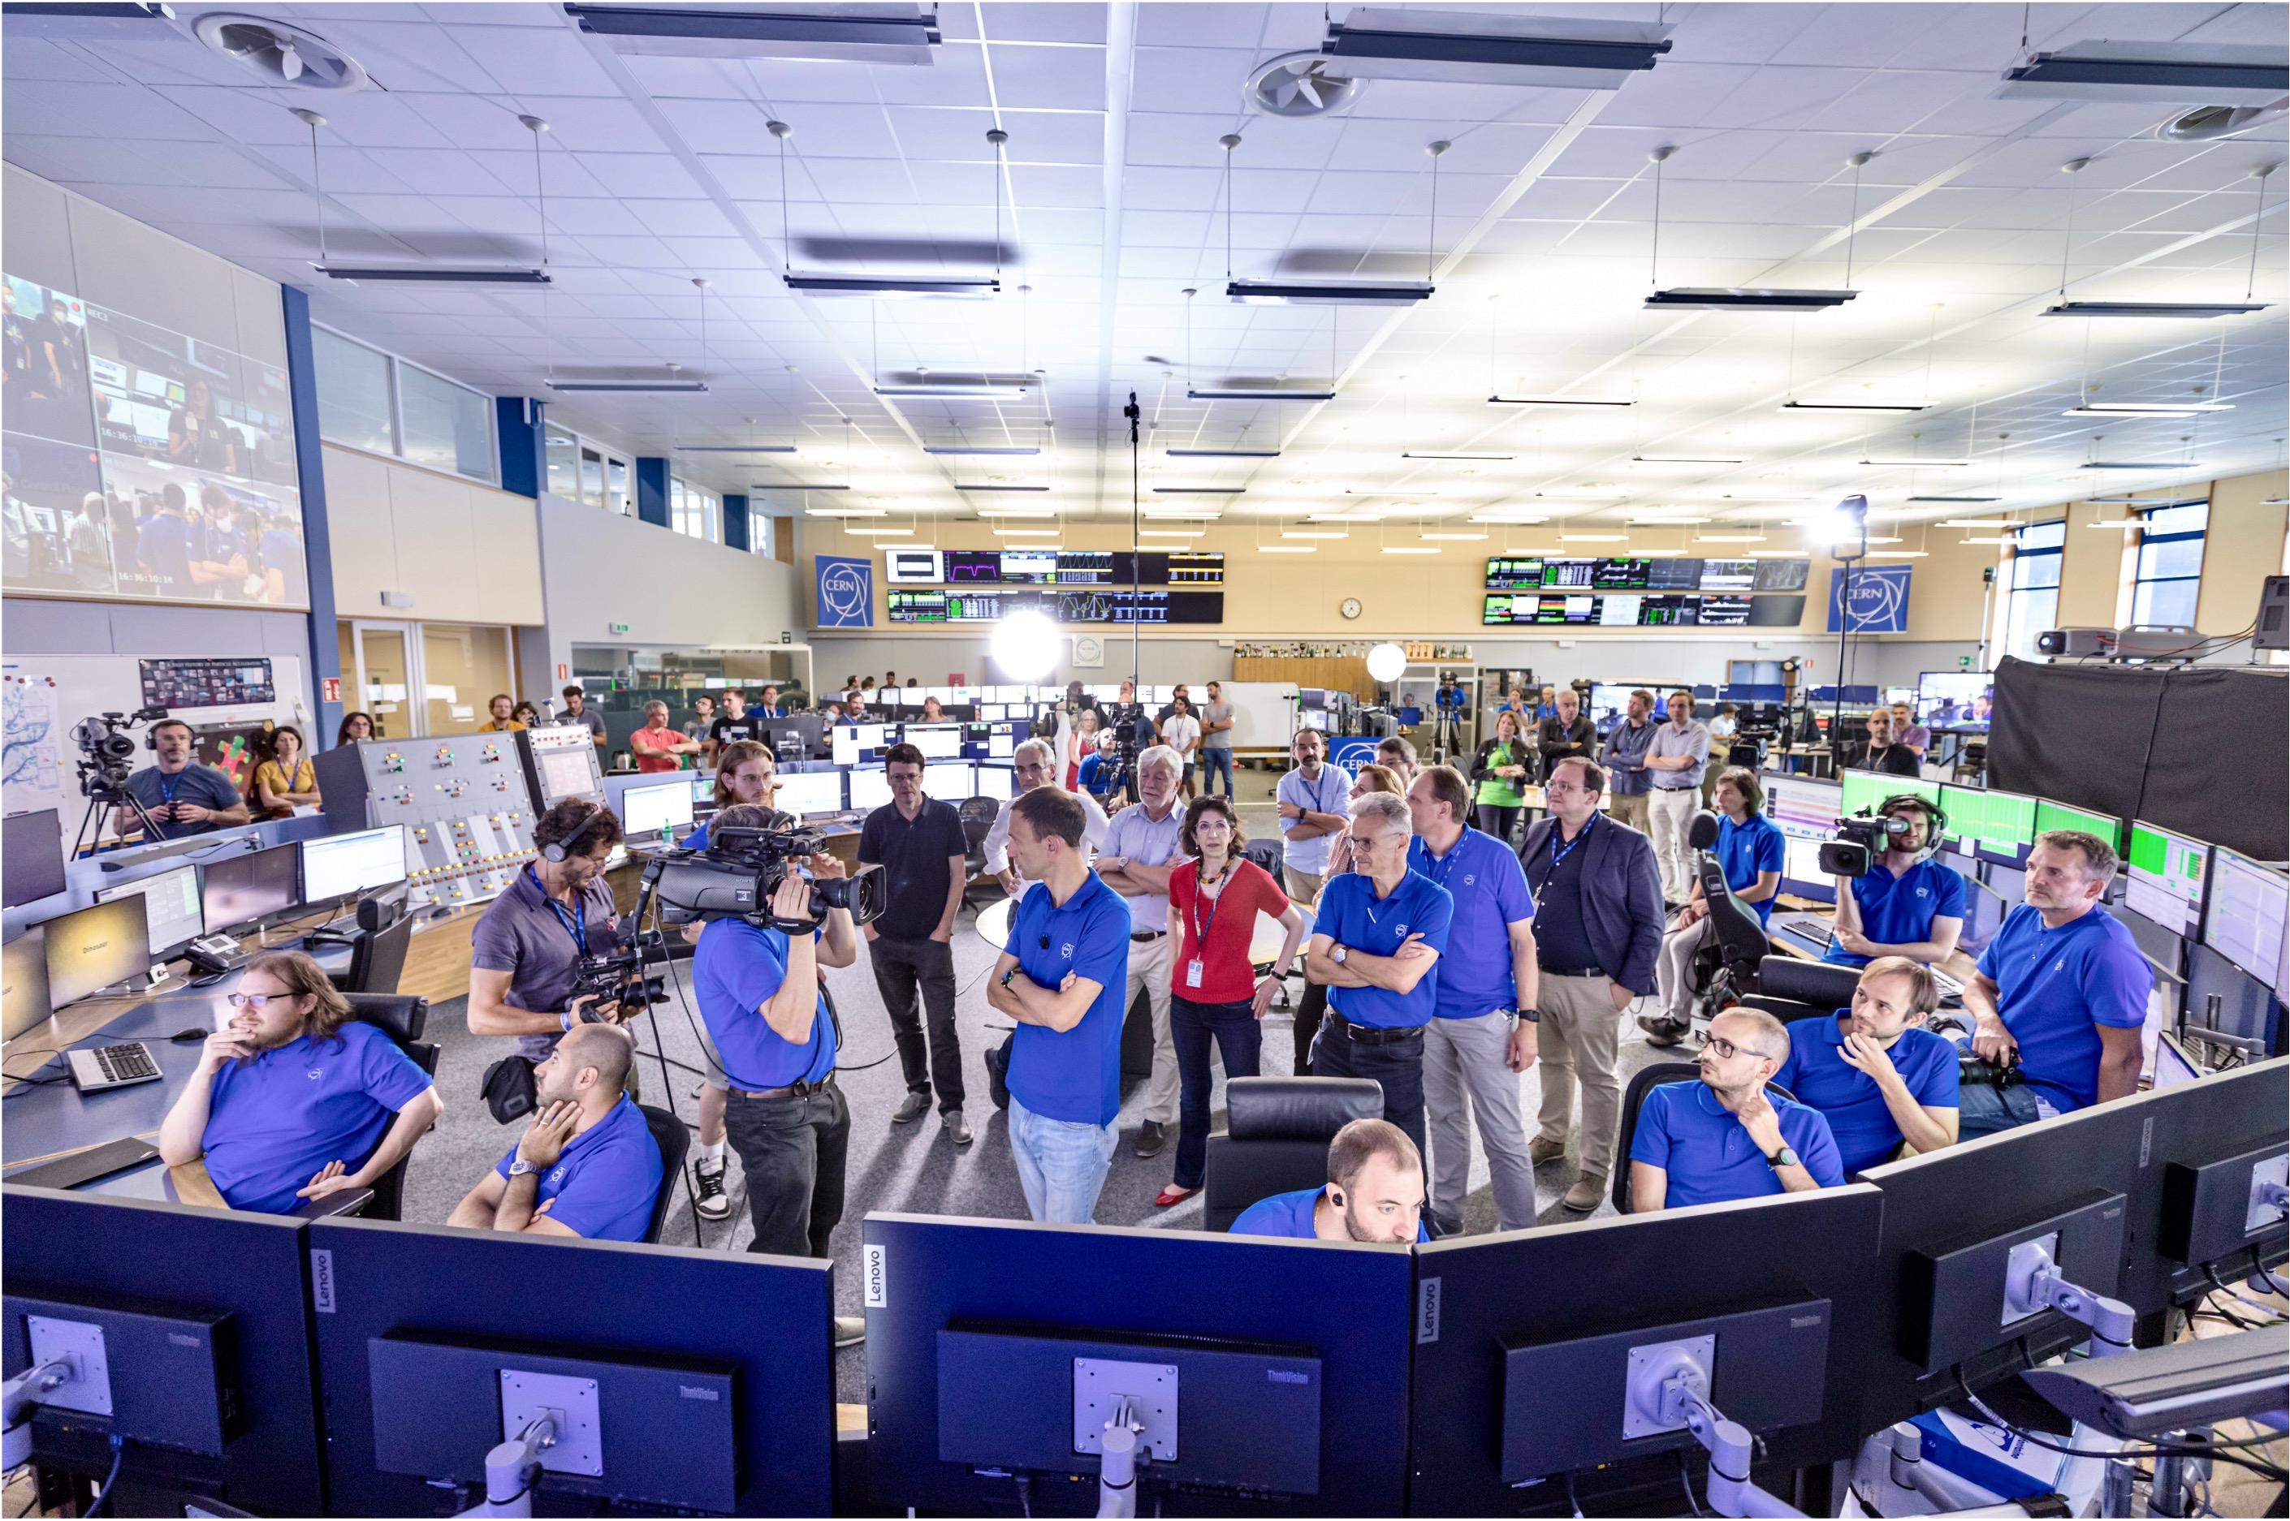
LHC Control Room (July 2022)

Slide 9
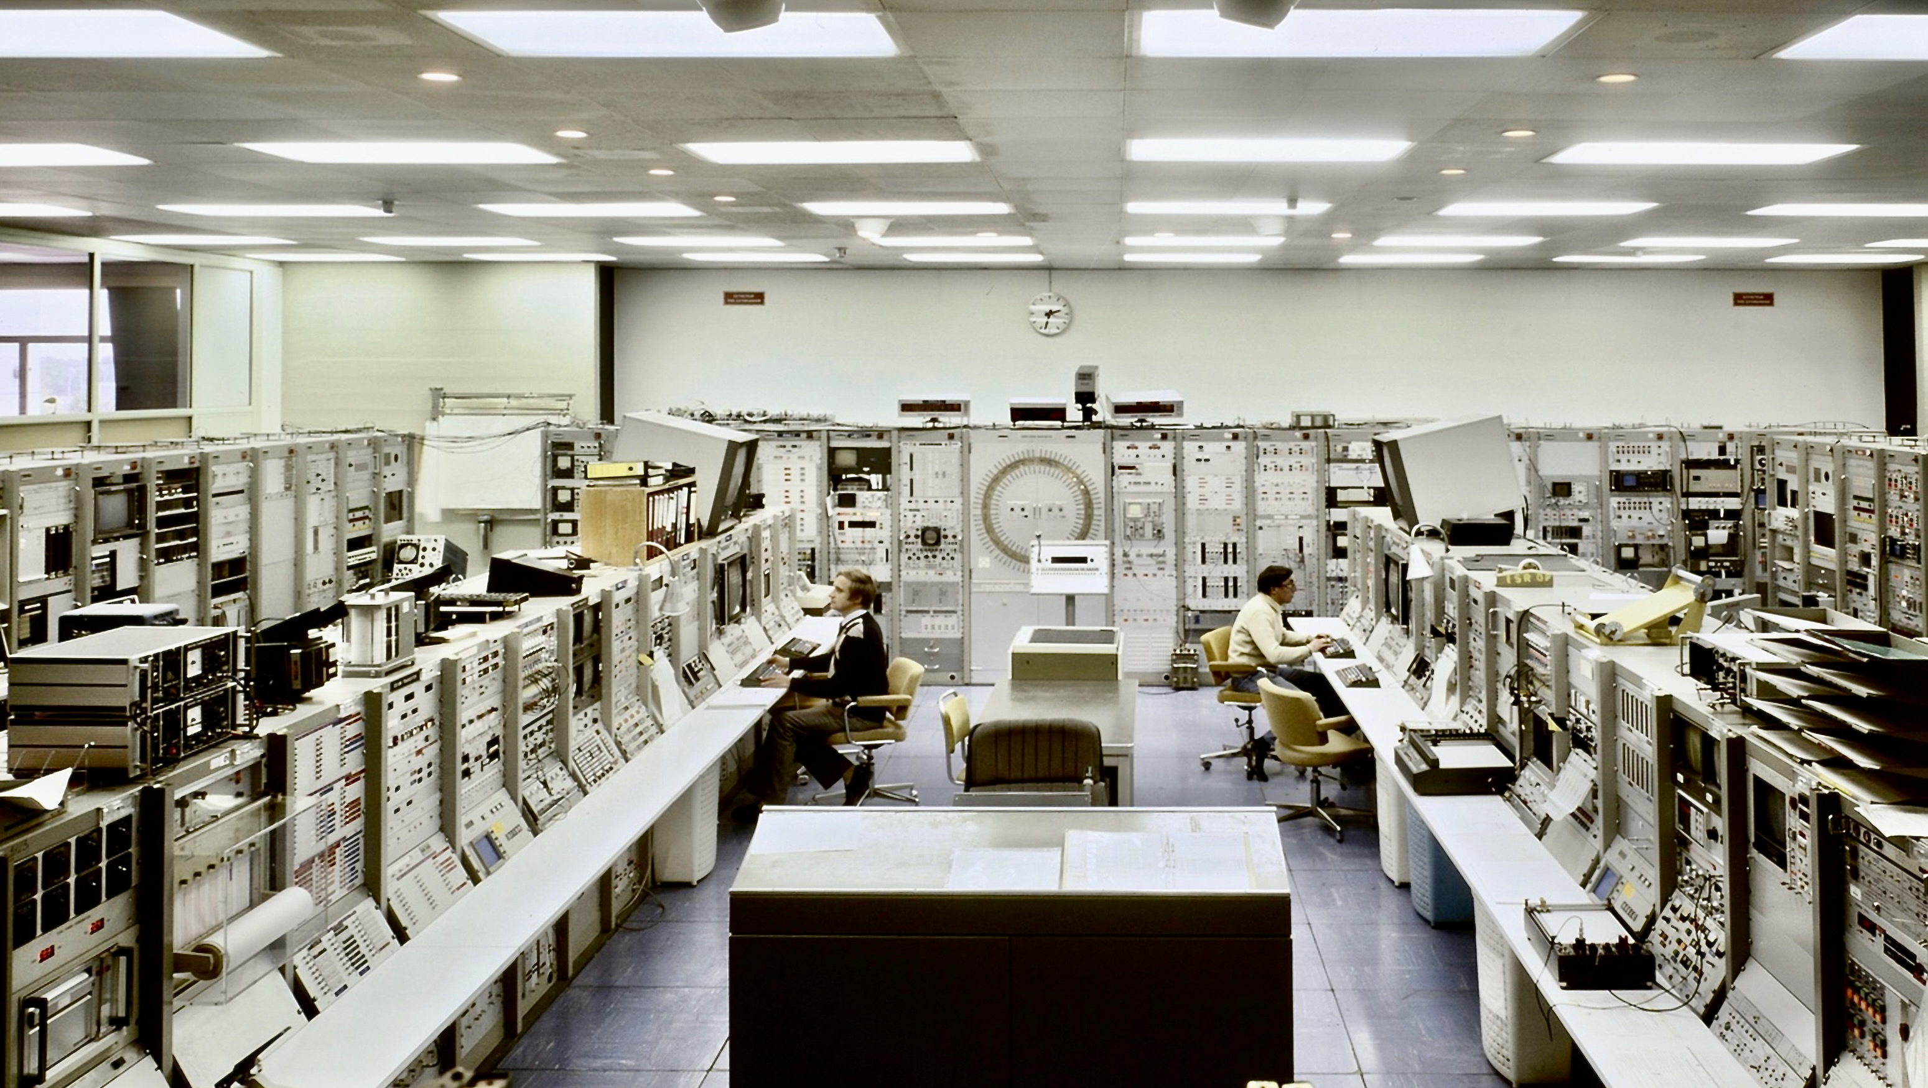
ISR Control Room (early 70s)

Slide 10
The ATLAS Experiment
CMS
ATLAS
LHC
CMS
ALICE
SPS
ALICE
ATLAS
LHCb
LHCb
PS
Areal view
Presentation

Slide 11
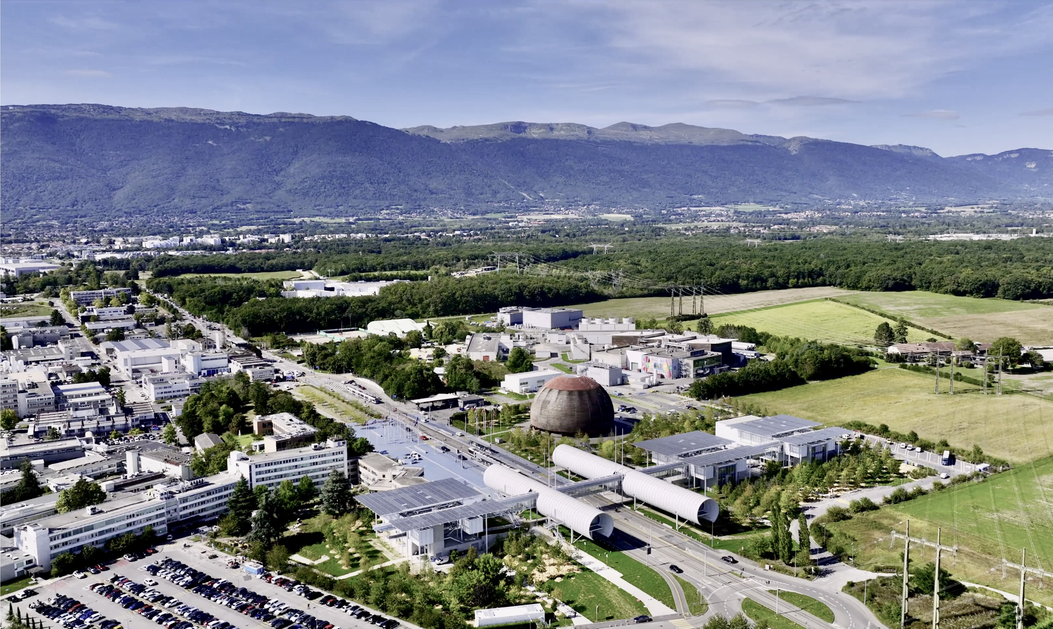
ATLAS Experiment

Slide 12

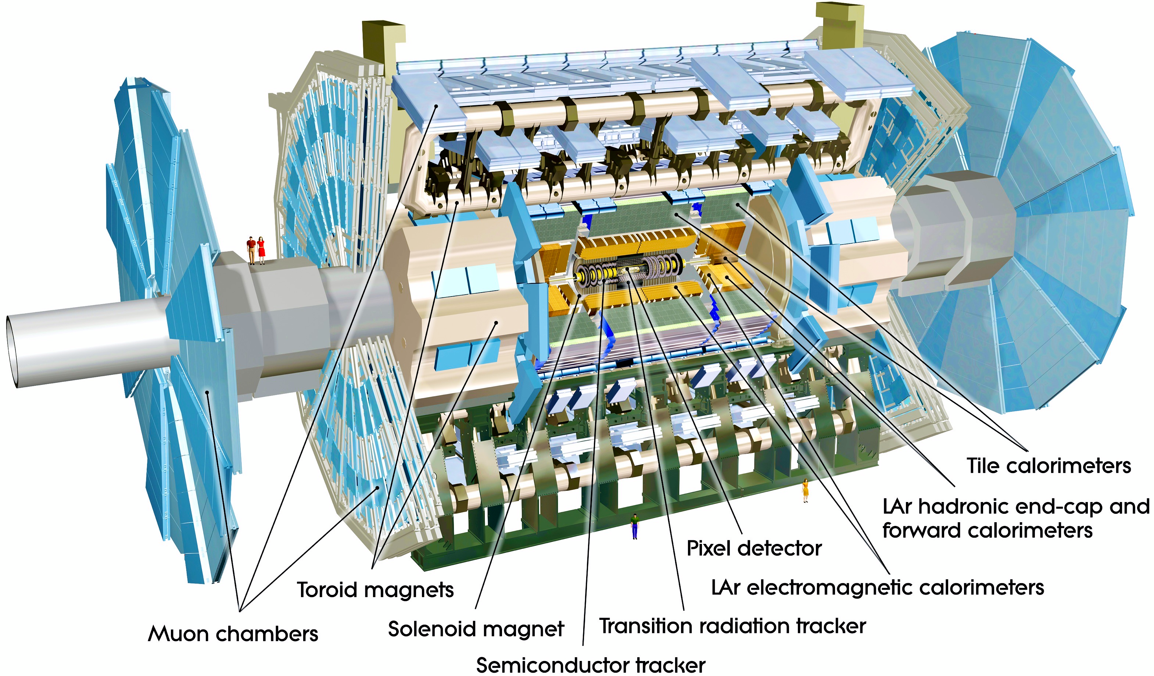

The ATLAS Detector
High resolution silicon detectors:
100 Mio. channels (50 µm x 250 µm)
6 Mio. channels (80 µm x 12 cm)
spatial resolution ~15 µm (in azimuthal direction)
Axial field provided by solenoid
(2 T) in central region (momentum measurement)
Energy measurement down to 1º to the beam line with a calorimeter system
Independent muon spectrometer (superconducting toroid magnet system)
Ultra-fast custom electronics and high-performance computers filter the collisions: only 1 out of 20,000 collisions is kept
25 m diameter, 44 m long, 7000 tons weight

Slide 13
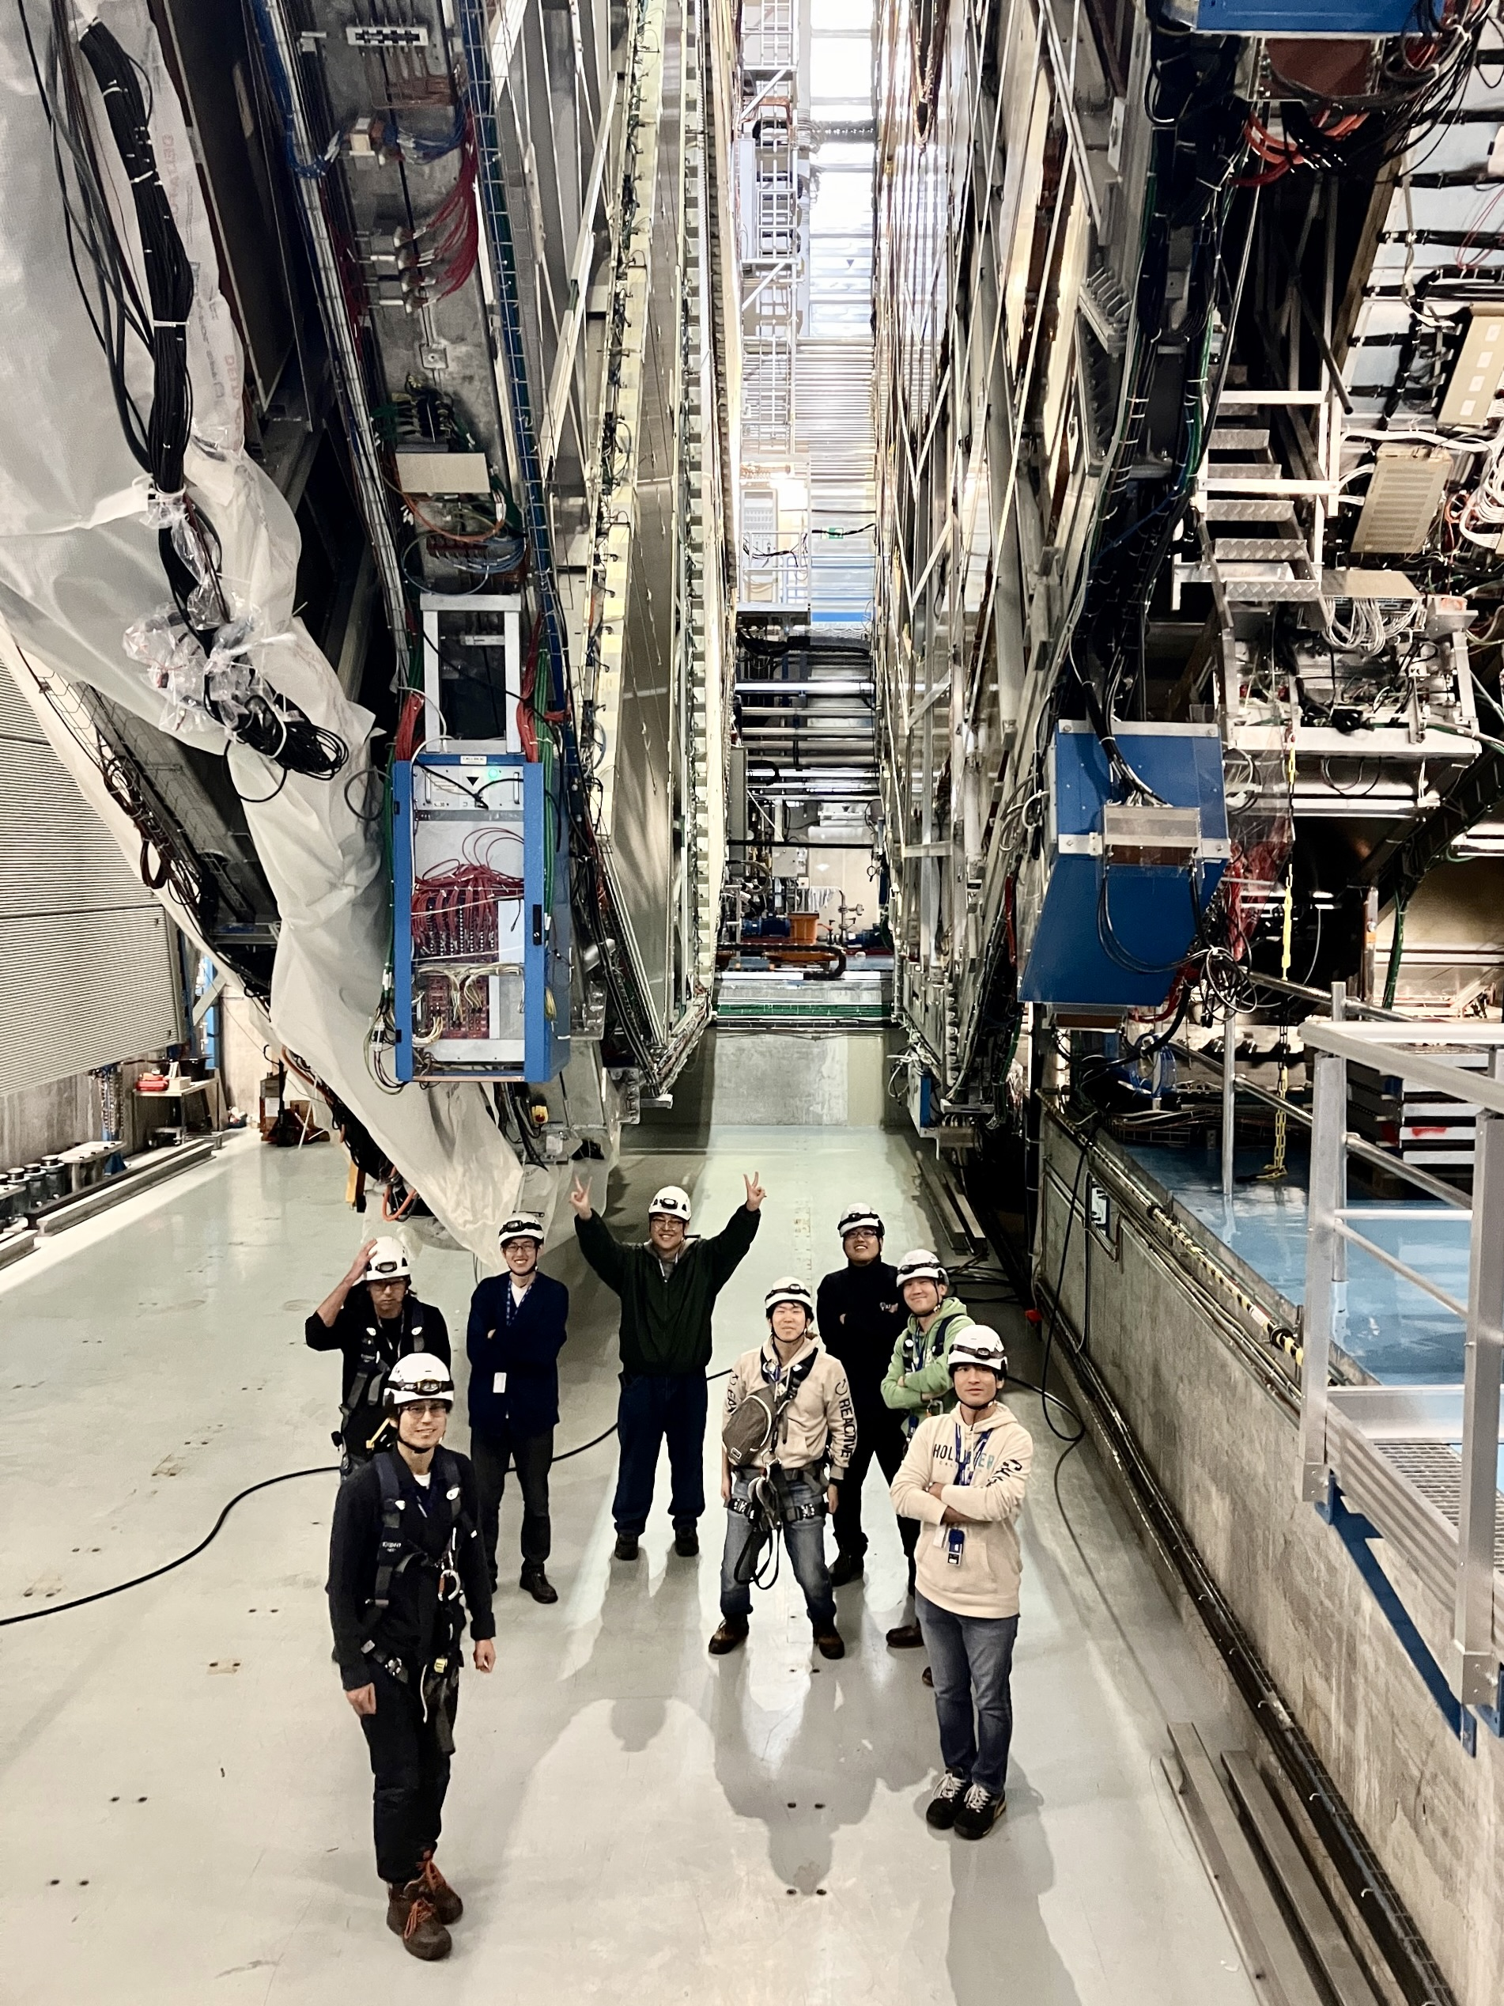
The ATLAS Collaboration
ATLAS is a multi-decade experimental programme involving:
242 institutes from 40 countries + 16 Technical Associate Institutes
2900 Scientific authors, 1200 Physics PhD students, 1300 Engineers or technicians, 100 Engineering students, 6000 Active members
Japan is a founding member of ATLAS
13 institutes, among which the Kobayashi-Maskawa Institute, Nagoya
183 members, 30 PhD students
Huge contributions to detector construction, operation, upgrade (also from Japanese industry), and to ATLAS physics results
Links: ATLAS public home page, Physics results, Interactive ATLAS world map, Static world maps, List of ATLAS institutes

Slide 14
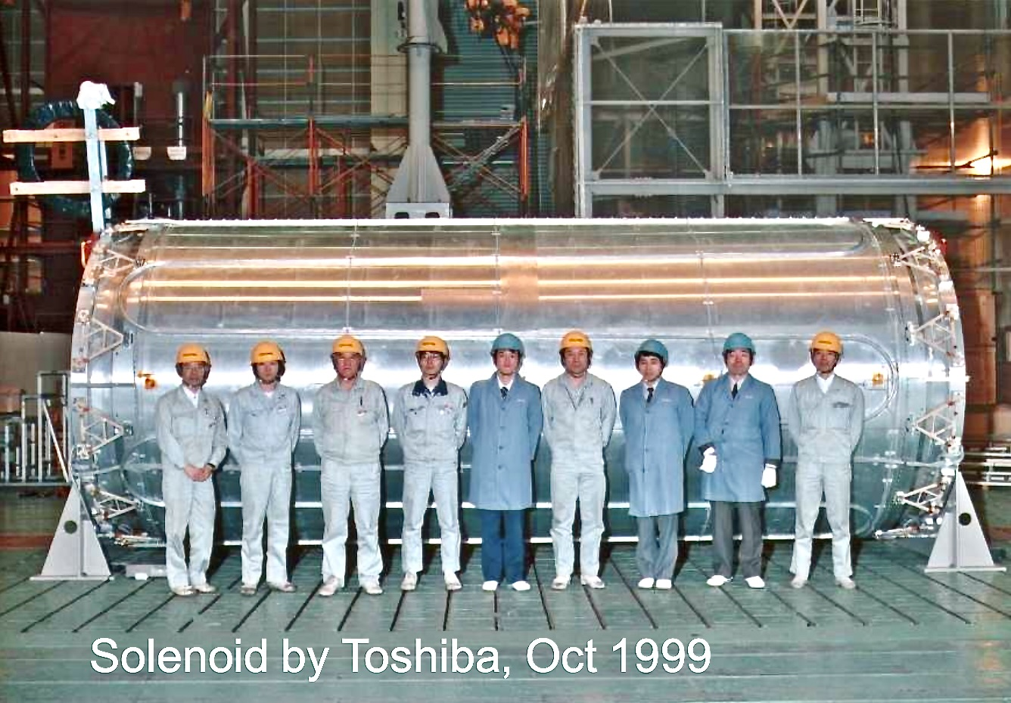
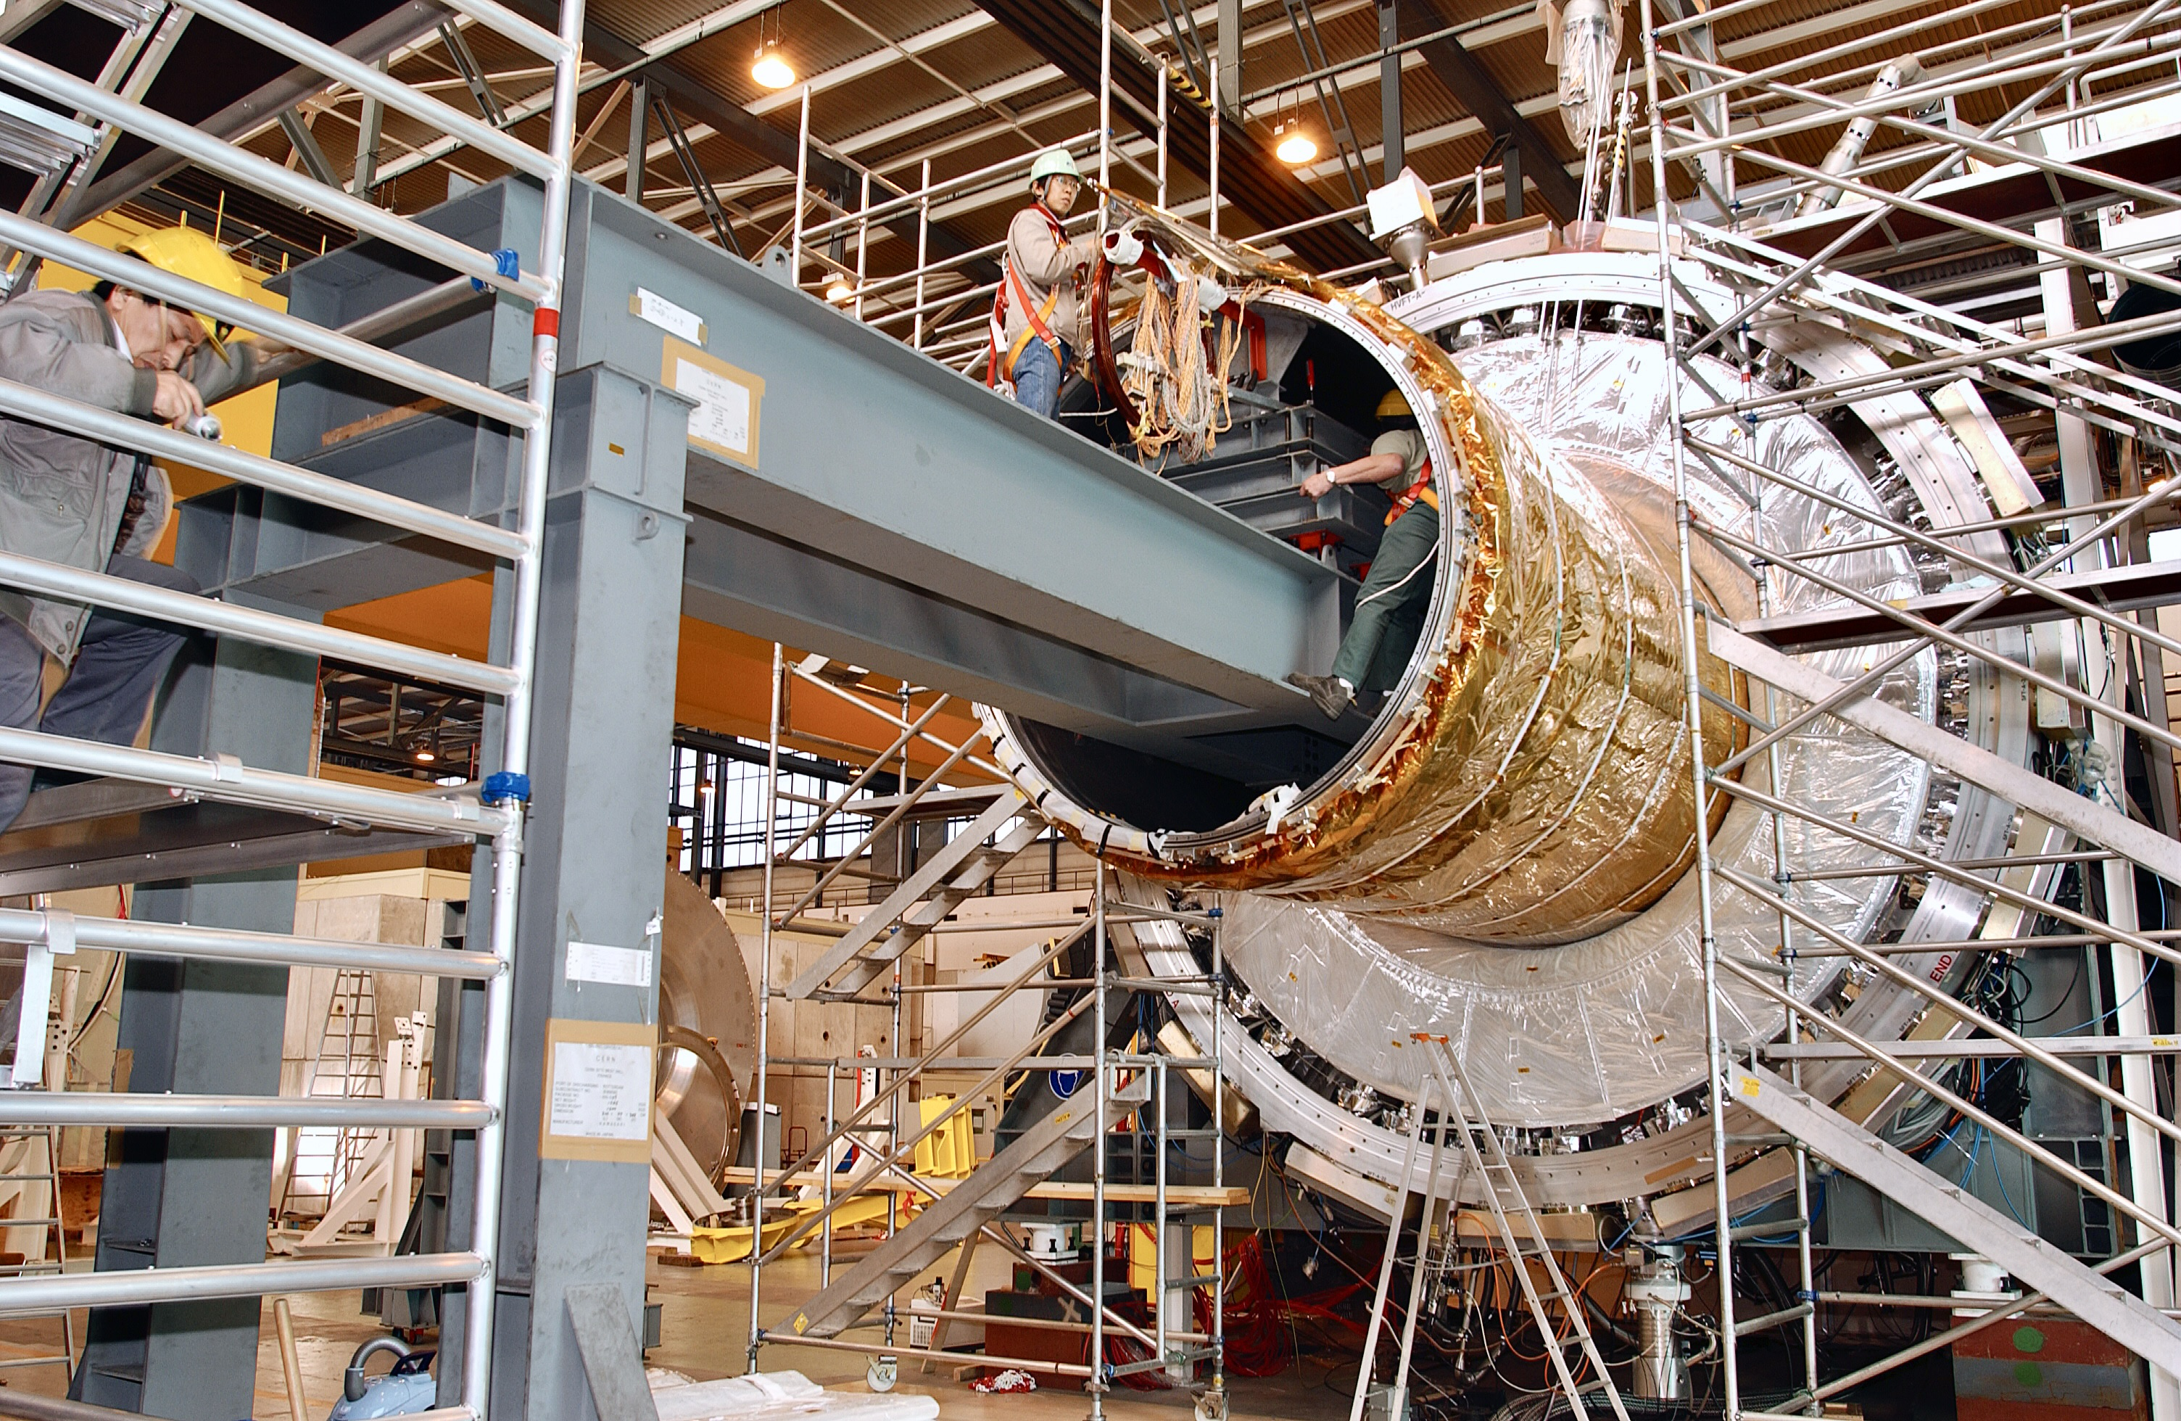
The ATLAS Collaboration
ATLAS is a multi-decade experimental programme involving:
242 institutes from 40 countries + 16 Technical Associate Institutes
2900 Scientific authors, 1200 Physics PhD students, 1300 Engineers or technicians, 100 Engineering students, 6000 Active members
Japan is a founding member of ATLAS
13 institutes, among which the Kobayashi-Maskawa Institute, Nagoya
183 members, 30 PhD students
Huge contributions to detector construction, operation, upgrade (also from Japanese industry) and to ATLAS physics results
Solenoid built from 4 coils welded together to give a single coil: 1159 turns, 5.3 m long, 1.25 m radius, 7600 A to produce axial field of 2 T at its centre
Insertion of Solenoid into barrel LAr calorimeter cryostat (by Kawasaki HI)
Links: ATLAS public home page, Physics results, Interactive ATLAS world map, Static world maps, List of ATLAS institutes

Slide 15
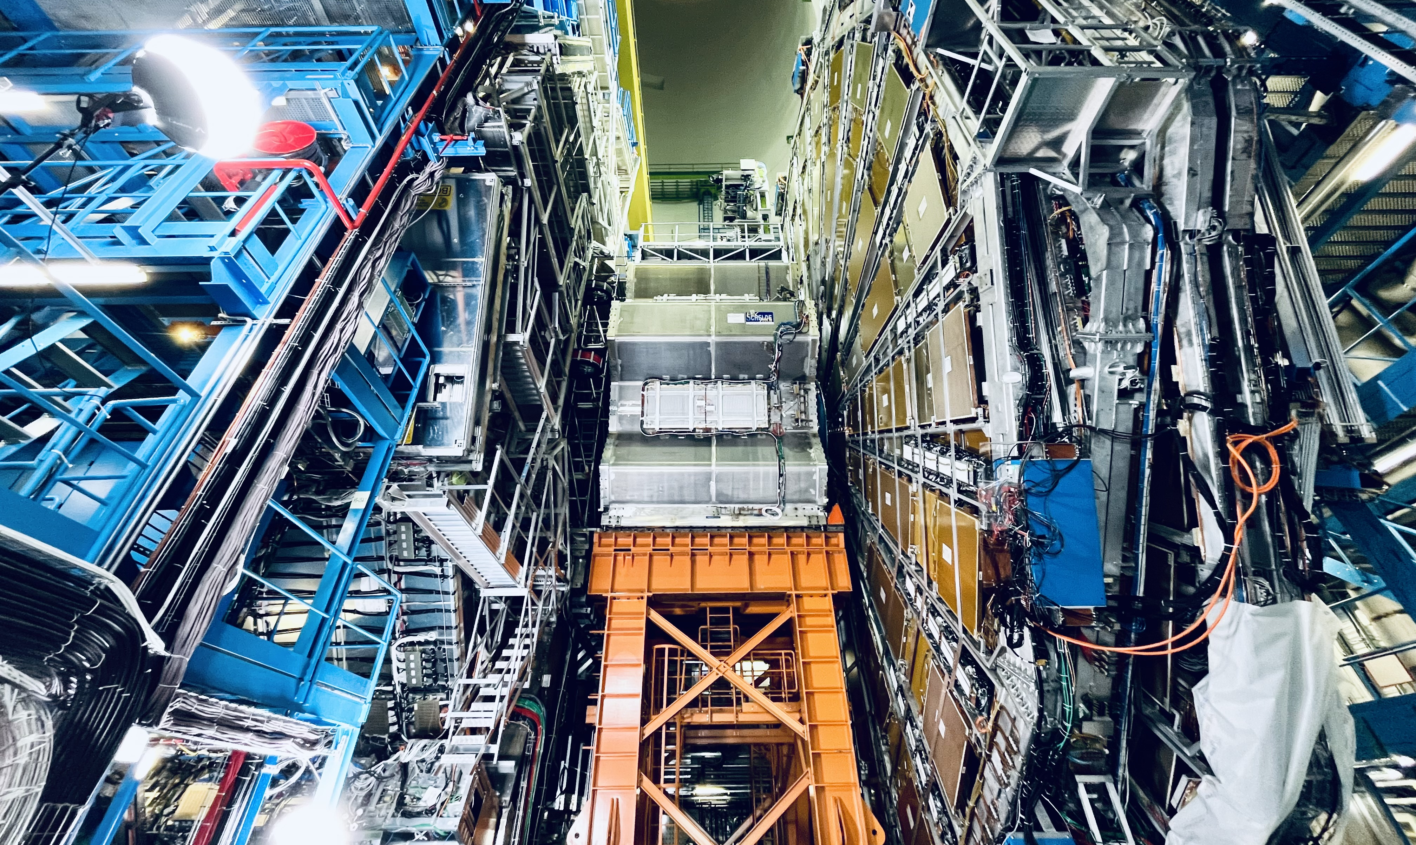

Slide 16
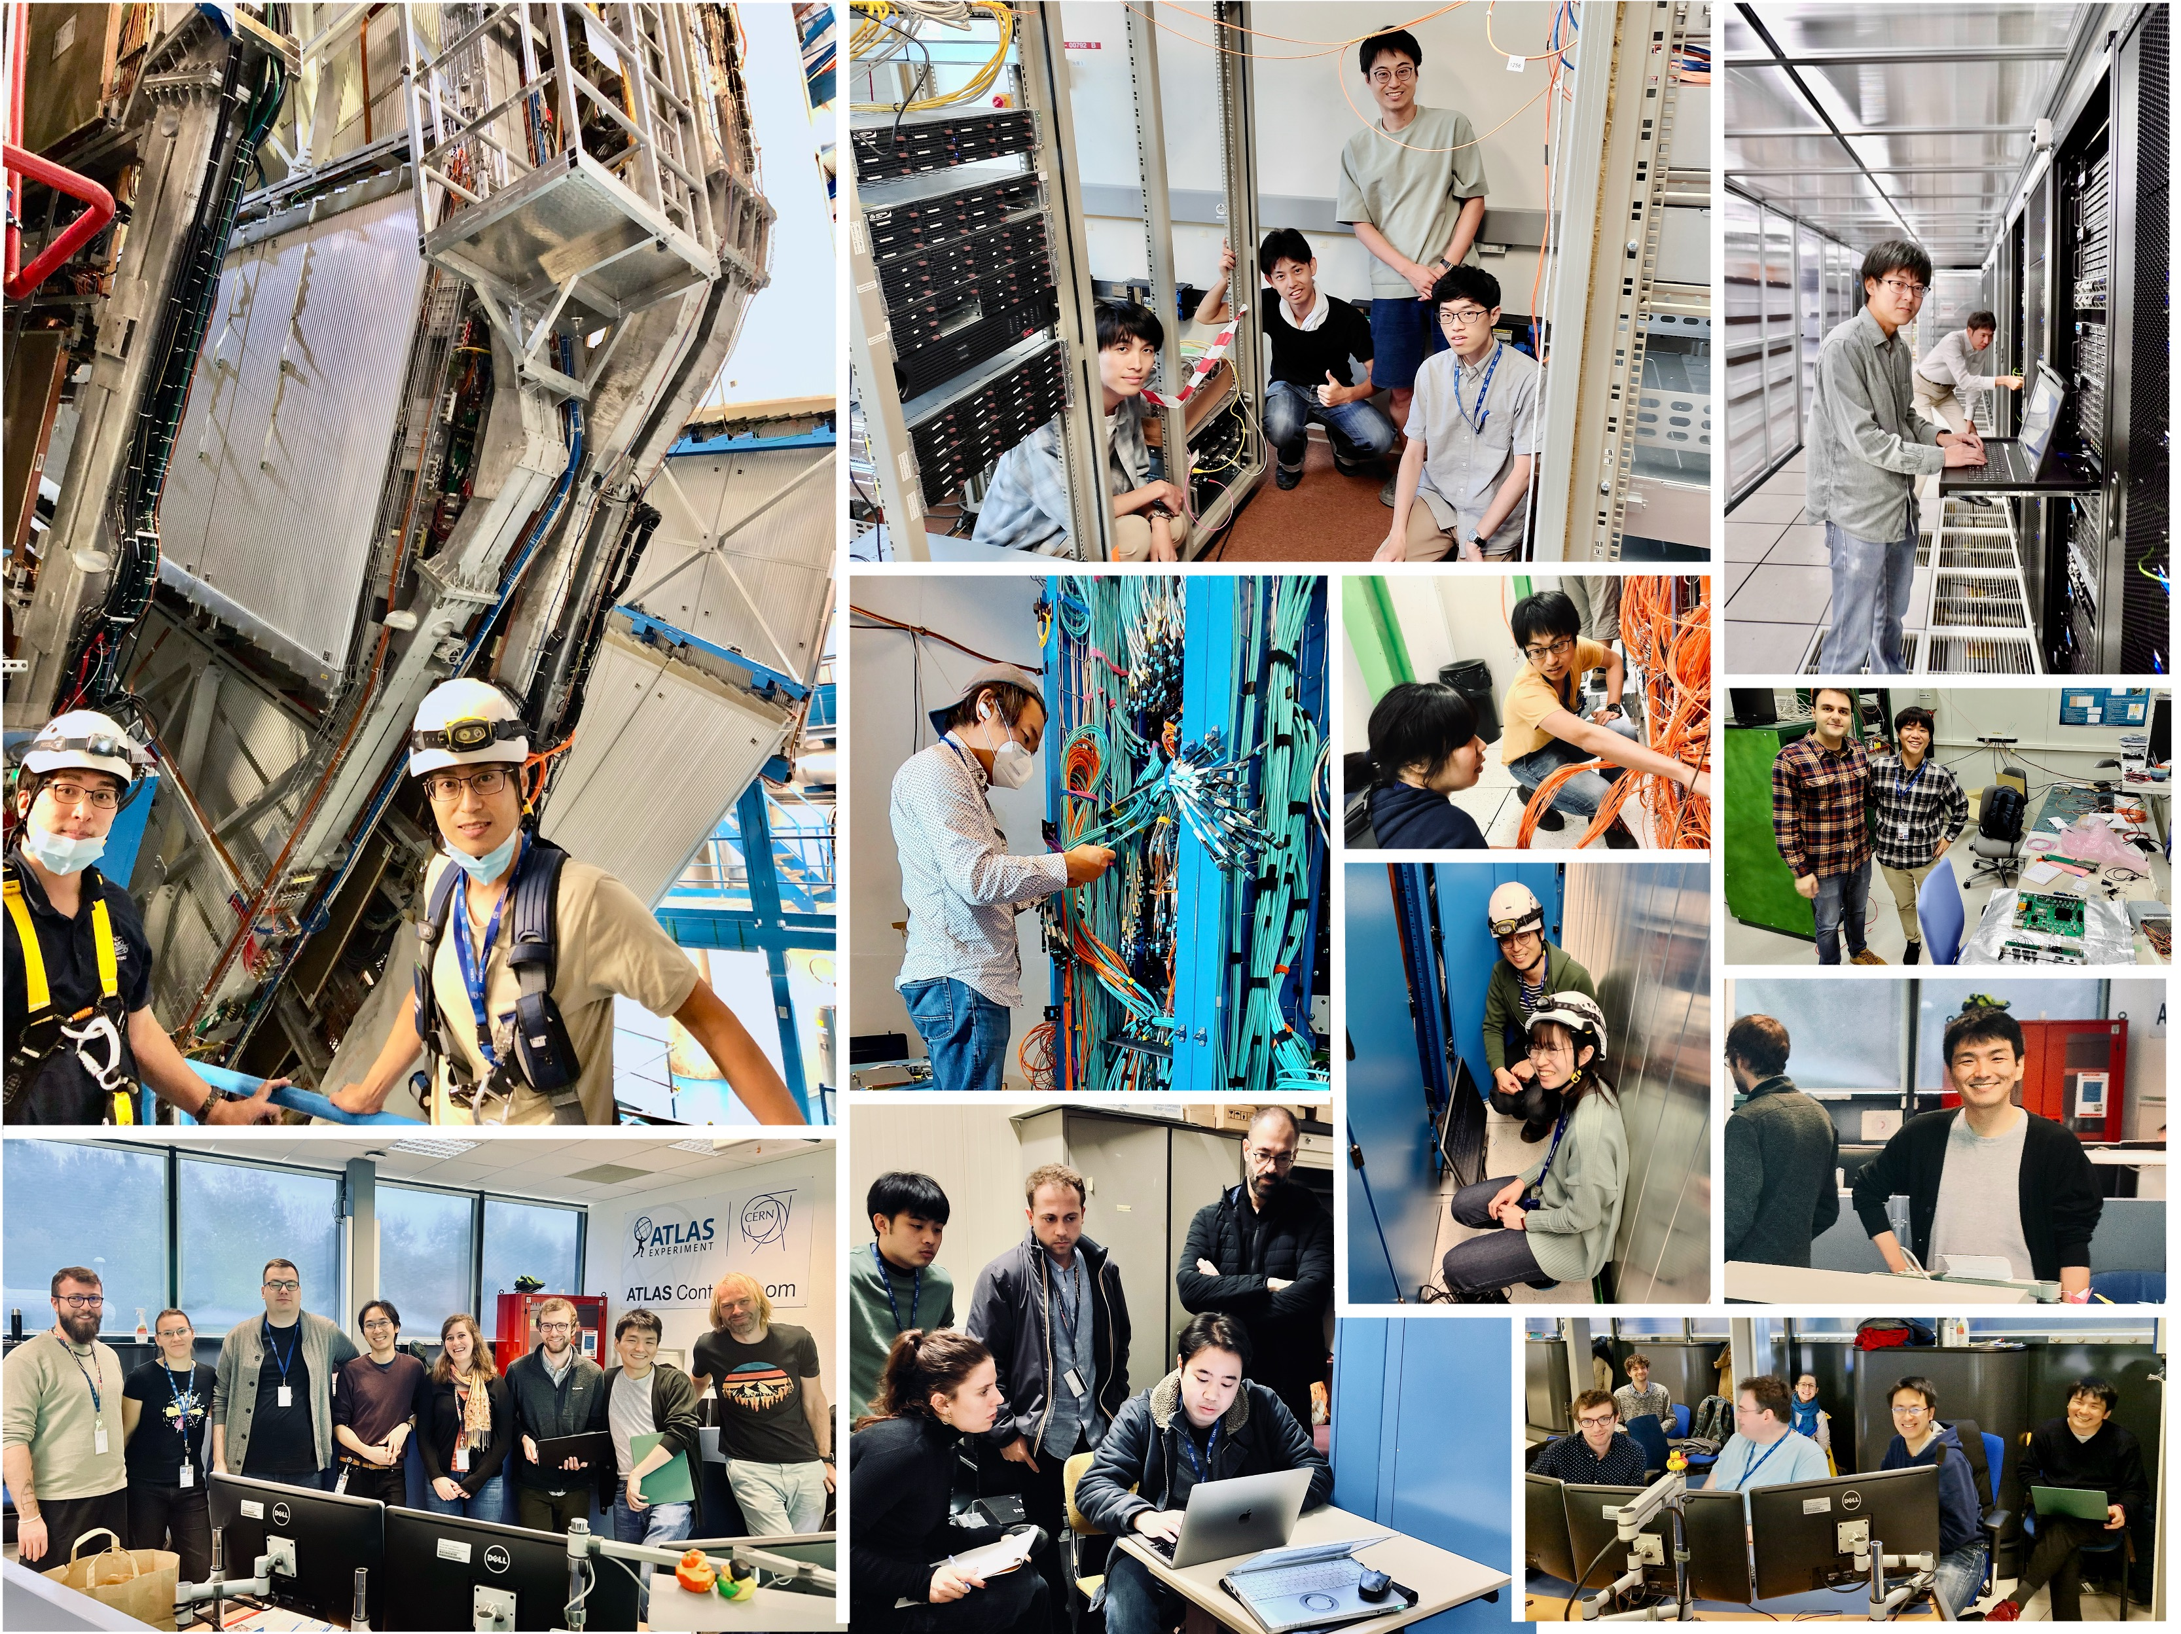

Slide 17
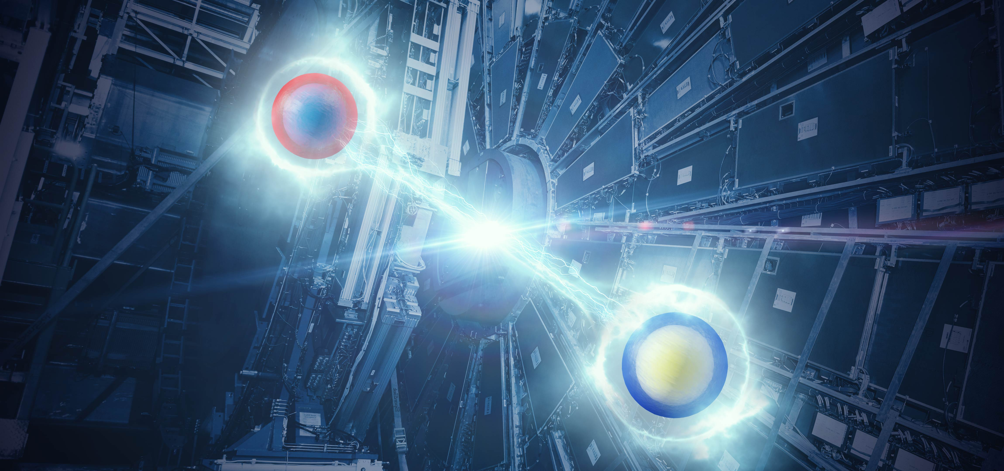
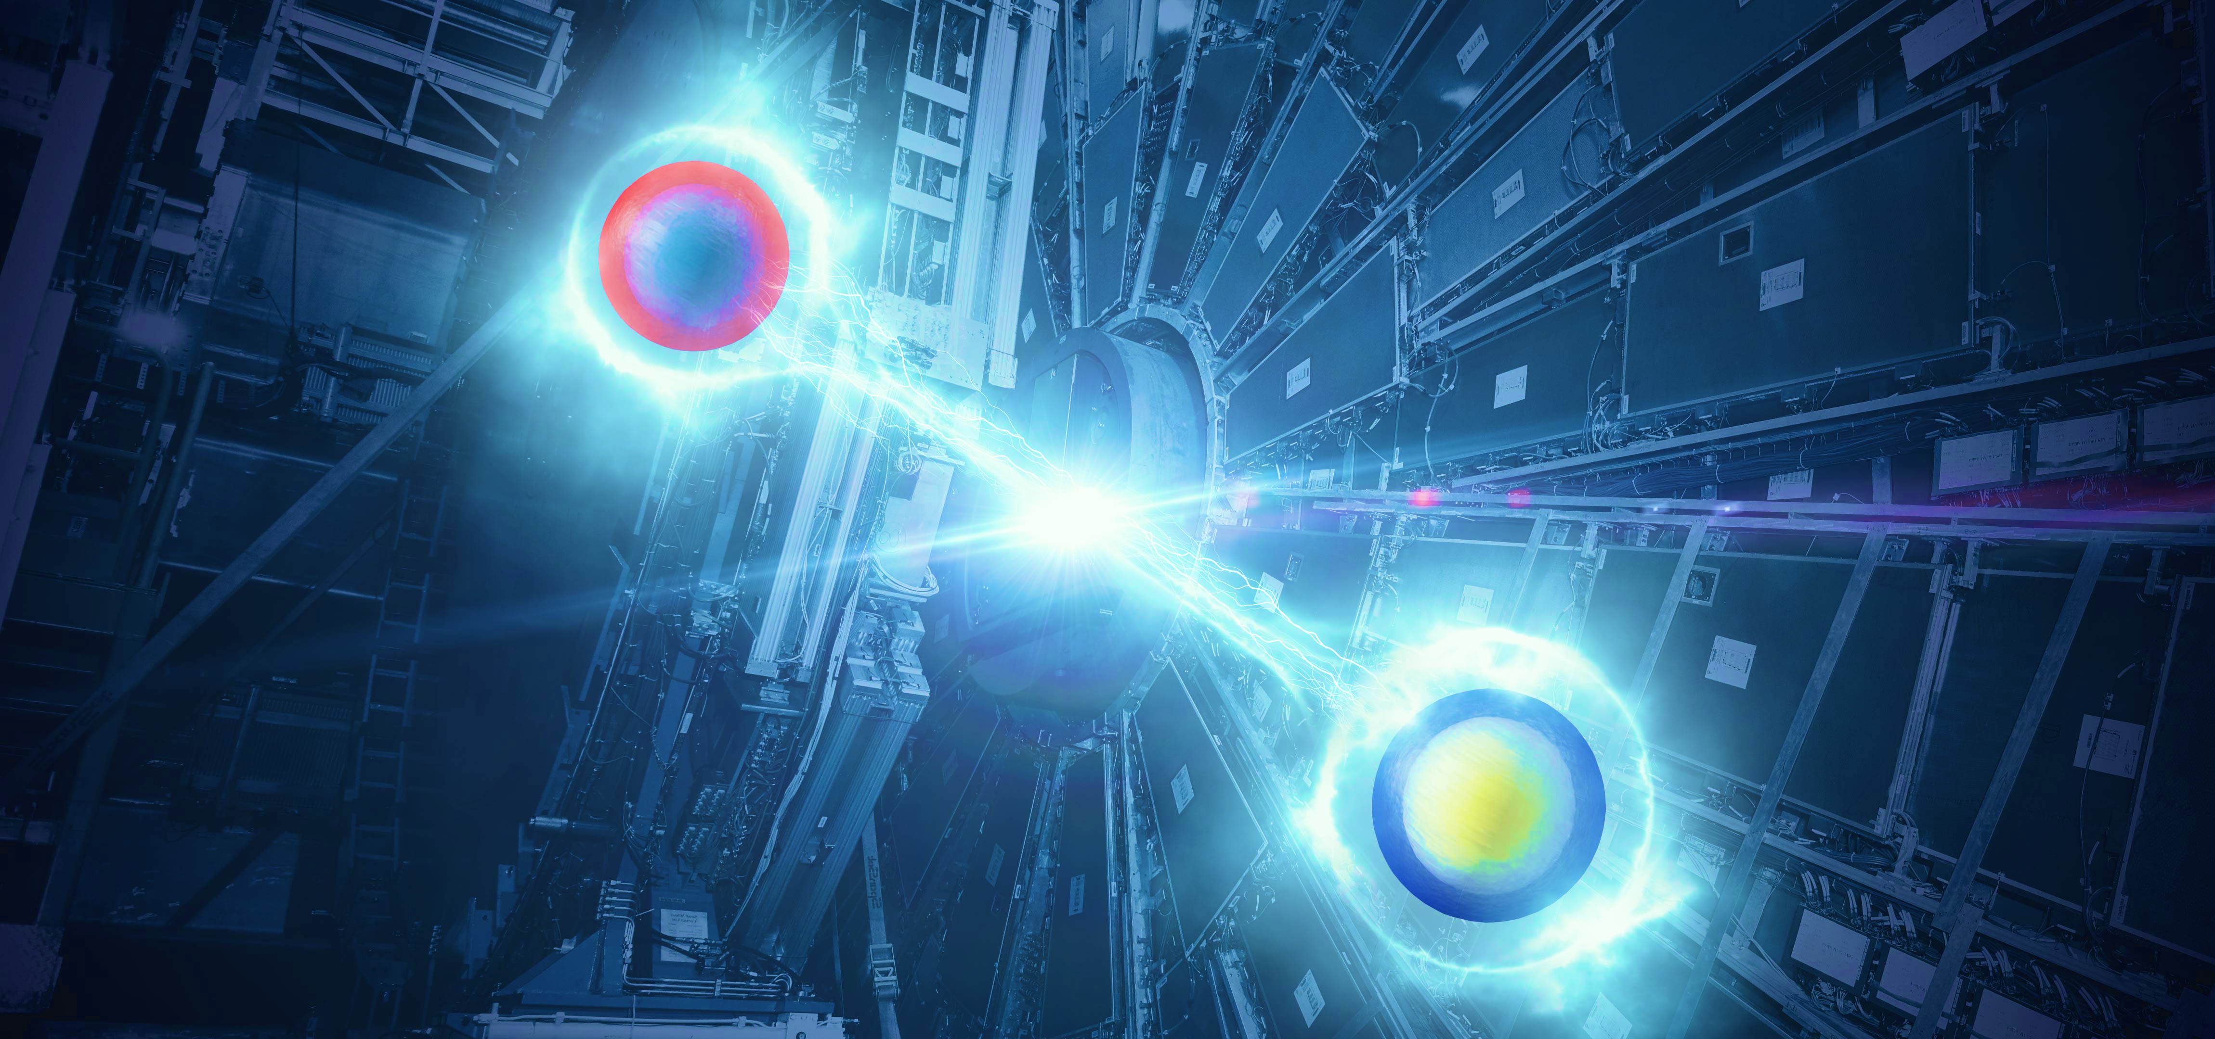
Physics results
  High-energy proton collisions enable an exceptionally broad physics program covering (almost) the full breadth of particle physics. ATLAS and CMS have each released more than 1350 papers
tt → eµ + jets candidate event in 2016 8.16 TeV p-Pb collisions
Observation quantum entanglement in top-pair production
Nature, 633, pages 542 (2024), CERN press release

Slide 18
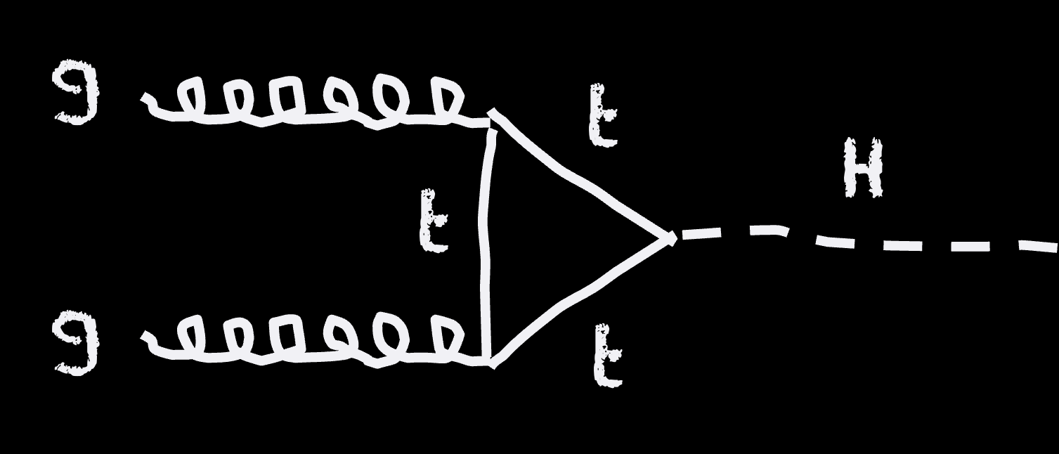
Higgs boson Physics
About 1 Higgs boson per second is produced in ATLAS at the LHC (about 20M total by today), mostly through gluon fusion
As the Higgs boson couples to mass, it decays predominantly into heavy particles (58% into bb)
Loop process, sensitive to heavy new particles
(88% of H production)
→ Shota Izumiyama’s talk at KMI2025
A Higgs boson to 4µ candidate event

Slide 19
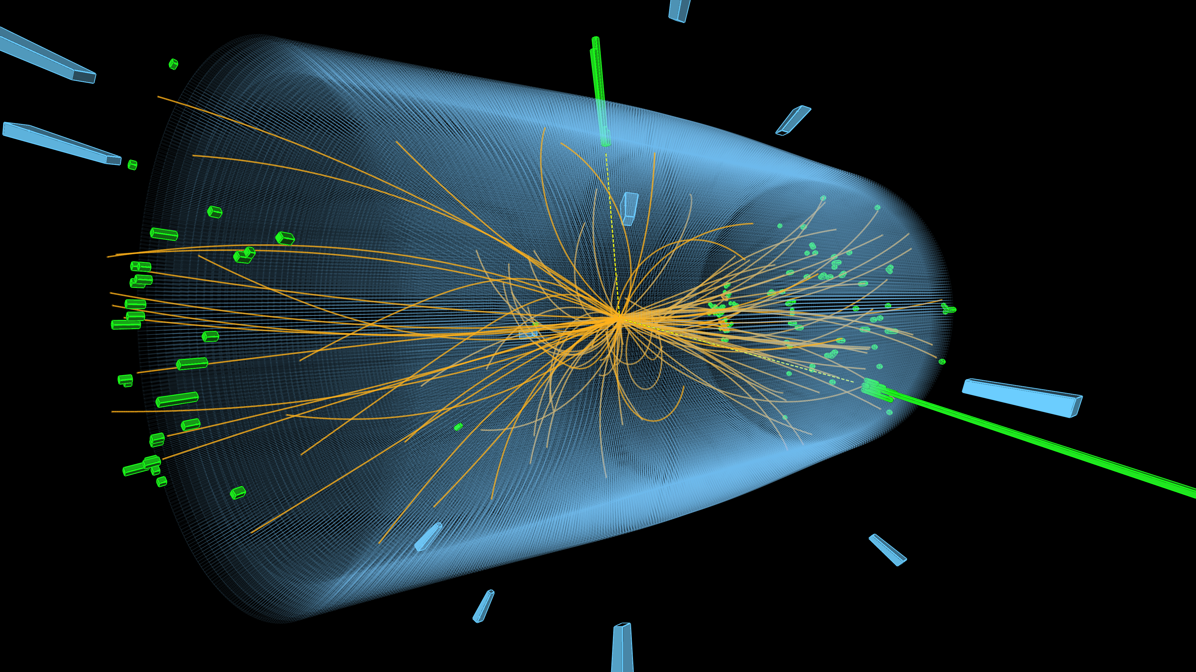
Higgs boson Physics
A Higgs boson to 2 photons candidate

Slide 20
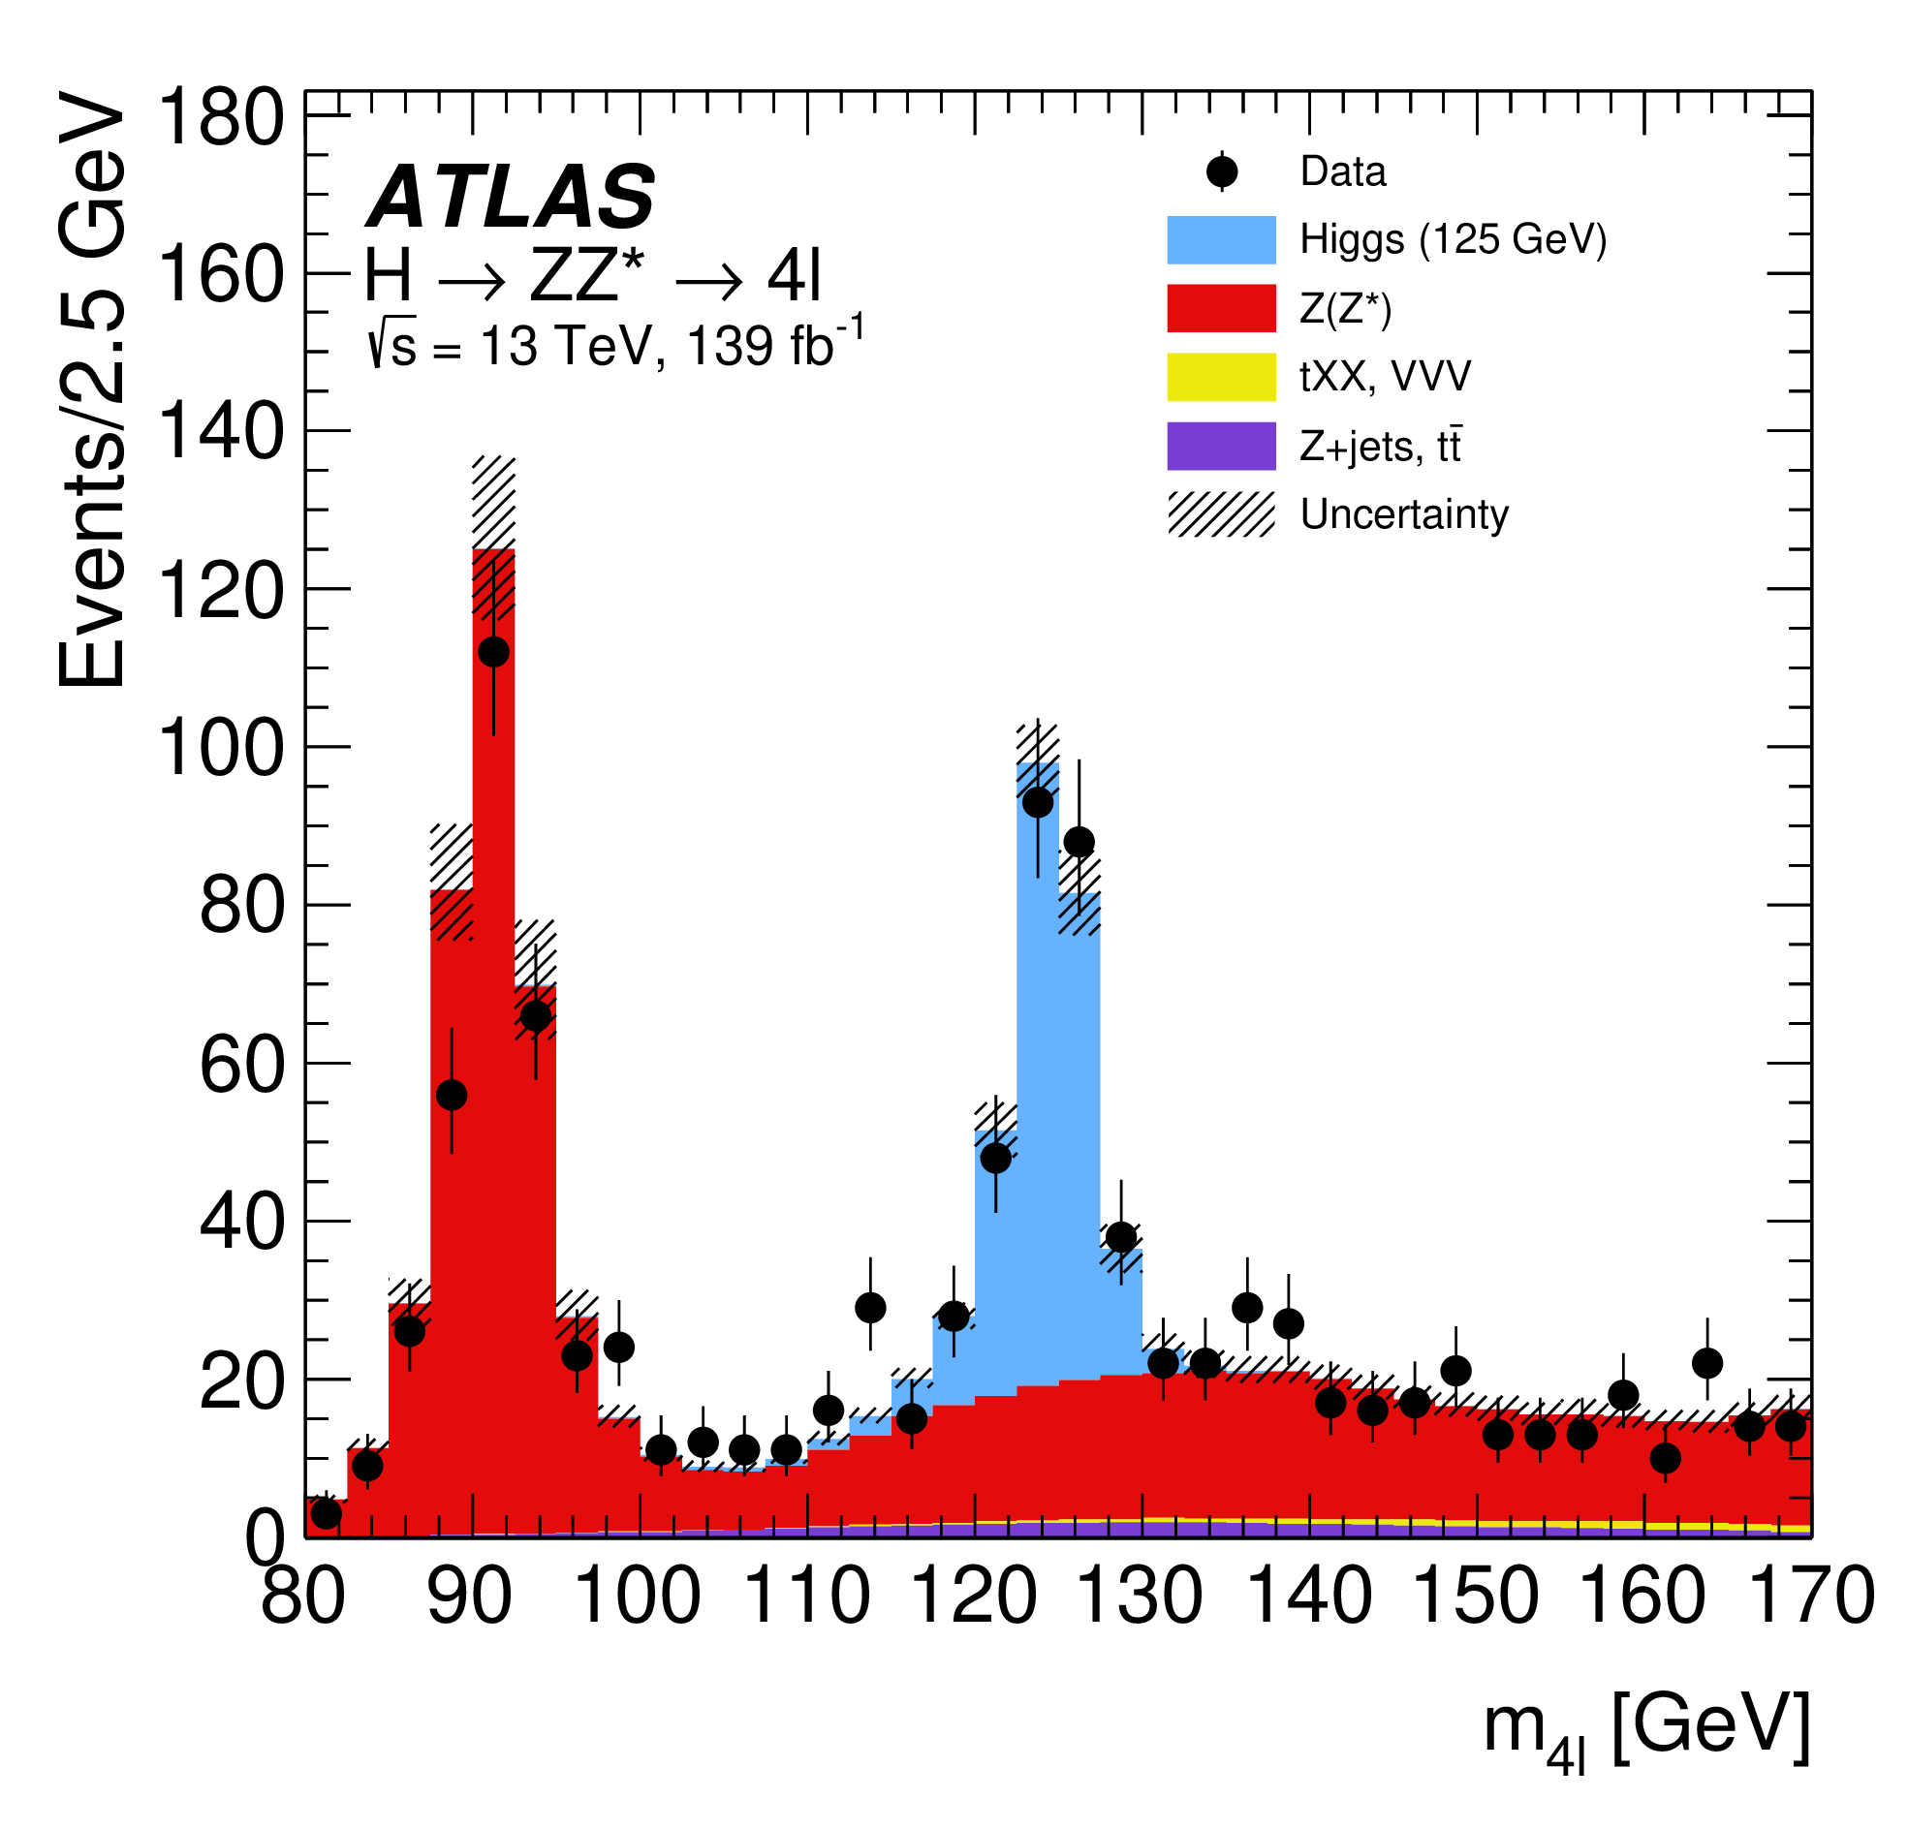
The Higgs boson — At 10
2020
JHEP 07 (2023) 088
Eur. Phys. J. C 80 (2020) 942
H → 𝛾𝛾
H → ZZ* → 4𝓁

Slide 21
Higgs boson mass
2020
Eur. Phys. J. C 80 (2020) 942
The Higgs mass is peculiar
m_{H} = 125.11 ± 0.11 GeV (0.09%)
arXiv:2308.04775

Slide 22
Higgs boson mass
Radiative corections sensitive to heavy particles in loop
The Higgs mass is peculiar
It is consistent with the global electroweak fit
Gfitter Group: arXiv:1803.01853

Slide 23
W mass
Recent CMS W mass meaurement from constrained profile likelihood fit to lepton p_{T} distribution
arXiv:2412.13872

Slide 24
Top mass and strong coupling strength
Combination of Run-1 ATLAS and CMS top mass measurements: 0.19% relative precision
arXiv:2309.12986
Most precise α_{S} measurement to date, from precise measurement of Z p_{T} spectra
arXiv:2402.08713

Slide 25
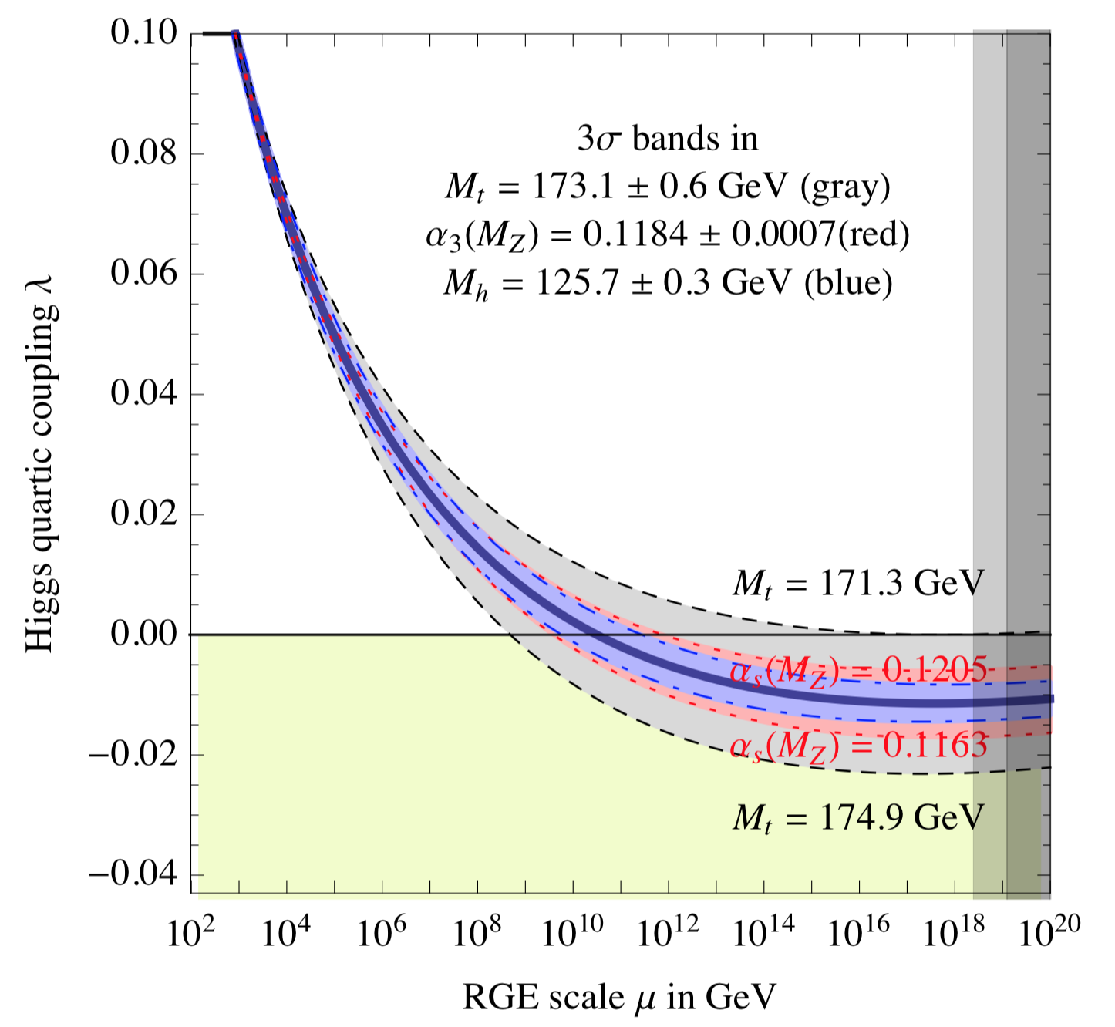
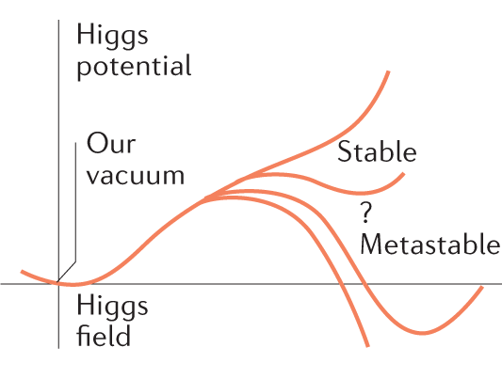


Higgs boson mass
Evolution of the Higgs quartic coupling, assuming SM (only)
The Higgs mass is peculiar
It is consistent with the global electroweak fit
But the electroweak vacuum seems to be metastable
$$V\left(φ\right)=−μ^{2}{\left|φ\right|}^{2}+λ{\left|φ\right|}^{4}$$
λ may become zero and even negative at high energy
where: $λ(μ)=\frac{m_{H}^{2}}{2υ^{2}}+δλ(μ)$
arXiv:1205.6497

Slide 26
Higgs boson couplings
Huge experimental programme, some channels suffer from large backgrounds, huge improvements from smart analysis techniques and machine learning
The Higgs boson couplings to the SM particles are experimentally determined by measuring cross-sections of all accessible Higgs boson production and decay modes
Channel categories |  | BR | ggF | VBF | VH | ttH
Cross Section (13 TeV) |  |  | 48.6 pb | 3.8 pb | 2.3 pb | 0.5 pb
γγ | 0.2 % | 0.2 % | ✓ | ✓ | ✓ | ✓
ZZ | 2.6% | 3% | ✓ | ✓ | ✓ | ✓
WW | 21% | 22% | ✓ | ✓ | ✓ | ✓
ττ | 6.3 % | 6.3 % | ✓ | ✓ | ✓ | ✓
bb | 58% | 55% | ✓ | ✓ | ✓ | ✓
Zγ (& γγ∗) | 0.2 % | 0.2 % | ✓ | ✓ | ✓ | ✓
μμ | 0.02 % | 0.02 % | ✓ | ✓ | ✓ | ✓
→ Shota Izumiyama’s talk at KMI2025
In grey: evidence for decays, but not observed yet

Slide 27
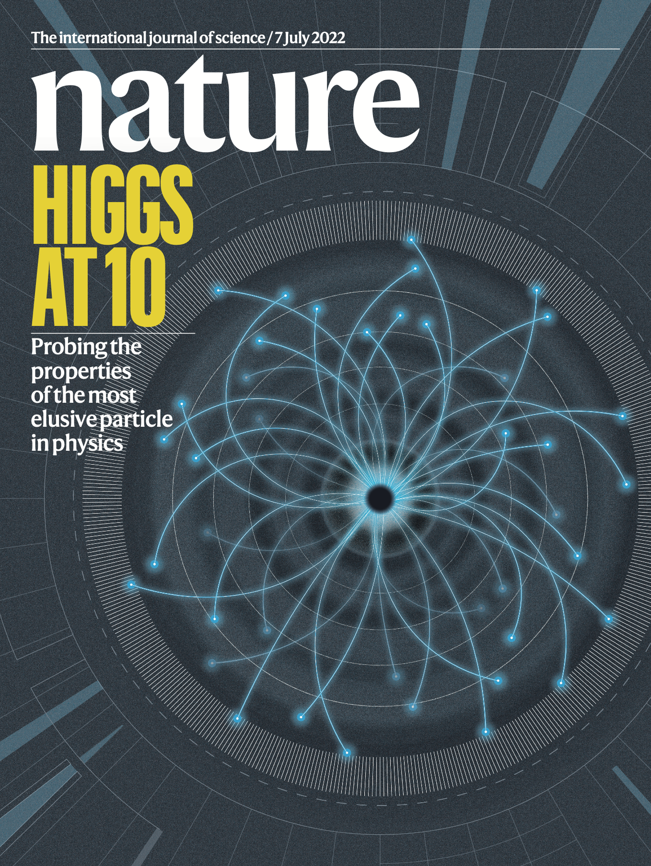
The Higgs mechanism is real !
Non-universal coupling
Measurements by ATLAS and CMS have confirmed the non-universal, mass-dependent coupling strengths of the Higgs boson to the SM particles
Nature 607, 52 (2022)

Slide 28
The Higgs mechanism is real !
Coupling strengths wrt SM:
κ_{𝛾} = 1.01 ± 0.06, κ_{g} = 0.95 ± 0.07
Non-universal coupling
Measurements by ATLAS and CMS have confirmed the non-universal, mass-dependent coupling strengths of the Higgs boson to the SM particles
κ_{µ} = 1.06
+0.25
κ_{top} = 0.94 ± 0.11
–0.30
κ_{b} = 0.89 ± 0.11
κ_{W} = 1.05 ± 0.06
κ_{Z} = 0.99 ± 0.06
κ_{𝜏} = 0.93 ± 0.07
Nature 607, 52 (2022)

Slide 29
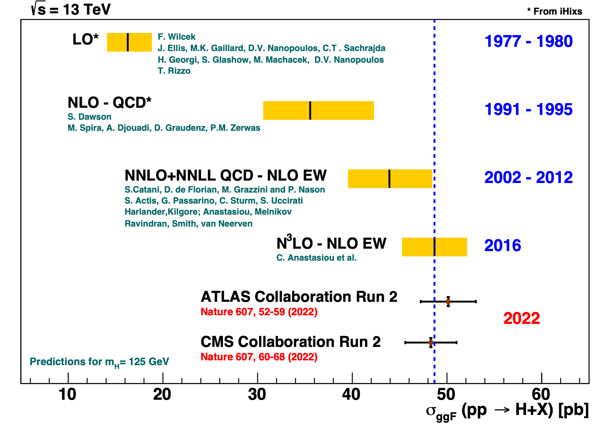
Theory predictions
Calculations of Higgs boson production via gluon fusion versus time
Predictions at hadron colliders are extremely complex and require several levels of modelling and calculations (higher order hard processes, parton fragmentation, hadronization, parton distribution functions, etc…)
The interpretability of our results relies on our ability to compute accurate and precise predictions
Marumi Kado

Slide 30
The Higgs mechanism is real !
Possible relations between the Higgs boson and open questions in particle physics and cosmology
What stabilises the Higgs mass versus high-scale new physics? Are there new TeV-scale symmetries? Is the Higgs boson elementary or composite, are there anomalies in its coupling to the W or Z?
Do Higgs interactions violate CP? Is there an anomalous Higgs self coupling to allow for a first order electroweak phase transition?
Is the Higgs boson unique?
What is the origin of dark matter, is the Higgs mechanism responsible for dark matter? Can the Higgs boson provide a portal to a dark sector?
What is the origin of the vast range of Yukawa couplings, are there modified interactions, lepton-flavour violation?
Is the vacuum metastable? Is the Higgs field connected with cosmic inflation? Are there possible cosmological observations related to the Higgs field?
The new sector opens a variety of possibilities and questions
The discovery of an (apparently) fundamental scalar particle, resulting from spontaneous symmetry breaking, fuels renewed interest in other fundamental (pseudo)scalars, such as the axion
Salam, Wang, Zanderighi: Nature 607, 41 (2022)

Slide 31
The Higgs mechanism is real !
Possible relations between the Higgs boson and open questions in particle physics and cosmology
What stabilises the Higgs mass versus high-scale new physics? Are there new TeV-scale symmetries? Is the Higgs boson elementary or composite, are there anomalies in its coupling to the W or Z?
Do Higgs interactions violate CP? Is there an anomalous Higgs self coupling to allow for a first order electroweak phase transition?
Is the Higgs boson unique?
What is the origin of dark matter, is the Higgs mechanism responsible for dark matter? Can the Higgs boson provide a portal to a dark sector?
What is the origin of the vast range of Yukawa couplings, are there modified interactions, lepton-flavour violation?
Is the vacuum metastable? Is the Higgs field connected with cosmic inflation? Are there possible cosmological observations related to the Higgs field?
The new sector opens a variety of possibilities and questions
The discovery of an (apparently) fundamental scalar particle, resulting from spontaneous symmetry breaking, fuels renewed interest in other fundamental (pseudo)scalars, such as the axion
Salam, Wang, Zanderighi: Nature 607, 41 (2022)

Slide 32
~
t
t
Supersymmetry?
H
H
H
H
~
t
t
arXiv:2403.02455

Slide 33
The Higgs mechanism is real !
Possible relations between the Higgs boson and open questions in particle physics and cosmology
What stabilises the Higgs mass versus high-scale new physics? Are there new TeV-scale symmetries? Is the Higgs boson elementary or composite, are there anomalies in its coupling to the W or Z?
Do Higgs interactions violate CP? Is there an anomalous Higgs self coupling to allow for a first order electroweak phase transition?
Is the Higgs boson unique?
What is the origin of dark matter, is the Higgs mechanism responsible for dark matter? Can the Higgs boson provide a portal to a dark sector?
What is the origin of the vast range of Yukawa couplings, are there modified interactions, lepton-flavour violation?
Is the vacuum metastable? Is the Higgs field connected with cosmic inflation? Are there possible cosmological observations related to the Higgs field?
The new sector opens a variety of possibilities and questions
Salam, Wang, Zanderighi: Nature 607, 41 (2022)

Slide 34
Extended Higgs sector ?
The scalar sector may feature an additional Higgs doublet with opposite weak hypercharge (→ h, H, A, H±) or even triplet (+ H±±) with rich phenomenology
ATL-PHYS-PUB-2024-008

Slide 35
Extended Higgs sector ?
Interesting recent development in searches for A/H → tt
CMS-PAS-HIG-22-013
CMS sees a significant excess close to the top–antitop threshold, which is consistent with a pseudoscalar colour-singlet quasi-bound “toponium” state
(Note: threshold enhancement ∝ 𝛼_{S} / β expected in NLO QCD)

Slide 36
Extended Higgs sector ?
Interesting recent development in searches for A/H → tt
JHEP 08 (2024) 013
ATLAS has similar but less sensitive analysis, as it did not optimise for toponium. A small threshold excess in data is absorbed by systematic uncertainties

Slide 37
The Higgs mechanism is real !
Possible relations between the Higgs boson and open questions in particle physics and cosmology
What stabilises the Higgs mass versus high-scale new physics? Are there new TeV-scale symmetries? Is the Higgs boson elementary or composite, are there anomalies in its coupling to the W or Z?
Do Higgs interactions violate CP? Is there an anomalous Higgs self coupling to allow for a first order electroweak phase transition?
Is the Higgs boson unique?
What is the origin of dark matter, is the Higgs mechanism responsible for the dark matter mass? Can the Higgs boson provide a portal to a dark sector?
What is the origin of the vast range of Yukawa couplings, are there modified interactions, lepton-flavour violation?
Is the vacuum metastable? Is the Higgs field connected with cosmic inflation? Are there possible cosmological observations related to the Higgs field?
The new sector opens a variety of possibilities and questions
Salam, Wang, Zanderighi: Nature 607, 41 (2022)

Slide 38
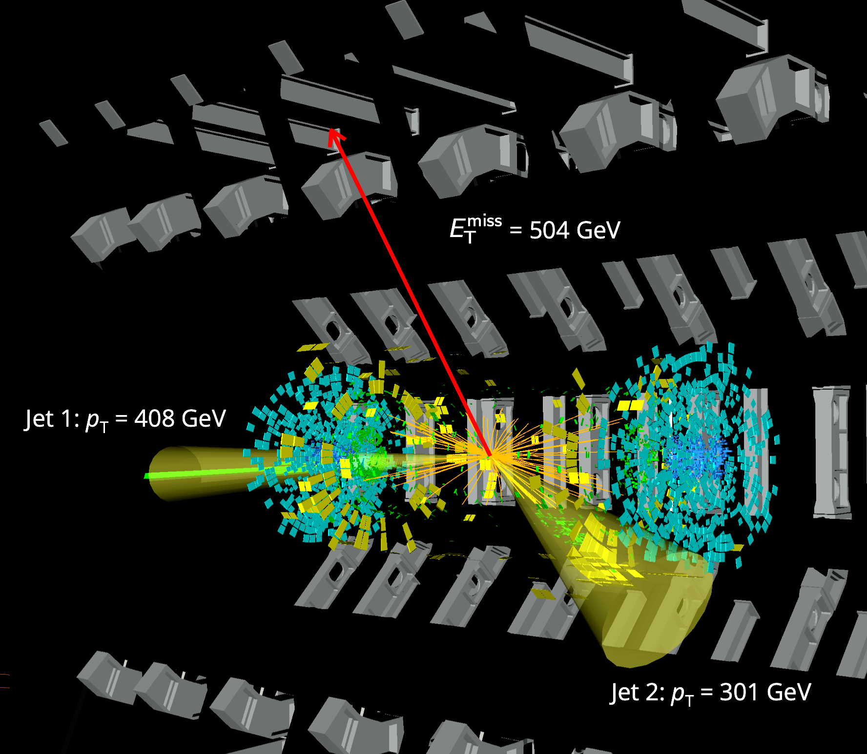
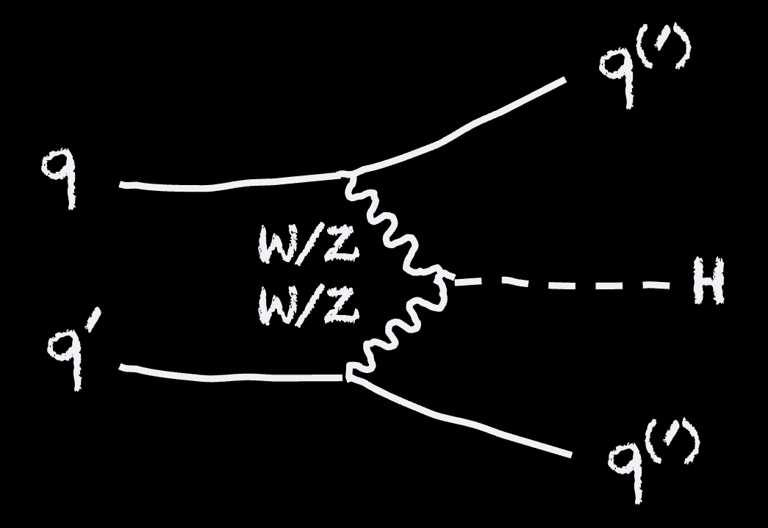

Dark matter
The Higgs boson may couple to dark matter and ”invisibly” decay to dark matter particles (if kinematically allowed)
E_{T,miss} = 504 GeV
H
→ Shion Chen’s talk at KMI2025

Slide 39
Dark matter
The Higgs boson may couple to dark matter and ”invisibly” decay to dark matter particles (if kinematically allowed)
arXiv:2202.07953, arXiv:2301.10731
H
→ Shion Chen’s talk at KMI2025
➠ BR(H → invisible) < 0.107 (0.077) at 95% CL

Slide 40
Dark matter
Spin-independent scattering cross-section of a weakly interacting massive particle (WIMP) and a nucleon
The Higgs boson may couple to dark matter and ”invisibly” decay to dark matter particles (if kinematically allowed)
arXiv:2202.07953, arXiv:2301.10731
H
→ Shion Chen’s talk at KMI2025
➠ BR(H → invisible) < 0.107 (0.077) at 95% CL

Slide 41
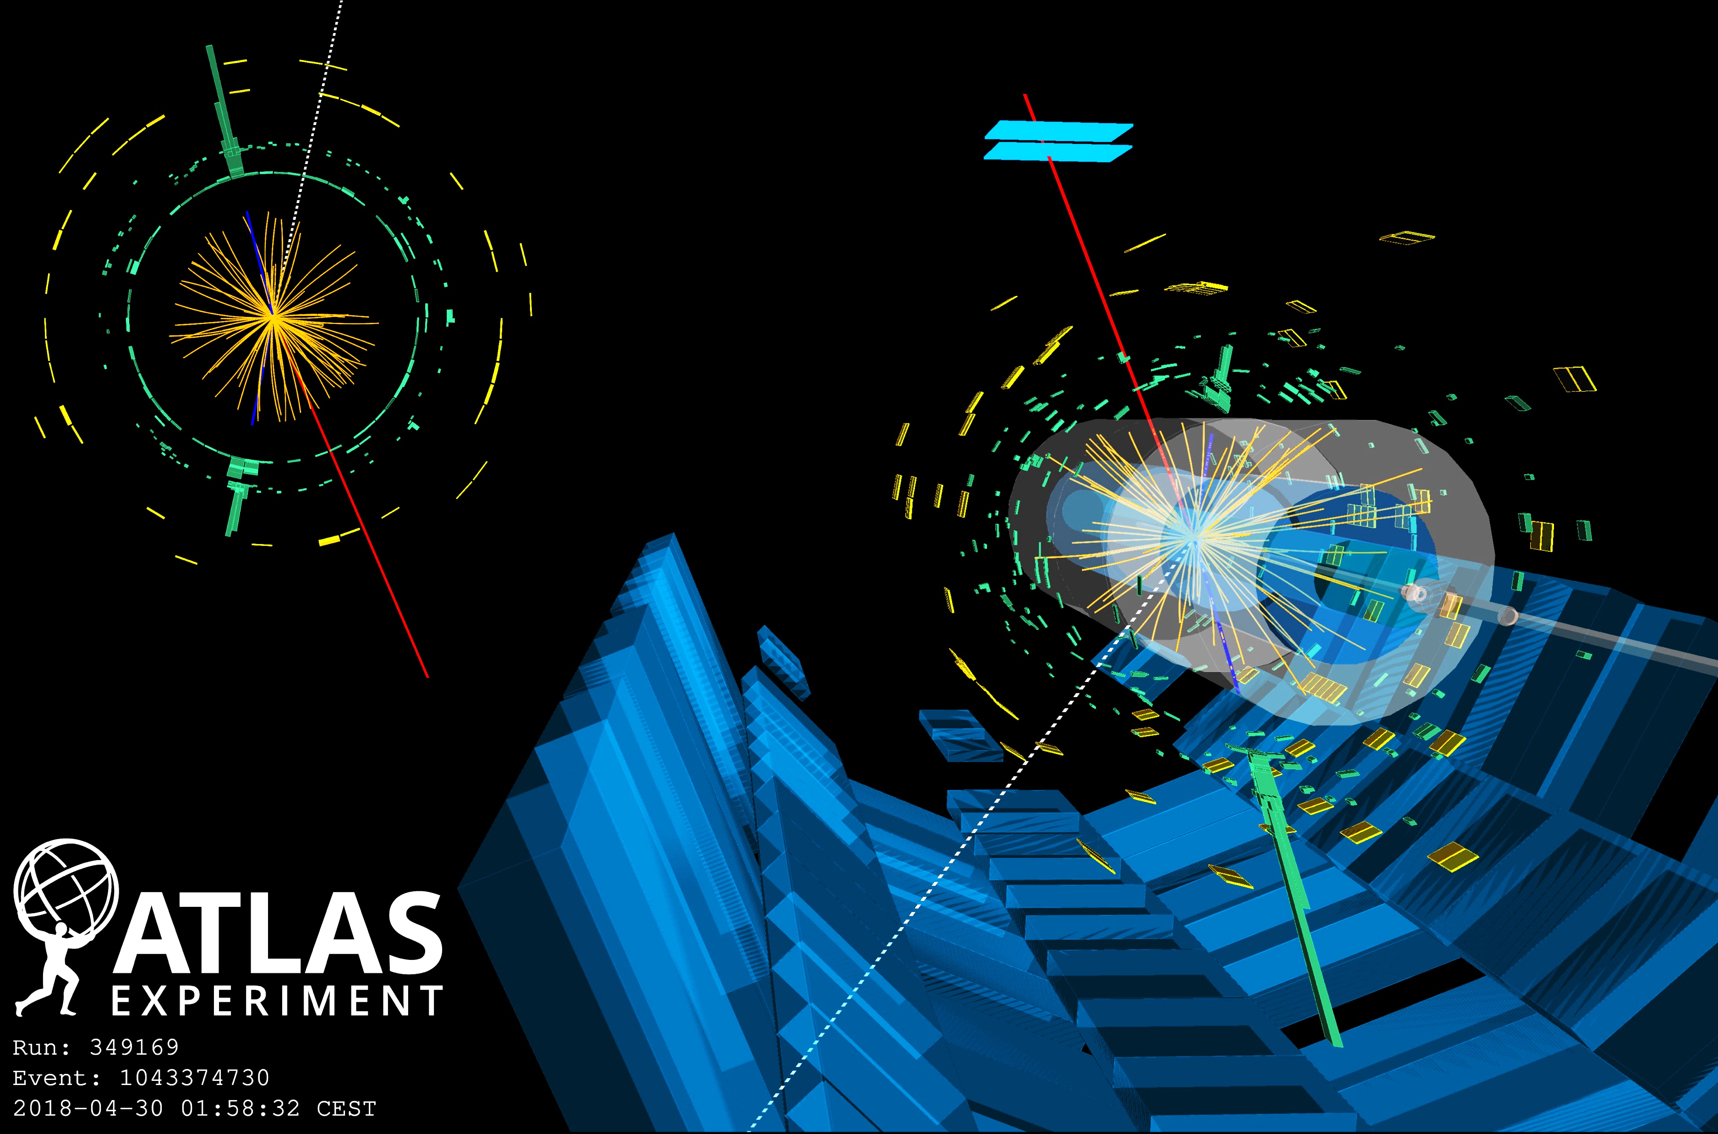

The LHC also provided a new understanding of hadron collider processes: the observation of numerous very rare channels testing the Standard Model
pp → WWW → $e$𝜈 $e$𝜈 μ𝜈 candidate

Slide 42
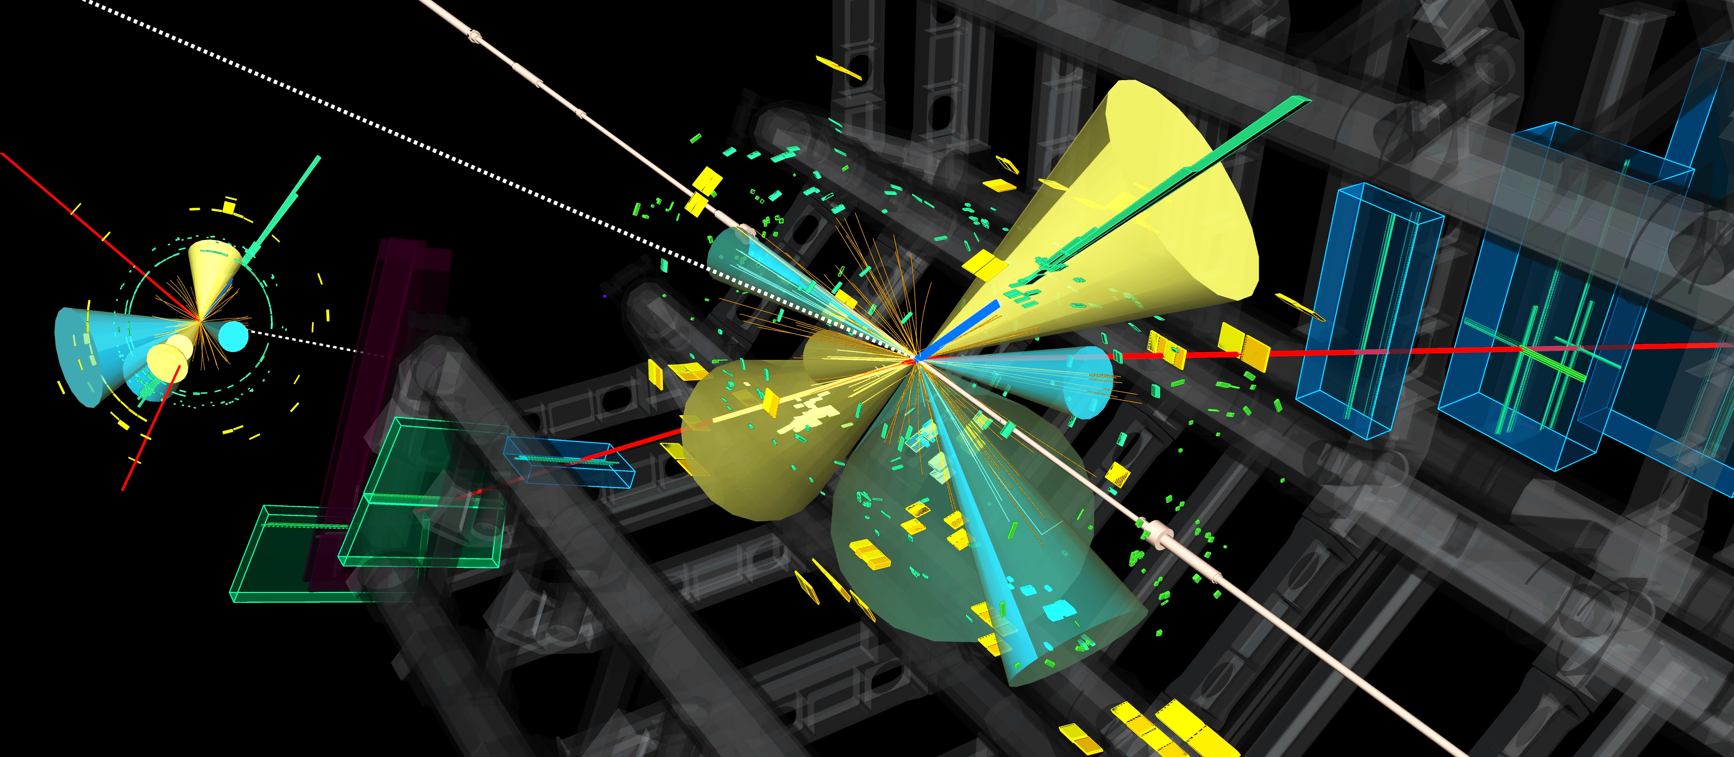
The LHC also provided a new understanding of hadron collider processes: the observation of numerous very rare channels testing the Standard Model
pp → tttt candidate event (very rare events, 70,000 rarer than tt, 4,000 rarer than Higgs boson production, with spectacular signature: 4 b-jets, many leptons and jets)

Slide 43
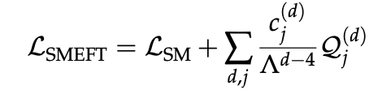
Consistent parametrisation of new physics with effective field theory (EFT)
CMS-PAS-SMP-24-003
Global fit of Wilson coefficients of D=6 operators in SM EFT to Higgs, EW, top, and multijet results
Presentation in terms of probed energy scale for benchmark values of the Wilson coefficients

Slide 45
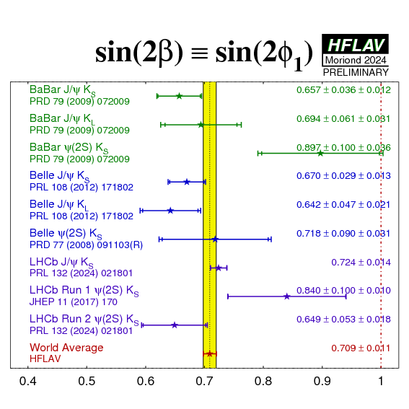
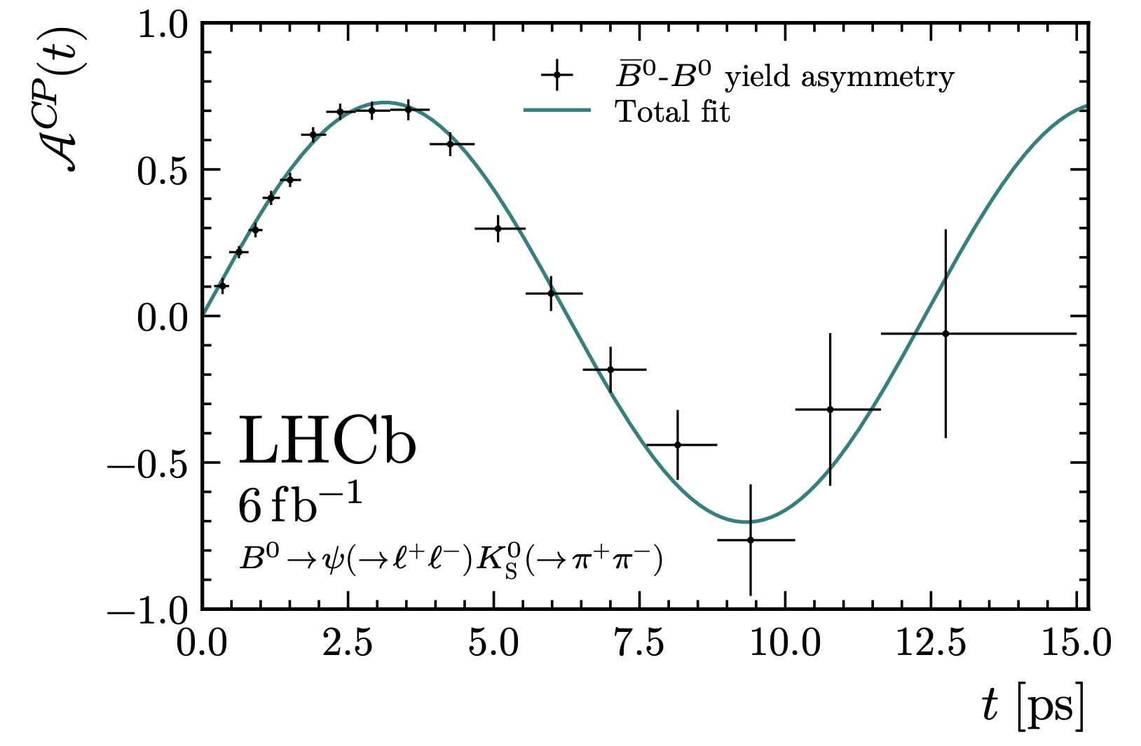
Powerful heavy-flavour measurements, complementary to Belle II
→ Gino Isidori’s talk at KMI2025
Precise measurement of CKM angles
𝛾 = ϕ₃ = 64.6 ± 2.8 deg (CKMfitter: 66.3 deg)
+0.7
–1.9
LHCb-CONF-2024-004
sin(2β / ϕ₁) = 0.724 ± 0.014 (CKMfitter: 0.742 ± 0.023)
arXiv:2309.09728

Slide 46
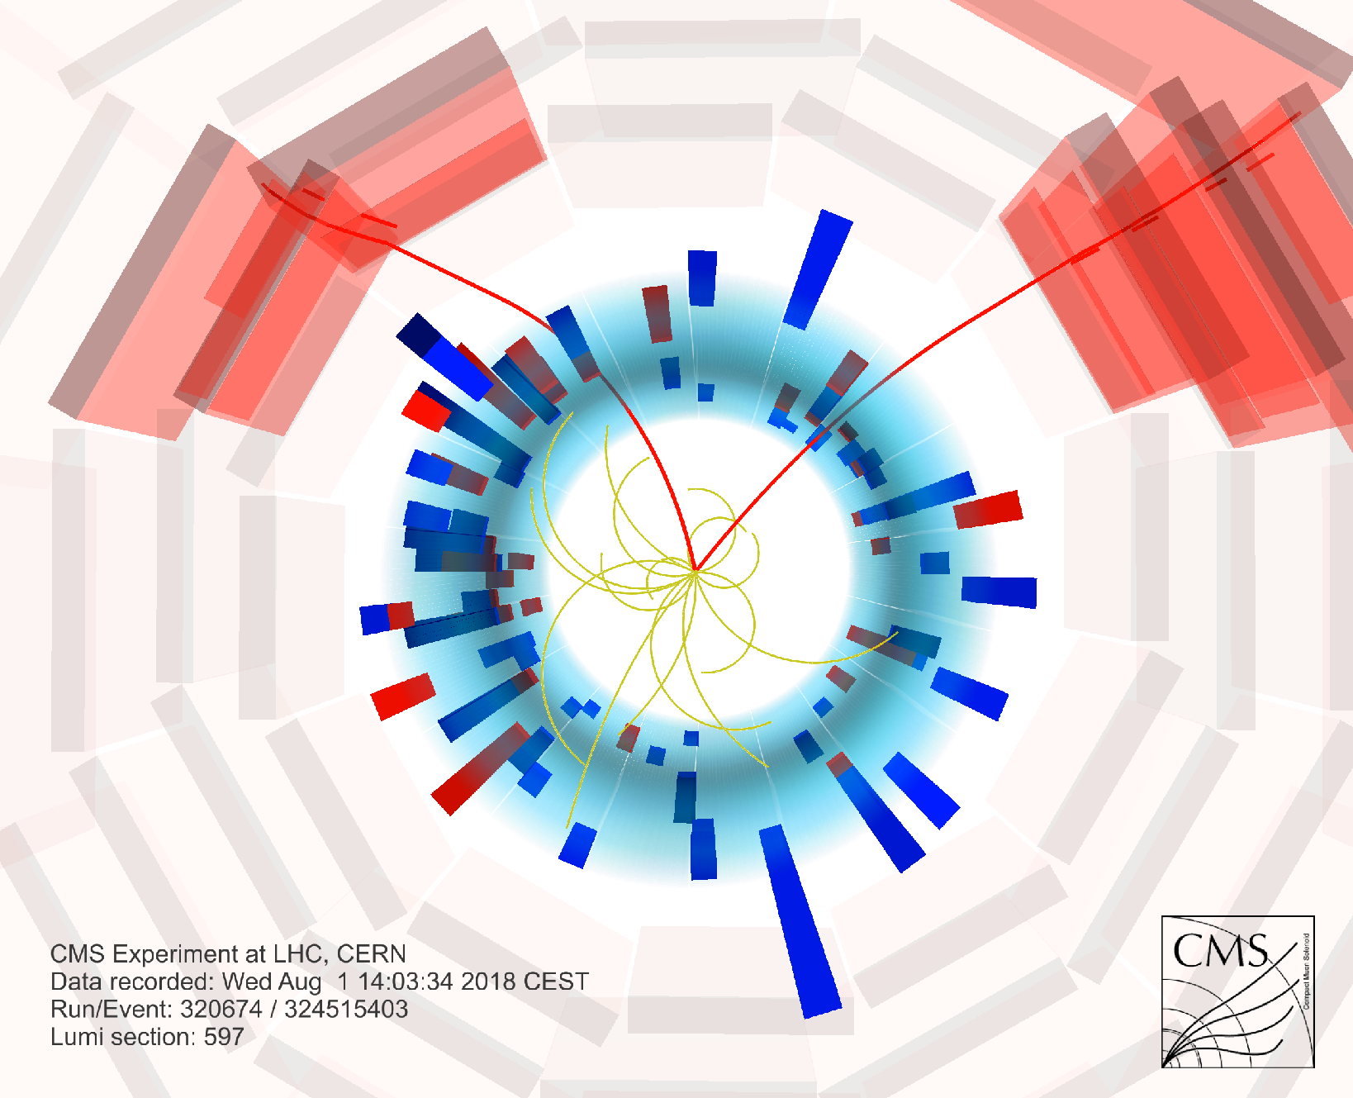
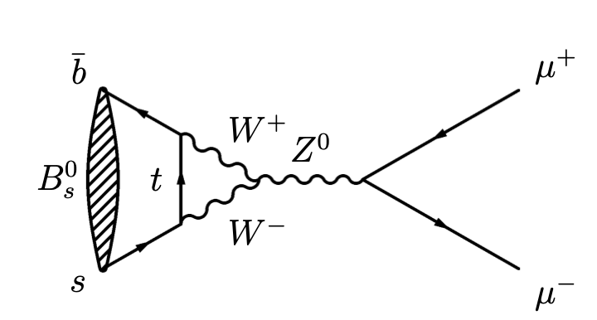
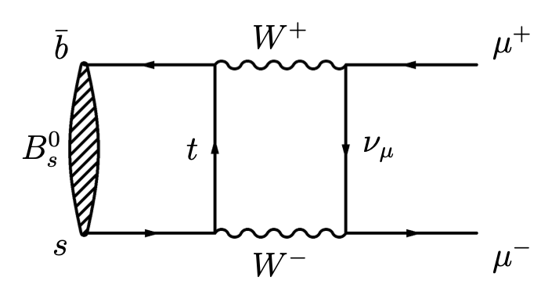
Powerful heavy-flavour measurements, complementary to Belle II
Rare B meson decays
B(B_{s} → μμ) = 3.8 ± 0.4 × 10^{–9} (SM: 3.7 ± 0.1 × 10^{–9})
arXiv:2212.10311

Slide 47
Powerful heavy-flavour measurements, complementary to Belle II
Spectroscopy
76 new hadrons discovered at the LHC (68 by LHCb), among which:
22 new mesons
31 new baryons
23 new exotic hadrons
→ Yasuhiro Yamaguchi’s talk at KMI2025
Link to figure and numbers

Slide 48
CMS
ATLAS
LHC
CMS
The next steps
ALICE
SPS
ALICE
LHCb
ATLAS
LHCb
PS
Areal view
Presentation

Slide 49
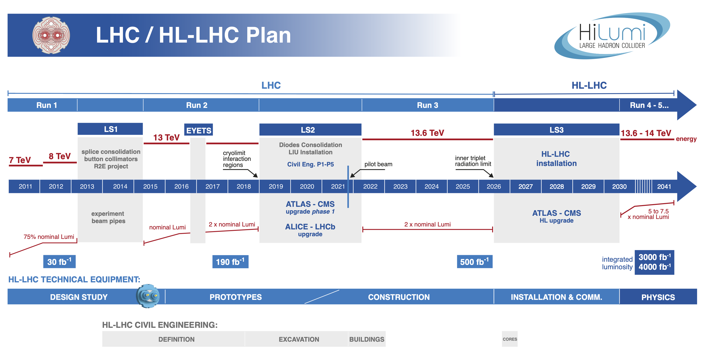
LHC project timeline
HL-LHC is the world’s flagship collider project during the next decades

Slide 50
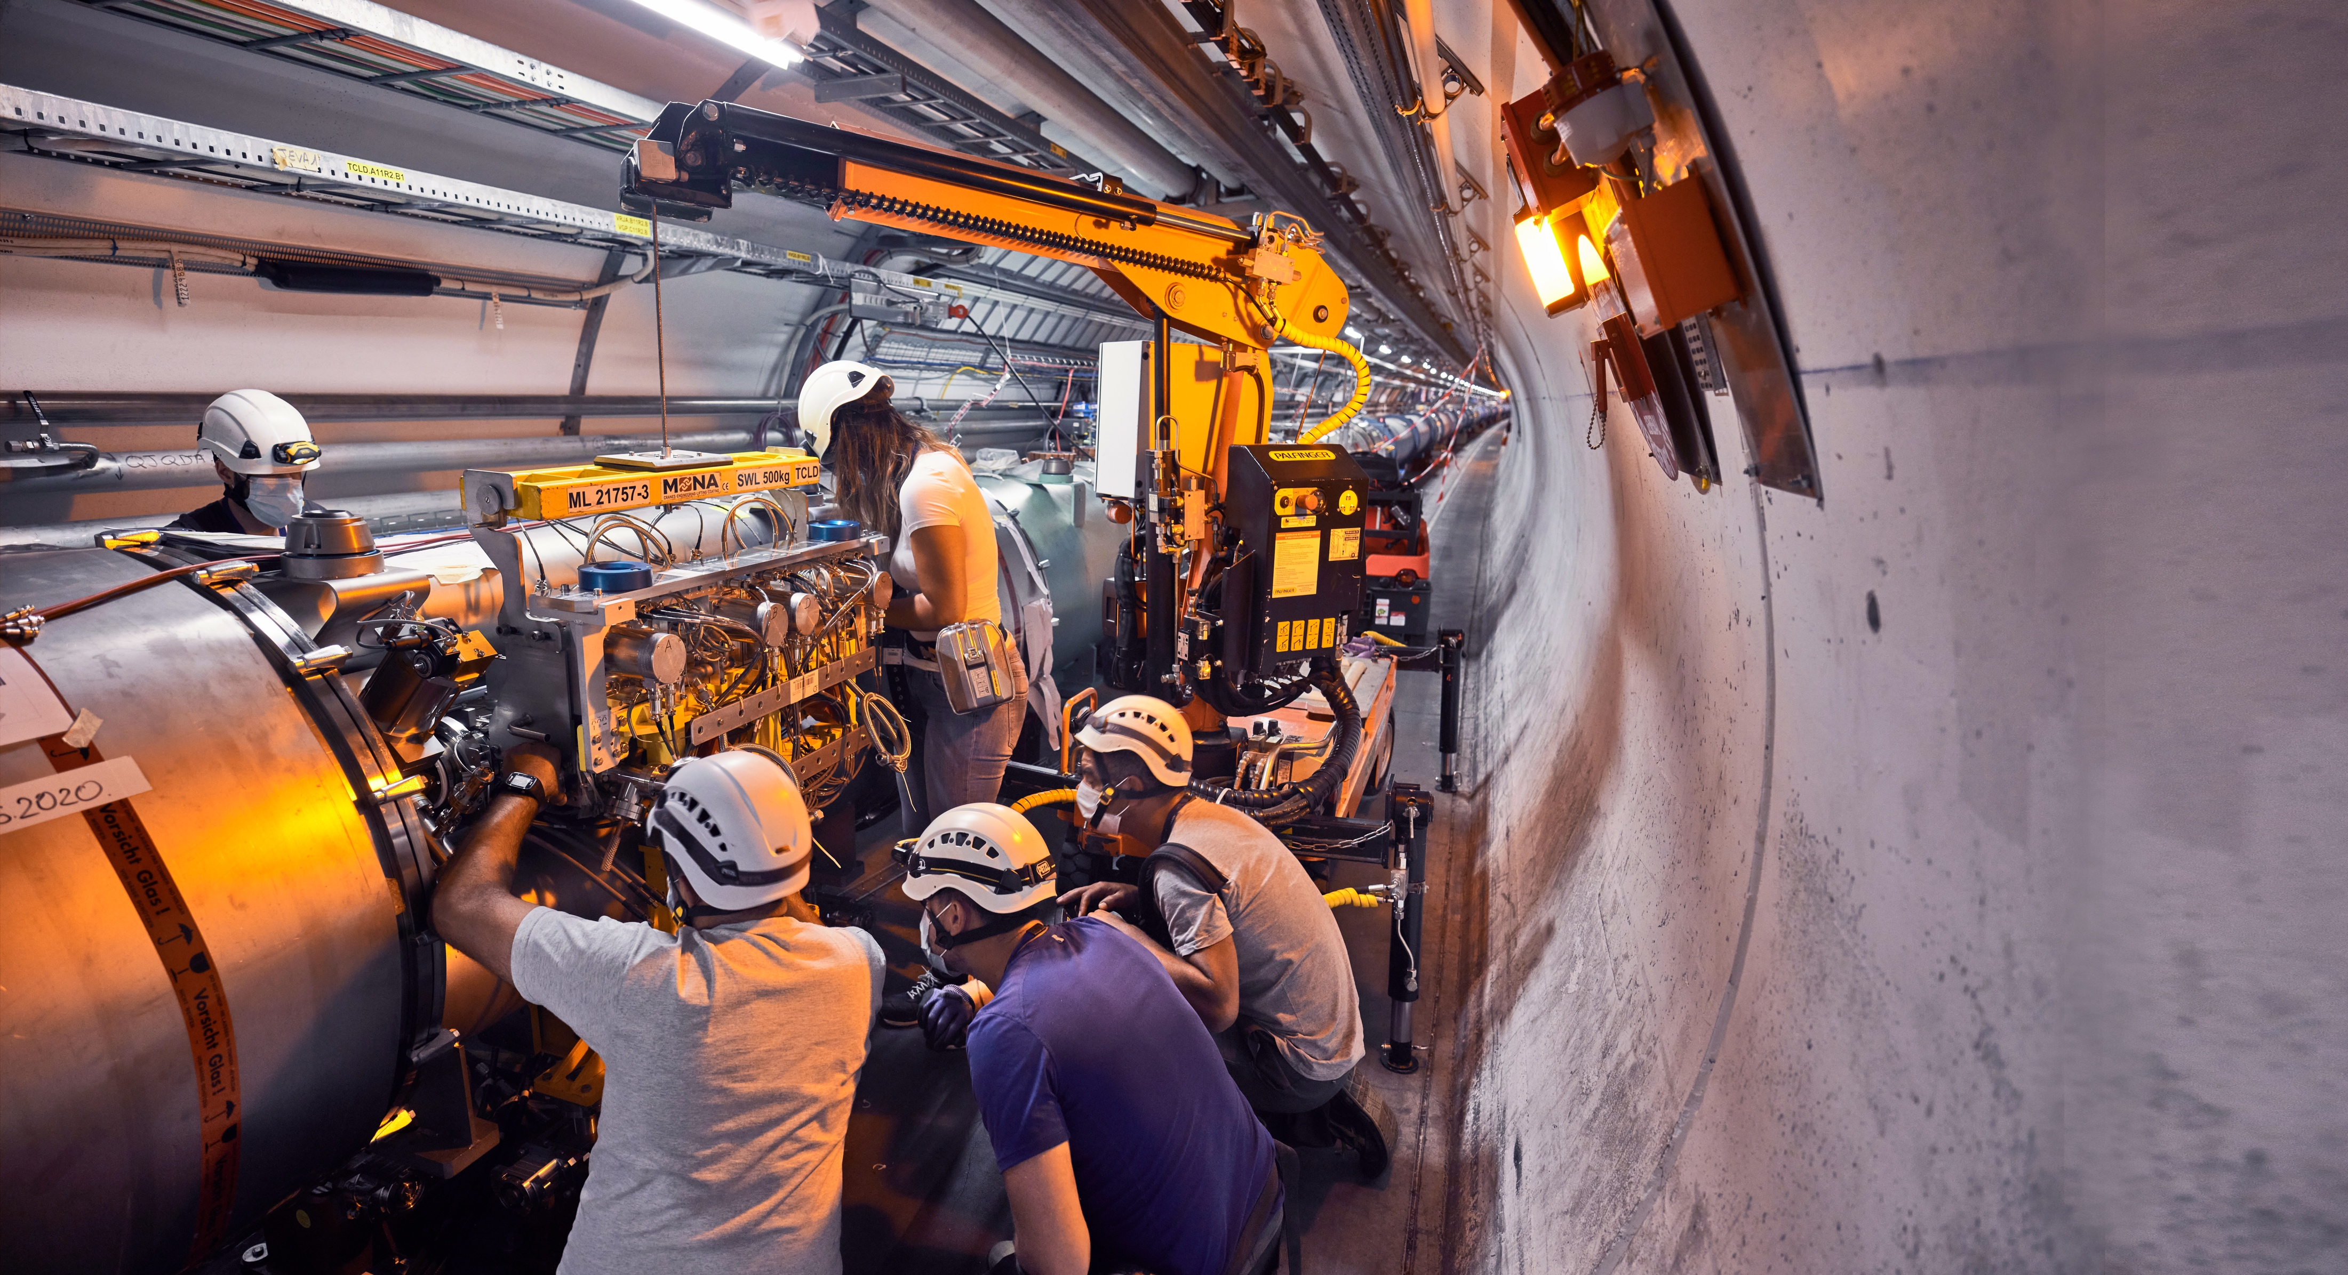
High-Luminosity LHC (HL-LHC)
Higgs factory (360M Higgs bosons produced) for precise Higgs coupling measurements, access to Higgs self interaction and longitudinal vector boson scattering, and increased overall rare & new physics sensitivity
It will begin operating in 2030, and run until 2041
Complementary to an e⁺e– Higgs / top / EW factory

Slide 51
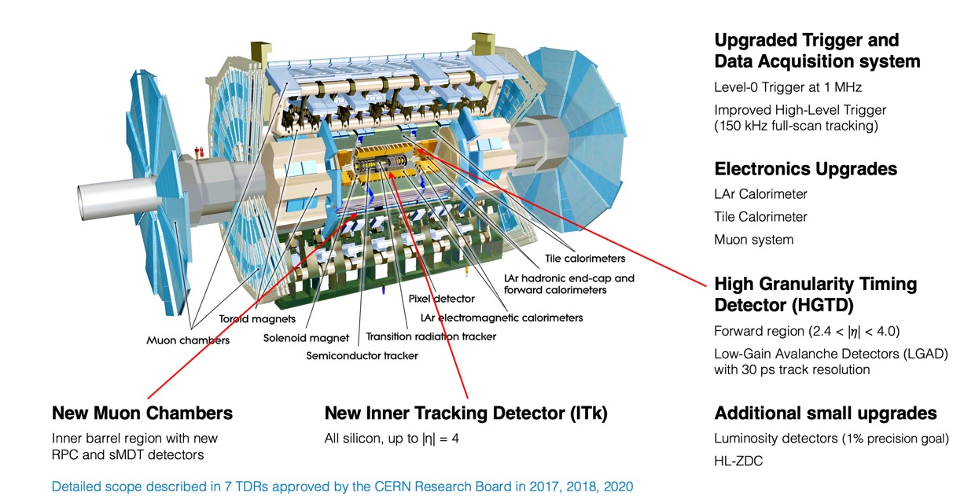
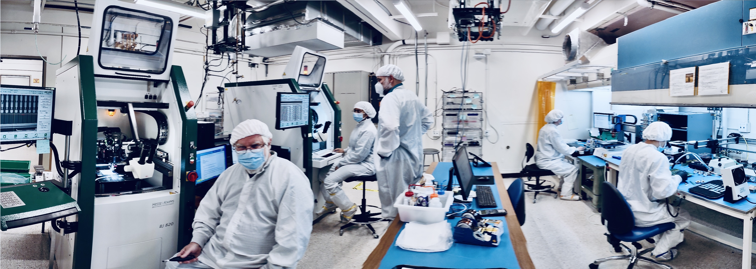
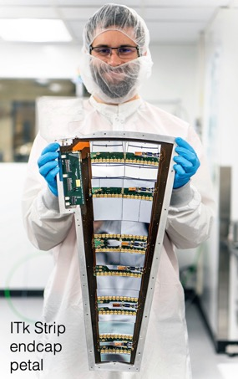
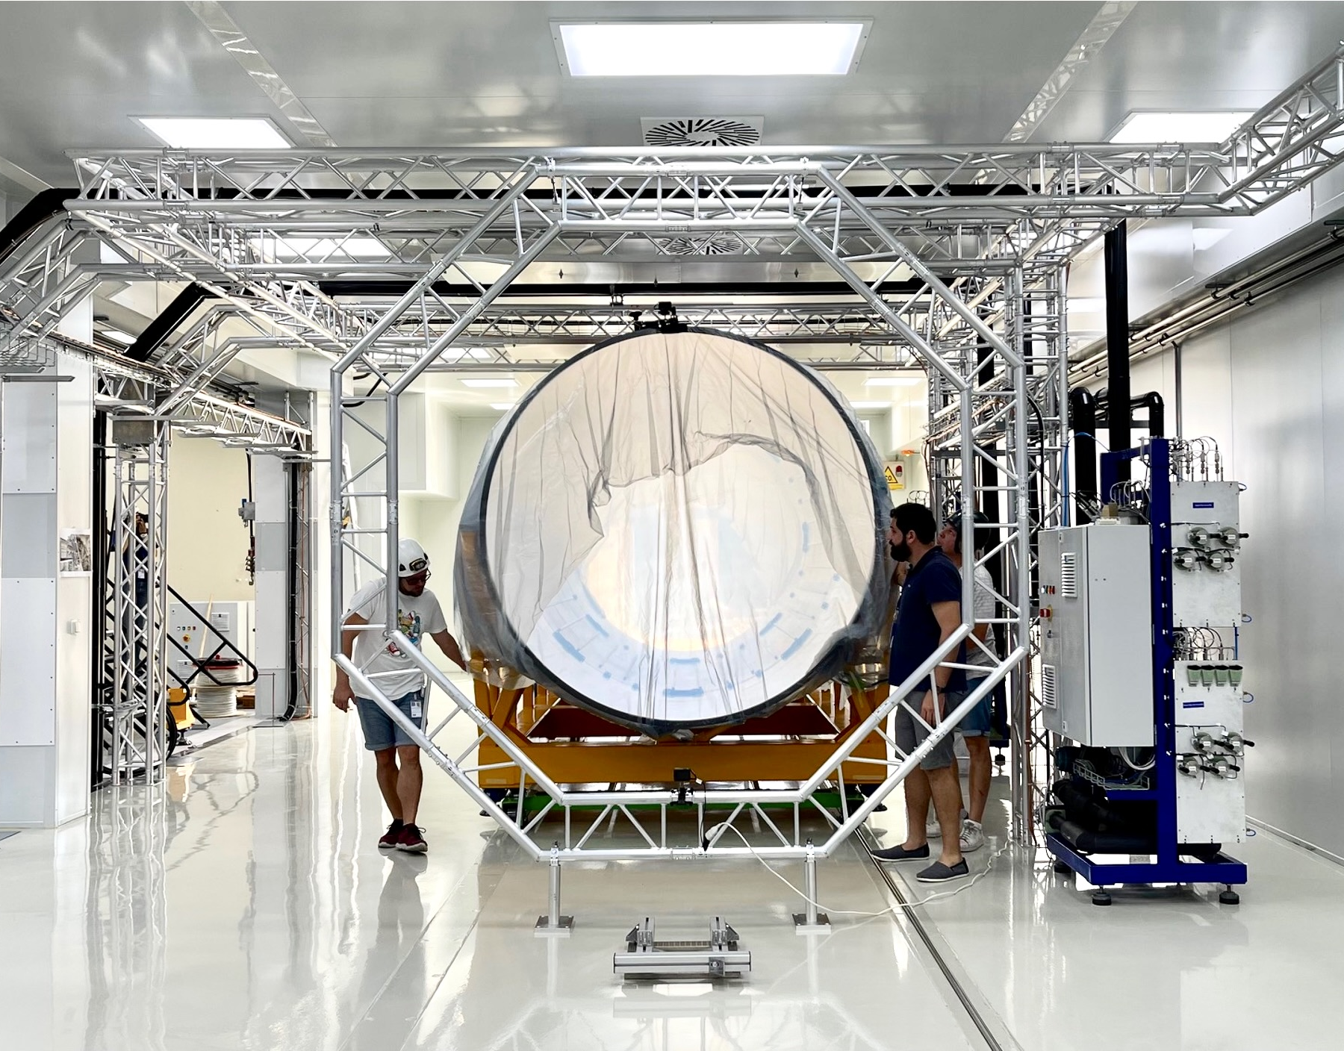
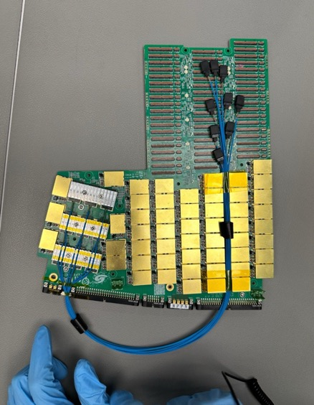
Upgrade to the High-Luminosity LHC (HL-LHC)
The HL-LHC’s intensity requires unprecedented detector and computing technologies:
Radiation hardness
High detection granularity and resolution
Precise timing detectors
More powerful triggers
Deeply embedded ML & AI
High-performance software & computing
Substantial upgrades for ATLAS & CMS
HGTD electronics board
Cleanroom at Santa Cruz UC
ITk Outer cylinder at CERN
200 pileup event simulated in ATLAS

Slide 52
Conclusions
The LHC has been transformative for particle physics
The Higgs boson discovery allows us to directly study electroweak symmetry breaking and the process of mass generation
The Higgs sector is connected with profound questions, whose study requires a broad experimental programme at the energy frontier
A large-scale upgrade programme is underway at the LHC and its experiments to prepare for the next phase of exploration: the HL-LHC

Slide 53

Spare slides

Slide 54
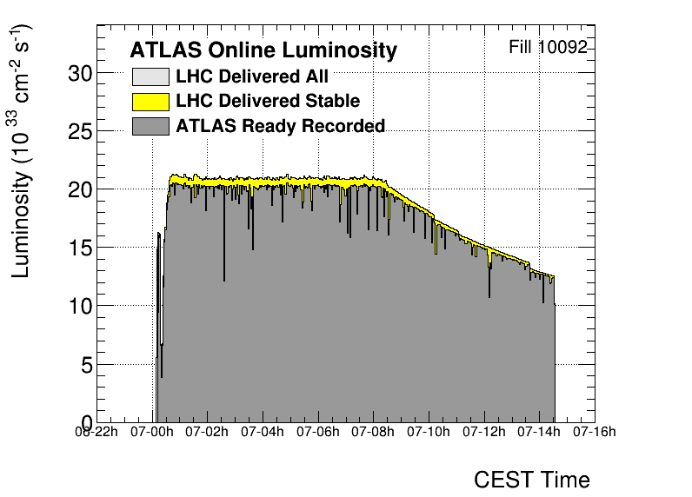
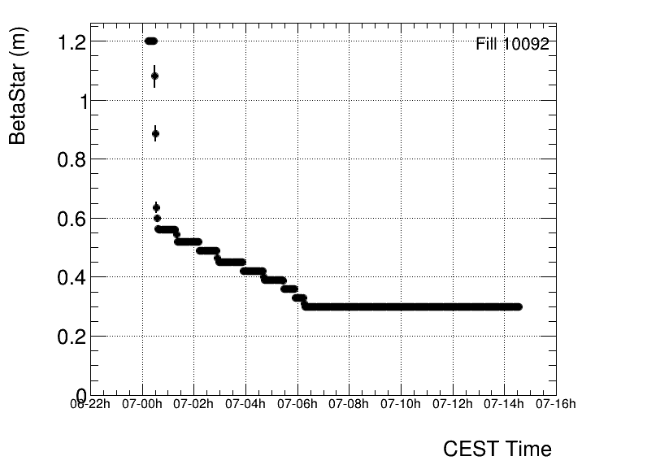
The Large Hadron Collider
CMS
Superb performance of the LHC
Luminosity profile of a typical run (6 September 2024)
Luminosity levelling at 2.1 × 10³⁴ cm^{–2}s^{–1} through defocusing and beam separation to keep pileup at ~63 until beam intensity has sufficiently dropped
LHC
ß* levelling between 120 and 30 cm
SPS
~8h luminosity levelling
ALICE
14h 21m stable beams
ATLAS
LHCb
PS
Areal view
Presentation

Slide 55
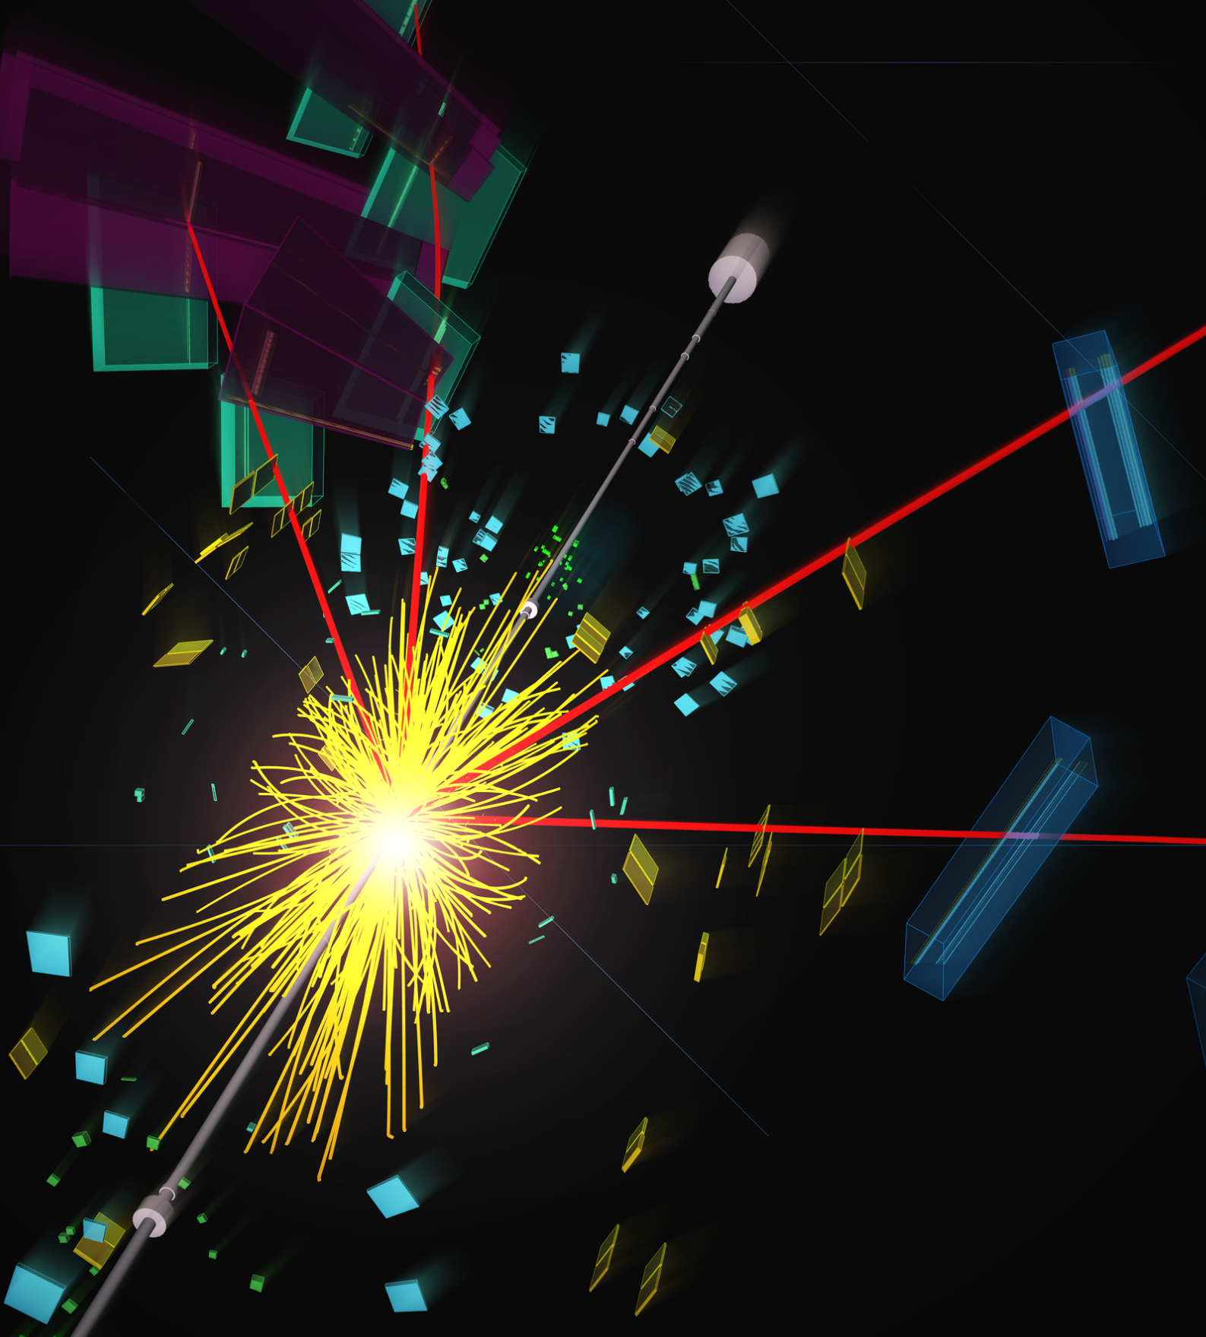

Higgs boson production at the LHC
About 1 Higgs boson per second is produced in ATLAS at the LHC (about 20M total by today)
tt → eµ + jets candidate event in 2016 8.16 TeV p-Pb collisions
(88% of H production)
Sensitivity to heavy new particles
(7%)
(0.9%)
(4%)

Slide 56



Higgs boson production at the LHC
About 1 Higgs boson per second is produced in ATLAS at the LHC (about 20M total by today)
It decays within 10^{–22} s
0.010% (e,µ)
f
H
$$∝\frac{m_{f}}{υ}$$
0.012% (e,µ)
f
W/Z
1.1% (e,µ)
H
$$∝\frac{2m_{W/Z}^{2}}{υ}$$
W/Z
H → 𝛾𝛾, Z𝛾 occur through virtual top or W loops (no direct Higgs coupling to massless particles)

