Slide 1

New Results from the LHC (1)
Andreas Hoecker (CERN)
September 26–28, 2016 in Freudenstadt, Germany

Slide 2
Outline
[ 3 lectures ]
Today:
Basic introduction
Overview of the LHC experimental programme and methods
Tomorrow
A review of Run-1 physics highlights
SM results from the LHC Run-2
After tomorrow
BSM searches from the LHC Run-2
Outlook to future projects
Disclaimer: I sincerely apologise to show more results from ATLAS than the other LHC experiments, which is a choice solely driven by convenience. In those cases, the CMS results are almost always similar (and vice versa).
I also apologise for not covering heavy-ion physics in my lecture.

Slide 3
Everyday life, and particle physics, are described by the Standard Model (SM)
Quite special
The SM is the legacy of 20th century particle physics
It unifies quantum mechanics, special relativity and field theory
It unifies electromagnetic and weak interactions
It describes ~ all laboratory data
Is the SM the theory of everything? Or rather of almost everything? No!
+ gravitation

Slide 4
Everyday life, and particle physics, are described by the Standard Model (SM)
The SM is the legacy of 20th century particle physics
It unifies quantum mechanics, special relativity and field theory
It unifies electromagnetic and weak interactions
It describes ~ all laboratory data
Is the SM the theory of everything? Or rather of almost everything? Or …
Below ~100 GeV, weak interaction is weaker than electromagnetism
Above ~100 GeV, electromagnetic and weak interactions are unified
Reduces 20 SM parameters to 19 (if 𝜈 = 0)
HERA data from electron–quark scattering into e+q (NC = γ,Z) or 𝜈+q (CC = W ±)

Slide 5
Scales in particle physics
Year when energy reached in labs
L_{gravitation} ~ 10⁻³⁵ m
10¹⁹ GeV
The scales of particle physics …
Planck scale (M_{Pl})
10¹⁶ GeV
(required for charge quantisation in n×1/3)
GUT ?
10¹⁴ GeV
ν_{R} ?
~ 2010
L_{weak} ~ 10⁻¹⁸ m
100 GeV
t, Z, W, H, EWSB
10 GeV
ψ, b, Υ, B
1 GeV
τ, c, n, p, ρ, φ
~ 1970
L_{strong} ~ 10⁻¹⁵ m
100 MeV
μ, s, π, QCD
10 MeV
u, d, nuclear binding E
1 MeV
e
100 keV
10 keV
1 keV
core of Sun
100 eV
10 eV
atomic binding E
~ 1900
L_{atomic} ~ 10⁻¹⁰ m
1 eV
ν’s
100 meV
?
10 meV
0
γ, g

Slide 6
Scales in particle physics
Year when energy reached in labs
L_{gravitation} ~ 10⁻³⁵ m
10¹⁹ GeV
The scales of particle physics …
Planck scale (M_{Pl})
10¹⁶ GeV
(required for charge quantisation in n×1/3)
GUT ?
10¹⁴ GeV
ν_{R} ?
LHC reach
10 TeV
New Physics ?
~ 2010
1 TeV
…probing attometre scales
L_{weak} ~ 10⁻¹⁸ m
100 GeV
t, Z, W, H, EWSB
10 GeV
ψ, b, Υ, B
1 GeV
τ, c, n, p, ρ, φ
~ 1970
L_{strong} ~ 10⁻¹⁵ m
100 MeV
μ, s, π, QCD
10 MeV
u, d, nuclear binding E
1 MeV
e
100 keV
10 keV
1 keV
core of Sun
100 eV
10 eV
atomic binding E
~ 1900
L_{atomic} ~ 10⁻¹⁰ m
1 eV
ν’s
100 meV
?
10 meV
0
γ, g

Slide 7
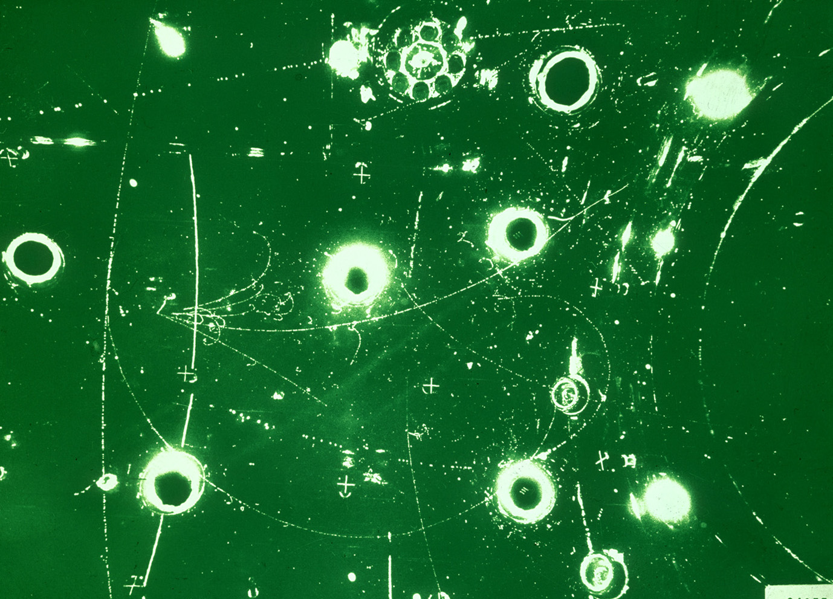
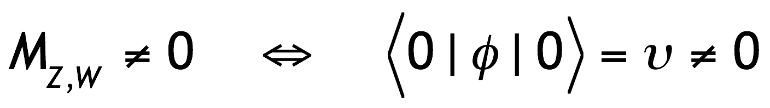
The Standard Model
Elementary particle physics is successfully described by local gauge theories
A problem: local gauge symmetry requires massless spin-1 “gauge” (=force) boson
This has been well verified for QED, with a massless photon (= infinite range)
However, the W, Z bosons are massive (→ finite range ~10⁻¹⁵ cm of weak interaction)
Only way to break gauge symmetry consistently is to spontaneously break the symmetry of the vacuum in the ground state:
[ non-zero vacuum expectation value ]
φ is a complex doublet field with non-zero vacuum expectation value. three d.o.fs become Z, W ± masses, fourth d.o.f is massive scalar Higgs boson
This is known as the “Brout-Englert-Higgs (BEH) mechanism”

Slide 8
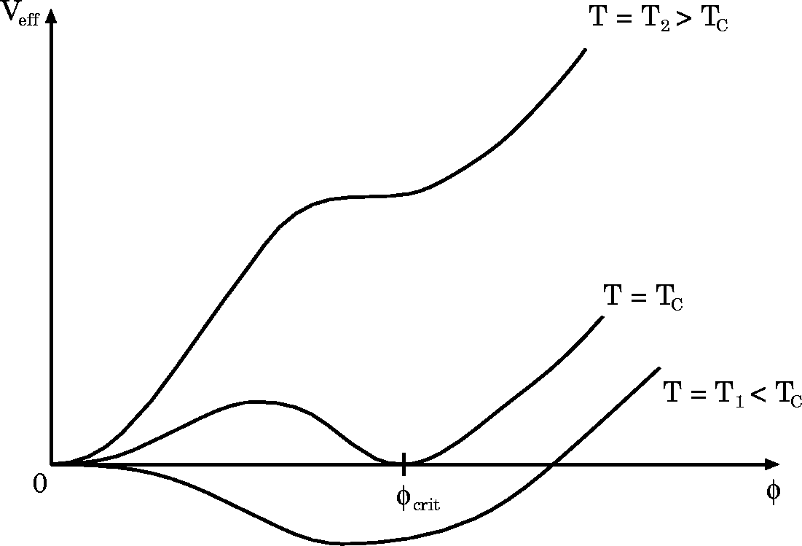



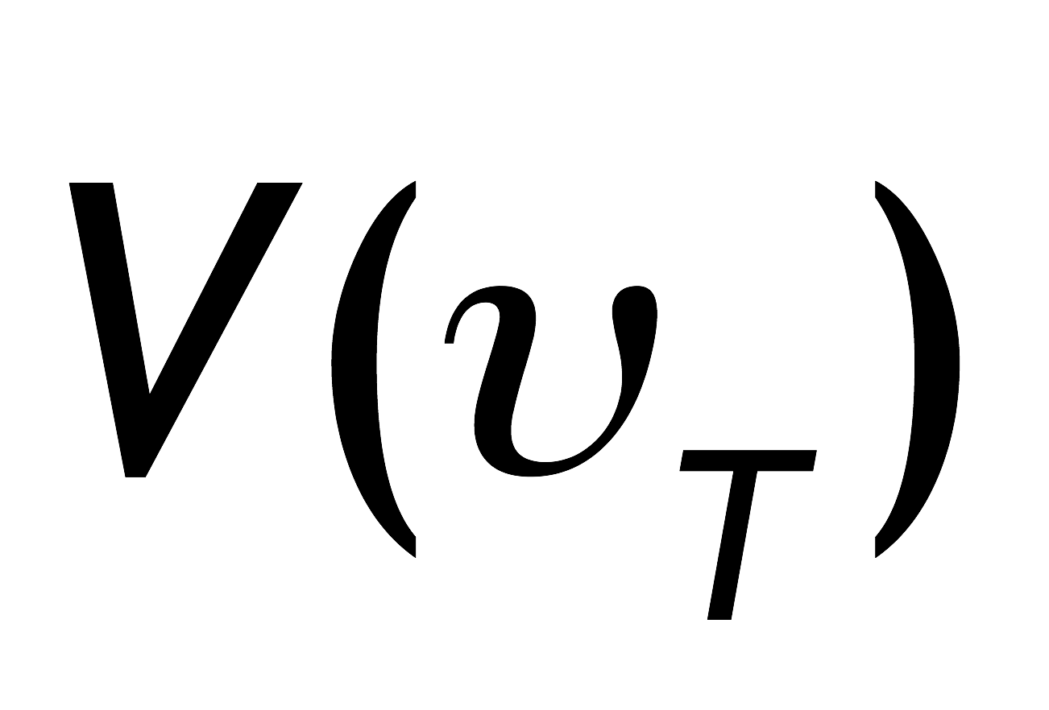

The Standard Model
BEH mechanism
The early universe, at temperature T > T_{EW}, was in a symmetric phase (|φ_{min}| = 0)

Slide 9
The Standard Model
BEH mechanism
The early universe, at temperature T > T_{EW}, was in a symmetric phase (|φ_{min}| = 0)
A phase transition at ~T_{EW} (~several 10⁻¹¹ s after big bang, causal domain of few cm) led to |φ_{min}| > 0
Phase transition
Potential barrier
BEH bubble expansion
Picture describes a 1st order phase transition that would require light Higgs, or new physics → currently disfavoured

Slide 10

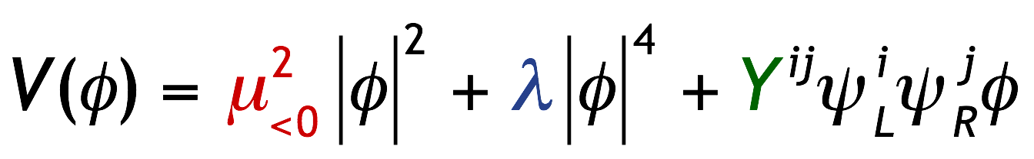
The Standard Model
BEH mechanism
The early universe, at temperature T > T_{EW}, was in a symmetric phase (|φ_{min}| = 0)
A phase transition at ~T_{EW} (~several 10⁻¹¹ s after big bang, causal domain of few cm) led to |φ_{min}| > 0
Phase transition
Potential barrier
Higgs bubble expansion
Condensation of Higgs field
v
“spontaneous” phase transition
Simplest scalar potential that breaks ground state symmetry. Does what we need, but bears fundamental problems.
Carries the seeds of new physics …
Higgs potential:
( µ, λ determined once Higgs mass known )

Slide 11
The Standard Model
BEH mechanism
Early universe: symmetric phase, fundamental particles are massless → gauge symmetry is respected
Symmetric phase – early universe
Gravity
Photon
Weak boson
Neutrinos
Electrons
Top quark
H. Murayama

Slide 12
The Standard Model
BEH mechanism
Early universe: symmetric phase, fundamental particles are massless → gauge symmetry is respected
Higgs quantum liquid in broken phase
Gravity
A Higgs field displaces ground state breaking gauge symmetry
Photon
×
×
It fills all space time (but without orientation as it has no spin)
Weak boson
×
×
×
×
Particles interact with Higgs field and effectively reduce their velocity. Acquired mass proportional to interaction strength
×
Neutrinos
ν_{L}
Λ⁻¹
ν_{L}
Electrons
×
e_{L}
e_{R}
×
e_{L}
×
×
×
_{L}
_{R}
Interaction with Higgs field alters chirality of massive Dirac fermion
×
×
→ Action of the Higgs field creates “vacuum viscosity”
Top quark
_{R}
_{R}
×
_{R}
×
×
_{L}
_{L}
t_{L}
_{L}
×
×
H. Murayama

Slide 13

The Higgs boson –
last of the particles* ?
The SM predicts all its properties, except for its mass
*No!
Full references for mechanism:
F. Englert and R. Brout, PRL 13 (1964) 321.
P.W. Higgs, PRL 13 (1964) 508.
G. Guralnik, C. Hagen, and T.W.B. Kibble, PRL 13 (1964) 585.
It should be noted that Landau and Ginzburg had proposed a field giving the photon a mass in a superconductor, the mathematics of which is identical to the “Higgs mechanism” and predates it by several years.
http://www.shardcore.org/shardpress

Slide 14
Particle physics at the dawn of the LHC
LEP (& SLC) had ended their programmes, with among their main results:
Three light active neutrino flavours
Direct Higgs searches excluded m_{H} < 114 GeV

Slide 15
Particle physics at the dawn of the LHC
LEP (& SLC) had ended their programmes, with among their main results:
Three light active neutrino flavours
Direct Higgs searches excluded m_{H} < 114 GeV
SM tests to unprecedented precision, no direct/indirect hint of BSM physics
Asymptotic freedom of strong interaction has been verified at the percent level
𝛼_{S}(µ) extracted from R_{𝜏}, R_{𝓁} (Z) measurements using NNNLO (=3NLO) perturbative QCD
Ratio with respect to tau-based value

Slide 16
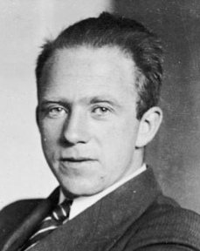

Particle physics at the dawn of the LHC
LEP (& SLC) had ended their programmes, with among their main results:
Three light active neutrino flavours
Direct Higgs searches excluded m_{H} < 114 GeV
SM tests to unprecedented precision, no direct/indirect hint of BSM physics
Precision measurements excluded m_{H} > 153 GeV (95% CL)
W. Heisenberg
H

Slide 17
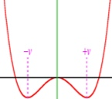
Particle physics at the dawn of the LHC
LEP (& SLC) had ended their programmes, with among their main results:
Three light active neutrino flavours
Direct Higgs searches excluded m_{H} < 114 GeV
SM tests to unprecedented precision, no direct/indirect hint of BSM physics
Precision measurements excluded m_{H} < 153 GeV (95% CL)
There also were theoretical arguments in favour of a light Higgs moderating W_{L}W_{L} scattering
  Also: perturbativity and (meta)stability bounds versus the SM cut-off scale Λ
The SM Higgs must steer a narrow course between two disastrous situations if the SM is to survive up to the Planck scale M_{P} ~ 2×10¹⁸ GeV

Slide 18
Particle physics at the dawn of the LHC
LEP (& SLC) had ended their programmes, with among their main results:
Three light active neutrino flavours
Direct Higgs searches excluded m_{H} < 114 GeV
SM tests to unprecedented precision, no direct/indirect hint of BSM physics
Precision measurements excluded m_{H} < 153 GeV (95% CL)
Tevatron was still continuing Run-2
Discovery of top-quark and < 1% mass measurement
B_{s} mixing precisely measured, agreeing with SM
Higgs beyond sensitivity except for m_{H} ~ 165 GeV
No hint of BSM physics

Slide 19
Particle physics at the dawn of the LHC
LEP (& SLC) had ended their programmes, with among their main results:
Three light active neutrino flavours
Direct Higgs searches excluded m_{H} < 114 GeV
SM tests to unprecedented precision, no direct/indirect hint of BSM physics
Precision measurements excluded m_{H} < 153 GeV (95% CL)
Tevatron was still continuing Run-2
Discovery of top-quark and < 1% mass measurement
B_{s} mixing precisely measured, agreeing with SM
Higgs beyond sensitivity except for m_{H} ~ 165 GeV
No hint of BSM physics
B-factories experiments BABAR & Belle about to end
CP violation measurements in B system confirm CKM
Despite ambiguous initial results, no hint of BSM

Slide 20
Particle physics at the dawn of the LHC
LEP (& SLC) had ended their programmes, with among their main results:
Three light active neutrino flavours
Direct Higgs searches excluded m_{H} < 114 GeV
SM tests to unprecedented precision, no direct/indirect hint of BSM physics
Precision measurements excluded m_{H} < 153 GeV (95% CL)
?
Tevatron was still continuing Run-2
Discovery of top-quark and < 1% mass measurement
B_{s} mixing precisely measured, agreeing with SM
Higgs beyond sensitivity except for m_{H} ~ 165 GeV
No hint of BSM physics
B-factories experiments BABAR & Belle about to end
CP violation measurements in B system confirm CKM
Despite ambiguous initial results, no hint of BSM
Low-energy experiments: no signs of charged LFV, EDM, only muon g–2 showed anomaly
Neutrino revolution: massive neutrinos established, unknown matter nature and hierarchy
No signal for dark matter particles (only gravitational effects), no axions, no proton decay

Slide 21
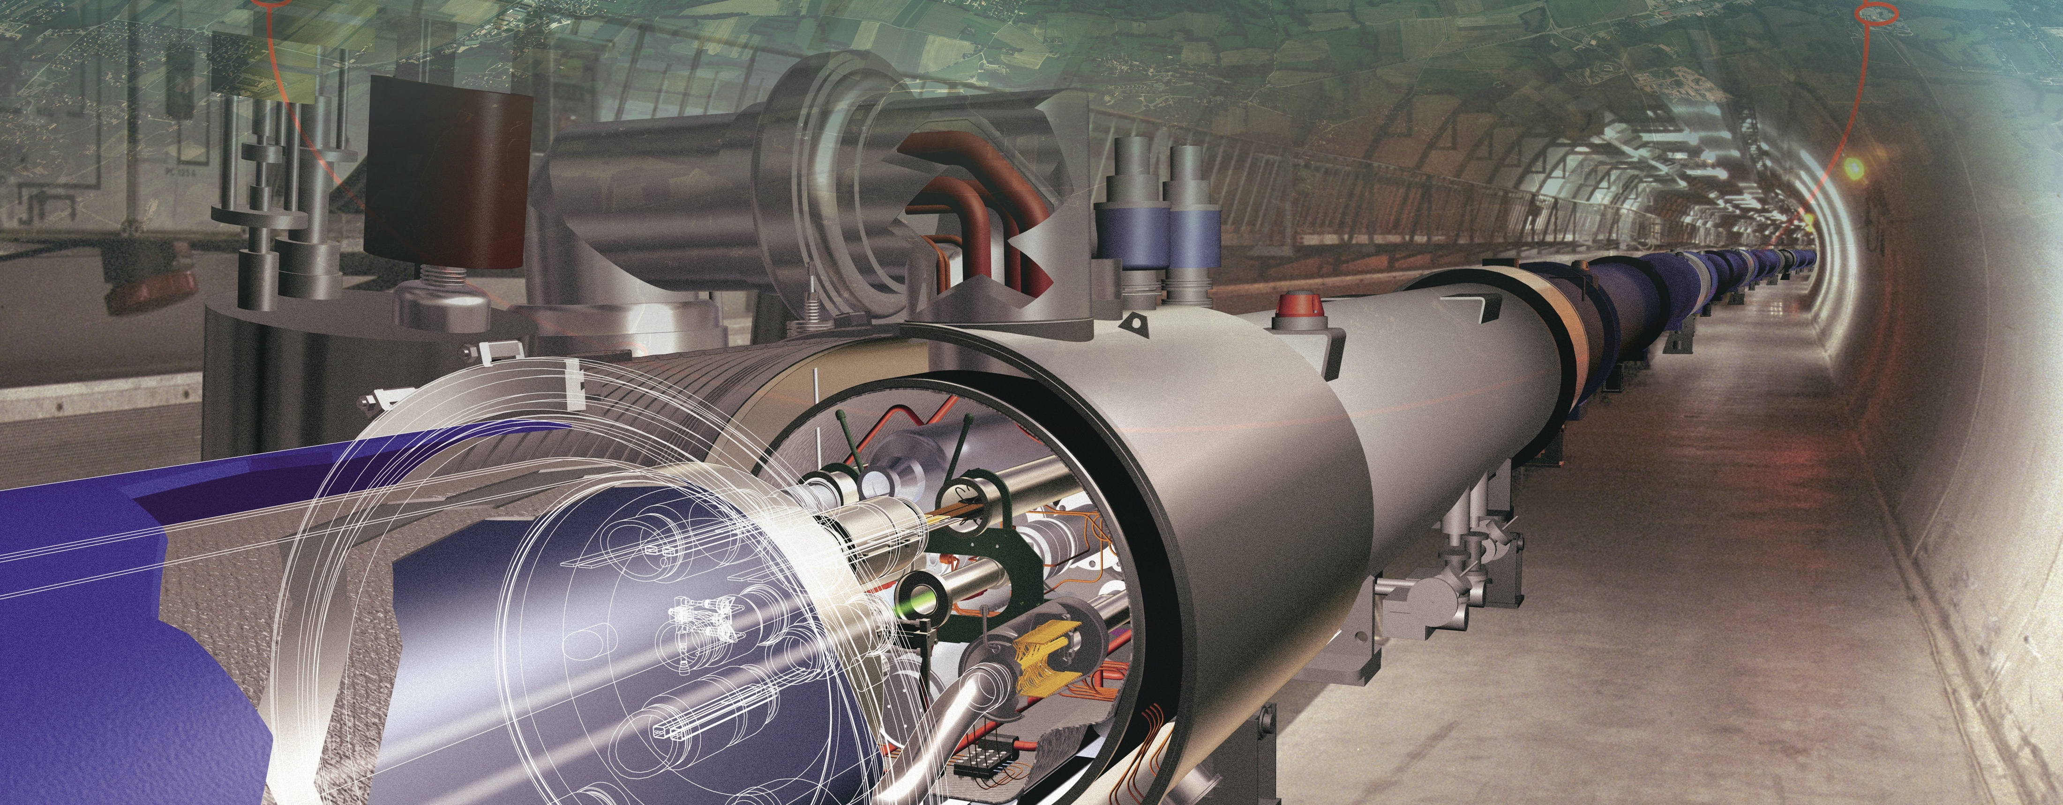
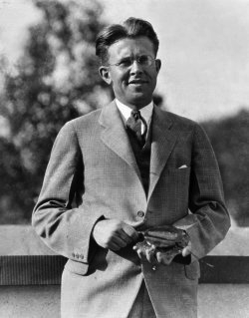
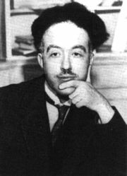
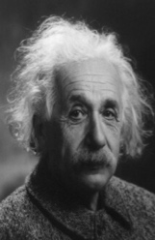
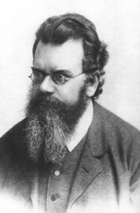
Producing the Higgs Boson and Searching for New Physics at the TeV Scale Requires a Huge Machine
de Broglie
Particles accelerators:
Look deeper into matter (size ~ 1/E ) (“powerful microscopes”)
Discover new heavier particles (E = mc ² )
Probe conditions of the early universe (E = kT )
Einstein
Lawrence
(First cyclotron provided 80 keV proton acceleration)
Boltzmann

Slide 22
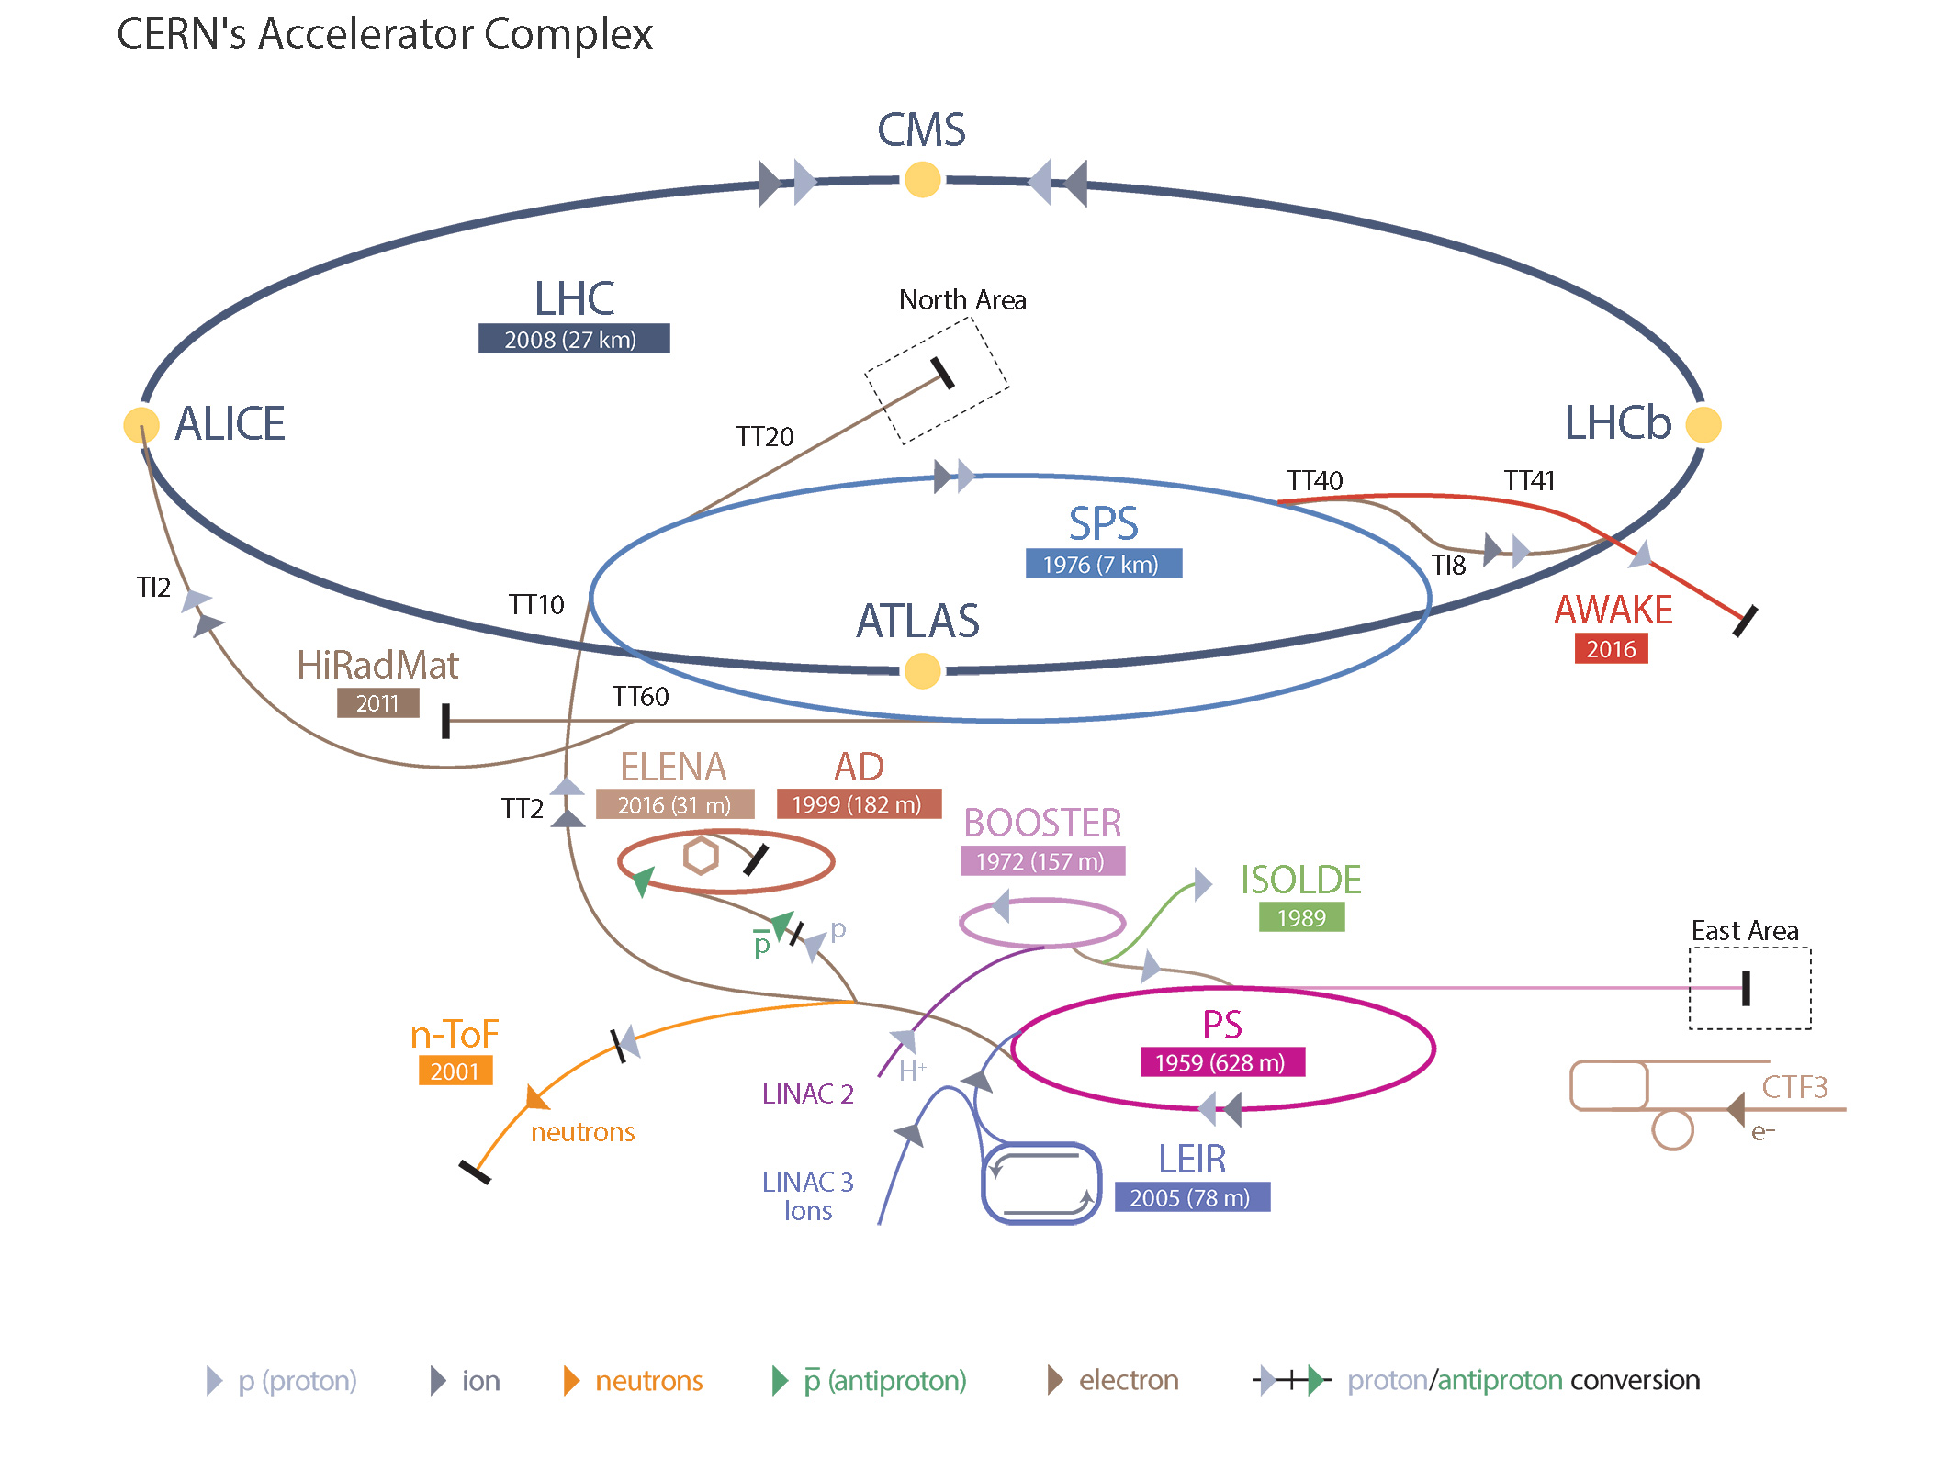
CERN’s Accelerator Complex

Slide 23

Superconducting proton/ion accelerator and collider installed in a 27 km circumference underground tunnel (4 m tunnel cross-section diameter )
LHC ring at CERN:
27 km circumference
70 — 140 m depth
LHC
control room
CERN (Prévessin site)
CERN (Meyrin site)

Slide 24

7 TeV
LHC
450 GeV
LHC ring at CERN:
27 km circumference
SPS
26 GeV
So far:
0.9 / 2.8 / 5 / 7 / 8 / 13 TeV proton—proton collisions
2.8 / 5 TeV Pb—Pb collisions
5 (soon 8) TeV p—Pb collisions
PS
1.4 GeV
BOO-
STER
SPS ring:
7 km circumference
50 MeV
LIN-
AC2
PROTONS
CERN (Meyrin site)
~20 minutes are required to accelerate the protons in the LHC from 450 GeV to 7 TeV

Slide 25
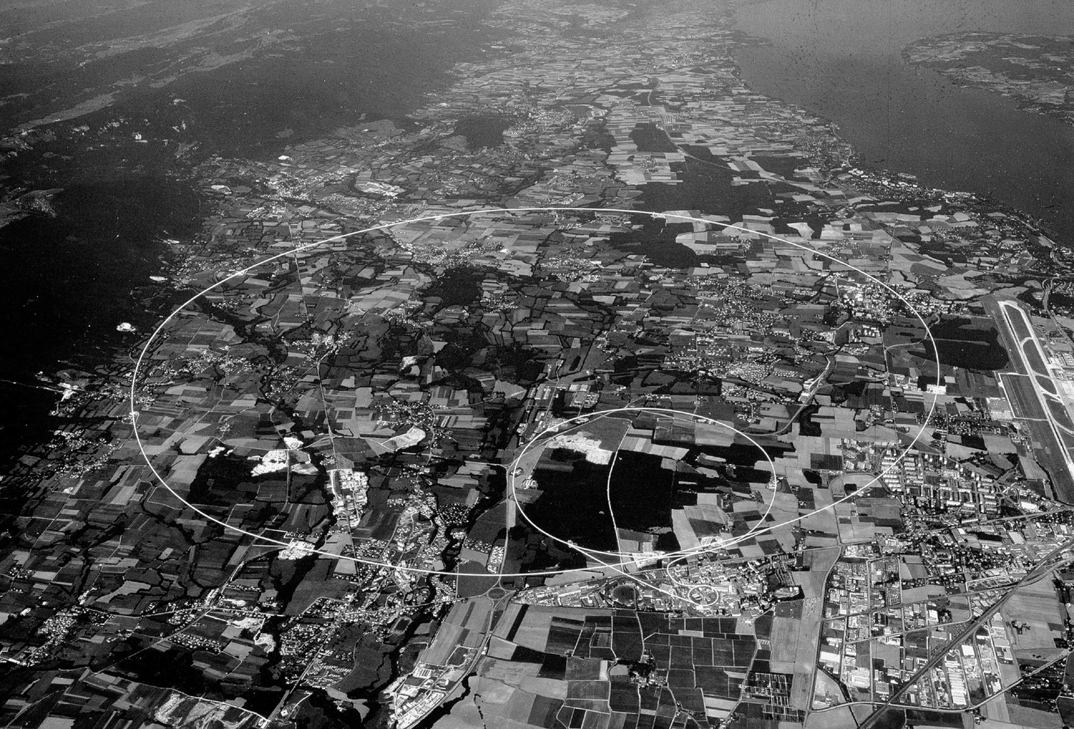

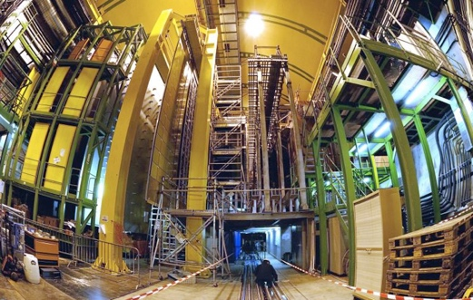

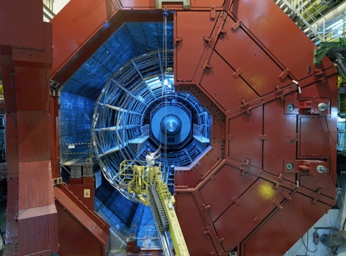
CMS
LHCb
ALICE
ATLAS

Slide 26
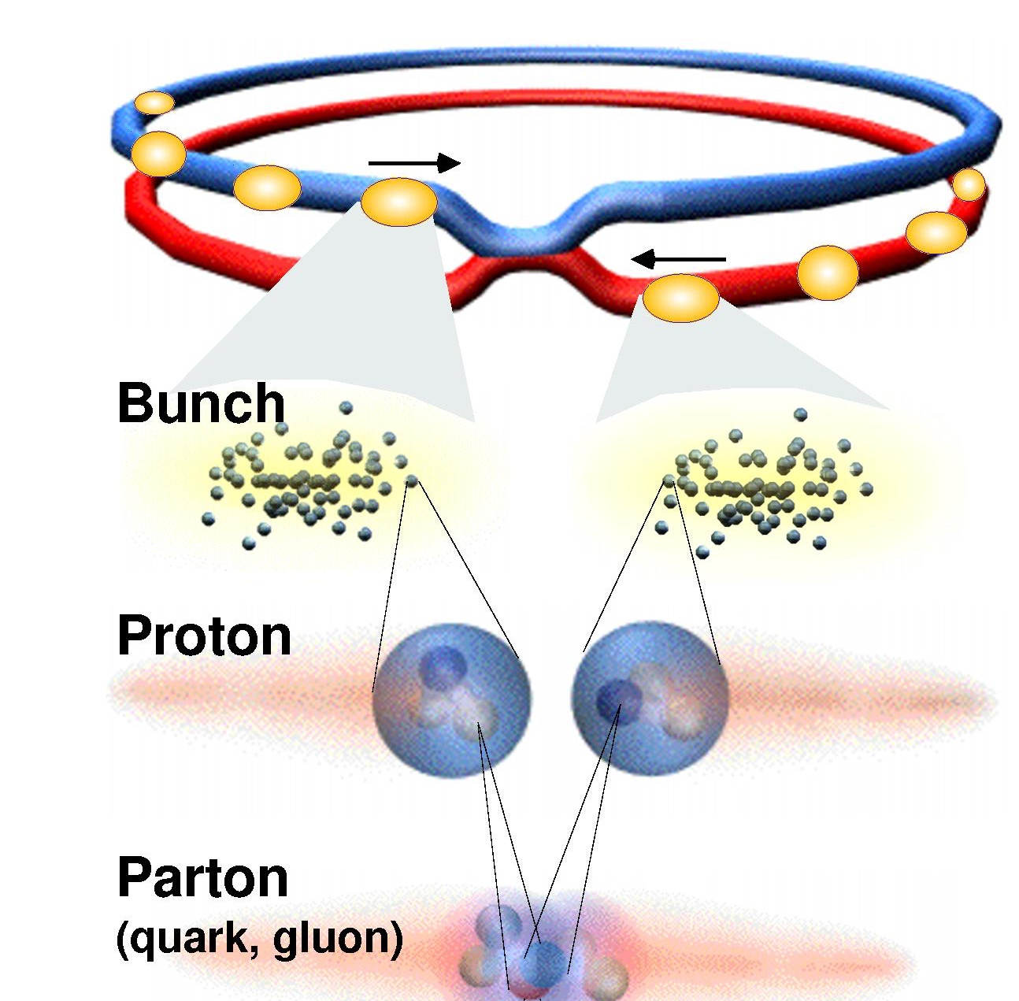
The search for new physics exploits smallest distances → largest energies
Proton energy is limited by magnets that guide the circular beams
E_{proton} ~ 0.3·B·r : since radius is fixed (4.3 km), use as strong fields as possible (> 8 T)
Length scale (am) ~ 200 GeV am / E (GeV) (am = atto-metre = 10^{–18} m)
The LHC collides protons at E_{CM} = 14 TeV → probing a distance of 10^{–20} m ? Not quite, since protons are composites: the energy is distributed among its partons
~1.2 10¹¹
p per bunch

Slide 27
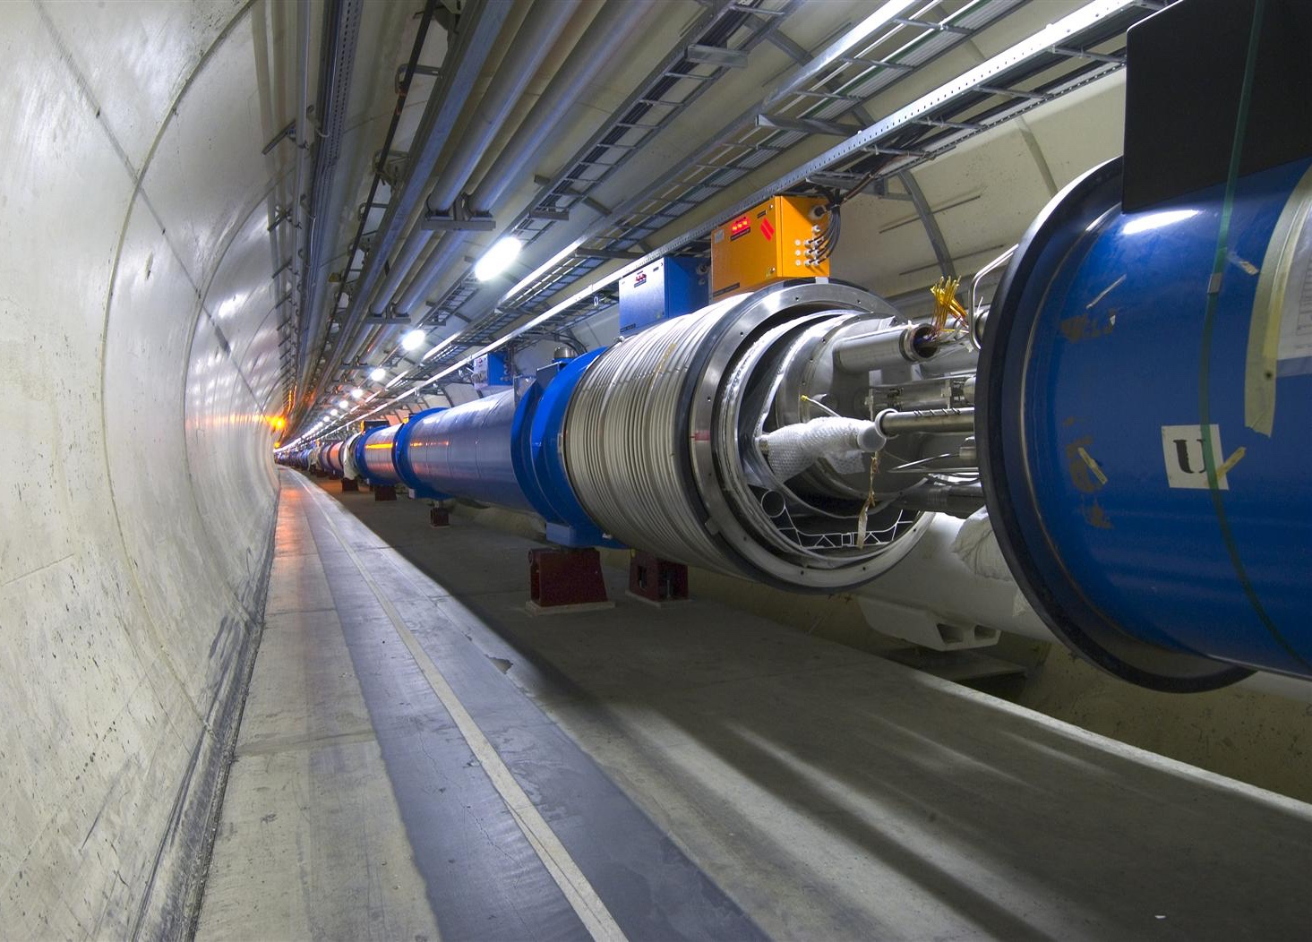
2-in-1 magnet
design
Most challenging component of LHC:
  1232 superconducting dipoles
  14.3 m length, 1.9 K cold
  8.3 Tesla → E_{beam} = 7 TeV
  11850 A total current
Also: 392 focusing quadrupoles and
3700 multipole corrector magnets

Slide 28
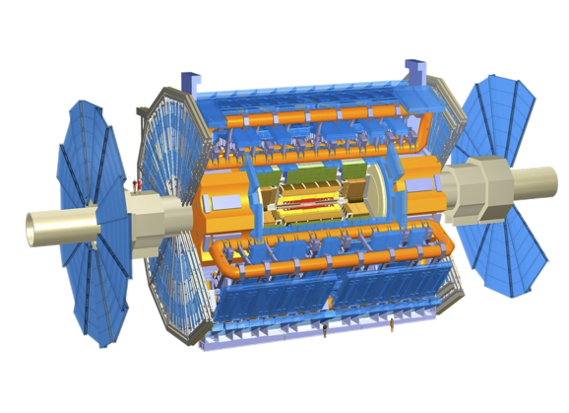

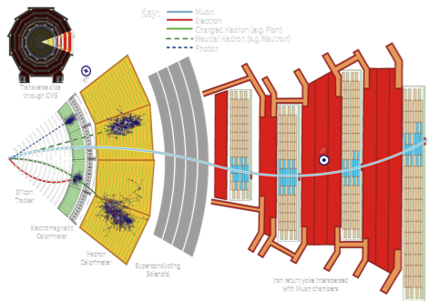
ATLAS & CMS: giant, ultra sophisticated particle detectors
ATLAS: emphasis on excellent jet and missing-E_{T} resolution, particle identification, flavour tagging, and standalone muon measurement
CMS: emphasis on excellent electron/photon energy & track (muon) momentum resolution, and flavour tagging
Both: excellent hermeticity – very few “cracks”

Slide 29
LHCb & ALICE: optimised for low-p_{T} physics
LHCb: forward spectrometer dedicated to pp flavour physics featuring hadronic trigger, excellent low-momentum track resolution, particle identification (π/K separation)
ALICE: dedicated to study of heavy-ion collisions and soft pp physics; ALICE features highly efficient track reconstruction in busy heavy-ion environment and particle identification

Slide 30
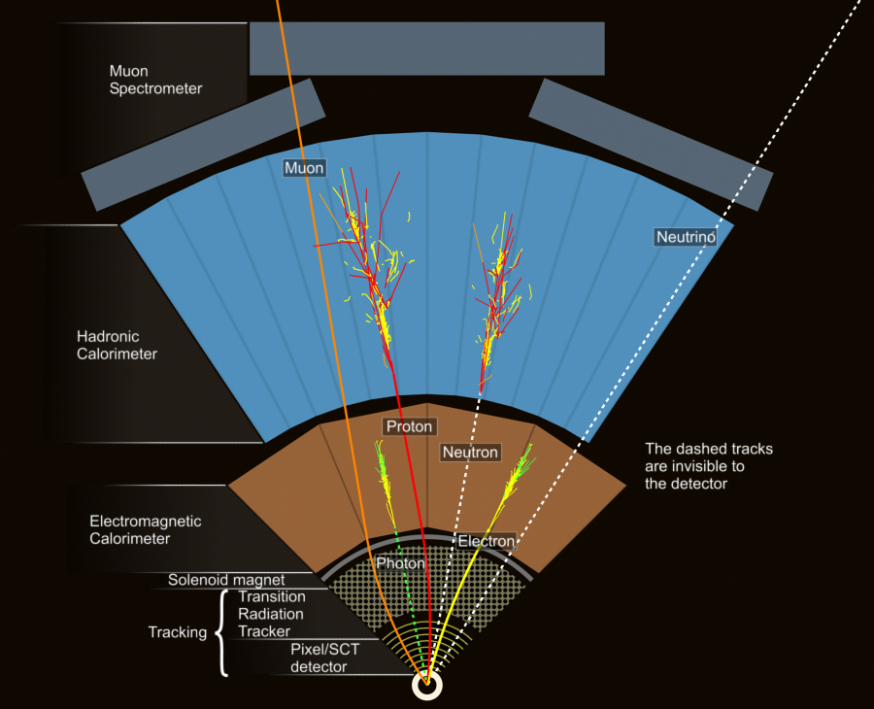
The detectors measure interaction of particles with active material
Also reconstruct jets, b-jets and missing transverse momentum (MET)
Ensemble of measured detector response in a given proton–proton bunch crossing makes up an “event”

Slide 31
LHC computing is big data
LHC experiments started more than a decade ago with large scale computing — now big data is everywhere
Note: LHC has a public science budget, unlike Google or Facebook
Business email sent per year
2,986 PB
Google search index
98 PB
US climate database
6 PB
Content uploaded to Facebook each year
182 PB
Video upload to YouTube / year: 15 PB
ATLAS managed data volume
130 PB
US Congress library
6 PB
Largest data volume from simulated events, not from real collision data !
ATLAS annual data volume
30 PB
Source: http://www.wired.com/2013/04/bigdata
http://www.wired.com/2013/04/bigdata

Slide 32

A few (basic) experimental concepts at the LHC

Slide 33


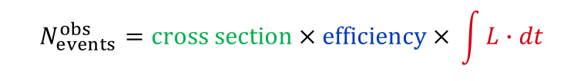
Luminosity — single most important quantity
Luminosity is a function of the LHC beam parameters
$$L \sim \frac{f_{rev}n_{bunch}N_{p}^{2}}{A}=\frac{f_{rev}n_{bunch}N_{p}^{2}}{4πσ_{x}σ_{y}}$$
L_{max} ~ 1.6 × 10³⁴ s^{–1}cm^{–2}
10 nb^{–1}s^{–1} = 10³⁴ s^{–1}cm^{–2}
~ 1 GHz interaction rate
$$[L]=\frac{1}{s∙{cm}^{2}}$$
  f_{rev} = 11245.5 Hz is the bunch revolution frequency
  n_{bunch} = 1…2808 is the number of bunches in the machine
  N_{p} = 1.1 × 10¹¹ is the number of protons per bunch (“bunch intensity”)
  σ_{x/y} = 12…50 µm is the transverse beam width characterising beam optics, σ ²_{x/y} = 𝜀_{x/y} 𝛽*_{x/y}
Luminosity drives our ability to detect low cross-section processes
“Cross section” given by Nature
“Efficiency” of detection optimised by experimentalist
Integrated luminosity delivered by LHC
$$N_{events}^{obs}=cross section × efficiency × \int{L∙dt}$$

Slide 34
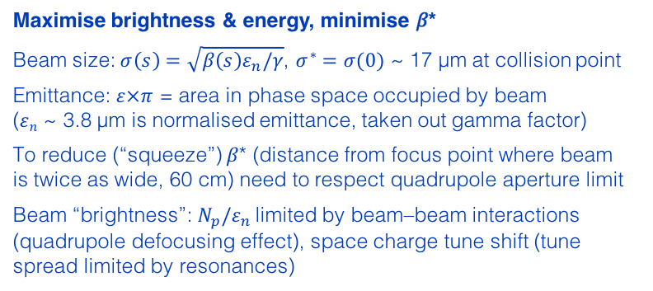
Luminosity — single most important quantity
Compensate reduction factor
Crossing angle (0.3 mrad) and “hourglass effect” (σ_{z} ~ 4–6 cm)
crossing angle
Maximising luminosity
hour glass
$$L=\frac{f_{rev}n_{bunch}N_{p}^{2}}{4πσ_{x}σ_{y}}∙R\left(θ_{c},ε,β^{∗},σ_{z}\right)=\frac{1}{4π}{∙f}_{rev}n_{bunch}N_{p}∙\frac{N_{p}}{ε_{n}}∙\frac{γ}{β^{∗}}∙R\left(θ_{c},ε,β^{∗},σ_{z}\right)$$
Maximise total beam current
Cryo-limit on maximum beam current anticorrelates N_{p} to n_{bunch}.
Collimation, cryogenics vacuum, protection improvements, … allow to increase limit.
Maximise brightness & energy, minimise 𝛽*
Beam size: $σ\left(s\right)=\sqrt{β\left(s\right)ε_{n}/γ}$, $σ^{∗}=σ(0)$ ~ 17 µm at collision point
Emittance: $ε×π$ = area in phase space occupied by beam ($ε﷮n$ ~ 3.8 µm is normalised emittance, taken out gamma factor)
To reduce (“squeeze”) 𝛽* (distance from focus point where beam is twice as wide, 60 cm) need to respect quadrupole aperture limit
Beam “brightness”:$N_{p}/ε_{n}$ limited by beam–beam interactions (quadrupole defocusing effect), space charge tune shift (tune spread limited by resonances)

Slide 35

Luminosity — single most important quantity
Compensate reduction factor
Crossing angle (0.3 mrad) and “hourglass effect” (σ_{z} ~ 4–6 cm)
crossing angle
Maximising luminosity
hour glass
$$L=\frac{f_{rev}n_{bunch}N_{p}^{2}}{4πσ_{x}σ_{y}}∙R\left(θ_{c},ε,β^{∗},σ_{z}\right)=\frac{1}{4π}{∙f}_{rev}n_{bunch}N_{p}∙\frac{N_{p}}{ε_{n}}∙\frac{γ}{β^{∗}}∙R\left(θ_{c},ε,β^{∗},σ_{z}\right)$$
Great LHC tool to compute luminosity and other relevant beam parameters as a function of LHC settings:
http://lpc.web.cern.ch/lpc/lumi2.html
Maximise total beam current
Cryo-limit on maximum beam current anticorrelates N_{p} to n_{bunch}.
Collimation, cryogenics vacuum, protection improvements, … increase the limit.
Maximise brightness & energy, minimise 𝛽*
Beam size: $σ\left(s\right)=\sqrt{β\left(s\right)ε_{n}/γ}$, $σ^{∗}=σ(s)$ ~ 17 µm at collision point
Emittance: $ε×π$ = area in phase space occupied by beam ($ε﷮n$ ~ 3.8 µm is normalised emittance, taken out gamma factor)
To reduce (“squeeze”) 𝛽* (distance from focus point where beam is twice as wide, 55 cm) need to respect quadrupole aperture limit
Beam “brightness”:$N_{p}/ε_{n}$ limited by beam–beam interactions (quadrupole defocusing effect), space charge tune shift (tune spread limited by resonances)

Slide 36
Luminosity — single most important quantity
The luminosity detectors of the experiments are calibrated with beam-separation scans (the so-called “van-der-Meer method”)
σ_{x/y} = 𝛴_{x/y} / √ 2
Specific visible interaction rate versus nominal beam separation
  𝛴_{x/y} = horizontal and transverse convolved beam widths directly determined from the scan
  The knowledge of L from the measured beam currents and beam widths allows to extract the visible cross section of a given luminosity detector
  During normal data taking the counts measured in that detector, together with the known visible cross section, allows to extract the luminosity

Slide 37
Luminosity — single most important quantity
Run-1 luminosity profile
  L_{int,recorded} = 21 fb^{–1} at 8 TeV
  L_{peak} = 7.7 ×10³³ cm^{–2}s^{–1}
  Max colliding bunches: 1380 with 50 ns bunch distance
  Max L_{int} / day: 286 pb^{–1}
  At L_{peak} every 45 min. 1 H → γγ, need ~2 typical 160 pb^{–1} fills to produced one H → 4l
CMS very similar

Slide 38
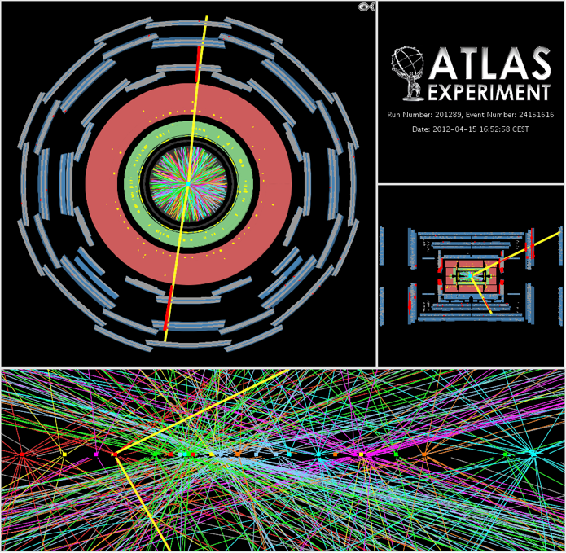

High luminosity comes at price of pileup interactions
Pileup interactions
  Average of 21 (peak: 40) interactions per crossing in 2012. Similar in 2016. LHC design value (14 TeV):
  Most analyses quite insensitive to pileup at this rate, several mitigation methods used
  However: higher trigger thresholds → low-p_{T} physics suffers
$$μ=\frac{σ_{inel}∙L}{f_{rev}∙n_{bunch}}≈\frac{80 mb∙10 {nb}^{−1}s^{−1}}{11245 s^{−1}∙2808}=25$$
CMS very similar

Slide 39
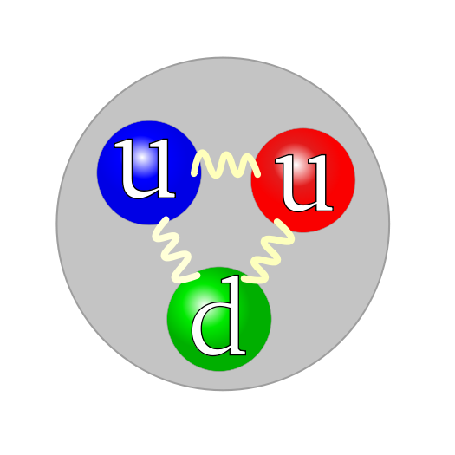
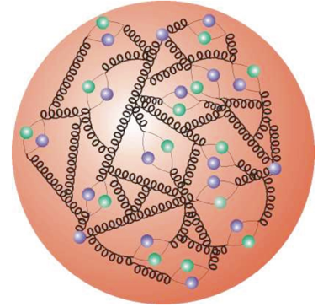
Proton–Proton Collisions
For proton–proton collisions, cross section is convolution of Parton Density Functions (PDF) with parton scattering Matrix Element
Parton distribution functions
Representing structure of proton, extracted using experimental data and QCD properties

Slide 40

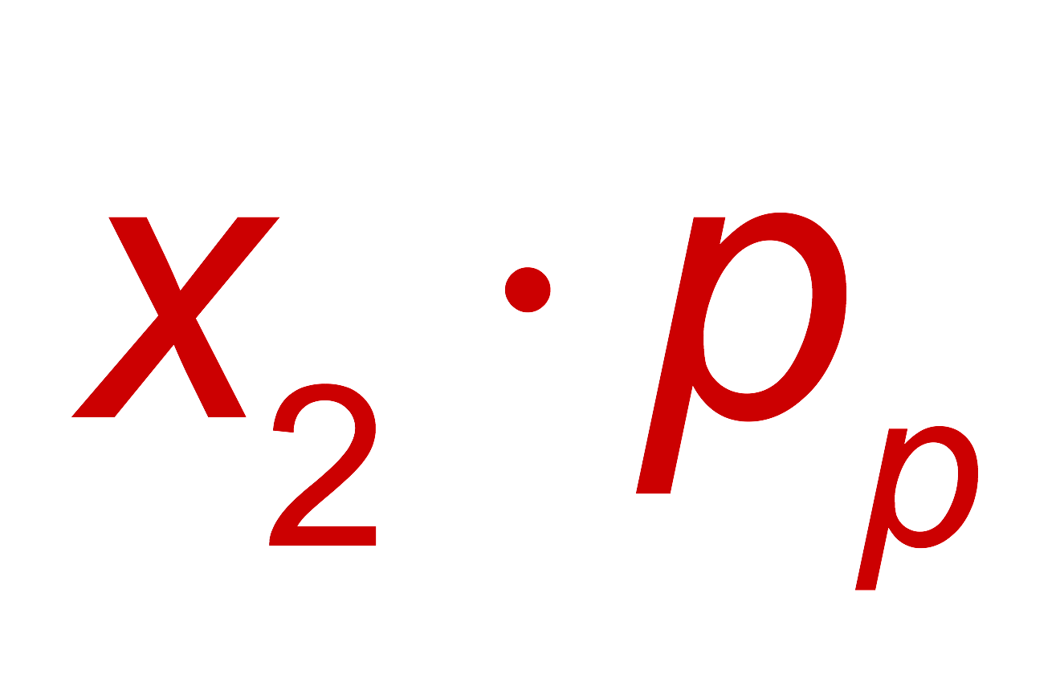

Proton–Proton Collisions
For proton–proton collisions, cross section is convolution of Parton Density Functions (PDF) with parton scattering Matrix Element
Parton distribution functions
Representing structure of proton, extracted using experimental data and QCD properties
Hard scatter parton cross section
Higher order pQCD correction; accompanying radiation, jets, …
p
Q ² = M_{X}²
X = jets, W, Z, top, Higgs, SUSY, …
p
Underlying event
CM energy-squared of parton collision:
The parton density functions rise dramatically towards low x:
  Higher cross section at higher proton−proton collision energy
  More luminosity also achieves higher achievable energy
  Low-x regime (eg, Higgs production) dominated by gluon−gluon collisions: “gluon collider”

Slide 41
Proton–Proton Collisions
Cross-section fully dominated by inelastic strong interaction “minimum bias” events
Detectors cannot record 40 MHz event rate* (each event ~2 MB size → 80 TB / second)
Online custom hardware and software “triggers” reduce rate to filter out events with a million & more times smaller cross-sections than minimum bias events
*LHCb phase-1 upgrade is preparing for exactly that!

Slide 42
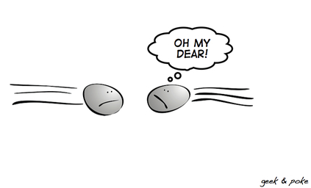
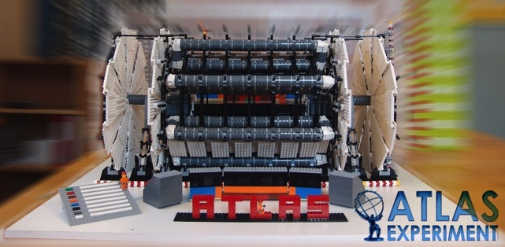
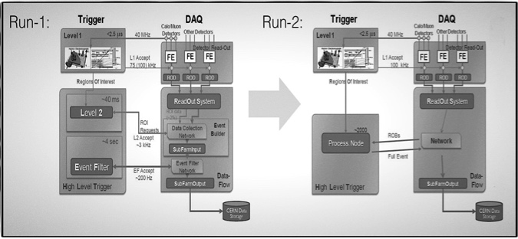
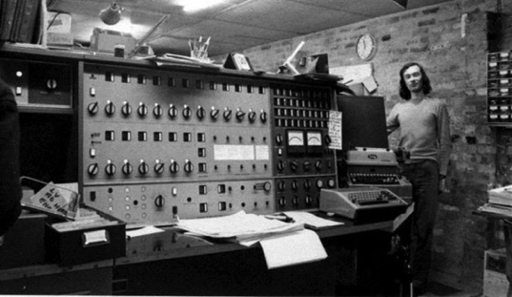
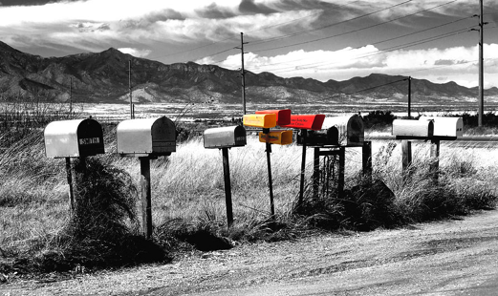
The data path in a nutshell (example ATLAS)
Large Hadron Collider
LHC Detector
Trigger & Online monitoring
25/50 ns bunch distance
L_{max} ~ 1 ×10³⁴ cm^{–2} s^{–1}
L1 (HW, up to 100 kHz) + HLT (SW, 1 kHz)
Low-threshold single lepton triggers, single MET and jet triggers, and low-threshold di-object & topological triggers
Calibration & Reconstruction
Distributed computing
Analysis
Performance groups provide standard physics objects with calibrations and uncertainties, unified in analysis release
Analysis groups build physics analyses upon this ground work
48h calibration & data quality processing, then prompt reconstruction of data in Tier-0
Production of standardised derived datasets for physics and performance analysis
Also: MC production — O(4 billion) 13 TeV events produced per experiment

Slide 43
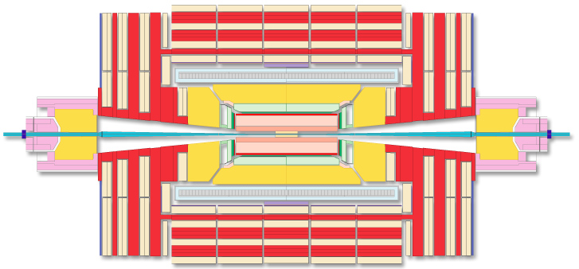
Trigger
First selection filter: reduce initial event rate by factor of one million for recording.
For each event the Trigger is a function of the event data, the apparatus, physics channel and parameters
T(
)=
Accept
Reject
Look at (almost) all bunch crossings, select most interesting one, collect all detector information and store it for offline analysis (do this with a reasonable amount of resources)

Slide 44
Schematic view of the ATLAS trigger / data acquisition system in Run-2
Trigger

Slide 45
MC event simulation is key for analysis
Event generation
Detector simulation
Digitisation
Reconstruction
Hard scattering event
Geant4 or parameterised
Mimics detector readout
“Mix-in” pileup events
Same as for real data
Physics modelling with event generators gives largest systematic uncertainty in many analyses
Hard scattering convolved with parton densities
Decays of the hard subprocesses, initial- and final-state radiation (ISR/FSR), multiple parton interactions (and their ISR/FSR)
Use matrix elements as much as possible, but cannot fully avoid phenomenological parton showers, hadronisation, and underlying event
State-of-the-art: NLO ME up to 2 partons, LO ME up to 5 partons, PS matching, non-perturbtive and electroweak corrections sometimes applied
Fixed-order calculations known to higher order
proton
proton
Rough sketch of proton–proton scattering in LHC

Slide 46
Theoretical cross-sections and uncertainties
Progress in theoretical calculations — NNLO revolution
Figure by Gavin Salam at LHCP 2016
Also experimental knowledge of PDFs limits precision in many LHC analyses !

Slide 47
Theoretical cross-sections and uncertainties
Are NLO theoretical uncertainties estimated from scale variations conservative enough ?
Also experimental knowledge of PDFs is limiting precision in many LHC analyses !

Slide 48

Testing theory
via unfolded measurements
Unfold measured distributions from detector effects (resolution, reconstruction and identification efficiencies) to particle level fiducial cross section (least theory bias)
Implement analysis in “Rivet” which allows to consistently apply cuts to HepMC formatted events
Main experimental measurement
$$σ_{pp→X}^{tot}={\frac{1}{A_{X}}σ}_{pp→X}^{fid}=\frac{1}{A_{X}}\left(\frac{N_{obs}−N_{background}}{L∙C_{X}}\right)$$
A_{X} : acceptance factor = N_{gen,fiducial} / N_{gen}
C_{X} : correction factor = N_{reco,selected} / N_{gen,fiducial}
Acceptance factors are computed entirely from theory (use best available fixed order calculation)
Correction factor depends on experiment, usually needs MC generator
Differential cross section corresponds to binned fiducial cross section; requires unfolding due to bin-to-bin correlations. Mathematically unstable procedure needing regularisation

Slide 49
Background determination
Example SUSY search: analyses look for tails in distributions of observables sensitive to high produced event mass: m_{eff}
Requires reliable estimate of SM backgrounds in signal region
Main background sources:
tt → W(→𝓁(τ) 𝜈)b + W (→qq) b
W(→𝓁 𝜈) + jets
Z(→ 𝜈 𝜈) + jets
WW, WZ, ZZ, tt +W /Z (+ jets)
QCD multijets, fake objects, …
Several estimation methods:
MC simulation
Data control regions + MC transfer
Fully data-driven (sidebands, ABCD method, etc.)
trigger threshold
SM (background)
“signal region”
SUSY

Slide 50
Basic physics objects
All LHC physics analyses use basic “physics objects” :
Object | Reconstructed how? | Calibrated how?
Tracks & vertices | Inner tracking systems | Hit residuals (alignment), hadrons, MC
Electron / photon | EM calorimeter cluster, track(s) | Z, J/𝜓 → ee(γ), W → e𝜈, π⁰, MC(γ)
Muon | Inner tracker and muon system combined | Z, Υ, J/𝜓 → µµ
Tau (hadronic decay) | Inner tracker and EM & had calorimeters* | Z → ττ, E_{calo}/p
Jet | Inner tracker and EM & had calorimeters* | Di-/multijet balance, γ + jet, Z + jet
Missing E_{T} | Reconstructed objects + “soft” objects* | Z → µµ (also ee) for soft term
b-jets (c-jets) | Inner tracker (+ jet reconstruction) | Top pairs, muons, …, MC(high p_{T})
*CMS uses event-wise particle flow

Slide 51
Reconstructing boosted particles
LHC can produce highly boosted W / Z / H bosons or top quarks so that their decays into jets can be merged
ΔR ~ 2m / p_{T}
Hence, for X → WW and m_{X} = 800 GeV (m_{W} = 80 GeV & p_{T} = 400 GeV) : ΔR ~ 0.4
Reconstruction as ”fat jets” (R ~ 1.2, compared to standard R = 0.4 anti-k_{t} jets)
Strategies to reconstruct substructure in fat jet (eg, jet mass), and to correct for pileup effects
Boosted signatures (BS) occur in high-mass new physics searches
BS can have better signal to background (multijet) ratio (eg, in H → bb / ττ )
BS via ISR jet can be used to render invisible modes accessible (eg, WIMPs, compressed spectra )

Slide 52

Systematic uncertainties
The evil in every measurement
Well designed experiments minimise as much as possible systematic uncertainties (full coverage, measurement precision, homogeneity and linearity, λ depth, longevity of components, etc)
Understanding, estimating and reducing remaining systematic uncertainties is often the main analysis challenge
A high quality analysis stands out by its thoroughness on all relevant sources of systematic uncertainty
It is important to distinguish relevant from irrelevant sources; in doubt → relevant
For many uncertainty sources, in particular theoretical ones, estimating a “one-sigma” error is very difficult, or simply impossible → be conservative !
(Reasonably) conservative uncertainty estimates are a must! It is of no use for science to make over-aggressive statements that one cannot fully trust.

Slide 53
Tomorrow:
Highlights from LHC’s Run-1 and results from Run-2

Slide 54
Extra slides

Slide 55
The Standard Model
BEH mechanism
“Mexican hat” BEH potential at T ≈ 0:
with vacuum expectation value:
At T < T_{EW}, the massless fermion fields interact with the non-vanishing BEH “condensate”:
+ …
=
+
+
×
×
×
Geometric series yields massive propagator creating effective mass for fermion:
And similar for gauge bosons

Slide 56
Theoretical cross-sections and uncertainties
Beyond event simulation, theory needed for cross-section and acceptance calculations
Inclusive jet production is known to NLO QCD (2→2 parton level) + nonperturbative corrections (particle to parton level cross-section ratio) + NLO electroweak corrections (up to 12% at large p_{T})
Inclusive W, Z production is known to full NNLO in QCD + NLO electroweak corrections
W/Z + jets production known at particle level to NLO up to 2 jets (up to 5 jets for parton level), LO matrix elements for additional partons. Also approximate NNLO calculation for W/Z+1 jet.
Diboson production, eg, WW: NNLO for quark annihilation, NLO for non-resonant gg → WW
Higgs production is known to N3LO in QCD + NLO EW (gluon fusion), VH in NNLO QCD and NLO EW, VBF in approx. NNLO QCD and NLO EW, ggZH, tt/bb_{4FS}H, tH in NLO QCD
Inclusive top-antitop production is known to full NNLO QCD + NNLL soft-gluon + EW corrections
Most other relevant processes known to NLO in QCD, some like single top in approximate NNLO
Theoretical uncertainties usually estimated by adding in quadrature:
Symmetrised renormalisation and factorisation scale variations (×2, /2), strong coupling and PDF variations (often maximum of uncertainty from main PDF used and comparison with alternative sets)
In some cases (such as for parton shower and hadronisation) comparison between alternative generators

