Slide 1
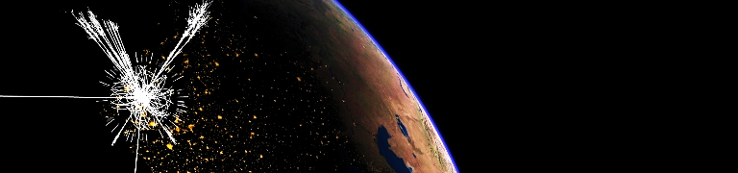
New Results from the LHC (2)
Andreas Hoecker (CERN)
September 26–28, 2016 in Freudenstadt, Germany

Slide 2
Outline
[ 3 × 1h lectures ]
Yesterday:
Basic introduction
Overview of the LHC experimental programme and methods
Today:
A review of Run-1 physics highlights
SM results from the LHC Run-2
Tomorrow
BSM searches from the LHC Run-2
Outlook to future projects

Slide 3
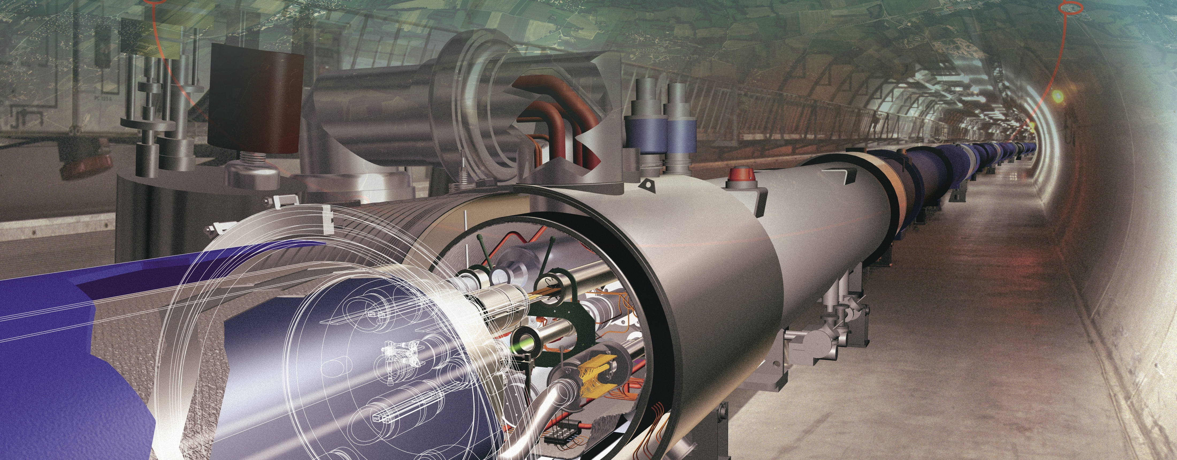

The LHC Run-1: 7 & 8 TeV pp, 5 & 20 fb^{–1}
A brief history of selected highlights

Slide 4
Inclusive and differential jet cross section vs. jet p_{T} and rapidity
Jet production [ CMS-PAS-SMP-14-001 ]
Precision measurements & theory developments (includes nonperturbative and electroweak corrections) → new quality of QCD tests at hadron colliders

Slide 5
Harvest of Run-1 results (> 500 papers / exp) confirming predictive power of SM
Standard Model cross-section measurements
Note !
Run-1 is not over yet: high-quality, extremely well understood data sample for precision measurements

Slide 6
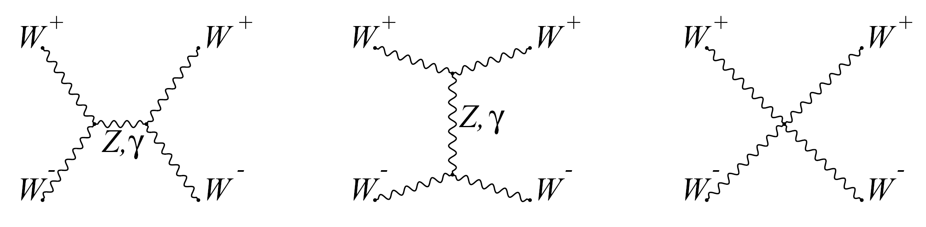
Run-1 allowed critical first electroweak studies
Higgs boson acts as “moderator” to unitarise high-energy longitudinal vector boson scattering
If only Z and W are exchanged, the amplitude of (longitudinal) W_{L}W_{L} scattering violates unitarity
Higgs boson restores unitarity of total amplitude:
H
m_{H} must not be too large (which is fulfilled)
H
Look for VBS scattering in high dijet invariant mass distributions
EW VBS production
Non-VBS production
Strong production

Slide 7
Run-1 allowed critical first electroweak studies
Higgs boson acts as “moderator” to unitarise high-energy longitudinal vector boson scattering
If only Z and W are exchanged, the amplitude of (longitudinal) W_{L}W_{L} scattering violates unitarity
Higgs boson restores unitarity of total amplitude:
Look for VBS scattering in high dijet invariant mass distributions
EW VBS production
Non-VBS production
Strong production

Slide 8
Top quark production has been studies with unprecedented experimental precision
tt cross-section measurement
[ ATLAS, EPJ C 74, 3109 (2014) ]
Precision test of NNLO QCD, used to derive the top mass and new physics limits
Many top properties measured
Luminosity and centre-of-mass energy open phase space to observe rare tt + vector-boson production
tt+W/Z: 7.1σ combined significance
[ ATLAS 1509.05276 ]

Slide 9
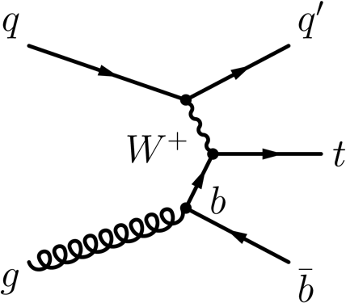
Single-top production and property measurements
Electroweak single top production
Top cross-sections significantly enhanced at LHC wrt Tevatron: at 8 TeV, factors of 42 (t-channel), 31 (tt ), but only 5 for s-channel (ie, worse S/B at LHC)
t-channel already measured differentially
[ ATLAS, 1406.7844, CMS 1511.02138 ]
Wt channel observed with 7.7σ
[ ATLAS, 1510.03752, CMS 1401.2942 ]
s-channel process first observed at Tevatron with 6.3σ in agreement with SM prediction
[ CDF & D0, 1402.5126 ]
ATLAS reported 3.2σ (3.9σ exp.) evidence in agreement with SM
[ ATLAS, 1511.05980 ]

Slide 10


W mass
No LHC result yet
World average value dominated by Tevatron measurements : 80.387 ± 0.016 GeV
[ CDF & D0, 1204.0042 ]
Global electroweak fit
No W mass measurement from LHC yet
Competitive top mass results from the LHC

Slide 11

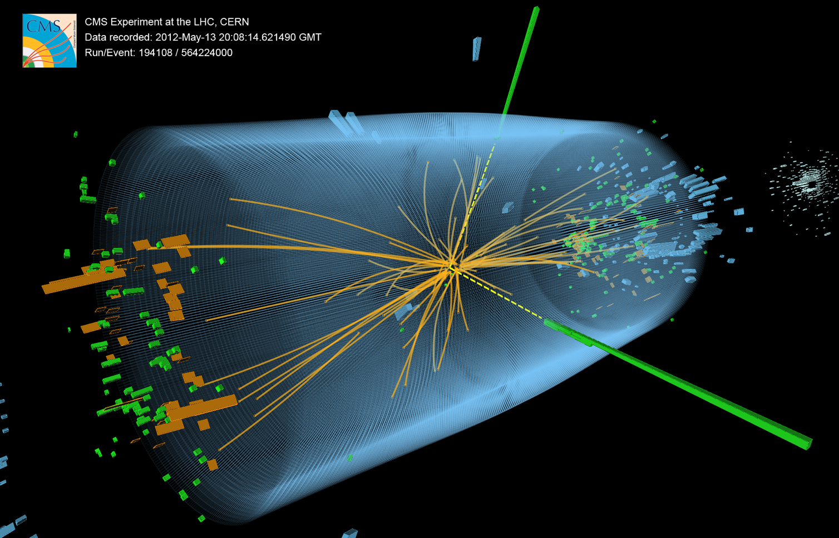
Higgs Boson — Run-1 Masterpiece
The Higgs boson had been vainly searched for at many accelerators
Best non-LHC 95% CL limits from LEP (CERN, 1989—2000) and Tevatron (Fermilab, 1990—2011):
m_{H} > 114 GeV
147 GeV < m_{H} > 179 GeV
EW fit: m_{H} < 153 GeV

Slide 12

Higgs boson production at the LHC
At the LHC, the Higgs boson is dominantly produced via gluon fusion for σ_{H,total} ~22 pb at 8 TeV for m_{H} = 125 GeV
Cross section steeply falling with Higgs mass
Vector boson fusion (σ_{W/Z+H} ~ 1.6 pb):
g
t
Higgs-strahlung (σ_{W/Z+H} ~ 0.7/0.4 pb):
H
t
g
t
σ_{H,ggF} ~ 19 pb
“ttH” production (σ_{ttH} ~ 0.13 pb):
Total production of ~470 thousand SM Higgs bosons of 125 GeV in 2012 in each ATLAS and CMS

Slide 13
Higgs boson decay
H(125 GeV) branching fractions:
Because of the coupling to the mass of the decay particles:
  … the Higgs will decay with preference to the heaviest particles allowed
  … the Higgs does not couple directly to photons and gluons, but only via “loops” involving preferentially heavy particles (e.g., top, W )
0.012% to 4(e/µ)
1.0% to 2(e/µ)2𝜈
Uncertainties 3∼12%

Slide 14
Higgs boson decay
Leptonic (e/µ) and photonic final states provide best discovery significance
  H → γγ / ZZ*(→ 4𝓁) have best mass resoluton
  H → WW* → 2𝓁2𝜈 good trigger, sustainable background level, and large branching fraction
H(125 GeV)
Decay channel | Mass resolution
H → γγ | 1–2%
H → ZZ*→ 4𝓁 | 1–2%
H → WW* → 2𝓁2𝜈 | 20%
H → bb | 10%
H → ττ | 15%

Slide 15
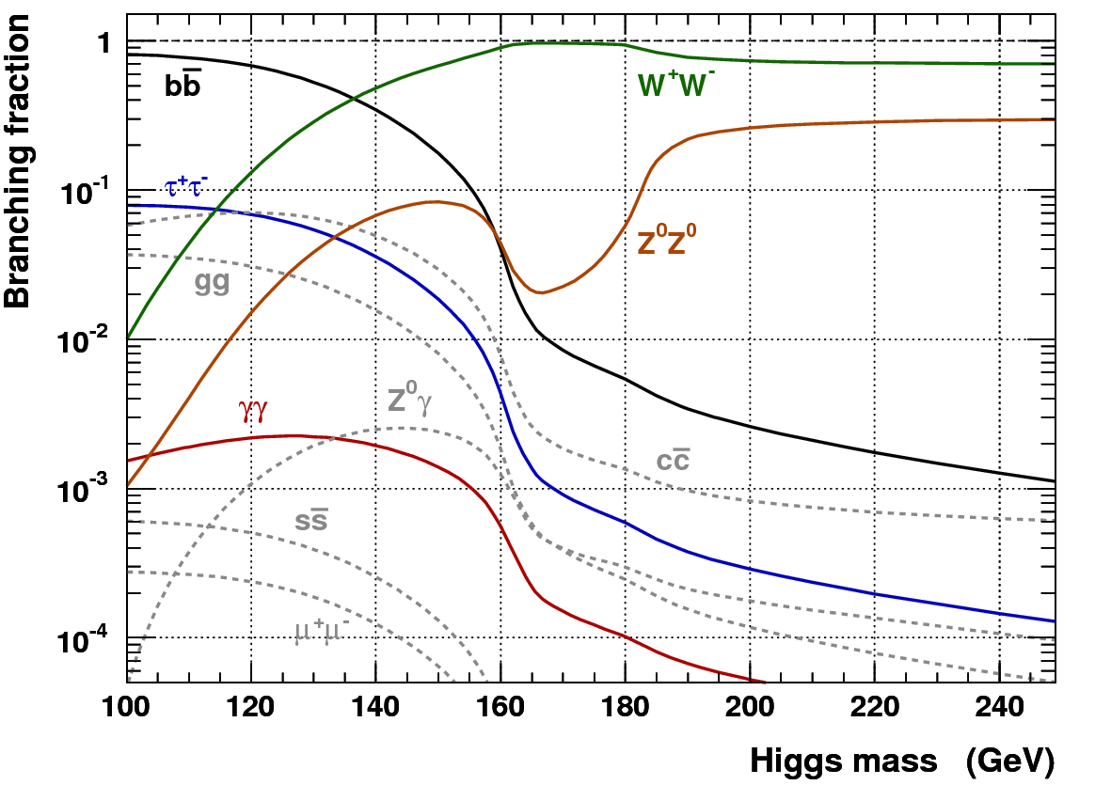
Higgs boson production at the LHC
H (125 GeV)
At m_{H} = 125 GeV, many decays experimentally accessible!
The phenomenological aspects of that mass might seem less appealing
The dominant H → bb mode is only exploitable in association with W/Z or tt, also with strong Higgs boost
Associated leptons provide trigger signal as they help to reduce huge QCD background, σ(bb) ~ O(100 µb)

Slide 16
No doubt on H₁₂₅ discovery in the bosonic channels
H → γγ
H → ZZ⁽*⁾ → 4𝓁
H → WW ⁽*⁾ → 2𝓁2ν
0
Very different experimental challenges in each of these discovery channels.
All analyses significantly improved since July 2012

Slide 17
Combined Higgs analysis and a flurry of property measurements
ATLAS & CMS Combinations of Higgs mass and coupling measurements
[ 1503.07589, 1606.02266 ]
Also:
Differential cross-section measurements
Limit on Γ_{H} from off-shell to on-shell coupling ratio
Limit on invisible Higgs branching ratio of < 25% [1509.00672, 1404.1344 ]
Constraints on anomalous off-shell coupling or spin/CP, forbidden decays (FCNC) and other scalar particles (BSM Higgs)
m_{H} = 125.09 ± 0.21_{stat} ± 0.11_{syst} GeV
Higgs production processes
Higgs decay processes
Agreement among experiments
Combined observation of H → ττ channel and VBF production
ttH channel a bit large: 4.4σ significance (2.0 exp), µ = 2.3
Note that the least model-dependent observables at the LHC are ratios of couplings

Slide 18
Combined Higgs analysis and a flurry of property measurements
ATLAS & CMS Combinations of Higgs mass and coupling measurements
[ 1503.07589, 1606.02266 ]
Couplings to massless particles mediated by loops involving heavy particles
Powerful test for new physics (eg, excludes SM-like heavy 4th fermion generation)

Slide 19
The Higgs boson as a portal to beyond the SM physics
Higgs as BSM portal
Higgs is narrow: 4.1 MeV
For comparison:
Γ_{W} = 2.1 GeV
Γ_{Z} = 2.5 GeV
Γ_{top} = 1.3 GeV
?
Even small couplings to new light states can measurably distort branching fractions
Γ_{H} = 4.1 MeV

Slide 20
Beautiful flavour and low-p_{T} physics measurements
Flurry of results from LHCb [ ~300 papers to date ]
Does the Higgs boson has brothers and sisters?
h, H, A
H ±
?
B_{s} → µµ is loop process (no tree-level FCNC) that is in addition CKM & helicity suppressed
SM: 3.7 ± 0.2 × 10^{–9}
CMS & LHCb: observation of B_{s} → µµ
[ Nat. 522 (2015) 68 ]
ATLAS Run-1 result ~2σ below SM
[1604.04263 ]

Slide 21


Beautiful flavour and low-p_{T} physics measurements
Flurry of results from LHCb [ ~300 papers to date ]
Precision measurement of 𝜙_{s}
[ PRL 114, 041801 (2015): φ_{s} = –0.010 ± 0.039 ]
Observation of new states consistent with pentaquarks
[ PRL 115, 072001 (2015) ]
Data
Fit result
P_{c} (4450)⁺
P_{c} (4380)⁺
? or ? or … ?

Slide 22
Beautiful flavour and low-p_{T} physics measurements
Long-term effort to overconstrain CKM matrix continues (phase value itself “accident” of nature?).
Huge contributions from LHCb:
Measurements of γ, sin(2β), |V_{ub}|, Δm_{s/d} from LHCb
World’s best constraints on CP violation in B⁰_{(s)} mixing (a_{sl}^{s}, a_{sl}^{d}) in agreement with SM (D0 sees 3.6σ deviation)
Is the CKM phase an “accident of nature” ?

Slide 23


Flavour anomalies ?
B-factories and LHCb measure ratios of semileptonic B decays. Robust SM predictions
$$R_{D^{(∗)}}=\frac{BR(B^{0}→D^{\left(∗\right)}τν)}{BR(B^{0}→D^{\left(∗\right)}ℓν)}$$
$$R_{K}=\frac{BR(B^{+}→K^{+}μμ)}{BR(B^{+}→K^{+}ee)}$$
Latest measurement by Belle using semileptonic tagging of recoil B (Moriond EW):
R_{D*} = 0.302 ± 0.030_{stat} ± 0.011_{syst} [SM: 0.252 ± 0.003, 1.6σ]
World average by HFAG: R_{D*} = 0.316 ± 0.016 ± 0.010 (3.3σ from SM, combined R_{D*} & R_{D} is 4.0σ)
http://www.slac.stanford.edu/xorg/hfag/semi/winter16/winter16_dtaunu.html

Slide 24
Since the LHC Run-1 the Standard Model is complete
ATLAS & CMS
ATLAS & CMS

Slide 25
Since the LHC Run-1 the Standard Model is complete
It is a triumph for the imagination and rigour of the scientific endeavour
It is a triumph for the greatest experimental undertaking ever:
Frontier of accelerator & detector technologies
Global data sharing, analysis & collaboration

Slide 26
Two beautiful, extremely precise theories
The Standard Model of EW and strong interactions
Predicting the anomalous magnetic moment of the electron to a relative precision of 10^{–10} in agreement with experiment
General relativity — theory of gravitation
Tested up to an accuracy of order 10^{–5} (Cassini probe)
Unfortunately, the SM and general relativity don’t work in regimes when both are important (ie, at very small scales)

Slide 27
Many open questions remain…
Scalar sector
Single doublet or more
Elementary or composite
Form of potential
Origin of Yukawa couplings
Quarks and leptons
Origin of families, mass, mixing, CPV
Matter–antimatter asymmetry
Baryon and lepton number conservation (proton decay)
Dark matter
Composition: WIMP, axions, sterile neutrinos, hidden sector particles, gravitational effect only
Single or multiple sources
Neutrinos
Origin and values of neutrino masses
Nature: Majorana or Dirac
CP violation
Sterile neutrinos
Expansion of Universe
Primordial expansion via inflation; which fields, role of quantum gravity?
Accelerated expansion today: cosmological constant problem
High-scale physics
Hierarchy problem and new physics at TeV scale
Grand unification of forces
Unification with gravity
Quantum gravity, string theory
Strong CP problem

Slide 28
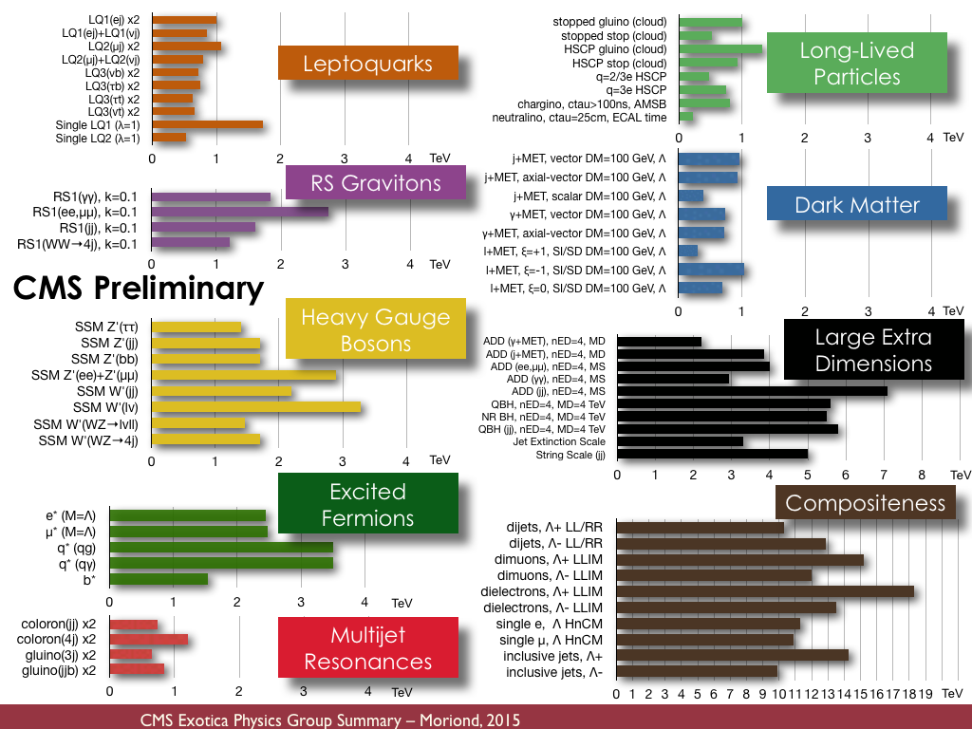
It therefore seems that the SM isn’t all there is
Vast amount of BSM searches
Theory-agnostic, signature based searches, as well as highly targeted model-dependent ones
No significant anomaly seen so far

Slide 29
The LHC Run-2 at 13 TeV and beyond

Slide 30
The LHC Run-2 at 13 TeV
Huge milestone achieved in 2015 with record proton–proton collision energy of 13 TeV
After a rocky start, the LHC delivered L_{int} = 4.2 fb^{–1}
That luminosity already surpassed the Run-1 new physics sensitivity of many searches
During 2016 reached peak 1.2×10³⁴ cm^{–2} s^{–1} and expect 35~40 fb^{–1} total delivered
Excellent machine efficiency!

Slide 31
The LHC Run-2: 13 TeV / 8 TeV inclusive “parton luminosity” ratio
PDFs
Strong interaction dominated processes
Electroweak processes
4 TeV
Larger cross section increase for gluon induced than for quark induced processes
Early Run-2 puts emphasis on searches

Slide 32
The LHC Run-2: 13 TeV / 8 TeV inclusive pp cross-section ratio
Heavy flavour cross section scales ≈ linearly with √s
At 10³⁴ cm^{–2} s^{–1} @ 13 TeV pp the LHC produces:
200 Hz W → 𝓁 ν
19 Hz Z → 𝓁𝓁
8 Hz top pair
0.5 Hz Higgs

Slide 33
2015 LHC proton–proton luminosities
Most results reported by ATLAS & CMS use total 2015 and summer 2016 dataset
ICHEP 2016
Peak luminosity (> design):
L_{max} = 1.2 × 10³⁴ cm^{–2} s^{–1}
12–16 fb^{–1} for results so far
2015 and 2016 pileup profile in ATLAS & CMS
(LHCb mean pileup of ~1.7 due to levelling)
LHCb after luminosity levelling: 1.3 (1.5) fb^{–1} recorded (delivered)
Current luminosity precision from van-der Meer scans: 2.9% (ATLAS), 2.3% (CMS), 3.8% (LHCb)

Slide 34
Standard Model and top physics results
Soft QCD: particle spectra
p_{T} < few GeV, > 99.999% of collisions
Probe LO matrix, parton shower models, generator tunings, pileup modelling
Hard QCD: jets
p_{T} > tens of GeV up to TeV, ~10^{–5} of collisions
Probe NLO QCD, running α_{s}, PDF, parton showers
Hard QCD & electroweak: W, Z, H, top → identified particles
p_{T} > tens of GeV, 10^{–6} ~ 10^{–8} of collisions
Probe NLO, NN(N)LO QCD, soft gluon resummation, PDF, electroweak physics

Slide 35
Standard Model and Higgs precision measurements
Key to the LHC programme up to the High-Luminosity LHC (HL-LHC)
Scientific perspective. No matter what BSM the LHC will unveil in the next years, improving the knowledge of Higgs properties is a must, which by itself requires and justifies the largest possible LHC statistics → stopping after 300 fb^{–1} will not be satisfying!
Pragmatic perspective. Higgs and SM physics are the only guaranteed deliverables of the LHC programme. Need to exploit this part of the programme to its maximum extent!
Utilitarian perspective. Elements of the SM, besides the Higgs, require further consolidation, control and improved precision, both in the EW and QCD sectors
  They hold a fundamental value (e.g. the precise determination of fundamental parameters), or are critical to fully exploit the BSM search potential (e.g. the knowledge of backgrounds, production rates and production dynamics)
Spinoffs. The study of SM processes at colliders is typically much more complex than that of BSM signatures (requires higher precision, larger final state multiplicities, etc), and in the years it has been the main driver of fundamental theoretical innovation
Taken from: Michelangelo Mangano @ SEARCH 2016

Slide 36
Inclusive inelastic cross-section measurement at 13 TeV
Fundamental initial measurement, based on forward scintillators
Measurement in fiducial region ξ = M_{X}² / s > 10^{–6} (M_{X} largest mass of two proton-dissociation systems)
Use Minimum Bias Trigger Scintillators (MBTS) with acceptance 2.07 < |η | < 3.86, 4.2M selected events
Systematic uncertainty fully dominated by luminosity
ATLAS: 1606.02625
Measured inclusive inelastic cross section:
σ_{13 TeV} = 79.3 ± 0.8 ± 1.3 (lumi) ± 2.5 (extr) mb
Best measurement of total cross section via elastic scattering and optical theorem:
σ_{tot} ∝Im f_{elastic}(t → 0)
using dedicated forward devices (up to 1.4% precision in Run-1, dominated by luminosity error)

Slide 37
Measurement of jet cross section at 13 TeV
Primary test of QCD at highest collision energy
CMS 1605.04436
Double differential cross section measured by CMS
Comparison with 8 TeV plot (right) shows effect of increased parton luminosities at high jet p_{T}

Slide 38


Z and W production at 13 TeV — examples: σ_{Z→µµ} (13 TeV) ~ 1.9 nb, σ_{W±→µ𝜈} (13 TeV) ~ 19.7 nb
Expect increase of cross section by factors of 1.7 and 1.6, respectively
Pure channels. Leptonic decays of Z & W are also standard candles to calibrate e/µ performance
[ ATLAS 1603.09222, CMS-PAS-SMP-15-004 ]
$$m_{T}=\sqrt{2p_{T,ℓ}E_{T}^{miss}\left(1−cosΔφ_{ℓν}\right)}$$
$$m_{e_{1}e_{2}}=\sqrt{2p_{T,1}p_{T,2}\left(cosh{Δη}_{12}−cosΔφ_{12}\right)}$$

Slide 39
Z and W production at 13 TeV
Expect increase of cross section by factors of 1.7 and 1.6, respectively
Inclusive cross sections shown, also fiducial cross sections measured
Comparison of measured cross-sections with NNLO QCD & NLO EW Drell-Yan predictions (FEWZ 3.1): good agreement found within uncertainties
Also: LHCb σ_{Z} (2.0 < η < 4.5) in agreement with SM

Slide 40
Cross-section ratios quite precise (< 1–2%)
Powerful tools to constrain PDFs: W⁺ / W– sensitive to low-x u & d valence, W / Z constrains s
Lepton universality test
Lepton universality in charged current was measured to the 0.14% level at LEP in tau lepton decays, however at low energy (off-shell), so less sensitivity to new physics in loops
LEP
LEP

Slide 41
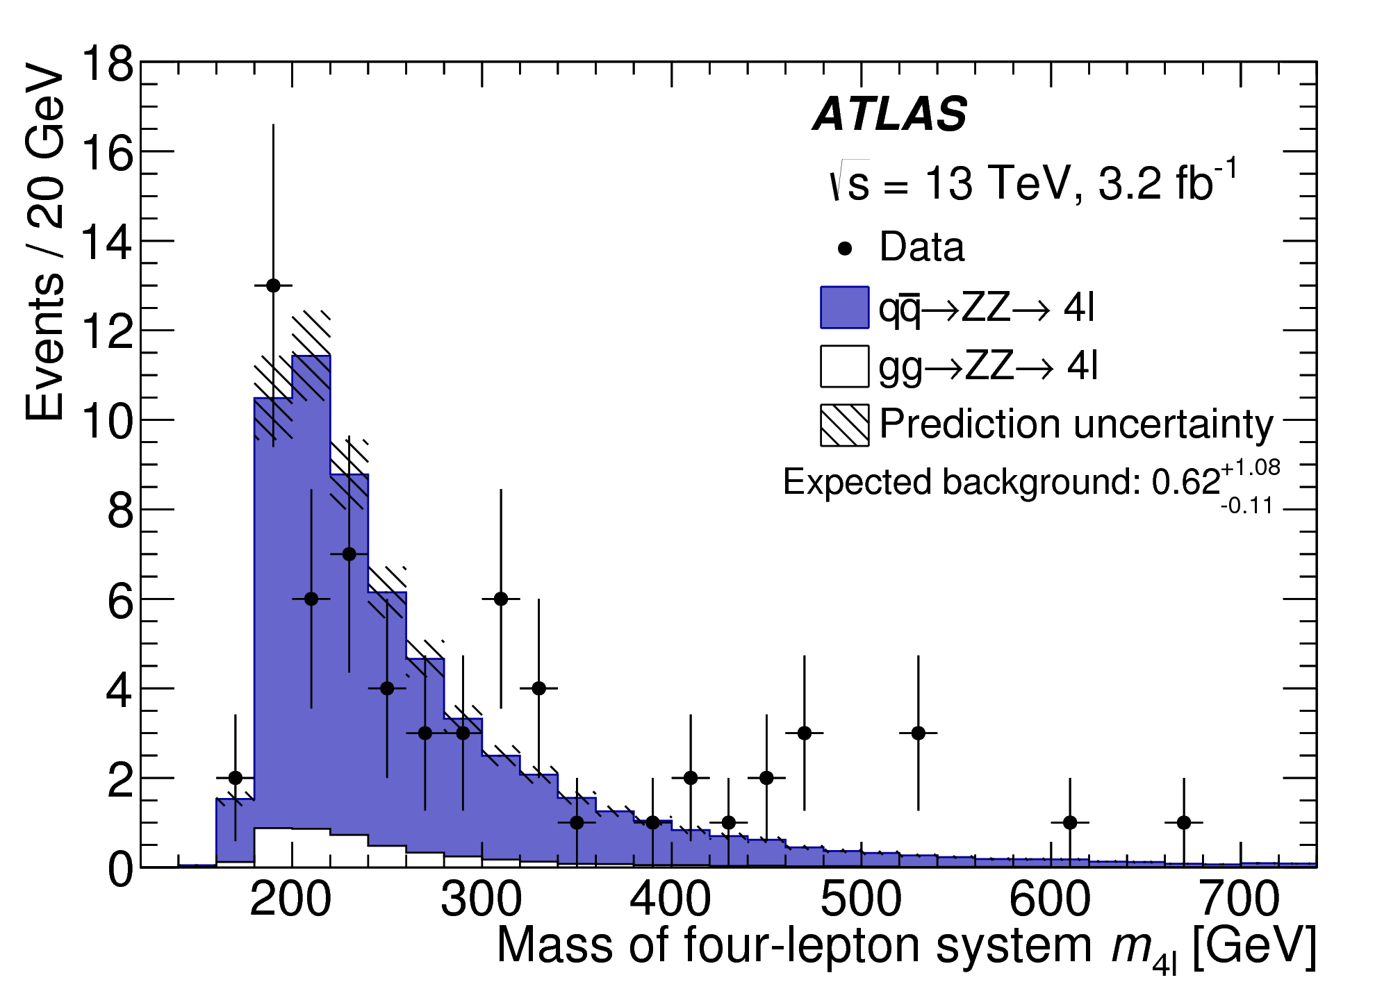
Diboson production — example: σ_{WW, no Higgs} (13 TeV) ~ 120 pb
Highly important sector of LHC physics, intimately related to electroweak symmetry breaking
ATLAS & CMS performed inclusive, fiducial and differential cross-section analyses at 8 TeV. First 13 TeV results. Theoretical predictions at NNLO needed to match data.
ATLAS 1512.05314
pp → ZZ (13 TeV)
pp → WZ (13 TeV)
pp → WZ (8 TeV)
ATLAS 1606.04017
MC normalised to NNLO
MC normalised to NLO
ATLAS 1603.02151
pp → WW (13 TeV)
CMS-PAS-SMP-16-006
All measurements agree with NNLO (+ NNLL soft gluon resummation in WW case, needed because of jet veto) predictions. WZ @ 13 TeV from CMS somewhat low.

Slide 42
Top-antitop production at 13 TeV
Extraction of top-pair cross section (expect: 13 TeV / 8 TeV ~ 3.3)
ATLAS 1606.02699, similar for CMS
Apply robust data-driven method that provided most precise Run-1 measurements (7 & 8 TeV)
Following relation allows to simultaneously determine σ_{tt} and ε_{b} from data
MC normalised to SM expectation
Where:
N₁₍₂₎ – number of selected events with 1(2) b-tags
N₁₍₂₎^{bkg} – number of background events with 1(2) b-tags
L – luminosity of data sample
ε_{eµ} – (tt →) eµ selection eff & acc (~0.9%) incl. BR
ε_{b} – probability to b-tag q from t → Wq
C_{b} = ε_{bb} / ε_{b} is non-factorisation correction
(1.002 ± 0.006 from MC)
Observe: N₁ = 11958, N₂ = 7069
Expect: N₁^{bkg} = 1370 ± 120, N₂^{bkg} = 340 ± 88, dominated by Wt (MC, approx. NNLO), then mis-id. e/µ (MC & data)

Slide 43
Top-antitop production at 13 TeV
Extraction of top-pair cross section (expect: 13 TeV / 8 TeV ~ 3.3)
ATLAS 1606.02699, similar for CMS
Solving the equation gives the following 13 TeV pp → tt + X cross section
σ_{tt} (13 TeV) = 818 ± 8 (stat) ± 27 (syst) ± 19 (lumi) ± 12 (beam-E) pb
Total relative uncertainty of 4.4%
(4.3% at 8 TeV)
+40
– 46
σ_{tt}[SM] (13 TeV) = 832 pb ( at NNLO + NNLL accuracy, m_{t} = 172.5 GeV, Top++ 2.0 )
Systematic uncertainty (3.3%) dominated by
tt parton shower & hadronisation (2.8%)
tt NLO modelling, ISR/FSR radiation & PDF (1.1%)
Single top modelling (0.8%)
Electron ID + isolation (0.5%)
Muon ID + isolation (0.5%)
Lepton mis-identification (0.6%)
Also find: ε_{b} = 0.559 ± 0.004 ± 0.003, in good agreement with simulation: 0.549

Slide 44
Top-antitop production at 13 TeV
Extraction of top-pair cross section (expect: 13 TeV / 8 TeV ~ 3.3)
ATLAS & CMS studied top production in many ways at 13 TeV → very prompt analyses turn around
Agreement with expected factor of 3.3
Robust eµ final state gives most precise inclusive results at all CM energies
Differential cross-section measurements at 13 TeV show reasonable modelling, though some deviations at large jet multiplicity. Known modelling problems from Run-1 not all solved!

Slide 45
Single top quark production
Increase of cross section by factor of 2.5 (t-channel) over 8 TeV, roughly 1/3rd of tt cross section
ATLAS & CMS have so far released preliminary t-channel measurements at 13 TeV (100 x cross-section of Tevatron)
“t-channel”
(“4 flavour scheme”)
13 TeV: ATLAS-CONF-2015-079, CMS-PAS-TOP-16-003
“Wt-channel”
“s-channel”
(not easier at 13 TeV)
Tevatron: 6.3σ, ATLAS Run-1: 3.2σ

Slide 46
Top-antitop production and a vector boson at 13 TeV
First results on important ttV process, in it’s own right, and as background to ttH and searches
ATLAS & CMS have preliminary 13 TeV results
Analyses combine several multilepton final states, difficult mis-ID background
At 8 TeV, both processes observed, and found to agree with SM prediction (ttW ~1σ up in both ATLAS & CMS)
Different production processes and thus 13/8 TeV cross-section ratios for ttZ & ttW: 3.6 & 2.4
13 TeV tt+W/Z results from ATLAS and CMS in agreement with SM:
ATLAS: 1609.01599, CMS-PAS-TOP-16-017
ATLAS (3.2 fb^{–1}, 2015):
ttW: 1.5 ± 0.8 pb
ttZ: 0.9 ± 0.3 pb
CMS (12.9 fb^{–1}, 2016):
ttW: 0.98 pb
ttZ: 0.70 pb
SM (NLO):
ttW: 0.60 ± 0.08 pb
ttZ: 0.84 ± 0.09 pb
+0.23
– 0.22
+0.22
– 0.18
+0.16
– 0.15
+0.14
– 0.12

Slide 47
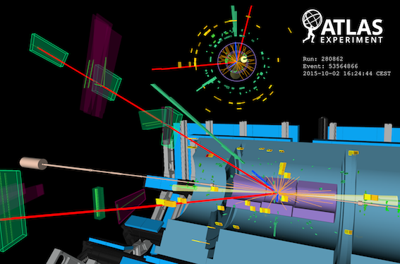
Re-observation of Higgs boson at 13 TeV
13/8 TeV cross section ratios of 2~2.4 for VH, ggH, VBF, and 3.9 for ttH
2015 & 2016 statistics combined achieves better significance and precision than in Run-1
Display of H → eeµµ candidate from 13 TeV pp collisions. The electrons have a transverse momentum of 111 and 16 GeV, the muons 18 and 17 GeV, and the jets 118 and 54 GeV. The invariant mass of the four lepton system is 129 GeV, the di-electron invariant mass is 91 GeV, the di-muon invariant mass is 29 GeV, the pseudorapidity difference between the two jets is 6.4 while the di-jet invariant mass is 2 TeV. This event is consistent with VBF production of a Higgs boson decaying to four leptons.

Slide 48
ATLAS and CMS studied H₁₂₅ in bosonic channels
Preliminary fiducial and total cross-section and coupling measurements (ggF and VBF significant)
H → ZZ* → 4𝓁
ATLAS-CONF-2016-079
CMS-PAS-HIG-16-033
+18
– 16
µ = σ_{data} / σ_{SM} = 0.99
+0.33
– 0.26
σ_{tot,data} = 81 pb
σ_{tot,SM} = 55 ± 4 pb
Expected significance (SM): 6.5σ
+0.48
– 0.44
CMS also measured: m_{H} = 124.50 GeV
(dominated by statistical uncertainty, compare to 125.09 ± 0.24 GeV from ATLAS & CMS Run-1 combination)

Slide 49
ATLAS and CMS studied H₁₂₅ in bosonic channels
Preliminary fiducial and total cross-section and coupling measurements (ggF and VBF significant)
H → γγ
ATLAS-CONF-2016-067
CMS-PAS-HIG-16-020
µ = 0.85
+0.22
– 0.20
µ = 0.91 ± 0.20
Expected significance (SM): 5.4σ
Expected significance (SM): 6.2σ

Slide 50
ATLAS and CMS studied H₁₂₅ in bosonic channels
Preliminary fiducial and total cross-section and coupling measurements (ggF and VBF significant)
H → γγ and H → ZZ* → 4𝓁 (right combined)
ATLAS-CONF-2016-067
Combination of
H → γγ and H → 4𝓁
ATLAS-CONF-2016-081
Differential fiducial cross-section measurement in H → 4𝓁 compared to NNLO+PS theoretical prediction

Slide 51
ATLAS and CMS studied H₁₂₅ in bosonic channels
Cross section versus centre-of-mass energy
H → γγ and H → ZZ* → 4𝓁 (left)
Combined H → 4𝓁, γγ
H → 4𝓁, fiducial cross section
ATLAS-CONF-2016-081
CMS-PAS-HIG-16-033
Expected rise of cross-section observed in data

Slide 52
ATLAS studied H₁₂₅ in bb decay channel
Associated production, challenging final states
H → W / Z + H → 𝓁𝜈 / 𝓁⁺𝓁–, 𝜈𝜈 + bb
ATLAS-CONF-2016-091
Slightly lower yield than expected in SM, similar for Run-1 (µ = 0.7 ± 0.3, ATLAS & CMS)

Slide 53
Searches for rare Higgs decays
Beyond SM reach at present, but could have new physics contributions ?
Strongly resolution dependent, improve sensitivity by categorising events (low/high p_{T}, central/forward, VBF)
H → µµ [expected branching fraction: 0.02%]
ATLAS-CONF-2016-041
Observed limit 4.4 times SM (3.5 combined with Run-1). Need about 300 fb^{–1} of data to reach SM
Can already exclude universal Higgs coupling to fermions !
(Would have observed H → µµ if same BR as H → ττ)

Slide 54
Tomorrow:
Searches — a fresh restart at 13 TeV

Slide 55
Extra slides

Slide 56



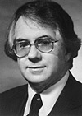










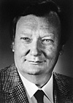
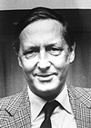
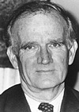



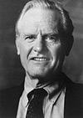




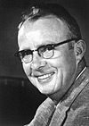



The Standard Model is the legacy of 20th century particle physics
Standard Model (36+1 particles, 3 forces)
Wilczek
Gross
Salam
Glashow
Weinberg
Veltman
‘t Hooft
Politzer
Friedman
Reines
Perl
Rubbia
Schwartz
Lederman
Ting
Englert & Higgs
van der
Meer
Fitch
Hofstadter
Steinberger
Cronin
Kendall
Selected Nobel Prizes since 1957 (incomplete!)
Schwinger
Feynman
Richter
Gell-Mann
Alvarez
Taylor
Yang
Lee
Gauge group = SU(3)_{C} x SU(2)_{L} x U(1)_{Y}
SU(3)_{C} x U(1)_{EM}
EWSB
Courtesy: Pascal Pralavorio

Slide 57
Broad search coverage — not only the standard signatures
Run-1 “tour de force” analysis of pMSSM
[ ATLAS, 1508.06608, CMS 1606.03577 ]
Combined use of 22 separate ATLAS SUSY searches in addition to external constraints (m_{H}, EWPO, flavour, LEP searches, dark matter) to probe 19 parameter pMSSM
Distinction of LSP types: bino, wino, higgsino
Analysis overall reproduces simplified models picture
Higgsino/wino scenarios biggest challenge

Slide 58
Broad search coverage — not only the standard signatures
All experiments looked for various types of long-lived massive particles

Slide 59
SM predictions in Monte Carlo simulations
Parton level examples (often require “hadronisation” and soft “parton shower” corrections):
MCFM: fixed-order NLO → vector bosons etc.
BLACKHAT+SHERPA: NLO fixed order pQCD (up to 4p) → vector bosons etc.
Jetphox: fixed-order NLO QCD → photons
PeTeR: resummed NNLO ( NNNLL accuracy) → photons, etc.
NLOjets++: fixed-order NLO QCD → jets
FEWZ, DYNNLO, Njetti etc. – NNLO calculations for vector bosons
Event generators at hadron/particle level, examples:
PYTHIA8, HERWIG++: LO ME with parton showers (PS) – general-purpose generator, hadronisation and PS tools
ALPGEN: LO matrix element (ME) multipartons (up to 5p)
SHERPA: LO/NLO multipartons (up to 5/2p) + PS (internal)
MadGraph/MG5_aMC@NLO: LO/NLO MEmultiparton (5/2p)
POWHEG, MC@NLO: NLO
State of the art is:
Parton level: NNLO with resummed logs
Hadron level: NLO + PS, LO multiparton + PS

Slide 60
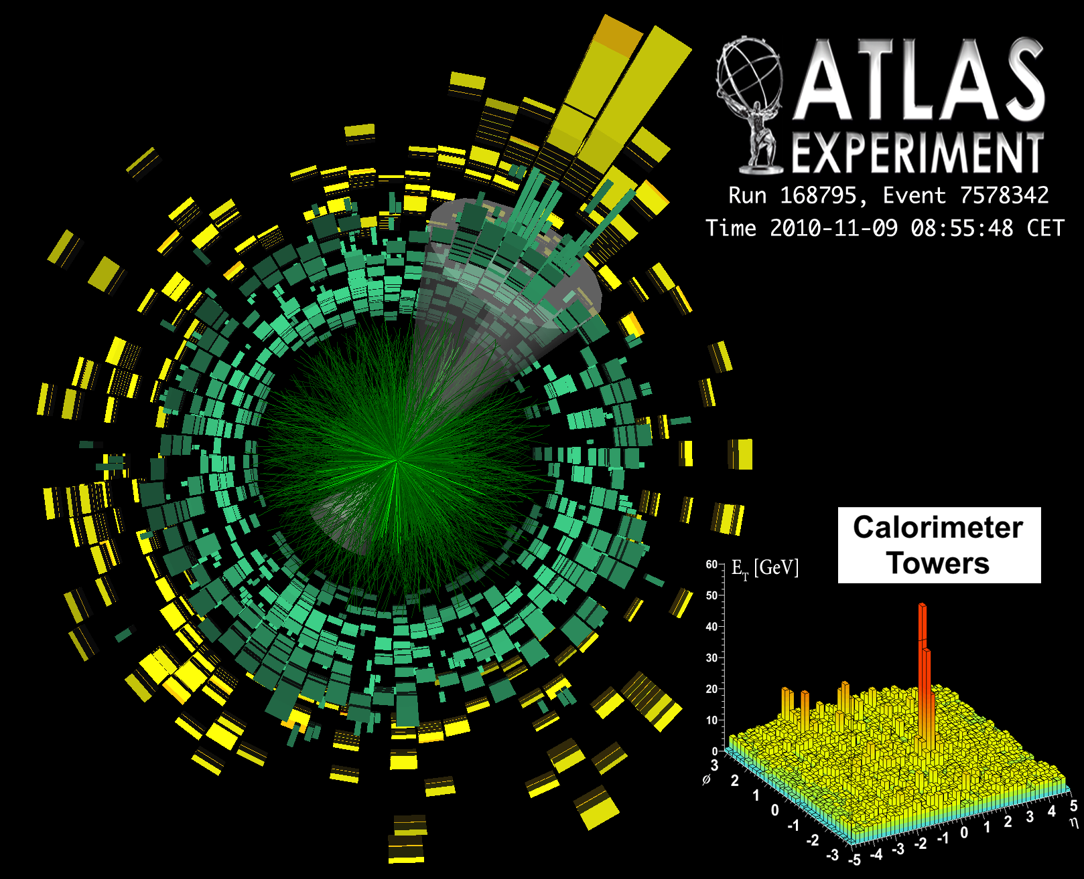
Striking phenomena observed, e.g. in lead–lead collisions and soft pp physics
ııııııııı
[ ATLAS, PRL 105, 252303 (2010) ]
[ CMS, PLB 718 (2013) 795 ]

Slide 61
Particle physics at the dawn of the LHC Run-2
Confirmation of mass generation through spontaneous symmetry breaking in BEH potential. Scalar sector SM-like so far (but lacking precision)
QED tested to parts per million accuracy (slight anomaly in muon g–2)
?
Asymptotic freedom in strong interactions verified at % level
Electroweak unification tested to high precision
Quark sector: CKM picture for quark mixing & CP violation confirmed
Lepton sector: massive neutrinos, unknown masses, nature, CP violation, sterile 𝜈’s ? No flavour violation in charged lepton sector. Lepton universality tested to per-mil level
No compelling sign of new physics found at high mass scales, or anywhere else, eg: no electric dipole moments (EDM), no dark matter particles (only gravitational hints), no axions (strong CP problem), no proton decay (GUT)

