Slide 1
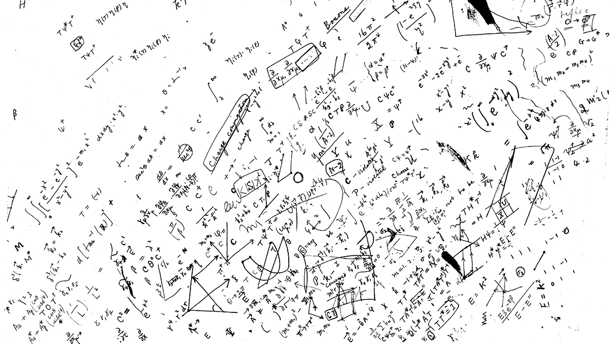
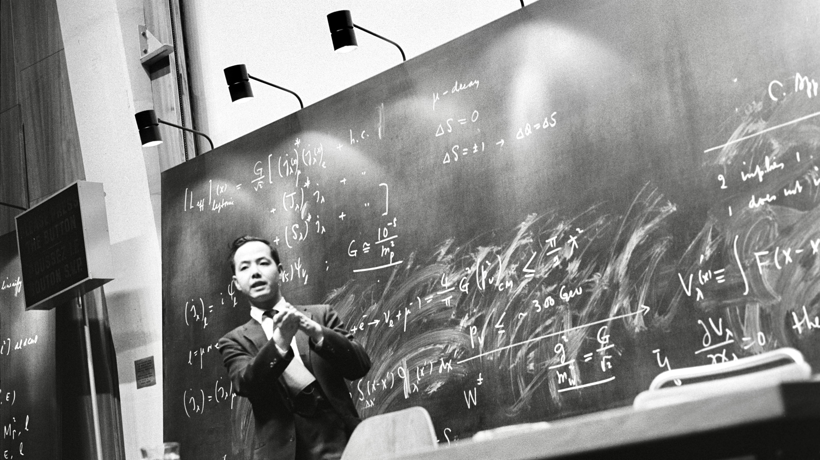
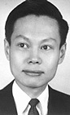

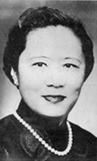
(Precision) probes of fundamental interactions at high-energy colliders
Andreas Hoecker (CERN)
Shanghai Symposium on Particle Physics and Cosmology: 70th Anniversary of the Discovery of Parity Nonconservation and Prospects in Frontier Physics, 23 June 2026
T. D. Lee speaking about weak interactions at a neutrino conference at CERN in 1965 [Ref]

Slide 2
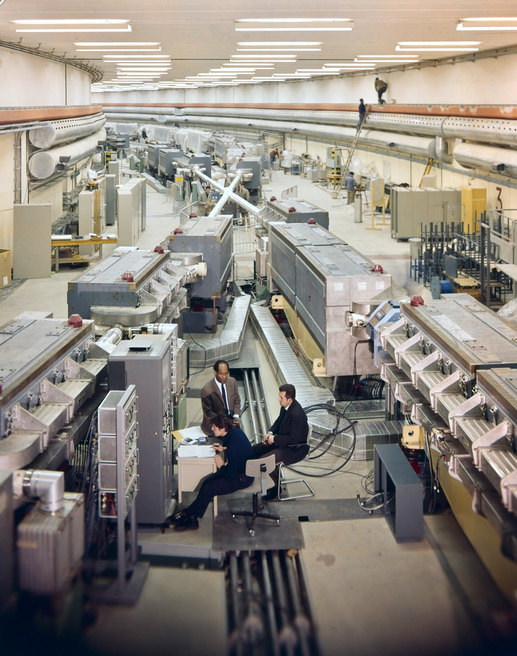
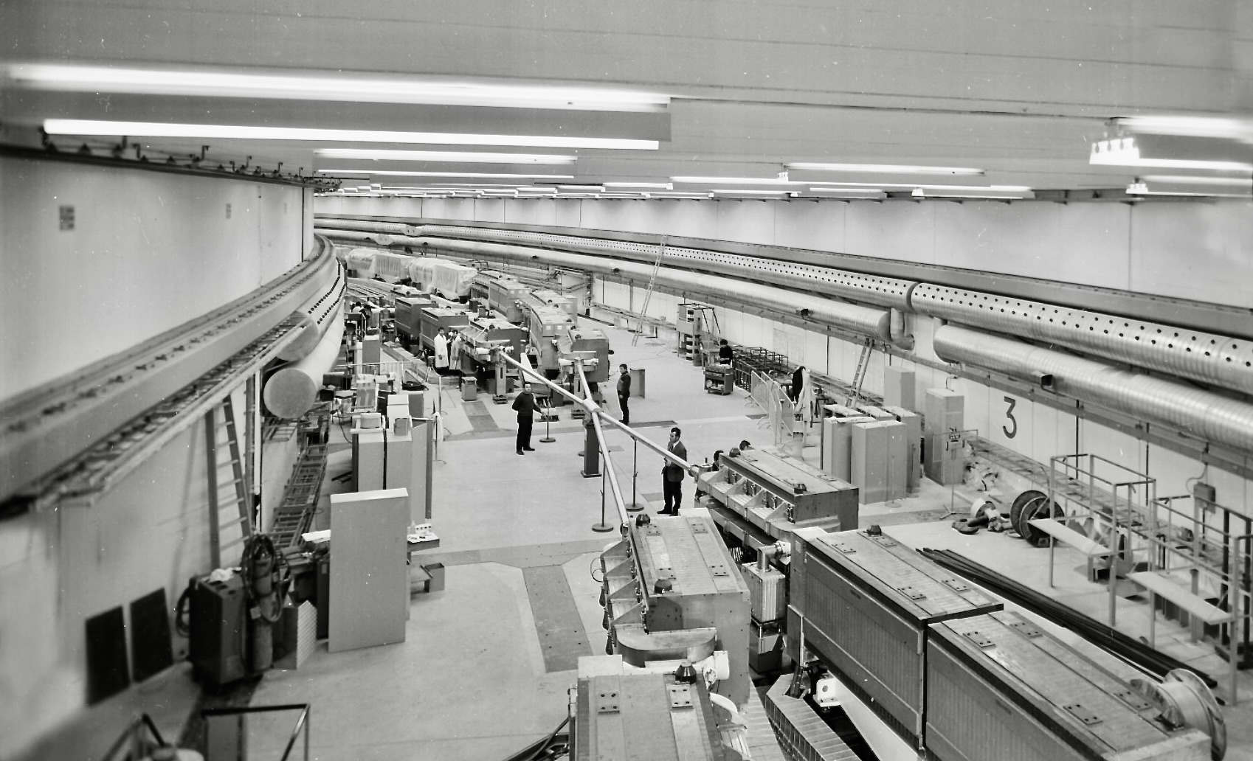
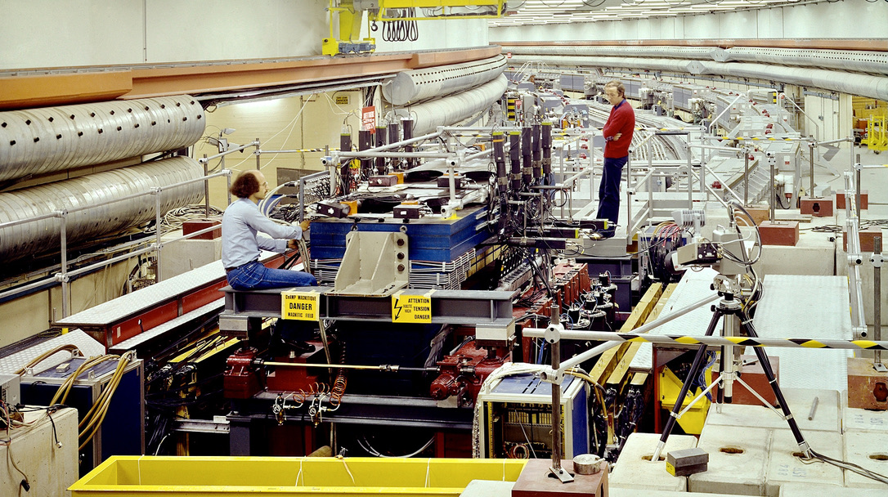
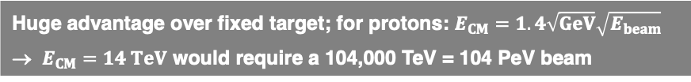
IP5
1971 — the first Hadron-Collider
Intersecting Storage Rings at CERN operated as a proton, proton–antiproton and ion collider for physics between 1971 and 1983. 943 m circumference, 1.3 T dipole field, CM energy up to 63 GeV, holding luminosity record for hadron machines until 2004
IP7: R702 in 1977
Huge advantage over fixed target; for protons: $E_{CM}=1.4\sqrt{GeV}\sqrt{E_{beam}}$
→ $E_{CM}=14 TeV$ would require a 104,000 TeV = 104 PeV beam

Slide 3
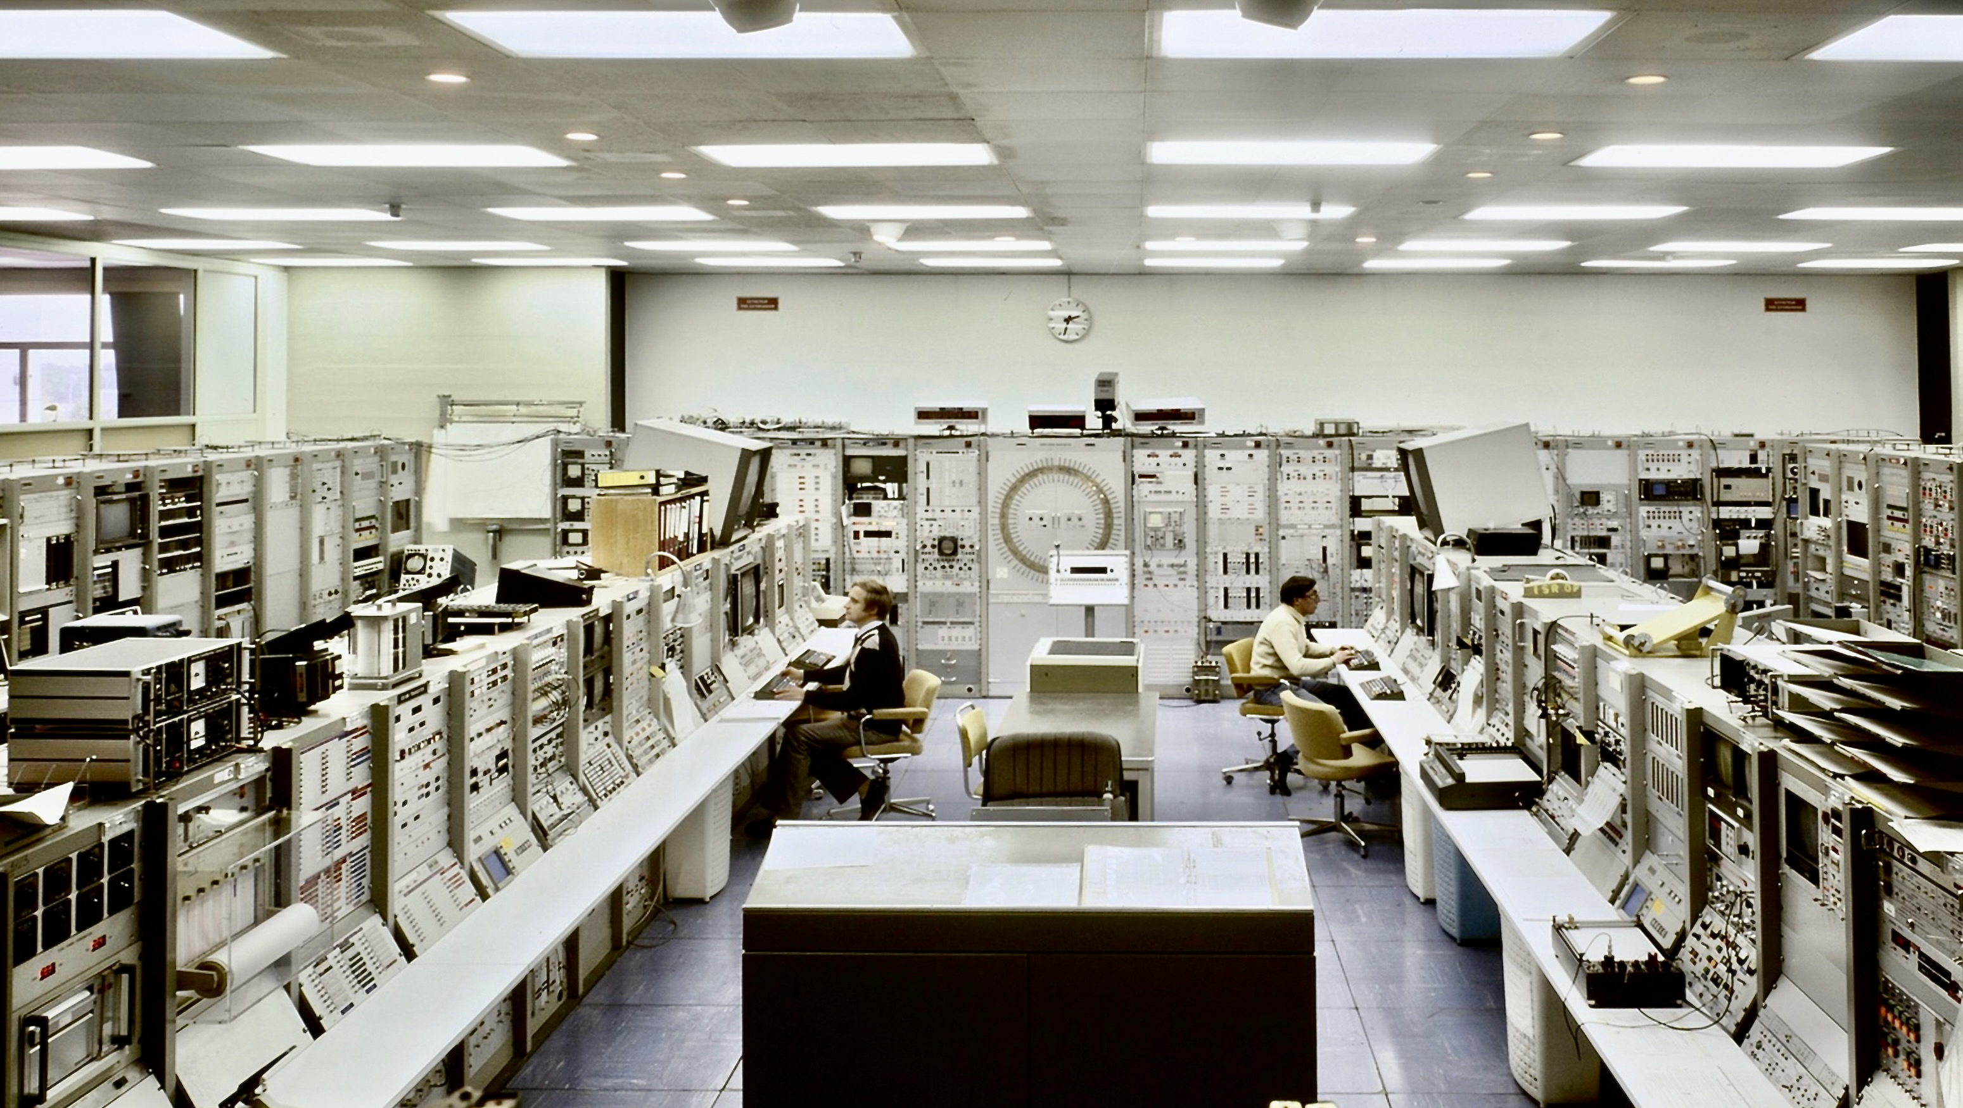
ISR Control Room (early 70s)

Slide 4
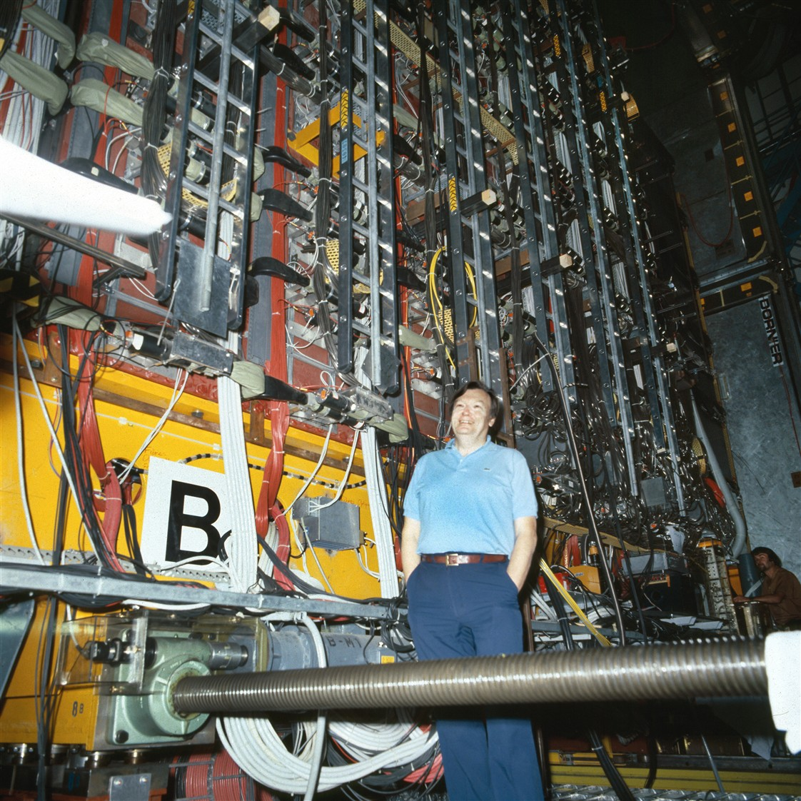
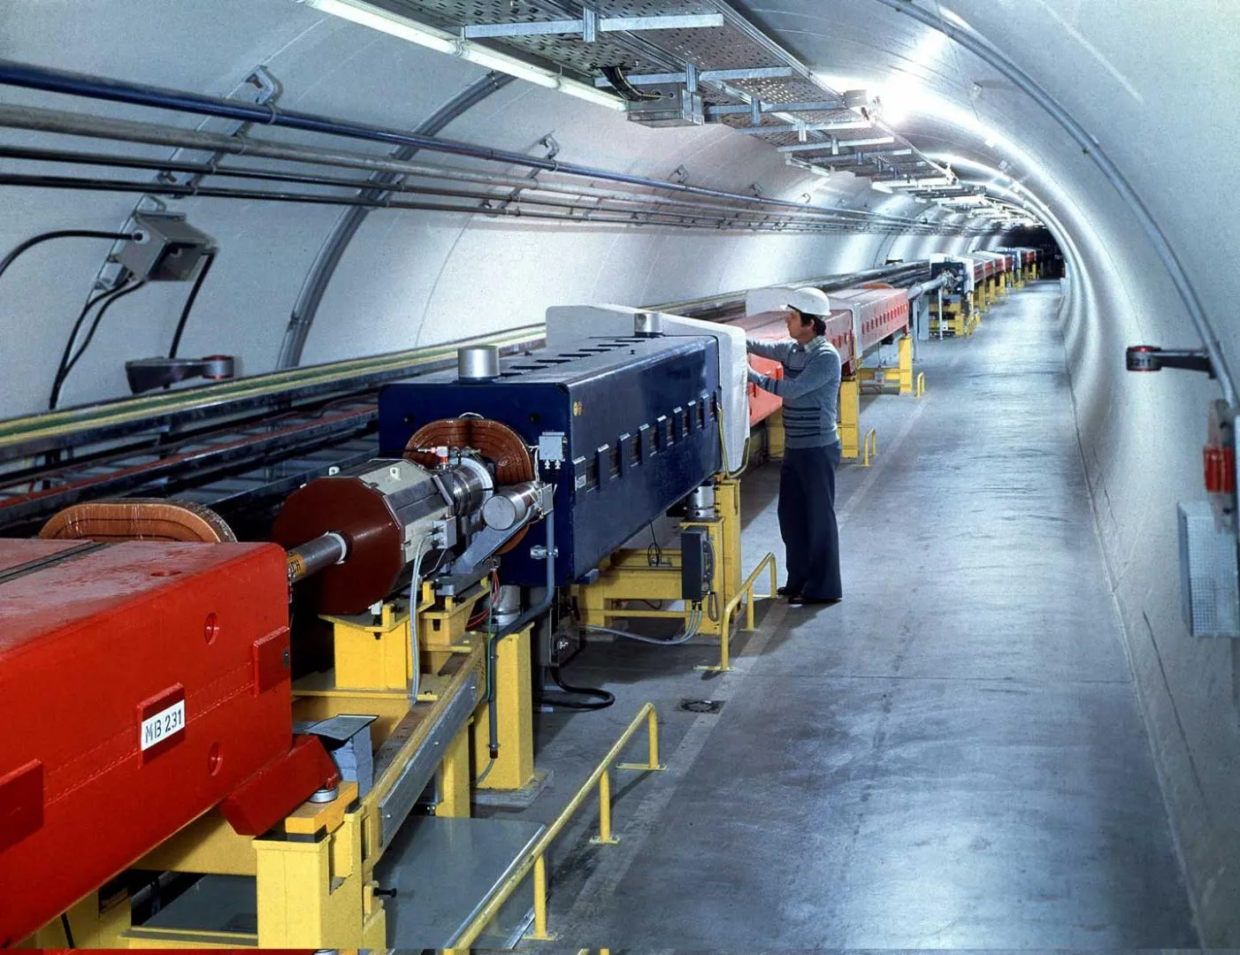
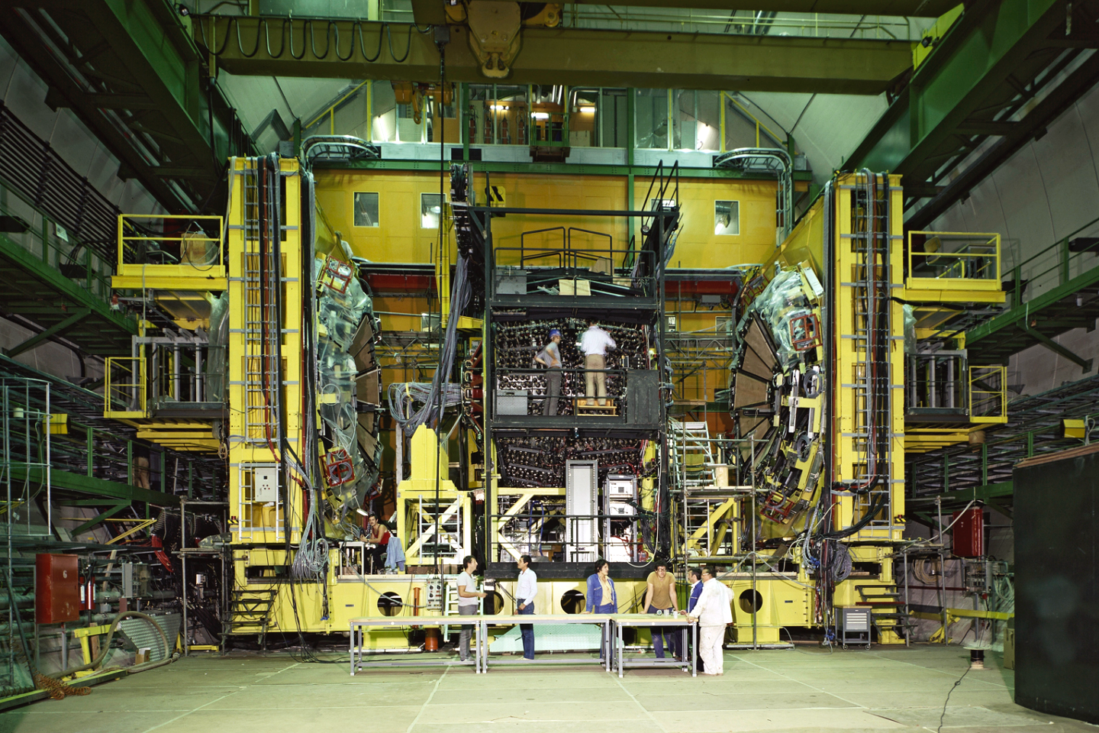
SPS: 6.9-km proton synchrotron and ppbar collider, (900 GeV) with UA1 and UA2 detectors
Both experiments were approved in 1978, first data taking in 1981

Slide 5
Discovery of the W and Z bosons by UA1 and UA2 at CERN’s SPS collider in 1983: the charged and neutral weak currents at the origin of parity violation
Neutrino (missing E_{T})
Electron
Positron
Electron
Displays show W (left) and Z (right) boson candidates from proton–antiproton collisions measured in the UA1 detector (1982/83)
Nobel Prize 1984 to Carlo Rubbia and Simon van der Meer for their decisive contributions to the large project, which led to the discovery of the field particles W and Z, communicators of weak interaction [Link]

Slide 6
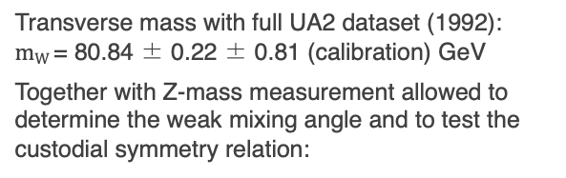
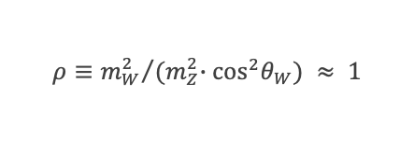
Discovery of the W and Z bosons by UA1 and UA2 at CERN’s SPS collider in 1983: the charged and neutral weak currents at the origin of parity violation
UA2, Phys. Lett. B 276 (1992) 354
UA1, Z. Phys. C 44 (1989) 15
UA1, Z. Phys. C 44 (1989) 15
Neutrino (missing E_{T})
Transverse mass with full UA2 dataset (1992):
$mW$ = 80.84 ± 0.22 ± 0.81 (calibration) GeV
Together with Z-mass measurement allowed to determine the weak mixing angle and to test the custodial symmetry relation:
$$ρ≡{m_{W}^{2}}/{{(m}_{Z}^{2}∙\cos^{2}θ_{W}) ≈ 1}$$
Charge asymmetry in the W → e𝜈 decay: W production polarised along anti-p beam due to V–A coupling
Universality of weak currents: flavour-independent parity violation

Slide 7
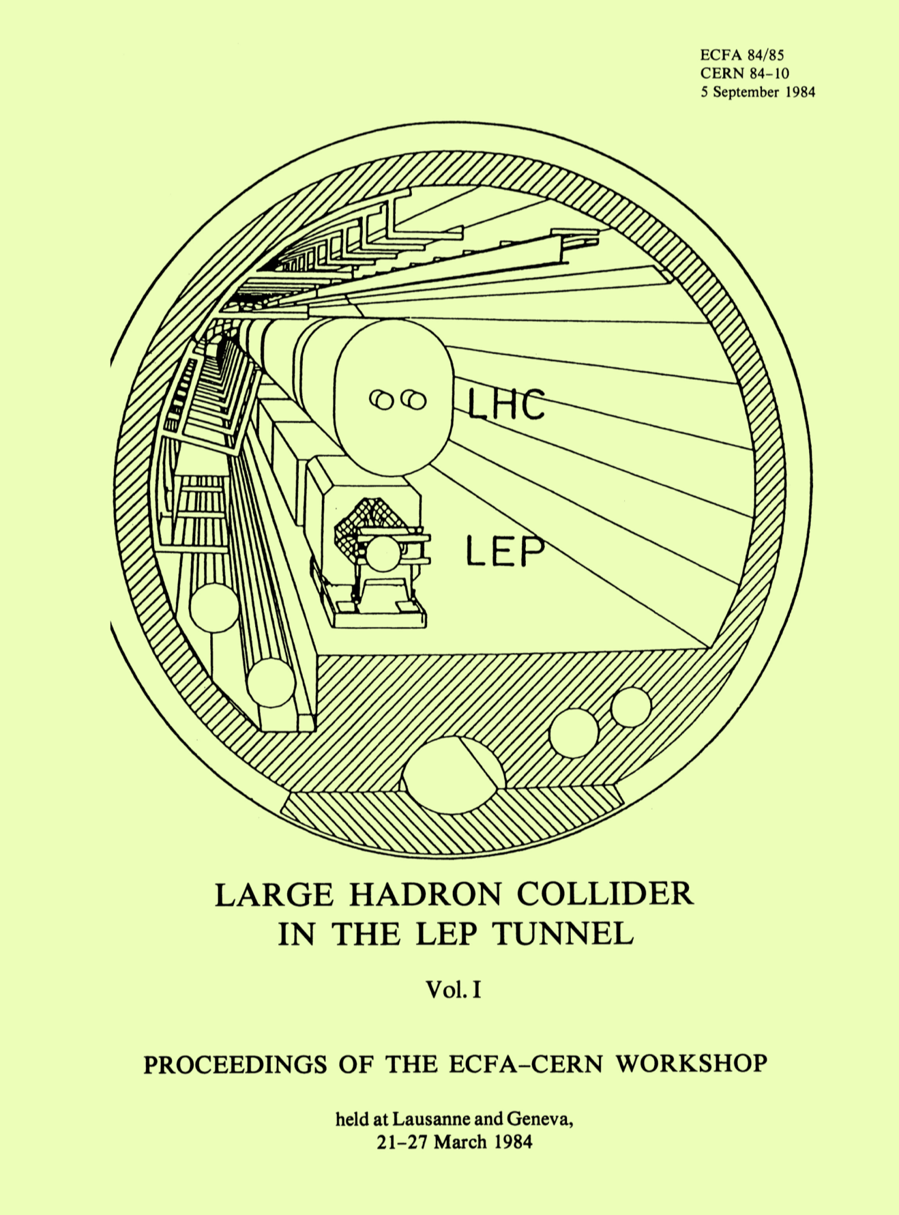
A new Circular Collider at CERN
The birth of LEP and the LHC: a 26.7 km tunnel facility

Slide 8
The Large Electron–Positron Collider
LEP was formally approved in 1981, tunnel construction 1983–1988, first beam on 14 July 1989
LEP tunnel before installation of bending magnets
OPAL logbook entry on 13 Aug 1989 with the first Z-boson candidate

Slide 9


With LEP and SLC, the Standard Model entered the precision era
Huge amount of experimental and theoretical developments during LEP and SLC (SLAC) years, pioneering era of high-precision physics in HEP, constraints on yet unseen heavy particles through quantum loops
There are 3 light neutrino families
The top quark is heavy
The Higgs boson is light, but > m_{Z}
m_{Z} measured to 2.1 MeV (0.0023%) precision via beam-energy calibration
Per-mil tests of lepton universality, QCD, and tau-lepton properties
$$∝m_{t}^{2}/m_{W}^{2}$$
$$∝log(m_{H}^{2}/m_{W}^{2})$$

Slide 10
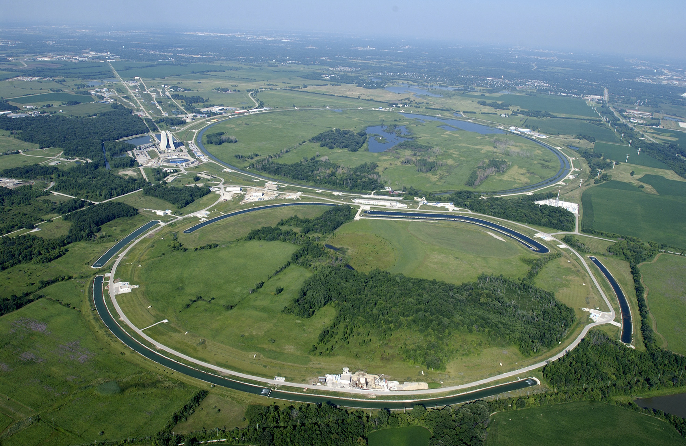
Late 1980s: the Tevatron at Fermilab climbed at the energy frontier
Thanks to 4.4 T superconducting dipole magnets, the 6.3-km circumference Tevatron reached 1.8 TeV proton–antiproton collision energy (later up to 1.98 TeV) and quickly overtook the SppS after physics operation started in 1987 (the antiproton cooling was based on Gersh Budker’s electron cooling method during Run 2) and ended in 2011
CDF
D0
Aerial view of Fermilab's proton--antiproton accelerator and collider complex in 2011. The Main Injector and Recycler ring is seen in front and the 6.3-kilometre circumference Tevatron collider ring in the background. On the left the iconic Wilson Hall, Fermilab's central laboratory building. Close-by are the proton source and the Booster. Tevatron's main detectors CDF and D0 are placed to the left and right along the ring, respectively.
Tevatron collider
Main Injector

Slide 11
Late 1980s: the Tevatron at Fermilab climbed at the energy frontier
Among the Tevatron legacies:
Top-quark discovery by CDF & D0 in 1995
Final combined CDF & D0 Higgs boson search result (2012)
CDF
High-precision top and W mass measurements, σ(m_{top}) = 0.65 GeV (0.4%), σ(m_{W}) = 16 MeV (0.02%)
Also: first observation of neutral B_{s} oscillation by CDF in 2006

Slide 12
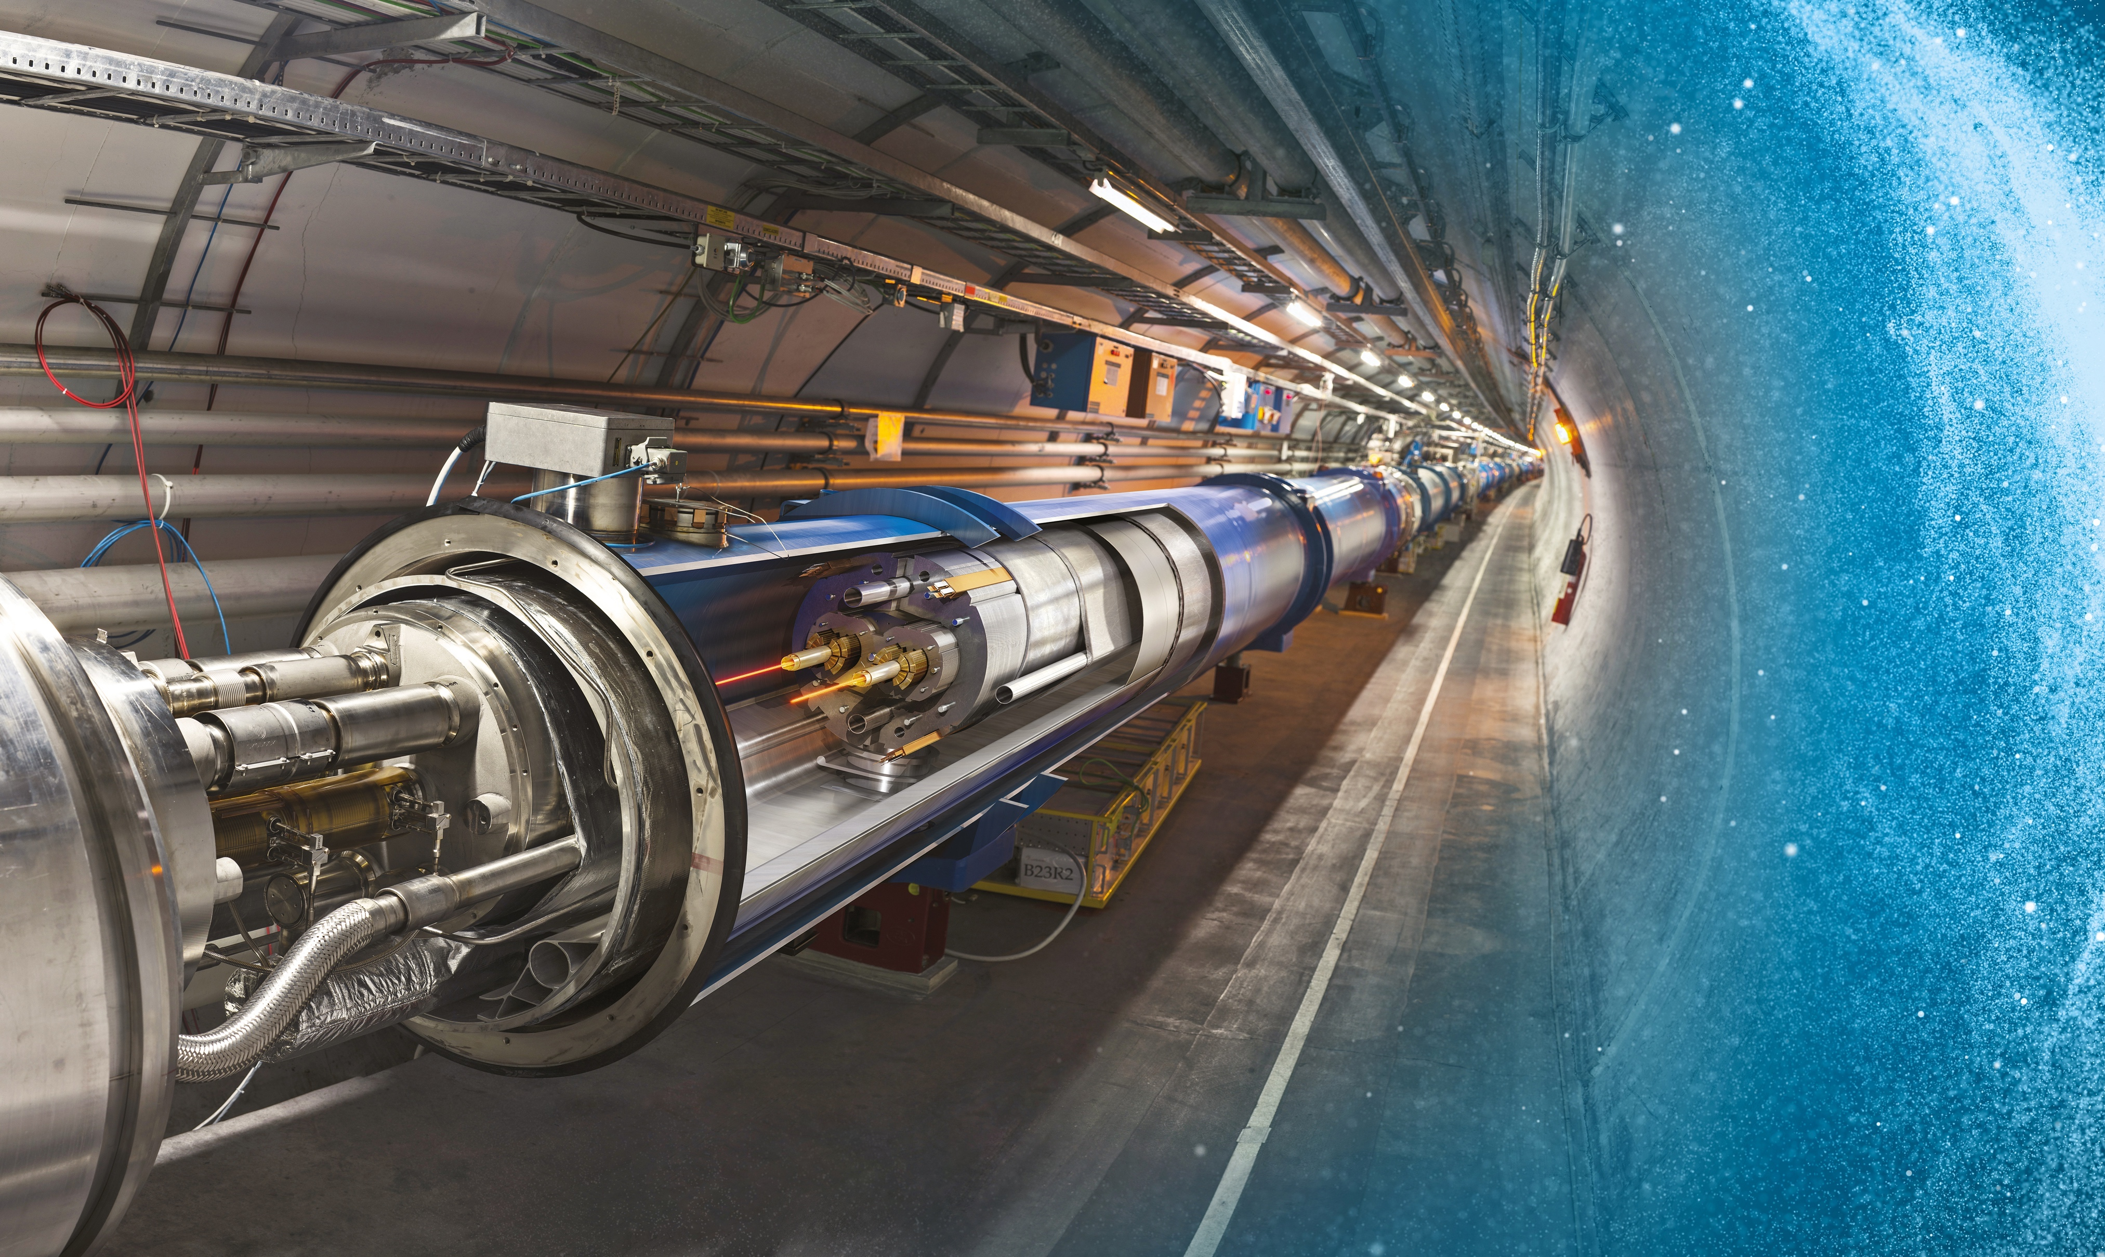
Large Hadron Collider (LHC) at CERN: the world’s largest accelerator reaching unprecedented energy and intensity
26.7 km underground accelerator and collider
Superconducting magnets (1.9 K = –271.3 °C) steer the particles around the ring
Proton and ions are accelerated to multi-TeV scale energies before they collide
12

Slide 13
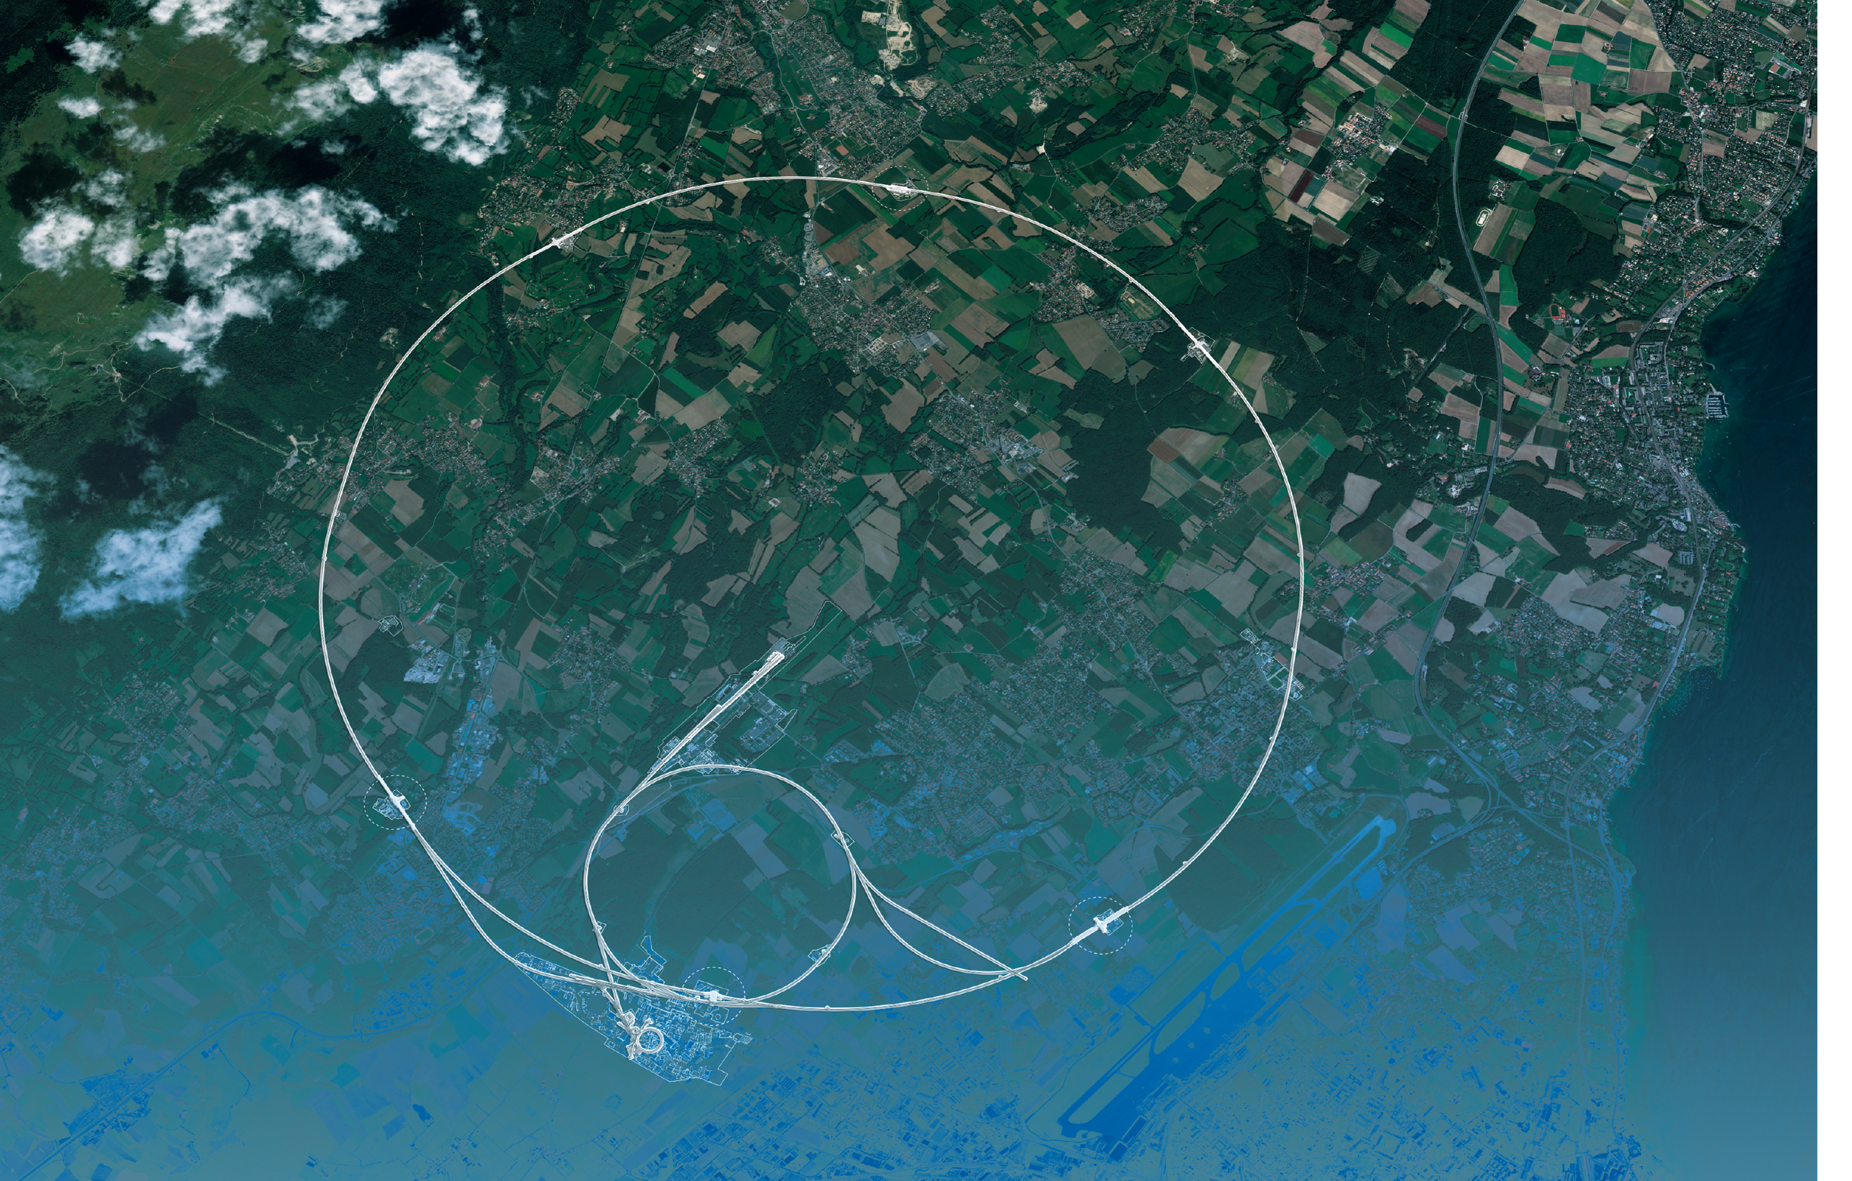
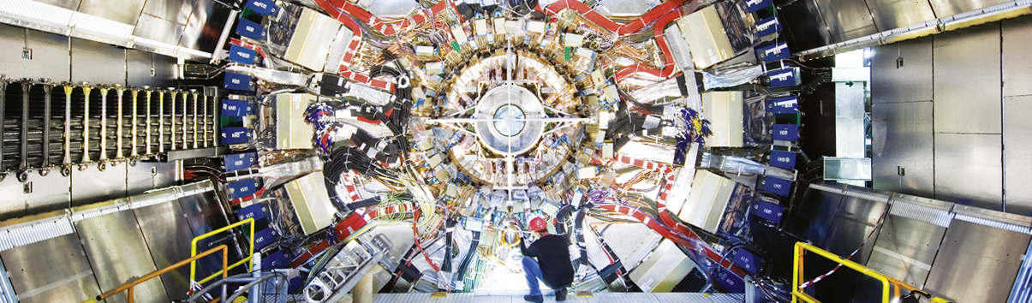
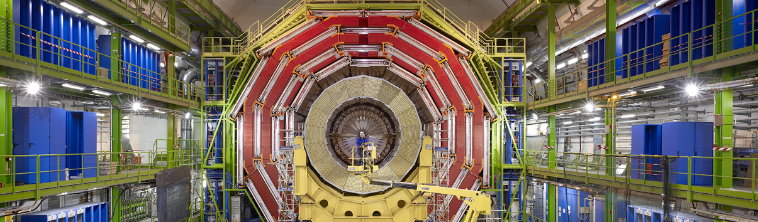
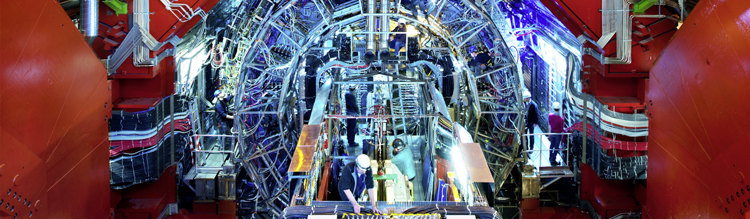
LHC and Experiments
CMS
ATLAS
LHC
CMS
ALICE
SPS
ALICE
LHCb
ATLAS
LHCb
PS
Huge, ultra-sophisticated detectors
Built and operated by global collaborations
Aerial view
Presentation

Slide 14
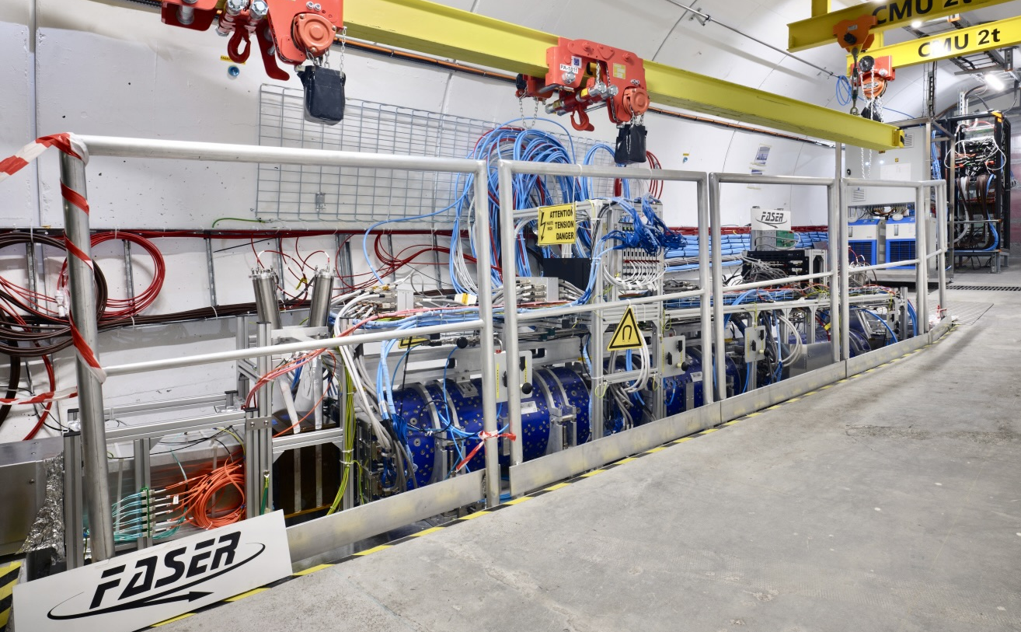
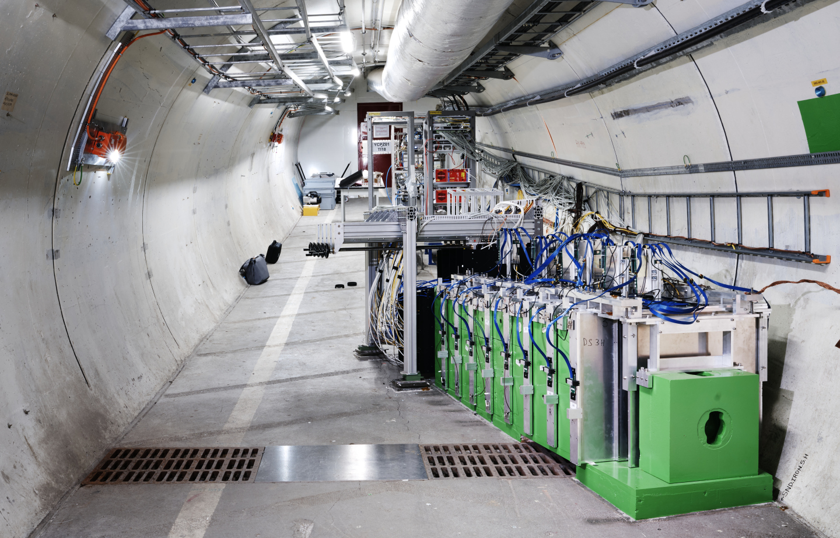
LHC and Experiments
CMS
MilliQan
FASER
LHC
SND@LHC
SPS
PRL 134 (2025) 21
ALICE
ATLAS
LHCf
LHCb
SND
FASER
MoEDAL
PS
Aerial view
Presentation

Slide 15
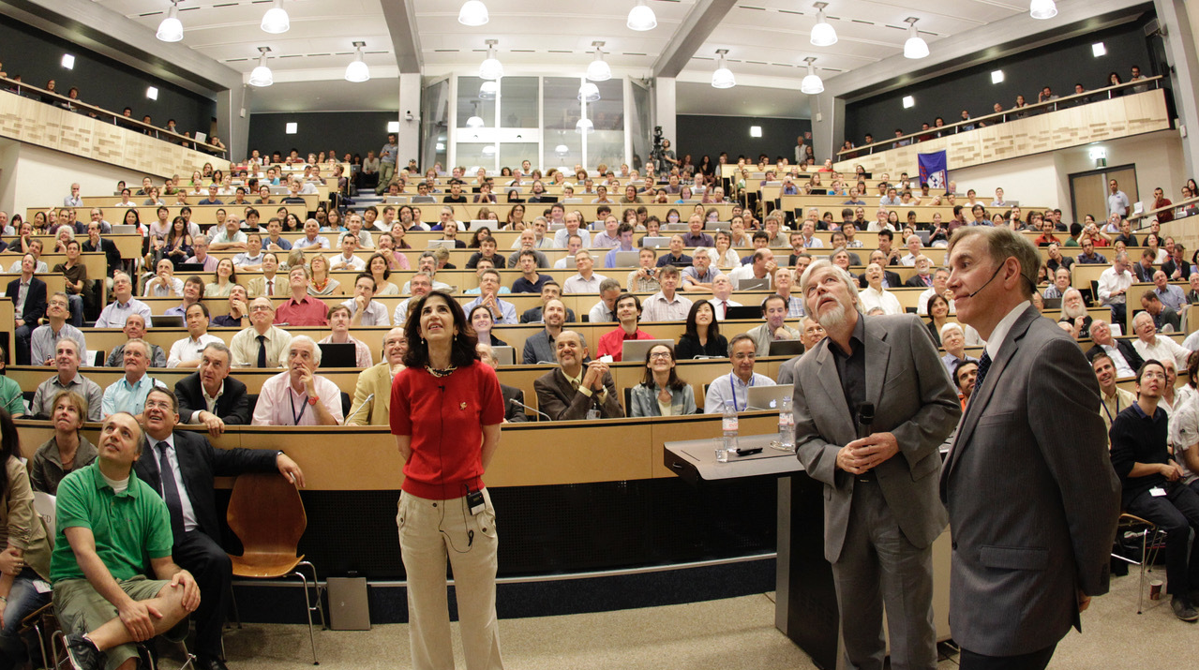
A monumental discovery
Presentation of Higgs boson discovery by ATLAS and CMS at CERN on 4 July 2012

Slide 16
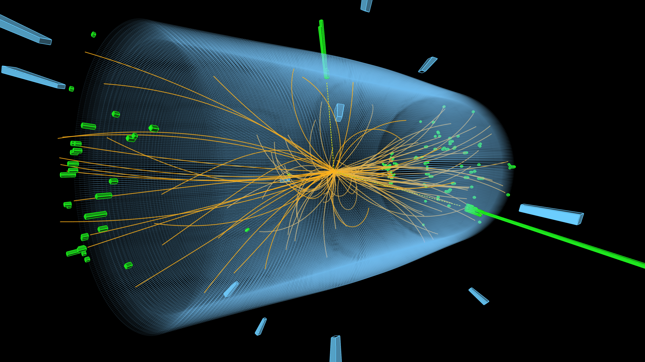
A monumental discovery
Presentation of Higgs boson discovery by ATLAS and CMS at CERN on 4 July 2012

Slide 17
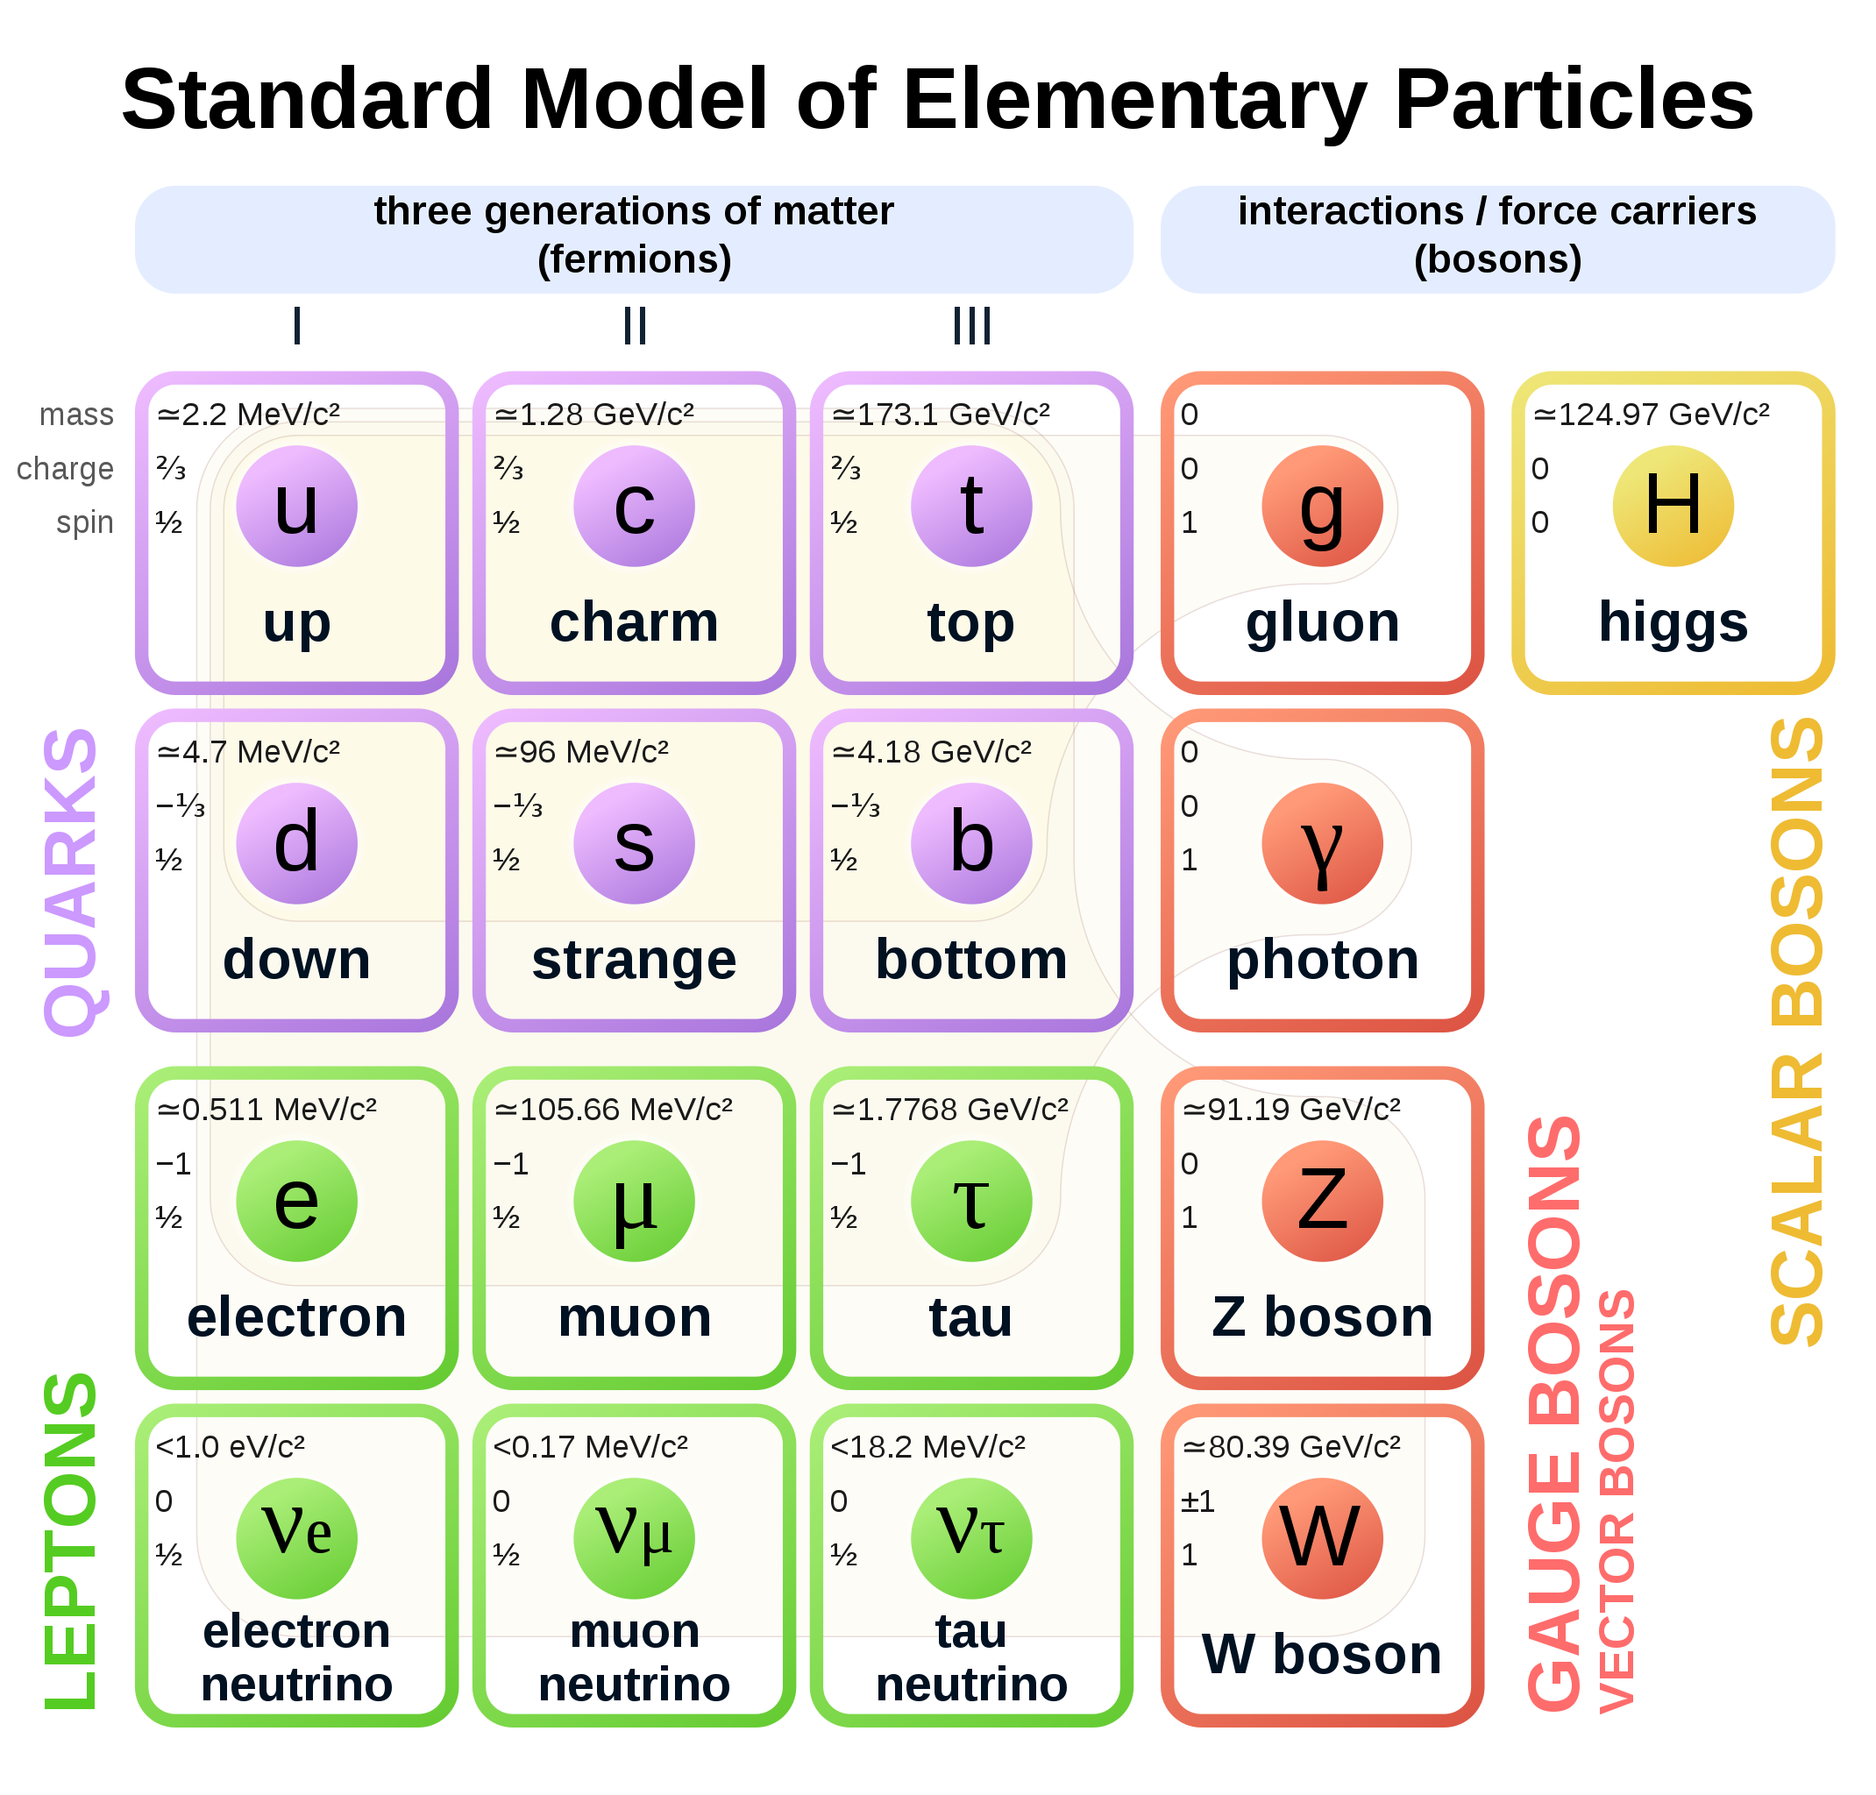
The fundamental universe is profoundly strange
The sub-atomic structure of matter and its interactions is described by the Standard Model (SM)
Spin 1/2

Slide 18
The fundamental universe is profoundly strange
The sub-atomic structure of matter and its interactions is described by the Standard Model (SM)
Particles discovered through decades of international, high-technology accelerator-based research
Spin 1/2
Spin 1
Spin 0

Slide 19
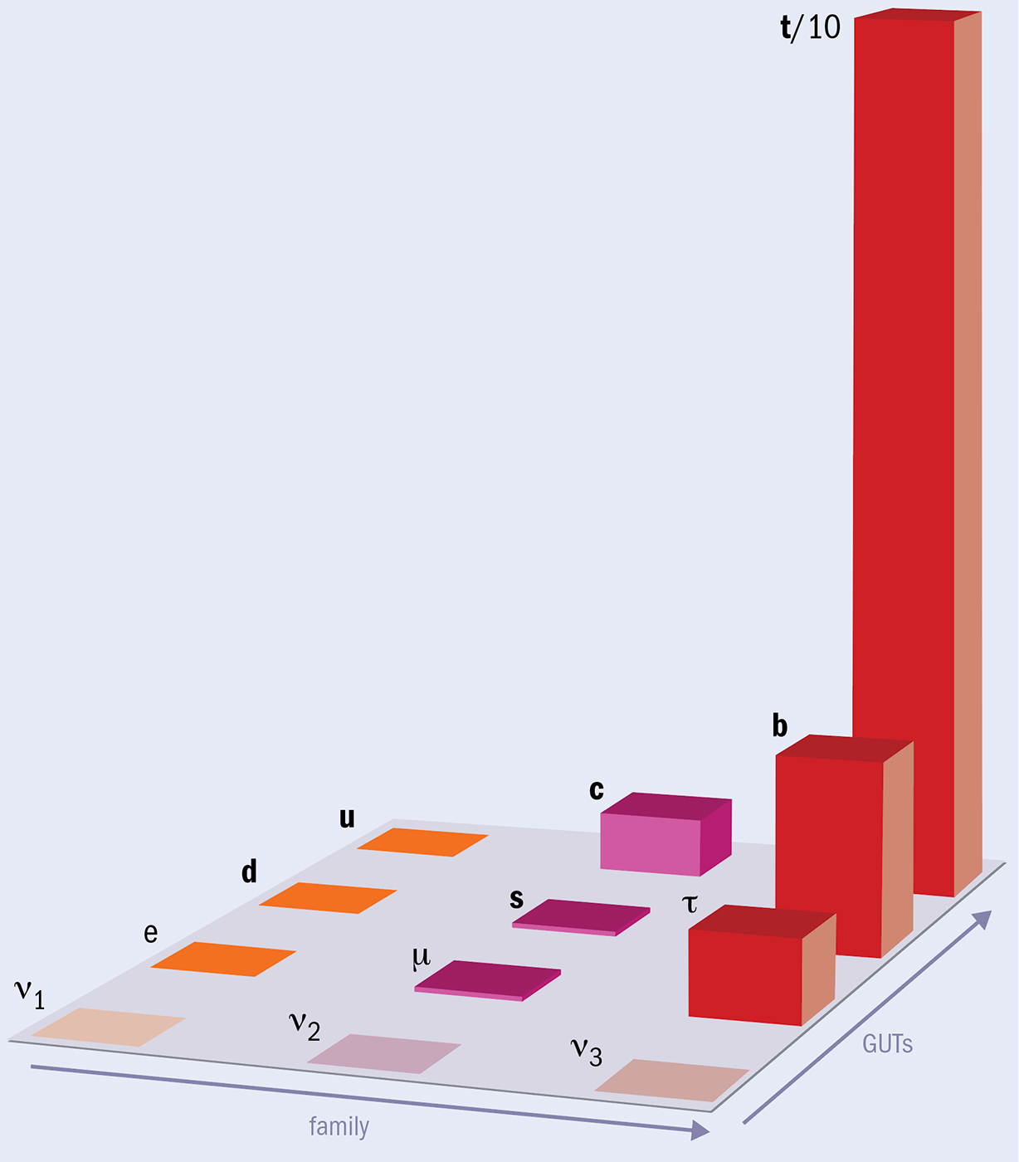
The fundamental universe is profoundly strange
The sub-atomic structure of matter and its interactions is described by the Standard Model (SM)
Fermion mass pattern (“flavour problerm”)
top quark 340,000 times heavier than electron
CERN Courier
Spin 1/2

Slide 20
The fundamental universe is profoundly strange
The sub-atomic structure of matter and its interactions is described by the Standard Model (SM)
New kind of interactions, unlike any known force
A manifestation of a vacuum field that gives elementary particles mass according to their coupling strength
The core conceptual challenges of the SM are tied to the Higgs sector (unstable mass)
The Higgs may also hold clues to dark matter, matter–antimatter asymmetry, and physics beyond the SM
Spin 1/2
Spin 1
Spin 0

Slide 21


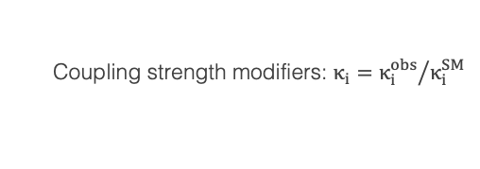




Is the Brout-Englert-Higgs mechanism real?
Discovery of Higgs boson enables the direct study of electroweak symmetry breaking and the process of mass generation
$$κ_{f}$$
f
H
$$∝\frac{m_{f}}{υ}$$
f
$$κ_{λ}$$
H
H
$$∝\frac{3m_{H}^{2}}{υ}$$
+ ….
Unpleasant scalar sector (23 parameters) — key to many mysteries
$$κ_{W/Z}$$
W/Z
H
$$∝\frac{2m_{W/Z}^{2}}{υ}$$
H
W/Z
Coupling strength modifiers: $κ_{i}={κ_{i}^{obs}}/{κ_{i}^{SM}}$

Slide 22

The Brout-Englert-Higgs mechanism is real !
Discovery of Higgs boson enables the direct study of electroweak symmetry breaking and the process of mass generation
ATLAS: ATLAS-CONF-2025-006, CMS: arXiv:2602.18611
2013, 2025
$$κ_{f}$$
f
H
$$∝\frac{m_{f}}{υ}$$
f
$$κ_{λ}$$
H
H
$$∝\frac{3m_{H}^{2}}{υ}$$
+ ….
Unpleasant scalar sector (23 parameters) — key to many mysteries
$$κ_{W/Z}$$
W/Z
H
$$∝\frac{2m_{W/Z}^{2}}{υ}$$
H
W/Z
Coupling strength modifiers: $κ_{i}={κ_{i}^{obs}}/{κ_{i}^{SM}}$

Slide 23
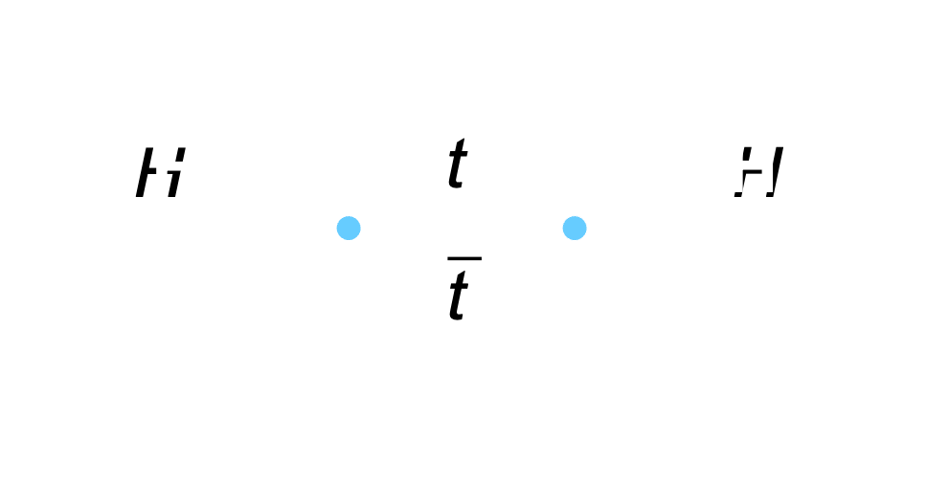
The Brout-Englert-Higgs mechanism is real
The Higgs boson and open questions in particle physics and cosmology
Why is the Higgs boson so light?
Is the Higgs boson elementary or composite ?
Do Higgs interactions violate matter-antimatter symmetry?
Is the Higgs boson unique?
Does the Higgs boson couple to dark matter?
What is the origin of the large mass hierarchy of the fermions in the Standard Model?
What is the form of the Higgs energy potential; is the vacuum metastable?
Is the Higgs field connected with cosmic inflation?
Why is the dark energy in the universe so much smaller than the Higgs vacuum energy?
The new Higgs sector opens up a range of possibilities and raises a number of important questions
See, eg: Salam, Wang, Zanderighi: Nature 607, 41 (2022)

Slide 24
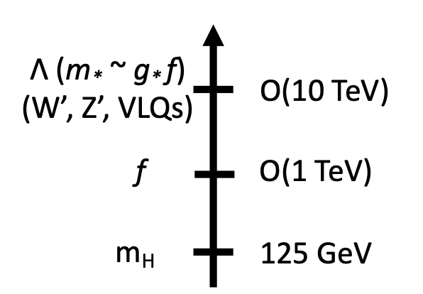
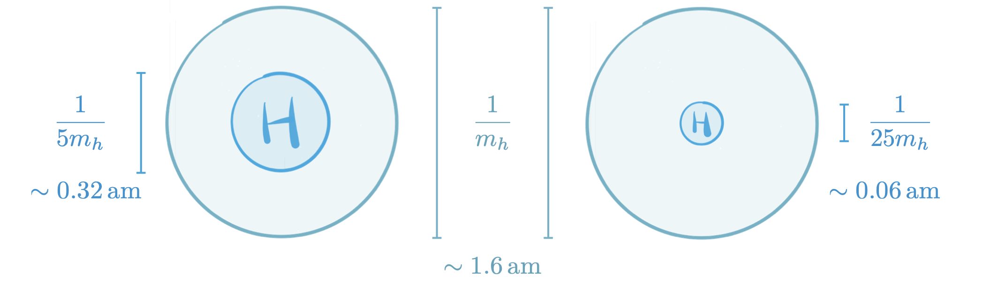
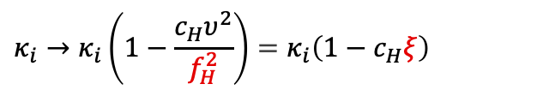


Is the Higgs boson elementary?
Potential spectrum of putative new strong dynamics
$λ_{H}\sim \frac{1}{m_{∗}}$
H
Higgs doublet might emerge as a composite bound state of a global symmetry that is spontaneously broken by new strong dynamics
$λ_{C}\sim \frac{1}{m_{H}}\sim 1.6 am$
In strongly interacting light Higgs (SILH) models, strong dynamics modifies the Higgs kinetic term, leading to a universal rescaling of all Higgs couplings
$$κ_{i}→κ_{i}\left(1−\frac{c_{H}υ^{2}}{f_{H}^{2}}\right)=κ_{i}\left(1−c_{H}ξ\right)$$
The best measured coupling probes compositness of the Higgs boson!
5.0 (0.1)% precision on $κ_{i}$ probes $f_{H} \sim$ 1.1 (7.8) TeV

Slide 25
The LHC delivers precision physics
Hadron colliders are discovery and precision machines
m_{H} = 125.11 ± 0.11 GeV [0.09%, ATLAS, 4𝓁 + 𝛾𝛾 | PRL 131 (2023) 251802], 125.07 ± 0.13 GeV [CMS, 𝛾𝛾 | CMS-PAS-HIG-24-007]
m_{top} = 172.52 ± 0.33 GeV [0.2%, LHC combination | PRL 132 (2024) 261902]
W mass (bottom)
Weak mixing angle (right)
CMS: PLB 866 (2025) 139526, LHCb: JHEP 12 (2024) 026
CMS
arXiv:2412.13872
0.23140 ± 0.00036
0.23152 ± 0.00031
0.23147 ± 0.00050
0.012% precision

Slide 26
The LHC delivers precision physics
Global Electroweak Fit — Testing the Standard Model
Gfitter group, latest update Moriond EW, 2026

Slide 27
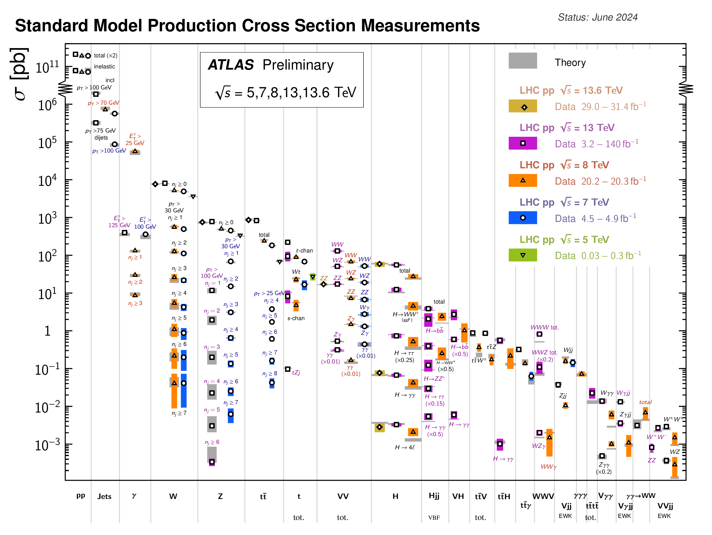
We have learned so much more at the LHC …
A plethora of measurements, some involving extremely rare and sensitive processes, confirm the predictive power of the SM and deepen our understanding
82 new hadronic bound states discovered so far (most by LHCb), 28 of which exotic, the heaviest being toponium
Heavy-ion collisions enabled unprecedented insights into the quark-gluon plasma
Searches for new phenomena have set tight constraints on some of the most popular SM extensions, thus completely changing the field of beyond the SM physics
PRD 105 (2022) 012010
Phys. Rep. 1116 (2025) 261

Slide 28
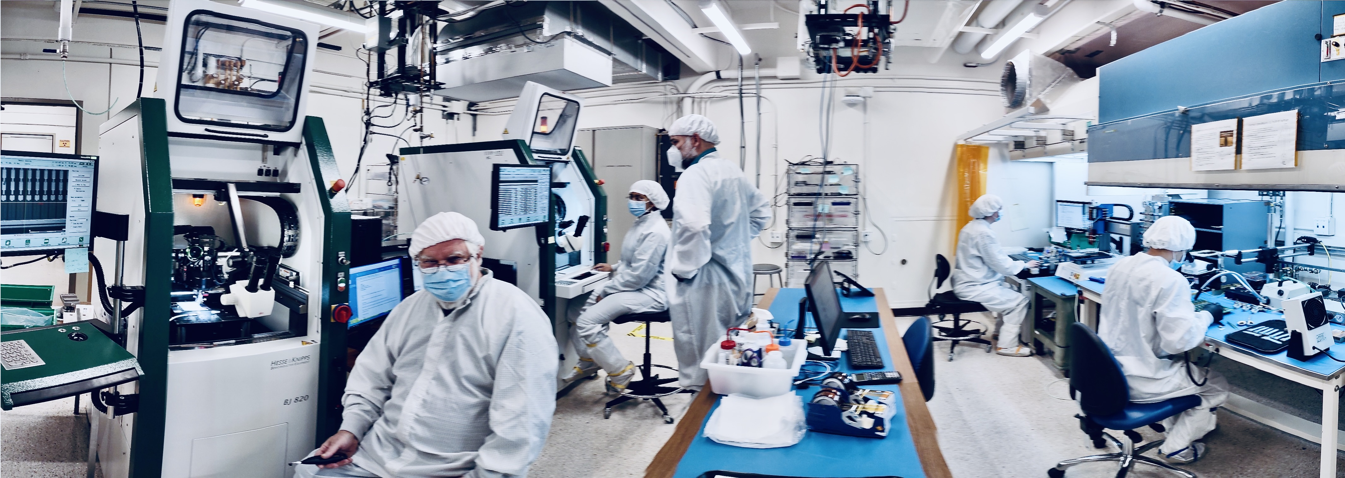
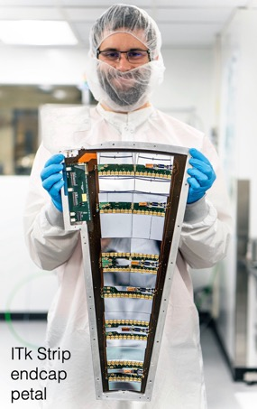
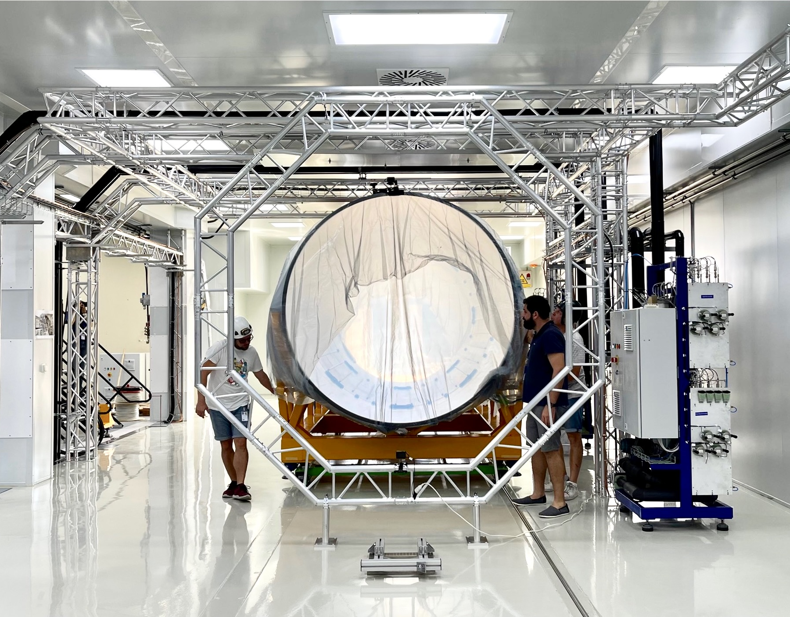
Upgrade to the
High-Luminosity LHC is under way
The HL-LHC will use new technologies to provide
6 times more collisions
than the LHC
Intensities require large-scale detector upgrades
It will start operating in 2030 and run until 2041, delivering 3000 fb^{–1}
Complementary in many ways to the FCC-ee / CEPC
Notes:
Additional information (OPTIONAL, TIME PERMITTING)
Key innovations in HL-LHC:
1) Powerful superconducting quadrupole magnets (12 Tesla) will be installed on either side of the ATLAS and CMS experiments to focus the particle bunches. These magnets will be made using niobium-tin (Nb₃Sn), used for the first time in an accelerator (instead of niobium-titanium)
2) Crab cavities for tilting the beams (16 in total) - give the head and tail of the particle bunches opposite-sign transverse momentum before they meet, enlarging the overlap area of the two bunches and thus increasing the probability of collisions.
3) One hundred new, more effective collimators will be installed: these devices absorb particles that stray from the beam trajectory and might otherwise damage the machine.
4) More compact and powerful bending magnets (11 Tesla), also made using the niobium-tin superconductor.
5) Innovative superconducting power lines will connect the power converters to the accelerator; will be able to carry currents of record intensities, up to 100 000 amps!

Slide 29
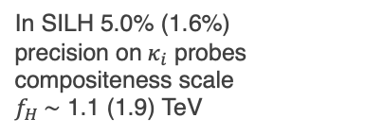
HL-LHC Physics prospects — Higgs
Higgs coupling prospects | Coupling strength modifiers ($κ_{i}^{2}≡{σ_{i}}/{σ_{i}^{SM}}$, assuming SM $Γ_{H}$)
In SILH 5.0% (1.6%) precision on $κ_{i}$ probes compositeness scale $f_{H} \sim$ 1.1 (1.9) TeV
Even with 2× better theory precision, theoretical uncertainties will be dominant
Unique sensitivity to rare decays and to top coupling
29

Slide 30
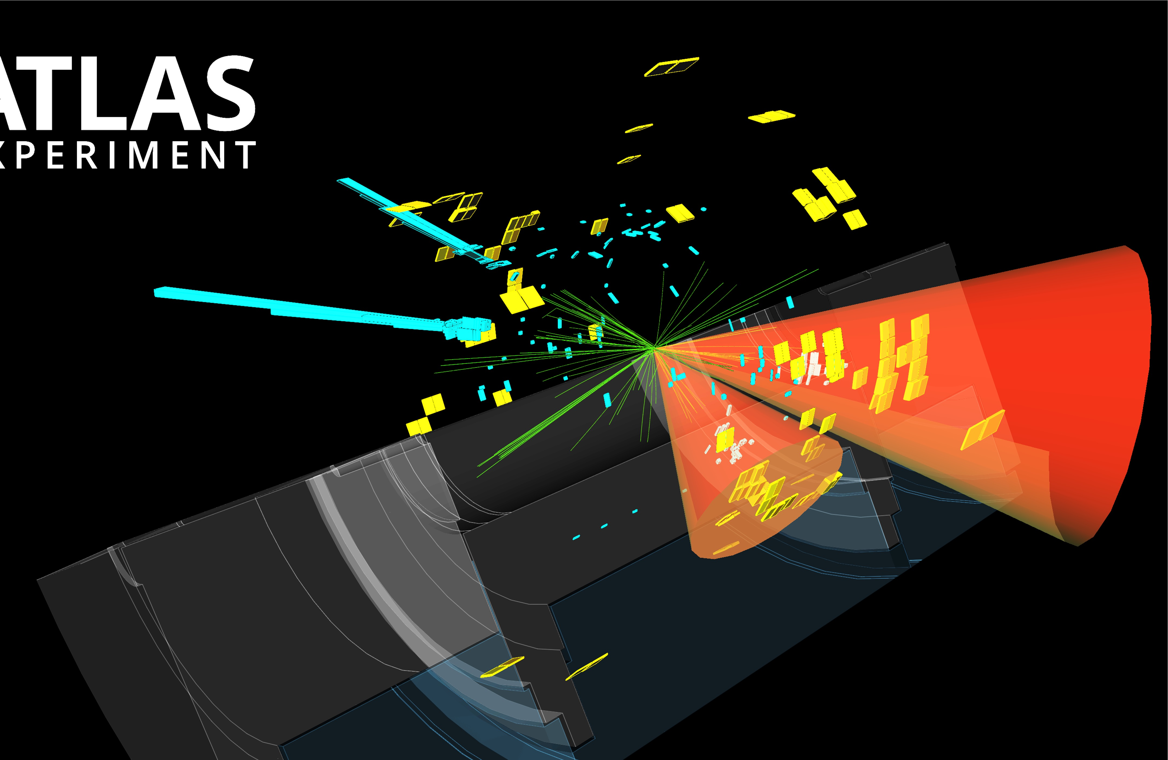

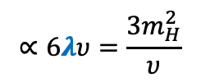

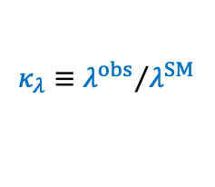


Cornering the Higgs potential through Higgs self-coupling
Higgs self-coupling via Higgs pair production: complex final states, eldorado for ML enthusiasts, strongest channels: HH → bb𝛾𝛾, bb𝜏𝜏, bbbb. Best sensitivity to $λ$ at low m(HH)
t
$$∝6λυ=\frac{3m_{H}^{2}}{υ}$$
$$κ_{t}$$
$$V\left(φ\right)=−μ^{2}{\left|φ\right|}^{2}+λ{\left|φ\right|}^{4}$$
$$κ_{λ}≡{λ^{obs}}/{λ^{SM}}$$
Destructive interferes with box diagram:
t
$$κ_{t}$$
t
$$κ_{t}$$
Very small HH SM cross section of 36 fb at 13.6 TeV, dominated by gluon fusion
A HH → 𝛾𝛾bb candidate event
30

Slide 31
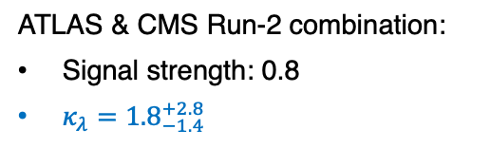
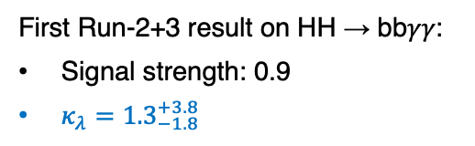
Cornering the Higgs potential through Higgs self-coupling
Higgs self-coupling via Higgs pair production: complex final states, eldorado for ML enthusiasts, strongest channels: HH → bb𝛾𝛾, bb𝜏𝜏, bbbb. Best sensitivity to $λ$ at low m(HH)
t
arXiv:2507.03495
$$∝6λυ=\frac{3m_{H}^{2}}{υ}$$
$$κ_{t}$$
$$V\left(φ\right)=−μ^{2}{\left|φ\right|}^{2}+λ{\left|φ\right|}^{4}$$
$$κ_{λ}≡{λ^{obs}}/{λ^{SM}}$$
Destructive interferes with box diagram:
t
$$κ_{t}$$
t
$$κ_{t}$$
Very small HH SM cross section of 36 fb at 13.6 TeV, dominated by gluon fusion
First Run-2+3 result on HH → bb𝛾𝛾:
Signal strength: 0.9
$κ_{λ}={1.3}_{−1.8}^{+3.8}$
ATLAS & CMS Run-2 combination:
Signal strength: 0.8
$κ_{λ}={1.8}_{−1.4}^{+2.8}$
+1.4
–1.1
+0.9
–0.7
arXiv:2602.23991
31

Slide 32
Cornering the Higgs potential through Higgs self-coupling
Higgs self-coupling via Higgs pair production: complex final states, eldorado for ML enthusiasts, strongest channels: HH → bb𝛾𝛾, bb𝜏𝜏, bbbb. Best sensitivity to $λ$ at low m(HH)
arXiv:2504.00672
t
$$∝6λυ=\frac{3m_{H}^{2}}{υ}$$
$$κ_{t}$$
$$V\left(φ\right)=−μ^{2}{\left|φ\right|}^{2}+λ{\left|φ\right|}^{4}$$
$$κ_{λ}≡{λ^{obs}}/{λ^{SM}}$$
Destructive interferes with box diagram:
t
$$κ_{t}$$
t
$$κ_{t}$$
Very small HH SM cross section of 36 fb at 13.6 TeV, dominated by gluon fusion
For SM at HL-LHC: expect HH observed > 7σ, and $λ$ precision < 30%
32

Slide 33
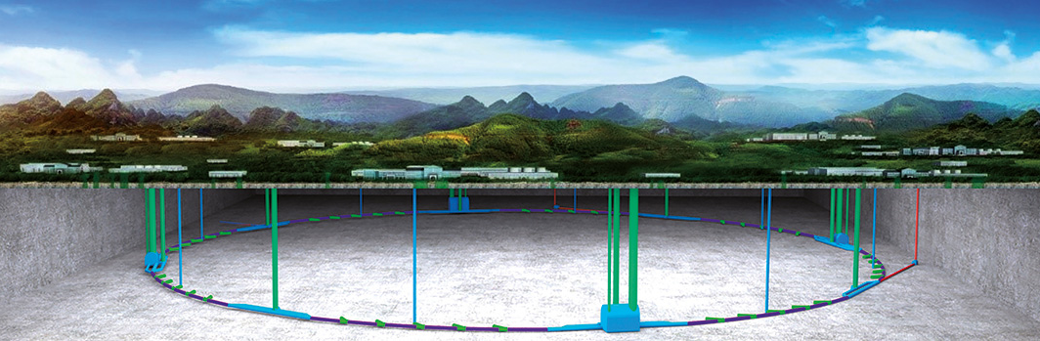
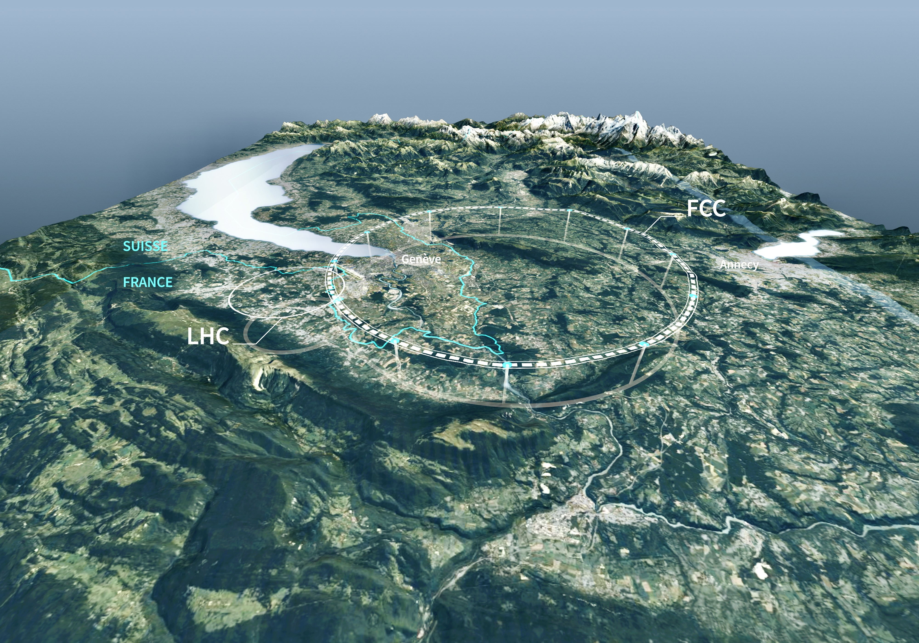
New facilities to explore the high-precision and high-energy frontiers
90–100 km circumference tunnels to host an e⁺e– and a hadron collider
CEPC (China)
FCC (CERN)
CEPC TDR: arXiv:2312.14363
Detector TDR: arXiv:2510.05260
Feasibility study: 3 volumes (physics & experiments, accelerator, civil engineering & sustainability) (March 2025), All documents
CEPC proposal was submitted in 2025 to Chinese Academy of Science for inclusion in 15th 5-year plan, but not retained. R&D continues, increased collaboration with FCC-ee, and resubmission in 2030 if FCC-ee does not go ahead
FCC-ee is proposed as CERN’s next flagship collider in the 2026 European Strategy for Particle Physics update [Link to recommendations / CERN Council resolution]. Aiming at go / no-go decision by CERN Council in 2028

Slide 34
FCC-ee
Next-generation circular e⁺e– collider to deliver extremely high luminosities across multiple energies

Slide 35
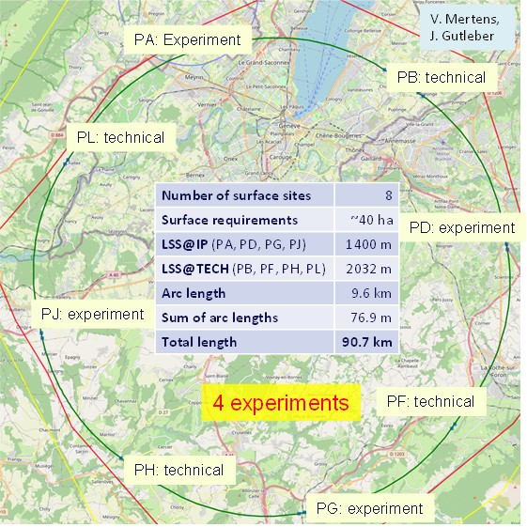
FCC-ee
Next-generation circular e⁺e– collider to deliver extremely high luminosities across multiple energies
Detailed feasibility study: layout selected from ~100 variants following the EU “Avoid–Reduce–Compensate” principle — 90.7 km ring, 8 surface sites (7 FR, 1 CH), 5.5 m tunnel diameter, 50–560 m depth

Slide 36
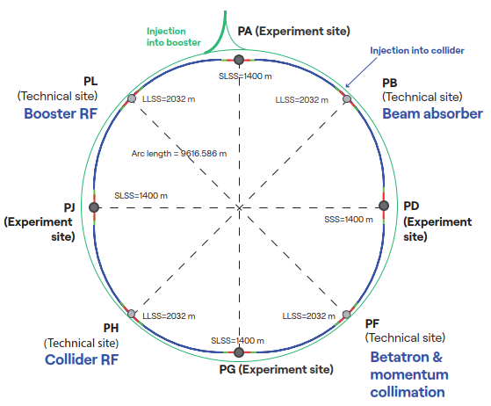
FCC-ee
Next-generation circular e⁺e– collider to deliver extremely high luminosities across multiple energies
Ring structure: 4 experiments, 1 RF-section / beam, 1 collimation section, 1 section for injection and dump
Booster is single-beam synchrotron which cycles within a few seconds between accelerating and top-up injecting e⁺ and e–

Slide 37
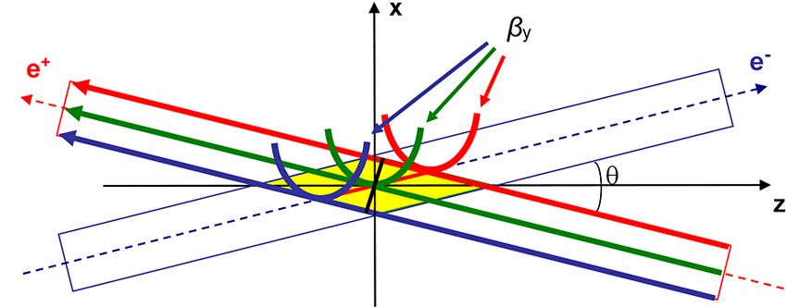
FCC-ee — maximum luminosity
FCC-ee collider concept for maximum luminosity
Double ring collider: many bunches, high current, like LHC and B factories, different from LEP (CERN)
Top-up injection (booster) during collisions: needed due to short luminosity lifetime (~10–20 min, radiative Bhabhas), standard at light sources and used at PEP-II, KEKB, BEPCII. Booster intensity ~1% of collider; full RF voltage as in collider
Superconducting RF: LEP-proven Nb/Cu 400 MHz cavities; bulk Nb 800 MHz cavities as in ESS/EuXFEL; efficient RF sources and simplified energy-switching scheme
Crab-waist collisions: successfully demonstrated at DAΦNE and SuperKEKB
Numbers assume 4 experiments
Crab waist scheme: sextupoles near IP rotate vertical waist along the opposing beam’s path (and suppresses beam-beam resonances)

Slide 38
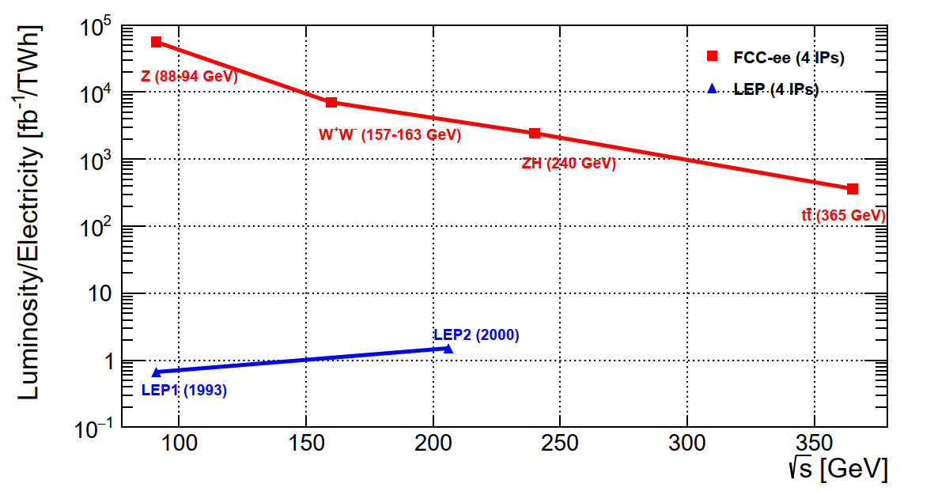
FCC-ee — maximum luminosity
FCC-ee collider concept for maximum luminosity
Combining all these concepts results in a giant efficiency step: 10⁴ – 10⁵ × luminosity / electrical power of LEP
Double ring collider: many bunches, high current, like LHC and B factories, different from LEP (CERN)
Top-up injection (booster) during collisions: needed due to short luminosity lifetime (~10–20 min, radiative Bhabhas), standard at light sources and used at PEP-II, KEKB, BEPCII. Booster intensity ~1% of collider; full RF voltage as in collider
Superconducting RF: LEP-proven Nb/Cu 400 MHz cavities; bulk Nb 800 MHz cavities as in ESS/EuXFEL; efficient RF sources and simplified energy-switching scheme
Crab-waist collisions: successfully demonstrated at DAΦNE and SuperKEKB
Crab waist scheme: sextupoles near IP rotate vertical waist along the opposing beam’s path (and suppresses beam-beam resonances)

Slide 39
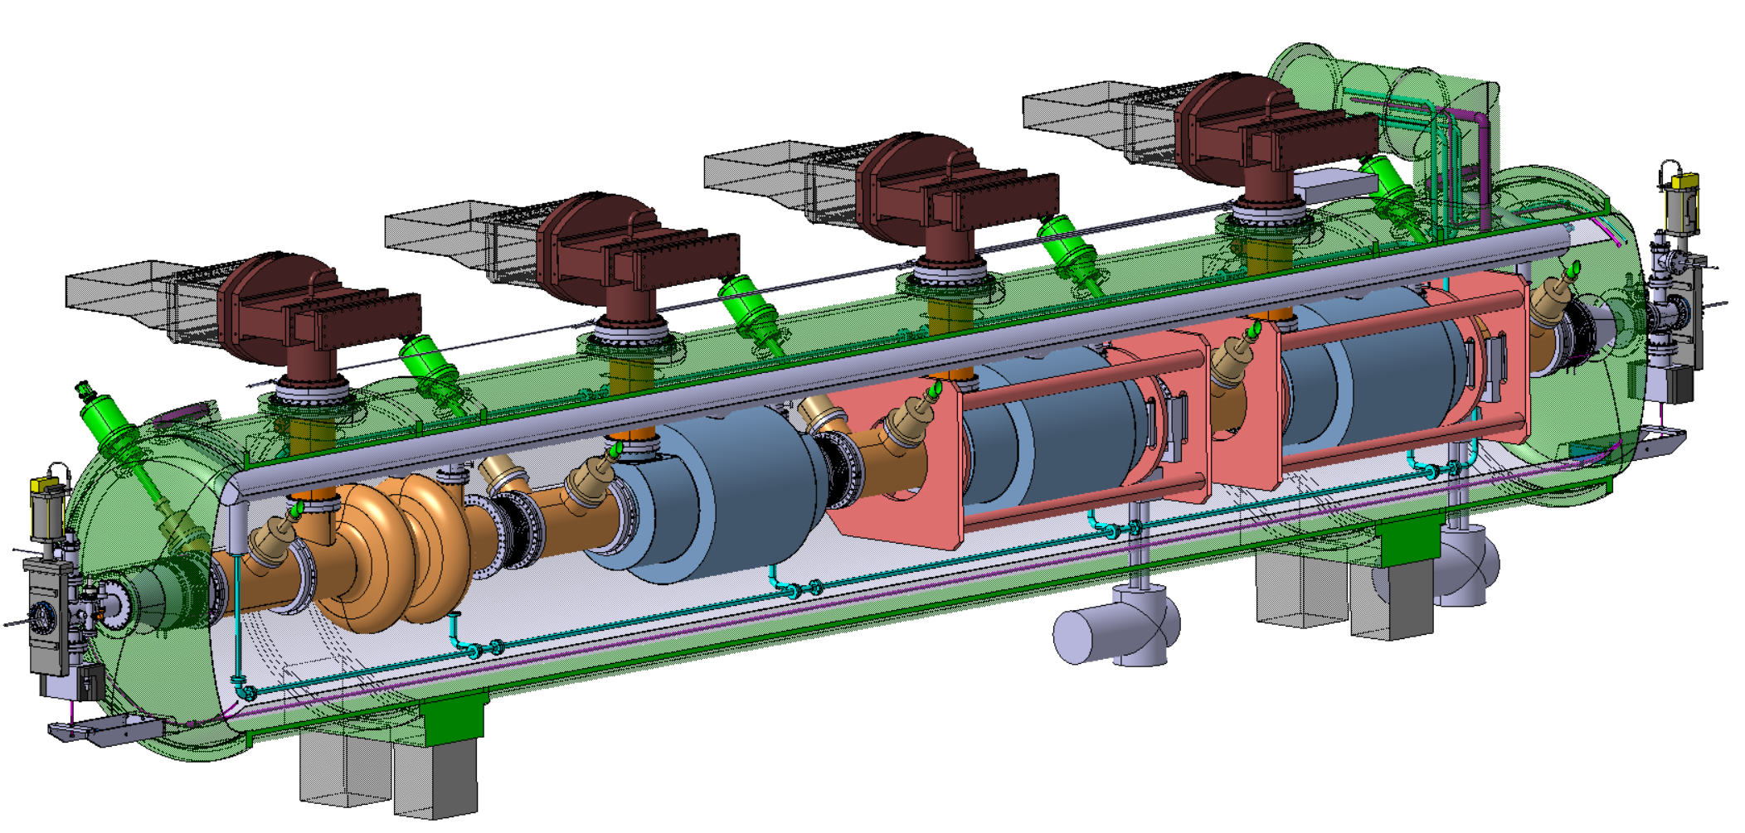
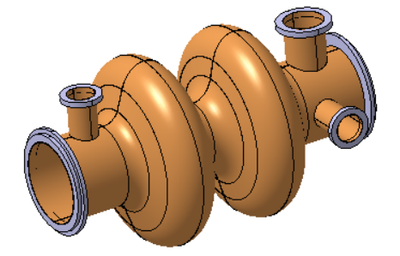



*A cell is one resonant section of the cavity where acceleration occurs (half a wavelength long = 38 cm for 400 MHz)
$$η=\frac{P_{RF out}}{P_{beam}}$$
FCC-ee — SRF
*
Superconducting RF system — key technology
Ref: arXiv:2505.00274
2-cell* 400 MHz SRF system for Z, W and ZH
Power source: 380 kW Klystron prototype built (HL-LHC) η* = 70% → two-stage Klystrons η = 86% → multibeam Tristrons η > 90% (R&D)
× 264
400 MHz superconducting cavity (6~10 MV/m), copper Nb coated, 1.5 m long
400 MHz Cryo-module
× 264
× 66
Higher gradient 6-cell 800 MHz SRF system for tt collider operation and booster at all energies
Klystron prototype
Compact 800 MHz cavity (~20 MV/m), 6-cell, bulk Nb, Nb₃Sn if R&D is successful
800 MHz Cryo-module
× (102 + 112 booster)
× 204 Tristons +
448 × 10 kW SSA booster
× (408 + 448 booster)

Slide 40



FCC-ee — parameters
${∆E}_{SR−loss}∝{E_{beam}^{4}}/{\left(m_{e}^{4}∙ρ\right)}$,
$$P_{SR}=U_{0}I, U_{0}∝E^{4}$$
FCC-ee main parameters (assuming 4 IPs / experiments)
Ref: arXiv:2505.00274
Parameter | Z | WW | H (ZH) | $$\text{t}\overline{\text{t}}$$
Collision energy √s [GeV] | 88, 91, 94 | 157, 163 | 240 | 340–350 | 365
SR energy loss / turn [GeV] | 0.036 | 0.08 | 1.7 | 7.8 | 9.2
Total RF voltage 400 / 800 MHz [GV] | 0.08 / 0 | 1.0 / 0 | 2.1 / 0 | 2.1 / 7.4 | 2.1 / 9.2
Synchrotron radiation/beam [MW] | 50 | 50 | 50 | 50 | 50
Number bunches / beam | 11200 | 1852 | 300 | 70 | 64
Luminosity / IP [10³⁴ cm^{–2}s^{–1}] | 144 | 20 | 7.5 | 1.8 | 1.4
Luminosity / year [ab^{–1}] | 68 | 9.6 | 3.6 | 0.83 | 0.67
Run time (including lumi ramp-up) [years] | 4 | 2 | 3 | 1 | 4
Total integrated luminosity [ab^{–1}] | 205 | 19.2 | 10.8 | 0.4 | 2.7
Total number of events | 6$∙$10¹² Z | 2.4$∙$10⁸ WW (incl. WW at higher √s) | 2.2$∙$10⁶ ZH 65k WW → H | 2$∙$10⁶ $\text{t}\overline{\text{t}}$ + 370k ZH + 92k WW → H
~350,000 × LEP-1 (~6 years)
~5,000 × LEP-2 (~5 years)

Slide 41

FCC-ee — detectors
*A too-strong detector solenoid (≥ 4 T) would distort the beam trajectories, induce transverse coupling, and blow up the vertical emittance — drastically reducing luminosity
Event rates and radiation are modest compared to HL-LHC, but Tera-Z precision demands unprecedented stability, resolution, luminosity control and acceptance knowledge; most measurements will ultimately be systematics- and theory-limited
Detector concepts use high-granularity particle-flow calorimetry, close-to-beam MAPS* vertex detectors, low-material central trackers, PID, a 2~3 T solenoids, and muon tagging. CEPC also has an innovative and ambitious reference detector design [Ref]
Dual-readout (DR) technique can in principle distinguish between EM and HAD responses in single CAL. Nevertheless, newest IDEA design proposes DR crystal ECAL and DR fibre HCAL
ALLEGRO detector concept around noble-liquid EM calorimeter [Ref]
CLD detector concept silicon-tungsten EM calorimeter and tracker [Ref]
IDEA detector concept around dual-readout (scintillation (all) & Cherenkov (relativistic – e/𝛾) light) fiber/Cu calorimeters [Ref]
*MAPS = Monolithic Active Pixel Sensors

Slide 42




FCC-ee — Higgs Factory
e⁺e– → X cross sections versus CM energy
Primary goal: Higgs precision measurements
HZ factory
Higgsstrahlung (σ = 232 fb at √s = 240 GeV)
s-channel: $σ∝1/s$ — falling off a resonance
W-boson fusion (6.7 fb)
(Z-boson fusion 0.63 fb)
WBF:$σ∝\ln^{2}\left(s/{m_{V}^{2}}\right)$ — e⁺/e– radiate W/Z, which increases with energy
Simulated e⁺e– → ZH event at √s = 240 GeV in IDEA detector

Slide 43



FCC-ee — Higgs Factory
Absolute coupling strengths — difficult at LHC due to weak constraint on $Γ_{H}$ (current precision ~50%, HL-LHC < 25%)
Can measure total HZ cross section and hence $κ_{Z}$ (0.1% precision) independently of Higgs decays via recoil mass (M_{recoil}) by counting events with an identified Z → 𝓁𝓁
Standard reference to be used by all other Higgs coupling measurements
$${σ(e}^{+}e^{−}→ZH)∝κ_{Z}^{2}$$
$$M_{recoil}^{2}={\left(\sqrt{s}−E_{ℓ^{+}}−E_{ℓ^{−}}\right)}^{2}−{\left|p_{ℓ^{+}}+p_{ℓ^{−}}\right|}^{2}$$
Higgsstrahlung (σ = 232 fb at √s = 240 GeV)
arXiv:2106.15438
$${σ(e}^{+}e^{−}→ZH(→ZZ^{∗}))∝\frac{κ_{Z}^{4}}{Γ_{H}}$$
Combination with measurement of
allows to determine $Γ_{H}$ to 0.8% precision (30 × HL-LHC)

Slide 44


FCC-ee – the Higgs factory
Why “factory”? 2.2M Higgs (FCC-ee) vs 350M (HL-LHC), production through Higgsstrahlung rather than s-channel
→ e⁺e– collisions offer exceptionally clean Higgs reconstruction, unmatched precision on decays with large branching ratios
FCC-ee feasibility stydu (Vol 1): arXiv:2505.00272
Uncertainty
HL-LHC / FCC-ee
1.6
1.6
3.6
2.4
1.9
~ 40
1.8
6.8
3.4
3.0
–
< 25
0.025
0.04
16
5.5
7.3
4.4
4.1
~ 44
1.6
1.6
1.1
0.9
–
~ 30
50
5.9
Most precise coupling, probes $f_{H} \sim 8 TeV$
*Incl. SM parametric uncertainties
*
Particularly large improvement over HL-LHC
Note: current uncertainties on Higgs branching fraction predictions O(1.5%)
BR(H → 4𝜈) = 10.6 $∙$ 10^{–4}
HL-LHC numbers updated from arXiv:2504.00672; they assume SM value for $Γ_{H}$, and incl. theoretical uncertainties (mostly dominant)

Slide 45

FCC-ee – the Higgs factory
Why “factory”? 2.2M Higgs (FCC-ee) vs 350M (HL-LHC), production through Higgsstrahlung rather than s-channel
→ e⁺e– collisions offer exceptionally clean Higgs reconstruction, unmatched precision on decays with large BR
FCC-ee feasibility stydu (Vol 1): arXiv:2505.00272
Uncertainty
HL-LHC / FCC-ee
1.6
1.6
3.6
2.4
1.9
~ 40
1.8
6.8
3.4
3.0
–
< 25
0.025
0.04
16
5.5
7.3
4.4
4.1
~ 44
1.6
1.6
1.1
0.9
–
< 32
50
5.9
*
Collider limits overlaid onto direct detection (Higgs portal assuming Majorana DM)
BR(H → 4𝜈) = 10.6 $∙$ 10^{–4}

Slide 46
FCC-ee – also a Tera-Z, W and top factory
Extreme luminosity on Z pole: 140$∙$10³⁴ cm^{–2}s^{–1} / IP, 205 ab^{–1} & 6$∙$10¹² Z (4 IPs) — ultimate EW precision data
arXiv:2505.00272
Improvements up to × 300 over current knowledge
Input to global electroweak fit: requires significant improvements in theoretical predictions

Slide 47

FCC-ee – also a Tera-Z, W and top factory
Global electroweak fit expressed on top versus W mass
ESPPU 2025 Briefing Book and R. Kogler at Moriond EW 2026
Conservative theoretical uncertainty scenario

Slide 48
FCC-ee – also a Tera-Z, W and top factory
Constraint heavy BSM physics to vacuum polarisation diagrams: “oblique parameters” S, T, U
ESPPU 2025 Briefing Book and R. Kogler at Moriond EW 2026
Conservative theoretical uncertainty scenario
Universal modifications to light particle scattering:
Neutral current interactions: S, T
Charged current: U

Slide 49



BR(Z → bb / cc) = 15% / 12%
Γ(Z → qq) ∝ ${(g}_{V}^{2}+g_{A}^{2})$
FCC-ee – also a flavour factory (on Z pole)
–
–
Large c and b-hadron statistics — combines strengths of Belle-II (e+e– → ϒ(4S) → BB) and LHCb (pp → bb + X)
The larger yield of B mesons than Belle II allows unmatched precision on B decays with neutrinos
arXiv:2505.00272
FCC-ee (×10⁹)
Yields for 6$∙$10¹² Z
Belle-II (×10⁹) 28 28 – – – 33 46
Yields for 50 ab^{–1}
Clean reconstruction due to boost and flavour tagging (> LHCb), excellent charm / 𝜏 separation (challenging at ϒ(4S))
Ultimate CKM angle precision (similar to LHCb)
Ultimate τ factory
B → 𝜏𝜈 allows 1% measurement of |V_{ub}| and running above WW threshold allows on-shell measurement of |V_{cb}| to ~1%
Current precision 3.5_{Vub} / 1.1_{Vcb}%, but discrepancies between exclusive and inclusive results of 17_{Vub} / 5_{Vcb}%, respectively

Slide 50

FCC — timeline of integrated programme
FCC-ee followed by FCC-hh
European strategy recommendation
Reference design phase
2033–2041 civil engineering construction work
2039–2043 technical infrastructure installation
2041–2045 accelerator installation

Slide 51

Conclusions
T. D. Lee lecturing at CERN in 1965
T. D. Lee lecturing at CERN in 1965 [Ref]
Notes:
THE WELCOME SLIDE
With this slide the speaker:
Introduces him/herself
Describes how this brief presentation aims to give an overview of CERN, as an introduction to the visit that will follow.

Slide 52
Conclusions
The discovery of parity violation profoundly changed elementary particle physics. It revealed the chiral nature of weak interactions, tying the weak-boson and fermion masses to electroweak symmetry breaking
But the Higgs sector raises profound conceptual questions whose study requires a broad collider programme
T. D. Lee lecturing at CERN in 1965
Notes:
THE WELCOME SLIDE
With this slide the speaker:
Introduces him/herself
Describes how this brief presentation aims to give an overview of CERN, as an introduction to the visit that will follow.

Slide 53
Conclusions
The discovery of parity violation profoundly changed elementary particle physics. It revealed the chiral nature of weak interactions, tying the weak-boson and fermion masses to electroweak symmetry breaking
But the Higgs sector raises profound conceptual questions, whose study requires a broad collider programme
LHC Run 3 and the HL-LHC will deliver 95% of the full LHC dataset, opening major opportunities complementary to a future e+e– collider, amidst a surge of innovation through AI/ML
FCC-ee is Europe’s priority for CERN’s next flagship collider. FCC-ee and CEPC are transformative precision instruments, deeply probing the quantum structure of Higgs and electroweak interactions
FCC-ee and CEPC also lay the foundation for a future hadron collider in the same infrastructure, creating a highly synergistic programme with maximal long-term physics reach
T. D. Lee lecturing at CERN in 1965
Notes:
THE WELCOME SLIDE
With this slide the speaker:
Introduces him/herself
Describes how this brief presentation aims to give an overview of CERN, as an introduction to the visit that will follow.

Slide 54
Extra slides …
Doodle pad by T.D. Lee during talks with C.N. Yang at BNL in summer 1956 [Link]

Slide 55
Assessment of physics reach
[Link to ESG WG2b report]
BSM
SM
e⁺e– colliders only
pp (+ e⁺e–) collider
High-E e⁺e– collider
μμ (+ e⁺e–) collider

Slide 56

LEP3 — a Higgs and EW factory in the LHC tunnel
Backup if (preferred) FCC-ee cannot be realised with long-term goal of an energy-frontier hadron or muon collider: similar to FCC-ee with booster and collider rings, 2 beampipes, 50 MW / beam, 2 IPs
Parameter | Z | WW | H (ZH) | $$\text{t}\overline{\text{t}}$$
Inst. luminosity / IP [10³⁴ cm^{–2}s^{–1}] | 40 | 6.2 (160 GeV) | 1.6 (230 GeV) | –
SR energy loss / turn [GeV] | 0.13 | 1.3 | 5.4 | (~25 GeV)
Integrated luminosity / year / IP [ab^{–1}] | 4.8 | 0.7 | 0.19 | –
Run time [years] | 5 | 4 | 6 | –
Total integrated luminosity [ab^{–1}, 2 IPs] | 48 | 6.0 | 2.3 | –
Total number of events [2 IPs] | 1.4$∙$10¹² | 0.36$∙$10⁸ | 0.42$∙$10⁶ | –
Inst. luminosity / IP [10³⁴ cm^{–2}s^{–1}] | 144 | 20 (157, 163 GeV) | 7.5 (240 GeV) | 1.8 (~350 GeV) | 1.4 (365 GeV)
SR energy loss / turn [GeV] | 0.036 | 0.08 | 1.7 | 7.8 | 9.2
Integrated luminosity / year / IP [ab^{–1}] | 17 | 2.4 | 0.9 | 0.21 | 0.17
Run time (including lumi ramp-up) [years] | 4 | 2 | 3 | 1 | 4
Total integrated luminosity [ab^{–1}, 4 IPs] | 205 | 19.2 | 10.8 | 0.4 | 2.7
Total number of events [4 IPs] | 6$∙$10¹² | 2.4$∙$10⁸ | 2.2$∙$10⁶ | 2$∙$10⁶
Construction:
LEP3
Total cost 3.7B CHF
ESPPU input: arXiv:2504.00541
FCC-ee
Total cost 13.7B + 1.3B_{tt} CHF
FCC-ee SR loss reference
Challenges for LEP3 include design of IRs, large E-loss, need 6.0 GV RF power installed in 4 long straight sections (2 booster, 2 collider), crab-waist scheme requires large crossing angle and widening tunnel on either side of the experiments from ~4m to 7m diameter along 270 m

Slide 57

Linear Collider Facility (LCF) at CERN
Very similar to ILC: baseline is 33.5 km tunnel, SRF cavities with an accelerating gradient of 31.5 MV m⁻¹, √s = 250 GeV upgradable to 550 GeV, longitudinal polarisation (± 80/30% for e–/e⁺, ~20% higher σ(ZH)), 2 IPs (sharing luminosity)
Parameter | Z | WW | H (ZH) | above $\text{t}\overline{\text{t}}$
Inst. luminosity / IP [10³⁴ cm^{–2}s^{–1}] | 0.28 | – | 1.4_{LP} / 2.7_{FP} (250 GeV) | 3.9 (550 GeV)
Integrated luminosity / year / IP [ab^{–1}] | 30 | – | 0.19_{LP} + 0.64_{FP} | 2.3
Run time [years] | 1 | – | 5_{LP} + 3_{FP} | 10
Total integrated luminosity [ab^{–1}, 2 IPs*] | 0.07 | – | 1.0_{LP} + 1.9_{FP} | 8.3
Total number of events [2 IPs*] | 0.002$∙$10¹² | – | 0.8$∙$10⁶ | ~ 1.6 (H) / 3.9 (tt)$∙$10⁶
Inst. luminosity / IP [10³⁴ cm^{–2}s^{–1}] | 144 | 20 (157, 163 GeV) | 7.5 (240 GeV) | 1.8 (~350 GeV) | 1.4 (365 GeV)
Integrated luminosity / year / IP [ab^{–1}] | 17 | 2.4 | 0.9 | 0.21 | 0.17
Run time (including lumi ramp-up) [years] | 4 | 2 | 3 | 1 | 4
Total integrated luminosity [ab^{–1}, 4 IPs] | 205 | 19.2 | 10.8 | 0.4 | 2.7
Total number of events [4 IPs] | 6$∙$10¹² | 2.4$∙$10⁸ | 2.2$∙$10⁶ | 2$∙$10⁶
Construction:
LCF
Total cost:
8.5B CHF (250 GeV, LP)
9.3B CHF (250 GeV, FP)
14.8B CHF (550 GeV)
ESPPU input: arXiv:2503.19983
Total cost 15.3B CHF
FCC-ee
*LCF proposes to share luminosity among two interaction regions, ie, same integrated luminosity as for single IP
Challenges for for LCF include the positron source, final focus and nano-beam stability ($σ_{y}^{∗}$ ~ 6–8 nm, FCC-ee: 40 nm)
Options to increase energy beyond 550 GeV with development and installation of higher gradient accelerating technologies (see here for a discussion of options)

Slide 58
Linear Collider Facility (LCF) at CERN
Very similar to ILC: baseline is 33.5 km tunnel, 1.3 GHz niobium SRF cavities with an accelerating gradient of 31.5 MV/m, √s = 250 GeV upgradable to 550 GeV, 10 Hz repetition frequency, low/full-power (LP/FP) 1312/2625 bunches per pulse, power usage of 140–320 MW at 250–550 GeV, longitudinal polarisation (±80/30% for e–/e⁺, ~20% higher σ(ZH)), 2 IPs (sharing luminosity)
√s = 550 GeV allows access to tt+V/H, HH (~20%), increased WW fusion cross section, and extended reach for BSM searches
Conceptual view of the ILC / LCF
ESPPU input: arXiv:2503.19983
Undulator based polarised positron source

Slide 59
Other collider options for CERN
Compact Linear e⁺e– Collider (CLIC): √s = 380 GeV – 1.5 TeV, two-beam acceleration with high-current 12 GHz drive beam to reach up to 100 MV/m gradient in main-beam X-band cavities, 100 Hz repetition rate, 0.5 ns bunch separation, 1.5–2 nm IP
Multiple test facilities were built at CERN, the latest, CTF3, demonstrated the drive-beam concept, but a larger-scale demonstrator is needed to fully validate the concept under realistic operating conditions → requires more R&D
Running at 1.5 TeV allows direct access to 𝜅_{λ} via ZHH and 𝜈𝜈HH (𝜅_{λ} = 1 , L = 2.5 ab^{–1} in 6 yr)
+0.11
–0.08
LC-550
CLIC-1.5
ESPPU input: arXiv:2503.24168
arXiv:1901.05897

Slide 60

Other collider options for CERN
Compact Linear e⁺e– Collider (CLIC): √s = 380 GeV – 1.5 TeV, two-beam acceleration with high-current 12 GHz drive beam to reach up to 100 MV/m gradient in main-beam X-band cavities, 100 Hz repetition rate, 0.5 ns bunch separation, 1.5–2 nm IP
Multiple test facilities were built at CERN, the latest, CTF3, demonstrated the drive-beam concept, but a larger-scale demonstrator is needed to fully validate the concept under realistic operating conditions → requires more R&D
Running at 1.5 TeV allows direct access to 𝜅_{λ} via ZHH and 𝜈𝜈HH (𝜅_{λ} = 1 , L = 2.5 ab^{–1} in 6 yr)
+0.11
–0.08
LC-550
CLIC-1.5
ESPPU input: arXiv:2503.24168
arXiv:1901.05897
LHeC electron–proton/ion collider: 50 GeV e−beam (√s = 1.2 TeV) with 1 GW power from innovative multi-pass energy recovery linac (ERL), up to 1 ab^{–1} in 6 years (HERA: √s = 320 GeV, 2 × 0.5 fb^{–1}) [ESPPU input: arXiv:2503.17727, see also this nice talk]
ERL test facility PERLE under construction at IJCLab (start 2029), success of LHeC relies on ERL concept to work as planned
Excellent PDF and QCD precision, 200k H allow precise measurements of 𝜅_{c}, 𝜅_{b}, 𝜅_{W}, 𝜅_{Z} (but Higgs yield strongly dependent on achieved e–beam power)
(P2)

Slide 61



High-energy frontier, longer term R&D projects
Significantly expanding the reach for new physics requires a new energy frontier, which are long-term R&D projects
FCC-hh: current baseline is 85 TeV based on 14 T Nb₃Sn high-field magnet technology, L = 30$∙$10³⁴ cm^{–2}s^{–1}, pileup 1000, 20 ab^{–1} / IP in 20 years of operation
Challenges: industrial production & cost control of magnets, beam screens (1200 kW synchrotron radiation vs 7.3 kW at HL-LHC), safety: 10 × stored energy of HL-LHC (6.5 vs 0.7 GJ), power consumption: 1.9 or 4.5 K helium cooling (2.5 vs 2.0 TWh annual)
Detector design: much of the SM physics (low Bjorken-x) peaks forward (Higgs produced up to rapidity of ~ 6.5 (0.3 deg) (up to 2.5 (9 deg) at LHC), Detector granularity will be critical: decay product of a Z at 10 TeV separated by Δ𝑅 ∼ 0.01
Superb BSM physics reach, Higgs & SM programme, incl. few % on 𝜅_{λ}
FCC-hh ESPPU input
H → 4𝓁 @ 100 TeV

Slide 62

High-energy frontier, longer term R&D projects
Significantly expanding the reach for new physics requires a new energy frontier, which are long-term R&D projects
Muon collider: best of all worlds? High energies (3–10 TeV), high luminosities with excellent luminosity per MW ratio, (relatively) clean lepton collision events
Challenges: muon production (MW-scale proton drivers, robust targets, ~20 T capture solenoids), ionisation cooling (longitudinal & transverse (6D) emittance reduction via absorbers + RF in strong B-fields), acceleration by series of high-energy rapid-cycling synchrotrons with fast rising magnets, collision — all within ~0.1 s, detector backgrounds, high neutrino flux (>3 TeV)
Demonstrator facility needed before full realisation
Superb BSM physics reach, Higgs & SM programme
Muon Collider ESPPU input
Conceptual layout of a muon collider

Slide 63
The big picture: next-generation collider projects for CERN
Project | Construction start | First beams | Peak lumi at Z per IP [10³⁴ cm^{–2}s^{–1}] | Peak lumi at HZ per IP [10³⁴ cm^{–2}s^{–1}] | Years of operation | Construction cost* [BCHF] | Next stage collider | Start of operation | Total construction cost* [BCHF]
FCC-ee | 2033 | 2046 | 144 | 7.5 | 14 | 15.3 | FCC-hh | 2079 | 34.7
LEP3 | 2037 | 2047 | 40 | 1.6 | 15 | 4.1 | FCC-hh | 2074 | 32.5
LCF 250 → 550 GeV | 2035 | 2045 | 0.28 | 1.4 – 2.7 | 19 | 9.4 + 5.4 = 14.8 | > 1 TeV collider? | – | –
CLIC 380 → 1500 GeV | 2035 | 2045 | – | 1.2_{380 GeV} | 20 | 7.5 + 7.1 = 14.6 | 3 TeV collider? | – | –
LHeC | 2037 | 2044 | – | 2.3 | 7 | 2.1 | FCC-hh | 2064 | 30.5
Similar start dates driven by HL-LHC running until 2041
*Construction costs include experiments

Slide 64


FCC-ee
Next-generation circular e⁺e– collider to deliver extremely high luminosities across multiple energies
Geology of FCC tunnel
FCC inclined at 0.5% gradient to minimise depth of point F
Limestone unavoidable between G–H
Tunneling mainly in molasse layer (soft rock), well suited for fast, low-risk construction, 6 million m³ excavated volume
→ 8.5 million m³ excavation material on surface (OpenSkyLab R&D project to study reuse), average shaft depths ~240 m
265’000 m³ concrete/year over 8 years (0.075% of annual EU production), use of low-carbon concrete under study
Total civil engineering construction carbon footprint estimate: 530,000 – 1,184,000 tCO₂(eq)
Assessed according to European Norms (EN 17472, EN15804+A2)
= 1.5 – 3.4 × CERN with LHC operation per year

Slide 65

FCC-ee – Injector
FCC-ee injector with high-energy linac
Located on CERN Prévessin site
Transfer line to FCC PA (LHC P8, LHCb), “cut and cover” construction
Conventional positron source using tungsten target + capture linac, need: 1.1⨯10¹³ e⁺/s (SLC: ∼6 ⨯10¹² e⁺/s)
2.9 GeV damping ring with wigglers (small synchrotron to reduce transverse and longitudinal beam emittance)
Main linac ~1 km with 22.5 MV/m to accelerate e⁺ and e– to 20 GeV for injection into booster
Total length about 1.2 km
SPS
FCC
Damping ring

Slide 66


FCC-ee — parameters
Parameter | Z | WW | H (ZH) | $$\text{t}\overline{\text{t}}$$
Collision energy √s [GeV] | 88, 91, 94 | 157, 163 | 240 | 340–350 | 365
SR energy loss / turn [GeV] | 0.036 | 0.08 | 1.7 | 7.8 | 9.2
Total RF voltage 400 / 800 MHz [GV] | 0.08 / 0 | 1.0 / 0 | 2.1 / 0 | 2.1 / 7.4 | 2.1 / 9.2
Synchrotron radiation/beam [MW] | 50 | 50 | 50 | 50 | 50
Beam current [mA] | 1294 | 135 | 26.8 | 6.0 | 5.1
Number bunches / beam | 11200 | 1852 | 300 | 70 | 64
Luminosity / IP [10³⁴ cm^{–2}s^{–1}] | 144 | 20 | 7.5 | 1.8 | 1.4
Luminosity / year [ab^{–1}] | 68 | 9.6 | 3.6 | 0.83 | 0.67
Run time (including lumi ramp-up) [years] | 4 | 2 | 3 | 1 | 4
Total integrated luminosity [ab^{–1}] | 205 | 19.2 | 10.8 | 0.4 | 2.7
Total number of events | 6$∙$10¹² Z | 2.4$∙$10⁸ WW (incl. WW at higher √s) | 2.2$∙$10⁶ ZH 65k WW → H | 2$∙$10⁶ $\text{t}\overline{\text{t}}$ + 370k ZH + 92k WW → H
Despite the constant synchrotron power ($U_{0}∝{E^{4}}/ρ$, $P_{SR}=U_{0}I$), due to the larger RF voltage and system size (increased cryogenic system), RF efficiency losses, and other increasing accelerator demands, the electrical power consumption increases with CM energy:
FCC-ee electrical energy consumption | Z | W | H | top
Beam energy [GeV] | 45.6 | 80 | 120 | 182.5
Peak power during beam operation [MW] | 250 | 275 | 297 | 381
Total FCC-ee yearly consumption [TWh] | 1.2 | 1.3 | 1.4 | 1.85
LHC + injectors: ~ 200 MW peak power
Today with LHC operating: ~1.3 TWh
Various R&D towards further reduction of electrical energy consumption

Slide 67


FCC-ee — beam energy
Precise knowledge of beam energy at Z pole crucial, meticulous work done at LEP to achieve
m_{Z} Γ_{Z}
LEP E_{CM} related syst. uncertainty: 1.7 MeV (1.9 × 10^{–5}) 1.2 MeV
FCC-ee statistical uncertainty: 4 keV (≪ 10^{–6}) 4 keV
Precise beam energy calibration (ΔE/E < 10^{–6}) through resonant depolarisation (RDP) as previously done at VEPP-2M (Novosibirsk) and LEP
Due to synchrotron radiation, e± in storage ring become transversely polarised with a spin tune (number of spin precessions per turn in the bending field): $ν_{e}=a_{e}γ=a_{e}{E_{e}}/{m_{e}}$. By applying an external RF field tuned to $ν_{e}$, which depolarises the beam, $E_{e}$can be measured with extraordinary precision
At LEP, RDP could only be performed in a few fills, before or after collisions. E_{CM} knowledge limited by modelling of time evolution between measurements. E_{CM} calibration must be a central consideration in FCC-ee design & operational strategy: quasi-continuous RDP using non-colliding (unpaired) bunches
Expect that E_{CM} systematics can be limited to 100 keV on m_{Z} and 25 keV on Γ_{Z}
See, eg, this CERN Courier article
~ 9 MeV
Beam energy variation at LEP from Earth tides

Slide 68



FCC-ee – the Higgs factory
Extremely challenging — cornering the electron Yukawa coupling: $g_{e}={\sqrt{2}m_{e}}/υ≈2.9∙{10}^{−6}$
Can we measure the decay? (recall: $Γ_{H}$ = 4.1 MeV)
$$BR\left(H→e^{+}e^{−}\right)≃\frac{1}{Γ_{H}}∙\frac{G_{F}m_{H}m_{e}^{2}}{4π\sqrt{2}}≈5.2∙{10}^{−9}$$
✅
✅
✅
✅
The entire HL-LHC may produce 2 such events!
At the FCC-ee, BW s-channel resonance:
✅
✅
✅
$$σ\left(e^{+}e^{−}→H\right)≃\frac{4πΓ_{H}Γ\left(H→e^{+}e^{−}\right)}{{\left(s−m_{H}^{2}\right)}^{2}+m_{H}^{2}Γ_{H}^{2}} \underset{⇒}{s=m_{H}^{2}} \frac{4π}{m_{H}^{2}}BR\left(H→e^{+}e^{−}\right)≈1.6 fb$$
❓
✅
✅
✅
but ISR and √s spread will lead to smearing of BW peak, so that effective cross section is 0.3 fb (remember: L_{ZH} = 10.8 ab^{–1}). Can it be done?
✅
Almost all Higgs couplings to SM particles will have been measured at HL-LHC & FCC-ee

Slide 69


FCC-ee – the Higgs factory
Extremely challenging — cornering the electron Yukawa coupling: $g_{e}={\sqrt{2}m_{e}}/υ≈2.9∙{10}^{−6}$
Can we measure the decay? (recall: $Γ_{H}$ = 4.1 MeV)
arXiv:2107.02686
$$BR\left(H→e^{+}e^{−}\right)≃\frac{1}{Γ_{H}}∙\frac{G_{F}m_{H}m_{e}^{2}}{4π\sqrt{2}}≈5.2∙{10}^{−9}$$
The entire HL-LHC may produce 2 such events!
At the FCC-ee, BW s-channel resonance:
$$σ\left(e^{+}e^{−}→H\right)≃\frac{4πΓ_{H}Γ\left(H→e^{+}e^{−}\right)}{{\left(s−m_{H}^{2}\right)}^{2}+m_{H}^{2}Γ_{H}^{2}} \underset{⇒}{s=m_{H}^{2}} \frac{4π}{m_{H}^{2}}BR\left(H→e^{+}e^{−}\right)≈1.6 fb$$
but ISR and √s spread will lead to smearing of BW peak, so that effective cross section is 0.3 fb (remember: L_{ZH} = 10.8 ab^{–1}). Can it be done?
Requires precise knowledge of Higgs mass to few MeV
Beam must be monochromatized to match narrow $Γ_{H}$ [arXiv: 2411.04210]
Correlate energy and transverse position so high-energy particles collide with low-energy ones (opposite beam dispersions at IP) — requires dedicated instruments: proposed for many e⁺e– colliders, but never implemented
Possible sensitivity to $g_{e}$ of ~0.5σ per year and IP

Slide 70
FCC-ee — projected construction cost
First stage incl. Z, WW and ZH working points. Upgrade to ttbar adds 1,260 MCHF
Domain | Cost [MCHF]
Civil engineering | 6,160
Technical infrastructures | 2,840
Injectors and transfer lines | 590
Booster and collider | 4,140
CERN contribution to four experiments | 290
FCC-ee total | 14,020
+ four experiments (non-CERN part) | 1,300
FCC-ee total incl. four experiments | 15,320
Note: First FCC-ee stage (up to ZH)
Over a period of 15 years
Human resources for construction estimated to 15,000 FTE-years

Slide 71

FCC-ee — projected construction cost
First stage incl. Z, WW and ZH working points. Upgrade to ttbar adds 1,260 MCHF
Socio-economic impact analysis (incl. investment, personnel, external effects, dismantling, …) estimates benefit–cost factor of 1.2 (net: 4.1 MCHF)
Domain | Cost [MCHF]
Civil engineering | 6,160
Technical infrastructures | 2,840
Injectors and transfer lines | 590
Booster and collider | 4,140
CERN contribution to four experiments | 290
FCC-ee total | 14,020
+ four experiments (non-CERN part) | 1,300
FCC-ee total incl. four experiments | 15,320
https://doi.org/10.5281/zenodo.10653395
Note: First FCC-ee stage (up to ZH)
Over a period of 15 years
Human resources for construction estimated to 15,000 FTE-years
90% CL lower limit

Slide 72


FCC-ee — global collaboration
Increasing international collaboration is a prerequisite for success. Links with science, R&D, and high-tech industry will be essential to further advance and prepare the implementation of the FCC
38 Countries (162 Institutes)
Austria – Belgium – Brazil – Canada – CERN – Chile – Colombia – Czech Republic – Denmark – Estonia – Finland – France – Georgia – Germany – Greece – Hungary – India – Iran – Italy – Japan – Latvia – Malta – Mexico – Netherlands – Norway – Pakistan – Poland – Portugal – Republic of Korea – Romania – Serbia – Spain – Sweden – Switzerland – Thailand – Türkiye – Ukraine – United Kingdom – United States of America

Slide 73
European Commission — moonshots
Recognition by the European Commission highlights the strategic value of the FCC, not only for fundamental research but also as a project fostering high-level collaboration in Europe
Link to document

Slide 74

The European Strategy for Particle Physics
Main recommendations of the 2026 strategy update
The full exploitation of the physics potential of the LHC and the HL-LHC and the completion of the high-luminosity upgrade remain the highest priorities of European particle physics. Every effort must be made to complete the HL-LHC upgrade within the current schedule
The electron–positron Future Circular Collider (FCC-ee) is recommended as the preferred option for the next flagship collider at CERN
A descoped FCC-ee* is the preferred alternative option for the next flagship collider at CERN *No ttbar run: –1.26 BCHF, drop 2 / 4 experiments: –0.80 BCHF, decrease RF power from 50 → 30 MW (–0.35 BCHF)
The particle physics community should continue and intensify its efforts to develop and adopt sustainable solutions
…
Links: CERN Council resolution, Recommendations, Briefing book, All documents, More information, CERN Colloquium by Karl Jakobs

Slide 75


Beyond the energy frontier
Asymmetric B-factories began data taking at KEK and SLAC in 1998 and observed CP violation in the B sector, a highly successful programme which continues at KEK with the SuperKEKB / Belle-II project
Left: DIRC — novel particle ID detector at the BABAR experiment
Right: legacy of the B factories (2012) — the Standard Model holds

Slide 76
Beyond the energy frontier
A lesson on penguins
sin2𝛽
sin2𝛽

Slide 77
LHC and Experiments
CMS
MilliQan
LHC
LHC, experiments, software & computing, object reconstruction and physics analysis — all perform beyond design. Many new analyses ideas emerged that were not thought of during the design phase. ML now ubiquitous
SPS
PRL 134 (2025) 21
ALICE
ATLAS
LHCf
LHCb
SND
FASER
MoEDAL
PS
Aerial view
Presentation

