Slide 1
First results from LHC's Run-2
Andreas Hoecker (CERN)
PITT-PACC, 4 Dec 2015

Slide 2


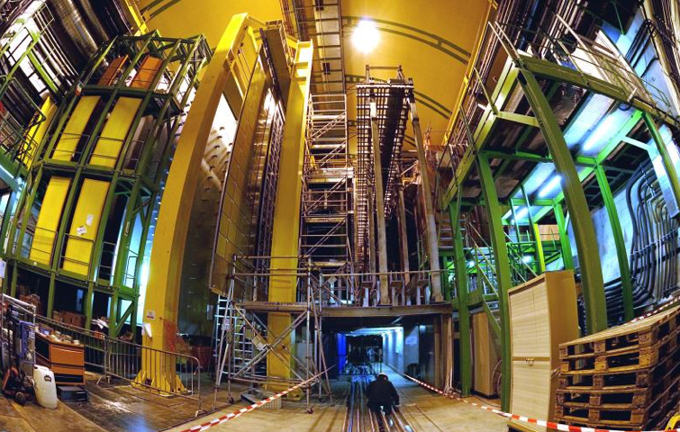

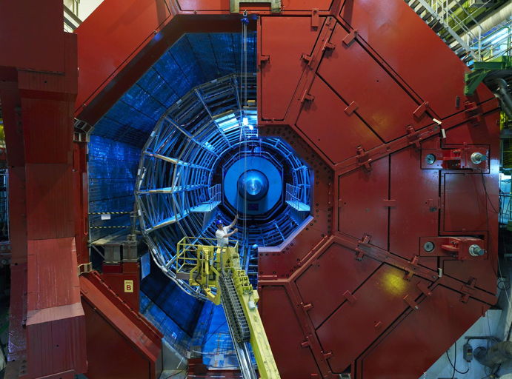
CMS
LHC ring at CERN:
27 km circumference
LHCb
So far:
0.9 / 2.8 / 5 / 7 / 8 / 13 TeV proton—proton collisions
2.8 / 5 TeV Pb—Pb collisions
5 TeV p—Pb collisions
SPS ring:
7 km circumference
CERN (Meyrin site)
ALICE
ATLAS

Slide 3
Run-1
7 & 8 TeV pp, 5 & 20 fb^{–1}
A few highlights, with apologies to CMS for showing a bit more ATLAS here, for convenience

Slide 4
Harvest of Run-1 results (approaching 500 papers / exp) confirming predictive power of SM
Note !
Run-1 is not over yet: high-quality, extremely well understood data sample for precision measurements

Slide 5
Numerous Standard Model measurements have driven QCD tests at hadron colliders to a new quality, accompanying new theoretical developments
W+jets analysis [ ATLAS, EPJ C 75, 82 (2015) ]
Precise tests of NLO matrix element calculations matched to parton shower models
And allowed to progress on critical electroweak studies related to the scalar sector
W±W± + jj production [ ATLAS, PRL 113, 141803 (2014) ]
EW VBS production
Non-VBS production
Strong production

Slide 6
Top quark production has been studies with unprecedented experimental precision
Dilepton tt cross-section measurement
[ ATLAS, EPJ C 74, 3109 (2014) ]
Precision test of NNLO QCD, used to derive the top mass and new physics limits
Luminosity and centre-of-mass energy open phase space to observe rare tt + vector-boson production
tt+W/Z: 7.1σ combined significance
[ ATLAS 1509.05276 ]

Slide 7
Similarly for top-quark properties
Top mass measurements
Newest top mass combination from CMS features total uncertainty of 480 MeV
[ CMS, 1509.04044 ]
640 MeV for Tevatron combination, ATLAS has no 8 TeV result yet
Important theoretical discussion on non-perturbative uncertainties
Alternative, but less precise, m_{top} determinations via cross-section measurements

Slide 8
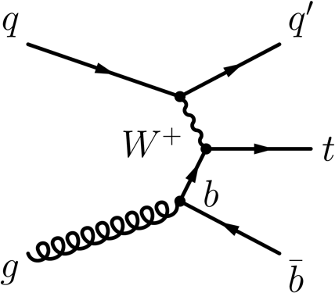
Single-top production and property measurements
Single top production
Top cross-sections significantly enhanced at LHC wrt Tevatron: at 8 TeV, factors of 42 (t-channel), 31 (tt ), but only 5 for s-channel (ie, worse S/B at LHC)
t-channel already measured differentially
[ ATLAS, 1406.7844, CMS 1511.02138 ]
Wt channel observed with 7.7σ
[ ATLAS, 1510.03752, CMS 1401.2942 ]
s-channel process first observed at Tevatron with 6.3σ in agreement with SM prediction
[ CDF & D0, 1402.5126 ]
ATLAS reported 3.2σ (3.9σ exp.) evidence in agreement with SM
[ ATLAS, 1511.05980 ]

Slide 9
W mass
No LHC result yet
World average value dominated by Tevatron measurements : 80.387 ± 0.016 GeV
[ CDF & D0, 1204.0042 ]
Standard Model prediction:

Slide 10
Discovery of an elementary (?) scalar boson and flurry of property measurements
ATLAS & CMS Combinations of Higgs mass and coupling measurements
[ arXiv:1503.07589, ATLAS-CONF-2015-044 & CMS-PAS-HIG-15-002 ]
Also:
Differential cross-section measurements
Limit on invisible Higgs branching ratio of < 25% [1509.00672, 1404.1344 ]
Constraints on anomalous off-shell coupling or spin/CP, forbidden decays (FCNC) and other scalar particles (BSM Higgs)
Higgs production processes
Higgs decay processes

Slide 11
Discovery of an elementary (?) scalar boson and flurry of property measurements
Higgs as BSM portal
Higgs is narrow: 4.1 MeV
For comparison:
Γ_{W} = 2.1 GeV
Γ_{Z} = 2.5 GeV
Γ_{top} = 1.3 GeV
?
Even small couplings to new light states can measurably distort branching fractions
Γ_{H} = 4.1 MeV

Slide 12


Beautiful flavour and low-p_{T} physics measurements
Flurry of beautiful results from LHCb [ almost 300 papers to date ]
Precision measurement of 𝜙_{s}
[ PRL 114, 041801 (2015) ]
CMS & LHCb: observation of B_{s} → µµ
[ Nat. 522 (2015) 68 ]
Observation of new states consistent with pentaquarks
[ PRL 115, 072001 (2015) ]
Data
Fit result
P_{c}(4450)⁺
P_{c}(4380)⁺
? or ? or … ?

Slide 13
Beautiful flavour and low-p_{T} physics measurements
The “bread-and-butter” CKM phase measurements continue to improve
Measurements of γ, sin(2β), |V_{ub}|, Δm_{s/d} from LHCb

Slide 14
Flavour anomalies ?
Test of lepton flavour universality: R (X ) = Γ(B → X τ ν) / Γ(B → X 𝓁 ν)
Robust theoretical prediction
HFAG, semileptonic combination for EPS-HEP 2015: http://www.slac.stanford.edu/xorg/hfag/semi/eps15/eps15_dtaunu.html
~ 3.0σ
~ 1.7σ
(3.9σ combined)

Slide 15
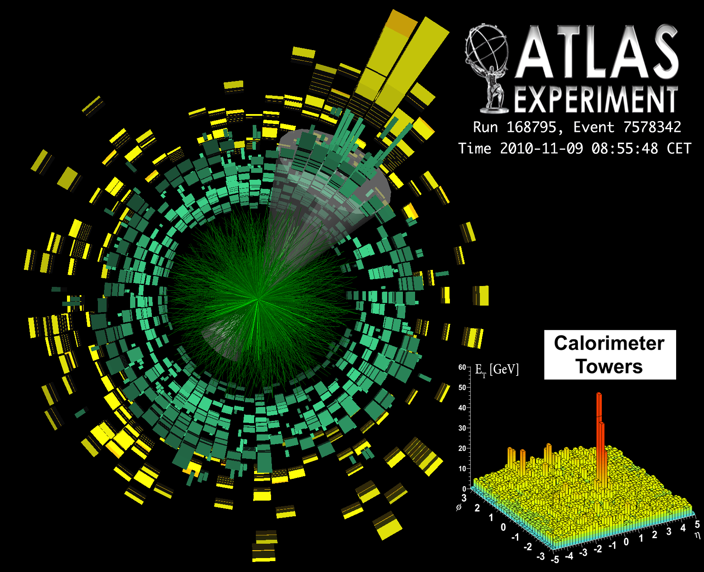
Striking phenomena observed, e.g. in lead–lead collisions and soft pp physics
ııııııııı
[ ATLAS, PRL 105, 252303 (2010) ]
[ CMS, PLB 718 (2013) 795 ]

Slide 16
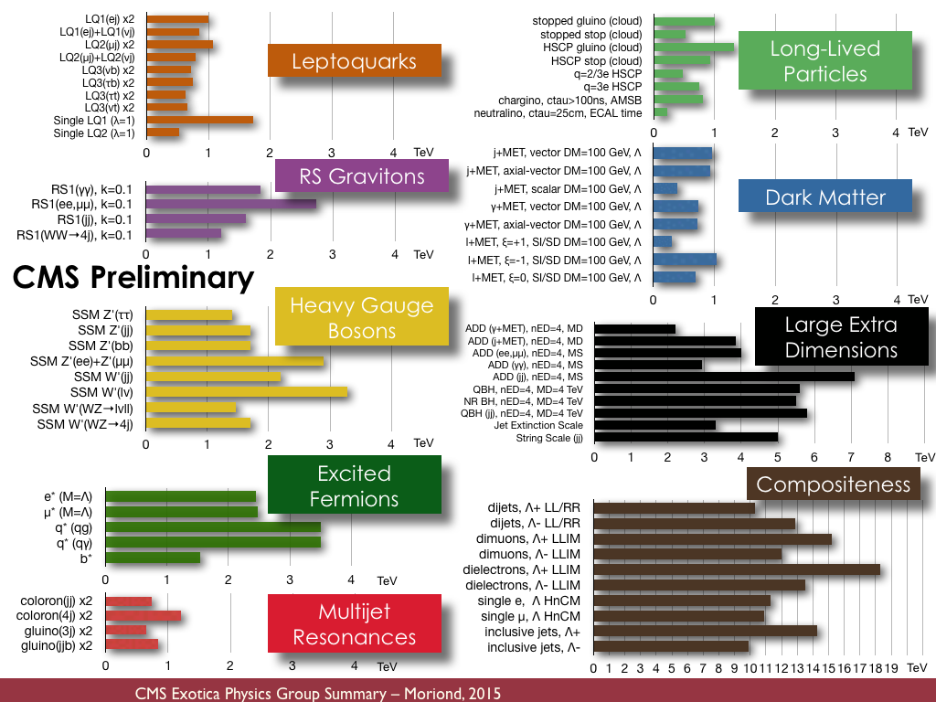
Vast amount of BSM searches — with no significant anomaly seen so far
Theory-agnostic, signature based searches, as well as naturalness driven, highly targeted model-dependent ones
Not unexpectedly, a few of these searches ended up showing some (non-significant) anomaly, a legacy to check in Run-2

Slide 17
Not unexpectedly, a few of these searches ended up showing some anomaly, a legacy to check in Run-2 (shown here: ATLAS examples)
2L(Z) + MET
[ ATLAS, arXiv:1503.03290 ]
2L(SS) + b-jets + H_{T} + MET
[ ATLAS, arXiv:1504.04605 ]
Diboson resonance (VV’ → JJ)
[ ATLAS, arXiv:1506.00962 ]
A few early papers with ideas:
http://arxiv.org/abs/1504.02244
http://arxiv.org/abs/1506.04435
http://arxiv.org/abs/1504.01768
http://arxiv.org/abs/1503.04184
…
A few early papers with ideas:
http://arxiv.org/abs/1507.01601
http://arxiv.org/abs/1507.01923
…
A few early papers with ideas:
http://arxiv.org/abs/1506.04392
http://arxiv.org/abs/1506.06736
http://arxiv.org/abs/1506.03931
http://arxiv.org/abs/1506.03751
http://arxiv.org/abs/1507.06312
…

Slide 18
Broad search coverage — not only the standard signatures
Run-1 “tour de force” analysis of pMSSM
[ ATLAS, 1508.06608 ]
Combined use of 22 separate ATLAS SUSY searches in addition to external constraints (m_{H}, EWPO, flavour, LEP searches, dark matter) to probe 19 parameter pMSSM
Distinction of LSP types: bino, wino, higgsino
Analysis overall reproduces simplified models picture
Higgsino/wino scenarios biggest challenge

Slide 19
Broad search coverage — not only the standard signatures
All experiments looked for various types of long-lived massive particles

Slide 20
Run-2
13 TeV
Complete overview of results, apologies for omitting analysis details

Slide 21

Life in 2015: 13 TeV / 8 TeV inclusive pp cross-section ratio
At 10³⁴ cm^{–2} s^{–1} @ 13 TeV pp the LHC produces:
200 Hz W → 𝓁 ν
19 Hz Z → 𝓁𝓁
8 Hz top pair
0.5 Hz Higgs
13/8 TeV sensitivity formula:
$$K_{13/8}≡ \frac{{S_{13}}/{\sqrt{B_{13}}}}{{S_{8}}/{\sqrt{B_{8}}}}=k_{S}\sqrt{\frac{k_{L}}{k_{B}}}$$
where k_{i} = 13/8 ratio, and i = S_{ignal}, B_{ackground}, L_{uminosity}
E.g.: K_{13/8} = 0.87 for ttH_{3.3/fb}

Slide 22

Shown by Mike Lamont at Lepton-Photon 2015
Fitzcarraldo moving a steamer over a muddy hill … (on his quest for money to build an opera house in the peruvian jungle)
Long-Shutdown 1
Preparing Run-2

Slide 23
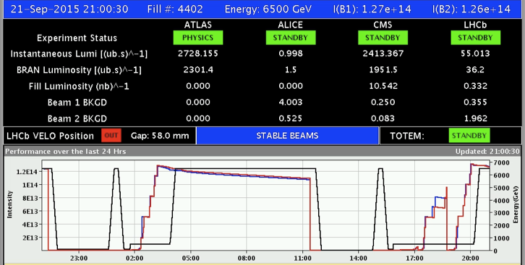
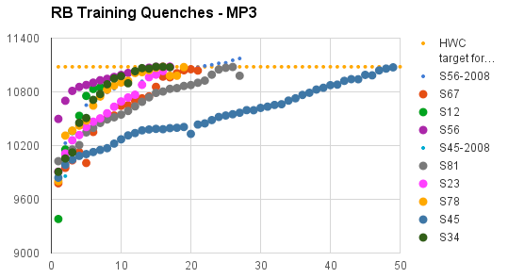
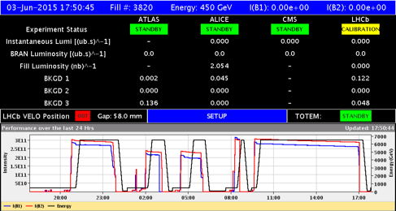
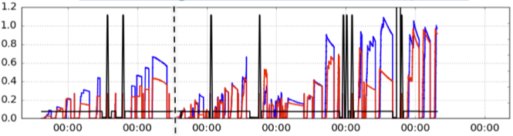
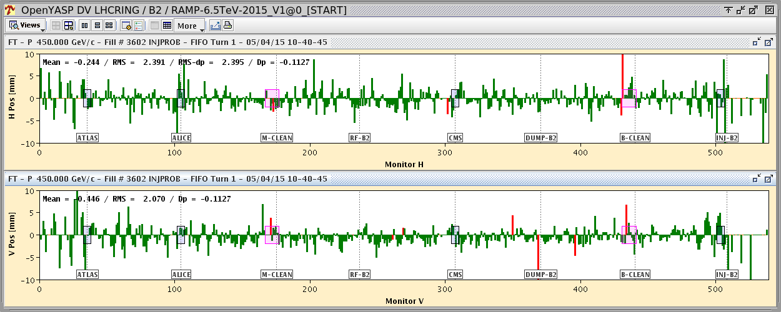

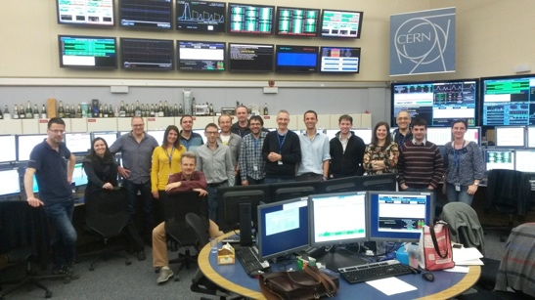
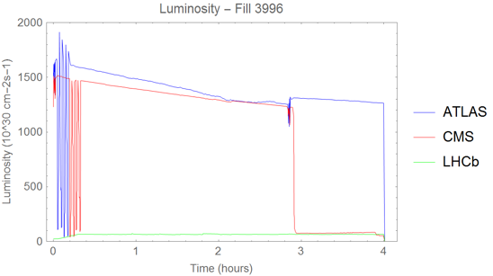
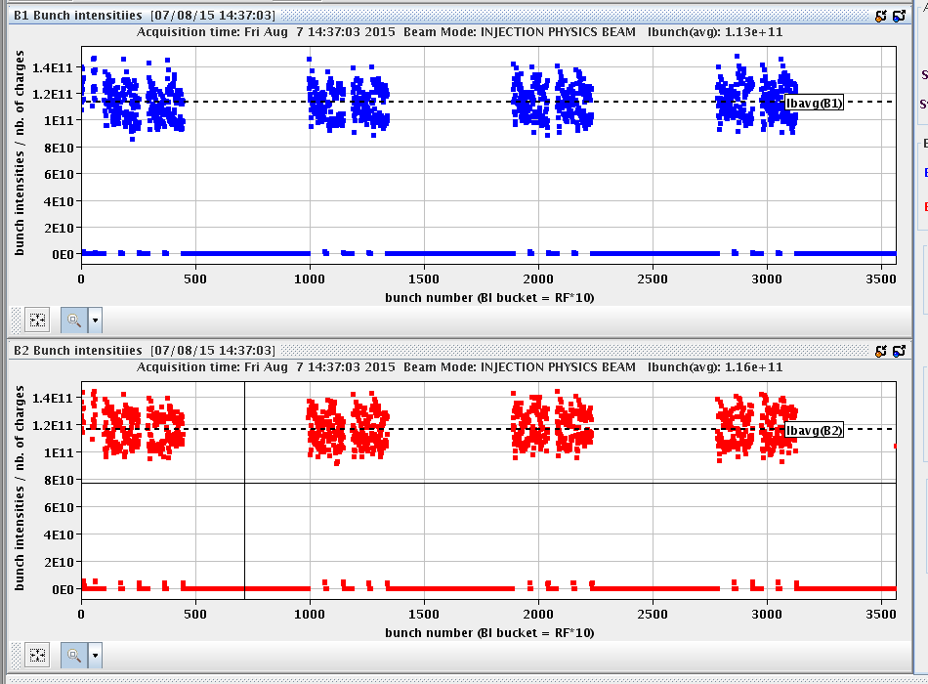

2015 LHC operation at a glance
From: Matteo Solfaroli, LHCC open session, Sep 23, 2015
21st Sep 25 ns STABLE BEAMS with 1177 bunches/beam
3rd Apr Completion of PT campaign
3rd June First STABLE BEAMS!
2.7 × 10³³ cm^{–2} s^{–1}
5th Apr First circulating beam
30th June end of scrubbing for 50 ns
TS-1
MD-1
MD-2 + TS-2
Intense beam commissioning phase
April
May
June
July
August
September
10th Apr 6.5 TeV for the first time (ever!)
14th July 476b (50 ns)
7th Aug end scrubbing for 25 ns
Since then, Oct/Nov:
2232 colliding bunches in ATLAS/CMS
L_{max} of 5.2・10³³
Nov 4: MD/TS-3
Nov 20: Ions
1.6 × 10³³ cm^{–2} s^{–1}

Slide 25
2015 LHC proton–proton luminosities
Results reported today only use summer datasets (up to LHCP 2015, max. of 85 pb^{–1})
Total in 2015 (recorded):
B = 3.8 T: 2.9 fb^{–1}
B ≠ 3.8 T: 0.8 fb^{–1}
(due to problem with cryogenic supply)
Peak luminosity:
L_{max} = 5.2 × 10³³ cm^{–2} s^{–1}
3.3 fb^{–1} for physics
2.4 fb^{–1} for physics
LHCb after luminosity levelling: 0.32 (0.36) fb^{–1} recorded (delivered)
Luminosity measurements calibrated with “mini” beam-separation scans in ATLAS/CMS: σ = 9% (ATLAS), 12/4.8% (CMS), and with the beam-gas imaging method in LHCb: 3.9% (!). Differences in amount of delivered luminosity between ATLAS and CMS under scrutiny by experiments
Pileup profiles: ATLAS/CMS: <µ>_{50 ns} = 20, <µ>_{25 ns} = 13 (<µ>_{8TeV} = 21), LHCb: <µ> ~ 1.7

Slide 26
ATLAS improvements for Run-2
Huge consolidation & improvement programme for detector, online, offline, computing
Infrastructure upgrades: magnet & cryogenic systems, additional muon chamber shielding, new beam pipes
Detector consolidation: muon chamber completion (1.0 < |η | < 1.3) & replacements, calorimeter electronics repairs, improved inner detector read-out capability to cope with 100 kHz L1 trigger rate, new pixel detector services and module repairs
Replacement of TGC chambers
New topological L1 trigger and new central trigger processor, restructured high-level trigger
New Insertable B-layer : fourth pixel layer at 3.3 cm from beam, consisting of planar & 3D (forward) silicon sensors, smaller pixels
New software, new production system, new analysis model, …
Also new beam pipe: r = 2.5 cm

Slide 27
CMS improvements for Run-2
Also significant updates and improvements
72 (144) new CSC (RPC) chambers
Source: Paolo Spagnolo, LHCP 2015
Also:
Multithreaded and more efficient reconstruction at CERN and Tier-1
New compact mini-AOD format (~10% of AOD)
Large efforts on improved (out-of-time) pileup mitigation

Slide 28
LHCb improvements for Run-2
Big effort in trigger area (among others)
Detector consolidation: muon HV and grounding, 15% PMTs replace in HCAL, ECAL monitoring fibres replaced, module repairs in OT, HPD exchange in RICH, fixes in cooling, gas, power, shielding, …
HeRSCheL: new scintillating counters to extend LHCb coverage to high rapidity (CEP, diffraction, …)
Trigger upgrade — split trigger:
All 1st stage (HLT1) output stored on disk
Used for real-time calibration and alignment
2nd stage (HLT2) uses offline-quality calibration
5 kHz of 12 kHz to Turbo stream:
  Objects produced by trigger are stored
  No raw event → smaller event size
  Used for high-yield channels (charm, J/ψ, ...)

Slide 29
Run-2 Physics & Performance

Slide 30
Preparation for Physics Results
A crucial ingredient for any physics result is a good understanding of the basic physics objects (tracks, e, µ, 𝜏, jets, missing transverse momentum, flavour tagging)
For early 13 TeV physics results, ATLAS developed concept of pre-recommendations with Run-1 & MC based object calibrations and enlarged uncertainties fully available for early physics (summer conferences → results presented here)
Pre-recommendations promptly validated with first data, and then during the year replaced with fully 13 TeV data-driven recommendations (ie, calibration & uncertainties)
Early & validated MC crucial. Key role of ATLAS Physics Modelling Group

Slide 31
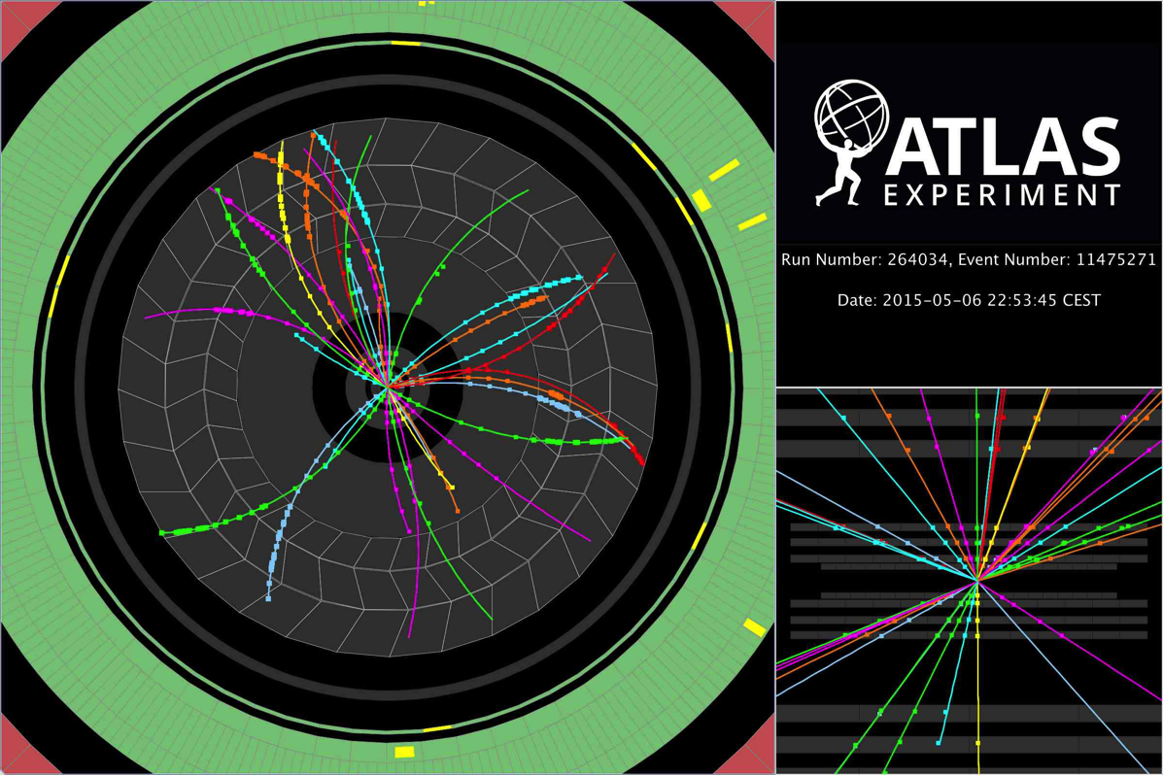
Soft physics with tracks at 13 TeV
One of the very first proton–proton collisions recorded by ATLAS in “quiet beam” conditions in May 2015

Slide 32
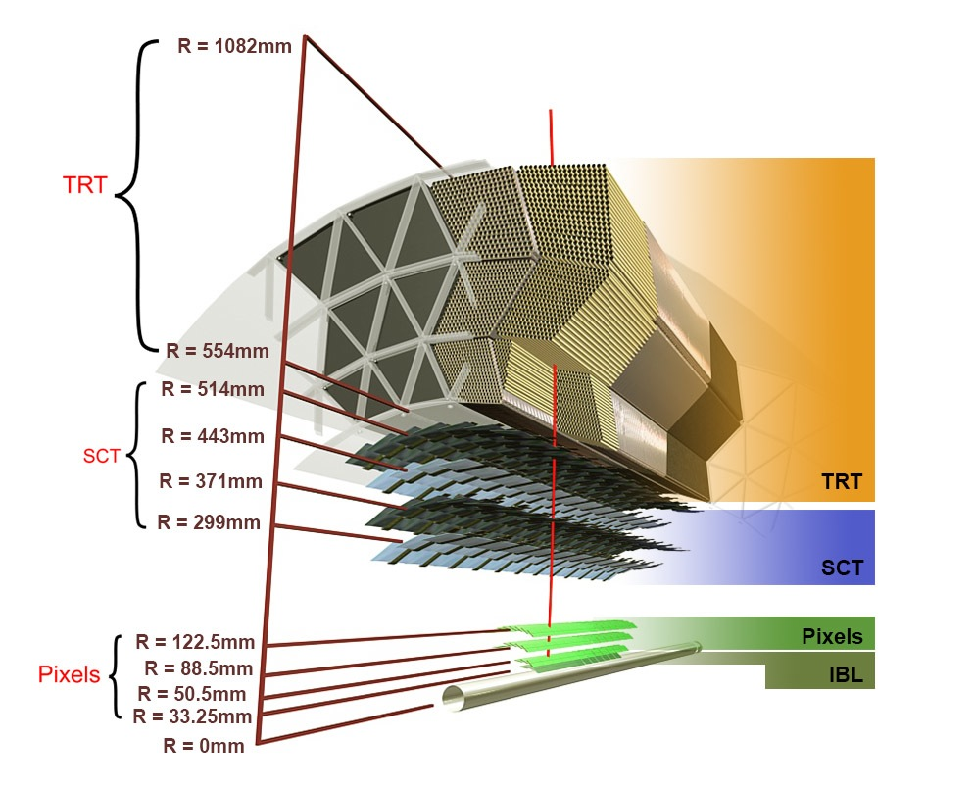
ATLAS inner tracking performance
[ ATL-PHYS-PUB-2015-018 ]
ATLAS tracking in Run-2 features the new IBL, reduced material within acceptance, and algorithmic improvements (eg, huge speed-up, tracking in dense environment [ ATL-PHYS-PUB-2015-006 ] )
Sketch of ATLAS inner tracking detectors
Impact parameter resolution improvement from IBL
Measured improvement of impact parameter resolution with IBL depending on track p_{T}
32

Slide 33
Properties of inelastic pp collisions at 13 TeV
Key input to pileup and underlying event modelling, uses low-µ data
[ ATLAS-CONF-2015-028 ]
Measurement of primary charged particle production: dN_{ch}/dη, d ²N_{ch}/dηdp_{T}, N_{ch}, <p_{T}>/N_{ch}
Fiducial cuts: p_{T} > 0.5 GeV, |η | < 2.5, N_{ch} ≥ 1
Trigger events with as little “bias” as possible: ≥1 hit in forward scintillators (MBTS, 2.07 < |η | < 3.86)
Measure trigger and vertexing efficiencies from data
Measure and subtract secondary interactions and fake tracks
Correct for tracking inefficiency
Unfold measured spectra from detector effects
1 vertex required with ≥2 tracks of p_{T} > 100 MeV

Slide 34
Properties of inelastic pp collisions at 13 TeV
Key input to pileup and underlying event modelling, uses low-µ data
[ ATLAS-CONF-2015-028 ]
Measurement of primary charged particle production: dN_{ch}/dη, d ²N_{ch}/dηdp_{T}, N_{ch}, <p_{T}>/N_{ch}
Fiducial cuts: p_{T} > 0.5 GeV, |η | < 2.5, N_{ch} ≥ 1
Trigger events with as little “bias” as possible
Measure trigger and vertexing efficiencies from data
Measure and subtract secondary interactions and fake tracks
Correct for tracking inefficiency
Unfold measured spectra from detector effects
Primary particles have τ > 300 ps (9 cm)
Secondaries are produced after τ > 30 ps (9 mm)
Strange baryons with 30 < τ < 300 ps are excluded
Tracking efficiency dominant uncertainty: 1.1% central, 6.5% forward
Secondaries after fit:
2.6 ± 0.6% of tracks in SR

Slide 35
Properties of inelastic pp collisions at 13 TeV
Key input to pileup and underlying event modelling, uses low-µ data
[ ATLAS-CONF-2015-028 ]
Resulting spectra from 9M data events & comparison to hadronic physics models
dN_{ch}/dη d ²N_{ch}/dηdp_{T} N_{ch} <p_{T}>/N_{ch}
Difficult to provide one universal tune that describe MB and UE data equally well (→ later slide)
Overall, the EPOS and PYTHIA 8 tunes describe the data most accurately EPOS best in η, p_{T}, and <p_{T}>, while PYTHIA 8 (A2 – ATLAS MB default) best in N_{ch}

Slide 36
CMS measurement without magnetic field
First LHC 13 TeV paper !
[ CMS PLB 751, 143 (2015) ]
Charged particle yield measurement for |η | < 2
Straight track (pixel, 55k events) and tracklet (pixel hit pairs, 170k) methods, good agreement
p_{T} coveage down to ~50 MeV, track efficiency between 80–85%
Secondary particle corrections, and track / tracklet acceptance & reconstruction efficiencies from MC
Systematic uncertainties of 3–4% for both methods, dominated by vertex efficiency and MC dependence
dn_{ch}/dη _{|η| < 0.5}
= 5.49 ± 0.01 (stat) ± 0.17 (syst)

Slide 37
Also preliminary ALICE result
First 13 TeV result by ALICE
[ CMS PLB 751, 143 (2015), ALICE-PUBLIC-2015-005 ]
Charged particle yield measurement for |η | < 2
Distinguish samples in inelastic (INEL) and inelastic + ≥1 track within |η | < 1 (INEL > 0)
Measure: dn_{ch}/dη _{|η| < 0.5} = 5.36 ± 0.13 in agreement with CMS

Slide 38
Charged particle production versus CM energy
[CMS PLB 751, 143 (2015) , ATLAS-CONF-2015-028 ]
Average charged-particle multiplicity per unit of rapidity for η = 0 vs √s
Fair agreement with model extrapolations
For comparison, the strange baryon contribution is included at 13 TeV in ATLAS (1.5% correction factor)

Slide 39
Inclusive inelastic cross-section measurement at 13 TeV
Fundamental initial measurement, based on forward scintillators
[ ATLAS-CONF-2015-038 ]
Measurement in fiducial region ξ = M_{X}² / s > 10^{–6} (M_{X} largest mass of two proton-dissociation systems)
Use Minimum Bias Trigger Scintillators (MBTS) with acceptance 2.07 < |η | < 3.86, 4.2M selected events
Use inclusive and single sided MBTS selections to constrain fraction of diffractive events in sample
Systematic uncertainty fully dominated by luminosity
Fiducial cross-section compared to model predictions
Extrapolated inelastic cross-section versus CM energy
Cross-section somewhat lower than predictions. Inclusive: σ_{13 TeV} = 73.1 ± 0.9 ± 6.6 (lumi) ± 3.8 (extr) mb

Slide 40
Long-range two-charged-particle angular correlations
In high-multiplicity pp collisions using low-µ data
Near-side (Δφ ~ 0) “ridge” shape along Δη seen in pp, pPb and PbPb collisions
First observed in pp by CMS: effect increases with particle multiplicity and moderate p_{T}
CMS, pp at 7 TeV:
N_{ch} > 110, 1.0 < p_{T} < 3.0 GeV
ATLAS, pPb at 5.02 TeV:
N_{ch} > 220, 1.0 < p_{T} < 3.0 GeV
ATLAS, PbPb at 2.76 TeV:
Centrality 0–5%
[ CMS 1009.4122 ]
[ ALICE 1212.2001,
ATLAS 1212.5198,
CMS 1409.3392,
LHCb-CONF-2015-004 (!) ]
[ ALICE 1105.3865,
ATLAS 1504.01289
CMS 1409.3392 ]
[ Enhancement found to be also present at Δφ ~ π, when subtracting hard scattering contributions ]

Slide 41
Two-charged-particle angular correlations at 13 TeV
In high-multiplicity pp collisions using low-µ data
[ ATLAS 1509.04776, CMS 1510.03068 ]
How does the pp ridge evolve with CM energy ?
ATLAS: trigger on MBTS (97M events) & high charged multiplicity (9.5M)
Exploit work on tracking corrections from minimum bias analysis
Extract two-particle correlation function (background from mixed events) →
Determine “ridge yield”
Low charged multiplicity
Integrate:
2 < |Δη | < 5

Slide 42
Two-charged-particle angular correlations at 13 TeV
In high-multiplicity pp collisions using low-µ data
[ ATLAS 1509.04776, CMS 1510.03068 ]
How does the pp ridge evolve with CM energy ?
ATLAS: trigger on MBTS (97M events) & high charged multiplicity (9.5M)
Exploit work on tracking corrections from minimum bias analysis
Extract two-particle correlation function (background from mixed events) →
Determine “ridge yield”
High charged multiplicity
Integrate:
2 < |Δη | < 5
b_{zero-yield-at-min} offset

Slide 43
Two-charged-particle angular correlations at 13 TeV
In high-multiplicity pp collisions using low-µ data
[ ATLAS 1509.04776, CMS 1510.03068 ]
How does the pp ridge evolve with CM energy ?
ATLAS: trigger on MBTS (97M events) & high charged multiplicity (9.5M)
Exploit work on tracking corrections from minimum bias analysis
Extract two-particle correlation function (background from mixed events) →
Determine “ridge yield”
High charged multiplicity
Integrate:
2 < |Δη | < 5
“ZYAM” offset method
Integrated “ridge yield”: Y_{int} (illustration only, integral is over appropriately
normalised “per-trigger yields”: Y (Δφ)

Slide 44
Two-charged-particle angular correlations at 13 TeV
In high-multiplicity pp collisions using low-µ data
[ CMS 1510.03068 ]
Resulting yield dependence (CMS)
Left: versus p_{T} and N_{trk} and compared between CM energies for 2 < |Δη | < 4
Right: versus N_{trk} and compared between processes for 2 < |Δη | < 4 and 1 < p_{T} < 2 GeV
No visible CM energy dependence of yield for pp colisions (also found by ATLAS)
The curves are predictions from gluon saturation (colour glass condensate) model: Dusling-Venugopalan,1302.7018.
No apparent dependence on CM energy, but on size of colliding system

Slide 45
Two-charged-particle angular correlations at 13 TeV
In high-multiplicity pp collisions using low-µ data
[ ATLAS 1509.04776 ]
ATLAS replaced ZYAM method by template fit and measured ridge at 13 TeV and 2.76 TeV
Ridge modulation in Y (Δφ) yield fitted by:
Near and far side ridge
Factorisation: v_{2,2} (p_{T}ª,p_{T}^{b}) = v₂ (p_{T}ª) v₂ (p_{T}^{b})
Ridge results from per-event cos(2Δφ) modulation of single-particle distribution with Fourier coefficient v₂
v₂ ~independent of multiplicity and CM energy, p_{T} dependence similar to pPb and PbPb

Slide 46
Moving to higher luminosity and p_{T}
Physics with photons and jets at 13 TeV
Early 13 TeV event recorded by CMS showing two high-energy particle jets with invariant mass of 5 TeV

Slide 47
Photon production at 13 TeV
Test perturbative QCD in cleaner environment than jets
[ ATL-PHYS-PUB-2015-016 ]
Measurement of isolated photon yield
Subtract mis-identification background from data using isolation distribution
Photon production vs. E_{T,γ} and |η_{γ} | (detector level, MC normalised to data)
Systematics dominated by photon energy scale, resolution and efficiency
Good agreement of shape with SHERPA 2.1 (LO + ≤3 partons)
Barrel–endcap transition region excluded
Systematic uncertainties dominated by: photon energy scale, photon ID, background subtraction

Slide 48
Jet production at 13 TeV
Early central-jet cross-section measurement at 13 TeV
[ ATLAS-CONF-2015-034 ]
Measurement performed within fiducial region 350 < p_{T} < 840 GeV and |y_{jet}| < 0.5:
Single jet trigger, fully efficient above 300 GeV jet p_{T}
Reconstruct anti-k_{t} R = 0.4 jets, calibrated using MC and Run-1 data, validated in Run-2 data
Unfold to particle level
Dominant systematic uncertainty: jet energy scale and resolution
Compare with NLO theory (incl. PS+UE corrections) of measured diff. cross sections vs. p_{T}

Slide 49
[ ATLAS-CONF-2015-034, CMS-PAS-EXO-15-001 ]
New physics searches with dijets
Early 13 TeV data already sensitive to very high-mass & cross section physics (eg, QBH)
Analysis strategy (dijet resonance):
  Look for deviation in dijet invariant mass spectrum from smooth function
Alternative functions / more parameters used following predefined rule (independent of data outcome)
QBH limits improved by ~1 TeV over Run-1

Slide 50
[ ATLAS-CONF-2015-034, CMS 1512.01224 ]
New physics searches with dijets
Early 13 TeV data already sensitive to very high-mass & cross section physics (eg, QBH)
Analysis strategy (dijet resonance):
  Look for deviation in dijet invariant mass spectrum from smooth function
Alternative functions / more parameters used following predefined rule (independent of data outcome)
QBH limits improved by ~1 TeV over Run-1
→ m (q*) > 5.0 TeV

Slide 51
[ ATLAS-CONF-2015-034 ]
New physics searches with dijets
Early 13 TeV data already sensitive to very high-mass & cross section physics (eg, QBH)
Analysis strategy (dijet angular):
Search for non-resonant high-mass anomalies using angular distribution
Define for jets 1 & 2:
  χ = exp | y₁ – y₂ |
  which is ~independent of m₁₂ for t-channel LO QCD at parton level
  Restrict analysis to |y₁ + y₂| < 2.2, and to m₁₂ > 2.5 TeV
Prediction from NLOJET++ and including electroweak effects
Systematic uncertainty dominated by QCD prediction and jet energy scale

Slide 52
8.8 TeV mass dijet event collected by ATLAS in September 2015

Slide 53
[ ATLAS-CONF-2015-043 ]
New physics searches with multiple jets
Similar analysis to dijets, but looking for deviation in inclusive jet production
Analysis strategy:
Search for deviation in H_{T} = Σ_{jets} p_{T} in events with at ≥ 3–8 jets with p_{T} > 50 GeV
High-H_{T} trigger ~fully efficient above 1 TeV
Data driven background fit as in dijet case, but more tricky as fit over full spectrum could “eat” signal
Define control (CR), validation (VR), signal regions (SR) depending on low, medium, high H_{T}
On lower luminosity bootstrap sample fit data in CR, use VR to validate functional form
Use function to fit full spectrum and derive background prediction in SR
Vary functions to assess extrapolation uncertainty
CR
VR
SR

Slide 54
[ ATLAS-CONF-2015-043 ]
New physics searches with multiple jets
Similar analysis to dijets, but looking for deviation in inclusive jet production
Sensitivity to TeV-scale gravity models beyond that of Run-1
Limit increased over Run-1 by more than 2 TeV in threshold mass for M_{D} < 4 TeV

Slide 55
[ ATLAS-CONF-2015-046 ]
New physics searches with lepton & jets
Similar analysis to dijets, but looking for deviation in inclusive jet production
Analysis strategy:
Search for non-resonance deviation in Σ_{e/µ+jets} p_{T} in events with at least 3 high-p_{T} objects (≥ 1 lepton)
Single lepton trigger, 2 signal regions with Σ_{e/µ+jets > 60 GeV} p_{T} > 2 (3) TeV
Dominant backgrounds (W/Z+jets, ttbar) from MC normalised to data in control regions, others from MC
Propagation of exp. and theoretical uncertainties
Validation region for 1.5 < Σ p_{T} < 2 TeV
BH sensitivity improves over Run-1, but not over multijet search

Slide 56
Physics with leptons at 13 TeV
Dimuon mass distribution collected with various dimuon triggers
[ CMS DP-2015/015 ]

Slide 57
J/Ψ production at 13 TeV
Good environment in early data with low trigger thresholds
[ LHCb 1509.00771 ]
J/Ψ are produced promptly and via weak decays of b-hadrons
LHCb used initial 3 pb^{–1} for first prompt & non-prompt J/Ψ cross-section measurement in forward rapidity
Systematic uncertainty mostly dominated by luminosity (3.9%)
Analysis performed almost promptly thanks to the “Turbo stream” trigger line

Slide 58
J/Ψ production at 13 TeV
Good environment in early data with low trigger thresholds
[ LHCb 1509.00771 ]
J/Ψ are produced promptly and via weak decays of b-hadrons
LHCb used initial 3 pb^{–1} for first prompt & non-prompt J/Ψ cross-section measurement in forward rapidity
Differential absolute cross-sections and ratios to 8 TeV obtained, show total fiducial cross-sections here
Fiducial region: p_{T} < 14 GeV and 2.0 < y < 4.5
Fiducial region: p_{T} < 14 GeV and 2.0 < y < 4.5
At 13 TeV: 15.30 ± 0.03 ± 0.86 μb
(assuming zero J/ Ψ polarisation)
At 13 TeV: 2.34 ± 0.01 ± 0.13 μb
(assuming zero J/ Ψ polarisation)
Cross-sections rise mostly due to CM energy; harder p_{T} spectrum at 13 TeV than at 8 TeV
Total σ(pp → bb+X ) = 515 ± 2 ± 53 μb (using BR(b → J/ψ X ) = 1.16 ± 0.10%).

Slide 59
J/Ψ production at 13 TeV
Good environment in early data with low trigger thresholds
[ ATLAS-CONF-2015-030 ]
ATLAS measured the J/Ψ non-promdpt fraction at 13 TeV in early 6.4 pb^{–1} dataset
Cuts: p_{T,µ} > 4 GeV, |η_{µ}| < 2.3, p_{T,µµ} > 8 GeV, |y_{µµ} | < 2, 2D fit to m_{µµ} and proper decay time τ = L_{xy} m_{J/Ψ} / p_{T,µµ}
Fitted non-prompt fraction for 3 J/Ψ rapidity bins
Depending on CM energy
Error bars are statistical and systematic
Non-prompt contribution to total rate rises rise from approximately 25% at p_{T,µµ} of 8 GeV to 65% at 40 GeV

Slide 60
Prompt charm production at 13 TeV
Second LHCb paper on 13 TeV
[ LHCb 1510.01707 ]
Measurements of prompt D ⁰, D ⁺, D_{s}⁺, D *⁺ forward cross-sections with 5 pb^{–1}
Measure differentially in bins of meson p_{T} and rapidity, and integrated fiducial cross-sections
Total charm (cc) cross-sections by correcting for cc → D fragmentation fractions measured at B-factories
Averaged integrated cross-section: σ(pp → cc+X ) = 2940 ± 3 (stat) ± 180 (syst) ± 160 (frag) µb

Slide 61
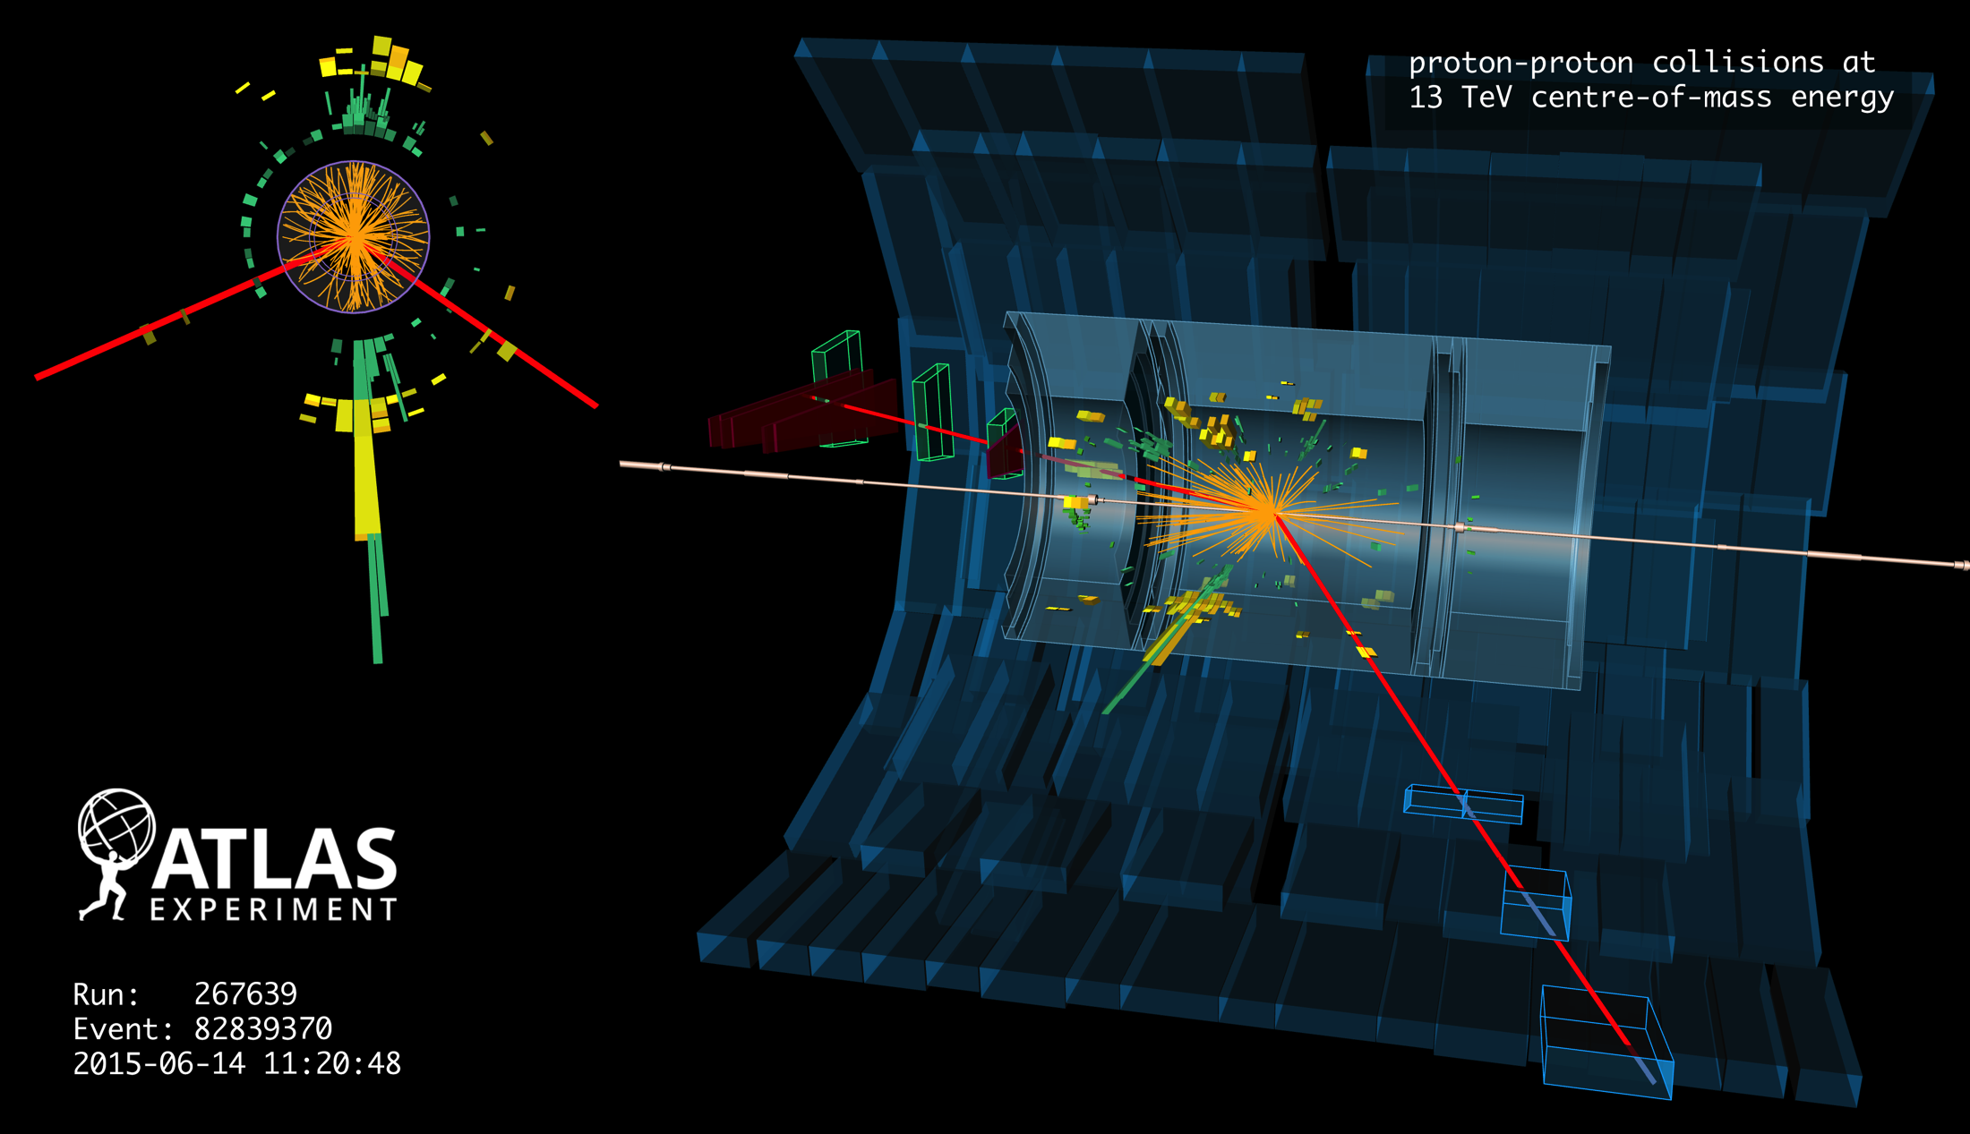
W and Z boson production at 13 TeV
Displays of one Z(→ µµ) + jets candidate event

Slide 62
Z and W production at 13 TeV (ATLAS)
Expect increase of cross section by factors of 1.7 and 1.6, respectively
[ ATLAS-CONF-2015-039 ]
Leptonic decays are important standard candles to verify and calibrate e/µ performance
Following plots are normalised to NNLO QCD and to luminosity. Error bands in plots do not include 9% luminosity uncertainty (leading uncertainty, other systematics dominated by lepton ID)
Electron efficiency scale factors (both trigger and offline) from data tag & probe, 8 TeV and MC extrapolation

Slide 63
Z and W production at 13 TeV (ATLAS)
Expect increase of cross section by factors of 1.7 and 1.6, respectively
[ ATLAS-CONF-2015-039 ]
Leptonic decays are important standard candles to verify and calibrate e/µ performance
Following plots are normalised to NNLO QCD and to luminosity. Error bands in plots do not include 9% luminosity uncertainty (leading uncertainty, other systematics dominated by lepton ID)
Muon efficiency scale factors (both trigger and offline) from data tag & probe

Slide 64
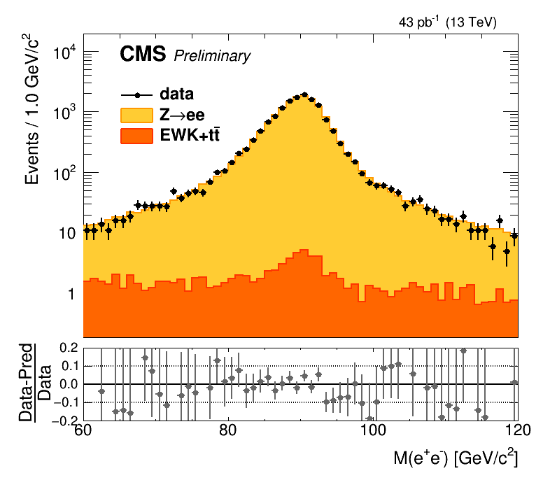
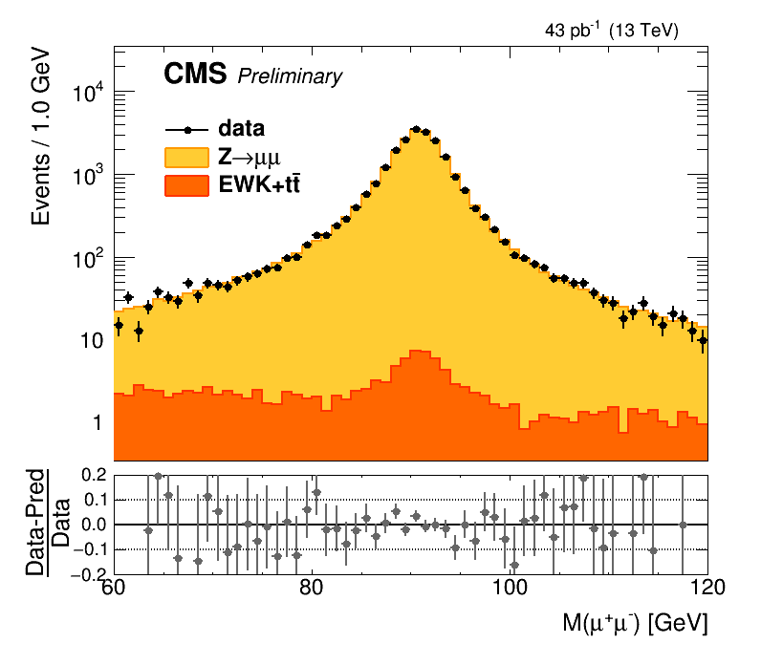
Z and W production at 13 TeV (CMS — new!)
Expect increase of cross section by factors of 1.7 and 1.6, respectively
[ CMS-PAS-SMP-15-004 ]
W and Z inclusive cross section measurements
For Z: count events in m(Z) region. Measurement benefits from a reduced luminosity uncertainty of 4.8%!
Leading systematic uncertainty from lepton identification (~2%)

Slide 65
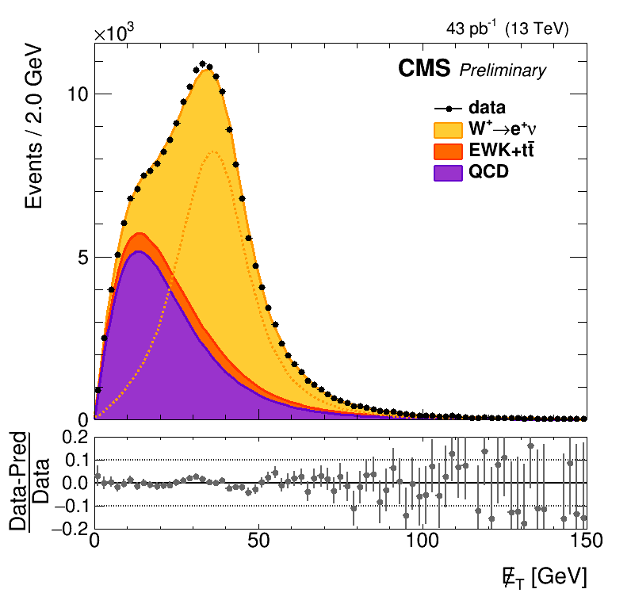
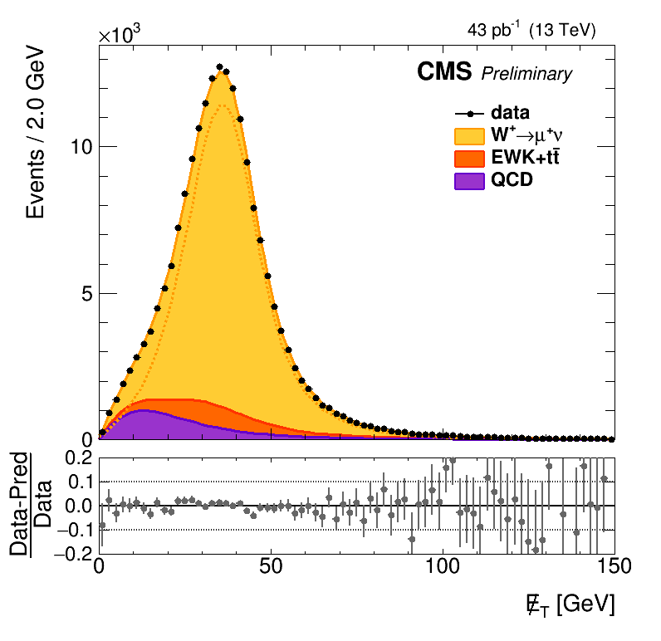
Z and W production at 13 TeV (CMS — new!)
Expect increase of cross section by factors of 1.7 and 1.6, respectively
[ CMS-PAS-SMP-15-004 ]
W and Z inclusive cross section measurements
For W: fit of E_{T,miss} spectrum. Measurement benefits from a reduced luminosity uncertainty of 4.8%!
Leading systematic uncertainty from lepton identification (~2%)

Slide 66
[ ATLAS-CONF-2015-039, CMS-PAS-SMP-15-004 ]
Z and W production at 13 TeV
Expect increase of cross section by factors of 1.7 and 1.6, respectively
Resulting inclusive cross sections
Comparison of measured cross-sections with NNLO QCD & NLO EW predictions (FEWZ 3.1)
Good agreement found within uncertainties, also with lepton universality
Measured also fiducial cross sections

Slide 67
[ ATLAS-CONF-2015-039, CMS-PAS-SMP-15-004 ]
Cross-section ratios quite precise (< 3%)
Powerful tools to constrain PDFs: W⁺ / W– sensitive to low-x u & d valence, W / Z constrains s
Note: fiducial cross-section ratios
Note: fiducial cross-section ratios

Slide 68
ATLAS also looked into production of Z associated with jets
Benchmark process to understanding QCD and EW physics at 13 TeV
[ ATLAS-CONF-2015-041 ]
Measurement in its own right and validation of important background to new physics searches
Good description by SHERPA 2.1.1 (ME+PS@NLO prescription, up to 2 partons at NLO, up to 4 partons at LO ME) and Madgraph (LO)

Slide 69
High-mass dilepton production
Insufficient luminosity yet to challenge Run-1 sensitivity to new physics
[ ATLAS EXOT-2015-001,
EXOT-2015-004 ]
Drell-Yan production at high q ²
Dominant irreducible backgrounds taken from MC simulation, DY normalised to Z peak
pp → µµ + X
pp → ee + X
881 GeV
1.8 TeV
[ 20.3 fb^{–1}, 8 TeV, arXiv:1405.4123 ]

Slide 70
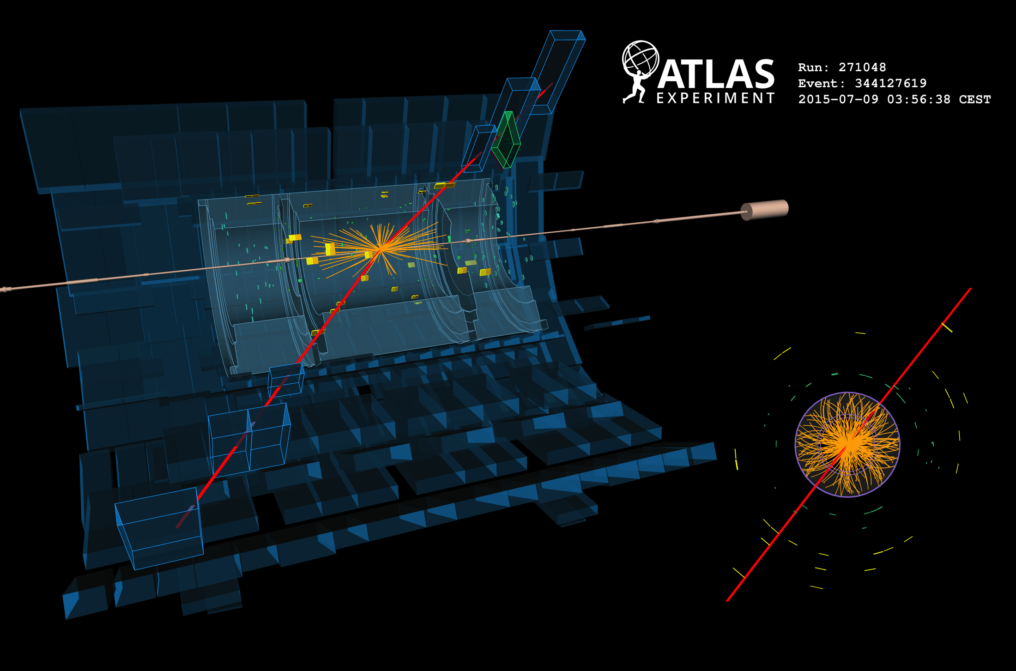
Display of µ⁺µ– event with 881 GeV invariant mass

Slide 71
Display of rare colossal e⁺e– candidate event with 2.9 TeV invariant mass
Each electron candidate has 1.3 TeV E_{T}
Back-to-back in φ
Highest-mass Run-1 events: 1.8 TeV (ee), 1.9 TeV (µµ)

Slide 72
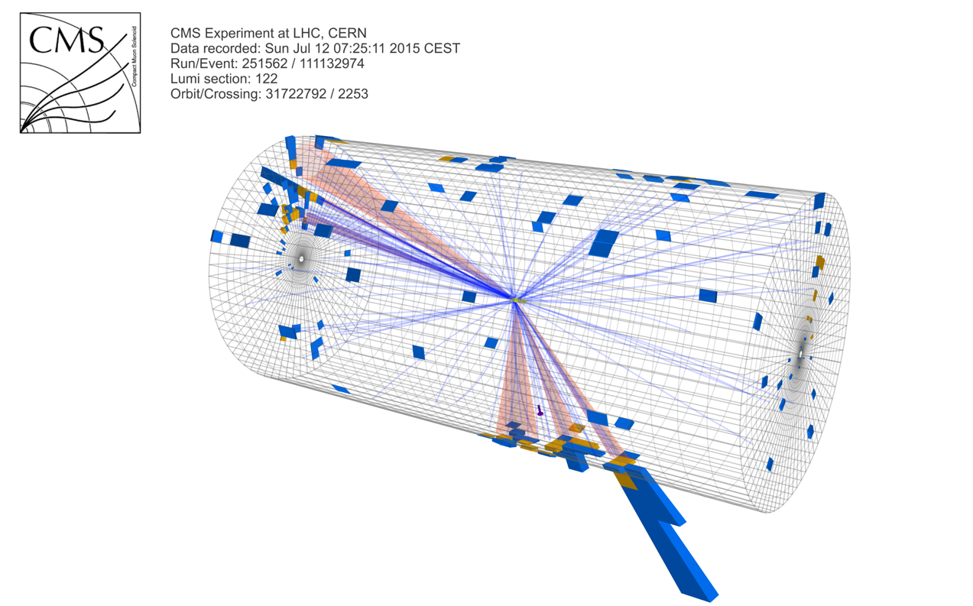
Top quark production at 13 TeV
Boosted hadronic ttbar event measured by CMS

Slide 73
Top-antitop production at 13 TeV
Expect increase of 8 TeV cross section by a factor of 3.3
[ ATLAS-CONF-2015-033, ATLAS-CONF-2015-049 ]
Cleanest channel: tt → (e + ν + b-jet) + (µ + ν + b-jet) = eµ + 2 b-jets + E_{T,miss}
Select: OS electrons & muons with p_{T} > 25 GeV, at least one b-tagged jet with p_{T} > 25 GeV (clean channel, no E_{T,miss} requirement needed → reduce systematics)
Shape comparison only. MC normalised to data

Slide 74
Top-antitop production at 13 TeV
Extraction of top-pair cross section
[ ATLAS-CONF-2015-033, ATLAS-CONF-2015-049 ]
Apply robust data-driven method that provided most precise Run-1 measurements (7, 8 TeV)
Following relation allows to simultaneously determine σ_{tt} and ε_{b} from data
MC normalised to SM expectation
Where:
N₁₍₂₎ – number of selected events with 1(2) b-tags
N₁₍₂₎^{bkg} – number of background events with 1(2) b-tags
L – luminosity of data sample
ε_{eµ} – (tt →) eµ selection eff & acc (~0.9%) incl. BR
ε_{b} – probability to b-tag q from t → Wq
C_{b} = ε_{bb} / ε_{b} is non-factorisation correction
(1.005 ± 0.006 from MC)
Observe: N₁ = 319, N₂ = 167
Expect: N₁^{bkg} = 37.3 ± 5.5, N₂^{bkg} = 8.5 ± 3.5, dominated by Wt (MC, approx. NNLO), then mis-id. e/µ (MC & data)

Slide 75
Top-antitop production at 13 TeV
Extraction of top-pair cross section
[ ATLAS-CONF-2015-033, ATLAS-CONF-2015-049 ]
Solving the equation gives the following 13 TeV pp → tt + X cross section
σ_{tt} (13 TeV) = 829 ± 50 (stat) ± 56 (syst) ± 83 (lumi) pb
Total relative uncertainty of 14%
(4.3% at 8 TeV)
+40
– 46
σ_{tt}[SM] (13 TeV) = 832 pb ( at NNLO + NNLL accuracy, m_{t} = 172.5 GeV, Top++ 2.0 )
Systematic uncertainty (7.3%) dominated by
tt hadronisation (4.5%) → large Pythia8 / Herwig++ parton shower effect, to be further studied
tt NLO modelling, ISR/FSR radiation & PDF (2.8%)
Electron ID + isolation (3.4%)
Muon ID + isolation (1.2%)
Lepton mis-identification (1.4%)
Lepton triggers (0.8%)
→ will improve with more data
Overall uncertainty dominated by luminosity (9%) → will improve with full van-der-Meer luminosity scan
We also measure: ε_{b} = 0.527 ± 0.026 ± 0.006, in good agreement with simulation: 0.543

Slide 76
Top-antitop production at 13 TeV
Extraction of top-pair cross section
[ ATLAS-CONF-2015-033, ATLAS-CONF-2015-049 ]
Solving the equation gives the following 13 TeV pp → tt + X cross section
σ_{tt} (13 TeV) = 829 ± 50 (stat) ± 56 (syst) ± 83 (lumi) pb
+40
–46
SM: 832 pb
Also: same-flavour and lepton+jets fiducial and inclusive cross-section measurements

Slide 77
Top-antitop production at 13 TeV
Extraction of top-pair cross section
[ ATLAS-CONF-2015-049 ]
Ratio to Z cross section reduces systematic uncertainty
R (tt / Z) = 0.445 ± 0.027 (stat) ± 0.028 (syst) [9%]
Ratio of ttbar(e–µ) to Z cross-section measurement
(sensitive to ratio of gluon to sea-quark PDFs)

Slide 78
Total and differential cross-section measurements
Test 13 TeV modelling (verify known problems during Run-1)
[ CMS 1510.05302, CMS PAS TOP-15-010 ]
Total cross-section measurement in dilepton e–µ channel
Select: OS electrons & muons with p_{T} > 20 GeV, ≥ 2 jets with p_{T} > 30 GeV, |η_{e, µ, jets}| < 2.4, no b-tagging (alternative analysis uses 0,1,2 b-tagging categories)
Trigger and lepton efficiencies largest systemtics after luminosity
σ_{tt} (13 TeV) = 769 ± 60 (stat) ± 55 (syst) ± 92 (lumi) pb
Total relative uncertainty of 16%

Slide 79
Total and differential cross-section measurements
Test 13 TeV modelling (verify known problems during Run-1)
[ CMS-PAS-TOP-15-005 ]
Total and differential cross-section measurements in lepton+jets channel
Select: 1 electron or muon with p_{T} > 30 GeV, |η_{e, µ}| < 2.1, ≥ 4 jets with p_{T} > 25 GeV, |η_{jets}| < 2.4, ≥ 1 b-tag
Dominant systematics: luminosity, b-tagging, JES/JER, PDF, PS
Also total inclusive cross-section measurement

Slide 80
Total and differential cross-section measurements
Test 13 TeV modelling (verify known problems during Run-1)
[ CMS-PAS-TOP-15-013 ]
Additional recent differential cross-section measurements in lepton+jets channel
Larger luminosity of 71 pb^{–1}, different variables

Slide 81
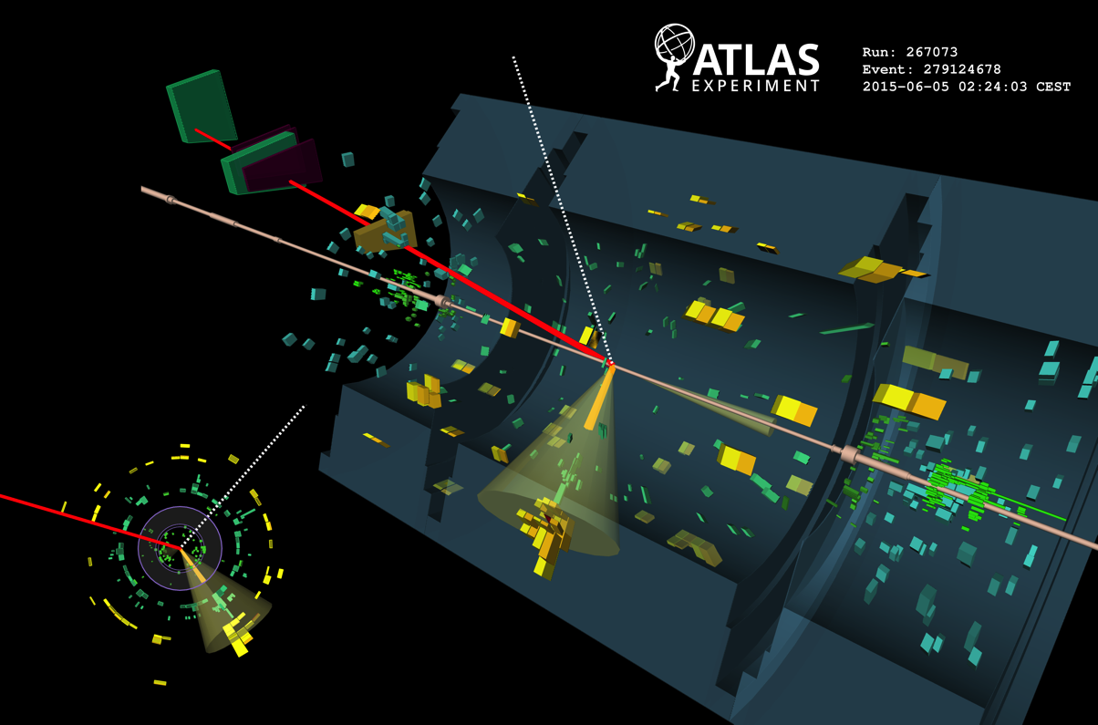
Display of t-channel single-top candidate event: muon with p_{T} of 30 GeV, central b-tagged jet of 50 GeV, forward jet 30 GeV, E_{T,miss} of 40 GeV

Slide 82
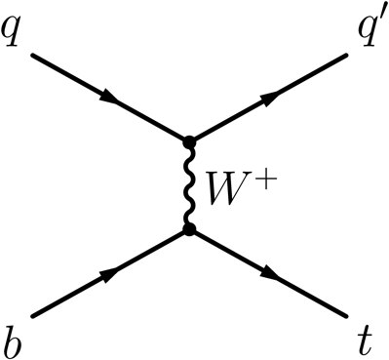
Finally: t-channel single top production
Expect factor 2.5 larger cross-section at 13 TeV compared to 8 TeV
[ CMS-PAS-TOP-15-004 ]
Early measurement by CMS using 42 pb^{–1} of data in muon channel
Select: =1 isolated muon with p_{T} > 22 GeV, |η_{µ}| < 2.1, jets > 40 GeV, |η_{jet}| < 4.7; t-channel enriched events have 2 jets, 1 b-tag and m_{µνb} ~ m_{top}. Signal extracted from fit to |η_{light-jet}| distribution in m_{µνb} signal region, top backgrounds from 2 b-tag control region. Systematics: JES (17%), luminosity (12%), b-tagging (6%), …
2→2 and 2→3 single-top t-channel processes

Slide 83
Finally: t-channel single top production
Expect factor 2.5 larger cross-section at 13 TeV compared to 8 TeV
[ CMS-PAS-TOP-15-004 ]
Early measurement by CMS using 42 pb^{–1} of data in muon channel
Select: =1 isolated muon with p_{T} > 22 GeV, |η_{µ}| < 2.1, jets > 40 GeV, |η_{jet}| < 4.7; t-channel enriched events have 2 jets, 1 b-tag and m_{µνb} ~ m_{top}. Signal extracted from fit to |η_{light-jet}| distribution in m_{µνb} signal region, top backgrounds from 2 b-tag control region. Systematics: JES (17%), luminosity (12%), b-tagging (6%), …
3.5σ (2.7σ) observed (expected) significance
σ_{tt} = 274 ± 98 (stat) ± 52 (syst) ± 33 (lumi) pb
+7
–6
σ_{t-channel}[SM] (13 TeV) = 217 (scale) ± 6 (PDF) pb (NLO)

Slide 84
CONCLUSIONS
Successful restart by LHC and detectors after LS1
Experiments were well prepared — lots of interesting physics results already
Much more to come
We are here
Next updates: watch the archive and the end-of-year seminars, 15 Dec 2015
[ http://indico.cern.ch/event/442432 ]

Slide 85
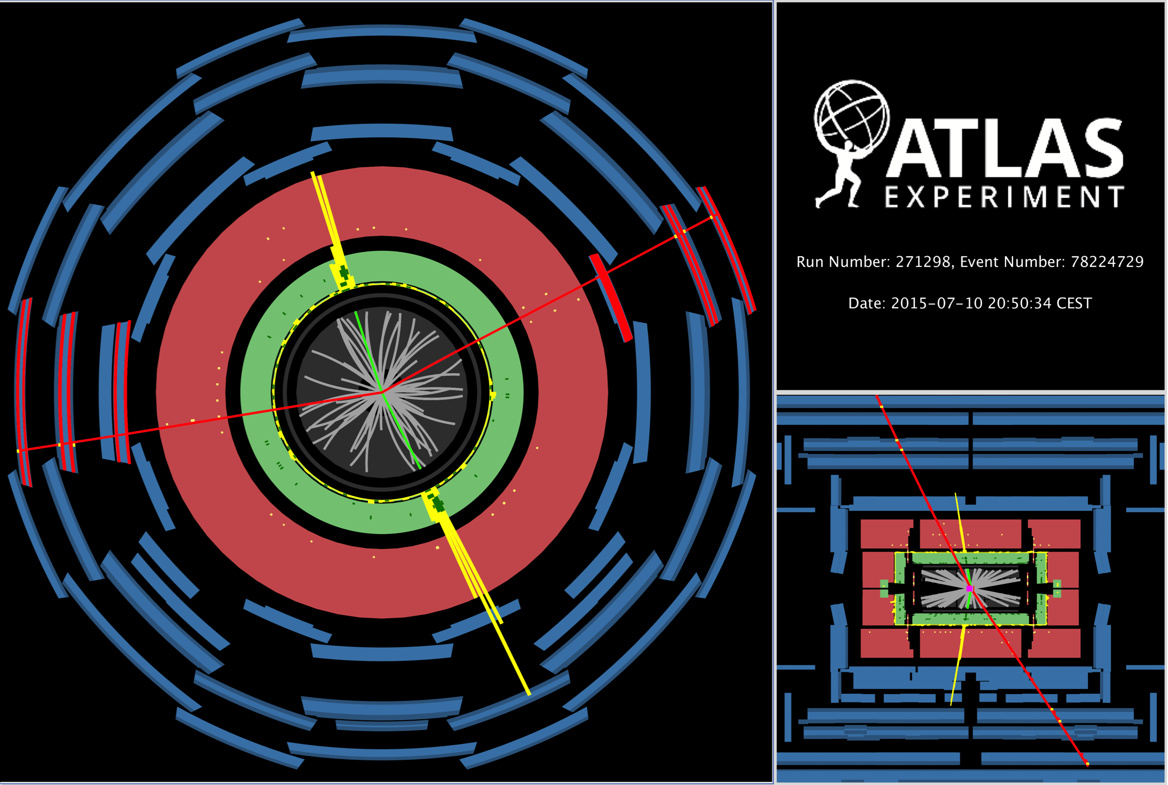
Display of ZZ → µ⁺µ– + e⁺e– candidate event (m_{µµ / ee} = 94 / 86 GeV, m_{µµee} = 191 GeV)

Slide 86
Display of H → 2µ2e candidate from 13 TeV pp collisions. The measured momenta are: p_{T}(µ) = 55, 33 GeV, p_{T}(e) = 14, 11 GeV The measured masses are: m(2µ2e) = 123 GeV, m(µµ) = 91 GeV, m(ee) = 27 GeV.

