Slide 1
Du modèle standard par le boson de Higgs vers la nouvelle physique
L'aventure du grand collisionneur LHC
Andreas Hoecker (CERN)
Académie des sciences, 26/11/2013

Slide 2
Everyday life, and particle physics, are described by the Standard Model (SM)
The SM is the legacy of 20th century particle physics
It unifies quantum mechanics, special relativity and field theory
It describes ~ all laboratory data
Is the SM the theory of everything? Or rather of almost everything? Or …

Slide 3
Year when energy reached in labs
L_{gravitation} ~ 10⁻³⁵ m
10¹⁹ GeV
The scales of particle physics …
Planck scale (M_{Pl})
10¹⁶ GeV
GUT ?
10¹⁴ GeV
ν_{R} ?
LHC reach
10 TeV
New Physics ?
~2010
1 TeV
…probing attometer scales
L_{weak} ~ 10⁻¹⁸ m
100 GeV
t, Z, W, H, EWSB
10 GeV
ψ, b, Υ, B
1 GeV
τ, c, n, p, ρ, φ
~1970
L_{strong} ~ 10⁻¹⁵ m
100 MeV
μ, s, π, QCD
10 MeV
u, d, nuclear binding E
1 MeV
e
100 keV
10 keV
1 keV
core of Sun
100 eV
10 eV
atomic binding E
~1900
L_{atomic} ~ 10⁻¹⁰ m
1 eV
ν’s
100 meV
?
10 meV
0
γ, g

Slide 4
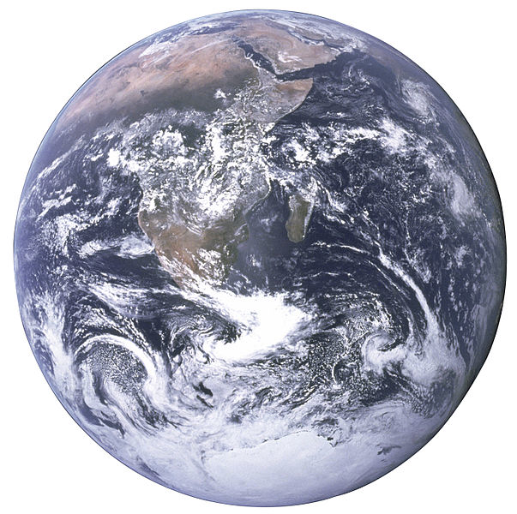

A 1 TeV-frequency microscope looks at really, really tiny objects…
Nanoscience
Particle physics today
(TeV scale)
Siphonaptera (flea)
Earth

Slide 5
The Standard Model (SM)
The SM has 24 elementary matter particles and 3 forces → 26 parameters
Fermions
Matter particles
Organised in 3 families
6 Leptons
6 Quarks
Bosons
Force quanta
Distinguishing 3 forces
Photon
3 weak bosons
8 Gluons
Electro-magnetic force
Weak force
Strong force
Higgs boson
Breaks electroweak symmetry
Generates boson and fermion masses

Slide 6
Everyday life, and particle physics, are described by the Standard Model (SM)
The SM is the legacy of 20th century particle physics
It unifies quantum mechanics, special relativity and field theory
It describes ~ all laboratory data
Is the SM the theory of everything? Or rather of almost everything? Or …

Slide 7
The strong force is asymptotically free
The SM is the legacy of 20th century particle physics
It unifies quantum mechanics, special relativity and field theory
It describes ~ all laboratory data
Is the SM the theory of everything? Or rather of almost everything? Or …

Slide 8
Example: lepton magnetic moment
Quantum corrections to physical observables can be very precisely predicted
Experiment: a_{μ} = 11 659 209.1 ± 6.3 × 10⁻¹⁰
SM: a_{μ} = 11 659 180.3 ± 4.9 × 10⁻¹⁰
Δ(Exp – SM)
= 28.8 ± 8.0 × 10⁻¹⁰
(3.6 σ)
The SM is the legacy of 20th century particle physics
It unifies quantum mechanics, special relativity and field theory
It describes ~ all laboratory data
Is the SM the theory of everything? Or rather of almost everything? Or …
?

Slide 9
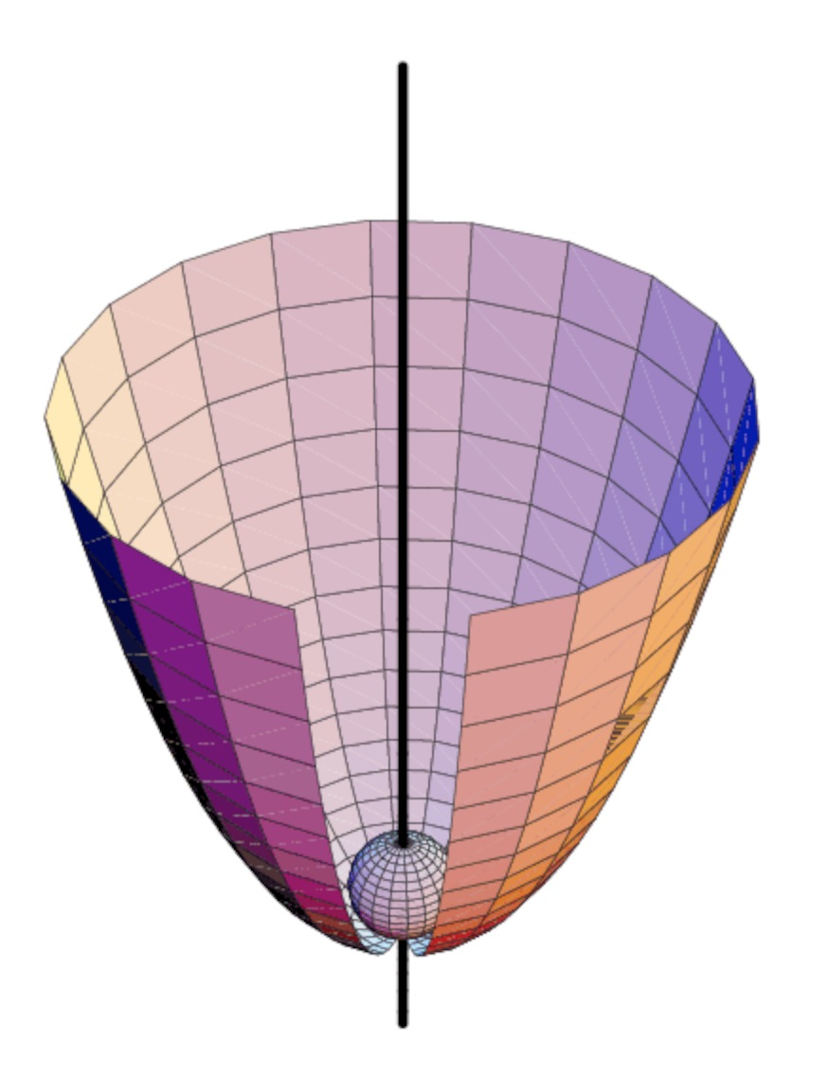
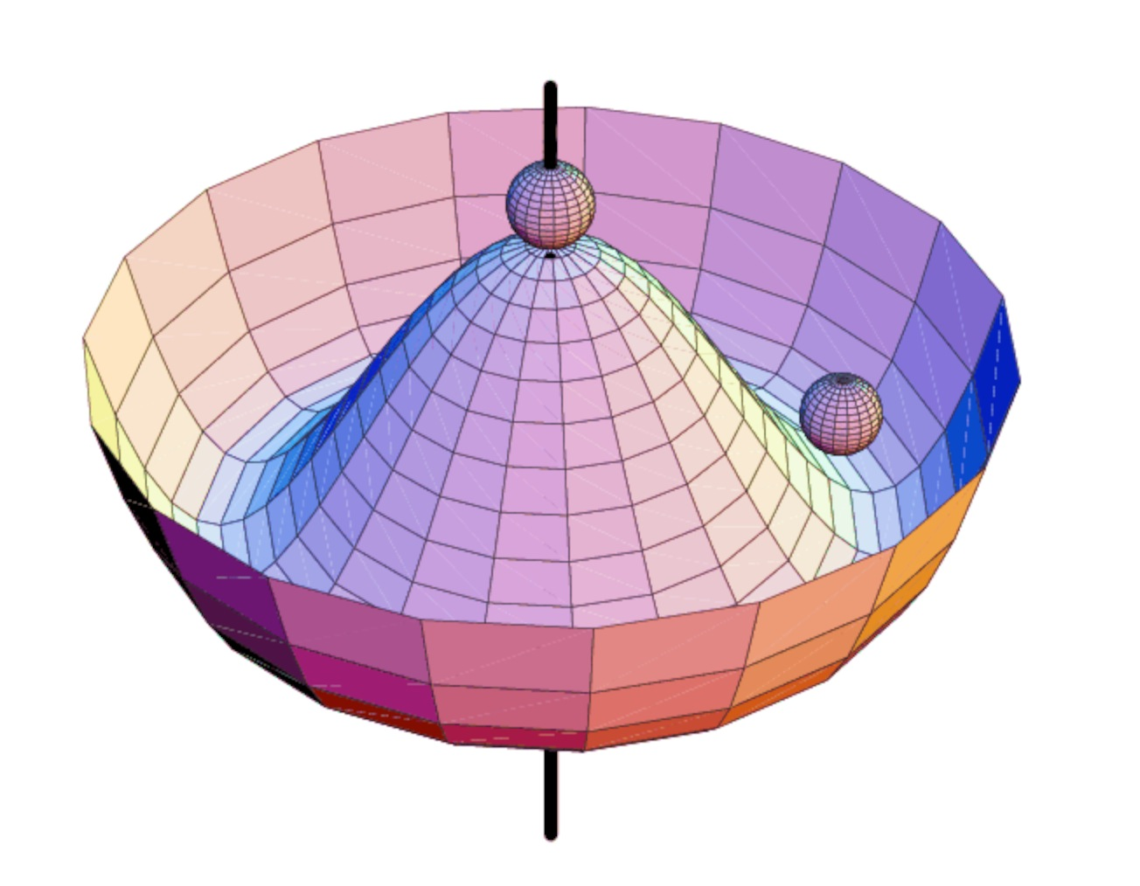
The Standard Model (SM)
The SM has 24 elementary matter particles and 3 forces → 26 parameters
A problem: local gauge symmetry requires massless spin-1 “gauge” (=force) boson
However, the W, Z bosons are massive !
Higgs potential V(φ)
A way to break gauge symmetry consistently is to spontaneously break the symmetry of the vacuum:
φ is a complex doublet field with non-zero vacuum expectation value. 3 d.o.fs become Z, W ± masses, remaining d.o.f is massive scalar Higgs boson
Symmetric phase
Broken phase
This is known as the “Brout-Englert-Higgs Mechanism”

Slide 10
Early universe: symmetric phase, fundamental particles are massless → gauge symmetry is respected
Symmetric phase – early universe
Gravity
Photon
Weak boson
Neutrinos
Electrons
Top quark
H. Murayama

Slide 11
Early universe: symmetric phase, fundamental particles are massless → gauge symmetry is respected
Higgs quantum liquid in broken phase
Symmetric phase – early universe
Gravity
Gravity
A Higgs field displaces ground state breaking gauge symmetry
It fills all space time (but w/o orientation as spin=0)
Photon
Photon
×
×
Weak boson
×
Weak boson
×
×
×
Particles interact with the Higgs field and reduce their velocity. They acquire a mass proportional to interaction strength
×
Neutrinos
Neutrinos
ν_{L}
Λ⁻¹
ν_{L}
Electrons
×
Electrons
e_{L}
e_{R}
×
e_{L}
×
×
×
_{L}
_{R}
×
×
→ Action of the Higgs field creates a vacuum viscosity
Top quark
_{R}
_{R}
Top quark
×
_{R}
×
×
_{L}
_{L}
t_{L}
_{L}
×
×
H. Murayama
H. Murayama

Slide 12

Massive particles interacting with the condensed Higgs field
… like fireflies in the night sky of Ochiai

Slide 13

The Higgs boson –
last of the particles ?
The SM predicts all its properties, except for its mass. What was known about it ?
Full references for mechanism:
F. Englert and R. Brout, PRL 13 (1964) 321.
P.W. Higgs, PRL 13 (1964) 508.
G. Guralnik, C. Hagen, and T.W.B. Kibble, PRL 13 (1964) 585.
It is also of note that Landau and Ginzburg had proposed a field giving the photon a mass in a superconductor, the mathematics of which is identical to the “Higgs mechanism” and predates it by several years.
http://www.shardcore.org/shardpress

Slide 14

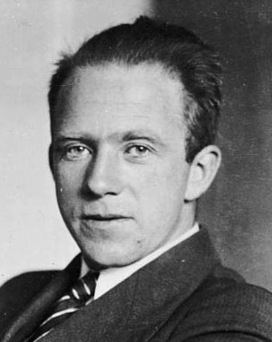
Constraints from global electroweak fit
Global fit of all EW precision measurements to SM prediction constrains M_{H}
H
W. Heisenberg
http://gfitter.desy.de

Slide 15

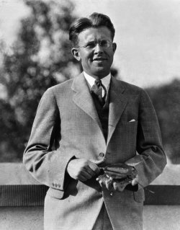
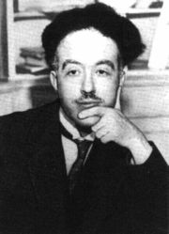
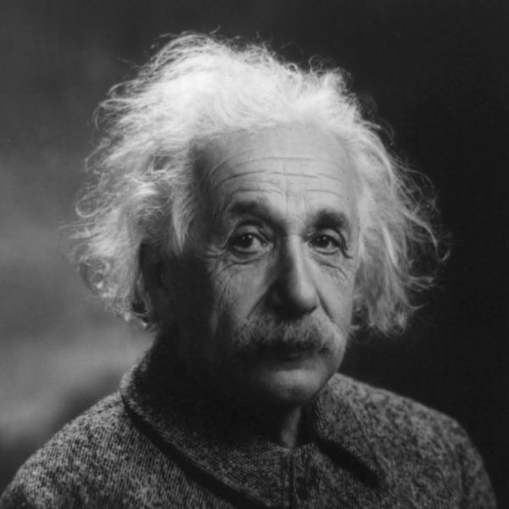
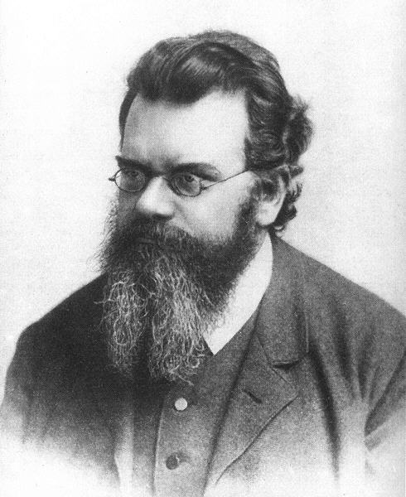
4th of July, 2012 — Higgs-day at CERN
Producing the Higgs Boson and Searching for New Physics at the TeV Scale Requires a Huge Machine
Particles accelerators:
Look deeper into matter (size ~ 1/E) (“powerful microscopes”)
Discover new heavier particles (E = mc²)
Probe conditions of the early universe (E = kT)
de Broglie
Einstein
Boltzmann
Lawrence

Slide 16

LHC ring at CERN:
27 km circumference
Blunt extrapolation for 2011
So far:
7/8 TeV proton—proton collisions
2.76 TeV Pb—Pb collisions

Slide 17

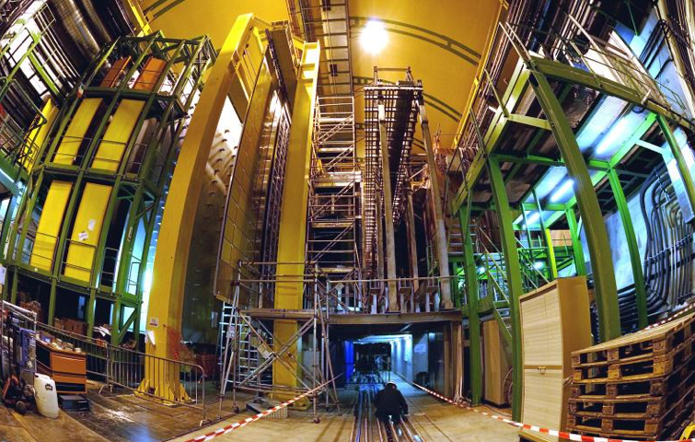
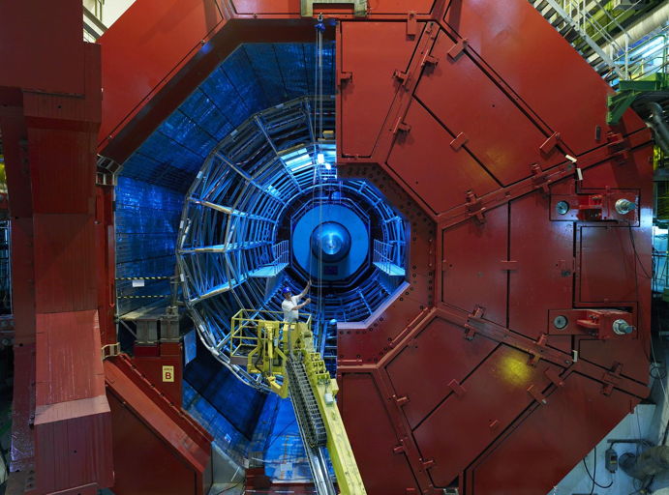

CMS
LHCb
Blunt extrapolation for 2011
ALICE
ATLAS

Slide 18
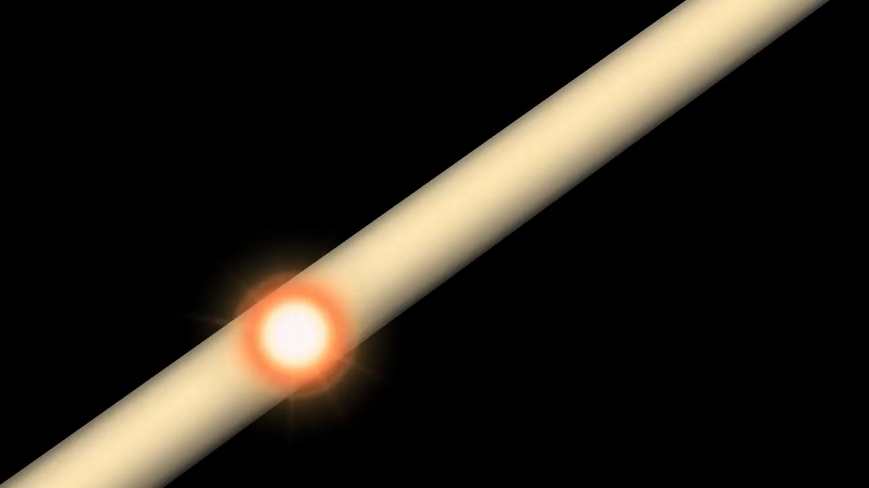
http://www.atlas.ch/multimedia/html-nc/animation-proton-event.html

Slide 19
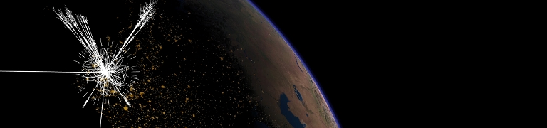
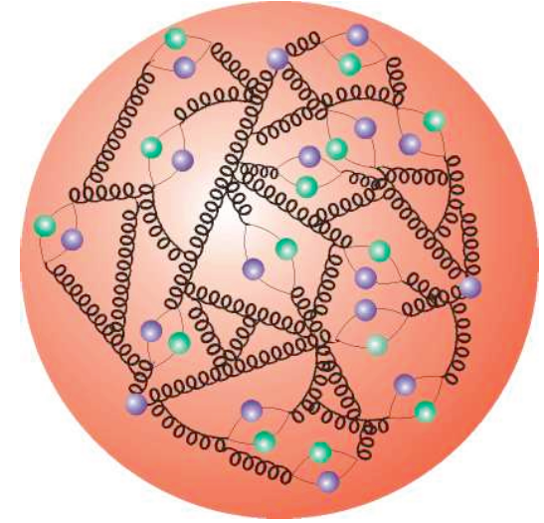
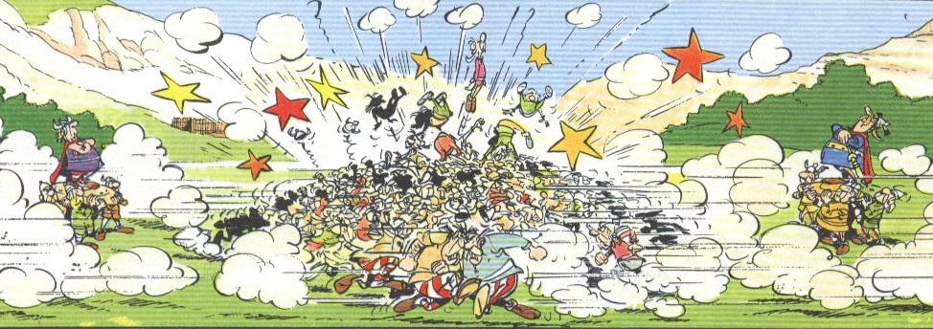
Although proton collisions are complex, we have gained excellent understanding
proton
proton
We can precisely predict the rates and properties of all produced SM particles, including those of the yet unseen Higgs boson
Particle production and their interaction with the detector layers are described with sophisticated numerical (“Monte Carlo”) simulations

Slide 20
Measurements of QCD and electroweak processes
Production rates spanning many orders of magnitude are understood
Summary of weak boson and top cross section measurements vs. theory

Slide 21
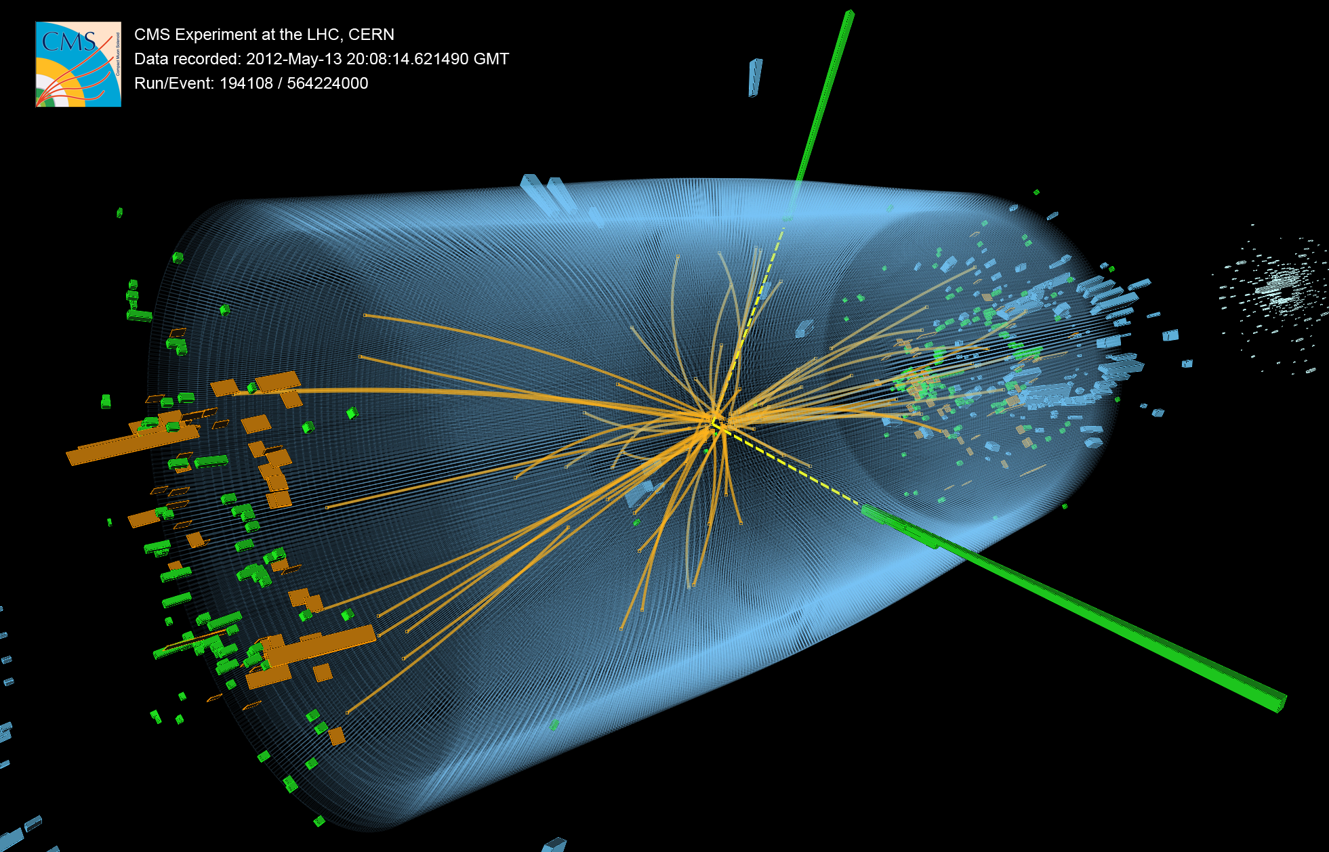
Hunting for the Higgs Boson

Slide 22

Higgs boson searches at the LHC
Higgs production and decay probabilities predicted vs. Higgs mass by SM
At the LHC, the Higgs boson is produced dominantly via gluon fusion
σ_{H,total} ~22 pb at 8 TeV for m_{H} = 125 GeV (~20 × Tevatron; >200 × rate given luminosity)
Cross section steeply falling with Higgs mass
q⁽’⁾
q
g
W/Z
t
H
H
q’
W/Z
t
Vector boson fusion
q⁽’⁾
g
t
q
H
Total production of ~470 thousand SM Higgs bosons of 125 GeV in 2012 in each ATLAS and CMS
W/Z
q’
W/Z
Higgs-strahlung

Slide 23
Higgs boson searches at the LHC
Higgs production and decay probabilities predicted vs. Higgs mass by SM
At the LHC, the Higgs boson is produced dominantly via gluon fusion
σ_{H,total} ~22 pb at 8 TeV for m_{H} = 125 GeV (~20 × Tevatron; >200 × rate given luminosity)
Because of the coupling to the mass of the decay particles:
  … the Higgs will decay with preference to the heaviest particles allowed
W,Z,q,l,g,γ
H
For light Higgs, discovery channels are
H → γγ
H → ZZ ⁽*⁾ → 4l
H → WW ⁽*⁾ → 2l2ν
-
-
-
W,Z,q,l,g,γ

Slide 24
H → γγ candidate event (CMS) — note: background dominated sample

Slide 25
H → γγ
Clean discovery channels for Higgs, allowing precise mass determination
ATLAS 1307.1427, CMS-PAS-HIG-13-001
Benefit from excellent energy resolution and photon identification capabilities of ATLAS and CMS
S/(S+B) weighted distribution
Maximum excess of 7.4σ (3.9σ) seen by ATLAS (CMS) at 126.8 ± 0.2 ± 0.7 GeV (125.4 GeV)
ATLAS (CMS) signal strength relative to SM expectation: 1.6 ± 0.3 (1.1 ± 0.3)

Slide 26
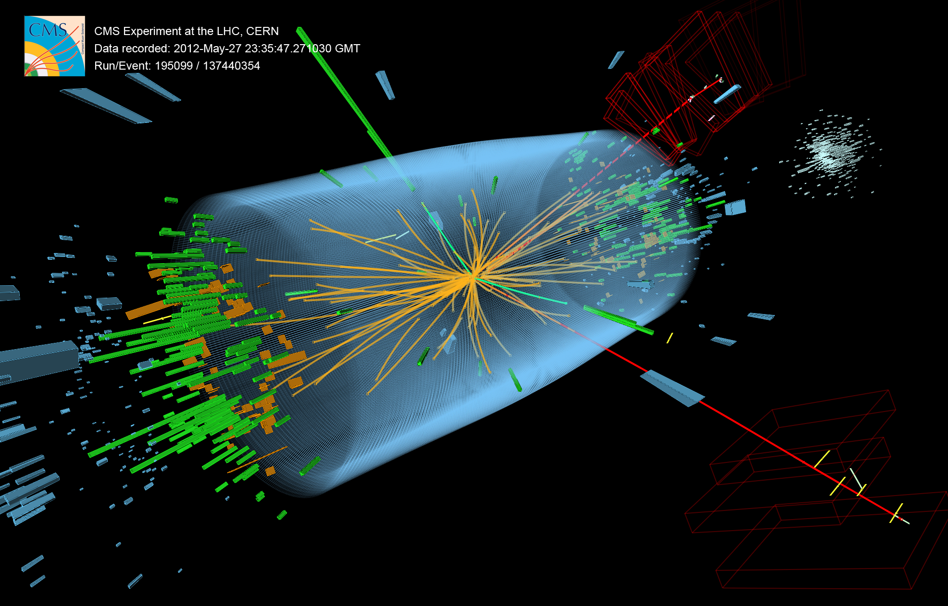
H → 2e2µ candidate event (CMS)

Slide 27
H → ZZ⁽*⁾ → 2(e, µ) + 2(e, µ)
Clean discovery channels for Higgs, allowing precise mass determination
ATLAS 1307.1427, CMS-PAS-HIG-13-002
Benefit from excellent energy/momentum resolution and identification capabilities at ATLAS/CMS
Maximum excess of 6.6σ (6.7σ) seen by ATLAS (CMS) at 124.3 ± 0.6 ± 0.4 GeV (125.8 GeV)
ATLAS (CMS) signal strength relative to SM expectation: 1.5 ± 0.4 (0.9 ± 0.3)

Slide 28
Combining all the channels — discovery significance
One new boson with Higgs-like properties … nothing else around
ATLAS-CONF-2013-034, CMS-PAS-HIG-13-005
All results [γγ, ZZ, WW, ττ, bb] combined. Here: ATLAS — no doubts left !
ATLAS (CMS) combined results
Higgs mass:
m_{H} = 125.5 ± 0.2 ± 0.5 GeV
(125.7 ± 0.3 ± 0.3 GeV)
Cross section relative to SM:
μ = 1.30 ± 0.13 ± 0.14
(0.80 ± 0.14)

Slide 29
Combining all the channels — cross section / couplings
Are channel-by-channel cross sections × branching fractions SM-like ?
ATLAS-CONF-2012-170, CMS-PAS-HIG-12-045
Individual σ[exp] / σ[SM] ratio for the channels: γγ, ZZ, WW, ττ, bb
Coupling strength versus mass
(hff for fermions)

Slide 30
Combining all the channels
Does it have Higgs-like quantum numbers (spin 0 and positive parity) ?
ATLAS-CONF-2013-040, CMS-PAS-HIG-13-002/-005
Use angular correlations in H → 4l (see below) and H → γγ to measure spin-parity
Spin-0 hypothesis strongly favoured (0⁻ hypothesis rejected with 3.3σ, 2⁺ similarly)

Slide 31


PRESS COVERAGE
after July 4th seminars at CERN
CERN black board, Jul 2012

Slide 32
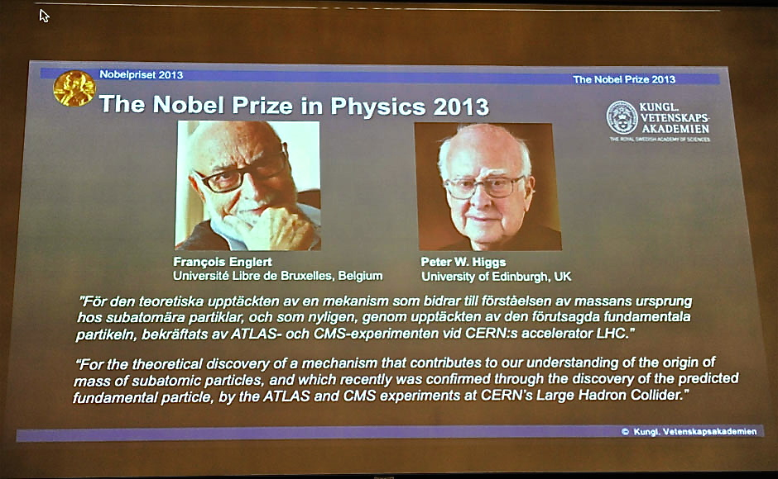
And then in Oct 2013:
« Pour la découverte théorique d’un mécanisme qui contribue à notre compréhension de l’origine de la masse des particules subatomiques, et qui a récemment été confirmé par la découverte de la particule fondamentale prédite, par les expériences ATLAS et CMS auprès du grand collisionneur de hadrons du CERN »

Slide 33

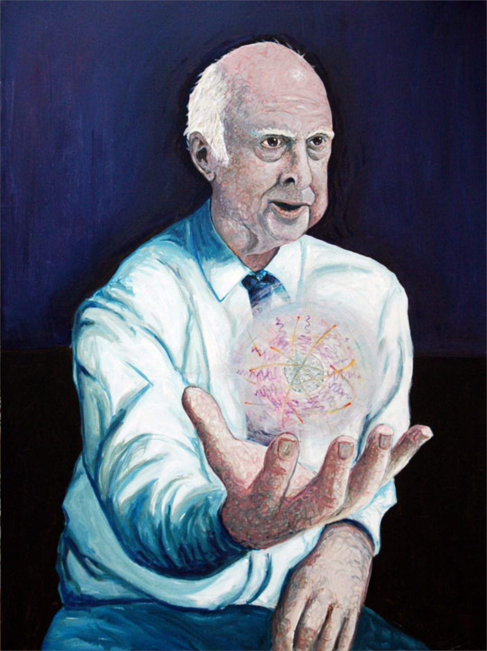
A new era in particle physics has begun: the exploration of the Higgs boson
A feast for experimentalists
Experimentalist
What is its mass and width ?
What is its spin ?
Does it break EW vacuum symmetry ?
How does it couple to SM particles ?
Does it couple to new particles ?
Does it have invisible decays ?
Does it have brothers and sisters ?
Does it have distant cousins ?
Is it a “natural” scalar ?

Slide 34

A new era in particle physics has begun: the exploration of the Higgs boson
Diet for theorists (?)
Theorist
Is it all just Standard Model ?

Slide 35
100 years after the discovery of cosmic rays…
The discovery of the Higgs boson completes the Standard Model
It is a triumph for the imagination and rigour of the human mind
It is a triumph for the greatest experimental undertaking ever:
Frontier of accelerator & detector technologies
Global data sharing, analysis & collaboration

Slide 36
100 years after the discovery of cosmic rays…
The discovery of the Higgs boson completes the Standard Model
But …

Slide 37
100 years after the discovery of cosmic rays…
The discovery of the Higgs boson completes the Standard Model
Can we conclude that the Standard Model is the theory of matter and force ?
But …

Slide 38

The SM cannot be the final theory, because …
Huge mass hierarchy between matter particles
Gauge hierarchy / Scalar SM sector is unstable
Higgs is only fundamental scalar
neither matter, nor force, — all known scalars are
composite states
Dark matter and dark energy
Grand unification of the forces
Causally connected observable universe
Massive neutrinos
Matter-antimatter asymmetry in universe
Strong CP problem
Gravitation

Slide 39


The
scalar
precipice
Double the particle spectrum?
Mrs. SUSY
EW scale^{—1}
t
H
H
−
t
∼
t
H
H
Mr. Higgs
GUT scale^{—1}
Planck scale^{—1}
Fundamental scalar length scale

Slide 40
Étudier certaines de ces questions et mesurer précisément les propriétés du boson de Higgs seront les tâches à venir pour les expériences au LHC

Slide 41
LHC timeline
?
2009
Start of LHC
Run 1, 7+8 TeV, ~25 fb⁻¹ int. lumi
2013 / 14
LS1: prepare LHC for design E & lumi
Collect ~30 fb⁻¹ per year at 13/14 TeV
Is the new boson the SM Higgs ?
2018
Phase-1 upgrade for ultimate lumi
If so, what protects it ?
Mr. SUSY
Twice nominal lumi at 14 TeV,
~100 fb⁻¹ per year
~2022
Phase-2 upgrade to HL-LHC
~300 fb⁻¹ per year, run up to > 3 ab⁻¹ collected
Mr. Higgs
~2030

Slide 42
Spares…

Slide 43

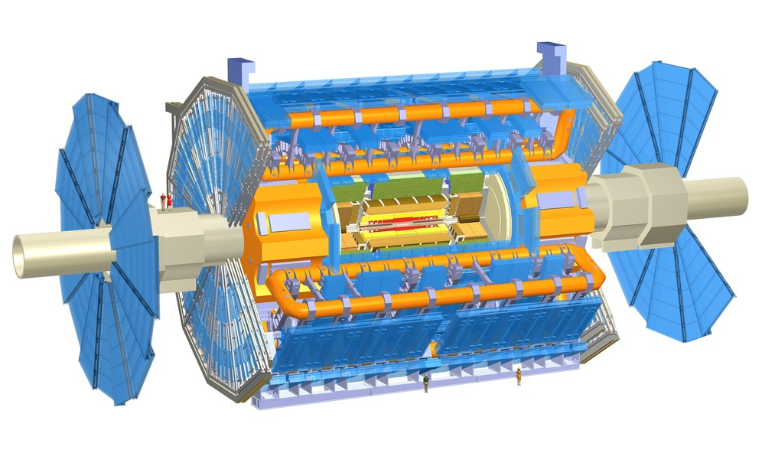
Muon Detectors Tile Calorimeter Liquid Argon Calorimeters
Experiment
22 m
46 m
Toroid Magnets Solenoid Magnet SCT Tracker Pixel Detector TRT Tracker

Slide 44
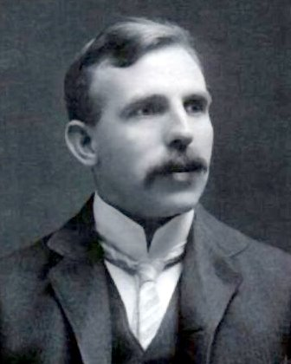
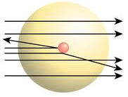
High-energy jets probe new particles and interactions
Measure di-jet invariant mass and angular distributions
p
q
2 → 2 parton scattering to two jets described by QCD
?
Tends to scatter at smaller angles than if there were new particles produced
Recall atomic substructure discovery in Rutherford scattering: deflection at large angles !
q
p
New, high-scale interaction ?
New bound state (particle) ?
Are quarks composites ?

Slide 45
High-energy jets probe new particles and interactions
Measure di-jet invariant mass and angular distributions
ATLAS-CONF-2012-148, CMS PAS EXO-12-016
Observed and fitted dijet mass
Data / fit ratio, compared to four q* models
m(q*) > 3.84 TeV (95% CL)

Slide 46
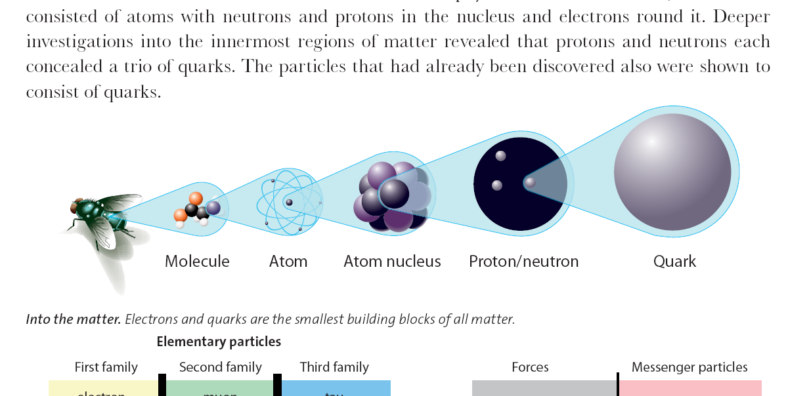
High-energy jets probe new particles and interactions
Measure di-jet invariant mass and angular distributions
ATLAS-CONF-2012-148, CMS PAS EXO-12-016
No deviations from SM seen → set limits on new phenomena:
Benchmark model | Observed limit at 95% CL
Excited quarks | m(q*) | > | 3.8 TeV
4-quark contact interactions | Λ | > | 7.8 TeV
Resonant
Non-resonant
< ~2 × 10 ^{–18} cm
10^{–14} cm
10^{–13} cm
10^{–9}–10^{–8} cm
10^{–9}–10^{–7} cm
quark

Slide 47
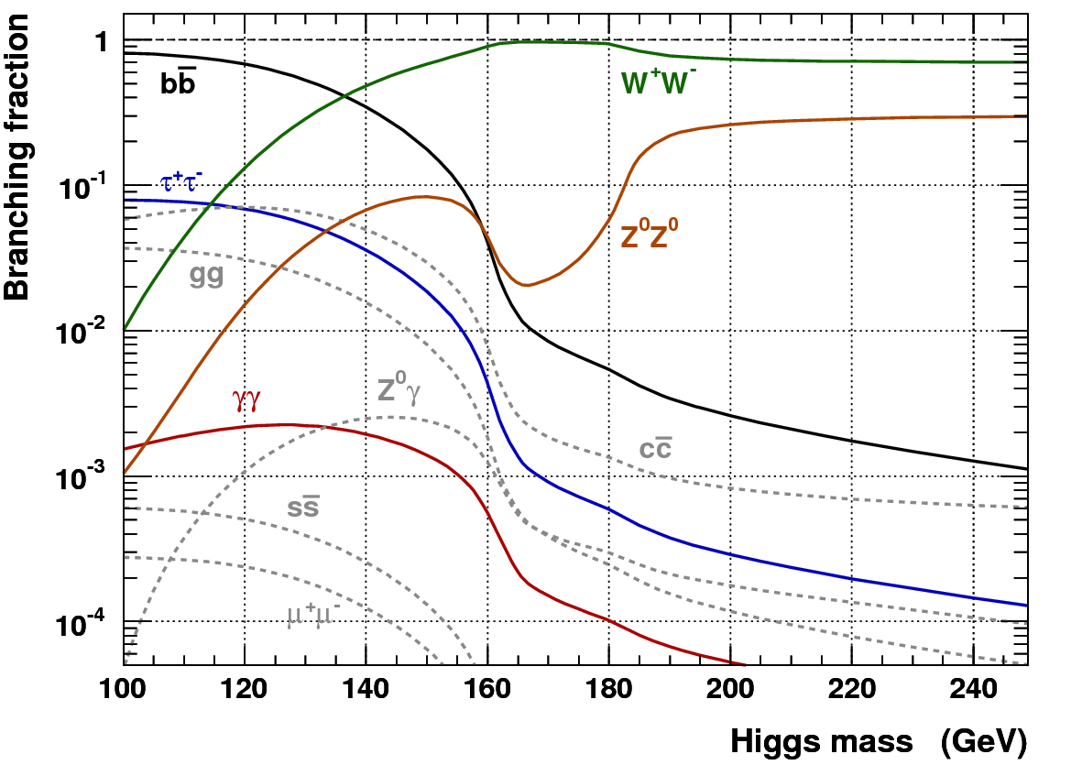
Higgs boson searches at the LHC
Dependence of the branching fractions on M_{H} drives search strategy
For medium to heavy Higgs:
Lepton final states via WW⁽*⁾, ZZ⁽*⁾
For light Higgs:
Lepton final states via WW*, ZZ*
Di-photon final state
Di-tau final state
The dominant H → bb mode is only exploitable in association with W/Z or tt, also with strong Higgs boost
Associated leptons provide trigger signal as they help to reduce huge QCD background, s(bb) ~ O(100 µb)

