Slide 1
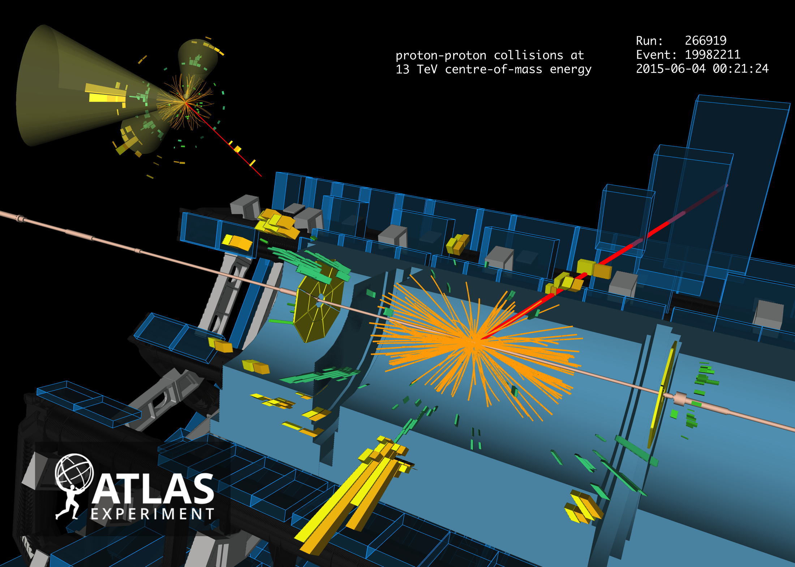
Candidate event for: pp → tt → µ + 4 jets (2 b-jets)
First ATLAS Results from Run-2
Andreas Hoecker (CERN) on behalf of the ATLAS Collaboration
EPS-HEP 2015, 27 July 2015, Vienna, Austria

Slide 2
Harvest of results from Run-1 (447 papers to date) confirming predictive power of SM
→ Covered by plenary speakers: Maxime Gouzevitch, Nicholas Hadley, Pierre Savard, Alessandro Tricoli
Run-1 is not over yet: high-quality, extremely well understood data sample for precision measurements

Slide 3
We also did a vast amount of BSM searches — with no significant anomaly seen so far
Theory-agnostic, signature based searches, as well as highly targeted model-dependent ones
→ Covered by plenary speakers: Ivan Mikulec, Anna Sfyrla
Not unexpectedly, a few of these searches ended up showing some anomaly, a legacy to check in Run-2

Slide 4
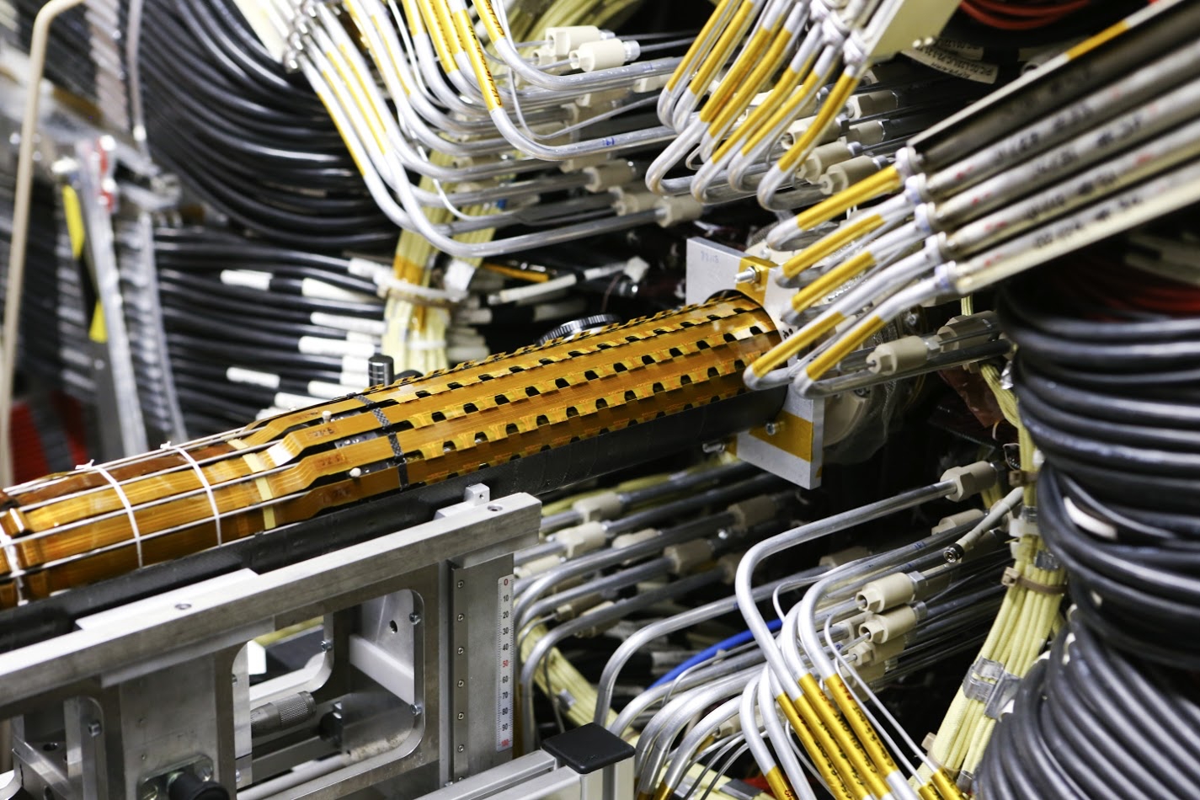
Long-Shutdown 1 — Preparing Run-2

Slide 5
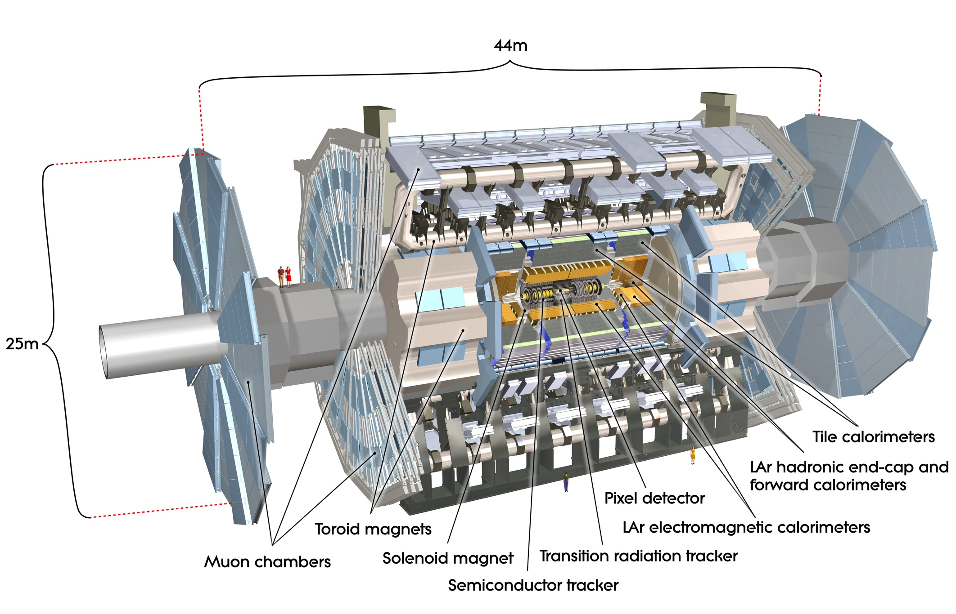
The (Run-1) ATLAS Detector

Slide 6
ATLAS went through important upgrades during LS1
In all areas: detector, online, offline, computing
Infrastructure upgrades: magnet & cryogenic systems, additional muon chamber shielding, new beam pipes
Detector consolidation: muon chamber completion (1.0 < |η | < 1.3) & replacements, calorimeter electronics repairs, improved inner detector read-out capability to cope with 100 kHz L1 trigger rate, new pixel detector services and module repairs
Replacement of TGC chambers
New topological L1 trigger and new central trigger processor, restructured high-level trigger
New Insertable B-layer : fourth pixel layer at 3.3 cm from beam, consisting of planar & 3D (forward) silicon sensors, smaller pixels
New software, new production system, new analysis model, …
Also new beam pipe: r = 2.5 cm

Slide 7
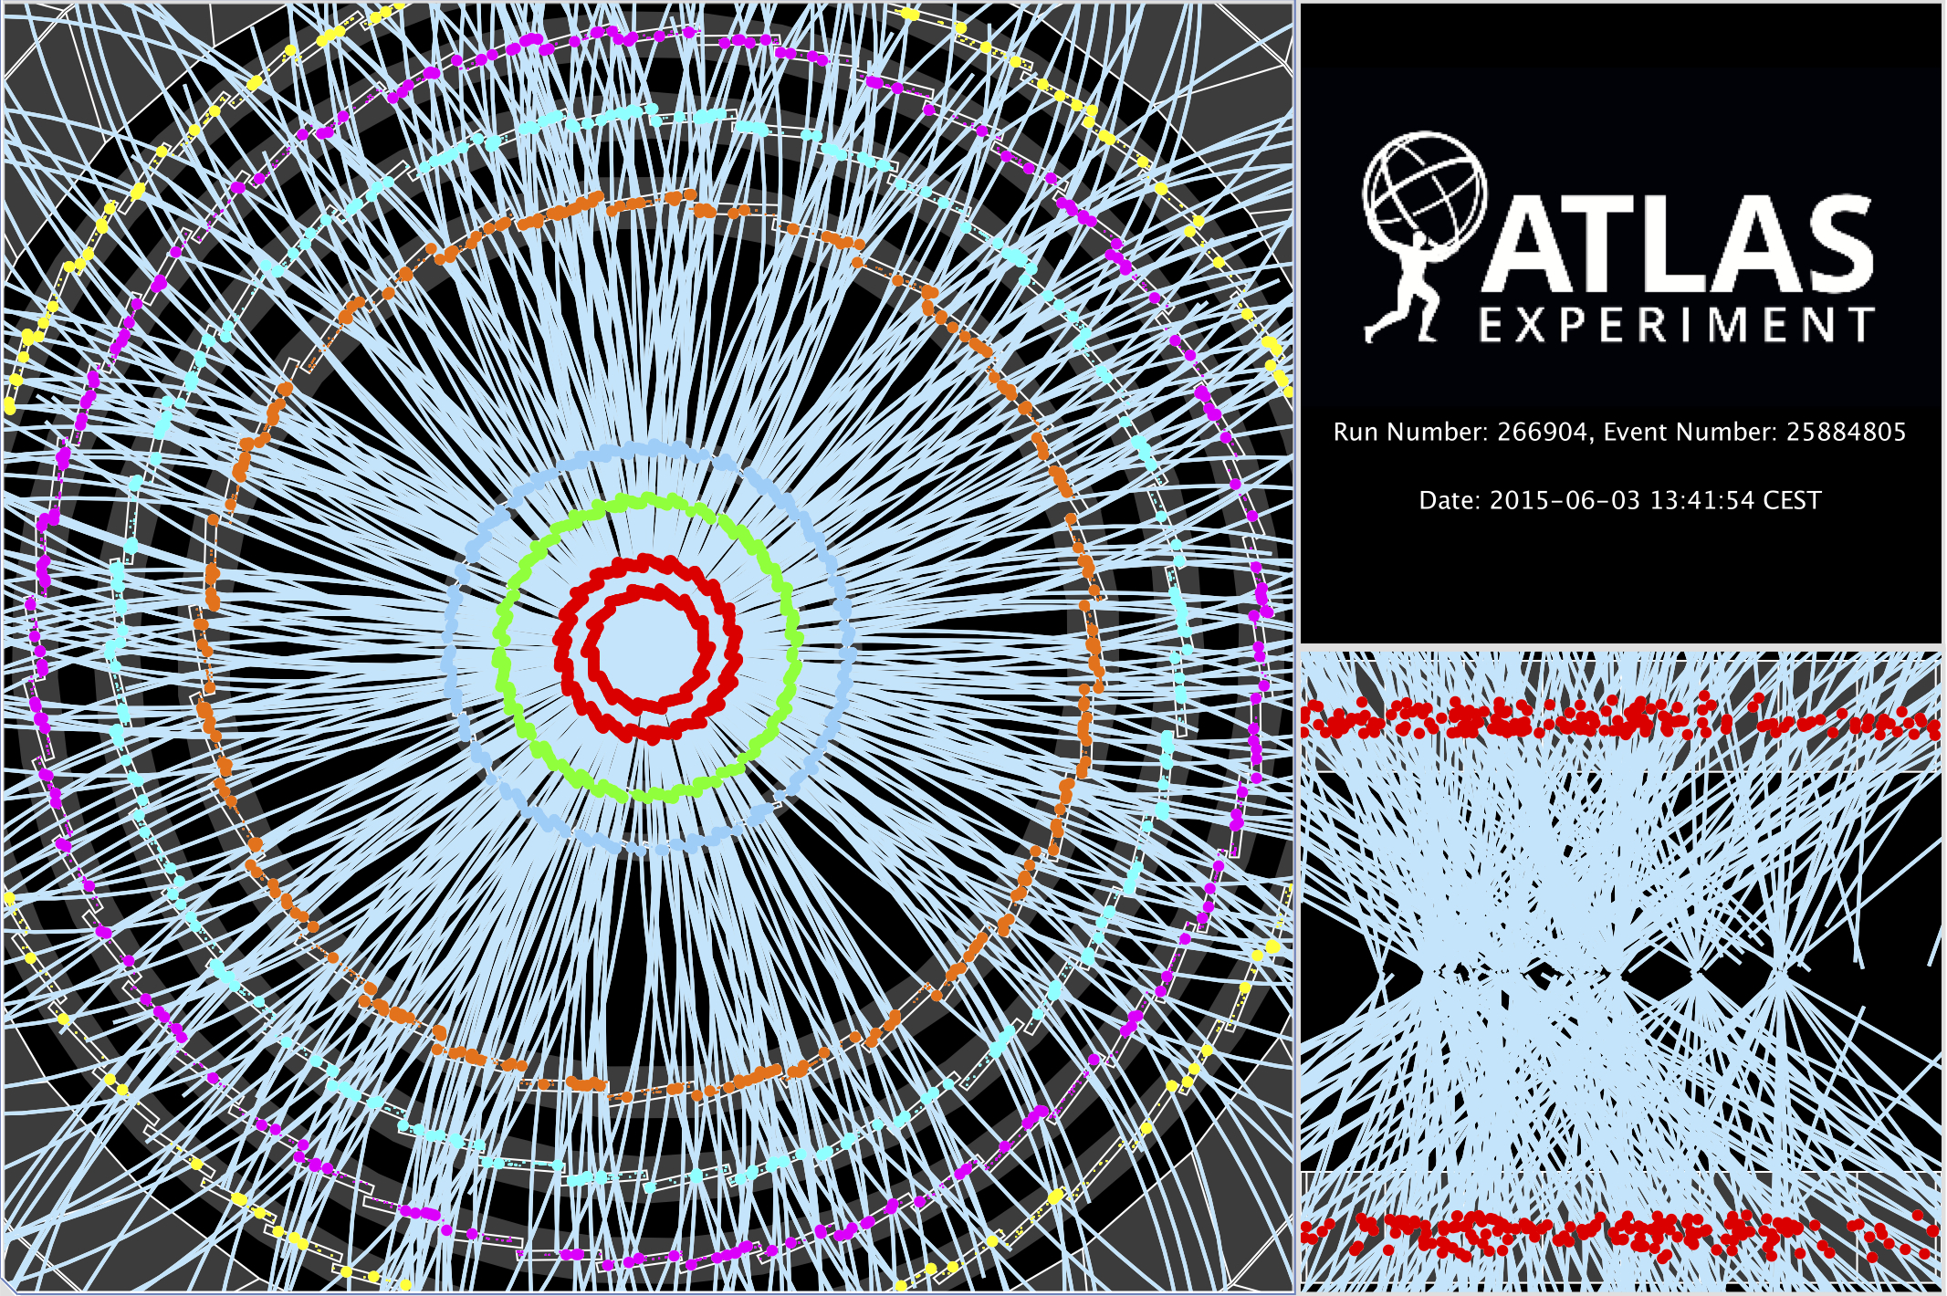
At 10³⁴ cm^{–2} s^{–1} @ 13 TeV pp the LHC produces:
200 Hz W → lν
19 Hz Z → ll
8 Hz top pair
0.5 Hz Higgs
Run-2 Physics & Performance

Slide 8
I will show results between 170 µb^{–1} and 85 pb^{–1} today
13 TeV data summaries
Maximum peak: L = 1.6 10³³ cm^{–2} s^{–1}
Pileup interactions profile
Luminosity
Measured with forward detectors, calibrated with “mini van-der-Meer” scan during low-µ run to 9% precision
Dedicated “low-µ” data
Data quality
All good for physics: 93.3%
An additional set of data recorded in special conditions for detector calibration purposes is not included in physics analysis

Slide 9
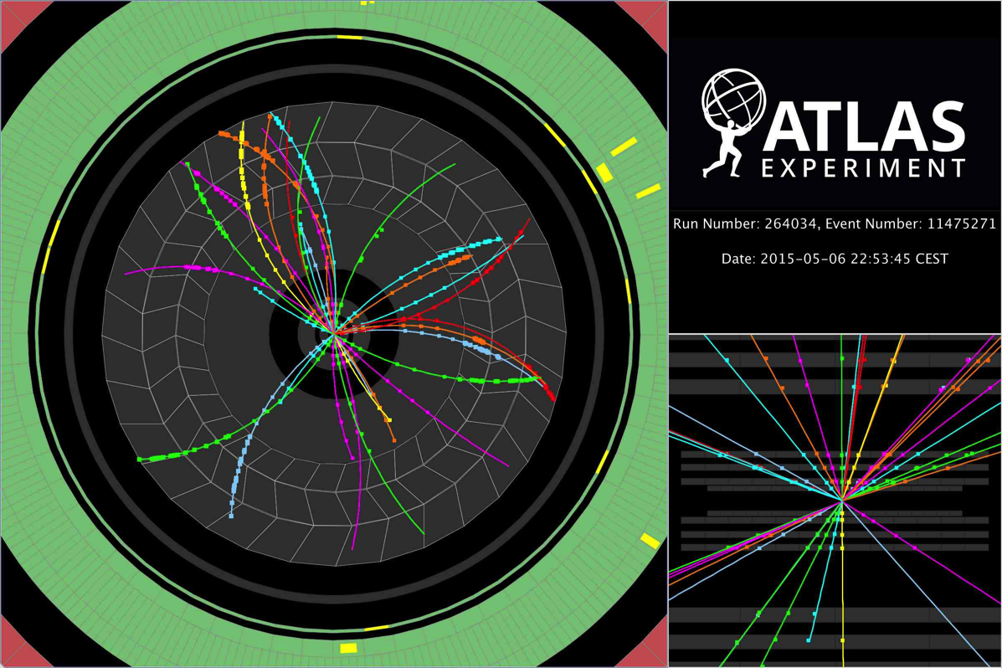
Soft physics with tracks at 13 TeV
One of the very first proton–proton collisions recorded by ATLAS in “quiet beam” conditions in May 2015

Slide 10
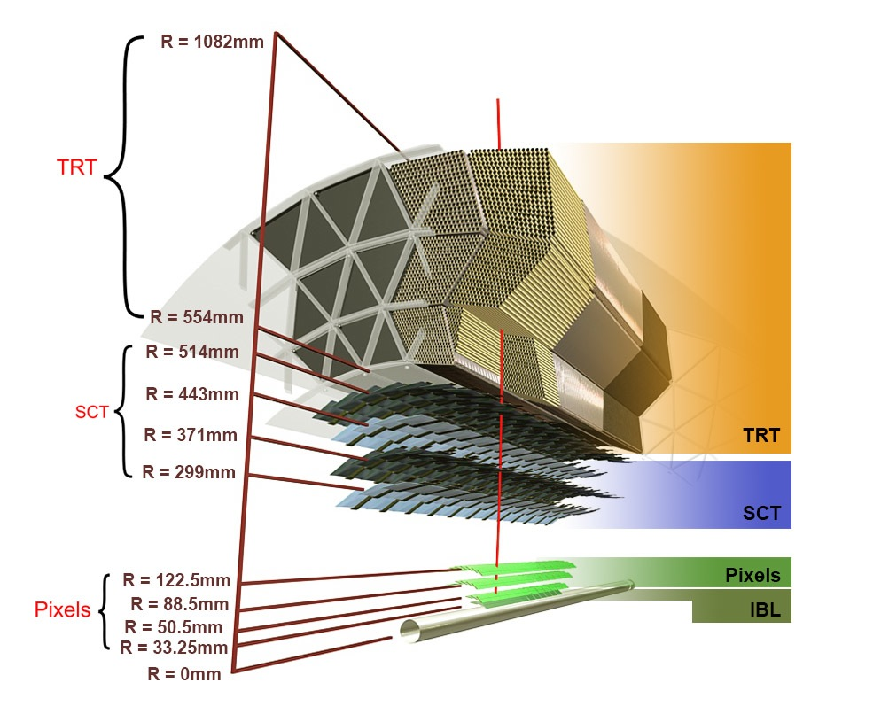
Inner tracking performance
[ ATL-PHYS-PUB-2015-018 ]
→ Karolos Potamianos’s talk at EPS
ATLAS tracking in Run-2 features the new IBL, reduced material within acceptance, and algorithmic improvements (eg, huge speed-up, tracking in dense environment [ ATL-PHYS-PUB-2015-006 ] )
Sketch of ATLAS inner tracking detectors
Hit reconstruction in data and MC
10

Slide 11
Inner tracking performance with IBL
[ IDTR-2015-003, IDTR-2015-006, IDTR-2015-007 ] → Karolos Potamianos
Detector alignment and material studies crucial for new detectors and services
Material studies
Based on:
Hadronic interactions
Photon conversions
“SCT extension”
Material uncertainty dominates tracking systematics
“Radiography” pictures used to validate material description in simulation
Hadronic interaction vertices
K_{S} mass as alignment & material probe
×10³
Impact parameter resolution improvement from IBL
Measured improvement of impact parameter resolution with IBL depending on track p_{T}

Slide 12
Properties of inelastic pp collisions at 13 TeV
Key input to pileup and underlying event modelling, uses low-µ data
[ ATLAS-CONF-2015-028 ]
→ Anthony Morley
Measurement of primary charged particle production: dN_{ch}/dη, d ²N_{ch}/dηdp_{T}, N_{ch}, <p_{T}>/N_{ch}
Fiducial cuts: p_{T} > 0.5 GeV, |η | < 2.5, N_{ch} ≥ 1
Trigger events with as little “bias” as possible: ≥1 hit in forward scintillators (MBTS, 2.07 < |η | < 3.86)
Measure trigger and vertexing efficiencies from data
Measure and subtract secondary interactions and fake tracks
Correct for tracking inefficiency
Unfold measured spectra from detector effects
1 vertex required with ≥2 tracks of p_{T} > 100 MeV

Slide 13
Properties of inelastic pp collisions at 13 TeV
Key input to pileup and underlying event modelling, uses low-µ data
[ ATLAS-CONF-2015-028 ]
→ Anthony Morley
Measurement of primary charged particle production: dN_{ch}/dη, d ²N_{ch}/dηdp_{T}, N_{ch}, <p_{T}>/N_{ch}
Fiducial cuts: p_{T} > 0.5 GeV, |η | < 2.5, N_{ch} ≥ 1
Trigger events with as little “bias” as possible
Measure trigger and vertexing efficiencies from data
Measure and subtract secondary interactions and fake tracks
Correct for tracking inefficiency
Unfold measured spectra from detector effects
Primary particles have τ > 300 ps (9 cm)
Secondaries are produced after τ > 30 ps (9 mm)
Strange baryons with 30 < τ < 300 ps are excluded
Tracking efficiency dominant uncertainty: 1.1% central, 6.5% forward
Secondaries after fit:
2.6 ± 0.6% of tracks in SR

Slide 14
Properties of inelastic pp collisions at 13 TeV
Key input to pileup and underlying event modelling, uses low-µ data
[ ATLAS-CONF-2015-028 ]
→ Anthony Morley
Resulting spectra from 9M data events & comparison to hadronic physics models
dN_{ch}/dη d ²N_{ch}/dηdp_{T} N_{ch} <p_{T}>/N_{ch}
Difficult to provide one universal tune that describe MB and UE data equally well (→ next slides)
Overall, the EPOS and PYTHIA 8 tunes describe the data most accurately EPOS best in η, p_{T}, and <p_{T}>, while PYTHIA 8 (A2 – ATLAS MB default) best in N_{ch}

Slide 15
Properties of inelastic pp collisions at 13 TeV
Key input to pileup and underlying event modelling, uses low-µ data
[ ATLAS-CONF-2015-028 ]
→ Anthony Morley
Average charged-particle multiplicity per unit of rapidity for η = 0 vs CM energy
For comparison, the strange baryon contribution is included at 13 TeV (1.5% correction factor)

Slide 16
Properties of inelastic pp coll. at 13 TeV
Key input to pileup and underlying event modelling, uses low-µ data
We also studied underlying event (UE) spectra to further validate the energy extrapolation of the MC modelling
[ ATL-PHYS-PUB-2015-019 ]
→ Thorsten Kuhl
Uncorrected detector level quantities

Slide 17
Long-range two-charged-particle angular correlations
In high-multiplicity pp collisions using low-µ data
Near-side (Δφ ~ 0) “ridge” shape along Δη seen in pp, pPb and PbPb collisions
Effect increases with particle multiplicity and moderate p_{T}
CMS, pp at 7 TeV:
N_{ch} > 110, 1.0 < p_{T} < 3.0 GeV
ATLAS, pPb at 5.02 TeV:
N_{ch} > 220, 1.0 < p_{T} < 3.0 GeV
ATLAS, PbPb at 2.76 TeV:
Centrality 0–5%
[ CMS, 1009.4122 ]
[ ATLAS, 1212.5198 ]
[ ATLAS, 1504.01289 ]
[ Enhancement found to be also present at Δφ ~ π, when subtracting hard scattering contributions ]

Slide 18
Two-charged-particle angular correlations at 13 TeV
In high-multiplicity pp collisions using low-µ data
[ ATLAS-CONF-2015-027 ]
→ Miguel Arratia
How does the pp ridge evolve with CM energy ?
Trigger on MBTS (97M events) & high charged multiplicity (9.5M)
Exploit work on tracking corrections from minimum bias analysis
Extract two-particle correlation function →
(background from mixed events)
Low charged multiplicity
Integrate:
2 < |Δη | < 5

Slide 19
Two-charged-particle angular correlations at 13 TeV
In high-multiplicity pp collisions using low-µ data
[ ATLAS-CONF-2015-027 ]
→ Miguel Arratia
How does the pp ridge evolve with CM energy ?
Trigger on MBTS (97M events) & high charged multiplicity (9.5M)
Exploit work on tracking corrections from minimum bias analysis
Extract two-particle correlation function →
(background from mixed events)
High charged multiplicity
Integrate:
2 < |Δη | < 5
b_{zero-yield-at-min} offset

Slide 20
Two-charged-particle angular correlations at 13 TeV
In high-multiplicity pp collisions using low-µ data
[ ATLAS-CONF-2015-027 ]
→ Miguel Arratia
How does the pp ridge evolve with CM energy ?
Trigger on MBTS (97M events) & high charged multiplicity (9.5M)
Exploit work on tracking corrections from minimum bias analysis
Extract two-particle correlation function →
(background from mixed events)
High charged multiplicity
Integrate:
2 < |Δη | < 5
b_{zero-yield-at-min} offset
Integrated “ridge yield”: Y_{int} (illustration only, integral is over Y (Δφ)

Slide 21
Two-charged-particle angular correlations at 13 TeV
In high-multiplicity pp collisions using low-µ data
[ ATLAS-CONF-2015-027 ]
→ Miguel Arratia
Integrated “ridge yield” versus charged multiplicity and p_{T} range
Y_{int} = integral of Y (Δφ) – b_{ZYAM} between ridge minima in Δφ (b_{ZYAM} is simple Y offset correction at minima)
Systematic effects dominated by tracking efficiency, ZYAM procedure, MC closure
→ Compatible yield at different CM energies
CMS uses 2 < |Δη | < 4.0. The yields from 1210.5482 were multiplied by 3.6 in above plots (see ATLAS-CONF-2015-027)

Slide 22
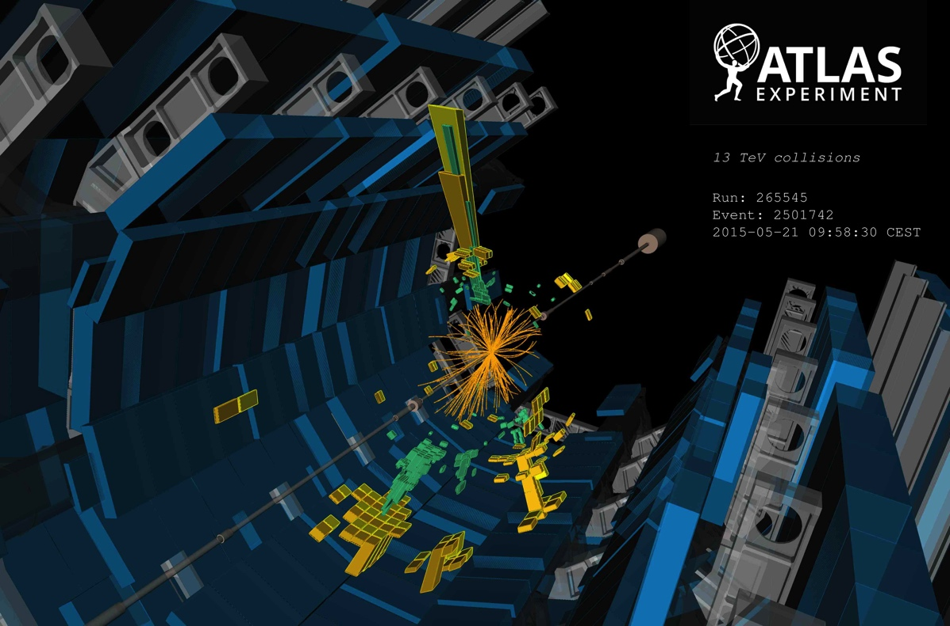
Now moving to higher luminosity and p_{T}
Physics with photons and jets at 13 TeV
One of the very first jetty (4 jets) events recorded by ATLAS in “quiet beam” conditions in May 2015

Slide 23
Photon production at 13 TeV
Test perturbative QCD in cleaner environment than jets
[ ATL-PHYS-PUB-2015-016 ] → Martine Bessner
Measurement of isolated photon yield
Subtract mis-identification background from data
Photon production vs. E_{T,γ} and |η_{γ} | (detector level, MC normalised to data)
Systematics dominated by photon energy scale, resolution and efficiency
Good agreement of shape with SHERPA 2.1 (LO + ≤3 partons)
Barrel–endcap transition region excluded
Systematic uncertainties dominated by: photon energy scale, photon ID, background subtraction

Slide 24
Jet production at 13 TeV
Early central-jet cross-section measurement at 13 TeV
[ ATLAS-CONF-2015-034 ] → Pavel Starovoitov
Measurement performed within fiducial region 350 < p_{T} < 840 GeV and |y_{jet}| < 0.5:
Single jet trigger, fully efficient above 300 GeV jet p_{T}
Reconstruct anti-k_{t} R = 0.4 jets, calibrated using MC and Run-1 data, validated in Run-2 data
Unfold to particle level
Dominant systematic uncertainty: jet energy scale and resolution
Compare with NLO theory (incl. PS+UE corrections) of measured diff. cross sections vs. p_{T}

Slide 25
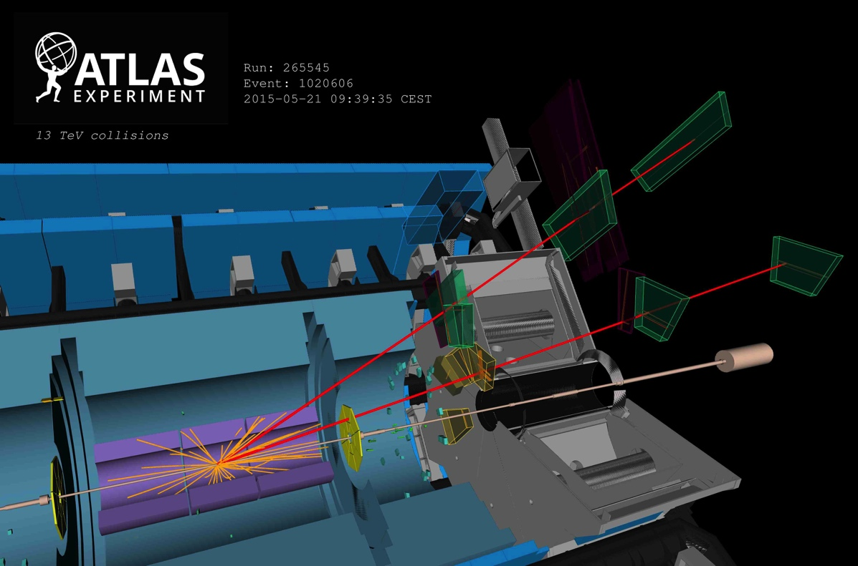
Physics with leptons at 13 TeV
One of the very first J/Ψ → µµ candidates recorded by ATLAS in “quiet beam” conditions in May 2015

Slide 26
J/Ψ production at 13 TeV
Good environment in early data with low trigger thresholds
[ ATLAS-CONF-2015-030
See also: ATLAS-CONF-2015-024 ]
→ Stefanos Leontsinis
J/Ψ are produced promptly and via weak decays of b-hadrons
Use the initial 6.4 pb^{–1} data to measure non-prompt J/Ψ fraction via 2D fit to m_{µµ} and proper decay time distribution: τ = L_{xy} m_{J/Ψ} / p_{T,µµ}
J/Ψ → µµ
J/Ψ → ee

Slide 27
J/Ψ production at 13 TeV
Good environment in early data with low trigger thresholds
[ ATLAS-CONF-2015-030
See also: ATLAS-CONF-2015-024 ]
→ Stefanos Leontsinis
Selection:
p_{T,µ} > 4 GeV, |η_{µ}| < 2.3, p_{T,µµ} > 8 GeV, |y_{µµ} | < 2,
70k candidates, fully data-driven analysis
Non-prompt J/Ψ fraction:
Fitted non-prompt fraction for 3 J/Ψ rapidity bins
Depending on CM energy
Error bars are statistical and systematic
Non-prompt contribution to total rate rises rise from approximately 25% at p_{T,µµ} of 8 GeV to 65% at 40 GeV

Slide 28
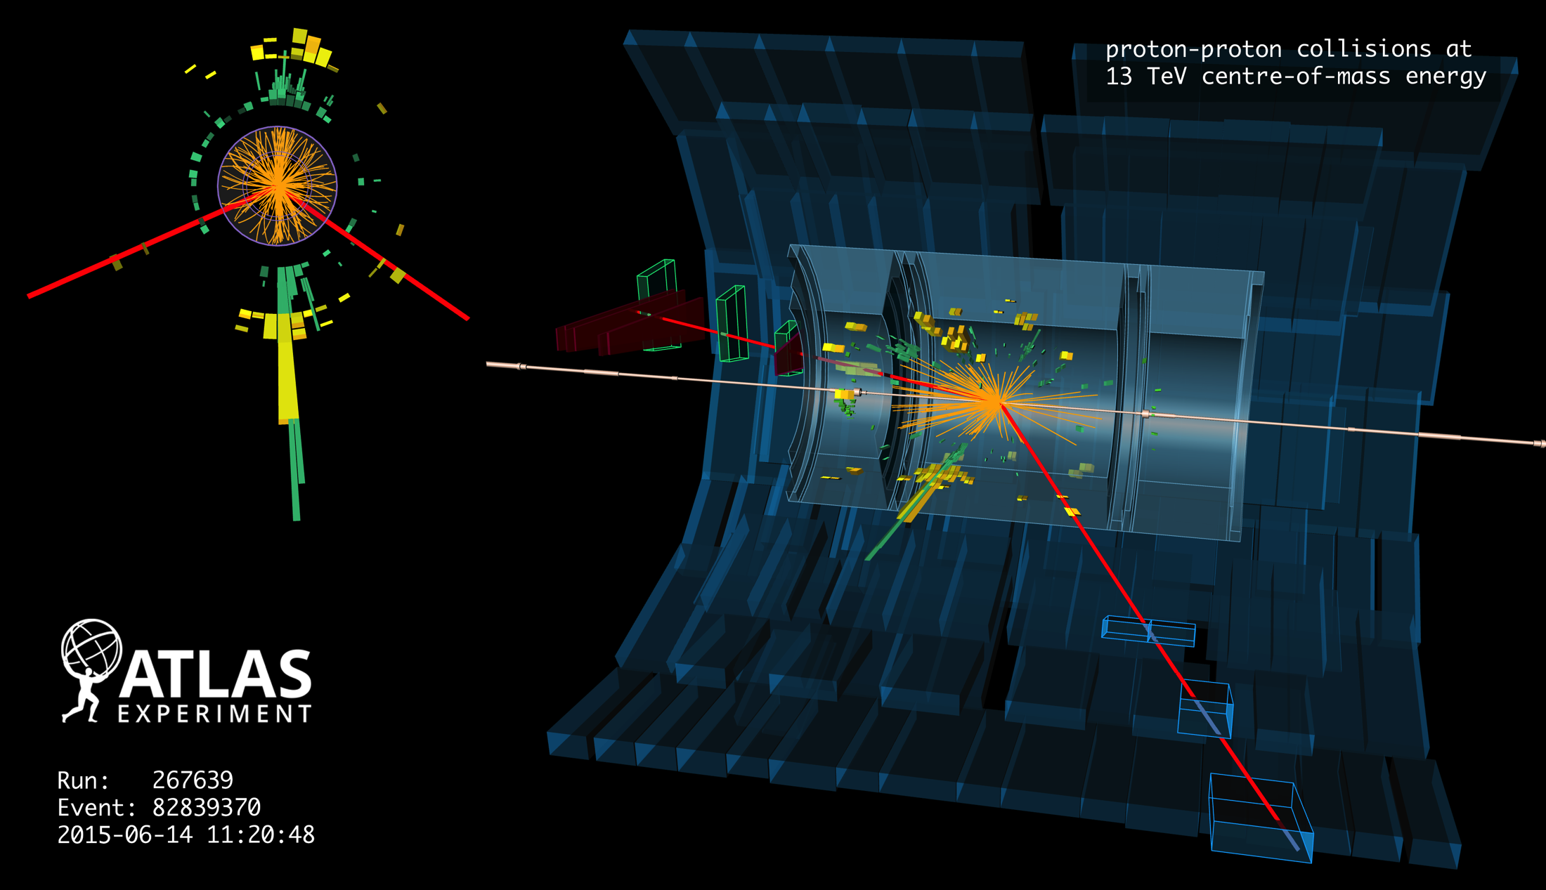
W and Z boson production at 13 TeV
Displays of one Z(→ µµ) + jets candidate event

Slide 29
Z and W production at 13 TeV
Expect increase of cross section by factors of 1.7 and 1.6, respectively
[ ATL-PHYS-PUB-2015-021 ]
→ Markus Zinser
Leptonic decays are important standard candles to verify and calibrate e/µ performance
Following plots are normalised to NNLO QCD and to luminosity. Observed Z and W yields agree with SM expectations within uncertainty. Error bands in plots do not include 9% luminosity uncertainty
Electron identification scale factors from 8 TeV data and MC

Slide 30
Z and W production at 13 TeV
Expect increase of cross section by factors of 1.7 and 1.6, respectively
[ ATL-PHYS-PUB-2015-021 ]
→ Markus Zinser
Leptonic decays are important standard candles to verify and calibrate e/µ performance
Following plots are normalised to NNLO QCD and to luminosity. Observed Z and W yields agree with SM expectations within uncertainty. Error bands in plots do not include 9% luminosity uncertainty
Muon identification scale factors from 13 TeV in situ
Large number of additional kinematic distributions in ATL-PHYS-PUB-2015-021

Slide 31
Z and W production at 13 TeV
Expect increase of cross section by factors of 1.7 and 1.6, respectively
[ ATL-PHYS-PUB-2015-021 ]
→ Markus Zinser
We also looked into Z production in association with jets
Important channel for QCD studies and background to new physics searches. Good description by SHERPA 2.1 generator (up to 2 partons at NLO, 4 partons at LO ME) (note: detector level plots)

Slide 32
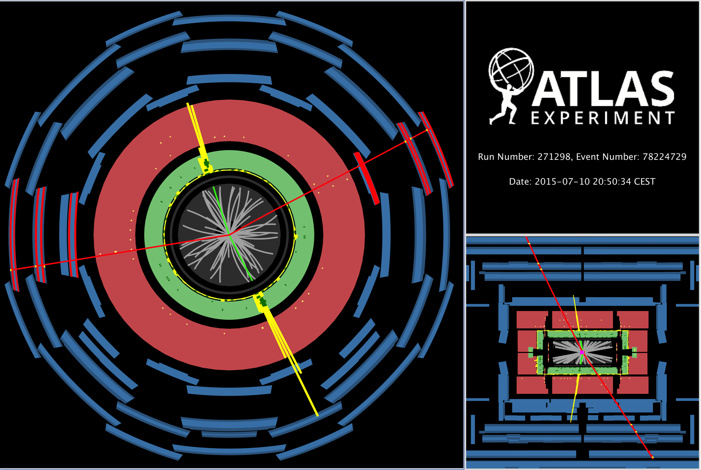
Display of ZZ → µ⁺µ– + e⁺e– candidate event (m_{µµ / ee} = 94 / 86 GeV, m_{µµee} = 191 GeV)

Slide 33
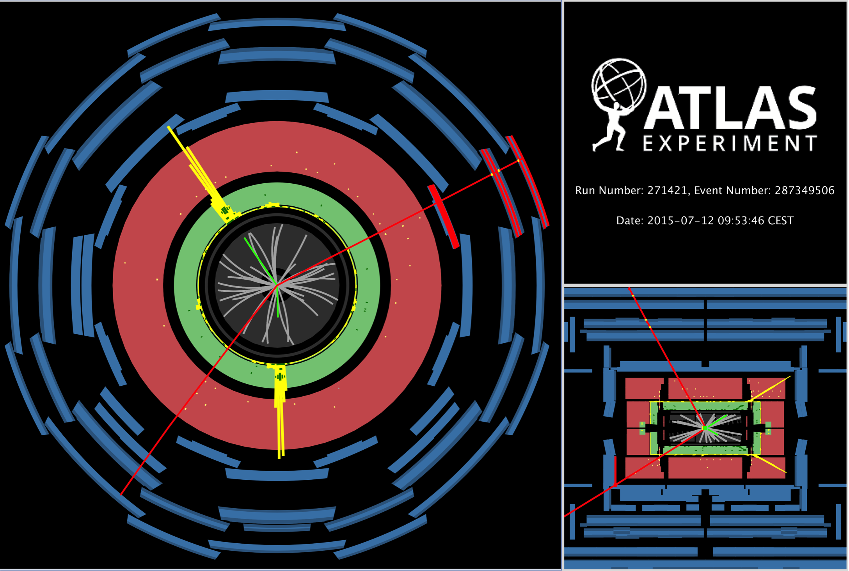
Display of ZZ → µ⁺µ– + e⁺e– candidate event (m_{µµ / ee} = 90 / 92 GeV, m_{µµee} = 305 GeV)

Slide 34
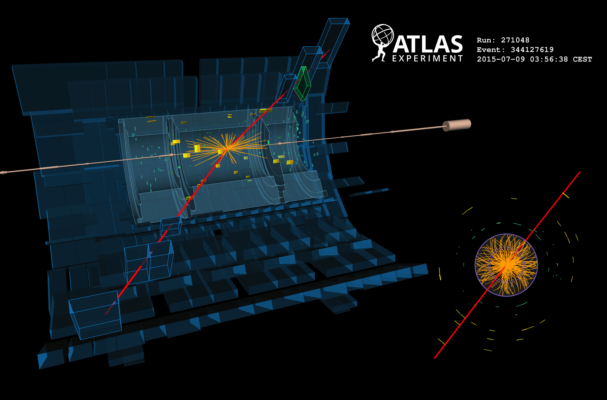
Display of µ⁺µ– event with 881 GeV invariant mass

Slide 35
High-mass dilepton production
Insufficient luminosity yet to challenge Run-1 sensitivity to new physics
[ EXOT-2015-001,
EXOT-2015-004 ]
→ Woiciech Fedorko
Drell-Yan production at high q ²
Dominant irreducible backgrounds taken from MC simulation, DY normalised to Z peak
pp → µµ + X
pp → eµ + X
881 GeV
1.8 TeV
[ 20.3 fb^{–1}, 8 TeV, arXiv:1405.4123 ]

Slide 36
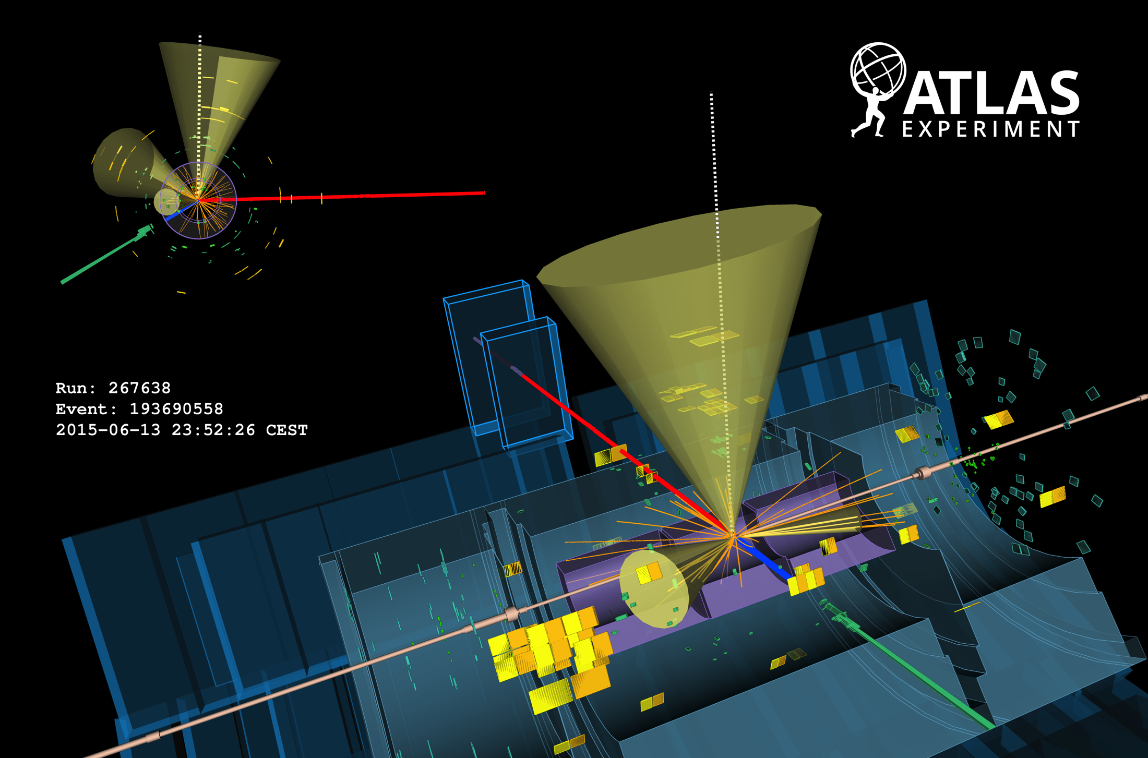
Display of tt → eµ + 2 b-jets candidate event
Top-quark production at 13 TeV

Slide 37
Top-antitop production at 13 TeV
Expect increase of 8 TeV cross section by a factor of 3.3
[ ATLAS-CONF-2015-033 ]
Cleanest channel: tt → (e + ν + b-jet) + (µ + ν + b-jet) = eµ + 2 b-jets + E_{T,miss}
Select: OS electrons & muons with p_{T} > 25 GeV, at least one b-tagged jet with p_{T} > 25 GeV (clean channel, no E_{T,miss} requirement needed → reduce systematics)
Shape comparison only. MC normalised to data

Slide 38
Top-antitop production at 13 TeV
Extraction of top-pair cross section
[ ATLAS-CONF-2015-033 ]
Apply robust data-driven method that provided most precise Run-1 measurements (7, 8 TeV)
Following relation allows to simultaneously determine σ_{tt} and ε_{b} from data
MC normalised to SM expectation
Where:
N₁₍₂₎ – number of selected events with 1(2) b-tags
N₁₍₂₎^{bkg} – number of background events with 1(2) b-tags
L – luminosity of data sample
ε_{eµ} – (tt →) eµ selection eff & acc (~0.9%) incl. BR
ε_{b} – probability to b-tag q from t → Wq
C_{b} = ε_{bb} / ε_{b} is non-factorisation correction
(1.005 ± 0.006 from MC)
Observe: N₁ = 319, N₂ = 167
Expect: N₁^{bkg} = 37.3 ± 5.5, N₂^{bkg} = 8.5 ± 3.5, dominated by Wt (MC, approx. NNLO), then mis-id. e/µ (MC & data)

Slide 39
Top-antitop production at 13 TeV
Extraction of top-pair cross section
[ ATLAS-CONF-2015-033 ]
Solving the equation gives the following 13 TeV pp → tt + X cross section
σ_{tt} (13 TeV) = 825 ± 49 (stat) ± 60 (syst) ± 83 (lumi) pb
Total relative uncertainty of 14%
(4.3% at 8 TeV)
+40
– 46
σ_{tt}[SM] (13 TeV) = 832 pb ( at NNLO + NNLL accuracy, m_{t} = 172.5 GeV, Top++ 2.0 )
Systematic uncertainty (7.3%) dominated by
tt hadronisation (4.5%) → large Pythia8 / Herwig++ parton shower effect, to be further studied
tt NLO modelling, ISR/FSR radiation & PDF (2.9%)
Electron ID + isolation (4.2%)
Muon ID + isolation (1.6%)
Lepton mis-identification (1.3%)
Lepton triggers (1.3%)
→ will improve with more data
Overall uncertainty dominated by luminosity (9%) → will improve with full van-der-Meer luminosity scan
We also measure: ε_{b} = 0.527 ± 0.026 ± 0.006, in good agreement with simulation: 0.543

Slide 40
Top-antitop production at 13 TeV
Extraction of top-pair cross section
[ ATLAS-CONF-2015-033 ]
Solving the equation gives the following 13 TeV pp → tt + X cross section
σ_{tt} (13 TeV) = 825 ± 49 (stat) ± 60 (syst) ± 83 (lumi) pb

Slide 41
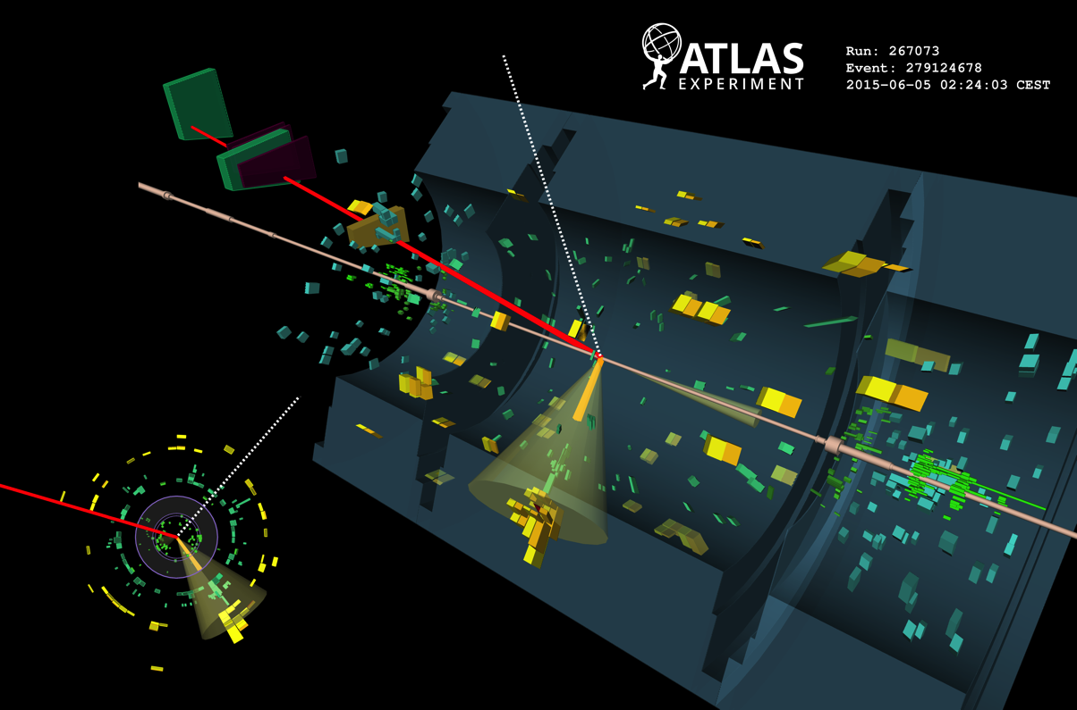
Conclusions
Display of t-channel single-top candidate event: muon with p_{T} of 30 GeV, central b-tagged jet of 50 GeV, forward jet 30 GeV, E_{T,miss} of 40 GeV

Slide 42
Conclusions
The LHC is back again — great data for physics collected: thanks to the CERN accelerator teams for tireless efforts
ATLAS is fully engaged into analysis of 13 TeV data, only a fraction of work shown today
New detector systems, software & analysis model successfully integrated & commissioned
Remarkable understanding of new 13 TeV data after only a few weeks of running
Performed soft physics measurements including verification of “Ridge” at 13 TeV Minimum bias and underlying event studies show good extrapolation from Run-1 tunes
Measurement of differential 13 TeV central jet cross section and photon studies
Early measurements of J/Ψ, W and Z production in agreement with expectations
Measurement of top-pair production cross section: heaviest particle known at highest collider energies ever reached — consistently predicted by the Standard Model
See next pages for a full list of ATLAS references to 13 TeV physics & performance analysis documents

Slide 43
List of 13 TeV ATLAS references for EPS-HEP 2015
PHYSICS OBJECT & TRIGGER PERFORMANCE
Tracking https://twiki.cern.ch/twiki/bin/view/AtlasPublic/InDetTrackingPerformanceApprovedPlots
Tracking Performance | ATL-PHYS-PUB-2015-018
Vertexing Performance | ATL-PHYS-PUB-2015-026
Inner detector Alignment | ATL-PHYS-PUB-2015-031
Hadronic resonances | IDTR-2015-006
IP resolution Run 1 vs Run 2 | IDTR-2015-007
Electron and photon https://twiki.cern.ch/twiki/bin/view/AtlasPublic/ElectronGammaPublicCollisionResults
Electron ID in Z / J/ψ → ee | EGAM-2015-003
Photon reconstruction | EGAM-2015-004
Photon ID efficiencies | EGAM-2015-002
Muon https://twiki.cern.ch/twiki/bin/view/AtlasPublic/MuonPerformancePublicPlots
ID and reconstruction | MUON-2015-002
Early reconstruction plots | MUON-2015-001
Jet and missing transverse momentum https://twiki.cern.ch/twiki/bin/view/AtlasPublic/JetEtMissPublicCollisionResults
Jet cleaning | ATLAS-CONF-2015-029
Early MET studies | ATL-PHYS-PUB-2015-027
MET performance for 13 TeV | ATL-PHYS-PUB-2015-023
Jet performance for 13 TeV | ATL-PHYS-PUB-2015-031
Uncertainty treatment | ATL-PHYS-PUB-2015-014
Tau https://twiki.cern.ch/twiki/bin/view/AtlasPublic/MuonPerformancePublicPlots
Early 13 TeV commissioning | ATL-PHYS-PUB-2015-025
Trigger https://twiki.cern.ch/twiki/bin/view/AtlasPublic/TriggerPublicResults#Public_results_from_signature_gr
The above link points to results from all trigger signatures
Use CDS to find ‘PUB’ and ‘CONF’ notes: https://cds.cern.ch
Performance plots (eg, IDTR-2015-007, that is not ‘CONF’ or ‘PUB’) can be directly accessed via the following bulk address: https://atlas.web.cern.ch/Atlas/GROUPS/PHYSICS/PLOTS
For example, for ‘IDTR-2015-007’, the link is:
https://atlas.web.cern.ch/Atlas/GROUPS/PHYSICS/PLOTS/IDTR-2015-007

Slide 44
List of 13 TeV ATLAS references for EPS-HEP 2015
PHYSICS ANALYSIS
Standard Model https://twiki.cern.ch/twiki/bin/view/AtlasPublic/StandardModelPublicResults
Charged particle spectra | ATLAS-CONF-2015-028
Underlying event study | ATL-PHYS-PUB-2015-019
Jet cross section | ATLAS-CONF-2015-034
Inclusive photon study | ATL-PHYS-PUB-2015-016
Diphoton study | ATL-PHYS-PUB-2015-020
W and Z production study | ATL-PHYS-PUB-2015-021
SUSY performance studies https://twiki.cern.ch/twiki/bin/view/AtlasPublic/SupersymmetryPublicResults
0-lepton + 2–6 jets + MET | ATL-PHYS-PUB-2015-028
1-lepton + 2–6 jets + MET | ATL-PHYS-PUB-2015-029
0-lepton + 6–7 jets + MET | ATL-PHYS-PUB-2015-030
Exotics performance studies https://twiki.cern.ch/twiki/bin/view/AtlasPublic/ExoticsPublicResults
Z’ → ll selection plots | EXOT-2015-001
Z’ → eµ selection plots | EXOT-2015-004
W’ → lν selection plots | EXOT-2015-002
Diphoton selection plots | EXOT-2015-003
Monojet selection plots | EXOT-2015-005
Mono-b-jet selection plots | EXOT-2015-007
Photon + MET trigger plot | EXOT-2015-006
Long-lived muon vertex plot | EXOT-2015-008
Heavy ions https://twiki.cern.ch/twiki/bin/view/AtlasPublic/HeavyIonsPublicResults
Two-particle correlations | ATLAS-CONF-2015-027
B-physics and quarkonia https://twiki.cern.ch/twiki/bin/view/AtlasPublic/BPhysPublicResults
Non-prompt J/Ψ production | ATLAS-CONF-2015-030
Top https://twiki.cern.ch/twiki/bin/view/AtlasPublic/TopPublicResults
Top-antitop cross section | ATLAS-CONF-2015-033
Top kinematic distributions | ATL-PHYS-PUB-2015-017

Slide 45
A few extra slides…

Slide 46
13 TeV / 8 TeV inclusive pp cross-section ratio
At 10³⁴ cm^{–2} s^{–1} @ 13 TeV pp the LHC produces:
200 Hz W → lν
19 Hz Z → ll
8 Hz top pair
0.5 Hz Higgs

Slide 47
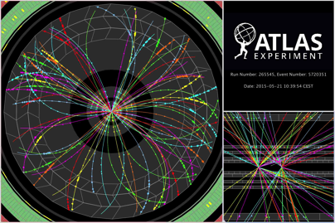
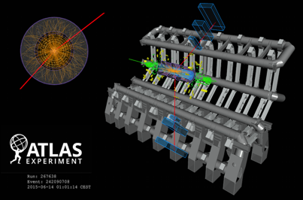
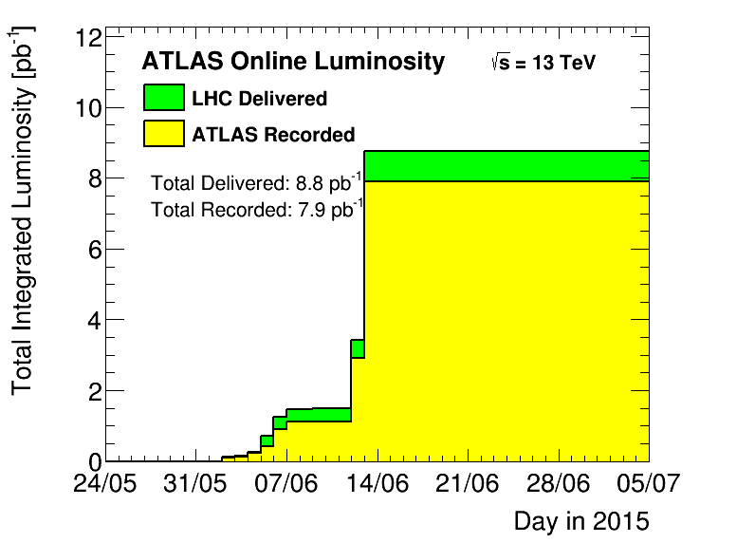

13 TeV data taking history
LHC schedule: https://espace.cern.ch/be-dep/BEDepartmentalDocuments/BE/LHC_Schedule_2015.pdf
∼8 pb^{–1} pre-intensity ramp data
First 13 TeV stable- beam collisions, low and high pileup
13 TeV test collisions with “quiet beam” periods
We are here, ATLAS recorded 100 pb^{–1} of 13 TeV pp data
83 pb^{–1} for physics (5 pb^{–1} muon alignment, rest DAQ/DQ ineff.)
Sep

Slide 48
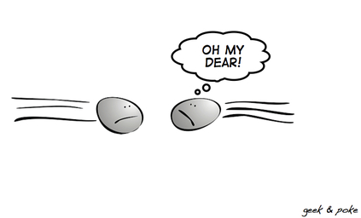
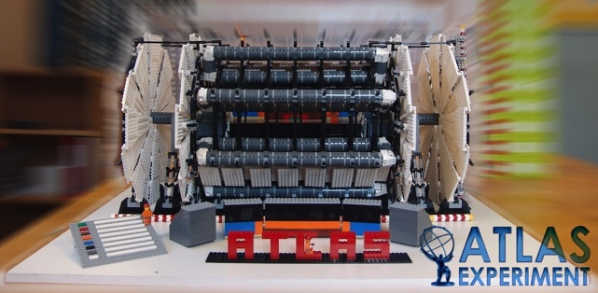
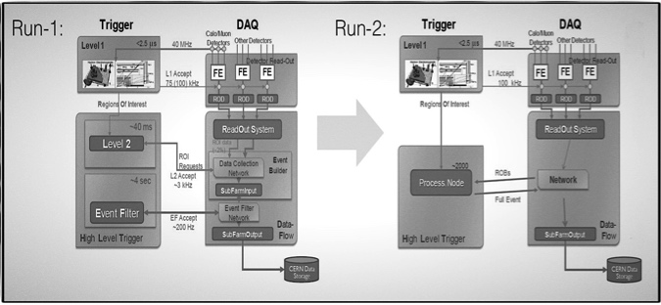
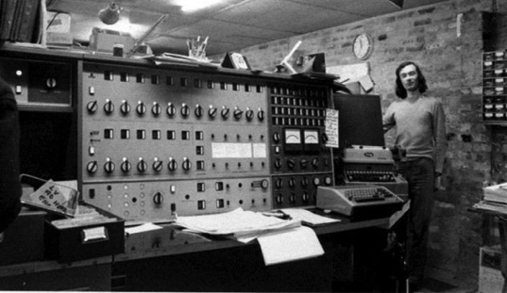
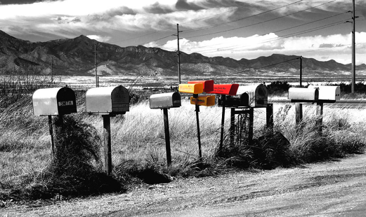
The ATLAS data path in a nutshell
Large Hadron Collider
ATLAS Detector
Trigger & Online monitoring
50 ns bunch distance
L_{max} ~ 1.7 ×10³³ cm^{–2} s^{–1}
L1 (HW, up to 100 kHz) + HLT (SW, 1 kHz)
Low-threshold single lepton triggers, single MET and jet triggers, and low-threshold di-object & topological triggers
Calibration & Reconstruction
Distributed computing
Analysis
Performance groups provide standard physics objects with calibrations and uncertainties, unified in analysis release
Analysis groups build physics analyses upon this ground work
48h calibration & data quality processing, then prompt reconstruction of data in Tier-0
Production of standardised derived datasets for physics and performance analysis
Also: MC production — 1.8 billion 13 TeV events

Slide 49
Diphoton production at 13 TeV
Irreducible background to Higgs, new physics sensitivity
[ ATL-PHYS-PUB-2015-020, EXOT-2015-003 ]
Isolated diphoton yield
Raw diphoton p_{T} spectrum (not background subtracted)
Diphoton mass, compared to SM prediction
NLO shoulder
hep-ph/0012191

