Slide 1
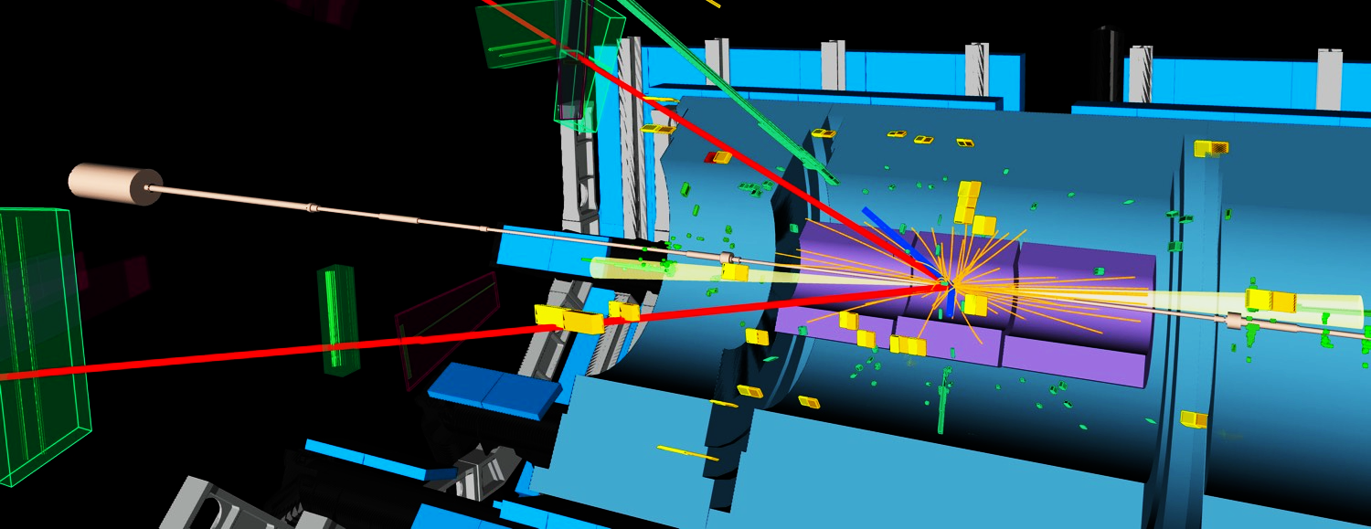
Measurement of Higgs boson properties
— What will the (HL-)LHC achieve
CMS H → γγ candidate event
Andreas Hoecker (CERN)
Chicago University, January 14, 2019
Discuss Higgs boson properties here, but the HL-LHC is obviously much more than Higgs !

Slide 2

Higgs boson production at the LHC
At the LHC, the Higgs boson is dominantly produced via gluon fusion for σ_{H,total} = 56 pb at √s = 13 TeV for m_{H} = 125 GeV
Cross section steeply falling with Higgs mass
Weak boson fusion (σ_{W/Z+H} ~ 3.8 pb):
g
t
t
H
Higgs-strahlung (σ_{W/Z+H} ~ 1.4/0.9 pb):
g
t
σ_{H,ggF} ~ 49 pb at 13 TeV
“ttH” production (σ_{ttH} ~ σ_{bbH} ~ 0.5 pb):
Total production of almost 9 million SM Higgs bosons of 125 GeV by today in each of ATLAS and CMS

Slide 3

Higgs boson production at the LHC
Because of the coupling to the mass of the decay particles:
  … the Higgs decays with preference to the heaviest particles allowed
  … the Higgs does not couple directly to photons and gluons, but only via loops involving preferentially heavy particles (e.g., top, W )
H(125 GeV) branching fractions:
0.008% (e,µ)
0.012% (e,µ)
1.1% (e,µ)
At the LHC we measure:
$Rate(pp→H→f)∝σ_{H}∙\frac{Γ_{H→f}}{Γ_{H}}$
  Higgs boson width $Γ_{H}$ not directly accessible (except using tricks)
  Absolute coupling measurement requires extraction of $σ_{H}∙Γ_{H→f}$
  Therefore, only coupling ratios model-independent at LHC
Uncertainties 3∼12%

Slide 4
Higgs boson production at the LHC
Leptonic (e/µ) and photonic final states provided best discovery significance
  H → γγ / ZZ*(→ 4𝓁) have best mass resoluton
  H → WW* → 2𝓁2𝜈 good trigger, sustainable background level, and large branching fraction
H(125 GeV)
Decay channel | Mass resolution
H → γγ | 1–2%
H → ZZ*→ 4𝓁 | 1–2%
H → WW* → 2𝓁2𝜈 | 20%
H → bb | 10%
H → ττ | 15%

Slide 5
A long time passed since the July 2012 discovery of a “Higgs-like” boson…
Higgs to diphoton and four-lepton discovery channels
Using up to 80 fb^{–1} 13 TeV data from Run-2
5

Slide 6
Combined ATLAS & CMS Higgs analysis — Run-1 legacy
ATLAS & CMS Run-1 combination of Higgs coupling measurements
Signal strength parameter: µ = σ(exp) / σ(SM)
Agreement among experiments
Overall signal strength (Run-1): µ = 1.09 ± 0.11 (A & C)
Run-2: 1.17 ± 0.10 (CMS)
1.13 (ATLAS)
+ 0.09
– 0.08
Higgs production processes
Higgs decay processes
arXiv1606.02266
Observed in Run-1
Observed in Run-1
Note that the least model-dependent observables at the LHC are ratios of couplings

Slide 7


Combined ATLAS & CMS Higgs analysis — Run-1 legacy
ATLAS & CMS Run-1 combination of Higgs coupling measurements
Coupling modifier: κ = κ(exp) / κ(SM)
$$κ_{g}$$
t
t
t
arXiv1606.02266
$$κ_{γ}$$
W
W
W
t
t
t
Couplings to massless particles mediated by loops involving heavy particles
Powerful test for new physics (eg, excludes SM-like heavy 4th fermion generation)

Slide 8


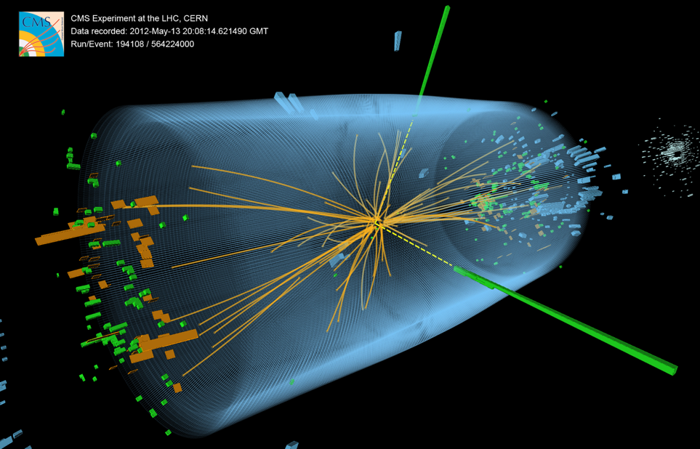
Higgs boson Highlights in 2018: fermionic channels

Slide 9

Observation of H → bb (ATLAS & CMS)
H → bb (BR: 58%), best channel: W/Z+H → 0 (+MET), 1, 2 leptons + H
Extremely challenging analysis requiring multivariate techniques to suppress background, and data driven constraint of background uncertainties. Powerful validation channel: W/Z+Z(→bb)
arXiv:1708.03299 (ATLAS), 1808.08242 (CMS)
µ(VH(bb)) = 1.01 ± 0.20 (ATLAS)
1.04 ± 0.20 (CMS)

Slide 10
Observation of ttH production (CMS & ATLAS)
Direct probe of Higgs–top coupling
1806.00425 (ATLAS) 1804.02610 (CMS)
Combine large variety of final state depending on top and Higgs decays
Distinguish: tt+H(→bb), tt+H(→WW*, 𝜏𝜏), tt+H(→γγ), tt+H(→ZZ*)
Heavy use of data-driven constraints and multivariate classification
Measurements agree with prediction
Strong rise with collision energy
ttH multi-lepton analysis

Slide 11
The Higgs boson as a “portal” to beyond the SM physics
Higgs is narrow: 4.1 MeV
For comparison:
Γ_{W} = 2.1 GeV
Γ_{Z} = 2.5 GeV
Γ_{top} = 1.3 GeV
Invisible dark matter?
?
Even small couplings to new light states can measurably distort branching fractions
→ Search for invisible Higgs boson decays
Γ_{H} = 4.1 MeV

Slide 12
Search for dark matter through invisibly decaying Higgs
Invisible Higgs decays can be probed by associated production (VBF, VH, …)
Missing energy
Sensitivity to WIMP mass < m_{H} / 2, complementary to direct dark matter searches
arXiv:1809.05937

Slide 13
Inventory of Higgs boson property measurements
Mass: Run-1 (ATLAS & CMS): 125.09 ± 0.24 GeV | confirmed by ATLAS and CMS with Run-2 data
Spin / CP: Spin 1, 2 excluded with high significance | CP-even, but CP-odd admixtures possible
Width: < 1.1 GeV from direct measurement | < 9.2 MeV from off-shell coupling | < 7 MeV from fit
SM: 4.1 MeV
(both results are model-dependent)
BR(H → invisible): < 26% (assuming SM production)
SM production and decay channels:
Upper Limit
Decay → Production ↓ | γγ | ZZ* | WW* | bb | cc | ττ | μμ | Zγ | Combined
ggF | Observed | Observed | Observed | UL | – | Evidence | UL | UL | Observed
VBF | UL | UL | UL | UL | – | Evidence | UL | – | Observed
VH | UL | UL | UL | Evidence | UL | UL | – | – | Observed
ttH | Evidence | UL | Evidence* | UL | – | Evidence* | – | – | Observed
Combined | Observed | Observed | Observed | Observed | UL | Observed | UL | UL
* both channels together
Differential cross section measurements (p_{T} (H ), N_{jets}, …): performed in most channels (+ STXS)
Di-Higgs production: < 6.7 x σ_{SM} (33 fb at √s = 13 TeV), strongest channels: bbγγ, bbττ
13

Slide 14
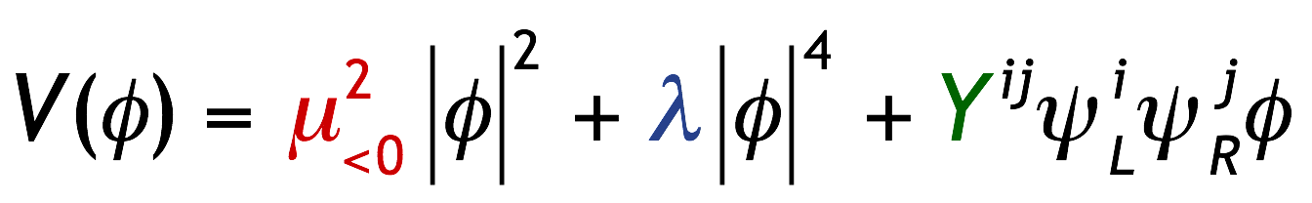
Is the scalar sector just that of the SM ?
Higgs sector may be non-minimal and/or Higgs boson may couple to new physics
Diverse search programme at the LHC:
So far no deviation from SM found in any of these searches
Light or heavy neutral Higgs bosons
Link to dark energy ?
Charged Higgs boson
Lepton flavour violating Higgs decays
BSM
Higgs
searches
Di-Higgs production (resonant or not)
Exotic Higgs decays
No sensitivity yet to SM di-Higgs production
Higgs as portal to hidden sector
Higgs in BSM decay chains
Higgs potential
Is it just the simplest model?
Carries the seed of new physics ?

Slide 15
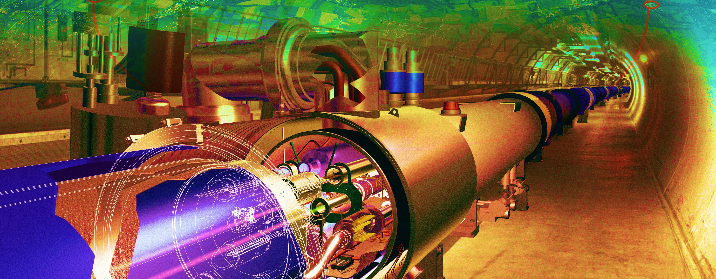
The next steps

Slide 16
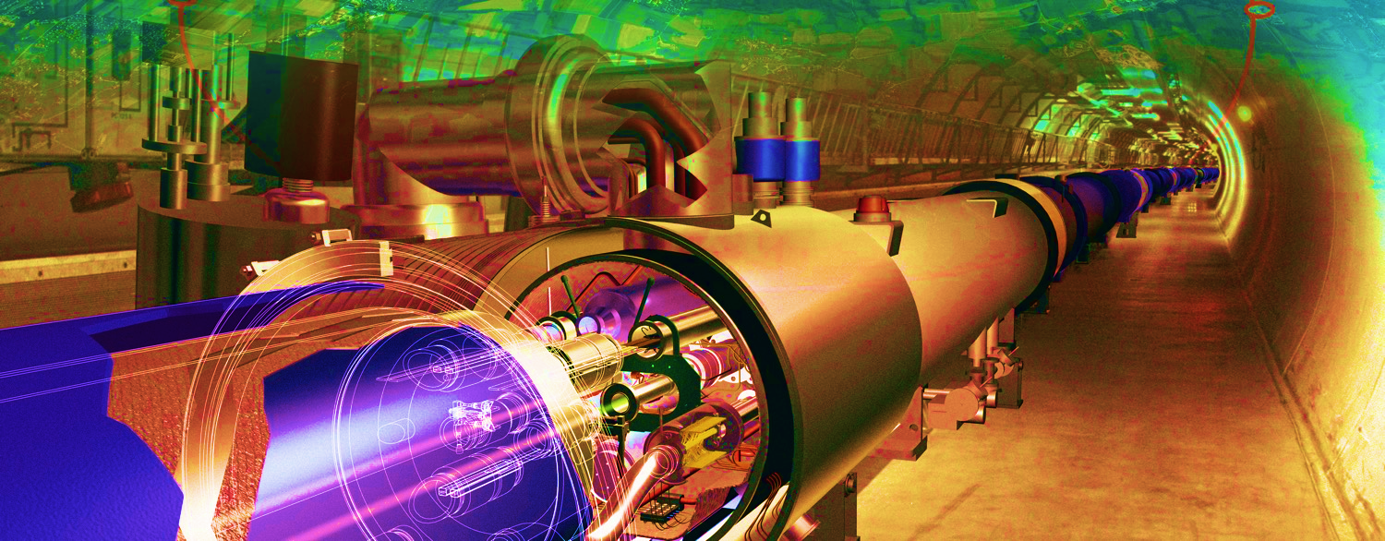
Phase-II:
The High-Luminosity LHC
We are here

Slide 17


Expected integrated luminosity of LHC & HL-LHC
3000
HL-LHC:
2500
We will be going here
Possibly up to 4 ab^{–1}
2000
Run-5
1500
HL-LHC
1000
We are here
Run-4
500
Run-3
0
Run-2
2015
2019
2023
2027
2031
2035
Year
© P. Ferreira da Silva at Moriond EW, 2016

Slide 18
Expected integrated luminosity of LHC & HL-LHC
3000
HL-LHC:
2500
We will be going here
Possibly up to 4 ab^{–1}
2000
Run-5
HL-LHC inclusive Higgs sample will be 23 times larger (30 times for 4 ab^{–1}) than that of the full Run-2 (~150 fb^{–1} at 13 TeV)
With 3 ab^{–1}: 190 million H and 120 thousand HH (ggF) produced (SM)
1500
HL-LHC
1000
We are here
Run-4
500
Run-3
0
Run-2
2015
2019
2023
2027
2031
2035
Year
© P. Ferreira da Silva at Moriond EW, 2016

Slide 19
14 TeV proton–proton centre-of-mass energy

Slide 20
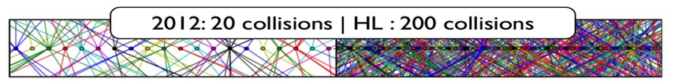
ATLAS & CMS Detector performance
The performance of trigger and physics object reconstruction degrades with pileup
Upgrades of HL-LHC (Phase-II) detectors designed to recover Phase-0 performance under high pileup
Improved trigger (L1 tracking, µ, e/γ, (b-)jets, E_{T}^{miss}), latency and bandwidth (~10 kHz output rate)
Improved pileup rejection (extended tracking acceptance, better z-vertex resolution, timing detectors)
Improved radiation hardness
Expected flavor tagging performance at HL-LHC
Parallel p-flow MET resolution vs. pileup density in Z → µµ events using PUPPI pileup mitigation

Slide 21
Higgs physics programme at the HL-LHC in a nutshell
Higgs properties:
mass (well known, expect to improve to ~33 MeV in H→4µ), width (through interference measurements)
spin (0⁺ established), CP (odd admixture possible) — not discussed today
Rare Higgs decays:
Observation of H → µµ, H → Zγ, HH production (constraint on Higgs self coupling)
Search for very rare (eg, H → Mγ, M=J/𝜓, 𝜙, 𝜌), difficult (H → cc) or anomalous decays (invisible or new particles, or flavour violating)
Higgs couplings:
Study of Higgs production and anomalous couplings by differential cross-section measurements
Global and partially global coupling fits: experiments moving from “kappa” interpretation to EFT
New physics in Higgs production or other scalar states
Search for anomalous FCNC through top decays, Higgs production via SUSY cascades, etc.
Search for additional scalar particles
21

Slide 22
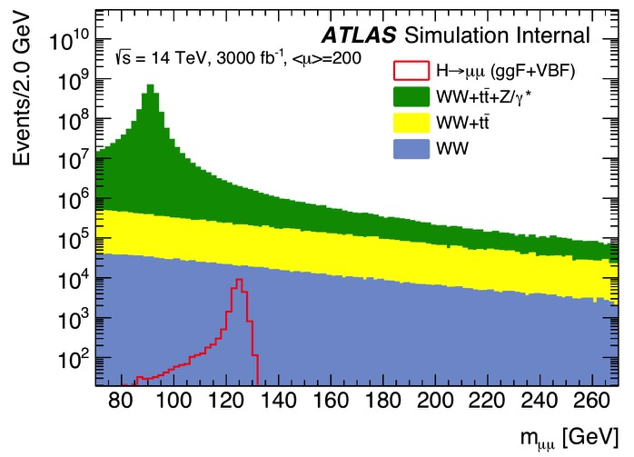
Coupling to 2nd generation: Higgs decay to H → µµ (BR: 0.022% in SM)
Upgraded detectors feature improved di-muon mass resolution
If SM branching fraction, H → µµ could be observed in Run-3 (ATLAS & CMS combined)
Cross-section times branching fraction measurement to ~14% (ATLAS), 10% (CMS) precision for 3 ab^{–1}
Challenging data-driven Drell-Yan background determination
ATLAS ITk Strip TDR: CERN-LHCC-2017-005
~25% improved mass resolution
Best (central) category, expected resolution ~1.05%
CMS Tracker TDR:
CERN-LHCC-2017-009
22

Slide 23
Rare loop decay to H → Zγ (BR: 0.15% in SM, 0.010% with Z → ee, µµ)
Large background from Z production with radiative photons
Observation with combined ATLAS & CMS dataset expected with 3 ab^{–1}
Combined statistical precision of about 17% on cross-section
Challenging data-driven background determination
Z / V / γ
H
γ
ATLAS ATL-PHYS-PUB-2014-006
Also searches for, eg, H → J/𝜓 γ with expected sensitivity of 15 times SM prediction (BR: 2.9 10^{–6})
ATLAS ATL-PHYS-PUB-2015-043
23

Slide 24

Di-Higgs production
HH ggF cross section predicted to 37 fb at 14 TeV, ie, >1000 times smaller than for single Higgs production
Sophisticated analyses needed, room for innovation; Extrapolation uncertainty in continuum background prediction
λ
$$λ=\frac{m_{H}^{2}}{2υ^{2}}\sim 0.13$$
Best channels: bbγγ (BR = 0.26%), bbττ (7.3%), bbbb (34%), bbWW, 25% → combination
Currently ATLAS (36 fb^{–1} combination at 13 TeV): µ_{HH} < 6.7 (10.4_{exp}), CMS: 22.2 (12.8_{exp})
Best expected sensitivity in ATLAS from bbtt (14.6) !
Projection to HL-LHC: 3.0σ significance for ATLAS, CMS: 2.6σ
Distributions after BDT cut
ATL-PHYS-PUB-2017-001, ATL-PHYS-PUB-2018-053
24

Slide 25
Di-Higgs production
HH ggF cross section predicted to 37 fb at 14 TeV, ie, >1000 times smaller than for single Higgs production
Sophisticated analyses needed, room for innovation; Extrapolation uncertainty in continuum background prediction
λ
$$λ=\frac{m_{H}^{2}}{2υ^{2}}\sim 0.13$$
Best channels: bbγγ (BR = 0.26%), bbττ (7.3%), bbbb (34%), bbWW, 25% → combination
Currently ATLAS (36 fb^{–1} combination at 13 TeV): µ_{HH} < 6.7 (10.4_{exp}), CMS: 22.2 (12.8_{exp})
Best expected sensitivity in ATLAS from bbtt (14.6) !
Projection to HL-LHC: 3.0σ significance for ATLAS, CMS: 2.6σ
ATL-PHYS-PUB-2017-001, ATL-PHYS-PUB-2018-053
It remains to be seen which of the three main channels will eventually be best
The bbbb channel strongly depends on the lowest jet p_{T} trigger threshold and on top background modelling
Combining ATLAS & CMS in all channels, hoping for analysis improvements, and including new channels may give 4σ HH sensitivity with 3 ab^{–1}
25

Slide 26
Constraints on Higgs trilinear self coupling λ_{HHH}
Constraint on λ_{HHH} by comparing data to NLO m _{HH} distributions for different λ_{HHH} values. Effects on total HH cross section and acceptance
λ
Projection to HL-LHC (combined channels)
LO diagrams contributing with negative interference to SM HH production
Box diagram dominates inclusive production
Sensitivity to H self coupling rises at low m_{HH}
ATL-PHYS-PUB-2018-053
Fitting differential variables such as m _{HH}, p_{T,H} allows to improve the constraint on λ
[See, eg, 1607.07441]
λ_{HHH} also affects single-H production at NLO through internal H loops → Complementary information from differential H cross-section measurements
95% CL limit: –0.4 < λ / λ_{SM} < 7.3
λ / λ_{SM} = 1
^{+0.9}
[ Note: ~20% measurement expected at HE-LHC with 15 ab^{–1} ]
_{–0.8}
26

Slide 27
Higgs production: differential cross-section measurements
The H → γγ, 4𝓁 channels will dominate most precise differential cross-section measurements at the HL-LHC
Inclusive spectra with 5% statistical uncertainty up to 400 GeV
Sensitive to Higgs to b/c coupling and QCD at low p_{T}, and to top coupling and BSM at high p_{T}
ATL-PHYS-PUB-2018-040
27

Slide 28
Off-shell coupling measurement — constraining the Higgs boson width
Both CMS and ATLAS have constrained the Higgs off-shell coupling and through this obtained upper limits on the Higgs total width Γ_{H}.
The method uses the independence of off-shell cross section on Γ_{H} and relies on identical on-shell and off-shell Higgs couplings. One can then determine Γ_{H} from measurements of µ_{off-shell} and µ_{on-shell}
arXiv:1706.09936
on-shell
off-shell
With L₂ = 3 ab^{–1}, we may find:
ATLAS: ATL-PHYS-PUB-2015-024
Large theory uncertainty (~30%) from gg → ZZ
28

Slide 29
Higgs → invisible constraints
If dark matter (DM) is a thermal relic of the early universe and it is light enough so the Higgs can decay to it, it leads to invisible Higgs decays
Such decays can be detected through Higgs VBF, ZH or ISR-jet production, or in a model-dependent way through the coupling fit (eg, assuming SM couplings to SM particles)
Best limit of ~3% on H → invisible branching fraction at 3 ab^{–1} (reminder: current limit: 26%)
However, systematics limited so difficult extrapolation
ECFA16 S1
ECFA16 S2
1/√ L scaling
CMS PAS FTR-16-002
29

Slide 30
Higgs couplings from global fit — ATLAS (Status 2018)
Consider two scenarios: S1 (Run-2 systematics), S2 (halved theory systematics, baseline shown here)
Luminosity uncertainty 1%, neglected spurious signal and MC statistics uncertainties
Most cross section measurements dominated by systematic uncertainties
Global signal strength:
S1 (S2)
30

Slide 31
Higgs couplings from global fit — ATLAS (Status 2018)
Consider two scenarios: S1 (Run-2 systematics), S2 (halved theory systematics, baseline shown here)
Luminosity uncertainty 1%, neglected spurious signal and MC statistics uncertainties
31

Slide 32
Higgs couplings from global fit — ATLAS (Status 2018)
Consider two scenarios: S1 (Run-2 systematics), S2 (halved theory systematics, baseline shown here)
Luminosity uncertainty 1%, neglected spurious signal and MC statistics uncertainties
Assumes B _{BSM} = 0
Run-1 ATLAS + CMS combination, 68% CL
32

Slide 33
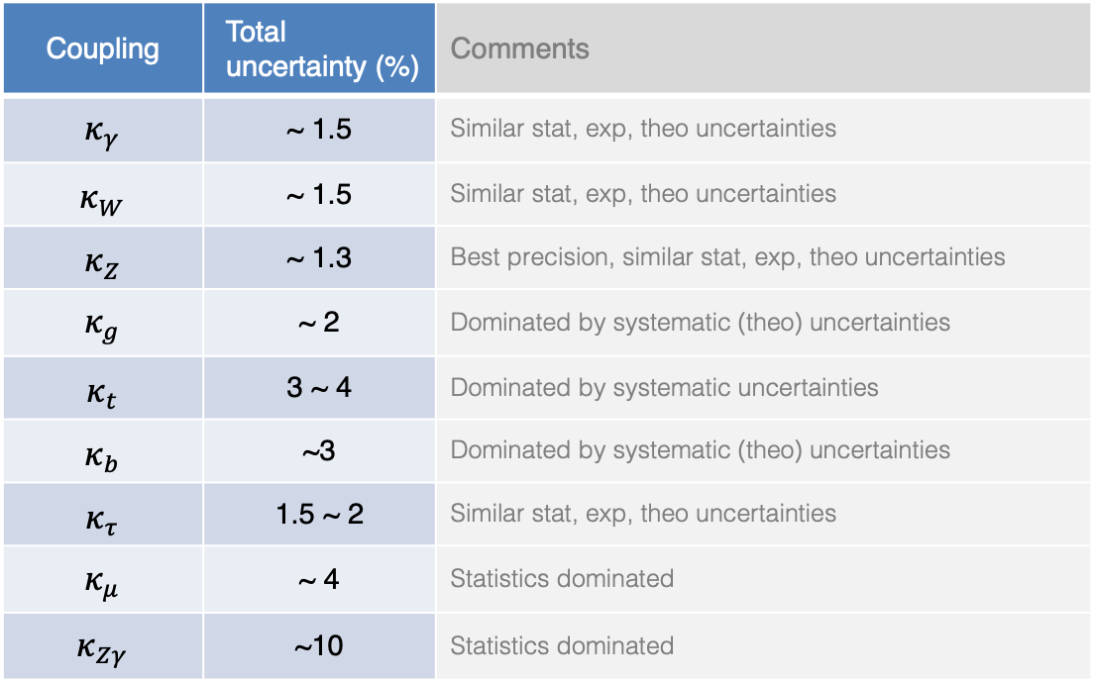
Higgs couplings from global fit — ATLAS & CMS
Combination of ATLAS and CMS not yet released, expect following approximate precision on couplings
Assumes B _{BSM} = 0
Coupling | Total uncertainty (%) | Comments
$$κ_{γ}$$ | ~ 1.5 | Similar stat, exp, theo uncertainties
$$κ_{W}$$ | ~ 1.5 | Similar stat, exp, theo uncertainties
$$κ_{Z}$$ | ~ 1.3 | Best precision, similar stat, exp, theo uncertainties
$$κ_{g}$$ | ~ 2 | Dominated by systematic (theo) uncertainties
$$κ_{t}$$ | 3 ~ 4 | Dominated by systematic uncertainties
$$κ_{b}$$ | ~3 | Dominated by systematic (theo) uncertainties
$$κ_{τ}$$ | 1.5 ~ 2 | Similar stat, exp, theo uncertainties
$$κ_{μ}$$ | ~ 4 | Statistics dominated
$$κ_{Zγ}$$ | ~10 | Statistics dominated
LHCb adds sensitivity to H → cc of ~5 ⋅ BR(SM) with 300 fb^{–1} [LHCb-CONF-2016-006]
ATLAS study indicates µ < 6.3 at 95% CL
33

Slide 34


Future e⁺e– collider
Several future e⁺e– collider options: linear (ILC, CLIC), circular (FCC-ee, CEPC)
Dominant production mechanisms: e⁺e– → ZH (Higgsstrahlung), 𝜈𝜈H (W fusion), eeH (Z fusion)
$$∝\frac{1}{s}$$
$$∝log⁡(s)$$
34

Slide 35
Future e⁺e– collider
Several future e⁺e– collider options: linear (ILC, CLIC), circular (FCC-ee, CEPC)
Baseline luminosity scenarios
Operational model for FCC-ee
Run plan for FCC-ee baseline configuration with two experiments
> 10⁵ × LEP
35

Slide 36
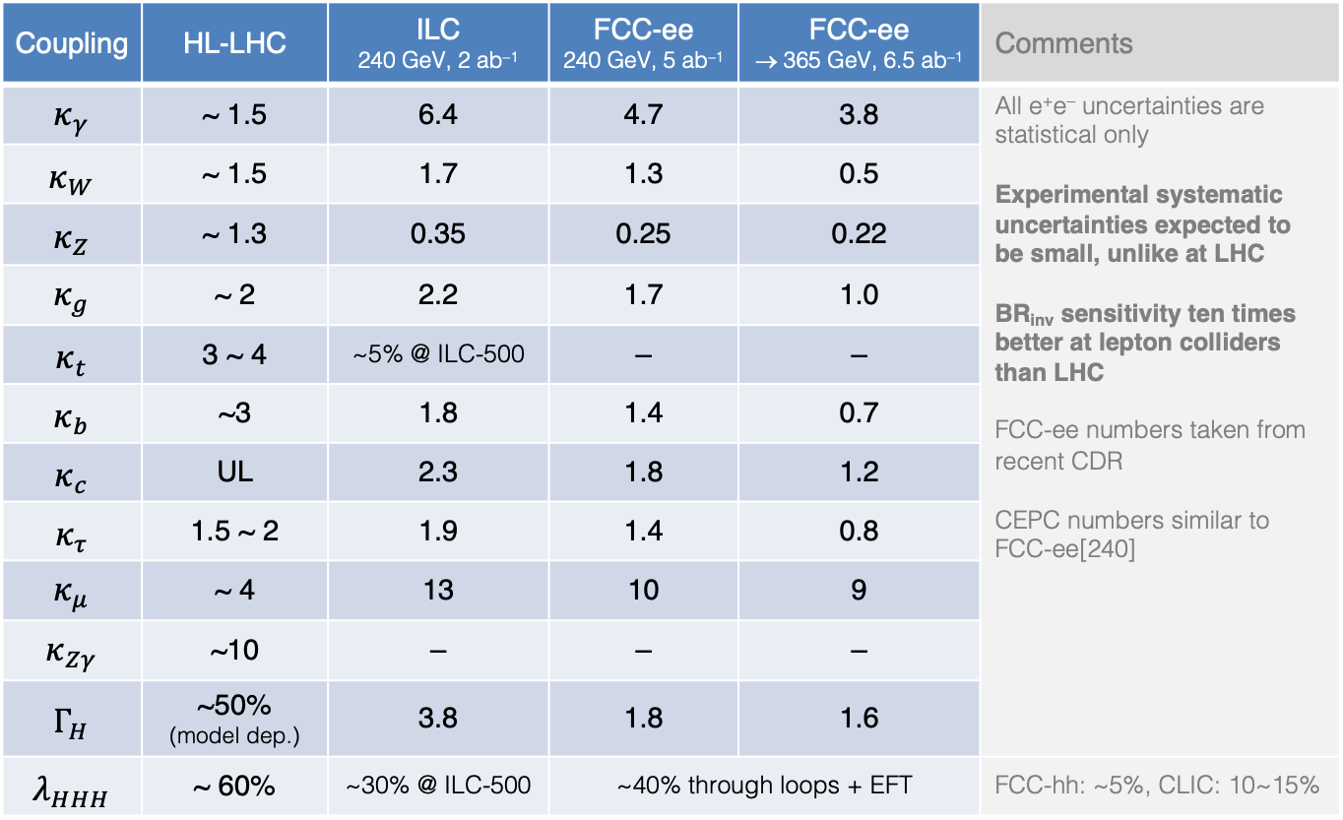
Comparison among colliders
Numbers taken from Nov 2018 FCC CDR (Physics case)
Uncertainties in %
Coupling | HL-LHC | ILC 240 GeV, 2 ab^{–1} | FCC-ee 240 GeV, 5 ab^{–1} | FCC-ee → 365 GeV, 6.5 ab^{–1} | Comments
$$κ_{γ}$$ | ~ 1.5 | 6.4 | 4.7 | 3.8 | All e⁺e– uncertainties are statistical only Experimental systematic uncertainties expected to be small, unlike at LHC BR_{inv} sensitivity ten times better at lepton colliders than LHC FCC-ee numbers taken from recent CDR CEPC numbers similar to FCC-ee[240]
$$κ_{W}$$ | ~ 1.5 | 1.7 | 1.3 | 0.5
$$κ_{Z}$$ | ~ 1.3 | 0.35 | 0.25 | 0.22
$$κ_{g}$$ | ~ 2 | 2.2 | 1.7 | 1.0
$$κ_{t}$$ | 3 ~ 4 | ~5% @ ILC-500 | – | –
$$κ_{b}$$ | ~3 | 1.8 | 1.4 | 0.7
$$κ_{c}$$ | UL | 2.3 | 1.8 | 1.2
$$κ_{τ}$$ | 1.5 ~ 2 | 1.9 | 1.4 | 0.8
$$κ_{μ}$$ | ~ 4 | 13 | 10 | 9
$$κ_{Zγ}$$ | ~10 | – | – | –
$$Γ_{H}$$ | ~50% (model dep.) | 3.8 | 1.8 | 1.6
$$λ_{HHH}$$ | ~ 60% | ~30% @ ILC-500 | ~40% through loops + EFT |  | FCC-hh: ~5%, CLIC: 10~15%
36

Slide 37
Some conclusions
We live in data-driven times, experiment must guide us to the next stage. That means we need a broad and diverse research programme. Higgs physics is key in that programme.
The HL-LHC will make a strong impact on Higgs property measurements. It has sensitivity to discover rare Higgs decays to µµ and Zγ, to study couplings to bosons and third generation fermions to (few) percent precision, and to significantly constrain invisible decays.
Most coupling measurements will be limited by theoretical uncertainties highlighting the importance of improving these.
Di-Higgs production can likely be seen, but a significant measurement of Higgs self-coupling seems beyond reach. However, important constraints can be obtained.
Higgs measurements in conjunction with other SM sectors such as diboson and top will allow to obtain coherent information in the framework of EFT or model extensions of the SM.
Precision measurements in the SM sector will contribute to these constraints.
Hadron and lepton colliders have complementary strengths

Slide 38
Extra slides

Slide 39
Current status of property measurements
Combined coupling fit (CMS)
2016 data, √s = 13 TeV
CMS-PAS-HIG-17-031
Assumes: BR_{inv} = 0
Higgs to boson and fermion coupling modifiers:
Run-1 ATLAS & CMS
39

Slide 40
More than observation: detailed measurements
Cross section measurements
2015+2016 data, √s = 13 TeV
ATLAS-CONF-2018-002
Combination of cleanest γγ and 4-lepton channels provides currently most sensitive differential cross section measurements, but still a long way to go to achieve good precision
40

Slide 41
More than observation: detailed measurements
Simplified template cross (STXS) section measurements
2015+2016 data, √s = 13 TeV
ATLAS arXiv:1712.02304, 1802.04146, ATLAS-CONF-2018-018
STXS define particle-level bins to maximize measurement precision and reduce theory dependence
41

