Slide 1
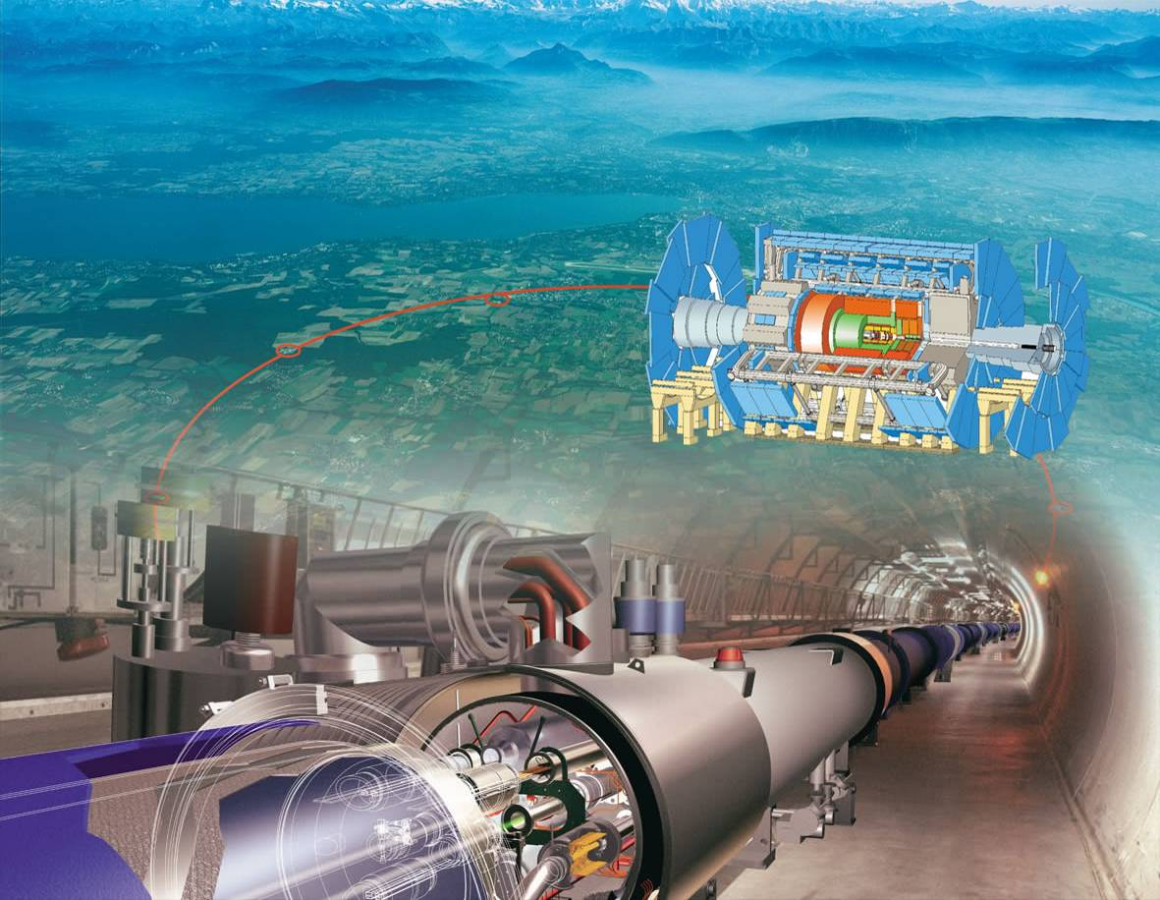
The electroweak fit
of the Standard Model after
the discovery of an SM-like scalar boson
Andreas Hoecker (CERN)
Solvay workshop “Facing the Scalar Sector”, May 29−31, 2013

Slide 2
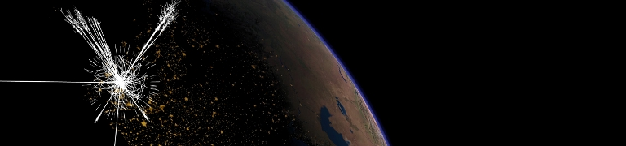
Introduction

Slide 3
Predictive power of the Standard Model
Electroweak physics at the Z-pole
Vector and axial-vector couplings for Z → ff in SM at tree level:
Z / γ
Z–lepton coupling almost pure axial-vector
(γ pure vector → large off-peak interference → could establish Z-fermion coupling at PETRA, interesting for Z’ searches via interference)
Electroweak unification: relation between weak and electromagnetic couplings:
Gauge sector of SM on tree level is given by three free parameters, e.g.: α, M_{Z}, G_{F} (best known!)
√s

Slide 4

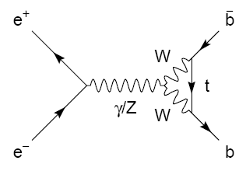
Predictive power of the Standard Model
Electroweak physics at the Z-pole
Radiative corrections – modifying propagators and vertices
Significance of radiative corrections can be illustrated by verifying tree level relation:
Using the measurements:
one predicts:
which is 18 σ away from the experimental value obtained by combining all asymmetry measurements:

Slide 5
Predictive power of the Standard Model
Electroweak physics at the Z-pole
Radiative corrections – modifying propagators and vertices
Parametrisation of radiative corrections: “electroweak form-factors”: ρ, κ, Δr
Modified (“effective”) couplings at the Z pole:
Modified W mass:
  ρ : overall scale
  κ : on-shell mixing angle
Δr function of Δρ

Slide 6
Predictive power of the Standard Model
Electroweak physics at the Z-pole
Radiative corrections – modifying propagators and vertices
Leading order terms (M_{W} ≪ M_{H})
ρ_{Z} and κ_{Z} can be split into sum of universal contributions from propagator self-energies:
and flavour-specific vertex corrections, which are very small, except for top quarks, owing to large mass and |V_{tb}| CKM element

Slide 7
Predictive power of the Standard Model
Electroweak physics at the Z-pole
Radiative corrections – modifying propagators and vertices
Radiative corrections allow us to test the SM
and to constrain unknown SM parameters
Leading order terms (M_{W} ≪ M_{H})
ρ_{Z} and κ_{Z} can be split into sum of universal contributions from propagator self-energies:
and flavour-specific vertex corrections, which are very small, except for top quarks, owing to large mass and |V_{tb}| CKM element

Slide 8
Predictive power of the Standard Model
Electroweak physics at the Z-pole
Observables computed using ρ_{Z}^{f}, κ_{Z}^{f}, Δr and QED/QCD radiator functions R_{A,f}, R_{V,f}
Asymmetries:
Measured asymmetries (forward-backward, left-right [+ FB] (SLD), tau polarisation) can be expressed as functions of different A_{f}
Partial widths:
Radiator functions for leptonic (hadronic) width involve QED (EW+QCD) corrections; → dependence on α_{QED}(M_{Z}) and α_{S}(M_{Z})
Partial widths are highly correlated set of parameters. For EW fit, use:
Z mass and width: M_{Z} (2×10^{–5} accuracy!), Γ_{Z}
Hadronic pole cross section: σ⁰_{had}
Three leptonic ratios (use lepton-univ.):
Hadronic width ratios:

Slide 9
Predictive power of the Standard Model
Electroweak physics at the Z-pole
Observables computed using ρ_{Z}^{f}, κ_{Z}^{f}, Δr and QED/QCD radiator functions R_{A,f}, R_{V,f}
Latest calculations for observables used
M_{W} mass of the W boson
O(²), O(_{s}), O(G_{F}_{s}²m_{t}²), O(G_{F}²_{s}m_{t}⁴), O(G_{F}³m_{t}⁶)
δ_{theo}M_{W} = 4 MeV
sin²θ^{l}_{eff} effective weak mixing angle
O(²), O(G_{F}²_{s}m_{t}⁴), O(G_{F}³m_{t}⁶)
δ_{theo}sin²θ^{l}_{eff} = 4.7×10⁻⁵
Γ_{Z} , Γ_{W} Total widths of Z and W
R_{l} leptonic width ratio
QCD Adler functions at 3NLO
α_{QED}(M_{Z}) from newest hadronic data
R_{b} Z→bb width ratio
Full two-loop fermionic correction (sizable:
theoretical uncertainties larger than expected?)
[ Awramik et al, PRD 69, 053006 (2004)* ]
[ Awramik et al, JHEP 11, 048, NP 813, 174 (2009)* ]
[ Cho et al, arXiv:1104* ]
[ Baikov et al., PRL 108, 222003 (2012)* ]
[ Davier et al., EPJ.C71, 1515 (2011) ]
[ Freitas et al, JHEP 08, 050 (2012)* ]
*References only those used directly by Gfitter. Full list of theoretical calculations referenced given in 0811.0009.

Slide 10
The electroweak fit

Slide 11
Electroweak fits
Several groups perform these fits with regular updates (LEPEWWG, PDG, Gfitter, BSM groups)
LEP: Phys. Rept. 427 (2006) 257, Gfitter: EPJ C72 (2012) 2003
A long tradition
Precision measurements crucial. After LEP/SLC era, results from Tevatron & soon also LHC
Huge & pioneering work to compute loop corrections to two-loop order or higher
Brout-Englert-Higgs hunting
M_{H} last missing parameter of the SM
Indirect determination (2011): M_{H} = 96 GeV
Exclusion limits were incorporated in EW fits
+31
−24
Discovery of new boson in July 2012
The cross section and branching ratios are (so far) compatible with the SM scalar boson
Assume in the following that the boson is the SM scalar: M_{H} = 125.7 ± 0.4 GeV*
*Exact value and uncertainty irrelevant for EW fit in SM
M_{H}
[LHC}

Slide 12
Experimental observables
Several groups perform these fits with regular updates (LEPEWWG, PDG, Gfitter, BSM groups)
Experimental inputs:
  Z-pole observables: LEP/SLD results (corrected for ISR/FSR QED effects)
  [ADLO & SLD, Phys. Rept. 427, 257 (2006)]
  Total and partial cross sections around Z: M_{Z}, Γ_{Z}, σ⁰_{had}, R_{l}⁰, R_{c}⁰, R_{b}⁰
  Asymmetries on the Z pole: A_{FB}^{0,l}, A_{FB}^{0,b}, A_{FB}^{0,c}, A_{l}, A_{c}, A_{b}, sin²θ ^{l}_{eff} (Q_{FB})
  M_{W} and Γ_{W} : LEP + Tevatron average [arXiv:1204:0042]
  m_{t}: latest Tevatron average [CDF & D0, new combination, arXiv:1305.3929]
  m_{c}, m_{b}: world averages [PDG, Phys. Lett. B667, 1 (2008) and 2009 partial update for the 2010 edition]
  Δα_{had}(M_{Z}): data + QCD-driven [Davier et al., EPJ.C71, 1515 (2011) + rescaling mechanism to account for α_{s} dependency]
  M_{H} : LHC [arXiv:1207.7214 , arXiv:1207.7235]
Fit parameters
Δα_{had}(M_{Z}), α_{S}(M_{Z}), M_{Z}, M_{H}, m_{c}, m_{b}, m_{t} + theory uncertainty parameters δ_{theo}M_{W} / sin²θ ^{l}_{eff}
  Other parameters well enough known and fixed in fit

Slide 13
LHC
LEP
Tevatron
& LEP
SLC
173.20 ± 0.87
Tevatron
SLC
Experimental Input
LEP
SLC
Correlations for observables from Z lineshape fit
Correlations for heavy-flavour observables at Z pole

Slide 14
http://gfitter.desy.de/Standard_Model/
Experimental Input and Fit Results

Slide 15
Goodness-of-fit:
χ²min/n_{dof} = 20.7/14 → p-value = 0.09_{toy-MC}
large value of χ²min not due to M_{H} measurement
Without M_{H} measurement:
χ²min/n_{dof} = 19.3/13 → p-value ∼ 0.11
Pull values after fit:
No pull value exceeds deviation of more than 3σ (consistency of SM)
Small pulls for M_{H}, A_{c}, R⁰_{c}, m_{c} and m_{b} indicate that their input accuracies exceed the fit requirements
Largest pulls in b-sector: A^{0,b}_{FB} and R⁰_{b} with 2.5σ and −2.1σ (little dependence on M_{H})
For comparison: R⁰_{b} using one fermionic loop calculation: 0.8σ
http://gfitter.desy.de/Standard_Model/
Experimental Input and Fit Results

Slide 16
Scan of the Δχ2 profile versus M_{H}
Blue line: full SM fit
Grey band: fit without M_{H} measurement
Fit without MH input gives
M_{H} = 94 GeV
Consistent within 1.3σ with measurement
+25
−22
Experimental Input and Fit Results
Tension in M_{H} fit ?
Determination of M_{H} removing all sensitive observables except the given one
Tension (2.5σ – from toy MC) between A^{0,b}_{FB}, A_{l}(SLD) and M_{W}
http://gfitter.desy.de/Standard_Model/

Slide 17
Global fit results
Indirect determination of the W boson mass
Scan of Δχ² profile versus M_{W}
M_{H} measurement allows for precise constraint of M_{W}
Also shown SM fit with minimal input:
M_{Z}, G_{F}, Δα_{had}(M_{Z}), α(M_{Z}), M_{H} and fermion masses
Consistency between total fit and SM fit with minimal input
Fit results in the indirect determination :
M_{W} = 80.3603 ± 0.0056(m_{top}) ± 0.0026(M_{Z}) ± 0.0018(Δα_{had})
± 0.0027(α_{S}) ± 0.0002(M_{H}) ± 0.0040(theo) GeV
= 80.360 ± 0.011(tot) GeV, more precise than experimental value
= 80.385 ± 0.015(exp) GeV [Tevatron/LEP: arXiv:1204.0042]

Slide 18
Global fit results
Effective weak mixing angle
Scan of Δχ² profile versus sin²θ ^{l}_{eff}
All observables sensitive to sin²θ ^{l}_{eff} removed from fit
M_{H} measurement allows for precise constraint
Also shown SM fit with minimal input
Fit results in the indirect determination :
sin²θ ^{l}_{eff} = 0.231496 ± 0.000030(m_{top}) ± 0.000015(M_{Z}) ± 0.000035(Δα_{had})
± 0.000010(α_{S}) ± 0.000002(M_{H}) ± 0.000047(theo)
= 0.23150 ± 0.00010(tot), more precise than LEP/SLD average
= 0.23153 ± 0.00016(exp) [LEP/SLD: Phys Rept 427 (2006) 257]

Slide 19
Global fit results
Top mass
Scan of Δχ² profile versus m_{top}
Fit results in the indirect determination :
+2.7
−2.4
m_{top} = 175.8 (tot) GeV
= 173.2 ± 0.9 (exp) [Tevatron: arXiv:1207.0980]

Slide 20
Global fit results
W boson and top mass correlation — impressive consistency of the SM
Once M_{H} fixed, the SM is cornered
Effects of new physics can enter through loop corrections
→ Improve measurements of EW precision observables

Slide 21
Global fit results
Constraints on new physics
Parametrise contributions from vacuum polarisation
Sensitivity to new physics
SM reference chosen to be
M_{H,ref} = 126 GeV, m_{t,ref} = 173 GeV
S, T depend logarithmically on M_{H}
Fit result:
S = 0.03 ± 0.10
T = 0.05 ± 0.12
U = 0.03 ± 0.10
with large correlation between S and T
Stronger constraints from fit with U = 0
S, T, U fit used to constrain new physics models (Little Higgs, 2HDM, SUSY, universal extra dimensions, Technicolor, …)

Slide 22
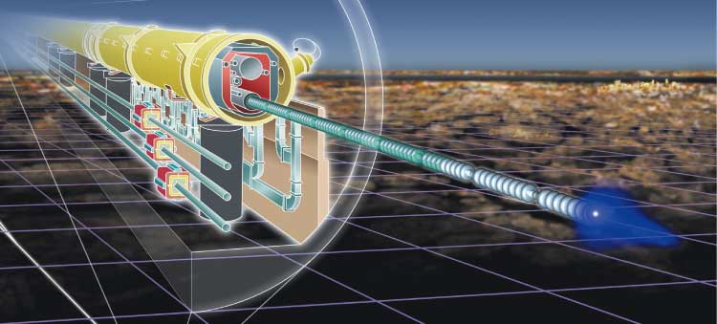
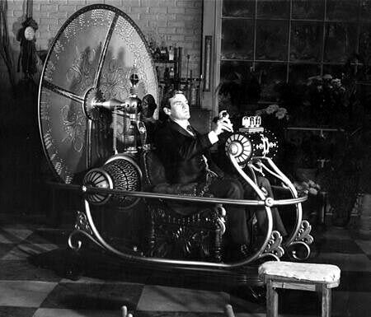
Future

Slide 23
A future linear collider could tremendously improve the precision of the electroweak observables
ILC with GigaZ
tt threshold: obtain m_{top} from production cross section: δ(m_{top}) ∼ 0.1 GeV
Z peak measurements
  Polarised beams, uncertainty δA^{0,f}_{LR}: 10⁻³ → 10⁻⁴
  translates into δsin²θ^{l}_{eff}: 10⁻⁴ → 1.3×10⁻⁵
  High statistics: 10⁹ Z decays: δR⁰_{l} : 2.5×10⁻² → 4×10⁻³
WW threshold: from threshold scan: δM_{W} = 15 → 6 MeV
Low energy data: Δα_{had}: more precise cross section data for low energy (√s < 1.8 GeV) and around cc resonance (BES-III), improved α_{S}, improvements in theory: 1.0×10⁻⁴ → 0.5×10⁻⁴

Slide 24
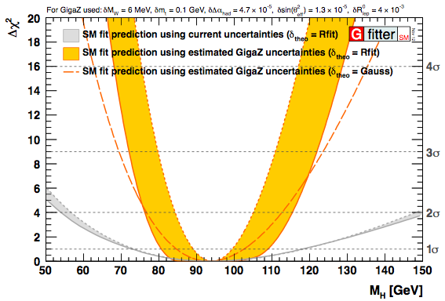
A future linear collider could tremendously improve the precision of the electroweak observables
Current theorey uncertainties
Prospects for ILC with GigaZ
M_{H} [LHC}
+5.3 [ +23 ]
−5.0 [ −19 ]
No theory uncertainty: M_{H} = 94.2 GeV
Rfit scheme: M_{H} = 92.3 GeV
In brackets the 4σ uncertainties
+17 [ +36 ]
−12 [ −23 ]

Slide 25
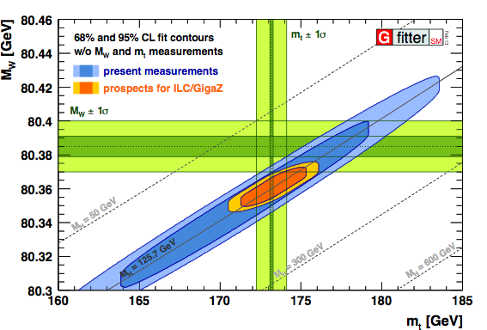
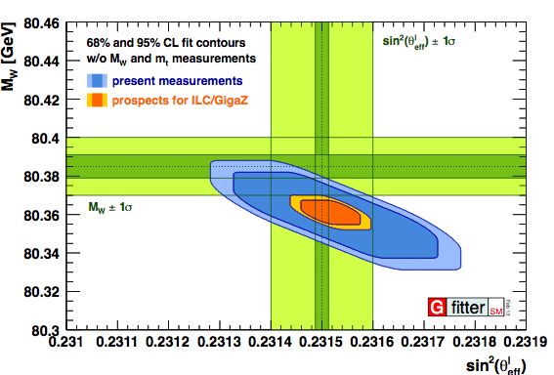
A future linear collider could tremendously improve the precision of the electroweak observables
Prospects for ILC with GigaZ
Assume 50% of today’s theoretical uncertainty (implies three-loop EW calculations), treated à la Rfit
Fit features huge uncertainty reduction for indirect determinations
Strong constraints on S, T, U

Slide 26
Summary
Knowledge of M_{H} over-constrains EW fit allowing a precise prediction of observables
http://gfitter.desy.de/Standard_Model
SM Fit with p-value of 0.07
Incentive to revisit Z → bb experimentally and theoretically !
Incentive also to compute higher order contributions to other partial width observables
Significant improvement in SM prediction of key observables with M_{H}
δM_{W} =
= 11 MeV
(exp: 15 MeV)
M_{W} : 28 → 11 MeV
sin2θ^{l}_{eff} : 2.3 → 1.0 × 10⁻⁵
m_{top} : 6.2 → 2.5 GeV
Improved accuracy sets benchmark for new direct measurements

Slide 27
Extra slides…

Slide 28
http://gfitter.desy.de/Standard_Model/
ILC with GigaZ projection

Slide 29
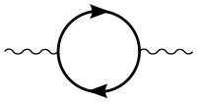
Oblique Corrections
Parametrising new physics contributions to electroweak precision observables
At low energies, BSM physics appears dominantly through vacuum polarisation
Aka, oblique corrections
Direct corrections (vertex, box, brems-strahlung) generally suppressed by m_{f}/Λ
Oblique corrections from New Physics
described through “STU parameters”
[Peskin-Takeuchi, Phys. Rev. D46, 381 (1992)]
  O_{meas} = O_{SM,ref}(M_{H},m_{t}) + c_{S}S + c_{T}T + c_{U}U
    S : (S+U) New Physics contributions
    to neutral (charged) currents
    T : Difference between neutral and
    charged current processes –
    sensitive to weak isospin violation
    U : Constrained by M_{W} and Γ_{W}. Usually very small in NP models (often: U=0)
Oblique corrections reabsorbed into electroweak parameters Δρ, Δκ, Δr
Electroweak fit sensitive to BSM physics through oblique corrections
In direct competition with Higgs loop corrections
H
Z
Z

Slide 30
Oblique Corrections
Parametrising new physics contributions to electroweak precision observables
At low energies, BSM physics appears dominantly through vacuum polarisation
Illustrations of constraints on S, T
[ arXiv:1107.0975 ]

Slide 31
Oblique Corrections
Parametrising new physics contributions to electroweak precision observables
Definitions of S,T,U,V,W,X :
[STU parameters suffice when (q/M)2 small, so that linear approximation is accurate]
[Burgess et al., PLB 326, 276 (1994), PRD 49, 6115 (1994)]

Slide 32
Oblique Corrections
Parametrising new physics contributions to electroweak precision observables
Dependence of electroweak observables on S,T,U,V,W,X.
[The numerical values are based on α^{–1}(M_{Z}) = 128 and sin²θ_{W} = 0.23]
[Burgess et al., PLB 326, 276 (1994), PRD 49, 6115 (1994)]

Slide 33
ILC with GigaZ
Prospects for M_{H} fit at ILC with GigaZ
Central values of input observables chosen to agree with their SM prediction for a Higgs mass of 126 GeV (left) and 94 GeV (right), respectively.

Slide 34
Status: Moriond QCD, 2013

Slide 35
Status: Moriond QCD, 2013

