Slide 1
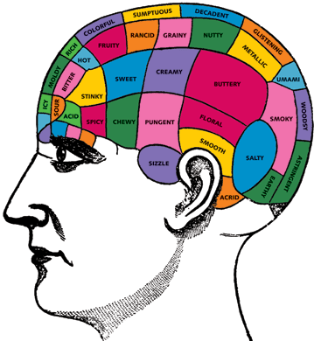
The Flavour of Higgs — EXPERIMENTAL INTRODUCTION
ANDREAS HOECKER, CERN
WEIZMANN, 23 JUNE 2014
Flavour in the SM — Charged lepton and quark flavour — Top flavour — Higgs flavour — Higgs FV — Outlook

Slide 2
Flavour in the SM

Slide 3
Flavour and CP violation in the Standard Model
SU(3) × SU(2) × U(1)_{Y}
Flavour physics fundamentally related to the Higgs mechanism, but what are implications of the Higgs boson discovery to flavour physics?
Field content and gauge charges:
+ possible D=5 terms related to neutrino masses
Three terms in renormalisable part of Largrangian: freedom in field definition used to move flavour changing currents from Higgs to gauge bosons after EW symmetry breaking
Only charged flavour-changing current
Only physical degree of freedom: neutral Higgs boson, no FCNC associated with it
Seems there is little direct impact of Higgs discovery (known mass) on flavour physics

Slide 4
Flavour and CP violation in the Standard Model
SU(3) × SU(2) × U(1)_{Y}
Flavour physics fundamentally related to the Higgs mechanism, but what are implications of the Higgs boson discovery to flavour physics?
Field content and gauge charges:
+ possible D=5 terms related to neutrino masses
Three terms in renormalisable part of Largrangian: freedom in field definition used to move flavour changing currents from Higgs to gauge bosons after EW symmetry breaking
Only charged flavour-changing current
Only physical degree of freedom: neutral Higgs boson, no FCNC associated with it
Seems there is little direct impact of Higgs discovery (known mass) on flavour physics
Flavour physics and CP violation naturally embedded into predictive SM
What is the origin of the observed flavour hierarchies?
Did we see everything? If not, why not?

Slide 5
Flavour and CP violation in the Standard Model
The gauge hierarchy flavour problem
SM expected to be valid only below some scale Λ
Scalar mass term is only dimensionful parameter in renormalisable part of L_{SM}
This sets the EW scale
Scalar mass term receives large quantum corrections if there is another scale Λ
Electroweak physics requires Λ ≤ M_{W} /g ≈ few hundred GeV
But flavour physics restricts the scale of dimension-6 ΔF = 2 operators to
[ eg: Isidori-Nir-Perez, 1002.0900 ]
unless it is special (weak coupling, loop suppression, CKM-like suppressions) Generic scale far beyond reach of LHC!
Difficult to construct natural models, if naturalness is a good concept

Slide 6
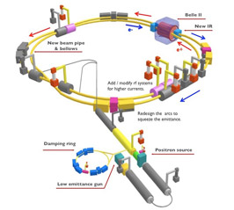
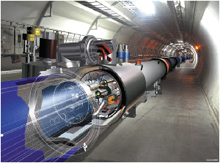
Flavour and CP violation in the Standard Model
Experimental probes
A) The usual suspects
Kaon and B-meson precision measurements at e⁺e⁻ factories
Rare decay and CP violation studies
Measurements at hadron colliders (most notably LHCb, but also ATLAS, CMS, CDF, D0) cover B_{s} physics, loop (“penguin”) phenomena, precise γ measurements, charm physics
B) New channels in LHC era
Top flavour (ATLAS, CMS, Tevatron)
Higgs flavour measurements (mainly ATLAS, CMS)
Search for direct production of new fermions (ATLAS, CMS)
Relation between direct and indirect searches via BSM physics only
Specific models needed

Slide 7
Some experimental highlights of quark flavour physics
“Classical” flavour physics

Slide 8
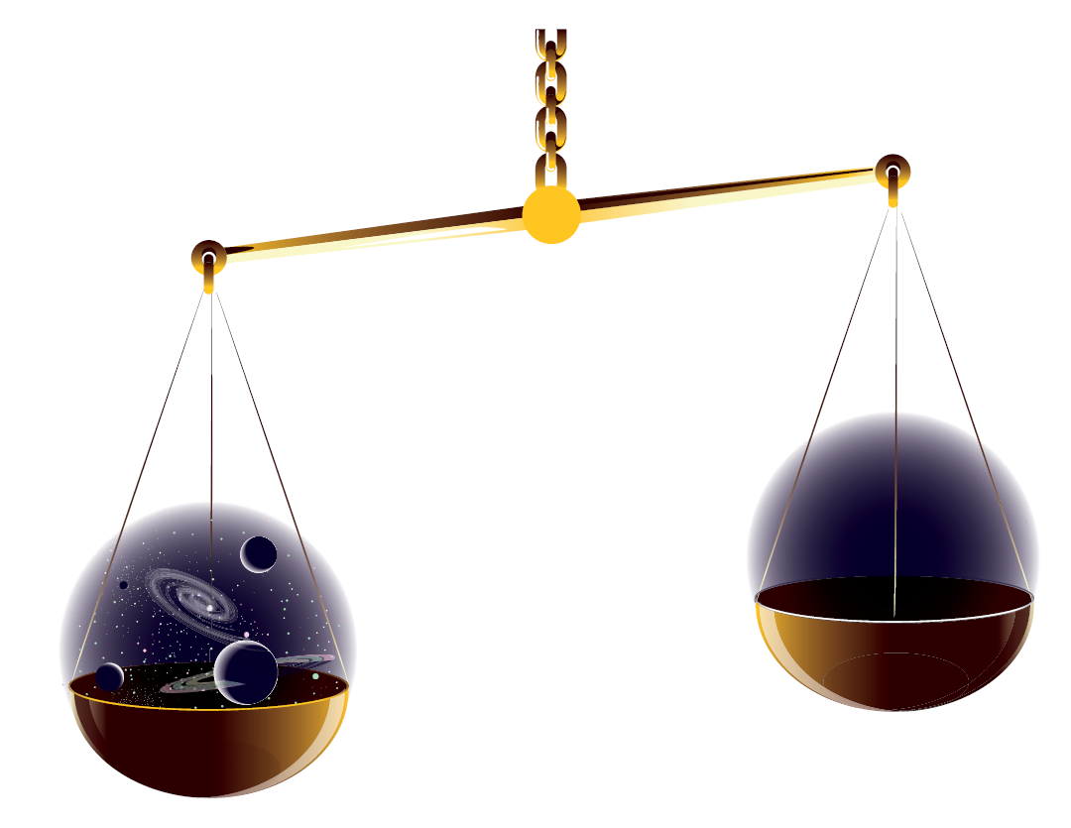
We believe that flavour physics is the key to understanding the matter-antimatter asymmetry in the universe
Quark sector proven (purpose?)
Lepton sector not yet proven, but thought of with great hopes for purpose
Strong CP problem still unsolved

Slide 9
Flavour Physics
SM consists of up to 24 elementary matter particles and 3 forces with total of 26 parameters
6 Leptons
6 Quarks
Fermions
Photon
3 weak bosons
8 Gluons
Electro-magnetic force
Bosons
Weak force
Strong force
Higgs field breaks electroweak symmetry and generates boson and fermion masses
Higgs boson
3 gauge couplings
2 Higgs sector parameters
6 quark masses
3 quark mixing angles + 1 phase
6 lepton masses
3 lepton mixing angles + 1 phase (+ 2 Majorana phases?)
22 of the 26 parameters related to flavour — some may appear tuned…

Slide 10
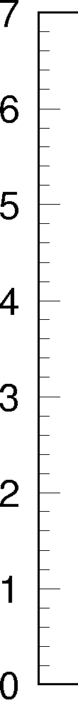
Quark Flavour Physics
Came a long way since the discovery of strange particles by Rochester, Butler in 1946/47
Unitary 3-generation quark mixing matrix — small CPV, top has ∼unity Yukawa coupling
Charge: +2/3
Charge: −1/3
log₁₀( mass [MeV/c²] )
top
FCNC suppressed
In SM
Flavour-changing transition by charged weak current
(boldness indicates transition probability ∝ |V_{ij}|)
bottom
charm
strange
Smallest couplings are complex → CP violation
(phase δ ∼ 70 degrees; accident as not responsible for baryogenesis?)
down
up

Slide 11
Quark Flavour Physics
Came a long way since the discovery of strange particles by Rochester, Butler in 1946/47
[ ckmfitter.in2p3.fr ]
Quark mixing matrix consistent with three-generation unitarity
1995 (top measured)
2001 (B-factories started)
2013 (B-factories + LHCb)
Several anomalies appeared and disappeared or became implausible (eg, CPV in “penguin” decays, B → τν, di-muon asymmetry A^{s}_{SL}, |V_{ub}| discrepancy?)
Precision constraints led to Minimal Flavour Violation (MFV) paradigm for new physics
Many more measurements available in quark-flavour sector…

Slide 12
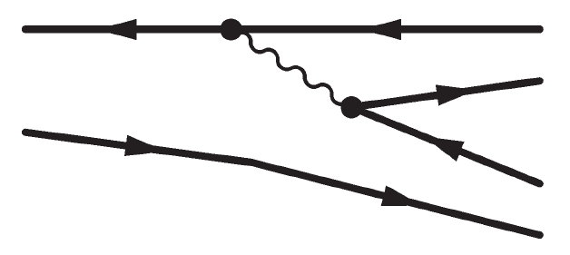
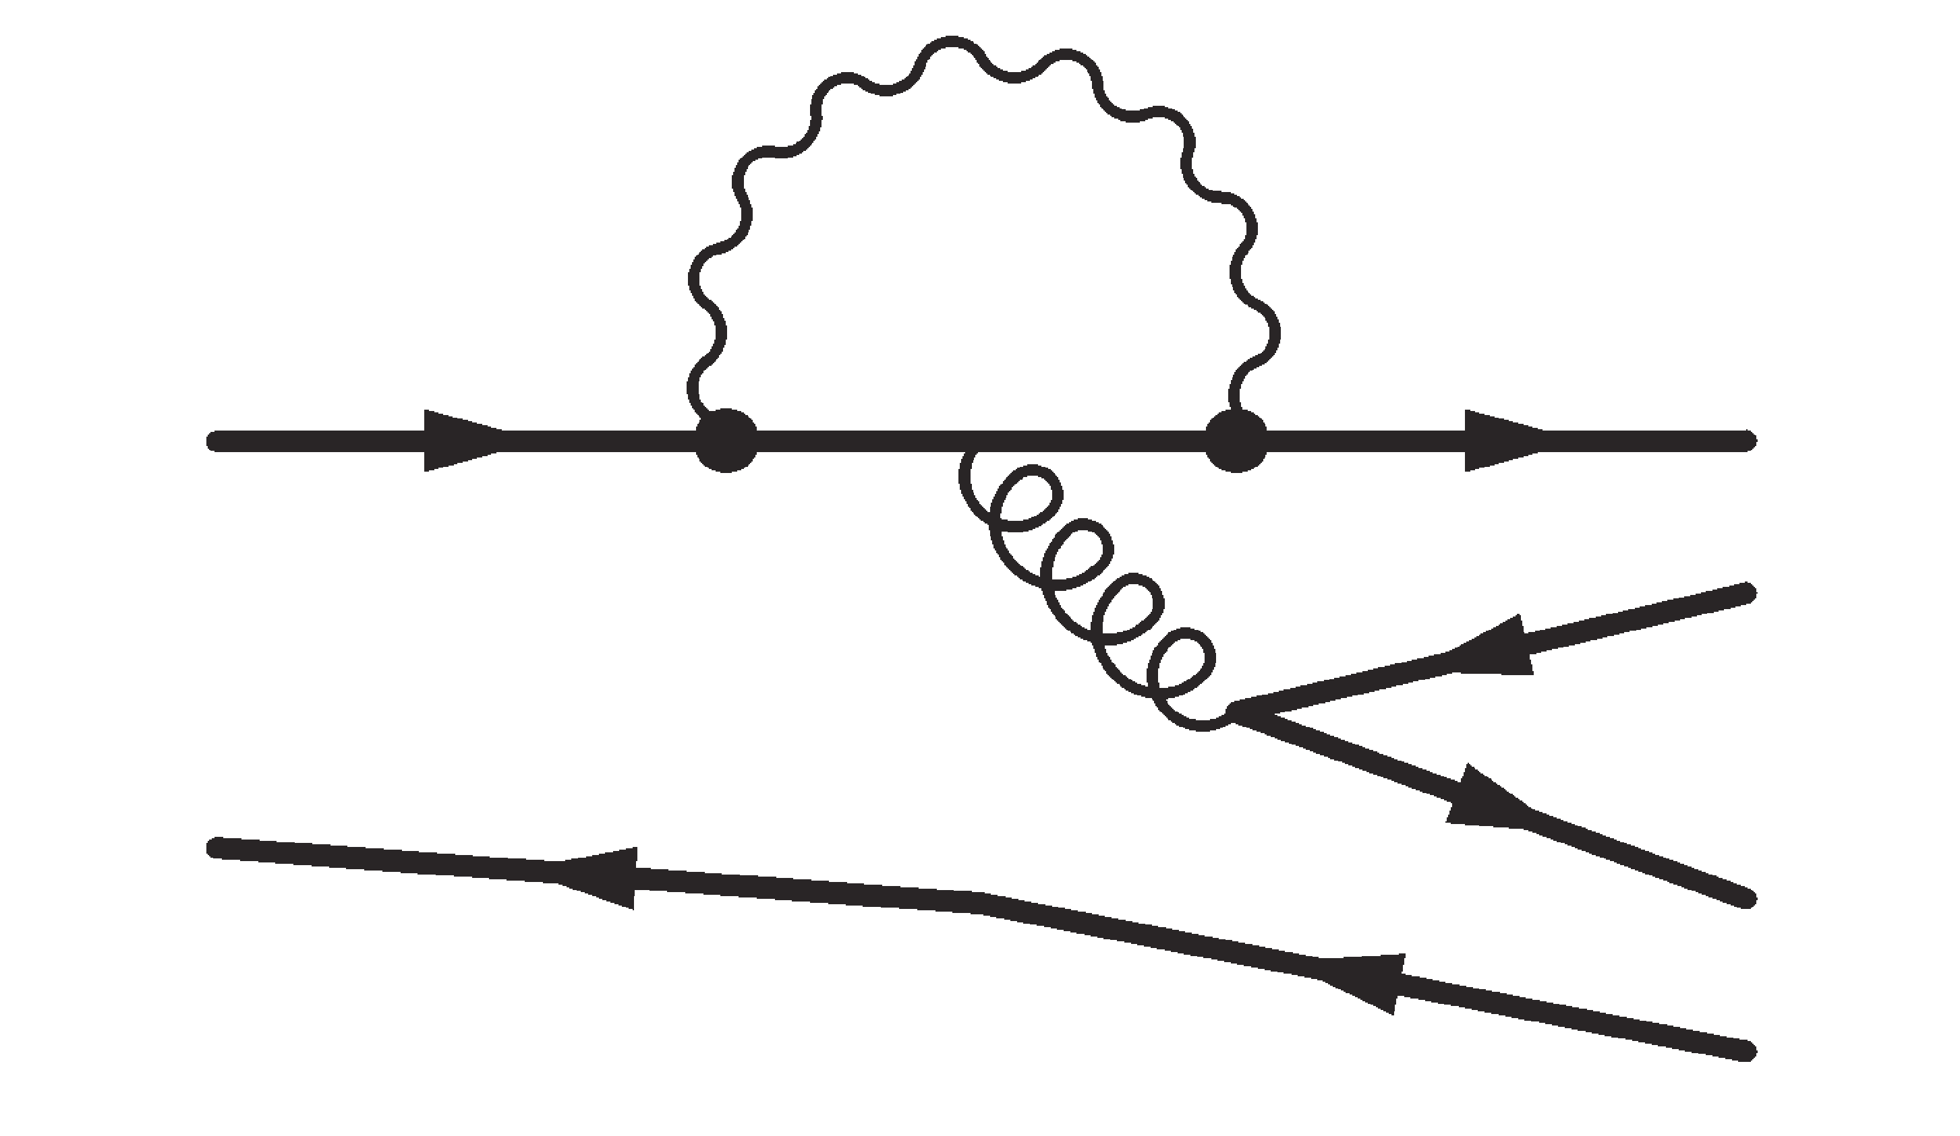
Quark Flavour Physics
Some hope to find hints for new physics in “Penguin modes”
Sensitive to same (or similar) CKM angle as B⁰ → J/ψ K_{s}
[ www.slac.stanford.edu/xorg/hfag ]
Tree transition:
“Penguin” transition:
sin(2β_{eff})

Slide 13
Quark Flavour Physics
LHC enters the game: B_{s} physics — CP violation and rare decays
The most expected flavour measurements at LHC: phase φ_{s} and B_{s} → µµ
[ CMS-PAS-BPH-13-007, LHCb-CONF-2013-012 ]
(2.9 ± 0.7) × 10⁻⁹
H⁺ ?
φ_{s} = –2β_{s} = 0.00 ± 0.07 [ HFAG, SM: –0.036 ± 0.002 ]
BTW: LHCb also measured sin(2β_{ψKs}): 0.73 ± 0.07 ± 0.04 [B-factories WA: 0.665 ± 0.024]
h, H, A ?
Penguin SM diagram, adds to box
Helicity-suppressed in SM
Flavour probe of EW and Higgs sector

Slide 14
Quark Flavour Physics
B_{s} → µµ history
[ https://twiki.cern.ch/twiki/bin/view/CMSPublic/PhysicsResultsCombined ]

Slide 15
Quark Flavour Physics
Electroweak penguin decays (FCNC)
Anomaly in LHCb B⁰ → K*⁰µ⁺µ– angular analysis
P_{4/5}’ : form-factor independent angular observable, theoretically clean at large recoil (low q² = m²_{µµ})
[ LHCb: 1308.1707, 3 fb⁻¹ announced to come soon SM: Déscotes-Genon et al.1303.5794]
Fluctuation in P₅’ (local 3.7σ, global 2.8σ)? Non-perturbative effect (Λ/m_{b})?
New physics in C₉ Wilson coefficient (NNLO)? [ C₇: b → sγ, C₁₀: B → µµ are constrained ]

Slide 16
Quark Flavour Physics
Rare charm decays
Very rare FCNC decay D⁰ → µµ also searched for
(Short distance: BR_{SM} ∼ 10^{–18}, GIM & helicity suppressed, possible long-distance enhancement)
[ Phys. Lett. B725 (2013) 15, theory: Burdman et al. hep-ph/0112235 ]
FCNC c → u transition in SUSY
D*⁺ → D⁰(→ π⁺π–)π⁺
D⁰ → µµ
BR(D⁰ → µµ) < 6.2 · 10^{–9}

Slide 17
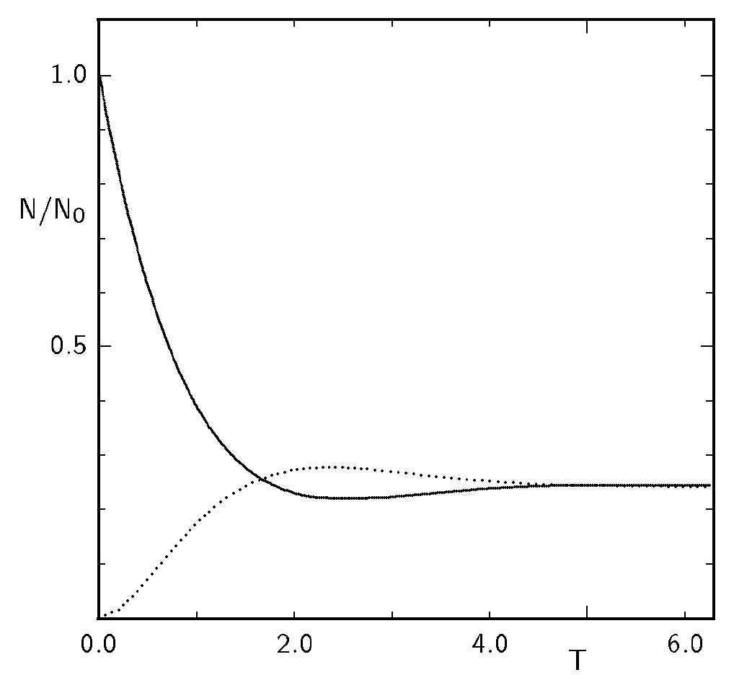
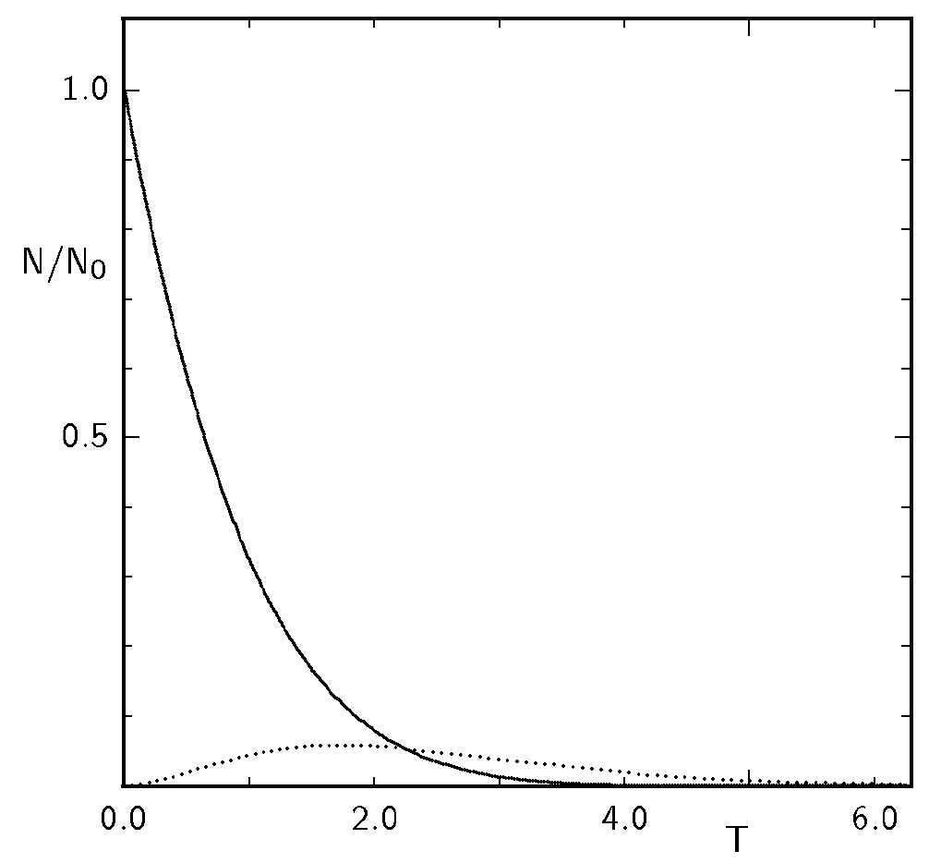
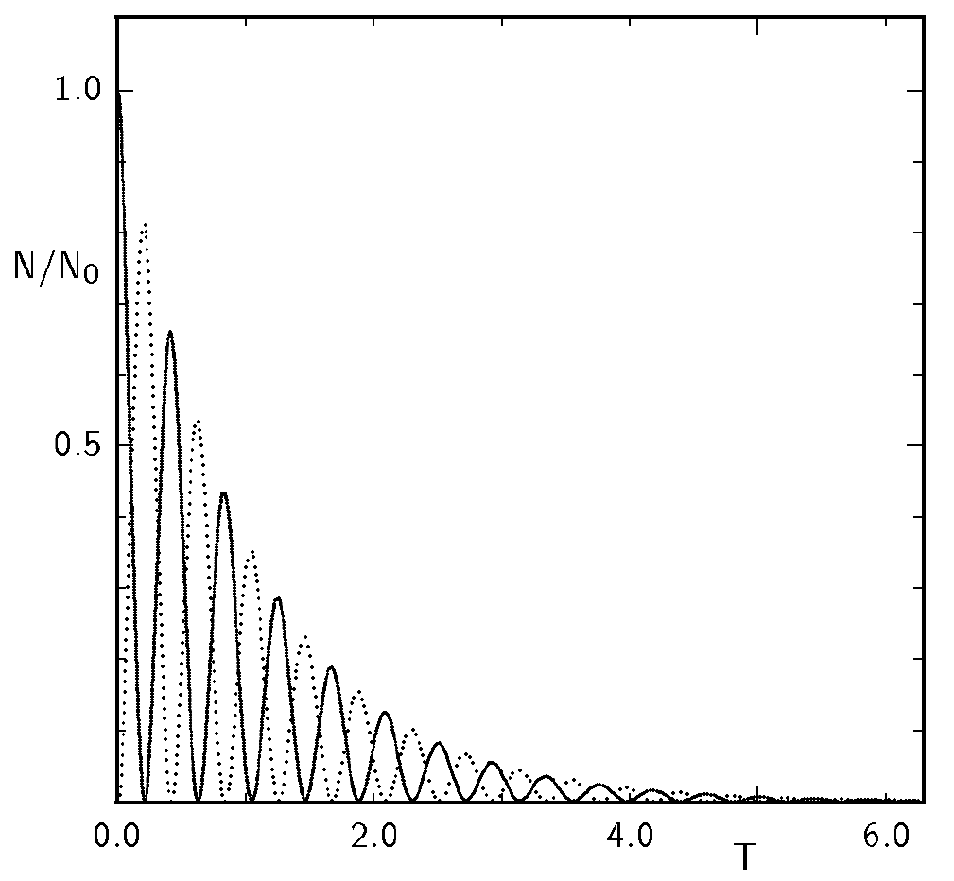
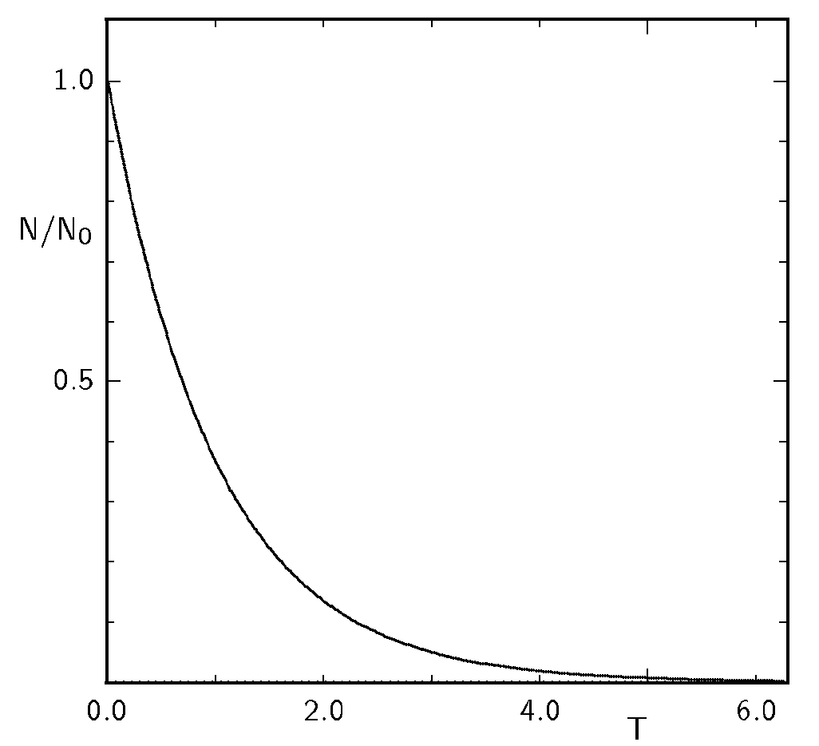
Quark Flavour Physics
Charm mixing
Neutral charm mesons mix much slower than neutral K and B mesons
Mixing probability: χ ∼ 50%
χ ∼ 18%
χ ∼ 50%
χ ∼ 10^{–6}
for the plot
x_{s} = 15
y_{s} = 0.10
δ_{s} = 0
Charm mixing discovered in 2007 by B-factories, huge statistics & tiny effect → high precision measurement
Confirmed and improved in 2012+2013 by LHCb, CDF
No indication of CP violation (in agreement with SM)
Direct CPV: ΔA_{CP}(D⁰→K⁺K–) — ΔA_{CP}(D⁰→π⁺π–) = —0.82 ± 0.21 ± 0.11 % (3.5σ) → +0.14 ± 0.16 ± 0.08 %
y’ [10^{–3}]
LHCb
x’² [10^{–3}]
[ PRL 108,111602 (2012) → 1405.2797, May 2014 ]

Slide 18
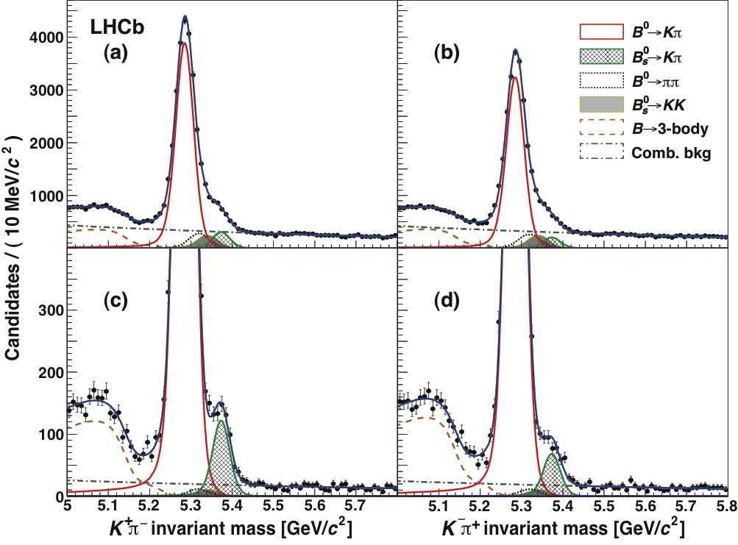
CPV is direct if the partial decay-width of a particle into a final state differs from the width of the corresponding antiparticle into the CP-conjugate final state
Quark Flavour Physics
Direct CP violation
Direct CPV is expected in the SM, but usually small as it requires interference amplitudes with strong and weak phase difference
[ LHCb: 1304.6173 ]
First observed in K ⁰ → ππ system (NA48 & KTeV, 1999): Re(ε’/ε) = (1.65 ± 0.26) · 10⁻³
Later in B ⁰ → K⁺π— system (BABAR, Belle, 2004): A_{Kπ} = −0.082 ± 0.006
And (!) in B_{s} → K—π⁺ system (LHCb 2013): A^{s}_{Kπ} = 0.27 ± 0.04
Although the existence of direct CPV is no surprise in the SM, its quantitative prediction is hard…

Slide 19
Some experimental highlights of charged lepton flavour physics
“Classical” flavour physics

Slide 20
Lepton Flavour Physics
Charged lepton sector: LFV
Negligible in SM → signal would be NP
Only null observation to date
Marciano et al., Annu. Rev. Nucl. Part. Sci.58, 315 (2008)
…
BABAR / Belle
Super-B (50 ab^{–1})
MEGA
MEG 2013
< 5.7 · 10^{—13}
SINDRUM-II
Spectacular perspective !
Mu2e / COMET

Slide 21
Lepton Flavour Physics
Charged lepton sector: LFV
CMSSM model point with 3 massive RH N for various
m(N₃) and θ₁₃
Antusch et al.. JHEP 11, 90 (2006)
Excluded by MEG 2013
Excluded by BABAR 2010

Slide 22
Lepton Flavour Physics
Charged lepton sector: LFV
Neutrinoless conversion: μ–N → e–N
Principle:
  Stopped muon captured by atom
  There: decay or capture or μ—e conversion
  Conversion gives single, distinctive monoenergetic electron (104.96 / 95.56 MeV for Al / Au)
New physics sensitivity compared to µ → eγ for generic dipole dominance models ~390 times lower for Al target
BR(µ → eγ) < 10^{—13} requires R_{µe}(Al) < 3×10^{—16}
Forthcoming experiments: Mu2e @ FNAL, COMET @ J-PARC
Goal: sensitivity down to ~2×10^{—17} with data-taking by 2018
[ Requires 5×10¹⁹ muons – approaching #grains of sand on earth… (R. Bernstein, Pittsburgh 2011) ]
~ α_{QED}

Slide 23
Lepton Flavour Physics
Muon anomalous magnetic moment
γ
BNL E821 (2006): a_{μ}^{exp} = 11 659 180.3 ± 0.1_{EW} ± 4.2_{LO-had} ± 2.6_{NLO-had}
SM (DHMZ e-based): a_{μ}^{exp} = 11 659 209.1 ± 5.4_{stat} ± 3.3_{syst}
?
[ in units of 10 ^{–10} ]
μ
PDG 2013, Status: summer 2013 (published results shown only)
Difference: experiment — SM
a_{μ} ^{exp} – a_{μ} SM | = | (28.8 ± 8.0) × 10 ^{–10}
 3.6 ”standard deviations“ (e⁺e–)
 2.4 ”standard deviations“ (τ)

Slide 24
Some experimental highlights of top flavour physics
Top entering the scene with Tevatron and LHC
Top has O(1) coupling to Higgs (y_{t} = √2m_{t}/υ ≈ 1), profound effect on EW and flavour physics

Slide 25
Top Flavour Physics
Electroweak top production
V_{tb}
Measurements of |V_{tb}| via single top production as test of CKM unitarity
(Precision, however, far below that of B-meson mixing)
|V_{tb}| = 0.998 ± 0.038_{exp} ± 0.016_{theo} [ CMS: 1403.7366 ] | CKM unitarity: 1—|V_{tb}| = (8.80 ± 0.36)·10^{—4}
All cross sections in agreement with SM, no unitarity break down

Slide 26
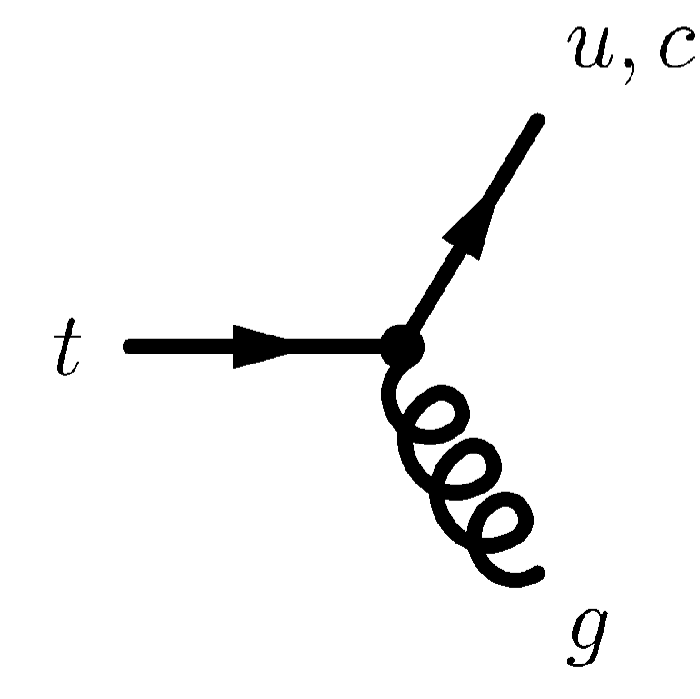
Top Flavour Physics
FCNC in top decay
FCNC top decays are suppressed in SM
(Only at loop level, there CKM suppressed: BR(t → cZ) ∼ 10^{—14})
Current limit (CMS): BR(t → cZ) < 0.21% [CMS: 1208.0957, 7 TeV]
Prospective (CMS):
[ CMS PAS FTR-13-016 ]
Other FCNC processes involve, eg, qg coupling: qg → t → W(→lν)b (additional jet veto)
ATLAS limit: BR(t → cg) < 0.027 % at 95% CL
[ ATLAS: 1203.0529, 7 TeV ]

Slide 27
Top Flavour Physics
FCNC in top decay
FCNC top decays are suppressed in SM
(Only at loop level, there CKM suppressed: BR(t → cH) ∼ 3·10^{—15})
γ
H
γ
Search in t → qH(→ γγ) channel
[ ATLAS: 1403.6293, 7+8 TeV ]
Branching fraction limit: BR(t → qH) ∼ (assumed) BR(t → cH) < 0.79 % at 95% CL
CMS combined multilepton + diphoton to: BR(t → cH) < 0.56 % at 95% CL [ CMS-PAS-HIG-13-034 ]

Slide 28
Top Flavour Physics
A_{FB} = (N(∆y_{tt} > 0) − N(∆y_{tt} < 0)) / ∑
Top-antitop forward-backward asymmetry at Tevatron
(A_{FB} = 0 at LO, but asymmetry in SM at NLO)
NLO QCD +EW: A_{FB} = +(5.0−8.8)% (δ_{NNLO} ∼ ±2%) [ Bernreuther-Si, PRD 86, 034026 (2012) ]
CDF: A_{FB} = +(16.4 ± 4.5)% on 9.4 fb⁻¹ [ CDF, PRD 87, 092002 (2013) ]
D0 (2011): A_{FB} = +(19.6 ± 6.5)% on 5.4 fb⁻¹ [ D0, PRD 84, 112005 (2011) ]
D0 (newest): A_{FB} = +(10.6 ± 3.0)% on 9.7 fb⁻¹ [ D0, 1405.0421 (May 2014) ]
Not conclusive…
Theory progress would require NNLO calculation

Slide 29

Higgs boson flavour physics
What do the data tell us about the flavour structure of the Higgs ?
Brief review of H → di-fermion decays, but production also sensitive to flavour
t
g
g
t
H
t
t
H
g
t
g
t
t

Slide 30
Higgs and Flavour Physics
The non-Higgs SM at the LHC — impressive understanding
[ CombinedSummaryPlots/SM ]

Slide 31
Higgs and Flavour Physics
125.5 GeV Higgs boson — SM properties
[ LHCPhysics/CrossSections ]
Cross sections and branching fractions precisely predicted (m_{H} = 125.5 GeV)
Uncertainties 3∼12%

Slide 32
Higgs and Flavour Physics
Higgs mass
SM predictions can (so far) live without a precision m_{H} measurement, but as experimentalists we want to do the best possible job
Recent final Run-1 result be ATLAS after improvement of detector material description and recalibration using all SM candles (Z, W, J/ψ, Υ)
[ ATLAS: 1406.3827 ]
Compatible in value and uncertainty with CMS result from 4-lepton channel: [ CMS: 1312.5353 ]
125.6 ± 0.4_{stat} ± 0.2_{syst} GeV

Slide 33
Higgs and Flavour Physics
Higgs spin and CP — Higgs boson appears to be SM-like: J^{P} = 0⁺
[ CMS: 1312.5353 ]
From most powerful spin/CP analyser: H → 4-lepton
0⁻ excluded at 3.6σ; CP-odd fraction in decay amplitude: f_{a3} < 0.51 (95% CL)
Spin-1, 2 hypotheses excluded >> 95% CL
SM Higgs hypothesis
Alternative hypothesis
Discrimination is based on 2D PDFs (D_{bkg}, D_{JP})

Slide 34
Higgs and Flavour Physics
SM Higgs to fermions — ττ
[ ATLAS-CONF-2013-108, CMS: 1401.5041 ]
Higgs to fermion analyses all very challenging (or too low BR)
Di-tau reconstructed in all lep/had topologies and jets: 0, 1 (boosted or not), 2 (VBF, VH)
BDT-based tau identification, Higgs discrimination based on m_{ττ}
Likelihood-based calculator to estimate m_{ττ}, σ(m_{ττ}) = 13% ~ 20%, best for boosted τ
Background dominated by Z → ττ (use “τ embedded” Z → μμ), also top & fakes important
At 125 GeV:
ATLAS (8 TeV):
µ = 1.4
(4.1 σ)
CMS (7+8 TeV):
µ = 0.78 ± 0.27
(3.4 σ)
+0.5
−0.4

Slide 35
Higgs and Flavour Physics
SM Higgs to fermions — µµ
[ ATLAS-CONF-2013-010, CMS-PAS-HIG-13-007 ]
Low branching fraction (ten times smaller than γγ), mainly data-driven fit akin to H → γγ
Slight complication due to sum of dominant DY and sub-dominant tt, WW backgrounds
Separation of jet (gluon fusion, VBF), and S/B (central, non-central) categories
At 125 GeV:
ATLAS (8 TeV):
µ < 9.8 (8.2 exp.)
(95% CL)
CMS (7+8 TeV):
µ < 7.4 (5.1 exp.)
(95% CL)

Slide 36
Digression
Upper limit on H → µµ is sufficient to exclude universal Higgs coupling to leptons
Poor man’s LHC averages (don’t quote me!): µ_{ττ} = 0.94 ± 0.23 together with µ_{µµ} < 7.4 (95% CL)
µ_{µµ} / µ_{ττ} < ≈15, but for universal couplings would expect: µ_{µµ} / µ_{ττ} = (m_{τ} / m_{µ})² ≈ 282

Slide 37
[ATLAS-CONF-2013-079, CMS: 1310.3687, 1401.6527 ]
Higgs and Flavour Physics
SM Higgs to fermions — W(→ l(CMS: τ_{had})ν)/Z(→ ll,νν) + H(→ bb)
Large branching fraction, but very challenging channel due to large backgrounds
Require 2 b-tags and distinguish 0, 1, 2 lepton channels, where 0-lepton uses E_{T}^{miss} trigger
Higgs discrimination based on m_{bb}, resolution of ∼16%, improved by including muons
Categories in p_{T}(V) & jets + topol. and kin. variables (reduced background for boosted Higgs)
CMS uses classification BDT and MV regression to improve m(bb) resolution
Dominant backgrounds (form CRs): 0L: Zbb, tt, some Wbb; 1L: tt, Wbb; 2L: Zbb, some tt
Dominant systematics: tt modeling, c-tag efficiency, multijet (1L), signal acceptance
At 125 GeV:
ATLAS (7+8 TeV):
µ = 0.2 ± 0.6
µ < 1.5 (1.4 exp.)
CMS (7+8 TeV):
µ = 1.0 ± 0.5
µ < 1.9 (1.0 exp.)
bb + ττ combined:
A: µ = 1.09 ± 0.34 (3.7σ)
C: µ = 0.83 ± 0.24 (3.8σ)

Slide 38
Higgs and Flavour Physics
SM Higgs to fermions — tt + H(→ bb): direct test of y_{t}
[ ATLAS-CONF-2014-011, CMS: 1303.0763 ]
Challenging channel, requires constraining model uncertainties from data
Reconstruct in 1, 2 lepton channels (fully had. channel in principle also accessible, b-jet triggers)
Categories in jets (2–6) and b-tags (2–4), MVAs (NN) used for signal extraction
Main backgrounds: tt+bb, tt+cc, tt+light
Global fit of all categories allows to constrain backgrounds and nuisance parameters
At 125 GeV:
ATLAS (8 TeV):
µ = 1.7 ± 1.4
µ < 4.1 (2.6 exp.)
(95% CL)
CMS (7+8 TeV):
µ < 5.8 (5.2 exp.)
(95% CL)
After fit

Slide 39
Higgs and Flavour Physics
SM Higgs to fermions — tt + H
[ CMSPublic/ttHCombinationTWiki ]
CMS produced preliminary tt + H(→ bb, ττ, multilepton, γγ) combination
bb, multilepton (incl. same-sign leptons) provide best expected sensitivity
∼2.7σ significance

Slide 40
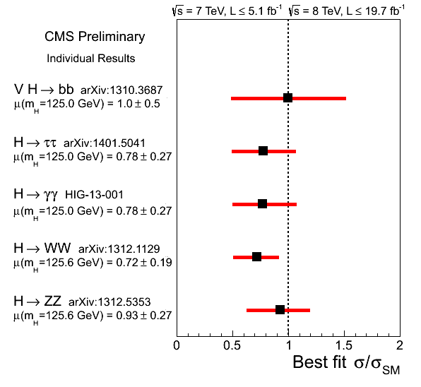
Higgs and Flavour Physics
Higgs couplings — the big picture: agreement with SM
[ ATLAS-CONF-2014-009, CMS: CMSPublic/PhysicsResultsHIG]
Combination of all Higgs production and decay channels (updates expected soon)
7% compatibility with µ = 1
4.6σ VBF significance

Slide 41
Higgs and Flavour Physics
Higgs couplings — the big picture: agreement with SM
[ ATLAS-CONF-2014-009 ]
Fits of effective LO couplings: κ_{F} = κ_{t,b,τ,g} vs. κ_{V} = κ_{W,Z} > 0|_{convention} , where κ_{γ}(κ_{F},κ_{V})
Sensitivity to relative sign between κ_{F} and κ_{V} from destructive interference between W and top loops in H → γγ decay:
κ_{γ}² ∼ 1.59·κ_{W}²
− 0.66·κ_{W}κ_{t}
+ 0.07·κ_{t}²
+ 0.17
− 0.15
κ_{F} = 0.99
κ_{V} = 1.15 ± 0.08

Slide 42
Higgs and Flavour Physics
BSM Higgs decays to invisible particles: H → χχ (DM)
[ ATLAS: 1402.3244, CMS: 1404.1344 ]
Powerful experimental methods to detect invisible decays of the Higgs
No experiment finds significant excess
Assuming SM production rates 95% CL upper limits on BR(H → invisible) can be set
ATLAS: BR < 0.75, ZH(→ ll)
CMS: BR < 0.58, combining ZH + VBF

Slide 43
Higgs and Flavour Physics
BSM Higgs decays to invisible particles: H → χχ (DM)
[ ATLAS-CONF-2014-010, CMS: 1404.1344 ]
Within “Higgs portal” models, these direct searches can be combined in a model-dependent way with the global Higgs coupling fit achieving a stronger constraint
Assume SM-like tree Higgs couplings, but allow new physics in H → γγ, gg loop couplings
Comparison of limits with direct DM searches assuming EFT validity
BR(H → invisible) < 0.37 (95% CL)
BR(H → invisible)

Slide 44
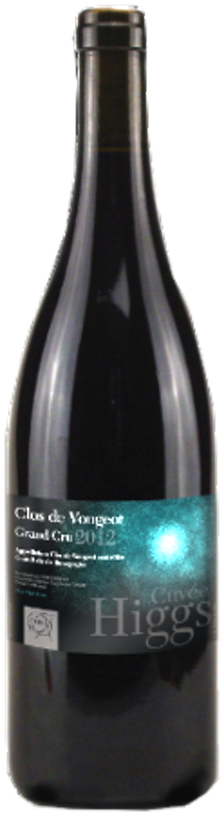
Higgs and Flavour Physics
Let’s recapitulate…
[ CMS-PAS-HIG-13-005 ]
Great measurements —the overall picture is as expected in the SM
Status: Apr 2013

Slide 45
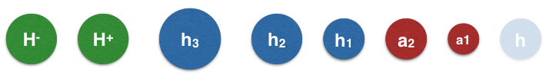
Charged Higgs boson flavour physics
As an example for flavour-related BSM Higgs physics (much more exists!)
BSM Higgs zoo
[ Will Davey, LHCP 2014 ]

Slide 46
BSM Higgs and Flavour Physics
In BSM models, a charged Higgs boson would compete with W current
In principle, any tree or loop processes mediated by W and involving heavy fermions may receive charged Higgs contributions → modification of SM flavour
Examples:
2HDM (T2)
[ CKMfitter: 0907.5135, many other groups ]
_
b
W ⁺
τ ⁺
316 GeV
u
H ⁺
ν
t
γ
W ⁻
b
s
Coloured regions are allowed
H ⁻
Many others: R_{b}, B → D⁽*⁾τν, rare leptonic kaon and tau decays, neutral meson mixing, …

Slide 47
BSM Higgs and Flavour Physics
Direct charged Higgs searches at the LHC
[ ATLAS-CONF-2013-090, CMS: 1205.5736 ]
Distinguish direct searches in light / heavy H ⁺
Light charged Higgs (m_{H+} < m_{top}): t → bH ⁺ (BR decreases with m_{H+} and rises with tanβ)
Heavy charged Higgs (m_{H+} > m_{top}): gb → tH ⁺ (4FS), gg → tbH ⁺ (5FS)

Slide 48
BSM Higgs and Flavour Physics
Direct charged Higgs searches at the LHC
[ ATLAS-CONF-2013-090, CMS: 1205.5736 ]
Interpreting the limits obtained in the (so-called) MSSM m_{h}^{max} scenario, one finds:
→ Little room left for light H⁺, much room for heavy H⁺ (expts. also search for H⁺ → tb)

Slide 49
Higgs boson flavour physics
Pulling it together — constraining BSM Higgs-LFV Yukawa terms

Slide 50
Higgs and Flavour Physics
Lepton flavour violating Higgs couplings
[Yotam Soreq: LHCP 2014, Harnik-Kopp-Zupan: 1209.1397 ]
In L_{Yukawa} we had assumed the SM and removed flavour-violating terms in Y ^{l}
D=5 penguin diagrams:
τ → µγ LFV via y_{τµ}
Though in all generality it would look like this:
Limits from LF
measurements
Upper limits (LHC)
(g – 2)_{µ} via y_{τµ}
H → ττ (∼m_{τ}/υ) measured (LHC)
Many more: µ→e conversion, electron EDM (limits on complex couplings), muonium oscillation, …

Slide 51
Higgs and Flavour Physics
Lepton flavour violating Higgs couplings
In L_{Yukawa} we had assumed the SM and removed flavour-violating terms in Y ^{l}
|Y_{eµ}|
Though in all generality it would look like this:
Limits from LF
measurements
Upper limits (LHC)
|Y_{eτ}|
H → ττ measured (LHC)
[Yotam Soreq: LHCP 2014, Harnik-Kopp-Zupan: 1209.1397 ]
|Y_{µτ}|

Slide 52
Higgs and Flavour Physics
Quark flavour violating Higgs couplings
[Yotam Soreq: LHCP 2014, Harnik-Kopp-Zupan: 1209.1397 ]
Diagonal elements of Yukawa matrix from Higgs-to-quark-pair couplings
H → bb to be measured (LHC)
Limits from t → qH and single-top production (LHC)
ttH to be measured (LHC)
[ ATLAS: 1403.6293 ]
Also limit on Im(ut·tu) from neutron EDM

Slide 53
Higgs and Flavour Physics
Quark flavour violating Higgs couplings
[Yotam Soreq: LHCP 2014, Harnik-Kopp-Zupan: 1209.1397 ]
Tight limits (10⁻⁶ … 10⁻¹²) on off-diagonal elements from neutral meson mixing
—
—
Limits on Re/Im (sd)², (ds)² from K⁰—K⁰ mixing,
on |db(s)|², |bd(s)|² from B⁰_{(s)}—B⁰_{(s)} mixing
Limits on |uc|², |cu|² from D⁰—D⁰ mixing
—
Examples of flavour violating diagrams contributing to neutral meson mixing [1209.1397 ]

Slide 54
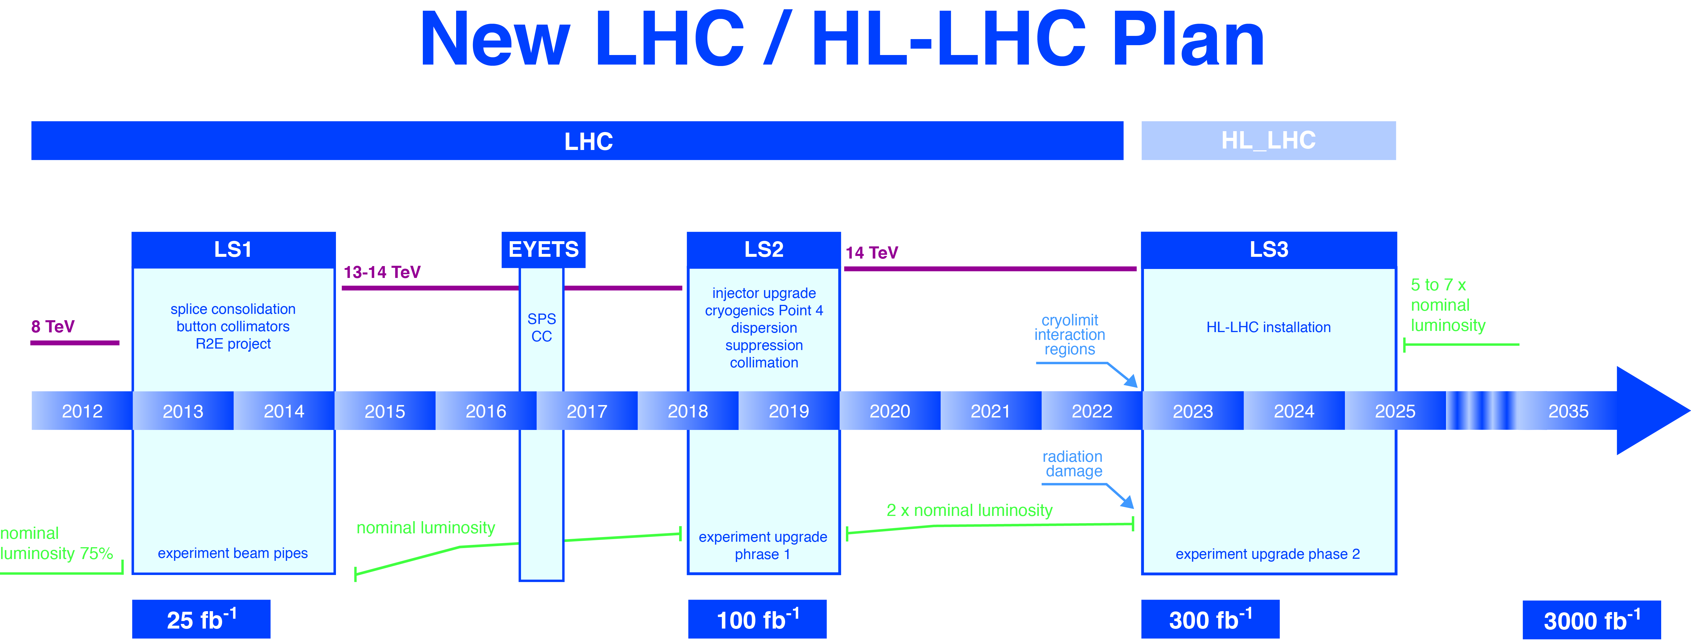
Higgs @ Run-2 and the HL-LHC
Fabiola Gianotti at LHCP 2014:
Full exploitation of LHC project with HL-LHC (√s = 14 TeV, 3000 fb⁻¹) is MANDATORY
(Europe’s top priority per European Strategy, US highest-priority near-term large project per P5)
New LHC / HL-LHC Plan
L = 7·10³³
Pileup ~ 30
L = 1.6·10³⁴
Pileup ~ 35
L = 2−3·10³⁴
Pileup ~ 60
L = 5·10³⁴
Pile-up ~ 140

Slide 55
Higgs @ Run-2 and the HL-LHC
Extrapolations of signal strength measurements
[ CMS: 1307.7135 ]
Scenario 1 (pessimistic):
Systematic uncertainties as today
Scenario 2 (optimistic):
Experimental uncertainties as 1/√L, theory halved
300 fb^{–1}
3000 fb^{–1}
Without theory errors
3000 fb^{–1}

Slide 56
Higgs @ Run-2 and the HL-LHC
Extrapolations of coupling measurements
[ ATLAS: ATL-PHYS-PUB-2013-014, ATL-PHYS-PUB-2014-006]
New ATLAS HL-LHC study on pp → H → Zγ
κ_{i} = measured coupling normalized to SM prediction λ_{ij} = κ_{i}/κ_{j}
Generic fit without assumptions
← Dashed: theory uncertainty
Improved in new study
Expect: 3.9σ (2.3σ) with 3000 (300) fb⁻¹

Slide 57
Higgs @ Run-2 and the HL-LHC
Extrapolations of coupling measurements
[ ATLAS: ATL-PHYS-PUB-2013-014, ATL-PHYS-PUB-2014-006]
New ATLAS study on pp → H → Zγ
κ_{i} = measured coupling normalized to SM prediction λ_{ij} = κ_{i}/κ_{j}
Generic fit without assumptions
Main conclusions:
3000 fb⁻¹: typical precision 2−10 % per experiment (except rare modes)
1.5−2 × better than with 300 fb⁻¹
Crucial to also reduce theory uncertainties
Improved in new study
Expect: 3.9σ (2.3σ) with 3000 (300) fb⁻¹

Slide 58


Slide 59
Cross section ratios
Hugely increased potential for discovery of heavy particles at 13~14 TeV
But life can become harder for states lighter than tt
Cross section ratios: 14 (13) TeV / 8 TeV
And: pp → H±(500) + X: 14 TeV/8 TeV ~ 7
(for 13 TeV / 8 TeV: 8.4)
(for 13 TeV / 8 TeV: 12)
(for 13 TeV / 8 TeV: 46)
(13 / 8: 2700)

Slide 60
Conclusions
Flavour physics is precisely predicted in the SM and allows experimentalists to study a large variety of very different phenomena, some reaching out to very high mass scales
The LHC added crucial new areas: precision Higgs, top and B_{s} physics
Mined from all sides flavour physics appears ever more SM like
Matching the picture that emerges from the LHC Run-1 new physics searches
Success of CKM paradigm is puzzling in light of EW hierarchy problem
In lack of guidance from new physics, flavour physics must remain as broad as possible and constraints from it become even more important
New tools are ahead: LHC Run 2, HL-LHC, Super-KEKB/Belle-2, NA62, KOTO, Mu2e, new g-2, and more

Slide 61
Spare slides …

Slide 62
Constraints on flavour violating Higgs couplings to quarks (left) and leptons (right)
[ Harnik-Kopp-Zupan: 1209.1397 ]

Slide 63
BSM Higgs and Flavour Physics
Direct charged Higgs searches at the LHC
Cross section and branching fractions for charged Higgs
Type-II 2HDM
MSSM
m_{h}^{max} scenario

Slide 64
[ Stefan Dittmaier, LHCP 2014 ]
Higgs processes at the LHC
Direct charged Higgs searches at the LHC

