Slide 1
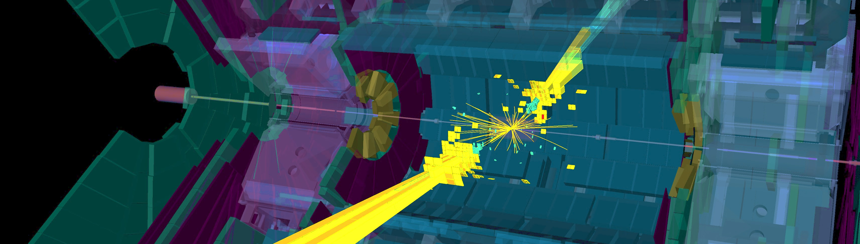
Daybreak at the LHC
— what we learned from the 13 TeV data so far
Andreas Hoecker (CERN)
Israeli Physical Society Meeting, Technion, December 17th, 2017

Slide 2


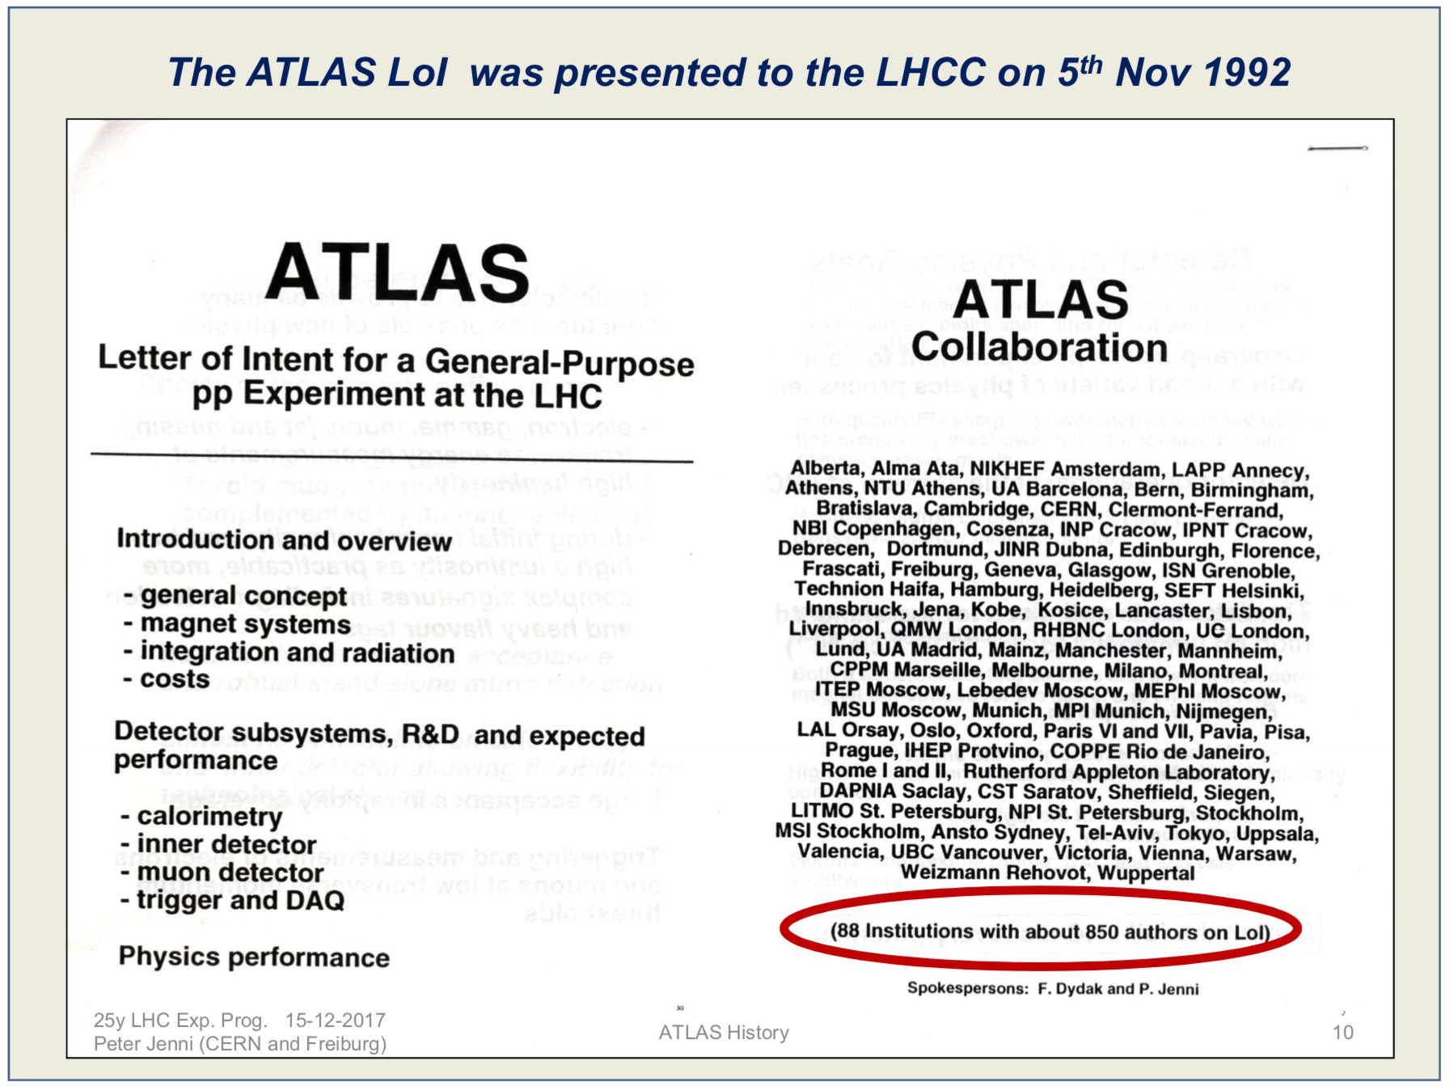
CERN Symposium: https://indico.cern.ch/event/653848

Slide 3
Experimental particle physics has come a long way…
Event shows tracks produced in the 1200 litre Gargamelle bubble chamber that provided the first confirmation of a neutral current interaction (image: CERN)

Slide 4
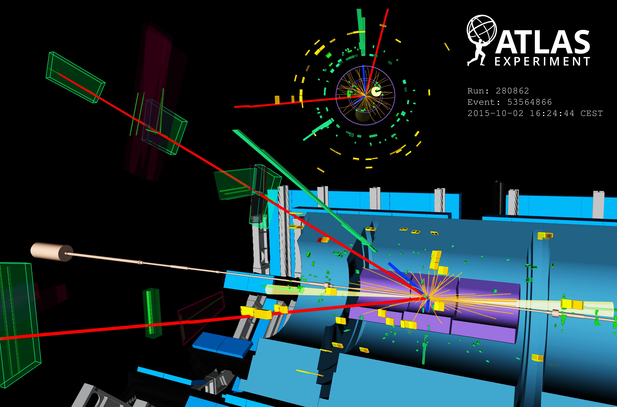
… to produce and observe this:
Display of VBF H → eeµµ + 2jets candidate from 13 TeV pp collisions. The electrons have a transverse momentum of 111 and 16 GeV, the muons 18 and 17 GeV, and the jets 118 and 54 GeV. The invariant mass of the four lepton system is 129 GeV, the dielectron (dimuon) invariant mass is 91 (29) GeV, the pseudorapidity difference between the two jets is 6.4 and the dijet invariant mass is 2 TeV.

Slide 5
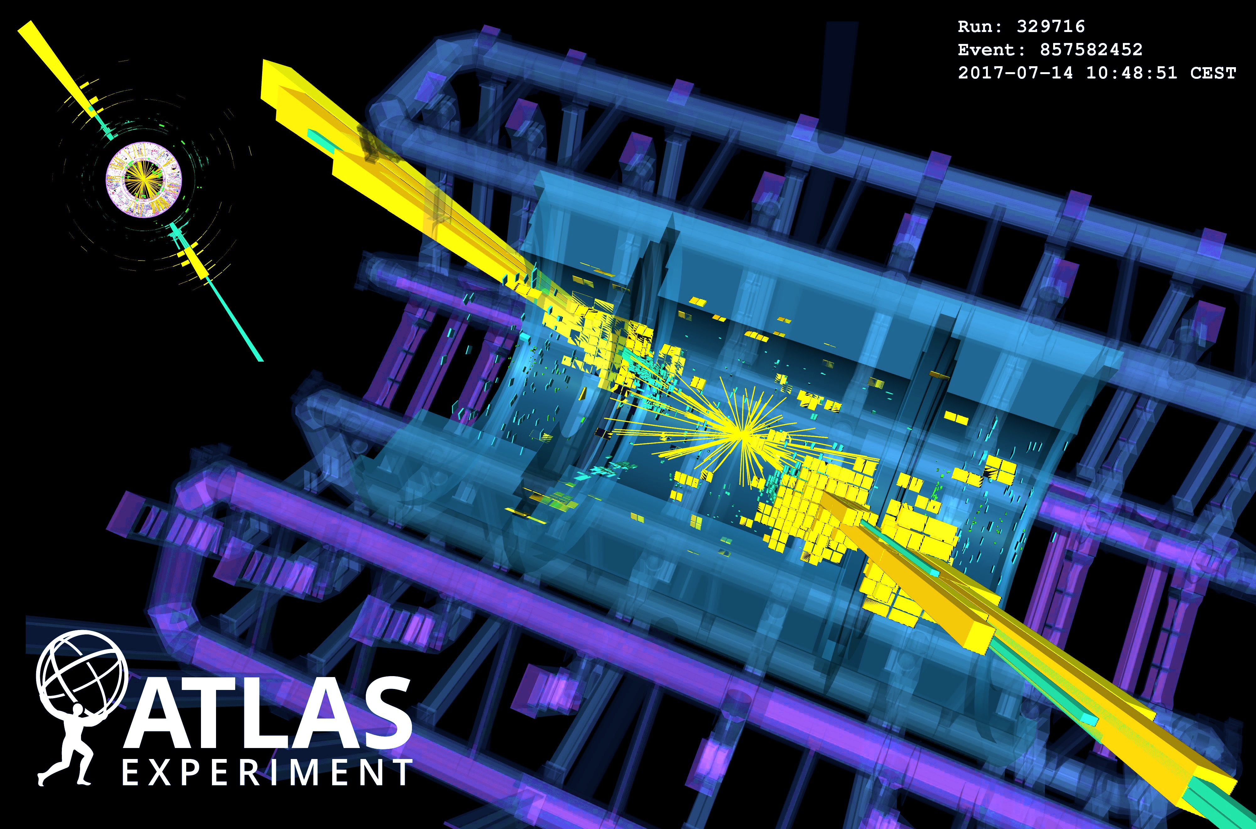
… and this:
Display of huge di-jet event with m_{jj}=9.3 TeV, produced in pp collisions at √s = 13 TeV in 2017. The two high-p_{T} jets both have p_{T}=2.9 TeV, one is at η=–1.2 and the other at η=0.9.

Slide 6
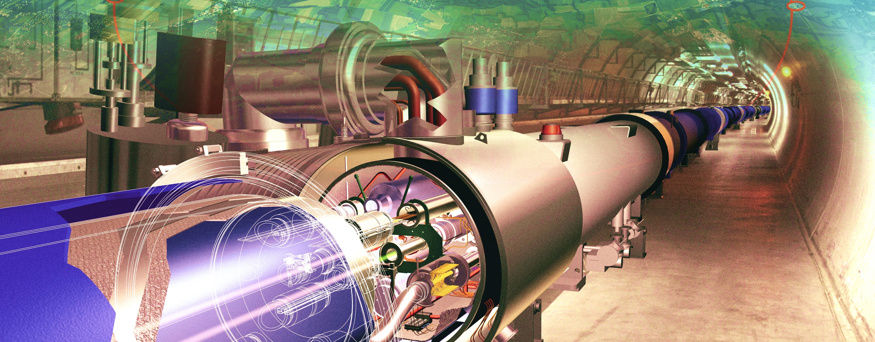
Producing the Higgs Boson and Searching for New Physics at the TeV Scale Requires a Huge Machine

Slide 7
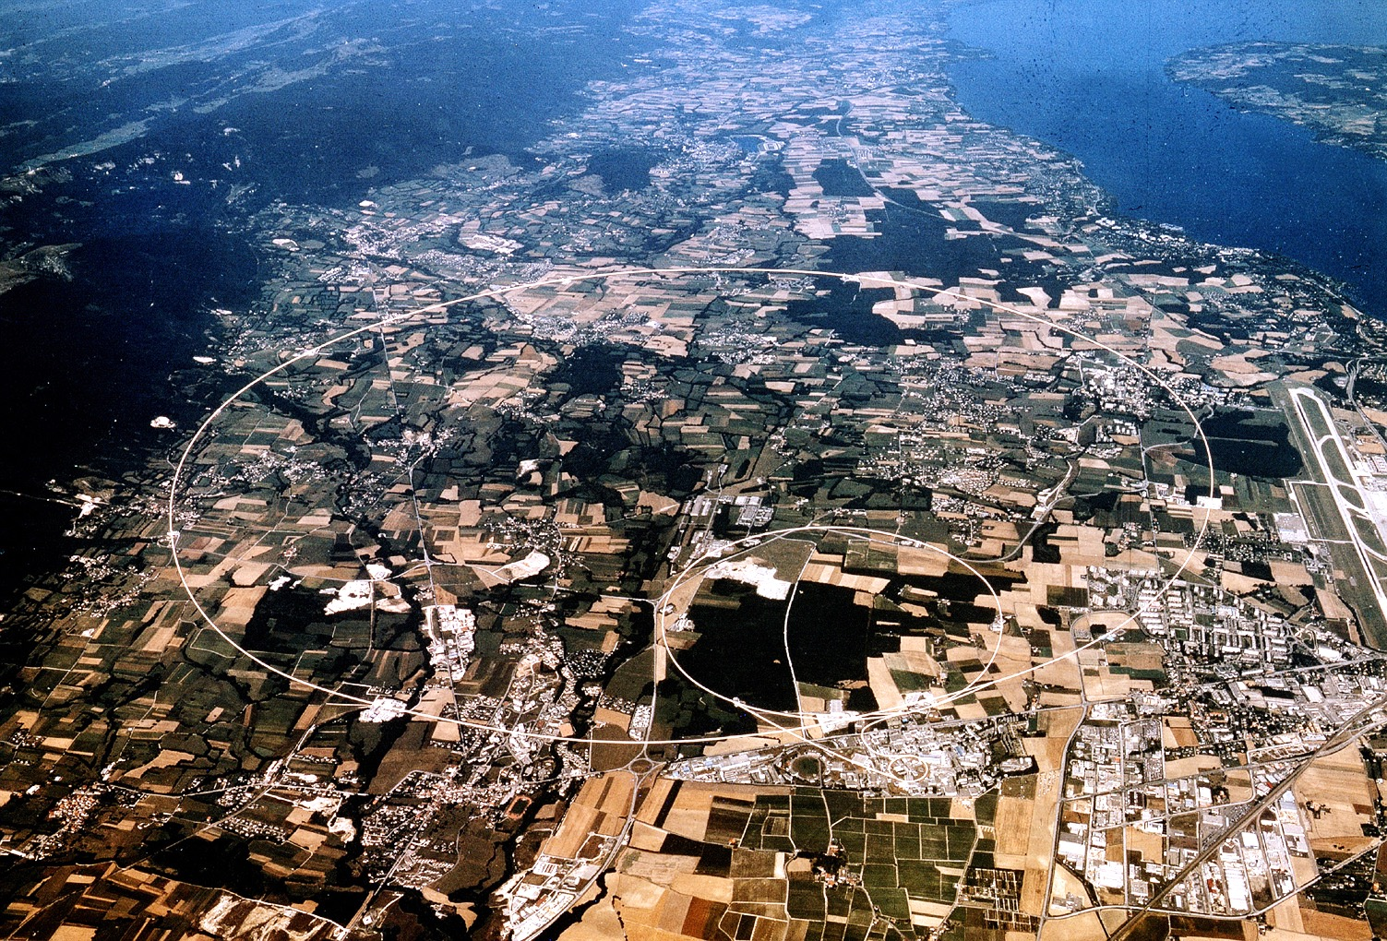
Superconducting proton/ion accelerator and collider installed in a 27 km circumference underground tunnel (4 m tunnel cross-section diameter )
LHC ring at CERN:
27 km circumference
70 — 140 m depth
LHC
control room
CERN (Prévessin site)
SPS ring:
7 km circumference

Slide 8
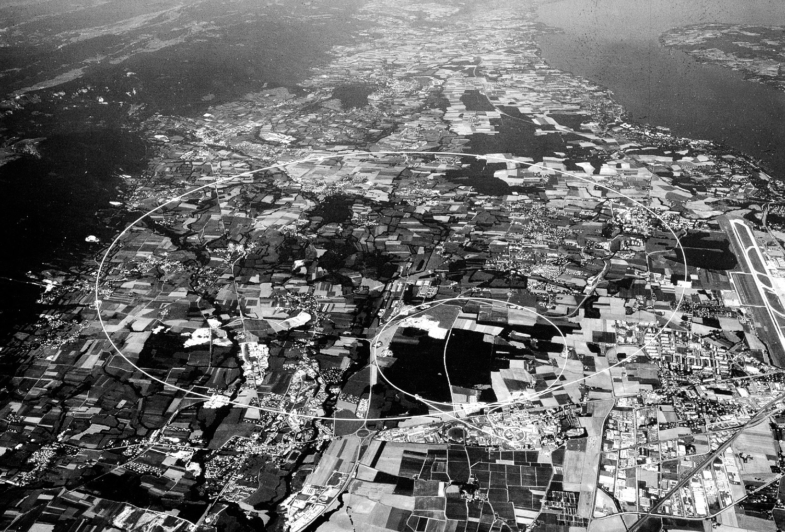
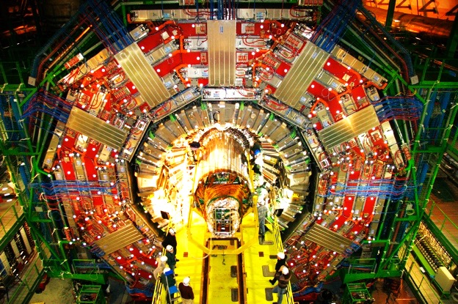
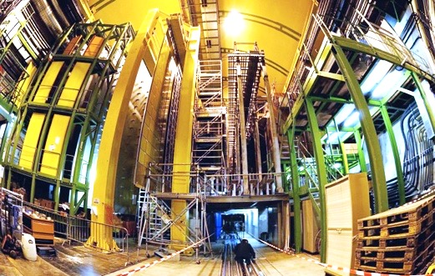
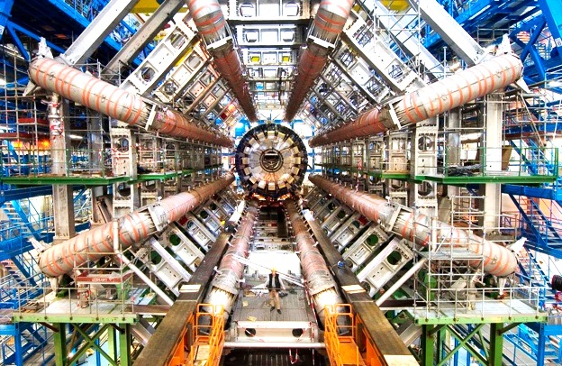
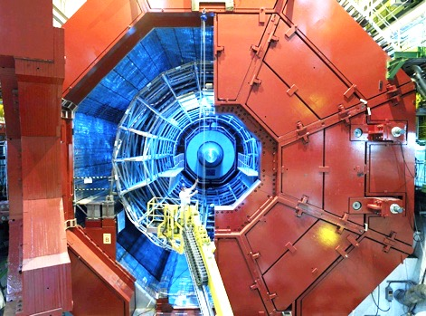
ATLAS & CMS: giant, ultra sophisticated general purpose particle detectors
CMS
LHCb
ALICE
ATLAS

Slide 9

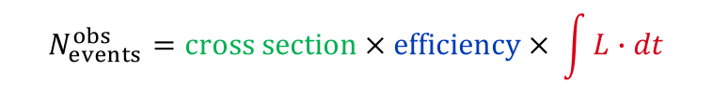
Luminosity — single most important quantity
Luminosity drives our ability to detect low cross-section processes
“Cross section” given by Nature
“Efficiency” of detection optimised by experimentalist
Integrated luminosity delivered by LHC
$$N_{events}^{obs}=cross section × efficiency × \int{L∙dt}$$
Luminosity is a function of the LHC beam parameters
$$L=\frac{f_{rev}n_{bunch}N_{p}^{2}}{4πσ_{x}σ_{y}}∙R\left(θ_{c},ε,β^{∗},σ_{z}\right)$$
Reduction factor
Crossing angle (0.3 mrad) and “hourglass effect” (σ_{z} ~ 4–6 cm)
crossing angle
hour glass

Slide 10
Luminosity — single most important quantity
Integrated delivered luminosity since 2011
High-luminosity comes with a challenge
Total of 93 fb^{–1} delivered at √s = 13 TeV during LHC Run-2, 80 fb^{–1} good for physics in ATLAS

Slide 11

The Higgs boson
Run-1 magnus opum
The SM predicts all its properties, except for its mass
Full references for mechanism:
F. Englert and R. Brout, PRL 13 (1964) 321.
P.W. Higgs, PRL 13 (1964) 508.
G. Guralnik, C. Hagen, and T.W.B. Kibble, PRL 13 (1964) 585.
It should be noted that Landau and Ginzburg had proposed a field giving the photon a mass in a superconductor, the mathematics of which is identical to the “Higgs mechanism” and predates it by several years.
http://www.shardcore.org/shardpress

Slide 12

Higgs boson production at the LHC
At the LHC, the Higgs boson is dominantly produced via gluon fusion for σ_{H,total} = 56 pb at √s = 13 TeV for m_{H} = 125 GeV
Cross section steeply falling with Higgs mass
Weak boson fusion (σ_{W/Z+H} ~ 3.8 pb):
g
t
t
H
Higgs-strahlung (σ_{W/Z+H} ~ 1.4/0.9 pb):
g
t
σ_{H,ggF} ~ 49 pb at 13 TeV
“ttH” production (σ_{ttH} ~ 0.5 pb):
Total production of almost 6 million SM Higgs bosons of 125 GeV by today in each ATLAS and CMS

Slide 13
Higgs boson production at the LHC
H(125 GeV) branching fractions:
Because of the coupling to the mass of the decay particles:
  … the Higgs will decay with preference to the heaviest particles allowed
  … the Higgs does not couple directly to photons and gluons, but only via “loops” involving preferentially heavy particles (e.g., top, W )
0.012% (e,µ)
1.1% (e,µ)
Uncertainties 3∼12%

Slide 14
Combined ATLAS & CMS Higgs analysis and flurry of Higgs property measurements
ATLAS & CMS Combinations of Higgs mass and coupling measurements
[ 1503.07589, 1606.02266 ]
Agreement among experiments
Overall signal strength: µ = 1.09 ± 0.11
Precise mass combination (0.2%):
m_{H} = 125.09 ± 0.21_{stat} ± 0.11_{syst} GeV
Higgs production processes
Higgs decay processes
Observed in Run-1
Observed in Run-1
Note that the least model-dependent observables at the LHC are ratios of couplings

Slide 15
Combined ATLAS & CMS Higgs analysis and flurry of Higgs property measurements
ATLAS & CMS Combinations of Higgs mass and coupling measurements
[ 1503.07589, 1606.02266 ]
t
t
t
W
W
W
t
t
t
Couplings to massless particles mediated by loops involving heavy particles
Powerful test for new physics (eg, excludes SM-like heavy 4th fermion generation)

Slide 16
The Higgs boson as a portal to beyond the SM physics
Higgs is narrow: 4.1 MeV
For comparison:
Γ_{W} = 2.1 GeV
Γ_{Z} = 2.5 GeV
Γ_{top} = 1.3 GeV
Invisible dark matter?
?
Even small couplings to new light states can measurably distort branching fractions
Γ_{H} = 4.1 MeV

Slide 17
Higgs in the bosonic channels
Reobservation at 13 TeV and improved property measurements
ATLAS-CONF-2017-047
+0.06 +0.06
– 0.05 – 0.05
Combination of γγ and ZZ* channels gives µ = 1.09 ± 0.09 stat exp theo
Combined measurement of Higgs mass: 124.98 ± 0.28 GeV (in agreement with Run-1 ATLAS & CMS)
arXiv:1708.02810
ATLAS-CONF-2017-045

Slide 18
Higgs in the fermionic channels
H → bb (BR: 58%), best channel: W/Z+H → 0 (+MET), 1, 2 leptons + H
Extremely complex and challenging analysis yielding H → bb evidence at 3.6σ (4.0σ expected)
Powerful validation channel: W/Z+Z(→bb) observed at 5.8σ (5.3σ expected)
Analysis benefits from improved b-tagging due to new innermost Pixel layer (IBL)
arXiv:1708.03299
µ(VH(bb)) = 0.90
+0.28
– 0.26

Slide 19
Higgs in the fermionic channels
tt+H production directly probes Higgs–top coupling
ATLAS-CONF-2017-076 ATLAS-CONF-2017-077
Combine large variety of final state depending on top and Higgs decays
Distinguish: tt+H(→bb), tt+H(→WW*, 𝜏𝜏), tt+H(→γγ), tt+H(→ZZ*)
ttH multi-lepton analysis
Heavy use of data-driven constraints and multivariate classification
Run-2 combination yields 4.2σ evidence (3.8σ expected)

Slide 20
The Brout-Englert-Higgs mechanism is real !
The (mysterious) scalar sector of the SM is directly connected with profound questions of the SM: naturalness, vacuum stability and energy, flavour
The Higgs discovery allows us to directly study this sector, requiring a broad experimental programme that will extend over decades

Slide 21
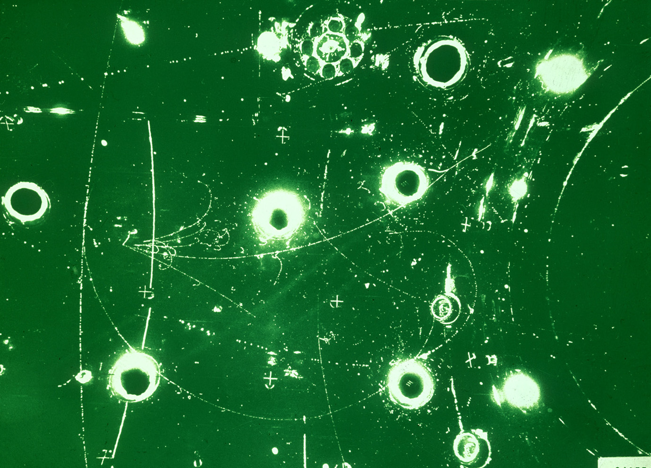
The Standard Model
BEH mechanism
Early universe: symmetric phase, fundamental particles are massless → gauge symmetry is respected
Symmetric phase – early universe
Gravity
Photon
Weak boson
Neutrinos
Electrons
Top quark
H. Murayama

Slide 22
The Standard Model
BEH mechanism
Early universe: symmetric phase, fundamental particles are massless → gauge symmetry is respected
Higgs quantum liquid in broken phase
Gravity
At a phase transition at ~T_{EW} (~several 10⁻¹¹ s after big bang, causal domain of few cm) the Higgs field displaces the ground state breaking gauge symmetry
It fills all space time (but without orientation as it has no spin)
Particles interact with Higgs field and effectively reduce their velocity. Acquired mass proportional to interaction strength
Photon
×
×
Weak boson
×
×
×
×
×
Neutrinos
ν_{L}
Λ⁻¹
ν_{L}
Electrons
×
e_{L}
e_{R}
×
e_{L}
×
×
→ Action of the Higgs field creates “vacuum viscosity”
×
_{L}
_{R}
Interaction with Higgs field alters chirality of massive Dirac fermion
×
×
Top quark
_{R}
_{R}
×
_{R}
×
×
_{L}
_{L}
t_{L}
_{L}
×
×
H. Murayama

Slide 23

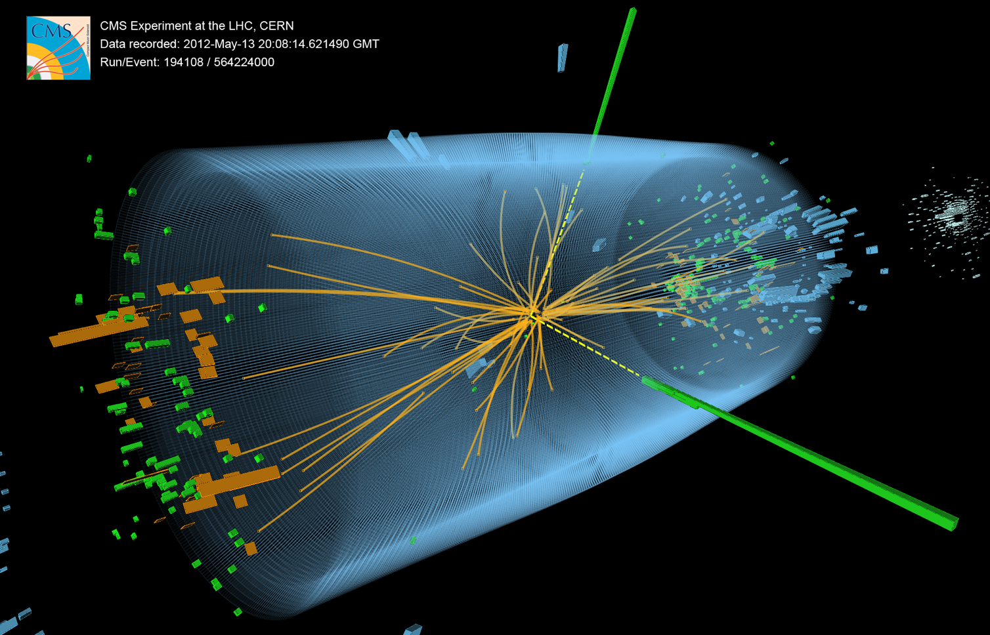
The Higgs boson does more

Slide 24
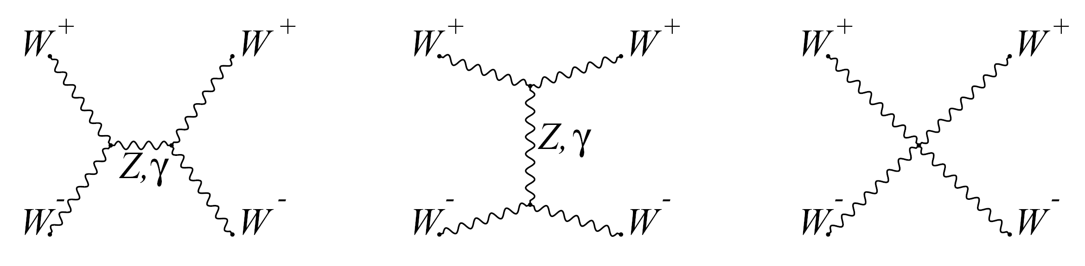
The electroweak sector needs the Higgs boson
Higgs boson acts as “moderator” to unitarise high-energy longitudinal vector boson scattering
Unitarity: if only Z and W are exchanged, the amplitude of (longitudinal) W_{L}W_{L} scattering violates unitarity
Higgs boson restores unitarity of total amplitude:
H
m_{H} must not be too large (which is fulfilled)
H
Same-sign WW selection greatly reduces strong production. Removes s-channel Higgs process:
Look for VBS scattering in high dijet invariant mass distributions
EW VBS production
Non-VBS production
Strong production

Slide 25
The electroweak sector needs the Higgs boson
Higgs boson acts as “moderator” to unitarise high-energy longitudinal vector boson scattering
Unitarity: if only Z and W are exchanged, the amplitude of (longitudinal) W_{L}W_{L} scattering violates unitarity
arXiv:1709.05822
Higgs boson restores unitarity of total amplitude:
Same-sign WW selection greatly reduces strong production. Removes s-channel Higgs process:
Look for VBS scattering in high dijet invariant mass distributions
CMS observes EW production at 5.7σ
EW VBS production
Non-VBS production
Strong production

Slide 26



The electroweak sector needs the Higgs boson
Global electroweak fit was masterpiece of LEP/SLD (e⁺e–) era
Discovery of Higgs over-constrains the fit and dramatically improves predictability
Higgs boson mass from LHC
Competitive W mass measurement from ATLAS
Also: precise measurement of sin²𝛳_{eff} (new result by CMS in 2017)
Most precise top mass results from the LHC

Slide 27
Ultimate precision is possible at the LHC
ATLAS measured the W boson mass to 0.02% and the top quark mass to 0.3% precision
Measurement uses W → e𝜈, µ𝜈 events
Excellent agreement of results among e / µ channels, W⁺ / W– and p_{T,𝓁} / m_{T}
Combined result:
m _{W} (ATLAS) = 80370 ± 7 stat ± 11 exp syst ± 14 mod syst MeV
= 80370 ± 19 MeV
arXiv:1701.07240
W boson mass
arXiv:1701.07240
Top quark mass
ATLAS-CONF-2017-071

Slide 28
Searches for new physics
Cover all areas: high mass, electroweak production, long-lived particles, forbidden decays, …
Theory-agnostic, signature based searches, as well as highly targeted model-dependent ones
Most high-profile searches on 2015+2016 data released
No significant anomaly seen so far

Slide 29
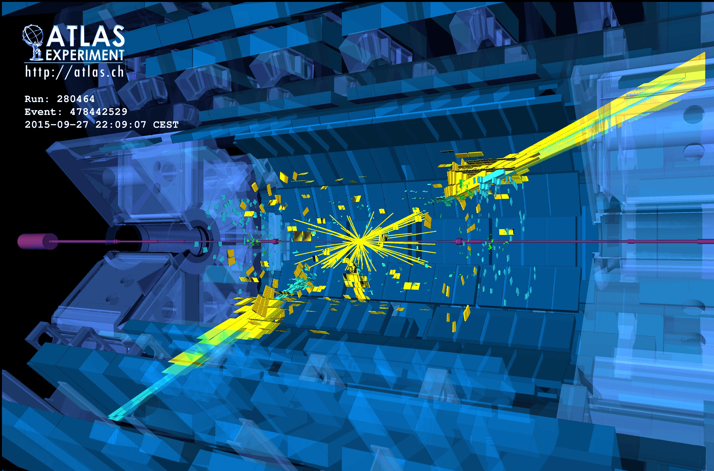
New physics in events with jets ?

Slide 30


New physics in events with jets ?
< 10 ^{–19} m
10^{–15} m
Several 10^{–15} m
O(10^{–10} m)
O(10^{–9} m)
quark
Do quarks have substructure? Can they be excited?

Slide 31
Searches in high-p_{T} multijet final states at 13 TeV
Processes with large cross-sections, sensitivity to highest new physics scales
Basic but very powerful searches
arXiv:1703.09127
Dijet resonance and angular distribution (incl. lower mass via ISR)
High-p_{T} multijets produced, eg, by strong gravity
Fit of empirical function to data
No anomaly seen in these or similar searches
Limits on excited quarks (for example) at 6.0 TeV

Slide 32
Supersymmetry
Offers elegant solution to: naturalness problem, unification, dark matter
Very diverse signatures. Highest cross-section events produce gluino / squark pairs with decays to jets and missing transverse momentum
arXiv:1712.02332

Slide 33
Naturalness driven SUSY searches
Searches for direct production of stop/sbottom & charginos/neutralinos
SUSY stop and sbottom, or “Electroweak-inos” may be the lightest SUSY particles. Low-cross section searches requiring dedicated optimisation. Long-term search effort
“Compressed” regions

Slide 34
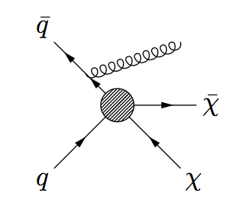
May not be able to prove at LHC that a signal is dark matter
Searches for dark matter production at the LHC
Canonical signature is ‘X+MET’ with large variety of ‘X’
Direct dark matter production at the LHC requires boost for triggering. Depending on coupling it can be made by different objects.
“break it ”
Experimentally challenging to control Z/W+jets background. Theory input needed.
“shake it ”
arXiv:1711.03301
“make it ”
Energetic gluon/photon radiation in the initial sate
Many other 13 TeV results available:
jets + MET
γ + MET
V + MET
H + MET
tt + MET
Can also directly search for mediator in, eg, dijet events
No anomaly seen so far

Slide 35


Anomalies in charged lepton transitions?
LHCb and the B-factories measure ratios of semileptonic B decays. Robust SM predictions due to lepton flavour universality
$$R_{D^{(∗)}}=\frac{BR(B^{0}→D^{\left(∗\right)}τν)}{BR(B^{0}→D^{\left(∗\right)}ℓν)}$$
$$R_{K}=\frac{BR(B^{+}→K^{+}μμ)}{BR(B^{+}→K^{+}ee)}$$
R_{K} (1.0 < q² < 6.0 GeV²)
R_{K*} (0.045 < q² < 1.1 GeV²)
R_{K*} (1.1 < q² < 6.0 GeV²)
Some deviation seen in both tree (left) and loop(right) decays, but more data needed before any conclusions can be drawn

Slide 36
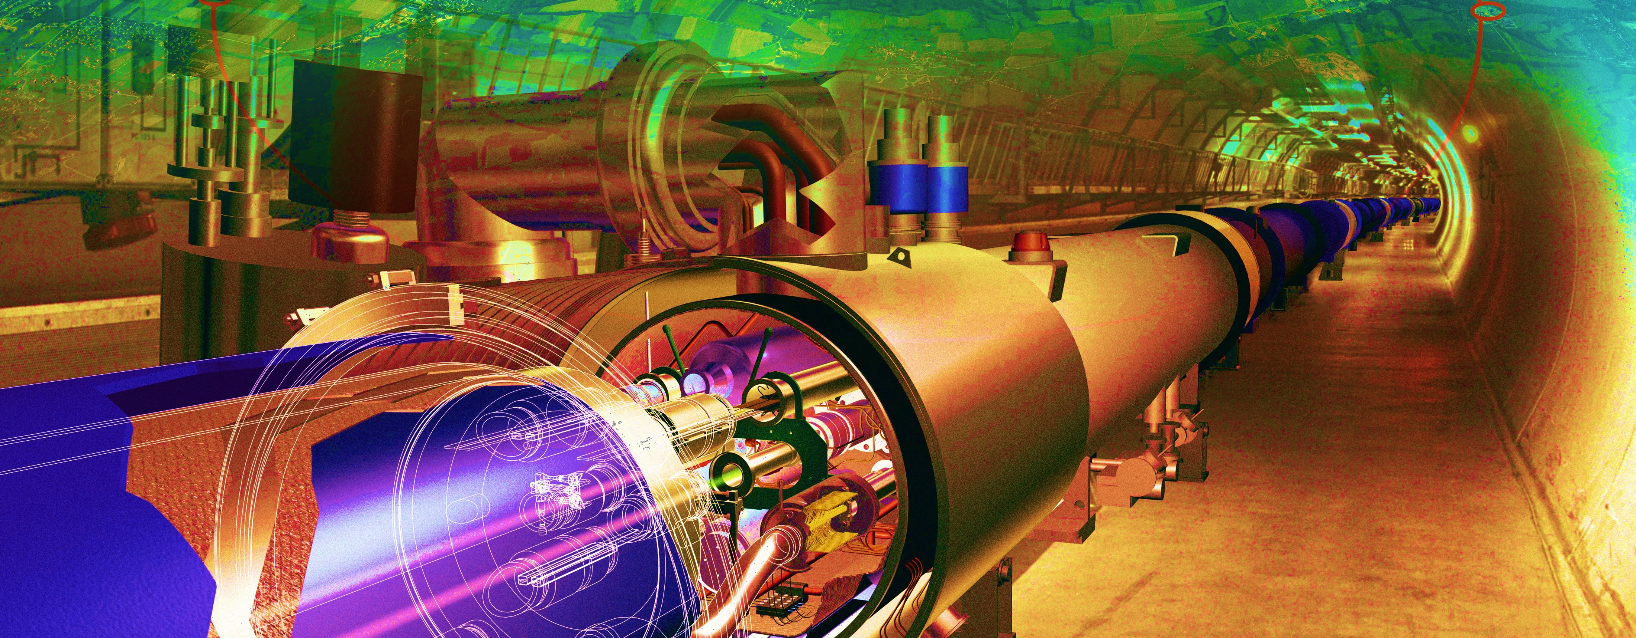
The next steps

Slide 37
Design image of the ATLAS Phase-2 tracker (ITk)
Phase-2:
The High-Luminosity LHC
HL-LHC
We are here

Slide 38
Expected integrated luminosity of LHC & HL-LHC
3000
2500
We will be going here
2000
Run-5
1500
HL-LHC
1000
Run-4
500
We are here
Run-3
0
Run-2
2015
2019
2023
2027
2031
2035
© P. Ferreira da Silva at Moriond EW, 2016

Slide 39
Challenges and opportunities
Particle physics has entered an era of uncertainty: we have a beautiful theory, and many indications that it is incomplete.
Contrary to Fermi, who knew the TeV scale, we do not know the next new physics scale. Naturalness suggests O(TeV), but we do not know how much Nature cares about naturalness.

Slide 40
Challenges and opportunities
Particle physics has entered an era of uncertainty: we have a beautiful theory, and many indications that it is incomplete.
Contrary to Fermi, who knew the TeV scale, we do not know the next new physics scale. Naturalness suggests O(TeV), but we do not know how much Nature cares about naturalness.
We live in data-driven times, experiment must guide us to the next stage. That means we need a very broad and diverse research programme.
We need flagship collider programmes at the energy frontier: the strength and diversity of the LHC and HL-LHC are unequalled today: ATLAS alone released > 700 papers on collision data
We need to develop high-field magnets and compact high-gradient accelerators for the long-term future
We need to continue and further extend the intensity and precision programme: rare B & kaon physics, g–2, lepton flavour violation, n/p/e/µEDM, neutrino physics with all that belongs to it, proton decay
We need to search for dark matter particles/WIMPs using direct DM experiments, indirect searches in space, fixed target searches, axion searches
Altogether, this is a fantastic toolset to find answers to the many open questions in our field

Slide 41
Extra slides

Slide 42
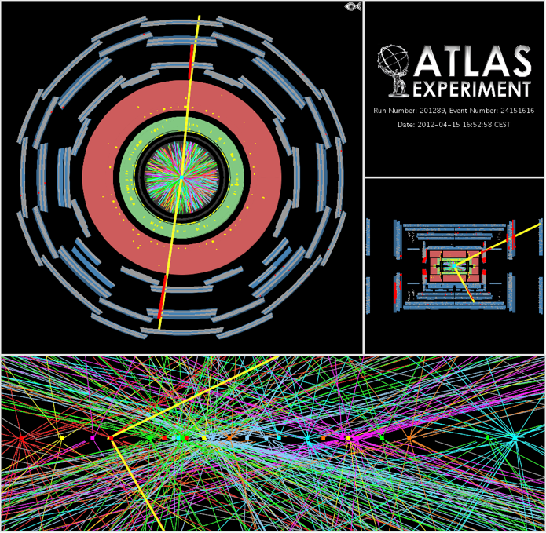

High luminosity comes at price of pileup interactions
Pileup interactions
  Average of 21 (peak: 40) interactions per crossing in 2012. Similar in 2016. LHC design value:
  Most analyses quite insensitive to pileup at this rate, several mitigation methods used
  However: higher trigger thresholds → low-p_{T} physics suffers
$$μ=\frac{σ_{inel}∙L}{f_{rev}∙n_{bunch}}≈\frac{80 mb∙10 {nb}^{−1}s^{−1}}{11245 s^{−1}∙2808}=25$$

Slide 43
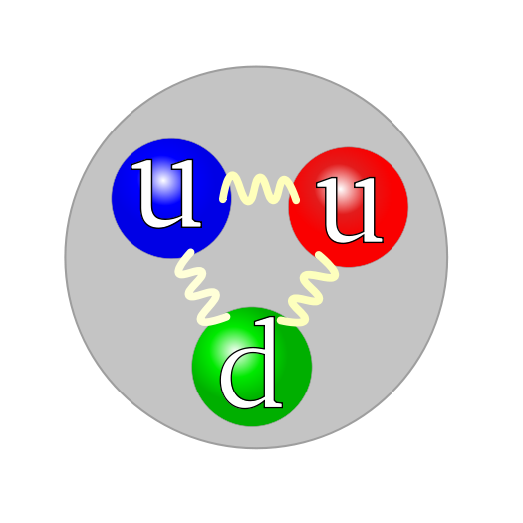
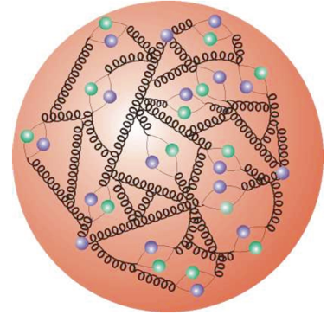
Proton–Proton Collisions
For proton–proton collisions, cross section is convolution of Parton Density Functions (PDF) with parton scattering Matrix Element
Parton distribution functions
Representing structure of proton, extracted using experimental data and QCD properties

Slide 44

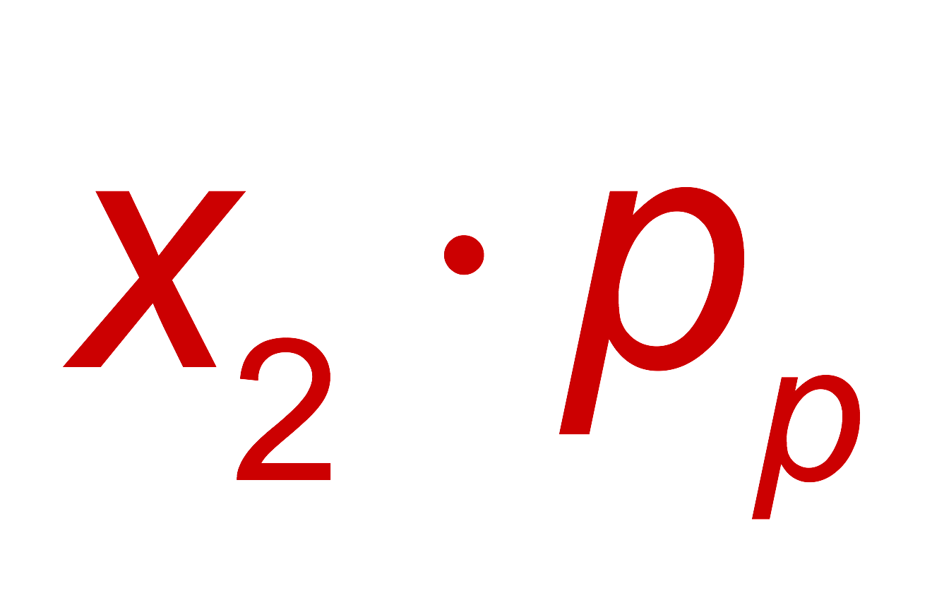

Proton–Proton Collisions
For proton–proton collisions, cross section is convolution of Parton Density Functions (PDF) with parton scattering Matrix Element
Parton distribution functions
Representing structure of proton, extracted using experimental data and QCD properties
Hard scatter parton cross section
Higher order pQCD correction; accompanying radiation, jets, …
p
Q ² = M_{X}²
X = jets, W, Z, top, Higgs, SUSY, …
p
Underlying event
CM energy-squared of parton collision:
The PDFs rise dramatically towards low x:
  Higher cross section at higher proton−proton collision energy
  More luminosity also achieves higher achievable energy
  Low-x regime (eg, Higgs production) dominated by gluon−gluon collisions: “gluon collider”

Slide 45
Proton–Proton Collisions
Cross-section fully dominated by inelastic strong interaction “minimum bias” events
Detectors cannot record 40 MHz event rate* (each event ~2 MB size → 80 TB / second)
Online custom hardware and software “triggers” reduce rate to filter out events with a million & more times smaller cross-sections than minimum bias events
*The LHCb phase-1 upgrade is preparing for exactly that!

Slide 46
Theoretical predictions based on perturbation theory
Progress in theoretical calculations — NNLO revolution
Figure by Gavin Salam at LHCP 2016
Also experimental knowledge of PDFs limits precision in many LHC analyses !

Slide 47
Theory so far agrees with all measured cross-sections
Across widely different processes
Harvest of cross-section measure-ments from LHC experiments (> 500 papers / exp) confirmed the predictive power of the Standard Model
Run-1 is not over yet: high-quality, extremely well understood data sample for precision measurements

Slide 48
Two beautiful, extremely precise theories
The Standard Model of EW and strong interactions
Predicting, e.g., the anomalous magnetic moment of the electron to a relative precision of better than 10^{–9} in agreement with experiment
General relativity — theory of gravitation
Tested up to an accuracy of order 10^{–5} (Cassini probe [B Bertotti et al., Nature 425, 2003])
Unfortunately, the SM and general relativity don’t work in regimes where both are important (ie, at very small scales)

Slide 49
Many open questions remain…
Scalar sector
Single doublet or more
Elementary or composite
Form of potential
Origin of Yukawa couplings
Quarks and leptons
Origin of families, mass, mixing, CPV
Matter–antimatter asymmetry
Baryon and lepton number conservation (proton decay)
Dark matter
Composition: WIMP, axions, sterile neutrinos, hidden sector particles, gravitational effect only
Single or multiple sources
Neutrinos
Origin and values of neutrino masses
Nature: Majorana or Dirac
CP violation
Sterile neutrinos
Expansion of Universe
Primordial expansion via inflation; which fields, role of quantum gravity?
Accelerated expansion today: cosmological constant problem
High-scale physics
Hierarchy problem and new physics at TeV scale
Grand unification of forces
Unification with gravity
Quantum gravity, string theory
Strong CP problem

Slide 50

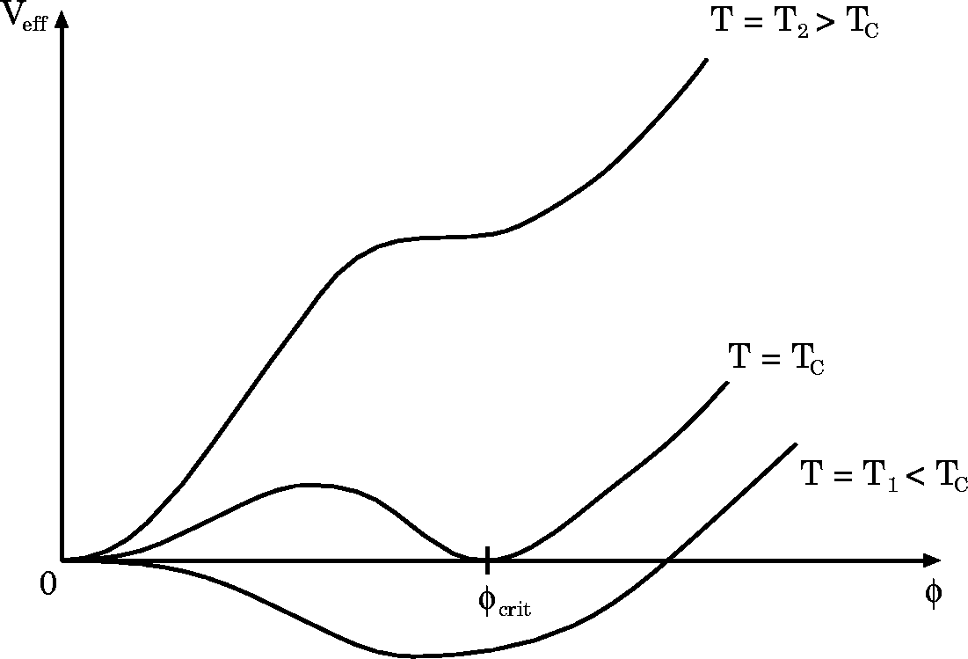



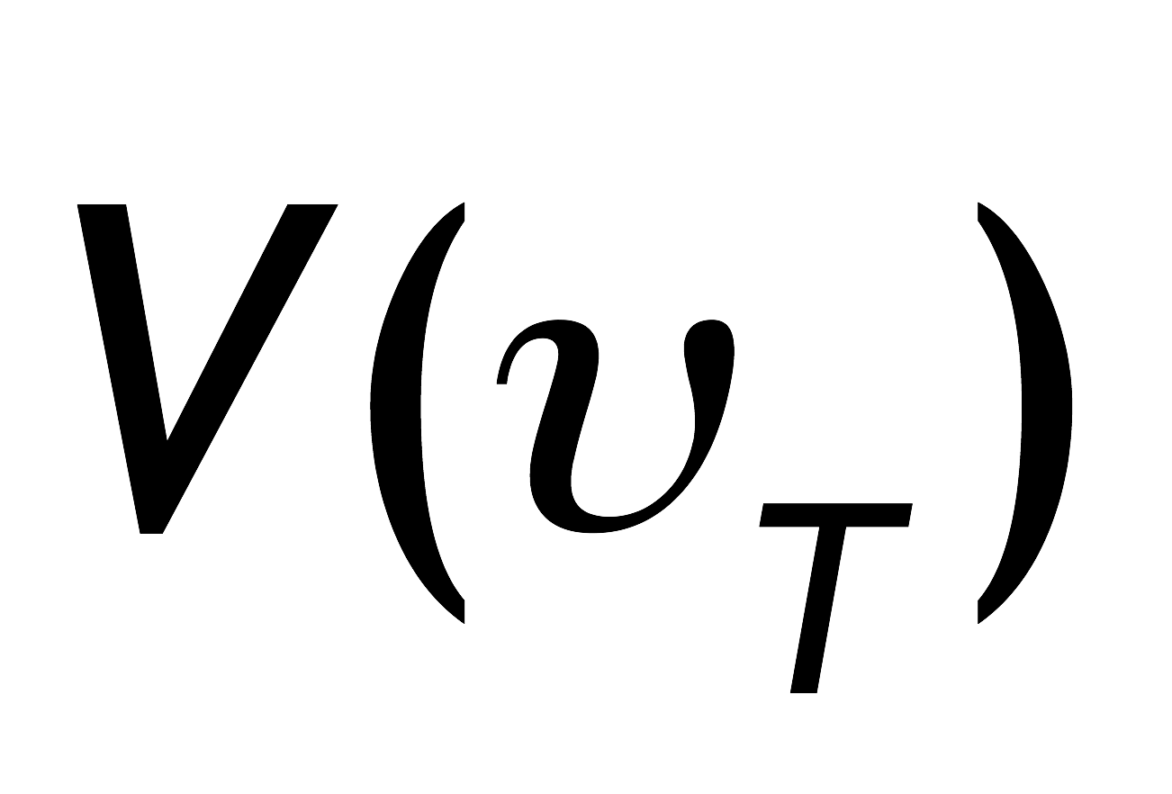

BEH Potential
The early universe, at temperature T > T_{EW}, was in a symmetric phase (|φ_{min}| = 0)
Elementary fermions and gauge bosons are massless
V(T) dependence mainly governed by top loop, adding a cubic 𝜙³ term
Drawings from W. Bernreuther, hep-ph/0205279

Slide 51
BEH Potential
The early universe, at temperature T > T_{EW}, was in a symmetric phase (|φ_{min}| = 0)
A phase transition at ~T_{EW} (~several 10⁻¹¹ s after big bang, causal domain of few cm) led to |φ_{min}| > 0
Phase transition
Elementary fermions and gauge bosons acquire mass
Potential barrier
BEH bubble expansion
Picture describes a 1st order phase transition that would require light Higgs, or new physics → currently disfavoured
Drawings from W. Bernreuther, hep-ph/0205279

Slide 52

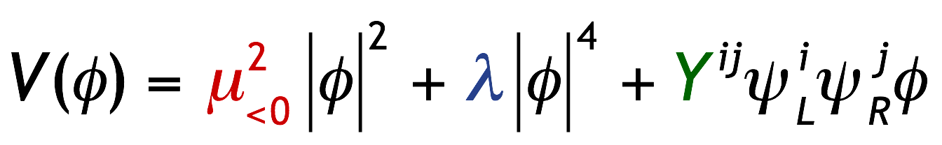
BEH Potential
The early universe, at temperature T > T_{EW}, was in a symmetric phase (|φ_{min}| = 0)
A phase transition at ~T_{EW} (~several 10⁻¹¹ s after big bang, causal domain of few cm) led to |φ_{min}| > 0
Phase transition
Potential barrier
BEH bubble expansion
The condensed field fills all space and time but without orientation as it has no spin. (One might view it as a Lorentz-invariant ether creating a vacuum viscosity)
Condensation of BEH field
v
“spontaneous” phase transition
Drawings from W. Bernreuther, hep-ph/0205279
52

Slide 53
Is it just the simplest toy model?
Higgs sector may be non-minimal and/or Higgs boson may couple to new physics
Diverse search programme at the LHC:
So far: no deviation from SM found in any of these searches
Light or heavy neutral Higgs bosons
Charged Higgs boson
Lepton flavour violating Higgs decays
BSM
Higgs
searches
Di-Higgs production (resonant or not)
Exotic Higgs decays
No sensitivity yet for SM di-Higgs production
Higgs as portal to hidden sector
Higgs in BSM decay chains

Slide 54
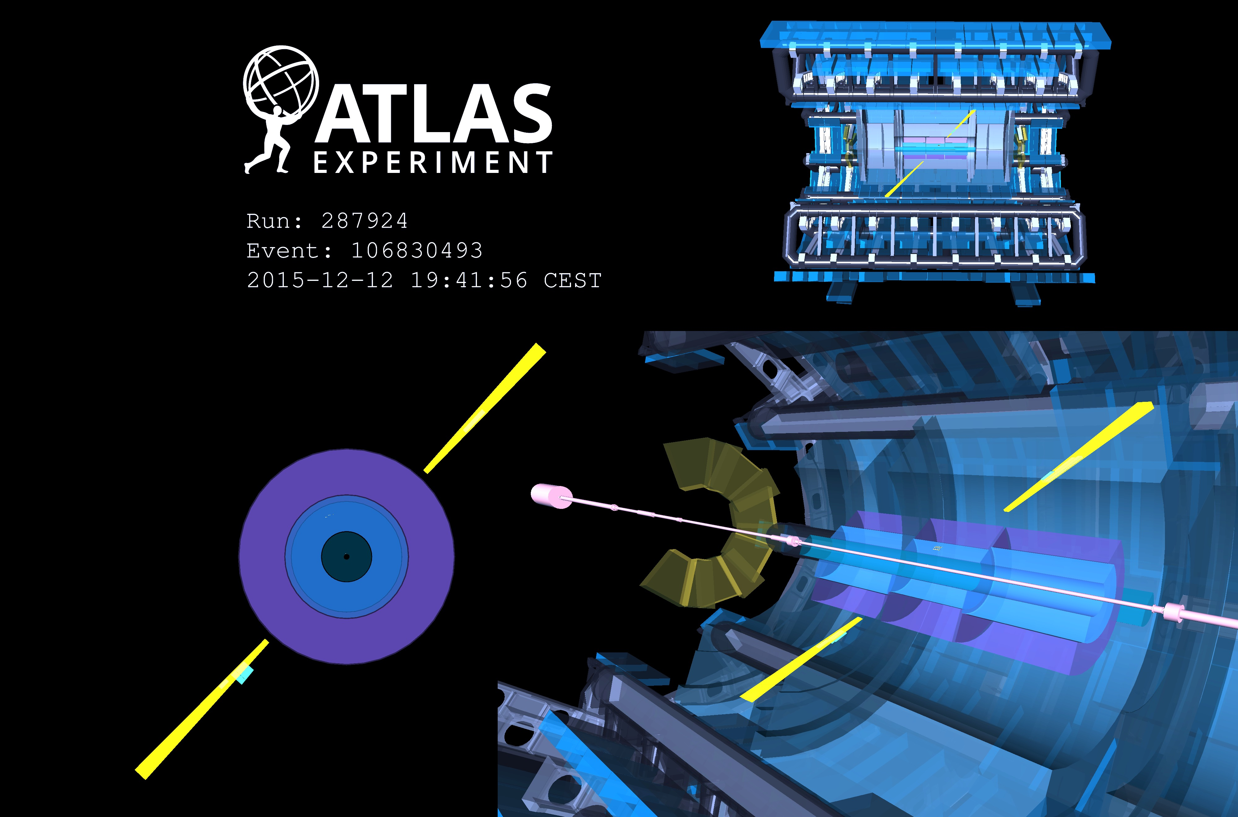
Evidence for γγ → γγ light-by-light scattering (LBLS) seen by ATLAS in 5.02 TeV ultraperipheral Pb+Pb collisions
13 events observed for 2.6 ± 0.7 expected background (4.4σ)
[ arXiv:1702.01625 ]
Field strength of up to 10²⁵ V/m reached
Picture shows LBLS candidate: two E_{T} = 4.9 GeV back-to- back photons with no additional activity

Slide 55
Measurement of jet cross section at 13 TeV
Primary test of QCD at highest collision energy
CMS 1605.04436, 1609.05331
Double differential cross section measured by CMS
Comparison with 8 TeV plot (right) shows effect of increased parton luminosities at high jet p_{T}

Slide 56
Searches for dark matter production at the LHC
Canonical signature is ‘X+MET’ with large variety of ‘X’
Comparison of ATLAS monojet and dijet resonance searches with direct dark matter searches
Spin-dependent DM-nucleon cross section versus DM mass
Spin-independent DM-nucleon cross section versus DM mass

Slide 57
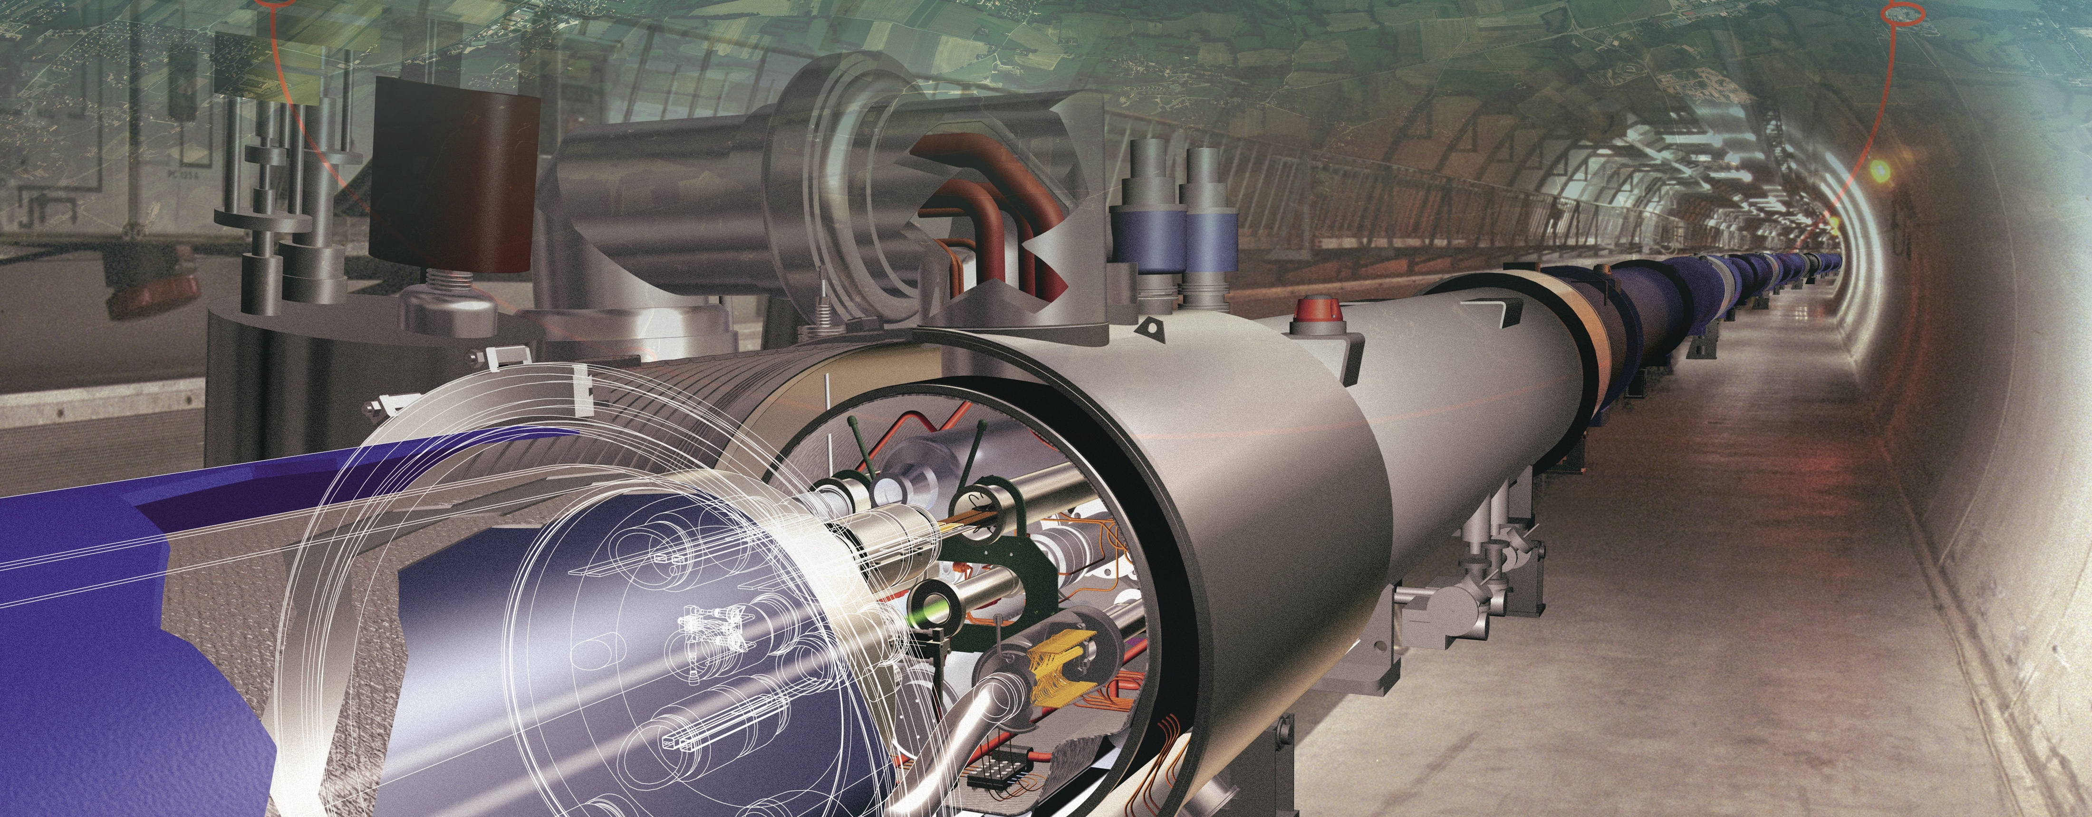
Beyond the HL-LHC
Only a very brief enumeration of projects

Slide 58
Future hadron collider projects in a nutshell
The next discovery machine
HL-LHC: E_{CM} = 14 TeV, 3 ab^{–1}, 2026~2035… (formally approved as project by CERN council last week)
Future Circular Collider FCC-hh (CERN):
E_{CM} ~ 100 TeV in 100 km ring, L ~ 2 × 10³⁵ s^{–1}cm^{–2}
~16 T magnets, possibly HE-LHC (E_{CM} ~ 28 TeV) as intermediate stage
Huge detectors needed for muon p_{T} measurement
Possible start of physics ~ 2035
SppC (China):
E_{CM} ~ 71 TeV in 55 km ring, L ~ 1 × 10³⁵ s^{–1}cm^{–2}
Requires very high gradient dipole magnets ~ 20 T
Possible start of physics ~ 2042

Slide 59
Future e–e⁺ collider projects in a nutshell
Measure EW & EWSB sector to highest precision
International Linear Collider ILC (host candidate: Japan)
20 years of R&D, mature technology, ~32 MV/m accelerating gradient ~ xFEL at DESY (45 MV/m for 1 TeV)
E_{CM} ~ 500–1000 GeV in 31–45 km total length, L ~ 1.8 × 10³⁴ s^{–1}cm^{–2}, only one interaction region
nm beam size, possible start of physics ~ 2030
*A low energy, high current, “drive” beam is decelerated in power extraction structures and the RF power is transferred to the cavities that accelerate the main beam
Compact Linear Collider CLIC (CERN)
High-gradient 2-beam scheme*: 100 MV/m gradient
E_{CM} ~ 380–3000 GeV, 11–50 km total length, L ~ a few × 10³⁴ s^{–1}cm^{–2}, only one interaction region
0.5 ns bunch distance, nm beam size, large beamstrahlung, physics ~ 2035
Future Circular Collider FCC-ee (CERN):
E_{CM} ~ 90–350 GeV in 2 rings (90k bunches), L ~ 70–1.3 × 10³⁴ s^{–1}cm^{–2}
Synchrotron power (E ⁴/R up to 7.5 GeV/turn): 100 MW (LEP-2: 22 MW)
Circular EP collider CEPC (China):
E_{CM} ~ 240 GeV, L ~ 2 × 10³⁴ s^{–1}cm^{–2}
Single ring, 50 bunches
Possible start of physics ~ 2028

Slide 60
More Standard Model and Flavour physics
Complementary to SuperKEKB / Belle II programme !
Expect ~40 times luminosity of 1st generation asymmetric B-factories: up to 50 ab^{–1}
Among the physics highlights:
Rare decays: B → τν (< 5%), R_{D*}, detailed b → s studies (incl. B → K⁽*⁾νν penguin+box to ~20%)
Lepton flavour violation, universality tests
CP violation in bottom and charm systems

Slide 61
How can these LHC luminosity improvements be achieved ?
We are here

Slide 62
Particle physics at the dawn of the LHC Run-2
No new physics in direct searches
or study of quantum fluctuations
QED tested to parts per million accuracy (slight anomaly in muon g–2)
Asymptotic freedom in strong interactions verified at % level
Electroweak unification tested to high precision
Quark sector: CKM picture for quark mixing & CP violation confirmed
Lepton sector: massive neutrinos, unknown nature, masses, CP violation, sterile 𝜈’s ? No flavour violation in charged lepton sector. Lepton universality tested to per-mil level
No compelling sign of new physics found at high mass scales, or anywhere else, eg: no electric dipole moments (EDM), no dark matter particles (gravitational hints only), no axions, no proton decay
?

