Slide 1
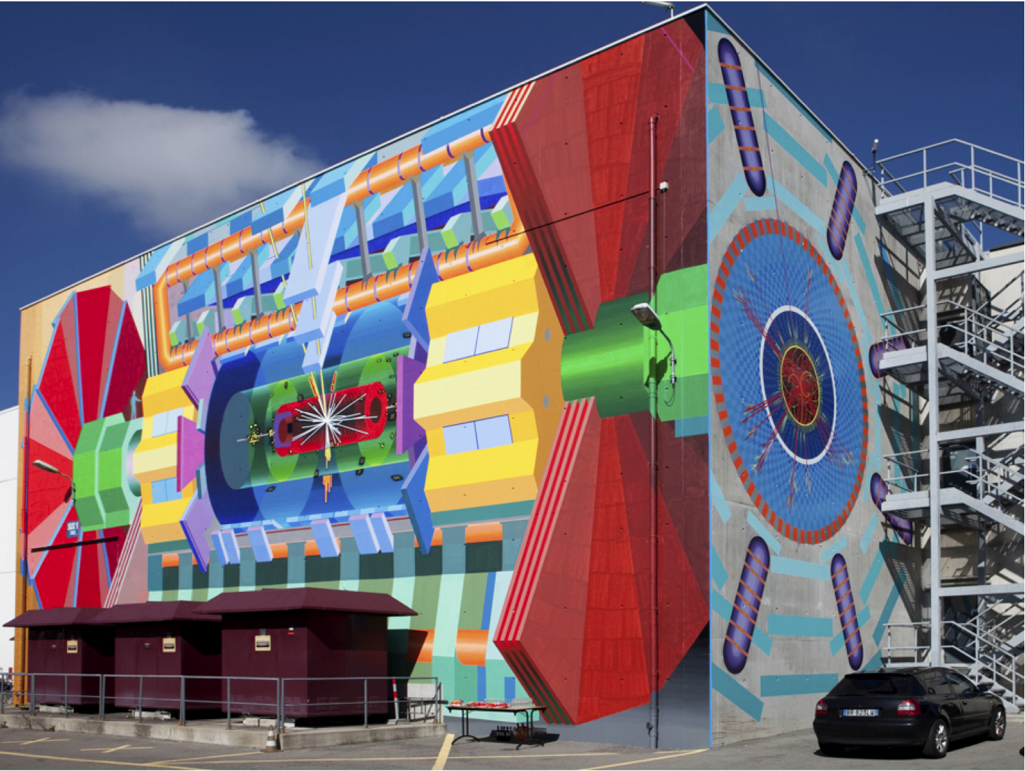
ATLAS Searches
Recent Results
Andreas Hoecker (CERN)
Aspen Physics Institute “Year One of the LHC”, July 2011, Aspen, USA
Version: May 31, 0:17

Slide 2
The LHC proton-proton Physics Programme
Mass and electroweak symmetry breaking
    Search for the Higgs Boson, measurement of its properties
Hierarchy in the TeV domain
    Search for new phenomena moderating the hierarchy problem
    Search for the unexpected at the high-energy frontier
Electroweak unification and strong interactions
    Precision measurements (M_{W}, m_{top}) and tests of the Standard Model
    Tests of perturbative QCD at the high-energy frontier
Flavour
    B, D mixing, rare decays and CP violation as tests of the Standard Model

Slide 3
The LHC proton-proton Physics Programme
Mass and electroweak symmetry breaking
    Search for the Higgs Boson, measurement of its properties
Hierarchy in the TeV domain
    Search for new phenomena moderating the hierarchy problem
    Search for the unexpected at the high-energy frontier
Electroweak unification and strong interactions
    Precision measurements (M_{W}, m_{top}) and tests of the Standard Model
    Tests of perturbative QCD at the high-energy frontier
Flavour
    B, D mixing, rare decays and CP violation as tests of the Standard Model
This talk

Slide 4
Most results shown still based on 2010 dataset of 35–43 pb^{–1} luminosity, though more and more analyses updated to 2011 → EPS, LP !
Almost all search analyses require data-driven estimates of backgrounds from data control regions and transfer functions using simulation → this is the primary analysis challenge!
These estimates rely on pioneering Standard Model measurements in ATLAS and accurate preparation work by the ATLAS physics objects and trigger groups.
Full list of ATLAS results: http://twiki.cern.ch/twiki/bin/view/AtlasPublic

Slide 5
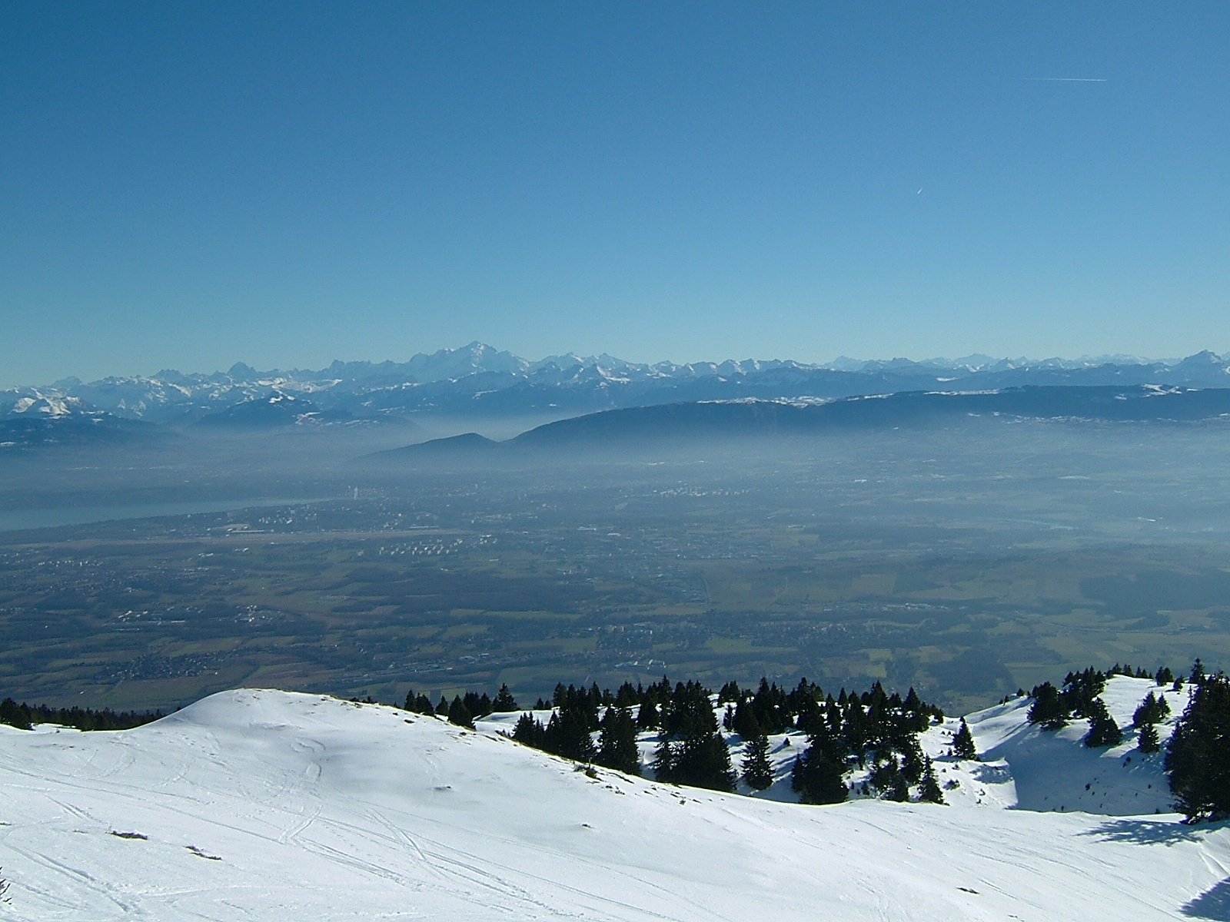

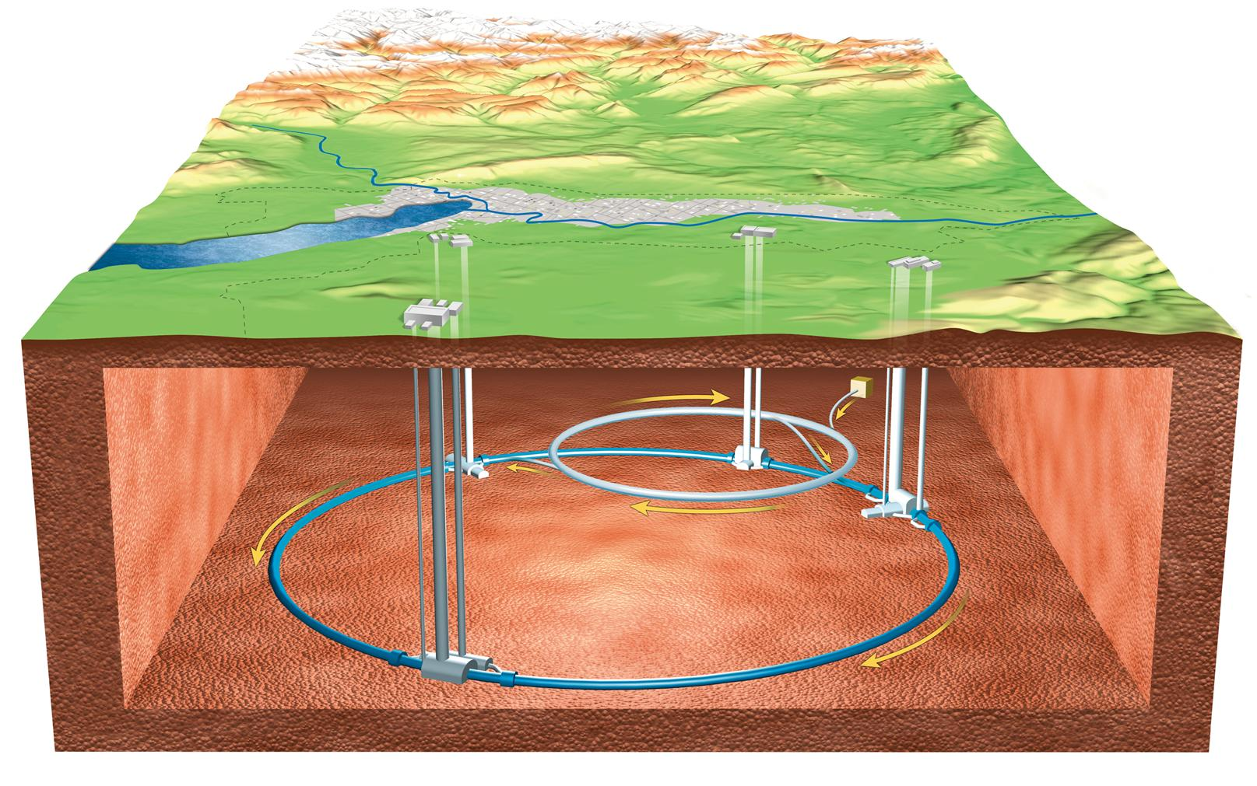

The LHC at CERN
3.5 TeV
LHC
4 large experiments: ATLAS, CMS, LHCb, ALICE
450 GeV
SPS
26 GeV
PS
1.4 GeV
BOO-
STER
50 MeV
LHCb
ATLAS
LIN-
AC2
ALICE
max: 150 m
PROTONS
CMS

Slide 6

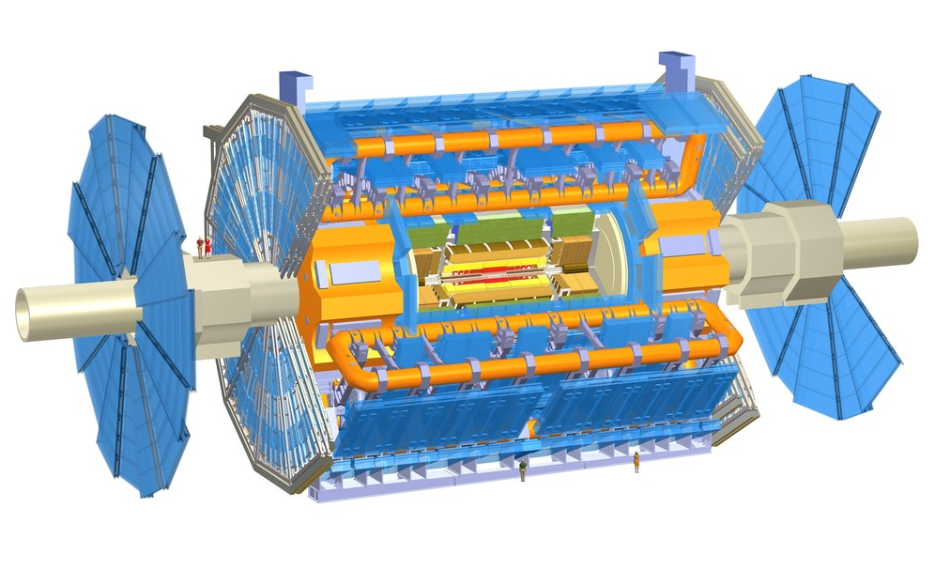
Muon Detectors Tile Calorimeter Liquid Argon Calorimeters
Experiment
Emphasis on
large acceptance and hermeticity
excellent jet and E_{T,miss} resolution
excellent particle identification
excellent vertex reconstruction
standalone muon measurement
22 m
All ATLAS subdetectors work well
Coverage 96.9-100%
On April 30th lost 0.4% of LAr barrel EM: hope to recover during technical stop in early July
46 m
Toroid Magnets Solenoid Magnet SCT Tracker Pixel Detector TRT Tracker

Slide 7

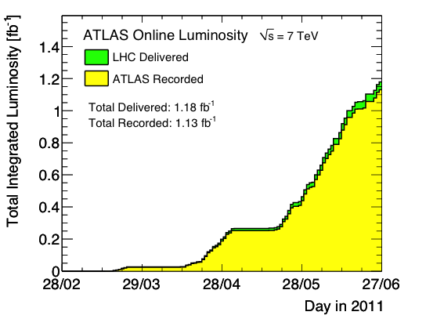
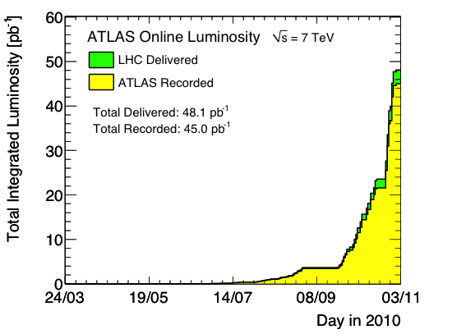
Recorded Luminosity in 2010 and 2011
Measured with forward detectors, calibrated with beam separation scans
ATLAS integrated luminosity vs time in 2010
Surpassed Tevatron record of 4.1 10³²
ATLAS integrated luminosity 2011
Peak L = 2.1×10³² s^{–1}cm^{–2}
Max L / fill = 6.3 pb^{–1} (β* = 3.5 m)
Max N_{coll-bunch} = 348 (Δt = 150 ns)
Peak L = 1.3×10³³ s^{–1}cm^{–2}
Max L / fill = 62 pb^{–1} (β* = 1.5 m)
Max N_{coll-bunch} = 1318 (Δt = 50 ns)
Status: 27 June 2011
Difference between del. and rec. luminosity from trigger deadtime and detector inefficiency
  95.8% data-taking efficiency
  Loose 1.6% at turn-on at start of stable beams
  Loose 2.6% due to deadtime

Slide 8
Recorded Luminosity in 2010 and 2011
Measured with forward detectors, calibrated with beam separation scans
Surpassed Tevatron record of 4.1 10³²
ATLAS integrated luminosity 2011
At L = 10³³ s^{–1}cm^{–2}, produce 1 SM Higgs boson with 115 (150) GeV every 48 (83) seconds in ATLAS and CMS → 75 (43) Higgs bosons per hour
Tevatron @ 115 GeV: 2 per hour at max luminosity
Peak L = 1.3×10³³ s^{–1}cm^{–2}
Max L / fill = 62 pb^{–1} (β* = 1.5 m)
Max N_{coll-bunch} = 1318 (Δt = 50 ns)
Status: 27 June 2011
10³³ cm^{–2}s^{–1} instantaneous luminosity corresponds to an integrated luminosity of 3.6 pb^{–1} per hour
→ 1.8 fb^{–1} per month (assuming design 70% LHC efficiency for physics – not presently achieved)
  95.8% data-taking efficiency
  Loose 1.6% at turn-on at start of stable beams
  Loose 2.6% due to deadtime

Slide 9
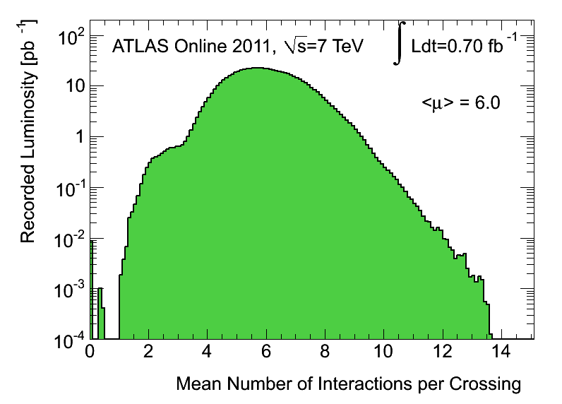
Pileup
The high luminosity comes to the price of multiple interactions per crossing
arXiv:1101.2185
Pileup in 2011 is on average <μ>=6 interactions per crossing
Significantly higher than 2010
Tails up to 14 interactions per crossing
Causes challenge for physics analyses and software
Detailed simulation models both the <μ> and the bunch train structure (detailed enough ?)
Software performance improved to accommodate Tier-0 resources (reco time 11–13s/event)
Physics performance reasonably unaffected
Luminosity-weighted distribution of the mean number of interactions per crossing for 2011

Slide 10
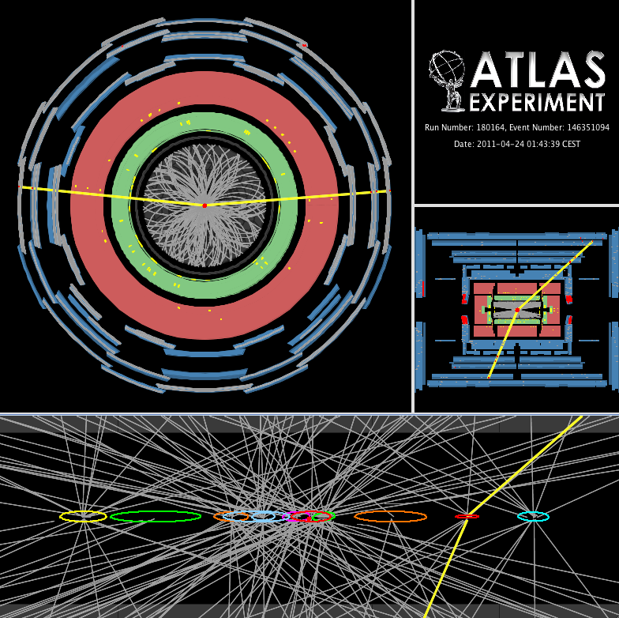
A candidate Z boson event in the dimuon decay with 11 reconstructed vertices

Slide 11
Trigger
Higher thresholds in 2011 than in 2010
Trigger menu kept stable
Primary triggers never prescaled
Supplemented by supporting and monitoring triggers
Typical output rates:
L1: 60 kHz, L2: 5 kHz, EF: 300-400 Hz
EF output rate constrained by offline resources
Can predict rates with ~20% accuracy
Performance of trigger well understood
Unprescaled trigger rates at L=1×10³³ cm^{–2}s^{–1}
trigger | L1 item | L1 Rate (Hz) | EF Rate (Hz)
E20_medium | EM14 | 8500 | 50
2e12_medium | 2EM7 | 5700 | 1
g80_loose | EM30 | 700 | 3
2g20_loose | 2EM14 | 750 | 2
mu18 | MU10 | 5300 | 40
2mu10 | 2MU10 | 100 | 1
xe60 | XE40 | 300 | 4
J180 | J75 | 200 | 6
Tau29medium_xe35 | TAU11_XE20 | 3800 | 6
Tau16_e15 | TAU6_EM10 | 7500 | 6
J75_xe45 | J50_XE20 | 500 | 10

Slide 12
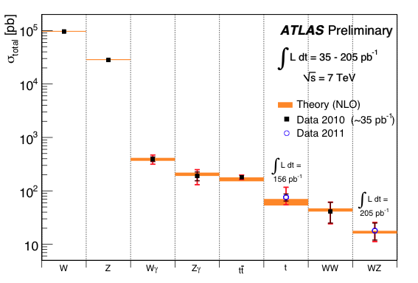
Electroweak and QCD measurements
Lots of truly novel results at unexplored centre-of-mass energies
Summary of EW boson and top cross section measurements vs. theory
2011
data

Slide 13
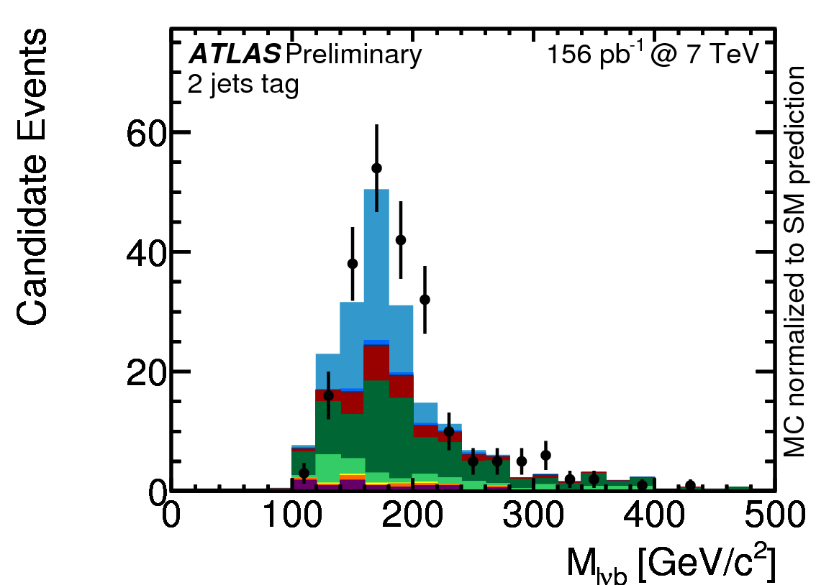

Electroweak and QCD measurements
Lots of truly novel results at unexplored centre-of-mass energies
Summary of EW boson and top cross section measurements vs. theory
6.2σ observation
σ_{t} = 76 pb
(SM: 66.2 pb)
+41
–21
ATLAS-CONF-2011-088
2011
data
t-channel dominates single-top production

Slide 14
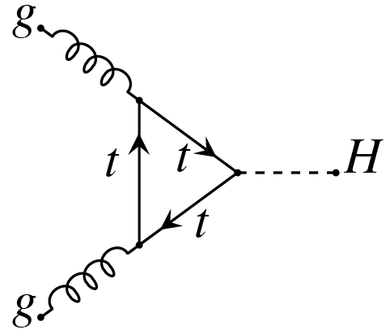
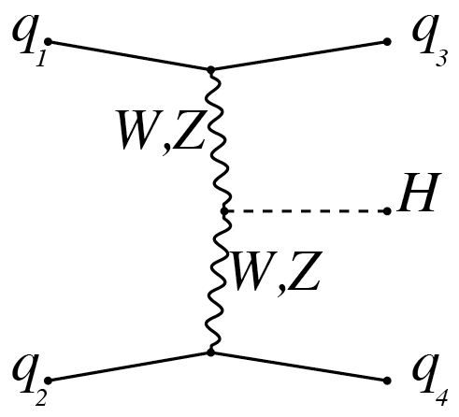
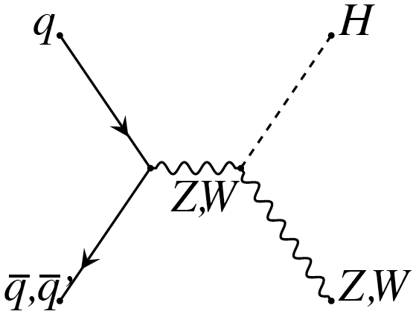
mass
Higgs boson searches
Standard Model and Beyond
σ_{M=120} = 16.6 pb (87%)
σ_{M=120} = 1.3 pb (7%)
σ_{M=120} = 1.0 pb (5%)
[ arXiv:1101.0593 ]

Slide 15
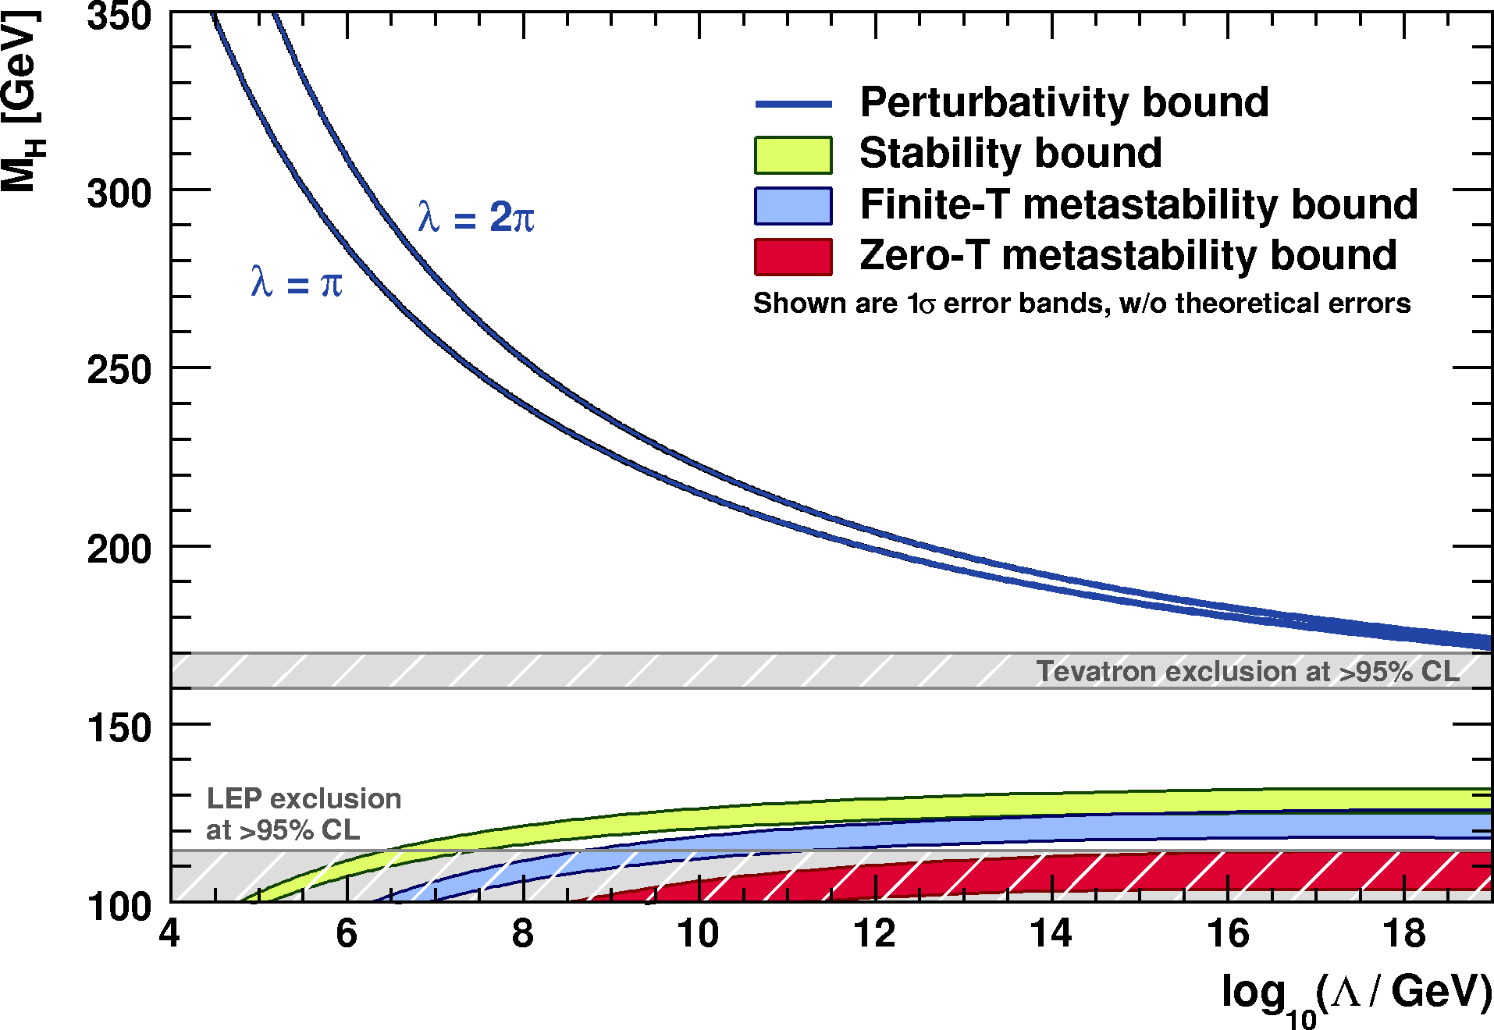
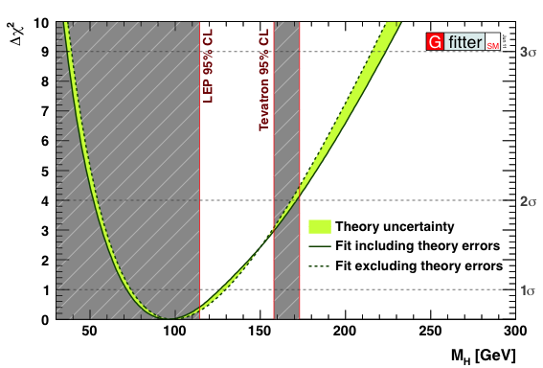
Theoretical and indirect exp. Higgs constraints
The Higgs boson should be light but not too light…
J. Ellis et al., arXiv:0906.0954
http://cern.ch/gfitter
Perturbativity and (meta)stability bounds versus the SM cut-off scale Λ
EW fit not including direct Higgs searches
Allowed
Not allowed
The SM Higgs must steer a narrow course between two disastrous situations if it is to survive up to the Planck scale M_{P} ~ 2×10¹⁸ GeV
Central value ±1σ:
95% CL upper limit: 169 GeV

Slide 16
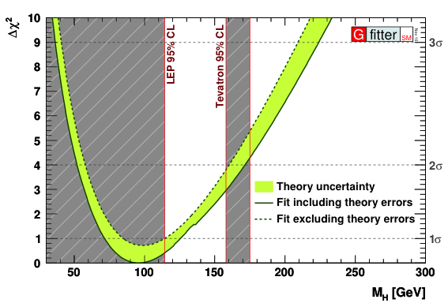
Theoretical and indirect exp. Higgs constraints
The Higgs boson should be light but not too light…
Perturbativity and (meta)stability bounds versus the SM cut-off scale Λ
EW fit not including direct Higgs searches
In the Standard Model the Higgs must be light.
BUT: Beyond the Standard Model the Higgs can be heavy !
→ MUST ALSO search for a heavy Higgs boson !
[ New physics scale can be low, and weak-isospin violating new physics
contributions may cancel heavy Higgs effects on electroweak precision data ]
Allowed
Not allowed

Slide 17
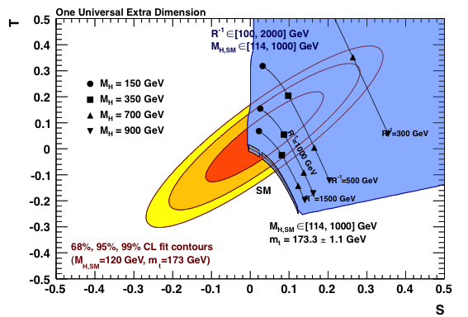
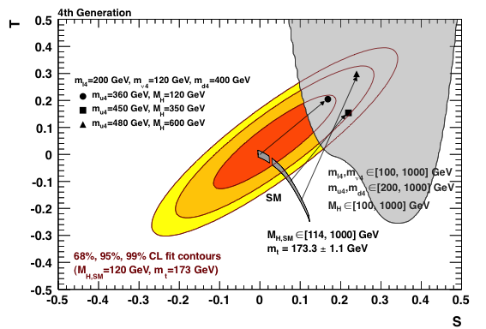
Higgs mass constraint in SM extensions
With sufficient weak isospin violation, Higgs can become heavy
http://cern.ch/gfitter
Constraint in S,T plane in sequential 4th gen.
Constraint in S,T plane in UED

Slide 18
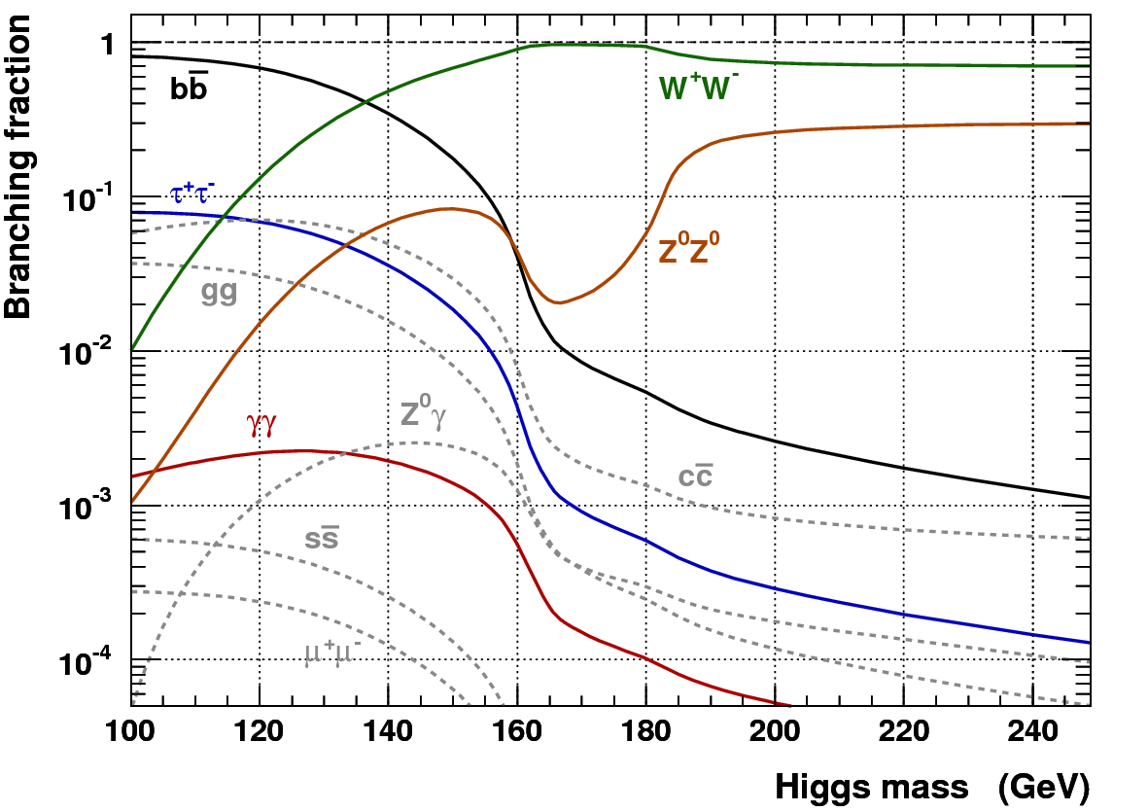
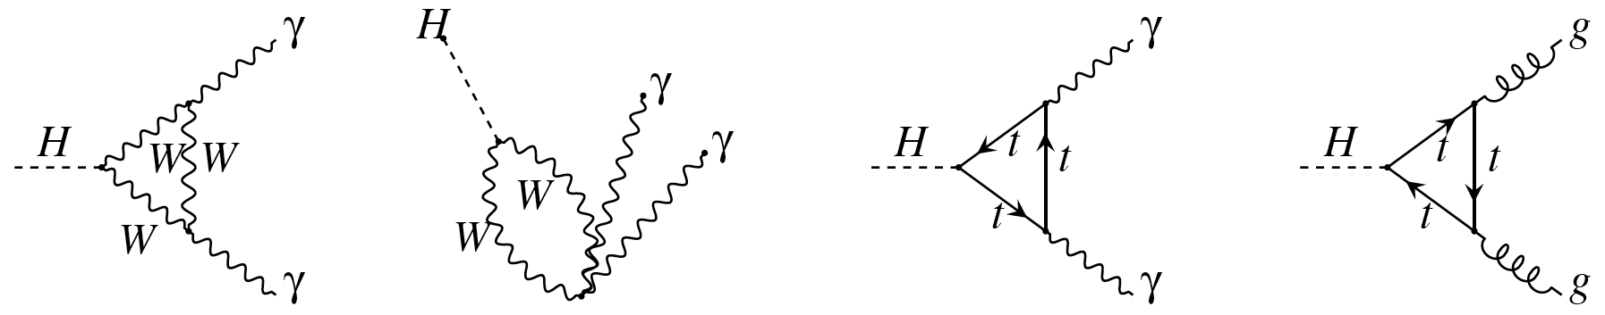
Higgs Searches at the LHC
Dependence of the branching fractions on M_{H} drives search strategy
For heavy Higgs:
Lepton final states via WW⁽*⁾, ZZ⁽*⁾
For light Higgs:
Lepton final states via WW*, ZZ*
Di-photon final state
Di-tau final state
The dominant H → bb mode is only exploitable in association with W/Z or tt, also with strong Higgs boost
Associated leptons provide trigger signal as they help to reduce huge QCD background, σ(bb) ~ O(100 µb)

Slide 19
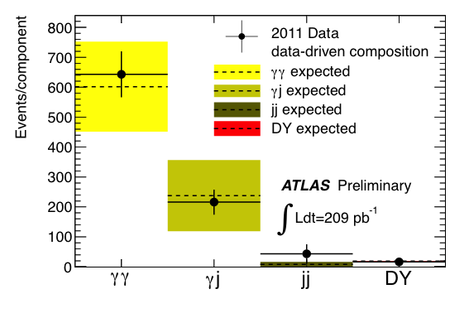
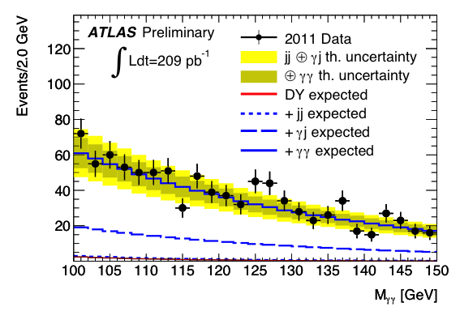
H → γγ
2011
data
ATLAS-CONF-2011-085
Clean discovery channel for light Higgs: σ × BR (115 / 140 GeV | √s=7 TeV ) ≈ 45 / 28 fb
Select tight & isolated high-p_{T} photons; need excellent E_{γ} resolution, efficient & pure PID, primary vertex
926 selected diphoton candidates
Diphoton purity of ~ 70%
  Total background shape and normalisation determined simultaneous with signal
  Higgs signal would manifest itself as narrow peak [ syst. error on signal yield ~ 24% ]

Slide 20
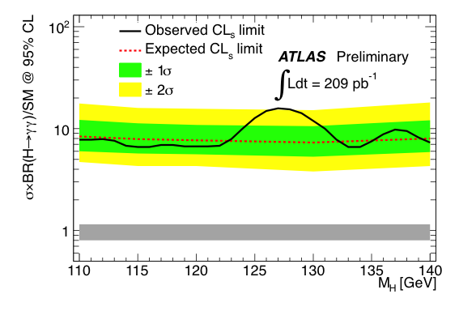
H → γγ
2011
data
ATLAS-CONF-2011-085
Clean discovery channel for light Higgs: σ × BR (115 / 140 GeV | √s=7 TeV ) ≈ 45 / 28 fb
Select tight & isolated high-p_{T} photons; need excellent E_{γ} resolution, efficient & pure PID, primary vertex
926 selected diphoton candidates
Expected limit about 8 times 95% SM exclusion
  Total background shape and normalisation determined simultaneous with signal
  Higgs signal would manifest itself as narrow peak [ syst. error on signal yield ~ 24% ]

Slide 21
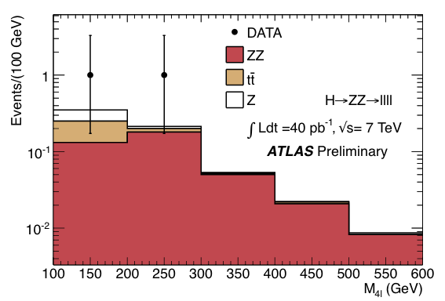
H → ZZ⁽*⁾ → 4 leptons (e, µ)
ATLAS-CONF-2011-048
Very clean channel, low BR: σ × BR (140 / 200 / 600 GeV | √s=7 TeV ) ≈ 4.2 / 6.8 / 0.5 fb
Signal selection: p_{T} > 15_{e} / 7_{μ} GeV, isolated leptons, M(1,2) ~ M_{Z}, M(3,4) >15–60 GeV (M_{4l} - dependent)
4-lepton mass distribution before applying lepton IP and isolation cuts
  Backgrounds:
Dominant background after isolation cuts: ZZ⁽*⁾ continuum
  Top production
  Also: associated Zbb production
    Reject by requiring leptons to be isolated and to match primary vertex
 | M_{H} = 130 GeV | M_{H} = 150 GeV
Observed | 0 | 0
Background | 0.010 ± 0.002 | 0.090 ± 0.014
Signal | 0.015 ± 0.003 | 0.095 ± 0.017

Slide 22
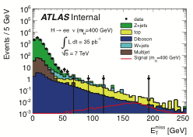
H → ZZ⁽*⁾ → 2 l (e, µ) + νν
ATLAS-CONF-2011-026
Benefit for M_{H} > 200 GeV from 3 times larger Z → νν BR
Higgs to 4 leptons transverse mass reconstruction from leptons and E_{T,miss} vector
  Backgrounds:
Z + jets: require large E_{T,miss} and veto back-to-back leptons
  Top production: veto b-jets
  Also: W + jets and diboson production
    Verify MC background yields with dedicted control regions
 | M_{H} = 200 GeV | M_{H} = 400 GeV
Observed | 5 | 5
Background | 5.8 ± 1.4 | 3.5 ± 0.9
Signal | 0.19 ± 0.04 | 0.30 ± 0.06
  Similarly powerful for M_{H} > 400 GeV : H → ZZ → 2l + qq mode [ also included in analysis ]

Slide 23
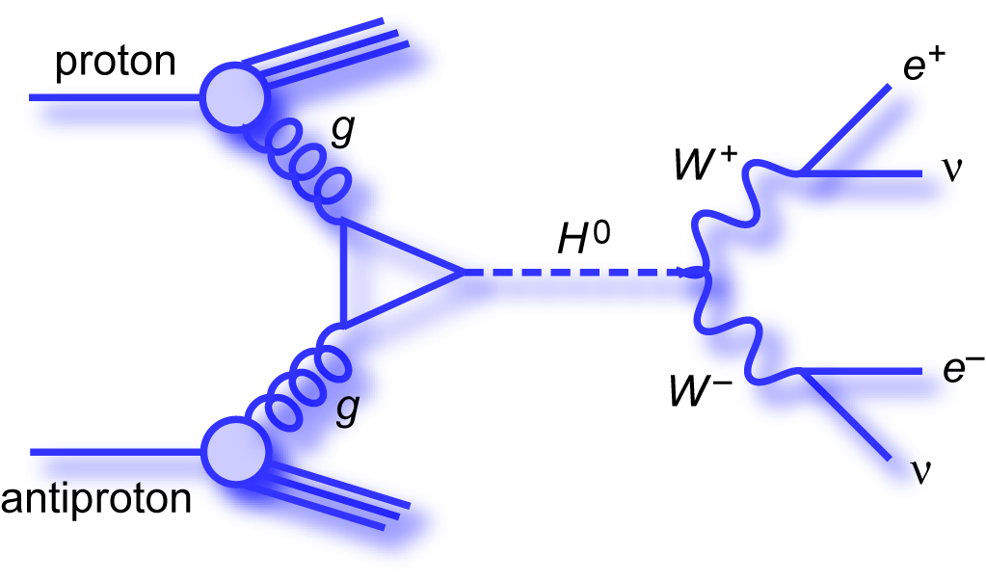
H → WW⁽*⁾ → 2 l (e, µ) + 2ν
ATLAS-CONF-2011-005
No clean channel but large σ × BR (120 / 165 / 200 GeV | √s=7 TeV ) ≈ 120 / 400 / 200 fb
Leptonic mode (lνlν) used for 120 < M_{H} < 220 GeV, semi-leptonic mode (lνqq) for 220 < M_{H} < 600 GeV
Signal selection: leptons, M_{T}² = (E_{T,ll} + E_{T,miss})² – (p_{T,ll} + p_{T,miss})² ~ M_{H}², exploit W polarisation, separate jets
proton
H
W⁺
W⁺
μ⁺
W–
ν
W–
e–
_
proton
ν
  Dominant backgrounds from
  WW continuum, W + jets, top…
W polarisation: correlated lepton emission
Dilepton opening angle is discriminant

Slide 24
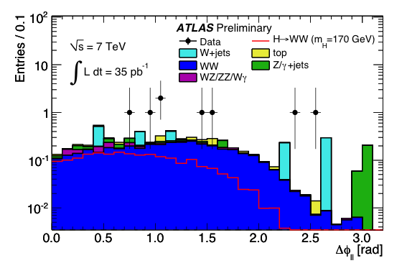
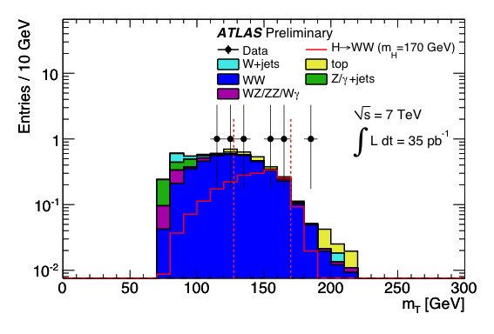
Data-driven background determination using background-enhanced control regions (anti-cuts)
0-jet channel: S/B ~ 0.7 at M_{H} = 170 GeV, after cuts on Δφ_{ll}, m_{ll}, m_{T}, E_{T,miss}
Observed and expected num. of events in eμ channel for M_{H} = 170 GeV
Higgs detection requires good understanding of WW background
Recent ATLAS measurement finds:
σ(pp → W ⁺W –) = (41 ± 5) pb
agreeing with NLO SM: (44 ± 3) pb
 | 0-jet | 1-jet
Observed | 1 | 0
Total Bkg. | 0.83 ± 0.15 | 0.47 ± 0.18
( WW bkg. | 0.71 ± 0.08 | 0.18 ± 0.04 )
Signal | 0.62 ± 0.18 | 0.31 ± 0.09
⁺²⁰
ATLAS-CONF-2011-005
^{–16}
arXiv:1104.5225

Slide 25
Data-driven background determination using background-enhanced control regions (anti-cuts)
0-jet channel: S/B ~ 0.7 at M_{H} = 170 GeV, after cuts on Δφ_{ll}, m_{ll}, m_{T}, E_{T,miss}
Observed and expected num. of events in eμ channel for M_{H} = 170 GeV
Higgs detection requires good understanding of WW background
Recent ATLAS measurement finds:
σ(pp → W ⁺W –) = (41 ± 5) pb
agreeing with NLO SM: (44 ± 3) pb
(Almost) counting experiment only
Requires accurate control of backgrounds in abundance and variable shapes
→ Hard work for experimentalists !
 | 0-jet | 1-jet
Observed | 1 | 0
Total Bkg. | 0.83 ± 0.15 | 0.47 ± 0.18
( WW bkg. | 0.71 ± 0.08 | 0.18 ± 0.04 )
Signal | 0.62 ± 0.18 | 0.31 ± 0.09
⁺²⁰
ATLAS-CONF-2011-005
^{–16}
arXiv:1104.5225

Slide 26
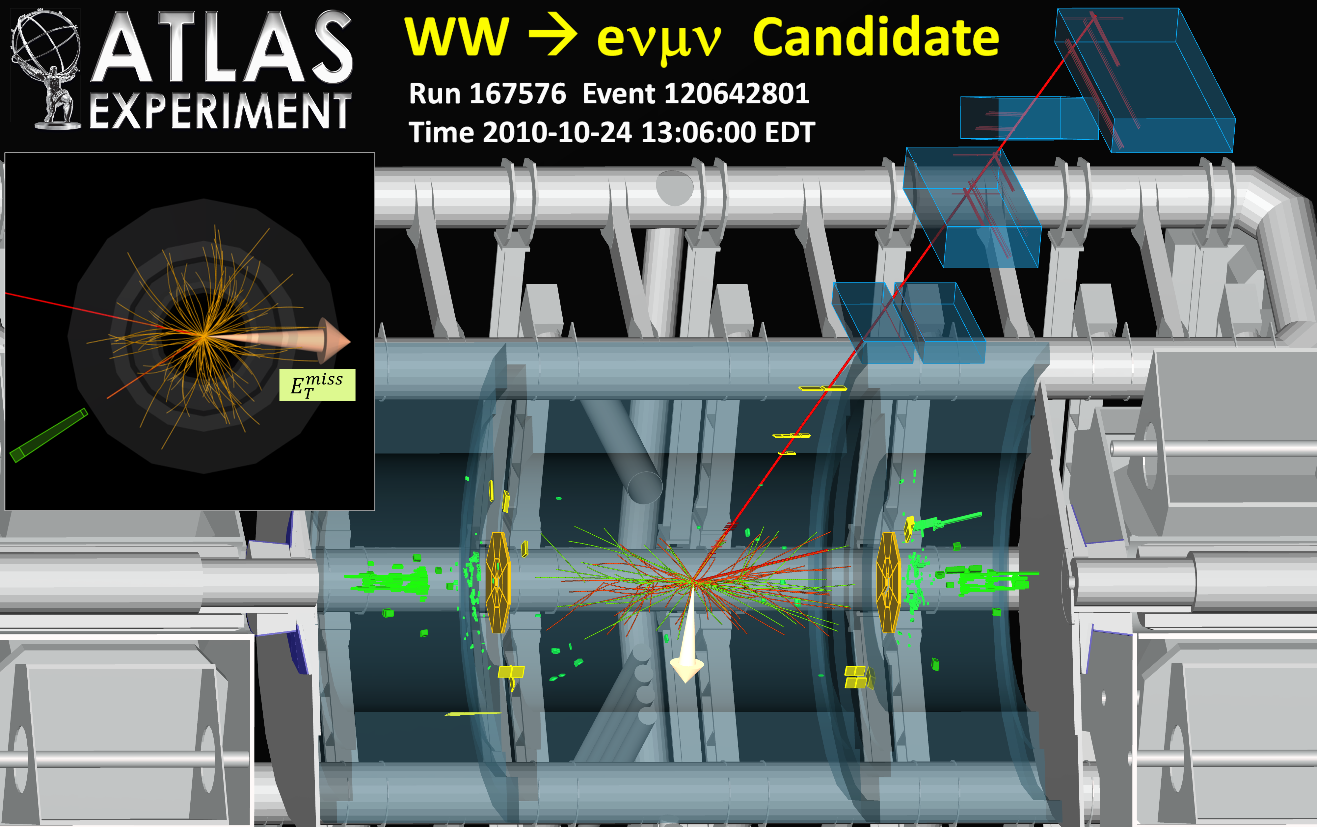

Slide 27
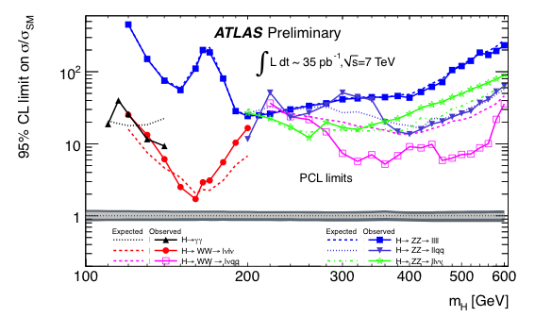
SM Higgs Exclusion
arXiv:1106.2748
  Observed and expected 95% CL exclusion limits in units of SM cross section
At M_{H} = 120 GeV,
WW competitive with γγ
Exclusion CL
Almost 95% exclusion at M_{H} ~ 160 GeV
Tevatron 95% CL
Between M_{H} ~ 210 and 290 GeV ZZ→llνν most sensitive
LEP 95% CL
Above M_{H} ~ 290 GeV WW→lνqq dominant
Above M_{H} ~ 400 GeV ZZ→llqq competitive
Significance
Power-constrained* limits (PCL) computed from CL_{s+b} of test statistics using toy MC
*Fluctuations below –1σ wrt. median of expected limits are not allowed
Corresponding CL_{s} limits provide reduced exclusion (overcoverage)

Slide 28
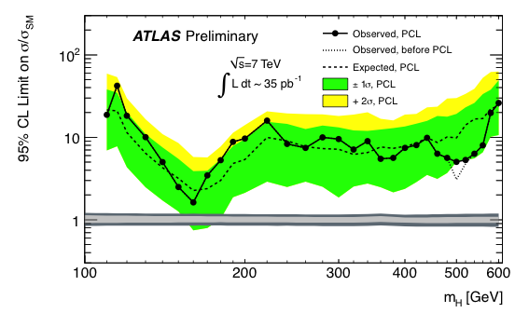
SM Higgs Exclusion
arXiv:1106.2748
  ATLAS combination of individual channels for 2010 data
Combination using maximum likelihood fit taking into account correlated nuisance parameters
Exclusion CL
Tevatron 95% CL
Uncertainty on cross section included in SM expectation
LEP 95% CL
Not yet reached at Tevatron who exclude 158–173 GeV
at 95% CL [arXiv:1103.3233]
Grey horizontal bands show cross section uncertainties
Inner region highlights contribution from QCD scale variation
Significance
Power-constrained* limits (PCL) computed from CL_{s+b} of test statistics using toy MC
*Fluctuations below –1σ wrt. median of expected limits are not allowed
Corresponding CL_{s} limits provide reduced exclusion (overcoverage)

Slide 29
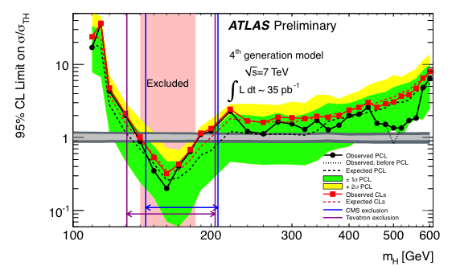
4-Gen SM Higgs Exclusion
arXiv:1106.2748
  Gluon fusion to Higgs via triangular heavy-quark loop sensitive to 4th generation
Exclusion CL
u₄, d₄ ?
4th generation ?
K-factor of ~3² = 9 using sequential model
Significance
95% CL exclusion of 140 < M_{H} < 185 GeV in SM4

Slide 30
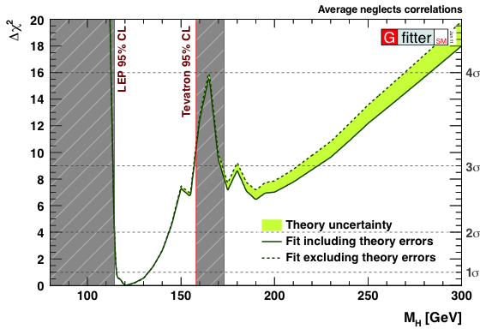
Constraints on Higgs mass
Combining direct Higgs searches with EW fit
http://cern.ch/gfitter
EW fit not including direct Higgs searches
EW fit including direct Higgs searches
Width of band indicates theory uncertainty
Central value ±1σ:
95% CL upper limit: 169 GeV
Central value ±1σ:
95% CL upper limit: 143 GeV

Slide 31
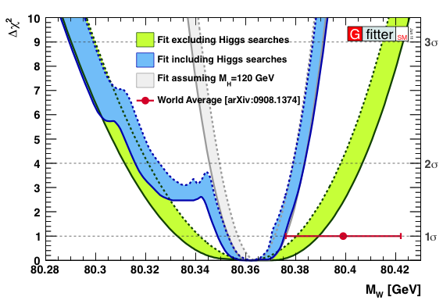
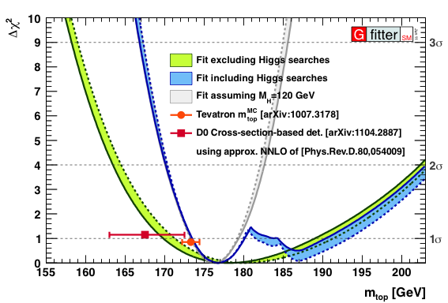
Constraints on other observables
Combining direct Higgs searches with EW fit to predict precision observables
http://cern.ch/gfitter
Constraint on top mass
Constraint on W mass
11 MeV error if Higgs known
3.0 GeV error if M_{H} = 120 GeV known
Central value ±1σ: m_{t} = (176.8 ± 3.3) GeV
Direct measurement: m_{t} = (173.3 ± 1.1) GeV
From cross section: m_{t} = (167.5 ) GeV
+0.017
–0.010
Central value ±1σ: m_{t} = (80.359 ) GeV
Direct measurement: m_{t} = (80.399 ± 0.023) GeV
+5.0
–4.5
D0: arXiv:1104.2887

Slide 32
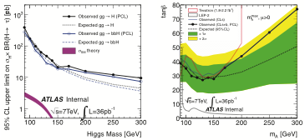


SM / SUSY Higgs to ττ
2 Higgs doublets required in MSSM, leading to 5 Higgs bosons: h, H, A, H±
Higgs coupling to down-type fermions can be strongly enhanced depending on tanβ = υ_{d} / υ_{u} and m_{A}
Search for h, H, A → ττ decays in e–μ & e/μ–had channels (52% BR), require E_{T,miss} > 20 GeV and low M_{T}
m_{h}^{max} scenario
Preliminary
Preliminary
Preliminary
  We also searched for CP-odd NMSSM Higgs a₁ → μμ for masses 6–9, 11–12 GeV → 95% CL limits O(250 pb)

Slide 33
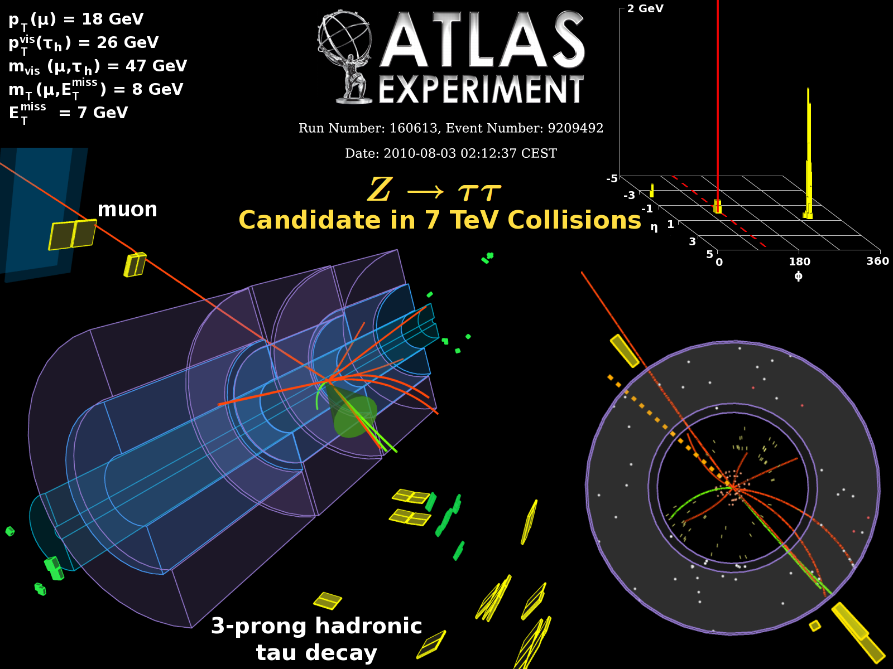

Slide 34
hierarchy
Supersymmetry searches
SUSY searches also sensitive to many other new physics scenarios (and vice versa)
Spin 0 | Spin 1/2 | Spin 1
 | ●
 | q
h⁰, H⁰, A⁰, H±
 |  | γ, Z⁰, W±
 |  | g_{a}
SM
SUSY
+ gravitino (S=3/2) and graviton (S=2)
Gauge-mixed physical states that propagate in space and time and can be observed

Slide 35
Characteristic SUSY Decay Cascades
R-parity conserving SUSY can cascade into high-p_{T} jets + leptons + E_{T,miss}
With R parity: SUSY production in pairs which requires energy 2  SUSY mass !
→ Incomplete event reconstruction
  SUSY evidence in tails of distributions
  Analysis concentrates on understanding backgrounds (top, W/Z+jets, QCD)
  Each background component is taken from / verified in control regions
2 LSPs escapes detection → missing E_{T}
“Typical” SUSY decay chain at the LHC
Typical LSP is spin-½ neutralino, linear combination of gauginos (typically mixture of photino and zino); LSP could also be gravitino

Slide 36
Different Analyses for Various Scenarios
arXiv:1102.5290, arXiv:1102.2357, arXiv:1103.6214, arXiv:1103.6208, ATLAS-CONF-2011-039, arXiv:1103.4344
Channel | Signature | Main backgrounds
Monojet + E_{T,miss} | ≥ 1 jet, large E_{T,miss} | W / Z(νν) + jets, top, QCD
0 leptons + jets + E_{T,miss} | ≥ 2–4 jets, large E_{T,miss}, m_{eff}⁽*⁾ | W / Z + jets, top, QCD
1 lepton + jets + E_{T,miss} | ≥ 3 jets, large E_{T,miss}, m_{eff}, m_{T} | top, W / Z + jets
2 leptons (SS / OS) + jets + E_{T,miss} (also “flavour subtraction” OS analysis) | large E_{T,miss} | SS: Fakes, diboson; OS: top, Z + jets, also cosmics (μμ)
≥ 3 leptons + jets + E_{T,miss} | ≥ 2 jets, E_{T,miss}, m_{l+l–} ≠ m_{Z} | top, Z + jets
⁽**⁾ 0(1) lepton + b-jets + E_{T,miss} | ≥ 3(2) jets, E_{T,miss}, m_{eff}, (m_{T}) | top, W / Z + jets
2 photons + E_{T,miss} | E_{T,miss} | QCD, top, W(γ) + jets
+ more targeted analyses for SUSY scenarios with features not covered by above inclusive searches
Incomplete list
⁽*⁾ m_{eff} = E_{T,miss} + Σp_{T,jets}
⁽**⁾ Large mixing scenario can give light sbottom, stop with:
ATLAS monojet paper out today (arxiv:1106.5327)
→ Discussion of ATLAS and CMS monojet analyses by David Berge this week

Slide 37
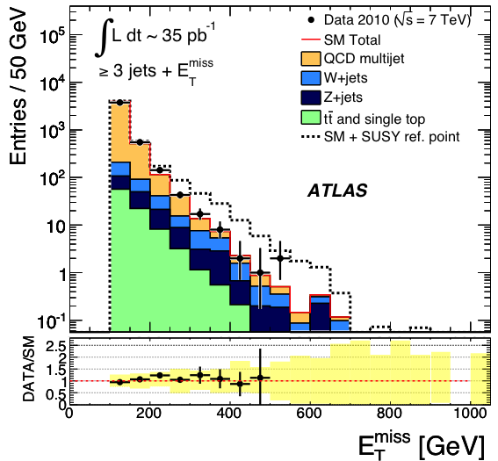
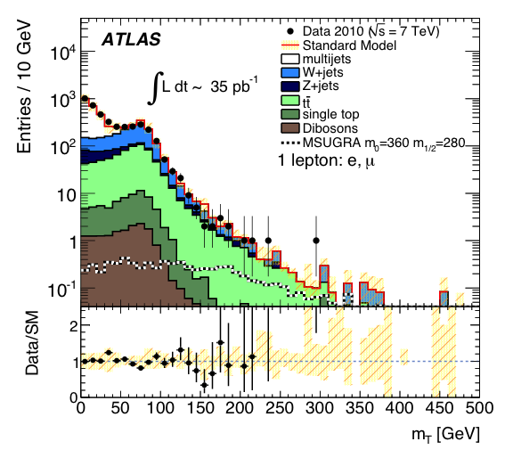
Data-driven background determination using background-enhanced control regions (anti-cuts)
Extrapolation into signal region(s) using MC (include systematic errors in transfer functions)
0-lepton channel, E_{T,miss}
1-lepton channel, transverse mass
arXiv:1102.5290
arXiv:1102.2357
Example for observed and predicted events in signal regions; pure selection gives best sensitivity
 | 0-lepton (SR-D) | 1-lepton (e) | 1-lepton (μ)
Observed | 2 | 1 | 1
Total SM background | 2.5 | 1.81 ± 0.75 | 2.25 ± 0.94
+ 1.4
– 1.1

Slide 38
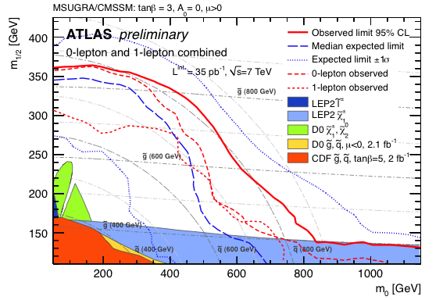
SUSY Exclusion
ATLAS-CONF-2011-064
  No signal evidence found → exclusion limits using CMSSM and simplified models
In CMSSM: combined 0 + 1-lepton analysis achieves best sensitivity
Exclusion CL
b-jet analysis competitive for large tanβ
Exclude equal squarks and gluino masses of 815 GeV at 95% CL
Significance
Power-constrained* limits (PCL) computed from CL_{PCL} of test statistics using toy MC
*Fluctuations below –1σ wrt. median of expected limits are not allowed
Corresponding CL_{s} limits provide reduced exclusion (overcoverage)

Slide 39
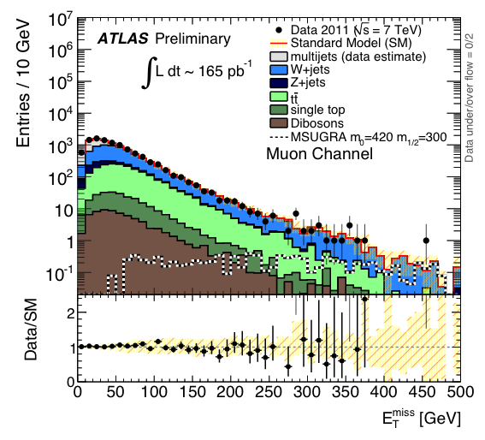
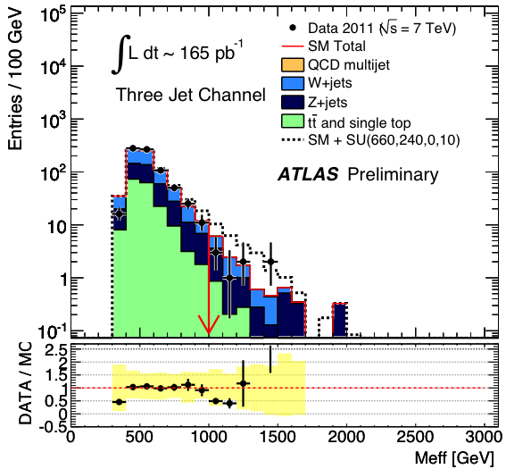
2011
data
0/1-lepton analyses updated for PLHC with improved signal regions (2+, 3+, 4+ jets)
Raised M_{eff} cut to 1 TeV in 0-lepton analysis (previously: 500 GeV)
0-lepton channel, M_{eff}
1-lepton channel, E_{T,miss}
ATLAS-CONF-2011-086
ATLAS-CONF-2011-090
Example for observed and predicted events in signal regions; pure selection gives best sensitivity
 | 0-lepton (≥3-jet) | 1-lepton (e) | 1-lepton (μ)
Observed | 8 | 10 | 12
Total SM background | 10.1 ± 2.3 | 14.5 ± 5.2 | 12.2 ± 3.8

Slide 40
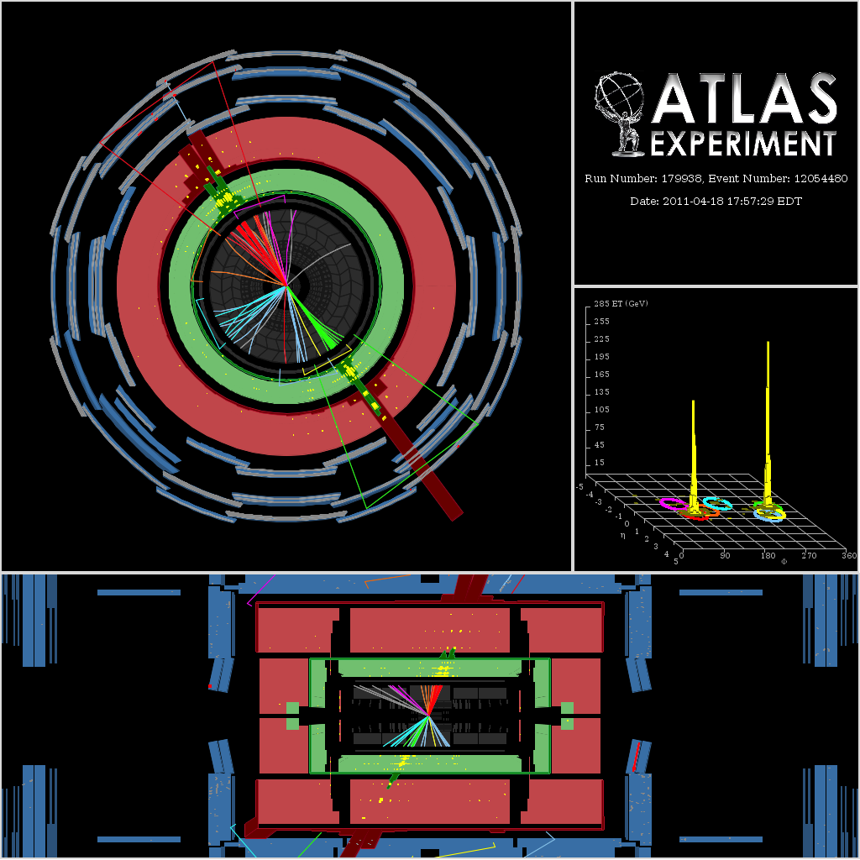
Event with 1.5 TeV effective mass and 550 GeV missing transverse energy

Slide 41
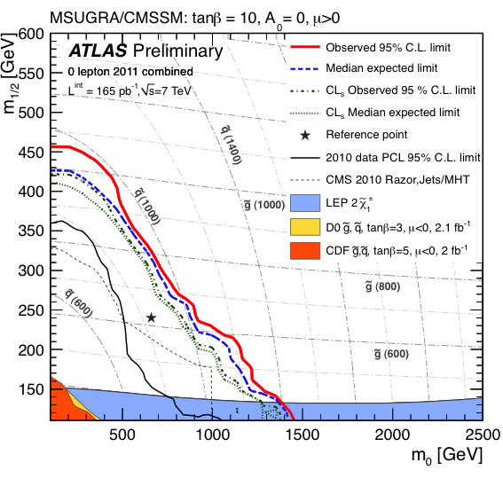
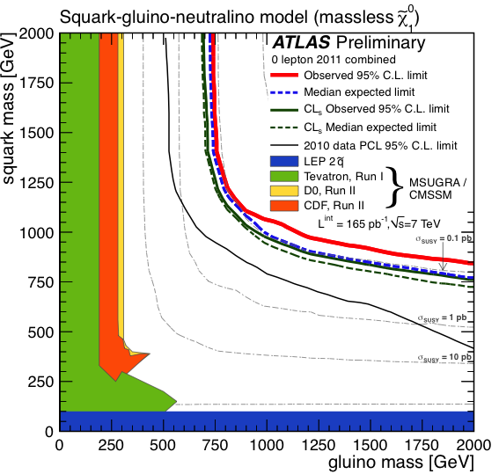
2011 Updates
2011
data
ATLAS-CONF-2011-086
ATLAS-CONF-2011-090
  0/1-lepton analyses updated for PLHC with improved signal regions (2+, 3+, 4+ jets)
  Raised m_{eff} cut to 1000 GeV in 0-lepton analysis (previously: 500 GeV) to optimise reach for increased statistics
Exclusion CL
Significance
0-lepton limits on PhenoGrid and CMSSM combining all signal regions

Slide 42
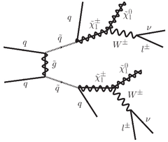
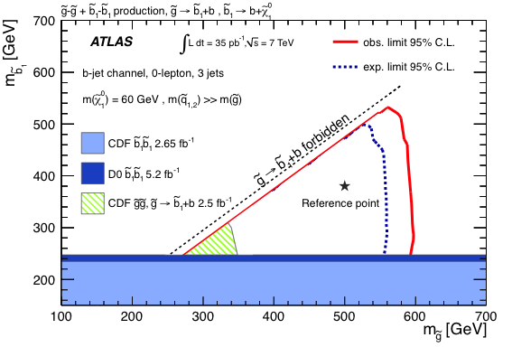
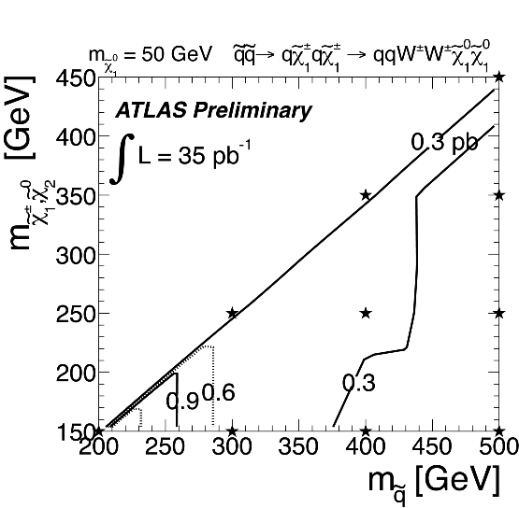
SUSY Exclusion with Simplified Models
Simplified models compendium: arXiv:1105.2838
  Limits in simplified models (“Pheno-grids”)
2-lepton channel (SS)
0-lepton + b-jet
arXiv:1103.4344
ATLAS-CONF-2011-091
95% CL upper limits on σ × BR
Significance
Exclude m(gluino) < 590 GeV for m(sbottom) < 500 GeV
  Useful to assess signature-driven performance,
  and to discover holes in search strategy

Slide 43
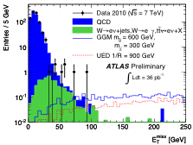
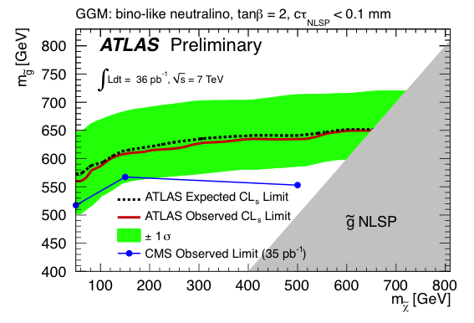
Inclusive search with 2 photons and E_{T,miss}
Sensitive to gauge-mediated SUSY breaking and also UED models
Preliminary
Observed and predicted E_{T,miss} spectrum
N_{obs} = 0
N_{exp} = 0.13 ± 0.05
Cut E_{T,miss} > 125 GeV sets 95% CL_{s} limits:
GGM gluino mass⁽*⁾ > 560 GeV; UED compactification scale⁽**⁾: 1/R_{UED} > 960 GeV
^{(*}*⁾ In GMSB: , giving γγ + E_{T,miss} signature
⁽**⁾ LKP γ∗ → γ + G (UED embedded in in eV^{–1} sized EDs)

Slide 44


Search for stable squarks and gluinos [ τ ~ O(100–1000) sec ]
Hadronize to e-neutral or charged colour-singlet R-hadrons:
arXiv:1103.1984
Detection of charged R-hadrons through specific ionisation loss and time-of-flight
dE/dx in Pixel detector ← measurements are combined →
Time-of-flight in Tile calorimeter
Trigger:
E_{T,miss} > 40 GeV
→ 95% CL: sbottom R-hadrons > 294 GeV; stop > 309 GeV; gluino > 562–586 GeV

Slide 45


Search for long-lived particles reaching muons system
Search for GMSB staus (“heavy muons”) and R-hadrons, ID and calo also used
arXiv:1106.4495
Detection of slow massive particles through time-of-flight → β (mass)
Measured mass and GMSB scenarios
Measured mass and R-hadron scenarios
Model-dependent limits:
Exclude stable staus of 136 GeV in GMSB benchmark model
Exclude R-hadrons (depending on scattering model and gluino-ball fraction) up to 544 GeV

Slide 46


R-parity violating SUSY: single sparticles, LFV, no E_{T,miss}
Consider: , search for high mass eμ signature
arXiv:1103.5559
Observed and predicted e-μ invariant mass
Limits on RPV couplings vs. sneutrino mass
Limits obtained assuming single-coupling dominance
Analysis also sensitive to Z ’ bosons
with non-diagonal flavour coupling allowing LFV
Limits on RPV coupling: at 95% CL exclude:

Slide 47


Lepton-jets from dark photon decays to lepton pairs
Hidden sector, weakly coupled to SM, allows for new light (GeV scale) boson
ATLAS-CONF-2011-076
Production of 2 lepton-jets from squark pairs
dark photon g_{d} decays to lepton pairs
dark fermion f_{d} (“darkino”) escapes undetected
Lepton-jets must have high-quality muons and be isolated
Background, domi-nated by QCD, is estimated from data
Search for ≥ 2 lepton-jets with ≥ 2 leptons
Zero events observed in signal region, for 0.20 ± 0.19 expected background
→ model-dependent limits on cross section of O(0.2 pb)

Slide 48
hierarchy
Searches for Other New Phenomena
Excited quarks, contact int., Z’/W’, Leptoquarks, 4th generation, Extra dimensions, …

Slide 49


Dijet mass and angular distributions as probes of NP
Excited quarks, contact interactions, axigluons, strong gravity, …
2011
data
ATLAS-CONF-2011-081
Observed and fitted m(jet-jet) distributions
95% CL σ x Acceptance limit vs. dijet mass
Multi-TeV probes !
Search for bump over continuous background (fit)
No deviations from SM seen → set limits

Slide 50
Event with 4.04 TeV dijet invariant mass

Slide 51
Dijet mass and angular distributions as probes of NP
Excited quarks, contact interactions, axigluons, strong gravity, …
2011
data
ATLAS-CONF-2011-081
arXiv:1103.3864
Benchmark model | Observed (expected) limit at 95% CL
Excited quarks | m(q*) | > | 2.64 (2.12) TeV
Axigluons | m | > | 2.67 (2.48) TeV
Quantum black hole (δ = 6) | M_{D} | > | 3.67 (3.64) TeV
4-quark contact interactions | Λ | > | 6.7 (5.7) TeV⁽*⁾
Resonant
Nonresonant
⁽*⁾ Bayesian limit
Limit on μμqq contact interactions derived from m(μμ) spectrum (42 pb^{–1}): Λ > 4.9 / 4.5 TeV at 95% CL
for constructive / destructive interference
New limit on size of quark:
< 2.1 (3.4) × 10^{–18} cm
arXiv:1104.4398
For the record: limit on electron radius from g – 2 : R_{g} < 4×10^{–11} × 10^{–12} cm ~ O(10^{–22}) cm

Slide 52


Searches for W ’ and Z’ resonances in decays to e/μ
Use transverse / dilepton mass to search for excess over SM
2011
data
arXiv:1103.1391, ATLAS-CONF-2011-082
arXiv:1103.6218, ATLAS-CONF-2011-083
Observed and predicted transverse mass, search bumps
Observed and predicted dielectron mass
Combination of 2010+2011 (W→μν only) sets 95% CL_{s} limit: m(W ’_{SSM}) > 1.70 (1.77) TeV⁽*⁾
Likelihood fit sets limit at 95% CL_{Bayesian}:
m(Z ’_{SSM}) > 1.41 (1.41) TeV⁽*⁾
⁽*⁾ limits for E₆ Z ’ models: 1.12_{Ψ} – 1.26_{χ} GeV ; for Z *

Slide 53

Searches for W ’ and Z’ resonances in decays to e/μ
Use transverse / dilepton mass to search for excess over SM
2011
data
arXiv:1103.1391, ATLAS-CONF-2011-082
arXiv:1103.6218, ATLAS-CONF-2011-083
Observed and predicted transverse mass
Observed and predicted dielectron mass
Combination of 2010+2011 (W→μν only) sets 95% CL_{s} limit: m(W ’_{SSM}) > 1.70 (1.77) TeV⁽*⁾
Likelihood fit sets limit at 95% CL_{Bayesian}:
m(Z ’_{SSM}) > 1.41 (1.41) TeV⁽*⁾
⁽*⁾ limits for E₆ Z ’ models: 1.12_{Ψ} – 1.26_{χ} GeV ; for Z *

Slide 54

Highest mass dielectron event with m(ee) = 920 GeV

Slide 55



Resonant tt production
Study tt invariant mass spectrum in lepton + jets final states
2011
data
ATLAS-CONF-2011-087
Top-antitop candidate invariant mass
Excluded visible cross section
Limit for RS KK gluon
Entries / GeV
g_{KK} = 0.5 TeV
g_{KK} = 1.0 TeV
yellow: SM
g_{KK}
Analysis
not yet sensitive to leptophobic Z ’ model chosen
95% CL_{Bayes.} limits:
σ × BR(g_{KK}→tt) < 38 pb (m_{gKK} = 500 GeV), < 4.2 pb (1300 GeV) → m(g_{KK}) < 650 GeV

Slide 56

Top-antitop candidate with m(tt) = 1.6 TeV
Collimation of top decays due to strong boost
Missing ET

Slide 57



Search for extra dimensions
Randall-Sundrum KK graviton G → γγ
ATLAS-CONF-2011-044
Observed and fitted diphoton mass⁽*⁾
Observed and expected RS graviton limit
95% CL_{s} limit: M_{G} > 545 (920 GeV) for k / M_{Pl} = 0.02 (0.1)
⁽*⁾Preliminary analysis using loose photon identification

Slide 58



Search for 1st and 2nd gen. leptoquarks
Study scalar LQ pair production to lljj and lνjj final states
arXiv:1104.4481
Observed and predicted ave. M(LQ) in eejj channel
Observed and expected 2nd generation LQ limit
Require large p_{T}, M_{eff}, and dilepton mass
95% CL_{s} limits on M(LQ) for 1st gen: > 376 (319) GeV; 2nd gen > 422 (362) GeV for β = 1.0 (0.5)

Slide 59


Search for extra dimensions – trans-Planck physics
Microscopic black hole search in multijet and same-sign dimuon events⁽*⁾
⁽*⁾BH signal simulated with BLACKMAX 2.01
ATLAS-CONF-2011-068
ATLAS-CONF-2011-065
Scaler Σp_{T} in events with ≥ 5 jets
Track multiplicity in same-sign dimuon events
Expectation for non-rotating BH
with M_{D} = 630 GeV, M_{th} = 3 TeV
N_{obs} = 7
N_{exp} = 3.7 ± 1.5
N_{tracks} with
p_{T} > 8 GeV
Fiducial non-SM cross section limits :
Multijet analysis: σ × BR × A < 0.29 (0.19) pb
SS dimuon analysis: σ × BR × A < 0.18 (0.28) pb
Also BH limit from t + X cross section: M_{th} > 2.35 TeV
ATLAS-CONF-2011-070

Slide 60


Search for long-lived highly ionising particles* (HIP)
Heavy particle with Q_{electric}~O(10e) → large specific energy loss in detector
arXiv:1102.0459
Fraction of TRT high-threshold hits ← combined →
Fraction of leaked calorimeter energy in EM layer 1
Background in signal region data-driven. The MC shown is indicative only.
No indication for HIPs
Analysis on low-luminosity data only to benefit from 10 GeV E_{T} EM trigger threshold
95% CL_{Bayes.} limits: σ < 3−12 pb (for DY mechanism) for 6e ≤ |Q_{e}| ≤ 17e and 0.2 < m_{HIP} < 1 TeV
^{(*}*⁾ Examples for models with HIPs: Q-balls, stable micro black-hole remnants, magnetic monopoles & dyons

Slide 61
Summary … after (only) one year of 7 TeV data taking

Slide 62


Slide 63

Is SUSY out already?
Not quite … yet!
But the interest seems to decrease?
Blunt extrapolation for 2011
Caution: serious science!

Slide 64

The LHC cumulates the hopes (and fears) of an entire generation of particle physicists…
Blunt extrapolation for 2011
Caution: serious science!

Slide 65
Conclusions
ATLAS is mining its data for the expected and the unexpected
  2010 data ~ fully analysed, strong effort on 2011 data → EPS, LP, …
Search for the SM Higgs boson
  First full ATLAS maximum likelihood combination of 6 Higgs analyses
  Touching 95% CL exclusion at 160 GeV [ expect 145–190 GeV with 1 fb–1 ]
Searches for beyond-SM phenomena
  Large amount of search analyses performed, exclusion reach between 300 GeV and 6.7 TeV obtained, SUSY in MSUGRA excluded up to 950 GeV
  Intensive work on detector and background understanding pays off
  Analyses in “factory” mode, setup to fast conduct new searches
No new physics in 2010 → expect ~100 × more data in 2011

Slide 66
Frank Zimmermann, ATLAS week, 20 June 2011
Luminosity potential of present LHC
How to go further?
50 ns spacing:
n_{b}: 1092 → 1380, N_{b}: 1.2x10¹¹→1.7x10¹¹ (double batch inj.)
β*: 1.5 →1.0 m
Total gain ~ factor 4 → 5x10³³ cm⁻²s⁻¹ at 3.5 TeV
25 ns spacing (e- cloud in SPS & LHC!?):
n_{b}: 1092 → 2808, N_{b}: 1.2x10¹¹
β*: 1.5 →1.0 m, γε: 3 μm → 4 μm
Total gain ~ factor 3 → 4x10³³ cm⁻²s⁻¹ at 3.5 TeV
Another factor 4 from going to ~7 TeV (&β*~0.5 m)
2x10³⁴ cm⁻²s⁻¹ at ~7 TeV does not appear impossible

Slide 67
Extra slides…

Slide 68





Higgs Searches at the LHC
Total Higgs cross section × BR versus M_{H}
Numbers based on LHC Higgs cross section group: arXiv:1101.0593
Cross section uncertainties include
Missing higher-order corrections
PDF uncertainties
α_{S} uncertainty
BRs: < ~2% (neglected)
Uncertainties per production mode
± (15–20)% for gg → H
± (3–9)% for qq → qq + H
± 5% for qq’ → H + W / Z
Incomplete list of graphs !

Slide 69




H → γγ
ATLAS-CONF-2011-071
Clean discovery channel for light Higgs: σ × BR (115 / 140 GeV | √s=7 TeV ) ≈ 48 / 28 fb
Select tight & isolated photons; requires excellent E_{γ} resolution, efficient & pure photon ID, primary vertex
  Dominant backgrounds:
  γ + γ (“irreducible” – not quite)
Quark annihilation
(dominant: O(α²))
Brensstrahlung, O(α²α_{S})
and quark fragmentation
Box diagram
O(α²α_{S}²), ≈ q-ann.
  γ + jet and jet + jet (reducible, but ~10⁶ × larger than γγ)
  Backgrounds composition measurement with calorimeter sideband techniques
  Agreement with (imprecise) theory predictions
QCD processes suffering from large uncertainties

Slide 70

SM Higgs Exclusion Potential
  ATLAS combination of individual channels for 2010 data / statistics comparison
Preliminary
Combination using maximum likelihood fit taking into account correlated nuisance parameters
Exclusion CL
Uncertainty on cross section included in SM expectation
Also indicated are LEP and Tevatron 95% CL exclusion regions
Grey horizontal bands show cross section uncertainties
Inner region highlights contribution from QCD scale variation
Significance
Comparison of PCL with CL_{s} results for observed and expected exclusion limits

Slide 71

SM Higgs Exclusion / Discovery Potential
  Luminosity required to exclude, see and discover an SM Higgs at √s = 7, 8 TeV
ATLAS-CONF-2011-022
Exclusion CL
Significance

Slide 72

Search for 1st and 2nd gen. leptoquarks
Study scalar LQ pair production to lljj and lνjj final states
ATLAS-CONF-2011-069
Spin-off of LQ analysis: W + 2 jets m(jj) plot
Observed and predicted ave. M(LQ) in eejj channel
2 jets with p_{T} > 20 GeV, |η | < 2.8, no cut on dijet p_{T}
Observed and expected 2nd generation LQ limit
95% CL_{s} limits on M(LQ) for 1st gen: > 376 (319) GeV; 2nd gen > 422 (362) GeV for β = 1.0 (0.5)

Slide 73



SUSY Higgs: a₁ → μμ
ATLAS-CONF-2011-020
NMSSM expands Higgs sector by scalar singlet → adds h₁, a₁ (CP-even/odd) fields
Higgs phenomenology dramatically altered if h₁→a₁a₁ dominant. σ × BR depends on tanβ and a₁–a₂ mixing
Search for a₁→μμ (BR ~ 0.5%) in mass ranges 6–9 and 11–12 GeV (cut out Y_{1–3S}), tight muon-pair selection
Upper limit on σ(gg → a₁ → μμ)
Example:
σ×BR ~ 3 pb for m(a )=8 GeV, tanβ=10, cosθ =0.1

Slide 74



Search for 4th generation quarks
Study Q₄ pair production to 2 × W(→lν)q final state (OS)
ATLAS-CONF-2011-022
Observed and predicted coll. mass for M(Q₄)=250 GeV
Observed and predicted coll. mass for M(Q₄)=350 GeV
Kinematic constraint (as for LQs) from equality of both reconstructed Q₄ masses
H_{T} cut tightens with
Q₄ mass hypothesis
95% CL_{FC} limit M(Q₄) > 270 GeV, applicable to u₄ and other exotic Q₄-like quark models

Slide 75

Highest mass W→μν candidate with m_{T} = 1.35 TeV

