Slide 1
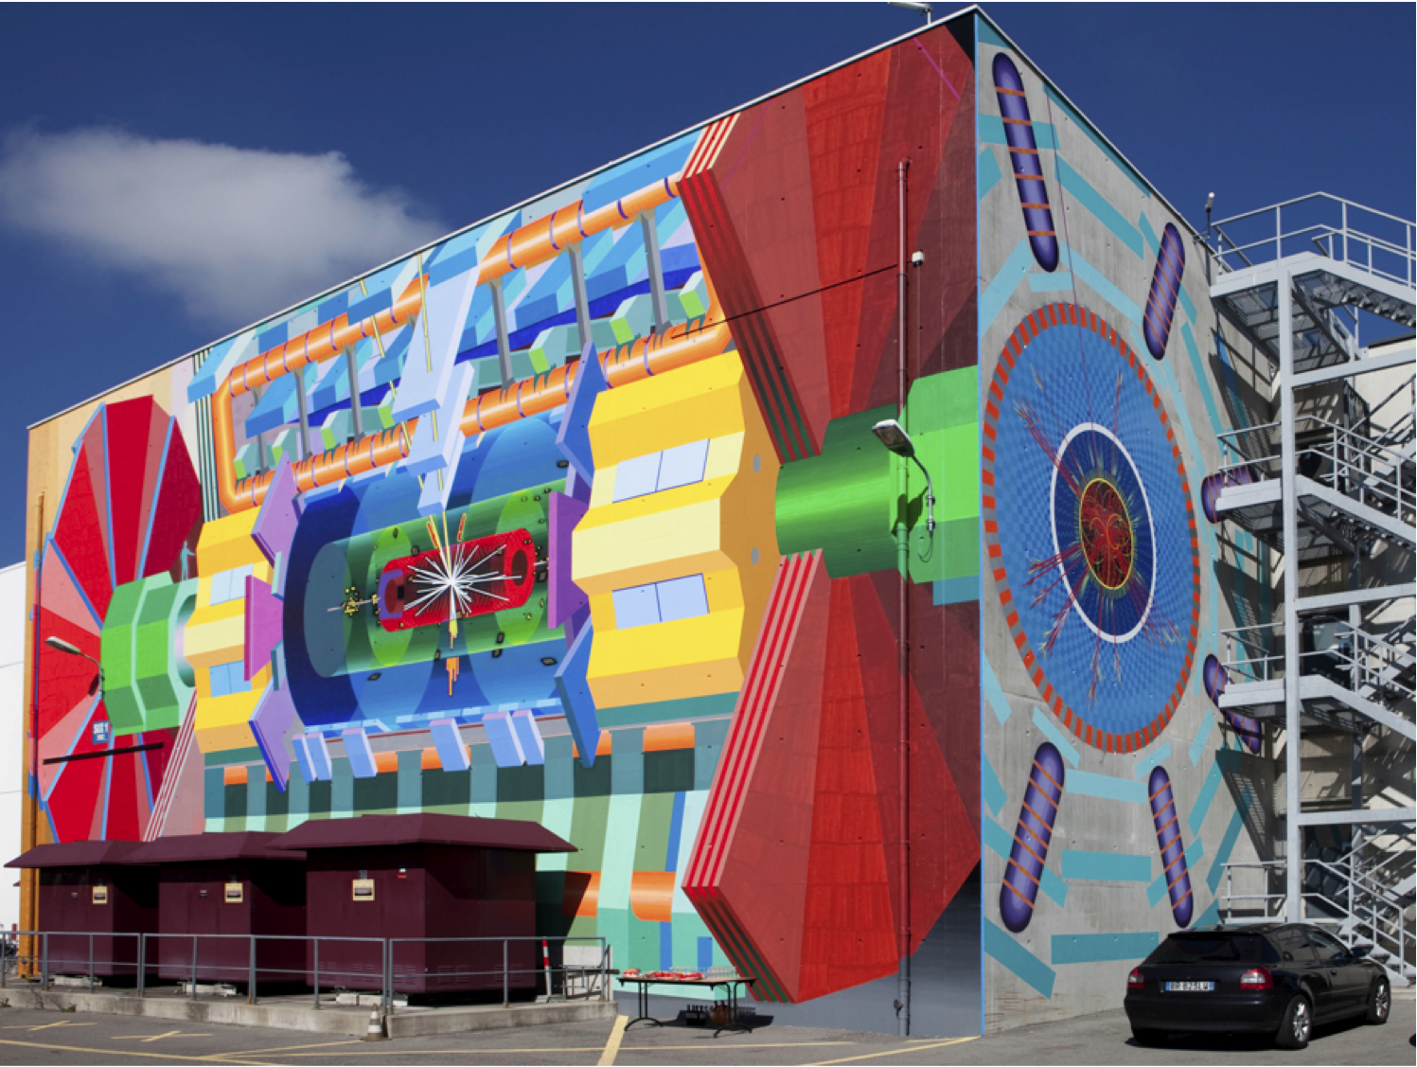
Particle Physics at Year Three
of the Large Hadron Collider
Andreas Hoecker (CERN)
11 May 2012, NBI-Copenhagen, Denmark
Version: May 31, 0:17

Slide 2
Outline
  Some words on the Standard Model
  LHC measurements and searches
  Epilogue

Slide 3
Particle Physics Scales
L_{gravitation} ~ 10⁻³⁵ m
10¹⁹ GeV
Planck scale (M_{Pl})
10¹⁶ GeV
GUT ?
10¹⁴ GeV
ν_{R} ?
LHC reach
10 TeV
New Physics ?
1 TeV
…probing attometer scales
L_{weak} ~ 10⁻¹⁸ m
100 GeV
t, Z, W, H, EWSB
10 GeV
ψ, Υ, B
1 GeV
τ, n, p, ρ, φ
L_{strong} ~ 10⁻¹⁵ m
100 MeV
μ, π, QCD
10 MeV
nuclear binding E
1 MeV
e
100 keV
10 keV
1 keV
core of Sun
100 eV
10 eV
atomic binding E
L_{atomic} ~ 10⁻¹⁰ m
1 eV
ν’s
100 meV
10 meV
?

Slide 4

Everyday life (and particle physics) are described by the Standard Model

Slide 5
Everyday life (and particle physics) are described by the Standard Model
The SM is the legacy of 20th century particle physics
It unifies quantum theory and special relativity
It describes ~ all laboratory data
But, the model has problems and even flaws, and that’s why we think it cannot be the final theory
Theorists have suggested many ways to improve the SM, but we need the experiments to separate right from wrong

Slide 6
The Standard Model
The Standard Model consists of 24 elementary matter particles and 3 forces
Interactions
Electro-magnetic
Weak
Strong

Slide 7
The Standard Model
The SM describes all observed phenomena in particle physics by 19 parameters (?)
6 quark masses
3 lepton masses
1 EM coupling
(massless Photon)
1 weak coupling
2 masses : Z, W
1 strong coupling
(massless Gluons)
1 Higgs mass
4 quark mixing parameters
= 20 parameters ?
− 1 by virtue of electroweak unification
+ at least 9 parameters for massive neutrinos
1 CPV QCD parameter ~ 0

Slide 8
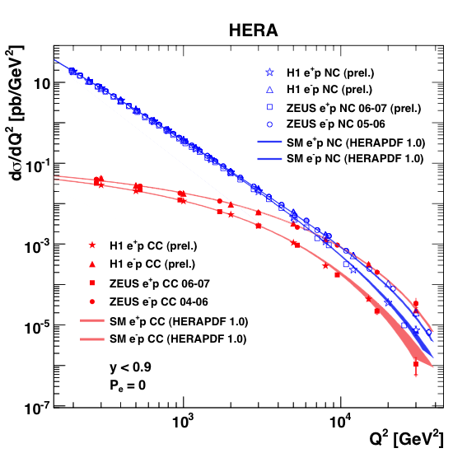
The Standard Model
The SM describes all observed phenomena in particle physics by 19 parameters (?)
Above ~100 GeV, electro-magnetic and weak interactions are unified
Below 100 GeV, weak interaction is weaker than electromagnetism
Electroweak interaction
γ, Z current
W current
HERA data from electron–quark scattering into e+q (NC = γ,Z) or ν+q (CC = W ±)
= 20 parameters ?
− 1 by virtue of electroweak unification
+ at least 9 parameters for massive neutrinos

Slide 9
The Standard Model
Elementary particle physics is successfully described by local gauge theories
Gauge symmetry is the invariance of equations of motion with respect to a local transformation belonging to a symmetry group
Example: translation group — uniform movement of particle
Global
symmetry:
Local
symmetry:
movement under influence of a potential
movement
movement
A new trajectory is possible, if forces act on the particle: a potential that restores the symmetry of the dynamic under this particular gauge transformation
The dynamic found is not just any dynamic, but one of the 4 forces of nature: gravitation
Requiring the same local gauge invariance for a wave function gives us: QED

Slide 10
The Standard Model
Elementary particle physics is successfully described by local gauge theories
Gauge symmetry is the invariance of equations of motion with respect to a local transformation belonging to a symmetry group
Example: translation group — uniform movement of particle
Global
symmetry:
Local
symmetry:
movement under influence of a potential
movement
movement
We can do so for all fundamental forces of the Standard Model, which have thus a
Geometric origin !

Slide 11

The Standard Model
Brout-Englert-Higgs mechanism
A problem: local gauge symmetry requires massless spin-1 “gauge” (=force) boson
This has been well verified for QED, with a massless photon (= infinite range)
However, the W, Z bosons are massive (= finite range ~10⁻¹⁵ cm)
Only way to break gauge symmetry consistently is to spontaneously break the symmetry of the vacuum:
[ non-zero vacuum expectation value ]
φ is a complex doublet field: 3 d.o.fs become Z, W ± masses, remaining d.o.f is massive scalar Higgs boson
This is called the Brout-Englert-Higgs Mechanism

Slide 12
The Standard Model
Brout-Englert-Higgs mechanism
Let’s imagine all particles have zero mass → gauge symmetry is respected
Higgs quantum liquid in broken phase
Gravity
A Higgs field displaces ground state breaking gauge symmetry
It fills all space time (but w/o orientation as spin=0)
Photon
×
×
Weak boson
×
×
×
×
The particles interact with the Higgs field thus reducing their velocity, which is equivalent to acquiring a mass
→ Action of the Higgs field creates a vacuum viscosity
×
Neutrinos
ν_{L}
Λ⁻¹
ν_{L}
Electrons
×
e_{L}
e_{R}
×
e_{L}
×
×
×
_{L}
_{R}
×
×
Top quark
_{R}
_{R}
×
_{R}
×
×
_{L}
_{L}
t_{L}
_{L}
×
×
H. Murayama

Slide 13
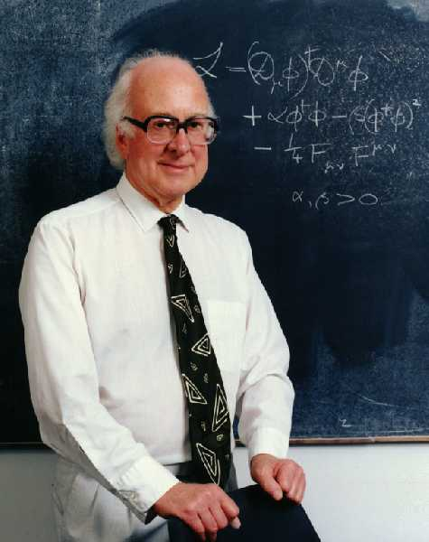
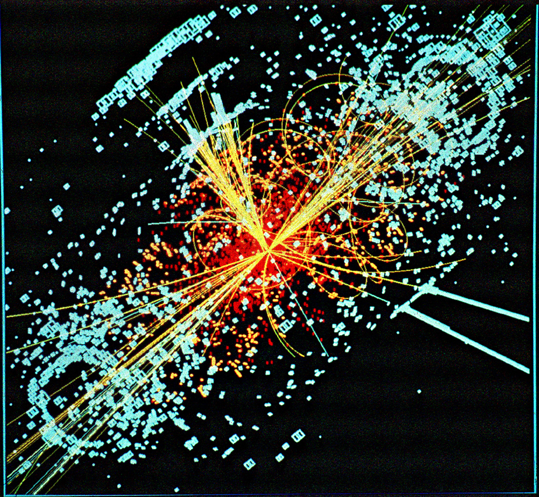
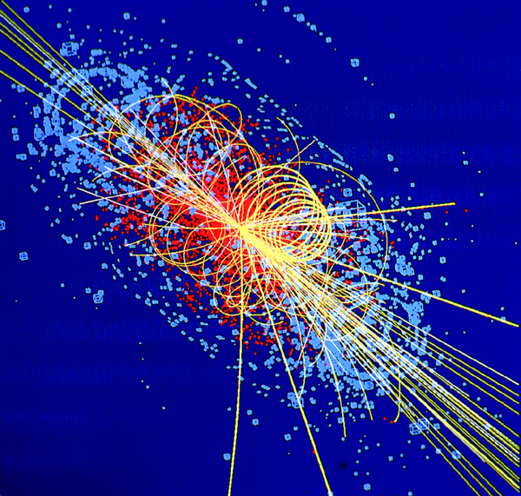
The Higgs boson is the last elusive elementary particle of the SM
P.W. Higgs, Phys. Lett. 12 (1964) 132
The Higgs boson – last of the particles ?
What is known about the Higgs Boson ?
© CMS
© ATLAS

Slide 14
The Higgs boson is the last elusive elementary particle of the SM
Daniel Froidevaux (CERN):
P.W. Higgs, Phys. Lett. 12 (1964) 132
The Higgs has been with us for >4 decades as
a theoretical concept
an incarnation of the “Communist Party since it controls the Masses”
[L. Alvarez-Gaumé at CERN summer school in Alushta]
a painful part of the first chapter in our PhD thesis …
© CMS
© ATLAS

Slide 15
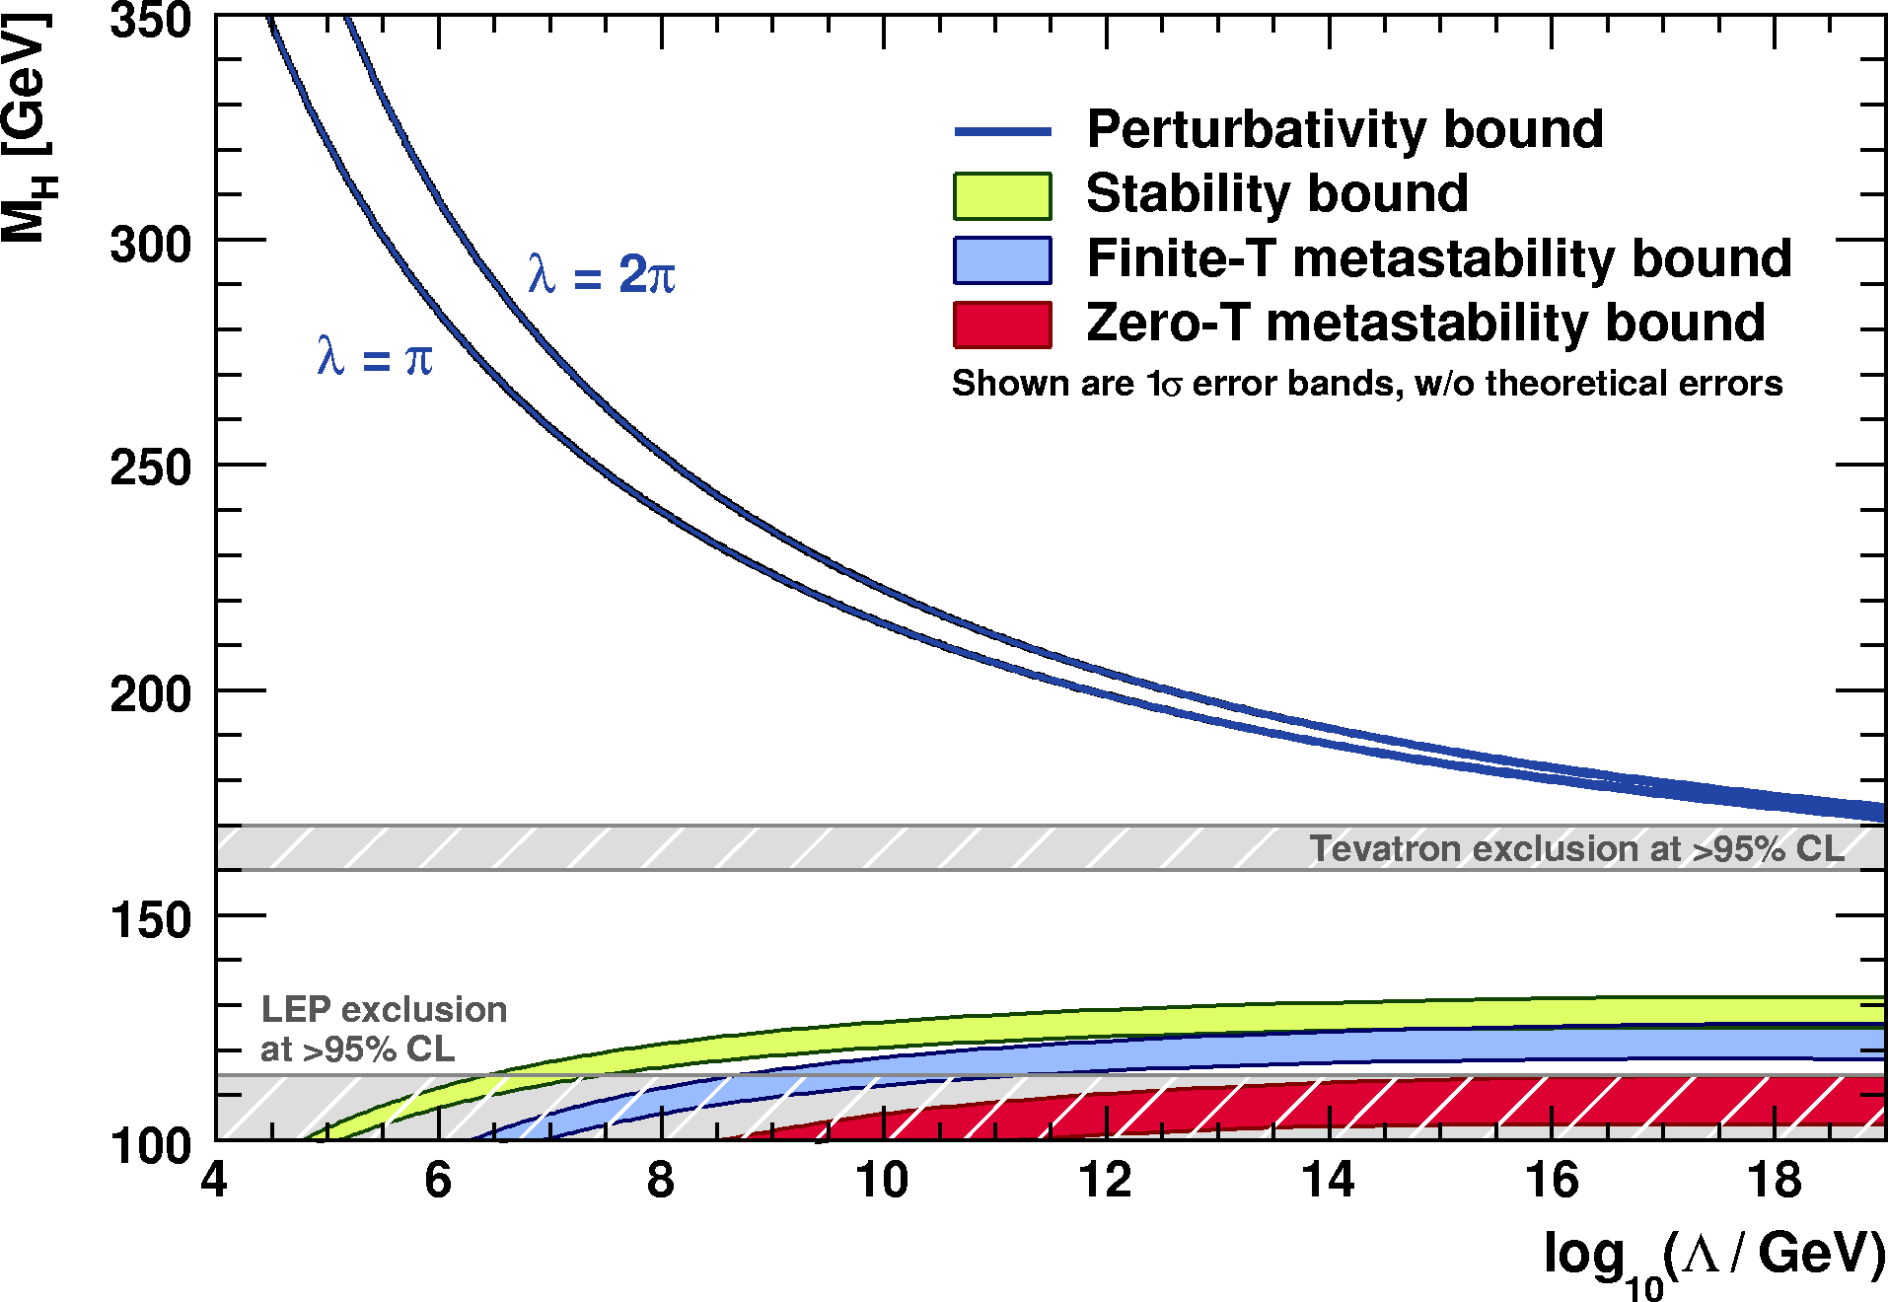
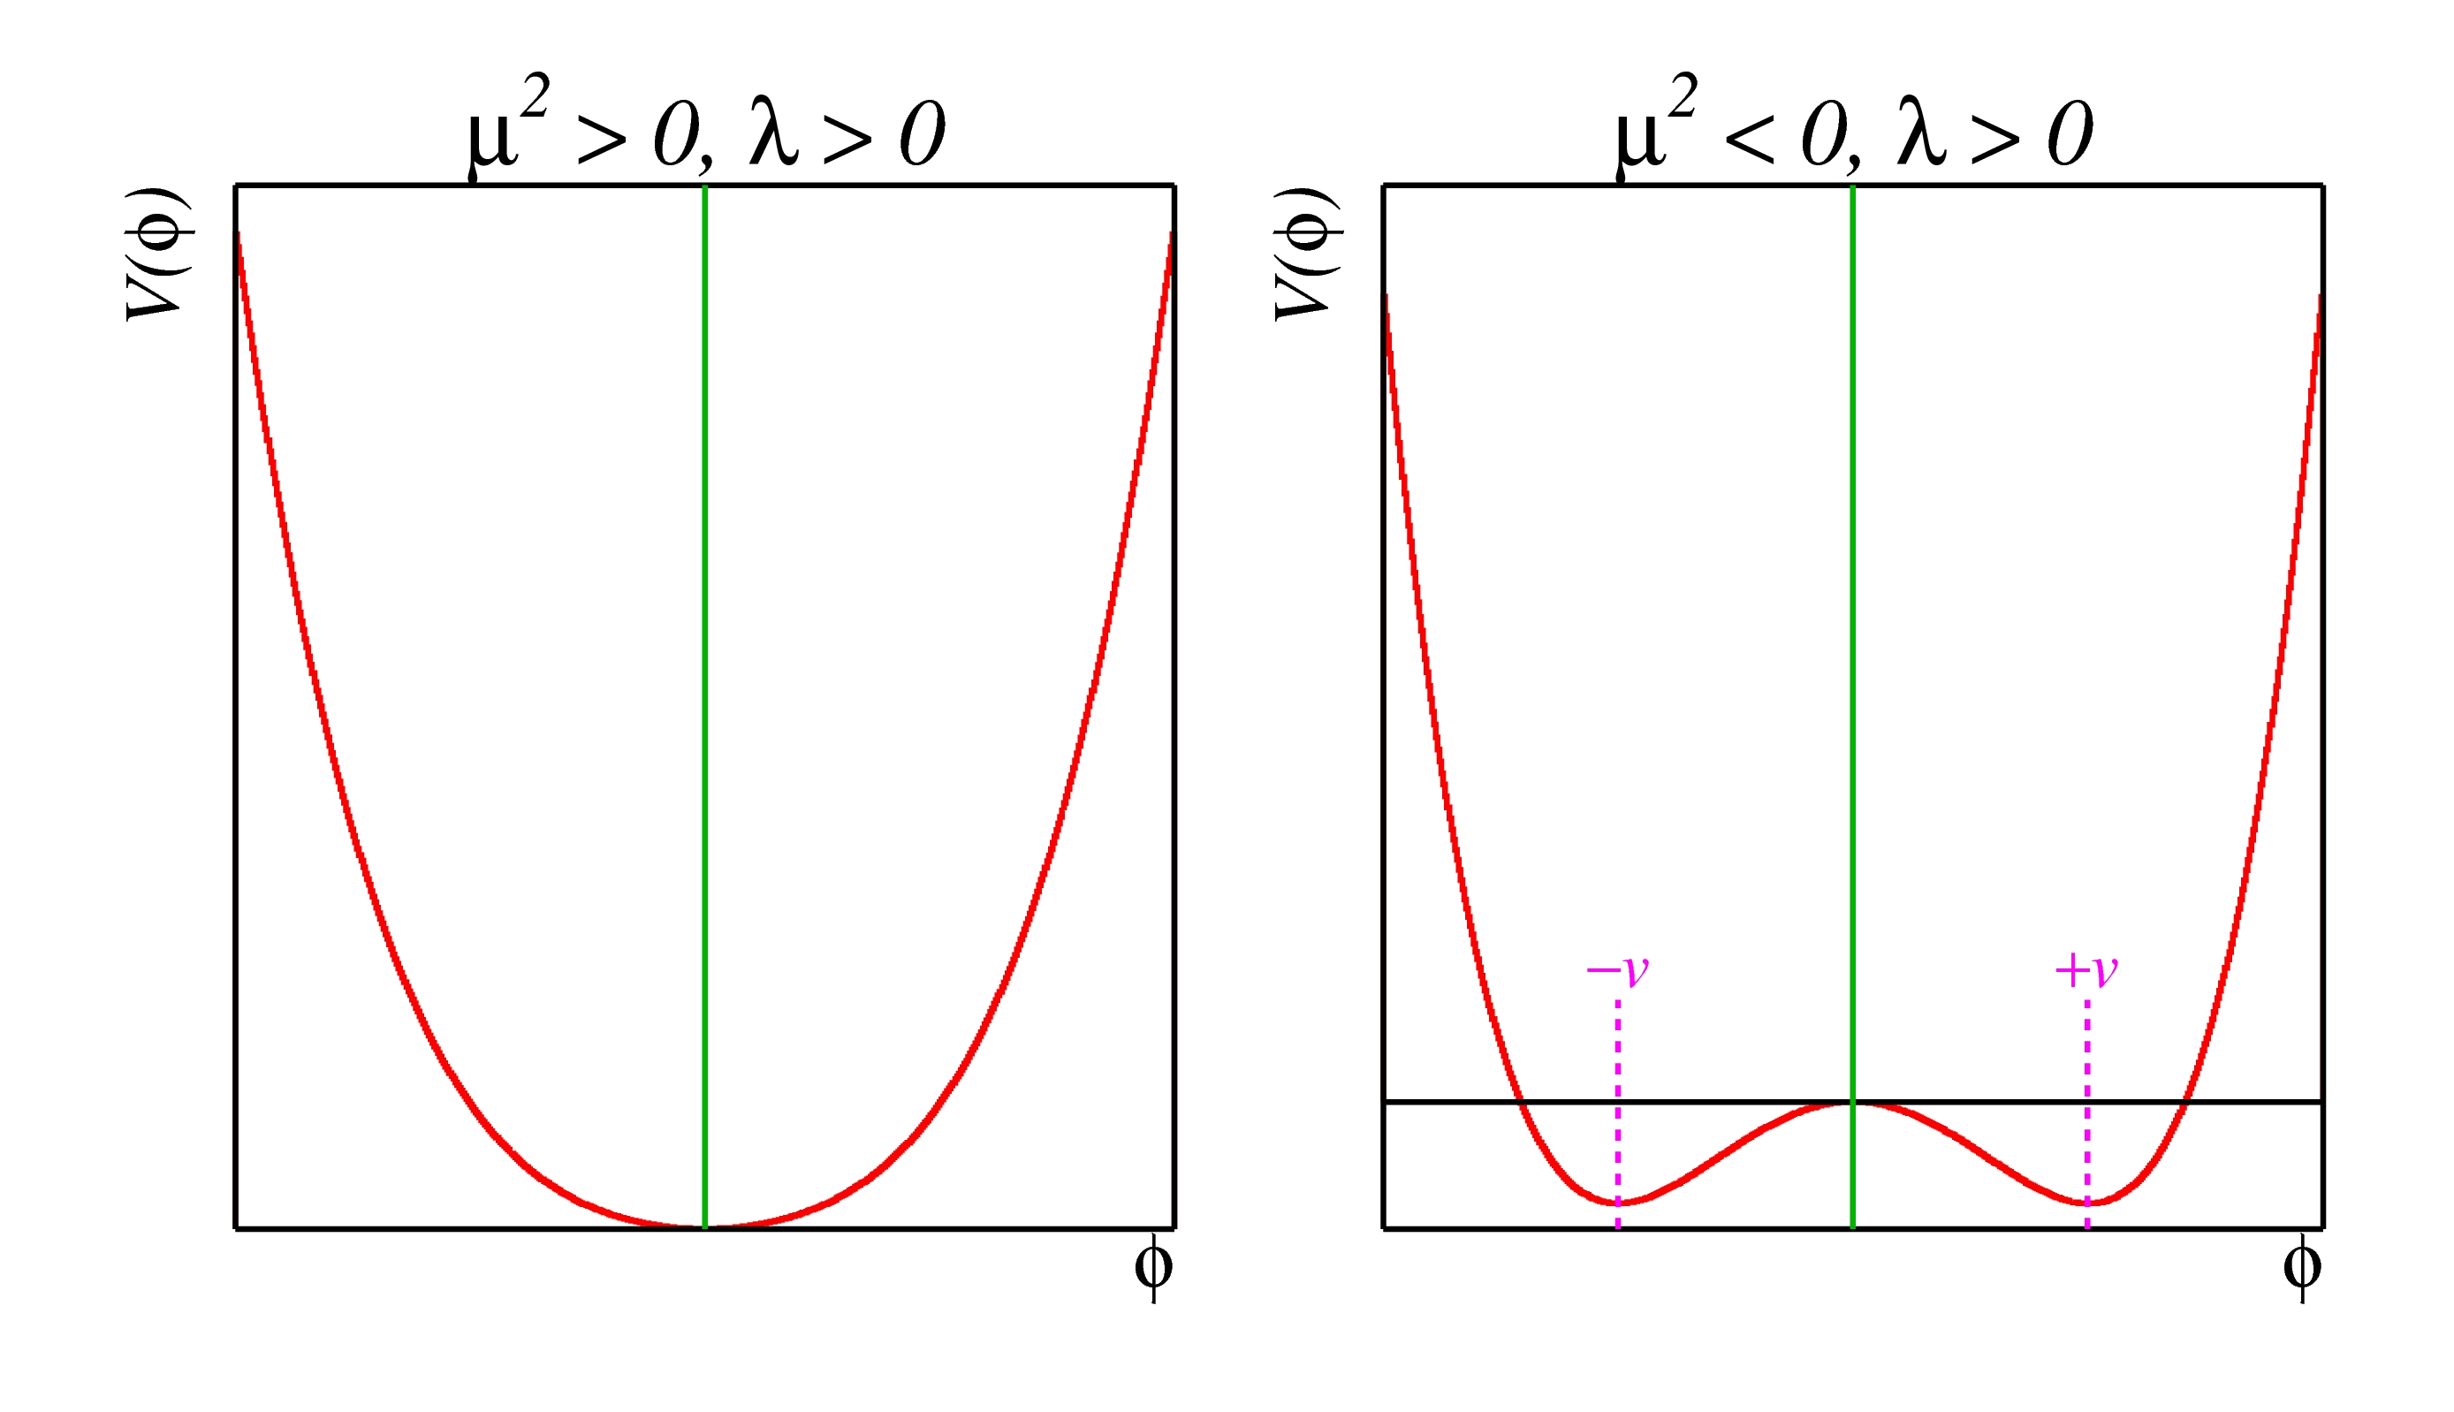
The Higgs boson should not be too light, and not too heavy…
  Perturbativity and (meta)stability bounds versus the SM cut-off scale Λ
Ellis et al, arXiv:0906.0954
Allowed
Not allowed
The SM Higgs must steer a narrow course between two disastrous situations if the SM is to survive up to the Planck scale M_{P} ~ 2×10¹⁸ GeV

Slide 16

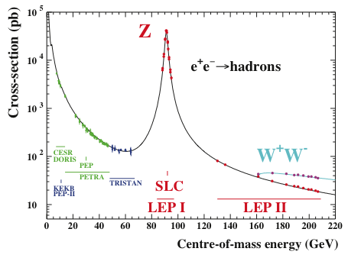
Constraints from global electroweak fit
Precision results from LEP, Tevatron and soon LHC
Z / γ
Precisely measured couplings around the Z peak (M_{W} also at Tevatron) via Z decay widths and asymmetry observables sensitive to parity violation → fit constrains log(M_{H}) and m_{t}²

Slide 17
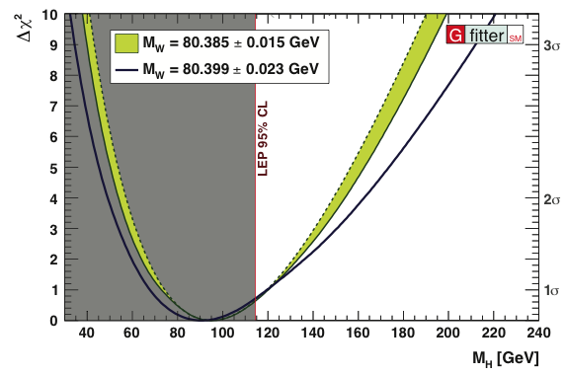
Constraints from global electroweak fit
Global fit of all EW precision measurements to SM prediction constrains M_{H}
New M_{W} average (WA):
arXiv:1204.0042
WA dominated by recent CDF measurement:
80.387 ± 0.019 GeV
[ PRL 108, 151803 (2012) ]
http://gfitter.desy.de

Slide 18
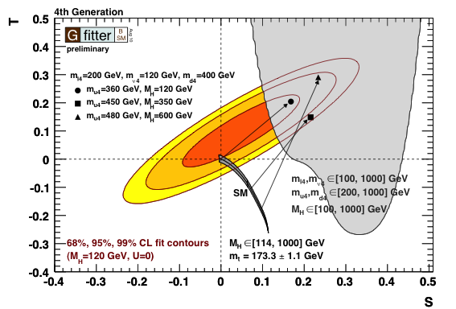
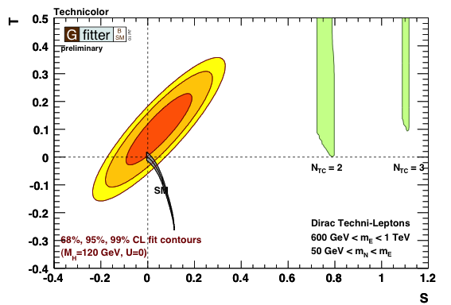
Constraints from global electroweak fit
We can also use the precision data to look beyond the SM !
For example: Can we add a 4th generation?
Or: can the vacuum be broken by a new strong interaction?
Gfitter: arXiv:1107.0975, http://gfitter.desy.de

Slide 19
Constraints from global electroweak fit
In the Standard Model the Higgs must be light.
BUT: Beyond the Standard Model the Higgs can be heavy !
→ MUST NOT stop searching for heavy Higgs boson !

Slide 20
Once the Higgs boson is discovered
The Standard Model is complete
But … does it hold tight ?

Slide 21
The Standard Model
During the last 35 years the Standard Model has been tested to great precision
Excited fundamental bosons or fermions have been excluded up to the TeV scale
Electroweak unification has been verified at, below and above the Z-boson scale
Universality of weak interaction has been verified at the per-mil level
The tininess of electric dipole moments has been verified at 10⁻²⁷ ecm [ … ]
Conservation of the charged lepton number verified at 10⁻¹² level
Asymptotic freedom of strong interaction has been verified at the percent level
All observations of matter-antimatter symmetry violations are described by single complex parameter in the quark mixing matrix
The electron and muon magnetic moments have been verified at ppm level...
Examples only, there are many more successful tests …

Slide 22
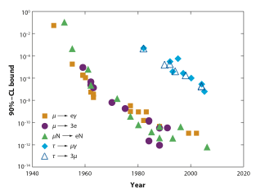
The Standard Model
During the last 35 years the Standard Model has been tested to great precision
Charged-lepton flavour violation
Only null observations to date
Marciano et al., Annu. Rev. Nucl. Part. Sci.58, 315 (2008)
…
BABAR / Belle
Super-B (50 ab^{–1})
MEGA
…
MEG
SINDRUM-II
Spectacular perspective:
Mu2e / COMET

Slide 23
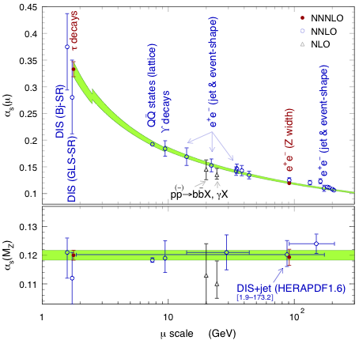
The Standard Model
During the last 35 years the Standard Model has been tested to great precision
NNNLO from tau data:
α_{s}(M_{Z}) = 0.1200 ± 0.0005_{exp} ± 0.0008_{theo} ± 0.0013_{CIPT/FOPT} ± 0.0005_{evol} (0.0017_{tot})
Excellent agreement with NNNLO result from EW fit
α_{s}(M_{Z}) = 0.1193 ± 0.0028
[ Hoecker, arXiv:1201.5093 ]
[ Gfitter, arXiv:1107.0975 ]
Precise test of asymptotic freedom property of QCD

Slide 24
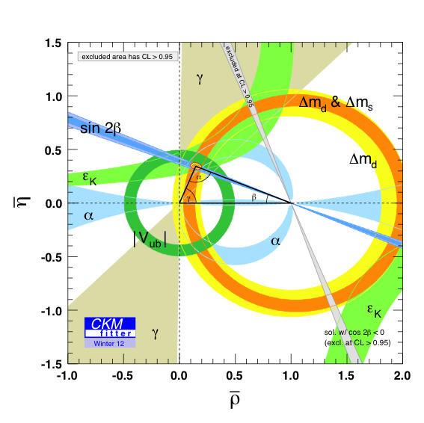
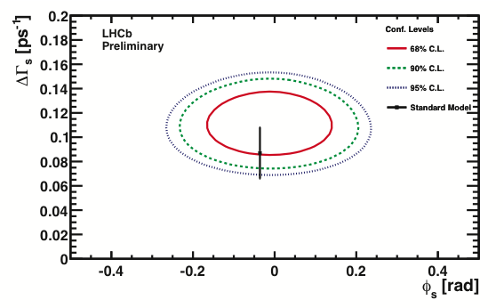
The Standard Model
During the last 35 years the Standard Model has been tested to great precision
[ CKMfitter.in2p3.fr ]
SM describes CP violation — also in the B_{s} system
[ LHCb, LHCb-CONF-2012-002, 2011 data, 1/fb ]

Slide 25
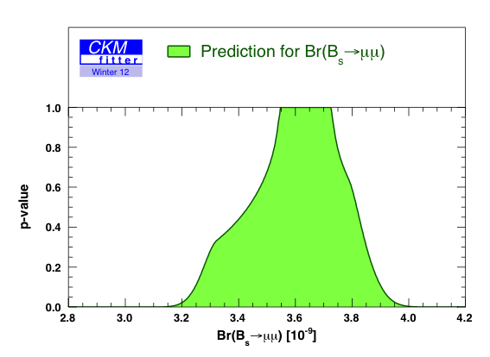
The Standard Model
During the last 35 years the Standard Model has been tested to great precision
[ CKMfitter.in2p3.fr ]
Also, no enhancement in
B_{s} → μμ branching fraction seen
[ LHCb, arXiv:1203.4493, CKMfitter.in2p3.fr ]
[ LHCb, LHCb-CONF-2012-002, 2011 data, 1/fb ]
LHCb 90% CL limit

Slide 26
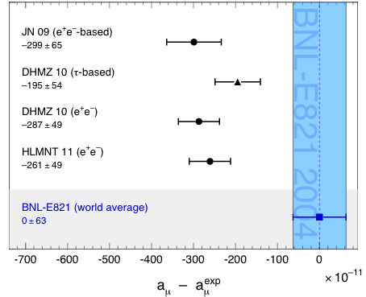
The Standard Model
During the last 35 years the Standard Model has been tested to great precision
Muon magnetic moment: comparison between measurement (blue band) and predictions (dots)
Status: summer 2011 (published results shown only)
But not everything perfectly agrees with expectation:
Top pairs produced in hadron collisions (at Tevatron) may have large angular asymmetry
Di-muon events (at Tevatron) may exhibit unexpected charge asymmetry
The muon anomalous magnetic moment may be stronger than expected
PDG 2011

Slide 27
Problems and Unexplained Observations
The success of the SM should not make us forget that it is an incomplete theory
The Higgs is not yet discovered !
The Higgs is the only fundamental scalar
Huge mass hierarchy between matter particles
Dark matter (particle) and accelerated expansion of universe
Causally connected observable universe
Matter-antimatter asymmetry in universe
Grand unification of the forces (related to baryon decay)
Gauge hierarchy (see later)
Why no matter-antimatter symmetry violation in strong interaction?
Neutrino masses
Gravitation
Neutrino masses and inclusion of gravity in the SM require new physics at the scales ~10¹⁴ GeV and ~10¹⁹ GeV, respectively !

Slide 28
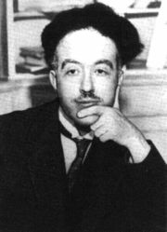
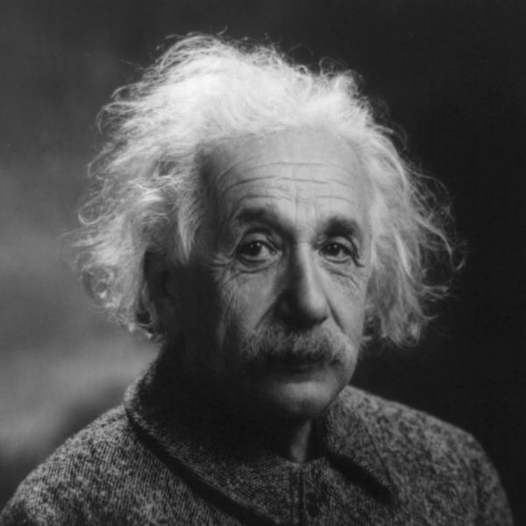
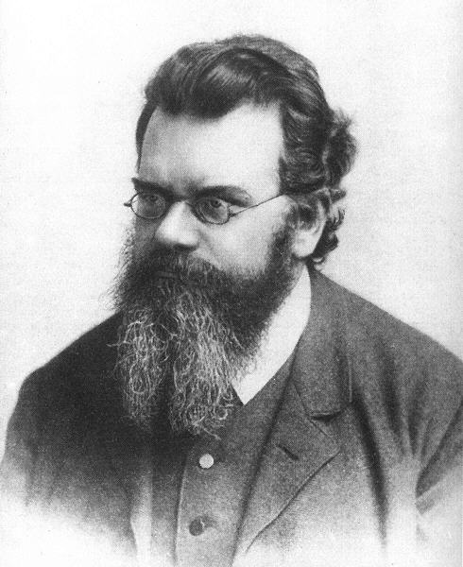
Producing the Higgs Boson and Searching for New Physics at the TeV Scale Requires a Huge Machine
Particles accelerators:
accelerate particles to the highest energies to
Look deeper into matter (size ~ 1/E) (“powerful microscopes”)
Discover new heavier particles (E = mc²)
Probe conditions of the early universe (E = kT)
de Broglie
Einstein
F. Gianotti
Boltzmann

Slide 29


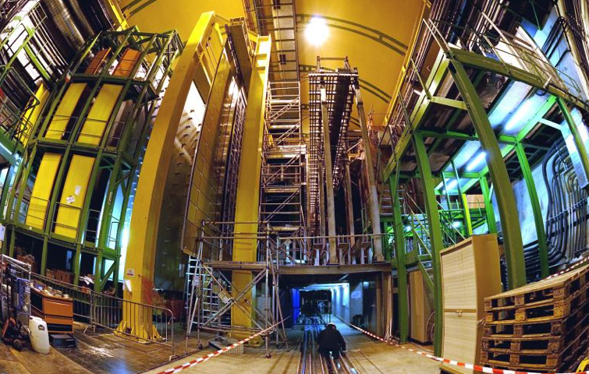
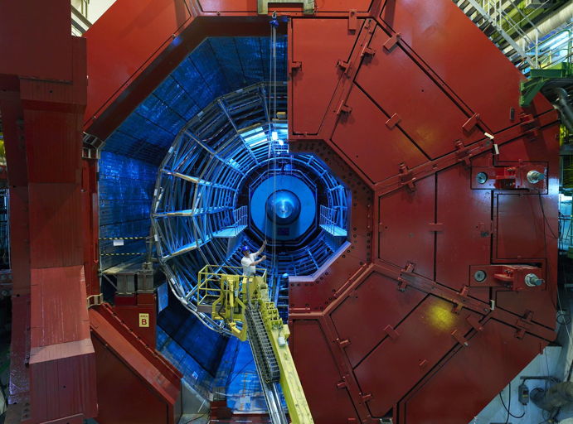

LHC ring:
27 km circumference
CMS
LHCb
Blunt extrapolation for 2011
ALICE
So far:
7/8 TeV proton—proton collisions
2.76 TeV Pb—Pb collisions
ATLAS

Slide 30
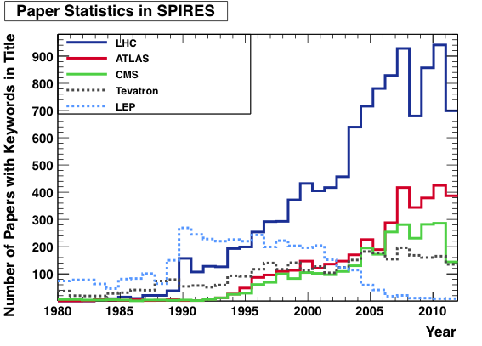
The LHC cumulates the hopes of an entire generation of particle physicists
Blunt extrapolation for 2011
Caution: serious science ;-)

Slide 31

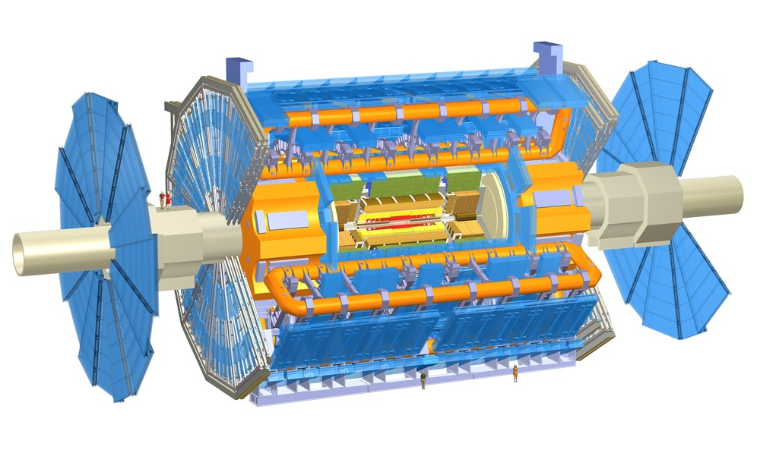
Muon Detectors Tile Calorimeter Liquid Argon Calorimeters
T h e A T L A S E x p e r i m e n t
22 m
46 m
Toroid Magnets Solenoid Magnet SCT Tracker Pixel Detector TRT Tracker

Slide 32
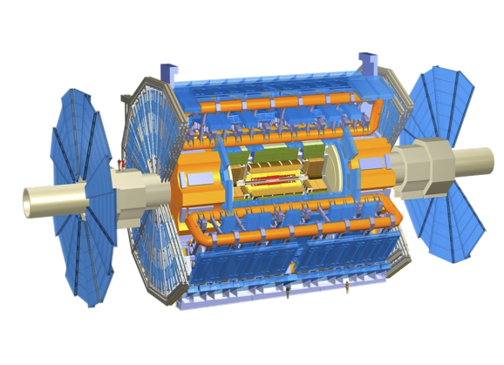
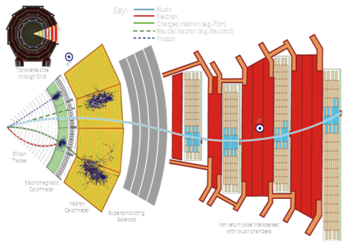

Muon Detectors Tile Calorimeter Liquid Argon Calorimeters
22 m
ATLAS: emphasis on excellent jet and missing-E_{T} resolution, particle identification, and standalone muon measurement
CMS: emphasis on excellent electron/photon and tracking (muon) resolution
Both: excellent hermeticity – very few “cracks”
46 m
Toroid Magnets Solenoid Magnet SCT Tracker Pixel Detector TRT Tracker

Slide 33
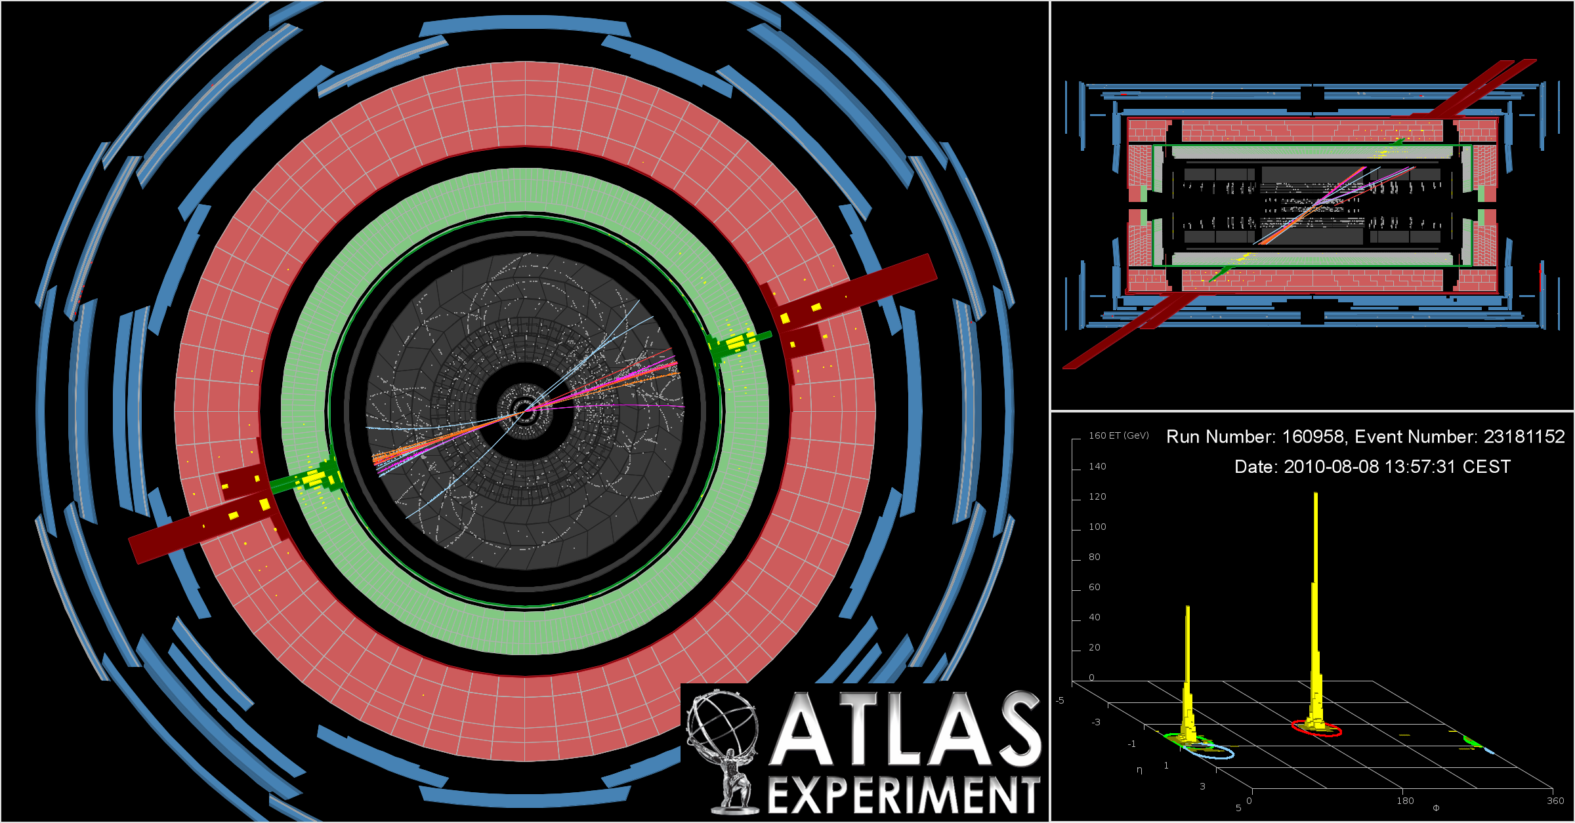
LHC Physics

Slide 34
The LHC proton—proton physics programme
Mass and electroweak symmetry breaking
    Search for the Higgs Boson, measurement of its properties
Hierarchy in the TeV domain
    Search for new phenomena moderating the hierarchy problem
    Search for the unexpected at the high-energy frontier
Electroweak unification and strong interactions
    Precision measurements and tests of the Standard Model
    Tests of perturbative QCD at the high-energy frontier
Flavour
    B, D mixing, rare decays and CP violation as tests of the Standard Model

Slide 35

Several hundred articles and conference notes published since LHC start
The LHC experiments have a prolific scientific production of which I can only discuss small parts here

Slide 36

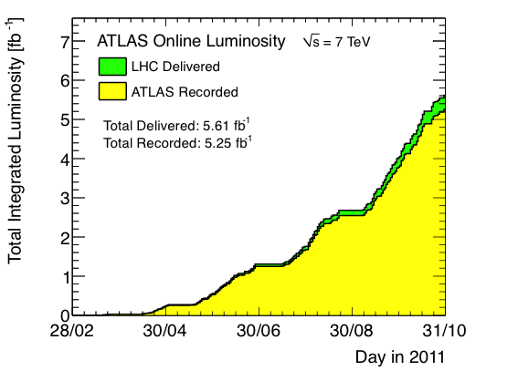
Recorded Luminosity in 2011
Luminosity is key quantity: rate = cross section × efficiency × luminosity
ATLAS integrated luminosity in 2011
(in 2010: 0.04 fb⁻¹ collected)
Surpassed Tevatron record of 4.1 10³²
Peak L = 3.6×10³³ s^{–1}cm^{–2}
Max N_{coll-bunch} = 1331 (Δt = 50 ns)
Max stored energy: 100 MJ
Status: 15 Oct 2011

Slide 37
Recorded Luminosity in 2011
Luminosity is key quantity: rate = cross section × efficiency × luminosity
At L = 3×10³³ s⁻¹cm⁻², produce 225 (129) Higgs bosons of 115 (150) GeV mass in ATLAS and CMS per hour
Tevatron @ 115 GeV: 2/h at max luminosity
Surpassed Tevatron record of 4.1 10³²
Peak L = 3.5×10³³ s^{–1}cm^{–2}
Max N_{coll-bunch} = 1331 (Δt = 50 ns)
Max stored energy: 100 MJ
Status: 15 Oct 2011

Slide 38
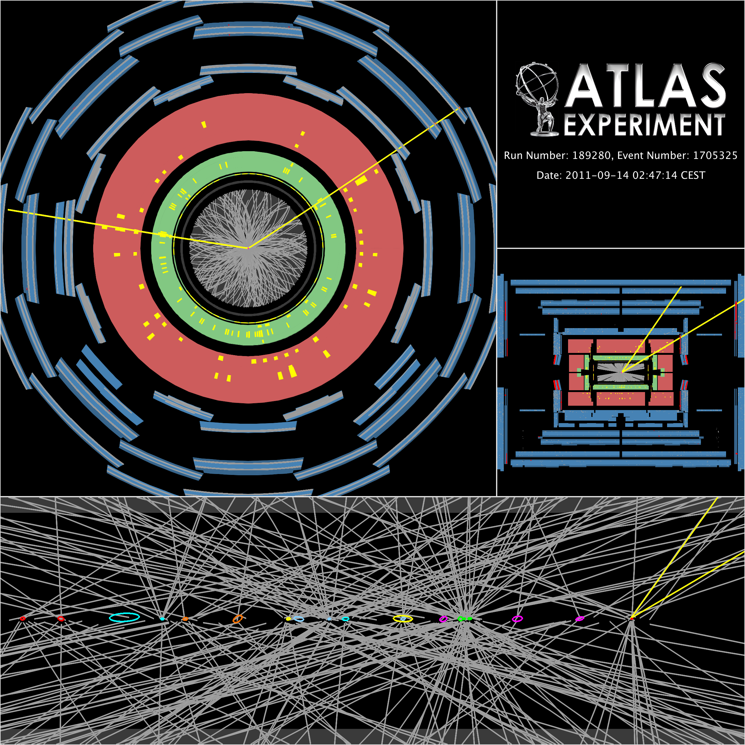
Recorded Luminosity in 2011
Measured with forward detectors, calibrated with beam separation scans
High luminosity comes at a price: probability of parasitic collisions in one bunch crossing (= pileup) increases
Peak of up to 22 collisions per crossing reached (almost doubled in 2012)
Another price to pay: higher trigger thresholds → low-pT physics suffers
Z → μμ event in ATLAS with 20 reconstructed vertices

Slide 39
A beautiful dijet event from ATLAS: m(jet-jet) = 1.9 TeV, p_{T} : 0.9 TeV, 0.8 TeV

Slide 40
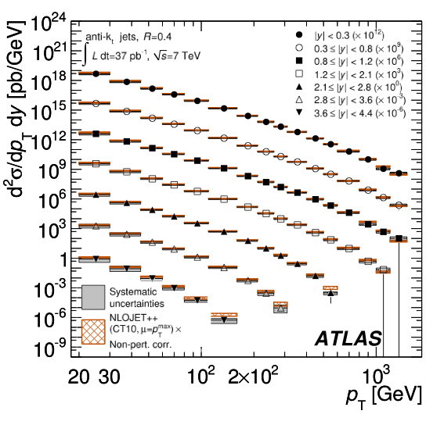
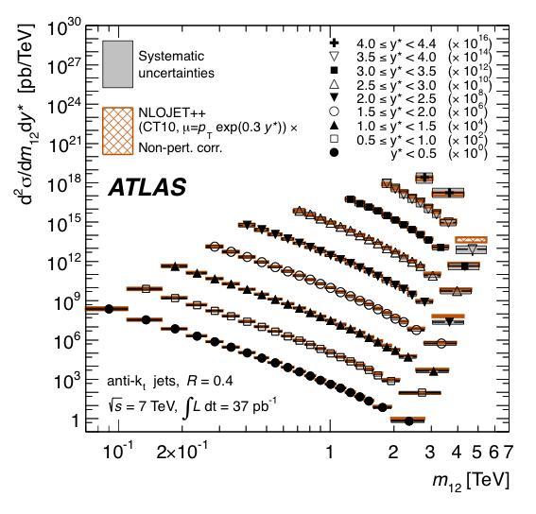
ATLAS and CMS have Measured Inclusive and Exclusive Jet Cross Sections at never Explored Energies
ATLAS arXiv:1112.6297
Differential jet cross section versus jet p_{T}
Differential jet cross section versus di-jet mass
Agreement over many orders of magnitude gives confidence for new physics searches

Slide 41

High-energy jets probe new particles and interactions
Measure di-jet invariant mass and angular distributions
q
q
2 → 2 parton scattering to two jets described by QCD
?
Tends to scatter at smaller angles than if there were new particles produced
Recall atomic substructure discovery in Rutherford scattering: deflection at large angles !
q
q
New, high-scale interaction ?
New bound state (particle) ?
Are quarks composites ?

Slide 42
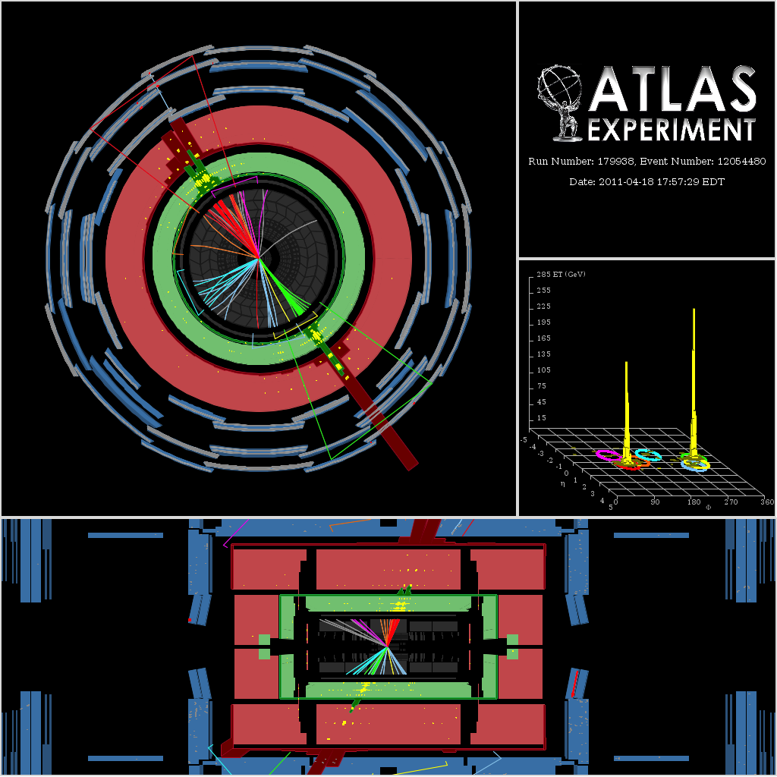
Event with 4.04 TeV dijet invariant mass

Slide 43
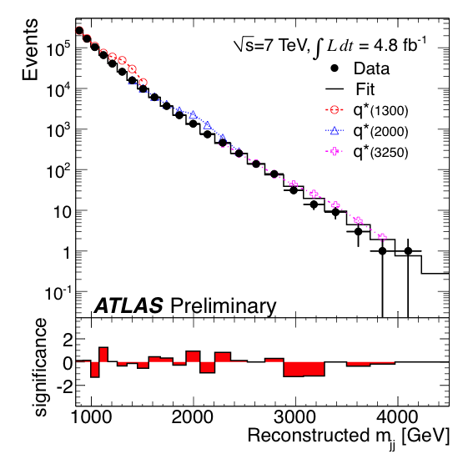
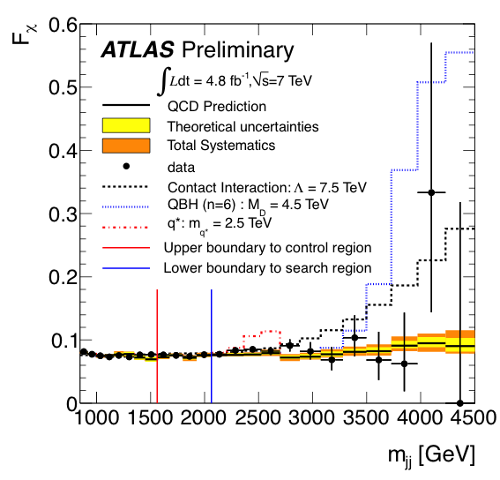
High-energy jets probe new particles and interactions
Measure di-jet invariant mass and angular distributions
ATLAS-CONF-2012-038
Observed and fitted m(jet-jet) distributions
Centrality versus m(jet-jet)

Slide 44
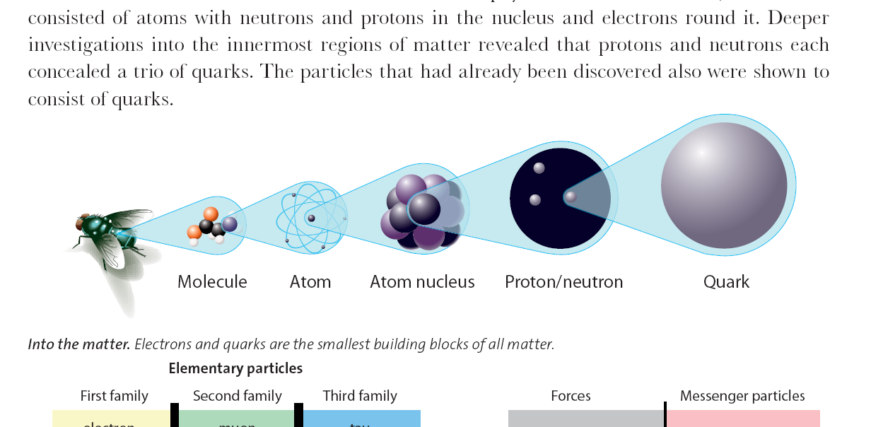
High-energy jets probe new particles and interactions
Measure di-jet invariant mass and angular distributions
ATLAS-CONF-2012-038
No deviations from SM seen → set limits on new phenomena:
Benchmark model | Observed limit at 95% CL
Excited quarks | m(q*) | > | 3.4 TeV
4-quark contact interactions | Λ | > | 7.8 TeV
Resonant
Non-resonant
< 1.8 × 10^{–18} cm
10^{–14} cm
10^{–13} cm
10^{–9}–10^{–8} cm
10^{–9}–10^{–7} cm
quark

Slide 45
Leptons are pure SM and new physics probes with much reduced strong-interactions background
q
e
Z and W bosons have mass of O(100) GeV
Created from quark initial states and decay to charged leptons and (undetected) neutrinos
Z⁰ / W±
Z’ / W’ ?
Z and W are heaviest known resonances producing lepton pairs.
q⁽‘⁾
e/ν
Unification of forces ?
Left-right symmetric models ?
Compact extra dimensions ?
Technicolour ?
Higgs extensions ?
Many theories predict new heavy Z / W bosons with similar properties

Slide 46
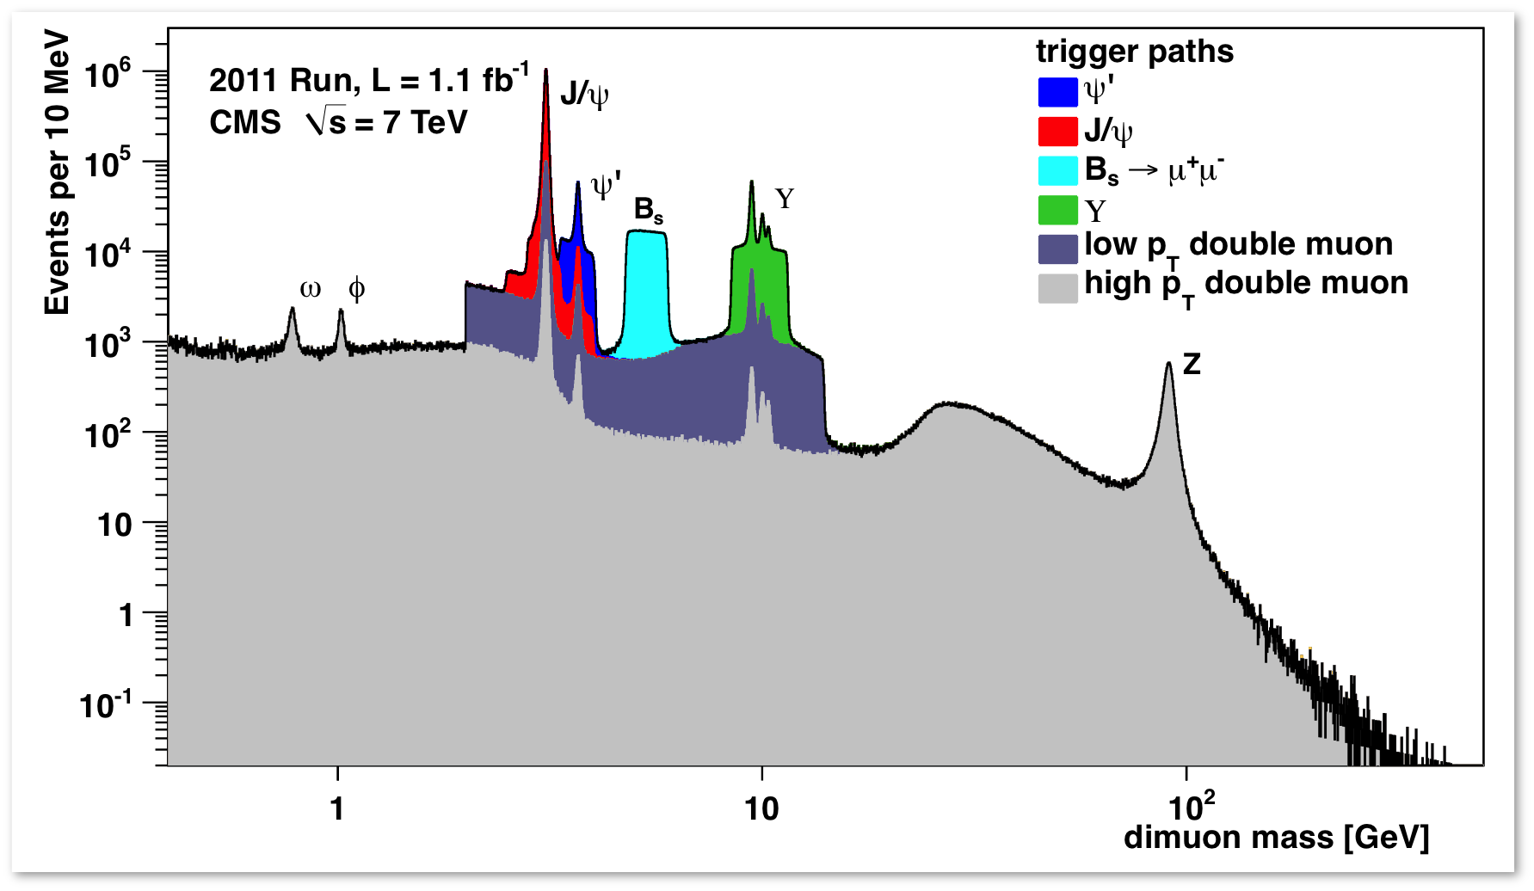
Leptons are pure SM and new physics probes with much reduced strong-interactions background
Z and W bosons have mass of O(100) GeV
Created from quark initial states and decay to charged leptons and (undetected) neutrinos
What’s happening in this tail ?
Z and W are heaviest known resonances producing lepton pairs.
Unification of forces ?
Left-right symmetric models ?
Compact extra dimensions ?
Technicolour ?
Higgs extensions ?
Many theories predict new heavy Z / W bosons with similar properties

Slide 47
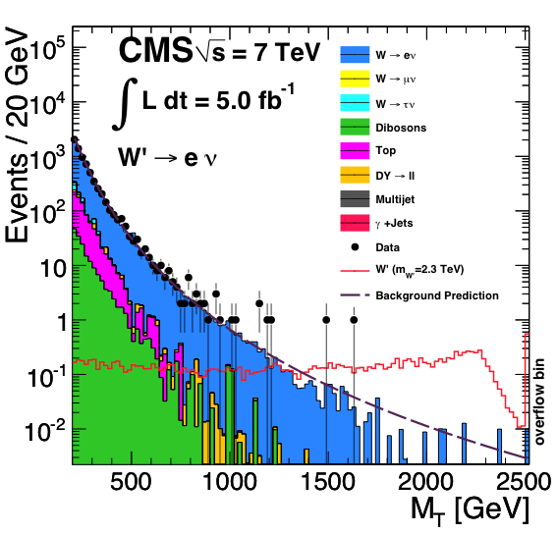
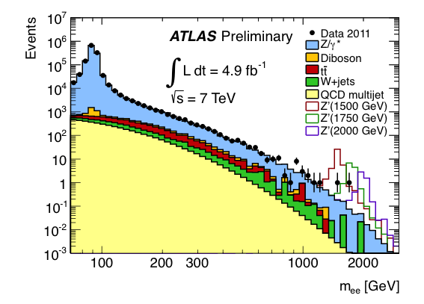
Searches for Z’ and W ’resonances in decays to e/μ
Use dilepton / transverse mass to search for excess over SM
ATLAS-CONF-2012-007, CMS arXiv:1204.4764
Observed and predicted dielectron mass, search bumps
Observed and predicted e-n transverse mass
95% CL lower limit: m(Z ’_{SSM}) > 2.2 TeV
95% CL lower limit: m(W ’_{SSM}) > 2.6 TeV⁽*⁾
⁽*⁾Constructive interference model

Slide 48
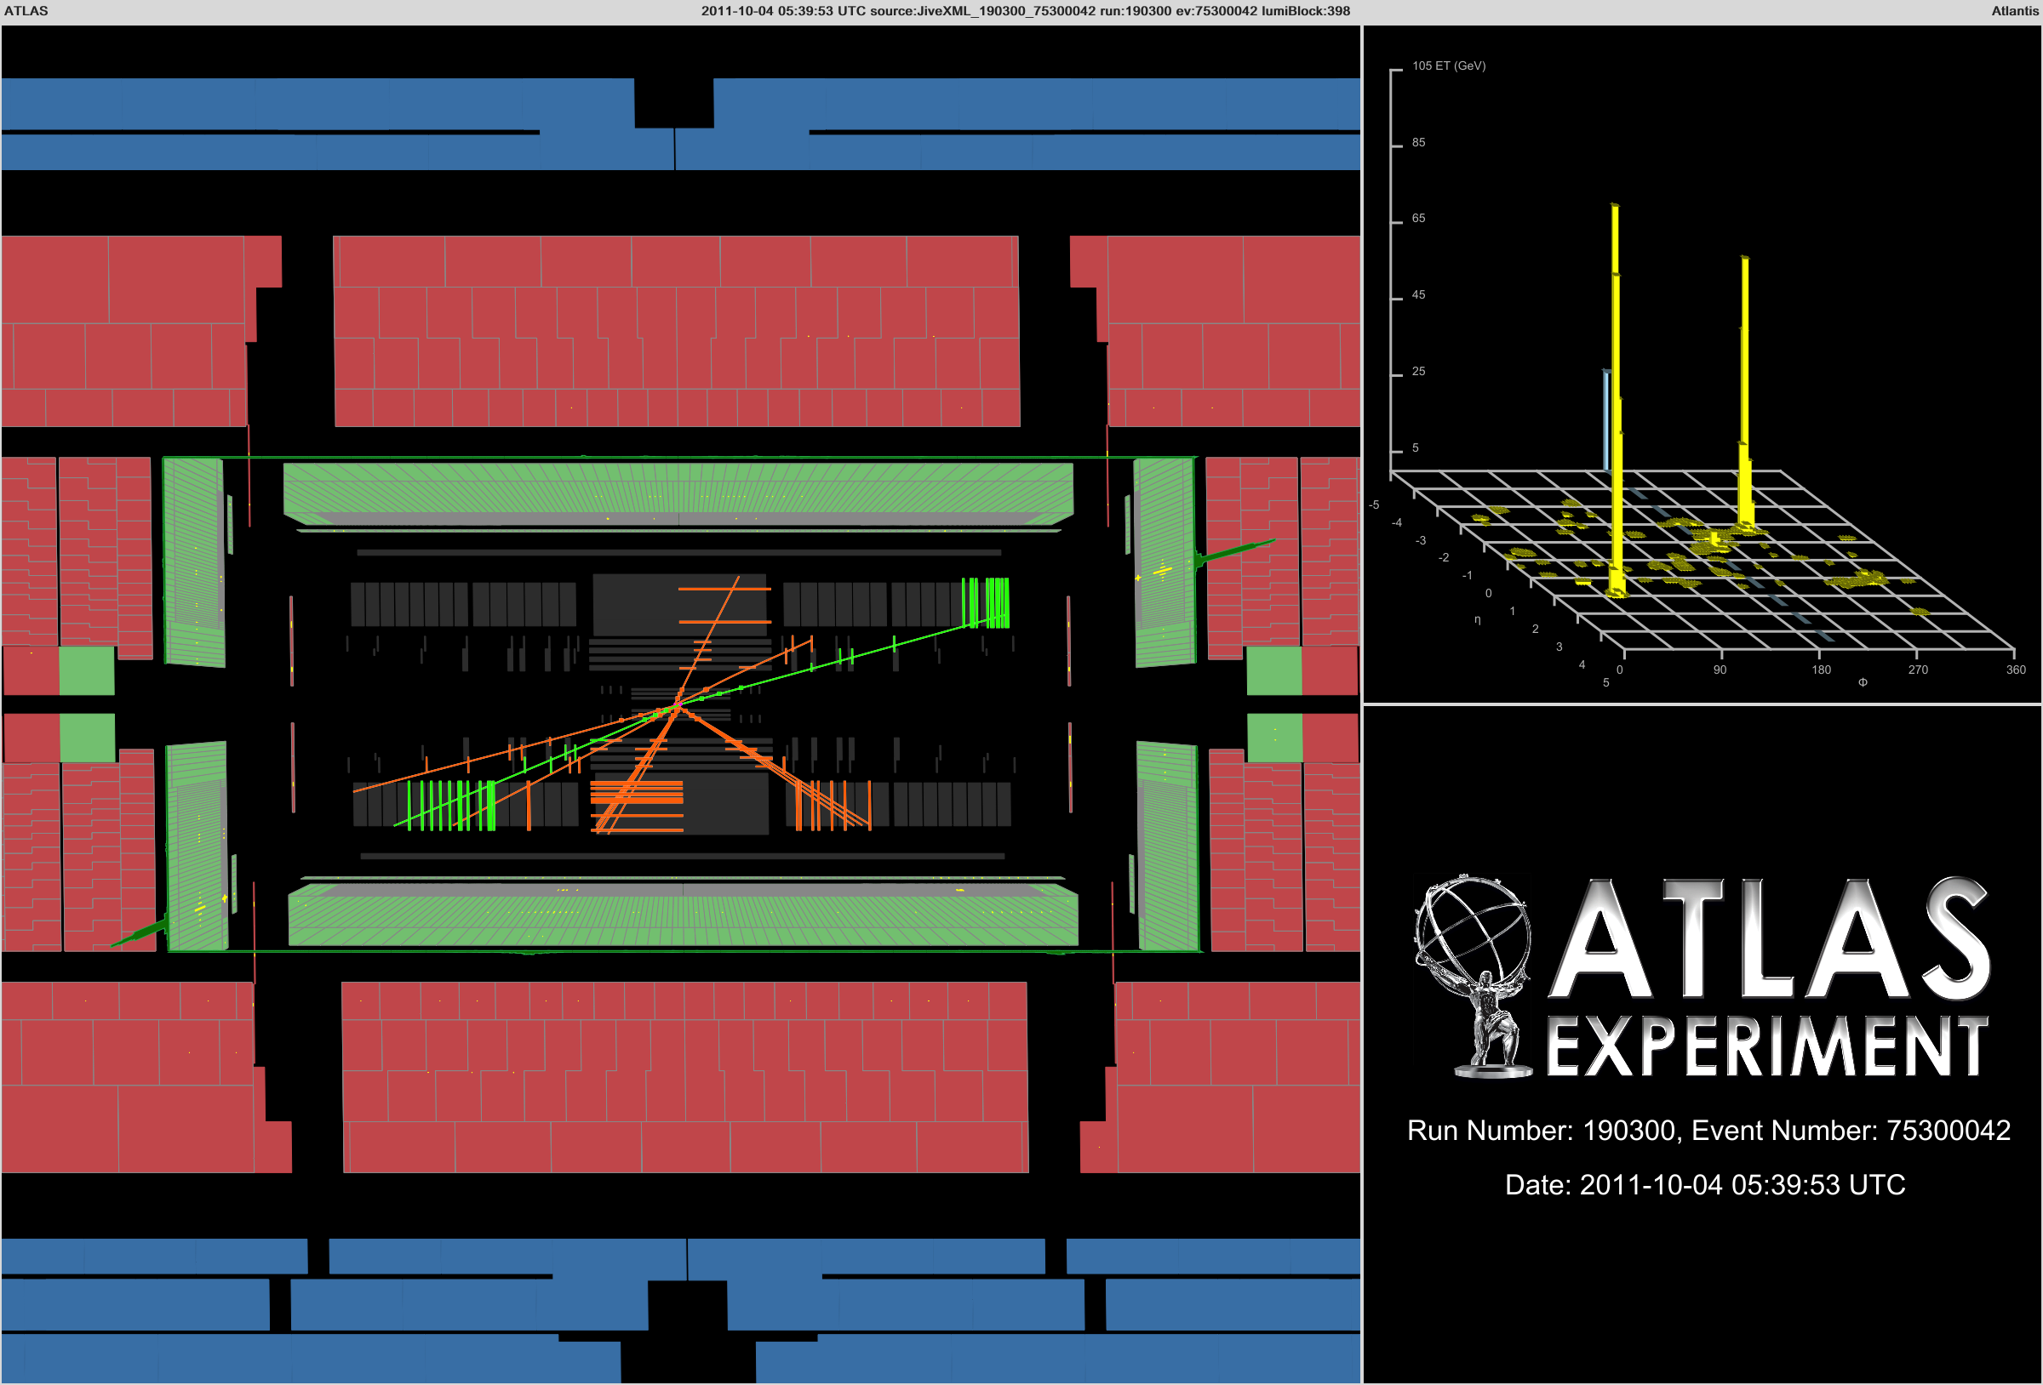
Highest mass dielectron event observed: m(ee) = 1.66 TeV (both electrons are in calorimeter endcaps)

Slide 49
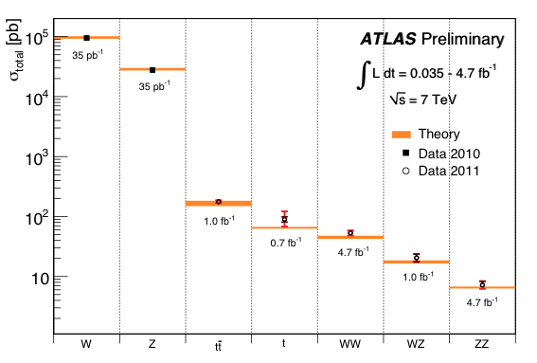
Electroweak and QCD measurements
Lots of truly novel results at unexplored centre-of-mass energies
Summary of weak boson and top cross section measurements vs. theory

Slide 50

Electroweak and QCD measurements
Lots of truly novel results at unexplored centre-of-mass energies
Summary of weak boson and top cross section measurements vs. theory
LHC is top factory:
  at 7 TeV CM energy: ~25 times larger cross section than at Tevatron

Slide 51
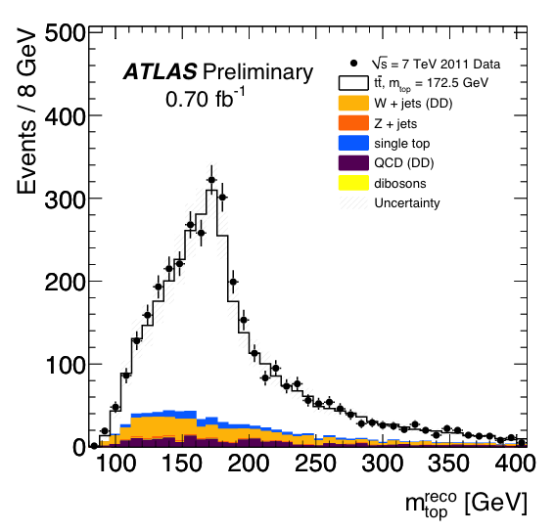
Electroweak and QCD measurements
Lots of truly novel results at unexplored centre-of-mass energies
Summary of weak boson and top cross section measurements vs. theory
Clean top reconstruction
(here: hadronic top mass)
First precision measurements of top cross section and mass at LHC
Searches for new physics in top production and decay

Slide 52

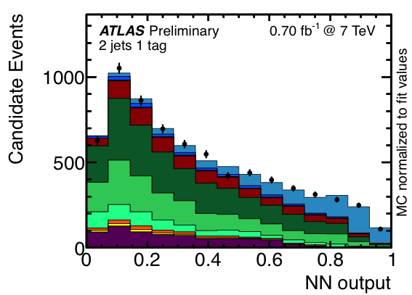
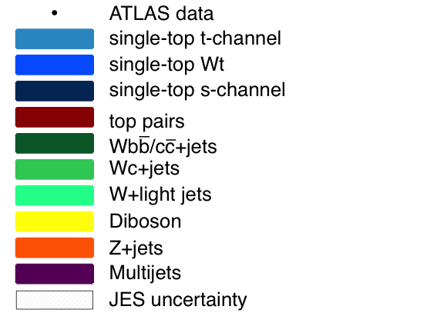
Electroweak and QCD measurements
Lots of truly novel results at unexplored centre-of-mass energies
Summary of weak boson and top cross section measurements vs. theory
t-channel dominates single-top production
ATLAS-CONF-2011-101
Expected cross sections for
t, Wt, s chans.: 65, 16, 4.6 pb

Slide 53
Electroweak and QCD measurements
Lots of truly novel results at unexplored centre-of-mass energies
Summary of weak boson and top cross section measurements vs. theory

Slide 54
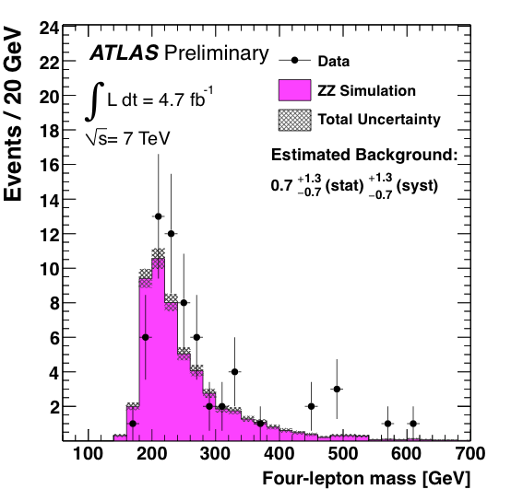
Electroweak and QCD measurements
Lots of truly novel results at unexplored centre-of-mass energies
Summary of weak boson and top cross section measurements vs. theory
The long road to measuring electroweak symmetry breaking
H(130 GeV) → WW
4.9 pb
H(130 GeV) → ZZ
0.65 pb

Slide 55
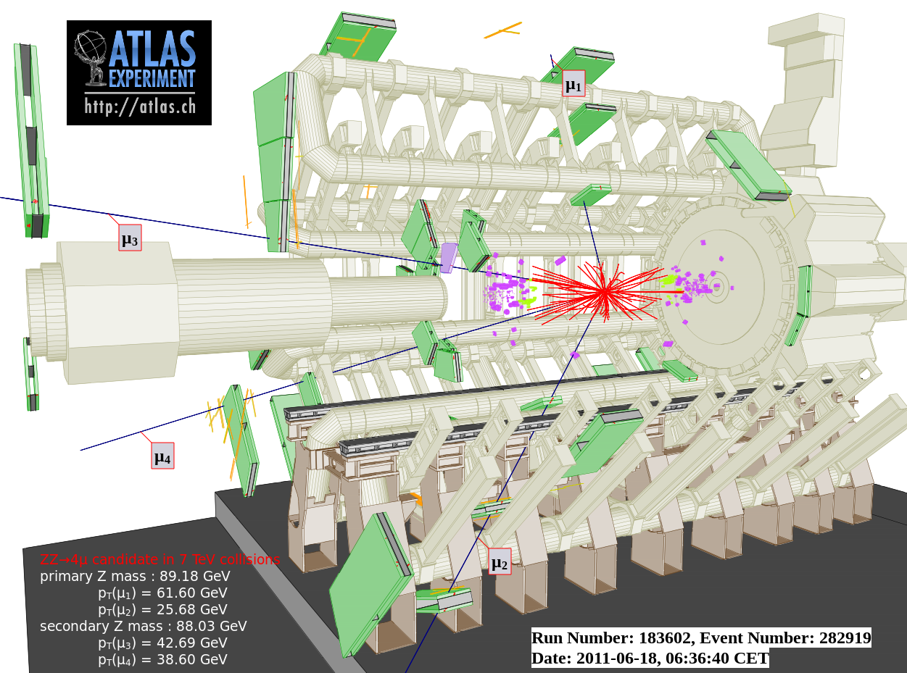
A beautiful 4-muon event seen in ATLAS

Slide 56
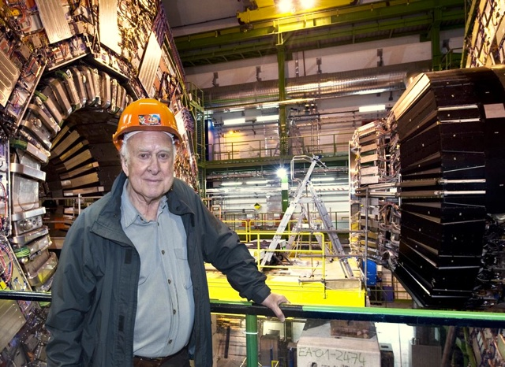
Hunting for the Higgs Boson
P. Higgs at CMS

Slide 57
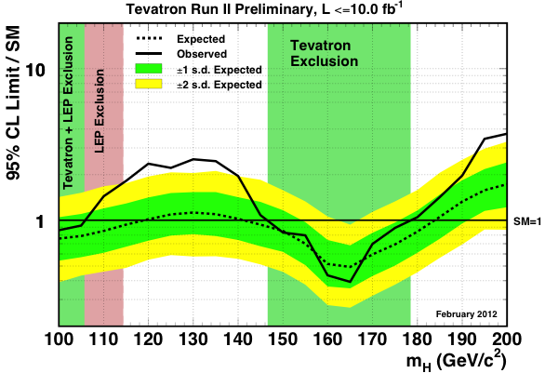
Hunting for the Higgs Boson
The Higgs boson has been vainly searched for at many accelerators
Best non-LHC 95% CL limits from LEP (CERN, 1989—2000) and Tevatron (Fermilab, 1990—2011):
m_{H} > 114 GeV
147 GeV < m_{H} < 179 GeV

Slide 58
Higgs boson
Higgs production and decay probabilities predicted vs. Higgs mass by SM
At the LHC, the Higgs boson is produced dominantly via gluon fusion
σ_{H,total} ~15 pb at 125 GeV (40—50 times larger rate than at Tevatron)
Because of the coupling to the mass of the decay particles:
  … the Higgs will decay with preference to the heaviest particles allowed
  … the Higgs does not couple directly to photons and gluons, but only via “loops” involving heavy particles (e.g., top, W )
W,Z,q,l,g,γ
H
-
-
-
W,Z,q,l,g,γ

Slide 59
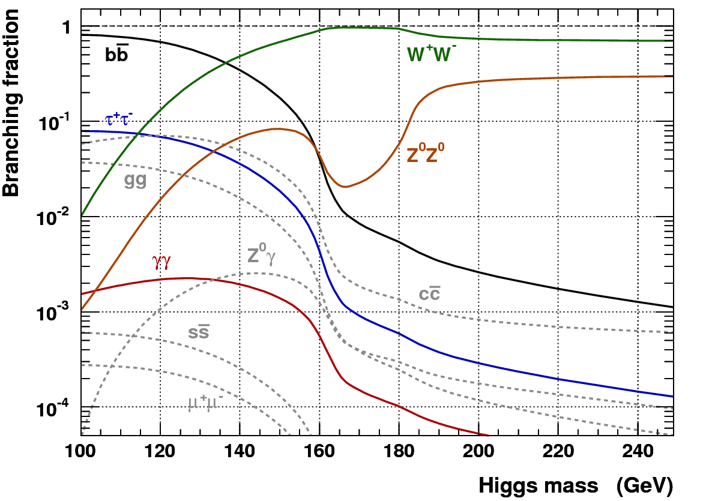
Higgs searches at the LHC
Dependence of the branching fractions on M_{H} drives search strategy
For medium to heavy Higgs:
Lepton final states via WW⁽*⁾, ZZ⁽*⁾
For light Higgs:
Lepton final states via WW*, ZZ*
Di-photon final state
Di-tau final state
The dominant H → bb mode is only exploitable in association with W/Z or tt, also with strong Higgs boost
Associated leptons provide trigger signal as they help to reduce huge QCD background, s(bb) ~ O(100 µb)

Slide 60
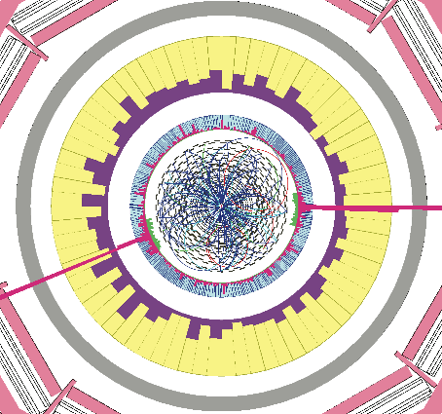
H → γγ
Simulated H → γγ event (CMS)

Slide 61
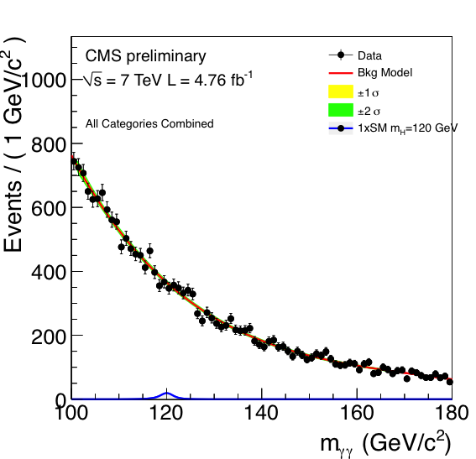


H → γγ : clean discovery channel for light Higgs
σ × BR (115 / 140 GeV | √s=7 TeV ) ≈ 48 / 28 fb
ATLAS arXiv:1202.1414, CMS-PAS-HIG-12-001
Signal selection: need excellent photon energy resolution, and efficient & pure photon identification
CMS uses heavy-BDT relying analysis including photon energy and resolution regression algorithms
Irreducible γγ background
Both exps. classify events according to resolution and topology in ML fit

Slide 62



H → γγ : clean discovery channel for light Higgs
σ × BR (115 / 140 GeV | √s=7 TeV ) ≈ 48 / 28 fb
ATLAS arXiv:1202.1414, CMS-PAS-HIG-12-001
Signal selection: need excellent photon energy resolution, and efficient & pure photon identification
2.9σ local p-value
2.8σ local p-value (1.5σ global)
Data excesses around 125 GeV seen in both experiments; large look elsewhere effect because of good diphoton mass resolution

Slide 63


H → ZZ⁽*⁾ → 2(e, µ) + 2(e, µ) : “golden channel”
σ × BR (120 / 140 / 200 GeV | √s=7 TeV ) ≈ 1.3 / 4.2 / 6.8 fb
ATLAS arXiv:1202.1415, CMS arXiv:1202.1997
Signal selection: precisely reconstruct mass of Higgs from 4 leptons, exploit on-shell Z mass constraint
2.1σ local p-value

Slide 64


H → ZZ⁽*⁾ → 2(e, µ) + 2(e, µ) : “golden channel”
σ × BR (120 / 140 / 200 GeV | √s=7 TeV ) ≈ 1.3 / 4.2 / 6.8 fb
ATLAS arXiv:1109.5945, CMS-PAS-HIG-11-015
Signal selection: precisely reconstruct mass of Higgs from 4 leptons, exploit on-shell Z mass constraint
Excluded:
m_{H} = 134—156, 182~415 GeV
Excluded:
m_{H} = 134—158, 180—305, 340—465 GeV
Non-concluding low-mass excesses; accidental coincidence in ALTAS ?

Slide 65


H → WW⁽*⁾ → 2(e, µ) + 2ν : not clean, but abundant
σ × BR (120 / 165 / 200 GeV | √s=7 TeV ) ≈ 120 / 400 / 200 fb
ATLAS-CONF-2012-012, CMS arXiv:1202.1489
Signal selection: reconstruct transverse Higgs mass, exploit W polarisation (leptons emitted in same dir.)
Cut-based
analysis by ATLAS
MVA-based analysis by CMS
Insufficient sensitivity at low mass, no overall sign of excess

Slide 66


H → WW⁽*⁾ → 2(e, µ) + 2ν : not clean, but abundant
σ × BR (120 / 165 / 200 GeV | √s=7 TeV ) ≈ 120 / 400 / 200 fb
ATLAS-CONF-2012-012, CMS arXiv:1202.1489
Signal selection: reconstruct transverse Higgs mass, exploit W polarisation (leptons emitted in same dir.)
Excluded:
m_{H} = 130—260 GeV
Excluded:
m_{H} = 129—270 GeV
Insufficient sensitivity at low mass, no overall sign of excess

Slide 67

Combining all channels (status: Lepton-Photon 2011)
At high mass also WW → llqq and ZZ → llνν channels contribute
ATLAS-CONF-2012-019
Individual channels sensitivities in one plot

Slide 68


Combining all channels (status: Lepton-Photon 2011)
At high mass also WW → llqq and ZZ → llνν channels contribute
ATLAS-CONF-2011-135, CMS-PAS-HIG-11-022
All results [γγ, ZZ, WW, ττ, bb] combined. Left: ATLAS — low mass region, right: CMS — all masses
3.1σ local p-value
(1.5σ global)
2.5σ local p-value
(2.9σ expected
– if 124 GeV Higgs !)
Excluded:
m_{H} = 110~122.5, 129—539 (120—555 exp.) GeV
Excluded: m_{H} = 127—600 (118—543 exp.) GeV
Both experiments see a >2σ combined excess at 123~127 GeV …

Slide 69


Combining all channels (status: Lepton-Photon 2011)
At high mass also WW → llqq and ZZ → llνν channels contribute
ATLAS-CONF-2011-135, CMS-PAS-HIG-11-022
Comparing local p-values for no-Higgs hypothesis versus Higgs mass
Size of excess would be expected in presence of Higgs; single-channel excess only in CMS data

Slide 70




Combining all channels (status: Lepton-Photon 2011)
At high mass also WW → llqq and ZZ → llνν channels contribute
ATLAS-CONF-2011-135, CMS-PAS-HIG-11-022
Comparing local p-values for no-Higgs hypothesis versus Higgs mass
Size of excess would be expected in presence of Higgs; single-channel excess only in CMS data

Slide 71




Combining all channels (status: Lepton-Photon 2011)
At high mass also WW → llqq and ZZ → llνν channels contribute
ATLAS-CONF-2011-135, CMS-PAS-HIG-11-022
Comparing local p-values for no-Higgs hypothesis versus Higgs mass
Size of excess would be expected in presence of Higgs; single-channel excess only in CMS data

Slide 72
Combining all channels (status: Lepton-Photon 2011)
Compare with constraints from perturbativity and (meta)stability
Ellis et al, arXiv:0906.0954
Allowed
Not allowed
Excluded by LHC
Still — barely — a stable solution up to M_{P} possible …
Excluded by LEP and LHC
The SM Higgs must steer a narrow course between two disastrous situations if the SM is to survive up to the Planck scale M_{P} ~ 2×10¹⁸ GeV
Ellis et al, arXiv:0906.0954

Slide 73

Constraints from global electroweak fit
Global fit of all EW precision measurements to SM prediction constrains M_{H}
Plotting also the results from direct searches at LEP and Tevatron …
http://gfitter.desy.de

Slide 74

Constraints from global electroweak fit
Vice versa, the strong direct Higgs mass constraints allow to predict M_{W} and m_{top}
http://gfitter.desy.de

Slide 75

Unfortunately, there is a problem with the Higgs!
P. Higgs at CMS

Slide 76
The Mass of the Scalar is Unprotected
If a Higgs boson with mass < 1 TeV is discovered, the Standard Model is complete !
However, when computing radiative corrections to the bare Higgs mass a problem occurs:
Higgs radiative corrections
where:
Integral quadratically divergent
The cut-off sets the scale where new particles and physical laws must come in
Above the EW scale we only know of two scales: GUT (~10¹⁶ GeV) and Planck (~10¹⁹ GeV)
Such a cut-off would require an incredible amount of finetuning to keep m_{H} light

Slide 77
The Mass of the Scalar is Unprotected
If a Higgs boson with mass < 1 TeV is discovered, the Standard Model is complete !
However, when computing radiative corrections to the bare Higgs mass a problem occurs:
Higgs radiative corrections
where:
Missing protection of scalar Higgs mass is related to absence of a symmetry principle. Setting m_{H} = 0 in SM Lagrangian, does not restore any symmetry in the model.
New physics models should address this. M_{H} should becomes the deviation from some exact symmetry, and is thus intrinsically small !
Integral quadratically divergent
The cut-off sets the scale where new particles and physical laws must come in
Above the EW scale we only know of two scales: GUT (~10¹⁶ GeV) and Planck (~10¹⁹ GeV)
Such a cut-off would require an incredible amount of finetuning to keep m_{H} light

Slide 78

The “Gauge Hierarchy Problem”
This strong dependence of the Higgs to the ultraviolet physics makes it a powerful probe to new physics
Possible solutions to the hierarchy problem:
New physics appears not much above the EW scale and regularises the quadratic divergences

Slide 79

The “Gauge Hierarchy Problem”
Possible solutions to the hierarchy problem:
New physics appears not much above the EW scale and regularises the quadratic divergences
New physics modifies the running of the couplings, approaching GUT to the EW scale

Slide 80

The “Gauge Hierarchy Problem”
Possible solutions to the hierarchy problem:
New physics appears not much above the EW scale and regularises the quadratic divergences
New physics modifies the running of the couplings, approaching GUT to the EW scale
Gravity is not as weak as we think, it’s only diluted in our 4D world but it is as strong as EW interactions at the TeV scale in, e.g., 5 or more dimensions, (M_{Pl})^{5D} ~ O(TeV)

Slide 81

The “Gauge Hierarchy Problem”
Possible solutions to the hierarchy problem:
New physics appears not much above the EW scale and regularises the quadratic divergences
New physics modifies the running of the couplings, approaching GUT to the EW scale
Gravity is not as weak as we think, it’s only diluted in our 4D world but it is as strong as EW interactions at the TeV scale in, e.g., 5 or more dimensions, (M_{Pl})^{5D} ~ O(TeV)
The theory is finetuned: explanation for parameter values is statistical rather than dynamic (anthropic multiverse solution)

Slide 82
S t a n d a r d M o d e l

Slide 83
E x t e n d i n g t h e
S t a n d a r d M o d e l

Slide 84
The crisis of the Standard Model calls for new physics at the TeV scale
Many models addressing the hierarchy and the dark matter problem have similar experimental signatures
Searching for them is another central pillar of the LHC physics programme
Unfortunately, there is a problem with the Higgs!
P. Higgs at CMS

Slide 85
Could a symmetry between fermions and bosons
regularise the Higgs radiative corrections ?
Supersymmetry (SUSY)
P. Higgs at CMS

Slide 86
Fermion loop
Boson loop
Supersymmetry (SUSY)
P. Higgs at CMS

Slide 87
Fermion loop
Boson loop
Supersymmetry (SUSY)
Fermion and boson loops contribute with different signs to the Higgs radiative corrections: if there existed a symmetry relating these two, this could protect the masses of the scalar Higgs
Supersymmetry realises this by transforming bosons  fermions
SUSY transforms, e.g., a scalar boson into a spin-½ fermion, whose mass is protected
Hence, the scalar mass is also protected (precisely through SUSY)
This solves the naturalness and the hierarchy problems of the SM (at least technically)
Local gauge invariance of SUSY requires existence of spin-3/2 and spin-2 particles, which naturally introduces the spin-2 graviton, assumed to mediate the gravitational force

Slide 88

The
Higgs
precipice
Mr. SUSY
EW scale
Mr. Higgs
GUT scale
Planck scale
Scalar mass

Slide 89
Grand Unification of the Gauge Couplings (GUT)
Recall: GUT motivated by quantisation of electric charge in multiples of 1/3
1 TeV
characteristic mass scale
1 / α( i )
60
i = 1
Standard Model
40
i = 2
GUT ?
30
i = 3
Supersymmetry
0
10 ²
10 ⁶
10 ¹⁰
10 ¹⁴
10 ¹⁸
Energy [ GeV ]

Slide 90
SUSY has: N_{dof} (bosons) = N_{dof} (fermions) [cf. SM: N_{dof} (bosons)  N_{dof} (fermions)]
To create supermultiplets, we need to add one superpartner to each SM particle
Superpartners have opposite spin statistics but otherwise equal quantum numbers
Need to introduce an additional Higgs doublet to the non-SUSY side
SUSY breaking introduces lots (> 100) of new parameters (masses and mixing angles)
Supersymmetry (SUSY)
Spin 0 | Spin 1/2 | Spin 1 | Spin 3/2 | Spin 2
sLeptons | Leptons |  | Gravitino | Graviton
sQuarks | Quarks
Higgs | Higgsino
 | Photino | Photon
 | Zino | Z
 | Wino | W
 | Gluino | Gluon

Slide 91
SUSY has: N_{dof} (bosons) = N_{dof} (fermions) [cf. SM: N_{dof} (bosons)  N_{dof} (fermions)]
To create supermultiplets, we need to add one superpartner to each SM particle
Superpartners have opposite spin statistics but otherwise equal quantum numbers
Need to introduce an additional Higgs doublet to the non-SUSY side
SUSY breaking introduces lots (> 100) of new parameters (masses and mixing angles)
Supersymmetry (SUSY)
Spin 0 | Spin 1/2 | Spin 1
 | ●
 | q
h⁰, H⁰, A⁰, H±
 |  | γ, Z⁰, W±
 |  | g_{a}
SM
SUSY
Eigenstates of mass
The gauge-mixed physical states that propagate in space and time and that can be observed.
Neutralinos: mass eigenstates of photinos, zinos, neutral higgsinos
Charginos : mass eigenstates of winos and charged higgsinos

Slide 92
Characteristic SUSY Decay Cascades
To avoid proton decay, a new conserved quantum number is introduced, which forces a SUSY particle to decay in at least in one other SUSY particle
The lightest SUSY particle is thus stable (LSP), and must be neutral and colourless → WIMP (dark matter candidate)
Typical LSP is spin-½ neutralino. It could also be a gravitino
With R parity: SUSY production in pairs only → requires energy 2  SUSY mass !
2 LSPs escapes detection → missing E_{T}
“Typical” SUSY decay chain at the LHC, driven by mass hierarchy of SUSY particles

Slide 93


SUSY searches at the LHC
Many different search channels along expected SUSY event topologies
Signatures of the SUSY “cascades” are driven by masses of the SUSY particles
To good generality we can expect:
High-p_{T} jets from squark & gluino decays
Leptons from gaugino & slepton decays
Missing energy from LSPs
Simulated
SUSY event
This lays out an inclusive search strategy
Most of the hard analysis work consists of understanding and modeling backgrounds from SM processes !

Slide 94

Searches for strongly produced squarks and gluinos
… do not yet reveal a signal
ATLAS-CONF-2012-033
Plot shows measured sum of jet and missing transverse momenta
Heavy squarks and gluinos would lead to excess over expected SM events at high tail of distribution
No such excess seen in current data, neither in ATLAS, nor in CMS
Can translate into limit on SUSY mass scale

Slide 95


Searches for strongly produced squarks and gluinos
… do not yet reveal a signal
ATLAS-CONF-2012-033, CMS-SUS-12011
Interpretation in terms of SUSY breaking, phenomenological or simplified models

Slide 96

Searches for strongly produced squarks and gluinos
… do not yet reveal a signal
ATLAS ArXiv:1109.6572, CMS-PAS-SUS-11-004
Under moderate assumptions on the SUSY mass hierarchy, ATLAS (similarly CMS) excludes:

Slide 97


Searches for strongly produced squarks and gluinos
… do not yet reveal a signal
ATLAS ArXiv:1109.6572, CMS-PAS-SUS-11-004
Under moderate assumptions on the SUSY mass hierarchy, ATLAS (similarly CMS) excludes:

Slide 98

Searches for strongly produced squarks and gluinos
… do not yet reveal a signal
Is SUSY out already?
ATLAS ArXiv:1109.6572, CMS-PAS-SUS-11-004
Under moderate assumptions on the SUSY mass hierarchy, ATLAS (similarly CMS) excludes:
Not quite … yet!
But the interest seems to decrease?
Blunt extrapolation for 2011

Slide 99
Does SUSY hide from our analyses?
What mechanisms could camouflage strong SUSY production?
Recall: we need to cancel the Higgs virtual corrections. Most important is top loop
Contrary to the SM, 3rd generation squarks can be lighter than 1st and 2nd generations

Slide 100

Does SUSY hide from our analyses?
What mechanisms could camouflage strong SUSY production?
ATLAS arXiv:1204.6736
Recall: we need to cancel the Higgs virtual corrections. Most important is top loop
Contrary to the SM, 3rd generation squarks can be lighter than 1st and 2nd generations
→ Maybe all squarks except stop and sbottom are heavy?
Gluinos and 1/2nd generation squarks are too heavy to be directly produced. Lightest top squark cascade-decays to b-jets + Z + MET

Slide 101

Does SUSY hide from our analyses?
What mechanisms could camouflage strong SUSY production?
ATLAS-CONF-2012-041
Maybe the neutralinos are almost as heavy as the squarks and gluinos so that not enough missing E_{T} is produced in the decays to select SUSY events?
Mass degeneracy close to diagonal in plot Little discovery reach there

Slide 102

Does SUSY hide from our analyses?
What mechanisms could camouflage strong SUSY production?
ATLAS-CONF-2012-041
Maybe the neutralinos are almost as heavy as the squarks and gluinos so that not enough missing E_{T} is produced in the decays to select SUSY events?
Use dedicated “soft” spectra analyses

Slide 103

Does SUSY hide from our analyses?
What mechanisms could camouflage strong SUSY production?
ATLAS-CONF-2012-041
Maybe the neutralinos are almost as heavy as the squarks and gluinos so that not enough missing E_{T} is produced in the decays to select SUSY events?
Maybe squarks & gluinos are too heavy and only neutralinos or dark matter WIMPs are produced? How can we detect them?
Energetic gluon radiation
→ Search for mono-jets events!
Use dedicated “soft” spectra analyses

Slide 104

Does SUSY hide from our analyses?
What mechanisms could camouflage strong SUSY production?
CMS-EXO-11059
Maybe the neutralinos are almost as heavy as the squarks and gluinos so that not enough missing E_{T} is produced in the decays to select SUSY events?
Maybe squarks & gluinos are too heavy and only neutralinos or dark matter WIMPs are produced? How can we detect them?
Energetic gluon radiation
→ Search for mono-jets events!

Slide 105


WIMP production search connects accelerator physics with searches in and from outer space
Original idea of overlay: David Berge (CERN)

Slide 106

CMS-EXO-11059

Slide 107
Several models other than Supersymmetry deal with the hierarchy problem …
some also provide dark matter candidates,
some also grand unification,
some of them provide new sources of matter-antimatter violation to create the remaining matter,
some may explain the hierarchy in the observed particle masses,
some are only valid up to several tenth of TeV, others up to GUT scales…

Slide 108


Record Black Hole with 24–33 Solar Masses in IC 10 dwarf galaxy
Many of these models have fascinating features.
Compact extra dimensions, for example, are small, curled dimensions of micron size or much smaller.
If gravitons propagates in them gravity may become strong and we should observe coupling of SM particles to gravity.
We might then even reach into the trans-Planck regime at the LHC! If also the SM fields propagate in the extra dimensions, they may develop new high-mass states.
If the new phenomena are of TeV scale we should see them.
We hence must search for them at the LHC!
Artist’s portrayal of the IC 10 X-1 system: the black hole lies at the upper left and its companion star is on the right

Slide 109

Record Black Hole with 24–33 Solar Masses in IC 10 dwarf galaxy
Many of these models have fascinating features.
Compact extra dimensions, for example, are small, curled dimensions of micron size or much smaller.
If gravitons propagates in them gravity may become strong and we should observe coupling of SM particles to gravity.
We might then even reach into the trans-Planck regime at the LHC! If also the SM fields propagate in the extra dimensions, they may develop new high-mass states.
If the new phenomena are of TeV scale we should see them.
We hence must search for them at the LHC!
We are still below 2% of the expected size of the LHC data sample
(0.2% of the expected sLHC one), and at half the energy
Artist’s portrayal of the IC 10 X-1 system: the black hole lies at the upper left and its companion star is on the right

Slide 110

The LHC is performing marvelously
What are the next steps?
Where are we heading to

Slide 111

Next Steps at the LHC
One more year 8 TeV, then shutdown in 2013/2014 → ~14 TeV
2012: LHC runs at 8 TeV until October 2012 → ~15 fb⁻¹
?
LHC on schedule. Current 2012 records:
peak Lumi: 5.6×10⁻³³ cm⁻²s⁻¹
#bunches: 1331
max. of 0.56 fb⁻¹ / week
max peak interactions / crossing: 44
max ave. interactions / crossing: 30
Mr. SUSY
First Higgs & SUSY results expected at ICHEP 12 (4th of July)
2013/2014: repair and upgrade LHC to 13~14 TeV
Then long run until ~2018, before further upgrade
Mr. Higgs

Slide 112

Conclusions

Slide 113
Summary
The experiments are chasing the last and most important (and peculiar) particle of the Standard Model: the Higgs boson
So far, we managed to exclude Higgs masses between ~118 and ~127 (< 600) GeV
Precision data predict via virtual Higgs effects:
Stability of the Standard Model up to the Planck mass requires M_{H} > ~127 GeV
The Higgs gives mass, but renders the Standard Model unstable
New theories exist that can stabilise the Standard Model Higgs
Some of these theories also explain dark matter, lead to grand unification, …
We are mining our data for their manifestations, but none have yet been observed
These results are corroborated by precision measurements (also from the LHC)
We are participating in the largest experiments ever built by mankind
It is our responsibility to work hard, be patient and humble,
in order to observe and interpret Nature as it reveals itself to us

Slide 114
Spare slides…

Slide 115
Particle Physics Scales
< 10⁻¹⁷ cm ?
10⁻¹⁴ cm
10⁻¹³ cm
10⁻⁹ − 10⁻⁸ cm
10^{–9} − 10⁻⁷ cm
molecule atom nucleus proton/neutron quark
a = atto = 10⁻¹⁸

Slide 116



The Standard Model
The Standard Model consists of 24 elementary matter particles and 3 forces
Fermions
Matter particles
Organised in 3 families
6 Leptons
6 Quarks
Bosons
Force quanta
Distinguishing 3 forces
Photon
3 weak bosons
8 Gluons
Electro-magnetic force
Weak force
Strong force
Breaks electroweak symmetry
Generates fermion and boson masses
Makes weak interaction short ranged
Higgs boson

Slide 117
The Standard Model
Brout-Englert-Higgs mechanism
Potential V(φ ) = μ ² |φ |² + λ |φ |⁴, φ scalar doublet
For μ ² < 0, the minimum moves away from φ = 0
The ground state (T = 0) acquires a non-zero vacuum expectation value (vev) υ
Perturbation theory around ground state: φ ∝ υ + H
H is the Higgs boson. The other 3 components of the doublet φ are absorbed to give mass to W ± and Z
υ precisely known from muon decay

Slide 118


Dark Matter
Dark matter does not emit or reflect sufficient electromagnetic radiation to be detected
Evidence for dark matter stems from:
  Gravitational lensing obs.
  Rotation curves galaxies
  Anisotropy of cosmic microwave background radiation
arXiv:astro-ph/0603451
74%
Source: NASA/WMAP Science Team, 2007
22%
→ 2006 Nobel Price in Physics: John C. Mather, and George F. Smoot (COBE satellite)
First peak determines curvature of universe
Second peak (ratio of odd-to-even peaks) determines reduced baryon density
Third peak is related to dark matter density !
First peak determines curvature of universe
First peak determines curvature of universe
Second peak (ratio of odd-to-even peaks) determines reduced baryon density
Data analysis reveals a flat universe and lots of unknown matter and energy !

Slide 119
Dark Matter – The “WIMP Miracle”
Consider Some new particle χ
During an early soup, its annihilation reaction is in thermal equilibrium
As the soup expands it cools down, so that (assuming here: m(χ)  m(f ), still remaining in thermal equilibrium)
When σ_{A}  H(T ), some χ freeze out and create weakly interacting dark matter Ω_{DM}
The abundance of the dark matter inverse proportional to the annihilation cross section
COINCIDENCE ?

Slide 120



Dedicated B physics Experiment
LHCb: emphasis on low-p_{T} physics with large forward cross section.
Excellent vertex and momentum resolution, π / K separation
Physics aims: search for new physics through measurement of CP violation and rare B decays

Slide 121


Why Colliding Hadrons instead of e⁺e– ?
Advantage of hadron collider
Can reach higher energies in ring (less synchrotron radiation)
Energy loss per turn:
High e⁺e– energy requires linear collider: ILC, CLIC
Disadvantages
Hadrons are composites → parasitic collisions beyond hard parton scattering
Energy and type of colliding parton unknown → kinematics partially unconstrained
e+e– collider
Hadron collider

Slide 122


Proton–Proton Collisions
For proton−proton collisions, cross section is convolution of Parton Density Functions (PDF) with parton scattering Matrix Element
Parton distribution functions
Representing structure of proton

Slide 123
Proton–Proton Collisions
For proton−proton collisions, cross section is convolution of Parton Density Functions (PDF) with parton scattering Matrix Element
Parton distribution functions
Representing structure of proton
Hard scatter parton cross section
Higher order pQCD correction; accompanying radiation, jets, …
p
Q ² = M_{X}
X = jets, W, Z, top, Higgs, SUSY, …
p
Underlying event
CM energy of parton collision:
The parton density functions rise dramatically towards low x:
  Higher cross section at higher proton−proton collision energy
  Low-x (eg, Higgs) dominated by gluon−gluon collisions: “gluon collider”

Slide 124

Proton–Proton Collisions
Proton is complicated composite of valence quarks, gluons and sea quarks
PDF depends on 2D mixture of
  Q² (evolution in ln(Q²) predicted by QCD)
  Bjorken x momentum fraction
CM energy of parton collision:
valence quarks
Typical ‘x’ values (assume: x₁ = x₂)
  LHC (√s = 14 TeV):
  M_{X} = 100 GeV (1 TeV) → <x> = 0.007 (0.07)
  Tevatron (√s = 2 TeV):
  M_{X} = 100 GeV (1 TeV) → <x> = 0.05 (0.5)
sea quarks
© MSTW 2008, NNLO
PDFs determined from global fits to (primarily) deep inelastic scattering data
PDFs rise dramatically towards low x
→ larger cross sections at LHC
→ “gluon collider”

Slide 125


Parton Luminosities at LHC and Tevatron
Ratio of “parton luminosities” of LHC-to-Tevatron and LHC 7 TeV-to-14 TeV
J. Stirling: http://projects.hepforge.org/mstwpdf/plots/plots.html
High M_{X} production through gluon fusion requires large CM energy
Less so for quark-antiquark scattering which has slow rise for M_{X} < 300 GeV

Slide 126

Detector Layers
Particles are detected through their interaction with the active detector materials

Slide 127

http://www.atlas.ch/multimedia/html-nc/animation-proton-event.html

Slide 128

pp(bar) Cross Sections
Process | Cross section (nb) at 14 TeV CM energy | Production rates (Hz) at L=10³⁴ cm⁻²s⁻²
Inelastic | 10⁸ | 10⁹
 | 5×10⁵ | 5×10⁶
 | 15 | 150
 | 2 | 20
 | 1 | 10
 | 0.05 | 0.5
 | 0.05 | 0.5
 | 0.04 | 0.4
 | 0.02 | 0.2

Slide 129
pp(bar) Cross Sections
Process | Cross section (nb) at 14 TeV CM energy | Production rates (Hz) at L=10³⁴ cm⁻²s⁻²
Inelastic | 10⁸ | 10⁹
 | 5×10⁵ | 5×10⁶
 | 15 | 150
 | 2 | 20
 | 1 | 10
 | 0.05 | 0.5
 | 0.05 | 0.5
 | 0.04 | 0.4
 | 0.02 | 0.2
Many orders of magnitude between QCD background and primary physics channels (only one in five billion events is Higgs – Tevatron: only every trillionth event!)
→ This fact drives the trigger and detector design

Slide 130
The LHC proton-proton Physics Programme
Mass and electroweak symmetry breaking
    Search for the Higgs Boson, measurement of its properties
Hierarchy in the TeV domain
    Search for new phenomena moderating the hierarchy problem
    Search for the unexpected at the high-energy frontier
Electroweak unification and strong interactions
    Precision measurements and tests of the Standard Model
    Tests of perturbative QCD at the high-energy frontier
Flavour
    B, D mixing, rare decays and CP violation as tests of the Standard Model

Slide 131
ATLAS / CMS Physics
Higgs ? SUSY ? W‘ / Z’ ?
ZZ Measurements
WZ Observation
WW Measurements
Physics Sensitivity / Time
top Measurements
W / Z + jets
Lepton-Photon 2011
top Observation
W / Z Measurements
First New Physics limit (q*)
EPS HEP 2011
Moriond 2011
W / Z Observation
Dijet
ICHEP 2010
Min bias
1 nb^{–1}
1 pb^{–1}
1 fb^{–1}
Integrated Luminosity
© P. Schieferdecker, Dec 17, 2010 at CERN

Slide 132

ATLAS and CMS have unambiguously seen top events
Both experiments measured cross sections and top properties
The top quark is the heaviest known elementary particle
Almost as heavy as a gold atom…
It is that heavy that it decays to bW ⁺ before it can form hadrons: its lifetime of 5×10^{–25} s (half a yoctosecond, Γt ≈ 1.5 GeV) is smaller than hadronization time: 1/Λ_{QCD} ~ 3×10^{–24} s
When a top pair is produced at LHC, it can only fly ~0.1 fm within its lifetime, but the typical hadron size is 1 fm. At 0.1 fm, QCD is weak due to asymptotic freedom
There are thus no topponium bound states
Top is believed to be preferably involved in reactions with heavy new physics particles
© Kurt Riesselmann, Symmetry 04-05-07

Slide 133

ATLAS and CMS have unambiguously seen top events
Both experiments measured cross sections and top properties
ATLAS-CONF-2011-108
Heaviest known particle
LHC is top factory:
  at 7 TeV CM energy: ~25 times larger cross section than at Tevatron
First precision measurements of top cross section and mass at LHC
Searches for new physics in top production and decay

Slide 134



ATLAS and CMS have unambiguously seen top events
Both experiments measured cross sections and top properties
Sketch of top pair production and semileptonic decay…
and how it looks like in the CMS detector

Slide 135
ATLAS and CMS have unambiguously seen top events
Both experiments measured cross sections and top properties
Clean top reconstruction
(here: hadronic top mass)
ATLAS-CONF-2011-120/
and how it looks like in the CMS detector

Slide 136

Higgs searches at the LHC
Dependence of the branching fractions on M_{H} drives search strategy
For medium to heavy Higgs:
Lepton final states via WW⁽*⁾, ZZ⁽*⁾
For light Higgs:
Lepton final states via WW*, ZZ*
Di-photon final state
Di-tau final state
The dominant H → bb mode is only exploitable in association with W/Z or tt, also with strong Higgs boost
Associated leptons provide trigger signal as they help to reduce huge QCD background, s(bb) ~ O(100 µb)

Slide 137


Constraints from global electroweak fit
Vice versa, the strong direct Higgs mass constraints allow to predict M_{W} and m_{top}
http://gfitter.desy.de

Slide 138

Unitarity – the Higgs Boson as UV Regulator
Unitarity problem: the amplitude of (longitudinal – since the W’s are massive) W ⁺W – scattering diverges if only Z bosons and photons are exchanged:
Scattering diagrams of longitudinally polarised W bosons
H
H
Higgs exchange regularises matrix element (if M_{H} ≤ 1/√G_{F} ~ 300 GeV, while when doing a proper partial wave analysis of the scattering amplitude, the limit weakens)
Higgs is a “UV Moderator”

Slide 139


Strong WW Scattering ?
If the Higgs is very heavy, or if EW symmetry is broken by something else than a Higgs condensate (e.g., by strong interactions), W bosons would become strongly interacting particles at TeV scale.
Fusion of longitudinally polarised W at the LHC
S. Allwood, thesis, Manchester U, 2006
+ ?
Growth of scattering amplitude cancelled at O(TeV) by exchange of new fields
The experimental signature could be strong WW resonances

Slide 140

Strong WW Scattering ?
If the Higgs is very heavy, or if EW symmetry is broken by something else than a Higgs condensate (e.g., by strong interactions), W bosons would become strongly interacting particles at TeV scale.
If the LHC does not find a Higgs boson, the study of longitudinal gauge boson scattering is the key !
This requires large statistics → sLHC
S. Allwood, thesis, Manchester U, 2006
Fusion of longitudinally polarised W at the LHC
The growth of the scattering amplitude is cancelled at scale M_{SB} of O(TeV) (unitarity limit) by exchange of new fields from L_{SB}
The experimental signature could be strong WW resonances

Slide 141
The Mass of the Scalar is Unprotected
If a Higgs boson with mass < 1 TeV is discovered, the Standard Model is complete !
However, when computing radiative corrections to the bare Higgs mass a problem occurs:
Higgs radiative corrections
where:
Integral quadratically divergent
The cut-off sets the scale where new particles and physical laws must come in
Above the EW scale we only know of two scales: GUT (~10¹⁶ GeV) and Planck (~10¹⁹ GeV)
Such a cut-off would require an incredible amount of finetuning to keep m_{H} light and stable

Slide 142
The “Gauge Hierarchy Problem”
The Gauge Hierarchy Problem…
…denotes this finetuning of parameters, and the strong dependence of physics at the weak scale on the physics at (presumably) much higher scale.
If the Higgs radiative corrections are cut off at the scale of gravity, why is the scale of electroweak symmetry breaking so different from the scale of gravity? Why is M_{W}  M_{Pl} ?
Equivalently, why is gravity so weak?
Ultimately, the missing protection of the scalar Higgs boson mass is related to the absence of a symmetry principle. Indeed, setting the Higgs mass to zero in the SM Lagrangian, does not restore any symmetry in the model.
New physics models should address this. Supersymmetry for example offers the feature that fermionic and bosonic d.o.f. consipire to cancel the quadratic loop divergences, when the symmetry is exact
Other models, like the Little Higgs, interpret the Higgs as Goldstone boson of some approximate symmetry.
→ M_{H} becomes a deviation from some exact symmetry, and thus is intrinsically small !

Slide 143
The Mass of the Scalar is Unprotected
If a Higgs boson with mass < 1 TeV is discovered, the Standard Model is complete !
However, when computing radiative corrections to the bare Higgs mass a problem occurs:
Missing protection of scalar Higgs mass is related to absence of a symmetry principle. Setting m_{H} = 0 in SM Lagrangian, does not restore any symmetry in the model.
New physics models should address this. In Supersymmetry for example fermionic and bosonic d.o.f. consipire to cancel loop divergences, when symmetry is exact
Other models, like the Little Higgs, interpret the Higgs as Goldstone boson of some approximate symmetry.
M_{H} becomes deviation from some exact symmetry, and is thus intrinsically small !
Higgs radiative corrections
where:
Integral quadratically divergent
The cut-off sets the scale where new particles and physical laws must come in
Above the EW scale we only know of two scales: GUT (~10¹⁶ GeV) and Planck (~10¹⁹ GeV)
Such a cut-off would require an incredible amount of finetuning to keep m_{H} light and stable

Slide 144
Is SUSY out already?
Not quite … yet!
But the interest seems to decrease?
Blunt extrapolation for 2011

