Slide 1

The Higgs Boson and Beyond
Particle physics today and what it could be in 50 years
Andreas Hoecker (CERN)
, 24 Aug 2012

Slide 2
“It’s all made of a handful of particles and forces”
“Through its relation with cosmology the study of particles and forces is also a journey back in time”
“Can we truly grasp the magnitude of everything that has unfolded in the natural universe between those first momentary particles and the present day ?”
Brian Watson in The Salem News (Aug 16, 2012)
Mankind’s search for the smallest unit of matter, its different forms, and the forces acting is much, much older than particle physics
Particle physics is a term naming the search for the ultimate laws of Nature

Slide 3
Everyday life, and particle physics, are described by the Standard Model (SM)
The SM is the legacy of 20th century particle physics
It unifies quantum mechanics, special relativity and field theory
It describes ~ all laboratory data
Is the SM the theory of everything? Or rather of almost everything? Or …

Slide 4
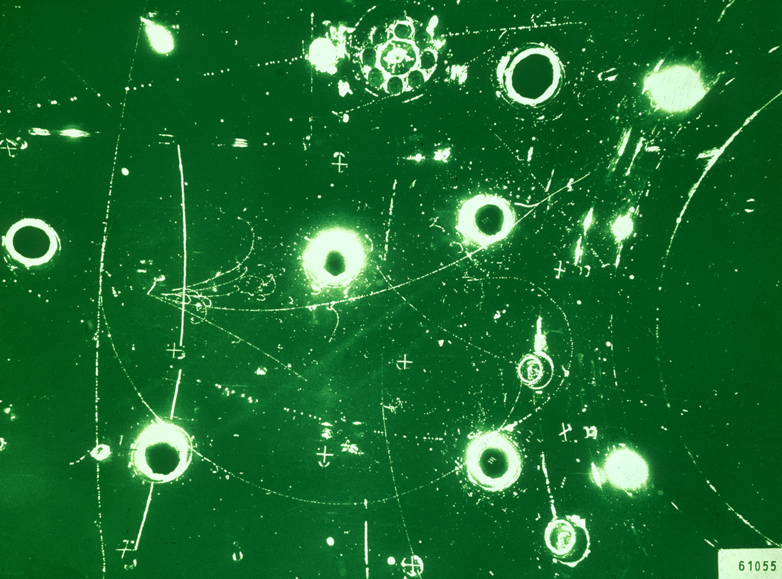
Year when energy reached in labs
L_{gravitation} ~ 10⁻³⁵ m
10¹⁹ GeV
The scales of particle physics …
Planck scale (M_{Pl})
10¹⁶ GeV
GUT ?
10¹⁴ GeV
ν_{R} ?
LHC reach
10 TeV
New Physics ?
~2010
1 TeV
…probing attometer scales
L_{weak} ~ 10⁻¹⁸ m
100 GeV
t, Z, W, H, EWSB
10 GeV
ψ, b, Υ, B
1 GeV
τ, c, n, p, ρ, φ
~1970
L_{strong} ~ 10⁻¹⁵ m
100 MeV
μ, s, π, QCD
10 MeV
u, d, nuclear binding E
1 MeV
e
100 keV
10 keV
1 keV
core of Sun
100 eV
10 eV
atomic binding E
~1900
L_{atomic} ~ 10⁻¹⁰ m
1 eV
ν’s
100 meV
?
10 meV
0
γ, g

Slide 5


A 1 TeV-frequency microscope looks at really, really tiny objects…
Nanoscience
Particle physics today
(TeV scale)
Siphonaptera (flea)
Earth

Slide 6
The Standard Model
The SM consists of 24 elementary matter particles and 3 forces with total of 26 parameters
Fermions
Matter particles
Organised in 3 families
6 Leptons
6 Quarks
Bosons
Force quanta
Distinguishing 3 forces
Photon
3 weak bosons
8 Gluons
Electro-magnetic force
Weak force
Strong force
Higgs boson
Breaks electroweak symmetry
Generates boson and fermion masses

Slide 7
The Standard Model
Elementary particle physics is successfully described by local gauge theories
A problem: local gauge symmetry requires massless spin-1 “gauge” (=force) boson
This has been well verified for QED, with a massless photon (= infinite range)
However, the W, Z bosons are massive (= finite range ~10⁻¹⁵ cm)
Only way to break gauge symmetry consistently is to spontaneously break the symmetry of the vacuum:
[ non-zero vacuum expectation value ]
φ is a complex doublet field with non-zero vacuum expectation value. 3 d.o.fs become Z, W ± masses, remaining d.o.f is massive scalar Higgs boson
This is known as the “Englert-Brout-Higgs-Guralnik-Hagen-Kibble Mechanism”

Slide 8
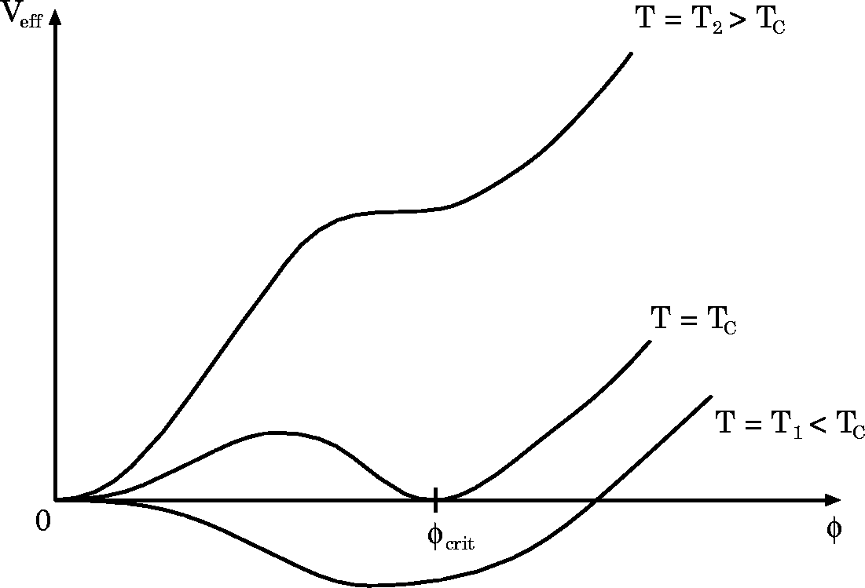
The Standard Model
Englert-Brout-Higgs-Guralnik-Hagen-Kibble mechanism
The early universe, at T > T_{EW}, was in a symmetric phase (|φ_{min}| = 0)
A phase transition at ∼T_{EW} (10⁻¹⁰ s after big bang) led to |φ_{min}| > 0
Phase transition
Potential barrier
Higgs bubble expansion

Slide 9
The Standard Model
Englert-Brout-Higgs-Guralnik-Hagen-Kibble mechanism
The early universe, at T > T_{EW}, was in a symmetric phase (|φ_{min}| = 0)
A phase transition at ∼T_{EW} (10⁻¹⁰ s after big bang) led to |φ_{min}| > 0
Phase transition
Potential barrier
Higgs bubble expansion
Condensation of Higgs field
“spontaneous” phase transition
Simplest scalar potential that breaks ground state symmetry. Does what we need, but bears fundamental problems.
Carries the seeds for new physics …
Higgs potential:

Slide 10
The Standard Model
Englert-Brout-Higgs-Guralnik-Hagen-Kibble mechanism
Early universe: symmetric phase, fundamental particles are massless → gauge symmetry is respected
Higgs quantum liquid in broken phase
Symmetric phase – early universe
Gravity
Gravity
A Higgs field displaces ground state breaking gauge symmetry
It fills all space time (but w/o orientation as spin=0)
Photon
Photon
×
×
Weak boson
×
Weak boson
×
×
×
Particles interact with the Higgs field and reduce their velocity. They acquire a mass proportional to interaction strength
×
Neutrinos
Neutrinos
ν_{L}
Λ⁻¹
ν_{L}
Electrons
×
Electrons
e_{L}
e_{R}
×
e_{L}
×
×
×
_{L}
_{R}
×
×
→ Action of the Higgs field creates a vacuum viscosity
Top quark
_{R}
_{R}
Top quark
×
_{R}
×
×
_{L}
_{L}
t_{L}
_{L}
×
×
H. Murayama
H. Murayama

Slide 11

Massive particles interacting with the condensed Higgs field
… like fireflies in the night sky of Ochiai

Slide 12
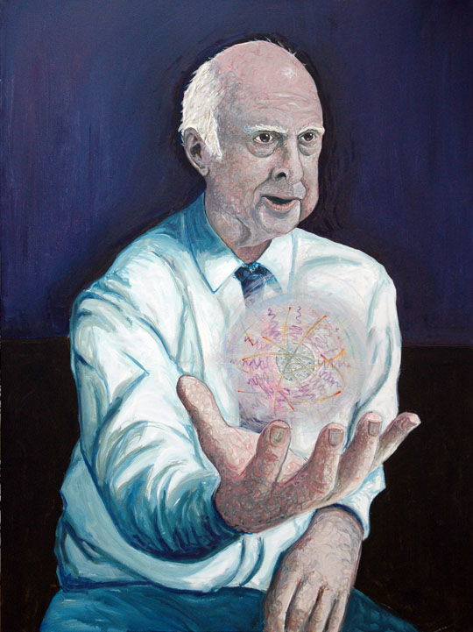
The Higgs boson –
last of the particles ?
The SM predicts all its properties, except for its mass. What was known about it ?
Full references for mechanism:
F. Englert and R. Brout, PRL 13 (1964) 321.
P.W. Higgs, PRL 13 (1964) 508.
G. Guralnik, C. Hagen, and T.W.B. Kibble, PRL 13 (1964) 585.
It is also of note that Landau and Ginzburg had proposed a field giving the photon a mass in a superconductor, the mathematics of which is identical to the “Higgs mechanism” and predates it by several years.
http://www.shardcore.org/shardpress

Slide 13

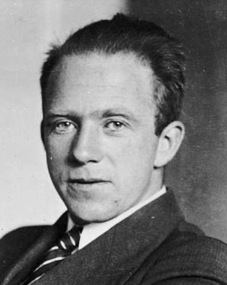
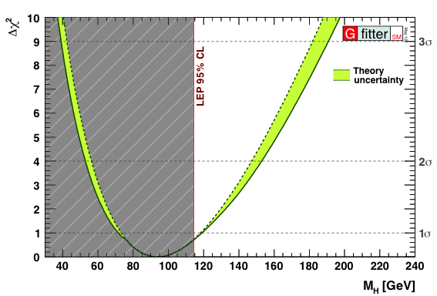
Constraints from global electroweak fit
Global fit of all EW precision measurements to SM prediction constrains M_{H}
H
A_{LR} measurement from SLC/SLD one of four best inputs to this fit
W. Heisenberg
http://gfitter.desy.de

Slide 14
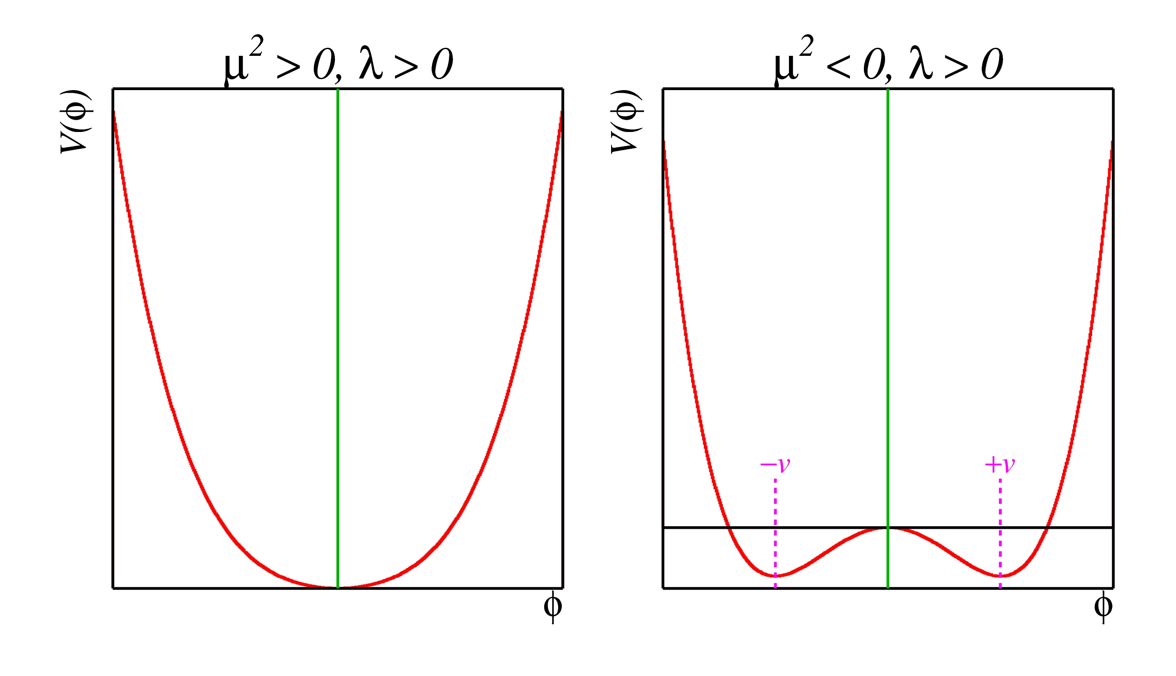
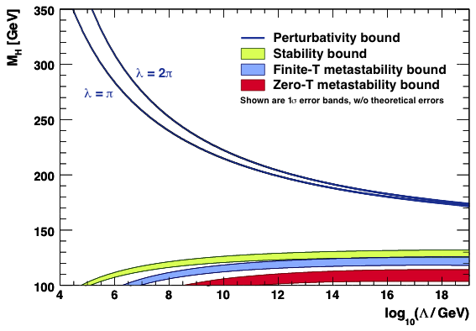
The Higgs boson should not be too light, and not too heavy…
  Perturbativity and (meta)stability bounds versus the SM cut-off scale Λ
Ellis et al, arXiv:0906.0954
Allowed
Not allowed
The SM Higgs must steer a narrow course between two disastrous situations if the SM is to survive up to the Planck scale M_{P} ~ 2×10¹⁸ GeV

Slide 15
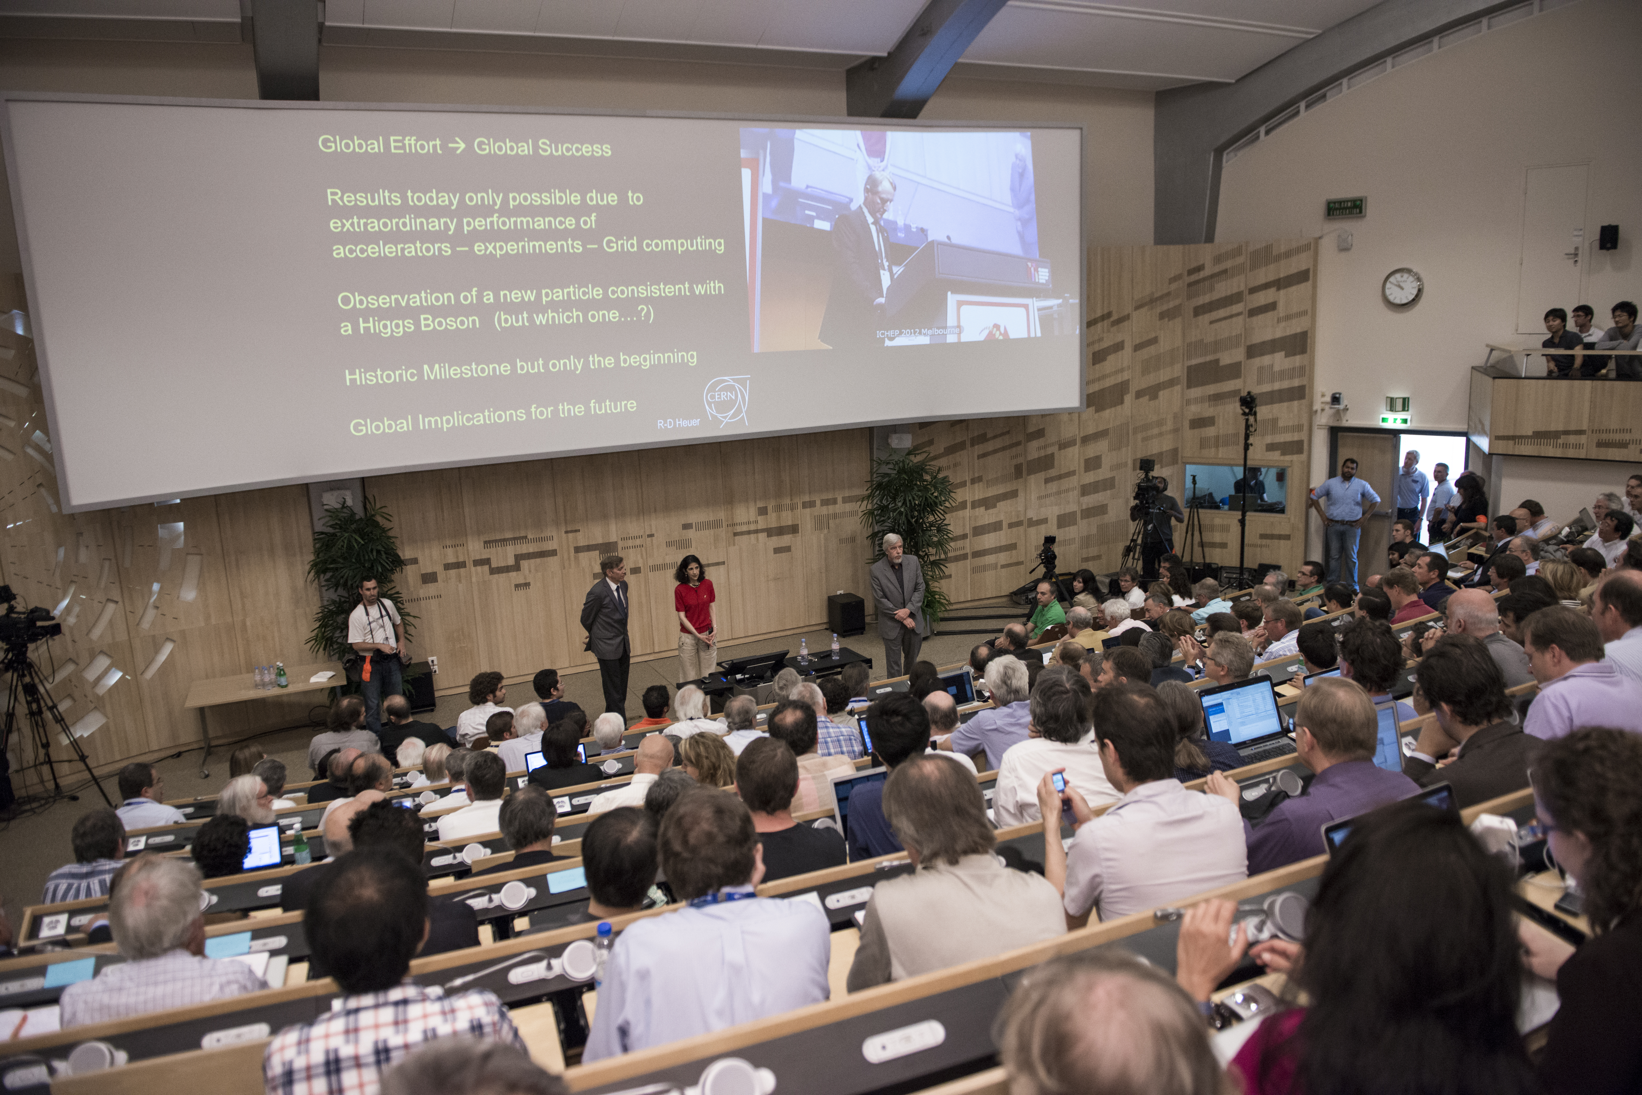
4th of July, 2012 — Higgs-day at CERN
Duration of projects /planning stability:
First LHC workshop 1984 !

Slide 16
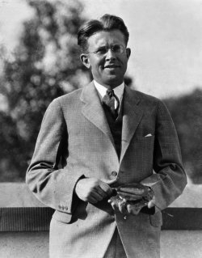
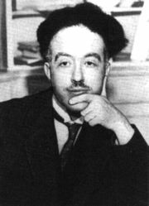
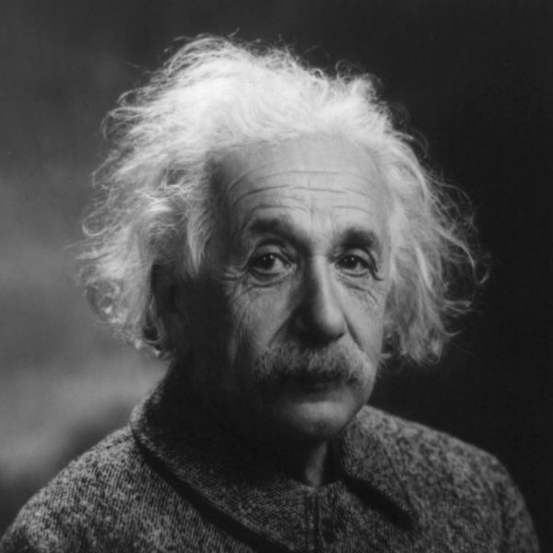
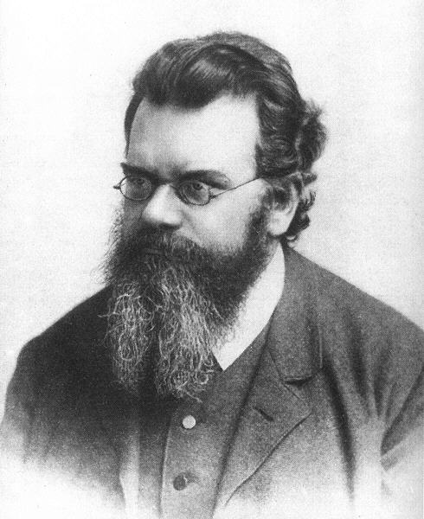
4th of July, 2012 — Higgs-day at CERN
Producing the Higgs Boson and Searching for New Physics at the TeV Scale Requires a Huge Machine
Particles accelerators:
Look deeper into matter (size ~ 1/E) (“powerful microscopes”)
Discover new heavier particles (E = mc²)
Probe conditions of the early universe (E = kT)
de Broglie
Einstein
Boltzmann
Lawrence

Slide 17

LHC ring at CERN:
27 km circumference
Blunt extrapolation for 2011
So far:
7/8 TeV proton—proton collisions
2.76 TeV Pb—Pb collisions

Slide 18

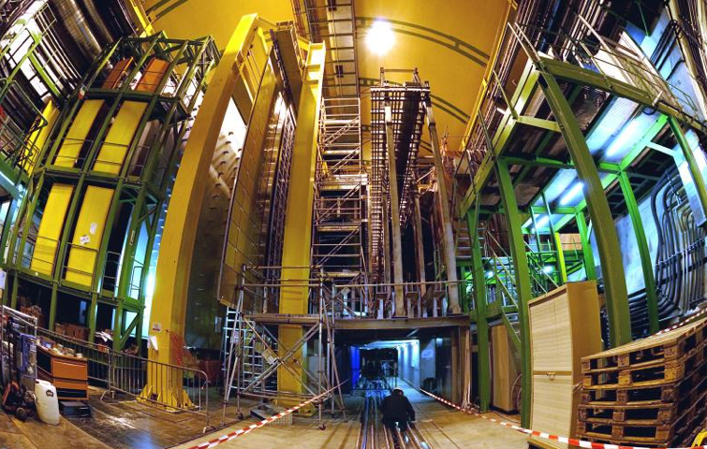
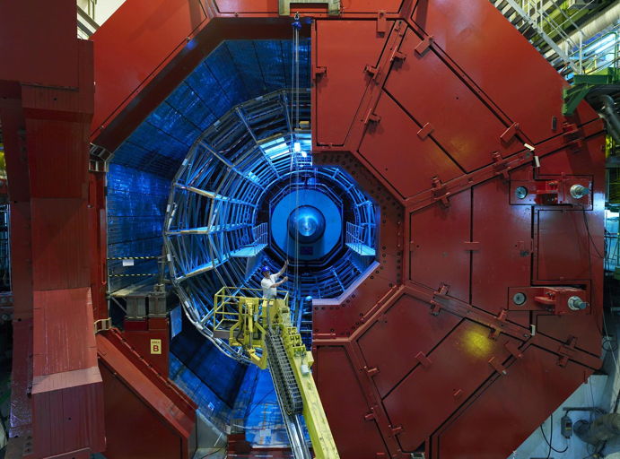

CMS
LHCb
Blunt extrapolation for 2011
ALICE
ATLAS

Slide 19

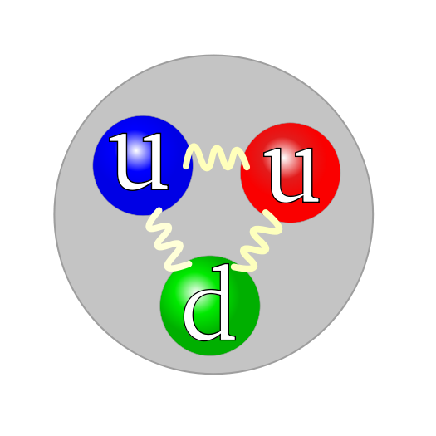
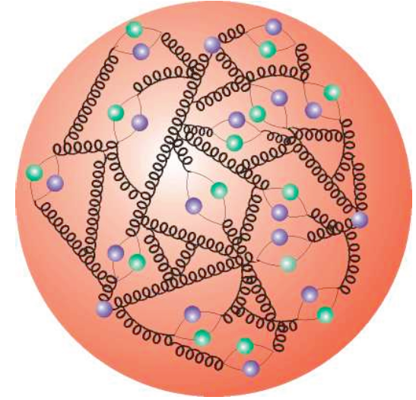
Higgs boson searches at the LHC
Higgs production and decay probabilities predicted vs. Higgs mass by SM
p
p
Parton distribution functions
Representing structure of proton

Slide 20
Higgs boson searches at the LHC
Higgs production and decay probabilities predicted vs. Higgs mass by SM
At the LHC, the Higgs boson is produced dominantly from gluon fusion via top loop
g
Total production of ∼210 thousand Higgs bosons of 125 GeV in 2011 and 2012 in each ATLAS and CMS (by 07/2012)
t
H
t
g
t
Higgs production cross section decreases with Higgs mass

Slide 21
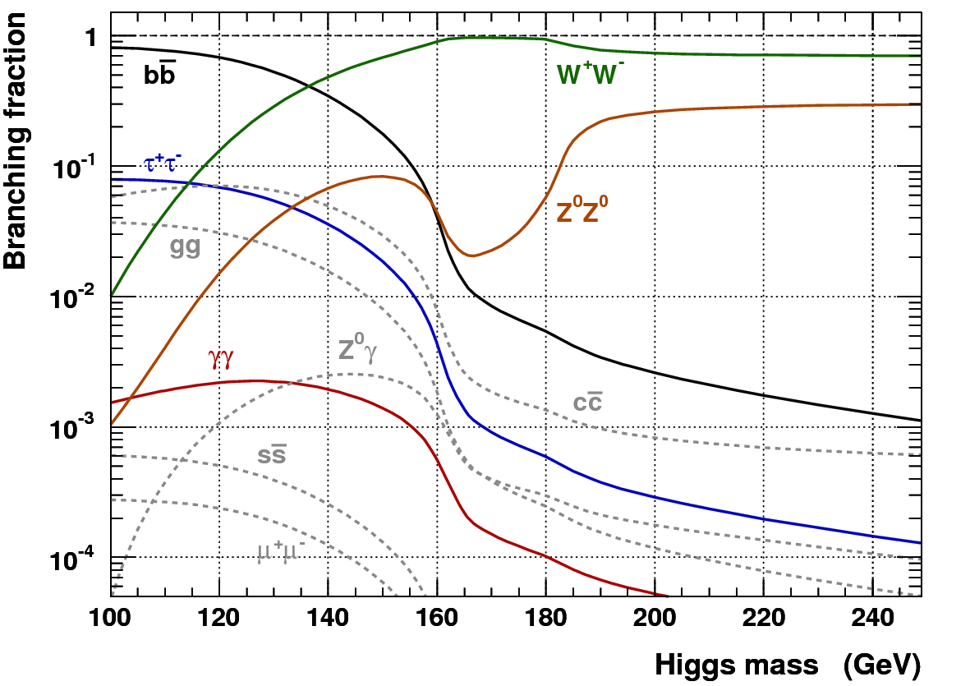
Higgs boson searches at the LHC
Higgs production and decay probabilities predicted vs. Higgs mass by SM
At the LHC, the Higgs boson is produced dominantly via gluon fusion through top
W,Z,q,l,g,γ
W,Z,q,l,g,γ
g
t
Dependence of the branching fractions on M_{H} drives search strategy
H
t
g
t
-
-
-
W,Z,q,l,g,γ
W,Z,q,l,g,γ
Higgs decays: Higgs couples to mass → stronger coupling to heavier particles
Coupling to massless particles (photons, gluons) through heavy virtual particles

Slide 22
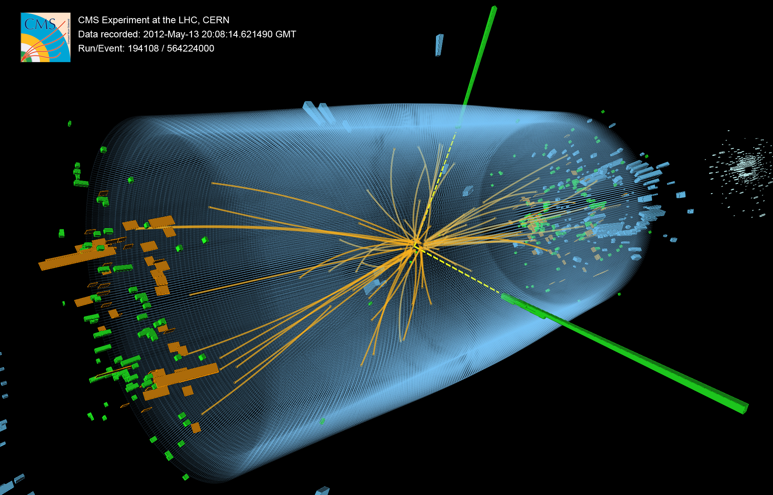
H → γγ candidate event (CMS) — note: background dominated sample

Slide 23
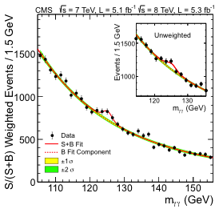
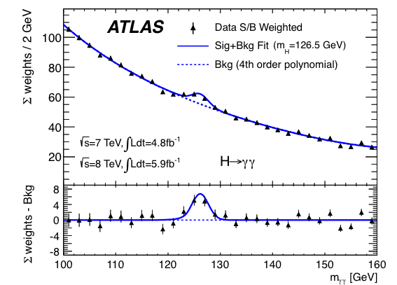
H → γγ
Clean discovery channels for Higgs, allowing precise mass determination
ATLAS arXiv:1207.7214, CMS arXiv:1207.7235, both submitted on Aug 1st, 2012 to PLB
Benefit from excellent energy resolution and photon identification capabilities of ATLAS/CMS
Both experiments classify events according to resolution and topology in ML fit
Maximum excess of 4.5σ (4.1σ) seen by ATLAS (CMS) at 126.5 (125) GeV

Slide 24
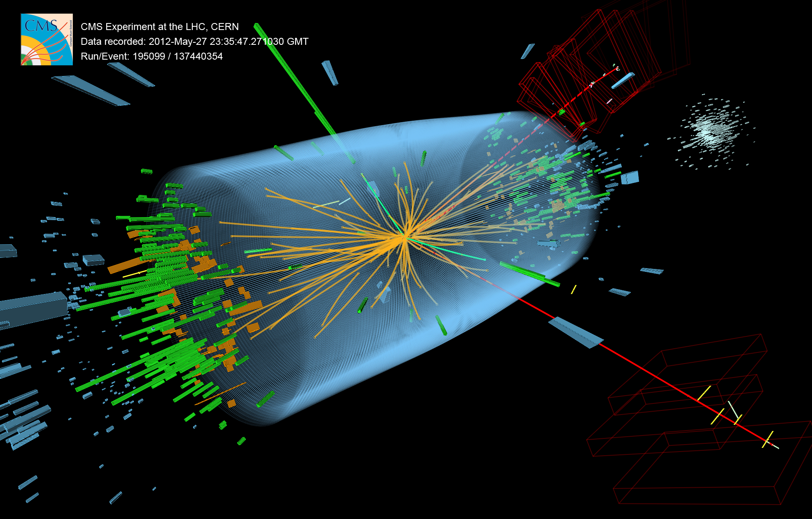
H → 2e2µ candidate event (CMS)

Slide 25
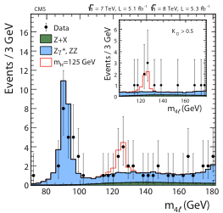
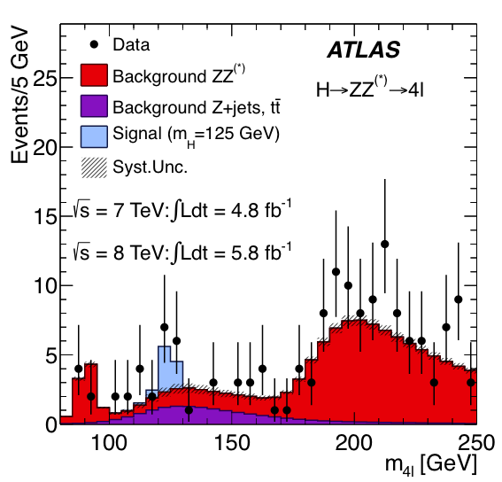
H → ZZ⁽*⁾ → 2(e, µ) + 2(e, µ)
Clean discovery channels for Higgs, allowing precise mass determination
ATLAS arXiv:1207.7214, CMS arXiv:1207.7235, both submitted on Aug 1st, 2012 to PLB
Benefit from excellent energy/momentum resolution and identification capabilities at ATLAS/CMS
Order one S/B ratio. Maximum excess of 3.6σ (3.2σ) seen by ATLAS (CMS) at 125 (125.6) GeV

Slide 26
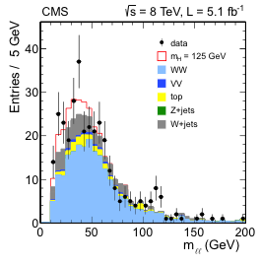
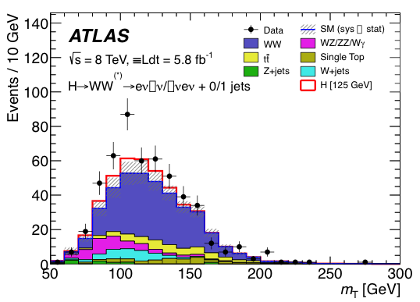
H → WW⁽*⁾ → 2(e, µ) + 2ν
Not clean, but abundant (competitive at 125 GeV) — little mass sensitivity
ATLAS arXiv:1207.7214, CMS arXiv:1207.7235, both submitted on Aug 1st, 2012 to PLB
Signal selection: reconstruct transverse Higgs mass, exploit W polarisation (leptons emitted in same dir.)
Some excess seen by both experiments: 2.8σ (1.6σ) for ATLAS (CMS) at ~125 GeV

Slide 27
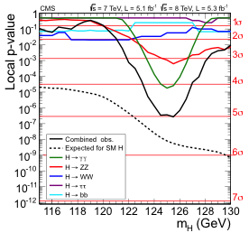
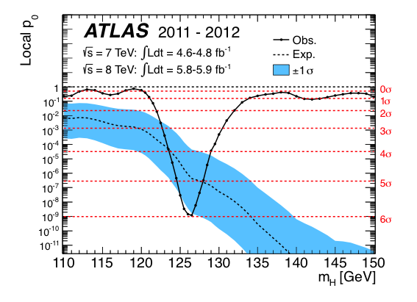
Combining all the channels
Discovery significance
ATLAS arXiv:1207.7214, CMS arXiv:1207.7235, both submitted on Aug 1st, 2012 to PLB
All results [γγ, ZZ, WW, ττ, bb] combined. Left: ATLAS right: CMS — low mass region shown only
5.9σ (4.9σ) local
p-value obs (exp)
ATLAS (CMS) sees 5.9σ (5.0σ) excess at mass of 126.5 (125.3) GeV, δ(mass) ~ 0.6 GeV

Slide 28
Combining all the channels
Discovery significance
ATLAS arXiv:1207.7214, CMS arXiv:1207.7235, both submitted on Aug 1st, 2012 to PLB
All results [γγ, ZZ, WW, ττ, bb] combined. Left: ATLAS right: CMS — low mass region shown only
ATLAS: m_{H} = (126.0 ± 0.4 ± 0.4) GeV
CMS: m_{H} = (125.3 ± 0.4 ± 0.5) GeV
m_{H} ~ (125.7 ± 0.4) GeV
5.9σ (4.9σ) local
p-value obs (exp)
Private average
ATLAS (CMS) sees 5.9σ (5.0σ) excess at mass of 126.5 (125.3) GeV, δ(mass) ~ 0.6 GeV

Slide 29


PRESS COVERAGE
after July 4th seminars at CERN
CERN black board, Jul 2012

Slide 30
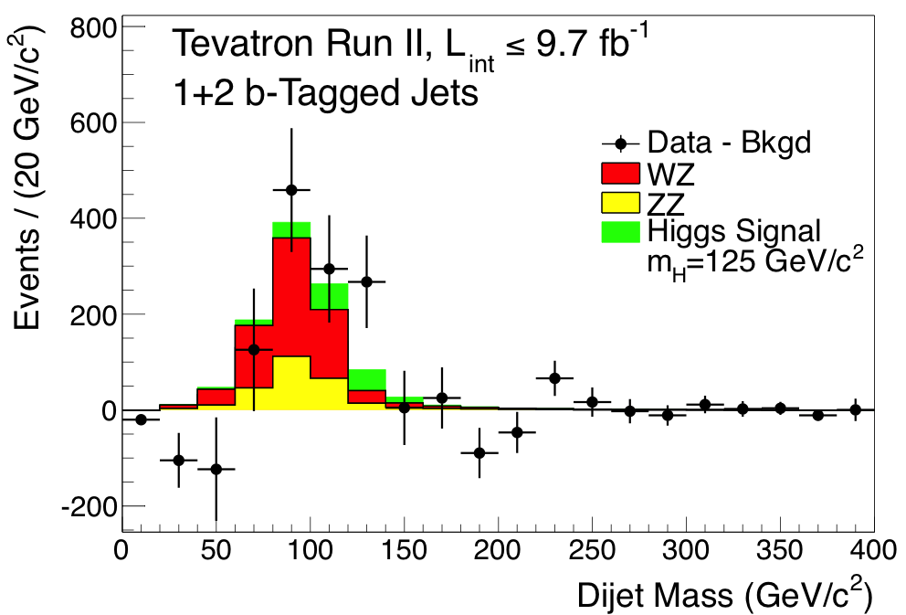
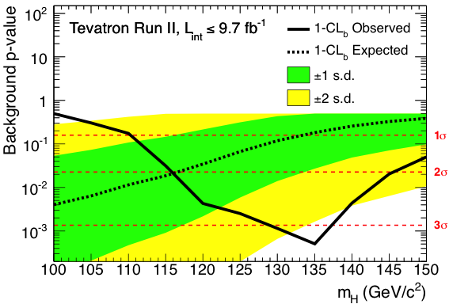
Tevatron publishing final Higgs search results
Evidence for excess in H → bb produced in association with Z/W
CDF & D0, arXiv:1207.6436
Channels depends on good jet energy reconstruction. Harder at LHC due to increased background
Maximum local excess of 3.1σ at 135 GeV (~1σ expected) but coarse mass resolution

Slide 31
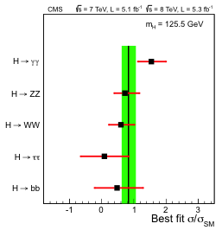
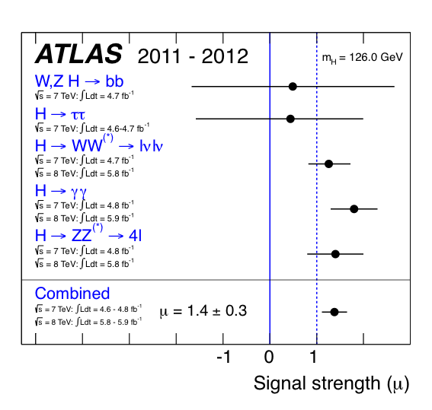
Is it the Higgs boson with J^{PC} = 0⁺⁺ and SM couplings ?
Individual channel strength wrt. SM expectation seen by ATLAS and CMS
ATLAS arXiv:1207.7214, CMS arXiv:1207.7235, both submitted on Aug 1st, 2012 to PLB
H → γγ channel a bit strong, overall agreement with SM within large uncertainties

Slide 32
Is it the Higgs boson with J^{PC} = 0⁺⁺ and SM couplings ?
Individual channel strength wrt. SM expectation seen by ATLAS and CMS
Michael Peskin, in theoretical summary talk at HiggsHunting (July 2012):
SM strength (i.e., ‘large’) Higgs coupling to WW, ZZ is “prima facie evidence that the particle is a CP even spin 0 state from a field with a vacuum expectation value that breaks SU(2) × U(1)”

Slide 33

A new era in particle physics has begun: the exploration of planet Higgs
What is its mass and width ?
What is its spin ?
Does it break EW vacuum symmetry ?
How does it couple to SM particles ?
Does it couple to new particles ?
Does it have invisible decays ?
Does it have brothers and sisters ?
Does it have distant cousins ?
Is it a “natural” scalar ?
© NASA

Slide 34
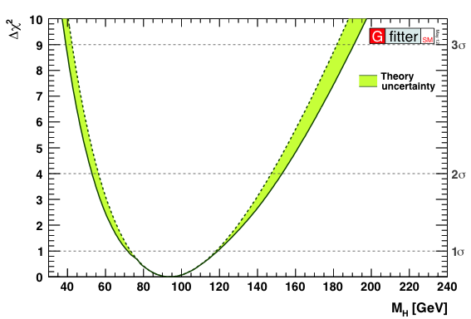
What can we conclude from this discovery
Recall: light Higgs was predicted from SM fit to precision measurements
Discovery of light Higgs boson is a huge success of the Standard Model
http://gfitter.desy.de
ATLAS & CMS
LEP, SLC, Tevatron
H

Slide 35
What can we conclude from this discovery
Is the electroweak vacuum stable or metastable (if SM holds) ?
Barely stable ?
But: prediction of the stability bound suffers from theoretical uncertainties …
Ellis et al, arXiv:0906.0954
Newest full NNLO result moves up stability bound at Planck mass by +0.8 GeV and reduces uncertainty
barely stable or metastable, but certainly the Higgs self coupling would become very weak at M_{Pl}
Allowed
Not allowed
ATLAS & CMS
Degrassi et al, arXiv:1205.6497

Slide 36
100 years after the discovery of cosmic rays…
The discovery of the Higgs boson completes the Standard Model
It is a triumph for the imagination and rigour of the human mind
It is a triumph for the greatest experimental undertaking ever:
Frontier of accelerator & detector technologies
Global data sharing, analysis & collaboration

Slide 37
The Standard Model holds tight
Let us go through a few more examples

Slide 38
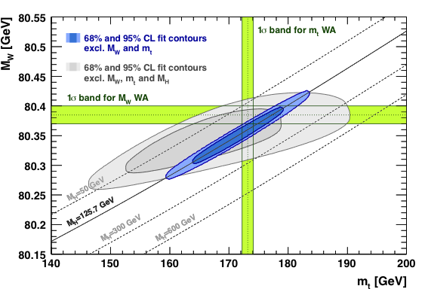
The Standard Model holds tight
Electroweak unification has been verified at, below and above the Z-boson scale
Measured W vs. top mass compared to EW prediction
Gauge sector of SM at tree level is given by 3 free parameters, e.g.: α, M_{Z}, G_{F}
Gfitter, preliminary
→ M_{W} predicted
Radiative corrections introduce quark mass dependence
Crucial contribution from SLC/SLD to this unification evidence

Slide 39
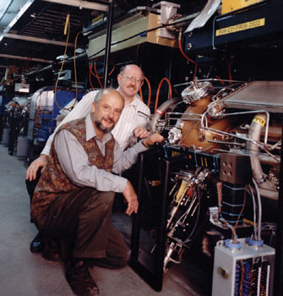
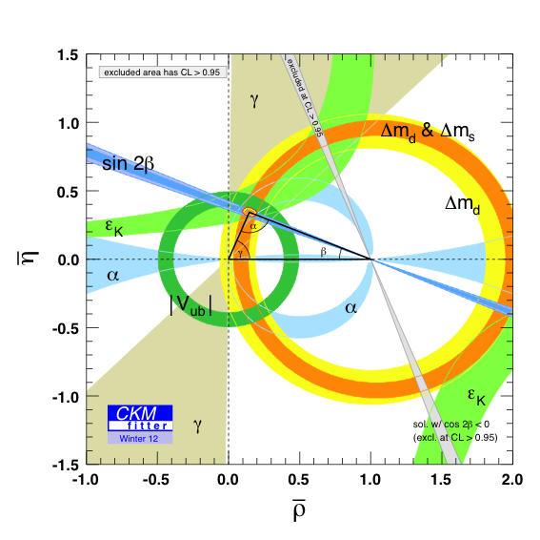
The Standard Model holds tight
All observations of CP violation are described by a single phase in the CKM matrix
∼ Im (CKM phase)
All CKM-phase sensitive measurements agree
[ So far, agreement with SM also in the B_{s} system (LHC) ]
Nobel prize for Kobayashi-Maskawa in 2008
Successful programme that relied on the strong vision and leadership of SLAC to build and exploit PEP-II and BABAR
http://ckmfitter.in2p3.fr
∼ Re (CKM phase)

Slide 40
The Standard Model holds tight
This is wonderful because:
— we quantitatively understand what we see
— we can exploit this understanding to look for deviations

Slide 41
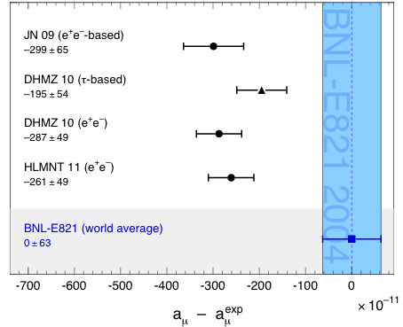
Does the Standard Model hold tight ?
The electron and muon magnetic moments have been verified at ppm level...
Status: summer 2011 (published results shown only)
Hoecker, Marciano, PDG 2011
The muon anomalous magnetic moment may deviate from the SM prediction (not conclusive): it would be stronger than expected

Slide 42
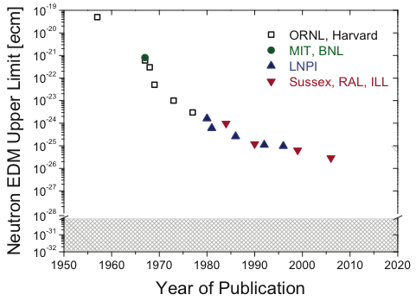
Does the Standard Model hold tight ?
Electric dipole moments are tiny — but why for neutrons ?
→ “strong CP problem”
Neutron EDM upper limits versus time. Current best limit: |d_{n}| < 2.9 × 10^{–26} ecm
Sussex-RAL-ILL,
PRL 97, 131801 (2006)
Is a new symmetry (Peccei-Quinn) responsible for this ?
Its manifestation would be a new particle, the axion, which could also be responsible for the cold dark matter
Zsigmond (nEDM Collaboration) at EPS-HEP 2011 — modified by A.H.
SM prediction if no strong CP violation

Slide 43
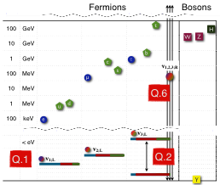
Does the Standard Model hold tight ?
The neutrino revolution: massive neutrinos are likely beyond the SM phenomena
Dramatic progress in neutrino physics — fundamental tasks/questions still open
Q1: Absolute mass scale of neutrinos
Q2: Normal or inverted mass hierarchy
Q3: CP violation in neutrino oscillations
Q4: Unitarity of neutrino mixing matrix
Q5: Neutrinoless double beta decay
Q6: Existence of “sterile neutrino(s)”
Dufour-Wark, arXiv:1207.3983

Slide 44
Does the Standard Model hold tight ?
Can we conclude that the Standard Model is the theory of matter and force ?

Slide 45

The SM cannot be the final theory, because …
Gauge hierarchy / Scalar SM sector is unstable
Huge mass hierarchy between matter particles
Gauge hierarchy / Scalar SM sector is unstable
Higgs is only fundamental scalar
Huge mass hierarchy between matter particles
Higgs is only fundamental scalar
neither matter, nor force, — all known scalars are
composite states
neither matter, nor force, — all known scalars are
composite states
Dark matter and dark energy
Grand unification of the forces
Causally connected observable universe
Massive neutrinos
Matter-antimatter asymmetry in universe
Strong CP problem
Gravitation

Slide 46
The SM cannot be the final theory, because …
The Higgs potential (μ < 0, λ > 0: physics or just mathematics ?) exemplifies our success with description but lack of understanding
~
Higgs boson mass term
“Hierarchy problem”
→ new physics at ~TeV

Slide 47
The SM cannot be the final theory, because …
The Higgs potential (μ < 0, λ > 0: physics or just mathematics ?) exemplifies our success with description but lack of understanding
~
Is this the right potential?
If the Higgs field fills all space-time, is it related to inflation and dark energy?
Higgs boson mass term
Higgs self coupling
Higgs—fermion couplings
λ_{SM} = G_{F} m_{H}²/√2 ∼ 0.13
EW vacuum may be meta-instable
“SM flavour problem”: large mass hierarchy between fermion families
“Hierarchy problem”
→ new physics at ~TeV
G. Isidori at HiggsHunting 2012
Through the missing protection of the scalar potential to high-scale physics (no symmetry for m_{H} = 0 !), the Higgs boson is considered a “portal to new physics”

Slide 48

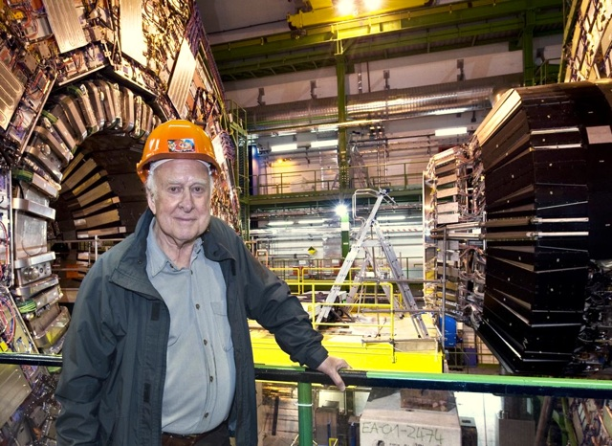
Higgs discovery puts these questions into spotlight
P. Higgs at CMS

Slide 49
Proposed solutions to hierarchy problem
Weakly coupled: Supersymmetry, …
Strongly coupled: Little Higgs, Composite Higgs, …
Different manifestations of similar scenarios. Many models also provide dark matter candidates
Higgs discovery puts these questions into spotlight
P. Higgs at CMS

Slide 50
Does a symmetry between fermions and bosons
regularise the Higgs radiative corrections ?
Fermion loop
Boson loop
(weak-scale) Supersymmetry (SUSY)
P. Higgs at CMS

Slide 51


The
scalar
precipice
Mrs. SUSY
EW scale^{—1}
Mr. Higgs
GUT scale^{—1}
Planck scale^{—1}
Fundamental scalar length scale

Slide 52
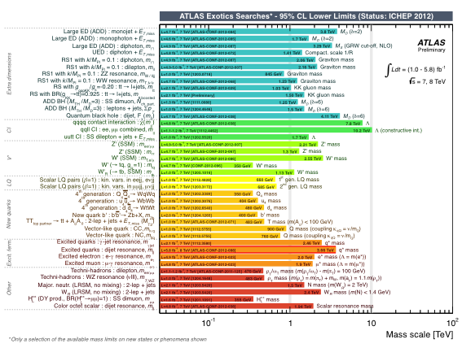
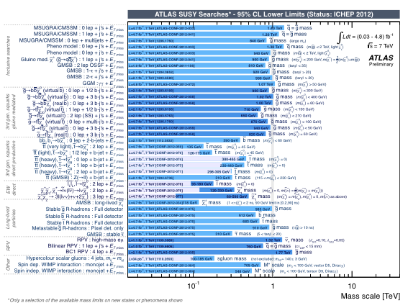
Broad search spectrum at ATLAS and CMS
So far unsuccessful new physics searches (beyond Higgs)
Mass reach of searches for SUSY (left) and other new phenomena (right) (here: ATLAS)

Slide 53
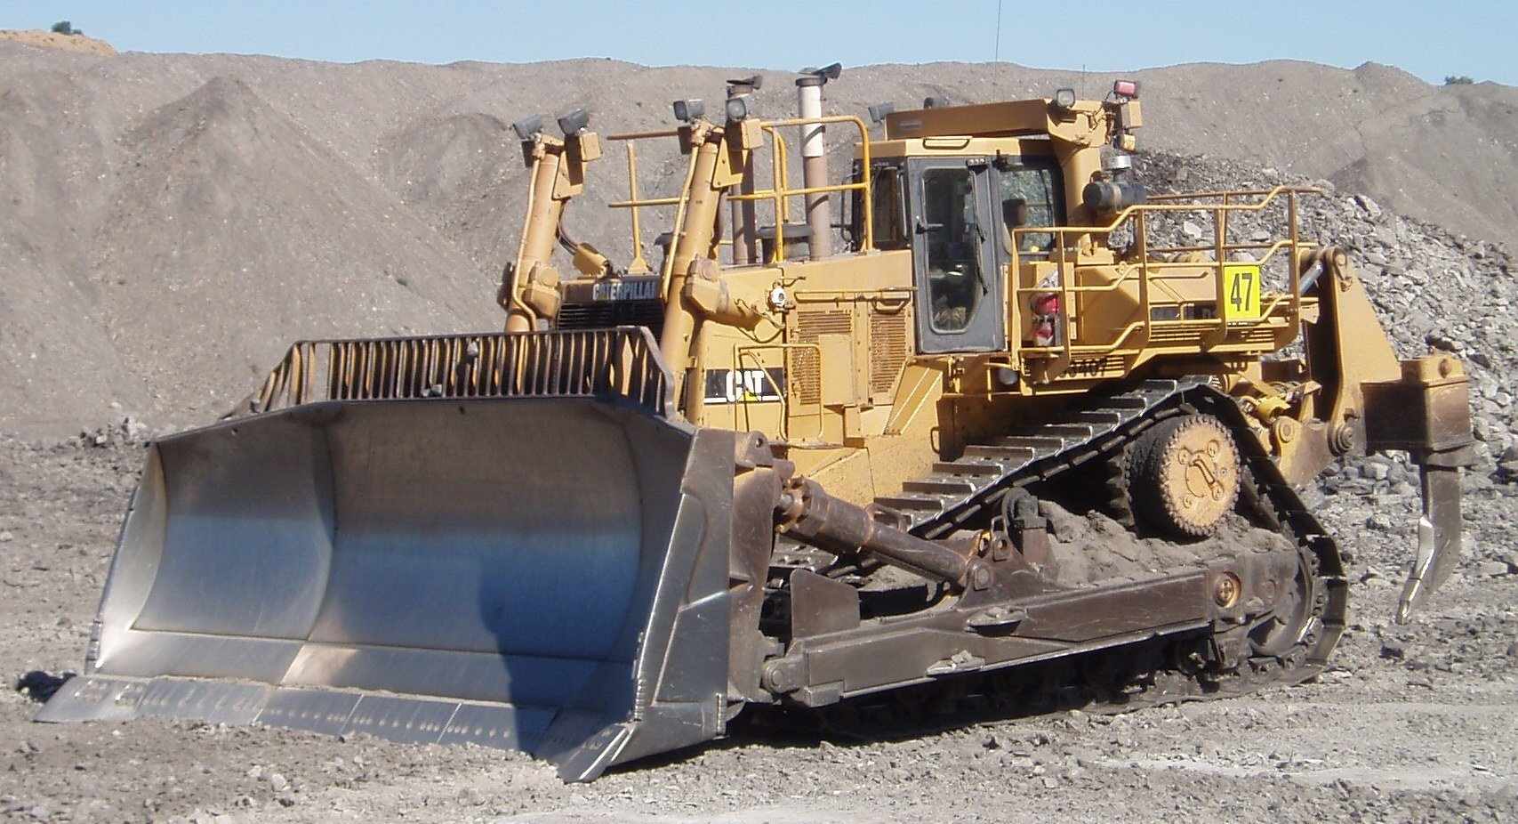
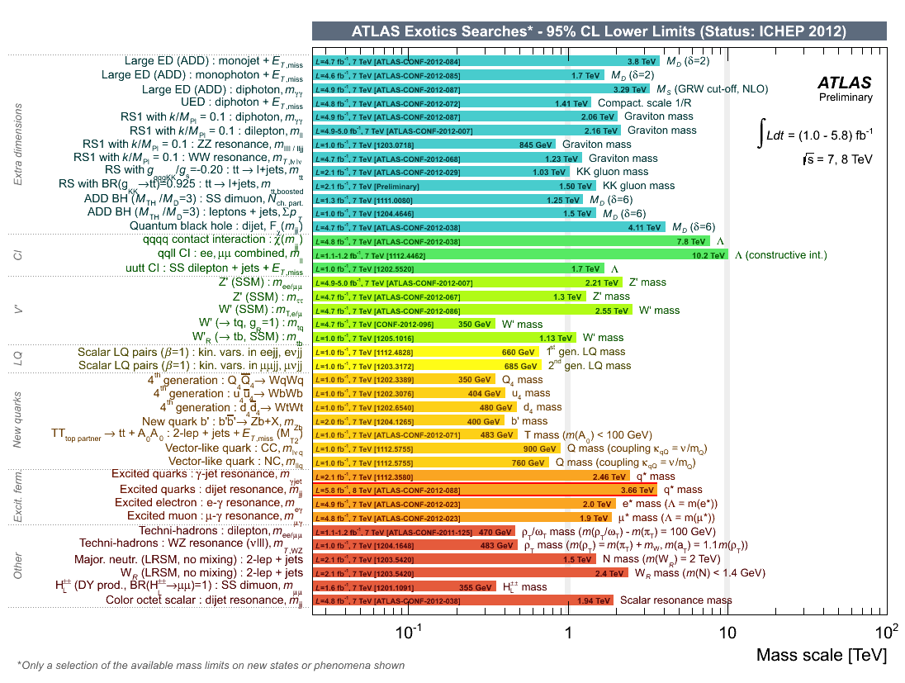
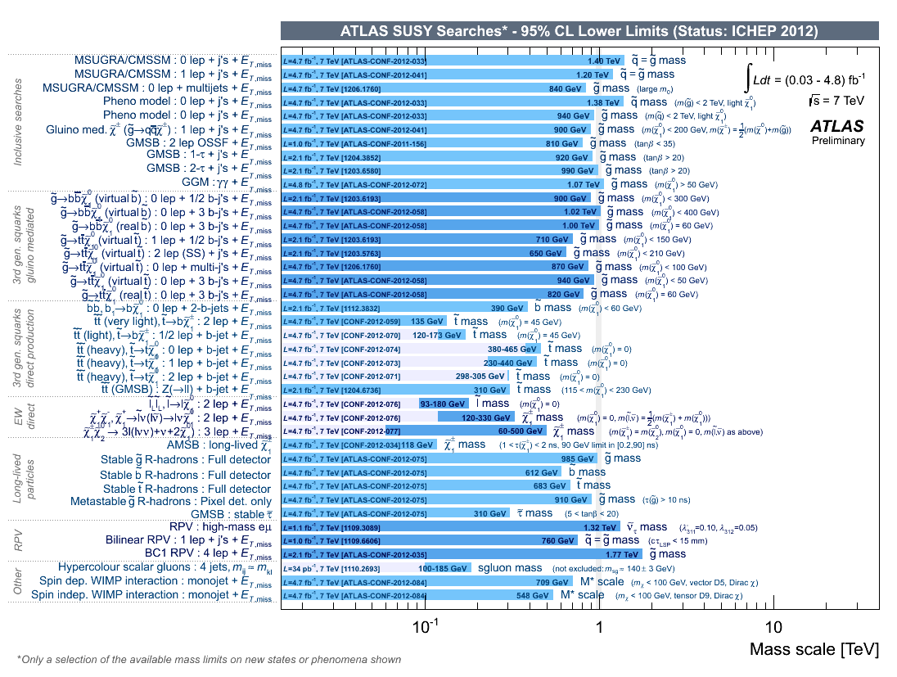
Broad search spectrum at ATLAS and CMS
The LHC is pushing the limits on new phenomena
Mass reach of searches for SUSY (left) and other new phenomena (right) (here: ATLAS)
F. Le Diberder @ CERN 2012

Slide 54
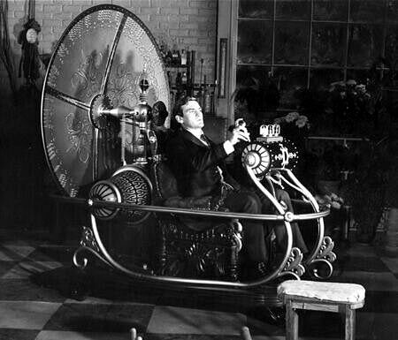
The next 50 years …
(remember particle physics 50 years ago ?)
I will be brief on:
The strong connection of particle physics with astrophysics and cosmology → Jonathan Feng & Rene Ong
Introduction to future accelerators → Frank Zimmermann
The energy frontier
The intensity frontier
The cosmic frontier (→ JF, RO)
Other areas

Slide 55
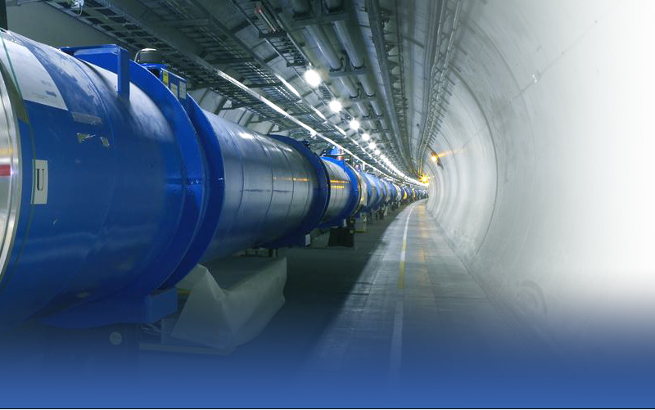
The next 50 years’ particle physics research programs depend on LHC results
By now, a new Higgs-like particle has been discovered and we are entering a new era of particle physics
[ More can be expected; let us assume here scenarios after accumulating more than 3 ab^{–1} of data at the HL-LHC at ∼2030 (~5×10³⁴ cm⁻¹ s⁻¹, up to 140 interactions per crossing) ]
The high-energy frontier

Slide 56

The next 50 years’ particle physics research programs depend on LHC results
By now, a new Higgs-like particle has been discovered and we are entering a new era of particle physics
[ More can be expected; let us assume here scenarios after accumulating more than 3 ab^{–1} of data at the HL-LHC at ∼2030 (~5×10³⁴ cm⁻¹ s⁻¹, up to 140 interactions per crossing) ]
The high-energy frontier
Options (→ see talk by F. Zimmermann)
HE-LHC
[pp up to 33 TeV, new magnets, reuse infrastructure]
ILC (H-Factory)
[e⁺e⁻ at 0.5-1 TeV, mature technology, new infrastructure]
CLIC
[e⁺e⁻ up to 4 TeV, new technology, new infrastructure]
VLHC
[pp up to 175 TeV, new everything]
LEP-3 (H-Factory)
[e⁺e⁻ at 0.25 TeV,
new accelerator, reuse infrastructure]
Muon Collider
[µ⁺µ⁻ up to 4 TeV, new everything]

Slide 57
The next 50 years’ particle physics research programs depend on LHC results
By now, a new Higgs-like particle has been discovered and we are entering a new era of particle physics
[ More can be expected; let us assume here scenarios after accumulating more than 3 ab^{–1} of data at the HL-LHC at ∼2030 (~5×10³⁴ cm⁻¹ s⁻¹, up to 140 interactions per crossing) ]
The high-energy frontier
Options (→ see talk by F. Zimmermann)
A remark is in order: CLIC & muon collider are here representatives for new accelerator technologies. Powerful alternatives, actively developed at SLAC, could become multi-TeV high-gradient accelerators using, eg, plasma wakefield acceleration. See talk by Tor Raubenheimer (SLAC) at EPS-HEP 2011 → F. Zimmermann
If the physics case is given (see later), all acceleration techniques will be on the table
HE-LHC
[pp up to 33 TeV, new magnets, reuse infrastructure]
ILC (H-Factory)
[e⁺e⁻ at 0.5-1 TeV, mature technology, new infrastructure]
CLIC
[e⁺e⁻ up to 4 TeV, new technology, new infrastructure]
VLHC
[pp up to 175 TeV, new everything]
LEP-3 (H-Factory)
[e⁺e⁻ at 0.25 TeV,
new accelerator, reuse infrastructure]
Muon Collider
[µ⁺µ⁻ up to 4 TeV, new everything]

Slide 58
Scenario 1) TeV-scale new particles are found at LHC
The high-energy frontier
Options (→ see talk by F. Zimmermann)
HE-LHC
[pp up to 33 TeV, new magnets, reuse infrastructure]
ILC
[e⁺e⁻ at 0.5-1 TeV, mature technology, new infrastructure]
CLIC
[e⁺e⁻ up to 4 TeV, new technology, new infrastructure]
VLHC
[pp up to 175 TeV, new everything]
LEP-3
[e⁺e⁻ at 0.25 TeV, new accelerator, reuse infrastructure]
Muon Collider
[µ⁺µ⁻ up to 4 TeV, new everything]

Slide 59
Scenario 1) TeV-scale new particles are found at LHC
Scenario 2) Higgs boson is SM and remains only new phenomenon seen at LHC
The high-energy frontier
Options (→ see talk by F. Zimmermann)
HE-LHC
[pp up to 33 TeV, new magnets, reuse infrastructure]
ILC
[e⁺e⁻ at 0.5-1 TeV, mature technology, new infrastructure]
CLIC
[e⁺e⁻ up to 4 TeV, new technology, new infrastructure]
VLHC
[pp up to 175 TeV, new everything]
LEP-3
[e⁺e⁻ at 0.25 TeV, new accelerator, reuse infrastructure]
Muon Collider
[µ⁺µ⁻ up to 4 TeV, new everything]

Slide 60
Scenario 1) TeV-scale new particles are found at LHC
Scenario 2) Higgs boson is SM and remains only new phenomenon seen at LHC
Scenario 3) As 2), but new physics from “intensity and precision frontier”
The high-energy frontier
Options (→ see talk by F. Zimmermann)
HE-LHC
[pp up to 33 TeV, new magnets, reuse infrastructure]
ILC
[e⁺e⁻ at 0.5-1 TeV, mature technology, new infrastructure]
CLIC
[e⁺e⁻ up to 4 TeV, new technology, new infrastructure]
VLHC
[pp up to 175 TeV, new everything]
LEP-3
[e⁺e⁻ at 0.25 TeV, new accelerator, reuse infrastructure]
Muon Collider
[µ⁺µ⁻ up to 4 TeV, new everything]

Slide 61
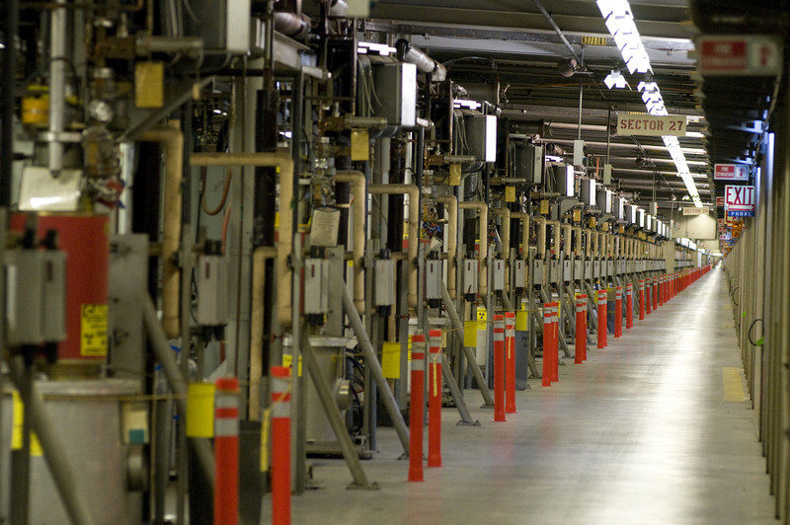
Scenario 1) TeV-scale new particles are found at LHC
Scenario 2) Higgs boson is SM and remains only new phenomenon seen at LHC
Scenario 3) As 2), but new physics from “intensity and precision frontier”
The high-energy frontier
In either scenario, in 50 years, we should have built, operated and exploited a new e⁺e⁻ collider
( and we might be operating CLIC and/or a HE-LHC, while a multi-TeV muon collider and large scale multi-GV/m gradient acceleration is technologically mature )
What will this (and the LHC) have taught us ?
SLAC’s SLC: pioneered large-scale LC technology with polarised beams
SLC klystron gallery [Photo: Nick Russell]

Slide 62
Higgs physics — in 50 years…
Higgs properties will have been precisely measured at linear collider
Higgs couplings will be known to a few % (LC, LHC: ratios > 5%; needs theory improvement)
W,Z,q,l,g,γ
g
t
H
t
g
t
-
-
-
W,Z,q,l,g,γ
→ New heavy particles may couple to the Higgs and modify the couplings

Slide 63
Higgs physics — in 50 years…
Higgs properties will have been precisely measured at linear collider
The trilinear Higgs self-coupling will have been measured (~20%)
λ _{HHH}
H
g
t
H
t
g
t
H
→ Teaching us about the form of the Higgs potential

Slide 64
The hierarchy problem — in 50 years…
We will have “some” answer to one of the primary shortcomings of the SM
If new particles were discovered at the TeV scale, they will have been studied in detail by a TeV scale linear collider. Energy scales up to 10 TeV may already have been covered by the HE-LHC.
We will have understood if the Higgs is fundamental, regularised by new weak couplings (e.g., SUSY), or rather a composite, e.g., a witness of a new strongly interacting TeV scale symmetry
  → a revolution to our perception of matter and force
If no new physics is discovered, the hierarchy problem may be reality and naturalness as scientific criterion has to be questioned
  → a revolution of thinking physics and possibly a hint to a statistical
  choice of the universe’s parameters ?

Slide 65
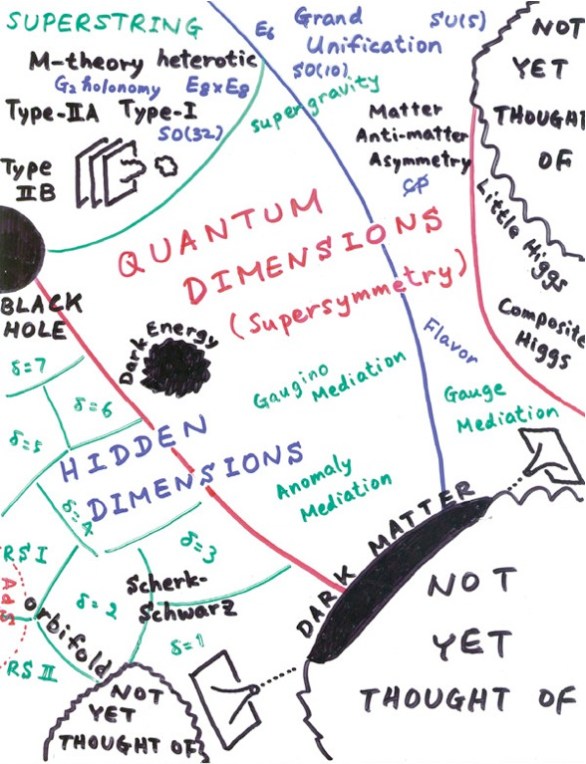
Beyond the Standard Model physics — in 50 years…
Tightly related to the hierarchy problem, to dark matter and to unification
If new particles were discovered and measured …
  Their nature will have been determined
  SUSY, new strong interactions with heavy partners of known SM particles, extra space dimensions, new vector-like matter states, …, or combinations of these
  Dark matter candidates may have been found, and if, their relic abundance precisely determined, possibly fully solving the dark matter puzzle
  New CP-violating interactions would impact our understanding of baryogenesis
  Likely the new physics will have taught us about physics at energy scales far above any accelerators
  Modified force evolution may enable grand gauge unification
H. Murayama

Slide 66
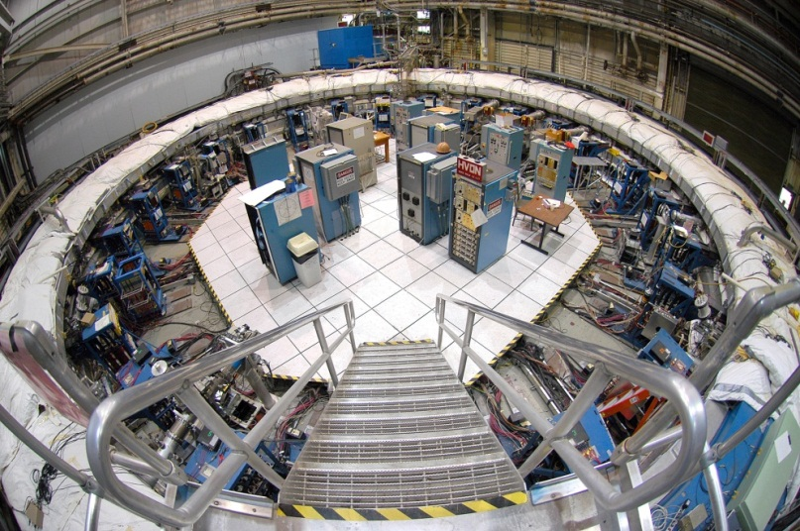
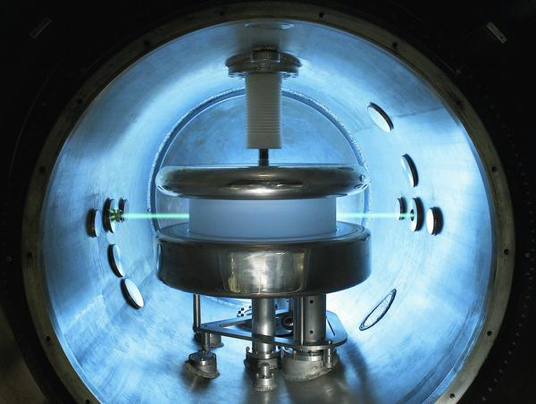
By exploiting contributions from radiative corrections, precision measurements, in line with accurate theoretical predictions, can be used to probe physics at higher energy scales than the masses of the particles directly involved in the experimental reactions.
Wise research decisions will have allowed to exploit a huge physics potential that complements the high-energy frontier
The intensity frontier

Slide 67



New techniques for the measurement of EDMs of the neutron, electron and muon will have improved the current sensitivity by three orders of magnitude
The LHC and new “Super B factories” led to sub-% CPV & rare decay measurements
High-intensity proton drivers (> 5 MW proton source) will increase K and μ production rates for rare decay experiments (CLFV to 10⁻¹⁹, observation of K_{L}→π⁰νν, etc)
The LC (also in Giga-Z mode) will have greatly improved the precision of EW sector
The intensity frontier
3 MW of total beam power to 3 GeV program and 2 MW to a neutrino production target at 60-120 GeV

Slide 68


Combination of long & short baseline and reactor neutrino experiments will have established the neutrino mass hierarchy, precision angle measurements and hints on leptonic CPV. A neutrino factory is the logical next step — already done ?
Ton-scale neutrinoless double beta experiments have explored the nature of neutrinos down to masses of meV (are neutrinos their own antiparticles ?)
Direct electron neutrino mass measurements obtained sensitivities to meV
The intensity frontier / neutrino properties
Project-X neutrino beam lines
EXO-200 detector
Exo-200 limit on effective Majorana neutrino mass of 140–380 meV in 2012
arxiv:1205.5608

Slide 69

Mega-ton neutrino detectors will have achieved a proton lifetime sensitivity of >10³⁶ y (SK: ~2×10³⁴ y), impacting our understanding of GUT & baryogenesis
Axion experiments will have covered the CDM mass range 1 μeV ~ 1 meV
Ground and space-based DM experiments may have detected dark matter reactions in complementarity to accelerator-based searches → Jonathan Feng
Protons, axions, dark matter
Super-K detector

Slide 70

The last 40 years we have seen a profusion of theoretical ideas motivated by the shortcomings of the SM, cosmological observations, and Planck-scale physics
Experiment is behind, but critically needed to understand the choices nature took
The next 50 years shall be the age of experiment and theoretical truth
Particle Theory

Slide 71


But particle theory is more than model building; it is also hard calculus and programming on which the interpretation of data crucially relies
Similar to experiment: it requires large-scale resources and organisation
Theoretical revolutions are perhaps even less predictable than experimental ones. It is clear, however, that SLAC must remain a world-leading theoretical centre
Particle Theory
Multi-jet event at hadron collider
Simulation: F. Krauss
Example: Lance Dixon’s (SLAC) talk emphasizing the NLO QCD revolution at ICHEP-12

Slide 72





Fermions
Bosons
b, t, ν_{τ}
g
DESY
u, d, c, τ
BNL
CERN
FNAL
c, ν_{μ}
W, Z, H
1967
1974
1975
Particles Physics Relies on Accelerators
Each new accelerator project pushed the limits of technology and organisation, and ended enriching our understanding of what we are made of
It is the price of knowledge — there is no other way

Slide 73
Fermions
Bosons
b, t, ν_{τ}
g
DESY
u, d, c, τ
BNL
c, ν_{μ}
CERN
W, Z, H
FNAL
1967
1974
1975
Particles Physics Relies on Accelerators
Each new accelerator project pushed the limits of technology and organisation, and ended enriching our understanding of what we are made of
It is the price of knowledge — there is no other way

Slide 74
FNAL
Intensity frontier ?
CERN
Energy frontier ?
1oo
KEK-2
Precision frontier ?
The Landscape of Particle Physics Labs in 2062 ?
Extremely challenging experimental programmes require global organisation
Several successful examples of global head organisations already (ICFA, ILC-GDE, IDS-NF,…) —
Also in communication: interactions.org, and also the wonderful SLAC/FNAL symmetry-magazine !
Global Labs in different world regions host the very large facilities
Strong and versatile national labs with technological leadership coordinate
R&D for new machines and detectors (e.g., FACET at SLAC) [map of labs not to trust!]

Slide 75
The next 50 years …
Looking back to what we’ve learned during the last 50 years, if we continue our path of globalising our strengths while keeping fruitful competition and the individual’s creativity vivacious, we will keep up the pace to unravel Nature’s deepest mysteries
In 50 years from now a new particle physics will have emerged with new symmetries, new particles, new interactions that have extended the SM to a far more complete theory.
SLAC will look back and enjoy its strong fingerprints in the making of it !

Slide 76


Congratulations
SLAC !

Slide 77
Fermions
Bosons
b, t, ν_{τ}
g
DESY
u, d, c, τ
BNL
CERN
FNAL
c, ν_{μ}
W, Z, H
I am indebted to Michel Davier, François Le Diberder and Michael Peskin for their help during the preparation of this talk.
My deepest thanks go to SLAC for giving me the opportunity to talk about our field at this extraordinaire anniversary during these extraordinary times for all particle physicists.
I thank my LHC colleagues for their dedication and work to make this scientific endeavour a success.
1967
1974
1975

