Slide 1

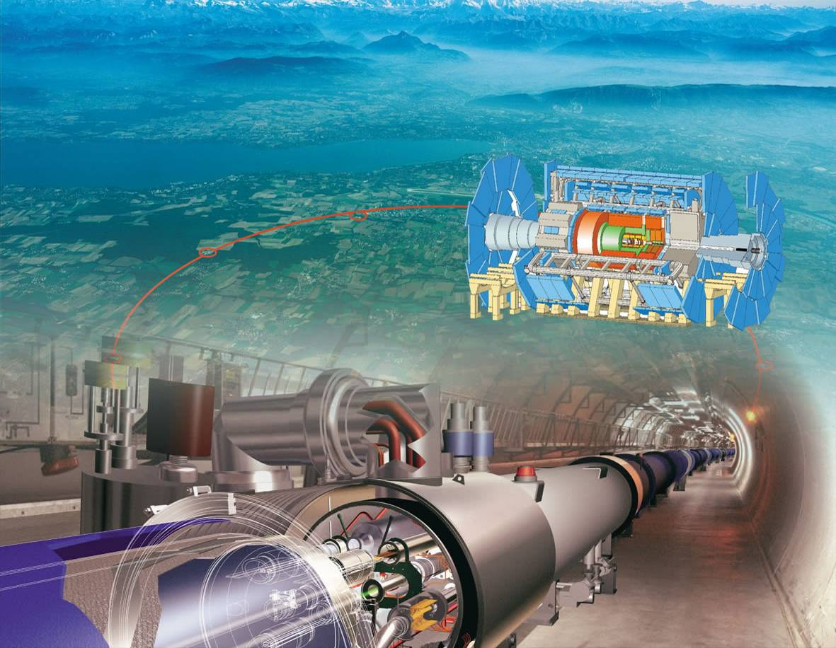


Quest for the Higgs Boson
Last Round LHC ?
Andreas Hoecker (CERN, ATLAS Collaboration)
Seminar, 5 March 2011, Stanford, CA

Slide 2
Seminar Themes
Higgs Mechanism
Indirect constraints on the Higgs boson mass
ATLAS and the LHC
Higgs boson searches at the LEP, Tevatron and the LHC

Slide 3
The Standard Model
Elementary particle physics is successfully described by local gauge theories
Take a gauge group G
The interactions (gauge bosons) are given by the generators of the group
The fermions are arranged in multiplets on which the gauge bosons act
The gauge group of the Standard Model is: SU(3)_{C} × SU(2)_{L} × U(1)_{Y}
  SU(3)_{C} : strong interactions with coupling α_{S}
  SU(2)_{L} × U(1)_{Y} : electroweak interactions with couplings g, g’
  SU(2)_{L} [ W⁺, W⁰, W– ] couples to left-handed fermion doublets only
  U(1)_{Y} [ B ] couples to left and right-handed fermions
In this scheme all SM particles must be massless (otherwise: gauge non-invariance)

Slide 4
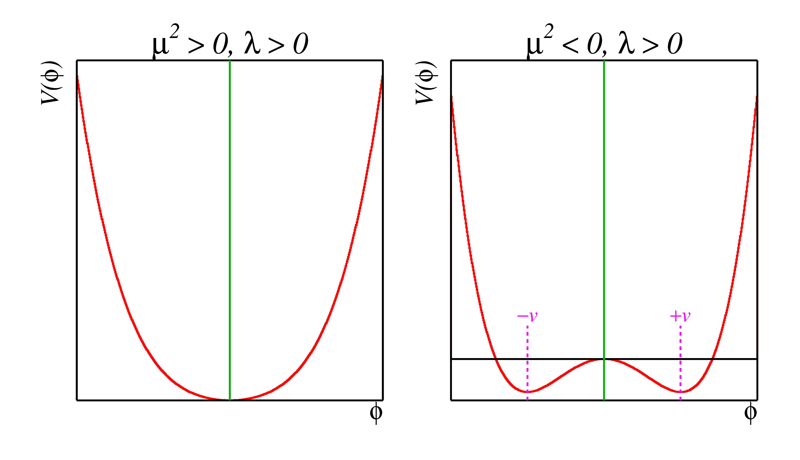
The “Higgs Mechanism”
F. Englert, R. Brout, PRL 13 (1964) 321; P.W. Higgs, PL 12 (1964) 132; PRL 13 (1964) 508; G. S. Guralnik, C.R. Hagan, T.W.B. Kibble, PRL 13 (1964) 585
How to give mass without breaking gauge invariance?
The answer is the Higgs mechanism, which is based on the observation that scalar mass terms are gauge invariant.
This is exploited to give mass to the gauge bosons through the back door…
Potential V(φ ) = μ ² |φ |² + λ |φ |⁴, φ scalar field doublet
For μ ² < 0, the minimum moves away from φ = 0
The ground state (T = 0) acquires a non-zero vacuum expectation value (vev) υ
Perturbation theory around ground state: φ ∝ υ + H
H is the Higgs boson. The other 3 components of the doublet φ are absorbed to give mass to W ± and Z
υ precisely known from muon decay

Slide 5
The Higgs Mechanism
Let’s imagine all particles have zero mass → gauge symmetry is respected
A Higgs field fills all space time (but w/o orientation as spin=0)
The particles interact with the Higgs field thus reducing their velocity, which is equivalent to acquiring a mass
The action of the Higgs field creates a vacuum viscosity
Weak interaction becomes short-ranged
During the history of the big bang, the Higgs field must have appeared during a phase transition (the fermions and bosons were massless in the early unbroken phase of the universe)

Slide 6
“Viscosity” of the Vacuum
At T < T_{EW}, the massless fermion fields interact with the non-vanishing Higgs “condensates”:
+ …
=
+
+
×
×
×
Geometric series yields massive propagator creating effective fermion mass
Similar for gauge bosons

Slide 7
The Higgs boson is the last elusive elementary particle of the SM
The Higgs boson –
last of the particles ?
What is known about the Higgs Boson ?

Slide 8
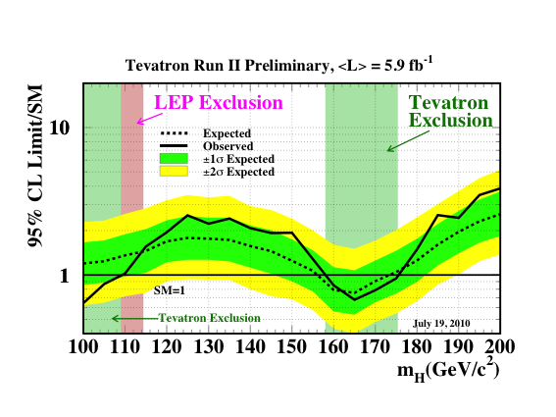
The Higgs boson is the last elusive elementary particle of the SM
Direct Higgs searches at LEP and Tevatron have been unfruitful so far…
CDF & D0:
arXiv: 1007.4587

Slide 9
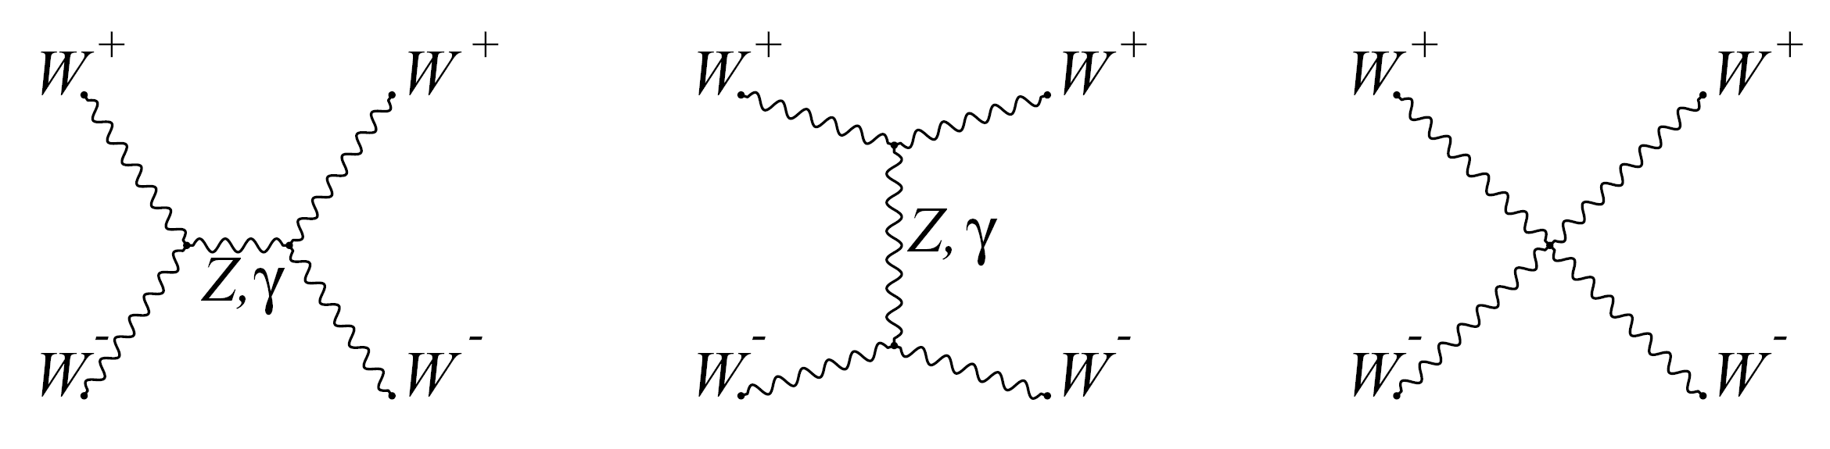
The Higgs boson should not be too light, and not too heavy…
Unitarity: if only Z and γ are exchanged, the amplitude of (longitudinal) W⁺W– scattering diverges with s
Higgs regularises total amplitude, if M_{H} not too large !
H
H
Perturbativity: Higgs self-coupling λ is UV divergent (“Landau pole”) → non-perturbative regime
Landau pole decreases with increasing cut-off scale Λ to which the SM is considered to be valid
Since M_{H} = υ √2λ → upper limit on M_{H} from limit on λ(Λ)
Stability: for a too light Higgs, top quark contributions can decrease λ and make it too small or negative
Critical M_{H} increases with SM cut-off scale Λ
Stability requirement sets lower limit on M_{H}

Slide 10
Vacuum Stability
  Requiring that the SM cannot develop a minimum deeper than the electroweak vacuum up to the Planck scale (i.e., λ(μ ) > 0, for all μ < Λ) gives the stability bound :
Theoretical error from missing higher order corrections in the RGE
  Requiring that the local EW vacuum survives for a time longer than the age of the universe, before quantum tunneling into the deeper vacuum, gives zero-T metastability bound :
The “unstable” region is not necessarily incompatible with our existence, as long as the electroweak vacuum survives for a time longer than the age of the universe, before quantum tunneling.
Metastability (at zero, or finite temperature)
  Requiring the local SM minimum to be stable against thermal fluctuations up to temperatures as large as the Planck scale translates into finite-T metastability bound :
Calculations based on NLO Higgs potential: J. Ellis et al., arXiv:0906.0954

Slide 11
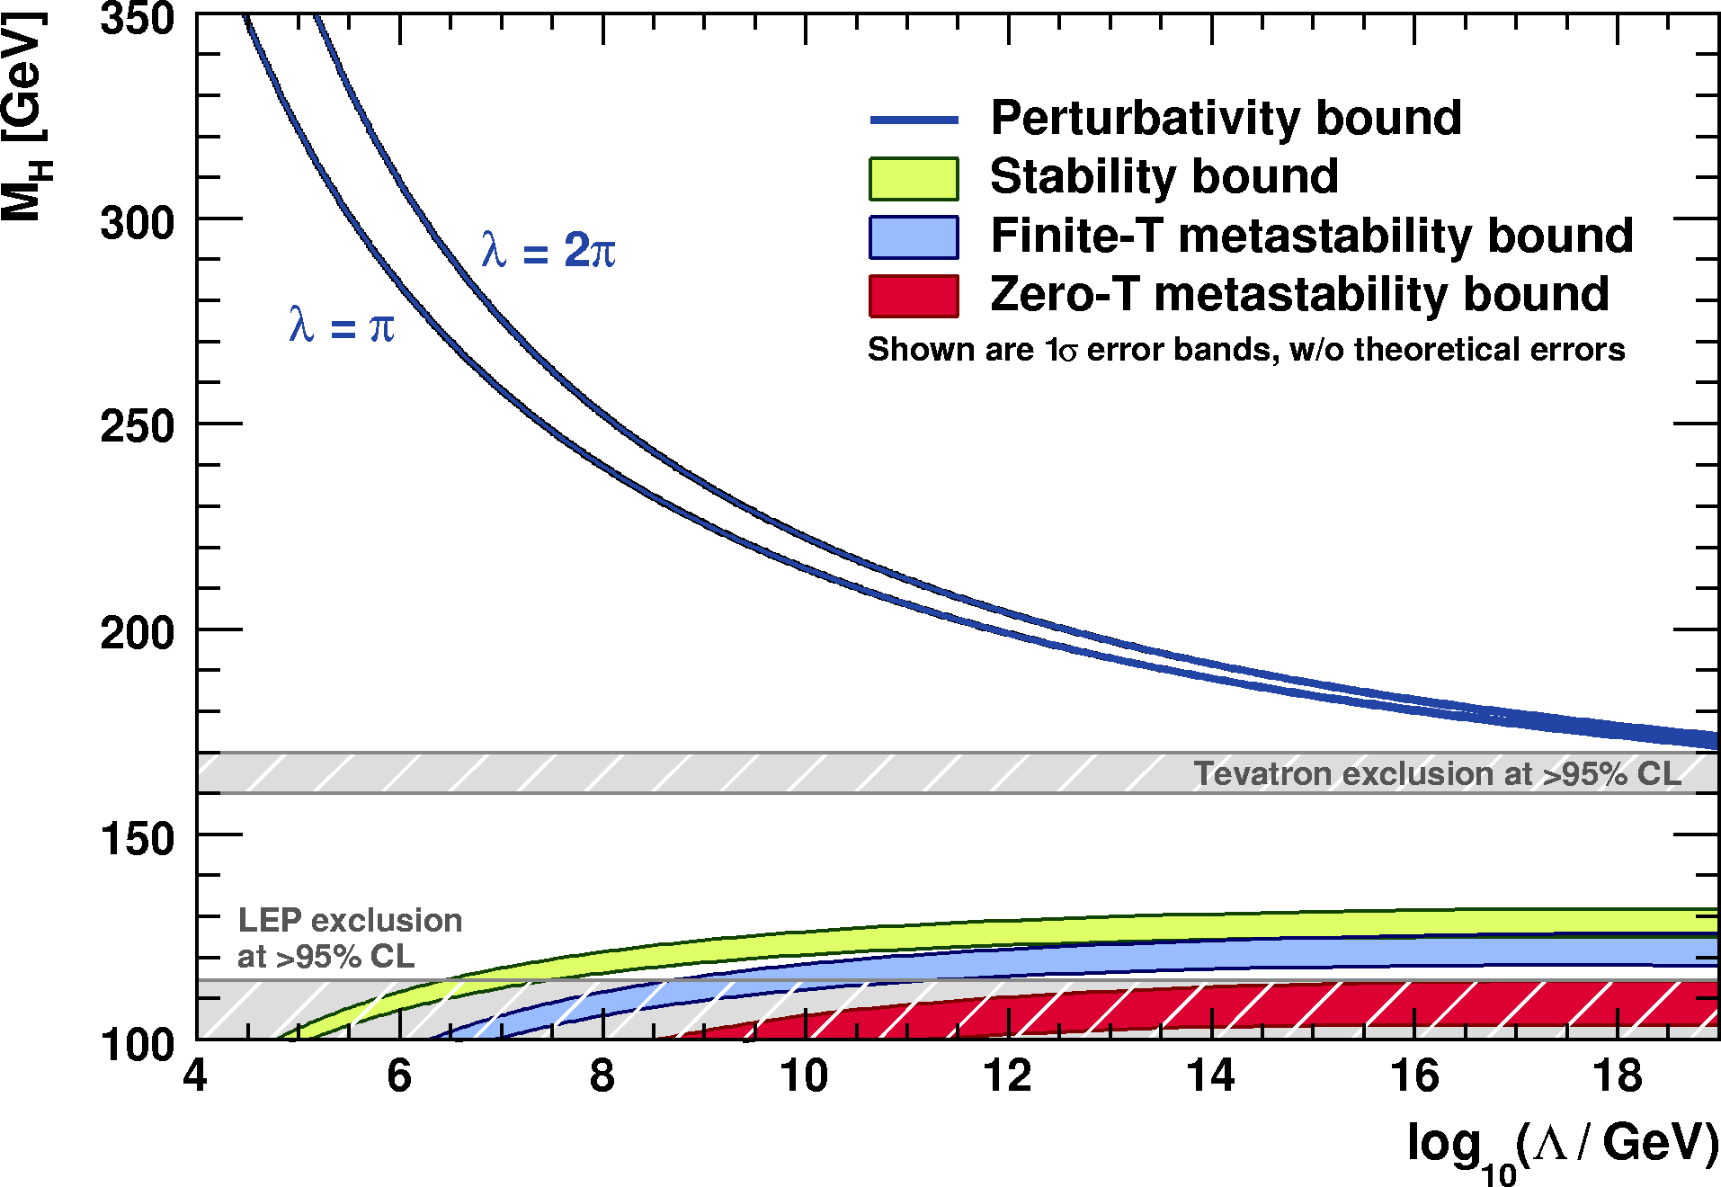
Driving the SM to the Planck Scale
  Perturbativity and (meta)stability bounds versus the SM cut-off scale Λ
Allowed
Not allowed
  Figures use NLO Higgs potential. The widths of bands account for errors in α_{S}, m_{t} and theory.
The SM Higgs must steer a narrow course between two disastrous situations if it is to survive up to the Planck scale M_{P} ~ 2×10¹⁸ GeV

Slide 12
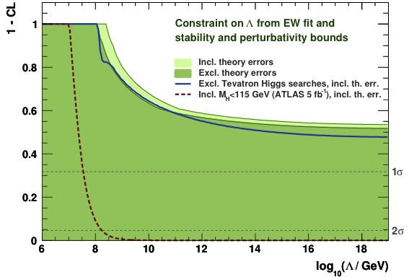
Driving the SM to the Planck Scale
  Limits on cut-off scale Λ when requiring absolute vacuum stability
  Figures use NLO Higgs potential. Theoretical errors from α_{S}, m_{t} uncertainties included.
If an SM Higgs of 115 GeV is found, there must be new physics at around 10⁹ GeV or the electroweak vacuum would be metastable

Slide 13
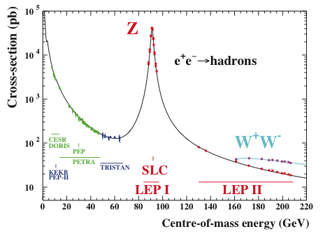
Constraints from EW Precision Data
Electroweak precision observables measured at the Z ⁰ resonance (LEP, SLC) and at the Tevatron can be used to constrain the Higgs boson mass
Z / γ

Slide 14
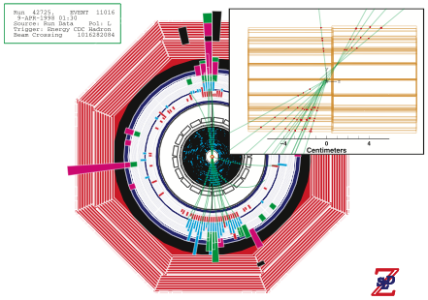
Taiki
A Z → bb event with displaced vertices seen in SLD

Slide 15

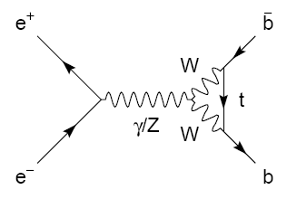
Electroweak Physics at the Z Pole
Radiative corrections – modifying propagators and vertices
Significance of radiative corrections can be illustrated by verifying tree level relation:
Using the measurements:
one predicts:
which is 18 σ away from the experimental value obtained by combining all asymmetry measurements:

Slide 16
Electroweak Physics at the Z Pole
Radiative corrections – modifying propagators and vertices
Parametrisation of radiative corrections: “electroweak form-factors”: ρ, κ, Δr
Modified (“effective”) couplings at the Z pole:
Modified W mass:
  ρ : overall scale
  κ : on-shell mixing angle
Δr func-tion of Δρ

Slide 17
Electroweak Physics at the Z Pole
Radiative corrections – modifying propagators and vertices
Leading order terms (M_{W} ≪ M_{H})
ρ_{Z} and κ_{Z} can be split into sum of universal contributions from propagator self-energies:
and flavour-specific vertex corrections, which are very small, except for top quarks, owing to large mass and |V_{tb}| CKM element

Slide 18
Electroweak Physics at the Z Pole
Radiative corrections – modifying propagators and vertices
Leading order terms (M_{H} ≪ M_{W})
ρ_{Z} and κ_{Z} can be split into sum of universal contributions from propagator self-energies:
Radiative corrections allow us to test the SM
and to constrain unknown SM parameters
and flavour-specific vertex corrections, which are very small, except for top quarks, due to large |V_{tb}| CKM element

Slide 19
Observables in the Global Fit
Experimental results:
  Z-pole observables: LEP/SLD results (corrected for ISR/FSR QED effects)
  [ADLO & SLD, Phys. Rept. 427, 257 (2006)]
  Total and partial cross sections around Z: M_{Z}, Γ_{Z}, σ⁰_{had}, R_{l}⁰, R_{c}⁰, R_{b}⁰
  Sensitive to the total coupling strength of the Z to fermions
  Asymmetries on the Z pole: A_{FB}^{0,l}, A_{FB}^{0,b}, A_{FB}^{0,c}, A_{l}, A_{c}, A_{b}, sin²θ^{l}_{eff} (Q_{FB})
  Sensitive to the ratio of the Z vector to axial-vector couplings (i.e. sin²θ_{eff}) → parity violation
  M_{W} and Γ_{W} : LEP + Tevatron average
  [ADLO, hep-ex/0612034] [CDF, Phys. Lett. 100, 071801 (2008)]
  [CDF & D0, Phys. Rev. D 70, 092008 (2004)] [CDF & D0, arXiv:0908.1374v1]
  m_{t}: latest Tevatron average [CDF & D0, new combination for ICHEP 2010, arXiv:1007.3178]
  m_{c}, m_{b}: world averages [PDG, Phys. Lett. B667, 1 (2008) and 2009 partial update for the 2010 edition]
  Δα_{had}(M_{Z}): [DHMZ arXiv:1010.4180 (2010)] + rescaling mechanism to account for α_{s} dependency
  Direct Higgs searches at LEP and Tevatron (ICHEP 2010 average)
  [ADLO: Phys. Lett. B565, 61 (2003)] [CDF & D0: arXiv:1007.4587 (2010)]
_
_

Slide 20
The Global Electroweak Fit
Theory predictions – state-of-the art calculations, in particular:
  M_{W} and sin²θ^{f}_{eff} : full two-loop + leading beyond-two-loop form factor corrections
  [M. Awramik et al., Phys. Rev D69, 053006 (2004) and ref.] [M. Awramik et al., JHEP 11, 048 (2006) and refs.]
  Radiator functions: 3NLO prediction of the massless QCD cross section
  [P.A. Baikov et al., Phys. Rev. Lett. 101 (2008) 012022]
  Theoretical uncertainties: M_{W} (δ_{theo}(M_{H}) = 4–6 MeV), sin²θ ^{l}_{eff} (δ_{theo} = 4.7·10^{–5})
Fit parameters
  In principle, all parameters used in theory predictions are varying freely in fit
  Masses of leptons and light quarks fixed to world-averages from PDG
  Free are running charm, bottom and top masses → m_{t} strongest impact on fit !
List of freely varying parameters in the SM fit:
Δα_{had}⁽⁵⁾(M_{Z}), α_{S}(M_{Z}), M_{Z}, M_{H}, m_{c}, m_{b}, m_{t}

Slide 21
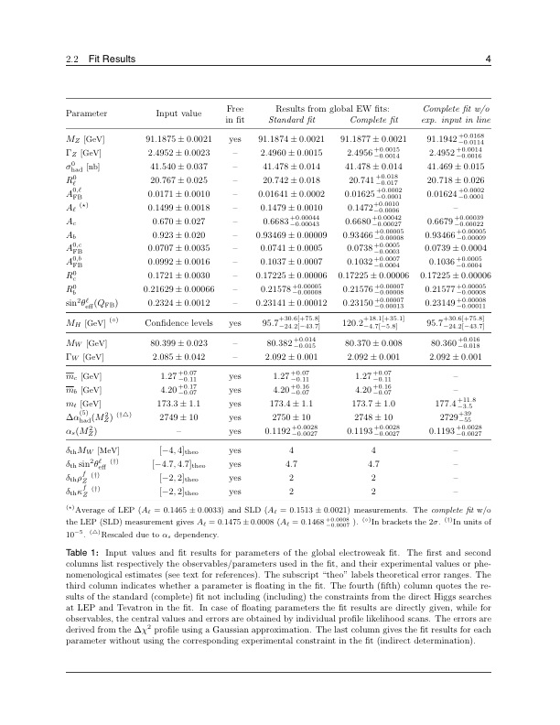
Experimental Input and Fit Results

Slide 22
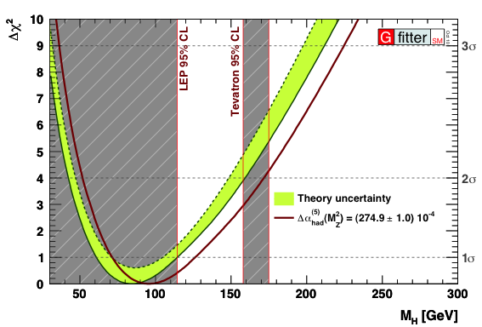
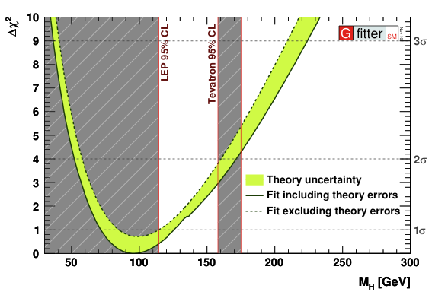
Higgs Mass Constraints
M_{H} from Standard fit:
Central value ±1σ:
95% CL upper limit: 170 GeV
M_{H} from old Standard fit:
Central value ±1σ:
95% CL upper limit: 164 GeV
Green band due to Rfit treatment of theory errors, fixed errors lead to larger χ²_{min}
Illustrate effect from new Δα_{had} precision determination (reduced EM coupling !)
Standard fit
Standard fit

Slide 23

Oblique Corrections
At low energies, BSM physics appears dominantly through vacuum polarisation
Aka, oblique corrections
Direct corrections (vertex, box, brems-strahlung) generally suppressed by m_{f} / Λ
Oblique corrections reabsorbed into electroweak parameters Δρ, Δκ, Δr
Electroweak fit sensitive to BSM physics through oblique corrections
In direct competition with Higgs loop corrections
Oblique corrections from New Physics
described through STU parameters
[Peskin-Takeuchi, Phys. Rev. D46, 381 (1992)]
  O_{meas} = O_{SM,ref}(M_{H},m_{t}) + c_{S}S + c_{T}T + c_{U}U
    S : (S+U) New Physics contributions
    to neutral (charged) currents
    T : Difference between neutral and
    charged current processes –
    sensitive to weak isospin violation
    U : Constrained by M_{W} and Γ_{W}. Usually very small in NP models (often: U=0)
H
Z
Z

Slide 24
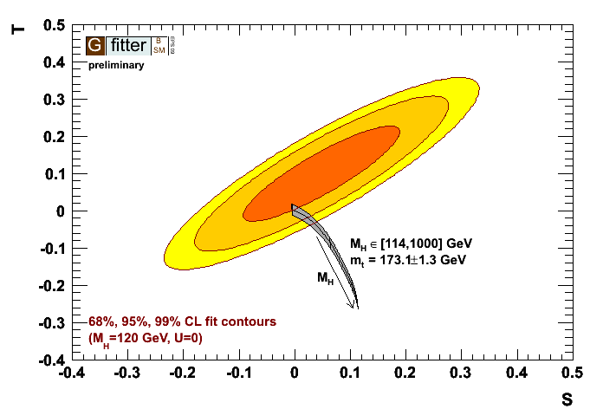
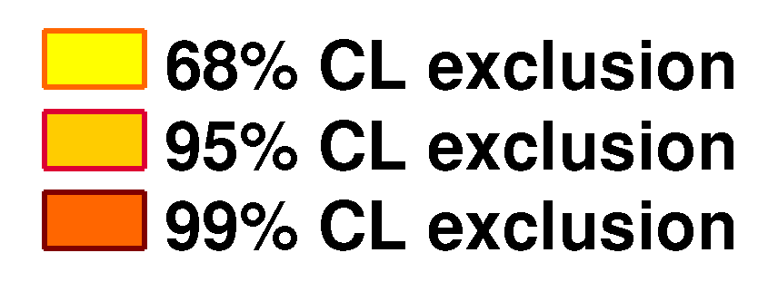
The Oblique Parameters in the Standard Model
STU references in SM obtained from fit to EW observables
SM_{ref} chosen at:
M_{H} = 120 GeV and m_{t} = 173.1 GeV
This defines (S,T,U) = (0,0,0)
Results from S, T, U fit to all the EW observables:
S = 0.02 ± 0.11
T = 0.05 ± 0.12
U = 0.07 ± 0.12
 | S | T | U
S | 1 | 0.88 | –0.47
T |  | 1 | –0.72
U |  |  | 1
Current experimental constraint
S, T depend logarithmically on M_{H}
Preference for low M_{H} values
Accommodate large M_{H} values by shifting T (S) positive (negative)
SM prediction

Slide 25
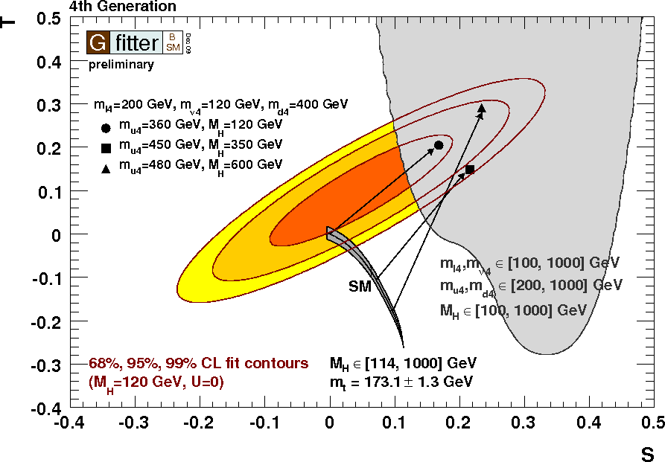
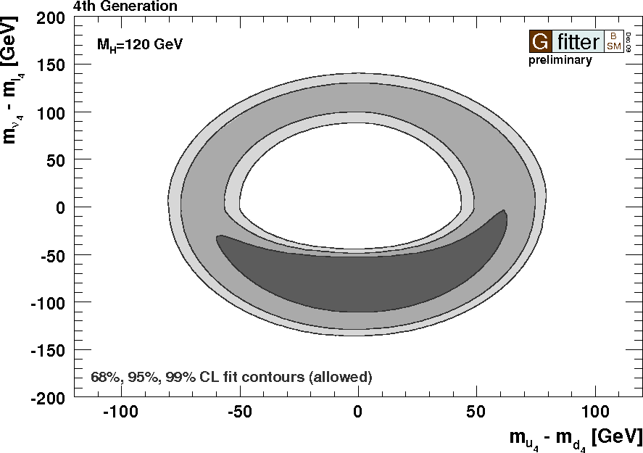
[H. He et al., Phys. Rev. D 64, 053004 (2001)]
Fourth (sequential) Fermion Generation
Introduce new lepton and quark states
Free parameters:
  Assume: no mixing of extra fermions
Shift ΔS ≈ 0.21 from heavy generation
Sensitive to mass difference between up- and down-type fields (not to absolute mass scale)
Results:
With appropriate mass differences: fourth fermion model consistent with EW data
    In particular a large M_{H} is allowed
5+ generations disfavored
M_{H} = 120 GeV

Slide 26
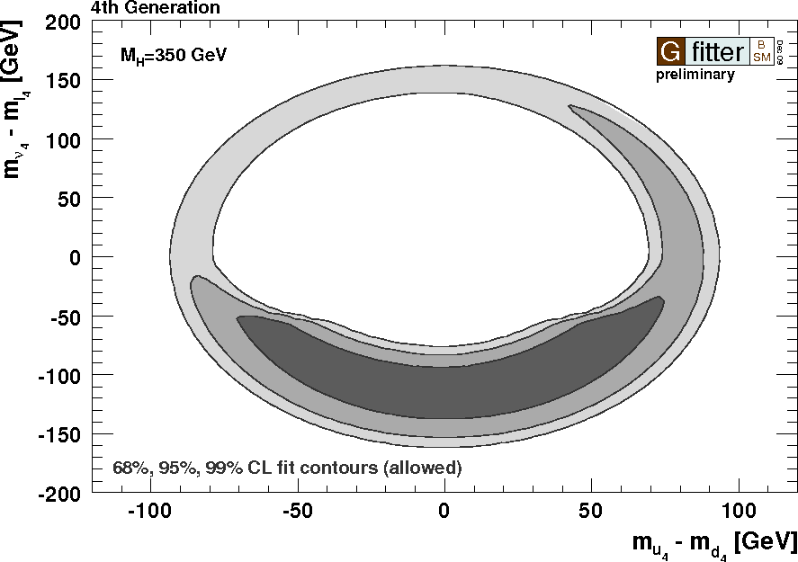
[H. He et al., Phys. Rev. D 64, 053004 (2001)]
Fourth (sequential) Fermion Generation
Introduce new lepton and quark states
Free parameters:
  Assume: no mixing of extra fermions
Shift ΔS ≈ 0.21 from heavy generation
Sensitive to mass difference between up- and down-type fields (not to absolute mass scale)
Results:
With appropriate mass differences: fourth fermion model consistent with EW data
    In particular a large M_{H} is allowed
5+ generations disfavored
M_{H} = 350 GeV

Slide 27
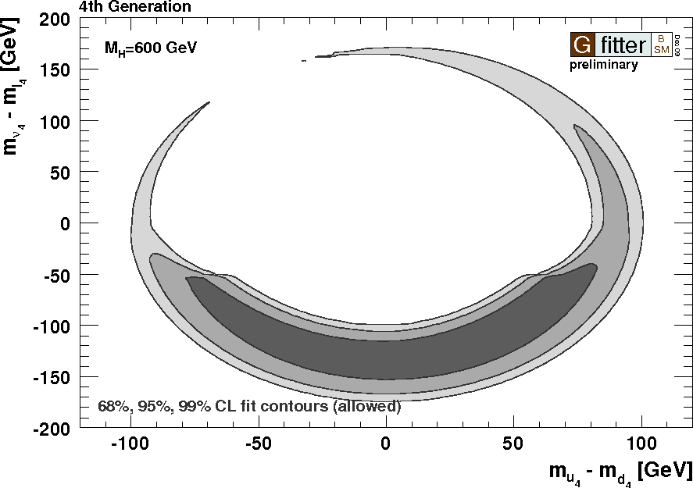
[H. He et al., Phys. Rev. D 64, 053004 (2001)]
Fourth (sequential) Fermion Generation
Introduce new lepton and quark states
Free parameters:
  Assume: no mixing of extra fermions
Shift ΔS ≈ 0.21 from heavy generation
Sensitive to mass difference between up- and down-type fields (not to absolute mass scale)
Results:
With appropriate mass differences: fourth fermion model consistent with EW data
    In particular a large M_{H} is allowed
5+ generations disfavored
M_{H} = 600 GeV

Slide 28
[H. He et al., Phys. Rev. D 64, 053004 (2001)]
Fourth (sequential) Fermion Generation
Introduce new lepton and quark states
Free parameters:
  Assume: no mixing of extra fermions
Shift ΔS ≈ 0.21 from heavy generation
Sensitive to mass difference between up- and down-type fields (not to absolute mass scale)
Results:
With appropriate mass differences: fourth fermion model consistent with EW data
    In particular a large M_{H} is allowed
5+ generations disfavored
In the Standard Model the Higgs must be light (< 155 GeV at 95% CL).
BUT: Beyond the Standard Model the Higgs can be heavy !
→ MUST NOT stop searching for heavy Higgs boson !
[ Weak isospin violating new physics contributions may cancel
heavy Higgs effects on electroweak precision data ! ]
M_{H} = 600 GeV

Slide 29

Once the Higgs boson is discovered
The Standard Model is complete
But … does it hold tight ?

Slide 30
It does !
Excited fundamental bosons or quarks have been excluded up to the TeV scale
Electroweak unification has been verified at, below and above the Z-boson scale
Universality of weak interaction has been verified at the per-mil level
Asymptotic freedom of strong interaction has been verified at the percent level
All observations of CP violation are described by a single complex parameter in the quark mixing matrix (all ?)
The tininess of elementary electric dipole moments has been verified to 10⁻²⁷ ecm
The electron and muon magnetic moments have been verified at the ppm level...
Examples only, there are many more successful tests …

Slide 31
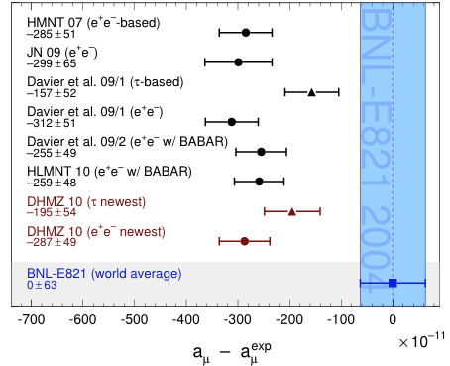
Muon magnetic moment: comparison between measurement (blue band) and predictions (dots)
The magnetic moment of the muon is predicted to a precision of several 10⁻⁶, …
… but some tension exists …
DMHZ, arXiv:1010.4180

Slide 32
Let’s find that Higgs boson !

Slide 33
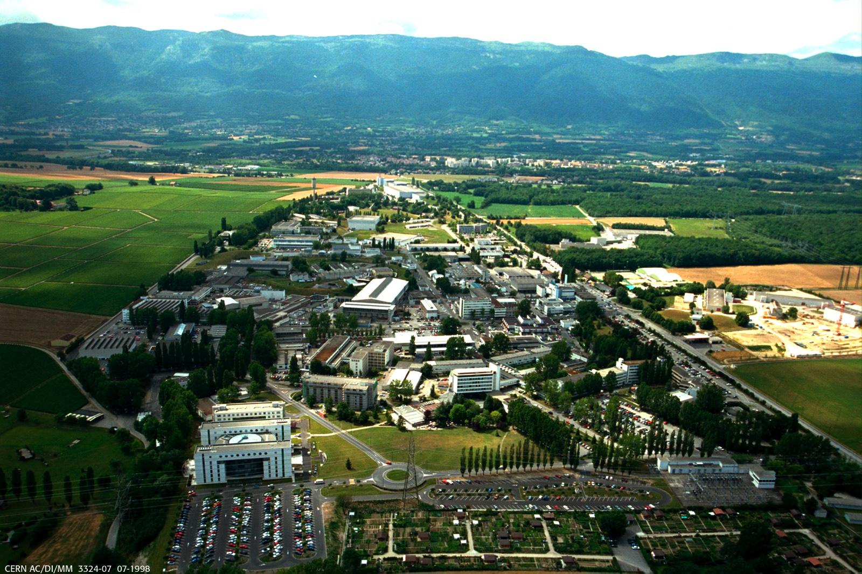
C E R N , t h e L H C a n d A T L A S
E x p e r i m e n t a l C h a l l e n g e s

Slide 34
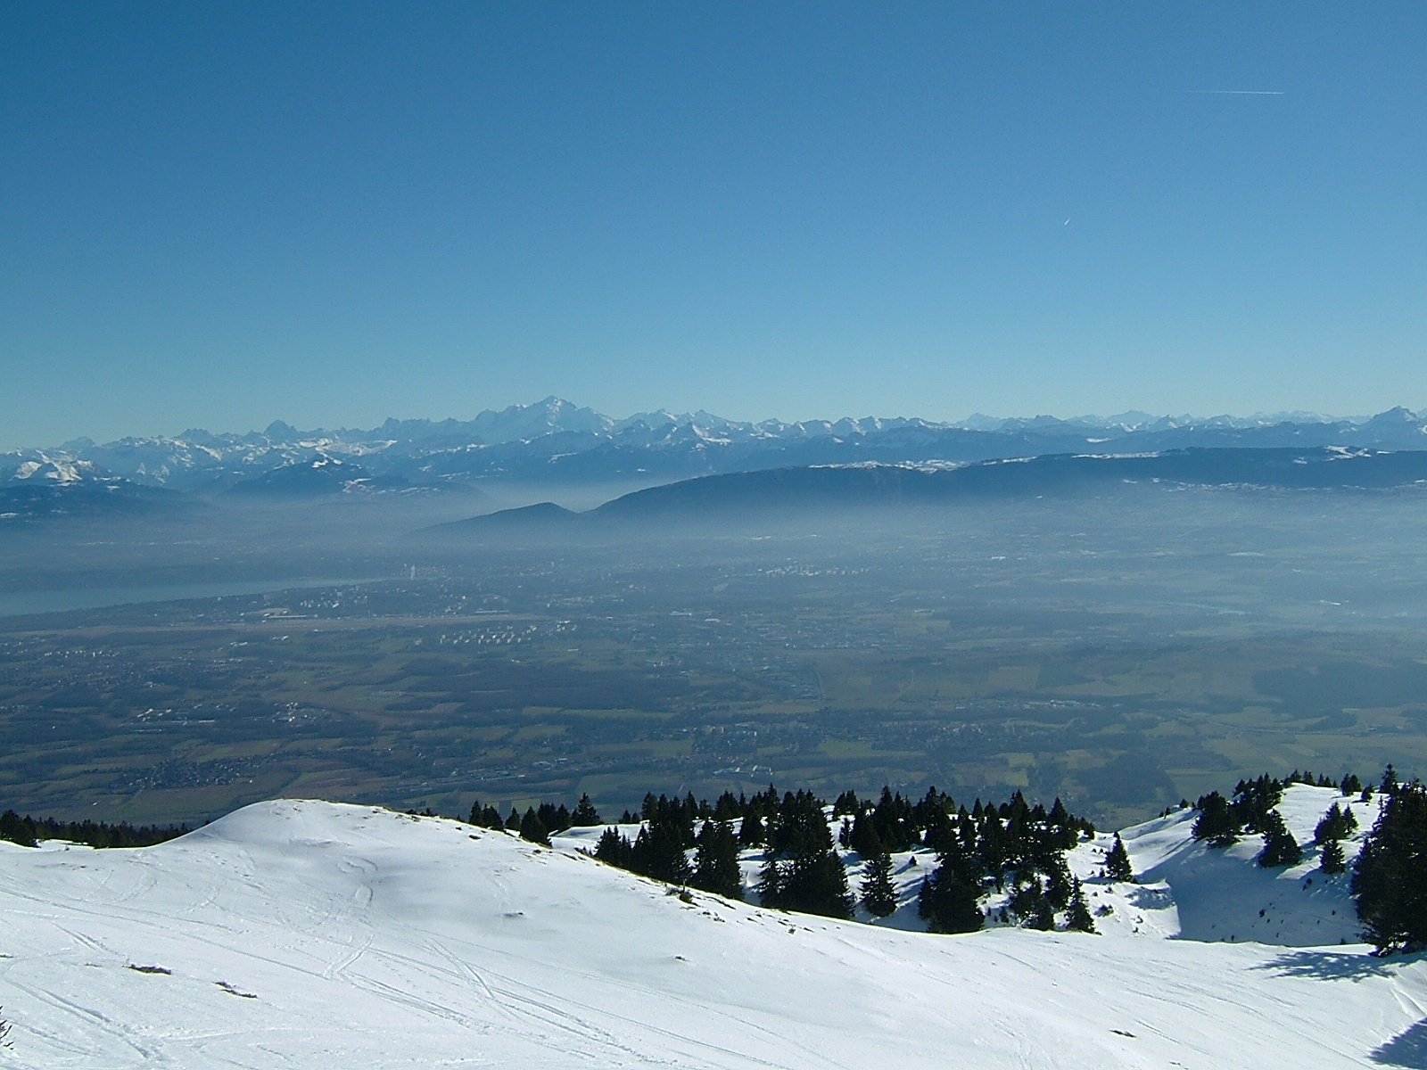

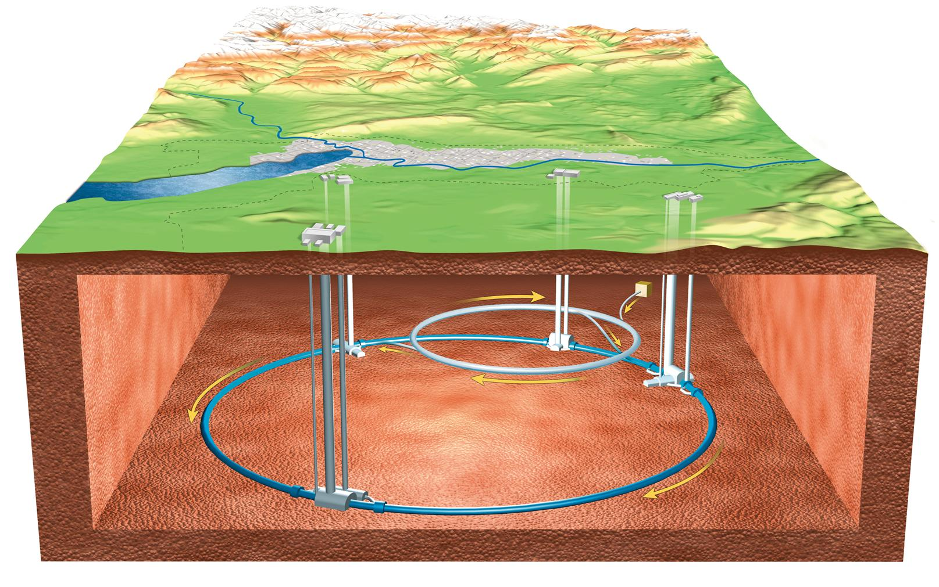

Accelerators for the LHC
7 TeV
LHC
LHC has 4 large experiments: ATLAS, CMS, LHCb, ALICE
450 GeV
SPS
26 GeV
PS
1.4 GeV
BOO-
STER
LHC
PS
50 MeV
LHCb
ATLAS
LIN-
AC2
SPS
ALICE
max: 150 m
PROTONS
CMS
20 minutes are required to accelerate a proton in the LHC from 450 GeV to 7 TeV

Slide 35
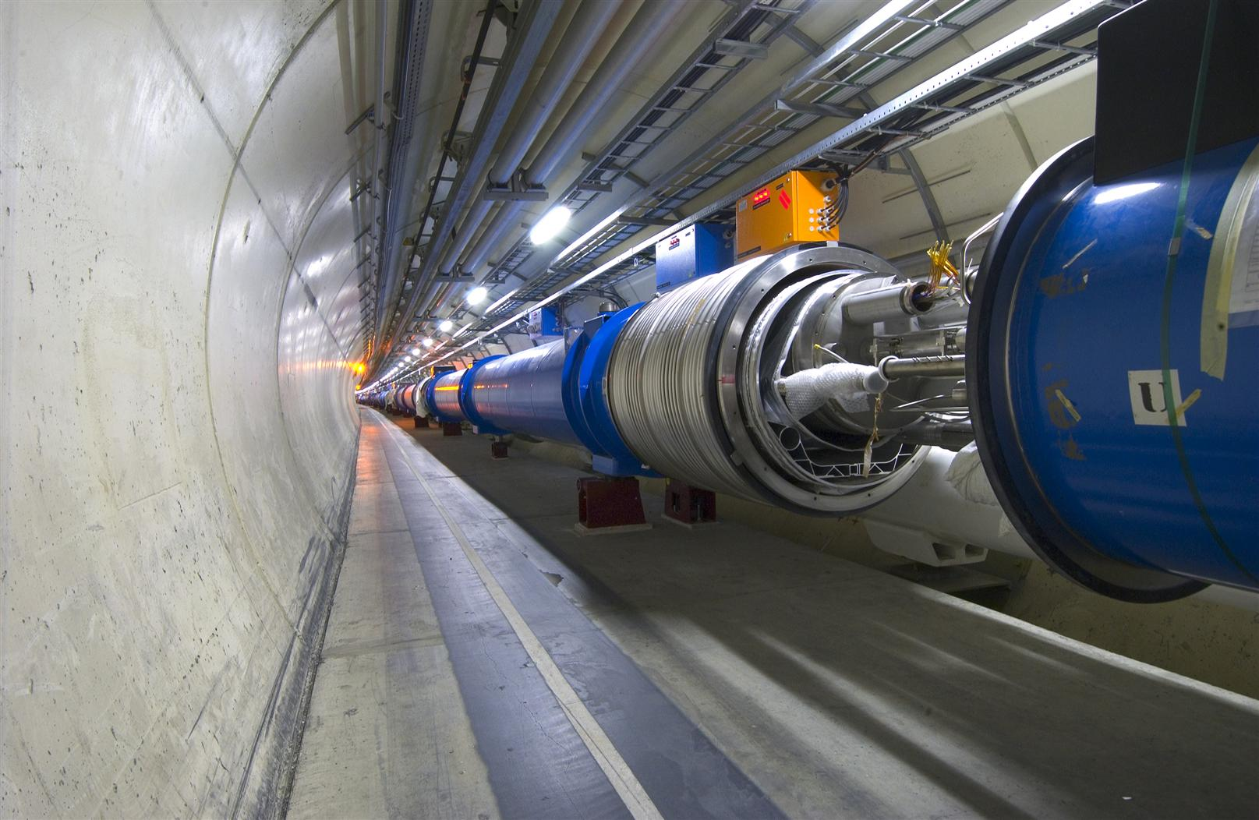
The LHC Dipole Sections
1232 superconducting dipoles
14.3 m length, 1.9 K cold
8.3 Tesla → E = 7 TeV
11850 A total current
392 focusing quadrupoles
3700 multipole corrector magnets

Slide 36
The LHC Dipole Sections
As a consequence of an accident on September 2008, the dipole currents cannot presently be raised to full power. The LHC is thus constrained to run at 7 TeV CM energy in 2010 and 2011, possibly being raised to 8 TeV in 2012. After a repair in 2013 14 TeV CM energy will be targeted in 2014.

Slide 37
The High–p_{T} LHC Detectors
ATLAS and CMS are “general purpose detectors”, capable of adequately covering the entire physics programme reachable with high-luminosity 14 TeV pp collisions
  From charm and beauty physics at lowest transverse momenta (~3 GeV) …
  … to new physics searches up to the highest reachable scales (several TeV)

Slide 38
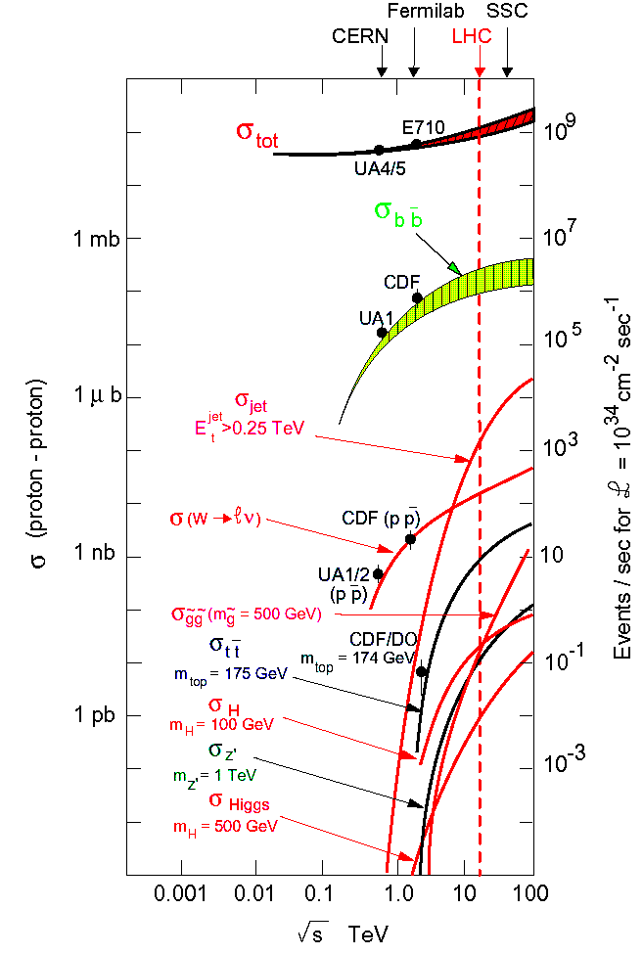
pp(bar) Cross Sections
Process | Cross section (nb) at 14 TeV CM energy | Production rates (Hz) at L=10³⁴ cm⁻²s⁻²
Inelastic | 10⁸ | 10⁹
 | 5×10⁵ | 5×10⁶
 | 15 | 150
 | 2 | 20
 | 1 | 10
 | 0.05 | 0.5
 | 0.05 | 0.5
 | 0.04 | 0.4
 | 0.02 | 0.2

Slide 39
pp(bar) Cross Sections
Process | Cross section (nb) at 14 TeV CM energy | Production rates (Hz) at L=10³⁴ cm⁻²s⁻²
Inelastic | 10⁸ | 10⁹
 | 5×10⁵ | 5×10⁶
 | 15 | 150
 | 2 | 20
 | 1 | 10
 | 0.05 | 0.5
 | 0.05 | 0.5
 | 0.04 | 0.4
 | 0.02 | 0.2
Many orders of magnitude between QCD background and primary physics channels (only one in five billion events is Higgs – Tevatron: only every trillionth event!)
→ This fact drives the detector design

Slide 40
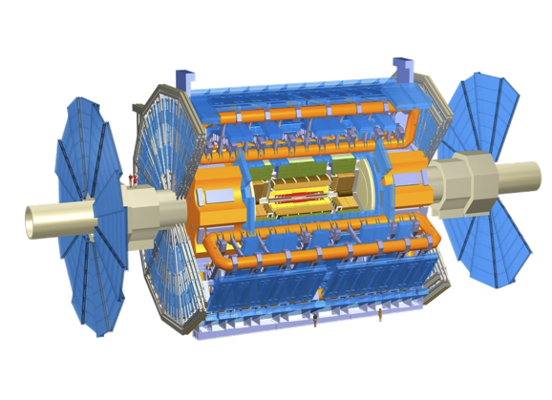
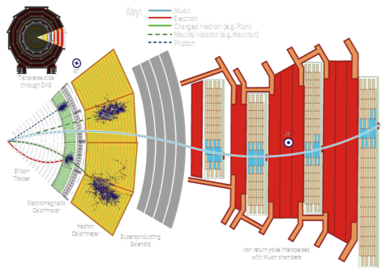


ATLAS & CMS: Design Choices
ATLAS: emphasis on excellent jet and missing-E_{T} resolution, particle identification, and standalone muon measurement
CMS: emphasis on excellent electron/photon and tracking (muon) resolution
Both: excellent hermeticity and forward acceptance – very few “cracks”

Slide 41
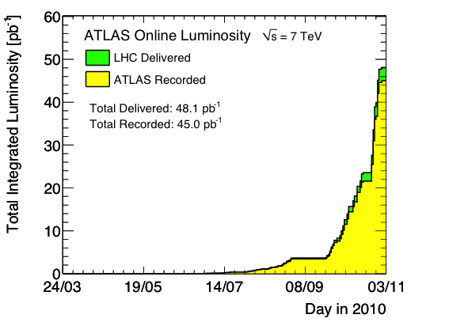
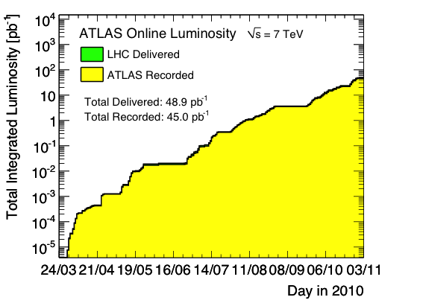
Recorded Luminosity at 7 TeV in 2010
Measured with forward detectors, calibrated with beam separation scans
ATLAS integrated luminosity vs time in linear scale
ATLAS integrated luminosity vs time in log scale
Peak luminosity: 2.1×10³² s^{–1}cm^{–2}
Difference between del. and rec. luminosity from trigger deadtime and detector inefficiency
Logarithmic rise of luminosity in 2010
Expect O(1 fb^{–1}) in 2011
10³² cm^{–2}s^{–1} instantaneous luminosity corresponds to an integrated luminosity of 0.1 nb^{–1} per second
→ 180 pb^{–1} per month (assuming 70% LHC efficiency for physics)

Slide 42
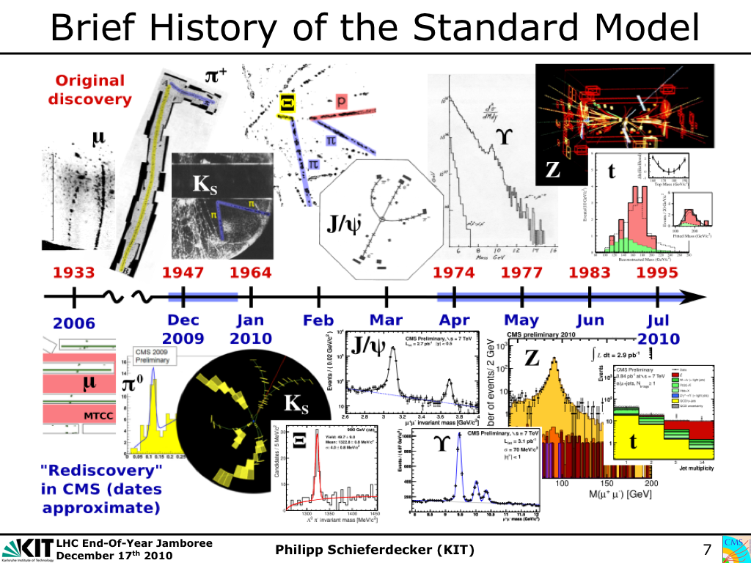
SM particles rediscovered in 2010 (taken from CMS)
© P. Schieferdecker, Dec 17, 2010 at CERN

Slide 43
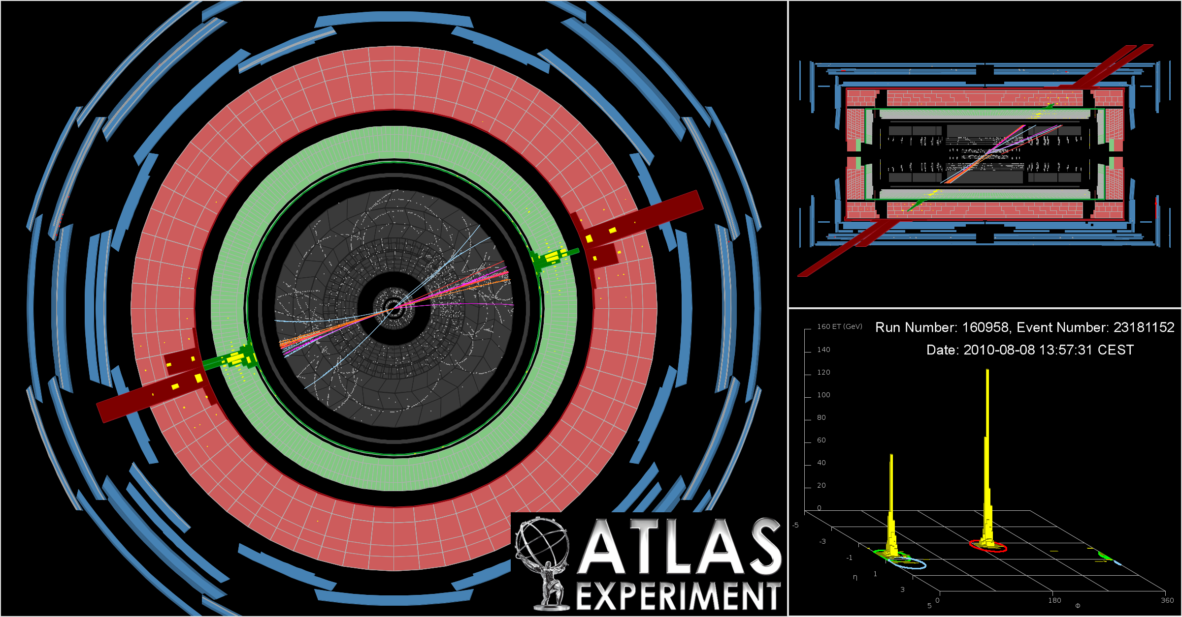
A beautiful dijet event from ATLAS: m(jet-jet) = 1.9 TeV, p_{T} : 0.9 TeV, 0.8 TeV
… by now found event with 3.1 TeV (4.0 TeV) di-jet mass for central (forward) jets
…and a highest-p_{T} di-jet event with 1.5 TeV

Slide 44
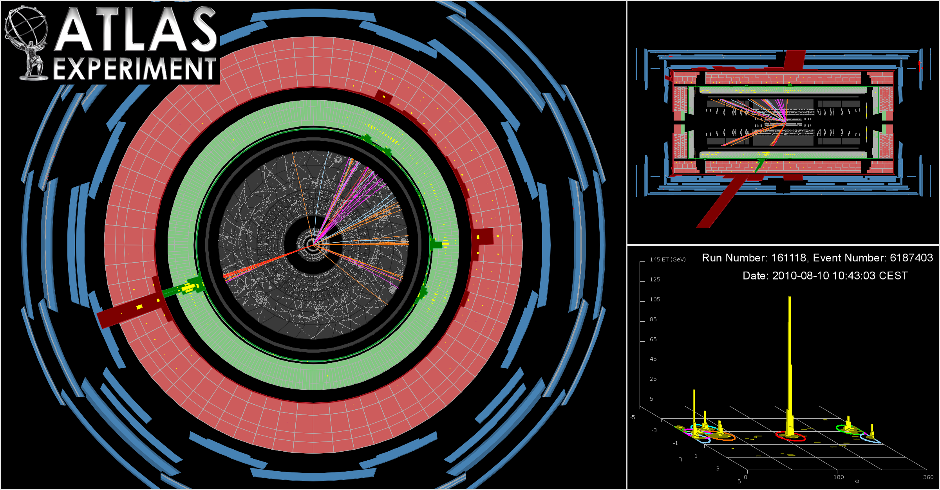
Multijet event seen by ATLAS: 4 jets with p_{T} > 200 GeV, and 6 jets with p_{T} > 100 GeV

Slide 45
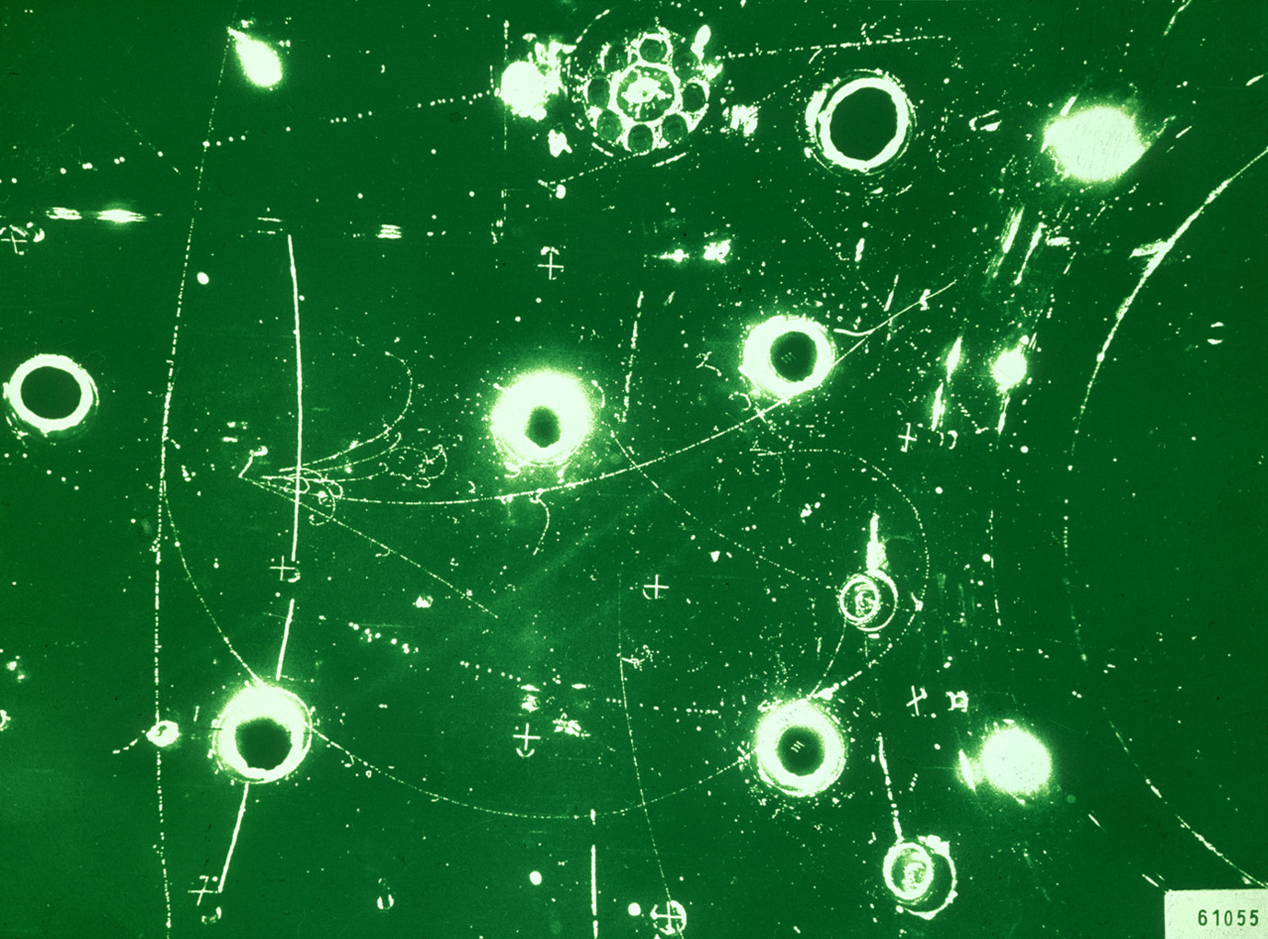
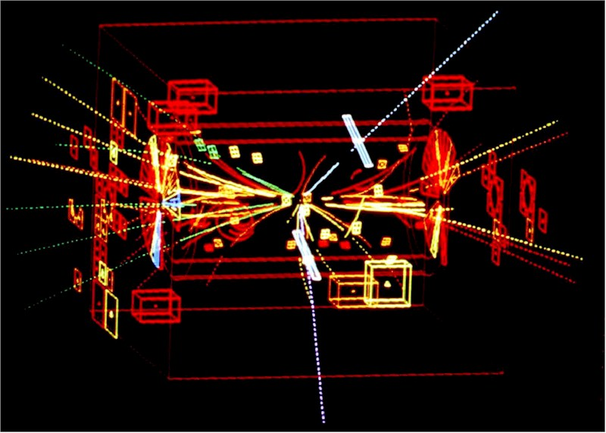
Z boson production on the mass shell, seen in April 1983 by UA1
electron
electron
UA1 @ CERN, 1983

Slide 46
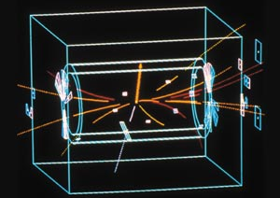
W boson production on the mass shell, seen in Jan. 1983 by UA1
Missing transverse energy
electron
UA1 @ CERN, 1982

Slide 47
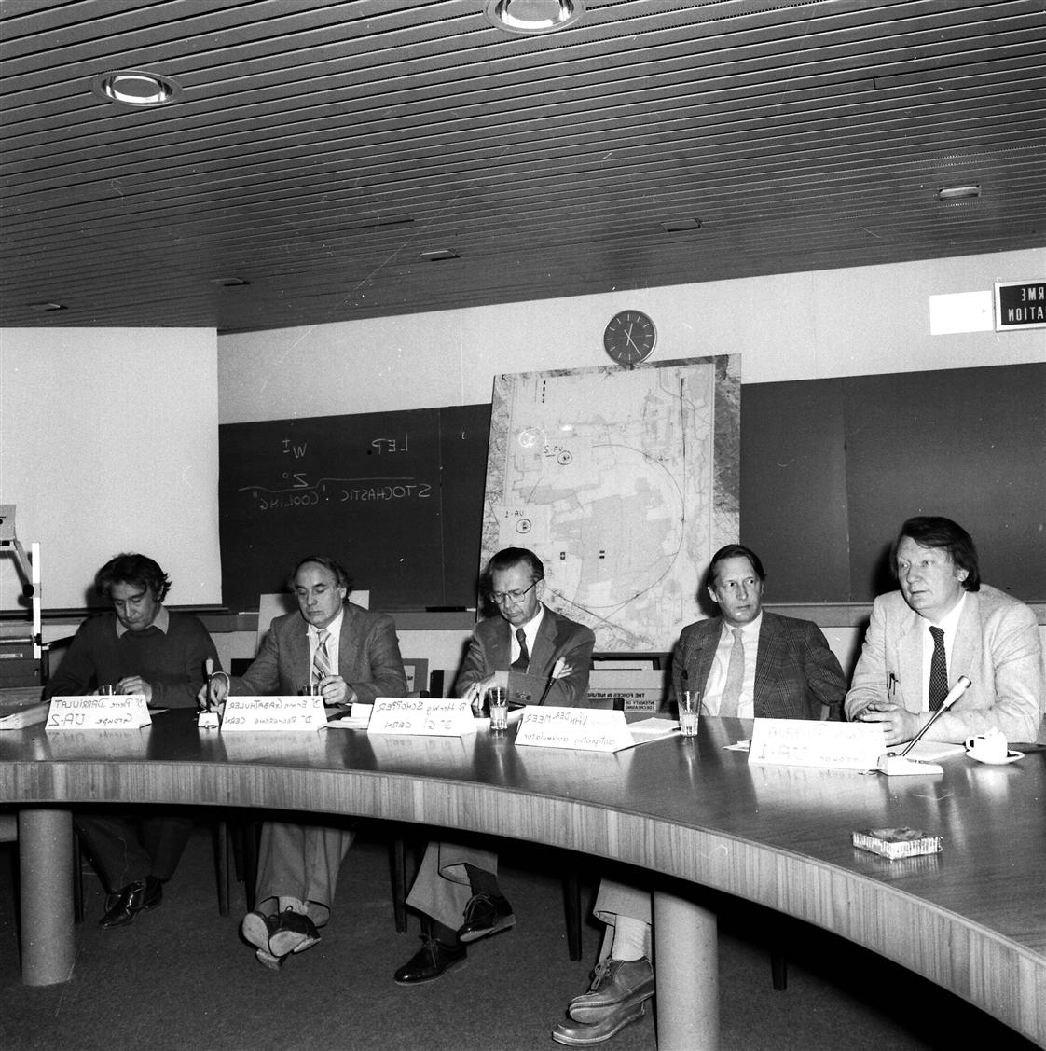
W boson production on the mass shell, seen in Jan. 1983 by UA1
NP 1984
Carlo
Rubbia
E. Gabathuler (RD)
Simon
van der
Meer
H. Schopper (DG)
P. Darriulat (UA2
CERN press conferences
on W discovery, 25 Jan 1983

Slide 48
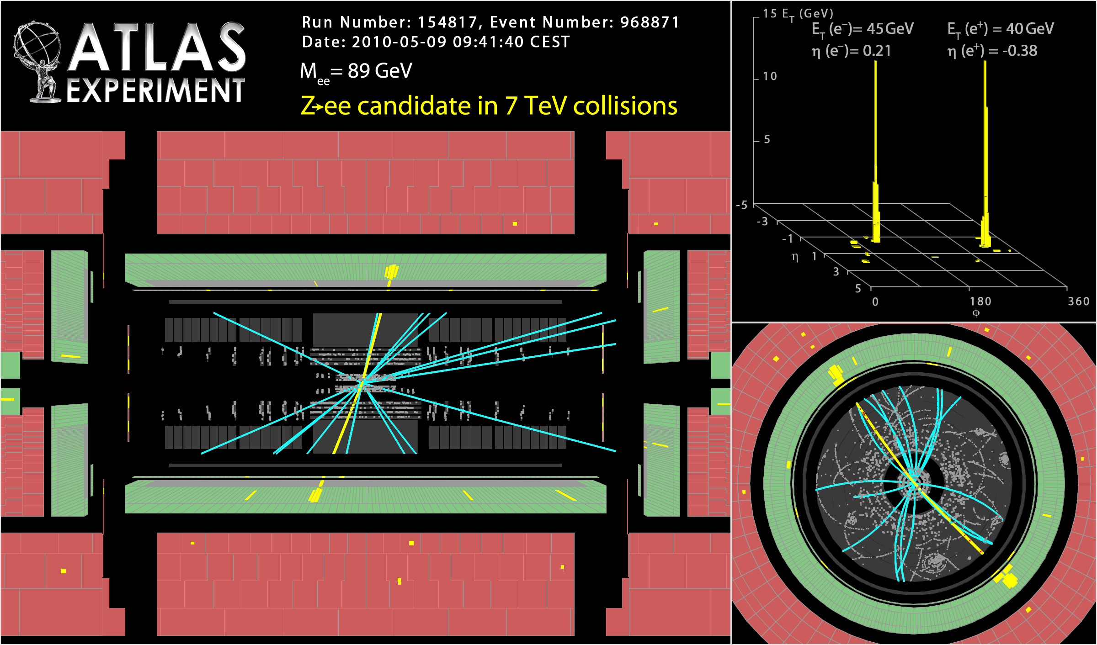

Slide 49
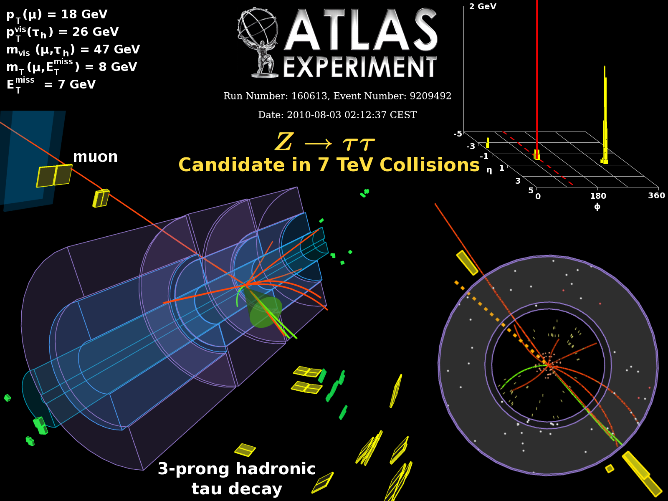

Slide 50
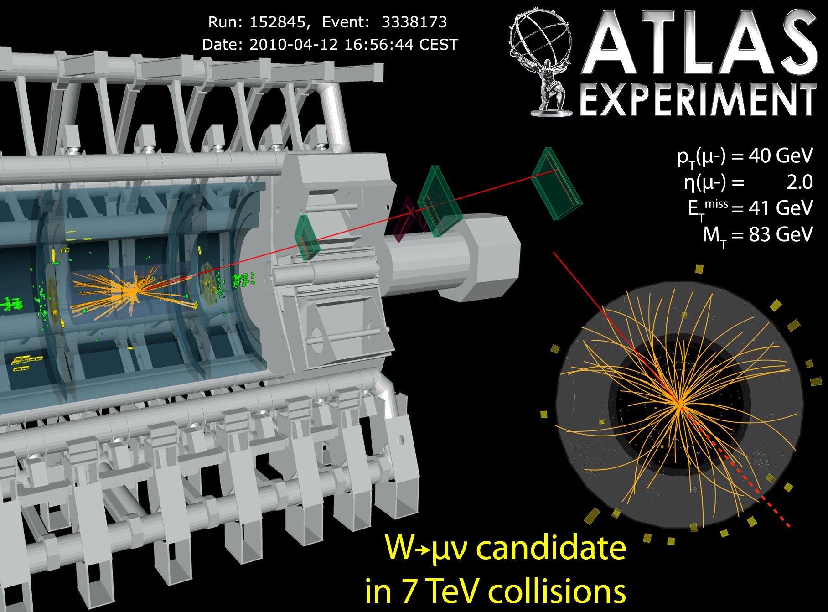

Slide 51
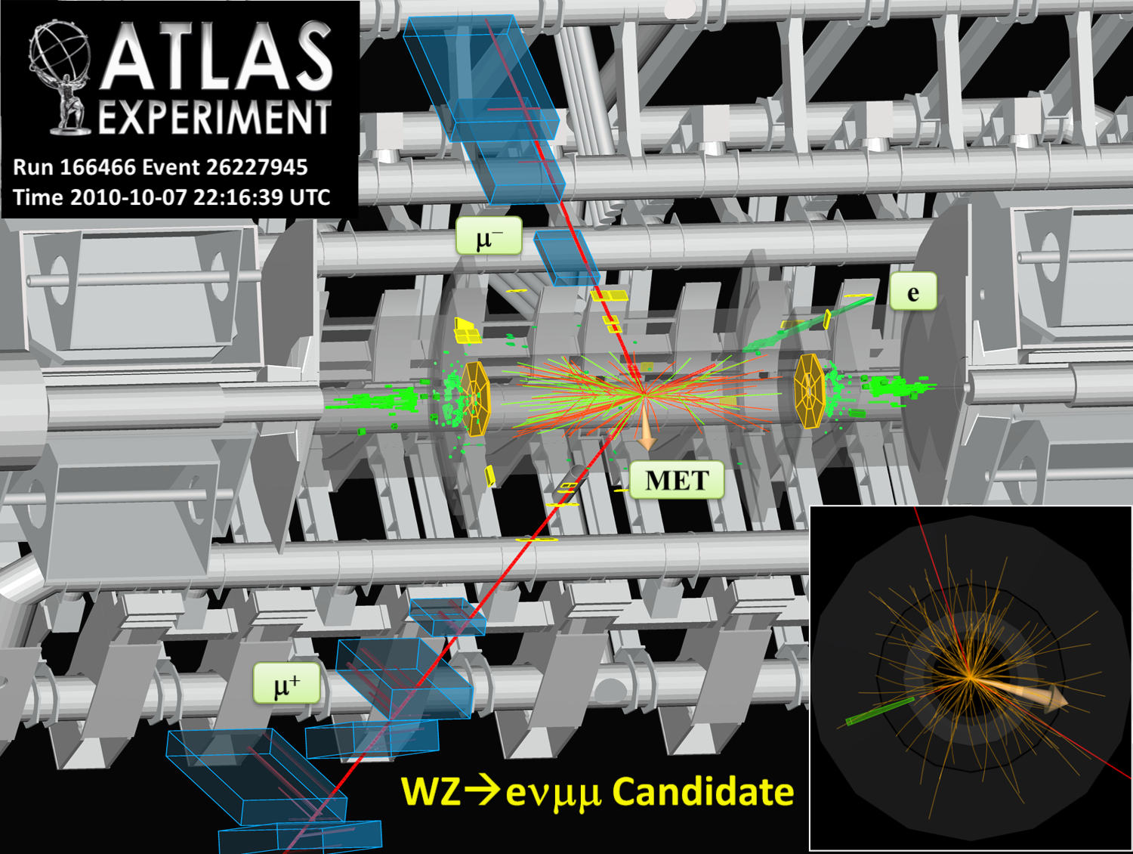

Slide 52
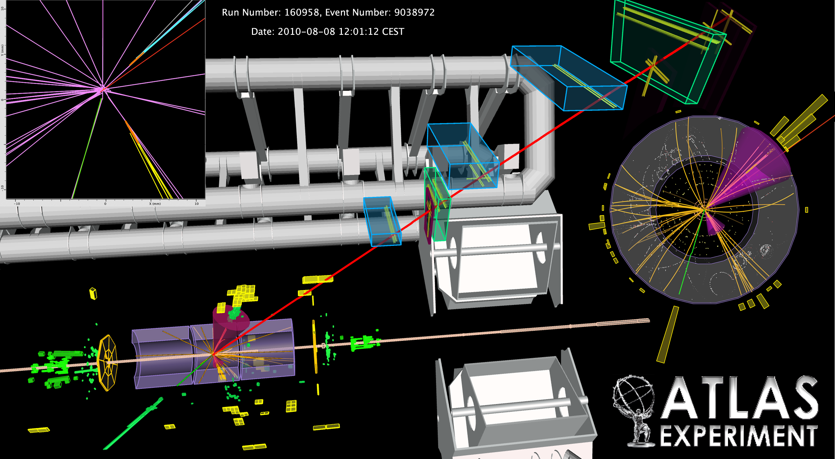
tt → eμ + jets candidate event with 2 b-tagged jets seen by ATLAS

Slide 53
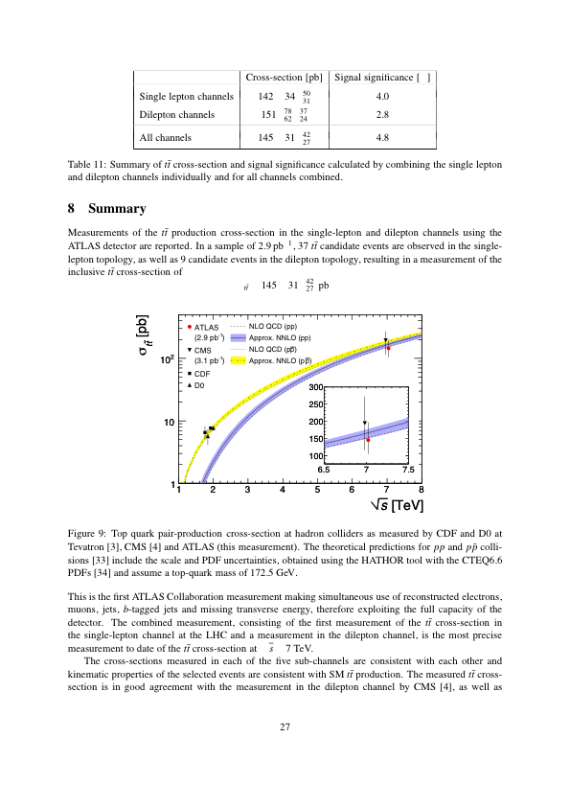
ATLAS and CMS have Unambiguously Seen top Events
Both experiments published cross section results on ~9% of full statistics
Inclusive tt cross section as measured by ATLAS and CMS compared to theory.
Errors (ATLAS):
21% statistical
21% systematic
11% luminosity
Theory error: ~8%
Many more top results forthcoming including cross section with full statistics & mass

Slide 54
Searching for the Higgs Boson

Slide 55
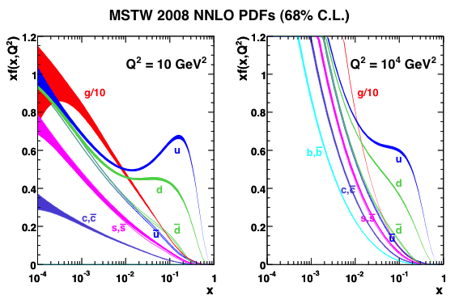
Proton–Proton Collisions
Proton is complicated composite of valence quarks, gluons and sea quarks
PDF depends on 2D mixture of
  Q² (evolution in ln(Q²) predicted by QCD)
  Bjorken x momentum fraction
CM energy of parton collision:
valence quarks
Typical ‘x’ values (assume: x₁ = x₂)
  LHC (√s = 14 TeV):
  M_{X} = 100 GeV (1 TeV) → <x> = 0.007 (0.07)
  Tevatron (√s = 2 TeV):
  M_{X} = 100 GeV (1 TeV) → <x> = 0.05 (0.5)
sea quarks
© MSTW 2008, NNLO
PDFs determined from global fits to (primarily) deep inelastic scattering data
PDFs rise dramatically towards low x
→ larger cross sections at LHC
→ gluon dominated

Slide 56
Higgs Boson Decays
The Higgs decay branching fractions are predicted by the SM …
H
…as a function of the Higgs mass
Because of the coupling to the mass of the decay particles:
… the Higgs will decay with preference to the heaviest particles allowed by phase space.
… the Higgs does not couple directly to photons and gluons, but only via triangular loops involving heavy intermediate states (e.g., top, W )

Slide 57
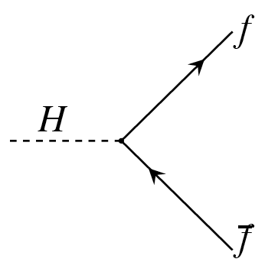
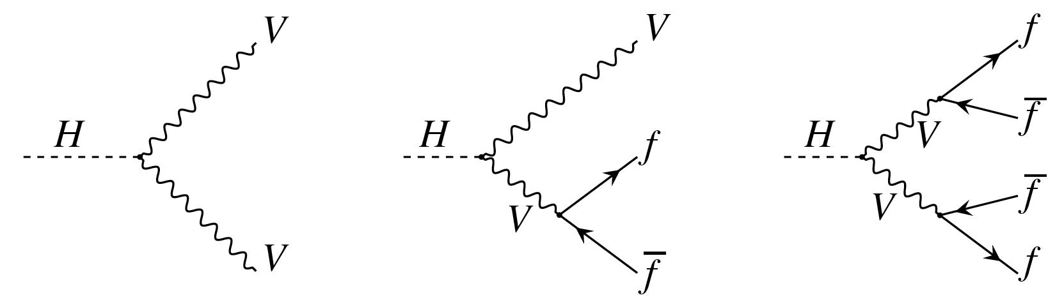
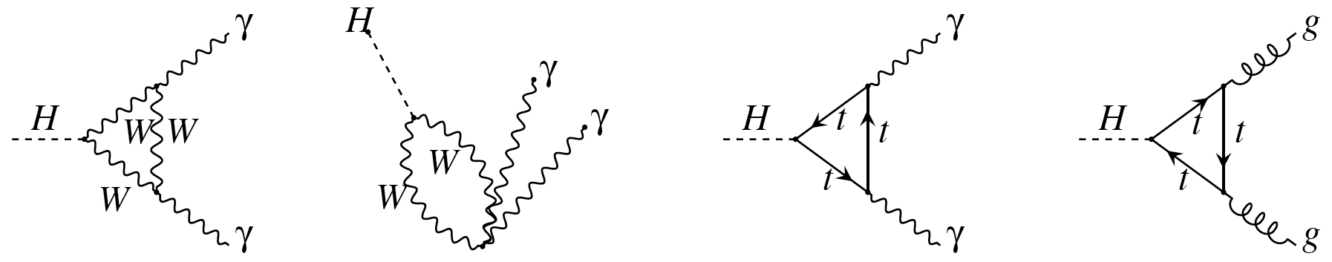
Higgs Boson Decays
Higgs decay width into fermion pair:
Some leading order diagrams shown only
Higgs decay into W or Z pairs (real or virtual)
Higgs decay into photon pair
Dominated by W loop

Slide 58
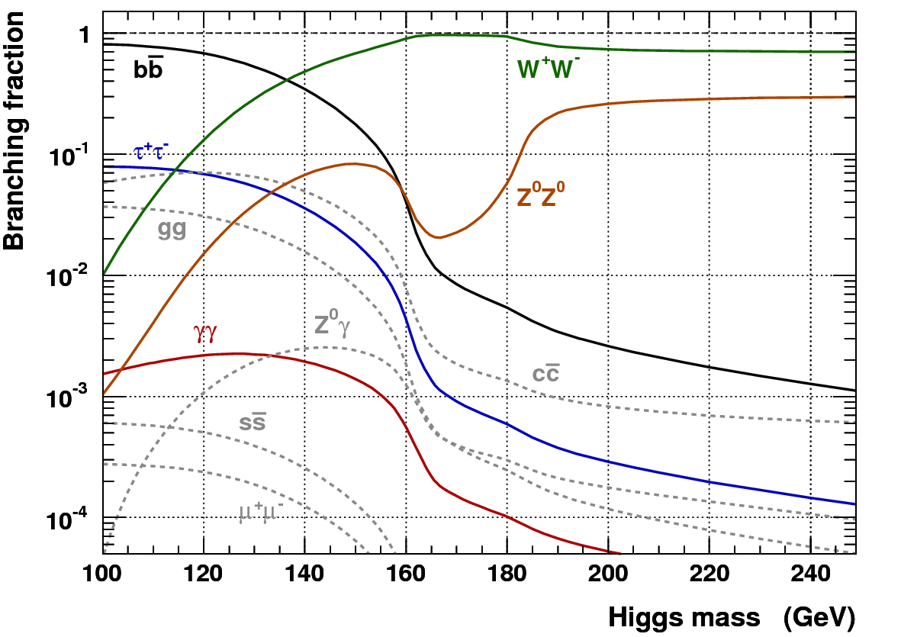
Summary of Higgs Boson Decays
  Higgs branching fractions and full width as function of Higgs boson mass
HDECAY 2.0

Slide 59
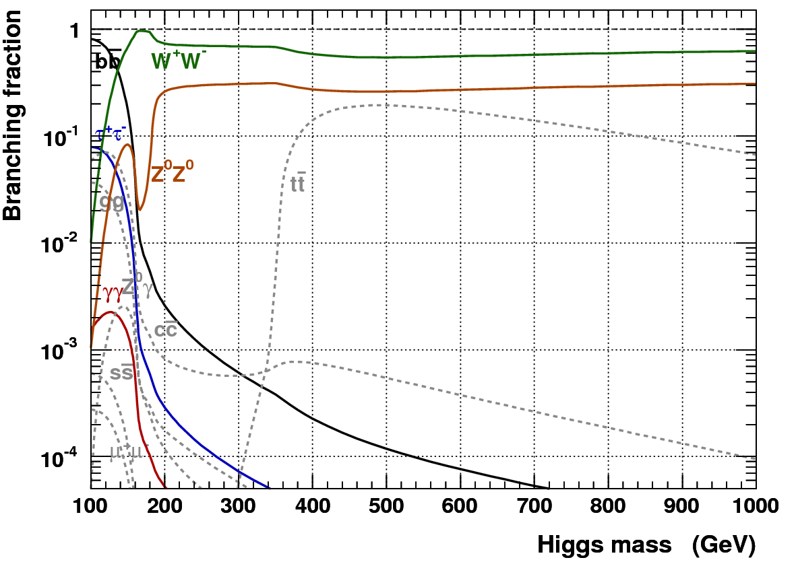
Summary of Higgs Boson Decays
  Higgs branching fractions and full width as function of Higgs boson mass
HDECAY 2.0

Slide 60
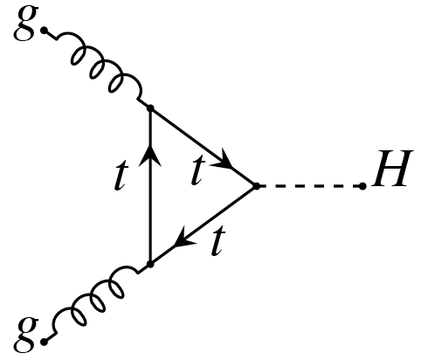
Higgs Boson Production
All QCD (EW) terms known to NNLO (NLO)
Gluon fusion
Due to large α_{S}, K factors of NLO/LO ~ 2, NNLO/LO ~ 3 at Tevatron, and ~1.7, ~2 at LHC
As for H → γγ loop-induced coupling only
Dominant production mode due to large gluon density in proton at small x
u₄, d₄ ?
4th generation ?
K-factor of ~3² = 9 using sequential model

Slide 61
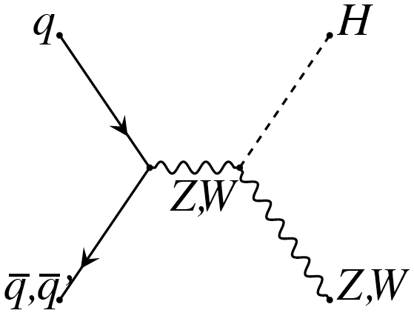
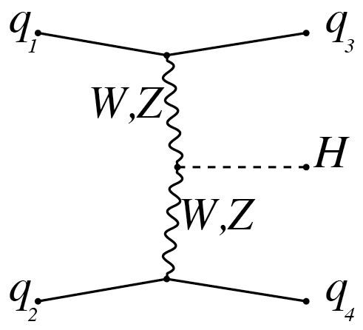
Higgs Boson Production
All QCD (EW) terms known to NNLO (NLO)
Gluon fusion
Due to large α_{S}, K factors of NLO/LO ~ 2, NNLO/LO ~ 3 at Tevatron, and ~1.7, ~2 at LHC
As for H → γγ loop-induced coupling only
Dominant production mode due to large gluon density in proton at small x
W or Z association (Higgs-strahlung)
More moderate K factors for Higgs-strahlung and WBF
Relatively more important at Tevatron owing to larger quark density in proton at larger x
Weak boson fusion
Striking event signature: small q² between quarks and virtual W / Z’s (M_{H} / 2 each q)
→ large Δη between jets! Central jet veto.
Large rapidity gap because no colour flow between initial and final state

Slide 62


Cross Sections at Tevatron & LHC (14 TeV)
Higgs production cross sections versus M_{H} at the Tevatron and the LHC
qq → W/Z + H cross sections ~10 × larger at the LHC
gg → H ~40–50 × larger at the LHC
Ongoing debate on gg → H cross section errors: Baglio-Djouadi (arXiv:1001.5027) versus CDF/D0 (answers: link-1, 2)

Slide 63

LHC 14 TeV vs 7 TeV
Unfortunately, the LHC runs only at 7 TeV CM energy in 2010 and 2011
For M_{H} = 160 GeV, reduction by factor of ~3.6 for gg → H
  ~2.8 for qq → W/Z + H
  ~3.7 for qq → qqH

Slide 64
Higgs Searches at Hadron Colliders
The dependence of the branching fractions on M_{H} drives search strategy
For heavy Higgs:
Lepton final states via WW⁽*⁾, ZZ⁽*⁾
For light Higgs:
Lepton final states via WW*, ZZ*
Di-photon final state
Di-tau final state
The dominant H → bb mode is only exploitable in association with W/Z or tt, also with strong Higgs boost
(Associated leptons provide trigger signal as they help to reduce huge QCD background, σ(bb) ~ 100 µb)

Slide 65

Briefly: Higgs Searches at Tevatron and LEP

Slide 66


Tevatron
2 general-purpose detectors
CDF & D0
Centre-of-mass energy:
1.96 TeV
Peak luminosity:
4.0 × 10³² cm^{–2}s^{–1}
Integrated luminosity:
~ 10 fb^{–1}
Anticipate 12–13 fb^{–1} by fall 2011 (shutdown)

Slide 67


Higgs Search Strategy at the Tevatron
135 GeV
Separate analyses into low-mass and high-mass searches

Slide 68
Higgs Search Strategy at the Tevatron
135 GeV
Separate analyses into low-mass and high-mass searches
Higgs search at Tevatron exploits all low and high-mass channels
Significant analysis improvements achieved, e.g.:
relaxed cuts
more efficient (looser) lepton identification
add final states with taus, fully hadronic modes, diphotons
improved b-tagging (also: b vs. c and b vs. bb (merged) discrimination)
improved dijet mass resolution in llbb channel from kinematic fit
improved dijet mass resolution by using tracker information
improved multivariate methods, e.g., matrix elements as input to boosted decision trees, separate training against different backgrounds, multi-class training
reduce top background using tight b-jet veto for high-mass search
LHC analyses yet miles away from such degree of sophistication !

Slide 69











Combination of all Higgs Searches
  Exclusion of any M_{H} is not possible by a single Tevatron channel / experiment
  Use most powerful statistical discriminators and combine all direct searches
WW
WW
Z(→νν)H
WH
WW
low M(ll)
…
Z(→μμ)H
W(→τν)H
WH(→WW)
WH
90 mutually exclusive modes !

Slide 70
Systematic Uncertainties
  The analyses are affected by significant systematic uncertainties, such as:
    Background normalisation (7 ~ 20%) and shape modelling (2 ~ 20%)
    Jet modelling (up to 20%) and Jet energy scale (~3%)
    b-tagging (0 ~ 9%)
    Luminosity (4 ~ 6%) and signal cross section (up to 11%), many more effects …
  Systematic uncertainties for background rates are generally several times larger than the signal expectation itself
  To minimize the degrading effect of systematic uncertainties on the search sensitivity, the individual background contributions are fitted to the data observation by maximising a likelihood function
  Nuisance parameters allow for variations within errors
  Each systematic error (incl. the error on the signal cross section) is folded into the signal and background expectation via Gaussian likelihood
  Correlations between nuisance parameters (due to common origin) are identified and preserved

Slide 71

Results of Tevatron Combination
CDF and D0, arXiv:1007.4587
Sensitivity is largest around 165 GeV
Observed LLR = –2lnQ, where Q = L_{S+B} / L_{B}, is consistent with background hypothesis, although at low mass, S+B is slightly favoured

Slide 72
Results of Tevatron Combination
CDF and D0, arXiv:1007.4587
Statistical and stat + syst ±1σ errors on expected limit
Tevatron experiments set a 95% CL exclusion of a SM Higgs boson in the mass region 158 – 175 GeV (first direct exclusion since LEP)

Slide 73
ALEPH
HZ → bb qq candidate
M_{bb} = 114 GeV
s/b|_{MH=115 GeV} = 4.7

Slide 74

ALEPH
HZ → bb qq candidate
M_{bb} = 114 GeV
s/b|_{MH=115 GeV} = 4.7
ADLO, PL B 565, 61 (2003)

Slide 75

Higgs Searches at the LHC

Slide 76






H → ZZ⁽*⁾ → 4 leptons (e, µ)
Golden discovery channel : σ × BR (140 / 200 GeV | √s=7 TeV ) ≈ 4 / 7 fb
Signal selection: p_{T}(1,2/3,4) > 20/7 GeV, |η|<2.5, isolated leptons, M(i,j) ~ M_{Z}, M(n,m) ~ < M_{Z}
  Backgrounds:
  Top production
M_{H} = 130 GeV
M_{H} = 150 GeV
M_{H} = 180 GeV
M_{H} = 300 GeV
M_{H} = 400 GeV
M_{H} = 600 GeV
  Also: associated Zbb production
Broad heavy Higgs:
Γ_{H (600 GeV)} = 123 GeV
    Reject by requiring leptons to be isolated and to match primary vertex
Dominant background after isolation cuts: ZZ⁽*⁾ continuum
    Depending on m_{H}, between 2 and 10 times smaller than signal
ATLAS, JINST 3 S08003 (2008)

Slide 77

H → ZZ⁽*⁾ → 4 leptons
Extrapolated SM Higgs Exclusion potential with 1 fb^{–1}
ATL-PHYS-PUB-2011-001
For M_{H} > 270 GeV, H → ZZ → llνν more powerful due to 6×BR and large missing E_{T}
→ see later

Slide 78

Low-Mass Search: H → γγ
Simulated H → γγ event (CMS)
M(γγ)

Slide 79
H → γγ
Clean discovery channel for light Higgs: σ × BR (115 / 140 GeV | √s=7 TeV ) ≈ 48 / 28 fb
Discovery primarily driven by photon energy resolution… but not only !
“Stochastic term”
Number of shower particles
“Noise term”
Electronics noise
(pile-up also contributes)
“Constant term”
Non-uniformities in calorimeter response due to inhomogeneities, non-linearities
Constant | ATLAS | CMS⁽*⁾
S | 10–12 % | 3–5.5 %
C | < 0.4 % | < 0.5 %
N | 250 MeV | 200–600 MeV
Current C (ATLAS): 1.1% (1.8%) for barrel (endcap) from Z→ee inter-calibration
⁽*⁾ Test beam numbers, w/o ID
Back-on-the-envelope for H → γγ :
But: full picture must include error on opening angle (θ_{γγ}), γ → ee conversions, jet backgr.

Slide 80


H → γγ
Significant amount of material in the ATLAS and CMS inner tracking systems (X/X₀ ~ 0.4 – 1.4) requires to include and efficiently reconstruct γ →ee conversions
γ →ee conversion reconstructed in the ATLAS inner tracking detector
Fractions of converted photons ~ 55%, strong angular dependence
Feynman diagram for photon conversion

Slide 81




H → γγ
Clean discovery channel for light Higgs: σ × BR (115 / 140 GeV | √s=7 TeV ) ≈ 48 / 28 fb
Signal selection: need excellent E_{γ} resolution, and efficient & pure photon ID; use MVA: M_{γγ}, cosθ *, p_{T,γγ}
  Backgrounds:
  γ + γ (“irreducible” – not quite)
Quark annihilation
(dominant: O(α²))
Brensstrahlung, O(α²α_{S})
and quark fragmentation
Box diagram
O(α²α_{S}²), ≈ q-ann.
  γ + jet and jet + jet (reducible, but ~10⁶ × larger than γγ)
Requires excellent calorimeter based γ–jet separation
ATLAS, JINST 3 S08003 (2008)

Slide 82

H → γγ
Clean discovery channel for light Higgs: σ × BR (115 / 140 GeV | √s=7 TeV ) ≈ 48 / 28 fb
Signal selection: need excellent E_{γ} resolution, and efficient & pure photon ID; use MVA: M_{γγ}, cosθ *, p_{T,γγ}
ATLAS data
Data-driven background fit from sidebands in identification and isolation variables
(“double sideband method”)
 | Data | MC
N(γγ) | 69 ± 12 | 86 ± 23
N(γj) | 11 ± 6 | 27 ± 14
N(jj) | 1.2 ± 0.8 | 1 ± 1
ATLAS-CONF-2011-004
Downward fluctuation of background. If confirmed, good news for H → γγ search !
Consistent within theoretical uncertainties

Slide 83
H → γγ
Clean discovery channel for light Higgs: σ × BR (115 GeV) ≈ 100 fb
Signal selection: need excellent E_{γ} resolution, and efficient & pure photon ID; use MVA: M_{γγ}, cosθ *, p_{T,γγ}
ATLAS data
Data-driven background fit from sidebands in identification and isolation variables
(“double sideband method”)
Precise theoretical prediction of background (amount and shape) not actually needed:
→ fit from data simultaneously with signal !
 | Data | MC
N(γγ) | 69 ± 12 | 86 ± 23
N(γj) | 11 ± 6 | 27 ± 14
N(jj) | 1.2 ± 0.8 | 1 ± 1
ATLAS-CONF-2011-004
Downward fluctuation of background. If confirmed, good news for H → γγ search !
Consistent within theoretical uncertainties

Slide 84

H → γγ – Exclusion potential
Based on these results, extrapolated SM Higgs Exclusion potential with 1 fb^{–1}
ATLAS-CONF-2011-004
Optimised analysis may improve significance by up to 50%

Slide 85
High-Mass Search: H → WW
proton
H
W⁺
W⁺
μ⁺
W–
ν
W–
e–
_
proton
ν
W polarisation: correlated lepton emission.
Di-lepton opening angle is strongest discriminant
Dominant cross section > 135 GeV, most sensitive channel

Slide 86

H → WW → 2 leptons (e, µ) + 2ν
No clean channel but large: σ × BR (120 / 165 / 200 GeV | √s=7 TeV ) ≈ 120 / 400 / 200 fb
Signal selection: large transverse mass, M_{T}² = (E_{T,ll} + E_{T,miss})² – (p_{T,ll} + p_{T,miss})², and exploit W polarisation
Separate analysis in H + 0, 1 jet (gluon fusion), and H + 2 jets (weak boson fusion)
  Visible cross section - sensitivity peak at ~ 160 GeV
  √s = 7 TeV
  Dominant backgrounds from
  WW continuum, W + jets, top…
ATLAS-CONF-2011-005

Slide 87



Data-driven background determination using background-enhanced control regions (anti-cuts)
0-jet channel: S/B ~ 0.7 at M_{H} = 170 GeV, after cuts on Δφ_{ll}, m_{ll}, m_{T}, E_{T,miss}
Higgs detection depends on good understanding of WW background
Recent measurement by CMS finds:
σ(pp → W ⁺W –) = (41.1 ± 15.3 ± 7.3) pb
compared to (43.0 ± 2.0) pb in NLO SM
ATLAS-CONF-2011-005
CMS-EWK-10-009

Slide 88

Data-driven background determination using background-enhanced control regions (anti-cuts)
0-jet channel: S/B ~ 0.7 at M_{H} = 170 GeV, after cuts on Δφ_{ll}, m_{ll}, m_{T}, E_{T,miss}
ATLAS-CONF-2011-005
2-jet channel
No b/extra jet veto applied in plot !

Slide 89

Data-driven background determination using background-enhanced control regions (anti-cuts)
0-jet channel: S/B ~ 0.7 at M_{H} = 170 GeV, after cuts on Δφ_{ll}, m_{ll}, m_{T}, E_{T,miss}
Thanks to the already excellent understanding of the LHC detectors, the experiments also embark into using powerful multivariate methods for background discrimination
2-jet channel
CMS-EWK-10-009

Slide 90

H → WW → 2 leptons + 2ν
Number of events found by ATLAS and predicted for M_{H} = 170 GeV hypothesis
Observed events compatible with B and S + B expectations → no exclusion yet
ATLAS-CONF-2011-005

Slide 91

H → WW → 2 leptons + 2ν
ATLAS Standard Model Higgs Exclusion with 35 fb^{–1}
Similar performance for CMS
CMS-EWK-10-009
ATLAS-CONF-2011-005

Slide 92

Exclusion Potential – Combination
  ATLAS combination of all considered channels at 7 TeV with 1 fb^{–1} luminosity
Further improvement from combination of ATLAS and CMS
ATL-PHYS-PUB-2010-015
Exclusion CL
At M_{H} = 200 GeV,
WW still competitive with γγ
Significance
With some luck, mass range between 129 and ~ 460 GeV can be excluded by one experiment

Slide 93
Exclusion Potential – Combination
  ATLAS combination of all considered channels at 7 TeV with 1 fb^{–1} luminosity
Further improvement from combination of ATLAS and CMS
ATL-PHYS-PUB-2010-015
Exclusion CL
Towards higher masses reduced WW sensitivity due to (mainly) reduced gg→H cross section (PDF), but entering of H → ZZ → llνν
Significance
With some luck, mass range between 129 and ~ 460 GeV can be excluded by one experiment

Slide 94
Is it a and the Higgs Boson ?
After a Higgs-like discovery, one needs to measure the properties of the new particle to consolidate whether it is indeed the wanted SM Higgs → Measure:
Mass (< 1% precision with H→γγ, H→ZZ⁽*⁾)
Spin and CP (angular correlations in H→WW⁽*) (spin only) H→ZZ⁽*⁾ (also CP), spin=0,2 if H→γγ)
Couplings to fermions and bosons
  model-independent ratios of couplings to Z/W, γ/W, τ/W to 20–30% precision (depends on M_{H})
  Higgs self coupling requires sLHC and more (ILC)

Slide 95
Unitarity – the Higgs Boson as UV Regulator
Unitarity problem: the amplitude of (longitudinal – since the W’s are massive) W ⁺W – scattering diverges if only Z bosons and photons are exchanged:
Scattering diagrams of longitudinally polarised W bosons
H
H
Higgs exchange regularises matrix element (if M_{H} ≤ 1/√G_{F} ~ 300 GeV, while when doing a proper partial wave analysis of the scattering amplitude, the limit weakens)
Higgs is a “UV Moderator”

Slide 96


Strong WW Scattering ?
If the Higgs is very heavy, or if EW symmetry is broken by something else than a Higgs condensate (e.g., by strong interactions), W bosons would become strongly interacting particles at TeV scale.
Fusion of longitudinally polarised W at the LHC
S. Allwood, thesis, Manchester U, 2006
+ ?
Growth of scattering amplitude cancelled at O(TeV) by exchange of new fields
The experimental signature could be strong WW resonances

Slide 97
Strong WW Scattering ?
If the Higgs is very heavy, or if EW symmetry is broken by something else than a Higgs condensate (e.g., by strong interactions), W bosons would become strongly interacting particles at TeV scale.
If the LHC does not find a Higgs boson, the study of longitudinal gauge boson scattering is the key !
This requires large statistics → sLHC
Fusion of longitudinally polarised W at the LHC
S. Allwood, thesis, Manchester U, 2006
+ ?
Growth of scattering amplitude cancelled at O(TeV) by exchange of new fields
The experimental signature could be strong WW resonances

Slide 98

Conclusions

Slide 99
Conclusions
Many constraints on the SM Higgs boson have been collected already
Stability up to M_{Pl} would require M_{H} > 129 GeV (perturbativity sets upper limit)
Electroweak precision data give:
Direct accelerator searches exclude M_{H} < 114 GeV and 158 < M_{H} < 175 GeV
The superb performance of the LHC in 2010 stimulates our imagination
ATLAS alone expects to exclude 129 < M_{H} < 460 GeV with 1 fb^{–1}
Possible 3σ evidence with ATLAS+CMS combined for 131 < M_{H} < 430 GeV with 1 fb^{–1}
Low mass Higgs is hardest, but H → γγ channel promising
Must not stop searching for heavy Higgs as EW constraints easily fooled
Many SM and BSM Higgs results from ATLAS in preparation for Moriond 2011
Expected for 2011: L_{peak} ≈ 1.3—2.0 × 10³³ cm^{–2}s^{–1}, L_{int} ≈ 2.7—3.7 fb^{–1}

Slide 100
e x t r a s l i d e s

Slide 101

The LHC Programme in a Nutshell
Only look at the luminosity – not the dates !!

Slide 102

Muon Detectors Tile Calorimeter Liquid Argon Calorimeters
T h e A T L A S E x p e r i m e n t
22 m
46 m
Toroid Magnets Solenoid Magnet SCT Tracker Pixel Detector TRT Tracker

Slide 103


Parton Luminosities at LHC and Tevatron
Ratio of “parton luminosities” of LHC-to-Tevatron and LHC 7 TeV-to-14 TeV
J. Stirling: http://projects.hepforge.org/mstwpdf/plots/plots.html
High M_{X} production through gluon fusion requires large CM energy
Less so for quark-antiquark scattering which has slow rise for M_{X} < 300 GeV

Slide 104
Hypothesis Testing
  The observed data are subjected to a likelihood-ratio test of 2 hypotheses:
  Background scenario (no Higgs signal assumed)
  Signal + Background scenario (Higgs signal with assumed mass added)
  Statistical analysis of hypothesis M_{H} is based on likelihood ratio:
Expectation for background (B) (M_{H} → ∞)
Data
  Use the log-likelihood ratio
  as test statistics
Expectation for S + B (M_{H})
  The expected distribution (PDF) of LLR(M_{H}) is obtained from MC and compared to data

Slide 105
Hypothesis Testing
  Quantify the level of agreement of the data
  with the “b only” hypothesis by estimating
  CL_{b} = 1 – P(LLR < LLR_{Data} | B)
  using pseudo (“toy”) MC experiments
  with the “s+b” hypothesis by estimating
  CL_{s+b} = P(LLR > LLR_{Data} | S+B)
  using pseudo MC experiments
“s+b”
“b”
  A frequentist exclusion limit is usually computed using CL_{s+b}
    The “s+b” hypothesis is excluded at 95% CL if CL_{s+b}< 0.05
  However, if the data undershoot the background, then CL_{s+b} small even if no sensitivity to signal !
  As a protection, collaborations use
  CL_{s} = CL_{s+b} / CL_{b}
  for exclusion limits
  Modified frequentist approach (conservative, as: CL_{s} > CL_{s+b})
  If CL_{s}<0.05: “hypothesis excluded at 95% CL”

Slide 106

Exclusion Potential vs. Luminosity
  ATLAS combination of all considered channels at 7 TeV with 1, 2, 5 fb^{–1} luminosity
Further improvement from combination of ATLAS and CMS
ATL-PHYS-PUB-2010-015
Exclusion CL
Significance
Each doubling of luminosity can reduce lower limit by ~ 7 GeV

Slide 107
3σ Evidence Potential vs. Luminosity
  ATLAS combination of all considered channels at 7 TeV with 1, 2, 5 fb^{–1} luminosity
Further improvement from combination of ATLAS and CMS
ATL-PHYS-PUB-2010-015
Exclusion CL
Significance
For 1 fb^{–1}, 3σ evidence possible for 139–180 GeV, for ATLAS & CMS → down to 131 GeV

Slide 108

A 4th Generation?
  Gluon fusion is very sensitive to additional heavy quarks, which do not decouple in the high-mass limit, and thus contribute ~ as the top quark to the triangular anomaly
Exclusion found for a particular 4th generation model.
Tevatron data already exclude M_{H} between 131 and 204 GeV for 4th generation.
Exclusion CL
H → WW
only
u₄, d₄ ?
4th generation:
K-factor of ~3² = 9 using sequential model
CDF & D0, arXiv: 1005.3216
Significance

