Slide 1
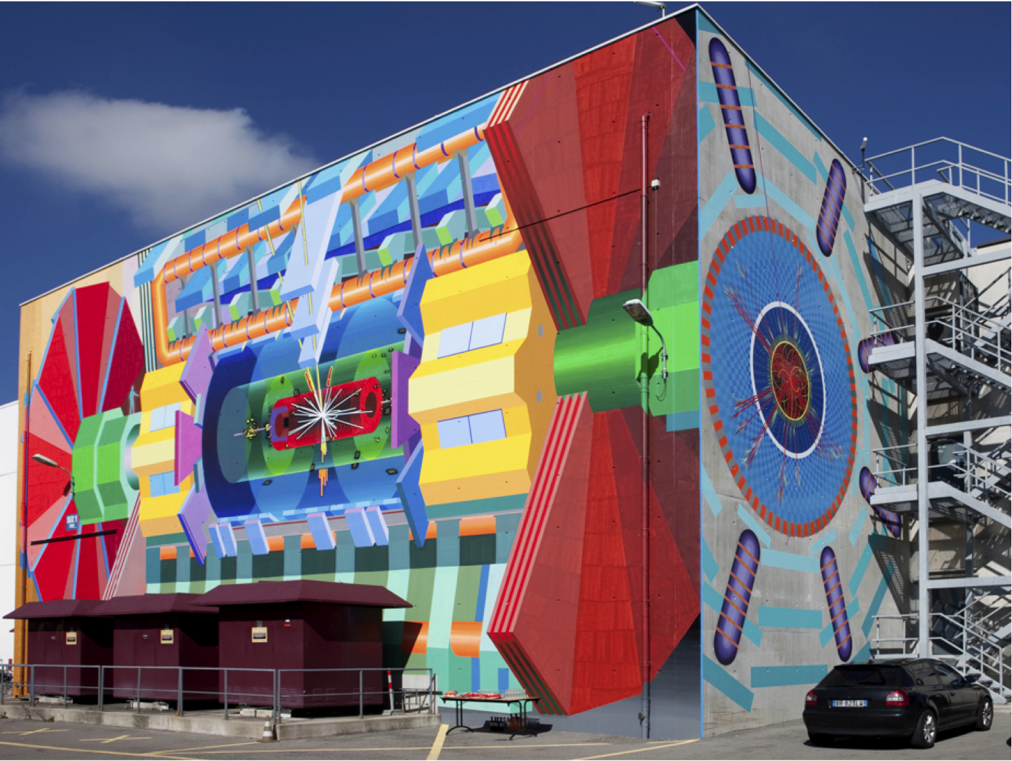
Searches for Supersymmetry and Dark Matter at the LHC
Andreas Hoecker (CERN)
20 May 2012, Zakopane, Poland

Slide 2
Outline
  Some words on the Standard Model
  The LHC
  Supersymmetry searches at the LHC
Apologies for the ATLAS bias in this lecture

Slide 3
Particle Physics Scales
L_{gravitation} ~ 10⁻³⁵ m
10¹⁹ GeV
Planck scale (M_{Pl})
10¹⁶ GeV
GUT ?
10¹⁴ GeV
ν_{R} ?
LHC reach
10 TeV
New Physics ?
1 TeV
…probing attometer scales
L_{weak} ~ 10⁻¹⁸ m
100 GeV
t, Z, W, H, EWSB
10 GeV
ψ, Υ, B
1 GeV
τ, n, p, ρ, φ
L_{strong} ~ 10⁻¹⁵ m
100 MeV
μ, π, QCD
10 MeV
nuclear binding E
1 MeV
e
100 keV
10 keV
1 keV
core of Sun
100 eV
10 eV
atomic binding E
L_{atomic} ~ 10⁻¹⁰ m
1 eV
ν’s
100 meV
10 meV
?

Slide 4

Everyday life (and particle physics) are described by the Standard Model

Slide 5


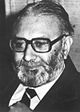
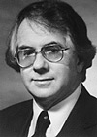




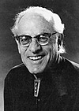
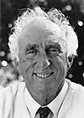
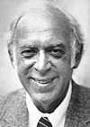
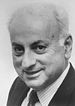
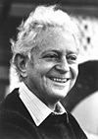

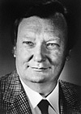
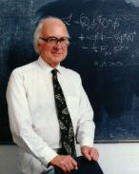
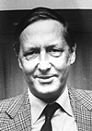
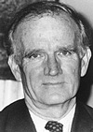
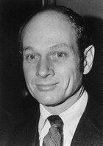


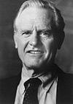


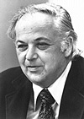
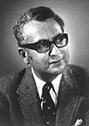
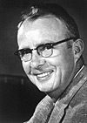

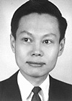

Everyday life (and particle physics) are described by the Standard Model
Standard Model (36+1 particles - 3 forces)
Wilczek
Gross
Salam
Glashow
Weinberg
Politzer
Veltman
‘t Hooft
Reines
Courtesy: Pascal Pralavorio
Perl
Friedman
Schwartz
Lederman
Ting
Rubbia
Higgs ?
van der
Meer
Fitch
Cronin
Hofstadter
Steinberger
Selected Nobel Prizes since 1957
Kendall
Schwinger
Feynman
Richter
Gell-Mann
Alvarez
Taylor
Yang
Lee
Gauge group = SU(3)_{C} x SU(2)_{L} x U(1)_{Y}
SU(3)_{C} x U(1)_{EM}
EWSB
The SM is the legacy of 20th century particle physics

Slide 6
The Standard Model
The Standard Model consists of 24 elementary matter particles and 3 forces
Fermions
Matter particles
Organised in 3 families
6 Leptons
6 Quarks
Bosons
Force quanta
Distinguishing 3 forces
Photon
3 weak bosons
8 Gluons
Electro-magnetic force
Weak force
Strong force
Breaks electroweak symmetry
Generates fermion and boson masses
Makes weak interaction short ranged
Higgs boson

Slide 7
The Standard Model
The Standard Model consists of 24 elementary matter particles and 3 forces
Interactions
Electro-magnetic
Weak
Strong

Slide 8
The Standard Model
The SM describes all observed phenomena in particle physics by 19 parameters (?)
6 quark masses
3 lepton masses
1 EM coupling
(massless Photon)
1 weak coupling
2 masses : Z, W
1 strong coupling
(massless Gluons)
1 Higgs mass
4 quark mixing parameters
= 20 parameters ?
− 1 by virtue of electroweak unification
+ at least 9 parameters for massive neutrinos
1 CPV QCD parameter ~ 0

Slide 9
The Standard Model
Elementary particle physics is successfully described by local gauge theories
Gauge symmetry is the invariance of equations of motion with respect to a local transformation belonging to a symmetry group
Example: translation group — uniform movement of particle
Global
symmetry:
Local
symmetry:
movement under influence of a potential
movement
movement
A new trajectory is possible, if forces act on the particle: a potential that restores the symmetry of the dynamic under this particular gauge transformation
The dynamic found is not just any dynamic, but one of the 4 forces of nature: gravitation
Requiring the same local gauge invariance for a wave function gives us: QED

Slide 10
The Standard Model
Elementary particle physics is successfully described by local gauge theories
Gauge symmetry is the invariance of equations of motion with respect to a local transformation belonging to a symmetry group
Example: translation group — uniform movement of particle
Global
symmetry:
Local
symmetry:
movement under influence of a potential
movement
movement
We can do so for all fundamental forces of the Standard Model, which have thus a
Geometric origin !

Slide 11

The Standard Model
Brout-Englert-Higgs mechanism
A problem: local gauge symmetry requires massless spin-1 “gauge” (=force) boson
This has been well verified for QED, with a massless photon (= infinite range)
However, the W, Z bosons are massive (= finite range ~10⁻¹⁵ cm)
Only way to break gauge symmetry consistently is to spontaneously break the symmetry of the vacuum:
[ non-zero vacuum expectation value ]
φ is a complex doublet field: 3 d.o.fs become Z, W ± masses, remaining d.o.f is massive scalar Higgs boson
This is called the Brout-Englert-Higgs Mechanism

Slide 12
The Standard Model
Brout-Englert-Higgs mechanism
Let’s imagine all particles have zero mass → gauge symmetry is respected
Higgs quantum liquid in broken phase
Symmetric phase – early universe
Gravity
A Higgs field displaces ground state breaking gauge symmetry
It fills all space time (but w/o orientation as spin=0)
Photon
×
×
Weak boson
×
×
×
×
Particles interact with the Higgs field and reduce their velocity. They acquire a mass proportional to interaction strength
×
Neutrinos
ν_{L}
Λ⁻¹
ν_{L}
Electrons
×
e_{L}
e_{R}
×
e_{L}
×
×
×
_{L}
_{R}
×
×
→ Action of the Higgs field creates a vacuum viscosity
Top quark
_{R}
_{R}
×
_{R}
×
×
_{L}
_{L}
t_{L}
_{L}
×
×
H. Murayama

Slide 13
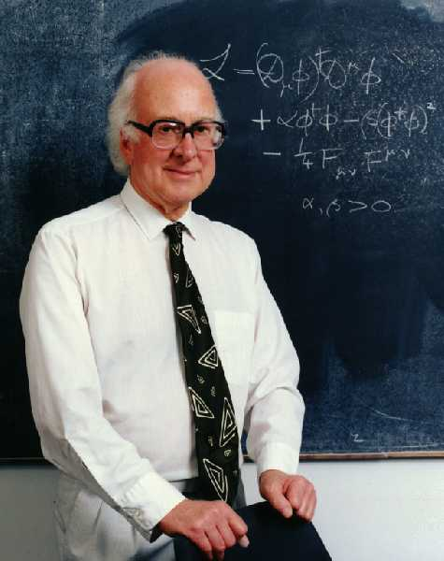
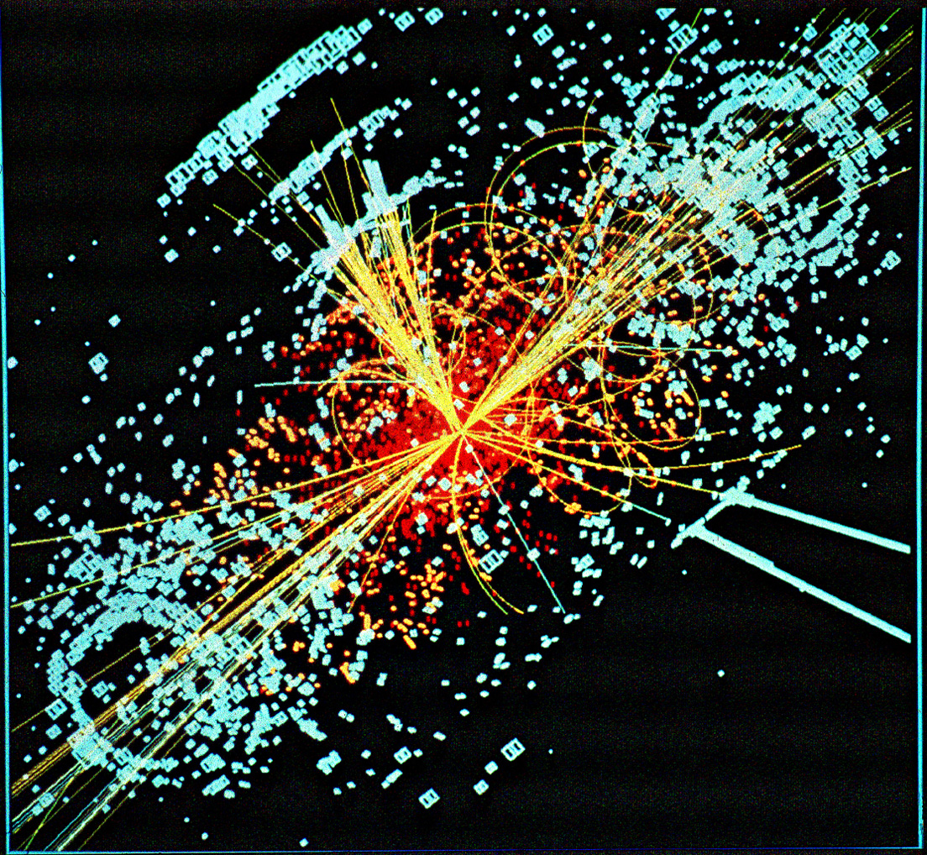
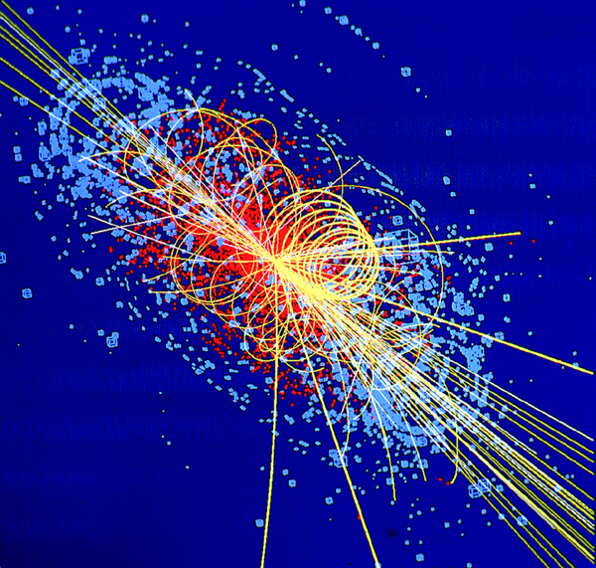
The Higgs boson is the last elusive elementary particle of the SM
P.W. Higgs, Phys. Lett. 12 (1964) 132
The Higgs boson – last of the particles ?
What is known about the Higgs Boson ?
© CMS
© ATLAS

Slide 14
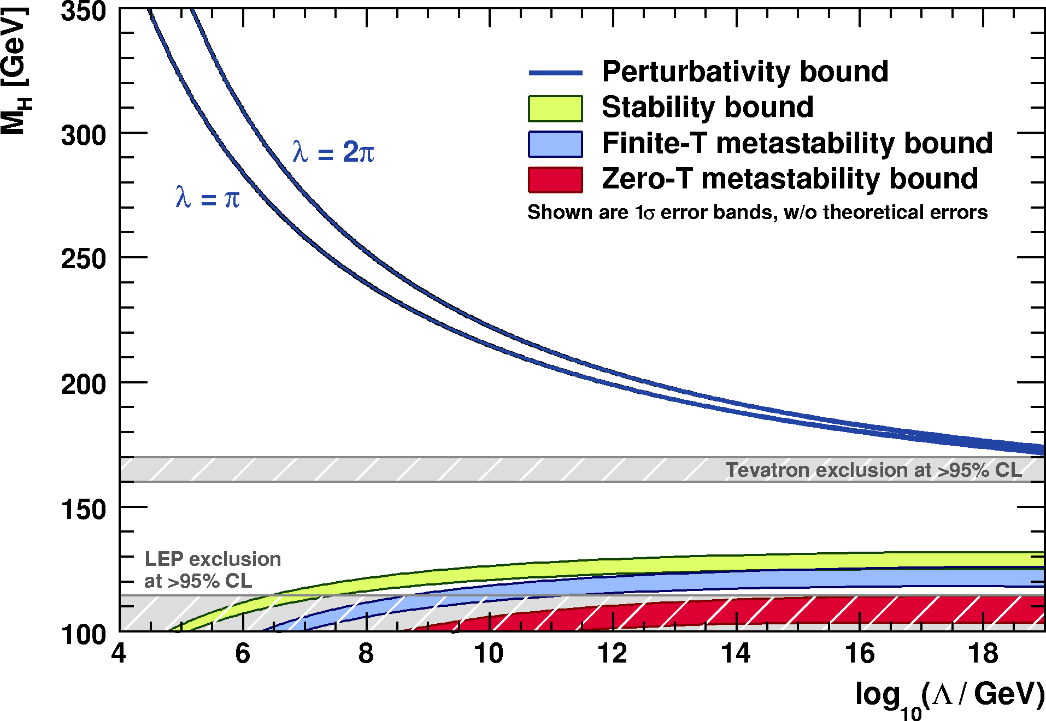
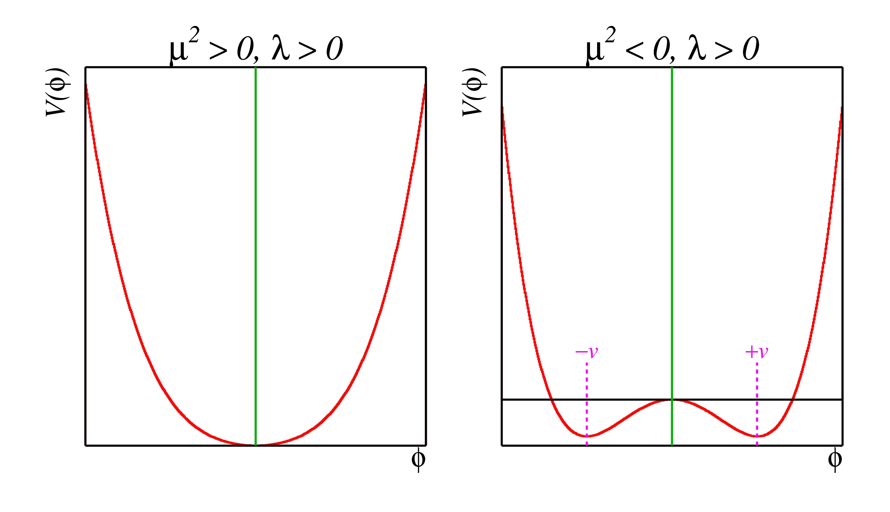
The Higgs boson should not be too light, and not too heavy…
  Perturbativity and (meta)stability bounds versus the SM cut-off scale Λ
Ellis et al, arXiv:0906.0954
Allowed
Not allowed
The SM Higgs must steer a narrow course between two disastrous situations if the SM is to survive up to the Planck scale M_{P} ~ 2×10¹⁸ GeV

Slide 15

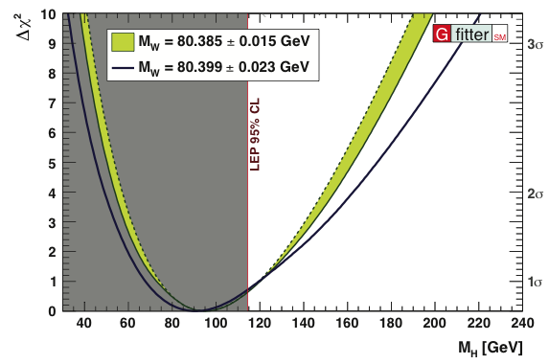
Constraints from global electroweak fit
Global fit of all EW precision measurements to SM prediction constrains M_{H}
New M_{W} average (WA):
arXiv:1204.0042
WA dominated by recent CDF measurement:
80.387 ± 0.019 GeV
[ PRL 108, 151803 (2012) ]
H
http://gfitter.desy.de

Slide 16
Constraints from global electroweak fit
In the Standard Model the Higgs must be light.
BUT: Beyond the Standard Model the Higgs can be heavy !
→ MUST NOT stop searching for heavy Higgs boson !

Slide 17
Once the Higgs boson is discovered
The Standard Model is complete
But … does it hold tight ?

Slide 18
The Standard Model
During the last 35 years the Standard Model has been tested to great precision
Excited fundamental bosons or fermions have been excluded up to the TeV scale
Electroweak unification has been verified at, below and above the Z-boson scale
Universality of weak interaction has been verified at the per-mil level
The tininess of electric dipole moments has been verified at 10⁻²⁷ ecm
Conservation of the charged lepton number verified at 10⁻¹² level
Asymptotic freedom of strong interaction has been verified at the percent level
All observations of matter-antimatter symmetry violations are described by single complex parameter in the quark mixing matrix
The electron and muon magnetic moments have been verified at ppm level...
Examples only, there are many more successful tests …

Slide 19
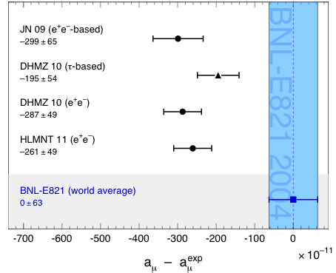
The Standard Model
During the last 35 years the Standard Model has been tested to great precision
Muon magnetic moment: comparison between measurement (blue band) and predictions (dots)
Status: summer 2011 (published results shown only)
But not everything perfectly agrees with expectation:
Top pairs produced in hadron collisions (at Tevatron) may have large angular asymmetry
Di-muon events (at Tevatron) may exhibit unexpected charge asymmetry
The muon anomalous magnetic moment may be stronger than expected
PDG 2011

Slide 20
Problems and Unexplained Observations
The success of the SM should not make us forget that it is an incomplete theory
The Higgs is not yet discovered !
The Higgs is the only fundamental scalar
Huge mass hierarchy between matter particles
Dark matter (particle) and accelerated expansion of universe
Causally connected observable universe
Matter-antimatter asymmetry in universe
Grand unification of the forces (related to baryon decay)
Gauge hierarchy / stability of the scalar SM sector (see later)
Why no matter-antimatter symmetry violation in strong interaction?
Neutrino masses
Gravitation

Slide 21
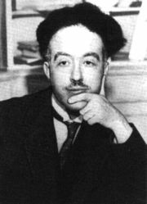
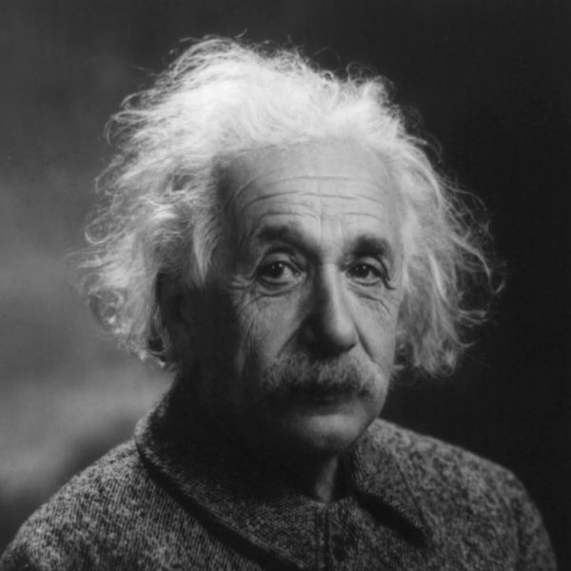
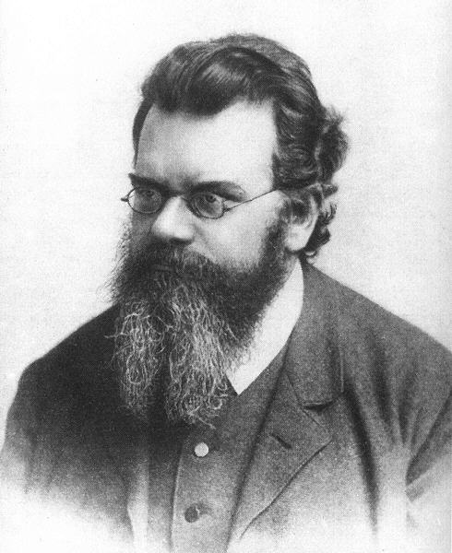
Producing the Higgs Boson and Searching for New Physics at the TeV Scale Requires a Huge Machine
Particles accelerators:
accelerate particles to the highest energies to
Look deeper into matter (size ~ 1/E) (“powerful microscopes”)
Discover new heavier particles (E = mc²)
Probe conditions of the early universe (E = kT)
de Broglie
Einstein
F. Gianotti
Boltzmann

Slide 22


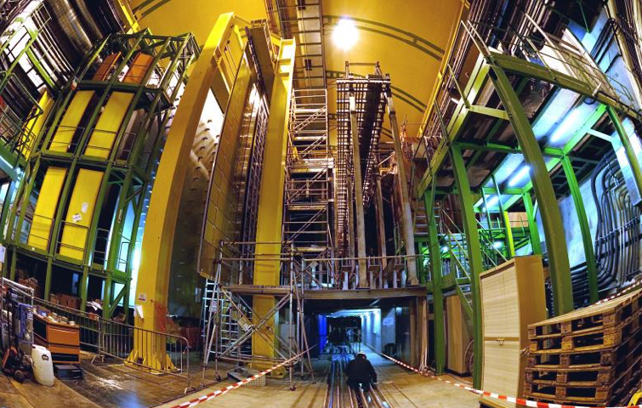
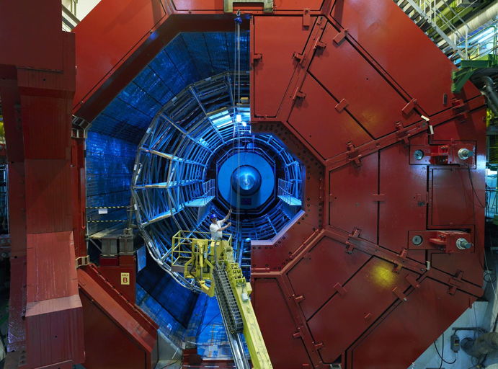

LHC ring at CERN:
27 km circumference
CMS
LHCb
Blunt extrapolation for 2011
ALICE
So far:
7/8 TeV proton—proton collisions
2.76 TeV Pb—Pb collisions
ATLAS

Slide 23
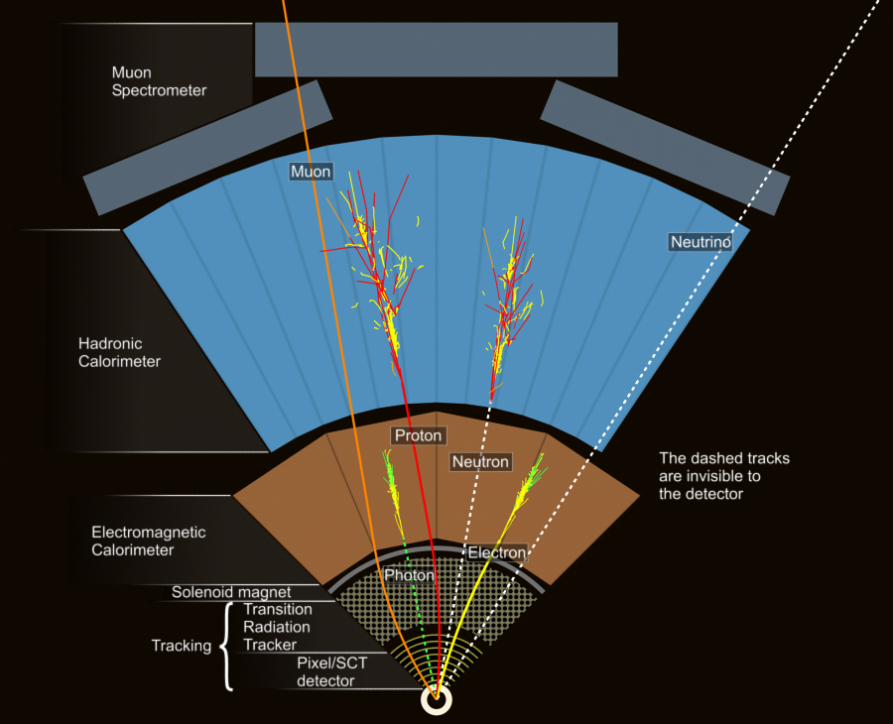

Detector Layers
Particles are detected through their interaction with the active detector materials

Slide 24
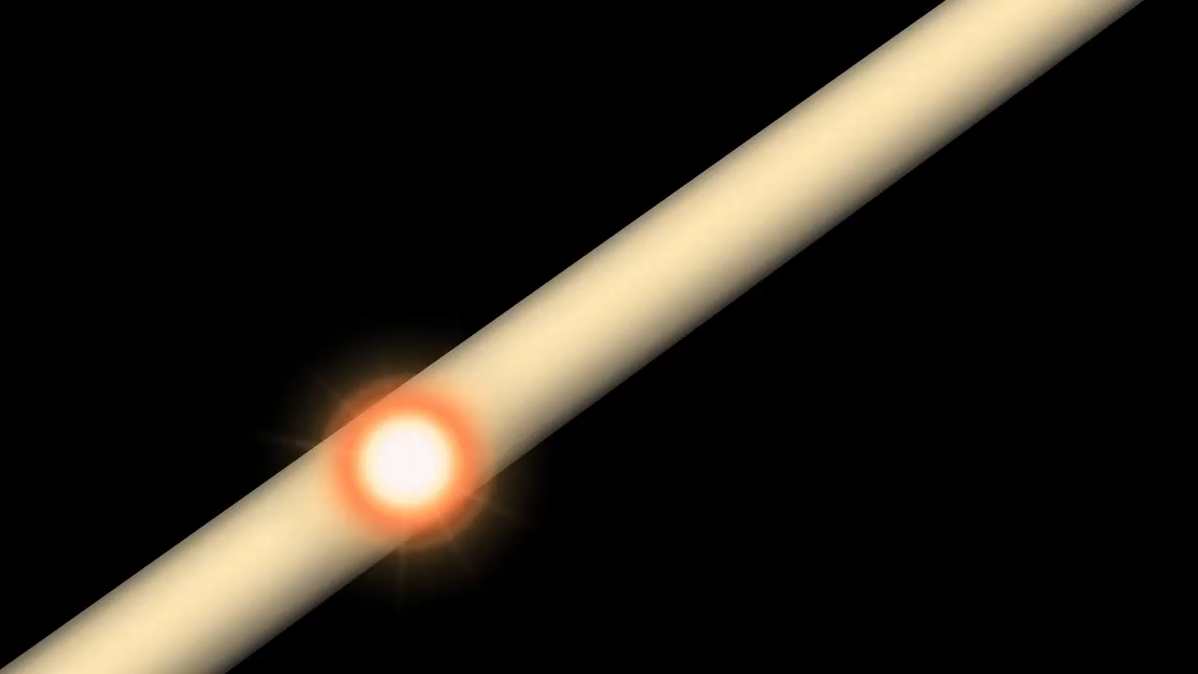
http://www.atlas.ch/multimedia/html-nc/animation-proton-event.html

Slide 25
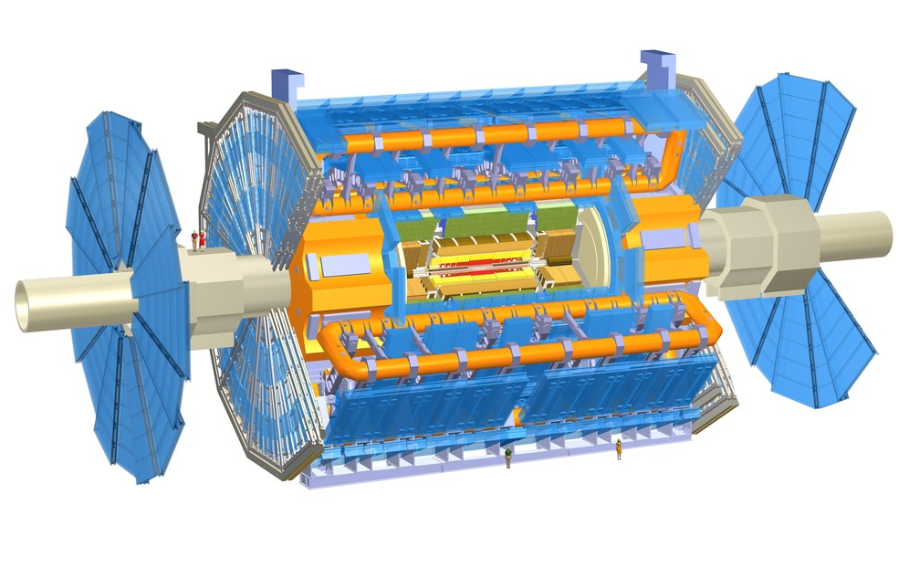
Muon Detectors Tile Calorimeter Liquid Argon Calorimeters
T h e A T L A S E x p e r i m e n t
25 m
44 m
Toroid Magnets Solenoid Magnet SCT Tracker Pixel Detector TRT Tracker

Slide 26
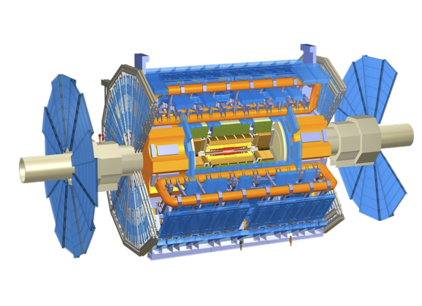
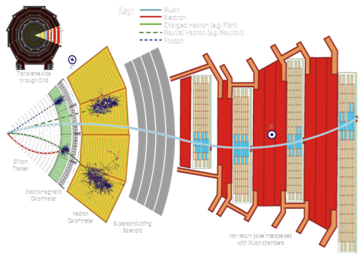

Muon Detectors Tile Calorimeter Liquid Argon Calorimeters
22 m
ATLAS: emphasis on excellent jet and missing-E_{T} resolution, particle identification, and standalone muon measurement
CMS: emphasis on excellent electron/photon and tracking (muon) resolution
Both: excellent hermeticity – very few “cracks”
46 m
Toroid Magnets Solenoid Magnet SCT Tracker Pixel Detector TRT Tracker

Slide 27
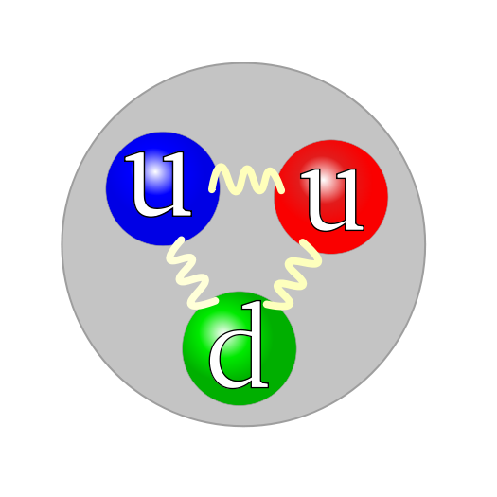
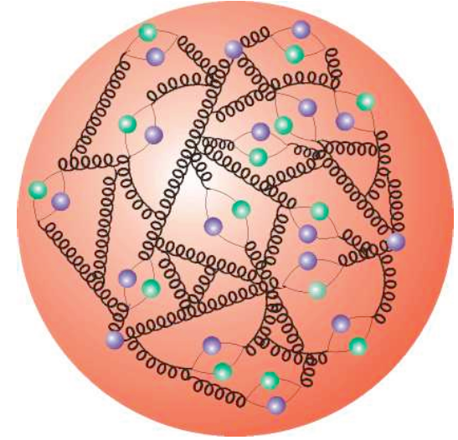
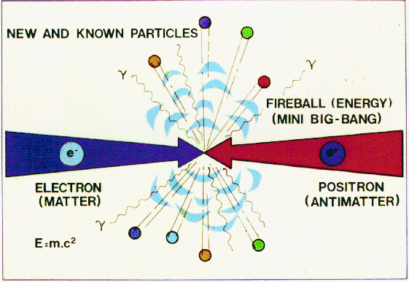
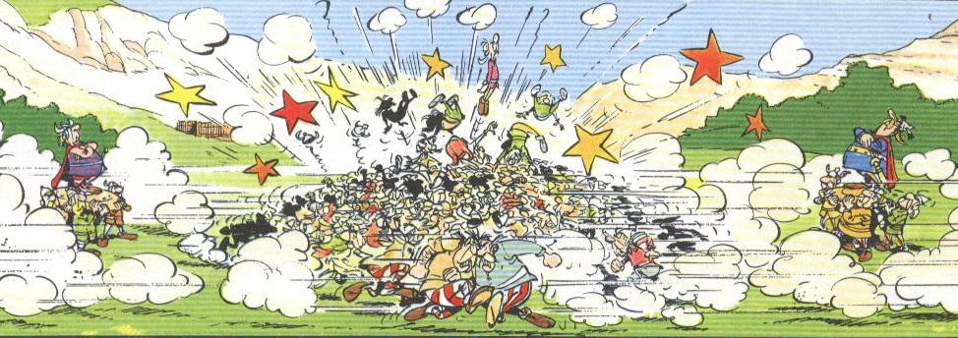
Proton–Proton Collisions
For proton−proton collisions, cross section is convolution of Parton Density Functions (PDF) with parton scattering Matrix Element
Parton distribution functions
Representing structure of proton
e+e– collider
Hadron collider

Slide 28
Proton–Proton Collisions
For proton−proton collisions, cross section is convolution of Parton Density Functions (PDF) with parton scattering Matrix Element
Parton distribution functions
Representing structure of proton
Hard scatter parton cross section
Higher order pQCD correction; accompanying radiation, jets, …
p
Q ² = M_{X}²
X = jets, W, Z, top, Higgs, SUSY, …
p
Underlying event
CM energy of parton collision:
The parton density functions rise dramatically towards low x:
  Higher cross section at higher proton−proton collision energy
  More luminosity also achieves higher effective energy
  Low-x (eg, Higgs) dominated by gluon−gluon collisions: “gluon collider”

Slide 29
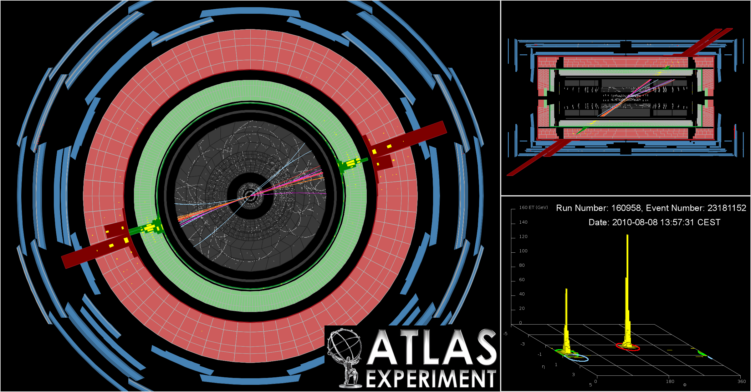
Physics at the LHC

Slide 30

Several hundred articles and conference notes published since LHC start
The LHC experiments have a prolific scientific production of which I can only discuss small parts here

Slide 31

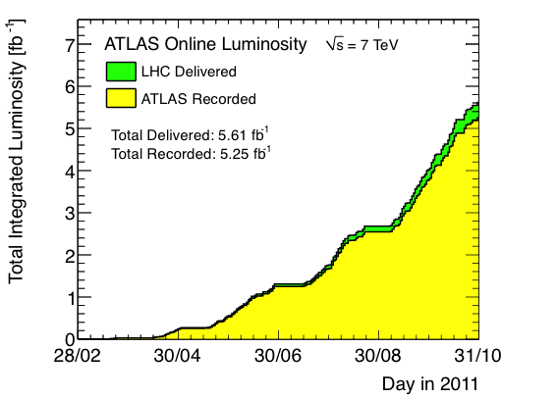
Recorded Luminosity in 2011
Luminosity is key quantity: rate = cross section × efficiency × luminosity
ATLAS integrated luminosity in 2011
(in 2010: 0.04 fb⁻¹ collected)
Surpassed Tevatron record of 4.1 10³²
Peak L = 3.6×10³³ s^{–1}cm^{–2}
Max N_{coll-bunch} = 1331 (Δt = 50 ns)
Max stored energy: 100 MJ
Status: 15 Oct 2011

Slide 32
Recorded Luminosity in 2011
Luminosity is key quantity: rate = cross section × efficiency × luminosity
At L = 3×10³³ s⁻¹cm⁻², produce 225 (129) SM Higgs bosons of 115 (150) GeV mass in ATLAS and CMS per hour
Tevatron @ 115 GeV: 2/h at max luminosity
Surpassed Tevatron record of 4.1 10³²
Peak L = 3.6×10³³ s^{–1}cm^{–2}
Max N_{coll-bunch} = 1331 (Δt = 50 ns)
Max stored energy: 100 MJ
Status: 15 Oct 2011

Slide 33
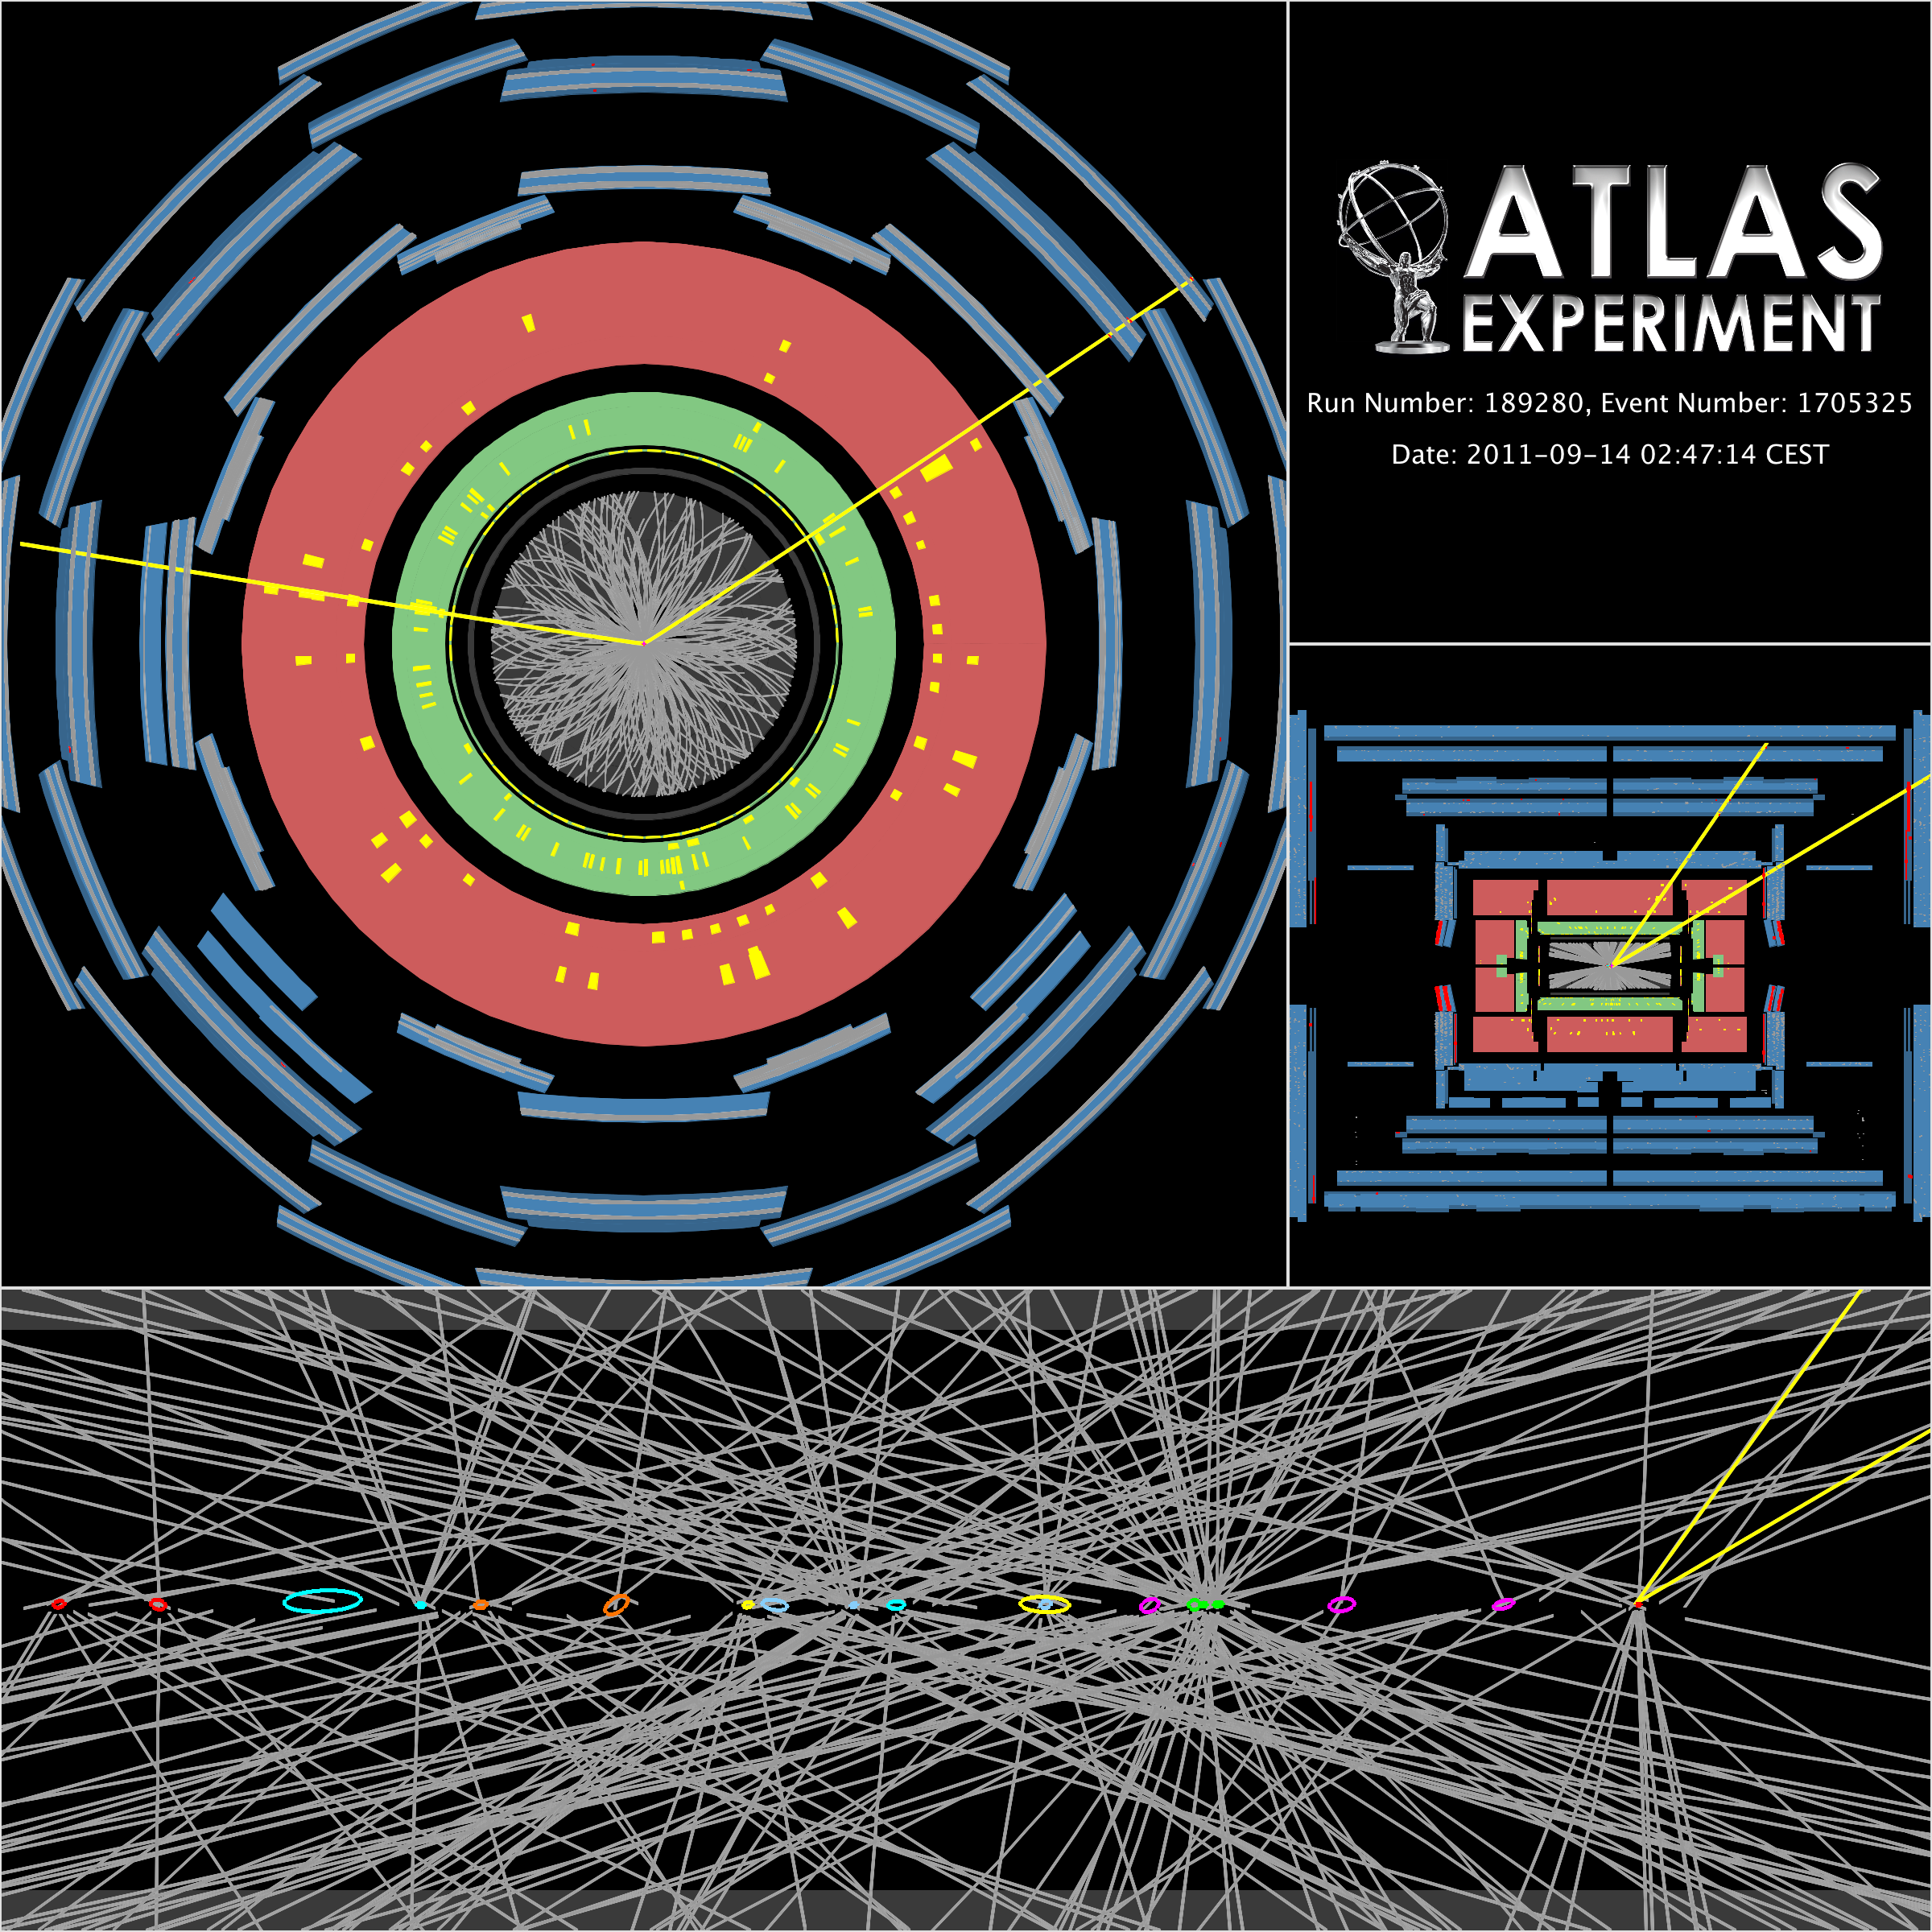
Recorded Luminosity in 2011
Measured with forward detectors, calibrated with beam separation scans
High luminosity comes at a price: probability of parasitic collisions in one bunch crossing (= pileup) increases
Peak of up to 22 collisions per crossing reached (almost doubled in 2012)
Another price to pay: higher trigger thresholds → low-pT physics suffers
Z → μμ event in ATLAS with 20 reconstructed vertices

Slide 34
Recorded Luminosity in 2011
Measured with forward detectors, calibrated with beam separation scans
High luminosity comes at a price: probability of parasitic collisions in one bunch crossing (= pileup) increases
Peak of up to 22 collisions per crossing reached (almost doubled in 2012)
Another price to pay: higher trigger thresholds → low-pT physics suffers
To search for “new” physics, we must make sure the “old” physics is well under control in our experiments
Z → μμ event in ATLAS with 20 reconstructed vertices

Slide 35
A beautiful dijet event from ATLAS: m(jet-jet) = 1.9 TeV, p_{T} : 0.9 TeV, 0.8 TeV

Slide 36
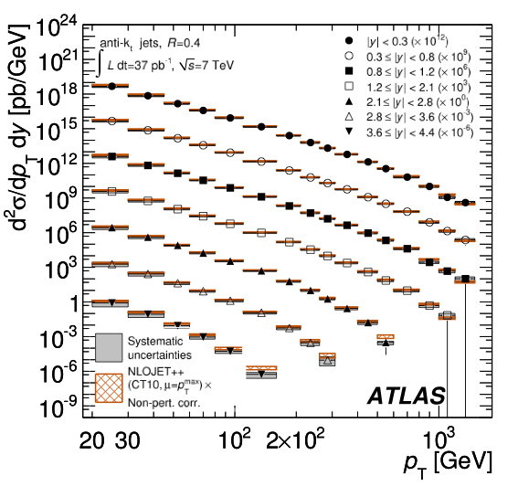
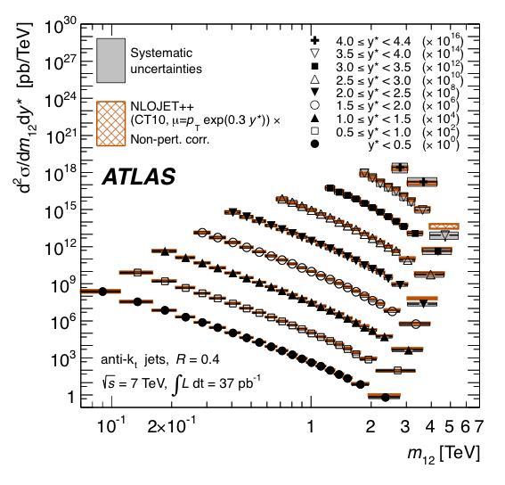
ATLAS and CMS have Measured Inclusive and Exclusive Jet Cross Sections at never Explored Energies
ATLAS arXiv:1112.6297
Differential jet cross section versus jet p_{T}
Differential jet cross section versus di-jet mass
Agreement over many orders of magnitude gives confidence for new physics searches

Slide 37

High-energy jets probe new particles and interactions
Measure di-jet invariant mass and angular distributions
q
q
2 → 2 parton scattering to two jets described by QCD
?
Tends to scatter at smaller angles than if there were new particles produced
Recall atomic substructure discovery in Rutherford scattering: deflection at large angles !
q
q
New, high-scale interaction ?
New bound state (particle) ?
Are quarks composites ?

Slide 38
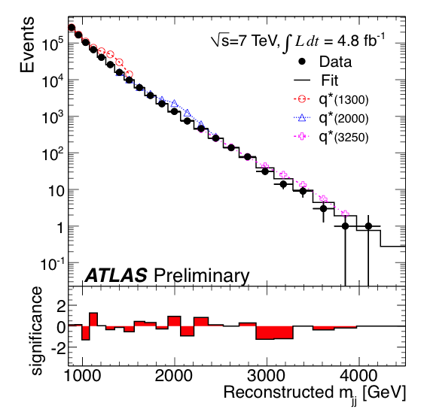
High-energy jets probe new particles and interactions
Measure di-jet invariant mass and angular distributions
ATLAS-CONF-2012-038
Observed and fitted m(jet-jet) distributions

Slide 39
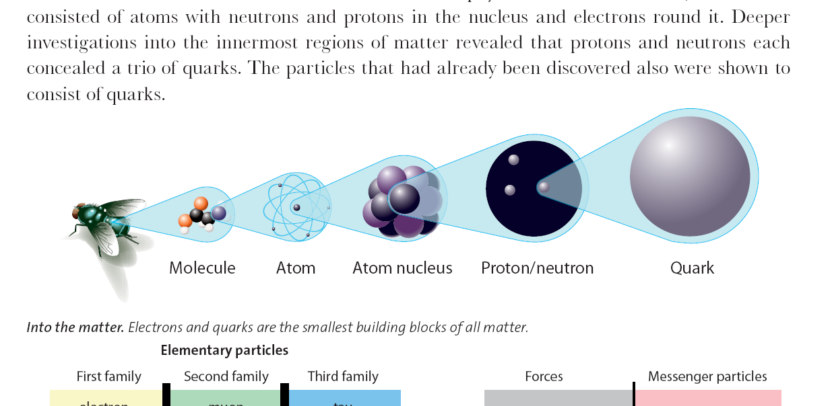
High-energy jets probe new particles and interactions
Measure di-jet invariant mass and angular distributions
ATLAS-CONF-2012-038
No deviations from SM seen → set limits on new phenomena:
Benchmark model | Observed limit at 95% CL
Excited quarks | m(q*) | > | 3.4 TeV
4-quark contact interactions | Λ | > | 7.8 TeV
Resonant
Non-resonant
< 1.8 × 10^{–18} cm
10^{–14} cm
10^{–13} cm
10^{–9}–10^{–8} cm
10^{–9}–10^{–7} cm
quark

Slide 40
Leptons are pure SM and new physics probes with much reduced strong-interactions background
q
e
Z⁰ / W±
Z’ / W’ ?
q⁽‘⁾
e/ν
Unification of forces ?
Left-right symmetric models ?
Compact extra dimensions ?
Technicolour ?
Higgs extensions ?

Slide 41
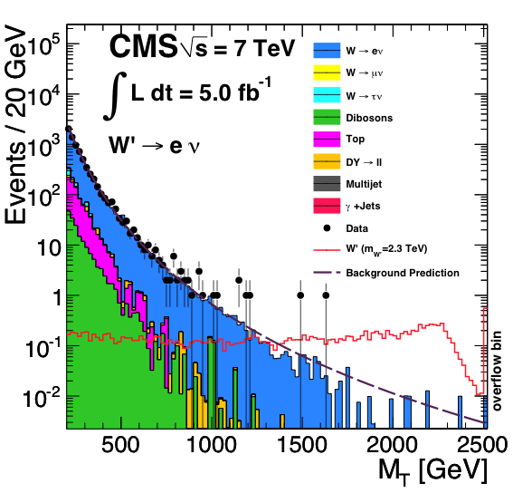
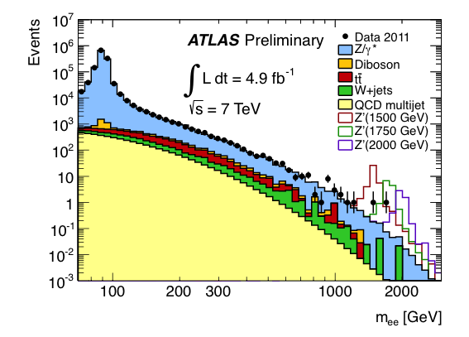
Searches for Z’ and W ’resonances in decays to e/μ
Use dilepton / transverse mass to search for excess over SM
ATLAS-CONF-2012-007, CMS arXiv:1204.4764
Observed and predicted dielectron mass, search bumps
Observed and predicted e-n transverse mass
95% CL lower limit: m(Z ’_{SSM}) > 2.2 TeV
95% CL lower limit: m(W ’_{SSM}) > 2.6 TeV⁽*⁾
⁽*⁾Constructive interference model

Slide 42
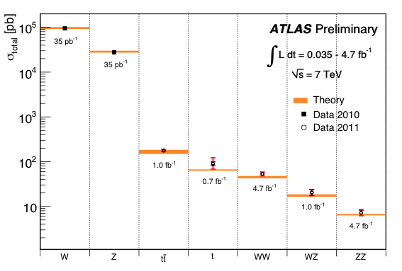
QCD and electroweak measurements
With more luminosity we are sensitive to every smaller cross sections
Summary of weak boson and top cross section measurements vs. theory

Slide 43

QCD and electroweak measurements
With more luminosity we are sensitive to every smaller cross sections
Summary of weak boson and top cross section measurements vs. theory
LHC is top factory:
  at 7 TeV CM energy: ~25 times larger cross section than at Tevatron

Slide 44
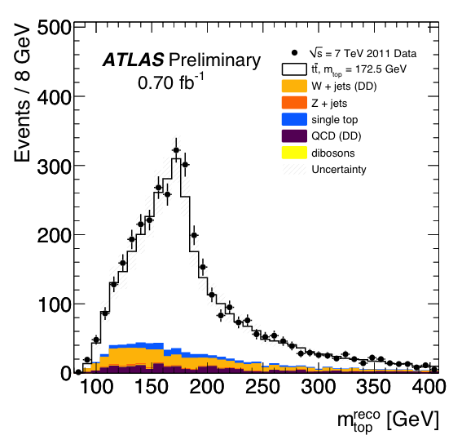
QCD and electroweak measurements
With more luminosity we are sensitive to every smaller cross sections
Summary of weak boson and top cross section measurements vs. theory
Clean top reconstruction
(here: hadronic top mass)
First precision measurements of top cross section and mass at LHC
Searches for new physics in top production and decay

Slide 45



QCD and electroweak measurements
With more luminosity we are sensitive to every smaller cross sections
Summary of weak boson and top cross section measurements vs. theory
t-channel dominates single-top production
ATLAS-CONF-2011-101
Expected cross sections for
t, Wt, s chans.: 65, 16, 4.6 pb

Slide 46
QCD and electroweak measurements
With more luminosity we are sensitive to every smaller cross sections
Summary of weak boson and top cross section measurements vs. theory

Slide 47

QCD and electroweak measurements
With more luminosity we are sensitive to every smaller cross sections
Summary of weak boson and top cross section measurements vs. theory
The long road to measuring electroweak symmetry breaking
H(130 GeV) → WW
4.9 pb
H(130 GeV) → ZZ
0.65 pb

Slide 48

A beautiful 4-muon event seen in ATLAS

Slide 49

Hunting for the Higgs Boson
P. Higgs at CMS

Slide 50
Higgs boson
Higgs production and decay probabilities predicted vs. Higgs mass by SM
At the LHC, the Higgs boson is produced dominantly via gluon fusion
σ_{H,total} ~15 pb at 125 GeV (40—50 times larger rate than at Tevatron)
Because of the coupling to the mass of the decay particles:
  … the Higgs will decay with preference to the heaviest particles allowed
  … the Higgs does not couple directly to photons and gluons, but only via “loops” involving heavy particles (e.g., top, W )
W,Z,q,l,g,γ
H
-
-
-
W,Z,q,l,g,γ

Slide 51

Higgs searches at the LHC
Dependence of the branching fractions on M_{H} drives search strategy
For medium to heavy Higgs:
Lepton final states via WW⁽*⁾, ZZ⁽*⁾
For light Higgs:
Lepton final states via WW*, ZZ*
Di-photon final state
Di-tau final state
The dominant H → bb mode is only exploitable in association with W/Z or tt, also with strong Higgs boost
Associated leptons provide trigger signal as they help to reduce huge QCD background, s(bb) ~ O(100 µb)

Slide 52

Combining all channels
At high mass also WW → llqq and ZZ → llνν channels contribute
ATLAS-CONF-2012-019
Individual channel expected sensitivities in one plot

Slide 53


Combining all channels
At high mass also WW → llqq and ZZ → llνν channels contribute
ATLAS-CONF-2011-135, CMS-PAS-HIG-11-022
All results [γγ, ZZ, WW, ττ, bb] combined. Left: ATLAS — low mass region, right: CMS — all masses
3.1σ local p-value
(1.5σ global)
2.5σ local p-value
(2.9σ expected
– if 124 GeV Higgs !)
Excluded:
m_{H} = 110~122.5, 129—539 (120—555 exp.) GeV
Excluded: m_{H} = 127—600 (118—543 exp.) GeV
Both experiments see a >2σ combined excess at 123~127 GeV …

Slide 54
Combining all channels (status: Lepton-Photon 2011)
Compare with constraints from perturbativity and (meta)stability
Ellis et al, arXiv:0906.0954
Allowed
Not allowed
Excluded by LHC
Still — barely — a stable solution up to M_{P} possible …
Excluded by LEP and LHC
The SM Higgs must steer a narrow course between two disastrous situations if the SM is to survive up to the Planck scale M_{P} ~ 2×10¹⁸ GeV
Ellis et al, arXiv:0906.0954

Slide 55

Constraints from global electroweak fit
Global fit of all EW precision measurements to SM prediction constrains M_{H}
Plotting also the results from direct searches at LEP and Tevatron …
http://gfitter.desy.de

Slide 56

Unfortunately, there is a problem with the Higgs!
P. Higgs at CMS

Slide 57
The “Gauge Hierarchy Problem”
If a Higgs boson with mass < 1 TeV is discovered, the Standard Model is complete !
However, when computing radiative corrections to the bare Higgs mass a problem occurs:
Higgs radiative corrections
where:
Integral quadratically divergent
The cut-off sets the scale where new particles and physical laws must come in
Above the EW scale we only know of two scales: GUT (~10¹⁶ GeV) and Planck (~10¹⁹ GeV)
Such a cut-off would require an incredible amount of finetuning to keep m_{H} light

Slide 58
The “Gauge Hierarchy Problem”
If a Higgs boson with mass < 1 TeV is discovered, the Standard Model is complete !
However, when computing radiative corrections to the bare Higgs mass a problem occurs:
Higgs radiative corrections
where:
Missing protection of scalar Higgs mass is related to absence of a symmetry principle. Setting m_{H} = 0 in SM Lagrangian, does not restore any symmetry in the model.
New physics models should address this. M_{H} should become a deviation from some exact symmetry, and is thus intrinsically small !
Integral quadratically divergent
The cut-off sets the scale where new particles and physical laws must come in
Above the EW scale we only know of two scales: GUT (~10¹⁶ GeV) and Planck (~10¹⁹ GeV)
Such a cut-off would require an incredible amount of finetuning to keep m_{H} light

Slide 59
The crisis of the Standard Model calls for new physics at the TeV scale
Many models addressing the hierarchy and the dark matter problem have similar experimental signatures
Searching for them is another central pillar of the LHC physics programme
Unfortunately, there is a problem with the Higgs!
P. Higgs at CMS

Slide 60
Could a symmetry between fermions and bosons
regularise the Higgs radiative corrections ?
(TeV-scale) Supersymmetry (SUSY)
P. Higgs at CMS

Slide 61
Fermion loop
Boson loop
(TeV-scale) Supersymmetry (SUSY)
P. Higgs at CMS

Slide 62
Fermion loop
Boson loop
(TeV-scale) Supersymmetry (SUSY)
Fermion and boson loops contribute with different signs to the Higgs radiative corrections: if there existed a symmetry relating these two, this could protect the masses of the scalar Higgs
Supersymmetry realises this by transforming bosons  fermions
SUSY transforms, e.g., a scalar boson into a spin-½ fermion, whose mass is protected
Hence, the scalar mass is also protected (precisely through SUSY)
This solves the naturalness and the hierarchy problems of the SM (at least technically)
Local gauge invariance of SUSY requires existence of spin-3/2 and spin-2 particles, which naturally introduces the spin-2 graviton, assumed to mediate the gravitational force

Slide 63

The
scalar
precipice
Mrs. SUSY
EW scale
Mr. Higgs
GUT scale
Planck scale
Scalar mass

Slide 64
SUSY has: N_{dof} (bosons) = N_{dof} (fermions) [cf. SM: N_{dof} (bosons)  N_{dof} (fermions)]
To create supermultiplets, we need to add one superpartner to each SM particle
Superpartners have opposite spin statistics but otherwise equal quantum numbers
Supersymmetry (SUSY)
Spin 0 | Spin 1/2 | Spin 1 | Spin 3/2 | Spin 2
sLeptons | Leptons |  | Gravitino | Graviton
sQuarks | Quarks
Higgs | Higgsino
 | Photino | Photon
 | Zino | Z
 | Wino | W
 | Gluino | Gluon

Slide 65
SUSY has: N_{dof} (bosons) = N_{dof} (fermions) [cf. SM: N_{dof} (bosons)  N_{dof} (fermions)]
To create supermultiplets, we need to add one superpartner to each SM particle
Superpartners have opposite spin statistics but otherwise equal quantum numbers
Need to introduce an additional Higgs doublet to the non-SUSY side → 5 Higgs bosons
Supersymmetry (SUSY)
Spin 0 | Spin 1/2 | Spin 1
 | ●
 | q
h ⁰, H ⁰, A⁰, H ±
 |  | γ, Z ⁰, W ±
 |  | g_{a}
SM
Squark/slepton mixing proportional to SM partner masses
→ largest for 3rd gen.
→ can become lightest squarks / sleptons
SUSY
Eigenstates of mass
The gauge-mixed physical states that propagate in space and time and that can be observed.
Neutralinos: mass eigenstates of photinos, zinos, neutral higgsinos
Charginos : mass eigenstates of winos and charged higgsinos

Slide 66

SUSY has: N_{dof} (bosons) = N_{dof} (fermions) [cf. SM: N_{dof} (bosons)  N_{dof} (fermions)]
To create supermultiplets, we need to add one superpartner to each SM particle
Superpartners have opposite spin statistics but otherwise equal quantum numbers
Need to introduce an additional Higgs doublet to the non-SUSY side → 5 Higgs bosons
SUSY breaking introduces lots (> 100) of new parameters (masses, mixing angles, phases)
Supersymmetry (SUSY)
SUSY breaking (SSB): assume some hidden sector transmitting through flavour-blind interactions SSB to the observables
RG evolution of unified mSUGRA mass parameters
Very predictive gravity / gauge / anomaly mediated SSB mechanisms invented
Can be tested (& falsified) experimentally!

Slide 67

SUSY has: N_{dof} (bosons) = N_{dof} (fermions) [cf. SM: N_{dof} (bosons)  N_{dof} (fermions)]
To create supermultiplets, we need to add one superpartner to each SM particle
Superpartners have opposite spin statistics but otherwise equal quantum numbers
Need to introduce an additional Higgs doublet to the non-SUSY side → 5 Higgs bosons
SUSY breaking introduces lots (> 100) of new parameters (masses and mixing angles)
Supersymmetry (SUSY)
True SUSY spectrum (if exists) unknown, but some guidance principles:
At least one light (< 135 GeV) neutral Higgs
Naturalness requires: m (t, b, χ) < 1 TeV to compensate top and W contributions to Higgs
LSP is χ₁⁰ or G
To avoid large FCNC: squarks, sleptons of 1st & 2nd generations heavy and degenerate
~
~
~
~
~
L. Hall @ LBNL, Oct 2011

Slide 68
Grand Unification of the Gauge Couplings (GUT)
Recall: GUT motivated by quantisation of electric charge in multiples of 1/3
1 TeV
characteristic mass scale
1 / α( i )
60
i = 1
Standard Model
40
i = 2
GUT ?
30
i = 3
Supersymmetry
0
10 ²
10 ⁶
10 ¹⁰
10 ¹⁴
10 ¹⁸
Energy [ GeV ]

Slide 69
Grand Unification of the Gauge Couplings (GUT)
Recall: GUT motivated by quantisation of electric charge in multiples of 1/3
1 TeV
characteristic mass scale
1 / α( i )
60
i = 1
Standard Model
Big problem: since ~30 years SUSY is supposed to be
“around the corner”, but has not been observed yet …
40
i = 2
GUT ?
30
i = 3
Supersymmetry
0
10 ²
10 ⁶
10 ¹⁰
10 ¹⁴
10 ¹⁸
Energy [ GeV ]

Slide 70
Characteristic SUSY Decay Cascades
To avoid proton decay, a new conserved quantum number (R) is introduced, which forces a SUSY particle to decay in at least one other SUSY particle
The lightest SUSY particle is thus stable (LSP), and must be neutral and colourless → WIMP (dark matter candidate)
Typical LSP is spin-½ neutralino. It could also be a gravitino
With R parity: SUSY production in pairs only → requires energy 2  SUSY mass !
2 LSPs escapes detection
→ missing E_{T}, no mass peak !
“Typical” SUSY decay chain at the LHC, driven by mass hierarchy of SUSY particles

Slide 71


SUSY searches at the LHC
Many different search channels along expected SUSY event topologies
Signatures of the SUSY “cascades” are driven by masses of the SUSY particles
To good generality we can expect:
High-p_{T} jets from squark & gluino decays
Leptons from gaugino & slepton decays
Missing transverse energy from LSPs
Simulated
SUSY event
This lays out an inclusive search strategy
Most of the hard analysis work consists of understanding and modelling backgrounds from SM processes !

Slide 72

SUSY searches at the LHC
Many different search channels along expected SUSY event topologies
Signatures of the SUSY “cascades” are driven by masses of the SUSY particles
To good generality we can expect:
High-p_{T} jets from squark & gluino decays
Leptons from gaugino & slepton decays
Missing transverse energy from LSPs
W boson discovery at UA1 (CERN)
Missing transverse energy
This lays out an inclusive search strategy
Most of the hard analysis work consists of understanding and modelling backgrounds from SM processes !
electron
UA1 @ CERN, 1982

Slide 73





Once mass spectrum fixed, all cross sections predicted
Spin structure of SUSY spectrum: lower σ than other BSM models, harder to find !
Direct squark pair production (example)
SUSY cross section versus sparticle mass
Gluino & squark production (examples)
Direct gaugino/slepton pair production (example)
1000 events produced in 2011
100 events produced in 2011
Prospino 2.1

Slide 74
SUSY searches at the LHC
Huge backgrounds from SM processes
Process | Cross section (nb) at 14 TeV CM energy | Production rates (Hz) at L=10³⁴ cm⁻²s⁻²
Inelastic | 10⁸ | 10⁹
 | 5×10⁵ | 5×10⁶
 | 15 | 150
 | 2 | 20
 | 1 | 10
 | 0.05 | 0.5
 | 0.05 | 0.5
 | 0.04 | 0.4
 | 0.02 | 0.2
1983/1984: SpS (CERN)
W, Z discovery
1995: Tevatron (FNAL)
Top discovery
Most of the hard analysis work consists of understanding and modelling backgrounds from SM processes !

Slide 75
SUSY searches at the LHC
Analysis and background determination strategy
SUSY search analyses look for tails in distributions of observables sensitive to high produced event mass: m_{eff}
trigger threshold
SM (background)
Can only exploit tails if detector response and SM backgrounds in signal region are understood
Main background sources:
tt → W(→l(τ)ν) b + W(→qq) b
W(→lν) + jets
Z(→νν) + jets
QCD multijets (“fake” E_{T}^{miss})
WW, WZ, ZZ, tt+W/Z (+ jets)
“signal region”
SUSY

Slide 76
SUSY searches at the LHC
Analysis and background determination strategy
Normalisation of dominant backgrounds obtained from
“control regions” (CR) with small expected signal contamination
SUSY
CR → SR transfer factors taken from MC simulation (many systematic effects cancel)
Also: exploit close-by SM processes, e.g., Z(νν) + jets from γ + jets
Fake backgrounds estimated from data using samples with known composition (Z, dijet) or from data-driven smearing techniques
Small backgrounds taken from MC
SM
signal region
W / top CR
QCD CR

Slide 77





SUSY searches at the LHC
Example: ATLAS inclusive jets + E_{T}^{miss} SUSY search
ATLAS-CONF-2012-033
Normalisations obtained in all CR and signal regions simultaneously by combined maximum likelihood fit

Slide 78





SUSY searches at the LHC
Example: ATLAS inclusive jets + E_{T}^{miss} SUSY search
ATLAS-CONF-2012-033
Define several signal regions, sensitive to different SUSY mass spectra and cascade patterns
Squarks and gluino production would lead to excess over expected SM events at high tail of m_{eff} distribution
No such excess seen in current ATLAS or CMS data
Translate into limit on SUSY cross section → limit on SUSY particle masses
→ ≥ 4 jets
→ ≥ 2 jets

Slide 79


ATLAS inclusive jets + E_{T}^{miss} SUSY search
Limits expressed in MSUGRA (left) and phenomenological model (right)
ATLAS-CONF-2012-033

Slide 80
ATLAS inclusive jets + E_{T}^{miss} SUSY search
Limits expressed in MSUGRA (left) and phenomenological model (right)
ATLAS-CONF-2012-033
Under moderate assumptions on the SUSY mass hierarchy, ATLAS (similarly CMS) excludes:
Perhaps such an inclusive analysis is not sensitive enough ?
→ Looked also in events with many jets (up
to 9!) and with at least 1 lepton

Slide 81


ATLAS multi-jets / 1-lepton + E_{T}^{miss} SUSY search
No excess seen either
ATLAS-CONF-2012-037, ATLAS-CONF-2012-041

Slide 82



ATLAS multi-jets / 1-lepton + jets + E_{T}^{miss} SUSY search
Limits expressed in MSUGRA (left) and simplified model (right)
ATLAS-CONF-2012-037, ATLAS-CONF-2012-041
Maybe m(LSP) ~ m(squarks & gluinos) so that not enough E_{T}^{miss} is produced in the decays to select SUSY events?

Slide 83


ATLAS 1-lepton + jets + E_{T}^{miss} SUSY search
Limits expressed in and simplified model (left and right)
ATLAS-CONF-2012-041
Use dedicated “soft” spectra search !
→ But again, no sign of SUSY !
Maybe m(LSP) ~ m(squarks & gluinos) so that not enough E_{T}^{miss} is produced in the decays to select SUSY events?

Slide 84


Does SUSY hide from our analyses?
What mechanisms could camouflage strong SUSY production?
Recall: we need to cancel the Higgs virtual corrections. Most important is top loop
~
~
Gluino-mediated virtual b/t production
Contrary to the SM, 3rd generation squarks can be lighter than 1st and 2nd generations
Watch out for tops and b’s in final state !
~
~
Direct b/t pair production

Slide 85


Does SUSY hide from our analyses?
What mechanisms could camouflage strong SUSY production?
ATLAS arXiv:1203.5763, ATLAS arXiv:1112.3832, CMS-PAS-SUS-11-020
Gluino-mediated stop production (4 tops!) produces events with same-sign leptons, and also many jets
→ very low SM backgrounds
Direct stop production is very similar to top (but smaller cross section), direct sbottom production has 2 b-jets + E_{T}^{miss} → kinematic reconstruction

Slide 86


Does SUSY hide from our analyses?
Limits on gluino-mediated stop (left) and direct sbottom production (right)
ATLAS-CONF-2012-037, ATLAS arXiv:1112.3832
Strongest limit from ATLAS multijet analysis
Weak limits for heavy LSP; insensitivity due to high trigger thresholds

Slide 87



Does SUSY hide from our analyses?
What mechanisms could camouflage strong SUSY production?
ATLAS arXiv:1204.5638
The limits on direct stop/sbottom production are still too weak to exclude them up to TeV (“naturalness”) scale
Perhaps, all strong production sparticles are yet too heavy to be produced with sufficient statistics and only gauginos are produced ?
Select events with 2−3 leptons + E_{T}^{miss} & no jets!

Slide 88



Does SUSY hide from our analyses?
What mechanisms could camouflage strong SUSY production?
ATLAS-CONF-2012-034
Some scenarios (AMSB) have a large degeneracy among gaugino masses, rendering the χ₁± long-lived
→ Search for heavy particles decaying in inner detector, giving a “disappearing track” in ATLAS TRT
χ₁⁰
χ₁⁺
background tracks
interacting hadronically
in TRT

Slide 89


Does SUSY hide from our analyses?
What mechanisms could camouflage strong SUSY production?
ATLAS-CONF-2012-035
R-parity could also be broken (RPV). Proton decay requires lepton and baryon-number violating couplings. If either one of them vanishes, the proton is stable, but neutralinos may decay:
No significant excess found in any channel combination (neither does CMS)
Search for events with many leptons with or w/o E_{T}^{miss}
If RPV coupling is small, search also for displaced vertices

Slide 90


Should we forget about SUSY ?
Maybe the electroweak scale is finetuned. But what about dark matter ?
CMS-EXO-11059
Should we give up on natural SUSY and directly search for WIMP (dark matter) production in proton−proton collisions ?
How can we detect (and trigger) them ?
Energetic gluon/photon radiation in the initial sate
→ Search for mono-jets or mono-photon events!

Slide 91


Should we forget about SUSY ?
Maybe the electroweak scale is finetuned. But what about dark matter ?
CMS-EXO-11059
Limit on WIMP pair production cross section can be transformed into limit on effective WIMP-hadronic contact interaction:
Vector (SI):
Axial-v. (SD):
WIMP-nucleon scattering cross section:
μ_{χ} = reduced mass of WIMP-nucleon system

Slide 92


WIMP production search connects accelerator physics with searches in and from outer space
Original idea of overlay: David Berge (CERN)

Slide 93


CMS-EXO-11059
WIMP production search connects accelerator physics with searches in and from outer space
Original idea of overlay: David Berge (CERN)

Slide 94
Wrapping up: SUSY searches at the LHC
Overall search strategy
Production
Strong production
(E_{T}^{miss} + jets,
leptons,
b-jets, photons)
Decay
M
ΔM
Δm
(LSP missing)
4. High ΔM/M explored. Focus also on low ΔM/M (compressed spectra)
Almost degenerate case (low Δm): LLP, displaced vertex, kinked track
6. RPV signatures: lower MET (no LSP), resonances, multijets, multileptons
M (GeV)
3. Direct gauginos
2. Direct stop / sbottom

Slide 95

The LHC is performing marvelously
What are the next steps?
Where are we heading to

Slide 96

Next Steps at the LHC
One more year 8 TeV, then shutdown in 2013/2014 → ~14 TeV
2012: LHC runs at 8 TeV until October 2012 → ~15 fb⁻¹
?
LHC on schedule. Current 2012 records:
2.0 fb⁻¹ integrated lumi delivered
peak Lumi: 6.0×10⁻³³ cm⁻²s⁻¹
#bunches: 1377
max. of 0.83 fb⁻¹ / week
max peak interactions / crossing: 44
max ave. interactions / crossing: 30
Mr. SUSY
First Higgs & SUSY results expected at ICHEP 12 (4th of July)
2013/2014: repair and upgrade LHC to 13~14 TeV
Then long run until ~2018, before further upgrade
Mr. Higgs

Slide 97

Thank you !

