Slide 1
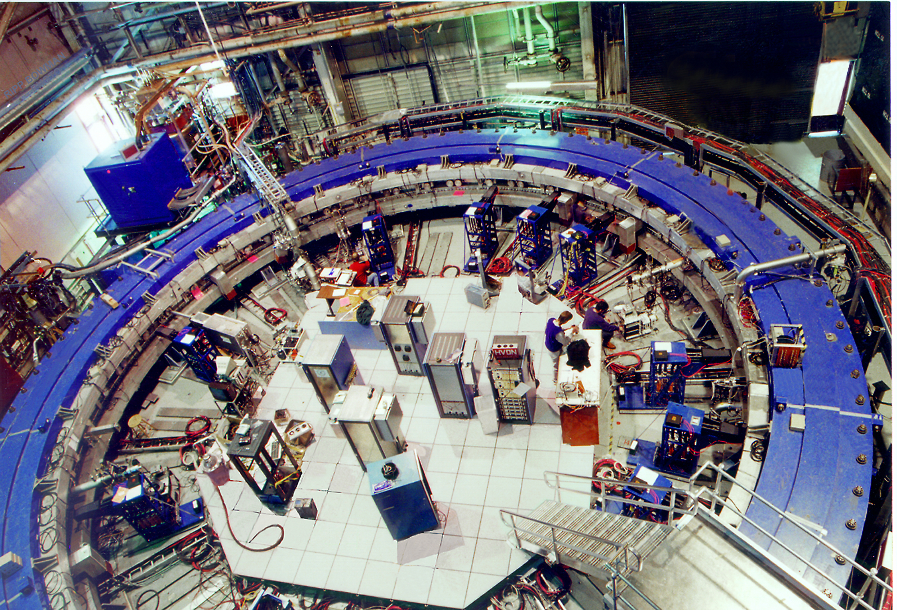
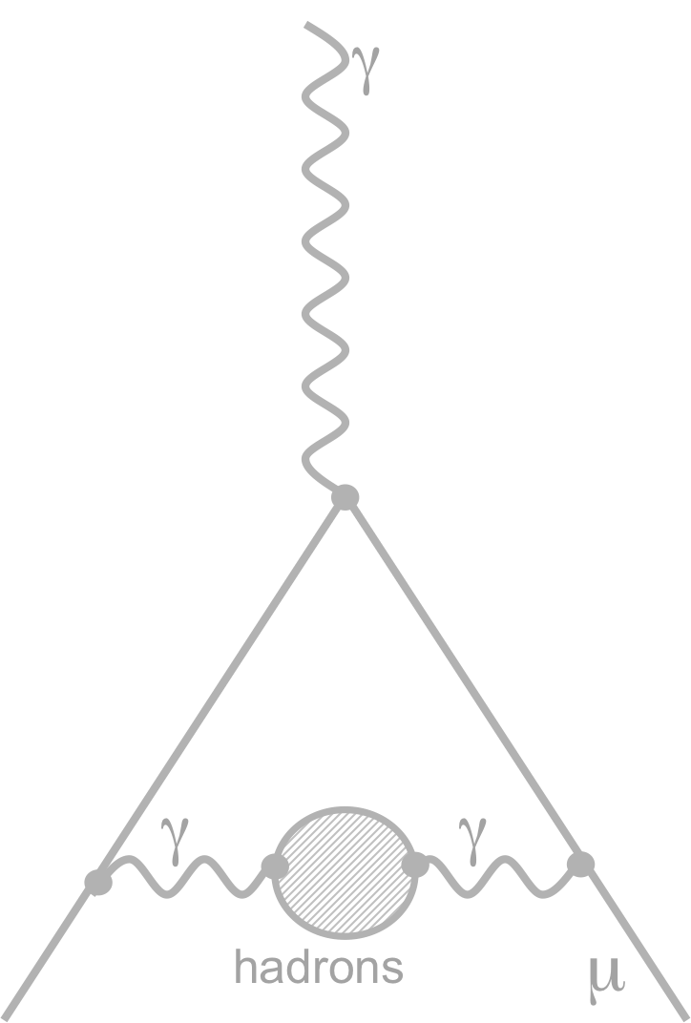
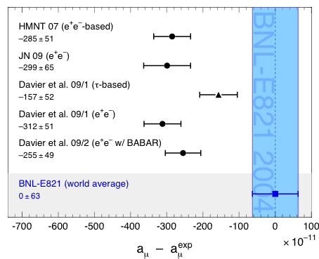
— Conclusions on the state of the art including new evaluations —
The Muon g – 2 and its Hadronic Contribution
[ … and also that of α_{QED}(M_{Z}) ] .
Andreas Hoecker (CERN)
Tau Workshop, Manchester, UK, Sep 13 – 17, 2010

Slide 2
Hadronic Contribution to Muon g – 2
→ SM error on a_{μ} dominated by hadronic part, ie, by experimental data !
In recent years, although not so visible in the final results, significant improvements in the evaluation of the hadronic contribution were obtained
BABAR and KLOE ISR data increase the redundant information on the π⁺π – channel
BABAR data very significantly improved the knowledge of many important final states
New tau data from Belle increased the redundancy on the π⁺π⁰ channel and, together with newly evaluated isospin-breaking corrections, the discrepancy with e⁺e– data could be much reduced (if not resolved, as it seems between Belle (tau) and BABAR (e⁺e–)).

Slide 3
DHMZ, Tau 2010
e⁺e– and Tau Data Comparisons

Slide 4
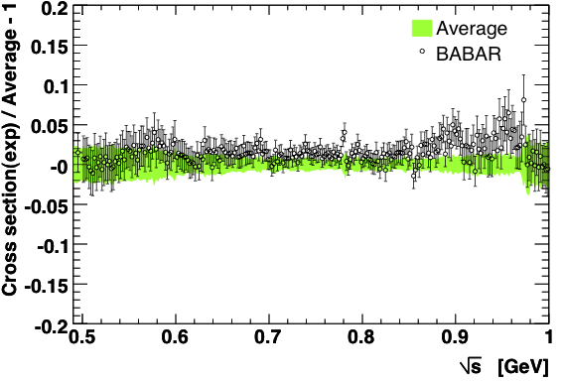
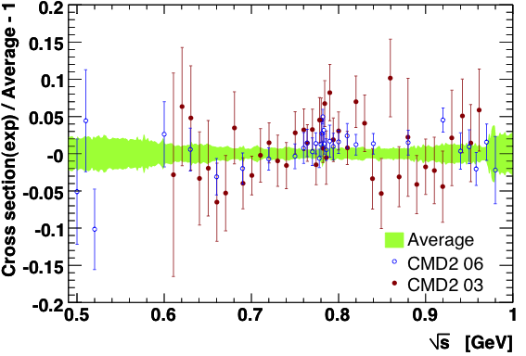
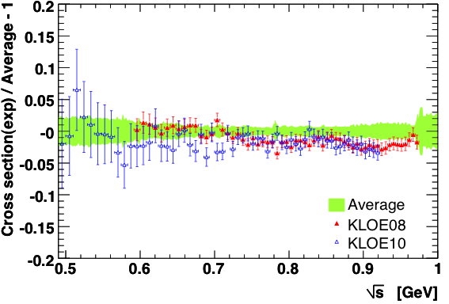
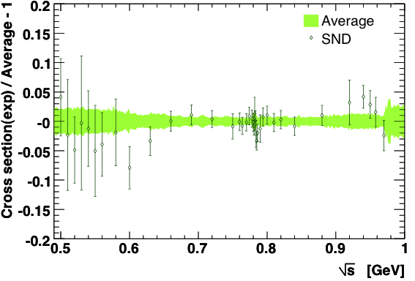
Situation of Two-Pion Channel (e⁺e–)

Slide 5
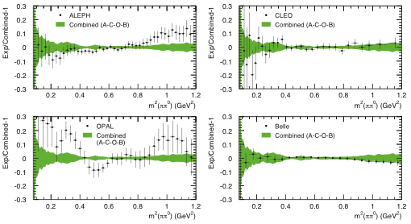
Situation of Two-Pion Channel (Tau)

Slide 6
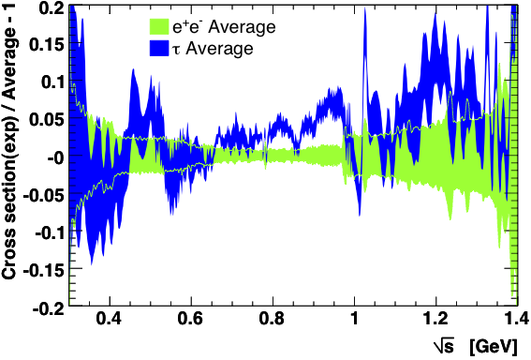
Situation in Two-Pion Channel
Good agreement between BABAR vs. Belle and CLEO Conflict between KLOE and Tau data

Slide 7
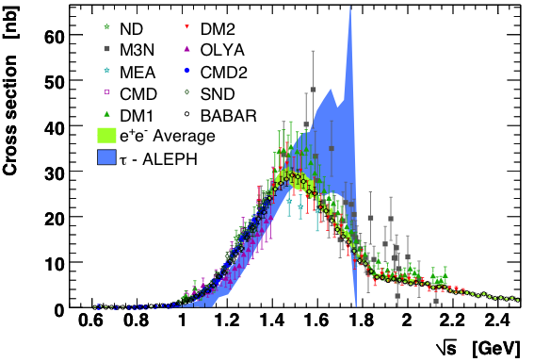
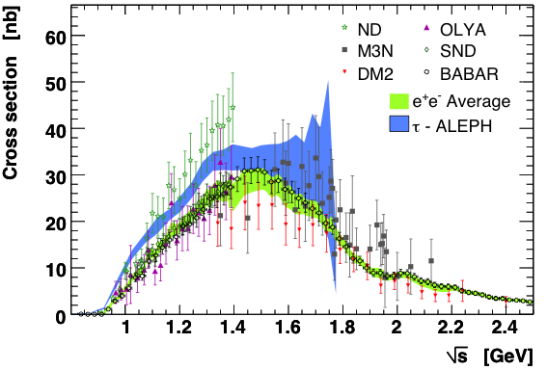
Situation in Four-Pion Channels
Recall 4π isospin relations:

Slide 8
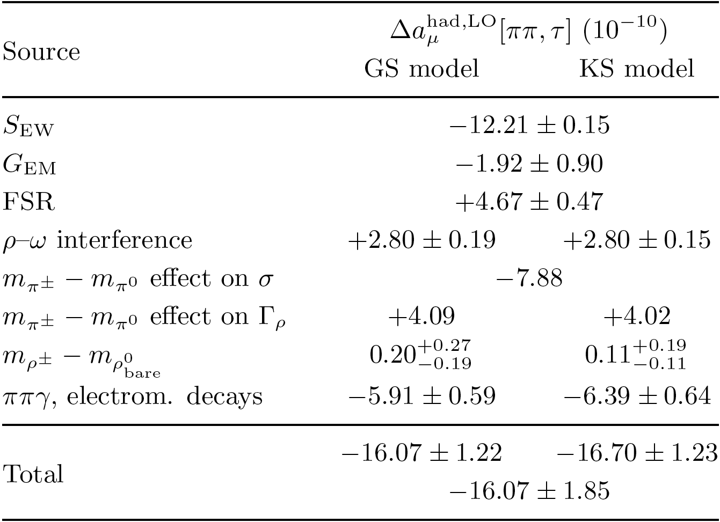
Isospin Breaking Corrections in π⁺π– Mode
Electromagnetism does not respect isospin and hence we have to consider isospin breaking when dealing with an experimental precision of 0.5%
Radiative corrections:
S_{EW} ~ 2% (short distance), G_{EM}(s) (long distance)
Charged/neutral mass splitting:
m_{π –} ≠ m_{π 0}, ρ -ω mixing, m,Γ_{ρ –} ≠ m,Γ_{ρ 0}
leads to phase space and width differences
Electromagnetic decays:
ρ → π π γ, ρ → π γ, ρ → η γ, ρ → l⁺l –
Quark mass difference:
m_{u} ≠ m_{d} negligible
Davier et al, arXiv:0906.5443

Slide 9
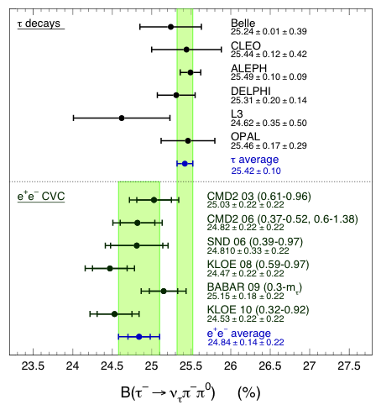
Predict Tau Branching Ratios from e⁺e–
IB corrections of +0.69 ± 0.22 applied for π⁺π⁰
Difference: BR[τ ] – BR[e⁺e – (CVC)]:
Mode | Δ(τ – e⁺e –) | “Sigma“
τ – → π – π ⁰ ν_{τ} | + 0.58 ± 0.28 | 2.1
τ – → π – 3π ⁰ ν_{τ} | – 0.03 ± 0.09 | 0.3
τ – → 2π – π ⁺ π ⁰ ν_{τ} | + 0.69 ± 0.22 | 3.2
CVC predictions of π⁺π– much improved with BABAR data and re-evaluated IB corrections (4.5σ previously) !
Davier et al, arXiv:0906.5443 (2009)

Slide 10
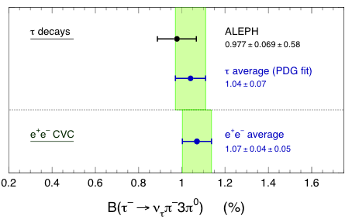
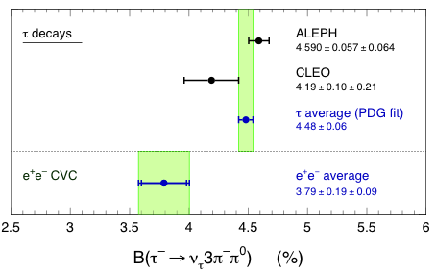

Predict Tau Branching Ratios from e⁺e–
IB corrections of +0.69 ± 0.22 applied for π⁺π⁰
Difference: BR[τ ] – BR[e⁺e – (CVC)]:
Mode | Δ(τ – e⁺e –) | “Sigma“
τ – → π – π ⁰ ν_{τ} | + 0.58 ± 0.28 | 2.1
τ – → π – 3π ⁰ ν_{τ} | – 0.03 ± 0.09 | 0.3
τ – → 2π – π ⁺ π ⁰ ν_{τ} | + 0.69 ± 0.22 | 3.2
CVC predictions of π⁺π– much improved with BABAR data and re-evaluated IB corrections (4.5σ previously) !
Davier et al, arXiv:0906.5443 (2009)

Slide 11

M. Davier, A. Hoecker, B. Malaescu, Z. Zhang (DHMZ) present …
A New Evaluation of (g – 2)_{µ} and α(M_{Z})
Use HVPTools for all channels
Include KLOE 2010 data (large photon angle)
Include preliminary 2π±2π⁰ data from BABAR
Re-estimate missing modes using new BABAR data on multi-pion and kaon modes
Use 4-loop Adler function for pQCD prediction

Slide 12
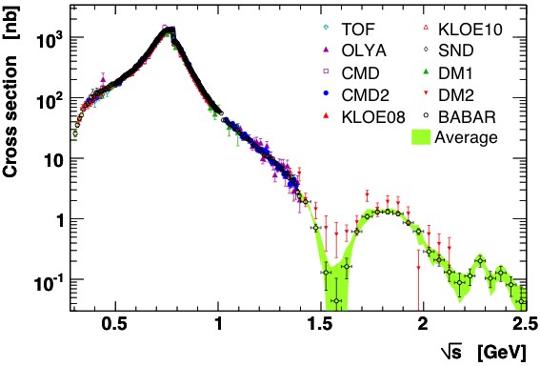
e⁺e– → π⁺π – Cross Section
Incompatibilities between data points lead to error rescaling using PDG prescription

Slide 13
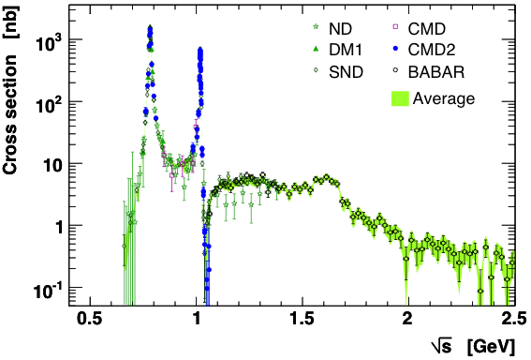
e⁺e– → π⁺π –π ⁰ Cross Section
ω
ϕ

Slide 14
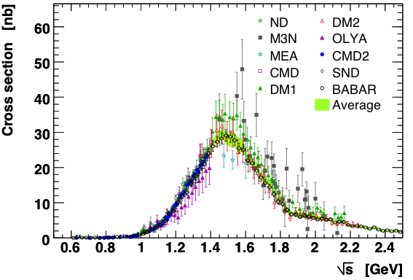
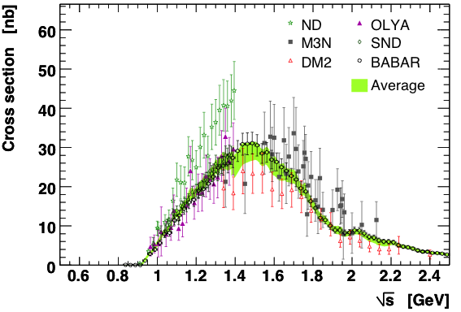
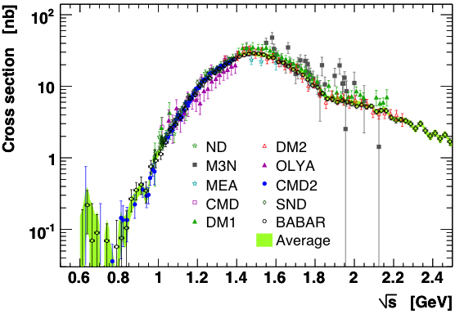
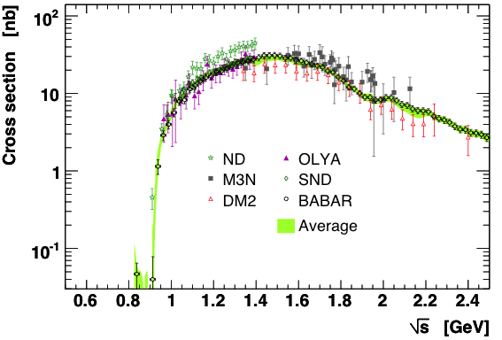
e⁺e– → 4π Cross Sections
preliminary
preliminary

Slide 15
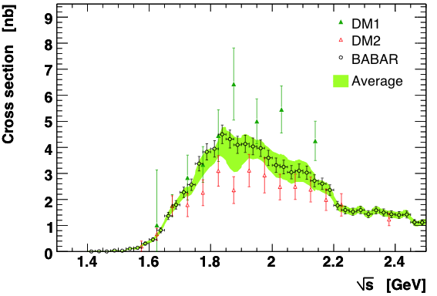
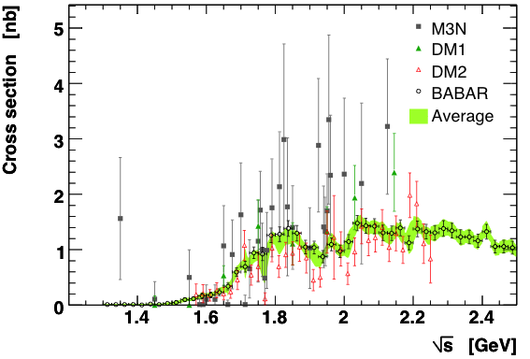
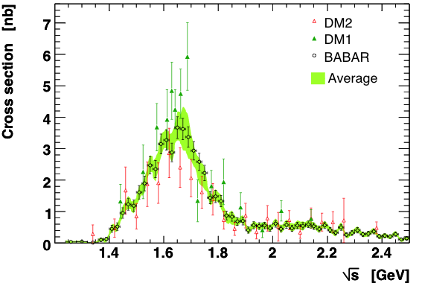
Rarer and High-Multiplicity Modes
Many rare(r) modes have been measured by BABAR (using the ISR technique), thus greatly reducing uncertainties in the determination of the dispersion integral.
Some rare modes are not known or incomplete, and must be estimated from known modes using isospin symmetry.

Slide 16
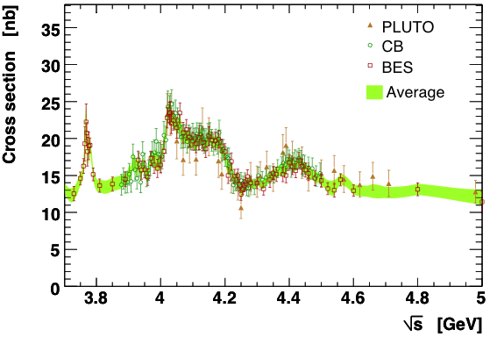
–
Inclusive Cross Section after DD Opening
ψ (4040)
ψ (3770)
ψ (4160)
ψ (4415)

Slide 17
Integrating Data
The integration of data points belonging to different experiments, with different within-experiment and inter-experiment correlated systematic errors, and with different data densities requires a careful treatment
It is mandatory to test the accurateness of the integration procedure in terms of central value and error using representative models with known truth.
DHMZ approach:
Quadratic interpolation of the data points/bins for each experiment
Local weighted average between interpolations performed in infinitesimal bins
Full covariance matrices: correlations between data points of an experiment (systematic errors), between experiments and channels (VP, luminosity, …)
Consistent error propagation using pseudo experiments
Possible bias tested in 2π channel using a GS model: negligible for quadratic interpolation, but not for linear model (trapezoidal rule)

Slide 18
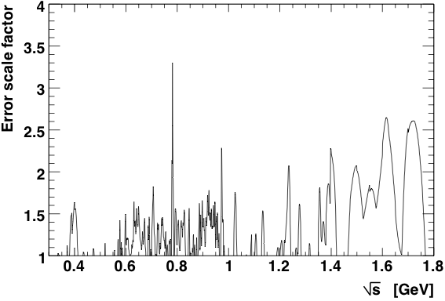
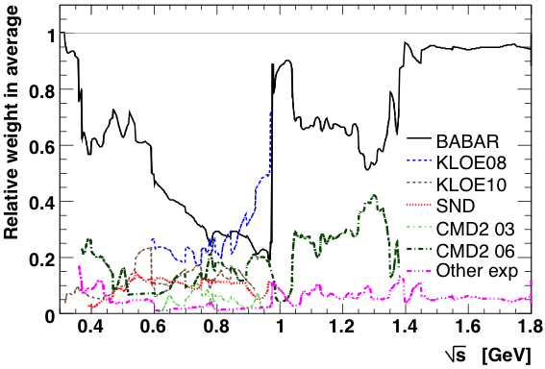
Integrating Data
Incompatibilities between data points lead to error rescaling
Performed using PDG prescription
Weights of experiments in average versus mass
BABAR dominates everywhere, except for KLOE 08 between 0.8 and 0.93 GeV

Slide 19
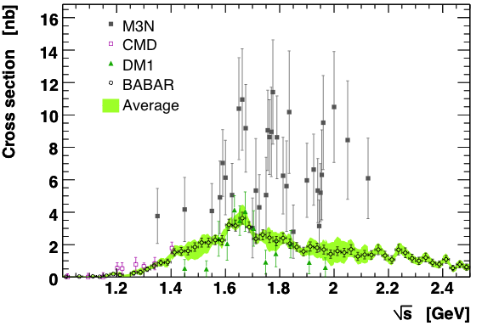
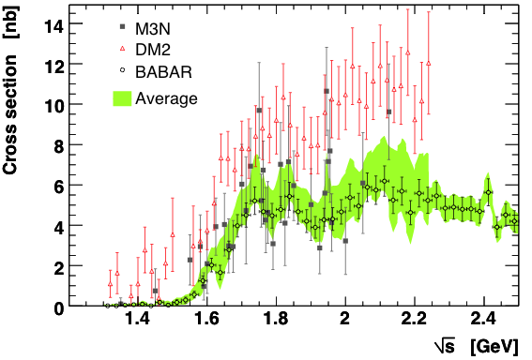
More Modes that Changed with BABAR
In several cases, bad measurements lead to overestimated cross sections

Slide 20
Determining Missing Channels
Use Pais isospin I=0,1 classification of N-pion states to derive relations between isospin-symmetric final states to constrain unmeasured channels
5-pion channels: isospin relation reads σ(2π⁺2π–π⁰) = 2×σ(π⁺π–3π⁰), but isospin-breaking (IB) ηππ contributions must be subtracted and treated apart
6-pion channels: the unknown σ(π⁺π–4π⁰) is determined from σ(3π⁺3π–) and σ(2π⁺2π–2π⁰) together with an upper limit from tau 6π data on two unconstrained Pais classes, and using the experimental fact that these modes are dominated by ω3π. IB contributions from ηω are subtracted and treated separately.
KKπ(π) channels: the missing modes K_{S}K_{L}π⁰ and K_{S}K⁺π–π⁰, K_{S}K_{S}π⁺π–, K_{S}K_{L}π⁺π– are determined from I=0,1 isospin relations using K*K dominance, and correcting for small φπ and KKρ contributions. The KKπππ contribution is determined from the measured K⁺K–π⁺π–π⁰ using observed K⁺K–ω dominance.
η4π channels: the total contribution is estimated as twice the measured σ(η2π⁺2π–)

Slide 21
Determining Missing Channels
Use Pais isospin I=0,1 classification of N-pion states to derive relations between isospin-symmetric final states to constrain unmeasured channels
5-pion channels: isospin relation reads σ(2π⁺2π–π⁰) = 2 σ(π⁺π–3π⁰), but isospin-breaking (IB) ηππ contributions must be subtracted (and re-added), and treated apart
All these estimates strongly benefit from BABAR’s measurements of rare high-multiplicity modes with and without kaons
Overall the new estimates reduce the contributions from unknown modes
6-pion channels: the unknown σ(π⁺π–4π⁰) is determined from σ(3π⁺3π–) and σ(2π⁺2π–2π⁰) together with an upper limit from tau 6π data on two unconstrained Pais classes, and using the experimental fact that these modes are dominated by ω3π. IB contributions from ηω are subtracted and treated separately.
KKπ(π) channels: the missing modes K_{S}K_{L}π⁰ and K_{S}K⁺π–π⁰, K_{S}K_{S}π⁺π–, K_{S}K_{L}π⁺π– are determined from I=0,1 isospin relations using K*K dominance, and correcting for small φπ and KKρ contributions. The KKπππ contribution is determined from the measured K⁺K–π⁺π–π⁰ using observed K⁺K–ω dominance.
η4π channels: the total contribution is estimated as twice the measured σ(η2π⁺2π–)

Slide 22
Full List of Contributions
Channel | a_{µ}^{had} (e⁺e–) | a_{µ}^{had} (τ)
π⁰ γ | 4.4 ± 0.1_{stat} ± 0.2_{syst}
π ⁺π – | 507.2 ± 1.2 ± 2.6 | 515.2 ± 3.0 ± 1.9_{IB}
π ⁺π – π⁰ | 46.0 ± 0.4 ± 1.4
2π ⁺ 2π – | 13.4 ± 0.1 ± 0.5 | 21.4 ± 1.3 ± 0.6_{IB}
π ⁺ π –2π⁰ | 18.0 ± 0.1 ± 1.2 | 12.3 ± 1.0 ± 0.4_{IB}
KK | 34.6 ± 0.3 ± 0.9
KKnπ | 3.7 ± 0.1 ± 0.4
Other exclusive modes | 6.0 ± 0.3 ± 0.3
Charm region (3.7 – 5 GeV) | 7.0 ± 0.1 ± 0.3
J /ψ, ψ (2S) | 7.9 ± 0.2
R [QCD] | 43.3 ± 0.3_{theo} | Error includes size of 4-loop term + FOPT/CIPT ambiguity
Sum | 691.4 ± 1.4 ± 4.2
All numbers given in units of 10^{–10}
Note: systematic errors partly correlated between channels !

Slide 23
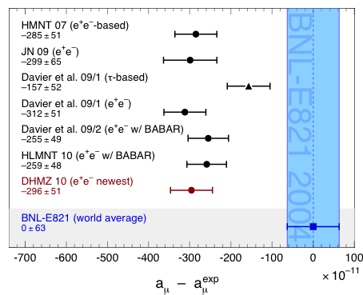
New Results for Muon g – 2
DHMZ, Tau 2010
HLMNT Tau 2010
Status: Tau2010, preliminary
Observed Difference with Experiment:
a_{μ} ^{exp} – a_{μ} SM | = | (29.6 ± 8.1) × 10 ^{–10}
 3.6 ”standard deviations“
DHMZ, Tau 2010
Note that the re-evaluated tau result would follow large part of shift (though not that due to KLOE …)
… →

Slide 24
Discussion
The Tau-2010 DHMZ result is – 4.1×10^{–10} smaller than that of 2009
(the latter of which is compatible with that of HLMNT 2010)
Origins of main changes:
π⁺π– | –1.2 | New KLOE 2010 data
π⁺π–π⁰π⁰ | +0.4 | Use preliminary BABAR data
Other exclusive modes and resonances | –2.9 | New BABAR data, improved isospin constraints on unknown modes
QCD | –0.5 | 4-loop pQCD coefficient
Many modes also have been computed for the first time with HVPTools
featuring a more precise interpolation, and better error propagation than our previous software

Slide 25
New Result for α_{QED} at M_{Z}
Also the hadronic contribution to α_{QED}(M_{Z}) has been re-evaluated:
DHMZ, Tau 2010
HLMNT, Tau 2010
The better precision of the DHMZ value with respect to HLMNT is because of the use of QCD instead of BES data between 1.8 and 3.7 GeV
(HLMNT employs QCD central values, but with BES errors)
Due to the – 40% correlation between Δα_{had}(M_{Z}) and M_{H} in the global electroweak fit, the change in the central value should increase M_{H} and reduce tension between fit and direct searches !

Slide 26
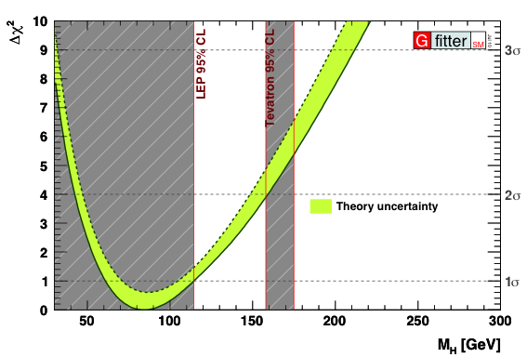
Global Electroweak Fit
Dependence of M_{H} constraint on Δα_{had}

Slide 27
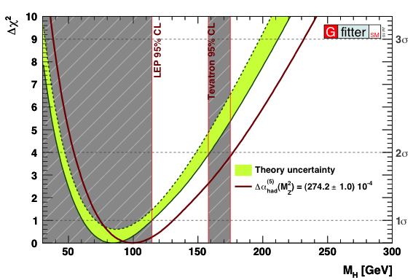
Global Electroweak Fit
Dependence of M_{H} constraint on Δα_{had}

Slide 28
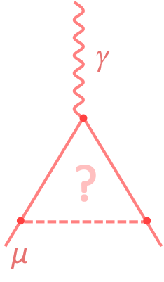
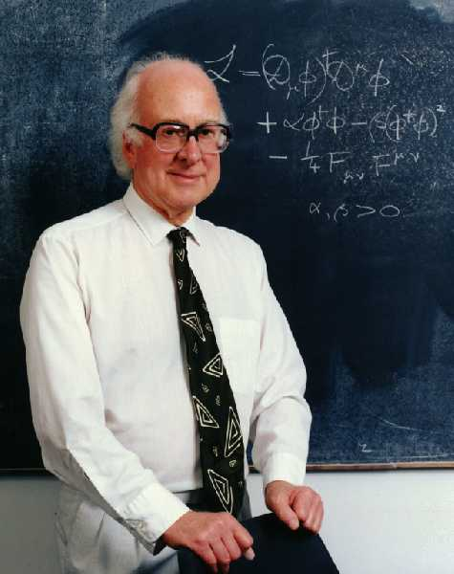
Conclusions and Perspectives
New evaluation increases SM vs. Exp discrepancy to 3.6σ
Agreement between e⁺e– and tau data improved, but still unsatisfactory in 2π and 2π2π⁰ channels
  Full agreement between BABAR (e⁺e–) and Belle (tau)
  KLOE disagrees with BABAR or tau data
New Δα_{had}(M_{Z}) value leads to +15 GeV M_{H} shift in EW fit
KLOE vs. BABAR problem must be solved
  Eagerly awaiting ππγ / µµγ ratio analysis from KLOE
  VEPP 2000 precision data also forthcoming
Must not forget to work/progress on LBLS contribution ! Error of 2.6×10^{–10} not uncontroversial; may be up to two times larger ?!

Slide 29
Conclusions and Perspectives
And (!) must further reduce experimental error !
→ See Lee Robert’s and Tsutomu Mibe’s talks !

