Slide 1
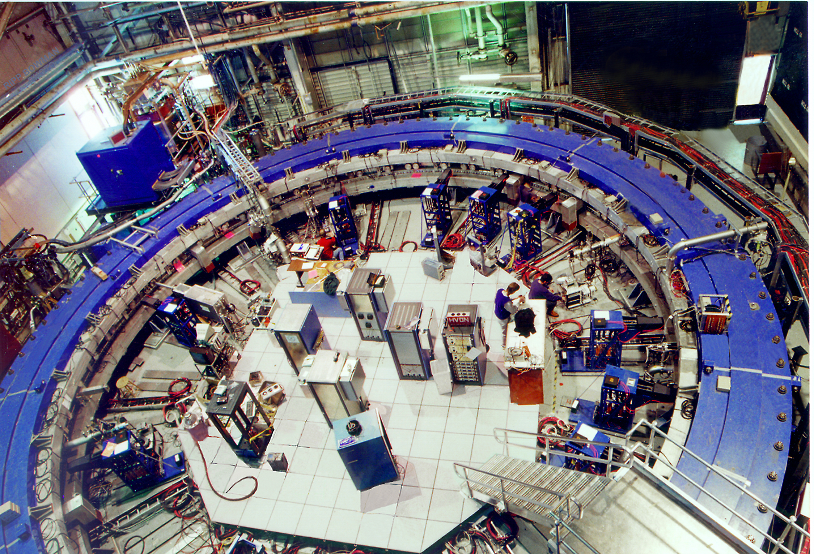
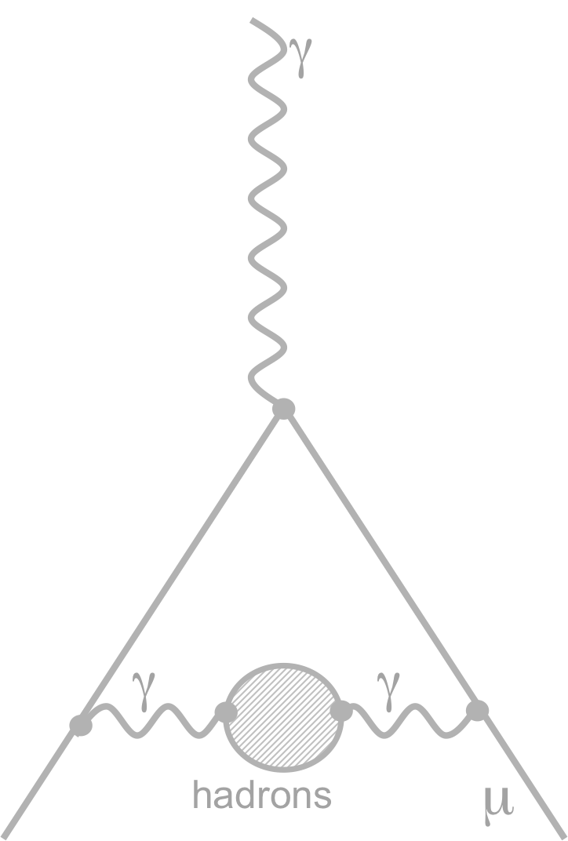
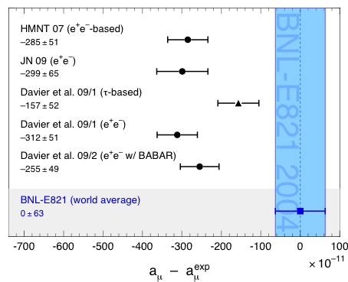
— Introduction —
The Muon g – 2 and its Hadronic Contribution
[ … and also that of α_{QED}(M_{Z}) ] .
Andreas Hoecker (CERN)
Tau Workshop, Manchester, UK, Sep 13 – 17, 2010

Slide 2
Brief Introduction to Muon g – 2

Slide 3
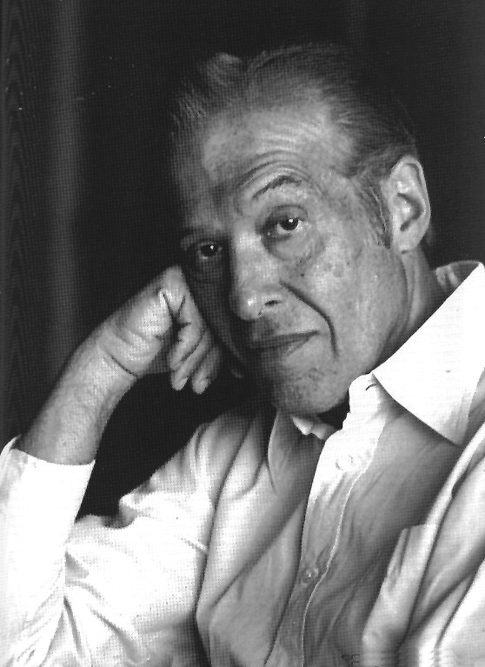
The Anomalous Magnetic Moment
Dirac’s gyromagnetic factor g = 2 is modified by virtual gauge boson and fermion exchanges
SM
QED
QED
γ
γ
γ
=
+
+ …
µ
µ
γ
µ
(g–2)_{e} ≠ 0 (full Standard Model)
(g–2)_{e} = 0 (Dirac)
coupling to virtual fields: (g–2)_{e} ≠ 0 (1st order QED)
“Anomalous” magnetic moment:
Julius Schwinger
1-loop calculation: 1948

Slide 4





Contributing diagrams:
QED
Hadronic
Weak
SUSY... ?
... or some unknown type of new physics ?
?
“Light-by-light scattering”
… or no effect on a_{µ}, but new physics at the LHC? That would be interesting as well !!

Slide 5
Quest for New Physics
The experimental precision for a will be worse than for a_{e}, so why do it ?
In lowest order, where mass effects appear, contributions from heavy virtual particles scale as m²_{e /μ} :
γ
?
Loose about a factor of 800 in experimental precision
μ
a_{μ} should be roughly 50 times more sensitive to NP than a_{e} !

Slide 6
Measuring (g – 2)_{µ}
For polarized muons moving in a uniform B field (perp. to muon spin and orbit plane), and vertically focused in E quadrupole field, the observed difference between spin precession frequency and cyclotron frequency is:
assuming, EDM = 0 !
The E dependence is eliminated at “magic γ ”: γ = 29.3 → p_{μ} = 3.09 GeV/c
The experiment measures directly (g – 2)/2 !

Slide 7
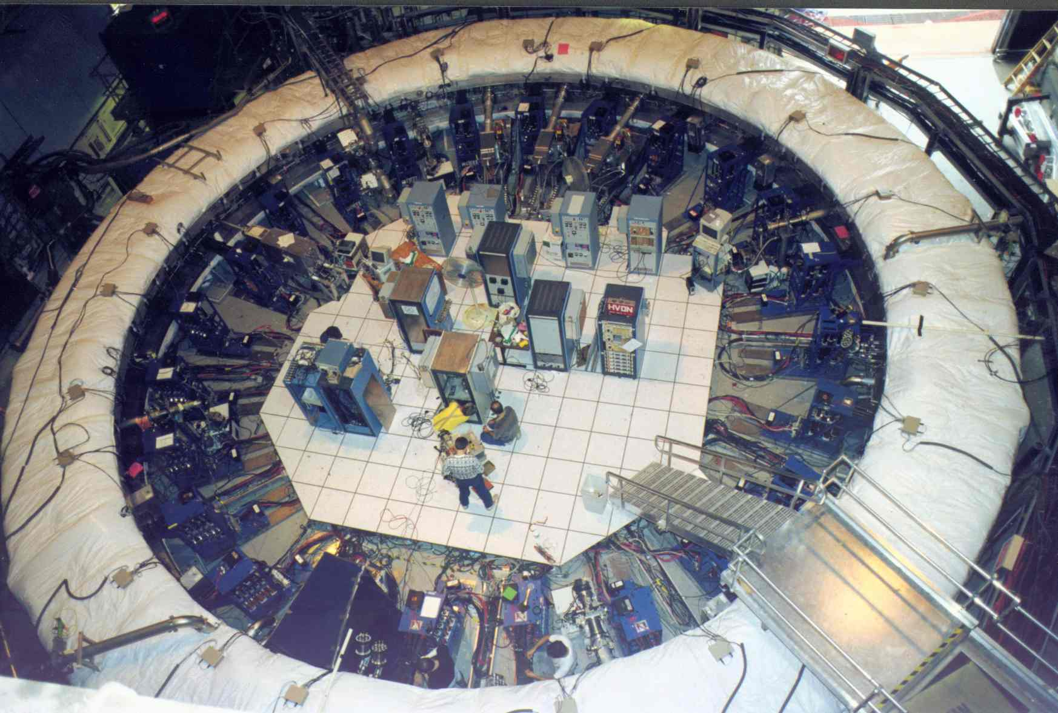
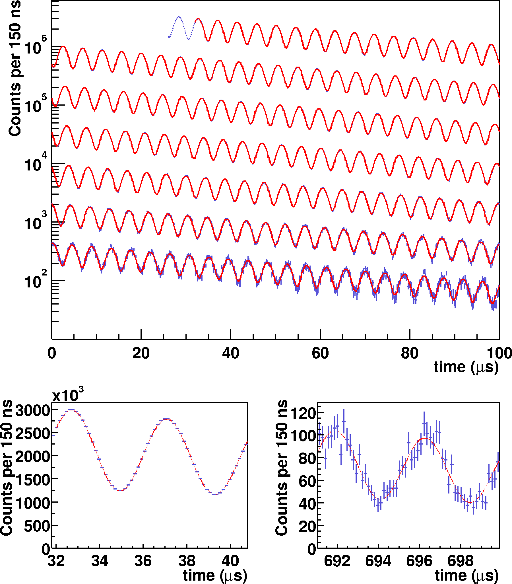
The BNL (g – 2)_{µ} Measurement
Observed positron rate in successive 100μs periods
Difference between spin preces-sion and cyclotron frequency:
obtained from fit to:
plot taken from:
E821 (g –2), hep-ex/0202024

Slide 8
The BNL (g – 2)_{µ} Measurement
Observed positron rate in successive 100μs periods
These quantities are measured independently and blind → doubly blind analysis!
Difference between spin preces-sion and cyclotron frequency:
obtained from fit to:
plot taken from:
E821 (g –2), hep-ex/0202024

Slide 9
The BNL (g – 2)_{µ} Measurement
Observed positron rate in successive 100μs periods
World average (2006 – final E821 report):
a_{μ} = 11 659 208.9 (5.4) (3.3) × 10⁻¹⁰
These quantities are measured independently and blind → doubly blind analysis!
Difference between spin preces-sion and cyclotron frequency:
E821: Phys. Rev. D73, 072003 (2006)
obtained from fit to:
plot taken from:
E821 (g –2), hep-ex/0202024

Slide 10
Confronting Experiment with Theory
The Standard Model prediction of a_{μ} is decomposed in its main contributions:
of which the hadronic contribution has the largest uncertainty!

Slide 11
The Muon g – 2 in the Standard Model
QED contribution
Using α from latest α_{e} [Gabrielse et al. PRL 97, 030802, 2006]
Computed up to 4th order
(5th order estimated)
1st order known since 1948
[J. Schwinger, PR73(48)416]
Up to 3rd order
known analytically
4th order known numerically
[T. Kinoshita et al, 1980’s]
5th order estimated recently, T. Kinoshita
& M. Nio, PRD 73, 053007, 2006

Slide 12
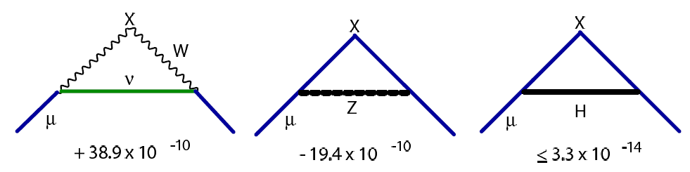
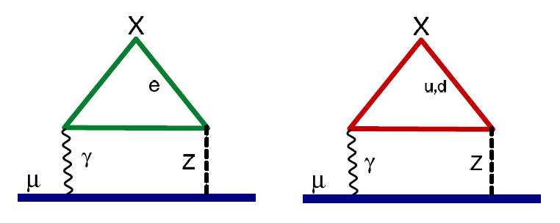
The Muon g – 2 in the Standard Model
Electroweak contribution
Computed up to 2nd order
Czarnecki et al., PRD 52, 2619 (1995); PRL 76, 3267 (1996)
2nd order contribution surprisingly large:
( due to large logs: ln[m_{Z} / m_{μ}] )
Note that between a_{μ} and a_{e}, the same sensitivity factor as for “new physics” applies here
1-loop [computed in 1972]
2-loop

Slide 13
Hadronic Contribution

Slide 14
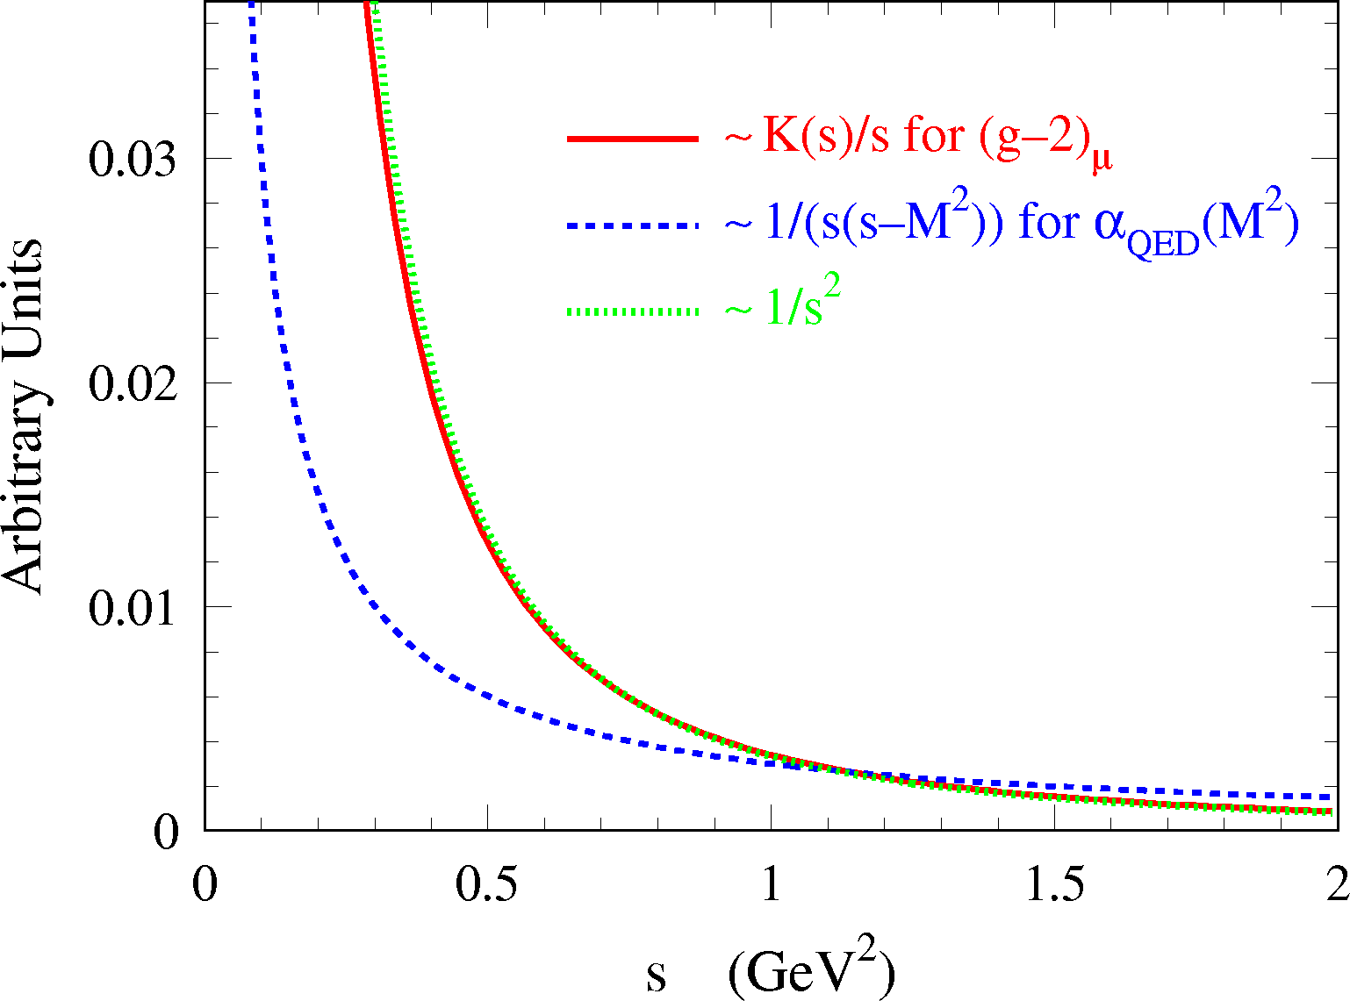
The Muon g – 2 in the Standard Model
Hadronic contribution provides the by far largest uncertainty to a_{μ}
Cannot be computed from first principles (quark loops) due to low-energy hadronic effects
Fortunately, one can use analyticity and unitarity to obtain real part of photon polarisation function from dispersion relation over total hadronic cross section data (or theory)
had
γ
Im[ ] ∝ | had |²
had
μ
γ
γ

Slide 15
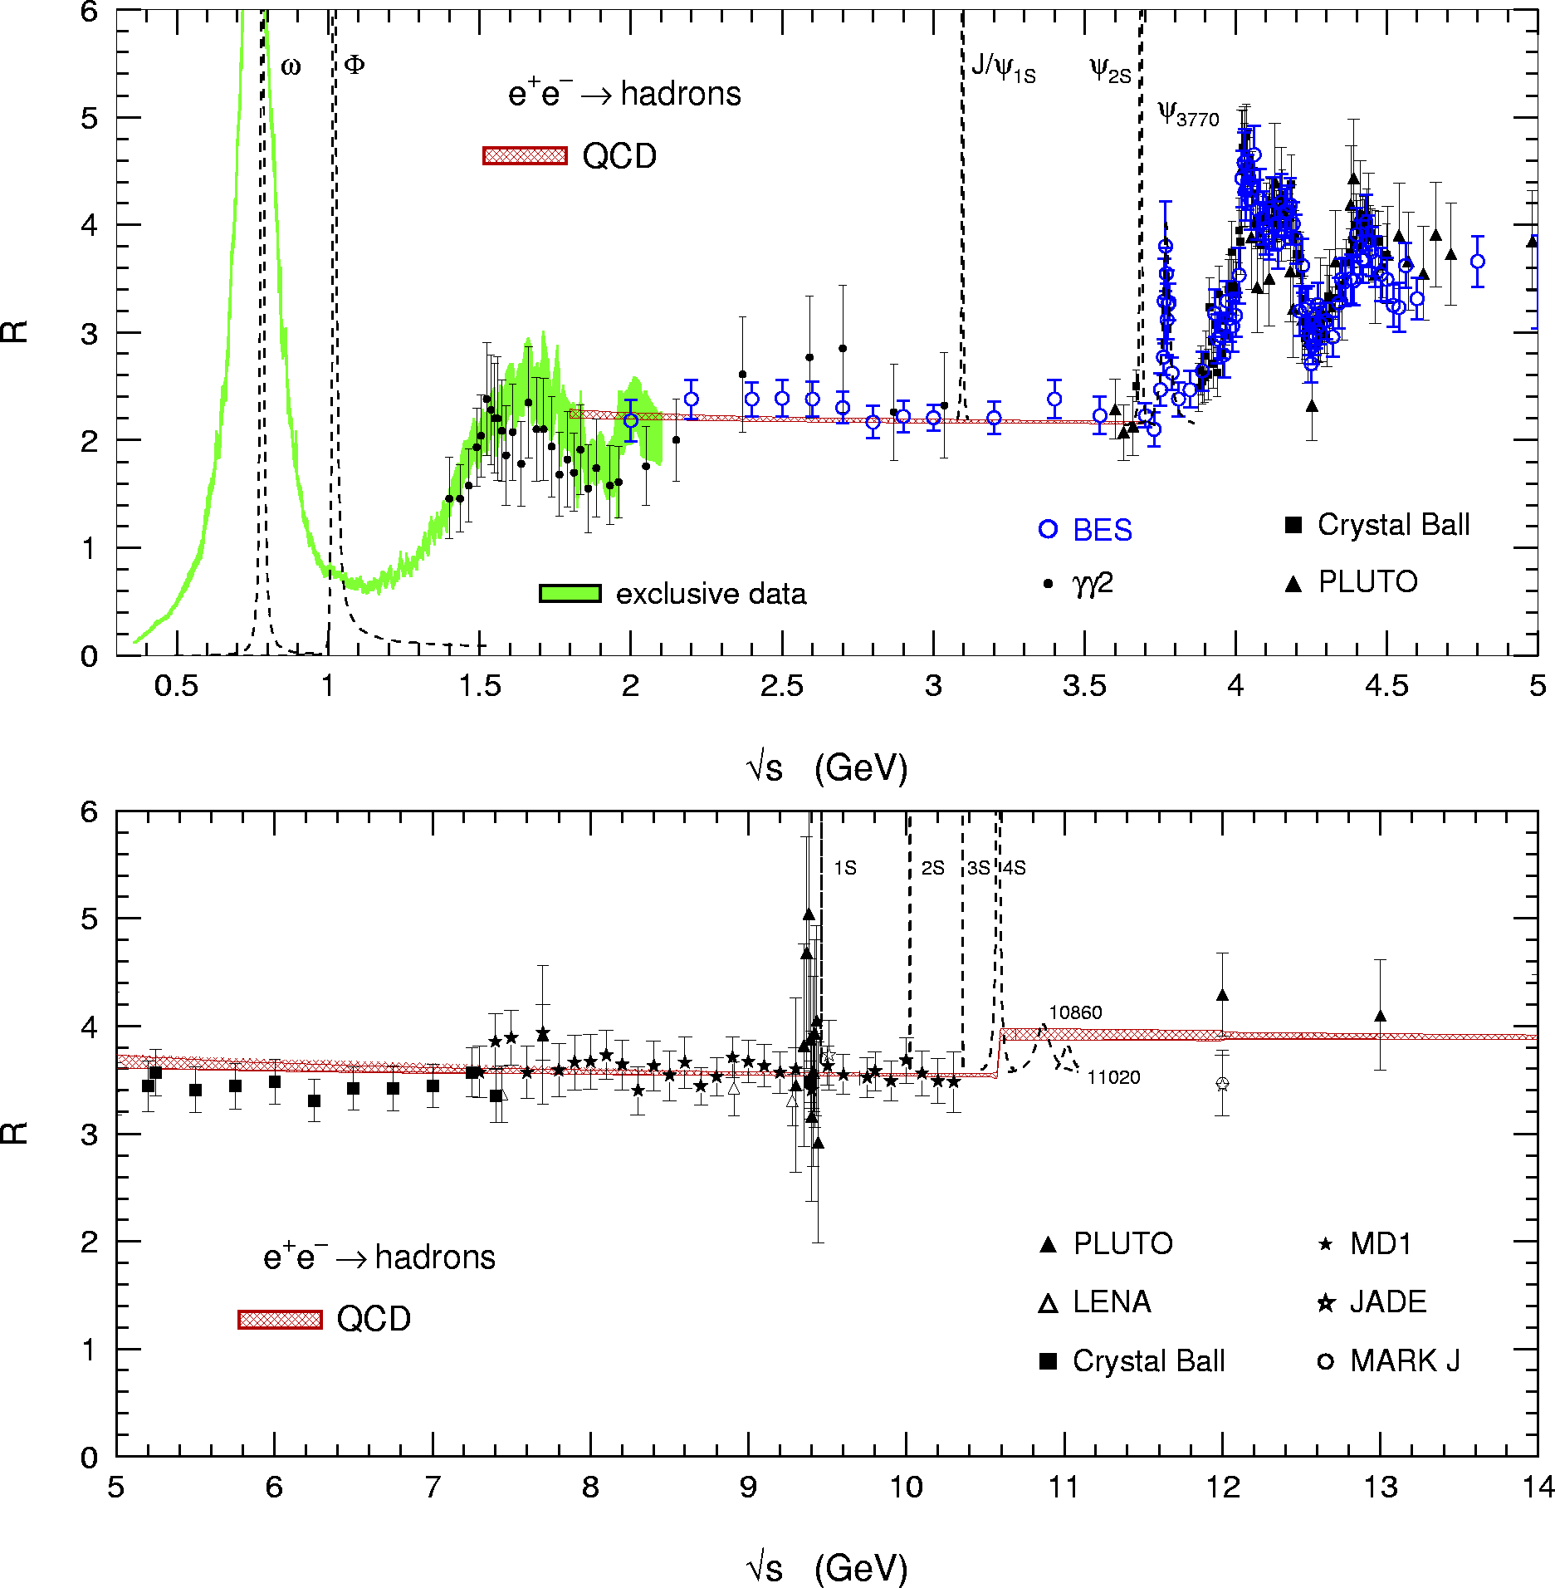
use QCD

Slide 16
use QCD
Due to the strongly decaying integration kernel, 73% of dispersion integral stems from π⁺π– channel, which must be obtained from experiment
use QCD

Slide 17
use QCD
use QCD
At low energy, the inclusive hadronic cross section is obtained by summing up to 26 exclusively measured final states, and by estimating unmeasured modes using isospin symmetry

Slide 18
Agreement between Data (BES) and pQCD (within correlated systematic errors)
use QCD
Perturbative QCD can (and should) be used away from quark thresholds in the continuum region
use QCD

Slide 19
use QCD
Experimental data must be used in the charm anti-charm resonance region
use QCD

Slide 20
Perturbative QCD can be used beyond the charm
use QCD
use QCD

Slide 21
Hadronic Contribution to Muon g – 2
[ units in10^{–10} ]
→ SM error on a_{μ} dominated by hadronic part, ie, by experimental data !
Huge 20-years effort by many experimentalists and phenomenologists to reduce error on lowest-order hadronic part:
Improved e⁺e– cross section data from Novisibirsk (Russia)
More use of perturbative QCD
Technique of “radiative return” allows to use cross section data from Φ and B factories
Isospin symmetry allows us to also use τ hadronic spectral functions

Slide 22
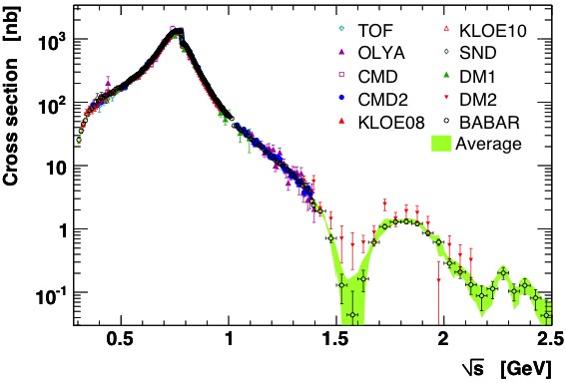
e⁺e– → π⁺π – Cross Section
Impressive precision.
Most data points dominated by systematic uncertainties that are mostly correlated between points belonging to same experiment.
Proper treatment of radiative corrections crucial!

Slide 23
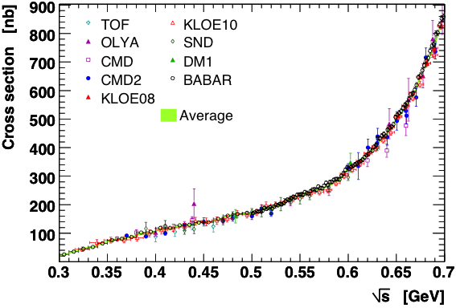
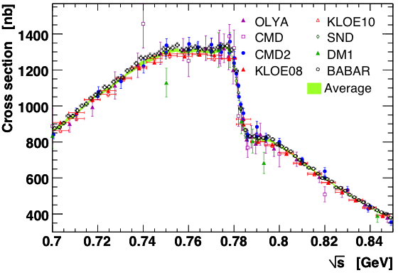
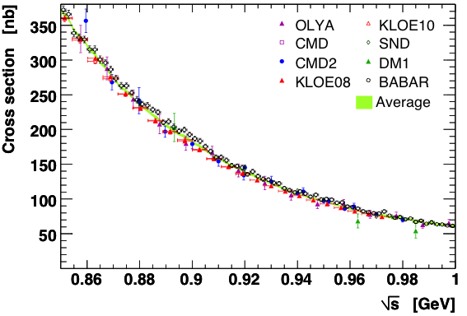
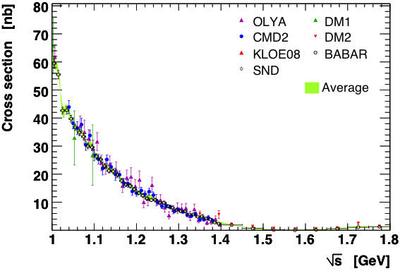
e⁺e– → 4π Cross Sections

Slide 24
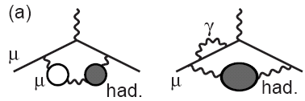
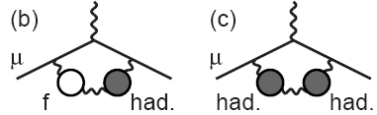
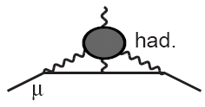
Adding all (28) Contributions Together
Hadronic LO contribution:
Davier et al. arXiv:0908.4300
Hadronic NLO contributions:
Vacuum polarization (1-loop) + additional photon or VP insertion
Computed akin to LO part via dispersion integral with modified kernel function
HLMNT 2010 (and others)
Light-by-light scattering
  Dispersion relation approach not possible (4-point function)
  No first-principle calculation yet (e.g., on the lattice)
  Model calculations using short dist. quark loops, π⁰, η⁽’⁾, … pole insertions and π± loops in the large-N_{C} limit
Prades-deRafael-Vainshtein (and others)

Slide 25
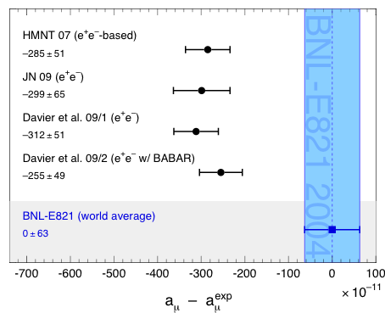
Pre-Tau-2010 Results for Muon g – 2
Davier et al. arXiv:0908.4300
Status: pre-Tau2010 !
BNL E821 (2004):
a_{μ}^{exp} = (11 659 208.9 ± 6.3) 10 ⁻¹⁰
Observed Difference with Experiment:
a_{μ} ^{exp} – a_{μ} SM | = | (25.5 ± 8.0) × 10 ^{–10}
 3.2 ”standard deviations“
Amount of discrepancy in ballpark of SUSY with mass scale of several 100 GeV !

Slide 26
Tau Hadronic Spectral Functions

Slide 27
Can exploit precise Tau data to increase precision on a_{µ}
W: I =1 & V,A
ν_{τ}
CVC: I =1 & V
γ: I =0,1 & V
e⁺
τ
γ
W
hadrons
hadrons
e –
Hadronic physics factorizes in Spectral Functions :
Isospin symmetry connects I =1 e⁺e– cross section (neutral) to τ vector spectral functions (charged):
Branching fractions Mass spectrum Kinematic factor (PS) Isospin
correction

Slide 28
Can exploit precise Tau data to increase precision on a_{µ}
In practice, used for 2π and 4π channels with isospin rotation
Tau spectral functions measured by ALEPH, Belle, CLEO, OPAL
Excellent precision of tau data. Branching ratio (ie, spectral function normalisation) for τ → ππ⁰ν known to 0.4%.
Invariant mass spectrum requires unfolding using detector simulation, which is however under good control
Main experimental challenge: abundance and shape modeling of feed-through from other tau final states
Main theoretical challenge: isospin breaking
Radiative corrections, charged vs. neutral mass splitting and electromagnetic decays: (–3.2 ± 0.4)% correction to a_{µ}^{had}

Slide 29
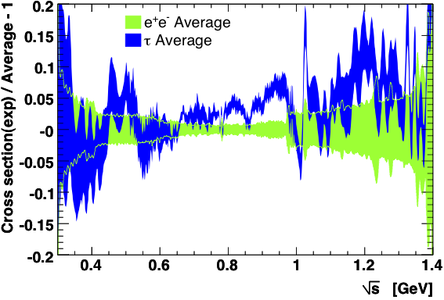
τ → ππ⁰ν Spectral Functions
Comparing tau to e⁺e– data:
DHMZ, Tau 2010
Good agreement between BABAR vs. Belle and CLEO Conflict between KLOE and Tau data
→ see talk by B. Malaescu for more detailed comparisons between all experiments

Slide 30
Pre-Tau-2010 Results for Muon g – 2
Davier et al. arXiv:0908.4300
Davier et al. arXiv: 0906.5443
Status: pre-Tau2010, including tau data !
Observed Difference with Experiment:
a_{μ} ^{exp} – a_{μ} SM | = | (15.7 ± 8.1) × 10 ^{–10}
1.9 ”standard deviations“ for τ data
Discrepancy between e⁺e– and tau data significantly reduced with new data.
In particular BABAR and Belle show excellent agreement !

Slide 31
Pre-Tau-2010 Results for Muon g – 2
Davier et al. arXiv:0908.4300
Davier et al. arXiv: 0906.5443
Status: pre-Tau2010, including tau data !
Observed Difference with Experiment:
a_{μ} ^{exp} – a_{μ} SM | = | (15.7 ± 8.1) × 10 ^{–10}
1.9 ”standard deviations“ for τ data
Discrepancy between e⁺e– and tau data significantly reduced with new data.
In particular BABAR and Belle show excellent agreement !
2010 Updates with New e⁺e– Data Later Today !

Slide 32
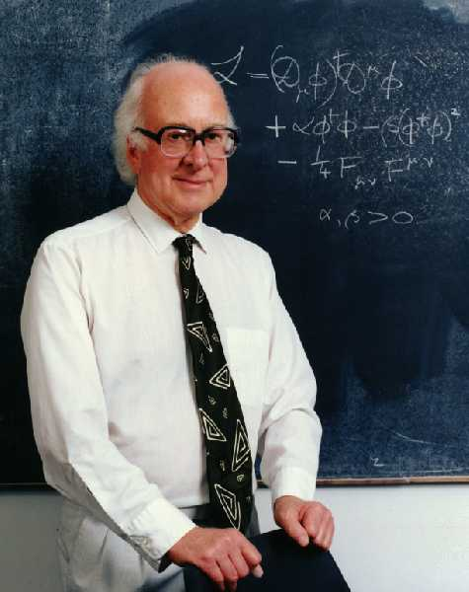
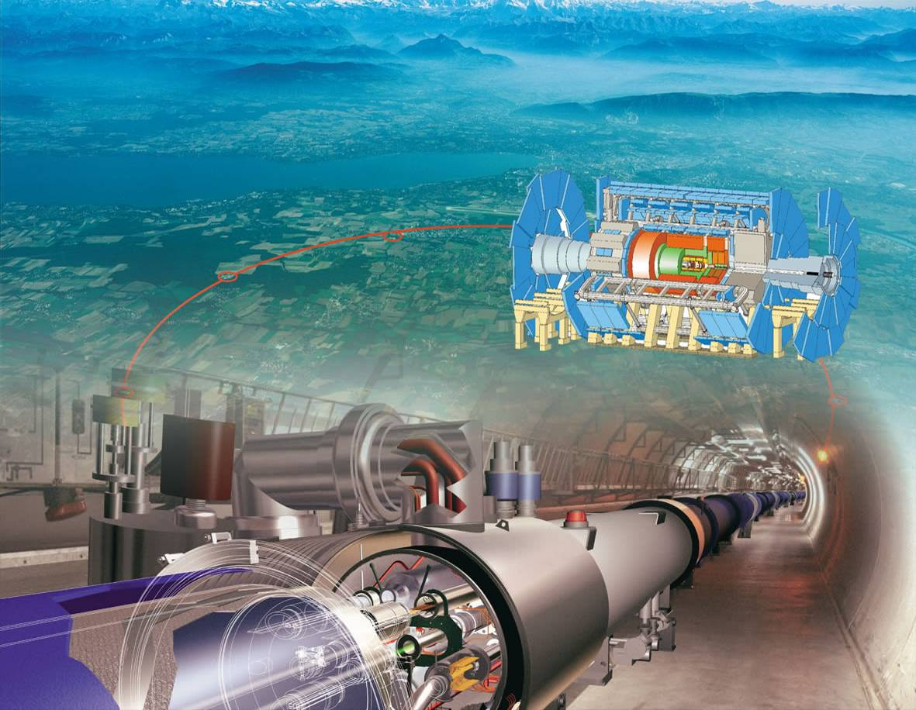
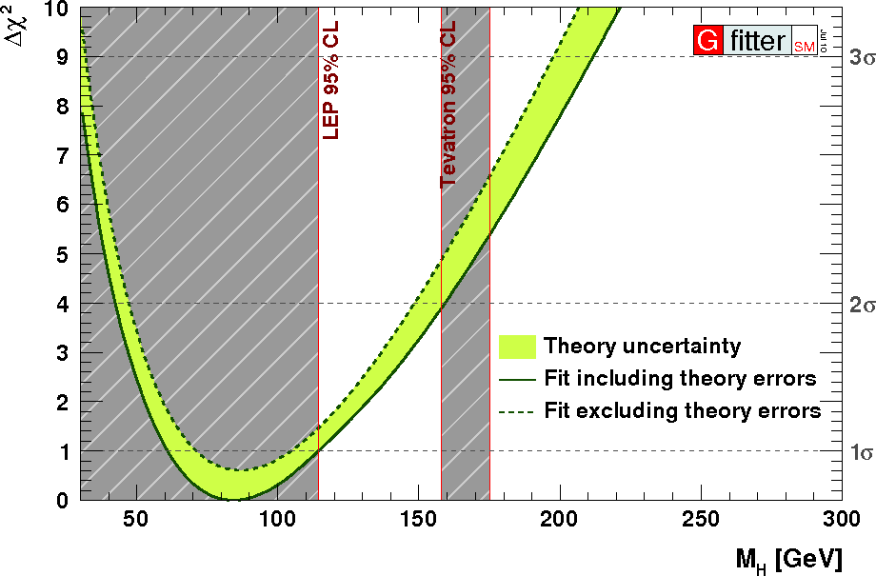
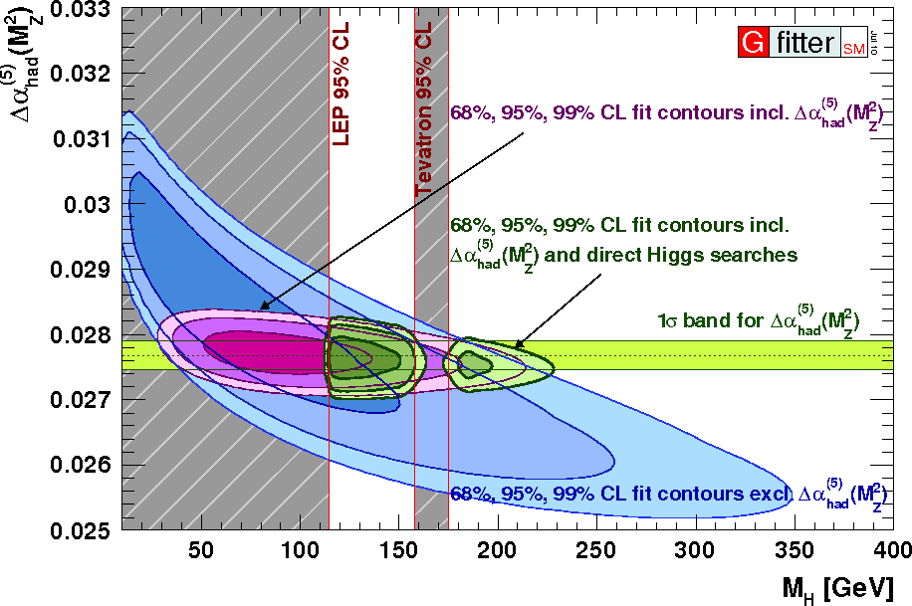
There is also the Running of α_{QED} !
Electromagnetic corrections to electroweak precision observables depend on α(M_{Z})

Slide 33
The Running α_{QED} at M_{Z}
Same principle as for g – 2: energy-dependent vacuum polarisation effects screen the bare electromagnetic coupling. Leptonic contributions computed via QED, hadronic contributions obtained from dispersion relation:
Steinhauser, hep-ph/9803313 (1998)
Integration kernel more “democratic” than for g – 2
(influence of tau data less pronounced)

Slide 34
The Running α_{QED} at M_{Z}
Same principle as for g – 2: energy-dependent vacuum polarisation effects screen the bare electromagnetic coupling. Leptonic contributions computed via QED, hadronic contributions obtained from dispersion relation:
Steinhauser, hep-ph/9803313 (1998)
Result:
HLMNT arXiv:hep-ph/0611102 (2006)
The current precision suffices for the global electroweak fit and the constraint of the Higgs boson mass, but the central value has an impact !

Slide 35
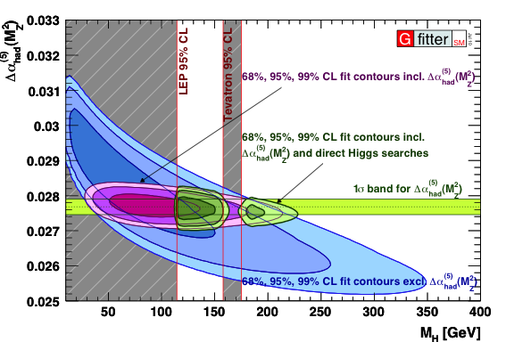
Global Electroweak Fit
Correlation between Δα_{had} and M_{H}

Slide 36
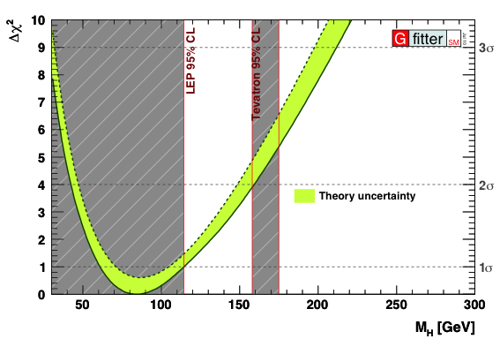
Global Electroweak Fit
Dependence of M_{H} constraint on Δα_{had}

Slide 37
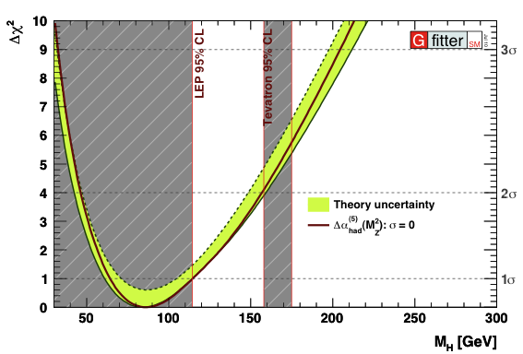
Global Electroweak Fit
Dependence of M_{H} constraint on Δα_{had}

Slide 38
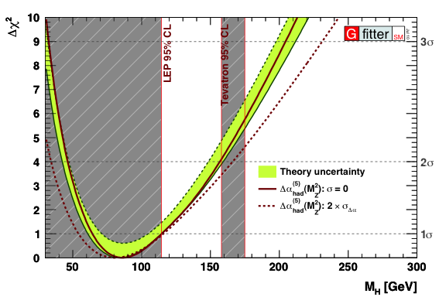
Global Electroweak Fit
Dependence of M_{H} constraint on Δα_{had}

Slide 39
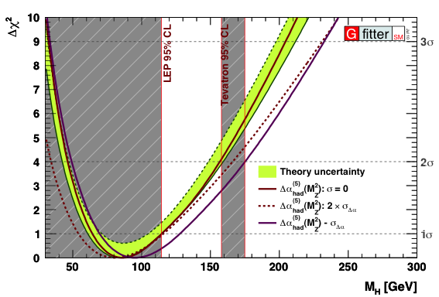
Global Electroweak Fit
Dependence of M_{H} constraint on Δα_{had}

Slide 40
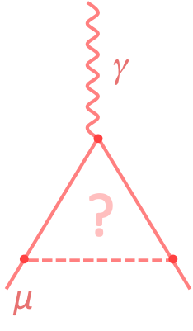
Will hear about many important results and developments at this session:
ISR simulation [Henryk Czyz]
KLOE and BABAR e⁺e– → π⁺π– results using ISR technique [Graziano Venanzoni, Bogdan Malaescu]
Hadronic cross section measurements at Novisibirsk [Boris Shwartz]
CVC tests in rare modes [Simon Eidelman]
New muon g – 2 and α(M_{Z}) results [Thomas Teubner, AH]
Future muon g – 2 experimental projects [Lee Roberts, Tsutomu Mibe]

