Slide 1
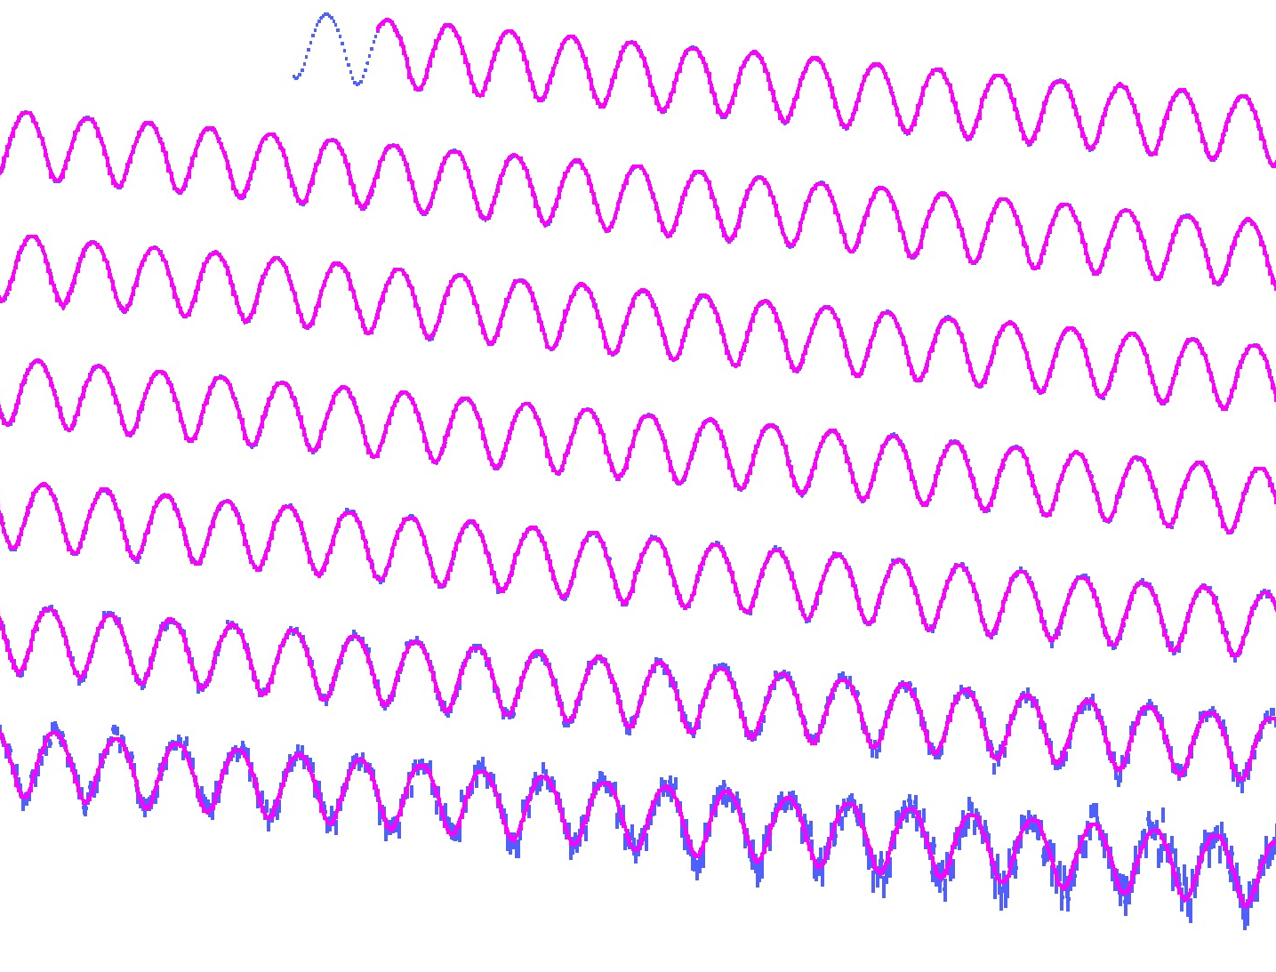
Hadronic vacuum polarization contributions to the muon g–2 and to 𝛼_{QED}(m_{Z})
Andreas Hoecker (CERN)
Ultimate Precision at Hadron Colliders Workshop, Paris-Saclay, Nov 29, 2019
Work in collaboration with M. Davier, B. Malaescu, Z. Zhang (DHMZ) [arXiv:1908.00921 (2019)]

Slide 2
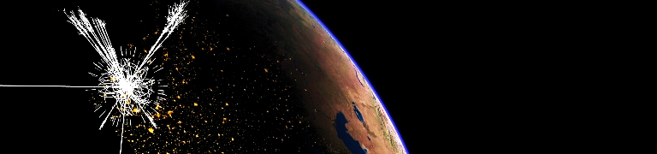
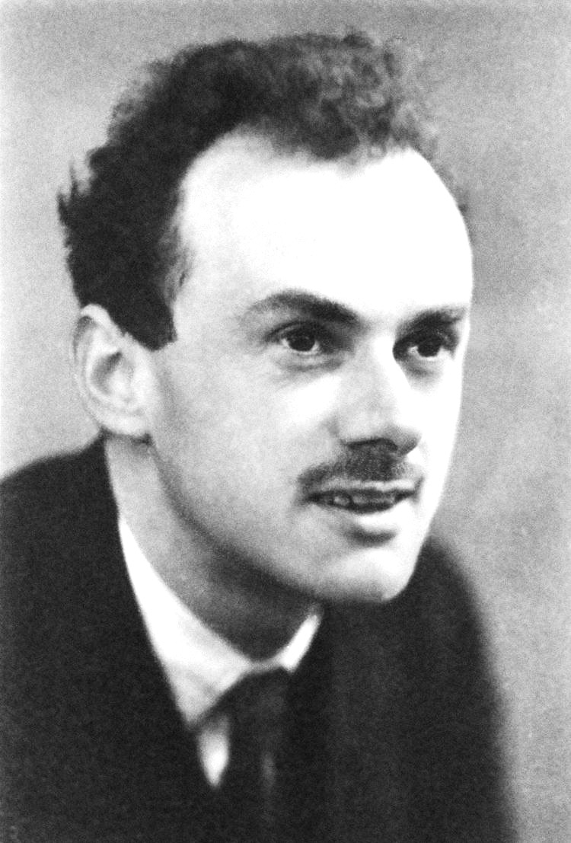



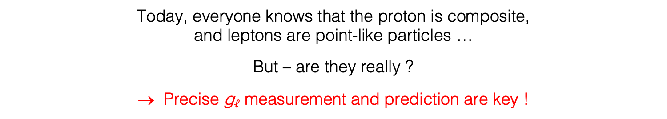
Lepton g factor
Dirac’s relativistic theory of the electron (1928) naturally accounted for quantized particle spin and described elementary spin-1/2 particles
In the classical limit, one finds the Pauli equation with magnetic moment:
$\overset{⃑}{μ}={−g}_{ℓ}\frac{e}{2m_{ℓ}}\overset{⃑}{S}$ ,
with ${|g}_{ℓ}|=2$ the gyromagnetic factor
(and radius $R_{ℓ}=0$, ie, elementary !)
Paul Dirac
Where $g_{p}/g_{e}=2.8$ hinted that the proton is not elementary
Today, everyone knows that the proton is composite,
and leptons are point-like particles …
But – are they really ?
→ Precise g$ℓ$ measurement and prediction are key !

Slide 3

The anomalous magnetic moment of the muon
Evolution versus running year [ hep-ex/0602035 ]
BNL-E821 final result (1997–2001 data):
$$a_{μ}=\frac{g_{μ}−2}{2}=11 659 209.1 (5.4)(3.3) ∙{10}^{−10}$$
(0.54 ppm precision, assumes CPT invariance)
[ Muon g–2, E821, hep-ex/0602035 with updated value for λ ]
Agreement between μ⁺ and μ – results
μ⁺
μ⁺
μ⁺
μ⁺
μ–
Evolution of experimental sensitivity:
[ See, eg, Miller, de Rafael, Roberts, hep-ph/0703049 ]
Experiment | Beam | Measurement | δa_{μ} / a_{μ} |  | Required theor. terms
Columbia-Nevis (‘57) | μ⁺ | g = 2.00 (σ = 0.10) |  |  | g = 2
Columbia-Nevis (‘60) | μ⁺ | 0.001 13 (+16)(–12) | 12 % |  | α/2π
CERN 1 (SC, 1961) | μ⁺ | 0.001 145 (22) | 1.9 % |  | α/2π
CERN 1 (SC, 1962) | μ⁺ | 0.001 162 (5) | 0.43 % |  | (α/π)²
CERN 2 (PS, 1968) | μ⁺ | 0.001 166 16 (31) | 266 ppm |  | (α/π)³
CERN 3 (PS, 1979) | μ± | 0.001 165 923 0 (84) | 7.2 ppm |  | (α/π)³ + had (60 ppm)
BNL E821 (1997–2001) | μ± | 0.001 165 920 91 (63) | 0.54 ppm |  | (α/π)⁴ + had + weak + ?
Muon behaves like heavy electron
Electrostatic focusing, magic γ

Slide 4
The anomalous magnetic moment of the muon
Evolution versus running year [ hep-ex/0602035 ]
BNL-E821 final result (1997–2001 data):
$$a_{μ}=\frac{g_{μ}−2}{2}=11 659 209.1 (5.4)(3.3) ∙{10}^{−10}$$
(0.54 ppm precision, assumes CPT invariance)
[ Muon g–2, E821, hep-ex/0602035 with updated value for λ ]
Agreement between μ⁺ and μ – results
μ⁺
μ⁺
μ⁺
μ⁺
μ–
Next is Fermilab’s new Muon g–2 Experiment
Evolution of experimental sensitivity:
[ See, eg, Miller, de Rafael, Roberts, hep-ph/0703049 ]
Experiment | Beam | Measurement | δa_{μ} / a_{μ} |  | Required theor. terms
Columbia-Nevis (‘57) | μ⁺ | g = 2.00 (σ = 0.10) |  |  | g = 2
Columbia-Nevis (‘60) | μ⁺ | 0.001 13 (+16)(–12) | 12 % |  | α/2π
CERN 1 (SC, 1961) | μ⁺ | 0.001 145 (22) | 1.9 % |  | α/2π
CERN 1 (SC, 1962) | μ⁺ | 0.001 162 (5) | 0.43 % |  | (α/π)²
CERN 2 (PS, 1968) | μ⁺ | 0.001 166 16 (31) | 266 ppm |  | (α/π)³
CERN 3 (PS, 1979) | μ± | 0.001 165 923 0 (84) | 7.2 ppm |  | (α/π)³ + had (60 ppm)
BNL E821 (1997–2001) | μ± | 0.001 165 920 91 (63) | 0.54 ppm |  | (α/π)⁴ + had + weak + ?
Muon behaves like heavy electron
Electrostatic focusing, magic γ

Slide 5

Confronting Experiment with Theory
The Standard Model prediction of a_{μ} is traditionally decomposed in its main contributions:
$$a_{μ}^{SM}=\frac{g_{μ}−2}{2}=a_{μ}^{QED}+a_{μ}^{EW}+a_{μ}^{Had}$$
of which the hadronic contribution has the largest uncertainty

Slide 6
Confronting Experiment with Theory
QED
Electroweak
Hadronic
SUSY ?
Some other type of new physics?
?

Slide 7


QED contribution
Known to 5 loops, good convergence, diagrams with internal electron loops enhanced:
$$a_{μ}^{QED}=\frac{α}{2π}+0.765 857 425(17){\left(\frac{α}{π}\right)}^{2}+ 24.050 509 96\left(32\right){\left(\frac{α}{π}\right)}^{3}$$
3-loop light-by-light scattering with electron loop
[ Schwinger term ]
$$+ 130.880\left(6\right){\left(\frac{α}{π}\right)}^{4}+ 752.2\left(1.0\right){\left(\frac{α}{π}\right)}^{5}$$
[ 5-loop: Aoyama, Hayakawa, Kinoshita, Nio, 1205.5370 (2012) ]
Using α ^{–1} = 137.035 999 046 (27) from a precise measurement* of h / m_{Cs} (0.2 ppb!), gives:
$$a_{μ}^{QED}=11 658 471.892(0.003)∙{10}^{−10}$$
Parker et al, 2018
with negligible uncertainty compared to experimental error of $6.3∙{10}^{−10}$
*From Parker et al., Science Vol. 360, Issue 6385, 191 (2018), reporting 2.4σ tension with α from electron g–2

Slide 8
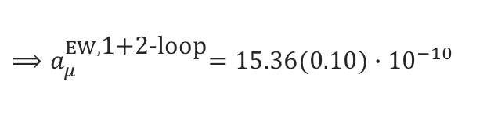
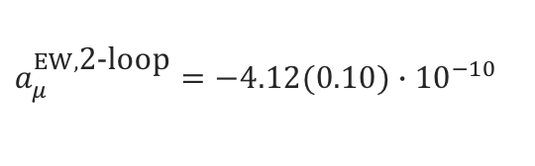

Electroweak contribution
$$\frac{α}{π}\frac{m_{μ}^{2}}{m_{W}^{2}}≈4∙{10}^{−9}$$
EW contribution involving W, Z or Higgs is suppressed at least by a factor:
The first loop gives: [ Jackiw, Weinberg and others 1972 ]
$$a_{μ}^{EW,\text{1−}\text{loop}}=\frac{{G_{F}m}_{μ}^{2}}{8\sqrt{2}π^{2}}\left[\frac{5}{3}+\frac{1}{3}{\left(1−4\sin^{2}θ_{W}\right)}^{2}+𝒪\left(\frac{m_{μ}^{2}}{m_{W}^{2}}\right)+𝒪\left(\frac{m_{μ}^{2}}{m_{H}^{2}}\right)\right]=19.48∙{10}^{−10}$$
1-loop diagrams (some cancellation between W/Z graphs)
Two-loop contribution surprisingly large due to large ln(m_{Z} /m_{μ}): [ Czarnecki, Krause, Marciano, 1995, and others ]
$$a_{μ}^{EW,\text{2−}\text{loop}}=−4.12(0.10)∙{10}^{−10}$$
2-loop diagrams (+ Higgs exchange)
$${⟹a}_{μ}^{EW,\text{1+2−}\text{loop}}=15.36(0.10)∙{10}^{−10}$$
Three-loop leading logarithms are found to be small (~10^{–12}) [ Degrassi, Giudice, hep-ph/9803384, and others ]

Slide 9
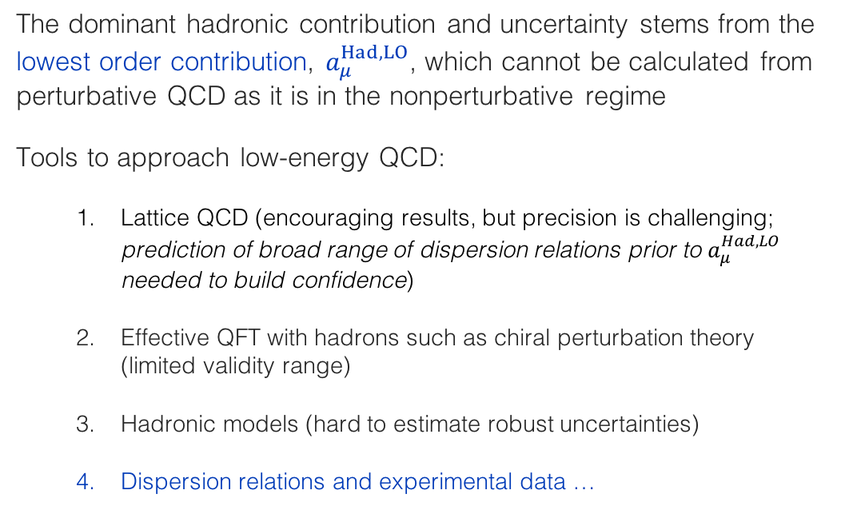
Hadronic contribution
The dominant hadronic contribution and uncertainty stems from the lowest order contribution, $a_{μ}^{Had,LO}$, which cannot be calculated from perturbative QCD as it is in the nonperturbative regime
Tools to approach low-energy QCD:
  Lattice QCD (encouraging results, but precision is challenging; prediction of broad range of dispersion relations prior to $a_{μ}^{Had,LO}$ needed to build confidence)
  Effective QFT with hadrons such as chiral perturbation theory (limited validity range)
  Hadronic models (hard to estimate robust uncertainties)
  Dispersion relations and experimental data …

Slide 10
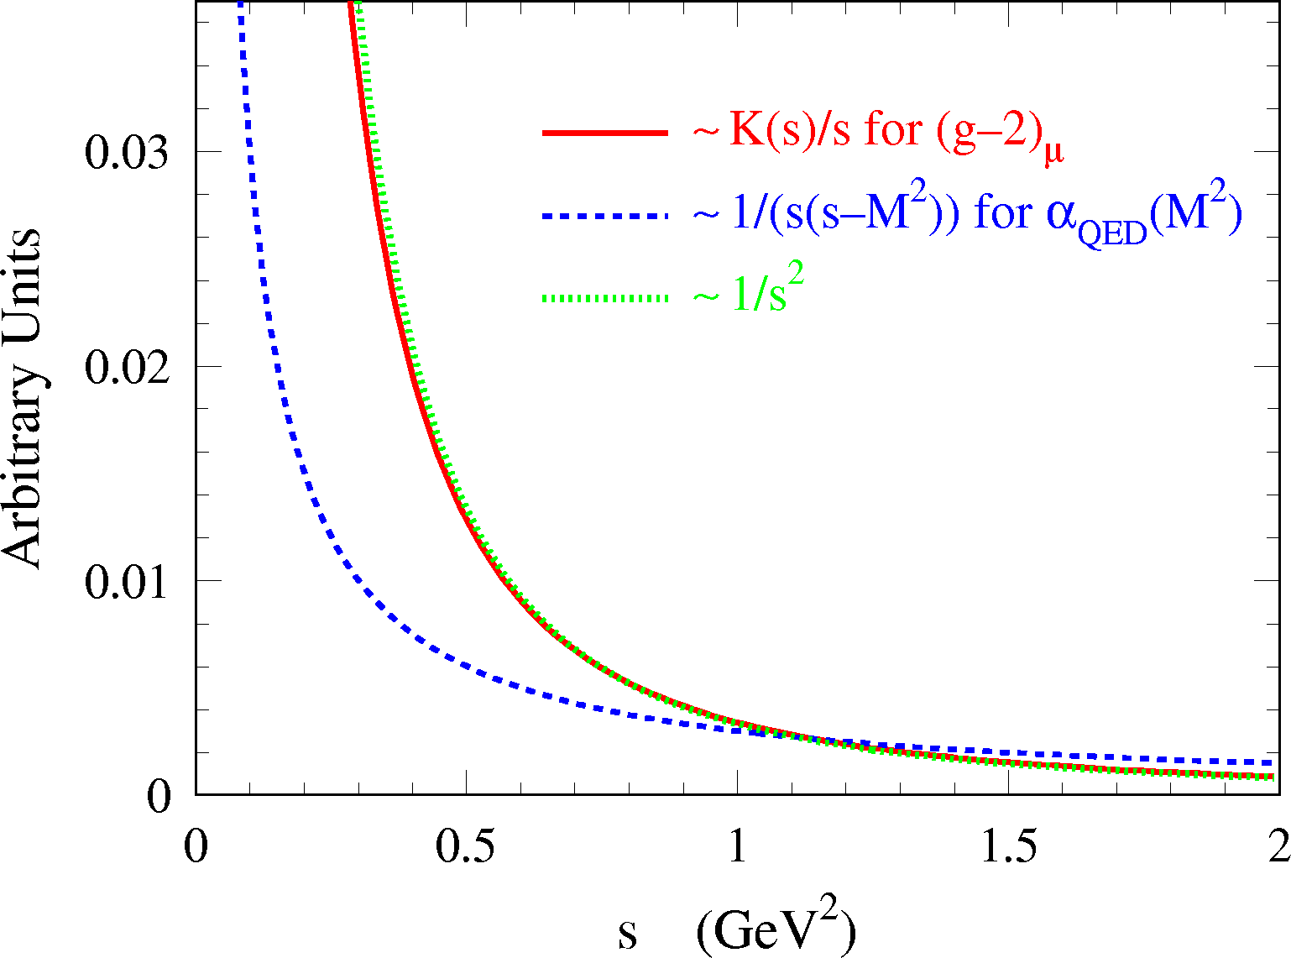

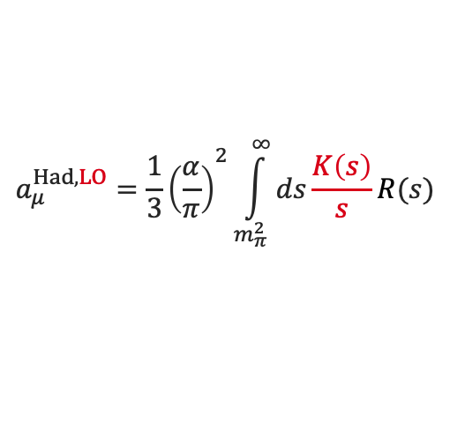

Lowest-order hadronic contribution
The lowest-order hadronic contribution to a_{μ} can be obtained from a dispersion relation:
[ Bouchiat, Michel, 1961 ]
[ Brodsky, de Rafael, 1968 ]
$$a_{μ}^{Had,LO}={\frac{1}{3}\left(\frac{α}{π}\right)}^{2}\int_{m_{π}^{2}}^{∞}{ds\frac{K\left(s\right)}{s}R(s)}$$
Integration kernel falls steeply with s, → emphasis on low-mass R (s ), which is dominated by low-multiplicity exclusive hadronic states, such as e⁺e– → 𝜋⁺𝜋–
Where: $R\left(s\right)=\frac{σ(e^{+}e^{−}→ hadrons)}{σ(e^{+}e^{−}→{ μ}^{+}μ^{−})}$
Recent estimate (2019):
$${⟹a}_{μ}^{Had,LO}=693.9(4.0)∙{10}^{−10}$$
[ Davier-Hoecker-Malaescu-Zhang (DHMZ), 1908.00921 (2019) ]
→ dominant uncertainty in SM prediction

Slide 11
The hadronic contribution to the muon g –2
All hadronic contributions (LO, NLO, NNLO), except for light-by-light scattering (LBLS), can be obtained via dispersion relations using a mix of experimental data and perturbative QCD
γ
The LBLS contribution is a four-point function that is currently estimated using meson models
had
γ
μ

Slide 12
The hadronic contribution to the muon g –2
In the following, all a_{μ} numbers are given in units of 10 ^{–10}

Slide 13
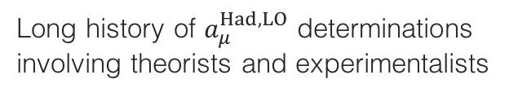
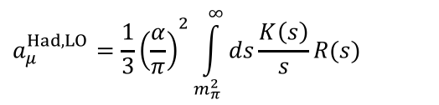
Introduction
Long history of $a_{μ}^{Had,LO}$ determinations involving theorists and experimentalists
$$a_{μ}^{Had,LO}={\frac{1}{3}\left(\frac{α}{π}\right)}^{2}\int_{m_{π}^{2}}^{∞}{ds\frac{K\left(s\right)}{s}R(s)}$$
Improvement mostly driven by better e⁺e – → hadrons data (intermittently also hadronic tau decays used to improve over insufficient-quality low-mass e⁺e – data)
The understanding of the data and the treatment of their uncertainties improved over time
Sum-rule tests allowed to expand the use of perturbative QCD to predict R (s)
Fairly consistent picture reached

Slide 14
The challenge
The dispersion relation is solved using a mix of e⁺e – → had data and QCD, depending on √s
Davier, Hoecker, Zhang, hep-ph/0507078 (2005) — FIGURE OUTDATED, FOR ILLUSTRATION ONLY
[ 𝜋⁰ γ – 1.8 GeV ]: sum of 32 exclusive channels; very few unmeasured channels are estimated using isospin symmetry
[ 1.8 – 3.7 GeV ]: agreement between data and QCD for uds continuum → more precise QCD NNNLO used; J/𝜓 & 𝜓(2S) resonances from Breit-Wigner forms
[ 3.7 – 5.0 GeV ]: open charm pair production: use of data
[ 5.0 GeV – ]: NNNLO QCD (assuming global quark-hadron duality to hold across bb threshold)
∞

Slide 15
Data combination procedure
The combination of data with dominant systematic uncertainties and sometimes discrepancies among datasets is a delicate procedure that requires care. The stake (new physics or not in the muon g–2) is high, so a (reasonably) conservative approach is mandatory.
Our procedure is as follows:
Quadratic interpolation (splines) of adjacent data points is performed for each experiment
A local combination of the interpolations of different datasets is computed in bins of 1 MeV, or in narrower bins for the ω, φ resonances
The test statistic for the local combination (conservatively) uses local information only, avoiding constraints from potentially badly controlled long-range correlations of systematic uncertainties
Where data are locally inconsistent, the uncertainty of the combination is rescaled following the PDG prescription
The uncertainties on the combined dataset and dispersion integral are computed using pseudo-experiments generated taking into account all known correlations between datapoints and datasets
The full procedure has been validated using pseudo-experiments with known truth

Slide 16
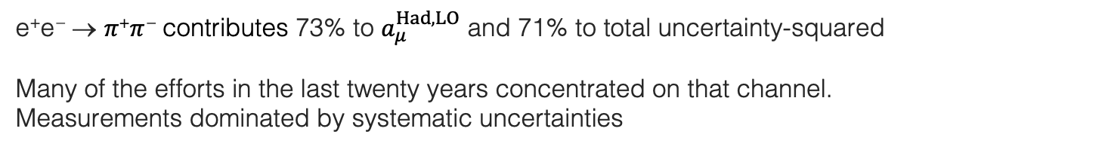
The dominant e ⁺e – → 𝜋⁺𝜋 – contribution
e⁺e – → 𝜋⁺𝜋 – contributes 73% to $a_{μ}^{Had,LO}$ and 71% to total uncertainty-squared
Many of the efforts in the last twenty years concentrated on that channel. Measurements dominated by systematic uncertainties
Relative to uncertainty² due to quadratic addition
Compilation and combination: DHMZ, arXiv:1908.00921 (2019)
Three types of input data:
Energy scans: CMD-2 (δ_{syst} ~ 0.8%), SND (δ_{syst} ~ 1.5%), + DM1, DM2, OLYA, TOF
ISR-based measurements: BABAR (δ_{syst} ~ 0.5%), BES-III (δ_{syst} ~ 0.9%), KLOE (δ_{syst} ~ 0.8–1.4%)
Hadronic tau decay data via isospin symmetry (CVC): ALEPH, OPAL, CLEO, Belle (δ_{syst-combined} ~ 0.7%),
𝜌(770)
𝜌–𝜔 mixing
𝜌(1450)
𝜌(1700)
Data combination
𝜌(2300) ?
e ⁺e – → 𝜋⁺𝜋 –

Slide 17
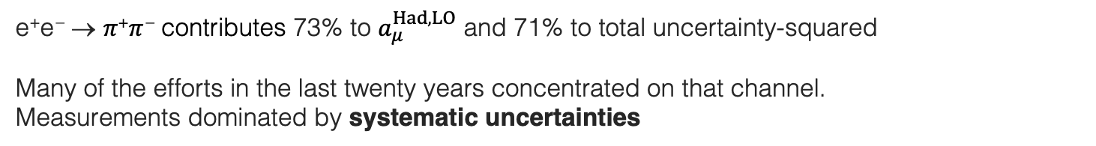
The dominant e ⁺e – → 𝜋⁺𝜋 – contribution
e⁺e – → 𝜋⁺𝜋 – contributes 73% to $a_{μ}^{Had,LO}$ and 71% to total uncertainty-squared
Many of the efforts in the last twenty years concentrated on that channel. Measurements dominated by systematic uncertainties
Relative to uncertainty² due to quadratic addition
Three types of input data:
Energy scans: CMD-2 (δ_{syst} ~ 0.8%), SND (δ_{syst} ~ 1.5%), + DM1, DM2, OLYA, TOF
ISR-based measurements: BABAR (δ_{syst} ~ 0.5%), BES-III (δ_{syst} ~ 0.9%), KLOE (δ_{syst} ~ 0.8–1.4%)
Hadronic tau decay data via isospin symmetry (CVC): ALEPH, OPAL, CLEO, Belle (δ_{syst-combined} ~ 0.7%),
Dominant systematic uncertainties / challenges: (in parentheses uncertainties for best measurements)
Energy scan measurements (ex. CMD-2 / 0.8%): detection efficiency, radiative corrections (0.4%), beam energy (0.3%), …
ISR-based measurements (ex. BABAR / >0.5%): pion identification (0.3%), μ ⁺μ – reference (0.4%), …
Tau data (ALEPH, 0.3% on normalisation): 𝜋 ⁰ and photon reconstruction (0.2%), hadronic interactions (0.2%), isospin-violating effects → not used anymore
Huge amount of precision data, but — with a close look — one notices issues…

Slide 18
The dominant e ⁺e – → 𝜋⁺𝜋 – contribution
Compilation and combination: DHMZ, arXiv:1908.00921 (2019)

Slide 19
The dominant e ⁺e – → 𝜋⁺𝜋 – contribution
Compilation and combination: DHMZ, arXiv:1908.00921 (2019)
Local discrepancies

Slide 20
The dominant e⁺e – → 𝜋⁺𝜋 – contribution — impact on a_{μ}
Weight in combination
Uncertainty scale factor due to local inconsistency
Comparison of results between 0.6–0.9 GeV for the various experiments.
In case of CMD-2 all available measurements have been combined using HVPTools. For KLOE the result from the public combination is displayed.
Removing from full combination BABAR or KLOE, respectively, leads to a difference of 5.6 ×10^{–10}, which (despite local error rescaling) is not covered by uncertainty of 2.1 ×10^{–10}
Add half of difference as additional
uncertainty to a_{μ} [𝜋⁺𝜋 –]

Slide 21
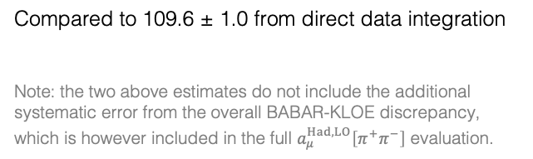


Phenomenological fit of 𝜋⁺𝜋 – threshold region
Use phenomenological fit to supplement less precise data in the low-energy domain < 0.6 GeV
Following approach of Hanhart et al, arXiv:1611.09359
Form factor expressed as unitary Breit-Wigner incl. $ρ−ω$ mixing with 6 fit parameters
Fit performed using conservative diagonal test statistic to avoid biased central values. Parameter and integration uncertainties determined via pseudo-experiments taking into account all known correlations
Evaluation between 0.3 – 0.6 GeV gives:
$${σ(a}_{μ}^{Had,LO})\left[π^{+}π^{−}\right]=109.8±{0.4}_{exp}±{0.4}_{model}$$
Compared to 109.6 ± 1.0 from direct data integration
Note: the two above estimates do not include the additional systematic error from the overall BABAR-KLOE discrepancy, which is however included in the full $a_{μ}^{Had,LO}\left[π^{+}π^{−}\right]$ evaluation.
Fit range
p-value (data | fit) = 0.27
Used for $a_{μ}^{Had,LO}\left[π^{+}π^{−}\right]$

Slide 22
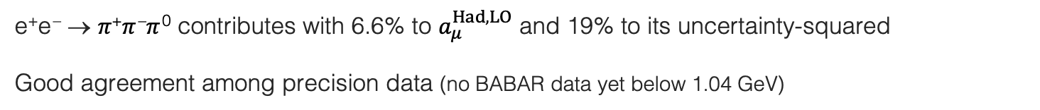
The e⁺e – → 𝜋⁺𝜋 –𝜋 ⁰ contribution
e⁺e – → 𝜋⁺𝜋 –𝜋 ⁰ contributes with 6.6% to $a_{μ}^{Had,LO}$ and 19% to its uncertainty-squared
Good agreement among precision data (no BABAR data yet below 1.04 GeV)
Compilation and combination: DHMZ, Davier 1612.02743 (2016)
𝜔(782) → 𝜋⁺𝜋 –𝜋 ⁰ w/ 89%
𝜙(1020) → 𝜋⁺𝜋 –𝜋 ⁰ w/ 15%

Slide 23
The e⁺e – → 𝜋⁺𝜋 –𝜋 ⁰ contribution
e⁺e – → 𝜋⁺𝜋 –𝜋 ⁰ contributes with 6.6% to $a_{μ}^{Had,LO}$ and 19% to its uncertainty-squared
Good agreement among precision data (no BABAR data yet below 1.04 GeV)
Compilation and combination: DHMZ, Davier 1612.02743 (2016)
𝜔(782) → 𝜋⁺𝜋 –𝜋 ⁰ w/ 89%
𝜙(1020) → 𝜋⁺𝜋 –𝜋 ⁰ w/ 15%
𝜔(782) → 𝜋⁺𝜋 –𝜋 ⁰ w/ 89%
𝜙(1020) → 𝜋⁺𝜋 –𝜋 ⁰ w/ 15%

Slide 24
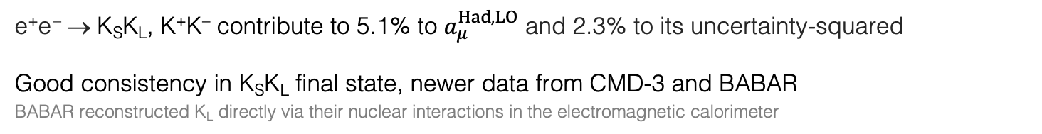
The e⁺e – → K_{S}K_{L}, K⁺K– contributions
e⁺e – → K_{S}K_{L}, K⁺K– contribute to 5.1% to $a_{μ}^{Had,LO}$ and 2.3% to its uncertainty-squared
Good consistency in K_{S}K_{L} final state, newer data from CMD-3 and BABAR
BABAR reconstructed K_{L} directly via their nuclear interactions in the electromagnetic calorimeter
Compilation and combination: DHMZ, Davier 1612.02743 (2016)

Slide 25
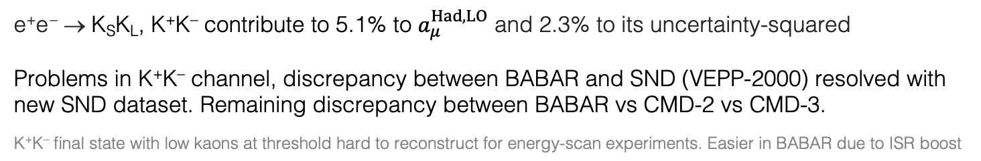
The e⁺e – → K_{S}K_{L}, K⁺K– contributions
e⁺e – → K_{S}K_{L}, K⁺K– contribute to 5.1% to $a_{μ}^{Had,LO}$ and 2.3% to its uncertainty-squared
Problems in K⁺K– channel, discrepancy between BABAR and SND (VEPP-2000) resolved with new SND dataset. Remaining discrepancy between BABAR vs CMD-2 vs CMD-3.
K⁺K– final state with low kaons at threshold hard to reconstruct for energy-scan experiments. Easier in BABAR due to ISR boost
Compilation and combination: DHMZ, arXiv:1908.00921 (2019)
Large error rescaling in combination
BABAR (σ_{syst} = 0.7%) higher by 5.1% than CMD-2 (σ_{syst} = 2.2%), but 5.5% lower than CMD-3 (σ_{syst} = 2.2%)
Overall difference of 11%, not covered by CMD-2/3 systematic uncertainties. Deterioration by factor of 2 of combined dataset due to local uncertainty rescaling

Slide 26
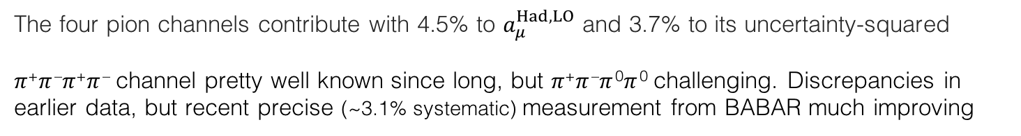
The e⁺e – → 𝜋⁺𝜋 –𝜋⁺𝜋 –, 𝜋⁺𝜋 –𝜋 ⁰𝜋 ⁰ contributions
The four pion channels contribute with 4.5% to $a_{μ}^{Had,LO}$ and 3.7% to its uncertainty-squared
𝜋⁺𝜋 –𝜋⁺𝜋 – channel pretty well known since long, but 𝜋⁺𝜋 –𝜋 ⁰𝜋 ⁰ challenging. Discrepancies in earlier data, but recent precise (~3.1% systematic) measurement from BABAR much improving
Compilation and combination: DHMZ, Davier 1612.02743 (2016)

Slide 27
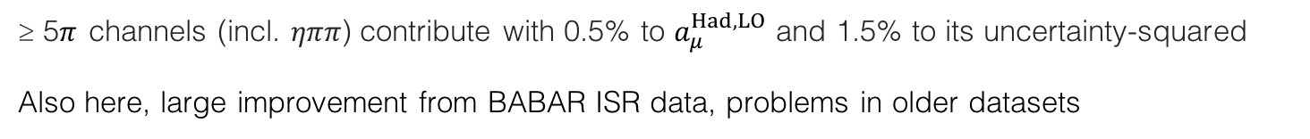
The e⁺e – → ≥ 5𝜋 contributions
≥ 5𝜋 channels (incl. 𝜂𝜋𝜋) contribute with 0.5% to $a_{μ}^{Had,LO}$ and 1.5% to its uncertainty-squared
Also here, large improvement from BABAR ISR data, problems in older datasets
Compilation and combination: DHMZ, Davier 1612.02743 (2016)

Slide 28
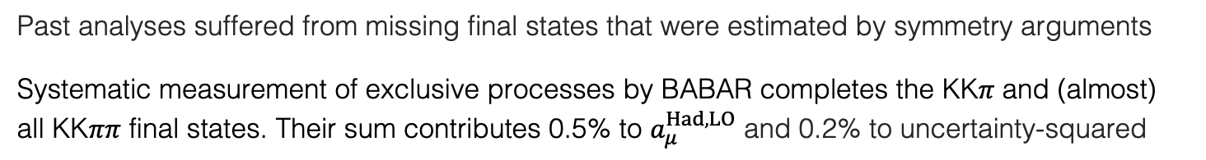
The e⁺e – → KK 𝜋(𝜋𝜋) contributions (many charge combinations)
Past analyses suffered from missing final states that were estimated by symmetry arguments
Systematic measurement of exclusive processes by BABAR completes the KK𝜋 and (almost) all KK𝜋𝜋 final states. Their sum contributes 0.5% to $a_{μ}^{Had,LO}$ and 0.2% to uncertainty-squared
Selection of measurements by BABAR and others

Slide 29
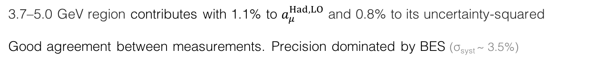
–
Charm resonance region (above DD threshold)
3.7–5.0 GeV region contributes with 1.1% to $a_{μ}^{Had,LO}$ and 0.8% to its uncertainty-squared
Good agreement between measurements. Precision dominated by BES (σ_{syst} ~ 3.5%)

Slide 30
Data, QCD and the big picture
Charm resonances integrated using data
Combines sum of exclusive channels discussed before
Use of QCD above
Use of QCD (found in good agreement with recent precision data)
(σ_{syst} > 3.5%)
(σ_{syst} > 2.3%)

Slide 31
Full compilation in numbers
DHMZ, arXiv:1908.00921 (2019)
Legend: First error statistical, second channel-specific systematic, third common systematic (correlated)
For R_{QCD}, uncertainties are due to: 𝛼_{S}, NNNLO truncation, resummation (FOPT vs. CIPT), quark masses
$$a_{μ}^{Had,LO}=693.9±{1.0}_{stat}±{3.8}_{syst}±{0.1}_{ψ}±{0.7}_{QCD}=693.9±4.0$$

Slide 32
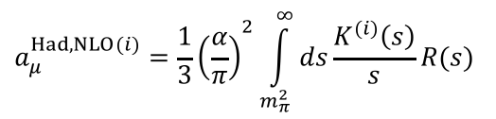

Higher order hadronic terms
NLO two-point correlation contributions to $a_{μ}^{Had,NLO}$ can be computed akin to the LO part via (a sum of) dispersion relations
$$a_{μ}^{Had,NLO(i)}={\frac{1}{3}\left(\frac{α}{π}\right)}^{2}\int_{m_{π}^{2}}^{∞}{ds\frac{K^{(i)}\left(s\right)}{s}R(s)}$$
$${⟹a}_{μ}^{Had,NLO}=(−9.87±0.09)∙{10}^{−10}$$
Each diagram corresponds to specific kernel function K ^{(i)}
Kurz et al, 1511.08222.
Kurz et al, 1511.08222.
NNLO two-point function corrections have also been computed: $a_{μ}^{Had,NNLO}=(1.24±0.01)∙{10}^{−10}$

Slide 33

Higher order hadronic terms
NLO two-point correlation contributions to $a_{μ}^{Had,NLO}$ can be computed akin to the LO part via (a sum of) dispersion relations
$$a_{μ}^{Had,NLO(i)}={\frac{1}{3}\left(\frac{α}{π}\right)}^{2}\int_{m_{π}^{2}}^{∞}{ds\frac{K^{(i)}\left(s\right)}{s}R(s)}$$
$${⟹a}_{μ}^{Had,NLO}=(−9.87±0.09)∙{10}^{−10}$$
Each diagram corresponds to specific kernel function K ^{(i)}
Kurz et al, 1511.08222.
Kurz et al, 1511.08222
NNLO two-point function corrections have also been computed: $a_{μ}^{Had,NNLO}=(1.24±0.01){∙10}^{−10}$
The four-point hadronic LBL scattering contribution, however, cannot be obtained this way and models are used instead
  Calculation uses hadronic models with 𝜋⁰, 𝜂⁽’⁾, … pole insertions and 𝜋± loops in the large-N_{C} limit (Lattice QCD offers promising alternative)
$${⟹a}_{μ}^{Had,LBL}=(10.5±2.6)∙{10}^{−10}$$
Prades, de Rafael, Vainshtein, 0901.0306
Educated guess (other groups find smaller / larger uncertainty)

Slide 34






Muon g – 2 summary
Summing all contributions [ ∙ 10^{–10} ]:
$$a_{μ}^{QED}=11 658 471.892±0.003$$
$$a_{μ}^{EW}=15.36±0.10$$
Davier et al, 1908.00921
$$a_{μ}^{Had,LO}=693.9±4.0$$
$$a_{μ}^{Had,NLO}=−9.87±0.09$$
Keshavarzi et al., 1911.00367
$$a_{μ}^{Had,NNLO}=1.24±0.01$$
$$a_{μ}^{Had,LBL}=10.5±2.6$$
Jegerlehner, 1705.00263
$$a_{μ}^{SM}=(11 659 183.0±4.8)∙{10}^{−10}$$
$${∆a_{μ}=a}_{μ}^{Exp}−a_{μ}^{SM}=26.1±{6.3}_{exp}±{4.8}_{SM} (±{7.9}_{tot})$$
→ 3.3σ level

Slide 35
Compilation of contributions to 𝛼_{QED}(m_{Z})
DHMZ, arXiv:1908.00921 (2019)
Legend: First error statistical, second channel-specific systematic, third common systematic (correlated)
For R_{QCD}, uncertainties are due to: 𝛼_{S}, NNNLO truncation, resummation (FOPT vs. CIPT), quark masses
$$∆α_{had}\left(m_{Z}^{2}\right)=\left(275.43±{0.15}_{stat}±{0.76}_{syst}±{0.09}_{ψ}±{0.55}_{QCD}\right)∙{10}^{−4}=\left(275.4±1.0\right)∙{10}^{−4}$$

Slide 36

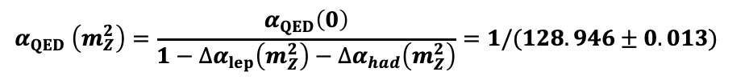

𝛼_{QED}(m_{Z})
Summing all contributions
$$∆α_{had}\left(m_{Z}^{2}\right)=\left(275.4±1.0\right)∙{10}^{−4}$$
DHMZ, arXiv:1908.00921 (2019)
$$∆α_{lep}(m_{Z}^{2})=(314.979 ±0.002)∙{10}^{−4}$$
4-loop QED, Sturm, arXiv: 1305.0581 (2013)
$$α_{QED} \left(m_{Z}^{2}\right)=\frac{α_{QED}\left(0\right)}{1−∆α_{lep}\left(m_{Z}^{2}\right)−∆α_{had}\left(m_{Z}^{2}\right)}=1/(128.946±0.013)$$
The uncertainty on $∆α_{had}\left(m_{Z}^{2}\right)$is (currently) subdominant in global electroweak fit, eg:
(to be compared with exp. uncertainty of 13 MeV)
Gfitter Group, arXiv:1803.01853 (2018)

Slide 37
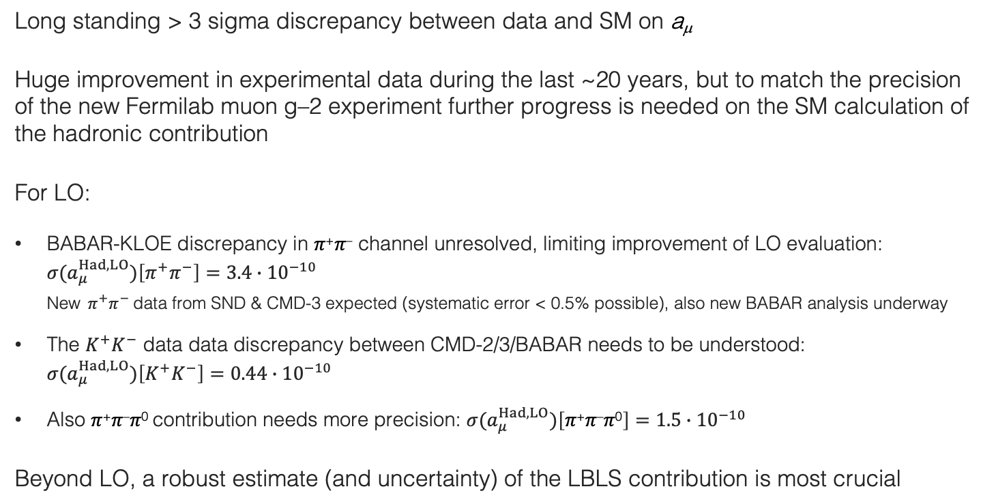
Conclusions
Long standing > 3 sigma discrepancy between data and SM on a_{μ}
Huge improvement in experimental data during the last ~20 years, but to match the precision of the new Fermilab muon g–2 experiment further progress is needed on the SM calculation of the hadronic contribution
For LO:
BABAR-KLOE discrepancy in 𝜋⁺𝜋– channel unresolved, limiting improvement of LO evaluation: ${σ(a}_{μ}^{Had,LO})\left[π^{+}π^{−}\right]=3.4∙{10}^{−10}$ New $π^{+}π^{−}$data from SND & CMD-3 expected (systematic error < 0.5% possible), also new BABAR analysis underway
The $K^{+}K^{−}$ data data discrepancy between CMD-2/3/BABAR needs to be understood: ${σ(a}_{μ}^{Had,LO})\left[K^{+}K^{−}\right]=0.44∙{10}^{−10}$
Also 𝜋⁺𝜋–𝜋⁰ contribution needs more precision: ${σ(a}_{μ}^{Had,LO})\left[\text{π}\text{+}\text{π}\text{–}\text{π}\text{0}\right]=1.5∙{10}^{−10}$
Beyond LO, a robust estimate (and uncertainty) of the LBLS contribution is most crucial

Slide 38
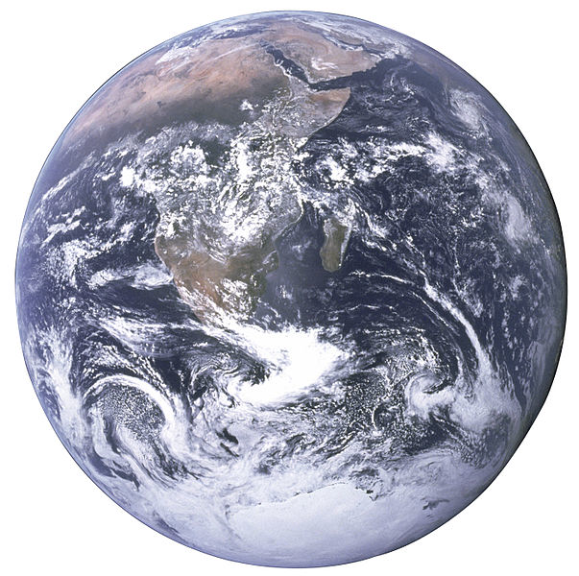
Conclusions
Accurate, minute measurement seems to the non-scientific imagination, a less lofty and dignified work than looking for something new.
But [many of] the grandest discoveries of science have been but the rewards of accurate measurement and patient long-continued labour in the minute sifting of numerical results.
Said to originate from: William Thomson Kelvin
2 Aug 1871 in a speech to the British Association for the Advancement of Science
Lord Kelvin

Slide 39
Additional slides

Slide 40
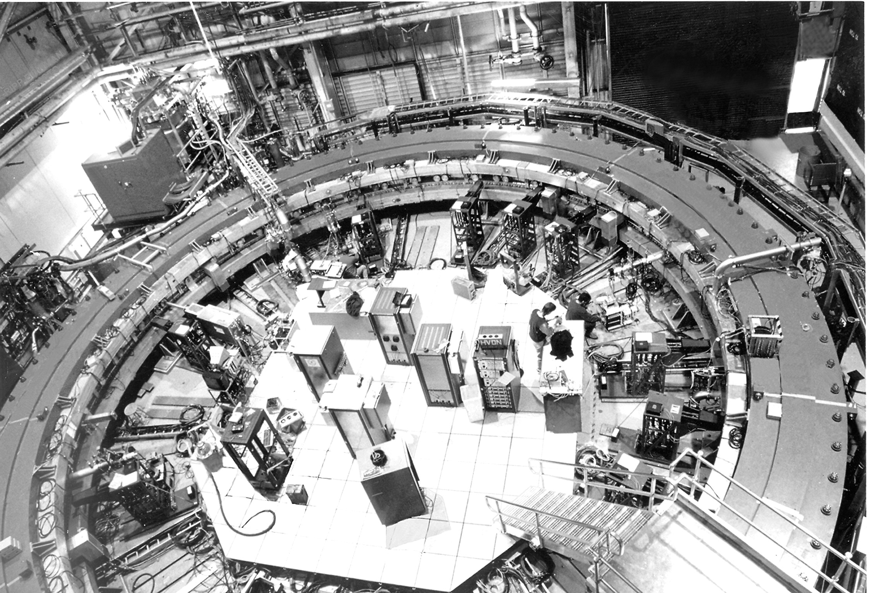
Measuring the muon g – 2
The BNL muon g–2 experiment (E821), 1997–2001

Slide 41
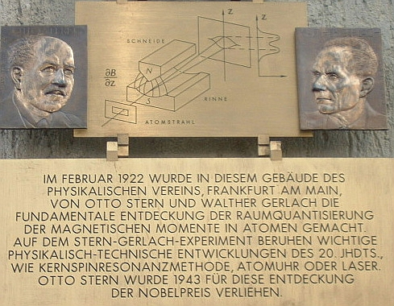
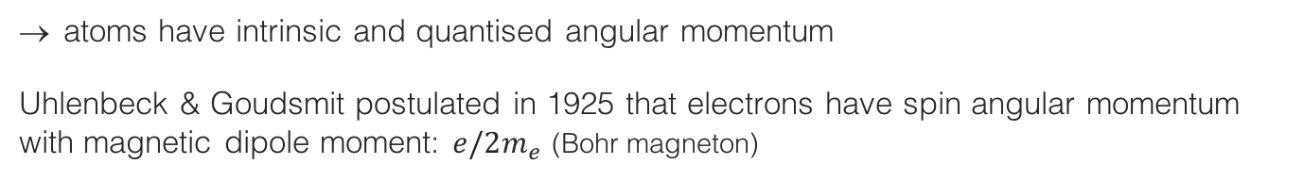
Magnetic moment
The magnetic dipole moment of a particle can be observed from its motion in a magnetic field
Intrinsic magnetic moment discovered in Stern-Gerlach experiment, 1922:
Observation
Expected result
Beam of neutral silver atoms (unpaired atomic electron)
Inhomogeneous magnetic field
A commemorative plaque at the Frankfurt physics institute
atoms have intrinsic and quantised angular momentum
Uhlenbeck & Goudsmit postulated in 1925 that electrons have spin angular momentum with magnetic dipole moment: $e/2m_{e}$ (Bohr magneton)

Slide 42
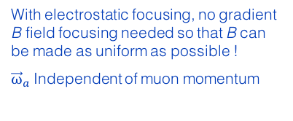
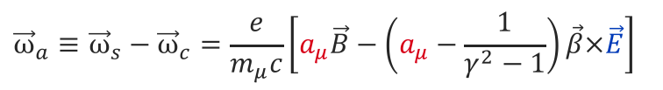
Measuring the muon g – 2
Analogous approach as for electron: search for discrepancy between the frequencies of cyclotron motion and spin precession
For polarised muons moving in a uniform B field (perp. to muon spin and orbit plane), and focused in an electric quadrupole field, the observed difference between spin precession and cyclotron frequency (= “anomalous frequency”), ignoring µEDM, is:
$${\vec{ω}}_{a}≡{\vec{ω}}_{s}−{\vec{ω}}_{c}=\frac{e}{m_{μ}c}\left[a_{μ}\vec{B}−\left(a_{μ}−\frac{1}{γ^{2}−1}\right)\vec{β}×\vec{E}\right]$$
With electrostatic focusing, no gradient B field focusing needed so that B can be made as uniform as possible !
${\vec{ω}}_{a}$Independent of muon momentum
Motional magnetic field
The E field dependence is eliminated at the “magic γ ”: γ = 29.3 → p_{μ} = 3.09 GeV
The experiment measures (g_{μ} – 2) / 2 directly
[ J. Bailey et al., NP B150, 1 (1979) ]

Slide 43
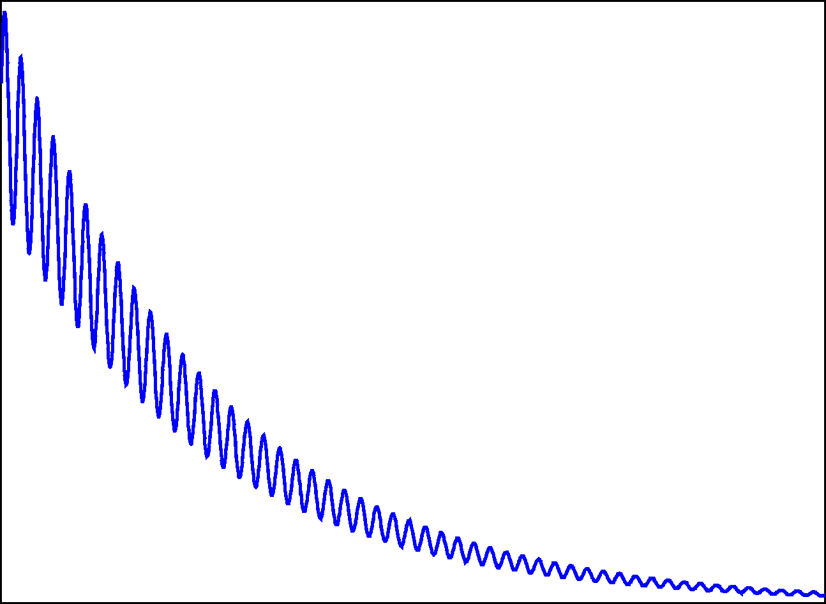
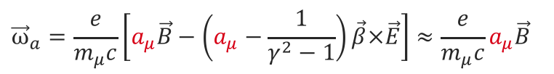



Exploit muon properties in experiment
spin orientation
$${\overline{ν}}_{μ}⟵π^{−}⟶μ_{polarised}^{−}$$
Parity violation polarizes muons in pion decay
Pions from proton-nucleon collision (AGS)
Anomalous frequency proportional to a_{μ}
$${\vec{ω}}_{a}=\frac{e}{m_{μ}c}\left[a_{μ}\vec{B}−\left(a_{μ}−\frac{1}{γ^{2}−1}\right)\vec{β}×\vec{E}\right]≈\frac{e}{m_{μ}c}a_{μ}\vec{B}$$
Magic γ :
$$ω_{a}$$
Again parity violation in muon decay
$$μ_{polarised}^{−}⟶e^{−}+{\overline{ν}}_{e}+ν_{μ}$$
electron counts
fast electron emitted in direction opposite to muon spin
Time
© D. Hertzog, UIUC

Slide 44
BNL E821: muon g – 2 experiment
A 24 GeV proton beam (AGS) incident on a target produces large number of pions that decay to muons
The 3.1 GeV muon beam (relativistically enhanced lifetime of 64 µs) is injected into a 7.1 m radius ring with 1.4 T vertical magnetic field, which produces cyclotron motion matching the ring radius
Electrostatic focusing of the beam is provided by a series of quadrupole lenses around the ring.
Decay electrons (correlated with μ spin precession) counted vs. time in calorimeters inside ring (→ 𝜔_{a})
Precise measurement of 𝜔_{a} and B allows to extract a_{μ}

Slide 45
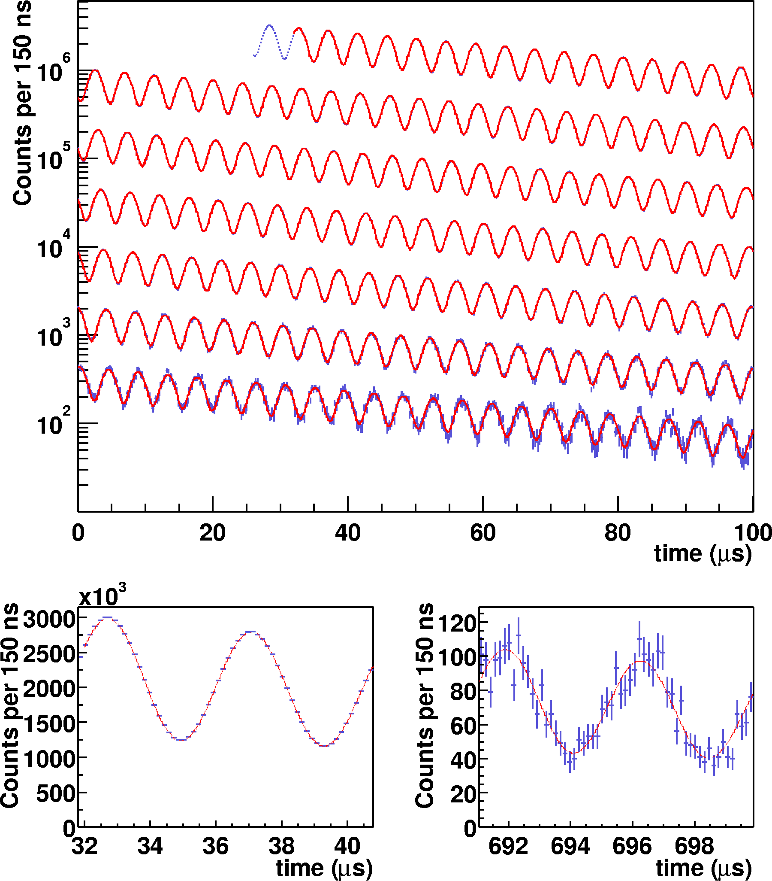

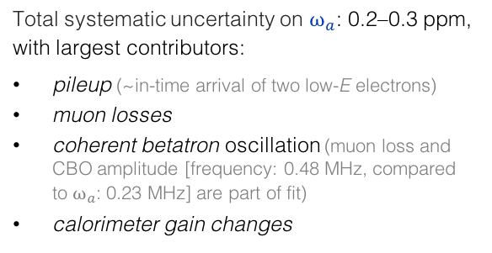

BNL E821: muon g – 2 experiment
E821 (g –2), hep-ex/0202024
Observed positron rate in successive 100 µs periods
~150 polarisation rotations during measurement period
Anomalous frequency:
$$ω_{a}≈\frac{e}{m_{μ}c}a_{μ}B$$
obtained from time-dependent fit to electron counts (for given energy E)
$$N\left(t\right)=N_{0}e^{−t/γτ}\left[1−A∙sin\left(ω_{a}t−φ\right)\right]$$
In blue: fit parameters
Total systematic uncertainty on $ω_{a}$: 0.2–0.3 ppm, with largest contributors:
pileup (~in-time arrival of two low-E electrons)
muon losses
coherent betatron oscillation (muon loss and CBO amplitude [frequency: 0.48 MHz, compared to $ω_{a}$: 0.23 MHz] are part of fit)
calorimeter gain changes

Slide 46
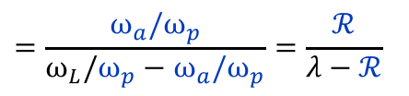
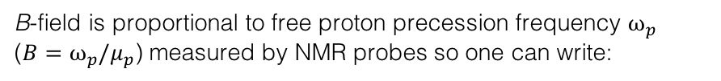

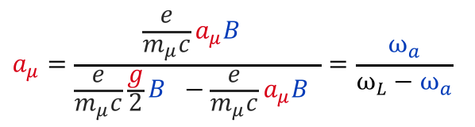
BNL E821: muon g – 2 experiment
The B-field is mapped with 17 NMR probes mounted on a trolley pulled through the beampipe
hep-ex/0602035
B-field is proportional to free proton precession frequency $ω_{p}$ ($B=ω_{p}/μ_{p}$) measured by NMR probes so one can write:
$$a_{μ}=\frac{\frac{e}{m_{μ}c}a_{μ}B }{\frac{e}{m_{μ}c}\frac{g}{2}B −\frac{e}{m_{μ}c}a_{μ}B }=\frac{ω_{a}}{ω_{L}−ω_{a}}$$
$$=\frac{ω_{a}/ω_{p}}{ω_{L}/ω_{p}−ω_{a}/ω_{p}}=\frac{ℛ}{λ−ℛ}$$
where: $ω_{L}$ is Larmor frequency of muon, $ℛ$ measured by E821, and the μ-to-p magnetic moment ratio is: $λ$ = 3.183 345 107(84)
Azimuthal average for one trolley run. Contours are 0.5 ppm field differences.
(λ is determined from muonium (µ ⁺e –) hyperfine level structure measurements)
→ Systematic uncertainty on $ω_{p}$ between 0.2 and 0.4 ppm
$ω_{a}$ and $ω_{p}$ measured independently in blind analyses → doubly blind experiment!

Slide 47
Digression : Running of α_{QED}(M_{Z})
Photon vacuum polarisation function Π_{γ}(q²)
Only vacuum polarisation “screens” electron charge
with:
split into leptonic and hadronic contribution
Leptonic Δα_{lep}(s) calculable in QED (known to 3-loops). However, quark loops are modified by long-distance hadronic physics, cannot be calculated with perturbative QCD
Way out: Optical Theorem (unitarity)
and the subtracted dispersion relation of Π_{γ}(q²) (analyticity)
Im[ ] ∝ | hadrons |²
Precise knowledge α(m_{Z}) important ingredient to global electroweak fit
Δα_{had}(s) uncertainty contributes 1.8 MeV to m_{W} SM prediction (total error of SM: 8 MeV), but dominant uncertainty to sin²θ_{eff} (SM)

Slide 48
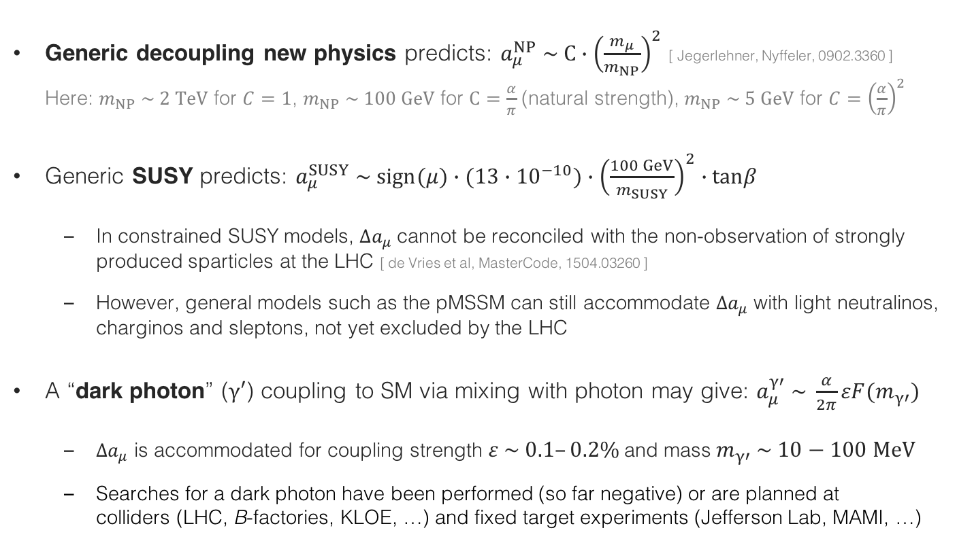
Digression: Can it be real ?
The absolute size of the effect $∆a_{μ}=27.4±7.6$ is large compared to EW contribution of $15.4$ (but some cancellation among bosons in latter contribution)
  Generic decoupling new physics predicts: $a_{μ}^{NP} \sim C∙{\left(\frac{m_{μ}}{m_{NP}}\right)}^{2}$ [ Jegerlehner, Nyffeler, 0902.3360 ] Here: $m_{NP} \sim 2 TeV$ for $C=1$, $m_{NP} \sim 100 GeV$ for $C=\frac{α}{π}$ (natural strength), $m_{NP} \sim 5 GeV$ for $C={\left(\frac{α}{π}\right)}^{2}$
Generic SUSY predicts: $a_{μ}^{SUSY} \sim sign(μ)∙(13∙{10}^{−10})∙{\left(\frac{100 GeV}{m_{SUSY}}\right)}^{2}∙tanβ$
  In constrained SUSY models, $∆a_{μ}$cannot be reconciled with the non-observation of strongly produced sparticles at the LHC [ de Vries et al, MasterCode, 1504.03260 ]
  However, general models such as the pMSSM can still accommodate $∆a_{μ}$with light neutralinos, charginos and sleptons, not yet excluded by the LHC
A “dark photon” ($γ′$) coupling to SM via mixing with photon may give: $a_{μ}^{γ′} \sim \frac{α}{2π}εF(m_{γ′})$
  $∆a_{μ}$ is accommodated for coupling strength $ε \sim 0.1–0.2\%$ and mass $m_{γ′} \sim 10−100 MeV$
  Searches for a dark photon have been performed (so far negative) or are planned at colliders (LHC, B-factories, KLOE, …) and fixed target experiments (Jefferson Lab, MAMI, …)

