Slide 1
Ultimate precision Standard Model tests: the muon magnetic anomaly
µ
B-field
?
µ
Andreas Hoecker (CERN)
Seminar, DESY, Feb 21th, 2017
Work in collaboration with M. Davier, B. Malaescu, and Z. Zhang (= DHMZ)

Slide 2
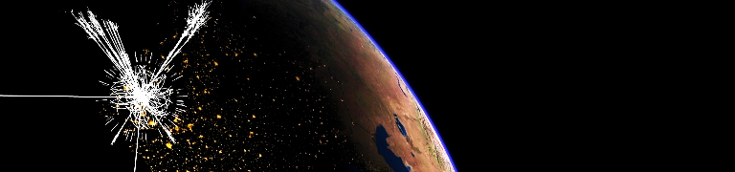
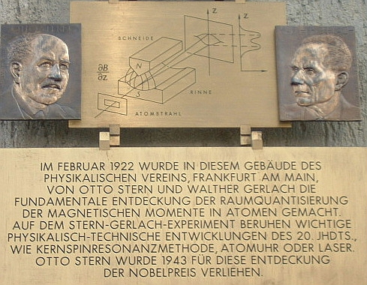
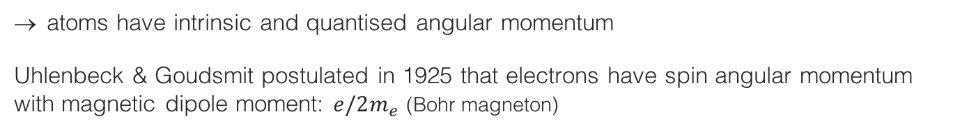
Magnetic moment
The magnetic dipole moment of a particle can be observed from its motion in a magnetic field
Intrinsic magnetic moment discovered in Stern-Gerlach experiment, 1922:
Observation
Expected result
Beam of neutral silver atoms (unpaired atomic electron)
Inhomogeneous magnetic field
A commemorative plaque at the Frankfurt physics institute
atoms have intrinsic and quantised angular momentum
Uhlenbeck & Goudsmit postulated in 1925 that electrons have spin angular momentum with magnetic dipole moment: $e/2m_{e}$ (Bohr magneton)

Slide 3
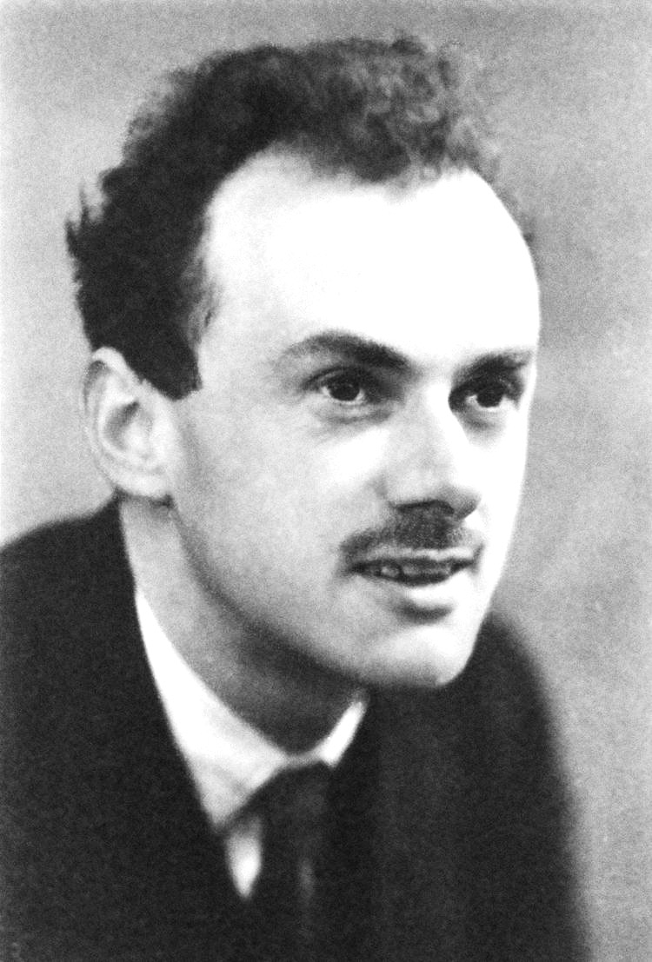



Electron g factor
Dirac’s relativistic theory of the electron (1928) naturally accounted for quantized particle spin, and described elementary spin-1/2 particles
In the classical limit, one finds the Pauli equation with magnetic moment:
$\overset{⃑}{μ}={−g}_{e}\frac{e}{2m_{e}}\overset{⃑}{S}$ ,
with ${|g}_{e}|=2$ the gyromagnetic factor
(and radius $R_{e}=0$, ie, elementary !)
Paul Dirac
Here $g_{p}/g_{e}=2.8$ hinted that proton is not elementary

Slide 4
Electron g factor
Dirac’s relativistic theory of the electron (1928) naturally accounted for quantized particle spin, and described elementary spin-1/2 particles
In the classical limit, one finds the Pauli equation with magnetic moment:
$\overset{⃑}{μ}={−g}_{e}\frac{e}{2m_{e}}\overset{⃑}{S}$ ,
with ${|g}_{e}|=2$ the gyromagnetic factor
(and radius $R_{e}=0$, ie, elementary !)
Paul Dirac
Here $g_{p}/g_{e}=2.8$ hinted that proton is not elementary
Today, everyone knows that the proton is composite,
and the electron is a point-like particle …
But – is it really ?
→ Precise g_{e} measurement is key !

Slide 5
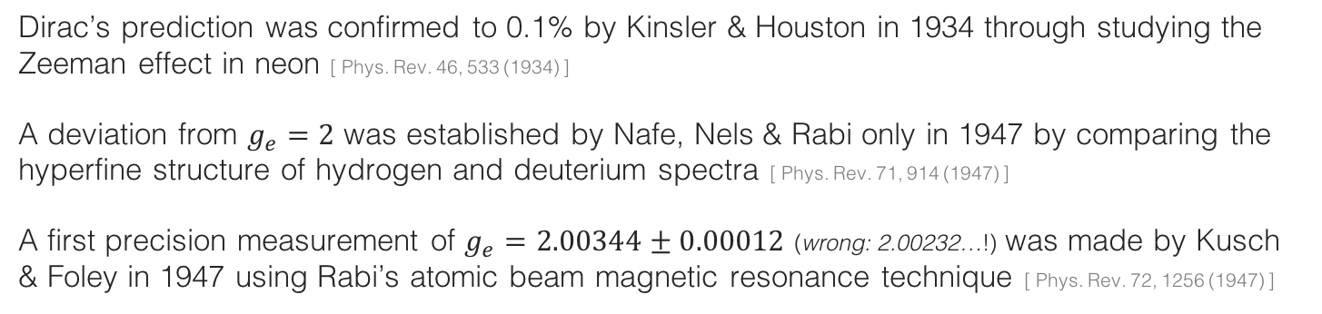
Electron g factor
Dirac’s relativistic theory of the electron (1928) naturally accounted for quantized particle spin, and described elementary spin-1/2 particles
In the classical limit, one finds the Pauli equation with magnetic moment:
$\overset{⃑}{μ}={−g}_{e}\frac{e}{2m_{e}}\overset{⃑}{S}$ ,
with ${|g}_{e}|=2$ the gyromagnetic factor
(and radius $R_{e}=0$, ie, elementary !)
Paul Dirac
Here $g_{p}/g_{e}=2.8$ hinted that proton is not elementary
Dirac’s prediction was confirmed to 0.1% by Kinsler & Houston in 1934 through studying the Zeeman effect in neon [ Phys. Rev. 46, 533 (1934) ]
A deviation from $g_{e}=2$ was established by Nafe, Nels & Rabi only in 1947 by comparing the hyperfine structure of hydrogen and deuterium spectra [ Phys. Rev. 71, 914 (1947) ]
A first precision measurement of $g_{e}=2.00344±0.00012$ (wrong: 2.00232…!) was made by Kusch & Foley in 1947 using Rabi’s atomic beam magnetic resonance technique [ Phys. Rev. 72, 1256 (1947) ]

Slide 6
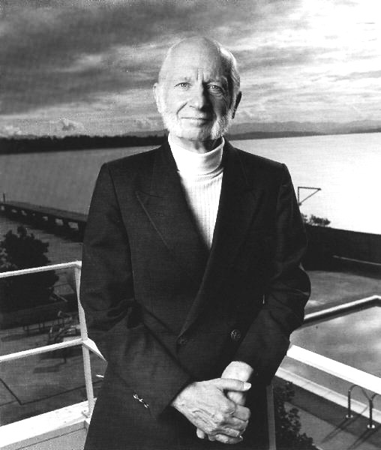
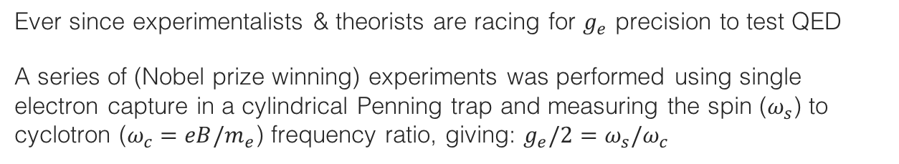

Electron g factor
Ever since experimentalists & theorists are racing for $g_{e}$ precision to test QED
A series of (Nobel prize winning) experiments was performed using single electron capture in a cylindrical Penning trap and measuring the spin ($ω_{s}$) to cyclotron ($ω_{c}=eB/m_{e}$) frequency ratio, giving: $g_{e}/2=ω_{s}/ω_{c}$
The most precise measurement from 2008 exploits (quantum non-demolition) spectroscopy with fully resolved lowest cyclotron and spin levels of a single electron quantum cyclotron in a cold (0.1 K) cylindrical Penning trap cavity immersed in 5.4 T B field
Hans G. Dehmelt
Nobel 1989
Anomalous magnetic moment:
$$a_{e}=\frac{g_{e}−2}{2}=1 159 652 180.73(28) ∙{10}^{−12}$$
(24 ppb precision, 1.8σ below 1987 value)
[ Hanneke, Fogwell, Gabrielse (Harvard), 0801.1134, 1009.4831 ]
Cylindrical Penning trap cavity used to confine a single electron and inhibit spontaneous emission

Slide 7
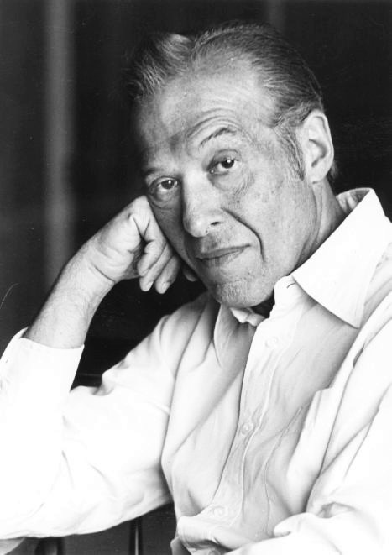
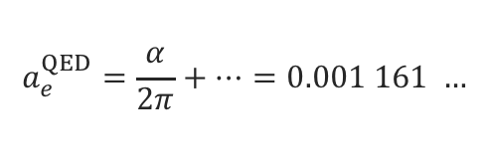
Quantum fluctuations
Dirac’s gyromagnetic factor is lowest order QED graph, but there are quantum corrections…
Schwinger 1948 (Nobel price 1965)
First QFT loop calculation!
[ Phys. Rev. 73, 416 (1948) ]
=
+
+ …
(g–2)_{e} ≠ 0 (full Standard Model)
(g–2)_{e} = 0 (Dirac)
coupling to virtual fields: (g–2)_{e} ≠ 0 (1st order QED)
Julian Schwinger
Quantum fluctuations slightly increase gyromagnetic factor, so that:
$$a_{e}^{QED}=\frac{α}{2π}+…=0.001 161 …$$

Slide 8
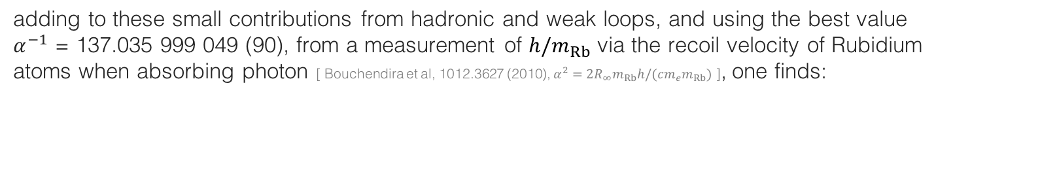
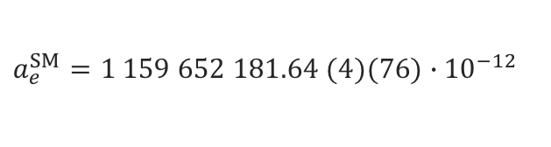
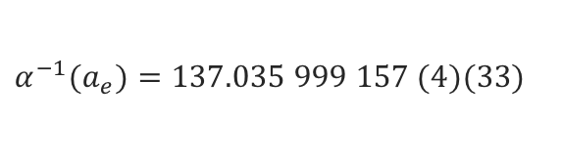
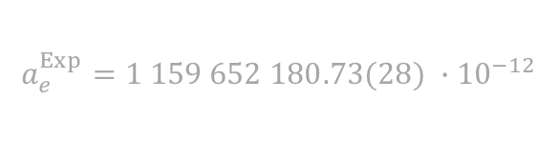
Theory and comparison with experiment
In a tour de force five QED loops have been computed [ Kinoshita et al, 1412.8284 (2014) ]
$$a_{e}^{QED}=\frac{α}{2π}−0.328478444{\left(\frac{α}{π}\right)}^{2}+1.181234{\left(\frac{α}{π}\right)}^{3}−1.912\left(1\right){\left(\frac{α}{π}\right)}^{4}−7.8\left(3\right){\left(\frac{α}{π}\right)}^{5}$$
adding to these small contributions from hadronic and weak loops, and using the best value $α^{−1}$ = 137.035 999 049 (90), from a measurement of ${h/m}_{Rb}$ via the recoil velocity of Rubidium atoms when absorbing photon [ Bouchendira et al, 1012.3627 (2010), $α_{ }^{2}=2R_{∞}m_{Rb}h/(cm_{e}m_{Rb})$ ], one finds:
$$a_{e}^{SM}=1 159 652 181.64 (4)(76)∙{10}^{−12}$$
→ In agreement with experiment
$$a_{e}^{Exp}=1 159 652 180.73(28) ∙{10}^{−12}$$
(errors are from loop terms and α respectively)
Measurement and SM prediction can be used to derive most precise value of α
$$α^{−1}(a_{e})=137.035 999 157 (4)(33)$$
(errors are from theory and experiment, respectively)
(0.25 ppb precision, 3 times better than Rb based value)
[ Kinoshita et al, 1412.8284 (2014) ]

Slide 9

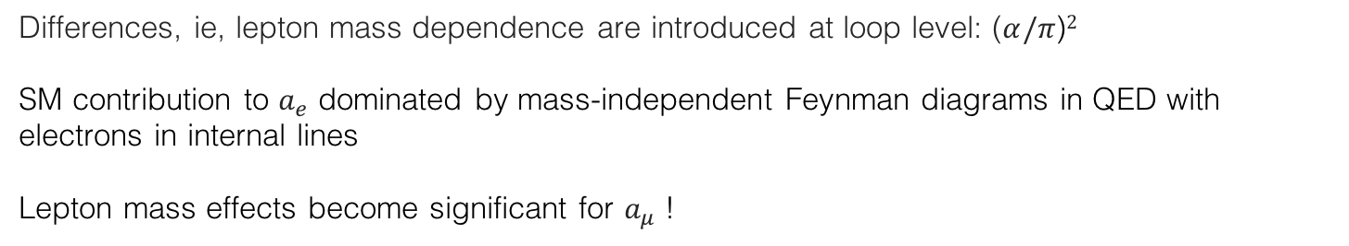
Theoretical properties
The anomalous magnetic moment of an elementary particle corresponds to an effective Lagrangian interaction of mass dimension 5. It is finite and calculable
At lowest order in QED, the anomalous magnetic moment is universal:
$$a_{e}^{QED,LO}=a_{μ}^{QED,LO}=a_{τ}^{QED,LO}=\frac{α}{2π}$$
Differences, ie, lepton mass dependence are introduced at loop level: ($α/π$)$2$
SM contribution to $a_{e}$ dominated by mass-independent Feynman diagrams in QED with electrons in internal lines
Lepton mass effects become significant for $a_{μ}$ !

Slide 10
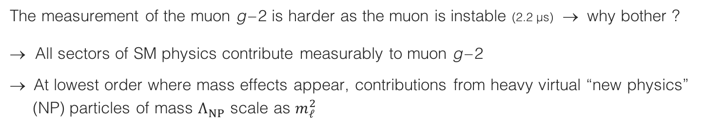
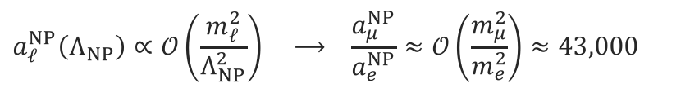
Muon g – 2
The measurement of the muon g – 2 is harder as the muon is instable (2.2 µs) → why bother ?
→ All sectors of SM physics contribute measurably to muon g – 2
→ At lowest order where mass effects appear, contributions from heavy virtual “new physics”
(NP) particles of mass $Λ_{NP}^{ }$ scale as $m_{ℓ}^{2}$
$$a_{ℓ}^{NP}\left(Λ_{NP}\right)∝𝒪\left(\frac{m_{ℓ}^{2}}{Λ_{NP}^{2}}\right) ⟶ \frac{a_{μ}^{NP}}{a_{e}^{NP}}≈𝒪\left(\frac{m_{μ}^{2}}{m_{e}^{2}}\right)≈43,000$$
Muon g – 2 looses “only” about factor 23 (4) in experimental (theoretical) precision, so a_{μ} expected to be significantly more sensitive to NP than a_{e}
Example: weak + Higgs boson contribution is 1536 ∙ 10^{–12} (μ ) and 0.030 ∙ 10^{–12} (e ) → ratio of ~ 51,000

Slide 11
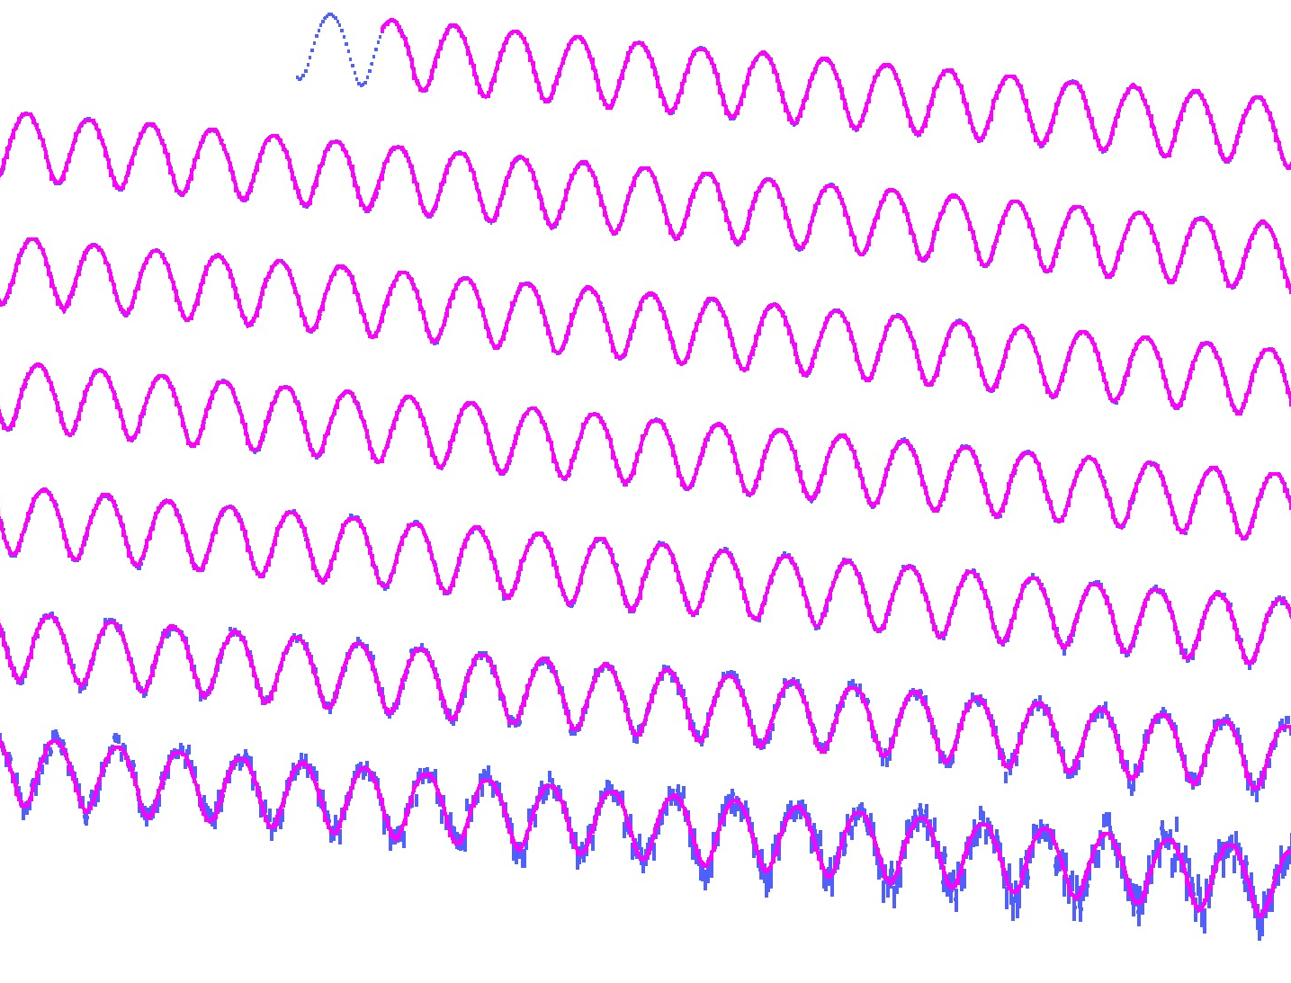
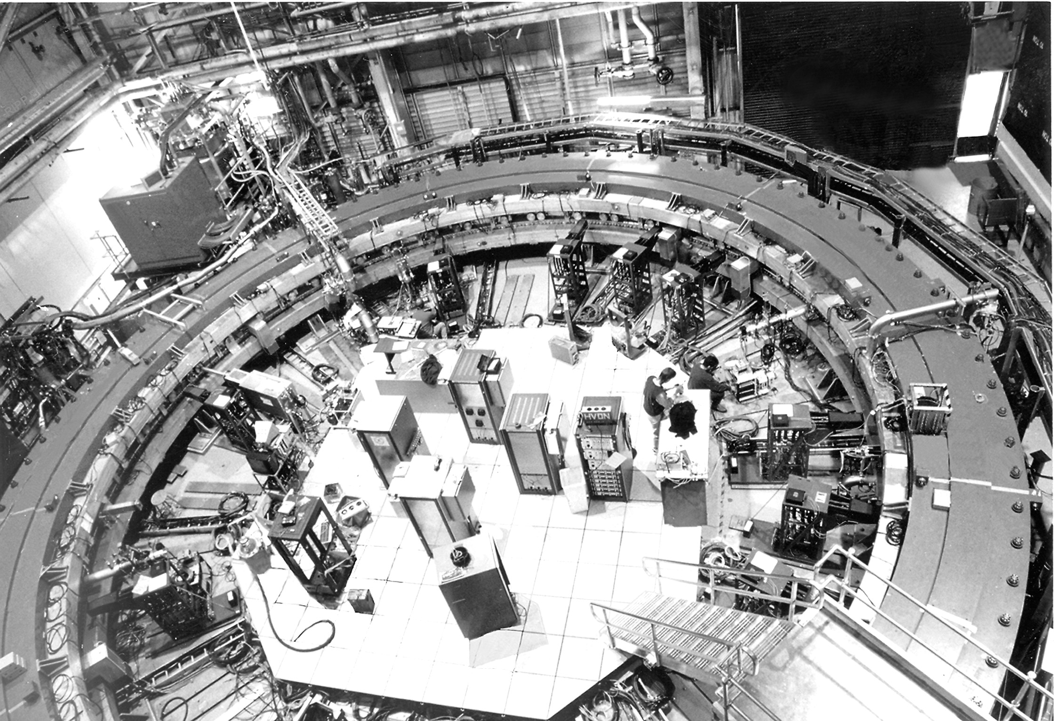
Measuring the muon g – 2
The BNL muon g–2 experiment (E821), 1997–2001

Slide 12
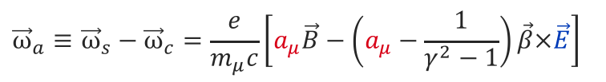
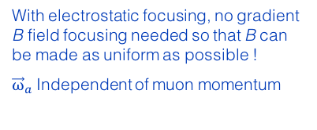
Measuring the muon g – 2
Analogous approach as for electron: search for discrepancy between the frequencies of cyclotron motion and spin precession
For polarised muons moving in a uniform B field (perp. to muon spin and orbit plane), and focused in an electric quadrupole field, the observed difference between spin precession and cyclotron frequency (= “anomalous frequency”), ignoring µEDM, is:
$${\vec{ω}}_{a}≡{\vec{ω}}_{s}−{\vec{ω}}_{c}=\frac{e}{m_{μ}c}\left[a_{μ}\vec{B}−\left(a_{μ}−\frac{1}{γ^{2}−1}\right)\vec{β}×\vec{E}\right]$$
With electrostatic focusing, no gradient B field focusing needed so that B can be made as uniform as possible !
${\vec{ω}}_{a}$Independent of muon momentum
Motional magnetic field
The E field dependence is eliminated at the “magic γ ”: γ = 29.3 → p_{μ} = 3.09 GeV
The experiment measures (g_{μ} – 2) / 2 directly
[ J. Bailey et al., NP B150, 1 (1979) ]

Slide 13
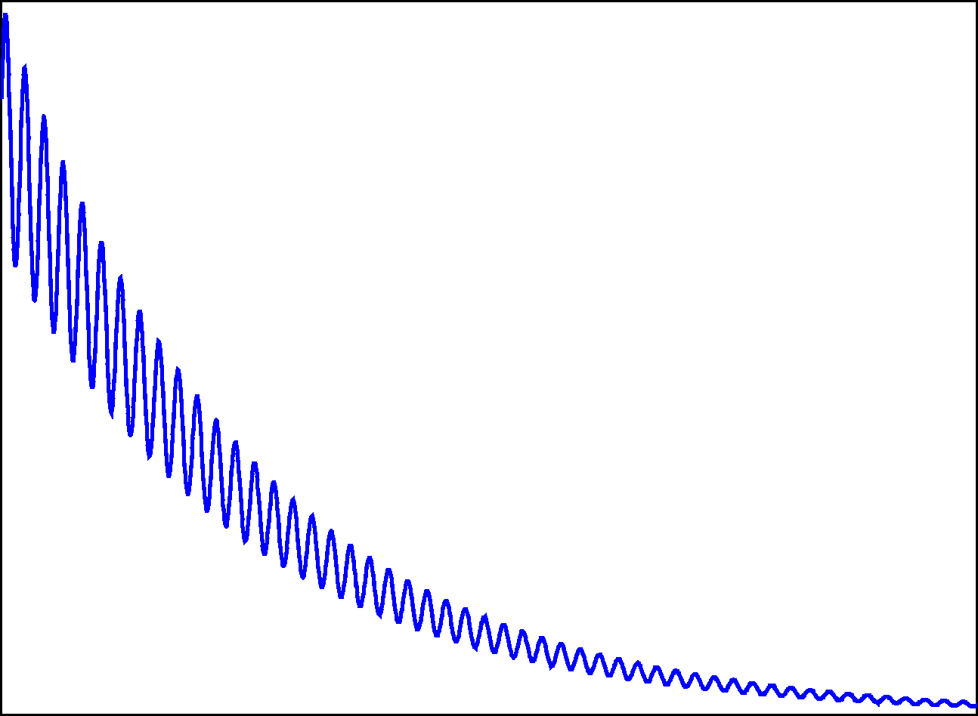
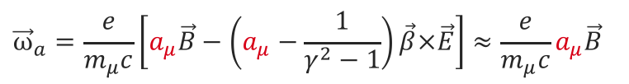



Exploit muon properties in experiment
spin orientation
$${\overline{ν}}_{μ}⟵π^{−}⟶μ_{polarised}^{−}$$
Parity violation polarizes muons in pion decay
Pions from proton-nucleon collision (AGS)
Anomalous frequency proportional to a_{μ}
$${\vec{ω}}_{a}=\frac{e}{m_{μ}c}\left[a_{μ}\vec{B}−\left(a_{μ}−\frac{1}{γ^{2}−1}\right)\vec{β}×\vec{E}\right]≈\frac{e}{m_{μ}c}a_{μ}\vec{B}$$
Magic γ :
$$ω_{a}$$
Again parity violation in muon decay
$$μ_{polarised}^{−}⟶e^{−}+{\overline{ν}}_{e}+ν_{μ}$$
electron counts
fast electron emitted in direction opposite to muon spin
Time
© D. Hertzog, UIUC

Slide 14
BNL E821: muon g – 2 experiment
A 24 GeV proton beam (AGS) incident on a target produces large number of pions that decay to muons
The 3.1 GeV muon beam (relativistically enhanced lifetime of 64 µs) is injected into a 7.1 m radius ring with 1.4 T vertical magnetic field, which produces cyclotron motion matching the ring radius
Electrostatic focusing of the beam is provided by a series of quadrupole lenses around the ring.
Decay electrons (correlated with μ spin precession) counted vs. time in calorimeters inside ring (→ 𝜔_{a})
Precise measurement of 𝜔_{a} and B allows to extract a_{μ}

Slide 15
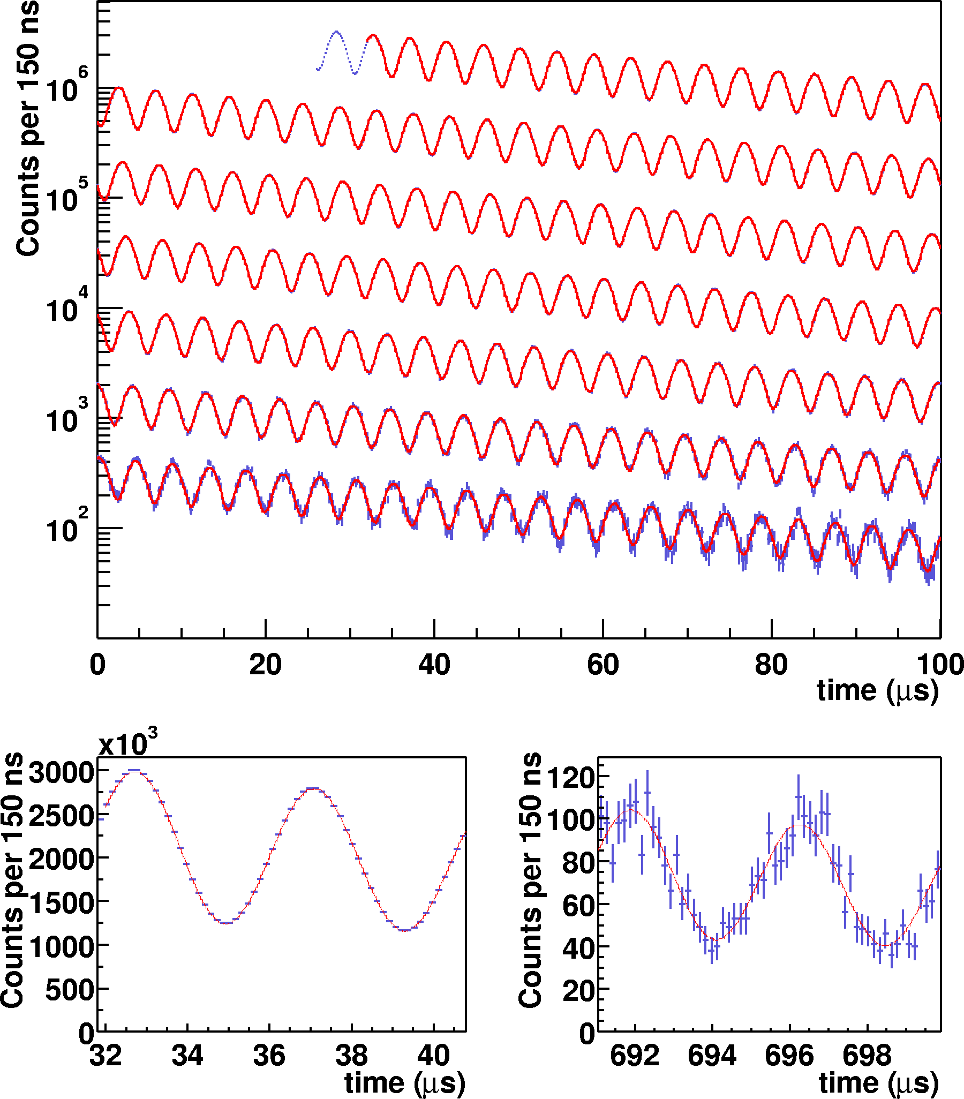


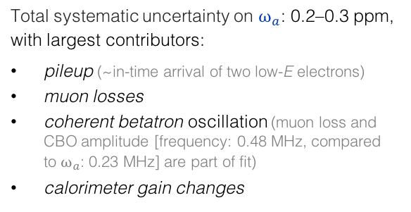
BNL E821: muon g – 2 experiment
E821 (g –2), hep-ex/0202024
Observed positron rate in successive 100 µs periods
~150 polarisation rotations during measurement period
Anomalous frequency:
$$ω_{a}≈\frac{e}{m_{μ}c}a_{μ}B$$
obtained from time-dependent fit to electron counts (for given energy E)
$$N\left(t\right)=N_{0}e^{−t/γτ}\left[1−A∙sin\left(ω_{a}t−φ\right)\right]$$
In blue: fit parameters
Total systematic uncertainty on $ω_{a}$: 0.2–0.3 ppm, with largest contributors:
pileup (~in-time arrival of two low-E electrons)
muon losses
coherent betatron oscillation (muon loss and CBO amplitude [frequency: 0.48 MHz, compared to $ω_{a}$: 0.23 MHz] are part of fit)
calorimeter gain changes

Slide 16
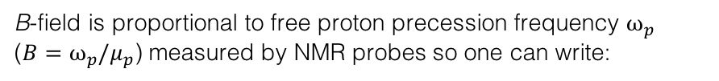
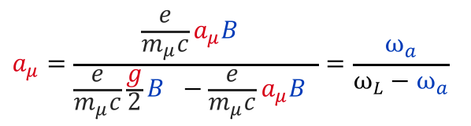

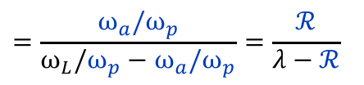
BNL E821: muon g – 2 experiment
The B-field is mapped with 17 NMR probes mounted on a trolley pulled through the beampipe
hep-ex/0602035
B-field is proportional to free proton precession frequency $ω_{p}$ ($B=ω_{p}/μ_{p}$) measured by NMR probes so one can write:
$$a_{μ}=\frac{\frac{e}{m_{μ}c}a_{μ}B }{\frac{e}{m_{μ}c}\frac{g}{2}B −\frac{e}{m_{μ}c}a_{μ}B }=\frac{ω_{a}}{ω_{L}−ω_{a}}$$
$$=\frac{ω_{a}/ω_{p}}{ω_{L}/ω_{p}−ω_{a}/ω_{p}}=\frac{ℛ}{λ−ℛ}$$
where: $ω_{L}$ is Larmor frequency of muon, $ℛ$ measured by E821, and the μ-to-p magnetic moment ratio is: $λ$ = 3.183 345 107(84)
Azimuthal average for one trolley run. Contours are 0.5 ppm field differences.
(λ is determined from muonium (µ ⁺e –) hyperfine level structure measurements)
→ Systematic uncertainty on $ω_{p}$ between 0.2 and 0.4 ppm
$ω_{a}$ and $ω_{p}$ measured independently in blind analyses → doubly blind experiment!

Slide 17
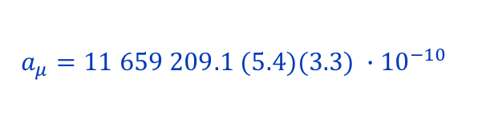
Result, and comparison with earlier experiments
Evolution versus running year [ hep-ex/0602035 ]
E821 final result (1997–2001 data):
$$a_{μ}=11 659 209.1 (5.4)(3.3) ∙{10}^{−10}$$
(0.54 ppm precision, assumes CPT invariance)
[ Muon g–2, E821, hep-ex/0602035 with updated value for λ ]
Agreement between μ⁺ and μ – results
μ⁺
μ⁺
μ⁺
μ⁺
μ–
Evolution of experimental sensitivity:
[ See, eg, Miller, de Rafael, Roberts, hep-ph/0703049 ]
Experiment | Beam | Measurement | δa_{μ} / a_{μ} |  | Required theor. terms
Columbia-Nevis (‘57) | μ⁺ | g = 2.00 (σ = 0.10) |  |  | g = 2
Columbia-Nevis (‘60) | μ⁺ | 0.001 13 (+16)(–12) | 12 % |  | α/2π
CERN 1 (SC, 1961) | μ⁺ | 0.001 145 (22) | 1.9 % |  | α/2π
CERN 1 (SC, 1962) | μ⁺ | 0.001 162 (5) | 0.43 % |  | (α/π)²
CERN 2 (PS, 1968) | μ⁺ | 0.001 166 16 (31) | 266 ppm |  | (α/π)³
CERN 3 (PS, 1979) | μ± | 0.001 165 923 0 (84) | 7.2 ppm |  | (α/π)³ + had (60 ppm)
BNL E821 (1997–2001) | μ± | 0.001 165 920 91 (63) | 0.54 ppm |  | (α/π)⁴ + had + weak + ?
Muon behaves like heavy electron
Electrostatic focusing, magic γ

Slide 18

Confronting Experiment with Theory
The Standard Model prediction of a_{μ} is decomposed in its main contributions:
$$a_{μ}^{SM}=\frac{g_{μ}−2}{2}=a_{μ}^{QED}+a_{μ}^{EW}+a_{μ}^{Had}$$
of which the hadronic contribution has the largest uncertainty

Slide 19
Confronting Experiment with Theory
QED
Electroweak
Hadronic
SUSY ?
Some other type of new physics?
?

Slide 20

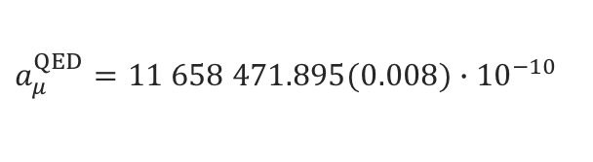
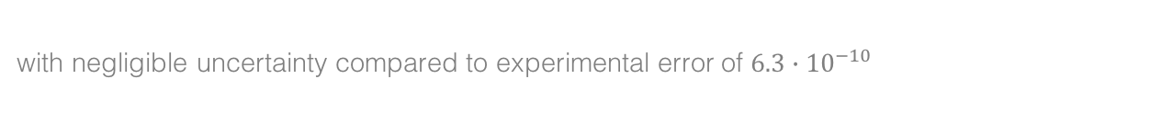
QED contribution
Known to 5 loops, good convergence, diagrams with internal electron loops enhanced:
$$a_{μ}^{QED}=\frac{α}{2π}+0.765 857 425(17){\left(\frac{α}{π}\right)}^{2}+ 24.050 509 96\left(32\right){\left(\frac{α}{π}\right)}^{3}$$
3-loop light-by-light scattering with electron loop
[ Schwinger term ]
$$+ 130.880\left(6\right){\left(\frac{α}{π}\right)}^{4}+ 753.3\left(1.0\right){\left(\frac{α}{π}\right)}^{5}$$
[ 5-loop: Aoyama, Hayakawa, Kinoshita, Nio, 1205.5370 (2012) ]
Using α = 137.035 999 049 (90) from Rubidium recoil measurement, gives:
$$a_{μ}^{QED}=11 658 471.895(0.008)∙{10}^{−10}$$
with negligible uncertainty compared to experimental error of $6.3∙{10}^{−10}$

Slide 21
Evidence for γγ → γγ light-by-light scattering (LBLS) seen by ATLAS in 5.02 TeV ultraperipheral Pb+Pb collisions
Picture shows LBLS candidate: two E_{T} = 4.9 GeV back-to- back photons with no additional activity
[ 1702.01625 ]
Field strength of up to 10²⁵ V/m reached

Slide 22

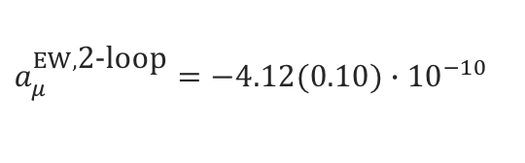
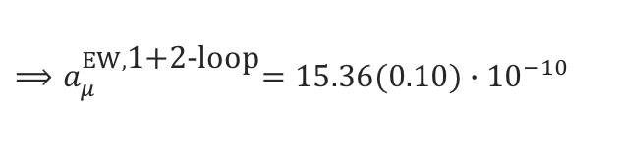
Electroweak contribution
$$\frac{α}{π}\frac{m_{μ}^{2}}{m_{W}^{2}}≈4∙{10}^{−9}$$
EW contribution involving W, Z or Higgs is suppressed at least by a factor:
The first loop gives: [ Jackiw, Weinberg and others 1972 ]
$$a_{μ}^{EW,\text{1−}\text{loop}}=\frac{{G_{F}m}_{μ}^{2}}{8\sqrt{2}π^{2}}\left[\frac{5}{3}+\frac{1}{3}{\left(1−4\sin^{2}θ_{W}\right)}^{2}+𝒪\left(\frac{m_{μ}^{2}}{m_{W}^{2}}\right)+𝒪\left(\frac{m_{μ}^{2}}{m_{H}^{2}}\right)\right]=19.48∙{10}^{−10}$$
1-loop diagrams (some cancellation between W/Z graphs)
Two-loop contribution surprisingly large due to large ln(m_{Z} /m_{μ}): [ Czarnecki, Krause, Marciano, 1995, and others ]
$$a_{μ}^{EW,\text{2−}\text{loop}}=−4.12(0.10)∙{10}^{−10}$$
2-loop diagrams (+ Higgs exchange)
$${⟹a}_{μ}^{EW,\text{1+2−}\text{loop}}=15.36(0.10)∙{10}^{−10}$$
Three-loop leading logarithms are found to be small (~10^{–12}) [ Degrassi, Giudice, hep-ph/9803384, and others ]

Slide 23
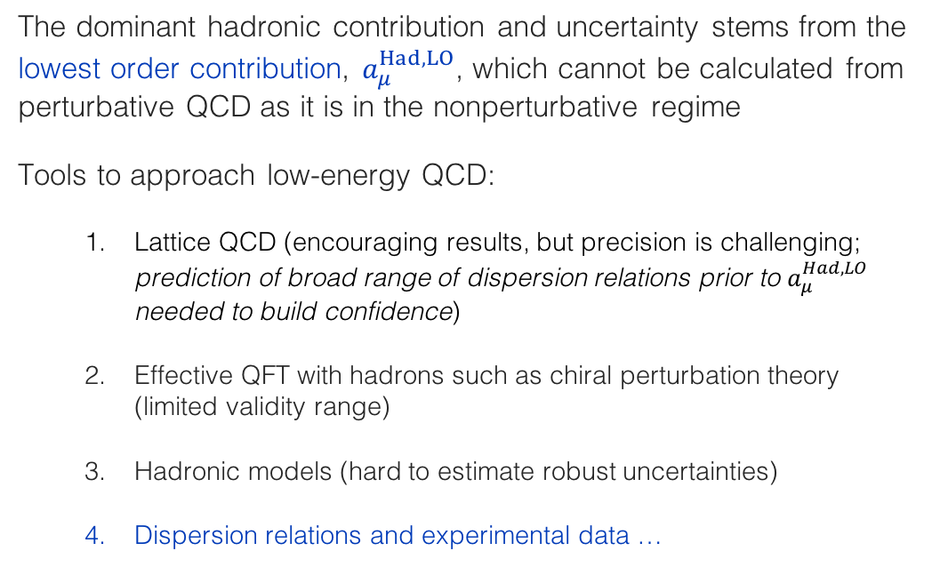
Hadronic contribution
The dominant hadronic contribution and uncertainty stems from the lowest order contribution, $a_{μ}^{Had,LO}$, which cannot be calculated from perturbative QCD as it is in the nonperturbative regime
Tools to approach low-energy QCD:
  Lattice QCD (encouraging results, but precision is challenging; prediction of broad range of dispersion relations prior to $a_{μ}^{Had,LO}$ needed to build confidence)
  Effective QFT with hadrons such as chiral perturbation theory (limited validity range)
  Hadronic models (hard to estimate robust uncertainties)
  Dispersion relations and experimental data …

Slide 24
Digression : Running of α_{QED}(M_{Z})
Photon vacuum polarisation function Π_{γ}(q²)
Only vacuum polarisation “screens” electron charge
with:
split into leptonic and hadronic contribution
Leptonic Δα_{lep}(s) calculable in QED (known to 3-loops). However, quark loops are modified by long-distance hadronic physics, cannot be calculated with perturbative QCD
Way out: Optical Theorem (unitarity)
and the subtracted dispersion relation of Π_{γ}(q²) (analyticity)
Im[ ] ∝ | hadrons |²
Precise knowledge α(m_{Z}) important ingredient to global electroweak fit
Δα_{had}(s) uncertainty contributes 1.8 MeV to m_{W} SM prediction (total error of SM: 8 MeV), but dominant uncertainty to sin²θ_{eff} (SM)

Slide 25
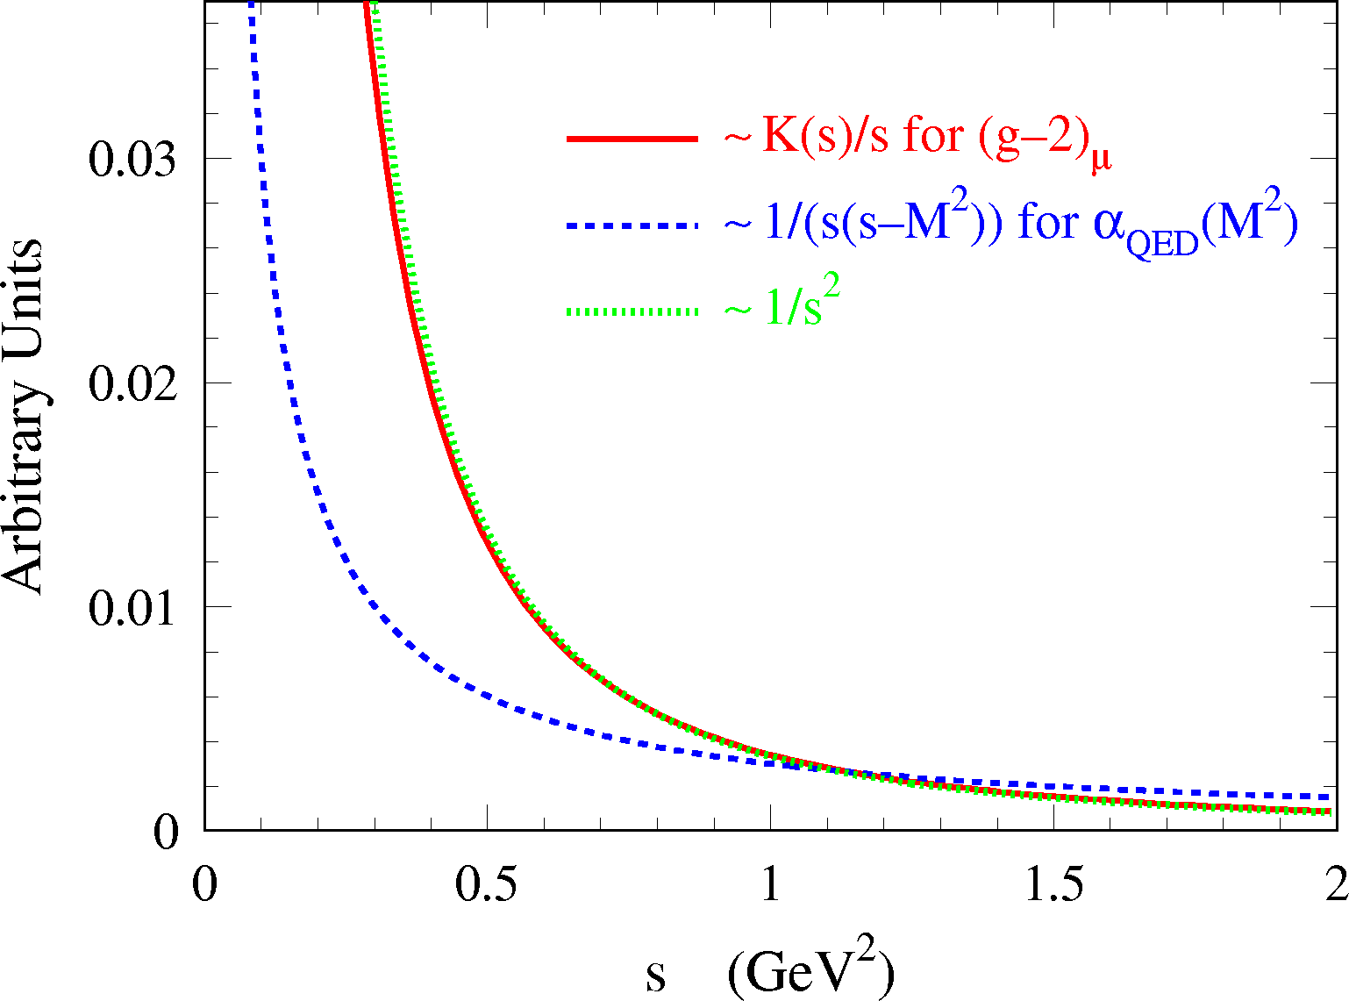
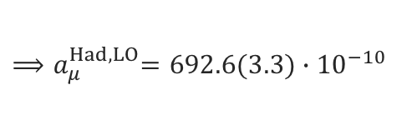
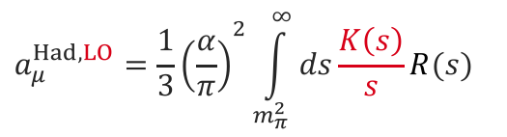
Hadronic contribution
Akin to Δα_{had}(s), the lowest-order hadronic contribution to a_{μ} can be obtained from a dispersion relation:
[ Bouchiat, Michel, 1961 ]
[ Brodsky, de Rafael, 1968 ]
$$a_{μ}^{Had,LO}={\frac{1}{3}\left(\frac{α}{π}\right)}^{2}\int_{m_{π}^{2}}^{∞}{ds\frac{K\left(s\right)}{s}R(s)}$$
Integration kernel steeply falls with s, putting emphasis on the low-mass R (s ), dominated by low-multiplicity exclusive hadronic states, such as e⁺e– → 𝜋⁺𝜋–
Most recent estimate (2016):
$${⟹a}_{μ}^{Had,LO}=692.6(3.3)∙{10}^{−10}$$
[ DHMZ, Davier 1612.02743 (2016) ]

Slide 26
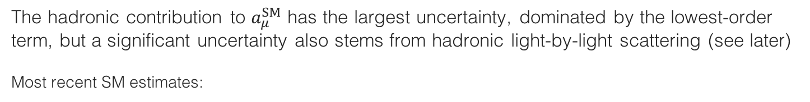
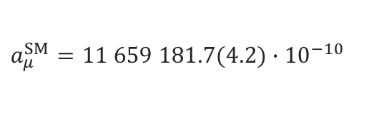
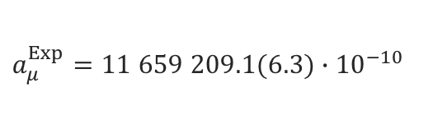
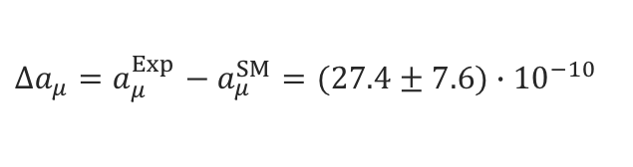
Hadronic contribution
The hadronic contribution to $a_{μ}^{SM}$ has the largest uncertainty, dominated by the lowest-order term, but a significant uncertainty also stems from hadronic light-by-light scattering (see later)
Most recent SM estimates:
[ Davier 1612.02743 ]
$$a_{μ}^{SM}=11 659 181.7(4.2)∙{10}^{−10}$$
compared to experiment:
$$a_{μ}^{Exp}=11 659 209.1(6.3)∙{10}^{−10}$$
with difference:
$${∆a_{μ}=a}_{μ}^{Exp}−a_{μ}^{SM}=(27.4±7.6)∙{10}^{−10}$$
→ 3.6σ level
Need to scrutinise hadronic contributions:
$${σ(a}_{μ}^{SM})[{10}^{−10}]=4.2={0.0}^{QED}⊕{0.1}^{EW}⊕{3.3}^{Had,LO}⊕{0.1}^{Had,N(N)LO}⊕{2.6}^{Had,LBL}$$

Slide 27
The hadronic contribution to the muon g –2
All hadronic contributions (LO, NLO, NNLO), except for light-by-light scattering (LBLS), can be obtained via dispersion relations using a mix of experimental data and perturbative QCD
γ
The LBLS contribution is a four-point function that is currently estimated using meson models
had
γ
μ

Slide 28
The hadronic contribution to the muon g –2
In the following, all a_{μ} numbers are given in units of 10 ^{–10}

Slide 29
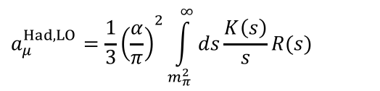
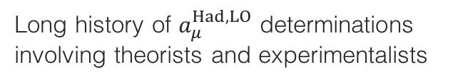
Introduction
Long history of $a_{μ}^{Had,LO}$ determinations involving theorists and experimentalists
$$a_{μ}^{Had,LO}={\frac{1}{3}\left(\frac{α}{π}\right)}^{2}\int_{m_{π}^{2}}^{∞}{ds\frac{K\left(s\right)}{s}R(s)}$$
Improvement mostly driven by better e ⁺e – → hadrons data (intermittently also hadronic tau decays used to improve over insufficient-quality low-mass e⁺e – data)
The understanding of the data and the treatment of their uncertainties improved over time
Sum-rule tests allowed to expand the use of perturbative QCD to predict R (s)
Fairly consistent picture reached

Slide 30
The challenge
The dispersion relation is solved using a mix of e ⁺e – → had data and QCD, depending on s
Davier, Hoecker, Zhang, hep-ph/0507078 (2005)
[ 𝜋⁰ γ – 1.8 GeV ]: sum of 34 exclusive channels; few unmeasured channels are estimated using isospin symmetry
[ 1.8 – 3.7 GeV ]: agreement between data and QCD for uds continuum → more precise QCD NNNLO used; J/𝜓 & 𝜓(2S) resonances from Breit-Wigners
[ 3.7 – 5.0 GeV ]: open charm pair production: use of data
[ 5.0 GeV – ]: NNNLO QCD (assuming global quark-hadron duality to hold across bb threshold)
∞

Slide 31
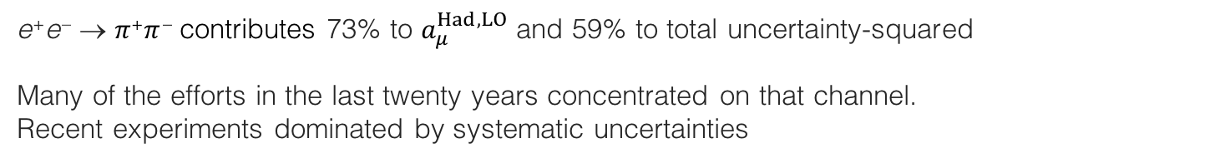
The dominant e ⁺e – → 𝜋⁺𝜋 – contribution
Relative to uncertainty² due to quadratic addition (neglecting inter-channel correlations here)
e ⁺e – → 𝜋⁺𝜋 – contributes 73% to $a_{μ}^{Had,LO}$ and 59% to total uncertainty-squared
Many of the efforts in the last twenty years concentrated on that channel. Recent experiments dominated by systematic uncertainties
Compilation and combination: DHMZ, Davier 1612.02743 (2016)
Three types of input data:
Energy scans: CMD-2 (δ_{syst} ~ 0.8%), SND (δ_{syst} ~ 1.5%), + DM1, DM2, OLYA, TOF
ISR-based measurements: BABAR (δ_{syst} ~ 0.5%), BES-III (δ_{syst} ~ 0.9%), KLOE (δ_{syst} ~ 0.8–1.4%)
Hadronic tau decay data via isospin symmetry (CVC): ALEPH, OPAL, CLEO, Belle (δ_{syst-combined} ~ 0.7%),
𝜌(770)
𝜌–𝜔 mixing
𝜌(1450)
𝜌(1700)
Data combination
𝜌(2300) ?
e ⁺e – → 𝜋⁺𝜋 –

Slide 32
The dominant e ⁺e – → 𝜋⁺𝜋 – contribution
Relative to uncertainty² due to quadratic addition (neglecting inter-channel correlations here)
e ⁺e – → 𝜋⁺𝜋 – contributes 73% to $a_{μ}^{Had,LO}$ and 59% to total uncertainty-squared
Many of the efforts in the last twenty years concentrated on that channel. Recent experiments dominated by systematic uncertainties
Monumental ISR analysis: BABAR, 1205.2228
Three types of input data:
Energy scans: CMD-2 (δ_{syst} ~ 0.8%), SND (δ_{syst} ~ 1.5%), + DM1, DM2, OLYA, TOF
ISR-based measurements: BABAR (δ_{syst} ~ 0.5%), BES-III (δ_{syst} ~ 0.9%), KLOE (δ_{syst} ~ 0.8–1.4%)
Hadronic tau decay data via isospin symmetry (CVC): ALEPH, OPAL, CLEO, Belle (δ_{syst-combined} ~ 0.7%),
BABAR data

Slide 33
The dominant e ⁺e – → 𝜋⁺𝜋 – contribution
Relative to uncertainty² due to quadratic addition (neglecting inter-channel correlations here)
e ⁺e – → 𝜋⁺𝜋 – contributes 73% to $a_{μ}^{Had,LO}$ and 59% to total uncertainty-squared
Many of the efforts in the last twenty years concentrated on that channel. Recent experiments dominated by systematic uncertainties
Monumental ISR analysis: BABAR, 1205.2228
Three types of input data:
Energy scans: CMD-2 (δ_{syst} ~ 0.8%), SND (δ_{syst} ~ 1.5%), + DM1, DM2, OLYA, TOF
ISR-based measurements: BABAR (δ_{syst} ~ 0.5%), BES-III (δ_{syst} ~ 0.9%), KLOE (δ_{syst} ~ 0.8–1.4%)
Hadronic tau decay data via isospin symmetry (CVC): ALEPH, OPAL, CLEO, Belle (δ_{syst-combined} ~ 0.7%),
Pion form factor fit well behaved, but complex structure

Slide 34
The dominant e ⁺e – → 𝜋⁺𝜋 – contribution
Relative to uncertainty² due to quadratic addition (neglecting inter-channel correlations here)
e ⁺e – → 𝜋⁺𝜋 – contributes 73% to $a_{μ}^{Had,LO}$ and 59% to total uncertainty-squared
Many of the efforts in the last twenty years concentrated on that channel. Recent experiments dominated by systematic uncertainties
Monumental ISR analysis: BABAR, 1205.2228
Three types of input data:
Energy scans: CMD-2 (δ_{syst} ~ 0.8%), SND (δ_{syst} ~ 1.5%), + DM1, DM2, OLYA, TOF
ISR-based measurements: BABAR (δ_{syst} ~ 0.5%), BES-III (δ_{syst} ~ 0.9%), KLOE (δ_{syst} ~ 0.8–1.4%)
Hadronic tau decay data via isospin symmetry (CVC): ALEPH, OPAL, CLEO, Belle (δ_{syst-combined} ~ 0.7%),
Pion form factor fit well behaved, but complex structure

Slide 35
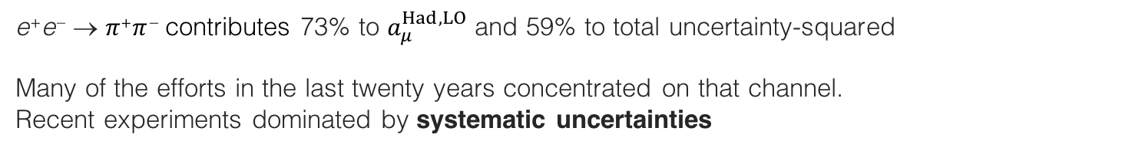
The dominant e ⁺e – → 𝜋⁺𝜋 – contribution
Relative to uncertainty² due to quadratic addition (neglecting inter-channel correlations here)
e ⁺e – → 𝜋⁺𝜋 – contributes 73% to $a_{μ}^{Had,LO}$ and 59% to total uncertainty-squared
Many of the efforts in the last twenty years concentrated on that channel. Recent experiments dominated by systematic uncertainties
Three types of input data:
Energy scans: CMD-2 (δ_{syst} ~ 0.8%), SND (δ_{syst} ~ 1.5%), + DM1, DM2, OLYA, TOF
ISR-based measurements: BABAR (δ_{syst} ~ 0.5%), BES-III (δ_{syst} ~ 0.9%), KLOE (δ_{syst} ~ 0.8–1.4%)
Hadronic tau decay data via isospin symmetry (CVC): ALEPH, OPAL, CLEO, Belle (δ_{syst-combined} ~ 0.7%),
Dominant systematic uncertainties / challenges: (in parentheses uncertainties for best measurements)
Energy scan measurements (ex. CMD-2 / 0.8%): detection efficiency, radiative corrections (0.4%), beam energy (0.3%), …
ISR-based measurements (ex. BABAR / >0.5%): pion identification (0.3%), μ ⁺μ – reference (0.4%), …
Tau data (see later, ALEPH, 0.3% on normalisation): 𝜋 ⁰ and photon reconstruction (0.2%), hadronic interactions (0.2%), …
Huge amount of precision data, but — with a close look — one notices issues…

Slide 36
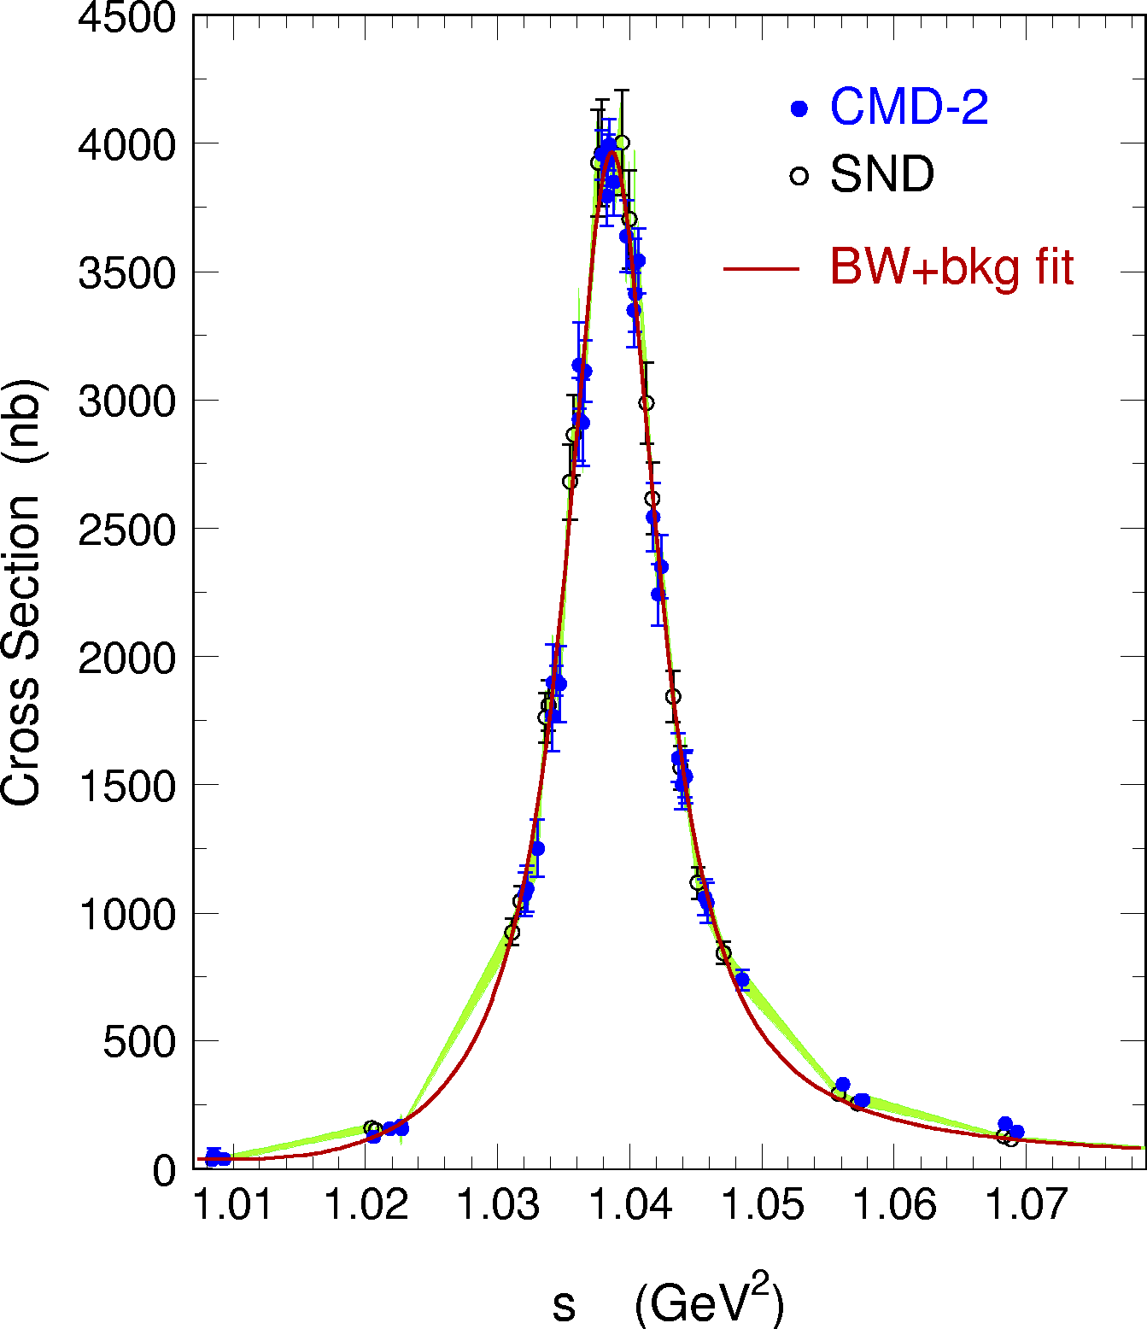
Digression: Combining data points for integration
The integration of data points belonging to different experiments, with different within-experiment, inter-experiment and inter-channel correlated systematic uncertainties, and with different data densities requires a careful treatment
It is thereby mandatory to test the accurateness of the integration procedure in terms of central value and uncertainty using representative models with known truth
Trapezoidal rule is biased
DHMZ approach for a given channel:
Quadratic interpolation of the data points for each experiment
Local weighted average between interpolations performed in infinitesimal bins (1 MeV); local PDG error rescaling in case of incompatibility
Full covariance matrices: correlations between data points of an experiment (systematic errors), between experiments and channels
Error propagation (up to dispersion integrals) using pseudo experiments
Possible bias tested in 2𝜋 channel using a GS model (closure test): negligible for quadratic interpolation, but not for linear model (trapezoidal rule)
Bias

Slide 37
The dominant e ⁺e – → 𝜋⁺𝜋 – contribution
Compilation and combination: DHMZ, Davier 1612.02743 (2016)
e ⁺e – → 𝜋⁺𝜋 –
e ⁺e – → 𝜋⁺𝜋 –
e ⁺e – → 𝜋⁺𝜋 –
e ⁺e – → 𝜋⁺𝜋 –

Slide 38
The dominant e ⁺e – → 𝜋⁺𝜋 – contribution — close comparison
Compilation and combination: DHMZ, Davier 1612.02743 (2016)
e ⁺e – → 𝜋⁺𝜋 –
e ⁺e – → 𝜋⁺𝜋 –
Local discrepancy
e ⁺e – → 𝜋⁺𝜋 –
e ⁺e – → 𝜋⁺𝜋 –

Slide 39
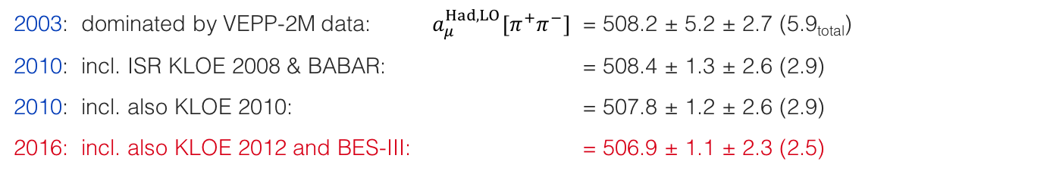
The dominant e ⁺e – → 𝜋⁺𝜋 – contribution — impact on a_{μ}
2003: dominated by VEPP-2M data: $a_{μ}^{Had,LO}[π^{+}π^{−}]$ = 508.2 ± 5.2 ± 2.7 (5.9_{total})
2010: incl. ISR KLOE 2008 & BABAR: = 508.4 ± 1.3 ± 2.6 (2.9)
2010: incl. also KLOE 2010: = 507.8 ± 1.2 ± 2.6 (2.9)
2016: incl. also KLOE 2012 and BES-III: = 506.9 ± 1.1 ± 2.3 (2.5)
Using all data except KLOE (BABAR): = 510.11 ± 2.8 (502.15 ± 3.5)
[ DHMZ numbers ]
It is possible to also use precise 𝜏 → 𝜋⁺𝜋⁰ 𝜈 data via isospin symmetry (CVC):
But it requires to correct for isospin breaking effects. Last estimate: 516.2 ± 2.9 ± 2.0_{IB} (3.5) [2.1σ above e ⁺e –]
Some IB effects still under debate (eg, γ–𝜌 mixing). While the use of tau data helped significantly in the 1990-ies when the quality of the e ⁺e – data was insufficient, with the much improved e ⁺e – precision we consider the tau data less appealing for the a_{μ} estimate

Slide 40
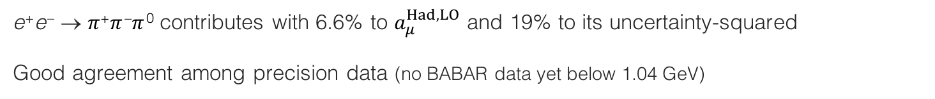
The e ⁺e – → 𝜋⁺𝜋 –𝜋 ⁰ contribution
e ⁺e – → 𝜋⁺𝜋 –𝜋 ⁰ contributes with 6.6% to $a_{μ}^{Had,LO}$ and 19% to its uncertainty-squared
Good agreement among precision data (no BABAR data yet below 1.04 GeV)
Compilation and combination: DHMZ, Davier 1612.02743 (2016)
𝜔(782) → 𝜋⁺𝜋 –𝜋 ⁰ w/ 89%
𝜙(1020) → 𝜋⁺𝜋 –𝜋 ⁰ w/ 15%

Slide 41
The e ⁺e – → 𝜋⁺𝜋 –𝜋 ⁰ contribution
e ⁺e – → 𝜋⁺𝜋 –𝜋 ⁰ contributes with 6.6% to $a_{μ}^{Had,LO}$ and 19% to its uncertainty-squared
Good agreement among precision data (no BABAR data yet below 1.04 GeV)
Compilation and combination: DHMZ, Davier 1612.02743 (2016)
𝜔(782) → 𝜋⁺𝜋 –𝜋 ⁰ w/ 89%
𝜙(1020) → 𝜋⁺𝜋 –𝜋 ⁰ w/ 15%
𝜔(782) → 𝜋⁺𝜋 –𝜋 ⁰ w/ 89%
𝜙(1020) → 𝜋⁺𝜋 –𝜋 ⁰ w/ 15%

Slide 42
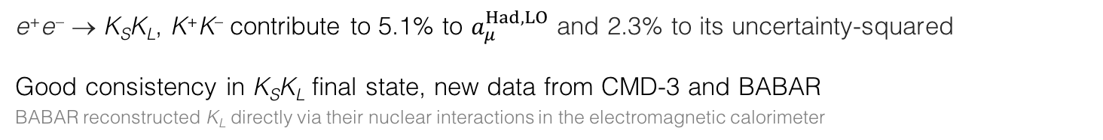
The e ⁺e – → 𝜙(1020) → K_{S}K_{L}, K⁺K– contributions
e ⁺e – → K_{S}K_{L}, K⁺K– contribute to 5.1% to $a_{μ}^{Had,LO}$ and 2.3% to its uncertainty-squared
Good consistency in K_{S}K_{L} final state, new data from CMD-3 and BABAR
BABAR reconstructed K_{L} directly via their nuclear interactions in the electromagnetic calorimeter
Compilation and combination: DHMZ, Davier 1612.02743 (2016)

Slide 43
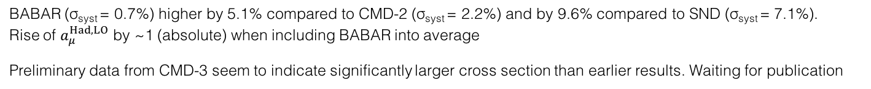

The e ⁺e – → 𝜙(1020) → K_{S}K_{L}, K⁺K– contributions
e ⁺e – → K_{S}K_{L}, K⁺K– contribute to 5.1% to $a_{μ}^{Had,LO}$ and 2.3% to its uncertainty-squared
Problems in K⁺K– channel, discrepancy between BABAR and CMD-2/SND (VEPP-2000)
K⁺K– final state with low kaons at threshold hard to reconstruct for energy-scan experiments. Easier in BABAR due to ISR boost
Compilation and combination: DHMZ, Davier 1612.02743 (2016)
Appears compatible w/ logarithmic scale
BABAR (σ_{syst} = 0.7%) higher by 5.1% compared to CMD-2 (σ_{syst} = 2.2%) and by 9.6% compared to SND (σ_{syst} = 7.1%). Rise of $a_{μ}^{Had,LO}$ by ~1 (absolute) when including BABAR into average
Preliminary data from CMD-3 seem to indicate significantly larger cross section than earlier results. Waiting for publication

Slide 44


The e ⁺e – → 𝜋⁺𝜋 –𝜋⁺𝜋 –, 𝜋⁺𝜋 –𝜋 ⁰𝜋 ⁰ contributions
The four pion channels contribute with 4.5% to $a_{μ}^{Had,LO}$ and 3.7% to its uncertainty-squared
𝜋⁺𝜋 –𝜋⁺𝜋 – channel pretty well known since long, but 𝜋⁺𝜋 –𝜋 ⁰𝜋 ⁰ challenging. Discrepancies in earlier data, but recent precise (~3.1% systematic) measurement from BABAR much improving
Compilation and combination: DHMZ, Davier 1612.02743 (2016)
Situation before BABAR data; then also tau data were used
$a_{μ}^{Had,LO}$ increased by 1.4 (absolute) with BABAR & uncertainty < halved
Tau data from ALEPH significantly above BABAR

Slide 45

The e ⁺e – → ≥ 5𝜋 contributions
≥ 5𝜋 channels (incl. 𝜂𝜋𝜋) contribute with 0.5% to $a_{μ}^{Had,LO}$ and 1.5% to its uncertainty-squared
Also here, large improvement from BABAR ISR data, problems in older datasets
Compilation and combination: DHMZ, Davier 1612.02743 (2016)

Slide 46

The e ⁺e – → KK 𝜋(𝜋𝜋) contributions (many charge combinations)
Past analyses suffered from missing final states that were estimated by symmetry arguments
Systematic measurement of exclusive processes by BABAR completes the KK𝜋 and (almost) all KK𝜋𝜋 final states. Their sum contributes 0.5% to $a_{μ}^{Had,LO}$ and 0.2% to uncertainty-squared
Selection of measurements by BABAR and others

Slide 47
Full combination of all exclusive modes: R (s ) [√s ≤ 2 GeV]
Resulting R (s ) function is finely binned with uncertainties mapped by covariance matrix
Accuracy of combination tested with pseudo-experiments
log-scale
DHMZ, Davier 1612.02743 (2016)
R (s ) spectrum dominated by BABAR ISR data measuring almost all exclusive channels until 2 GeV
lin-scale

Slide 48

Full combination of all exclusive modes: R (s ) [√s ≤ 2 GeV]
Resulting R (s ) function is finely binned with uncertainties mapped by covariance matrix
Accuracy of combination tested with pseudo-experiments
R (s) correlation matrix
log-scale
Correlation coefficient
DHMZ, Davier 1612.02743 (2016)
R (s ) spectrum dominated by BABAR ISR data measuring almost all exclusive channels until 2 GeV
lin-scale

Slide 49

–
The charm resonance region (above DD threshold)
3.7–5.0 GeV region contributes with 1.1% to $a_{μ}^{Had,LO}$ and 0.8% to its uncertainty-squared
Good agreement between measurements. Precision dominated by BES (σ_{syst} ~ 3.5%)

Slide 50
Data, QCD and the big picture (2016)
Charm resonances integrated using data
Combines sum of exclusive channels discussed before
Use of QCD above
Use of QCD (found in good agreement with recent precision data)
(σ_{syst} > 3.5%)
(σ_{syst} > 2.3%)

Slide 51

Full compilation in numbers
Davier & DHMZ, 1612.02743 (Dec 2016)
Legend: First error statistical, second channel-specific systematic, third common systematic (correlated)
For R_{QCD}, uncertainties are due to: 𝛼_{S}, NNNLO truncation, resummation (FOPT vs. CIPT), quark masses
$$a_{μ}^{Had,LO}=(692.6±3.3)∙{10}^{−10}$$

Slide 52


Higher order hadronic terms
NLO two-point correlation contributions to $a_{μ}^{Had,NLO}$ can be computed akin to the LO part via (a sum of) dispersion relations
$$a_{μ}^{Had,NLO(i)}={\frac{1}{3}\left(\frac{α}{π}\right)}^{2}\int_{m_{π}^{2}}^{∞}{ds\frac{K^{(i)}\left(s\right)}{s}R(s)}$$
$${⟹a}_{μ}^{Had,NLO}=(−9.87±0.09)∙{10}^{−10}$$
Each diagram corresponds to specific kernel function K ^{(i)}
AKurz et al, 1511.08222.
AKurz et al, 1511.08222.
NNLO two-point function corrections have also been computed: $a_{μ}^{Had,NNLO}=(1.24±0.01)∙{10}^{−10}$

Slide 53

Higher order hadronic terms
NLO two-point correlation contributions to $a_{μ}^{Had,NLO}$ can be computed akin to the LO part via (a sum of) dispersion relations
$$a_{μ}^{Had,NLO(i)}={\frac{1}{3}\left(\frac{α}{π}\right)}^{2}\int_{m_{π}^{2}}^{∞}{ds\frac{K^{(i)}\left(s\right)}{s}R(s)}$$
$${⟹a}_{μ}^{Had,NLO}=(−9.87±0.09)∙{10}^{−10}$$
Each diagram corresponds to specific kernel function K ^{(i)}
AKurz et al, 1511.08222.
AKurz et al, 1511.08222.
NNLO two-point function corrections have also been computed: $a_{μ}^{Had,NNLO}=(1.24±0.01){∙10}^{−10}$
The four-point hadronic LBL scattering contribution, however, cannot be obtained this way and models are used instead
  Calculation uses hadronic models with 𝜋⁰, 𝜂⁽’⁾, … pole insertions and 𝜋± loops in the large-N_{C} limit (Lattice QCD offers promising alternative)
$${⟹a}_{μ}^{Had,LBL}=(10.5±2.6)∙{10}^{−10}$$
Prades, de Rafael, Vainshtein, 0901.0306
Educated guess (other groups find smaller / larger uncertainty)

Slide 54








Muon g – 2 summary
Summing all contributions [ ∙ 10^{–10} ]:
Davier & DHMZ, 1612.02743 (Dec 2016)
$$a_{μ}^{QED}=11 658 471.895±0.008$$
$$a_{μ}^{EW}=15.36±0.10$$
$$a_{μ}^{Had,LO}=692.6±3.3$$
$$a_{μ}^{Had,NLO}=−9.87±0.09$$
$$a_{μ}^{Had,NNLO}=1.24±0.01$$
$$a_{μ}^{Had,LBL}=10.5±2.6$$
$$a_{μ}^{SM}=(11 659 181.7±4.2)∙{10}^{−10}$$
$${∆a_{μ}=a}_{μ}^{Exp}−a_{μ}^{SM}=27.4±{6.3}_{exp}±{4.2}_{SM} (±{7.6}_{tot})$$
→ 3.6σ level

Slide 55

Digression: Can it be real ?
The absolute size of the effect $∆a_{μ}=27.4±7.6$ is large compared to EW contribution of $15.4$ (but some cancellation among bosons in latter contribution)
  Generic decoupling new physics predicts: $a_{μ}^{NP} \sim C∙{\left(\frac{m_{μ}}{m_{NP}}\right)}^{2}$ [ Jegerlehner, Nyffeler, 0902.3360 ] Here: $m_{NP} \sim 2 TeV$ for $C=1$, $m_{NP} \sim 100 GeV$ for $C=\frac{α}{π}$ (natural strength), $m_{NP} \sim 5 GeV$ for $C={\left(\frac{α}{π}\right)}^{2}$
Generic SUSY predicts: $a_{μ}^{SUSY} \sim sign(μ)∙(13∙{10}^{−10})∙{\left(\frac{100 GeV}{m_{SUSY}}\right)}^{2}∙tanβ$
  In constrained SUSY models, $∆a_{μ}$cannot be reconciled with the non-observation of strongly produced sparticles at the LHC [ de Vries et al, MasterCode, 1504.03260 ]
  However, general models such as the pMSSM can still accommodate $∆a_{μ}$with light neutralinos, charginos and sleptons, not yet excluded by the LHC
A “dark photon” ($γ′$) coupling to SM via mixing with photon may give: $a_{μ}^{γ′} \sim \frac{α}{2π}εF(m_{γ′})$
  $∆a_{μ}$ is accommodated for coupling strength $ε \sim 0.1–0.2\%$ and mass $m_{γ′} \sim 10−100 MeV$
  Searches for a dark photon have been performed (so far negative) or are planned at colliders (LHC, B-factories, KLOE, …) and fixed target experiments (Jefferson Lab, MAMI, …)

Slide 56


SM perspectives
( $∆a_{μ}=27.4 )$
Long standing 3-ish sigma discrepancy between data and SM on a_{μ}. On the SM side:
BABAR-KLOE discrepancy in 𝜋⁺𝜋 – channel unresolved. New data from CMD-3 expected, and a new BABAR analysis with the full data sample (0.3% systematic uncertainty may be reachable, current BABAR: 0.5% on peak)
The 𝜋⁺𝜋 –𝜋 ⁰ channel should be further improved (need BABAR data at and below 𝜙(1020))
The K ⁺K – data from CMD-2/3/SND must be scrutinized and understood
Need to compare BABAR and forthcoming CMD-3/SND results in the 1–2 GeV range (so far they agree)
More results will come from BES-III and Belle-2
Alternative $a_{μ}^{Had,LO}$ determinations: (1) Lattice calculations; (2) proposal via a dispersion integral in the spacelike region by an ultra-precise µe → µe differential cross section measurement [Abbiendi et al, 1609.08987]

Slide 57

SM perspectives
( $∆a_{μ}=27.4 )$
Long standing 3-ish sigma discrepancy between data and SM on a_{μ}. On the SM side:
BABAR-KLOE discrepancy in 𝜋⁺𝜋 – channel unresolved. New data from CMD-3 expected, and a new BABAR analysis with the full data sample (0.3% systematic uncertainty may be reachable, current BABAR: 0.5% on peak)
The 𝜋⁺𝜋 –𝜋 ⁰ channel should be further improved (need BABAR data at and below 𝜙(1020))
The K ⁺K – data from CMD-2/3/SND must be scrutinized and understood
Need to compare BABAR and forthcoming CMD-3/SND results in the 1–2 GeV range (so far they agree)
More results will come from BES-III and Belle-2
Alternative $a_{μ}^{Had,LO}$ determinations: (1) Lattice calculations; (2) Proposal via a dispersion integral in the spacelike region by an ultra-precise µe → µe differential cross section measurement [Abbiendi et al, 1609.08987]
Uncertainty on $a_{μ}^{Had,LO}$ improved by factor of 2 during the last 13 years. Now twice smaller than exp. uncertainty. LBL scattering, estimated from hadronic models, has an uncertainty of similar size that currently appears irreducible. Lattice QCD calculations may provide the way forward.
The recent & future SM improvements pave the road of a full exploitation of the next generation g – 2 experiments at Fermilab and J-PARC

Slide 58


New muon g – 2 experiments
Fermilab E989
J-PARC E34
E989 storage ring
E34 beamline
E989 aims at overall factor 4 improvement (σ_{tot} ~ 1.5), following measurement principle of E821 (reusing E821 magnet) [1501.06858]
Statistics: increased μ injection efficiency, higher repetition rate
Reduction of systematic uncertainty on 𝜔_{a} and B-field by factor 3 by improved instrumentation, shimming, stability, monitoring
E34 follows entirely new, compact “zero E-field” approach (off magic γ) using low-emittance, low-momentum (“cold muon”) beam
µ⁺ stopped to form muonium (e –µ ⁺) atoms → laser ionisation leaves ~3 keV µ⁺ → reacceleration to 300 MeV → injection into compact 3 T storage magnet with 66 cm orbit diameter → measure decay e⁺ in silicon tracker
Target a_{µ} precision: 4.5 at stage-one, 1.2 final
Start of commissioning of E989 in 2017, final results expected by 2020!
E34 approved among future priority projects by KEK. Detector partially funded, moving ahead with construction. Fascinating project!
Both exps. also aim at improving µEDM sensitivity by 2 orders of magnitude to < 10^{–21} e cm (E821: < 1.9 10^{–19} e cm )
EDM tilts spin precession plane radially → µ polarisation acquires vertical component which oscillates with horizontal precession frequency

Slide 59
Conclusions
Davier & DHMZ, 1612.02743 (Dec 2016)
Non-conclusive 3.6σ discrepancy between experiment and SM prediction in muon g – 2
The “effect” is large, too large for new physics in light of the negative LHC results?
Fortunately, we do not need to speculate at this stage as new experiments and improved SM predictions are forthcoming!

Slide 60

Conclusions
Accurate, minute measurement seems to the non-scientific imagination, a less lofty and dignified work than looking for something new.
But [many of] the grandest discoveries of science have been but the rewards of accurate measurement and patient long-continued labour in the minute sifting of numerical results.
Said to originate from: William Thomson Kelvin
2 Aug 1871 in a speech to the British Association for the Advancement of Science
Lord Kelvin

Slide 61
Additional slides

Slide 62
New experiments
_{Fermilab E989}
E989 storage ring (Fermilab)
E821 result had larger statistical uncertainty (5.4_{stat} vs. 3.3_{syst}) [∙ 10^{–10}]
New experiment E989 at Fermilab aims at overall factor 4 improvement (σ_{tot} ~ 1.5) with equal statistical and systematic uncertainty, following measurement principle of E821: [1501.06858]
Reuse of E821 magnet, radial magnetic and vertical electric focusing of muons in storage ring, magic γ
Reduction of statistical uncertainty by factor ~√21 (~200B detected positrons) with less intense proton beam (ie, 84 times larger integrated luminosity needed): increased μ injection efficiency, higher repetition rate
Reduction of systematic uncertainty on 𝜔_{a} by factor 3: segmented calorimeters and waveform digitisation to separate pileup positrons; also improved timing measurement, energy resolution, gain stability
Three tracker stations in front of calorimeters: monitor muon loss, muon momentum spread (deviation from magic γ), and coherent betatron oscillation motion (via positron trajectory),
Improved magnetic field (aka 𝜔_{p}) uniformity by passive shimming (mechanical adjustments), better mechanical and thermal stability, better monitoring, frequent field mapping under running conditions
Start of commissioning of E989 in 2017, final results expected by 2020!
E989 also aims at improving µEDM sensitivity by 2 orders of magnitude to < 10^{–21} e cm (E821: < 1.9 10^{–19} e cm )
EDM tilts spin precession plane radially → µ polarisation acquires vertical component which oscillates with horizontal precession frequency

Slide 63
New experiments
_{J-PARC E34}
E34 beamline (J-PARC)
Entirely new, compact “zero E-field” approach (off magic γ)
Replace electric quadrupole field focusing in E821 by low-emittance, low-momentum (“cold muon”) beam
Positive muons from pion decays are stopped in aerogel target where they form muonium (e –µ ⁺) atoms
The muonium atoms are laser ionised, leaving cold muons of momentum 3 keV in average
These are reaccelerated (to increase lifetime) in a linac to 300 MeV
Muons are injected into a compact, ultra-precise (iron shimmed) 3 T storage magnet with 66 cm orbit diameter (14 m in E821 / E989)
The decay positrons are measured in silicon strip tracking detector (not a calorimeter) needed because of dense muon decay environment
Target: 4.5 at stage-one, and 1.2 final on a_{µ} [∙ 10^{–10}], and ~10^{–21} e cm final µEDM sensitivity
E34 was approved among the future priority projects by KEK. Detector partially funded, moving ahead with construction. Fascinating project!

Slide 64
Dark photon search summary
Jegerlehner, Nyffeler, Phys. Rept. 477 (2009) 1 [0902.3360]
Hoecker, Marciano, brief PDG review on muon g–2 (regular updates)
Denig, EPJ Web of Conferences 130, 01005 (2016)
pedagogical introduction:
https://arxiv.org/pdf/0902.3360.pdf
Digression on EDM (see Lee Robert’s talk)
Limits on electron radius, and comparison with contact interaction:
http://gabrielse.physics.harvard.edu/gabrielse/overviews/ElectronSubstructure/ElectronSubstructure.html

