Slide 1
Ultimate precision Standard Model tests: the muon magnetic anomaly — taming its hadronic contributions
µ
B field
?
µ
Andreas Hoecker (CERN)
Seminar, Geneva University, May 25th, 2021
Work in collaboration with M. Davier, B. Malaescu, and Z. Zhang (DHMZ): Eur. Phys. J. C 80, 241 (2020)

Slide 2
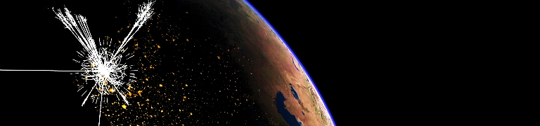
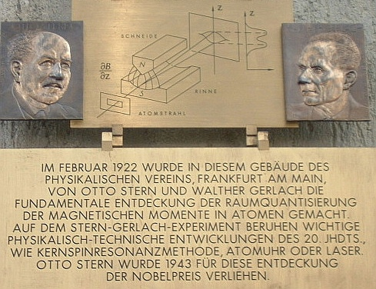
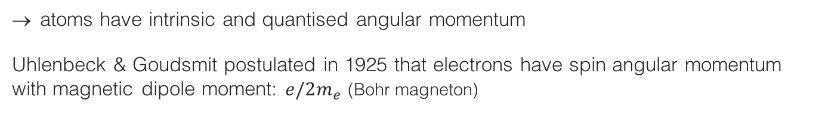
Magnetic moment
The magnetic dipole moment of a particle can be observed from its motion in a magnetic field
Intrinsic magnetic moment discovered in Stern-Gerlach experiment, 1922:
Observation
Expected result
Beam of neutral silver atoms (unpaired atomic electron)
Inhomogeneous magnetic field
A commemorative plaque at the Frankfurt physics institute
atoms have intrinsic and quantised angular momentum
Uhlenbeck & Goudsmit postulated in 1925 that electrons have spin angular momentum with magnetic dipole moment: $e/2m_{e}$ (Bohr magneton)

Slide 3
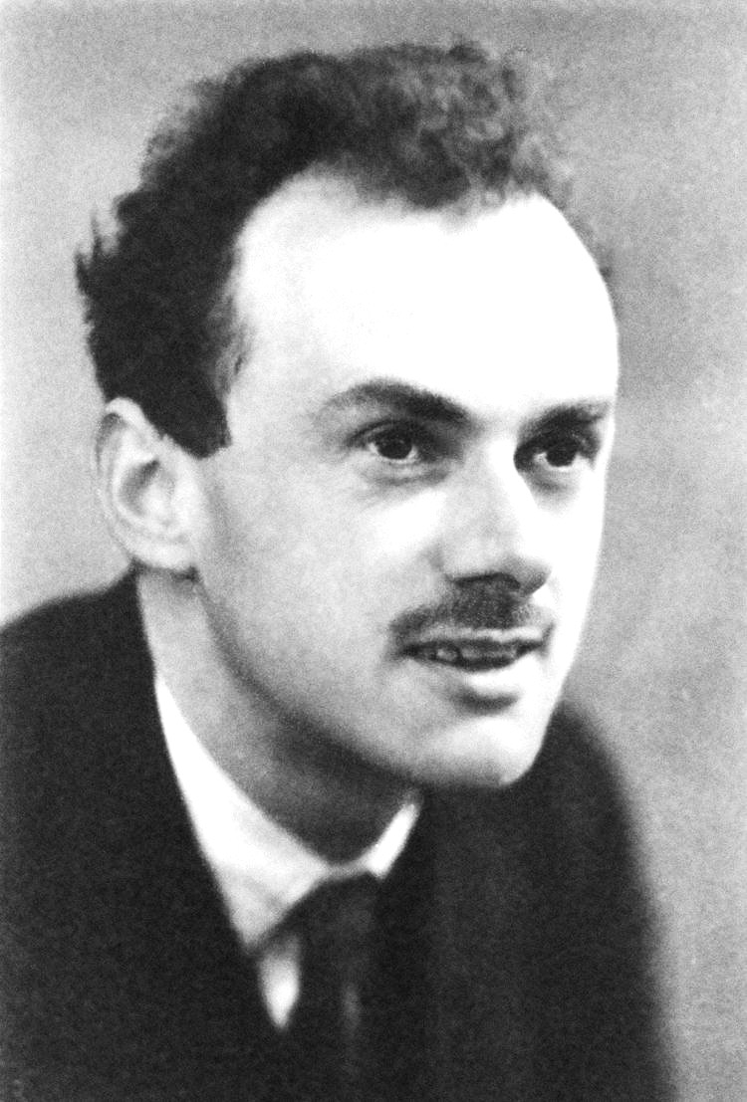



Electron g factor
Dirac’s relativistic theory of the electron (1928) naturally accounted for quantized particle spin, and described elementary spin-1/2 particles
In the classical limit, one finds the Pauli equation with magnetic moment:
$\overset{⃑}{μ}={−g}_{e}\frac{e}{2m_{e}}\overset{⃑}{S}$ ,
with ${|g}_{e}|=2$ the gyromagnetic factor
(and radius $R_{e}=0$, ie, elementary !)
Paul Dirac
Here $g_{p}/g_{e}=2.8$ hinted that proton is not elementary

Slide 4
Electron g factor
Dirac’s relativistic theory of the electron (1928) naturally accounted for quantized particle spin, and described elementary spin-1/2 particles
In the classical limit, one finds the Pauli equation with magnetic moment:
$\overset{⃑}{μ}={−g}_{e}\frac{e}{2m_{e}}\overset{⃑}{S}$ ,
with ${|g}_{e}|=2$ the gyromagnetic factor
(and radius $R_{e}=0$, ie, elementary !)
Paul Dirac
Here $g_{p}/g_{e}=2.8$ hinted that proton is not elementary
Today, everyone knows that the proton is composite,
and the electron is a point-like particle …
But – is it really ?
→ Precise g_{e} measurement is key !

Slide 5
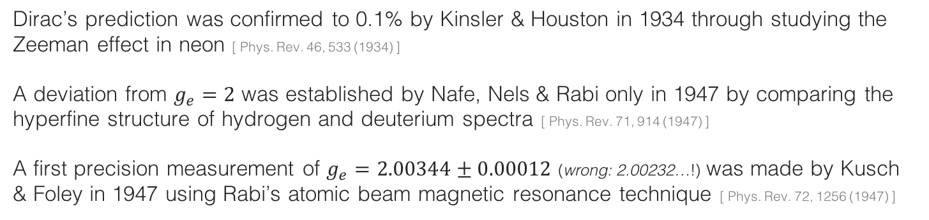
Electron g factor
Dirac’s relativistic theory of the electron (1928) naturally accounted for quantized particle spin, and described elementary spin-1/2 particles
In the classical limit, one finds the Pauli equation with magnetic moment:
$\overset{⃑}{μ}={−g}_{e}\frac{e}{2m_{e}}\overset{⃑}{S}$ ,
with ${|g}_{e}|=2$ the gyromagnetic factor
(and radius $R_{e}=0$, ie, elementary !)
Paul Dirac
Here $g_{p}/g_{e}=2.8$ hinted that proton is not elementary
Dirac’s prediction was confirmed to 0.1% by Kinsler & Houston in 1934 through studying the Zeeman effect in neon [ Phys. Rev. 46, 533 (1934) ]
A deviation from $g_{e}=2$ was established by Nafe, Nels & Rabi only in 1947 by comparing the hyperfine structure of hydrogen and deuterium spectra [ Phys. Rev. 71, 914 (1947) ]
A first precision measurement of $g_{e}=2.00344±0.00012$ (wrong: 2.00232…!) was made by Kusch & Foley in 1947 using Rabi’s atomic beam magnetic resonance technique [ Phys. Rev. 72, 1256 (1947) ]

Slide 6
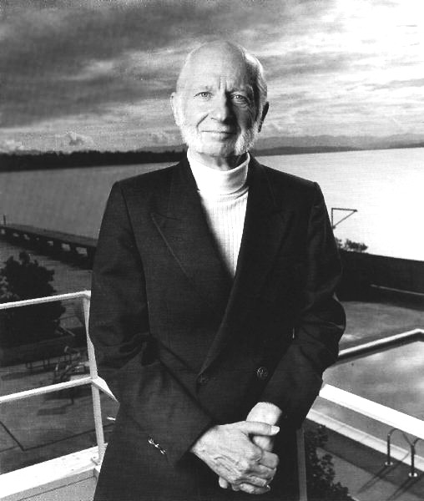

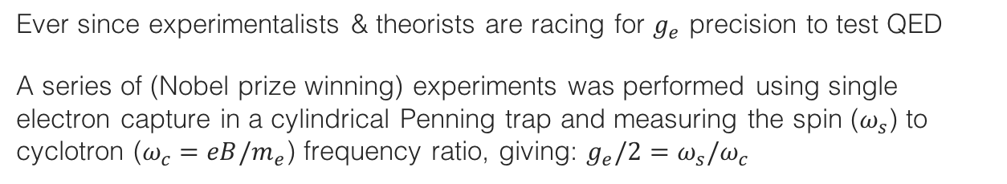
Electron g factor
Ever since experimentalists & theorists are racing for $g_{e}$ precision to test QED
A series of (Nobel prize winning) experiments was performed using single electron capture in a cylindrical Penning trap and measuring the spin ($ω_{s}$) to cyclotron ($ω_{c}=eB/m_{e}$) frequency ratio, giving: $g_{e}/2=ω_{s}/ω_{c}$
The most precise measurement from 2008 exploits spectroscopy with fully resolved lowest cyclotron and spin levels of a single electron quantum cyclotron in a cold (0.1 K) cylindrical Penning trap cavity immersed in 5.4 T B field
Hans G. Dehmelt
Nobel 1989
Anomalous magnetic moment:
$$a_{e}=\frac{g_{e}−2}{2}=1 159 652 180.73(28) ∙{10}^{−12}$$
(24 ppb precision, 1.8σ below 1987 value)
[ Hanneke, Fogwell, Gabrielse (Harvard), 0801.1134, 1009.4831 ]
Cylindrical Penning trap cavity used to confine a single electron and inhibit spontaneous emission

Slide 7
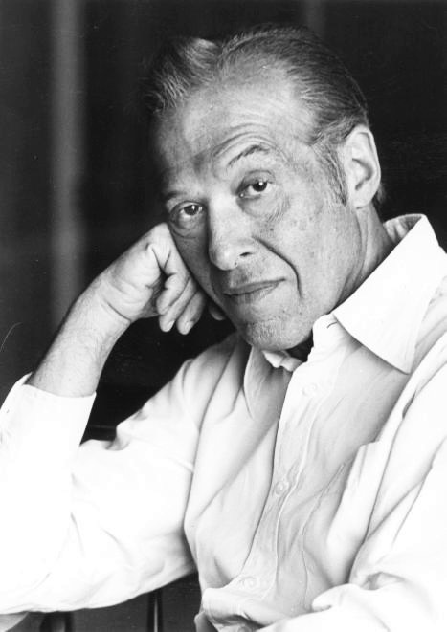
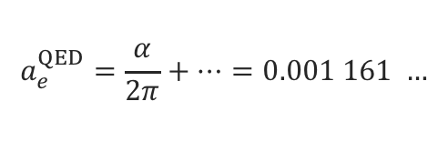
Quantum fluctuations
Dirac’s gyromagnetic factor is lowest order QED graph, but there are quantum corrections…
Schwinger 1948 (Nobel price 1965)
First QFT loop calculation!
[ Phys. Rev. 73, 416 (1948) ]
=
+
+ …
(g–2)_{e} ≠ 0 (full Standard Model)
(g–2)_{e} = 0 (Dirac)
coupling to virtual fields: (g–2)_{e} ≠ 0 (1st order QED)
Julian Schwinger
Quantum fluctuations slightly increase gyromagnetic factor, so that:
$$a_{e}^{QED}=\frac{α}{2π}+…=0.001 161 …$$

Slide 8
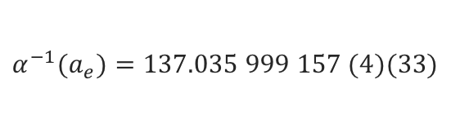
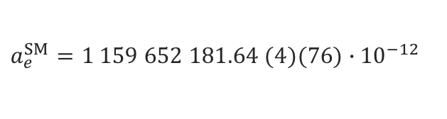
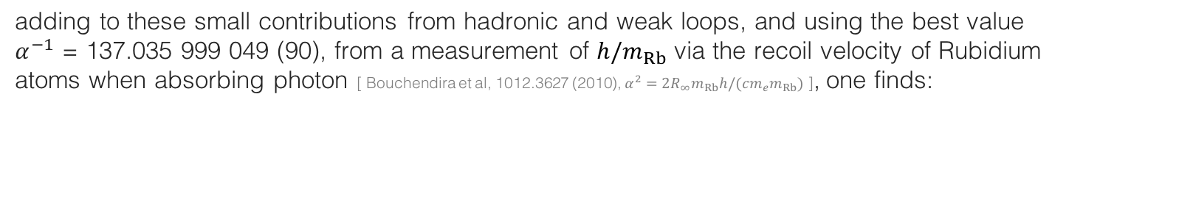

Theory and comparison with experiment
In a tour de force, five QED loops have been computed [ Kinoshita et al, 1412.8284 (2014) ]
$$a_{e}^{QED}=\frac{α}{2π}−0.328478444{\left(\frac{α}{π}\right)}^{2}+1.181234{\left(\frac{α}{π}\right)}^{3}−1.912\left(1\right){\left(\frac{α}{π}\right)}^{4}−7.8\left(3\right){\left(\frac{α}{π}\right)}^{5}$$
adding to these small contributions from hadronic and weak loops, and using the best value $α^{−1}$ = 137.035 999 049 (90), from a measurement of ${h/m}_{Rb}$ via the recoil velocity of Rubidium atoms when absorbing photon [ Bouchendira et al, 1012.3627 (2010), $α_{ }^{2}=2R_{∞}m_{Rb}h/(cm_{e}m_{Rb})$ ], one finds:
$$a_{e}^{SM}=1 159 652 181.64 (4)(76)∙{10}^{−12}$$
→ In agreement with experiment
$$a_{e}^{Exp}=1 159 652 180.73(28) ∙{10}^{−12}$$
(errors are from loop terms and α, respectively)
Measurement and SM prediction can be used to derive most precise value of α
$$α^{−1}(a_{e})=137.035 999 157 (4)(33)$$
(errors are from theory and experiment, respectively)
(0.25 ppb precision, 3 times better than Rb based value)
[ Kinoshita et al, 1412.8284 (2014) ]

Slide 9
Theory and comparison with experiment
In a tour de force, five QED loops have been computed [ Kinoshita et al, 1412.8284 (2014) ]
$$a_{e}^{QED}=\frac{α}{2π}−0.328478444{\left(\frac{α}{π}\right)}^{2}+1.181234{\left(\frac{α}{π}\right)}^{3}−1.912\left(1\right){\left(\frac{α}{π}\right)}^{4}−7.8\left(3\right){\left(\frac{α}{π}\right)}^{5}$$
adding to these small contributions from hadronic and weak loops, and using the best value $α^{−1}$ = 137.035 999 049 (90), from a measurement of ${h/m}_{Rb}$ via the recoil velocity of Rubidium atoms when absorbing photon [ Bouchendira et al, 1012.3627 (2010), $α_{ }^{2}=2R_{∞}m_{Rb}h/(cm_{e}m_{Rb})$ ], one finds:
Recent Update
$$a_{e}^{SM}=1 159 652 181.64 (4)(76)∙{10}^{−12}$$
→ In agreement with experiment
$$a_{e}^{Exp}=1 159 652 180.73(28) ∙{10}^{−12}$$
(errors are from loop terms and α respectively)
Measurement and SM prediction can be used to derive most precise value of α
$$α^{−1}(a_{e})=137.035 999 157 (4)(33)$$
(errors are from theory and experiment, respectively)
(0.25 ppb precision, 3 times better than Rb based value)
[ Kinoshita et al, 1412.8284 (2014) ]

Slide 10


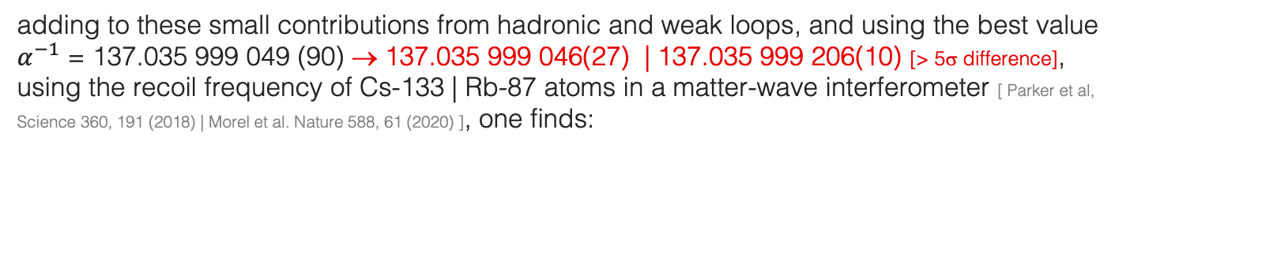
Theory and comparison with experiment
In a tour de force, five QED loops have been computed [ Kinoshita et al, 1412.8284 (2014) ]
$$a_{e}^{QED}=\frac{α}{2π}−0.328478444{\left(\frac{α}{π}\right)}^{2}+1.181234{\left(\frac{α}{π}\right)}^{3}−1.912\left(1\right){\left(\frac{α}{π}\right)}^{4}−7.8\left(3\right){\left(\frac{α}{π}\right)}^{5}$$
adding to these small contributions from hadronic and weak loops, and using the best value $α^{−1}$ = 137.035 999 049 (90) → 137.035 999 046(27) | 137.035 999 206(10) [> 5σ difference], using the recoil frequency of Cs-133 | Rb-87 atoms in a matter-wave interferometer [ Parker et al, Science 360, 191 (2018) | Morel et al. Nature 588, 61 (2020) ], one finds:
$$a_{e}^{SM}=1 159 652 181.64 (76)∙{10}^{−12}$$
→ $1 159 652 181.61\left(23\right) | …180.25(10)∙{10}^{−12}$
$$a_{e}^{Exp}=1 159 652 180.73(28) ∙{10}^{−12}$$
so that the experimental value differs from the SM prediction by –2.4σ | +1.6σ, respectively

Slide 11
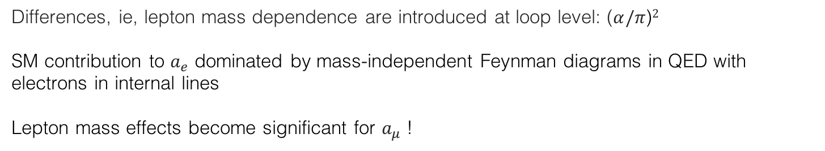

Theoretical properties
The anomalous magnetic moment of an elementary particle corresponds to an effective Lagrangian interaction of mass dimension 5. It is finite and calculable
At lowest order in QED, the anomalous magnetic moment is universal:
$$a_{e}^{QED,LO}=a_{μ}^{QED,LO}=a_{τ}^{QED,LO}=\frac{α}{2π}$$
Differences, ie, lepton mass dependence are introduced at loop level: ($α/π$)$2$
SM contribution to $a_{e}$ dominated by mass-independent Feynman diagrams in QED with electrons in internal lines
Lepton mass effects become significant for $a_{μ}$ !

Slide 12
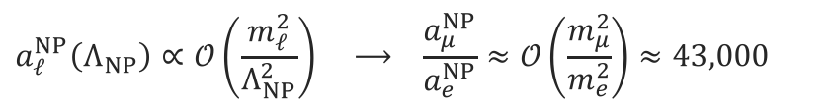
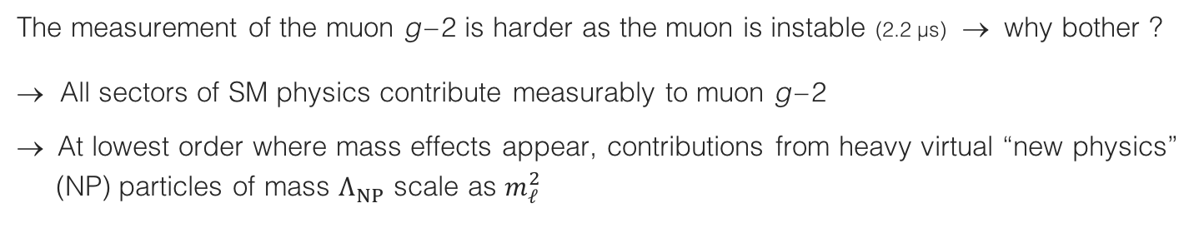
Muon g – 2
The measurement of the muon g – 2 is harder as the muon is instable (2.2 µs) → why bother ?
→ All sectors of SM physics contribute measurably to muon g – 2
→ At lowest order where mass effects appear, contributions from heavy virtual “new physics”
(NP) particles of mass $Λ_{NP}^{ }$ scale as $m_{ℓ}^{2}$
$$a_{ℓ}^{NP}\left(Λ_{NP}\right)∝𝒪\left(\frac{m_{ℓ}^{2}}{Λ_{NP}^{2}}\right) ⟶ \frac{a_{μ}^{NP}}{a_{e}^{NP}}≈𝒪\left(\frac{m_{μ}^{2}}{m_{e}^{2}}\right)≈43,000$$
Muon g – 2 looses “only” about factor 23 (4) in experimental (theoretical) precision, so a_{μ} expected to be significantly more sensitive to NP than a_{e}
Example: weak + Higgs boson contribution is 1536 ∙ 10^{–12} (μ ) and 0.030 ∙ 10^{–12} (e ) → ratio of ~ 51,000

Slide 13
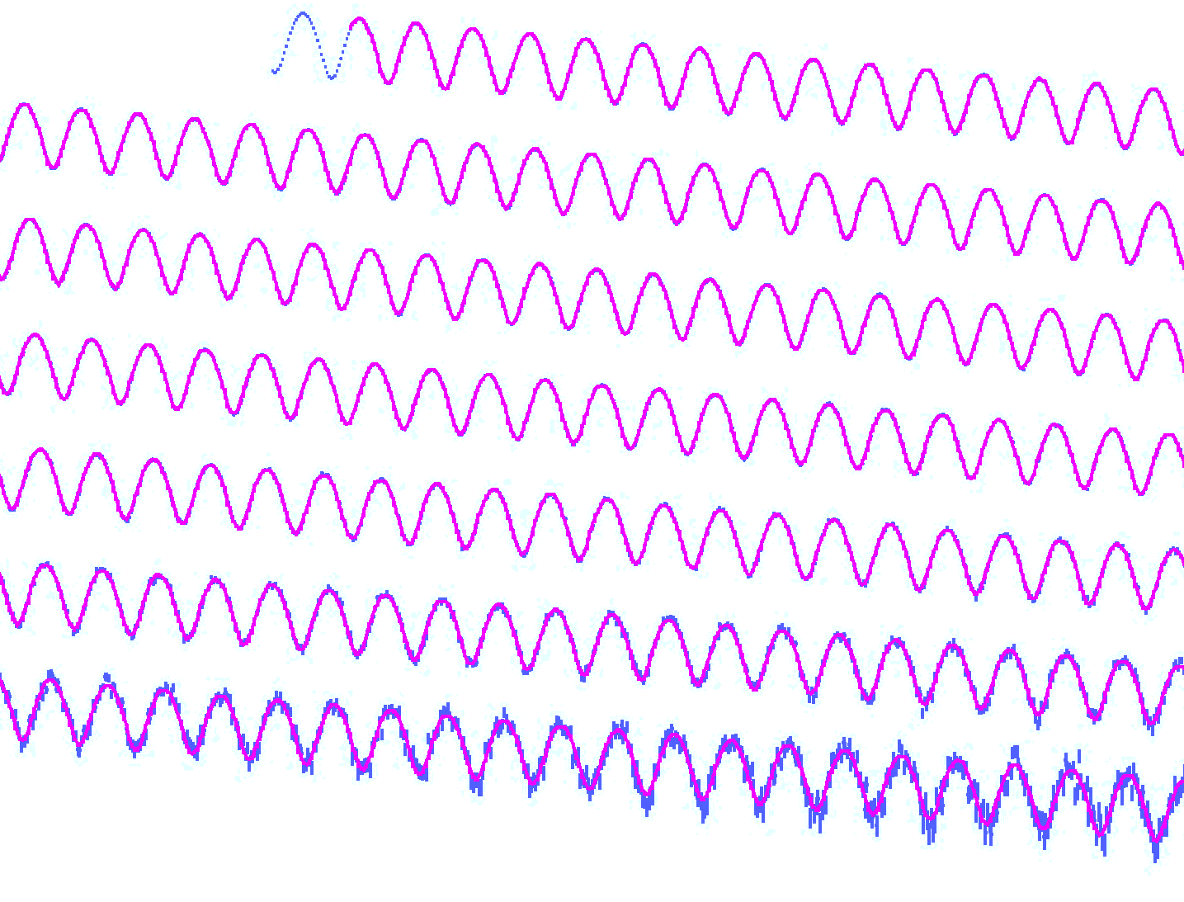
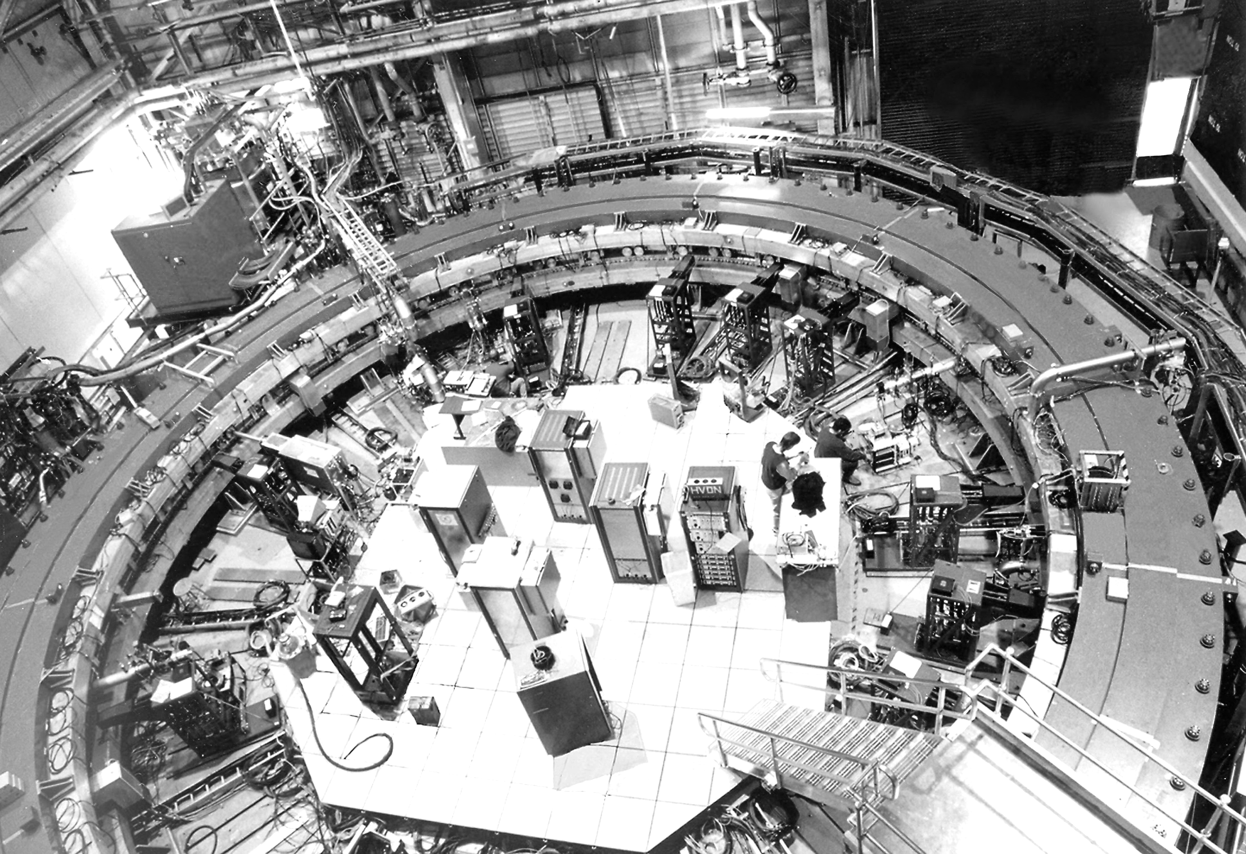
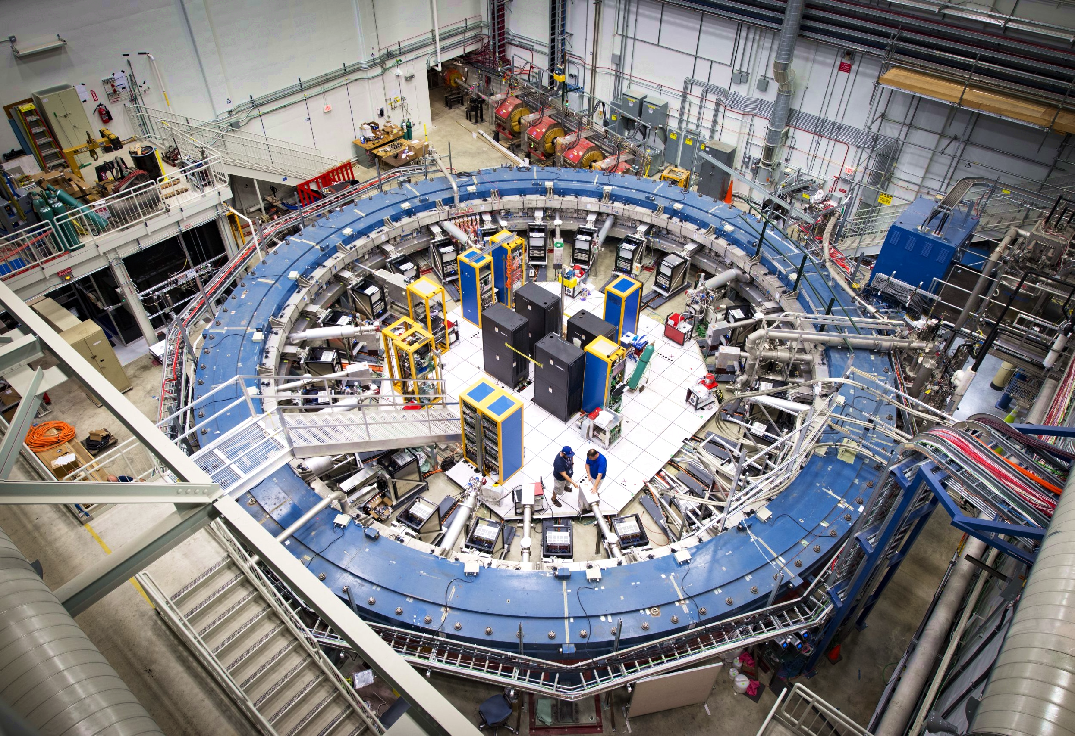
Measuring the muon g – 2
BNL muon g–2 experiment (E821), 1997–2001 (data taking)
Fermilab muon g–2 experiment, 2018–…

Slide 14
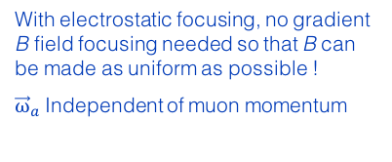
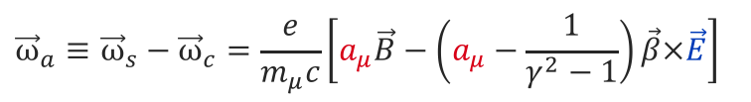
Measuring the muon g – 2
Analogous approach as for electron: search for discrepancy between the frequencies of cyclotron motion and spin precession
For polarised muons moving in a uniform B field (perp. to muon spin and orbit plane), and focused in an electric quadrupole field, the observed difference between spin precession and cyclotron frequency (= “anomalous frequency”), ignoring µEDM, is:
$${\vec{ω}}_{a}≡{\vec{ω}}_{s}−{\vec{ω}}_{c}=\frac{e}{m_{μ}c}\left[a_{μ}\vec{B}−\left(a_{μ}−\frac{1}{γ^{2}−1}\right)\vec{β}×\vec{E}\right]$$
With electrostatic focusing, no gradient B field focusing needed so that B can be made as uniform as possible !
${\vec{ω}}_{a}$Independent of muon momentum
Motional magnetic field
The E field dependence is eliminated at the “magic γ ”: γ = 29.3 → p_{μ} = 3.09 GeV
The experiment measures (g_{μ} – 2) / 2 directly
[ J. Bailey et al., NP B150, 1 (1979) ]

Slide 15
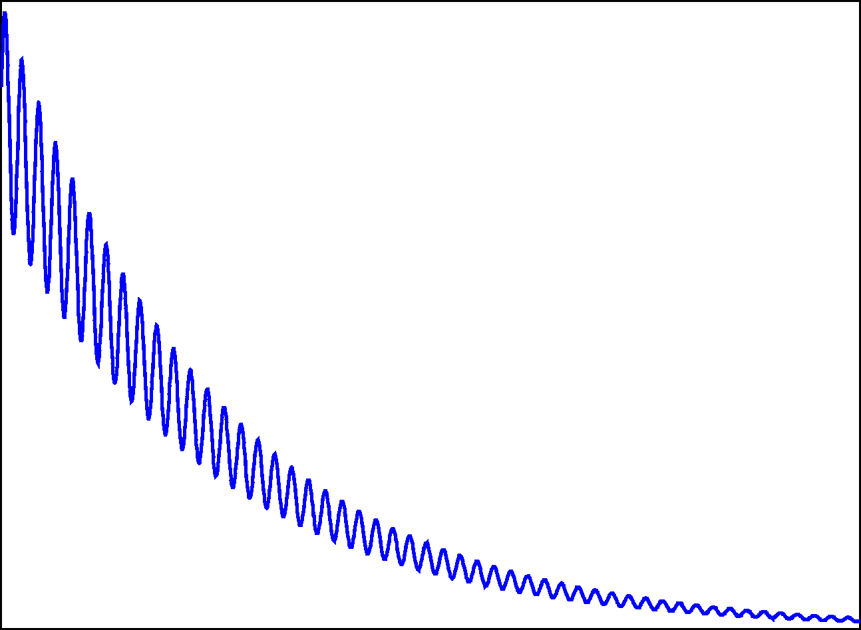
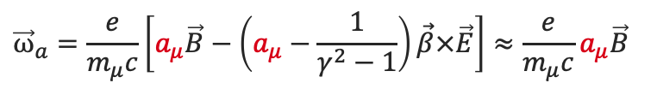



Exploit muon properties in experiment
spin orientation
$${\overline{ν}}_{μ}⟵π^{−}⟶μ_{polarised}^{−}$$
Parity violation polarizes muons in pion decay
~97% polarized for forward decays
Anomalous frequency proportional to a_{μ}
$${\vec{ω}}_{a}=\frac{e}{m_{μ}c}\left[a_{μ}\vec{B}−\left(a_{μ}−\frac{1}{γ^{2}−1}\right)\vec{β}×\vec{E}\right]≈\frac{e}{m_{μ}c}a_{μ}\vec{B}$$
Magic γ :
$$ω_{a}$$
Parity violation in muon decay
$$μ_{polarised}^{+}⟶e^{+}+{ν_{e}+\overline{ν}}_{μ}$$
electron counts
fast positron emitted preferentially in direction of muon spin
Time
© D. Hertzog, UIUC

Slide 16
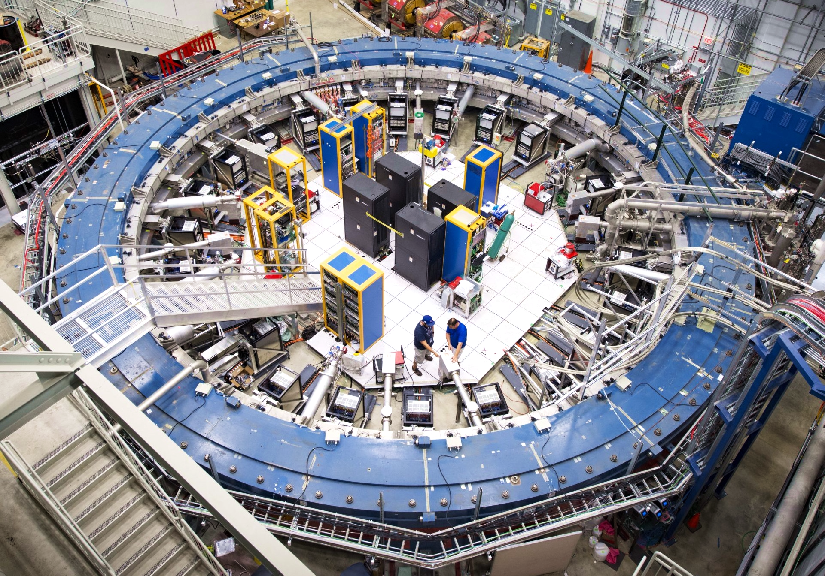
Fermilab muon g – 2 experiment
8 GeV proton beam incident on a target produces large number of pions that decay to muons
3.1 GeV muons (relativistically enhanced lifetime of 64 µs) is injected into a 45 m circumference ring with 1.4 T vertical magnetic field, which produces cyclotron motion matching the ring radius
Vertical focusing via electrostatic quadrupole lenses around the ring
Straw-tracking station
Direct muons into ideal orbit
Decay positrons (correlated with μ spin precession) counted vs. time in calorimeters inside ring (→ 𝜔_{a})
Muon beam profile measured with tracking stations
Precise measurement of 𝜔_{a} and B allows to extract a_{μ}

Slide 17


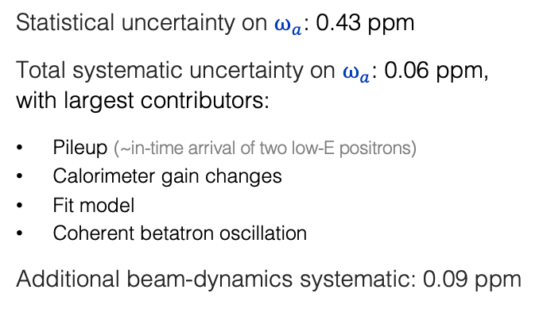
Fermilab muon g – 2 experiment
PRD 103, 072002 (2021)
Observed positron rate in successive 102.5 µs periods
5-paramerter fit not adequate to describe data
Anomalous frequency:
Statistical uncertainty on $ω_{a}$: 0.43 ppm
Total systematic uncertainty on $ω_{a}$: 0.06 ppm, with largest contributors:
Pileup (~in-time arrival of two low-E positrons)
Calorimeter gain changes
Fit model
Coherent betatron oscillation
Additional beam-dynamics systematic: 0.09 ppm
$$ω_{a}≈\frac{e}{m_{μ}c}a_{μ}B$$
obtained from time-dependent fit to electron counts (for given energy E), in simplified form:
$$N\left(t\right)=N_{0}e^{−t/γτ}\left[1−A∙cos\left(ω_{a}t+φ\right)\right]$$
In blue: fit parameters (full fit has 22 free parameters)

Slide 18
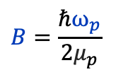
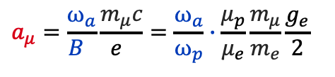
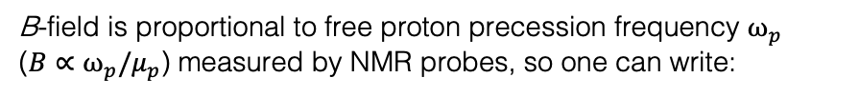
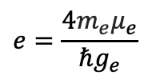
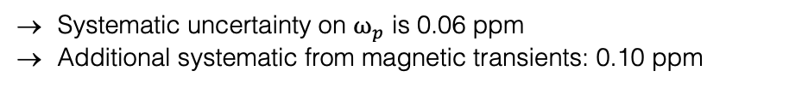
Fermilab muon g – 2 experiment
B-field is mapped with 17 NMR probes on a trolley pulled through beampipe every 2-3 days
PRL 126, 141801 (2021)
B-field is proportional to free proton precession frequency $ω_{p}$ ($B∝ω_{p}/μ_{p}$) measured by NMR probes, so one can write:
$$a_{μ}=\frac{ω_{a}}{B }\frac{m_{μ}c}{e }=\frac{ω_{a}}{ω_{p}}∙\frac{μ_{p}}{μ_{e}}\frac{m_{μ}}{m_{e}}\frac{g_{e}}{\text{2}}$$
Precise external data
(total uncertainty: 0.03 ppm)
Measured by Fermilab experiment
where was used:
$$B=\frac{ℏω_{p}}{2μ_{p}}$$
$$e=\frac{4m_{e}μ_{e}}{ℏg_{e}}$$
and
Azimuthal average magnetic field contours overlaid on the time and azimuthally averaged muon distribution
.
The full expression includes corrections for the muon distribution and NMR temperature reference
Systematic uncertainty on $ω_{p}$ is 0.06 ppm
Additional systematic from magnetic transients: 0.10 ppm
$ω_{a}$ and $ω_{p}$ measured independently in blind analyses → doubly blind experiment!

Slide 19


Result, and comparison with earlier experiments
Fermilab g–2 Result (Run 1): [ PRL 126, 141801 (2021) ]
$$a_{μ}=11 659 204.0 (5.1)(1.8) ∙{10}^{−10}$$
(0.46 ppm precision, assumes CPT invariance)
Combination with BNL E821 result:
Run-1 analysis
done
[ PRD 73, 072003 (2006) with updated reference values ]
$$a_{μ}=11 659 206.1 (4.1) ∙{10}^{−10}$$
(0.35 ppm)
Run-2 analysis underway
Evolution of the experimental sensitivity:
[ See, eg, Miller, de Rafael, Roberts, hep-ph/0703049 ]
Experiment | Beam | Measurement | δa_{μ} / a_{μ} |  | Required theor. terms
Columbia-Nevis (‘57) | μ⁺ | g = 2.00 (σ = 0.10) |  |  | g = 2
Columbia-Nevis (‘60) | μ⁺ | 0.001 13 (+16)(–12) | 12 % |  | α/2π
CERN 1 (SC, 1961) | μ⁺ | 0.001 145 (22) | 1.9 % |  | α/2π
CERN 1 (SC, 1962) | μ⁺ | 0.001 162 (5) | 0.43 % |  | (α/π)²
CERN 2 (PS, 1968) | μ⁺ | 0.001 166 16 (31) | 266 ppm |  | (α/π)³
CERN 3 (PS, 1979) | μ± | 0.001 165 923 0 (84) | 7.2 ppm |  | (α/π)³ + had (60 ppm)
BNL E821 (1997–2001) | μ± | 0.001 165 920 91 (63) | 0.54 ppm |  | (α/π)⁴ + had + weak + ?
Fermilab 2020 | μ⁺ | 0.001 165 920 40 (54) | 0.46 ppm |  | same
Muon behaves like heavy electron
Electrostatic focusing, magic γ

Slide 20

Confronting Experiment with Theory
The Standard Model prediction of a_{μ} is decomposed in its main contributions:
$$a_{μ}^{SM}=\frac{g_{μ}−2}{2}=a_{μ}^{QED}+a_{μ}^{EW}+a_{μ}^{Had}$$
of which the hadronic contribution has the largest uncertainty

Slide 21
Confronting Experiment with Theory
QED
Electroweak
Hadronic
SUSY ?
Some other type of new physics?
?

Slide 22
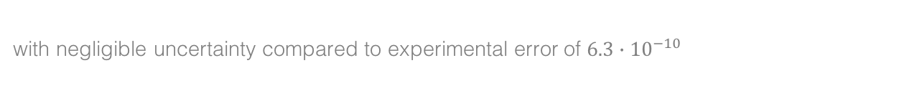
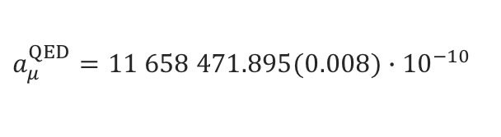

QED contribution
Known to 5 loops, good convergence, diagrams with internal electron loops enhanced:
$$a_{μ}^{QED}=\frac{α}{2π}+0.765 857 425(17){\left(\frac{α}{π}\right)}^{2}+ 24.050 509 96\left(32\right){\left(\frac{α}{π}\right)}^{3}$$
3-loop light-by-light scattering with electron loop
[ Schwinger term ]
$$+ 130.880\left(6\right){\left(\frac{α}{π}\right)}^{4}+ 753.3\left(1.0\right){\left(\frac{α}{π}\right)}^{5}$$
[ 5-loop: Aoyama, Hayakawa, Kinoshita, Nio, 1205.5370 (2012) ]
Using α = 137.035 999 049 (90) from Rubidium recoil measurement, gives:
$$a_{μ}^{QED}=11 658 471.895(0.008)∙{10}^{−10}$$
with negligible uncertainty compared to experimental error of $6.3∙{10}^{−10}$

Slide 23
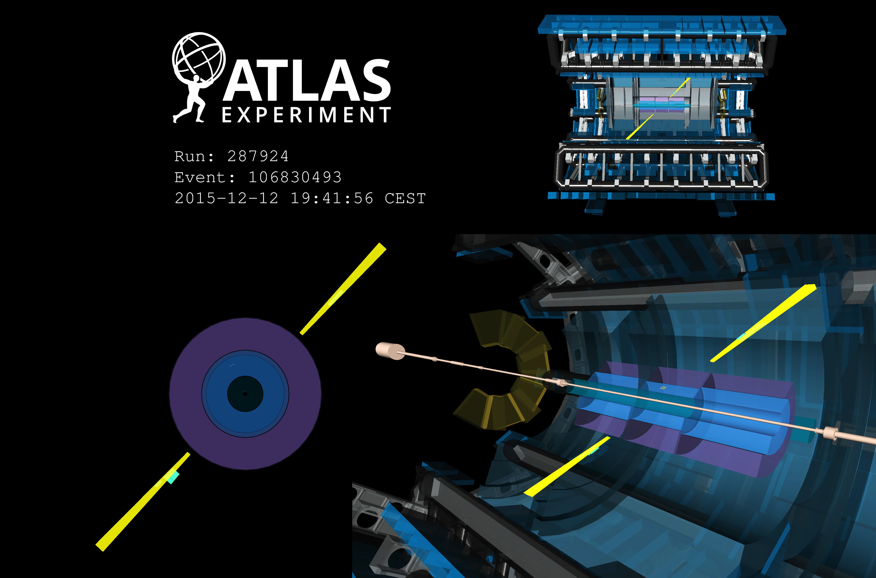
Observation of γγ → γγ light-by-light scattering (LBLS) by ATLAS in 5.02 TeV ultraperipheral Pb+Pb collisions
Picture shows LBLS candidate: two E_{T} = 4.9 GeV back-to- back photons with no additional activity
[ PRL 123 (2019) 052001 ]
Field strength of up to 10²⁵ V/m reached

Slide 24
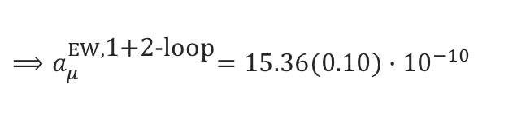
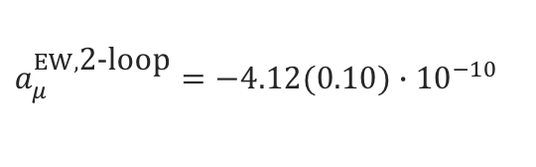

Electroweak contribution
$$\frac{α}{π}\frac{m_{μ}^{2}}{m_{W}^{2}}≈4∙{10}^{−9}$$
EW contribution involving W, Z or Higgs is suppressed at least by a factor:
The first loop gives: [ Jackiw, Weinberg and others 1972 ]
$$a_{μ}^{EW,\text{1−}\text{loop}}=\frac{{G_{F}m}_{μ}^{2}}{8\sqrt{2}π^{2}}\left[\frac{5}{3}+\frac{1}{3}{\left(1−4\sin^{2}θ_{W}\right)}^{2}+𝒪\left(\frac{m_{μ}^{2}}{m_{W}^{2}}\right)+𝒪\left(\frac{m_{μ}^{2}}{m_{H}^{2}}\right)\right]=19.48∙{10}^{−10}$$
1-loop diagrams (some cancellation between W/Z graphs)
Two-loop contribution surprisingly large due to large ln(m_{Z} /m_{μ}): [ Czarnecki, Krause, Marciano, 1995, and others ]
$$a_{μ}^{EW,\text{2−}\text{loop}}=−4.12(0.10)∙{10}^{−10}$$
2-loop diagrams (+ Higgs exchange)
$${⟹a}_{μ}^{EW,\text{1+2−}\text{loop}}=15.36(0.10)∙{10}^{−10}$$
Three-loop leading logarithms are found to be small (~10^{–12}) [ Degrassi, Giudice, hep-ph/9803384, and others ]

Slide 25

Hadronic contribution
The dominant hadronic contribution and uncertainty stems from the lowest order contribution, $a_{μ}^{Had,LO}$, which cannot be calculated from perturbative QCD as it is in the nonperturbative regime
Tools to approach low-energy QCD:
  Lattice QCD (encouraging results, but precision is challenging)
  Effective QFT with hadrons such as chiral perturbation theory (limited validity range)
  Hadronic models (hard to estimate robust uncertainties)
  Dispersion relations and experimental data

Slide 26
Digression : Running of α_{QED}(m_{Z})
Photon vacuum polarisation function Π_{γ}(q²)
Only vacuum polarisation “screens” electron charge
with:
split into leptonic and hadronic contribution
Leptonic Δα_{lep}(s) calculable in QED (known to 3-loops). However, quark loops are modified by long-distance hadronic physics, cannot be calculated with perturbative QCD
Way out: Optical Theorem (unitarity)
and the subtracted dispersion relation of Π_{γ}(q²) (analyticity)
Im[ ] ∝ | hadrons |²
Precise knowledge α(m_{Z}) important ingredient to global electroweak fit
Δα_{had}(s) uncertainty contributes 1.8 MeV to m_{W} SM prediction (total error of SM: 8 MeV), but dominant uncertainty to sin²θ_{eff} (SM)

Slide 27
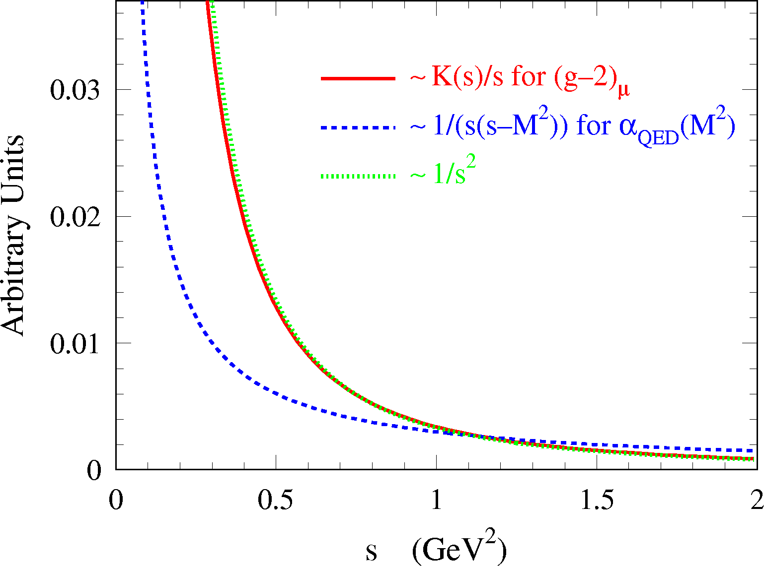

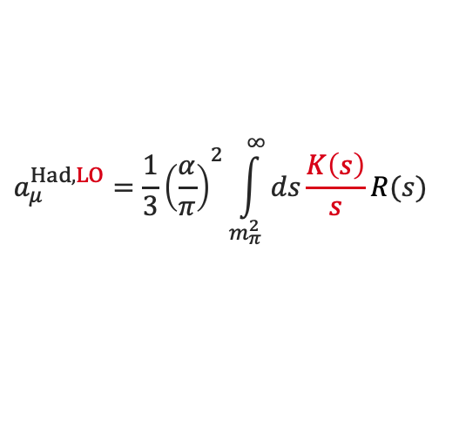
Hadronic contribution
Akin to Δα_{had}(s), the lowest-order hadronic contribution to a_{μ} can be obtained from a dispersion relation:
[ Bouchiat, Michel, 1961 ]
[ Brodsky, de Rafael, 1968 ]
$$a_{μ}^{Had,LO}={\frac{1}{3}\left(\frac{α}{π}\right)}^{2}\int_{m_{π}^{2}}^{∞}{ds\frac{K\left(s\right)}{s}R(s)}$$
Integration kernel steeply falls with s, putting emphasis on the low-mass R (s ), dominated by low-multiplicity exclusive hadronic states, such as e⁺e– → 𝜋⁺𝜋–
Most recent DHMZ evaluation (2019):
$${⟹a}_{μ}^{Had,LO}=694.0(4.0)∙{10}^{−10}$$
[ DHMZ,1908.00921 (2019), EPJ C 80, 241 (2020) ]
$${σ(a}_{μ}^{SM})[{10}^{−10}]=4.4={0.0}^{QED}⊕{0.1}^{EW}⊕{4.0}^{Had,LO}⊕{0.1}^{Had,N(N)LO}⊕{1.8}^{Had,LBL}$$

Slide 28
The hadronic contribution to the muon g –2
All hadronic contributions (LO, NLO, NNLO), except for light-by-light scattering (LBLS), can be obtained via dispersion relations using a mix of experimental data and perturbative QCD
γ
The LBLS contribution is a four-point function that is currently estimated using meson models
had
γ
μ

Slide 29
The hadronic contribution to the muon g –2
In the following, all a_{μ} numbers are given in units of 10 ^{–10}

Slide 30
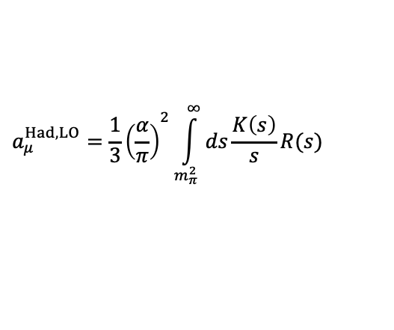
The challenge
The dispersion relation is solved using a mix of e ⁺e – → had data and QCD, depending on s
Davier, Hoecker, Zhang, hep-ph/0507078 (2005)
$$a_{μ}^{Had,LO}={\frac{1}{3}\left(\frac{α}{π}\right)}^{2}\int_{m_{π}^{2}}^{∞}{ds\frac{K\left(s\right)}{s}R(s)}$$
[ 𝜋⁰ γ – 1.8 GeV ]: sum of 34 exclusive channels; very few unmeasured channels are estimated using isospin symmetry
[ 1.8 – 3.7 GeV ]: agreement between data and QCD for uds continuum → more precise QCD NNNLO used; J/𝜓 & 𝜓(2S) resonances from Breit-Wigners
[ 3.7 – 5.0 GeV ]: open charm pair production: use of data
[ 5.0 GeV – ]: NNNLO QCD (assuming global quark-hadron duality to hold across bb threshold)
∞

Slide 31
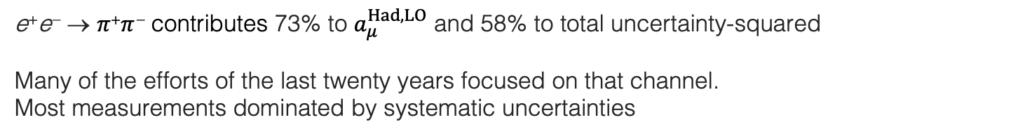
The dominant e ⁺e – → 𝜋⁺𝜋 – contribution
Relative to uncertainty² due to quadratic addition (neglecting inter-channel correlations here)
e ⁺e – → 𝜋⁺𝜋 – contributes 73% to $a_{μ}^{Had,LO}$ and 58% to total uncertainty-squared
Many of the efforts of the last twenty years focused on that channel. Most measurements dominated by systematic uncertainties
Compilation and combination: DHMZ, 1908.00921 (2019)
Three types of input data:
Energy scans: CMD-2 (δ_{syst} ~ 0.8%), SND (δ_{syst} ~ 1.5%), + DM1, DM2, OLYA, TOF
ISR-based measurements: BABAR (δ_{syst} ~ 0.5%), BES-III (δ_{syst} ~ 0.9%), KLOE (δ_{syst} ~ 0.8–1.4%)
Hadronic tau decay data via isospin symmetry (CVC): ALEPH, OPAL, CLEO, Belle (δ_{syst-combined} ~ 0.7%),
𝜌(770)
𝜌–𝜔 mixing
𝜌(1450)
𝜌(1700)
Data combination
𝜌(2300) ?
e ⁺e – → 𝜋⁺𝜋 –

Slide 32
The dominant e ⁺e – → 𝜋⁺𝜋 – contribution
Relative to uncertainty² due to quadratic addition (neglecting inter-channel correlations here)
e ⁺e – → 𝜋⁺𝜋 – contributes 73% to $a_{μ}^{Had,LO}$ and 58% to total uncertainty-squared
Many of the efforts of the last twenty years focused on that channel. Most measurements dominated by systematic uncertainties
Monumental ISR analysis: BABAR, 1205.2228
Three types of input data:
Energy scans: CMD-2 (δ_{syst} ~ 0.8%), SND (δ_{syst} ~ 1.5%), + DM1, DM2, OLYA, TOF
ISR-based measurements: BABAR (δ_{syst} ~ 0.5%), BES-III (δ_{syst} ~ 0.9%), KLOE (δ_{syst} ~ 0.8–1.4%)
Hadronic tau decay data via isospin symmetry (CVC): ALEPH, OPAL, CLEO, Belle (δ_{syst-combined} ~ 0.7%),
BABAR data
𝜌(770)
𝜌–𝜔 mixing

Slide 33
The dominant e ⁺e – → 𝜋⁺𝜋 – contribution
Relative to uncertainty² due to quadratic addition (neglecting inter-channel correlations here)
e ⁺e – → 𝜋⁺𝜋 – contributes 73% to $a_{μ}^{Had,LO}$ and 58% to total uncertainty-squared
Many of the efforts of the last twenty years focused on that channel. Most measurements dominated by systematic uncertainties
Monumental ISR analysis: BABAR, 1205.2228
Three types of input data:
Energy scans: CMD-2 (δ_{syst} ~ 0.8%), SND (δ_{syst} ~ 1.5%), + DM1, DM2, OLYA, TOF
ISR-based measurements: BABAR (δ_{syst} ~ 0.5%), BES-III (δ_{syst} ~ 0.9%), KLOE (δ_{syst} ~ 0.8–1.4%)
Hadronic tau decay data via isospin symmetry (CVC): ALEPH, OPAL, CLEO, Belle (δ_{syst-combined} ~ 0.7%),
BABAR data
Pion form factor fit well behaved, but complex structure

Slide 34
The dominant e ⁺e – → 𝜋⁺𝜋 – contribution
Relative to uncertainty² due to quadratic addition (neglecting inter-channel correlations here)
e ⁺e – → 𝜋⁺𝜋 – contributes 73% to $a_{μ}^{Had,LO}$ and 58% to total uncertainty-squared
Many of the efforts of the last twenty years focused on that channel. Most measurements dominated by systematic uncertainties
Monumental ISR analysis: BABAR, 1205.2228
Three types of input data:
Energy scans: CMD-2 (δ_{syst} ~ 0.8%), SND (δ_{syst} ~ 1.5%), + DM1, DM2, OLYA, TOF
ISR-based measurements: BABAR (δ_{syst} ~ 0.5%), BES-III (δ_{syst} ~ 0.9%), KLOE (δ_{syst} ~ 0.8–1.4%)
Hadronic tau decay data via isospin symmetry (CVC): ALEPH, OPAL, CLEO, Belle (δ_{syst-combined} ~ 0.7%),
BABAR data
Pion form factor fit well behaved, but complex structure

Slide 35
The dominant e ⁺e – → 𝜋⁺𝜋 – contribution
Relative to uncertainty² due to quadratic addition (neglecting inter-channel correlations here)
e ⁺e – → 𝜋⁺𝜋 – contributes 73% to $a_{μ}^{Had,LO}$ and 58% to total uncertainty-squared
Many of the efforts of the last twenty years focused on that channel. Most measurements dominated by systematic uncertainties
Three types of input data:
Energy scans: CMD-2 (δ_{syst} ~ 0.8%), SND (δ_{syst} ~ 1.5%), + DM1, DM2, OLYA, TOF
ISR-based measurements: BABAR (δ_{syst} ~ 0.5%), BES-III (δ_{syst} ~ 0.9%), KLOE (δ_{syst} ~ 0.8–1.4%)
Hadronic tau decay data via isospin symmetry (CVC): ALEPH, OPAL, CLEO, Belle (δ_{syst-combined} ~ 0.7%),
Dominant systematic uncertainties / challenges: (in parentheses uncertainties for best measurements)
Energy scan measurements (ex. CMD-2 / 0.8%): detection efficiency, radiative corrections (0.4%), beam energy (0.3%), …
ISR-based measurements (ex. BABAR / >0.5%): pion identification (0.3%), μ ⁺μ – reference (0.4%), …
Tau data (ALEPH, 0.3% on normalisation): 𝜋 ⁰ and photon reconstruction (0.2%), hadronic interactions (0.2%), …
Huge amount of precision data, but — with a close look — one notices issues…

Slide 36
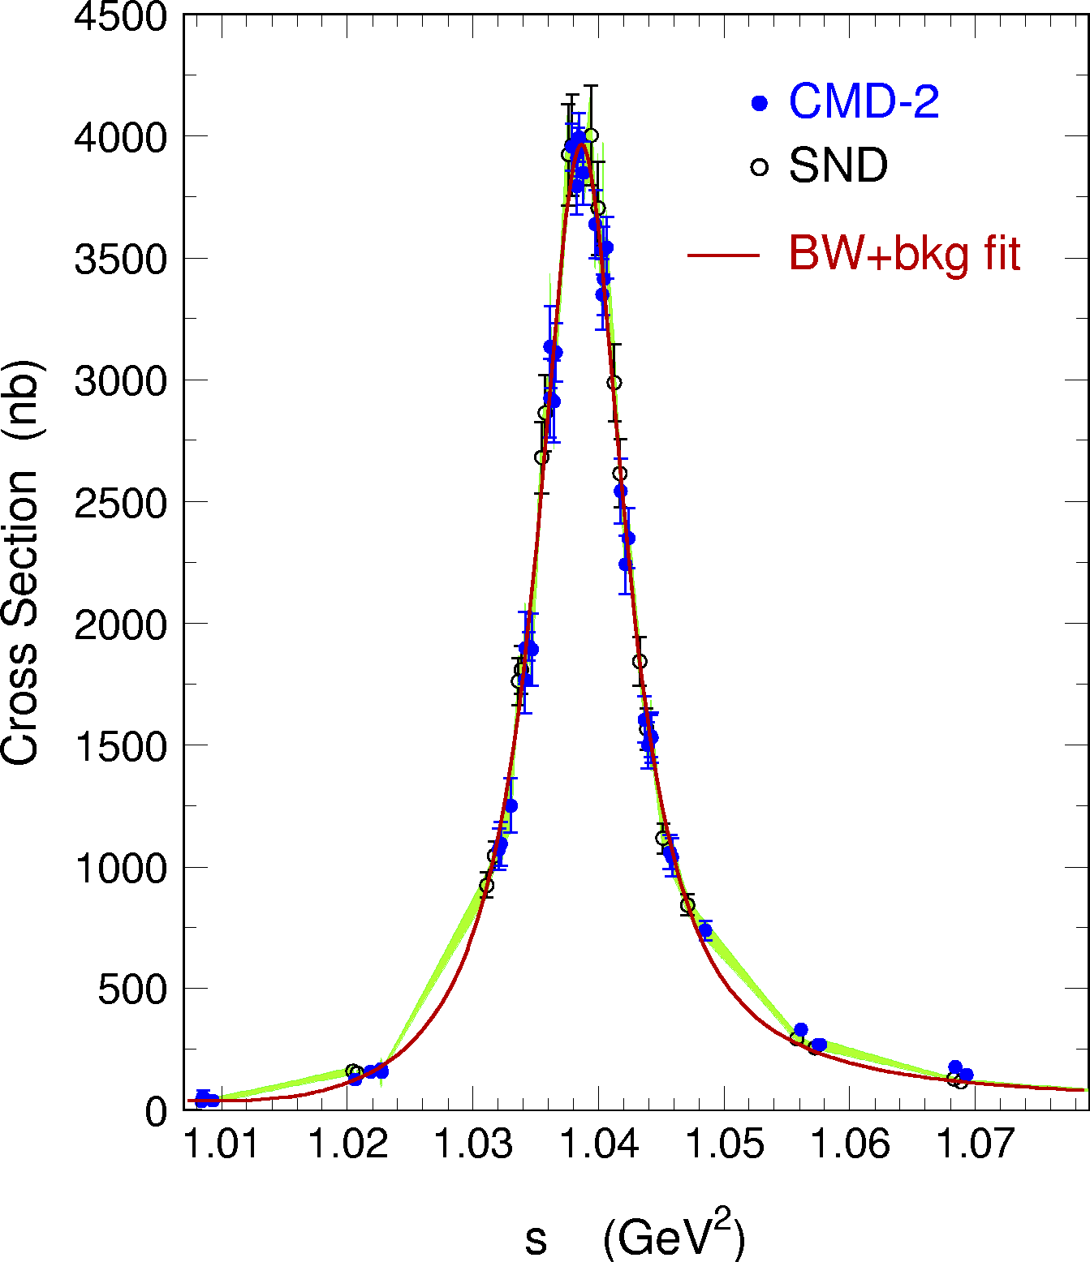
Digression: Combining data points for integration
The integration of data points belonging to different experiments, with different within-experiment, inter-experiment and inter-channel correlated systematic uncertainties, and with different data densities requires a careful treatment
It is thereby mandatory to test the accurateness of the integration procedure in terms of central value and uncertainty using representative models with known truth
Trapezoidal rule is biased
DHMZ approach for a given channel:
Quadratic interpolation of the data points for each experiment
Local weighted average between interpolations performed in infinitesimal bins (1 MeV); local PDG error rescaling in case of incompatibility
Full covariance matrices: correlations between data points of an experiment (systematic errors), between experiments and channels
Error propagation (up to dispersion integrals) using pseudo experiments
Possible bias tested in 2𝜋 channel using a form factor model (closure test): negligible for quadratic interpolation, but not for linear model (trapezoidal rule)
Bias

Slide 37
The dominant e ⁺e – → 𝜋⁺𝜋 – contribution
Compilation and combination: DHMZ, 1908.00921 (2019)
e ⁺e – → 𝜋⁺𝜋 –

Slide 38
The dominant e ⁺e – → 𝜋⁺𝜋 – contribution — close comparison
Compilation and combination: DHMZ, 1908.00921 (2019)
e ⁺e – → 𝜋⁺𝜋 –

Slide 39
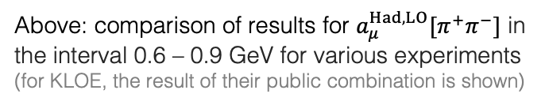
The dominant e ⁺e – → 𝜋⁺𝜋 – contribution — close comparison
Compilation and combination: DHMZ, 1908.00921 (2019)
e ⁺e – → 𝜋⁺𝜋 –
Local uncertainty rescaling of combined data due to incompatibility (following PDG rule)
Above: comparison of results for $a_{μ}^{Had,LO}[π^{+}π^{−}]$ in the interval 0.6 – 0.9 GeV for various experiments (for KLOE, the result of their public combination is shown)

Slide 40
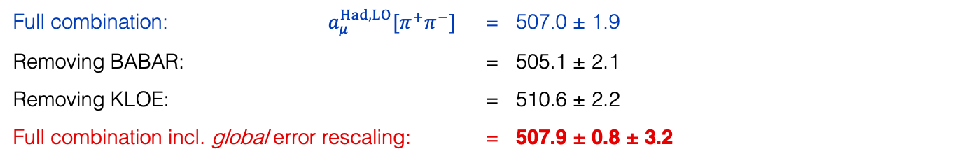
The dominant e ⁺e – → 𝜋⁺𝜋 – contribution — impact on a_{μ}
Local uncertainty rescaling does not fully capture global BABAR-KLOE discrepancy
Full combination: $a_{μ}^{Had,LO}[π^{+}π^{−}]$ = 507.0 ± 1.9
Removing BABAR: = 505.1 ± 2.1
Removing KLOE: = 510.6 ± 2.2
Full combination incl. global error rescaling: = 507.9 ± 0.8 ± 3.2
[ DHMZ 1908.00921 numbers ]
It is possible to also use precise 𝜏 → 𝜋⁺𝜋⁰ 𝜈 data via isospin symmetry (CVC):
But it requires to correct for isospin breaking effects. Last estimate: 516.2 ± 2.9 ± 2.0_{IB} (3.5) [2.1σ above e ⁺e –]
Some IB effects still under debate (eg, γ–𝜌 mixing). While the use of tau data helped significantly in the 1990-ies when the quality of the e ⁺e – data was insufficient, with the much improved e ⁺e – precision we consider the tau data less appealing for the a_{μ} estimate

Slide 41
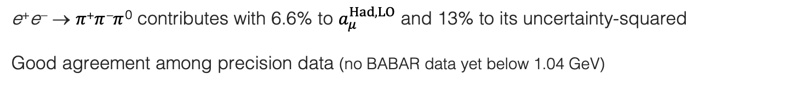
The e ⁺e – → 𝜋⁺𝜋 –𝜋 ⁰ contribution
e ⁺e – → 𝜋⁺𝜋 –𝜋 ⁰ contributes with 6.6% to $a_{μ}^{Had,LO}$ and 13% to its uncertainty-squared
Good agreement among precision data (no BABAR data yet below 1.04 GeV)
Compilation and combination: DHMZ, Davier 1612.02743 (2016)
𝜔(782) → 𝜋⁺𝜋 –𝜋 ⁰ w/ 89%
𝜙(1020) → 𝜋⁺𝜋 –𝜋 ⁰ w/ 15%

Slide 42
The e ⁺e – → 𝜋⁺𝜋 –𝜋 ⁰ contribution
e ⁺e – → 𝜋⁺𝜋 –𝜋 ⁰ contributes with 6.6% to $a_{μ}^{Had,LO}$ and 13% to its uncertainty-squared
Good agreement among precision data (no BABAR data yet below 1.04 GeV)
Compilation and combination: DHMZ, Davier 1612.02743 (2016)
𝜔(782) → 𝜋⁺𝜋 –𝜋 ⁰ w/ 89%
𝜙(1020) → 𝜋⁺𝜋 –𝜋 ⁰ w/ 15%
𝜔(782) → 𝜋⁺𝜋 –𝜋 ⁰ w/ 89%
𝜙(1020) → 𝜋⁺𝜋 –𝜋 ⁰ w/ 15%

Slide 43
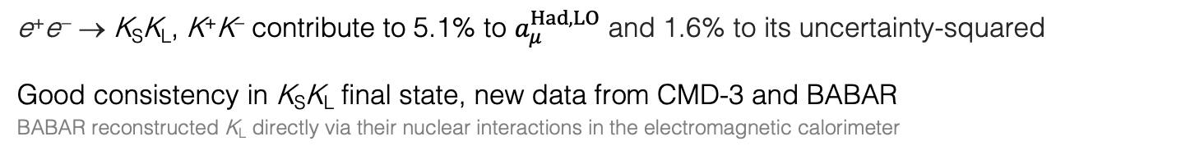
The e ⁺e – → 𝜙(1020) → K_{S}K_{L}, K⁺K– contributions
e ⁺e – → K_{S}K_{L}, K⁺K– contribute to 5.1% to $a_{μ}^{Had,LO}$ and 1.6% to its uncertainty-squared
Good consistency in K_{S}K_{L} final state, new data from CMD-3 and BABAR
BABAR reconstructed K_{L} directly via their nuclear interactions in the electromagnetic calorimeter
Compilation and combination: DHMZ, Davier 1612.02743 (2016)

Slide 44
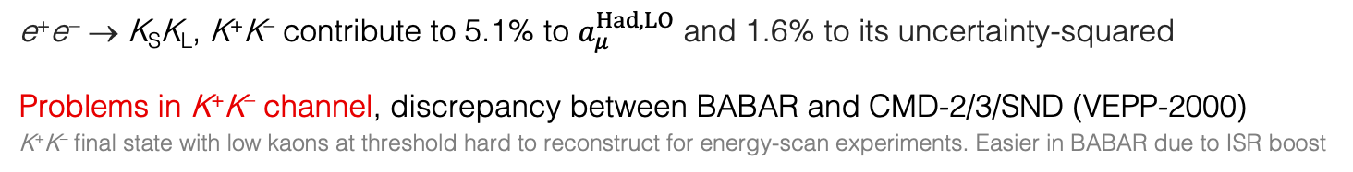
The e ⁺e – → 𝜙(1020) → K_{S}K_{L}, K⁺K– contributions
e ⁺e – → K_{S}K_{L}, K⁺K– contribute to 5.1% to $a_{μ}^{Had,LO}$ and 1.6% to its uncertainty-squared
Problems in K⁺K– channel, discrepancy between BABAR and CMD-2/3/SND (VEPP-2000)
K⁺K– final state with low kaons at threshold hard to reconstruct for energy-scan experiments. Easier in BABAR due to ISR boost
Compilation and combination: DHMZ, 1908.00921 (2019)
BABAR (σ_{syst} = 0.7%) higher by 5.1% compared to CMD-2 (σ_{syst} = 2.2%) and by 9.6% compared to SND (σ_{syst} = 7.1%). New SND results agree with BABAR and supersede previous ones. New CMD-3 results are 5.5% higher than BABAR. 11% difference between CMD-2 and CMD-3 results, compared to 2.2% systematic uncertainties quoted
→ apply global error rescaling as for 𝜋⁺𝜋 –

Slide 45
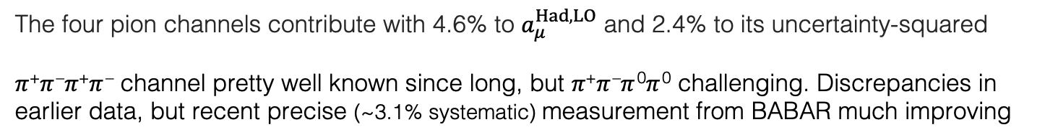
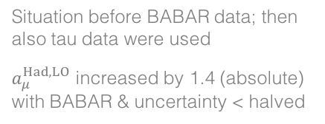
The e ⁺e – → 𝜋⁺𝜋 –𝜋⁺𝜋 –, 𝜋⁺𝜋 –𝜋 ⁰𝜋 ⁰ contributions
The four pion channels contribute with 4.6% to $a_{μ}^{Had,LO}$ and 2.4% to its uncertainty-squared
𝜋⁺𝜋 –𝜋⁺𝜋 – channel pretty well known since long, but 𝜋⁺𝜋 –𝜋 ⁰𝜋 ⁰ challenging. Discrepancies in earlier data, but recent precise (~3.1% systematic) measurement from BABAR much improving
Compilation and combination: DHMZ,,1612.02743 (2016)
Situation before BABAR data; then also tau data were used
$a_{μ}^{Had,LO}$ increased by 1.4 (absolute) with BABAR & uncertainty < halved
Tau data from ALEPH significantly above BABAR

Slide 46
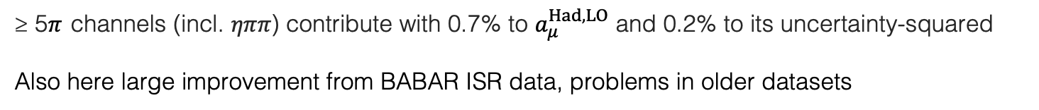
The e ⁺e – → ≥ 5𝜋 contributions
≥ 5𝜋 channels (incl. 𝜂𝜋𝜋) contribute with 0.7% to $a_{μ}^{Had,LO}$ and 0.2% to its uncertainty-squared
Also here large improvement from BABAR ISR data, problems in older datasets
Compilation and combination: DHMZ, 1612.02743 (2016)

Slide 47

The e ⁺e – → KK 𝜋(𝜋𝜋) contributions (many charge combinations)
Past analyses suffered from missing final states that were estimated by symmetry arguments
Systematic measurement of exclusive processes by BABAR completes the KK𝜋 and (almost) all KK𝜋𝜋 final states. Their sum contributes 0.4% to $a_{μ}^{Had,LO}$ and 0.1% to uncertainty-squared
Selection of measurements by BABAR and others

Slide 48

–
The charm resonance region (above DD threshold)
3.7–5.0 GeV region contributes with 1.1% to $a_{μ}^{Had,LO}$ and 0.6% to its uncertainty-squared
Good agreement between measurements. Precision dominated by BES (σ_{syst} ~ 3.5%)

Slide 49
The big picture
Charm resonances integrated using data
Combines sum of exclusive channels discussed before
Use of QCD above
Use of QCD (found in good agreement with recent precision data)
(σ_{syst} > 3.5%)
(σ_{syst} > 2.3%)

Slide 50

Full compilation in numbers
DHMZ, 1908.00921 (2019)
Legend: First error statistical, second channel-specific systematic, third common systematic (correlated)
For R_{QCD}, uncertainties are due to: 𝛼_{S}, NNNLO truncation, resummation (FOPT vs. CIPT), quark masses
$$a_{μ}^{Had,LO}=(694.0±4.0)∙{10}^{−10}$$

Slide 51


Higher order hadronic terms
NLO two-point correlation contributions to $a_{μ}^{Had,NLO}$ can be computed akin to the LO part via (a sum of) dispersion relations
$$a_{μ}^{Had,NLO(i)}={\frac{1}{3}\left(\frac{α}{π}\right)}^{2}\int_{m_{π}^{2}}^{∞}{ds\frac{K^{(i)}\left(s\right)}{s}R(s)}$$
$${⟹a}_{μ}^{Had,NLO}=(−9.87±0.09)∙{10}^{−10}$$
Each diagram corresponds to specific kernel function K ^{(i)}
Kurz et al, 1511.08222 (2015)
Kurz et al, 1511.08222 (2015)
NNLO two-point function corrections have also been computed: $a_{μ}^{Had,NNLO}=(1.24±0.01)∙{10}^{−10}$

Slide 52

Higher order hadronic terms
NLO two-point correlation contributions to $a_{μ}^{Had,NLO}$ can be computed akin to the LO part via (a sum of) dispersion relations
$$a_{μ}^{Had,NLO(i)}={\frac{1}{3}\left(\frac{α}{π}\right)}^{2}\int_{m_{π}^{2}}^{∞}{ds\frac{K^{(i)}\left(s\right)}{s}R(s)}$$
$${⟹a}_{μ}^{Had,NLO}=(−9.87±0.09)∙{10}^{−10}$$
Each diagram corresponds to specific kernel function K ^{(i)}
Kurz et al, 1511.08222 (2015)
Kurz et al, 1511.08222 (2015)
NNLO two-point function corrections have also been computed: $a_{μ}^{Had,NNLO}=(1.24±0.01){∙10}^{−10}$
The four-point hadronic LBL scattering contribution, however, cannot be obtained this way and models are used instead
  Calculation uses hadronic models with 𝜋⁰, 𝜂⁽’⁾, … pole insertions and 𝜋± loops in the large-N_{C} limit, Lattice QCD offers promising alternative
$${⟹a}_{μ}^{Had,LBL}=(9.2±1.8)∙{10}^{−10}$$
Muon g–2 Theory White Paper, 2006.04822 (2020)
Educated guess (other groups find smaller / larger uncertainty)

Slide 53






Muon g – 2 summary
Summing all contributions [ ∙ 10^{–10} ]:
$$a_{μ}^{QED}=11 658 471.895±0.008$$
$$a_{μ}^{EW}=15.36±0.10$$
1908.00921, updated with WP 2020 LBL value
$$a_{μ}^{Had,LO}=694.0±4.0$$
$$a_{μ}^{Had,NLO}=−9.87±0.09$$
1911.00367, updated with WP 2020 LBL value
$$a_{μ}^{Had,NNLO}=1.24±0.01$$
$$a_{μ}^{Had,LBL}=9.2±1.8$$
Muon g–2 Theory White Paper, 2006.04822
$$a_{μ}^{SM}=(11 659 181.8±4.3)∙{10}^{−10}$$
$${∆a_{μ}=a}_{μ}^{Exp}−a_{μ}^{SM}=24.3±{4.1}_{exp}±{4.3}_{SM} (±{6.0}_{tot})$$
→ 4.1σ level, using WP 2020 it is 4.2σ

Slide 54


Alternative prediction of the hadronic contribution: Lattice QCD
Lattice QCD allows to directly compute the real part of the two-point correlation function without invoking the resonances occurring on the imaginary axis
The required sub-percent precision is, however, a huge challenge, requiring to master systematic and extrapolation uncertainties
The BMW collaboration recently published* $a_{μ}^{Had,LO}=(707.5±5.5)∙{10}^{−10}$, which reduces the discrepancy with experiment to $∆a_{μ}=10.8±{4.1}_{exp}±{5.8}_{SM} (=1.9σ)$
$2.0σ$ towards DHMZ dispersive approach
*BMW, Nature 593, 51 (2021)

Slide 55

Digression : Conflict with Electroweak fit ?
Same dispersive approach used to determine hadronic contribution to α_{QED}(m_{Z}) which is a critical ingredient in the global electroweak (EW) fit
  If $a_{μ}^{Had,LO}$ were 3–4% larger to accommodate experiment, would the EW fit break down?
Gfitter group, 1803.01853 (2018)
  While the 𝜋⁺𝜋 – channel contributes 73% to $a_{μ}^{Had,LO}$ it is only 13% in the case of $∆α_{had}(m_{Z})$ → a 5% change in the former would lead to a shift in the latter value by 1.7σ
  A shift of $∆α_{had}(m_{Z})$ by 1σ leads to $∆m_{W}$ = 2.4 MeV → no problem
Studies in the literature: Crivellin et al, 2003.04886; Keshavarzi et al., 2006.12666 ;de Rafael, 2006.13880; Malaescu & Schott, 2008.08107; Colangelo et al, 2010.07943

Slide 56

Digression : Can it be real ?
The absolute size of the effect $∆a_{μ}=24.3±6.0$ is large compared to EW contribution of $15.4$ (but some cancellation among bosons in latter contribution)
  Generic decoupling new physics predicts: $a_{μ}^{NP} \sim C∙{\left(\frac{m_{μ}}{m_{NP}}\right)}^{2}$ [ Jegerlehner, Nyffeler, 0902.3360 ] Here: $m_{NP} \sim 2 TeV$ for $C=1$, $m_{NP} \sim 100 GeV$ for $C=\frac{α}{π}$ (natural strength), $m_{NP} \sim 5 GeV$ for $C={\left(\frac{α}{π}\right)}^{2}$
Generic SUSY predicts: $a_{μ}^{SUSY} \sim sign(μ)∙(13∙{10}^{−10})∙{\left(\frac{100 GeV}{m_{SUSY}}\right)}^{2}∙tanβ$
  In constrained SUSY models, $∆a_{μ}$cannot be reconciled with the non-observation of strongly produced sparticles at the LHC [ de Vries et al, MasterCode, 1504.03260 ]
  However, general models such as the pMSSM can still accommodate $∆a_{μ}$with light neutralinos, charginos and sleptons, not fully excluded by the LHC
A “dark photon” ($γ′$) coupling to SM via mixing with photon may give: $a_{μ}^{γ′} \sim \frac{α}{2π}ε^{2}F(m_{γ′})$
  $∆a_{μ}$ is accommodated for coupling strength $ε \sim 0.1–0.2\%$ and mass $m_{γ′} \sim 10−100 MeV$
  Recent experimental constraints disfavour such a scenario if the dark photon decays primarily into charged lepton pairs
Many, many new papers since the Fermilab g–2 result, apologies for not reporting them here

Slide 57


Conclusions
Independently of this discrepancy, there is so much wonder in these high-precision tests, as beautifully expressed by CERN physicist Francis Farley some time ago (before the crisis):
“What the theorists do and what we experimenters do is completely different. They talk about Feynman diagrams, amplitudes, integrals, expansions and a whole lot of complex mathematics. We hook up an accelerator to beam lines and steering magnets to the device itself, which is stuffed with wires, thousands of cables, timing devices, sensors and such things. It’s two totally different worlds! But, they come out with a number, we come out with a number, and these numbers agree to parts per million! It's unbelievable! That is the most astonishing thing for me!”
Quote reported by Robert P. Crease in Scientific American Online, 2 May 2021
https://www.scientificamerican.com/article/the-fermilab-muon-measurement-may-or-may-not-point-to-new-physics-but1/
Francis Farley, pioneer of muon g–2 measurements

Slide 58
Conclusions
But, we do have a problem to solve …
?

Slide 59
Additional slides

Slide 60


Introduction
Long history of $a_{μ}^{Had,LO}$ determinations involving theorists and experimentalists
$$a_{μ}^{Had,LO}={\frac{1}{3}\left(\frac{α}{π}\right)}^{2}\int_{m_{π}^{2}}^{∞}{ds\frac{K\left(s\right)}{s}R(s)}$$
Improvement mostly driven by better e ⁺e – → hadrons data (intermittently also hadronic tau decays used to improve over insufficient-quality low-mass e⁺e – data)
The understanding of the data and the treatment of their uncertainties improved over time
Sum-rule tests allowed to expand the use of perturbative QCD to predict R (s)
Fairly consistent picture reached

Slide 61
Full combination of all exclusive modes: R (s ) [√s ≤ 2 GeV]
Resulting R (s ) function is finely binned with uncertainties mapped by covariance matrix
Accuracy of combination tested with pseudo-experiments
log-scale
DHMZ, 1612.02743 (2016)
R (s ) spectrum dominated by BABAR ISR data measuring almost all exclusive channels until 2 GeV
lin-scale

Slide 62

Full combination of all exclusive modes: R (s ) [√s ≤ 2 GeV]
Resulting R (s ) function is finely binned with uncertainties mapped by covariance matrix
Accuracy of combination tested with pseudo-experiments
R (s) correlation matrix
log-scale
Correlation coefficient
DHMZ, 1612.02743 (2016)
R (s ) spectrum dominated by BABAR ISR data measuring almost all exclusive channels until 2 GeV
lin-scale

Slide 63


SM perspectives
( $∆a_{μ}=27.4 )$
Long standing 3-ish sigma discrepancy between data and SM on a_{μ}. On the SM side:
BABAR-KLOE discrepancy in 𝜋⁺𝜋 – channel unresolved. New data from CMD-3 expected, and a new BABAR analysis with the full data sample (0.3% systematic uncertainty may be reachable, current BABAR: 0.5% on peak)
The 𝜋⁺𝜋 –𝜋 ⁰ channel should be further improved (need BABAR data at and below 𝜙(1020))
The K ⁺K – data from CMD-2/3/SND must be scrutinized and understood
Need to compare BABAR and forthcoming CMD-3/SND results in the 1–2 GeV range (so far they agree)
More results will come from BES-III and Belle-2
Alternative $a_{μ}^{Had,LO}$ determinations: (1) Lattice calculations; (2) Proposal via a dispersion integral in the spacelike region by an ultra-precise µe → µe differential cross section measurement [Abbiendi et al, 1609.08987]
Uncertainty on $a_{μ}^{Had,LO}$ improved by factor of 2 during the last 13 years. Now twice smaller than exp. uncertainty. LBL scattering, estimated from hadronic models, has an uncertainty of similar size that currently appears irreducible. Lattice QCD calculations may provide the way forward.
The recent & future SM improvements pave the road of a full exploitation of the next generation g – 2 experiments at Fermilab and J-PARC

Slide 64

New experiments
_{J-PARC E34}
E34 beamline (J-PARC)
Entirely new, compact “zero E-field” approach (off magic γ)
Replace electric quadrupole field focusing in E821 by low-emittance, low-momentum (“cold muon”) beam
Positive muons from pion decays are stopped in aerogel target where they form muonium (e –µ ⁺) atoms
The muonium atoms are laser ionised, leaving cold muons of momentum 3 keV in average
These are reaccelerated (to increase lifetime) in a linac to 300 MeV
Muons are injected into a compact, ultra-precise (iron shimmed) 3 T storage magnet with 66 cm orbit diameter (14 m in E821 / E989)
The decay positrons are measured in silicon strip tracking detector (not a calorimeter) needed because of dense muon decay environment
Target: 4.5 at stage-one, and 1.2 final on a_{µ} [∙ 10^{–10}], and ~10^{–21} e cm final µEDM sensitivity
E34 was approved among the future priority projects by KEK. Detector partially funded, moving ahead with construction. Fascinating project!

