Slide 1
The Higgs Boson and Beyond
Highlights of the LHC proton−proton physics programme
Andreas Hoecker (CERN)
Colloquium Regensburg, Jan 28, 2013

Slide 2
What is particle physics ?

Slide 3
“It’s all made of a handful of particles and forces”
“Through its relation with cosmology the study of particles and forces is also a journey back in time”
“Can we truly grasp the magnitude of everything that has unfolded in the natural universe between those first momentary particles and the present day ?”
Brian Watson in The Salem News (Aug 16, 2012)
Mankind’s search for the smallest unit of matter, its different forms, and the forces acting is much, much older than particle physics
Particle physics is a term naming the search for the ultimate laws of Nature

Slide 4
Everyday life, and particle physics, are described by the Standard Model (SM)
The SM is the legacy of 20th century particle physics
It unifies quantum mechanics, special relativity and field theory
It describes ~ all laboratory data
Is the SM the theory of everything? Or rather of almost everything? Or …

Slide 5
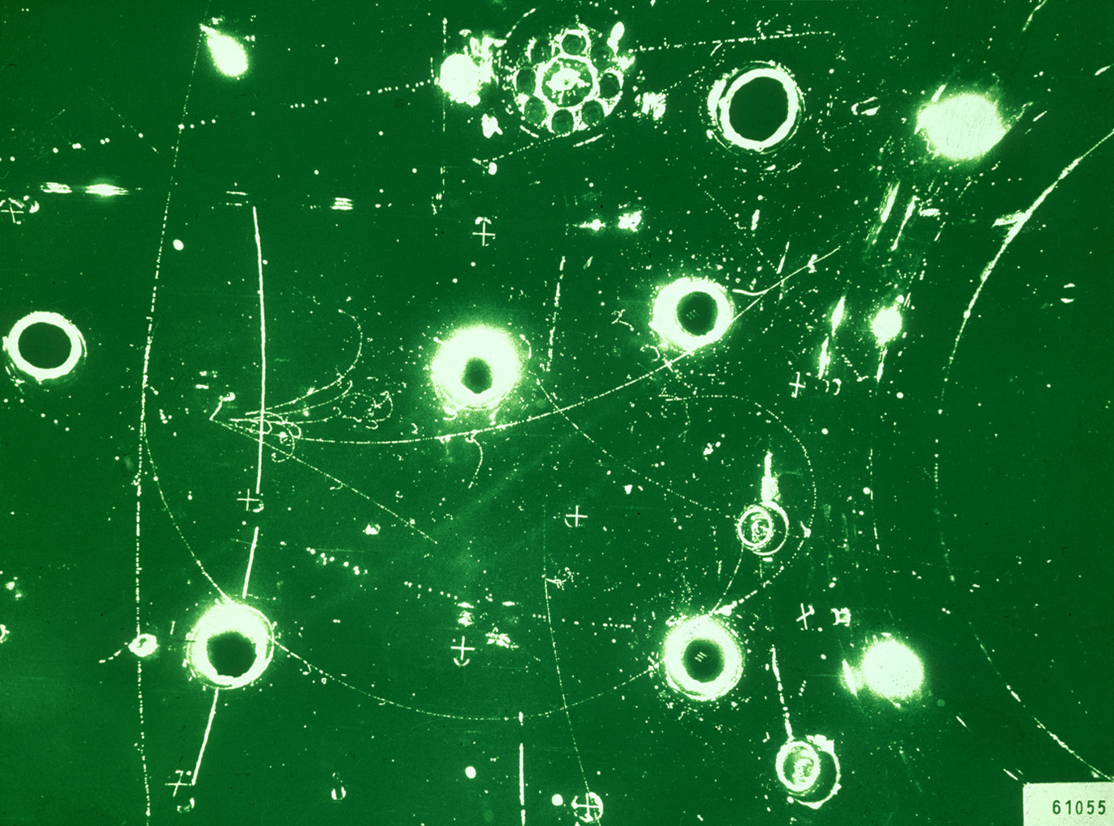
Year when energy reached in labs
L_{gravitation} ~ 10⁻³⁵ m
10¹⁹ GeV
The scales of particle physics …
Planck scale (M_{Pl})
10¹⁶ GeV
GUT ?
10¹⁴ GeV
ν_{R} ?
LHC reach
10 TeV
New Physics ?
~2010
1 TeV
…probing attometer scales
L_{weak} ~ 10⁻¹⁸ m
100 GeV
t, Z, W, H, EWSB
10 GeV
ψ, b, Υ, B
1 GeV
τ, c, n, p, ρ, φ
~1970
L_{strong} ~ 10⁻¹⁵ m
100 MeV
μ, s, π, QCD
10 MeV
u, d, nuclear binding E
1 MeV
e
100 keV
10 keV
1 keV
core of Sun
100 eV
10 eV
atomic binding E
~1900
L_{atomic} ~ 10⁻¹⁰ m
1 eV
ν’s
100 meV
?
10 meV
0
γ, g

Slide 6
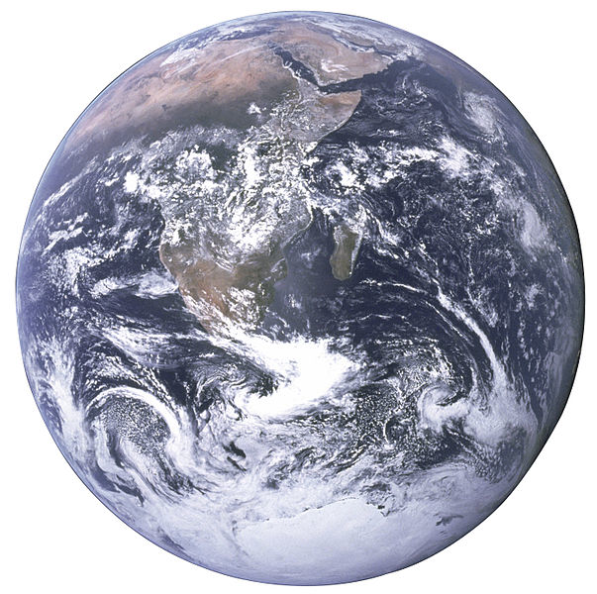

A 1 TeV-frequency microscope looks at really, really tiny objects…
Nanoscience
Particle physics today
(TeV scale)
Siphonaptera (flea)
Earth

Slide 7
The Standard Model
The SM consists of 24 elementary matter particles and 3 forces with total of 26 parameters
Fermions
Matter particles
Organised in 3 families
6 Leptons
6 Quarks
Bosons
Force quanta
Distinguishing 3 forces
Photon
3 weak bosons
8 Gluons
Electro-magnetic force
Weak force
Strong force
Higgs boson
Breaks electroweak symmetry
Generates boson and fermion masses

Slide 8
The Standard Model
Elementary particle physics is successfully described by local gauge theories
A problem: local gauge symmetry requires massless spin-1 “gauge” (=force) boson
This has been well verified for QED, with a massless photon (= infinite range)
However, the W, Z bosons are massive (= finite range ~10⁻¹⁵ cm)
Only way to break gauge symmetry consistently is to spontaneously break the symmetry of the vacuum:
[ non-zero vacuum expectation value ]
φ is a complex doublet field with non-zero vacuum expectation value. 3 d.o.fs become Z, W ± masses, remaining d.o.f is massive scalar Higgs boson
This is known as the “Englert-Brout-Higgs-Guralnik-Hagen-Kibble Mechanism”

Slide 9
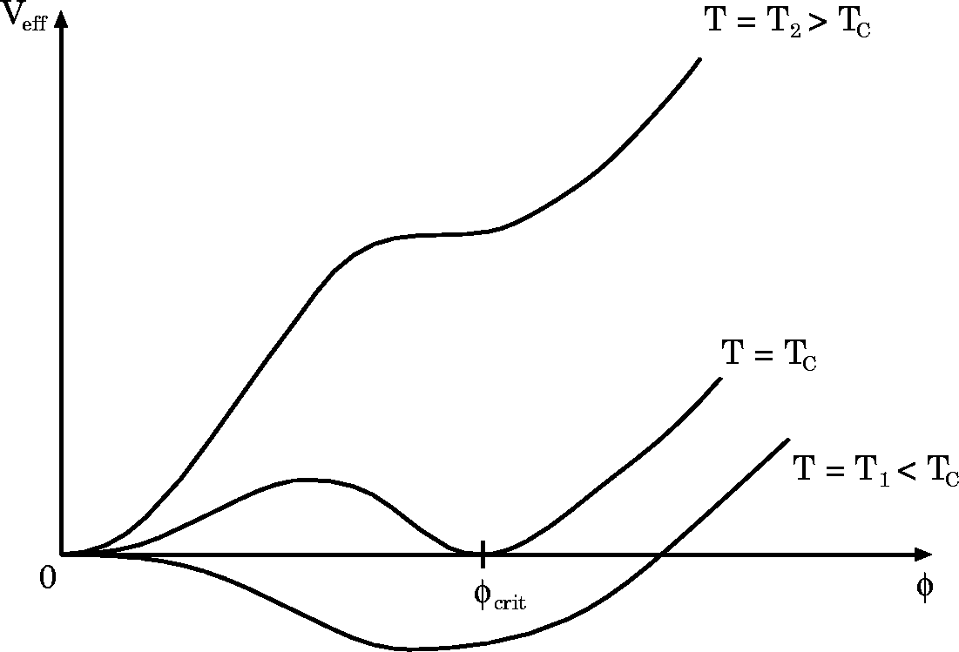
The Standard Model
Englert-Brout-Higgs-Guralnik-Hagen-Kibble mechanism
The early universe, at T > T_{EW}, was in a symmetric phase (|φ_{min}| = 0)
A phase transition at ∼T_{EW} (10⁻¹⁰ s after big bang) led to |φ_{min}| > 0
Phase transition
Potential barrier
Higgs bubble expansion

Slide 10
The Standard Model
Englert-Brout-Higgs-Guralnik-Hagen-Kibble mechanism
The early universe, at T > T_{EW}, was in a symmetric phase (|φ_{min}| = 0)
A phase transition at ∼T_{EW} (10⁻¹⁰ s after big bang) led to |φ_{min}| > 0
Phase transition
Potential barrier
Higgs bubble expansion
Condensation of Higgs field
“spontaneous” phase transition
Simplest scalar potential that breaks ground state symmetry. Does what we need, but bears fundamental problems.
Carries the seeds for new physics …
Higgs potential:

Slide 11
The Standard Model
Englert-Brout-Higgs-Guralnik-Hagen-Kibble mechanism
Early universe: symmetric phase, fundamental particles are massless → gauge symmetry is respected
Symmetric phase – early universe
Gravity
Photon
Weak boson
Neutrinos
Electrons
Top quark
H. Murayama

Slide 12
The Standard Model
Englert-Brout-Higgs-Guralnik-Hagen-Kibble mechanism
Early universe: symmetric phase, fundamental particles are massless → gauge symmetry is respected
Higgs quantum liquid in broken phase
Symmetric phase – early universe
Gravity
Gravity
A Higgs field displaces ground state breaking gauge symmetry
It fills all space time (but w/o orientation as spin=0)
Photon
Photon
×
×
Weak boson
×
Weak boson
×
×
×
Particles interact with the Higgs field and reduce their velocity. They acquire a mass proportional to interaction strength
×
Neutrinos
Neutrinos
ν_{L}
Λ⁻¹
ν_{L}
Electrons
×
Electrons
e_{L}
e_{R}
×
e_{L}
×
×
×
_{L}
_{R}
×
×
→ Action of the Higgs field creates a vacuum viscosity
Top quark
_{R}
_{R}
Top quark
×
_{R}
×
×
_{L}
_{L}
t_{L}
_{L}
×
×
H. Murayama
H. Murayama

Slide 13

Massive particles interacting with the condensed Higgs field
… like fireflies in the night sky of Ochiai

Slide 14
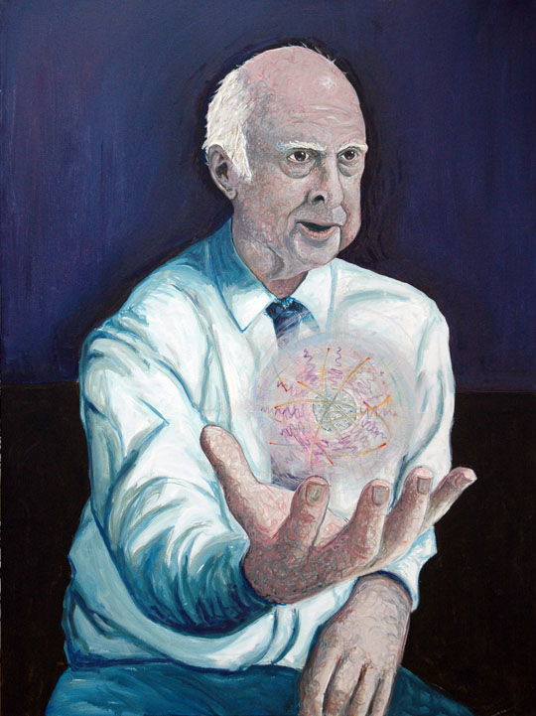
The Higgs boson –
last of the particles ?
The SM predicts all its properties, except for its mass. What was known about it ?
Full references for mechanism:
F. Englert and R. Brout, PRL 13 (1964) 321.
P.W. Higgs, PRL 13 (1964) 508.
G. Guralnik, C. Hagen, and T.W.B. Kibble, PRL 13 (1964) 585.
It is also of note that Landau and Ginzburg had proposed a field giving the photon a mass in a superconductor, the mathematics of which is identical to the “Higgs mechanism” and predates it by several years.
http://www.shardcore.org/shardpress

Slide 15

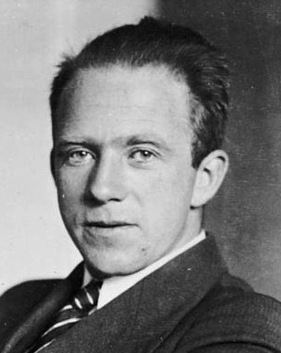
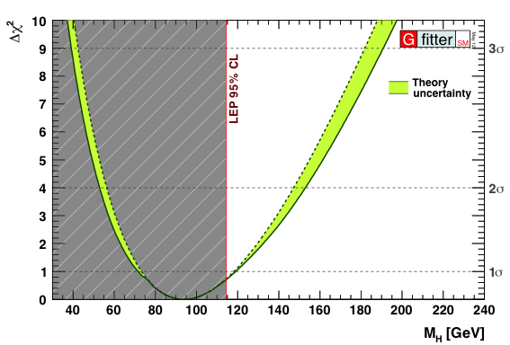
Constraints from global electroweak fit
Global fit of all EW precision measurements to SM prediction constrains M_{H}
H
W. Heisenberg
http://gfitter.desy.de

Slide 16
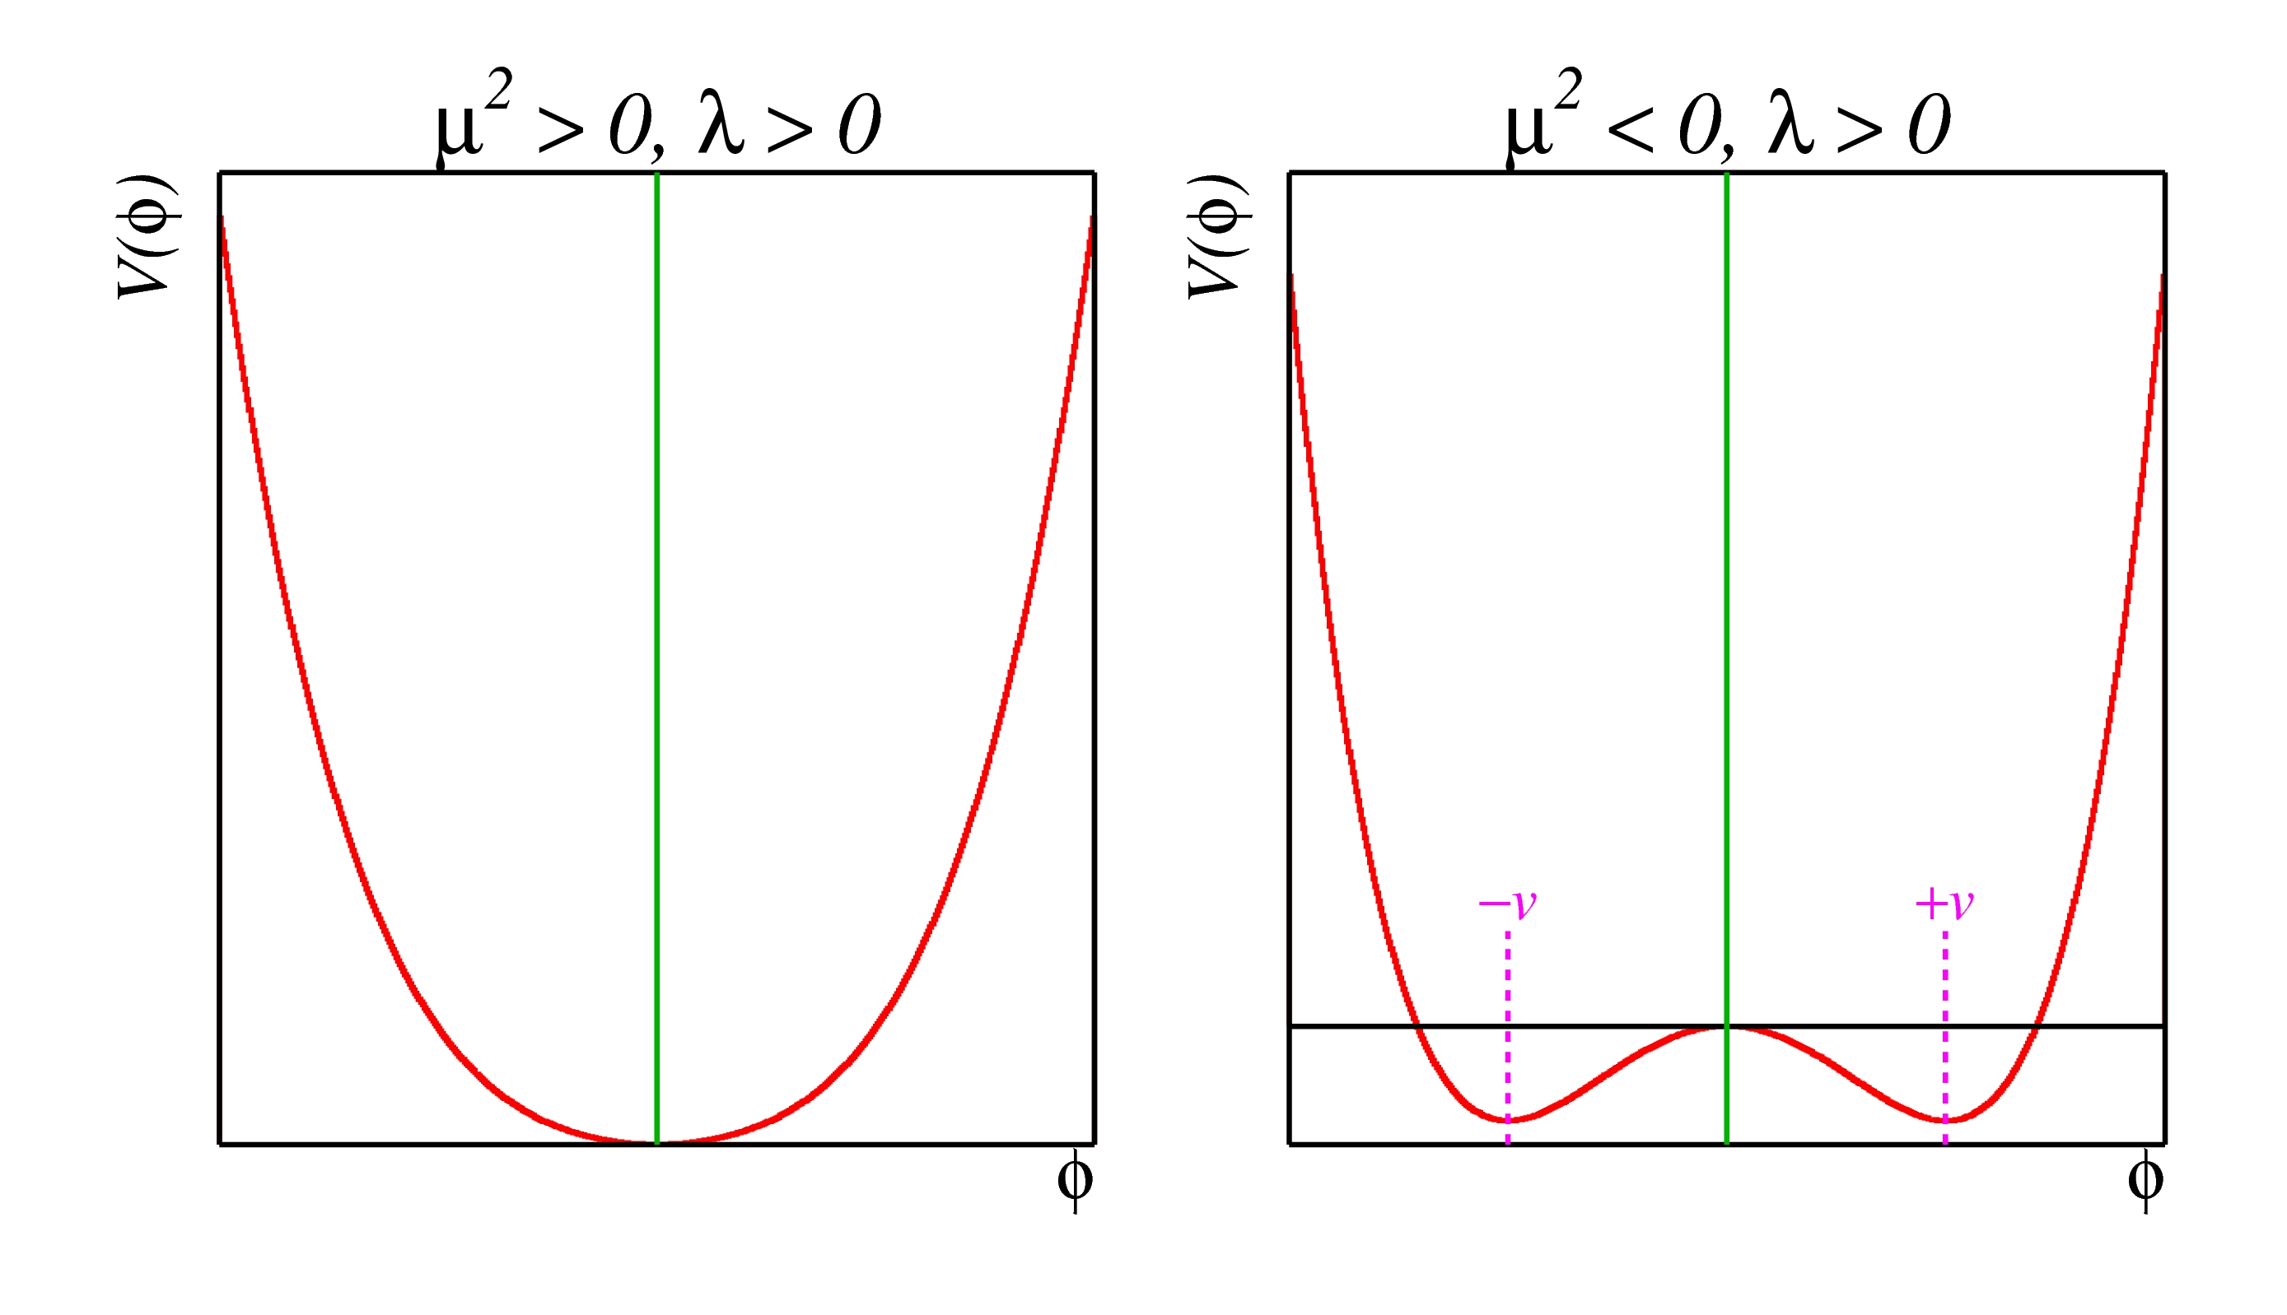
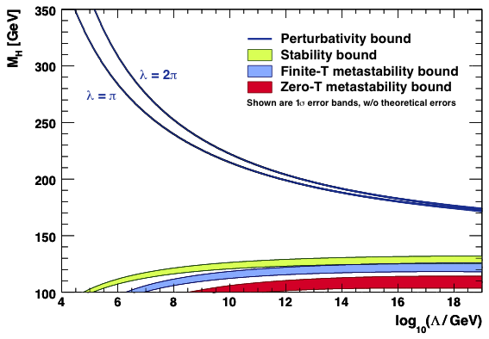
The Higgs boson should not be too light, and not too heavy…
  Perturbativity and (meta)stability bounds versus the SM cut-off scale Λ
Ellis et al, arXiv:0906.0954
Allowed
Not allowed
The SM Higgs must steer a narrow course between two disastrous situations if the SM is to survive up to the Planck scale M_{P} ~ 2×10¹⁸ GeV

Slide 17
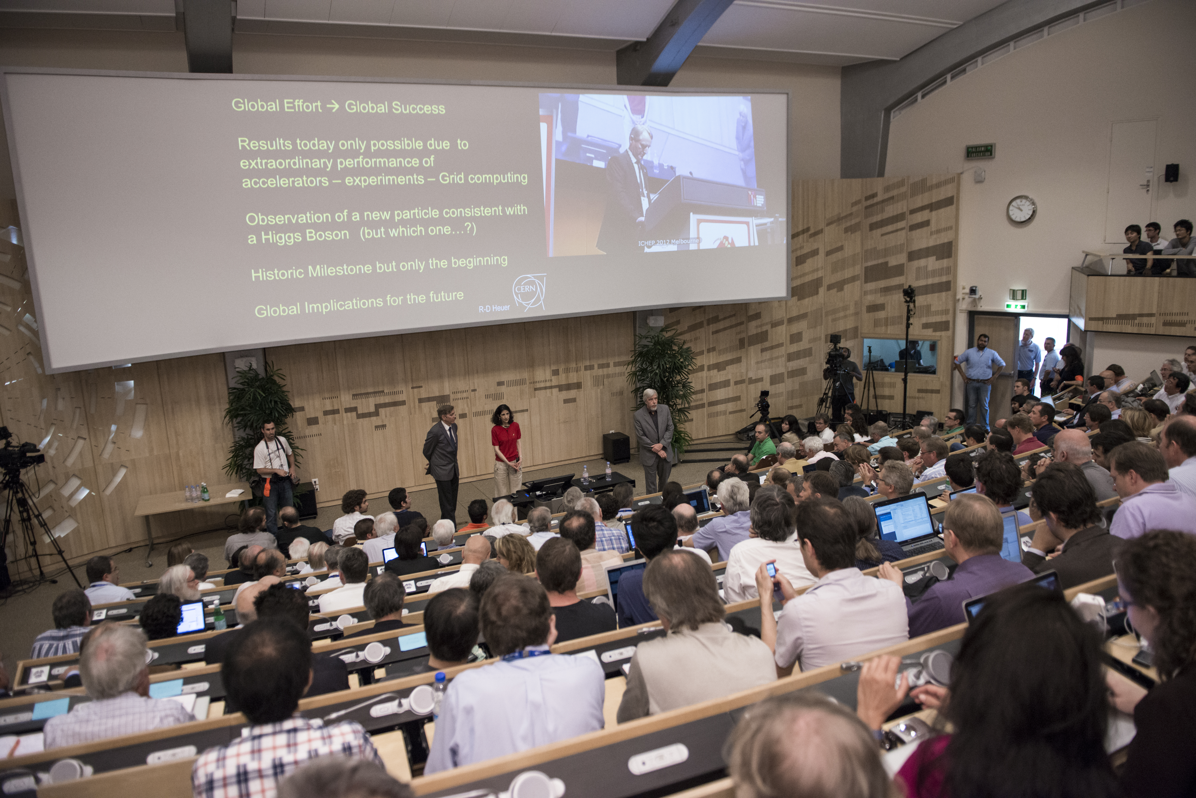

4th of July, 2012 — Higgs-day at CERN
Duration of projects /planning stability:
First LHC workshop 1984 !

Slide 18
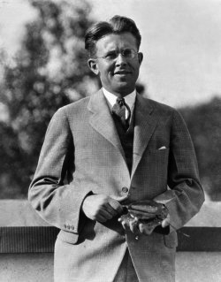
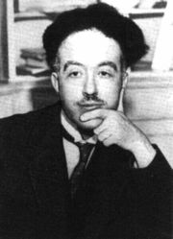
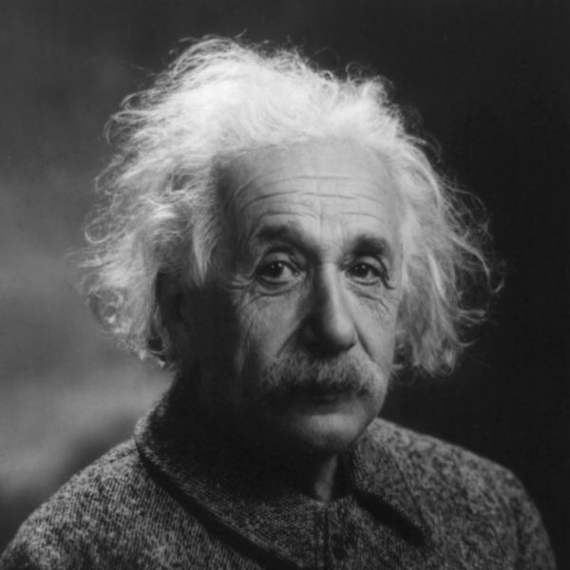
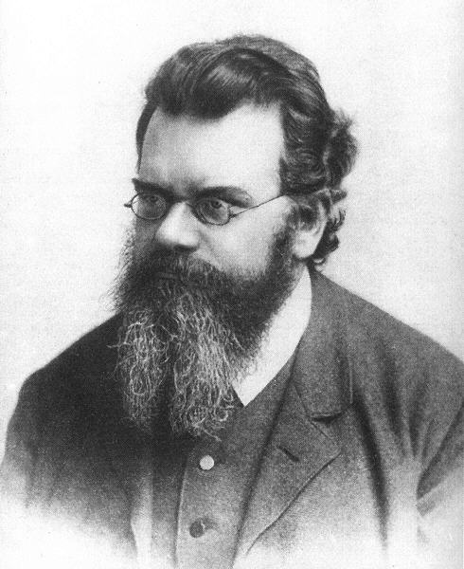
4th of July, 2012 — Higgs-day at CERN
Producing the Higgs Boson and Searching for New Physics at the TeV Scale Requires a Huge Machine
Particles accelerators:
Look deeper into matter (size ~ 1/E) (“powerful microscopes”)
Discover new heavier particles (E = mc²)
Probe conditions of the early universe (E = kT)
de Broglie
Einstein
Boltzmann
Lawrence

Slide 19

LHC ring at CERN:
27 km circumference
Blunt extrapolation for 2011
So far:
7/8 TeV proton—proton collisions
2.76 TeV Pb—Pb collisions

Slide 20

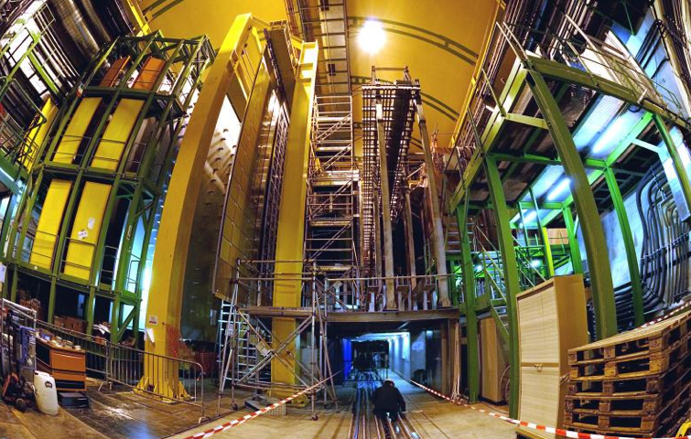
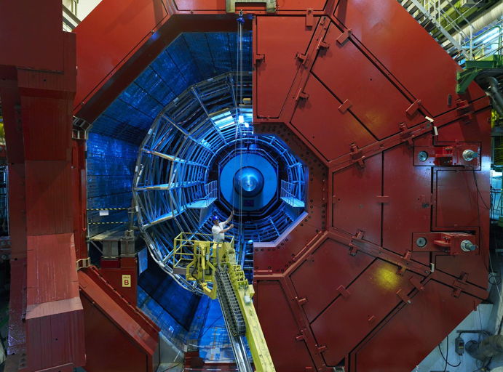

CMS
LHCb
Blunt extrapolation for 2011
ALICE
ATLAS

Slide 21
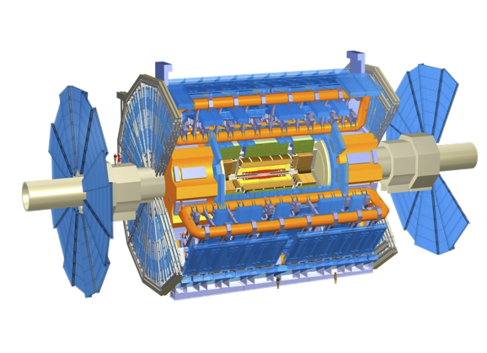

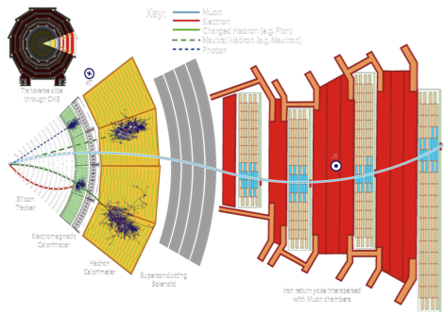

ATLAS: emphasis on excellent jet and missing-E_{T} resolution, particle identification, and standalone muon measurement
CMS: emphasis on excellent electron/photon and tracking (muon) resolution
Both: excellent hermeticity – very few “cracks”

Slide 22
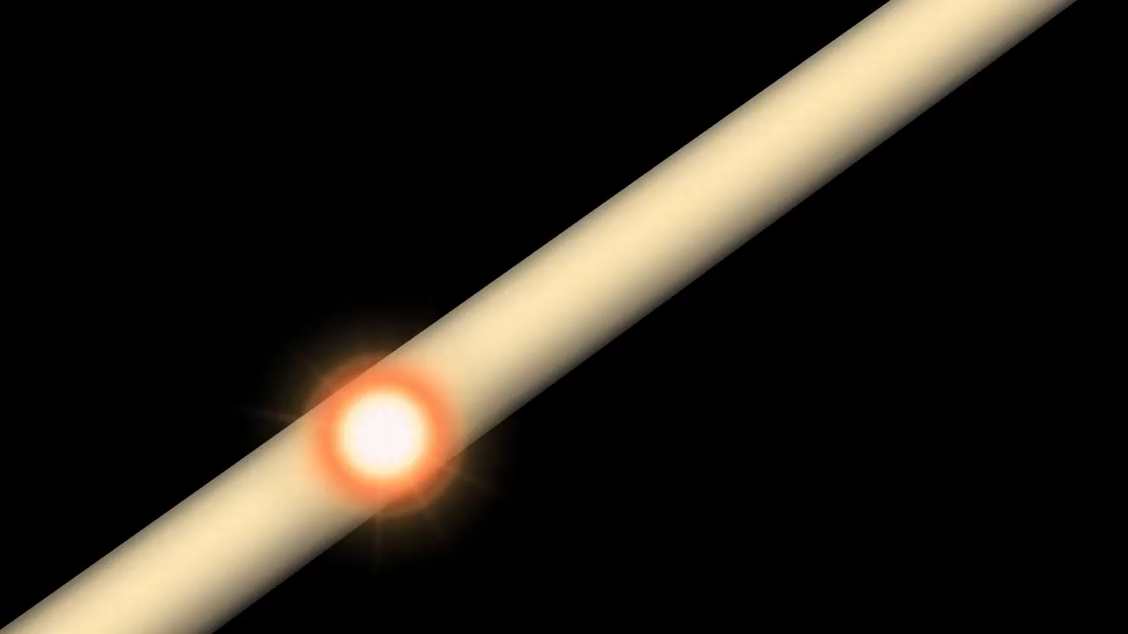
http://www.atlas.ch/multimedia/html-nc/animation-proton-event.html

Slide 23
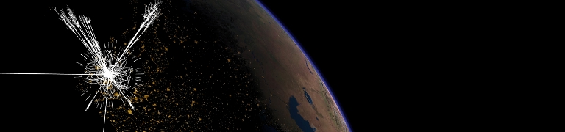
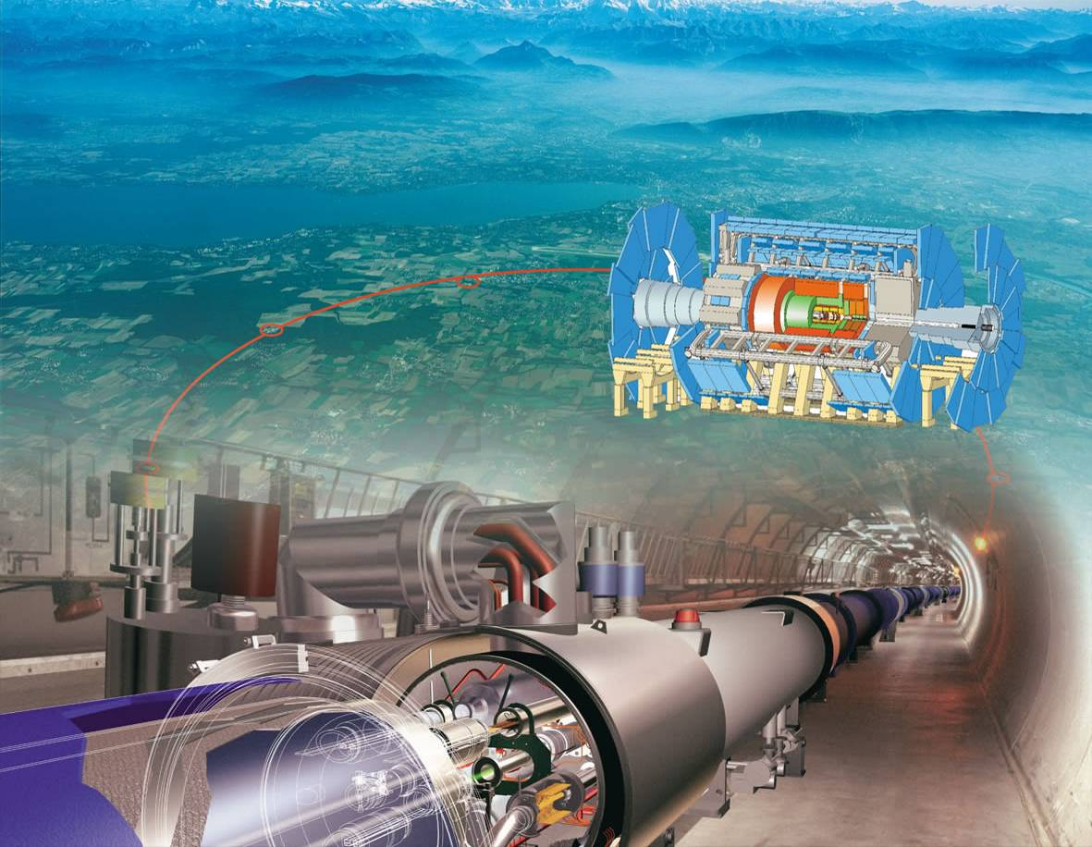
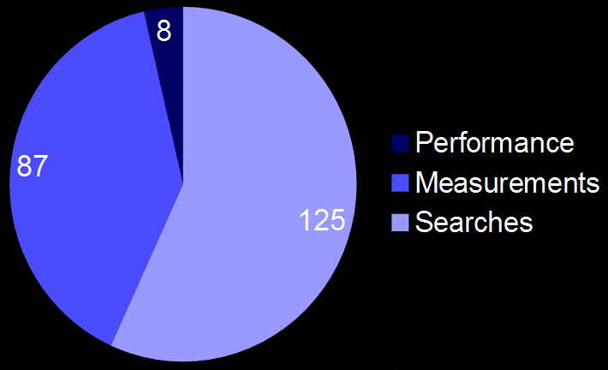
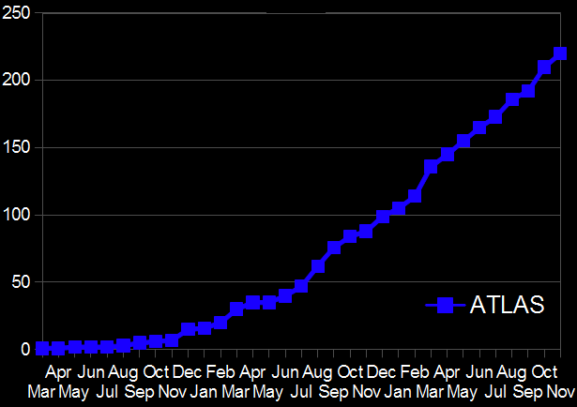
LHC High-p_{T} Physics
Small extract of huge amount of results available
ATLAS publications
http://atlasresults.web.cern.ch/atlasresults
On Nov 30:
  ATLAS produced 220 papers using collision data
  421 preliminary conference notes
CMS very similar

Slide 24
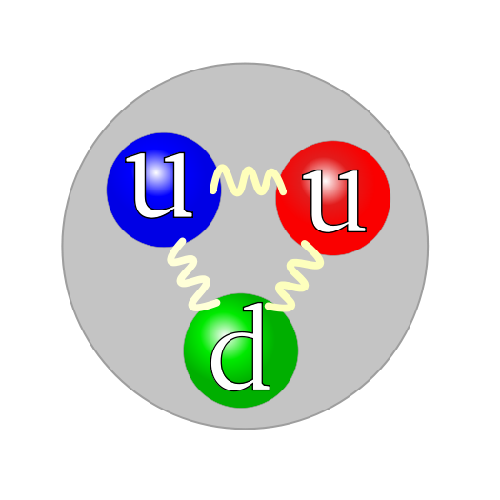
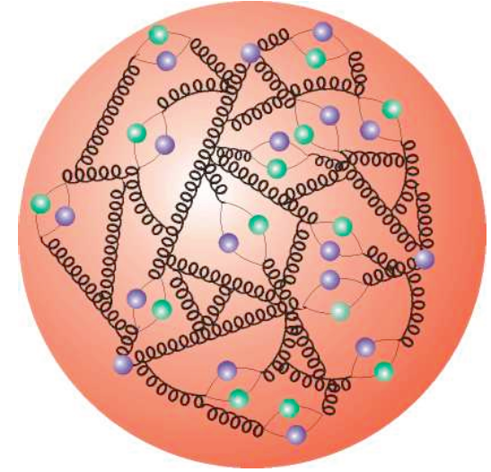
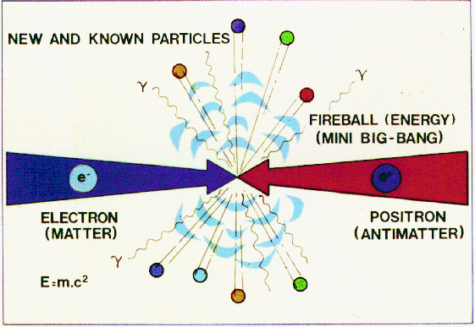
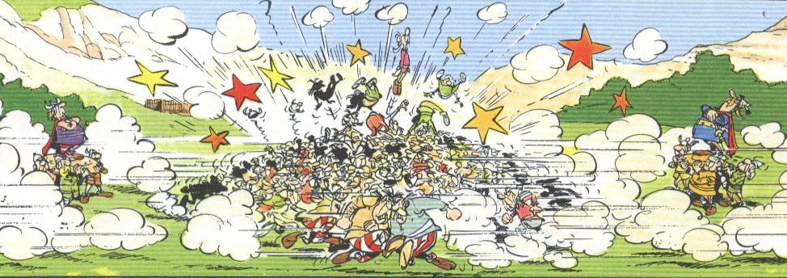
Proton–Proton Collisions
For proton−proton collisions, cross section is convolution of Parton Density Functions (PDF) with parton scattering Matrix Element
Parton distribution functions
Representing structure of proton
e⁺e– collider
Hadron collider

Slide 25
Proton–Proton Collisions
For proton−proton collisions, cross section is convolution of Parton Density Functions (PDF) with parton scattering Matrix Element
Parton distribution functions
Representing structure of proton
Hard scatter parton cross section
Higher order pQCD correction; accompanying radiation, jets, …
p
Q ² = M_{X}²
X = jets, W, Z, top, Higgs, SUSY, …
p
Underlying event
CM energy of parton collision:
The parton density functions rise dramatically towards low x:
  Higher cross section at higher proton−proton collision energy
  More luminosity also achieves higher effective energy
  Low-x (eg, Higgs) dominated by gluon−gluon collisions: “gluon collider”

Slide 26
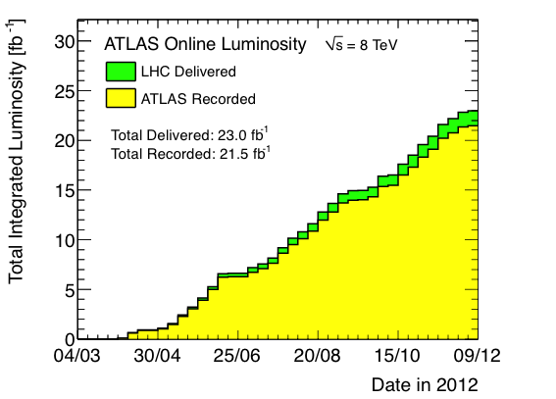
Recorded Luminosity in 2012
Luminosity is key quantity: rate = cross section × efficiency × luminosity
ATLAS integrated luminosity in 2012
Peak L = 7.7×10³³ s^{–1}cm^{–2} (Aug)
Max L/fill: 237 pb⁻¹ (June)
Weekly record: 1350 pb⁻¹ (June)
Longest stable beams: 22.8 h (July)
Fastest turn-around between stable beams: 2.1 h (April)
Best weekly data-taking efficiency: 92 h (55%) (July)
At L = 7×10³³ s⁻¹cm⁻² and 8 TeV pp collisions, 560 Higgs bosons of mass 125 GeV (σ_{pp→H} = 22.3 pb) are produced in ATLAS and CMS per hour
Or: every 45 min. 1 H → γγ, need ~2 typical 160 pb⁻¹ fills to produced one H→ 4l (l=e/μ)

Slide 27
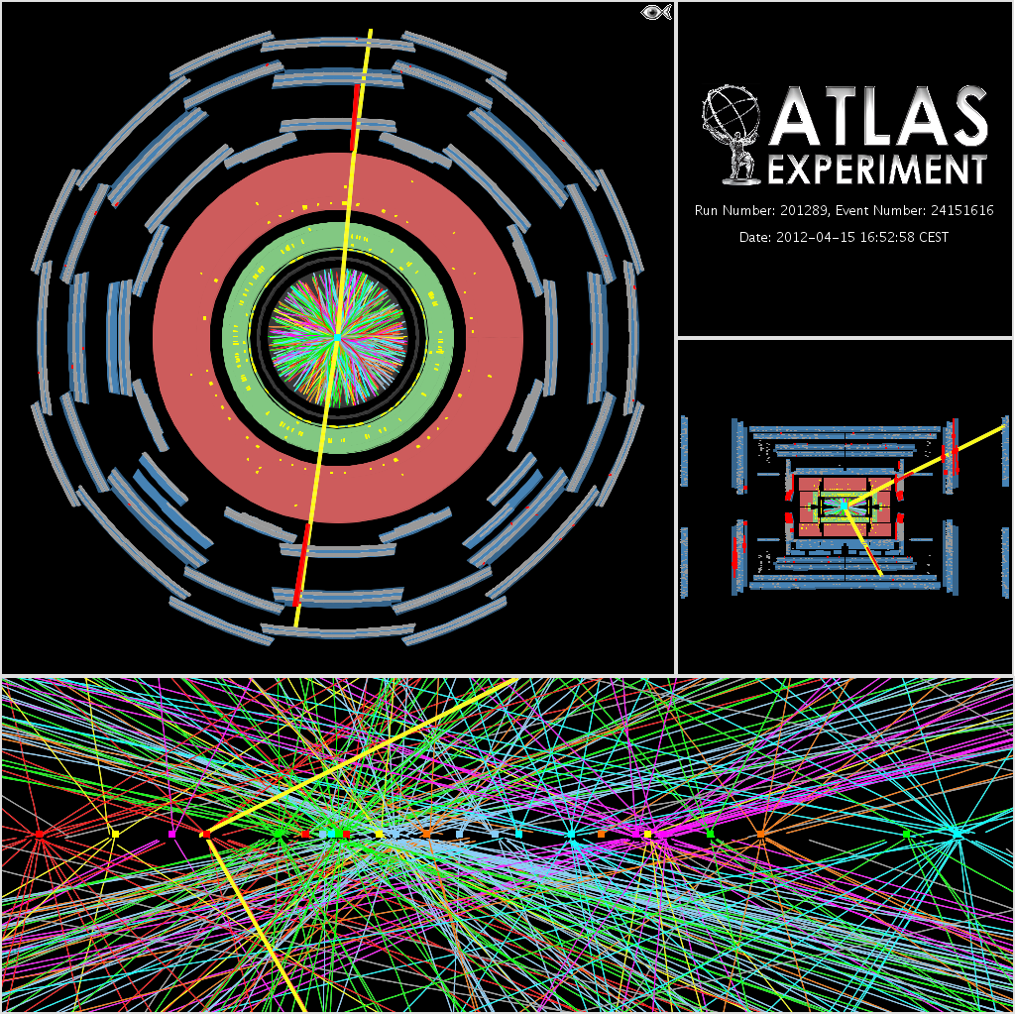
Many interactions per bunch crossing: “Pileup”
High luminosity comes at a price: probability of parasitic collisions in one bunch crossing (= pileup) increases
Average of 21 (peak: 40) collisions per crossing in 2012
Another price to pay: higher trigger thresholds → low-pT physics suffers
Z → μμ event in ATLAS with 25 reconstructed vertices

Slide 28
Many interactions per bunch crossing: “Pileup”
High luminosity comes at a price: probability of parasitic collisions in one bunch crossing (= pileup) increases
Average of 21 (peak: 40) collisions per crossing in 2012
Another price to pay: higher trigger thresholds → low-pT physics suffers
To search for “new” physics, we must make sure the “old” physics is well under control in our experiments
Z → μμ event in ATLAS with 25 reconstructed vertices

Slide 29
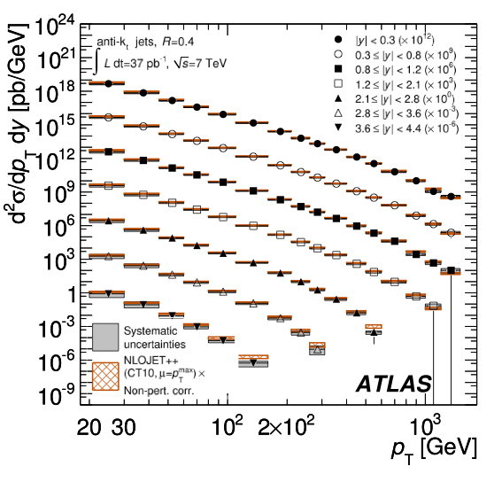
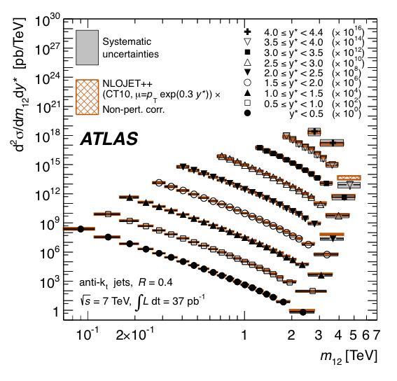
ATLAS and CMS have Measured Inclusive and Exclusive Jet Cross Sections at never Explored Energies
ATLAS arXiv:1112.6297
Differential jet cross section versus jet p_{T}
Differential jet cross section versus di-jet mass
Agreement over many orders of magnitude gives confidence for new physics searches

Slide 30

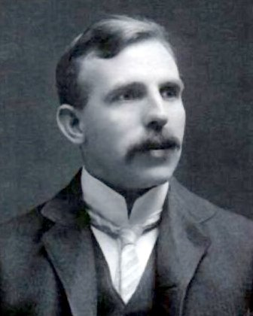
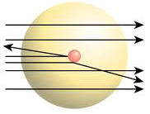
High-energy jets probe new particles and interactions
Measure di-jet invariant mass and angular distributions
q
q
2 → 2 parton scattering to two jets described by QCD
?
Tends to scatter at smaller angles than if there were new particles produced
Recall atomic substructure discovery in Rutherford scattering: deflection at large angles !
q
q
New, high-scale interaction ?
New bound state (particle) ?
Are quarks composites ?

Slide 31
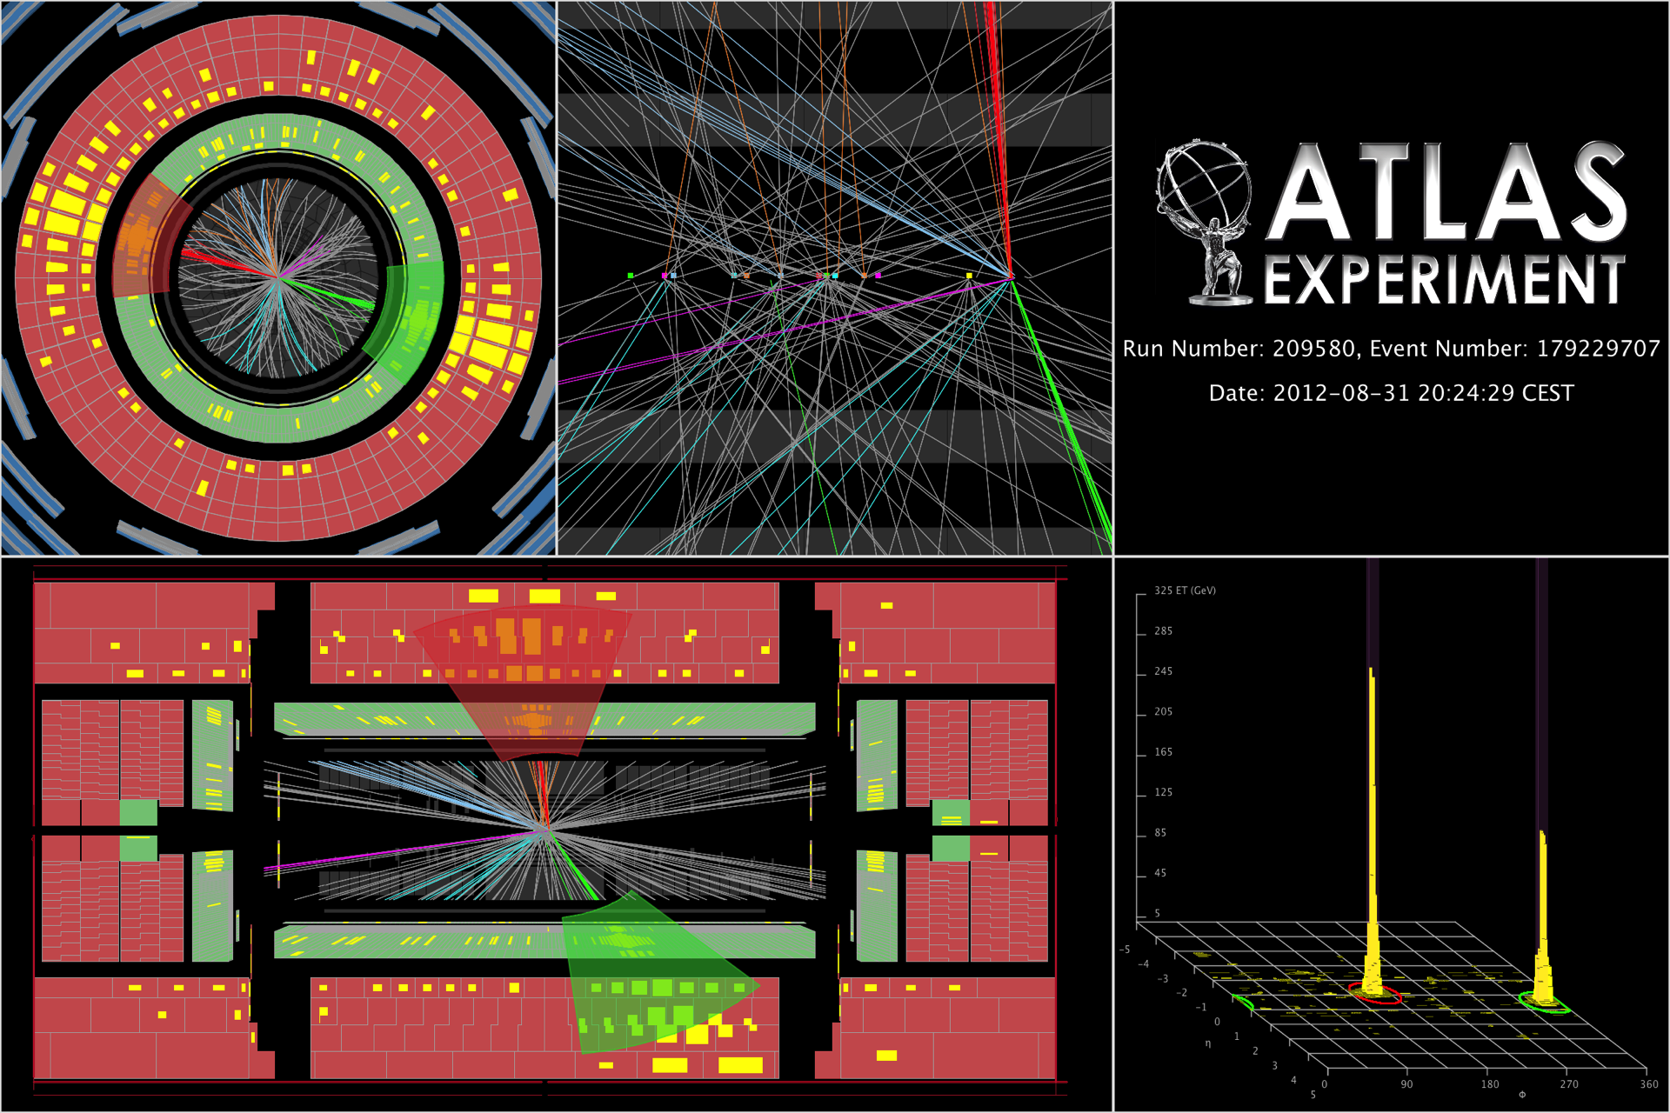
The highest-mass central dijet event collected. The two central high-p_{T} jets have an invariant mass of 4.69 TeV

Slide 32
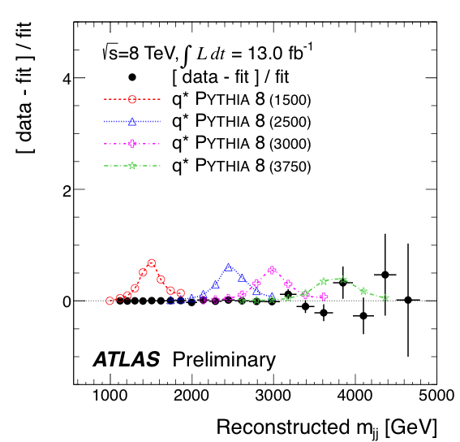
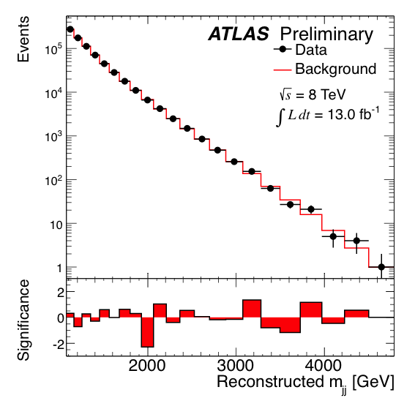
High-energy jets probe new particles and interactions
Measure di-jet invariant mass and angular distributions
ATLAS-CONF-2012-148, CMS PAS EXO-12-016
Observed and fitted dijet mass
Data / fit ratio, compared to four q* models
m(q*) > 3.84 TeV (95% CL)

Slide 33
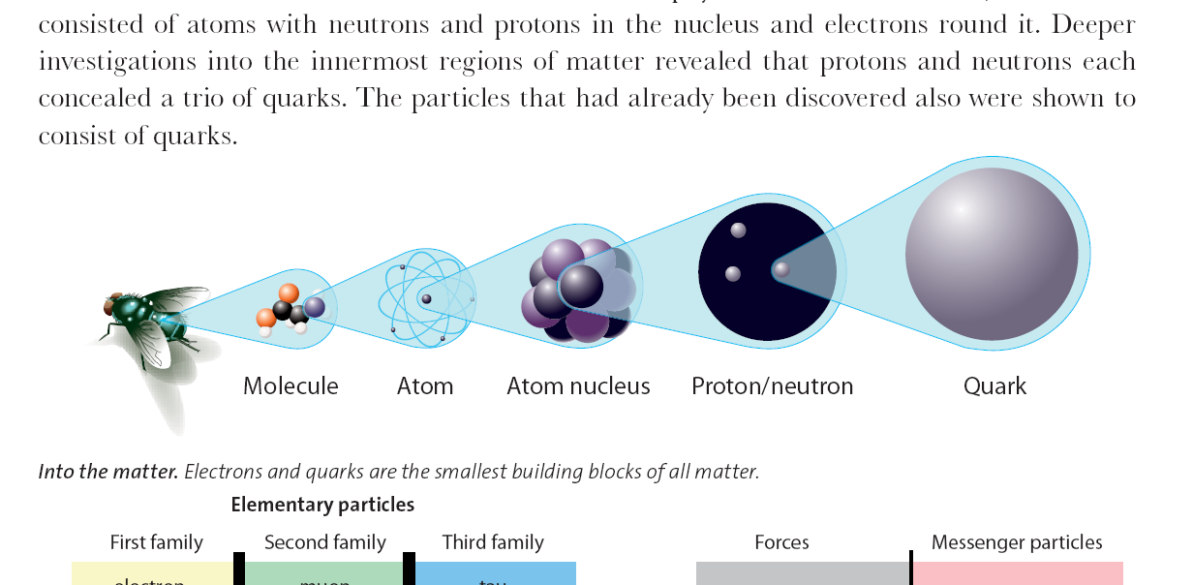
High-energy jets probe new particles and interactions
Measure di-jet invariant mass and angular distributions
ATLAS-CONF-2012-148, CMS PAS EXO-12-016
No deviations from SM seen → set limits on new phenomena:
Benchmark model | Observed limit at 95% CL
Excited quarks | m(q*) | > | 3.8 TeV
4-quark contact interactions | Λ | > | 7.8 TeV
Resonant
Non-resonant
< ~2 × 10 ^{–18} cm
10^{–14} cm
10^{–13} cm
10^{–9}–10^{–8} cm
10^{–9}–10^{–7} cm
quark

Slide 34
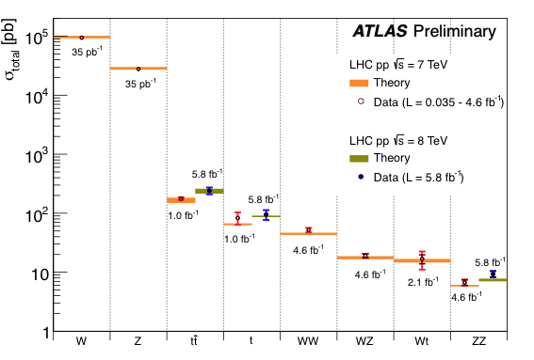
QCD and electroweak measurements
With more luminosity we are sensitive to ever smaller cross sections
Summary of weak boson and top cross section measurements vs. theory

Slide 35

QCD and electroweak measurements
With more luminosity we are sensitive to ever smaller cross sections
Summary of weak boson and top cross section measurements vs. theory
LHC is top factory:
  At 8 TeV CM energy: ~36 × larger cross section than at Tevatron

Slide 36
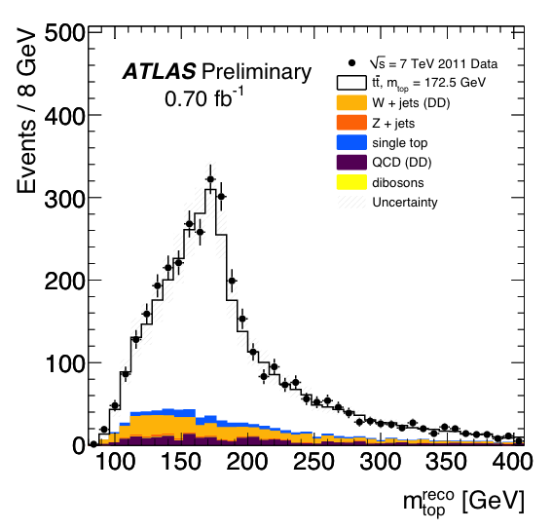
QCD and electroweak measurements
With more luminosity we are sensitive to ever smaller cross sections
Summary of weak boson and top cross section measurements vs. theory
Clean top reconstruction
(here: hadronic top mass)
First precision measurements of top cross section and mass at LHC
Searches for new physics in top production and decay

Slide 37
QCD and electroweak measurements
With more luminosity we are sensitive to ever smaller cross sections
Summary of weak boson and top cross section measurements vs. theory
Electroweak di-boson production

Slide 38
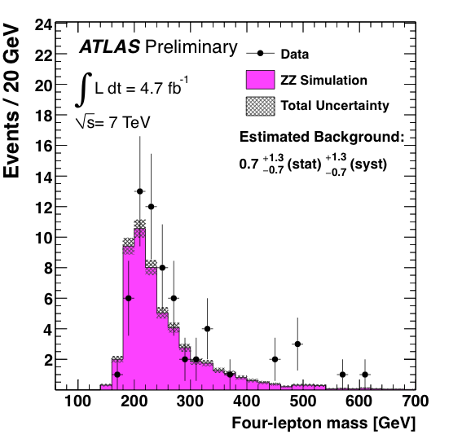
QCD and electroweak measurements
With more luminosity we are sensitive to ever smaller cross sections
Summary of weak boson and top cross section measurements vs. theory
The long road to measuring electroweak symmetry breaking
H(130 GeV) → WW
4.9 pb
H(130 GeV) → ZZ
0.65 pb

Slide 39
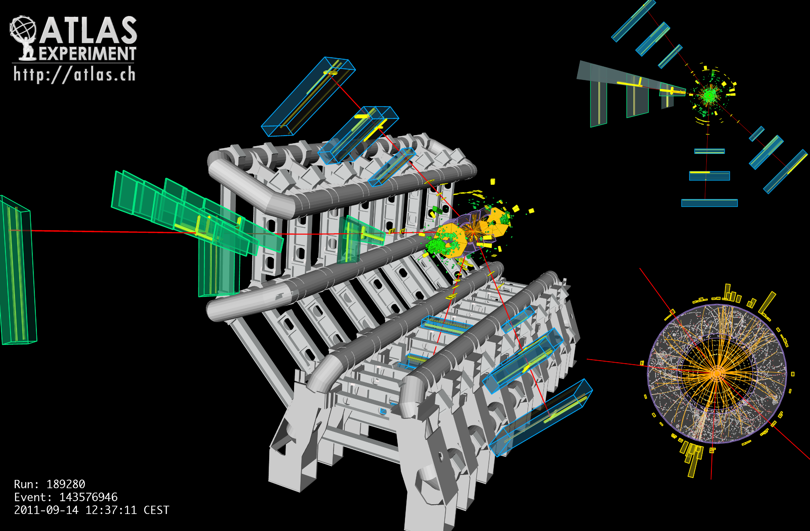
A 4μ event seen in ATLAS

Slide 40
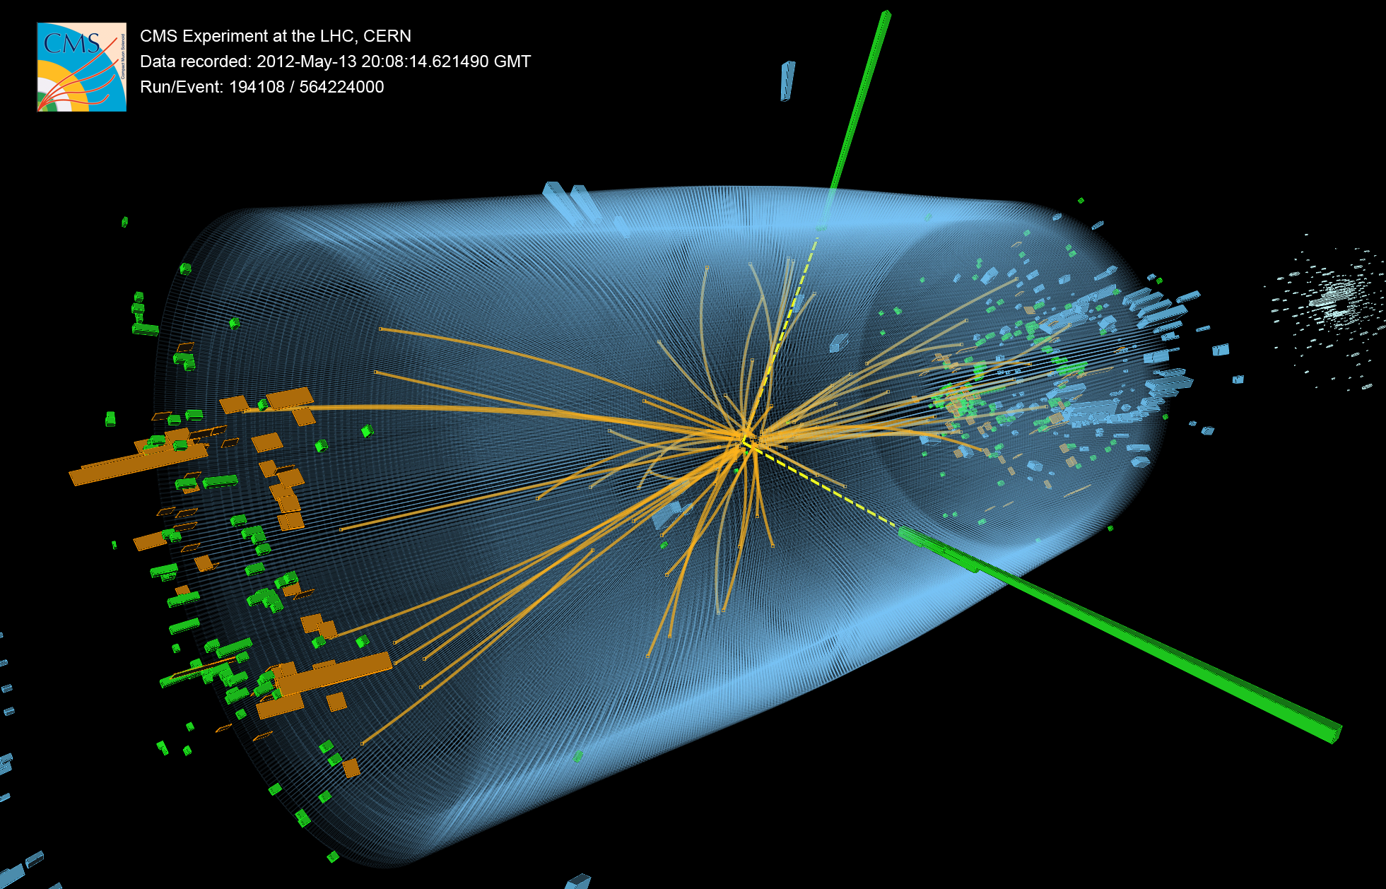
Hunting for the Higgs Boson

Slide 41
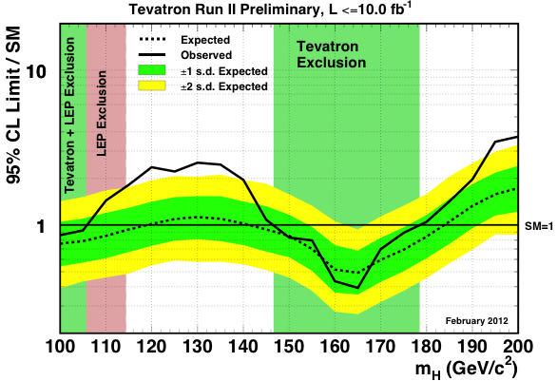
Hunting for the Higgs Boson
The Higgs boson has been vainly searched for at many accelerators
Best non-LHC 95% CL limits from LEP (CERN, 1989—2000) and Tevatron (Fermilab, 1990—2011):
m_{H} > 114 GeV
147 GeV < m_{H} < 179 GeV

Slide 42
Higgs boson searches at the LHC
Higgs production and decay probabilities predicted vs. Higgs mass by SM
At the LHC, the Higgs boson is produced dominantly via gluon fusion
σ_{H,total} ~22 pb at 8 TeV for m_{H} = 125 GeV (~20 × Tevatron; >200 × rate given luminosity)
Cross section steeply falling with Higgs mass
q⁽’⁾
q
g
W/Z
t
H
H
q’
W/Z
t
Vector boson fusion
q⁽’⁾
g
t
q
H
Total production of ~470 thousand SM Higgs bosons of
125 GeV in 2012 in each ATLAS and CMS
W/Z
q’
W/Z
Higgs-strahlung

Slide 43
Higgs boson searches at the LHC
Higgs production and decay probabilities predicted vs. Higgs mass by SM
At the LHC, the Higgs boson is produced dominantly via gluon fusion
σ_{H,total} ~22 pb at 8 TeV for m_{H} = 125 GeV (~20 × Tevatron; >200 × rate given luminosity)
Because of the coupling to the mass of the decay particles:
  … the Higgs will decay with preference to the heaviest particles allowed
  … the Higgs does not couple directly to photons and gluons, but only via “loops” involving heavy particles (e.g., top, W )
W,Z,q,l,g,γ
H
-
-
-
W,Z,q,l,g,γ

Slide 44
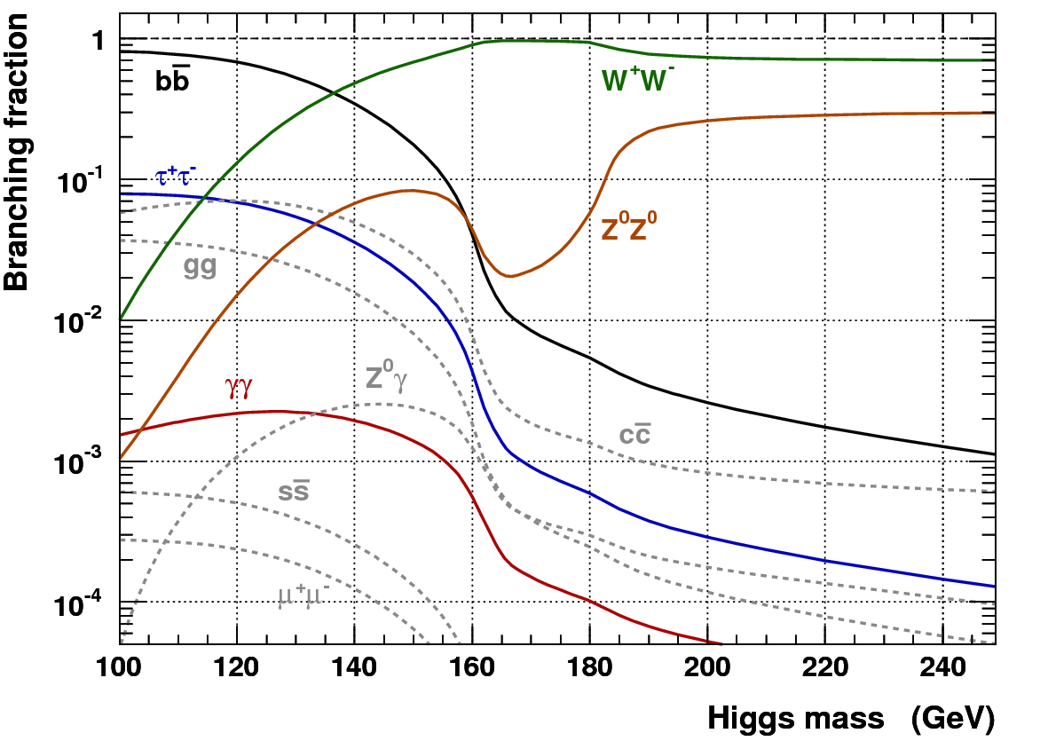
Higgs boson searches at the LHC
Dependence of the branching fractions on M_{H} drives search strategy
For medium to heavy Higgs:
Lepton final states via WW⁽*⁾, ZZ⁽*⁾
For light Higgs:
Lepton final states via WW*, ZZ*
Di-photon final state
Di-tau final state
The dominant H → bb mode is only exploitable in association with W/Z or tt, also with strong Higgs boost
Associated leptons provide trigger signal as they help to reduce huge QCD background, s(bb) ~ O(100 µb)

Slide 45
H → γγ candidate event (CMS) — note: background dominated sample

Slide 46
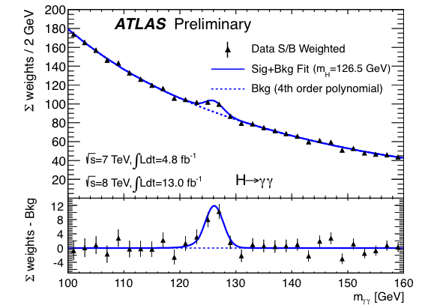
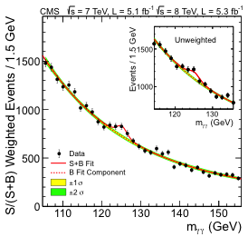
H → γγ
Clean discovery channels for Higgs, allowing precise mass determination
ATLAS-CONF-2012-168, CMS arXiv:1207.7235
Benefit from excellent energy resolution and photon identification capabilities of ATLAS/CMS
Both experiments classify events according to resolution and topology in ML fit
Maximum excess of 6.1σ (4.1σ) seen by ATLAS (CMS) at 126.6 ± 0.3 ± 0.7 GeV (125 GeV)

Slide 47
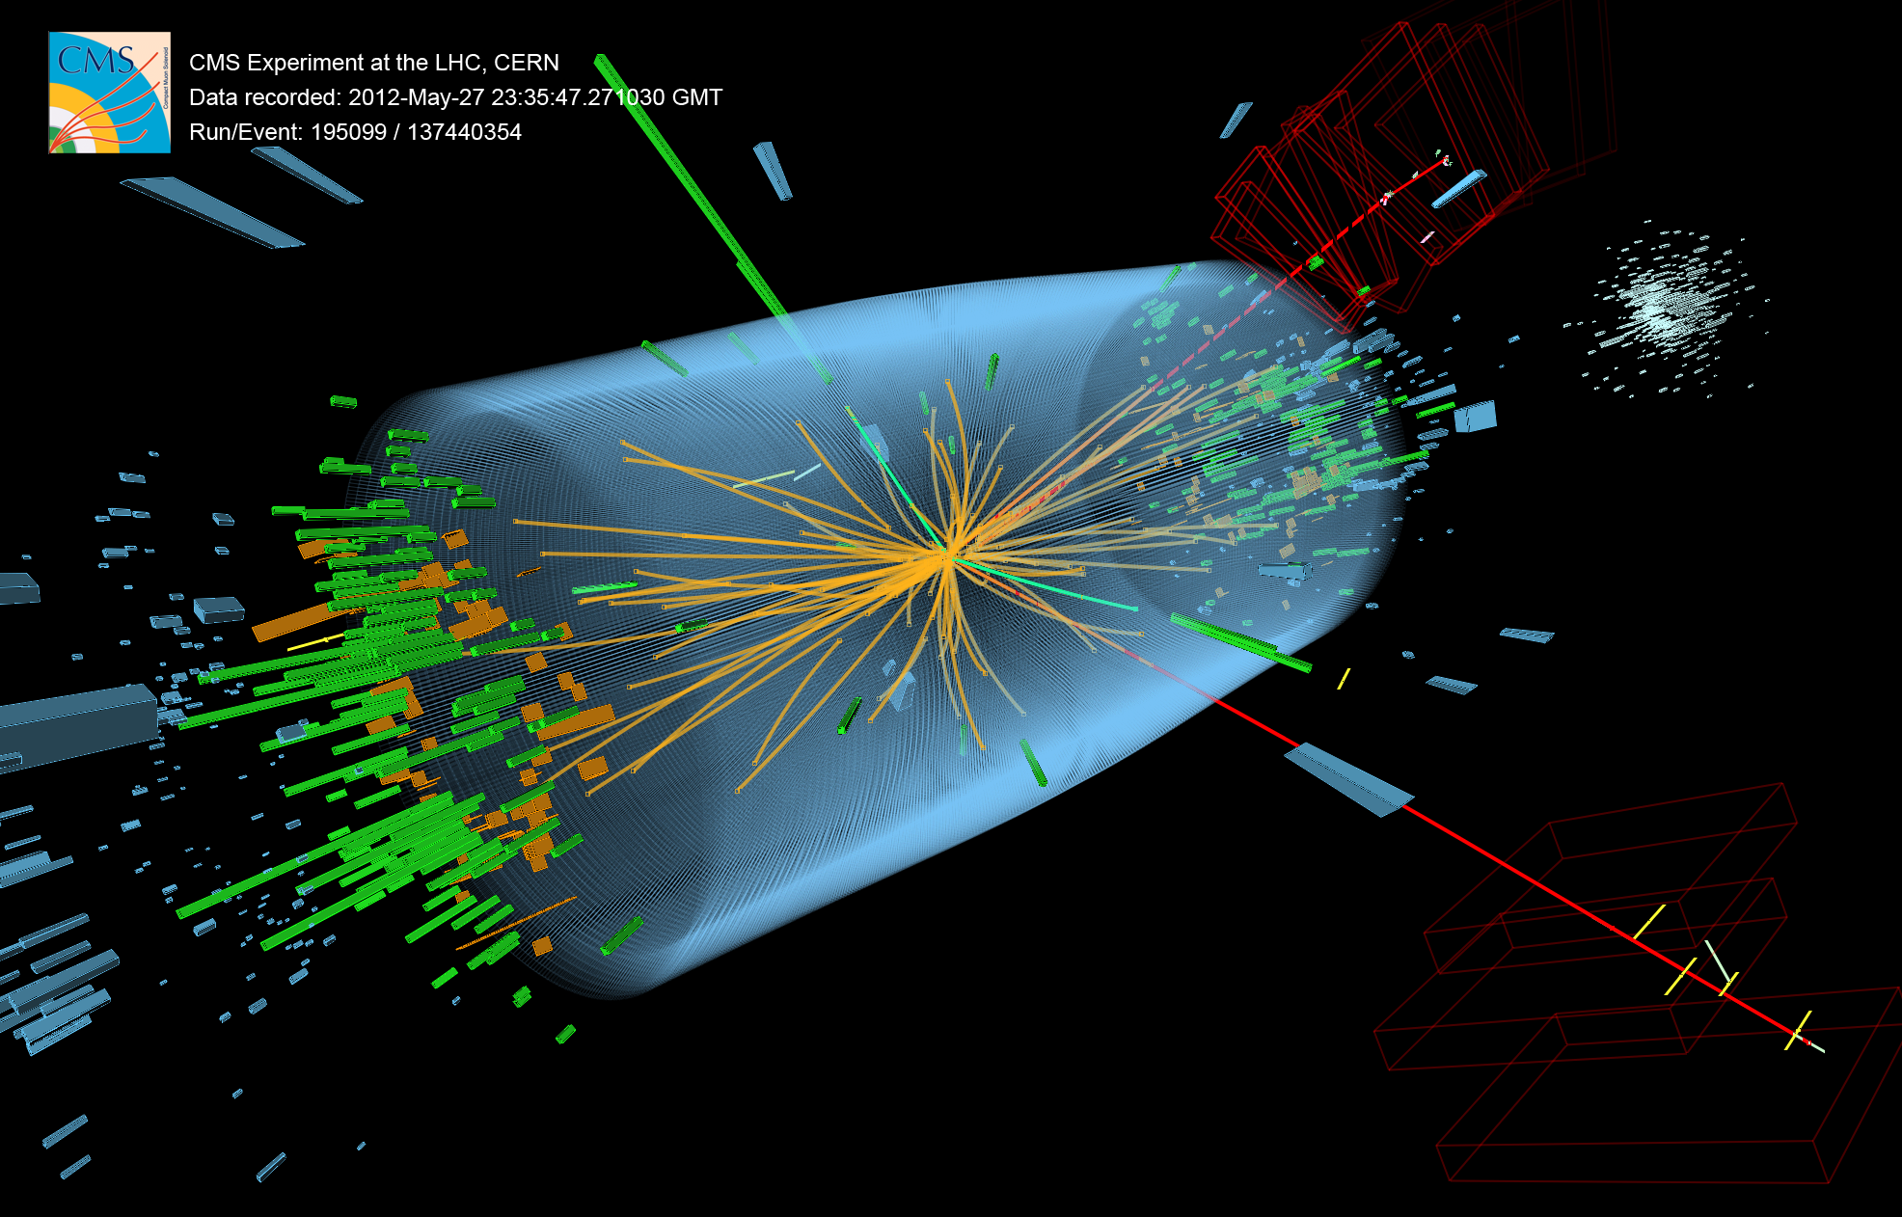
H → 2e2µ candidate event (CMS)

Slide 48
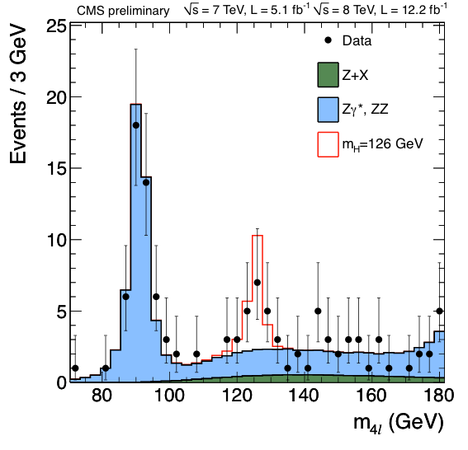
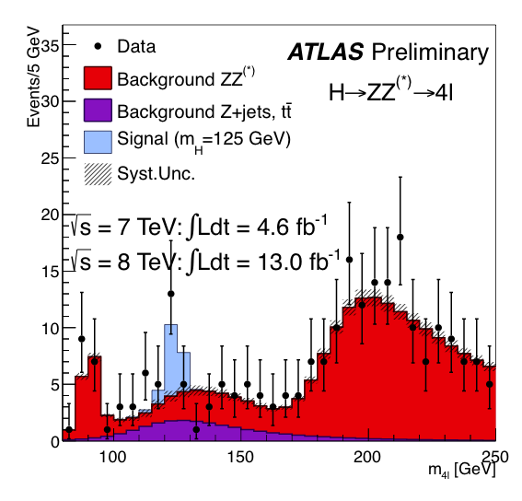
H → ZZ⁽*⁾ → 2(e, µ) + 2(e, µ)
Clean discovery channels for Higgs, allowing precise mass determination
ATLAS-CONF-2012-169, CMS-PAS-HIG-12-041
Benefit from excellent energy/momentum resolution and identification capabilities at ATLAS/CMS
Maximum excess of 4.1σ (4.5σ) seen by ATLAS (CMS) at 123.5 ± 0.9 ± 0.3 GeV (126.2 GeV)

Slide 49
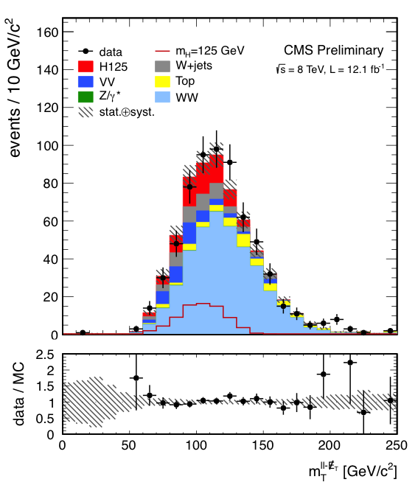
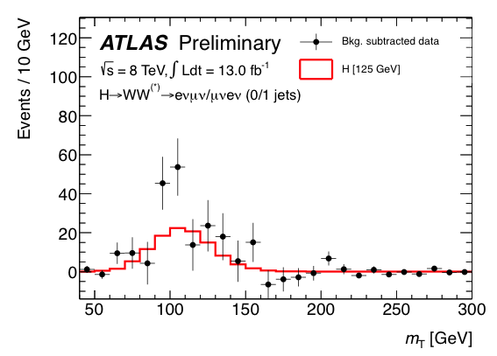
H → WW⁽*⁾ → 2(e, µ) + 2ν
Not clean, but abundant (competitive at 125 GeV) — little mass sensitivity
ATLAS-CONF-2012-158, CMS-PAS-HIG-12-042
Signal selection: reconstruct transverse Higgs mass, exploit W polarisation (leptons emitted in same dir.)
Some excess seen by both experiments: 2.8σ (3.1σ) for ATLAS (CMS) at ~125 GeV

Slide 50


H → ττ and (W/Z)+H → (lν/ll,νν)+bb
Challenging, non-clean channels — not yet significant
ATLAS-CONF-2012-160, ATLAS-CONF-2012-161, CMS-PAS-HIG-12-043, CMS-PAS-HIG-12-044
Signal selection: reconstruct (broad) Higgs mass peak, close to Z, background understanding crucial
Slight excess seen by both experiments for ττ, ATLAS does not yet see excess in bb

Slide 51


Combining all the channels — discovery significance
One new boson with Higgs-like properties … nothing else around
ATLAS-CONF-2012-170, CMS-PAS-HIG-12-045
All results [γγ, ZZ, WW, ττ, bb] combined. Left: ATLAS, right: CMS — low mass region shown only
2.7σ mass difference between 4l and γγ
Maximum excess of 7.0σ (6.9σ) seen by ATLAS (CMS) at 125.2 ± 0.3 ± 0.6 (125.8 ± 0.4 ± 0.4) GeV

Slide 52


Combining all the channels — cross section
Are channel-by-channel cross sections × branching fractions SM-like ?
ATLAS-CONF-2012-170, CMS-PAS-HIG-12-045
Individual σ[exp] / σ[SM] ratio for the channels: γγ, ZZ, WW, ττ, bb. Left: ATLAS, right: CMS
Compatibility with SM (μ=1): 13% for ATLAS, > 50% for CMS

Slide 53


Combining all the channels — couplings
Is it the Higgs boson with J^{PC} = 0⁺⁺ and SM couplings ?
ATLAS-CONF-2012-168, CMS-PAS-HIG-12-045
Observed σ:
κ_{F}
κ_{V}
Spin-0 hypothesis slightly favoured; Higgs to vector and fermion couplings agree with SM

Slide 54
Combining all the channels — couplings
Is it the Higgs boson with J^{PC} = 0⁺⁺ and SM couplings ?
Michael Peskin, in theoretical summary talk at HiggsHunting (July 2012) [arXiv:1208.5152]:
SM strength (i.e., ‘large’) coupling to WW, ZZ is
“ prima facie evidence that the new particle is CP even spin zero field with a vacuum expectation value that breaks SU(2) × U(1). This is what we call a ‘Higgs boson’. ”

Slide 55


PRESS COVERAGE
after July 4th seminars at CERN
CERN black board, Jul 2012

Slide 56

— Intense curiosity —
A new era in particle physics has begun: the exploration of planet Higgs
What is its mass and width ?
What is its spin ?
Does it break EW vacuum symmetry ?
How does it couple to SM particles ?
Does it couple to new particles ?
Does it have invisible decays ?
Does it have brothers and sisters ?
Does it have distant cousins ?
Is it a “natural” scalar ?
© NASA

Slide 57

What can we conclude from this discovery
Recall: light Higgs was predicted from SM fit to precision measurements
Discovery of light Higgs boson — if confirmed — is a huge success of the Standard Model
http://gfitter.desy.de
ATLAS & CMS
LEP, SLC, Tevatron
H

Slide 58
What can we conclude from this discovery
Is the electroweak vacuum stable or metastable (if SM holds) ?
Barely stable ?
But: prediction of the stability bound suffers from theoretical uncertainties …
Ellis et al, arXiv:0906.0954
Allowed
Not allowed
ATLAS & CMS

Slide 59

What can we conclude from this discovery
Is the electroweak vacuum stable or metastable (if SM holds up to M_{Pl}) ?
Barely stable ?
But: prediction of the stability bound suffers from theoretical uncertainties …
Let’s zoom into the interesting region
Ellis et al, arXiv:0906.0954
ATLAS & CMS
Newest full NNLO result moves up stability bound at Planck mass by +0.8 GeV and reduces uncertainty
barely stable or metastable, but certainly the Higgs self coupling would become very weak at M_{Pl}
Degrassi et al, arXiv:1205.6497

Slide 60
100 years after the discovery of cosmic rays…
The discovery of the Higgs boson — if confirmed — completes the Standard Model
It is a triumph for the imagination and rigour of the human mind
It is a triumph for the greatest experimental undertaking ever:
Frontier of accelerator & detector technologies
Global data sharing, analysis & collaboration

Slide 61

100 years after the discovery of cosmic rays…
The discovery of the Higgs boson — if confirmed — completes the Standard Model
But …

Slide 62
Can we conclude that the Standard Model is the theory of matter and force ?

Slide 63

The SM cannot be the final theory, because …
Gauge hierarchy / Scalar SM sector is unstable
Huge mass hierarchy between matter particles
Gauge hierarchy / Scalar SM sector is unstable
Higgs is only fundamental scalar
Huge mass hierarchy between matter particles
Higgs is only fundamental scalar
neither matter, nor force, — all known scalars are
composite states
neither matter, nor force, — all known scalars are
composite states
Dark matter and dark energy
Grand unification of the forces
Causally connected observable universe
Massive neutrinos
Matter-antimatter asymmetry in universe
Strong CP problem
Gravitation

Slide 64
The SM cannot be the final theory, because …
The Higgs potential (μ < 0, λ > 0: physics or just mathematics ?) exemplifies our success with description but lack of understanding
~
Higgs boson mass term
“Hierarchy problem”
→ new physics at ~TeV

Slide 65
The SM cannot be the final theory, because …
The Higgs potential (μ < 0, λ > 0: physics or just mathematics ?) exemplifies our success with description but lack of understanding
~
Is this the right potential?
If the Higgs field fills all space-time, is it related to inflation and dark energy?
Higgs boson mass term
Higgs self coupling
Higgs—fermion couplings
λ_{SM} = G_{F} m_{H}²/√2 ∼ 0.13
EW vacuum may be meta-instable
“SM flavour problem”: large mass hierarchy between fermion families
“Hierarchy problem”
→ new physics at ~TeV
G. Isidori at HiggsHunting 2012
Through the missing protection of the scalar potential to high-scale physics (no symmetry for m_{H} = 0 !), the Higgs boson is considered a “portal to new physics”

Slide 66


Higgs discovery puts these questions into spotlight
P. Higgs at CMS

Slide 67
Proposed solutions to hierarchy problem
Weakly coupled: Supersymmetry, …
Strongly coupled: Little Higgs, Composite Higgs, …
Different manifestations of similar scenarios. Many models also provide dark matter candidates
Higgs discovery puts these questions into spotlight
P. Higgs at CMS

Slide 68
Does a symmetry between fermions and bosons
regularise the Higgs radiative corrections ?
Supersymmetry (SUSY)
P. Higgs at CMS

Slide 69
Fermion loop
Boson loop
Supersymmetry (SUSY)
Fermion and boson loops contribute with different signs to the Higgs radiative corrections: if there existed a symmetry relating these two, this would protect the mass of the scalar Higgs
Supersymmetry realises this by transforming bosons  fermions
This solves the hierarchy and naturalness problems of the SM (and other problems)
Each SM particle has thus a supersymmetric partner (which is of ~TeV scale — “broken SUSY”)

Slide 70


The
scalar
precipice
Mrs. SUSY
EW scale^{—1}
Mr. Higgs
GUT scale^{—1}
Planck scale^{—1}
Fundamental scalar length scale

Slide 71
SUSY has: N_{dof} (bosons) = N_{dof} (fermions) [cf. SM: N_{dof} (bosons)  N_{dof} (fermions)]
To create supermultiplets, we need to add one superpartner to each SM particle
Superpartners have opposite spin statistics but otherwise equal quantum numbers
Supersymmetry (SUSY)
Spin 0 | Spin 1/2 | Spin 1 | Spin 3/2 | Spin 2
sLeptons | Leptons |  | Gravitino | Graviton
sQuarks | Quarks
Higgs | Higgsino
 | Photino | Photon
 | Zino | Z
 | Wino | W
 | Gluino | Gluon

Slide 72
SUSY has: N_{dof} (bosons) = N_{dof} (fermions) [cf. SM: N_{dof} (bosons)  N_{dof} (fermions)]
To create supermultiplets, we need to add one superpartner to each SM particle
Superpartners have opposite spin statistics but otherwise equal quantum numbers
Need to introduce an additional Higgs doublet to the non-SUSY side → 5 Higgs bosons
SUSY breaking introduces lots (> 100) of new parameters (masses, mixing angles, phases)
Supersymmetry (SUSY)
Spin 0 | Spin 1/2 | Spin 1
 | ●
 | q
h ⁰, H ⁰, A⁰ |  | γ, Z ⁰
H ± |  | W ±
 |  | g_{a}
SM
Squark/slepton mixing proportional to SM partner masses
→ largest for 3rd gen.
→ can become lightest squarks / sleptons
SUSY
Eigenstates of mass
The gauge-mixed physical states that propagate in space and time and that can be observed.
Neutralinos: mass eigenstates of photinos, zinos, neutral higgsinos
Charginos : mass eigenstates of winos and charged higgsinos

Slide 73
SUSY has: N_{dof} (bosons) = N_{dof} (fermions) [cf. SM: N_{dof} (bosons)  N_{dof} (fermions)]
To create supermultiplets, we need to add one superpartner to each SM particle
Superpartners have opposite spin statistics but otherwise equal quantum numbers
Need to introduce an additional Higgs doublet to the non-SUSY side → 5 Higgs bosons
SUSY breaking introduces lots (> 100) of new parameters (masses, mixing angles, phases)
Supersymmetry (SUSY)
Problem: since ~30 years SUSY is supposed to be
“around the corner”, but has not been observed yet …
Spin 0 | Spin 1/2 | Spin 1
 | ●
 | q
h ⁰, H ⁰, A⁰ |  | γ, Z ⁰
H ± |  | W ±
 |  | g_{a}
SM
Squark/slepton mixing proportional to SM partner masses
→ largest for 3rd gen.
→ can become lightest squarks / sleptons
SUSY
Eigenstates of mass
The gauge-mixed physical states that propagate in space and time and that can be observed.
Neutralinos: mass eigenstates of photinos, zinos, neutral higgsinos
Charginos : mass eigenstates of winos and charged higgsinos

Slide 74
Characteristic SUSY Decay Cascades
To avoid proton decay, a new conserved quantum number (R) is introduced, which forces a SUSY particle to decay in at least one other SUSY particle
The lightest SUSY particle is thus stable (LSP), and must be neutral and colourless → WIMP (dark matter candidate)
Typical LSP is spin-½ neutralino. It could also be a gravitino
With R parity: SUSY production in pairs only → requires energy 2  SUSY mass !
2 LSPs escapes detection
→ missing E_{T}, no mass peak !
“Typical” SUSY decay chain at the LHC, driven by mass hierarchy of SUSY particles

Slide 75

SUSY searches at the LHC
Many different search channels along expected SUSY event topologies
Signatures of the SUSY “cascades” are driven by masses of the SUSY particles
To good generality we can expect:
High-p_{T} jets from squark & gluino decays
Leptons from gaugino & slepton decays
Missing transverse energy from LSPs
Simulated
SUSY event
This lays out an inclusive search strategy
Most of the hard analysis work consists of understanding and modelling backgrounds from SM processes !

Slide 76

SUSY searches at the LHC
Many different search channels along expected SUSY event topologies
ATLAS-CONF-2012-109, ATLAS-CONF-2012-103
Signatures of the SUSY “cascades” are driven by masses of the SUSY particles
To good generality we can expect:
High-p_{T} jets from squark & gluino decays
Leptons from gaugino & slepton decays
Missing transverse energy from LSPs
This lays out an inclusive search strategy
Most of the hard analysis work consists of understanding and modelling backgrounds from SM processes !

Slide 77


SUSY searches at the LHC
Many different search channels along expected SUSY event topologies
ATLAS-CONF-2012-109, ATLAS-CONF-2012-103
Signatures of the SUSY “cascades” are driven by masses of the SUSY particles

Slide 78


Does SUSY hide from our analyses?
What is required to keep SUSY “natural” ?
Recall: we need to cancel the Higgs virtual corrections. Most important is top loop
~
~
Gluino-mediated virtual b/t production
Contrary to the SM, 3rd generation squarks can be lighter than 1st and 2nd generations
Watch out for tops and b’s in final state (“natural SUSY”)
~
~
Direct b/t pair production

Slide 79


Does SUSY hide from our analyses?
Dedicated searches for gluino-mediated (left) and direct stop production (right)
See: https://twiki.cern.ch/twiki/bin/view/AtlasPublic/SupersymmetryPublicResults

Slide 80


Should we forget about SUSY ?
Maybe the electroweak scale is finetuned. But what about dark matter ?
CMS arXiv:1206.5663
Should we give up on natural SUSY and directly search for WIMP (dark matter) production in proton−proton collisions ?
How can we detect (and trigger) them ?
Energetic gluon/photon radiation in the initial sate
→ Search for mono-jets events!

Slide 81



Should we forget about SUSY ?
Maybe the electroweak scale is finetuned. But what about dark matter (DM) ?
CMS arXiv:1206.5663, ATLAS 1210.4491
Limit on WIMP pair production cross section can be transformed into limit on effective WIMP-hadronic contact interaction:
Vector (SI):
Axial-v. (SD):
WIMP-nucleon
scattering cross-section:

Slide 82



WIMP production search connects accelerator physics with searches in and from outer space
Courtesy:
David Berge (CERN)

Slide 83
Many models other than Supersymmetry deal with the hierarchy problem …
some also provide dark matter candidates,
some also grand unification,
some of them provide new sources of matter-antimatter violation to create the remaining matter,
some may explain the hierarchy in the observed particle masses,
some are only valid up to several tenth of TeV, others up to GUT scales…

Slide 84


Record Black Hole with 24–33 Solar Masses in IC 10 dwarf galaxy
Many of these models have fascinating features.
Compact extra dimensions, for example, are small, curled dimensions of micron size or much smaller.
If gravitons propagates in them gravity may become strong and we should observe coupling of SM particles to gravity.
We might then even reach into the trans-Planck regime at the LHC! If also the SM fields propagate in the extra dimensions, they may develop new high-mass states.
If the new phenomena are of TeV scale we should see them.
We hence must search for them at the LHC!
Artist’s portrayal of the IC 10 X-1 system: the black hole lies at the upper left and its companion star is on the right

Slide 85


Broad search spectrum at ATLAS and CMS
Record Black Hole with 24–33 Solar Masses in IC 10 dwarf galaxy
Many of these models have fascinating features.
Compact extra dimensions, for example, are small, curled dimensions of micron size or much smaller.
If gravitons propagates in them gravity may become strong and we should observe coupling of SM particles to gravity.
We might then even reach into the trans-Planck regime at the LHC! If also the SM fields propagate in the extra dimensions, they may develop new high-mass states.
If the new phenomena are of TeV scale we should see them.
We hence must search for them at the LHC!
Mass reach of searches for SUSY (left) and other new phenomena (right) (here: ATLAS)
Artist’s portrayal of the IC 10 X-1 system: the black hole lies at the upper left and its companion star is on the right

Slide 86



Broad search spectrum at ATLAS and CMS
The LHC is pushing the limits on new phenomena
We are still below 10% of the expected size of the LHC data sample
(below 1% of the expected HL-LHC one), and at half the energy
Mass reach of searches for SUSY (left) and other new phenomena (right) (here: ATLAS)

Slide 87
What’s next ?

Slide 88
LHC timeline
?
2009
Start of LHC
Run 1, 7+8 TeV, ~25 fb⁻¹ int. lumi
2013 / 14
LS1: prepare LHC for design E & lumi
Collect ~30 fb⁻¹ per year at 13/14 TeV
Is the new boson the SM Higgs ?
To answer these question we need more data and higher collision energy
2018
Phase-1 upgrade for ultimate lumi
If so, what protects it ?
Mr. SUSY
Twice nominal lumi at 14 TeV,
~100 fb⁻¹ per year
~2022
Phase-2 upgrade to HL-LHC
~300 fb⁻¹ per year, run up to > 3 ab⁻¹ collected
Thank you !
Mr. Higgs
~2030

Slide 89
Spare slides

Slide 90

The Standard Model
The SM consists of 24 elementary matter particles and 3 forces with total of 26 parameters
Above ~100 GeV, electro-magnetic and weak interactions are unified
Below 100 GeV, weak interaction is weaker than electromagnetism
Electroweak interaction
γ, Z current
W current
HERA data from electron–quark scattering into e+q (NC = γ,Z) or ν+q (CC = W ±)

Slide 91

The LHC proton—proton physics programme
Mass and electroweak symmetry breaking
    Search for the Higgs Boson, measurement of its properties
Hierarchy in the TeV domain
    Search for new phenomena moderating the hierarchy problem
    Search for the unexpected at the high-energy frontier
Electroweak unification and strong interactions
    Precision measurements and tests of the Standard Model
    Tests of perturbative QCD at the high-energy frontier
Flavour
    B, D mixing, rare decays and CP violation as tests of the Standard Model

Slide 92


Recorded Luminosity in 2011
Luminosity is key quantity: rate = cross section × efficiency × luminosity
ATLAS integrated luminosity in 2011
Peak L = 3.6×10³³ s^{–1}cm^{–2} (Aug)
Max coll-bunch: 1331 (Δt = 50 ns)
Weekly record: 580 pb⁻¹ (June)
Surpassed Tevatron record of 4.1×10³²

Slide 93
Leptons are pure SM and new physics probes with much reduced strong-interactions background
q
e
Z⁰ / W±
Z’ / W’ ?
q⁽‘⁾
e/ν
Unification of forces ?
Left-right symmetric models ?
Compact extra dimensions ?
Technicolour ?
Higgs extensions ?

Slide 94

Leptons are pure SM and new physics probes with much reduced strong-interactions background
What’s happening in this tail ?
Unification of forces ?
Left-right symmetric models ?
Compact extra dimensions ?
Technicolour ?
Higgs extensions ?

Slide 95


Searches for Z’ and W ’resonances in decays to e/μ
Use dilepton / transverse mass to search for excess over SM
ATLAS-CONF-2012-129
Observed and predicted dielectron mass spectrum
→ Search for bumps
Observed and predicted dimuon mass spectrum
95% CL lower limit: m(Z ’_{SSM}) > 2.5 TeV
⁽*⁾Constructive interference model

Slide 96

QCD and electroweak measurements
With more luminosity we are sensitive to ever smaller cross sections
The top quark is the heaviest known elementary particle
Almost as heavy as a gold atom…
It is that heavy that it decays to bW ⁺ before it can form hadrons: its lifetime of 5×10^{–25} s (half a yoctosecond, Γt ≈ 1.5 GeV) is smaller than hadronization time: 1/Λ_{QCD} ~ 3×10^{–24} s
When a top pair is produced at LHC, it can only fly ~0.1 fm within its lifetime, but the typical hadron size is 1 fm. At 0.1 fm, QCD is weak due to asymptotic freedom
There are thus no topponium bound states
Top is believed to be preferably involved in reactions with heavy new physics particles
© Kurt Riesselmann, Symmetry 04-05-07

Slide 97

QCD and electroweak measurements
With more luminosity we are sensitive to ever smaller cross sections
Summary of weak boson and top cross section measurements vs. theory
LHC is top factory
  Semi-leptonic tt decay (~30%, lep=e,μ)

Slide 98

QCD and electroweak measurements
With more luminosity we are sensitive to ever smaller cross sections
Summary of weak boson and top cross section measurements vs. theory
Clean top reconstruction
(here: hadronic top mass)
First precision measurements of top cross section and mass at LHC
Searches for new physics in top production and decay

Slide 99

QCD and electroweak measurements
With more luminosity we are sensitive to ever smaller cross sections
Summary of weak boson and top cross section measurements vs. theory
Clean top reconstruction
(here: hadronic top mass)
First precision measurements of top cross section and mass at LHC
Searches for new physics in top production and decay
Gfitter arXiv:1209.2716

Slide 100



QCD and electroweak measurements
With more luminosity we are sensitive to ever smaller cross sections
Summary of weak boson and top cross section measurements vs. theory
t-channel dominates single-top production
ATLAS-CONF-2011-101
Expected cross sections for
t, Wt, s chans.: 65, 16, 4.6 pb

Slide 101

QCD and electroweak measurements
With more luminosity we are sensitive to ever smaller cross sections
Summary of weak boson and top cross section measurements vs. theory
q
t
Z’
-
-
q
t
CMS PAS EXO-11-092

Slide 102

Higgs boson searches at the LHC
Higgs production and decay probabilities predicted vs. Higgs mass by SM
At the LHC, the Higgs boson is produced dominantly via gluon fusion
σ_{H,total} ~22 pb at 8 TeV for m_{H} = 125 GeV (~20 × Tevatron; >200 × rate given luminosity)
Higgs cross section decreases rapidly with Higgs mass
q
q
g
W/Z
t
H
H
q’
W/Z
t
q’
g
Vector boson fusion
t
q
H
Total production of ~210 thousand SM Higgs bosons of
125 GeV in 2011 and 2012 in each ATLAS and CMS (by 07/2012)
W/Z
q’
W/Z
Higgs-strahlung

Slide 103

What can we conclude from this discovery
Under the SM hypothesis, the global EW fit is complete and over-constrained
Gauge sector of SM at tree level is given by 3 free parameters, e.g.: α, M_{Z}, G_{F}
Gfitter, arXiv:1209.2716
→ M_{W}, sin²(θ_{W}) predicted
Radiative corrections introduce quark mass dependence
→ m_{top} predicted
M_{W} ^{[fit]} = 80.359 ± 0.011
M_{W} ^{[exp]} = 80.385 ± 0.015

Slide 104

SUSY has: N_{dof} (bosons) = N_{dof} (fermions) [cf. SM: N_{dof} (bosons)  N_{dof} (fermions)]
To create supermultiplets, we need to add one superpartner to each SM particle
Superpartners have opposite spin statistics but otherwise equal quantum numbers
Need to introduce an additional Higgs doublet to the non-SUSY side → 5 Higgs bosons
SUSY breaking introduces lots (> 100) of new parameters (masses, mixing angles, phases)
Supersymmetry (SUSY)
Broken SUSY spectrum (if exists) unknown, but some guidance principles:
At least one light (< 135 GeV) neutral Higgs
Naturalness requires: m (t, b, χ) < 1 TeV to compensate top and W contributions to Higgs
To avoid large FCNC: squarks, sleptons of 1st & 2nd generations heavy and degenerate
~
~
~
L. Hall @ LBNL, Oct 2011

Slide 105
Grand Unification of the Gauge Couplings (GUT)
Recall: GUT motivated by quantisation of electric charge in multiples of 1/3
1 TeV
characteristic mass scale
1 / α( i )
60
i = 1
Standard Model
40
i = 2
GUT ?
30
i = 3
Supersymmetry
0
10 ²
10 ⁶
10 ¹⁰
10 ¹⁴
10 ¹⁸
Energy [ GeV ]

Slide 106

SUSY searches at the LHC
Many different search channels along expected SUSY event topologies
Signatures of the SUSY “cascades” are driven by masses of the SUSY particles
To good generality we can expect:
High-p_{T} jets from squark & gluino decays
Leptons from gaugino & slepton decays
Missing transverse energy from LSPs
W boson discovery at UA1 (CERN)
Missing transverse energy
This lays out an inclusive search strategy
Most of the hard analysis work consists of understanding and modelling backgrounds from SM processes !
electron
UA1 @ CERN, 1982

Slide 107
Should we forget about SUSY ?
Maybe the electroweak scale is finetuned. But what about dark matter ?
(
)
Consider a new stable weakly interacting particle χ
During an early universe, its annihilation reaction is in thermal equilibrium:
As the universe expands it cools down, so that:
When σ_{A}  H(T ), some χ freeze out and create dark matter Ω_{DM}
Its abundance is inverse proportional to its annihilation cross section:
COINCIDENCE ?

Slide 108

Broad search spectrum at ATLAS and CMS
The LHC is pushing the limits on new phenomena
Is SUSY out already?
We are still below 5% of the expected size of the LHC data sample
(0.2% of the expected HE-LHC one), and at half the energy
Blunt extrapolation for 2011

