Slide 1
The ATLAS Experiment at CERN — Lessons from a Large International Research Collaboration
Andreas Hoecker (CERN) <andreas.hoecker@cern.ch >
International Open-Source LLM Builders Summit, EPFL, 9 Feb 2026

Slide 2
It’s all made of a handful of particles and forces
The sub-atomic structure of matter (a very simplified picture)
The universe is a strange place
Elementary particles are point-like — with no spatial extent at all (this is likely not true)
Without some remarkable mechanism at play, elementary particles would have no mass (except for spin-zero particles)

Slide 3
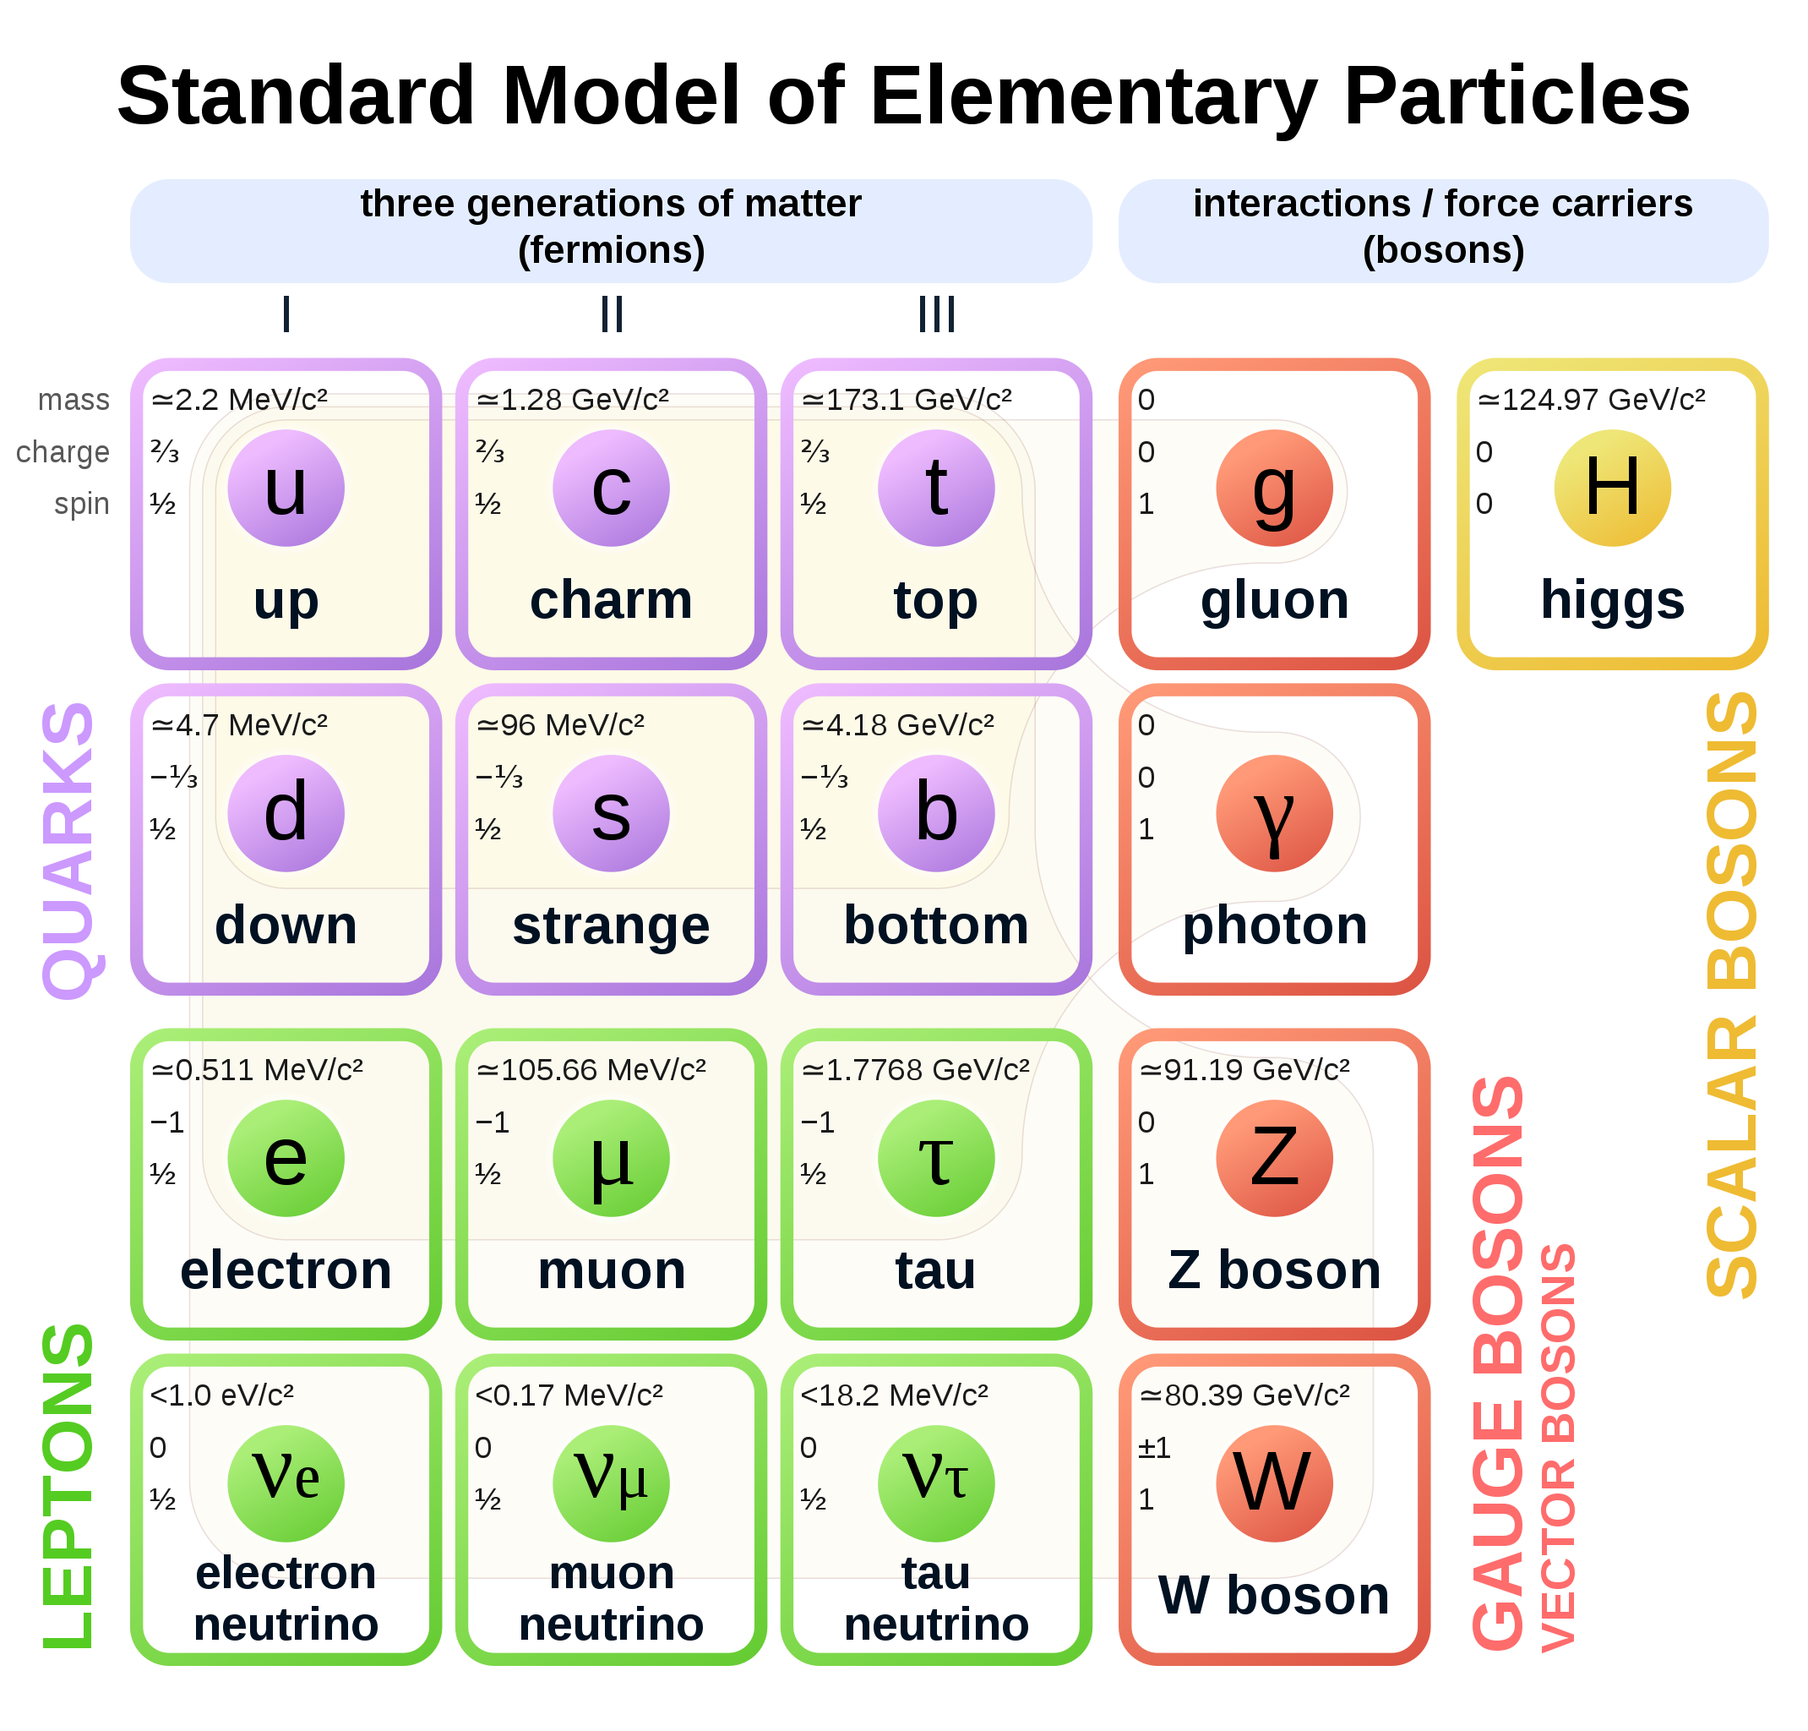
It’s all made of a handful of particles and forces
The sub-atomic structure of matter and its interactions is described by the Standard Model
In mathematical terms, particles are local excitations of quantum fields. There are matter fields (fermions) and force fields (bosons)
Completely new type of non-universal interactions, nothing to do with known forces
Spin 1/2
Spin 1
Spin 0

Slide 4
It’s all made of a handful of particles and forces
The sub-atomic structure of matter and its interactions is described by the Standard Model
Decades of international high-technology accelerator-based research gave us these insights
Completely new type of non-universal interactions, nothing to do with known forces
Spin 1/2
Spin 1
Spin 0

Slide 5
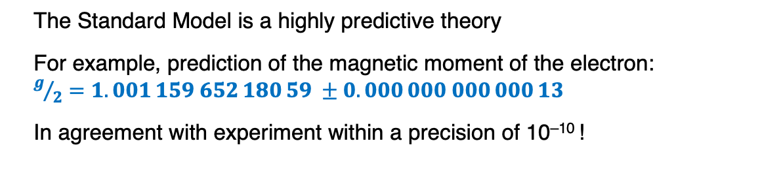
It’s all made of a handful of particles and forces
The sub-atomic structure of matter and its interactions is described by the Standard Model
The Standard Model is a highly predictive theory
For example, prediction of the magnetic moment of the electron: $g/2=1.001 159 652 180 59 ±0.000 000 000 000 13$
In agreement with experiment within a precision of 10^{–10} !
Mathematical structure of the Standard Model
Spin 1/2
Spin 1
Spin 0

Slide 6
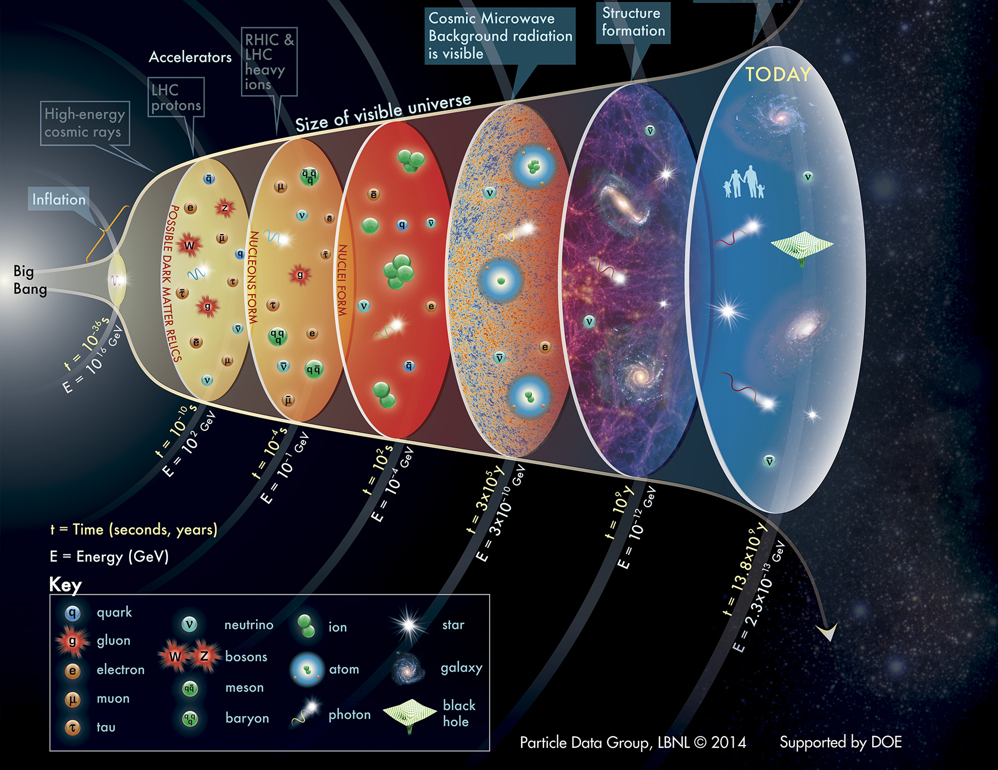
The Standard Model
… should not only work today, but also describe the history of the universe since the Big Bang 13.8 billion years ago
–12
T = 10¹⁵ K
T = 10¹² K
T = 10⁹ K
T = 4000 K
T = 60 K
T = 2.7 K

Slide 7
The Standard Model
… should not only work today, but also describe the history of the universe since the Big Bang 13.8 billion years ago
matter ~ antimatter
→ annihilation
(very little) matter
But why is there only matter left in the universe?
–12
T = 10¹⁵ K
T = 10¹² K
T = 10⁹ K
T = 4000 K
T = 60 K
T = 2.7 K

Slide 8
The Standard Model
… should not only work today, but also describe the history of the universe since the Big Bang 13.8 billion years ago
matter ~ antimatter
→ annihilation
(very little) matter
But why is there only matter left in the universe?
And what is the origin of the huge quantity of dark matter (5 times more than the baryonic matter)?
–12
invisible “dark” matter
T = 10¹⁵ K
T = 10¹² K
T = 10⁹ K
T = 4000 K
T = 60 K
T = 2.7 K

Slide 9
The Standard Model
… should not only work today, but also describe the history of the universe since the Big Bang 13.8 billion years ago
matter ~ antimatter
→ annihilation
(very little) matter
But why is there only matter left in the universe?
And what is the origin of the huge quantity of dark matter (5 times more than the baryonic matter)?
–12
invisible “dark” matter
T = 10¹⁵ K
T = 10¹² K
T = 10⁹ K
T = 4000 K
T = 60 K
And how do elementary particles obtain mass?
T = 2.7 K

Slide 10
The Standard Model
… should not only work today, but also describe the history of the universe since the Big Bang 13.8 billion years ago
matter ~ antimatter
→ annihilation
(very little) matter
But why is there only matter left in the universe?
And what is the origin of the huge quantity of dark matter (5 times more than the baryonic matter)?
–12
invisible “dark” matter
T = 10¹⁵ K
T = 10¹² K
T = 10⁹ K
T = 4000 K
T = 60 K
And how do elementary particles obtain mass?
T = 2.7 K
We do not know why the laws and parameters of physics are set in a way to permit complex chemistry and life

Slide 11
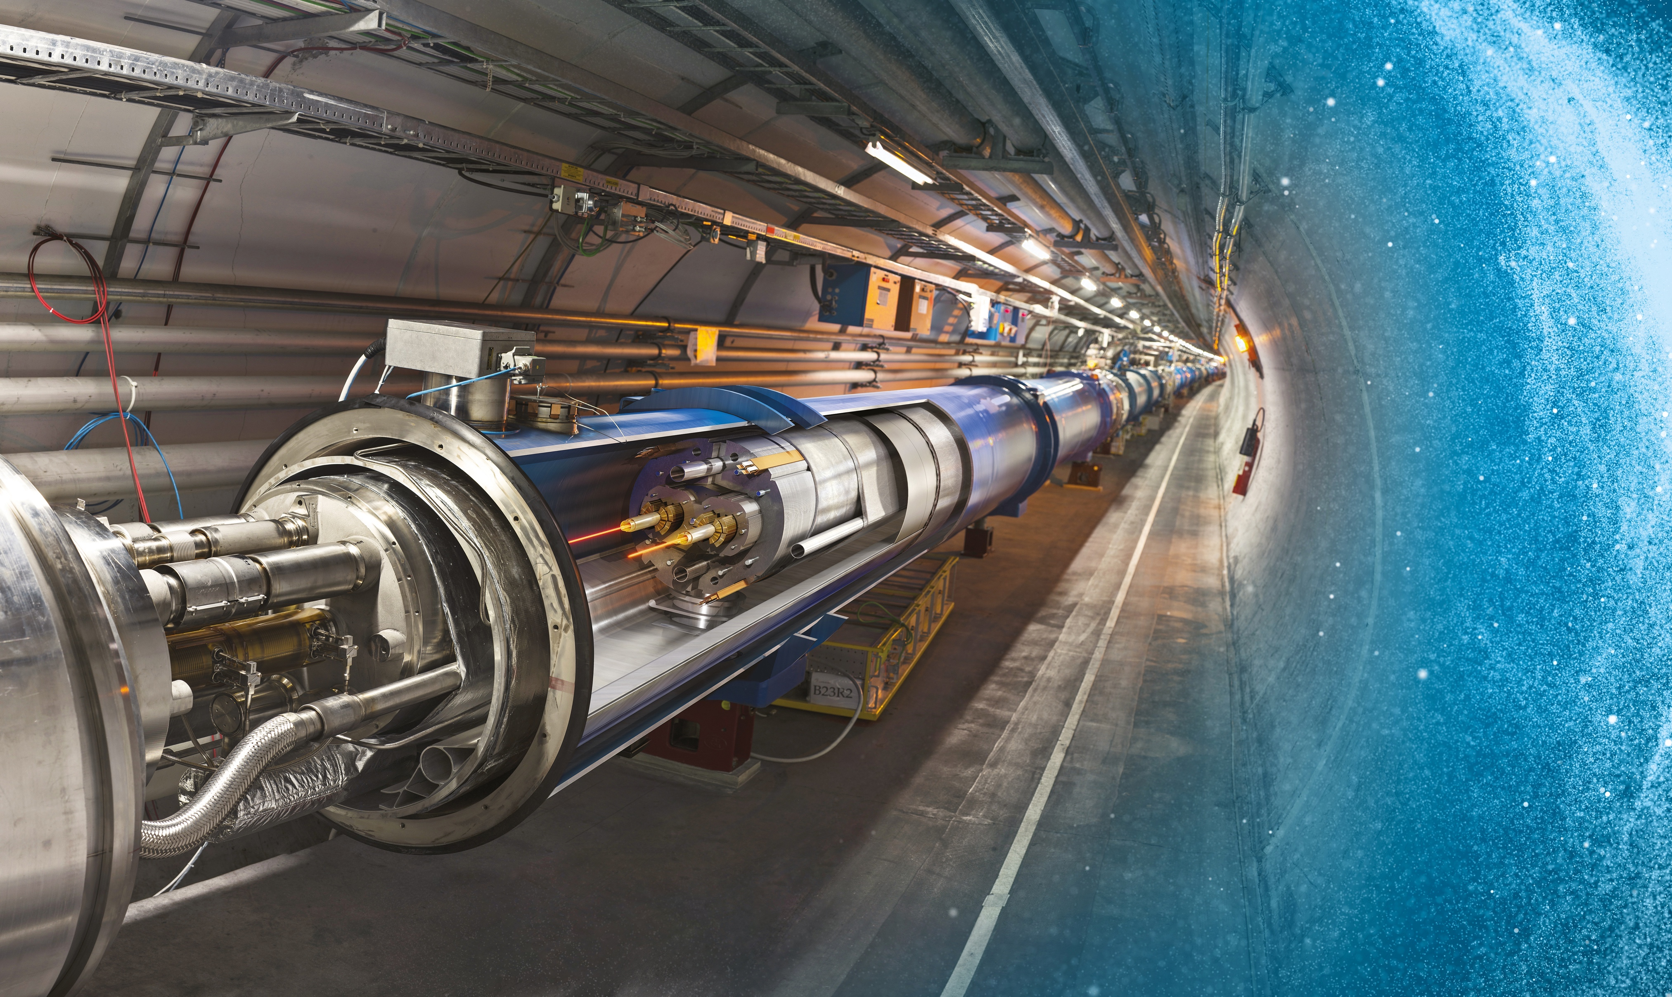
Exploring physics near the Big Bang requires a huge accelerator

Slide 12
Exploring physics near the Big Bang requires a huge accelerator
Large Hadron Collider (LHC)
27 km underground accelerator and collider
Superconducting magnets (1.9 K = –271.3 °C) steer the particles around the ring
Proton and ions are accelerated to multi-TeV scale energies before they collide

Slide 13
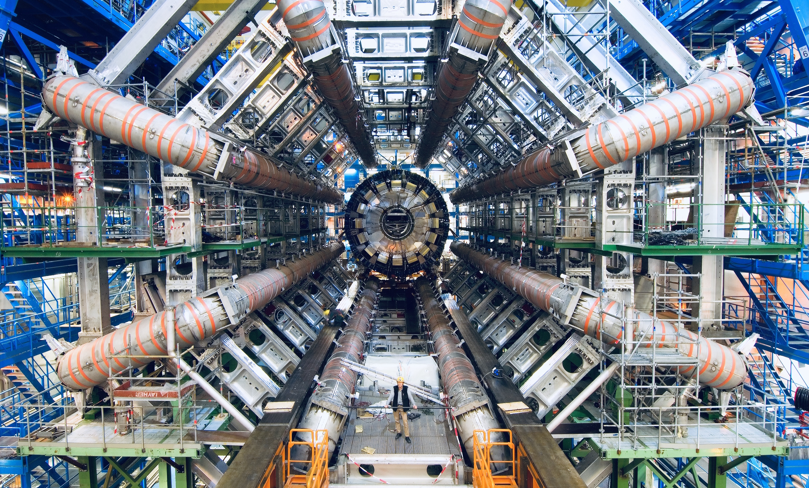
Exploring physics near the Big Bang requires a huge accelerator and gigantic particle detectors

Slide 14
Exploring physics near the Big Bang requires a huge accelerator and gigantic particle detectors
Making this possible rests on sustained and focused international collaboration

Slide 15
Exploring physics near the Big Bang requires a huge accelerator and gigantic particle detectors
And embracing collective authorship on publications
…
…
…
Observation of Higgs boson (2012), 17k citations
2932 authors in alphabetical order
250 institutes worldwide

Slide 16
Exploring physics near the Big Bang requires a huge accelerator and gigantic particle detectors
As well as a strong international hub for large-scale experiments: CERN

Slide 17


CERN — Science for peace
Objective: Creation of a powerful and competitive infrastructure for fundamental research in nuclear / particle physics in Europe
1952: Creation of a Council: "Conseil Européen pour la Recherche Nucléaire“ (CERN)
  Belgium, Denmark, France, West Germany, Greece, Italy, The Netherlands, Norway, Sweden, Switzerland, United Kingdom, Yugoslavia
Coming into force of the convention on 29 September 1954: Foundation as "Organisation Européenne pour la Recherche Nucléaire“
“Panorama” photograph taken around 1954 of the site that would become the CERN laboratory
Find more on CERN’s history here: https://timeline.web.cern.ch/timeline-header/89

Slide 18
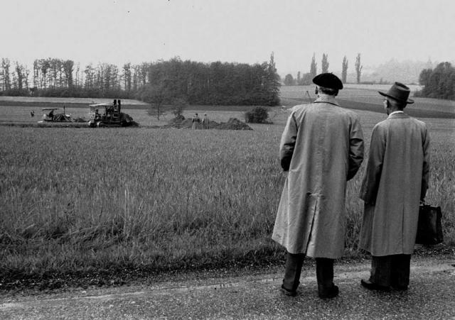
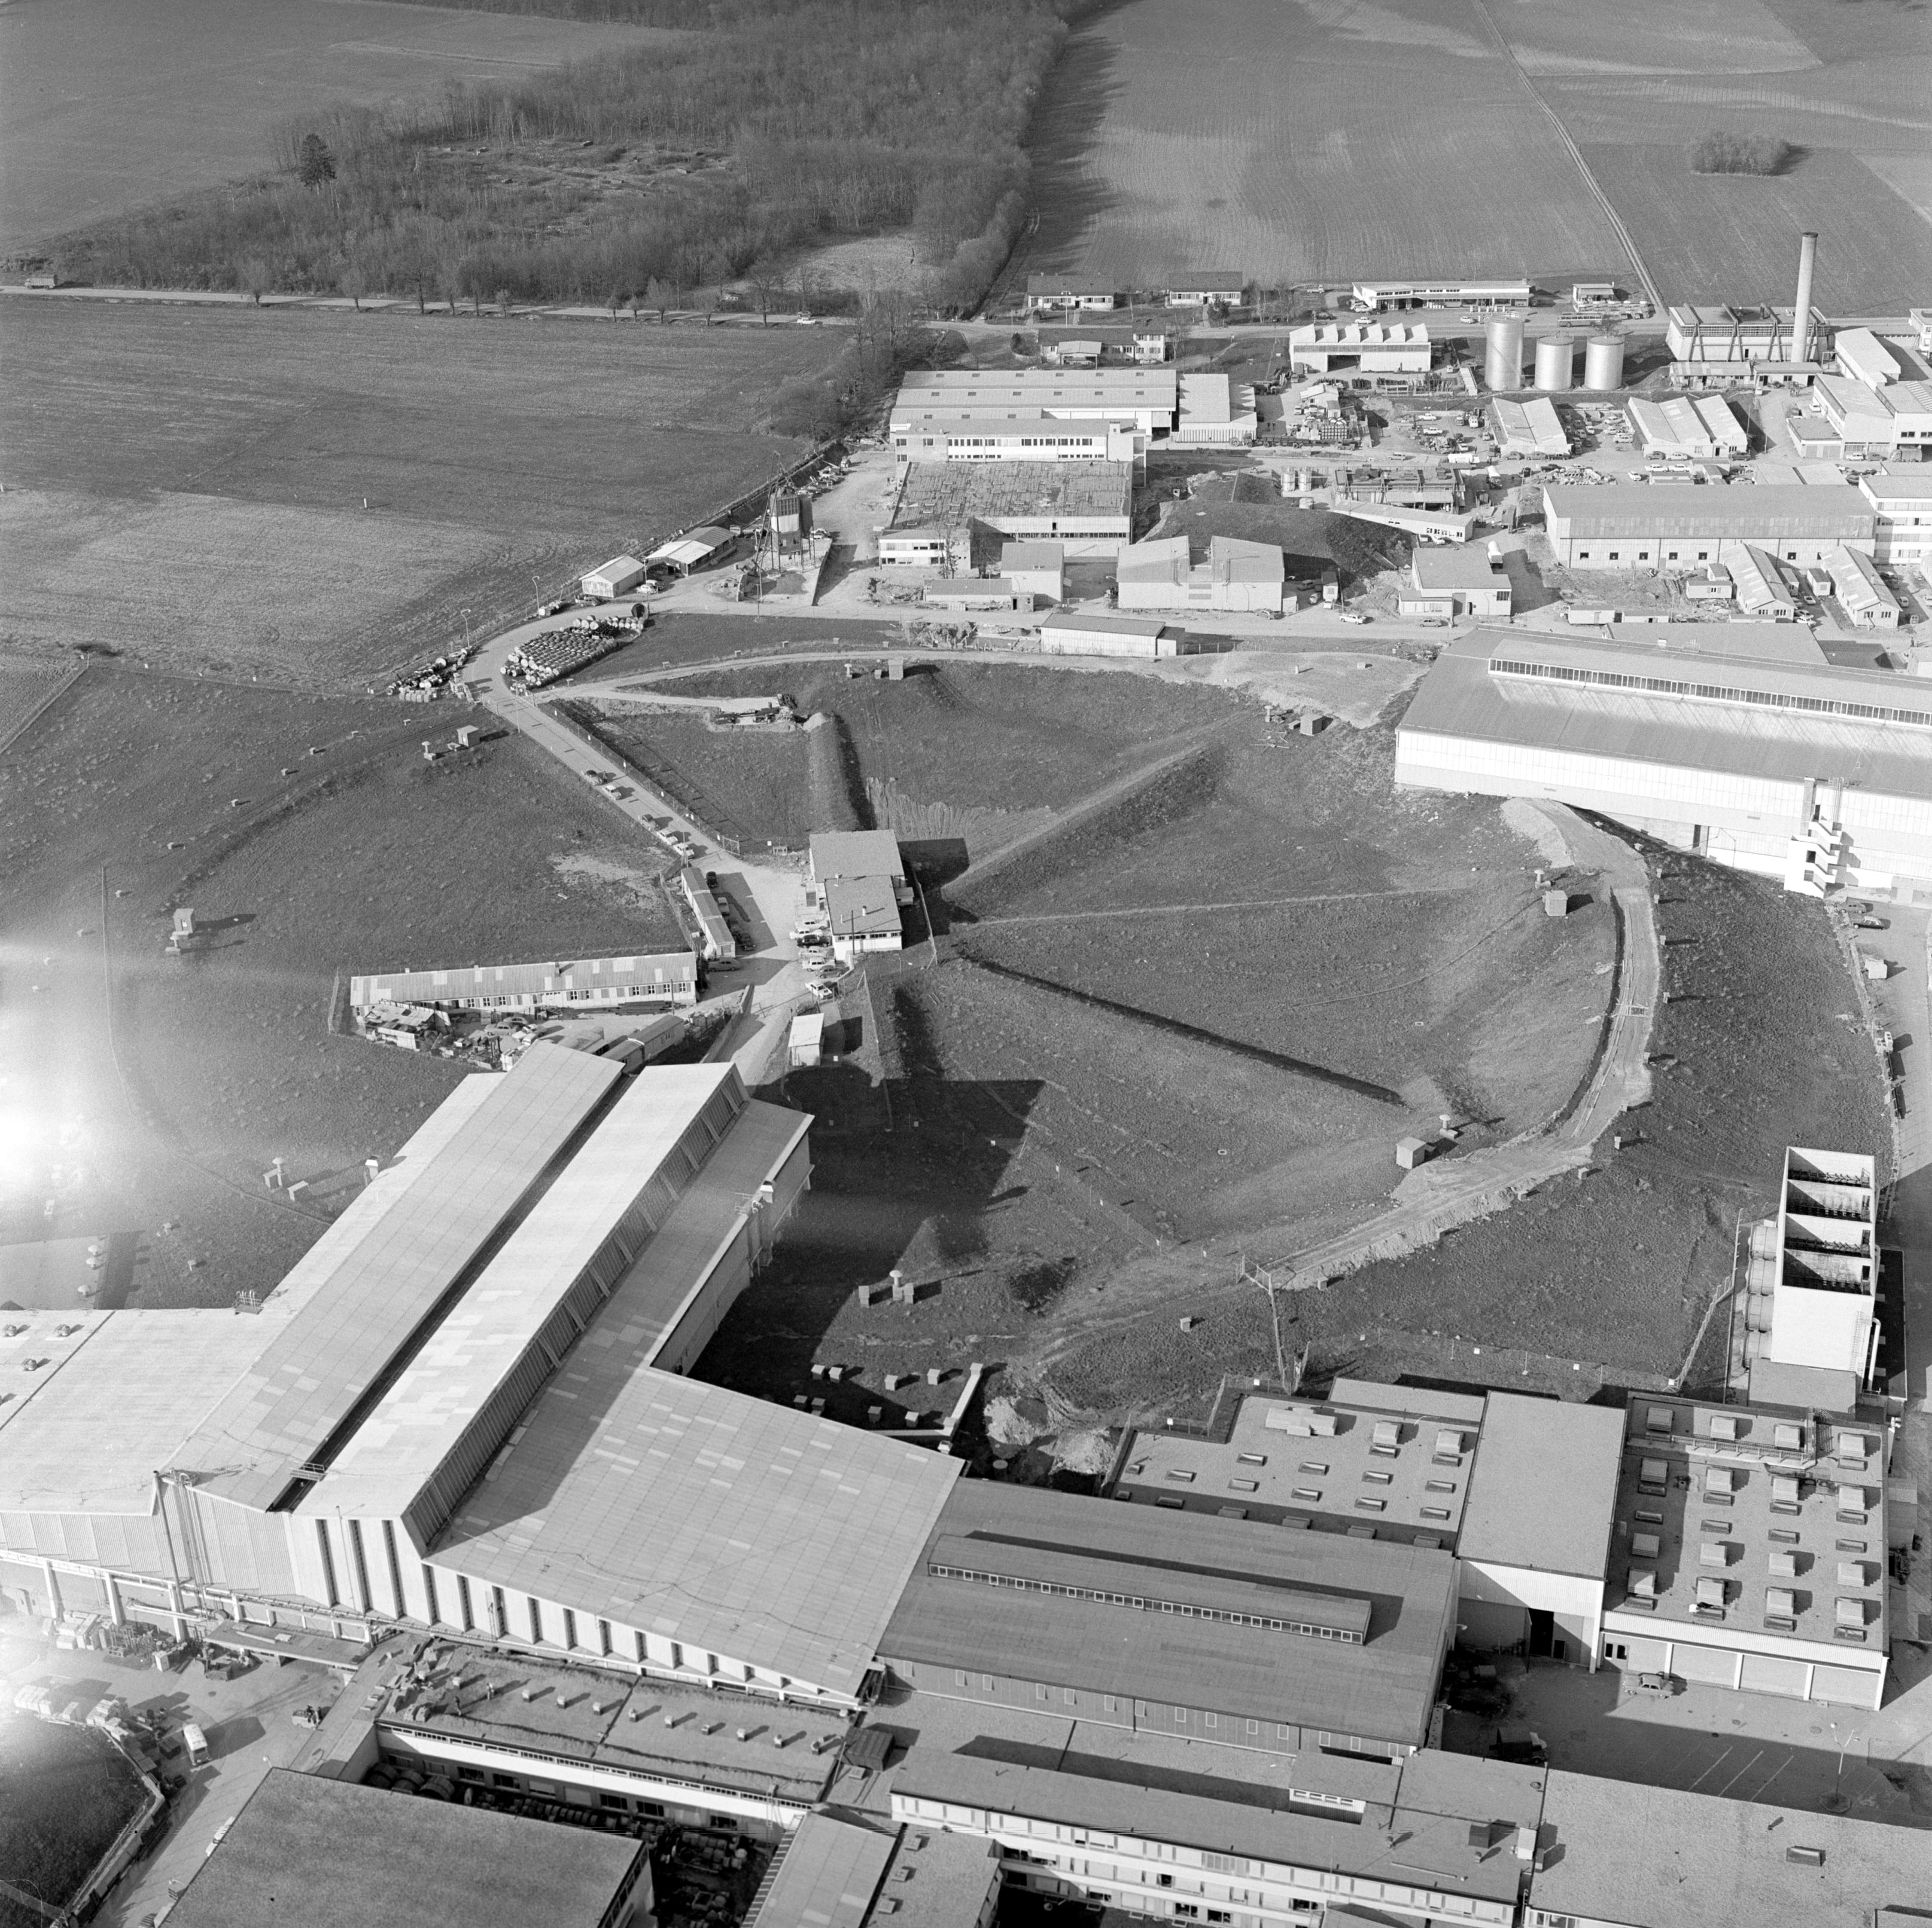
On 17 May 1954, the first shovel of earth was dug on the Meyrin site in Switzerland under the eyes of Geneva officials and members of CERN staff
Aerial view of the 25 GeV Protron Synchrotron at CERN in 1965

Slide 19
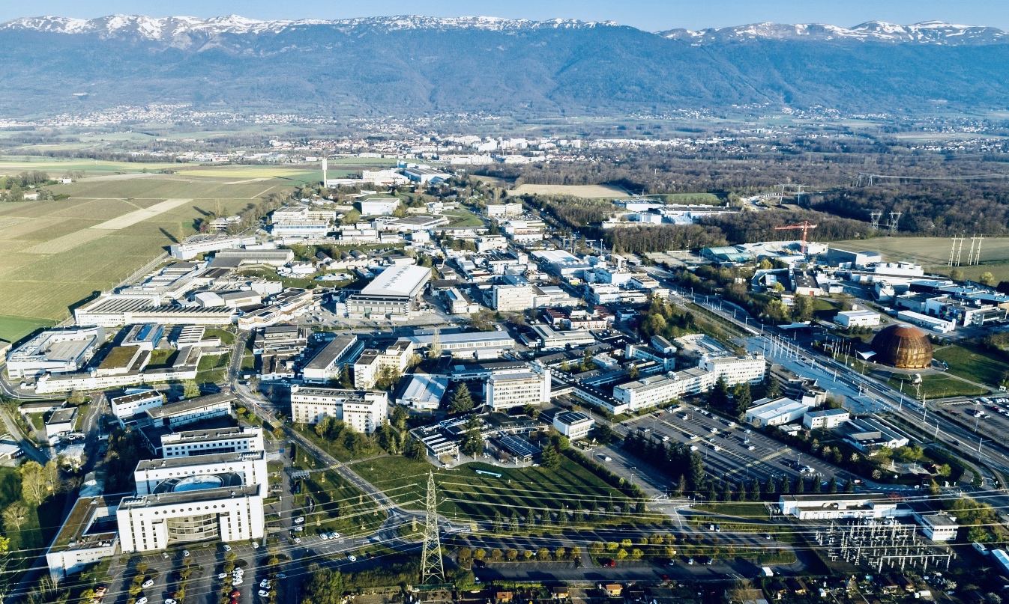
CERN today

Slide 20
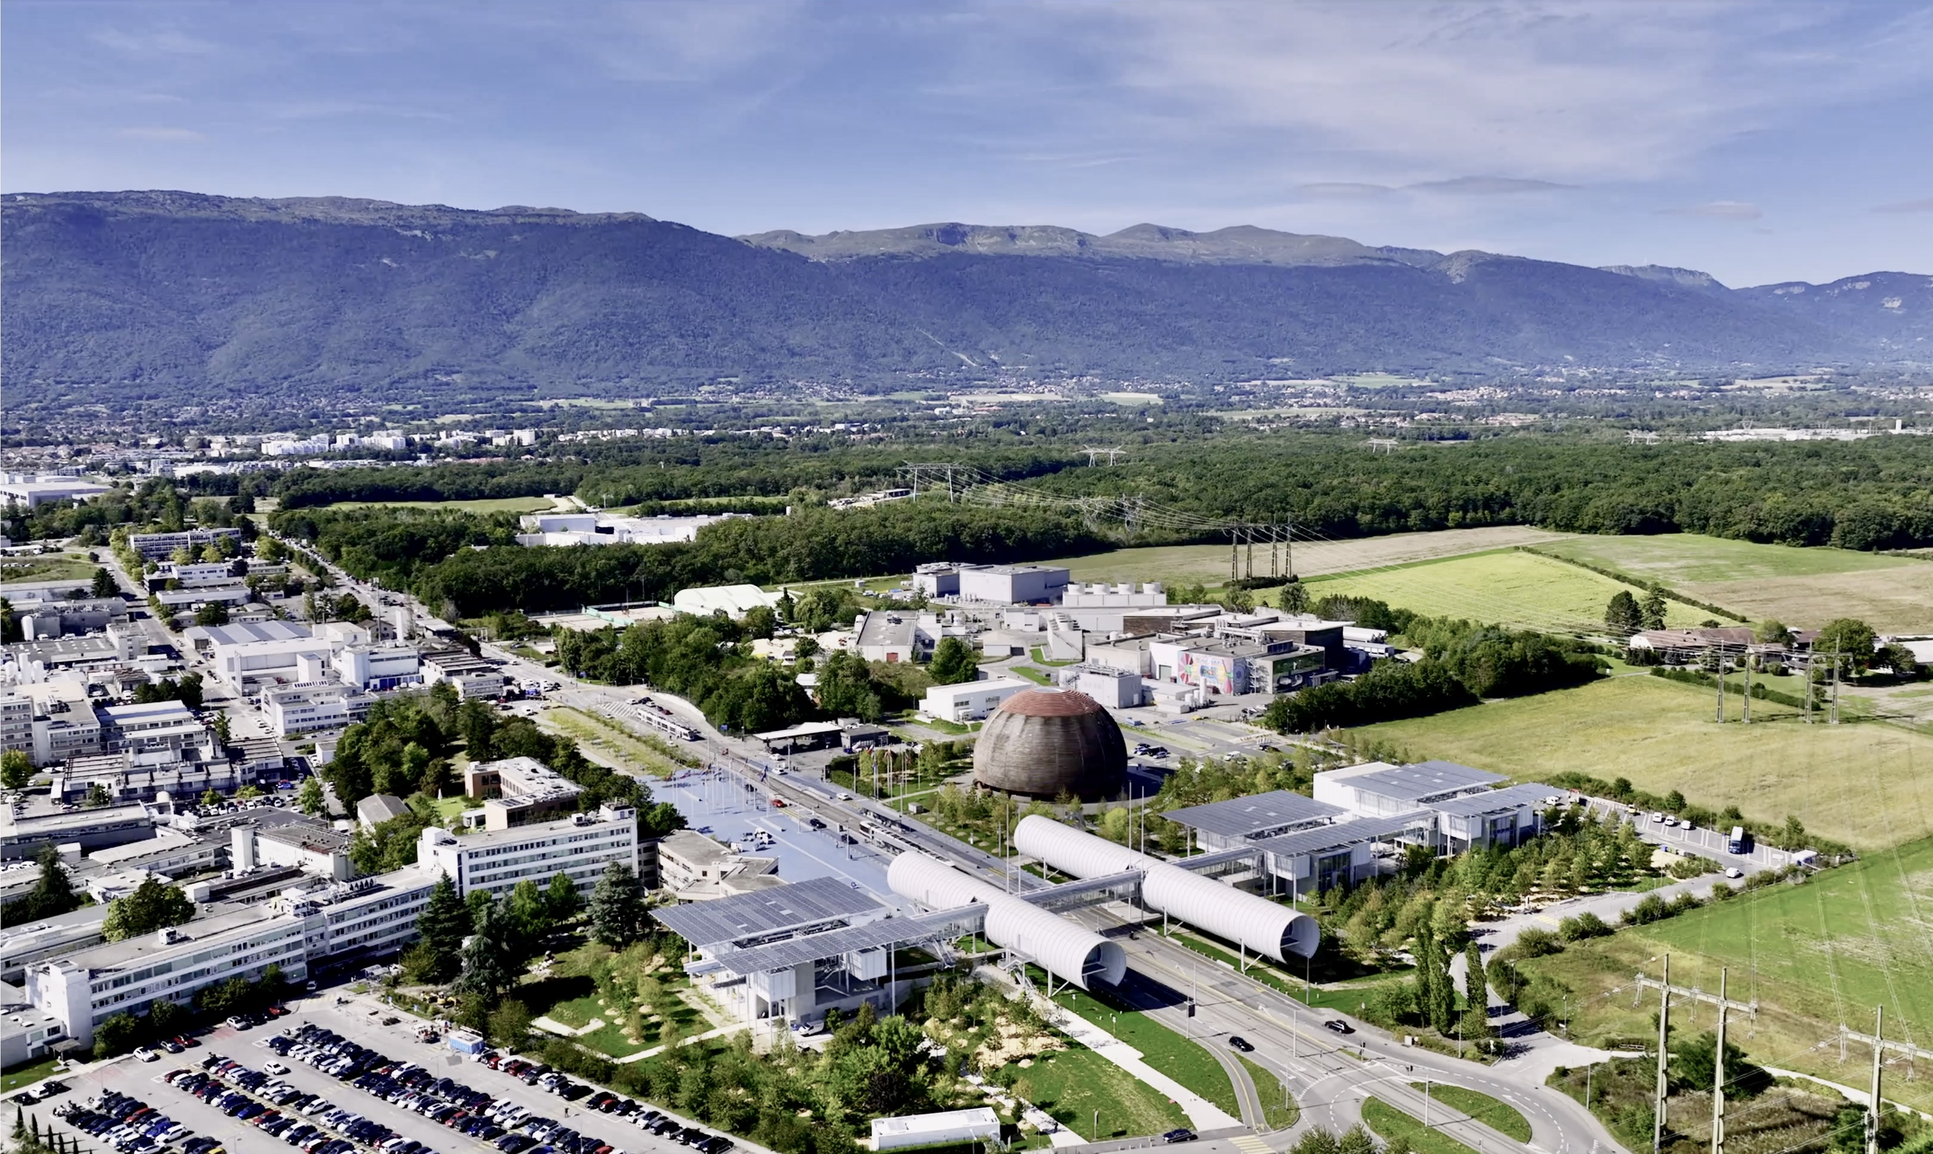
CERN today
ATLAS Experiment

Slide 21

CERN today — the world’s largest centre for particle physics
25 Member States
Austria – Belgium – Bulgaria – Czech Republic
Denmark – Estonia – Finland – France – Germany Greece – Hungary – Israel – Italy – Netherlands Norway – Poland – Portugal – Romania – Serbia Slovakia – Slovenia – Spain – Sweden – Switzerland United Kingdom
CERN – Science for Peace
10 Associate Member States
Brazil – Croatia – Cyprus – India – Ireland – Latvia Lithuania – Pakistan – Türkiye – Ukraine
6 Observers
Japan – JINR (suspended) – USA
European Union – UNESCO
As of 31 December 2023
Employees:
2,666 staff, 1,002 graduates
Associates:
12,370 users, 1,513 others
Around 50 Cooperation Agreements with non-Member States and Territories
Albania – Algeria – Argentina – Armenia – Australia – Azerbaijan – Bangladesh – Belarus – Bolivia
Bosnia and Herzegovina – Brazil – Canada – Chile – Colombia – Costa Rica – Ecuador – Egypt – Georgia – Iceland
Iran – Jordan – Kazakhstan – Latvia – Lebanon – Malta – Mexico – Mongolia – Montenegro – Morocco – Nepal
New Zealand – North Macedonia – Palestine – Paraguay – People's Republic of China – Peru – Philippines – Qatar
Republic of Korea – Saudi Arabia – Sri Lanka – South Africa – Thailand – Tunisia – United Arab Emirates – Vietnam
Very successful: CERN
Summer Student
Programme, open to Non-
Member States

Slide 22
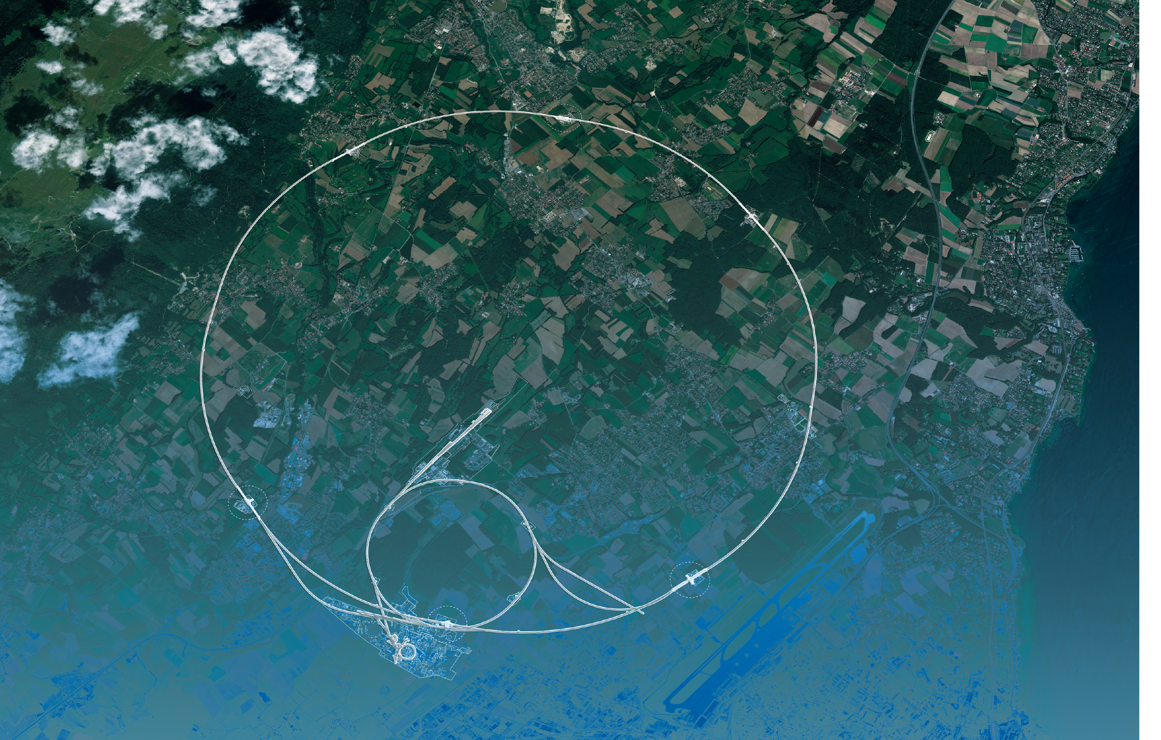
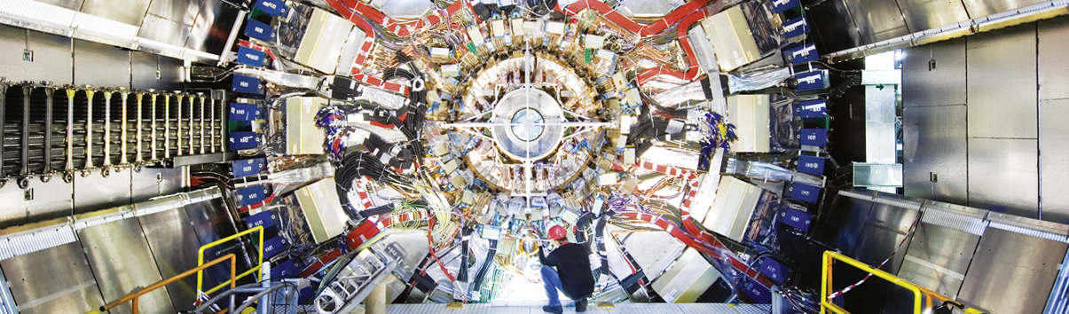
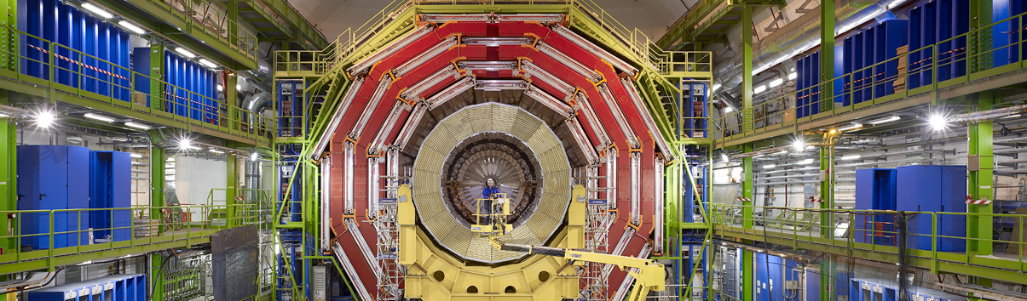
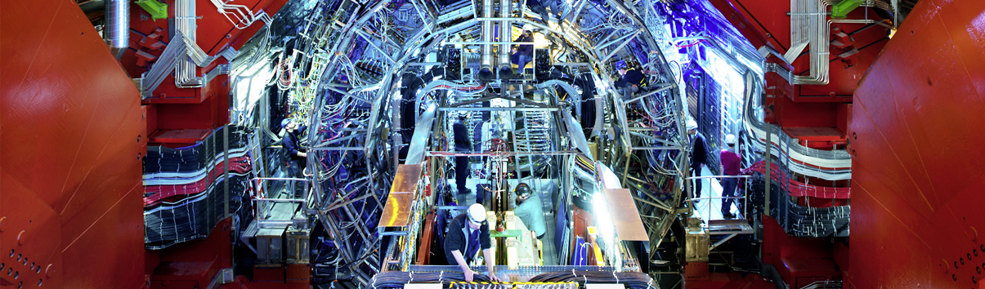
LHC and Detectors
CMS
ATLAS
LHC
CMS
ALICE
SPS
ALICE
ATLAS
LHCb
LHCb
PS
Aerial view
Presentation

Slide 23
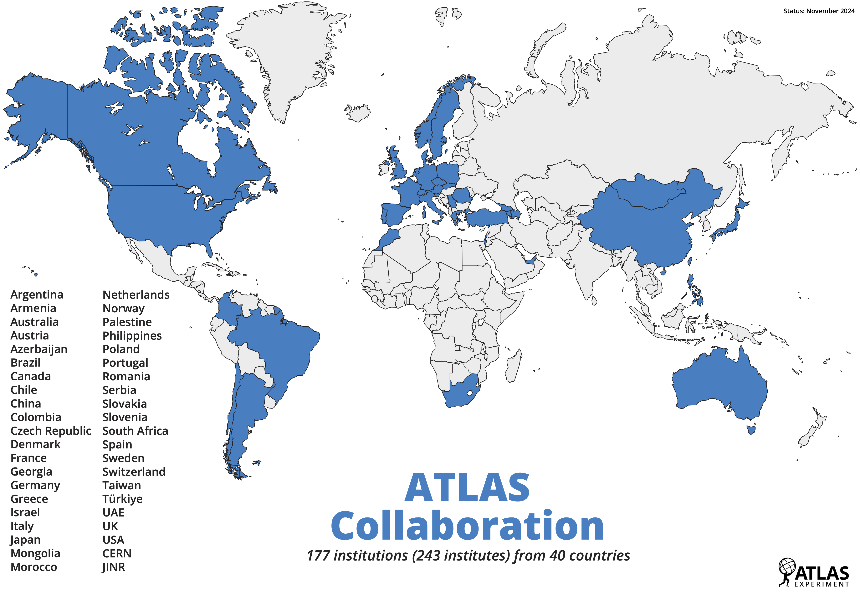

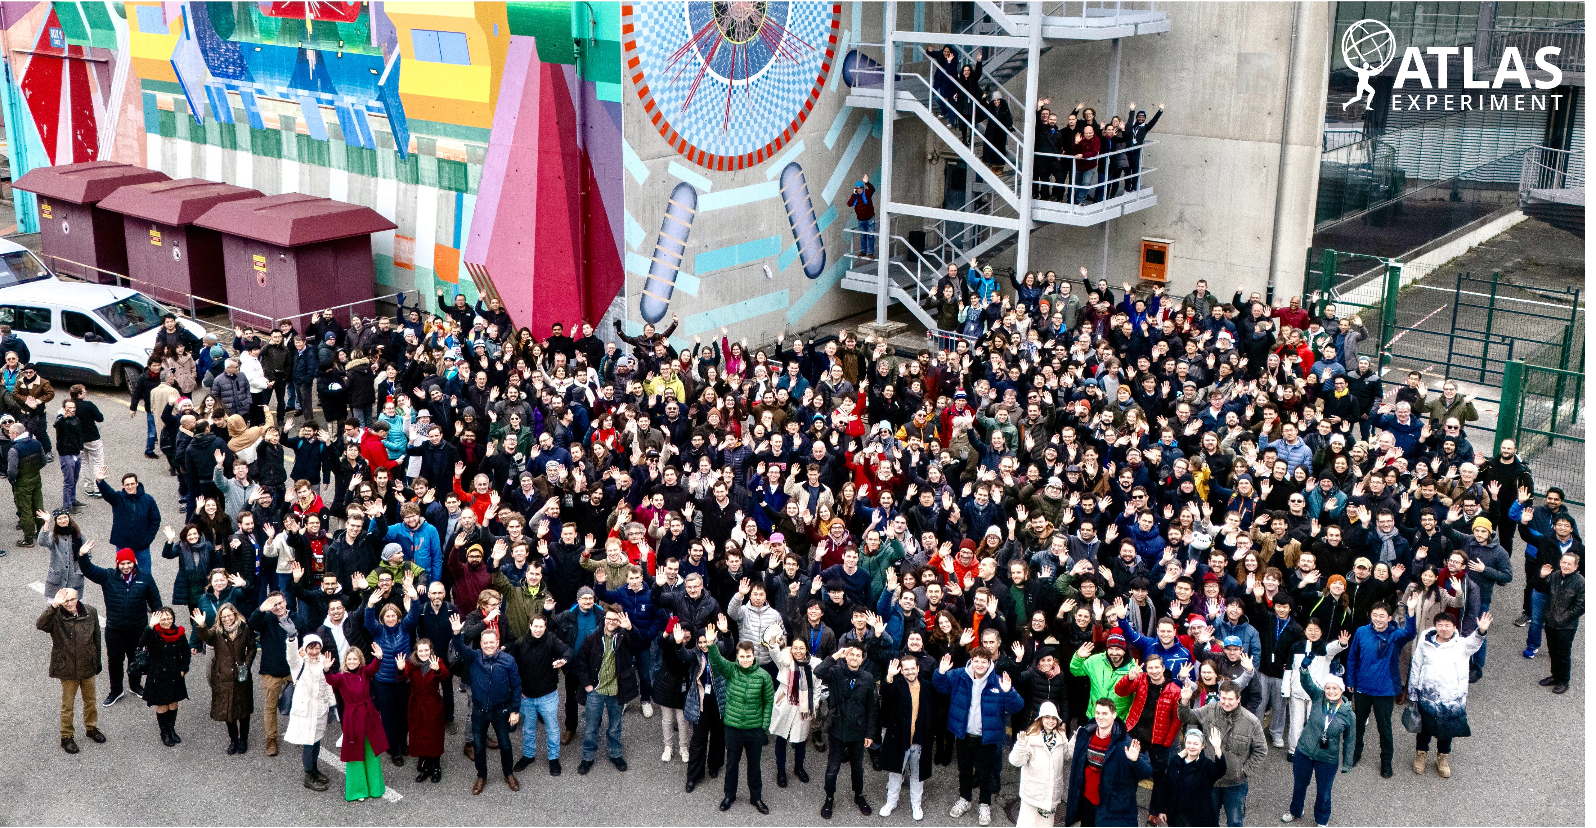
248 Institutes from 41 countries (>100 nationalities)
2900 scientific authors
1200 physics PhD students
1300 engineers and technicians
6000 members
177 institutions (248 institutes) from 41 countries
Try the intereactive ATLAS map: https://atlaspo.cern.ch/public/ATLASMap/

Slide 24
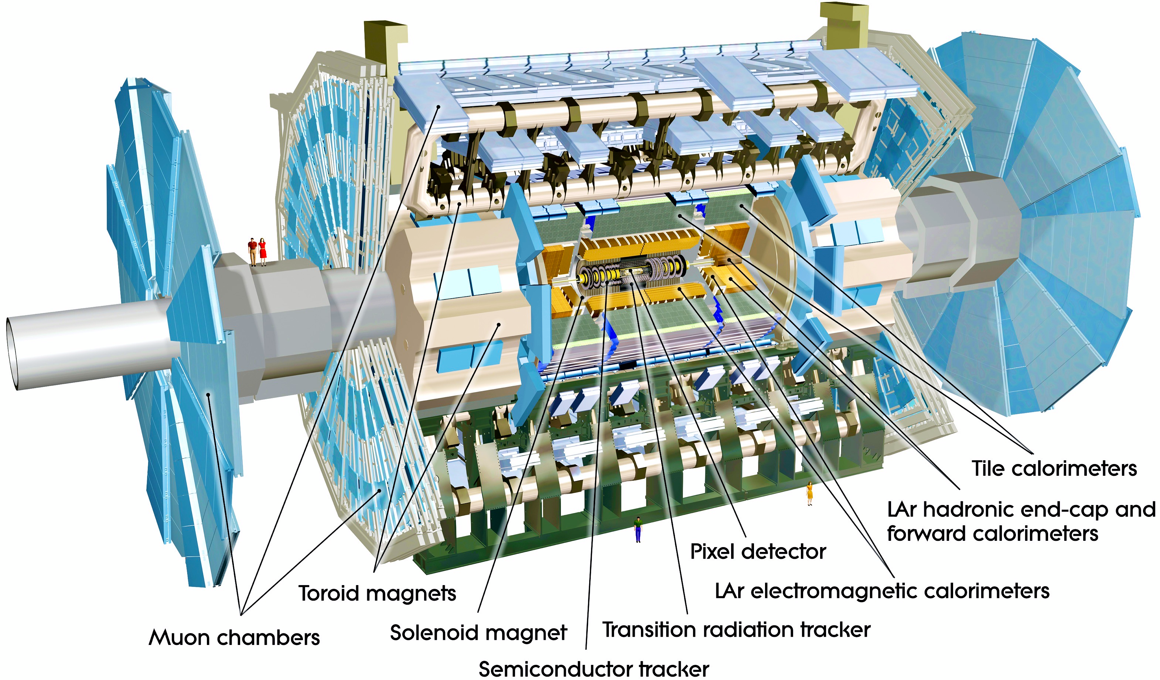
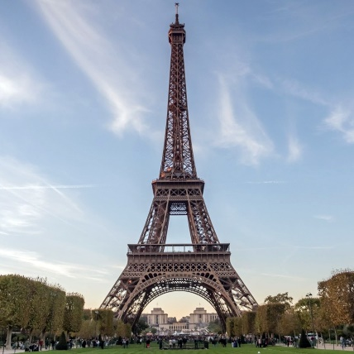
The ATLAS Detector
Axial field provided by solenoid
(2 T) in central region (momentum measurement)
High resolution silicon detectors:
100 Mio. channels (50 µm x 250 µm)
6 Mio. channels (80 µm x 12 cm)
spatial resolution ~15 µm (in azimuthal direction)
Energy measurement down to 1º to the beam line with a calorimeter system
Independent muon spectrometer (superconducting toroidal magnet system)
Ultra-fast custom electronics and high-performance computers filter the collisions: only 1 out of 20,000 collisions is kept
25 m diameter, 44 m long, 7000 tons weight ~

Slide 25
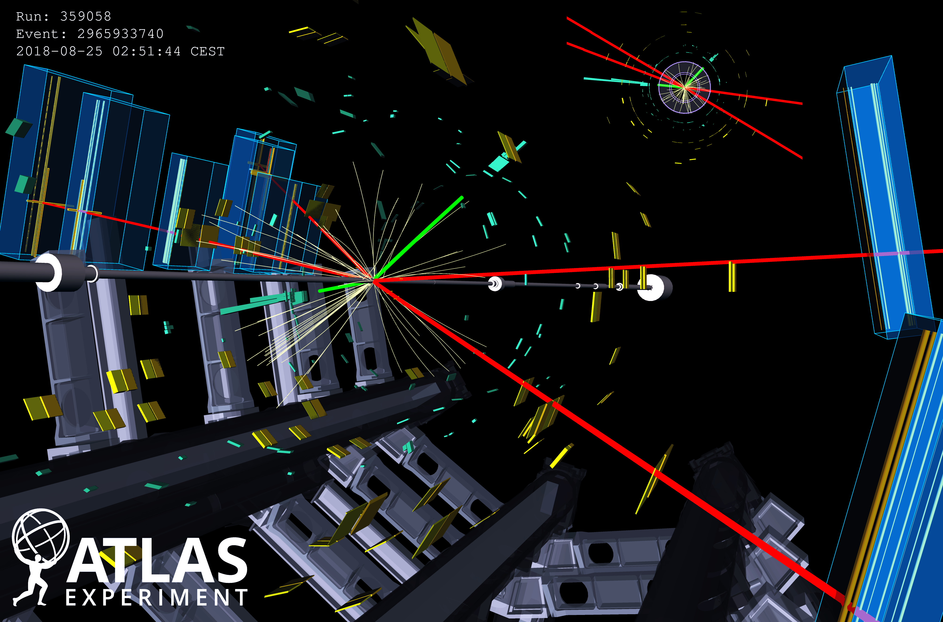
A Higgs boson to 2e2µ plus a Z boson to 2µ candidate event

Slide 26
Eur. Phys. J. C 80 (2020) 942
The Higgs boson

Slide 27
Particle reconstruction / tagging — eldorado for modern ML
Neural networks have been used in particle physics since the 1990s; boosted decision trees since the 2000s
GNNs with Transformers are currently among the most performing ML algorithms (but much smaller than LLMs)
Illustration of ALTAS GN2 quark tagging algorithm [arXiv:2505.19689]
3. A Transformer (attention network) followed by a network produce track representations that incorporate information from other tracks inside the jet
2. Combined GNN feature vectors are fed into a per-track initialisation network
1. Jet features are copied for each track associated with the jet
4. Jet representation and output track embeddings are inputs to three task-specific networks
Jet/track features → Per-track embeddings → Transformer builds context across tracks → 3 heads deliver (i) jet flavour, (ii) track origins, and (iii) explicit displaced-vertex structure

Slide 28

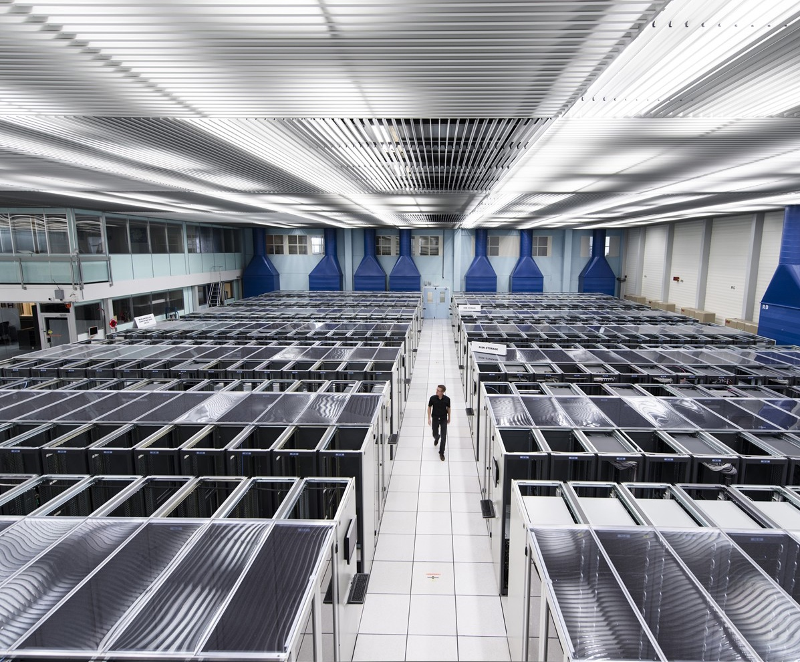
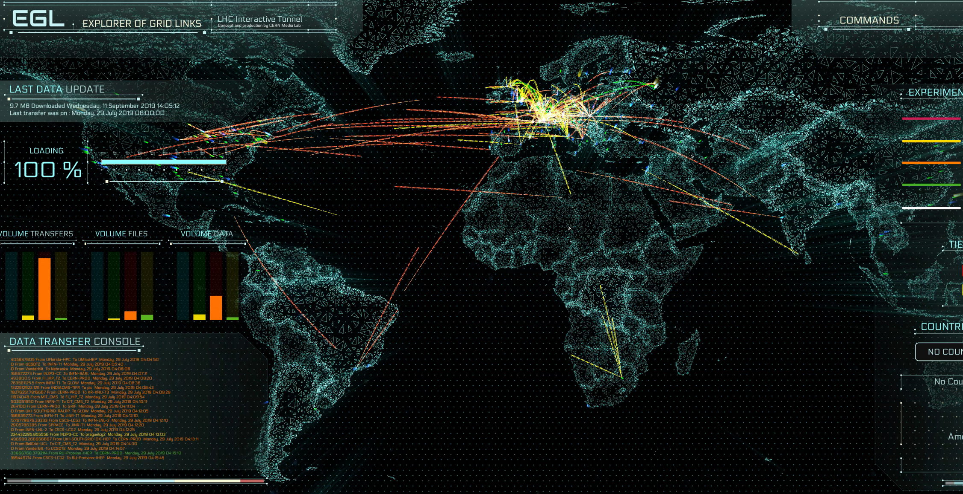

The Worldwide LHC Computing Grid (WLCG)
WLCG stores, distributes, processes and analyses LHC experiments’ data
1.4 million processing cores in 170 data centres and more than 40 countries
> 2000 Petabytes (2 Exabytes) of LHC data stored worldwide

Slide 29
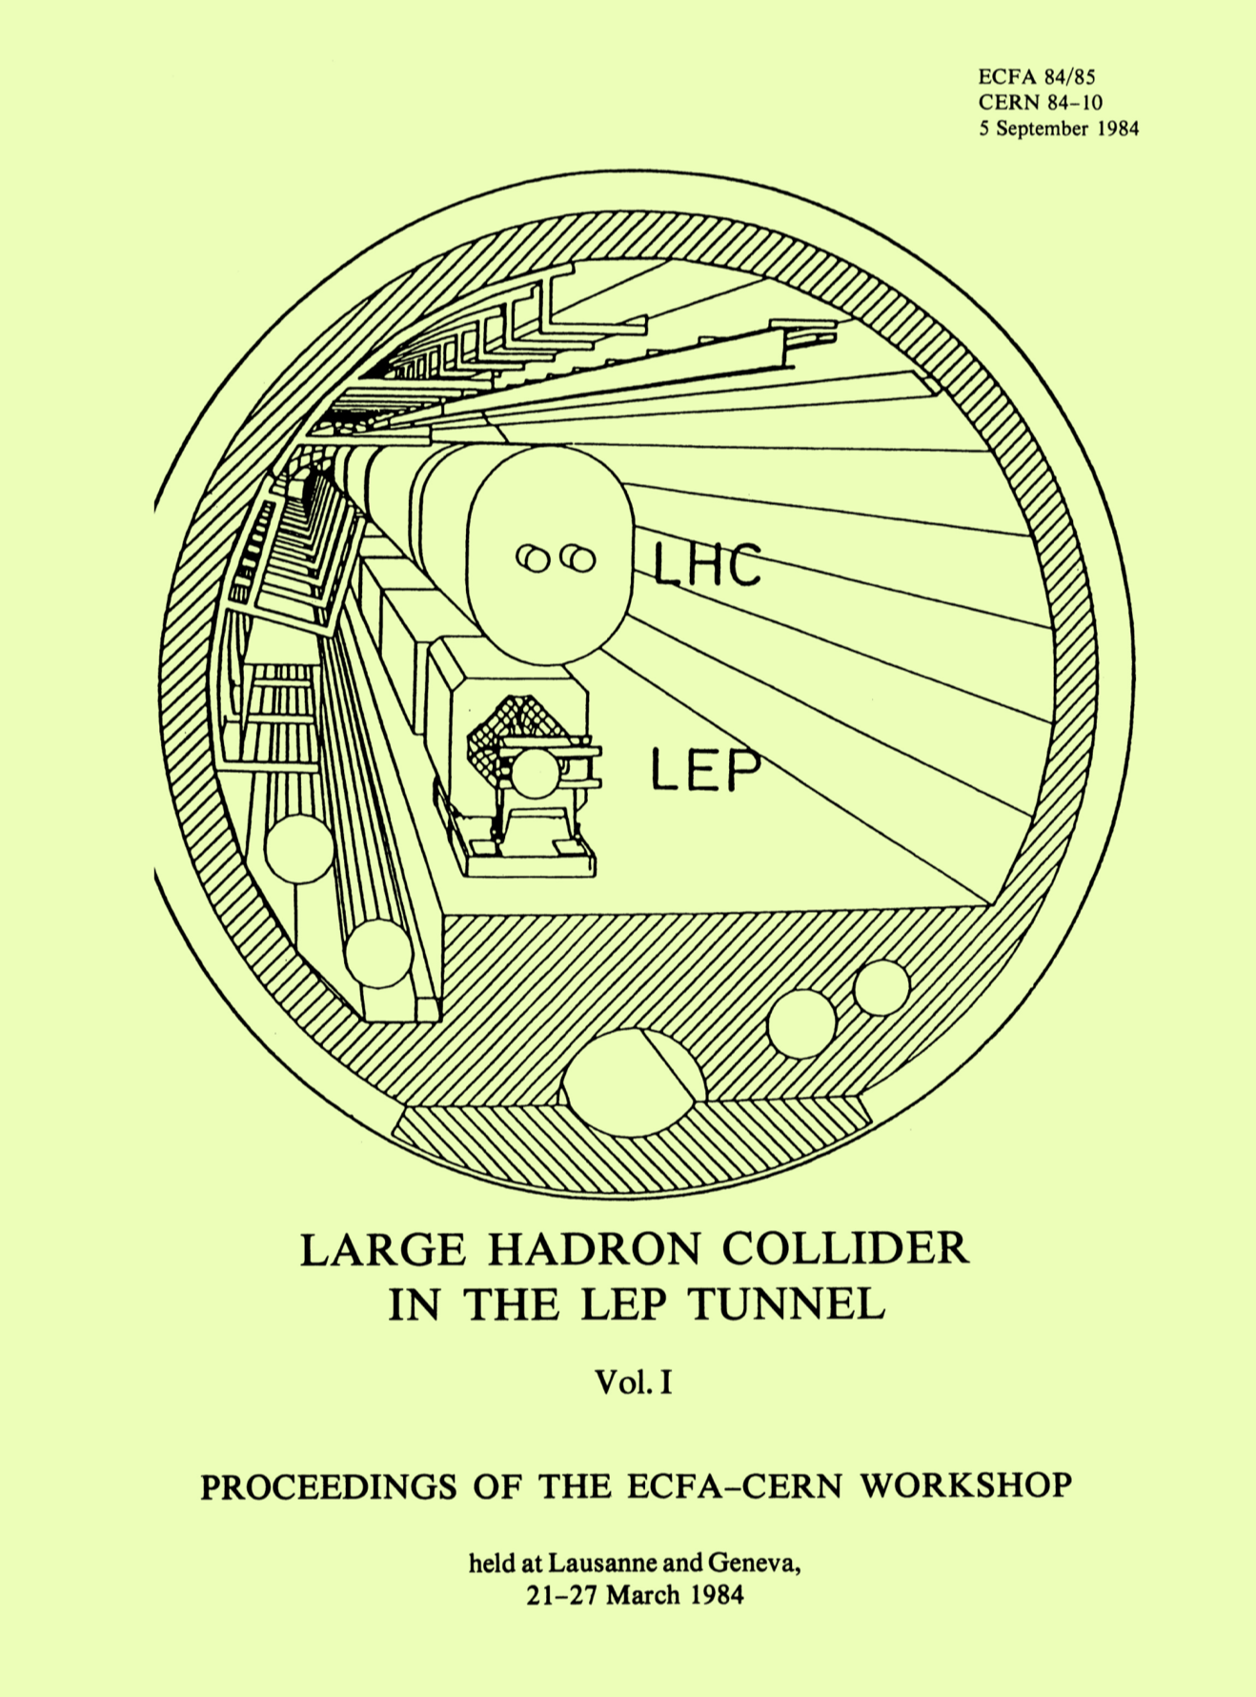
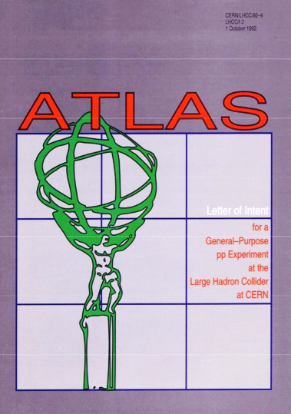
Brief history of ATLAS and the LHC
1984: For the community it all started with the CERN-ECFA Workshop in Lausanne on the feasibility of a hadron collider in the future LEP tunnel
1990: Large Hadron Collider Workshop Aachen (CERN-ECFA)
1992: ATLAS Letter of Intent (official birth of ATLAS)

Slide 30


Brief history of ATLAS and the LHC
1984: For the community it all started with the CERN-ECFA Workshop in Lausanne on the feasibility of a hadron collider in the future LEP tunnel
1990: Large Hadron Collider Workshop Aachen (CERN-ECFA)
1992: ATLAS Letter of Intent (official birth of ATLAS)
1994: ATLAS Technical Proposal, followed by series of Technical Design Reports
1997: Formal approval of ATLAS Construction
2008: Start of LHC Operation
Google doodle on 10 September 2008 to celebrate LHC startup

Slide 31
Following slides discuss:
Pathway of large particle physics experiments
Governance and oversight
Collaboration organisation
Keys to success
Challenges and pitfalls
General lessons

Slide 32
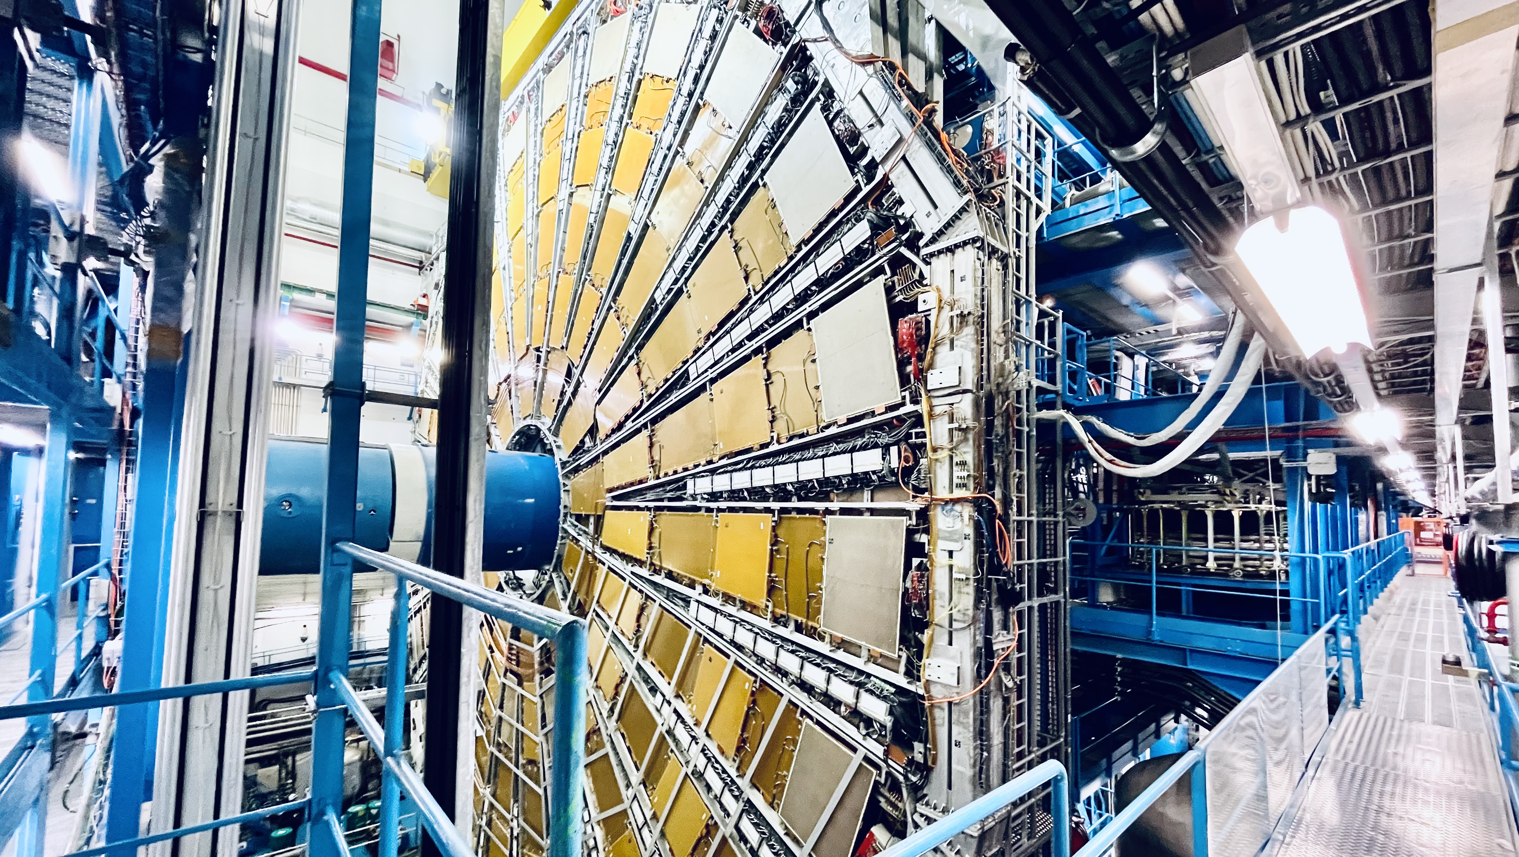
Pathway of large particle physics experiments
Large particle-physics collaborations form bottom-up, evolving from informal discussions through workshops, simulations, and R&D into a formal collaboration defined by an LoI and TDR and approved by governing bodies and funding agencies. Following approval, MoUs establish responsibilities and deliverables, leading to construction, commissioning, and the transition to long-term experimental operation and exploitation

Slide 33
Pathway of large particle physics experiments
Historically, particle physics collaborations form “bottom-up” …
Initial scientific and technical convergence At the outset of a major project (e.g. the LHC), small groups of colleagues from different institutes — motivated by physics goals and/or detector technologies — begin informal discussions and concept development
Community building and concept maturation Workshops are organised to present ideas, compare approaches, and explore detector and physics concepts. Informal proto-collaborations emerge and grow organically
Early studies with limited resources At this stage, there is usually no dedicated project funding. Researchers rely on existing grants, institutional support, or small R&D funds to pursue feasibility studies
Physics and detector simulations Simulation studies are carried out to establish the scientific case, evaluate performance, and optimise detector layouts and subsystem designs
Targeted R&D and prototyping R&D proposals are submitted, leading to the construction of small-scale prototypes that are tested in laboratories and test beams to validate technologies
Letter of Intent (LoI) The collaboration formally crystallises with the submission of an LoI, marking its official beginning. While not all technologies are finalised, major design directions are established. A governance structure is defined (see later)
Technical Design Report (TDR) A TDR is produced, detailing the final detector design, technology choices (this may be painful), performance, cost estimates, schedules, organisational structure, and risk mitigation
Review and approval The TDR is submitted to the project’s governing bodies and funding agencies for technical and scientific review and approval

Slide 34
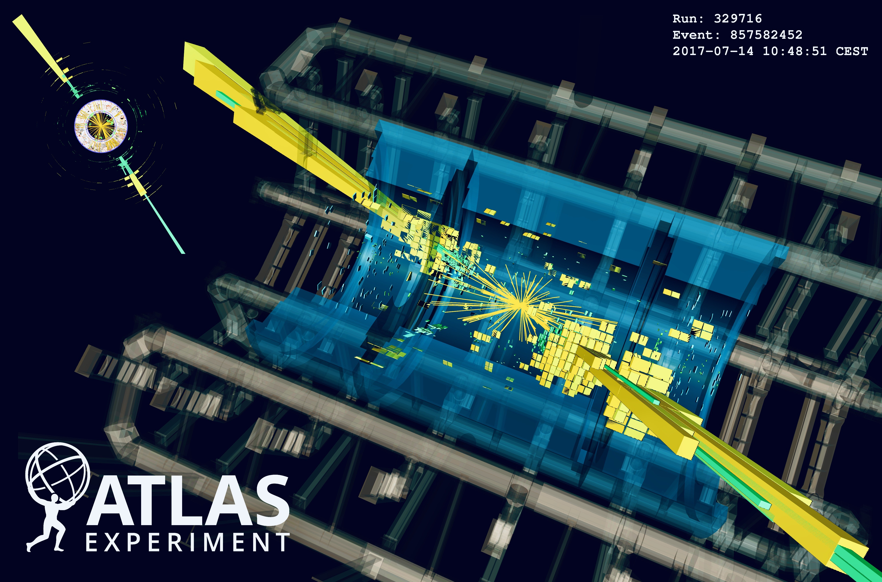
Pathway of large particle physics experiments
Formal commitments and construction phase Following approval, Memoranda of Understanding (MoUs) are signed, defining institutional responsibilities, funding commitments, and deliverables. Large-scale construction, integration, and installation begin
Commissioning and transition to operation The collaboration evolves from a construction project into an operational experiment, with increasing emphasis on detector commissioning, data taking, physics analysis, and long-term governance

Slide 35
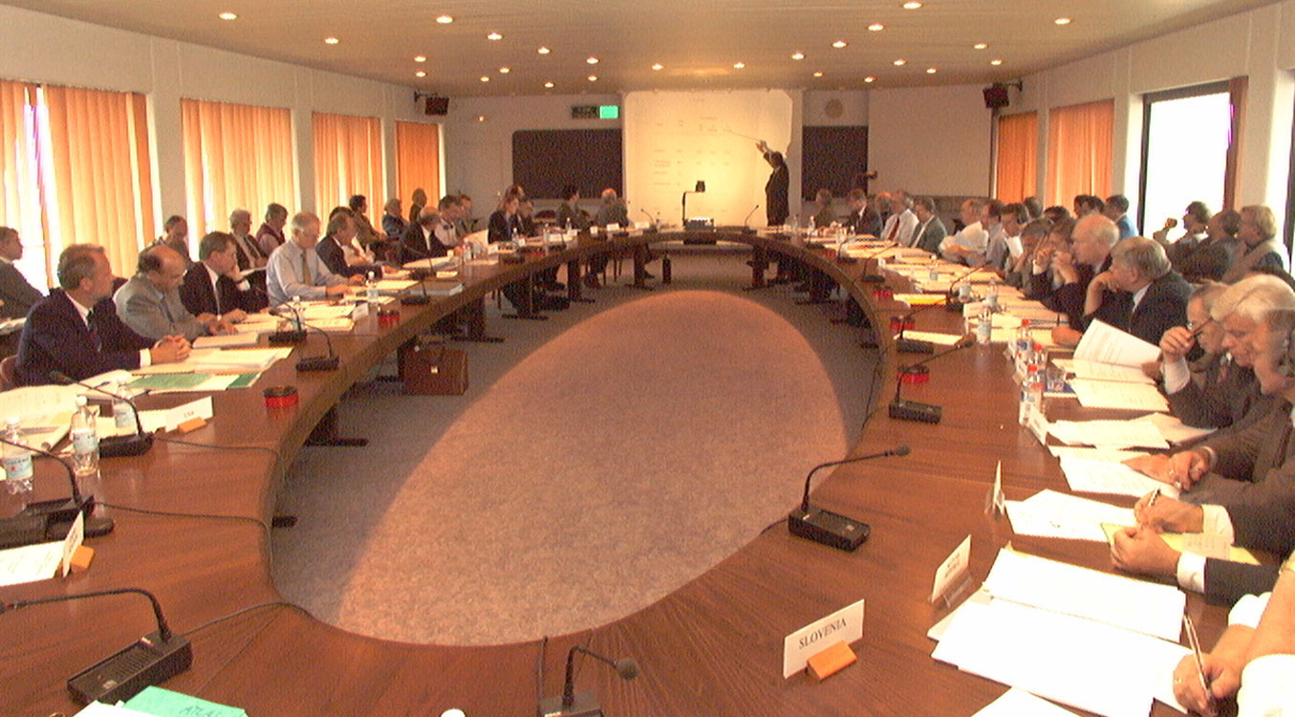
ATLAS Resources Review Board meeting at CERN in the 1990s

Slide 36
Pathway of large particle physics experiments
Governance and oversight
Large particle-physics experiments combine exceptional technological complexity with international collaboration, requiring robust management, review, and approval structures. At CERN, projects are supported by a stable host-laboratory framework, governed through coordinated national and international oversight, internal project management, independent technical reviews, and a deliverables-based funding model supervised by the Resources Review Board
Large particle-physics collaborations form bottom-up, evolving from informal discussions through workshops, simulations, and R&D into a formal collaboration defined by an LoI and TDR and approved by governing bodies and funding agencies. Following approval, MoUs establish responsibilities and deliverables, leading to construction, commissioning, and the transition to long-term experimental operation
ATLAS Resources Review Board meeting at CERN in the 1990s

Slide 37
Governance and oversight of large particle physics experiments
The scale of particle physics experiments requires robust management, review, and approval procedures
Technological scale and complexity Particle-physics experiments are exceptionally complex and expensive, requiring the development of custom detector, electronics, and computing technologies
Role of CERN as host laboratory CERN-based experiments benefit from a stable institutional framework, well-defined procedures, and decades of experience in R&D, construction, and operation of large-scale projects — an essential ingredient for their success
International collaboration and national funding Experiments are conducted by international collaborations supported by national funding agencies with their own review processes, requiring coordinated national and international approvals
Project approval and oversight Large experiments are approved by CERN management (strategic projects like the LHC also by the CERN Council), often following extensive technical, scientific, and financial reviews involving the funding agencies
Internal project management The collaboration’s project office is responsible for coordinating technical progress, schedules, costs, and risk mitigation across detector systems and institutes
External technical reviews Independent expert review committees regularly assess progress of project milestones. Their findings are reported to CERN management and to the Resources Review Board (RRB)
Resources Review Board (RRB) CERN-led board of funding agencies with financial-legal responsibility. The RRB reviews project status and approves, usually by consensus, evolving budgets for construction, operation, and upgrades
Deliverables-based funding model Funding agencies commit to providing specific detector components, systems, or services rather than fixed monetary amounts, except for agreed cash contributions to common items and operations according to fair share

Slide 38
Governance and oversight of large particle physics experiments
Financing is obviously the basis of everything
The RRB provides a framework for resolving funding issues despite differing agency practices — such as US contingency requirements, their absence in much of Europe, or Japan’s tendency not to quote full costs. Conservative cost estimates are essential for building trust, while cost overruns are usually managed through the deliverables model, though this is not always sufficient…

Slide 39
Governance and oversight of large particle physics experiments
Evolution of ATLAS ‘core’ (material & industry) 1995 CHF cost versus year (CtC = cost-to-completion)
Cost [million CHF)
15% cost overrun
Full US-type costing (incl. all salaries) would increase numbers by factor of 2~3
Operation costs of ~21 MCHF / year, shared among funding agencies according to author count
Year

Slide 40
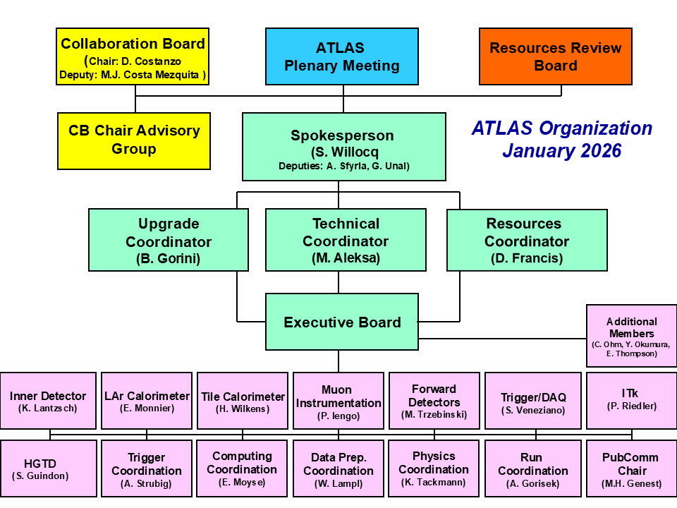
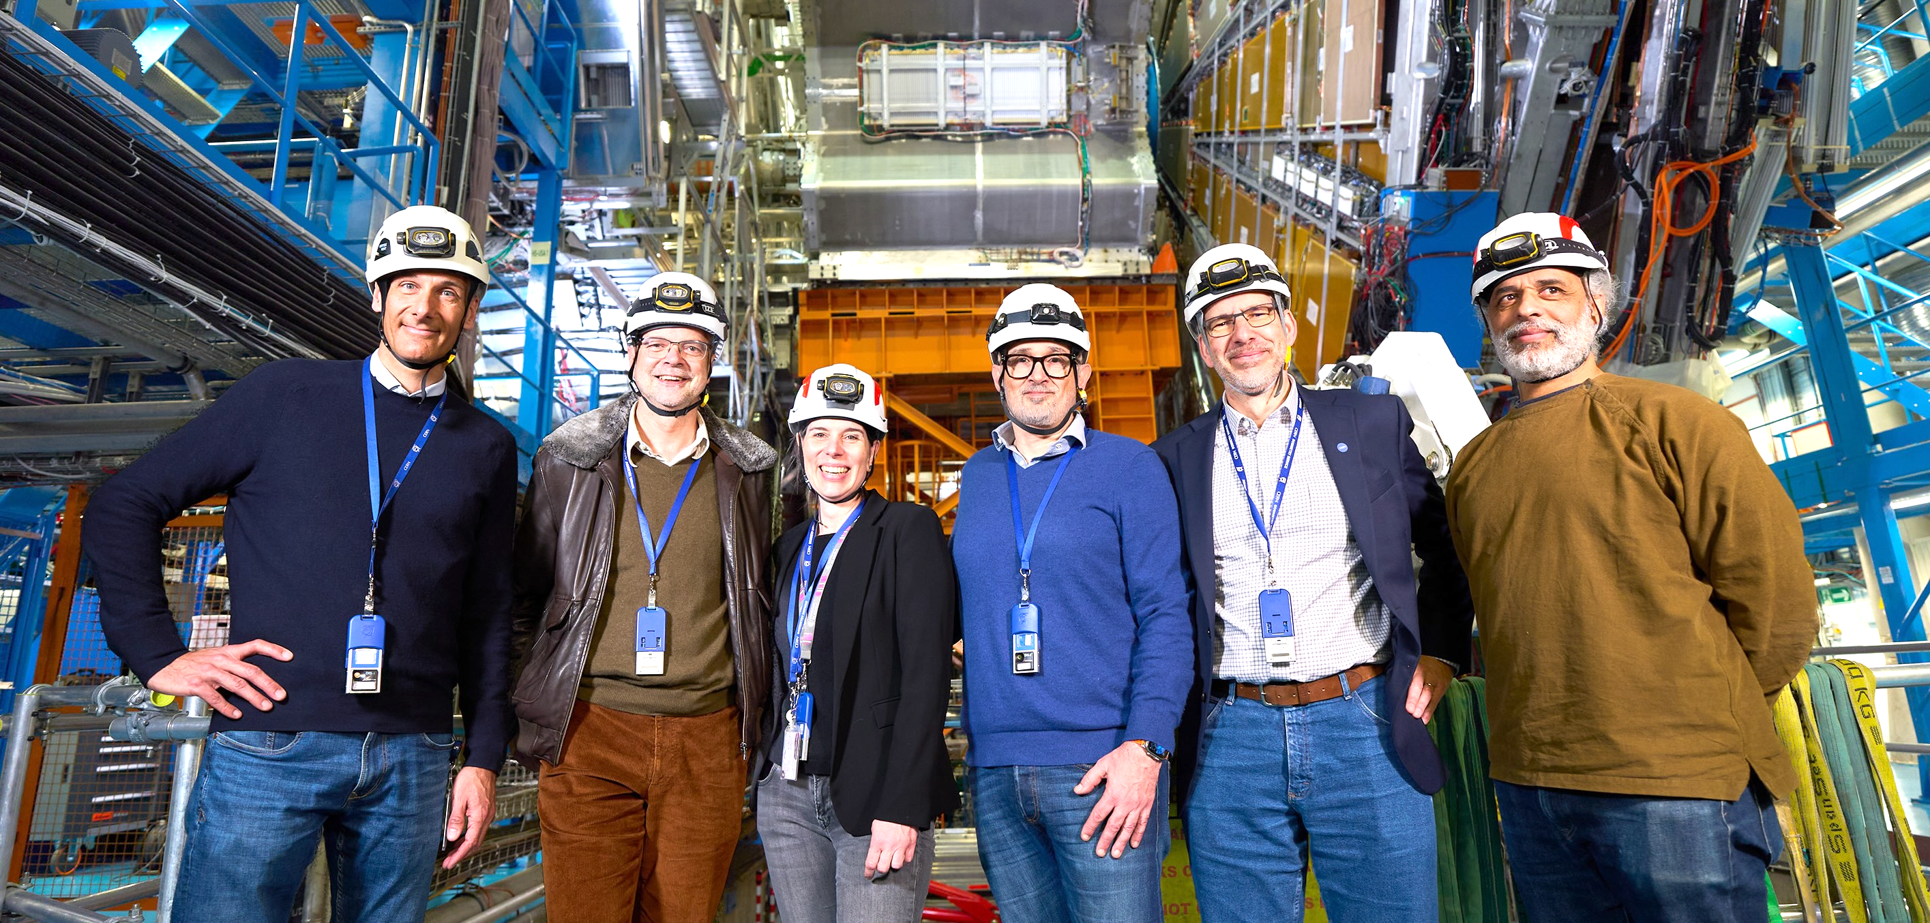
Collaboration organisation
Particle physics experiments have a democratic structure with a policy making and executive branch
Collaboration board
Composed of institute PIs, each one vote
Elects leadership and sets policy
Collaboration management
Elected or endorsed by Collaboration Board
ATLAS Management team in 2026
Executive board
System and activity leaders — all elected or endorsed by Collaboration Board

Slide 41
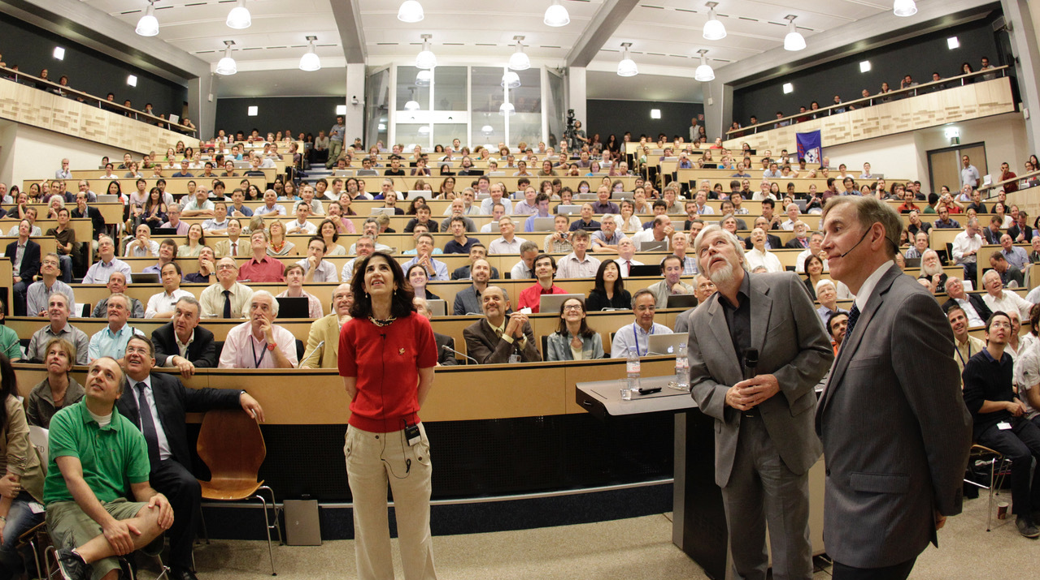
Keys to success
Presentation of Higgs boson discovery at CERN on 4 July 2012

Slide 42
Keys to success
Successful large collaborations are built on mutual trust, respect, and transparent, fair procedures, with leadership grounded in excellence and expertise. Open and inclusive governance — through clear structures, representative decision bodies, merit-based evaluation of ideas, consensus building, and collective ownership of major decisions — ensures that all members, including early-career researchers, have a voice and that innovation is encouraged and rewarded
Presentation of Higgs boson discovery at CERN on 4 July 2012

Slide 43
Keys to success
Input by Peter Jenni
Mutual trust and respect, as well as transparent and fair procedures are key
Trust-based governance Large collaborations rely on mutual trust and respect. Leadership hierarchies are collectively defined, and there is typically no formal line management
Excellence-driven leadership Scientific and technical excellence, as well as demonstrated expertise, should be the primary criteria for leadership at all levels
Clear organisational structure A well-defined and transparent organisational structure is essential and has served ATLAS well
Open and inclusive discussion The collaboration should provide open forums in which all members can express their views and contribute to discussions
Transparent decision processes For major technical choices, the decision path, criteria, and timeline must be clearly defined and communicated before engaging in discussions of competing options
Collective ownership of major decisions Decisions that affect the experiment as a whole must be understood and supported by the entire collaboration, not only by the subgroups directly involved
Representative decision-making bodies A Collaboration Board with equal institutional representation (one vote per institute) encourages consensus-building and has proven effective. At the same time, project leaders must maintain close dialogue with the contributing institutes

Slide 44
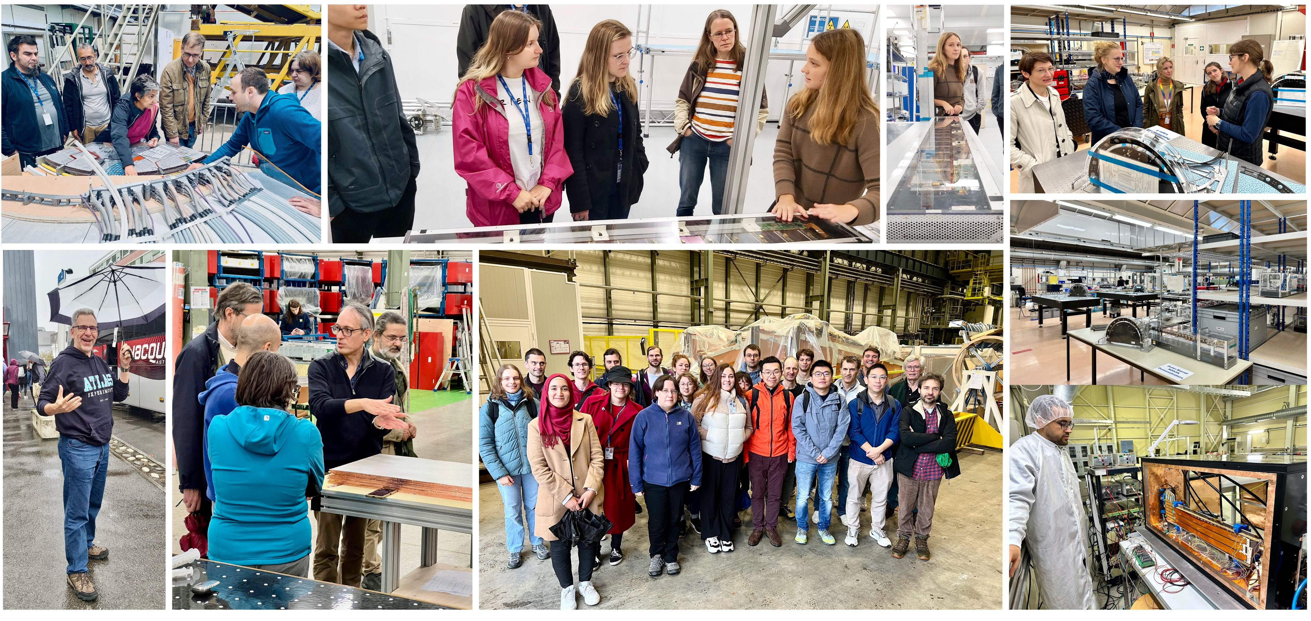
Keys to success
Input by Peter Jenni
Give the individual a voice in large collaborations
Value and reward innovation Large collaborations need to actively encourage, recognise, and reward new ideas, whether they concern scientific strategy, technical solutions, or organisational practices, independent of their origin within the collaboration
Merit-based evaluation of ideas Proposals should be assessed on their scientific and technical merit, feasibility, and impact, rather than on seniority, institutional weight, or established conventions
Ensure a fair representation at all levels Inclusiveness, representation of early career researchers, fair assignment of talks

Slide 45
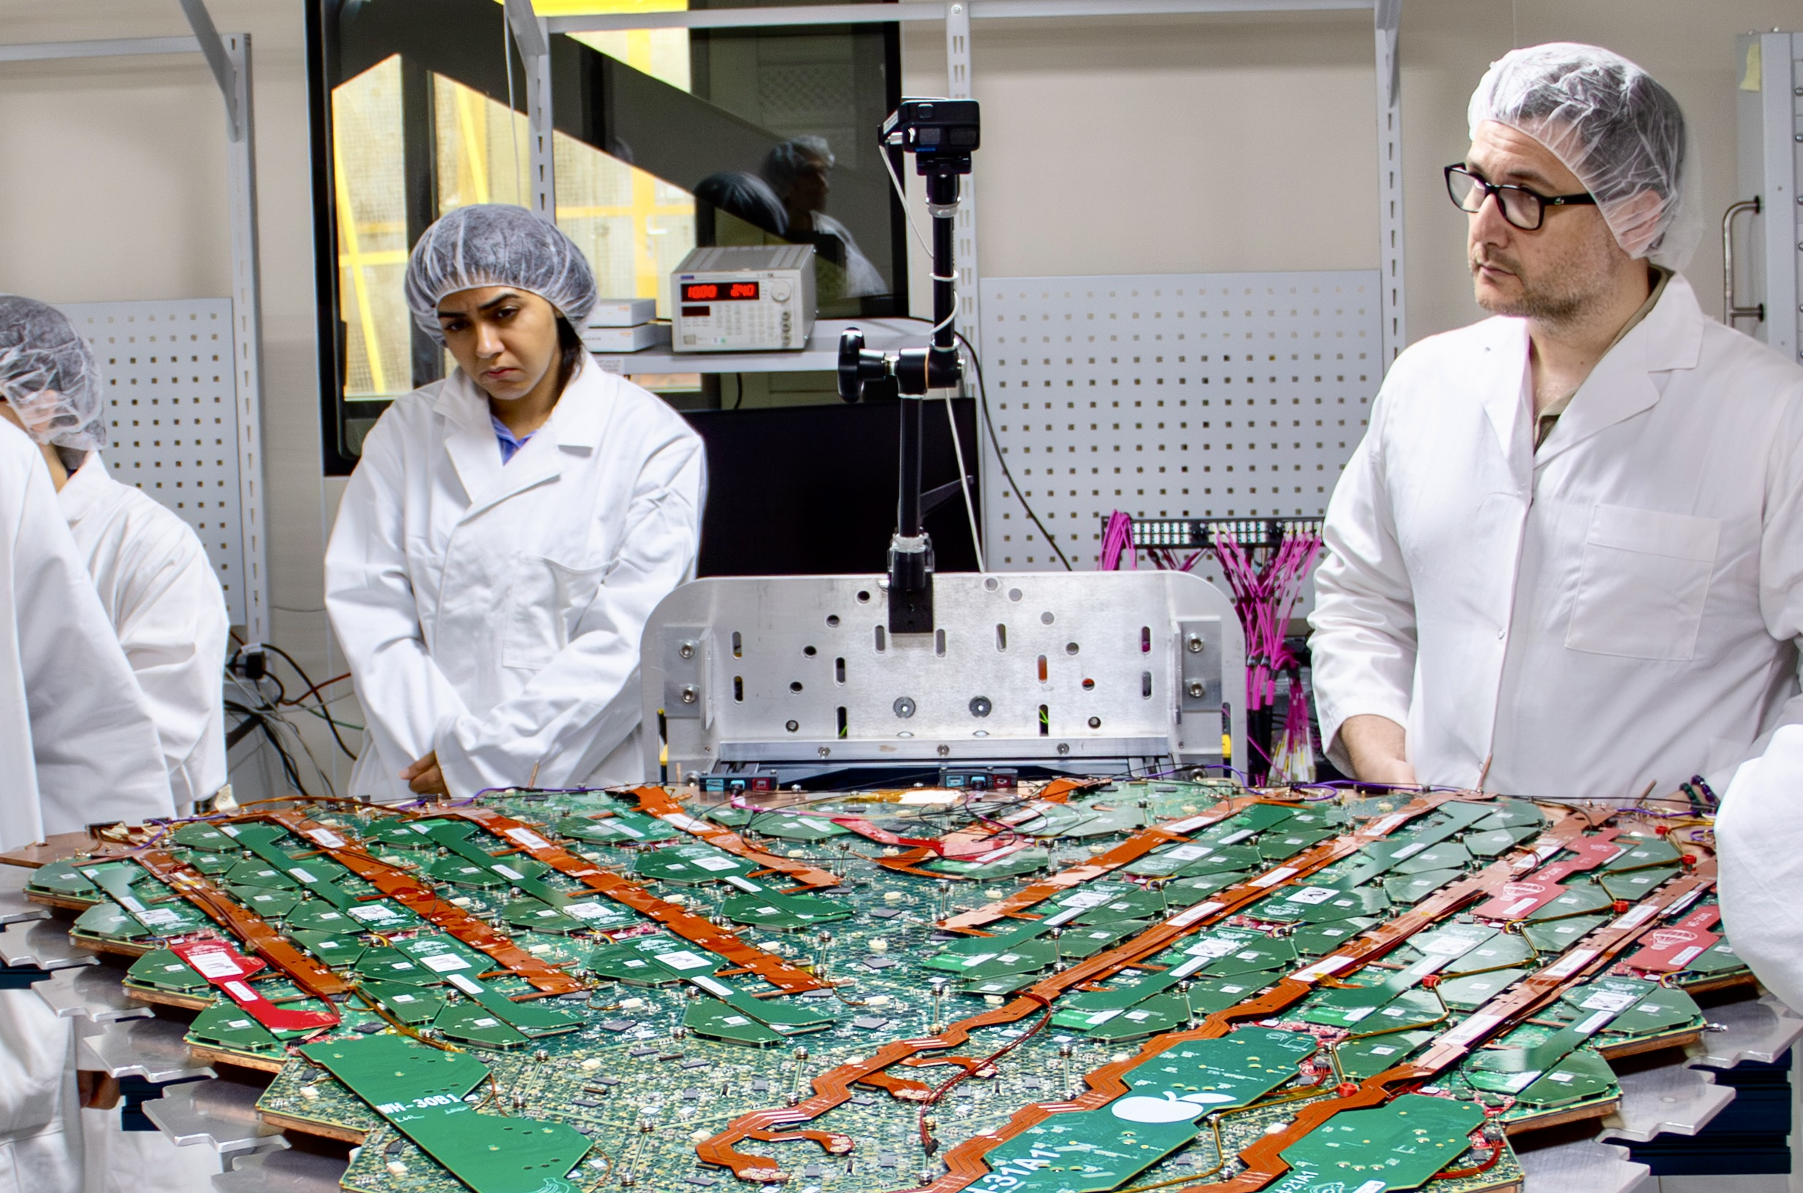
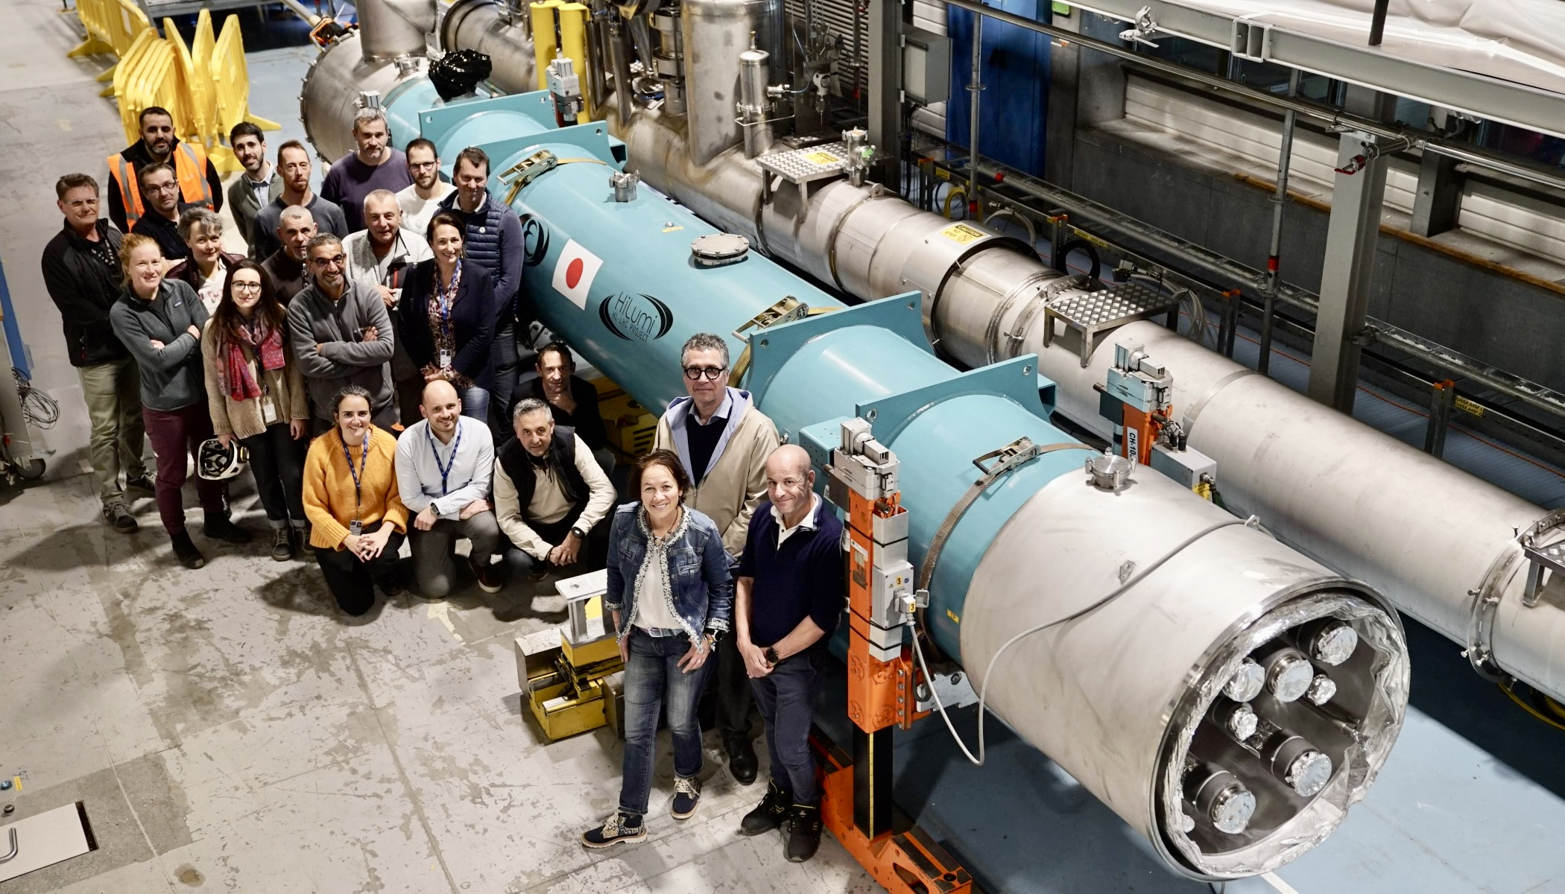
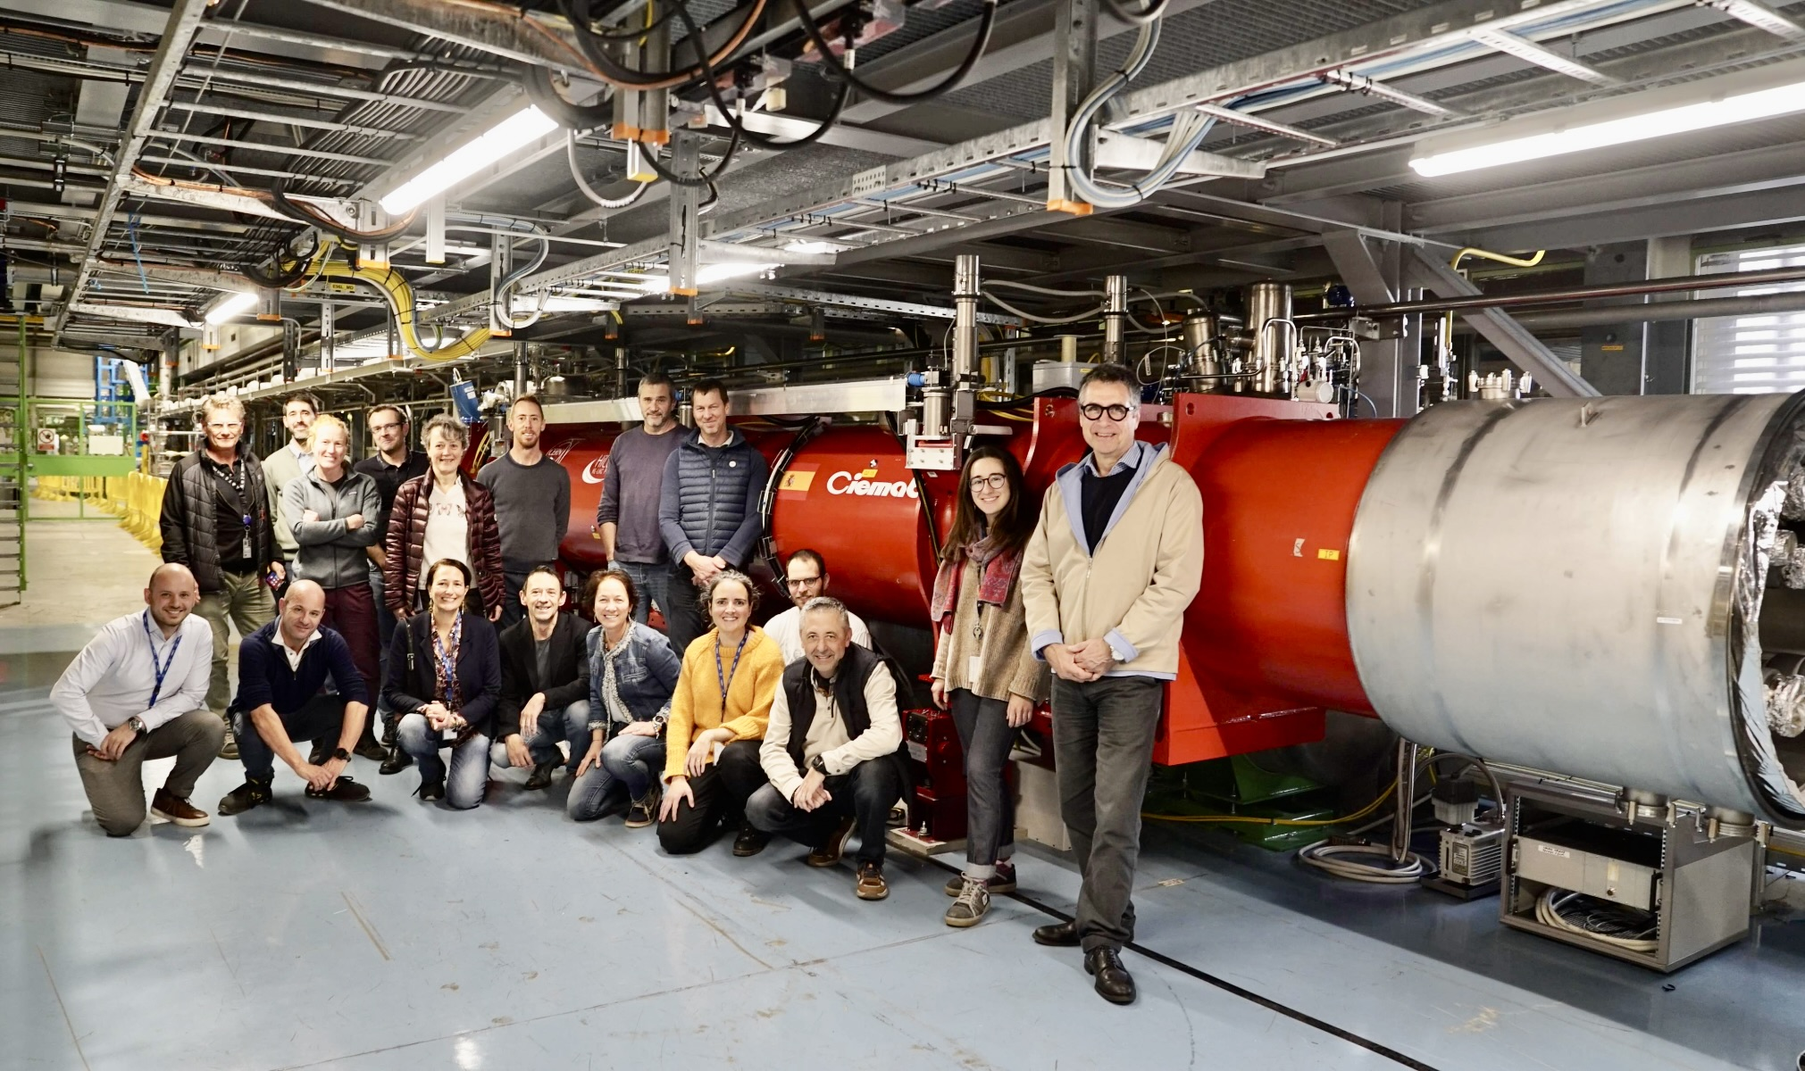
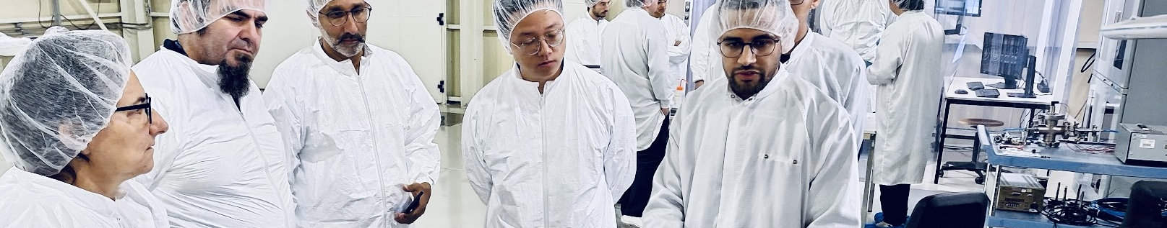
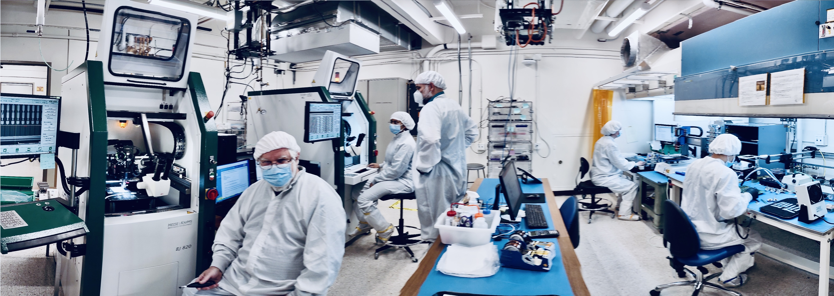
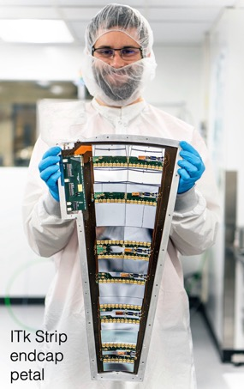
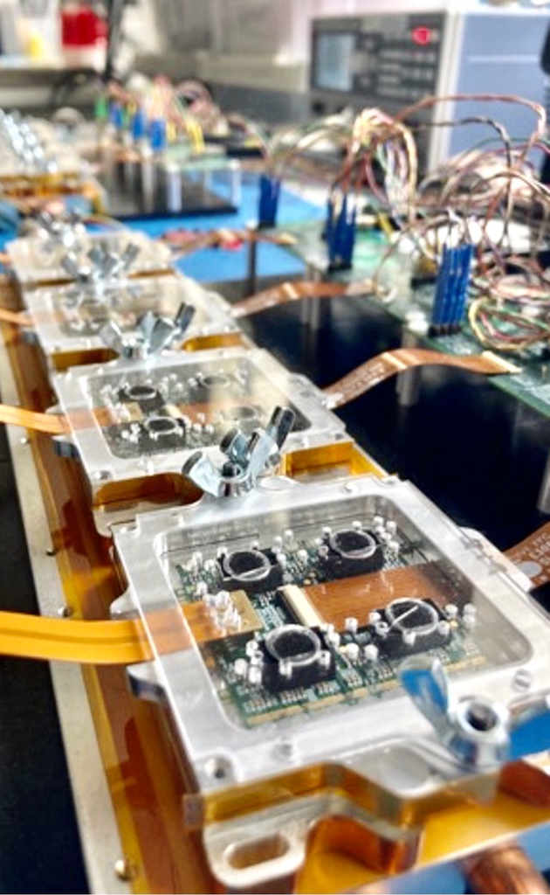
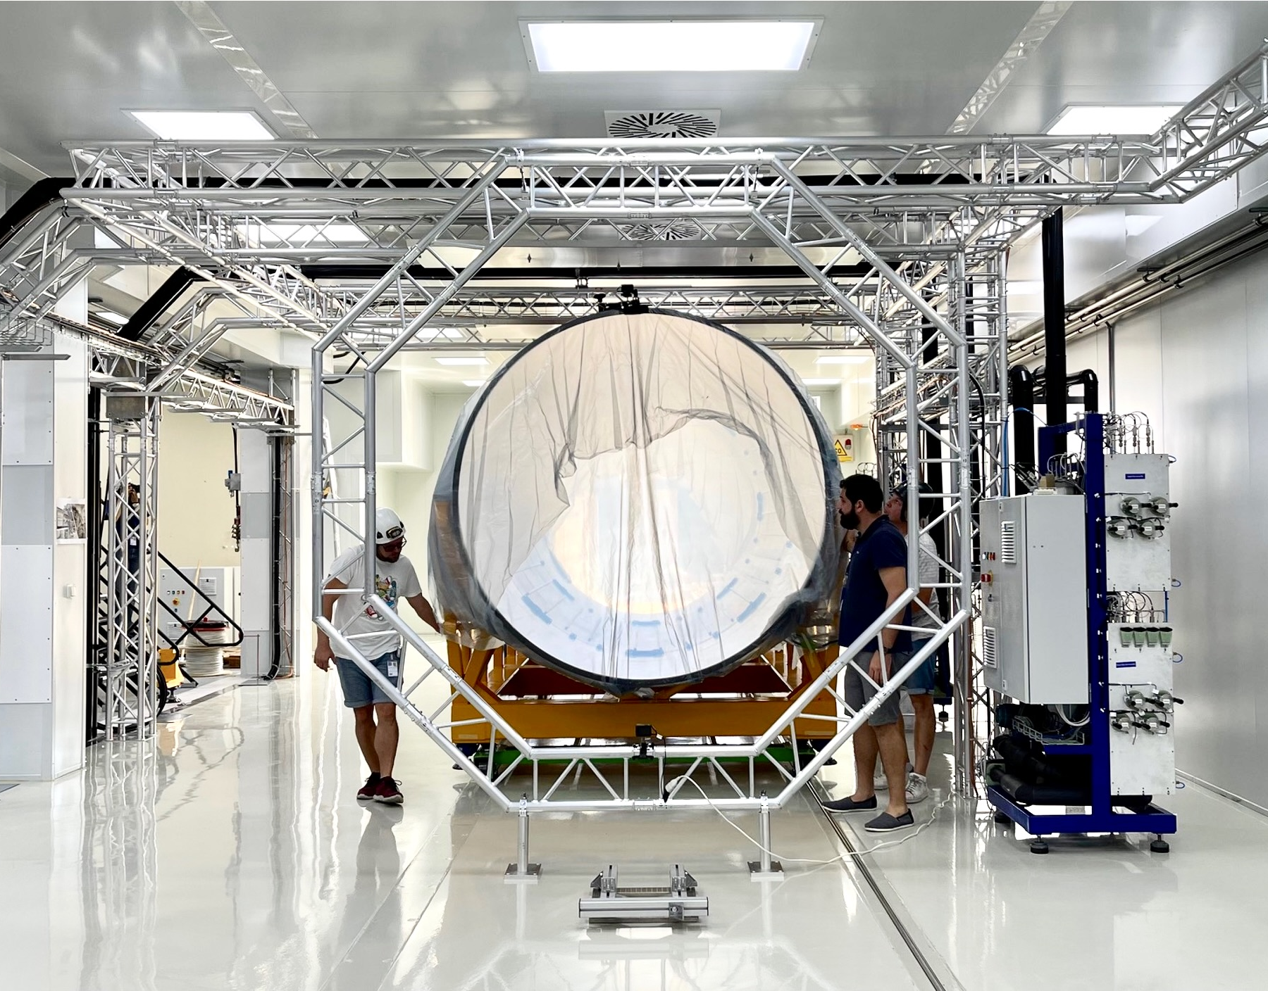
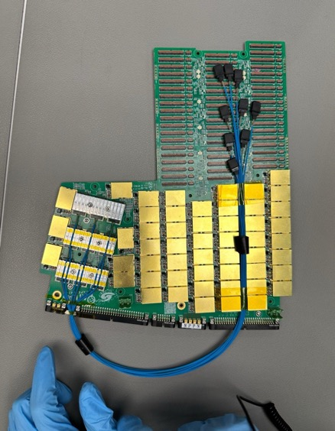
Challenges and pitfalls in delivering large collaborative research projects
Large-scale particle-physics projects must deliver mission-critical systems on time and on budget while managing a difficult transition from R&D to production, rising technological complexity, and the need for transparent technology selection and robust project management. Success depends on pragmatic choices, strong technical reviews, realistic ambition, and sustained long-term funding commitments aligned with the project’s full lifecycle
HGTD electronics board
ITk Outer cylinder at CERN
45

Slide 46
Challenges and pitfalls in delivering large research projects
Staying on budget and schedule while focusing on mission-critical developments is essential yet challenging
From R&D to production Researchers in curiosity-driven fields are R&D-oriented; the transition to large-scale production is critical and often starts too late
Rising technological complexity Modern detector technologies are increasingly complex and require strong engineering support, which is costly and scarce in research environments (e.g. radiation-hard, low-power, high-throughput ASICs)
Technology down-selection Choosing among competing options with many person-years R&D invested is difficult in consensus-driven collaborations, making transparent criteria and decision processes essential
Project management culture Industrial-style project management may clash with academic culture, yet is essential and often mandated by funding agencies
Strength of technical reviews Expert reviews must be enabled to recommend stopping or restructuring projects when justification or feasibility is insufficient — a threshold too rarely enforced
Pragmatism over perfection The pursuit of technically “perfect” solutions can delay or jeopardise delivery. Pragmatic and robust technological choices often lead more reliably to the desired scientific outcome
Long-term funding commitments Large projects require funding agencies to commit over their full duration. This can be challenging, particularly for agencies in smaller countries or with limited experience in long-term big-science investments
Managing ambition Over-ambitious project scopes increase risk and can lead to failure. Striking the right balance between innovation and feasibility is crucial

Slide 47
A few general lessons from particle physics for you
Collaborate out of necessity Very large projects exceed the capacity of any single group
Earn trust through delivery and openness Deliver on commitments; work transparently and open-source by default
Enable, don’t control Use clear governance and transparent decisions, not rigid hierarchies
Reward excellence wherever it appears Leadership follows expertise and contribution, not seniority or resources
Plan the R&D to production transition early Innovation needs freedom; large-scale delivery needs discipline
Be pragmatic Robust, timely solutions beat “perfect” ones that arrive too late
Make hard choices transparently Down-selection preserves trust when criteria are clear
Invest in people Empower early-career contributors and sustain the community
Anchor in stable institutions Long-term success needs neutral, reliable hubs
Remember the human side Large-scale collaboration is demanding — and deeply rewarding
By joining forces with trust, openness, and pragmatism, communities can achieve game-changing science and technology beyond the reach of any single group — and enjoy doing it

Slide 48
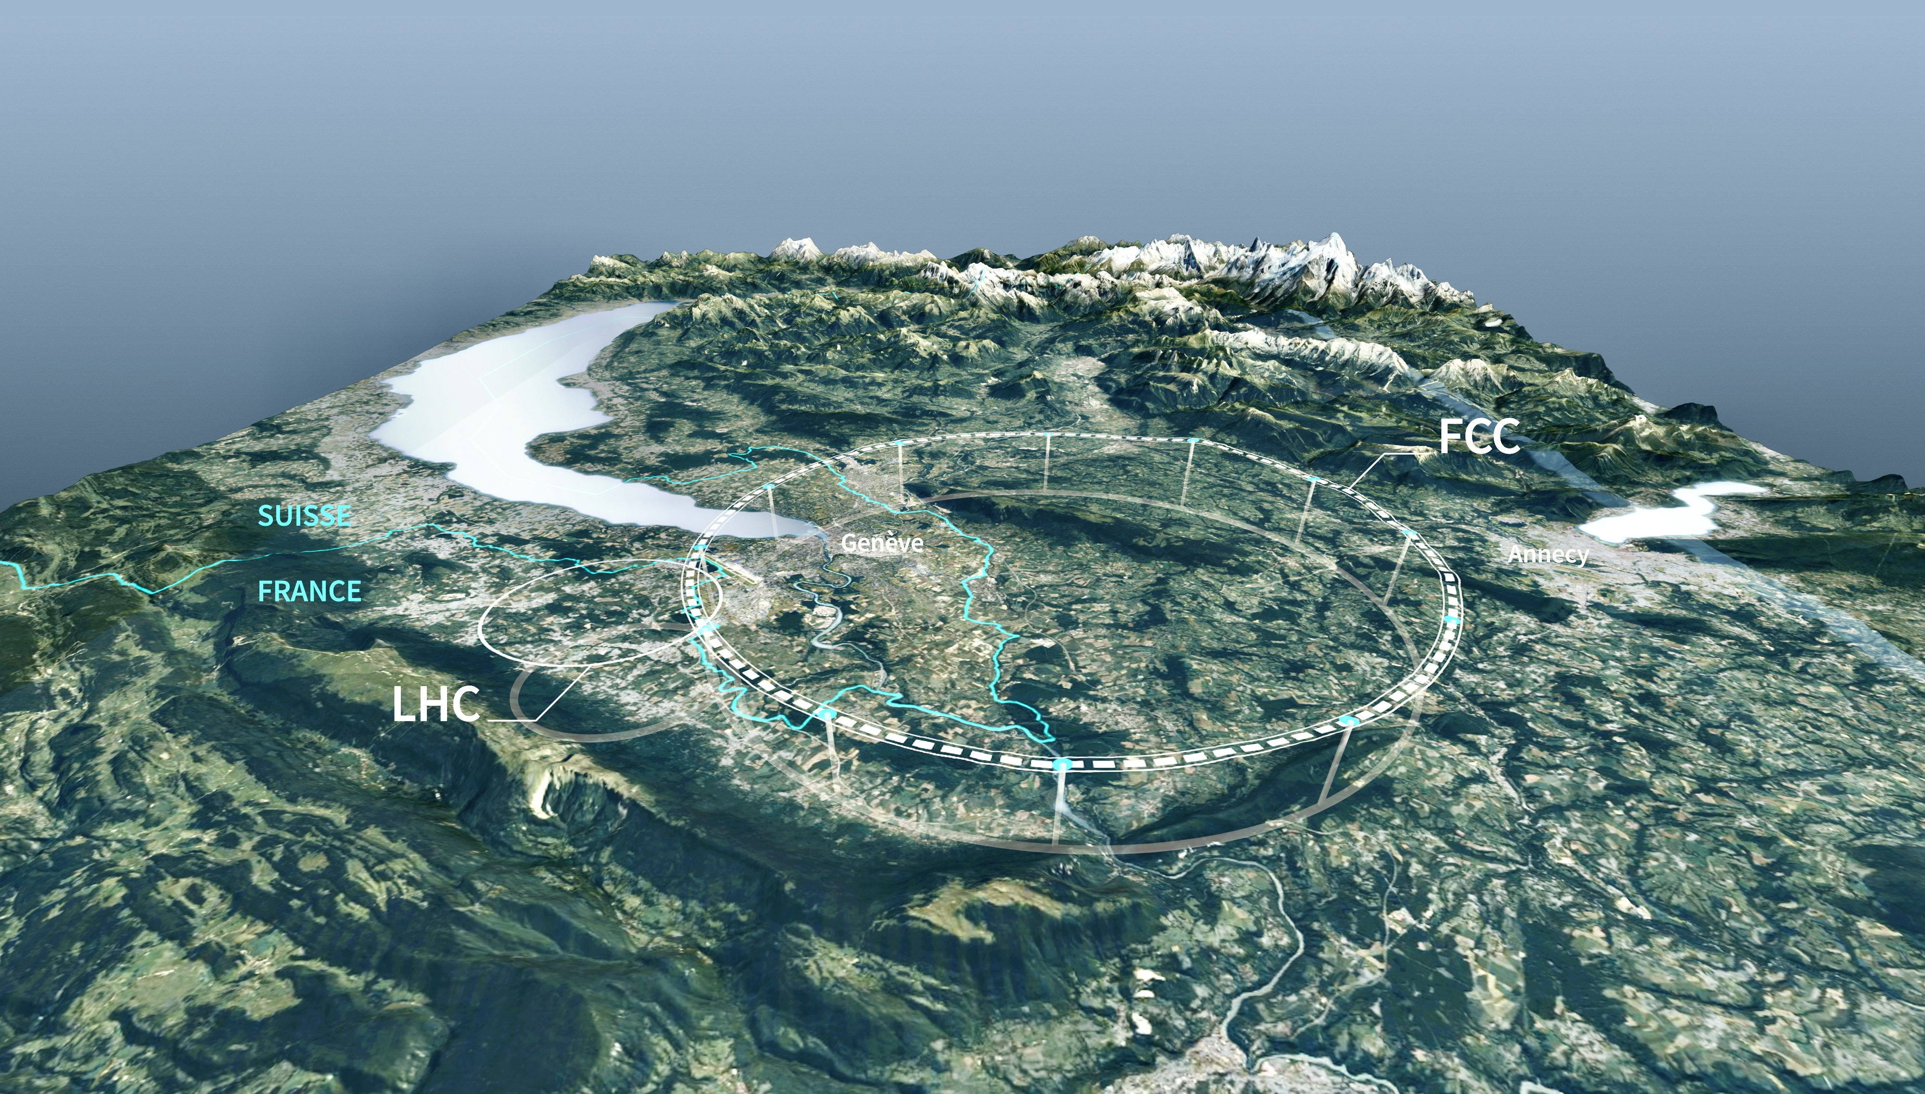
Also particle physics continues to evolve
A globally inclusive European Strategy process has just defined what should be next flagship project for CERN (if approved)

Slide 49
Future Circular Collider at CERN
Preferred option by national inputs to European Strategy for Particle Physics Update
90.7 km circumference tunnel facility to host an e⁺e– and, later, a hadron collider
Feasibility study Vol 1, Vol 2 (March 2025)

Slide 50
Future Circular Collider at CERN
Preferred option by national inputs to European Strategy for Particle Physics Update
90.7 km circumference tunnel facility to host an e⁺e– and, later, a hadron collider
Feasibility study Vol 1, Vol 2 (March 2025)
Thank you for your attention, and all the very best for your large-scale collaboration project!

Slide 51
Extra slides

Slide 52
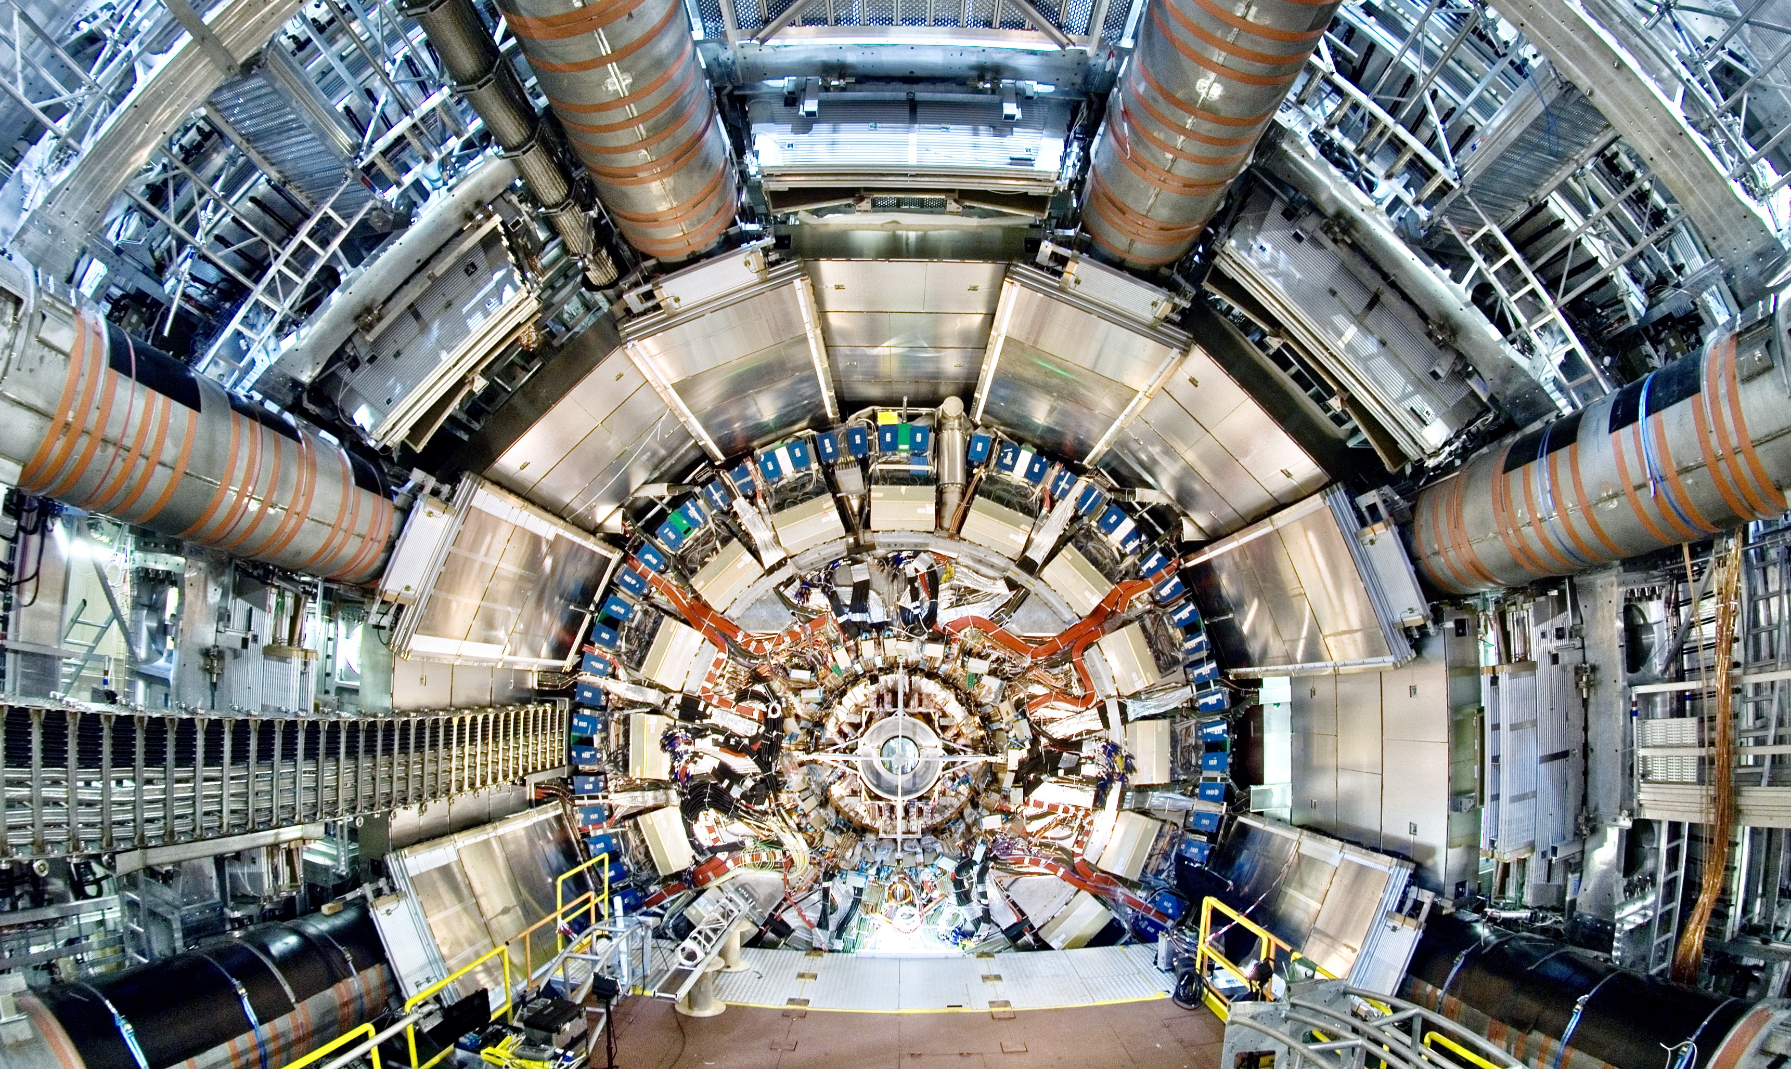
View on the ATLAS inner detectors. At the centre, the inner tracking detector with a radius of about 1m. It is surrounded by the inner solenoid producing a uniform 2-Tesla field throughout the volume of the tracker. The magnet itself is located inside the cryostat of the liquid argon electromagnetic calorimeter, whose electronic read-out boxes are visible, covering in part the hadronic calorimeter located at larger radius. On the outer part, the first layers of muon chambers, part of the muon spectrometer, subdivided into sixteen azimuthal sectors, are seen

Slide 53
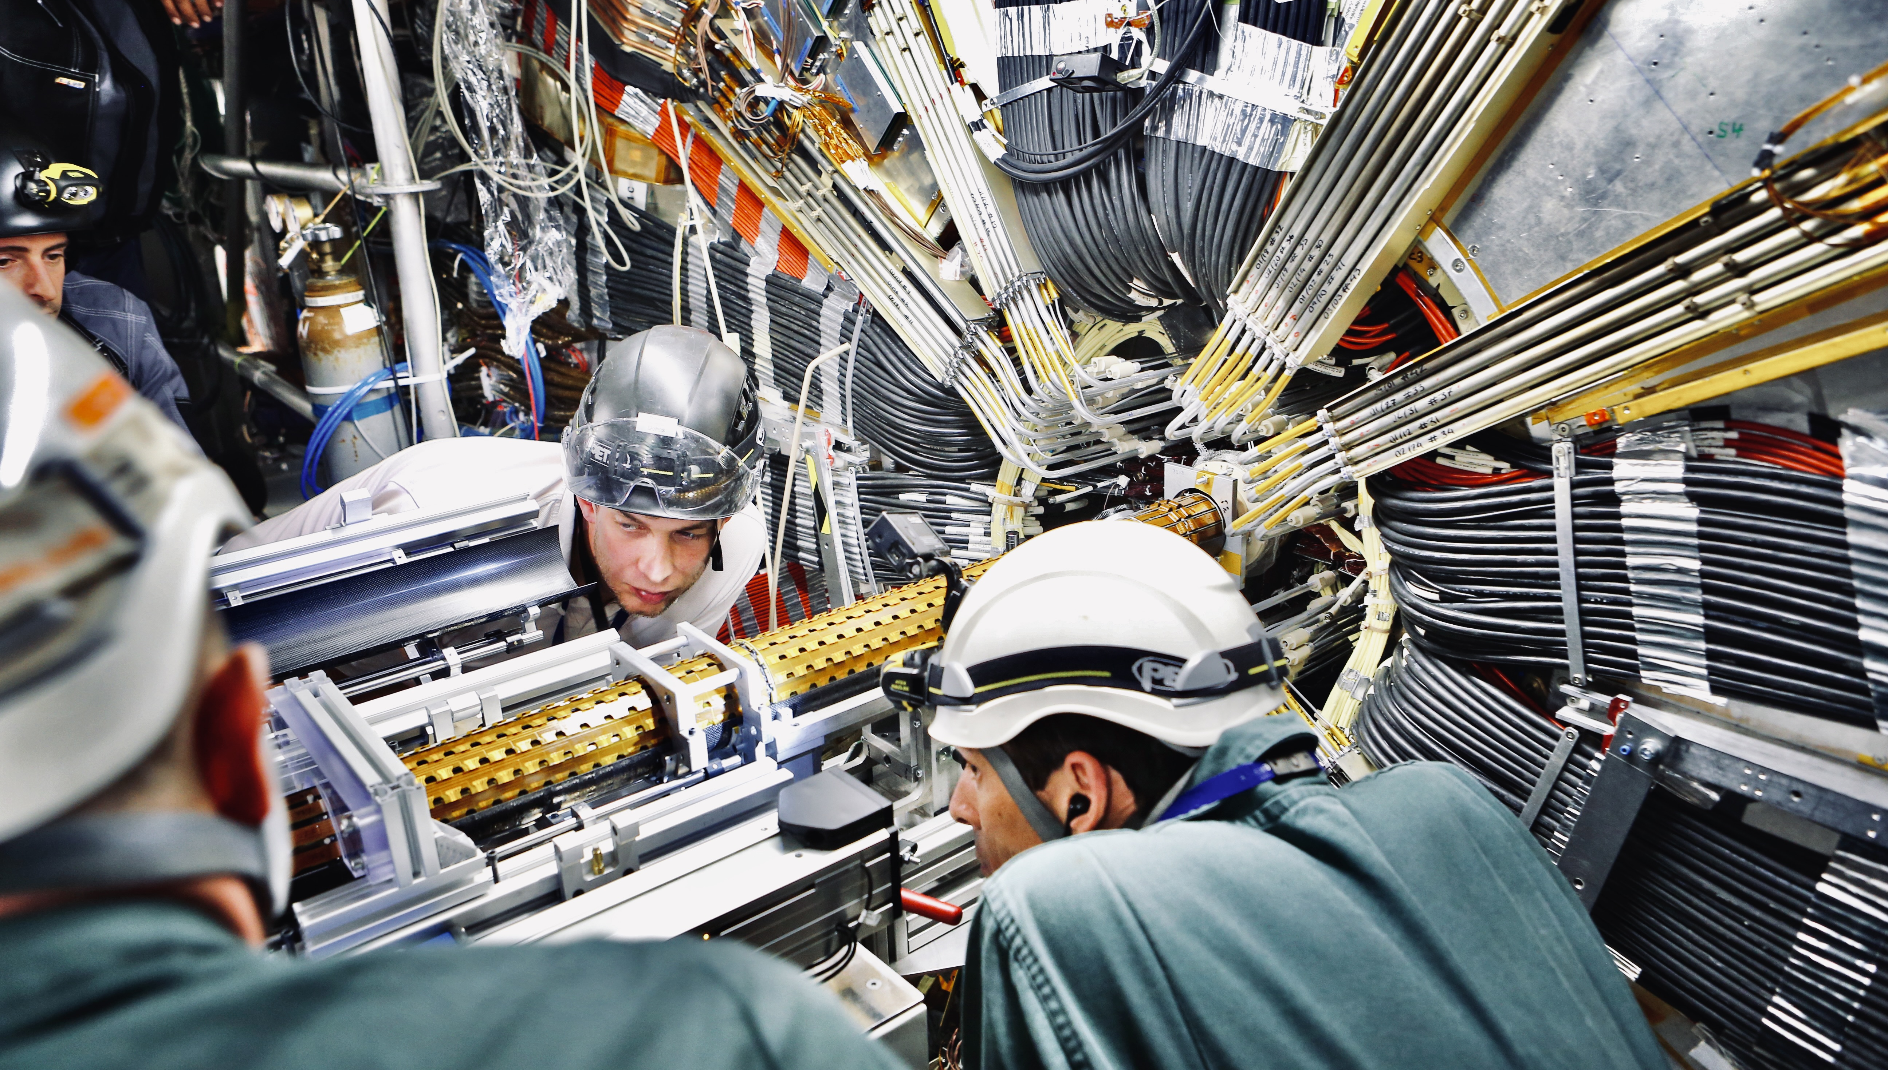
Installation of ATLAS Insertable B-layer on 15 May 2014

Slide 54
Organisation is key in any project, and especially in large-scale international ones: it must empower efficient, creative, and trust-based collaboration — not hinder it

