Slide 1
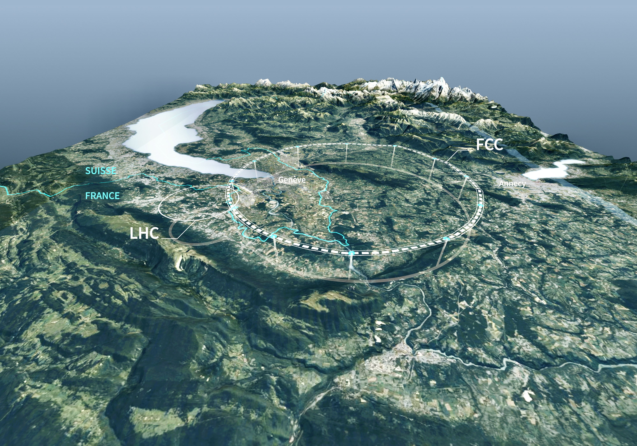
Future Circular Collider (FCC)
Europe’s Next-Generation Flagship Particle Physics Project at CERN
Andreas Hoecker (CERN), 57. Herbstschule HEP, 1–11 September 2026, Bad Honnef, Germany

Slide 2

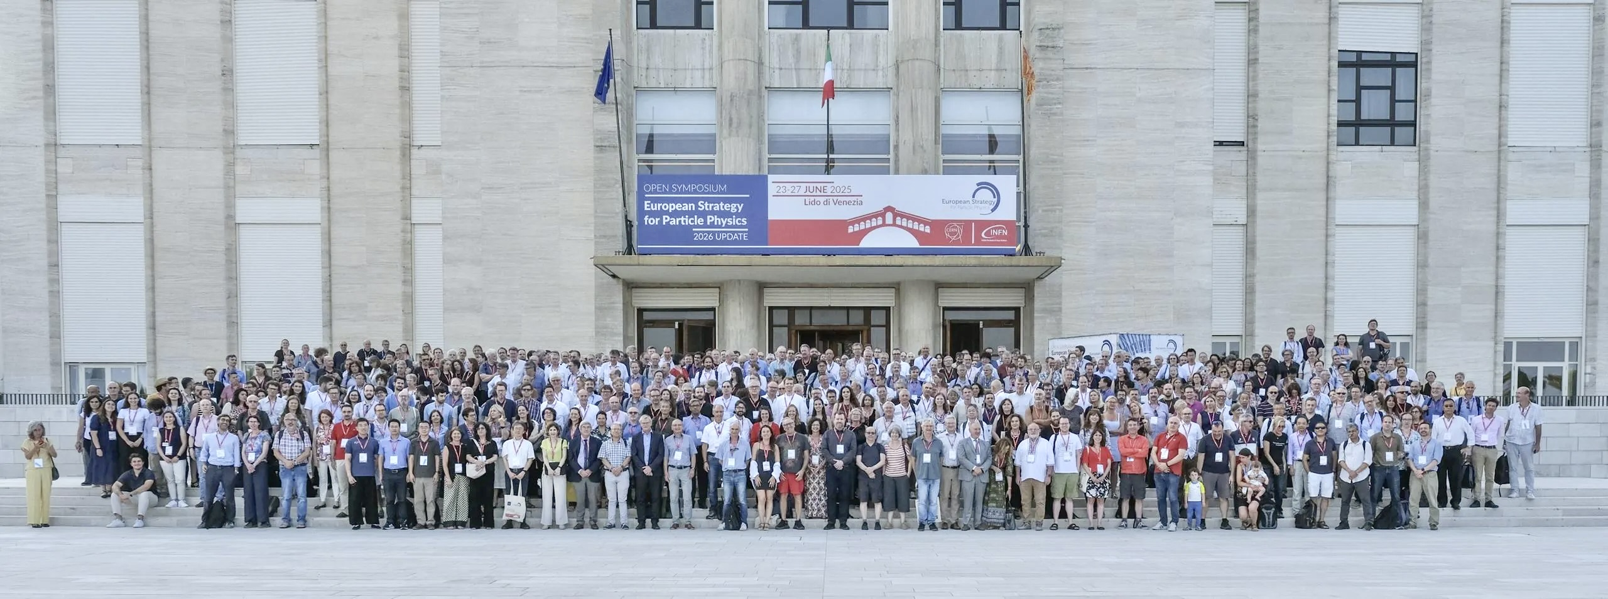
The European Strategy for Particle Physics
Open Symposium, European Strategy of Particle Physics, 23–27 Jun 2025, Venice Lido [Link]

Slide 3
The European Strategy for Particle Physics
Cornerstone of Europe’s decision-making process for the long-term future of the field
Mandated by CERN Council, the Strategy is formed through a broad consultation of the particle physics communities in Europe and worldwide (266 individual and national submissions, 2-year process)
In the Strategy process, recommendations are developed which are submitted to the CERN Council for an update of the Strategy
It is not a project approval process; projects are approved by the CERN Council through a separate decision process, taking the Strategy recommendations into account
Original Strategy (2006): LHC, mooting of luminosity upgrade of LHC, R&D in accelerator technologies, coordination with a potential ILC project
1st Update (2013): High Luminosity LHC, need for a post-LHC programme
2nd Update (2020): FCC feasibility study
3rd Update (2026): Recommendation for the next large-scale accelerator project at CERN

Slide 4
The European Strategy for Particle Physics
Main recommendations of the 2026 strategy update
The full exploitation of the physics potential of the LHC and the HL-LHC and the completion of the high-luminosity upgrade remain the highest priorities of European particle physics. Every effort must be made to complete the HL-LHC upgrade within the current schedule
The electron–positron Future Circular Collider (FCC-ee) is recommended as the preferred option for the next flagship collider at CERN
A descoped FCC-ee* is the preferred alternative option for the next flagship collider at CERN *No ttbar run: –1.26 BCHF, drop 2 / 4 experiments: –0.80 BCHF, decrease RF power from 50 → 30 MW (–0.35 BCHF)
The particle physics community should continue and intensify its efforts to develop and adopt sustainable solutions
…
Links: CERN Council resolution, Recommendations, Briefing book, All documents, More information, CERN Colloquium by Karl Jakobs

Slide 5
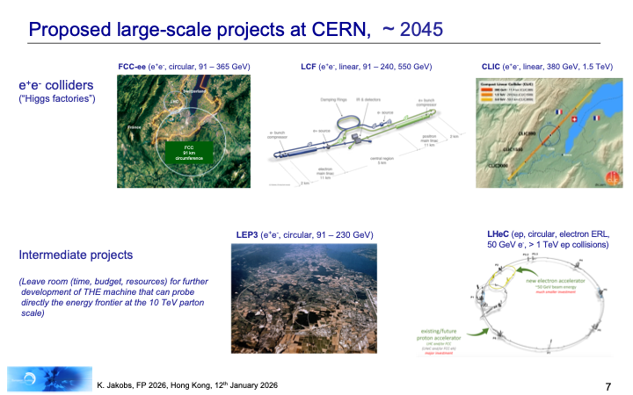
Proposed next-generation large-scale projects at CERN, ~ 2045
Slide from Karl Jakobs

Slide 6
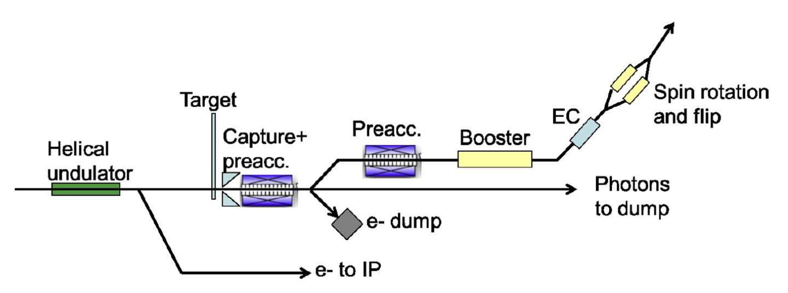
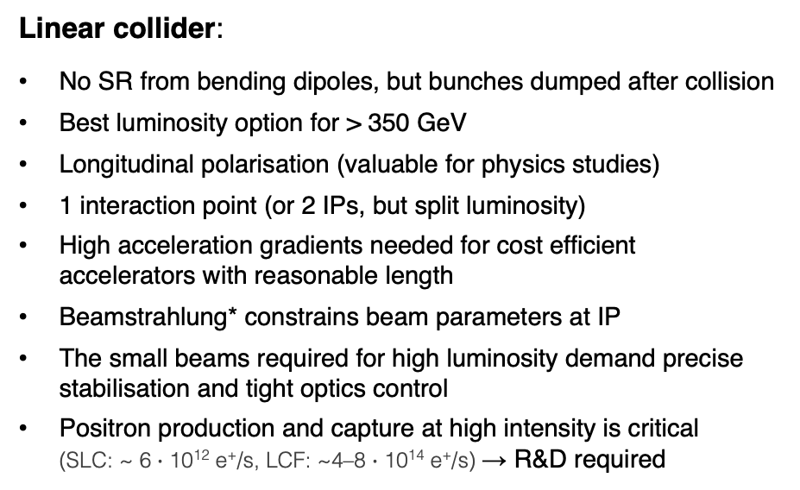
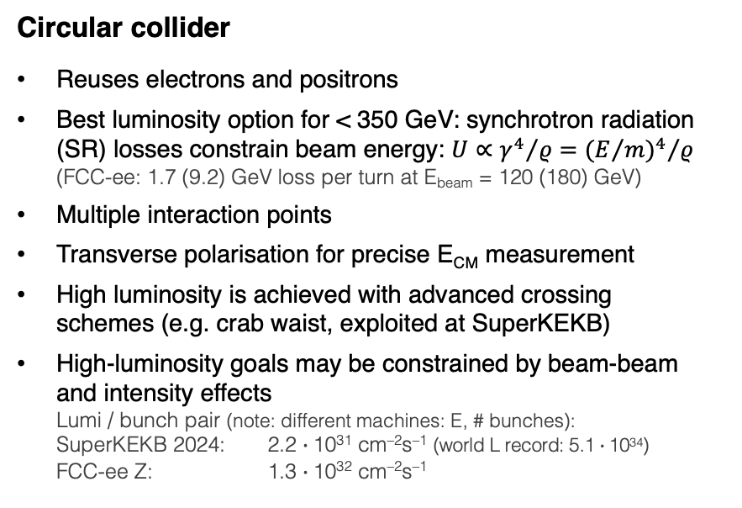
*Beamstrahlung (“beam + bremsstrahlung”) is synchrotron radiation emitted by the e–/e⁺ when they pass through the intense EM field of the opposing bunch during a collision → Collision effect, stronger for tight bunches (emitted photons carry away energy, causing energy spread and luminosity degradation, as well as background)
e⁺e– Higgs (+ EW and top) factory
The optional future e⁺e– projects have different strengths and challenges
Circular collider
Reuses electrons and positrons
Best luminosity option for < 350 GeV: synchrotron radiation (SR) losses constrain beam energy: $U∝{γ^{4}}/ρ={{(E/m)}^{4}}/ρ$ (FCC-ee: 1.7 (9.2) GeV loss per turn at E_{beam} = 120 (180) GeV)
Multiple interaction points
Transverse polarisation for precise E_{CM} measurement
High luminosity is achieved with advanced crossing schemes (e.g. crab waist, exploited at SuperKEKB)
High-luminosity goals may be constrained by beam-beam and intensity effects Lumi / bunch pair (note: different machines: E, # bunches): SuperKEKB 2024: 2.2 $∙$10³¹ cm^{–2}s^{–1} (world L record: 5.1 $∙$10³⁴) FCC-ee Z: 1.3 $∙$10³² cm^{–2}s^{–1}
Linear collider:
No SR from bending dipoles, but bunches dumped after collision
Best luminosity option for > 350 GeV
Longitudinal polarisation (valuable for physics studies)
1 interaction point (or 2 IPs, but split luminosity)
High acceleration gradients needed for cost efficient accelerators with reasonable length
Beamstrahlung* constrains beam parameters at IP
The small beams required for high luminosity demand precise stabilisation and tight optics control
Positron production and capture at high intensity is critical (SLC: ~ 6 $∙$ 10¹² e⁺/s, LCF: ~4–8 $∙$ 10¹⁴ e⁺/s) → R&D required
Longitudinally polarised positrons
Periodic magnetic field causing electrons to wiggle and emit polarised photons (231 m)
Undulator-based ILC positron source

Slide 7
FCC-ee
Next-generation circular e⁺e– collider to deliver extremely high luminosities across multiple energies

Slide 8
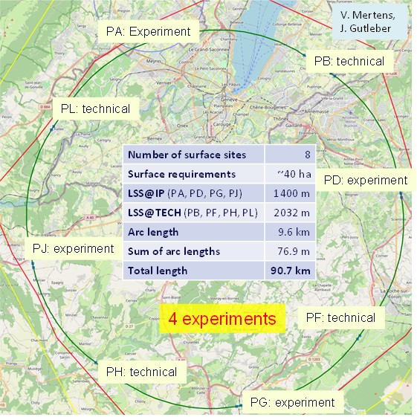
FCC-ee
Next-generation circular e⁺e– collider to deliver extremely high luminosities across multiple energies
Detailed feasibility study: layout selected from ~100 variants following the EU “Avoid–Reduce–Compensate” principle — 90.7 km ring, 8 surface sites (7 FR, 1 CH), 5.5 m tunnel diameter, 50–560 m depth

Slide 9
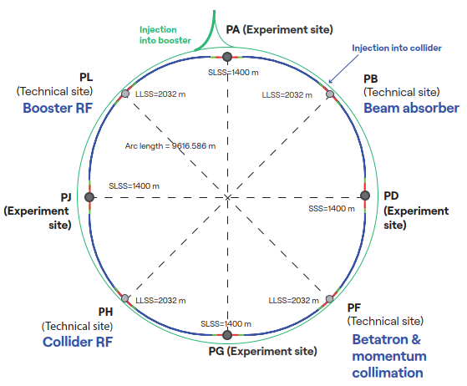
FCC-ee
Next-generation circular e⁺e– collider to deliver extremely high luminosities across multiple energies
Ring structure: 4 experiments, 1 RF-section / beam, 1 collimation section, 1 section for injection and dump
Booster is single-beam synchrotron which cycles within a few seconds between accelerating and top-up injecting e⁺ and e–

Slide 10
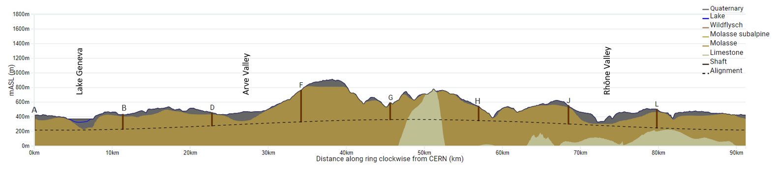
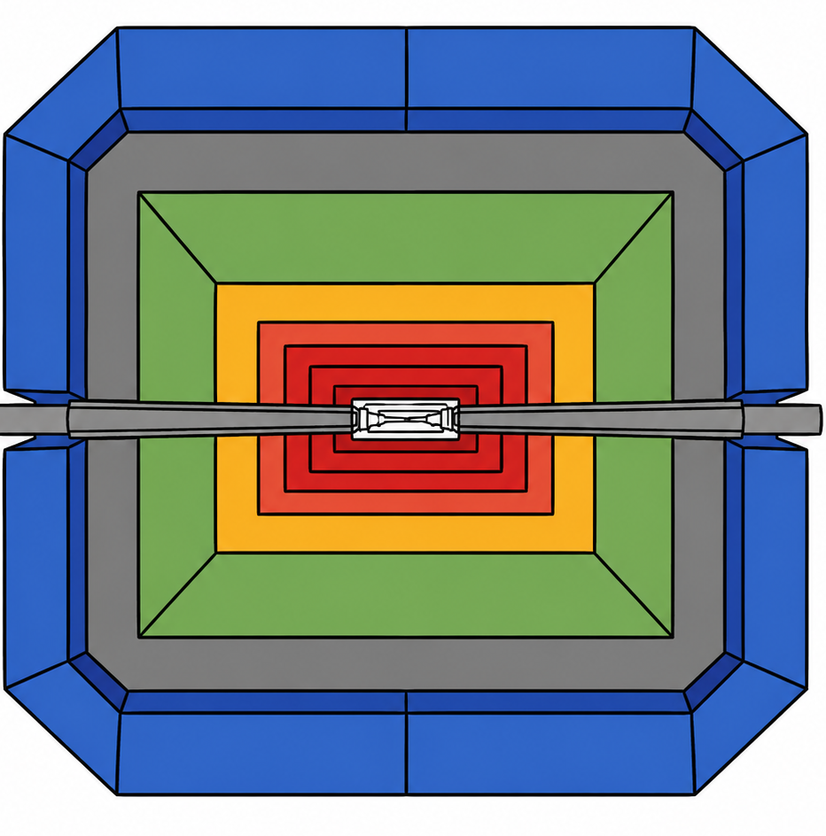
FCC-ee
Next-generation circular e⁺e– collider to deliver extremely high luminosities across multiple energies
Geology of FCC tunnel
FCC inclined at 0.5% gradient to minimise depth of point F
Limestone unavoidable between G–H
Tunneling mainly in molasse layer (soft rock), well suited for fast, low-risk construction, 6 million m³ excavated volume
→ 8.5 million m³ excavation material on surface (OpenSkyLab R&D project to study reuse), average shaft depths ~240 m
265’000 m³ concrete/year over 8 years (0.075% of annual EU production), use of low-carbon concrete under study
Total civil engineering construction carbon footprint estimate: 530,000 – 1,184,000 tCO₂(eq)
Assessed according to European Norms (EN 17472, EN15804+A2)
= 1.5 – 3.4 × CERN with LHC operation per year

Slide 11
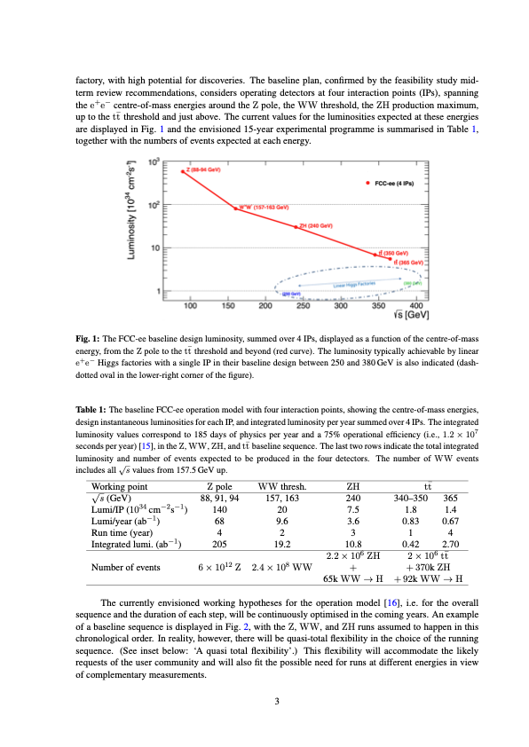
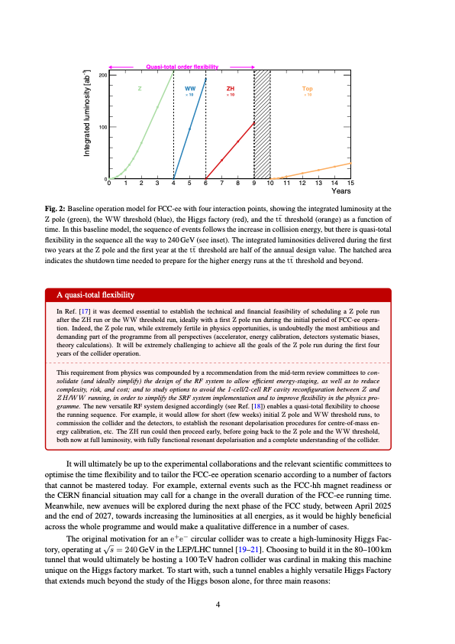
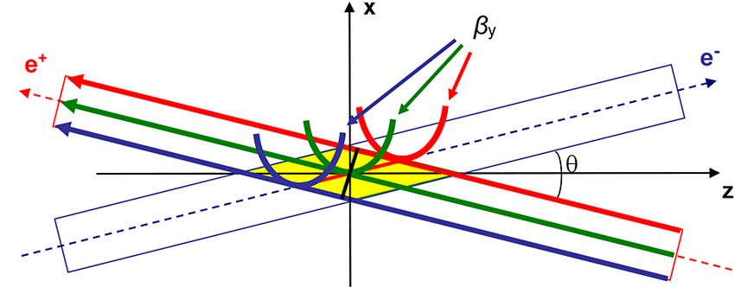
FCC-ee — maximum luminosity
FCC-ee collider concept for maximum luminosity
Double ring collider: many bunches, high current, like LHC and B factories, different from LEP (CERN)
Top-up injection (requiring booster) during collisions: needed due to short luminosity lifetime (~10–20 min, radiative Bhabhas), standard at light sources and used at PEP-II, KEKB, BEPCII. Booster intensity ~1% of collider; full RF voltage as in collider
Superconducting RF: LEP-proven Nb/Cu 400 MHz cavities; bulk Nb 800 MHz cavities as in ESS/EuXFEL; efficient RF sources and simplified energy-switching scheme
Crab-waist collisions: successfully demonstrated at DAΦNE and SuperKEKB
Numbers assume 4 experiments
~350,000 × LEP-1
~5,000 × LEP-2
Crab waist scheme: sextupoles near IP rotate vertical waist along the opposing beam’s path (and suppresses beam-beam resonances)

Slide 12
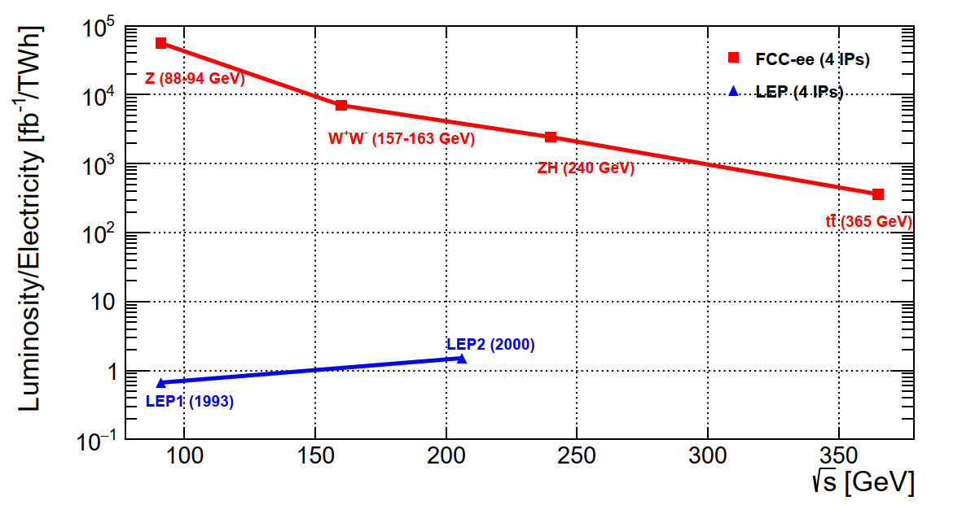
FCC-ee — maximum luminosity
FCC-ee collider concept for maximum luminosity
Combining all these concepts results in a giant efficiency step: 10⁴ – 10⁵ × luminosity / electrical power of LEP
Double ring collider: many bunches, high current, like LHC and B factories, different from LEP (CERN)
Top-up injection (requiring booster) during collisions: needed due to short luminosity lifetime (~10–20 min, radiative Bhabhas), standard at light sources and used at PEP-II, KEKB, BEPCII. Booster intensity ~1% of collider; full RF voltage as in collider
Superconducting RF: LEP-proven Nb/Cu 400 MHz cavities; bulk Nb 800 MHz cavities as in ESS/EuXFEL; efficient RF sources and simplified energy-switching scheme
Crab-waist collisions: successfully demonstrated at DAΦNE and SuperKEKB
Crab waist scheme: sextupoles near IP rotate vertical waist along the opposing beam’s path (and suppresses beam-beam resonances)

Slide 13
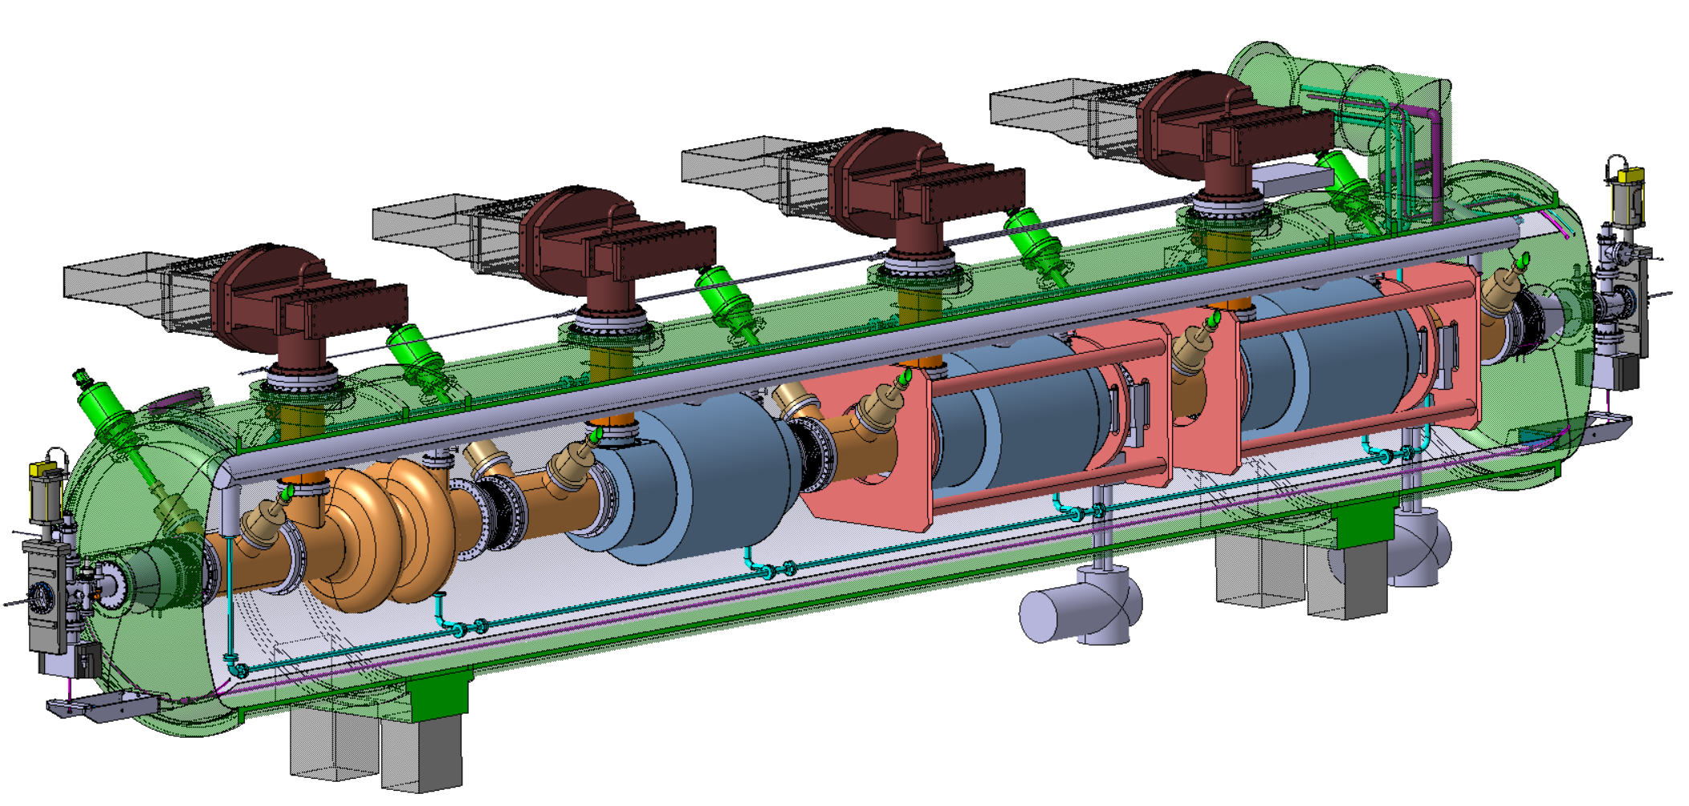
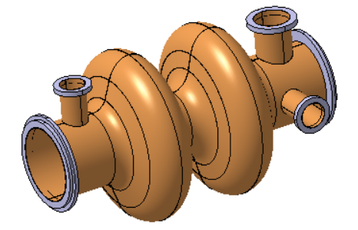
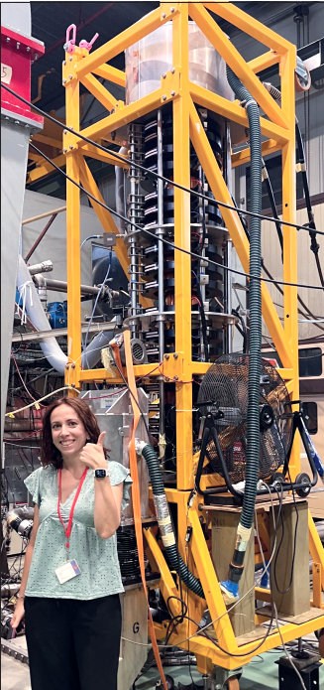
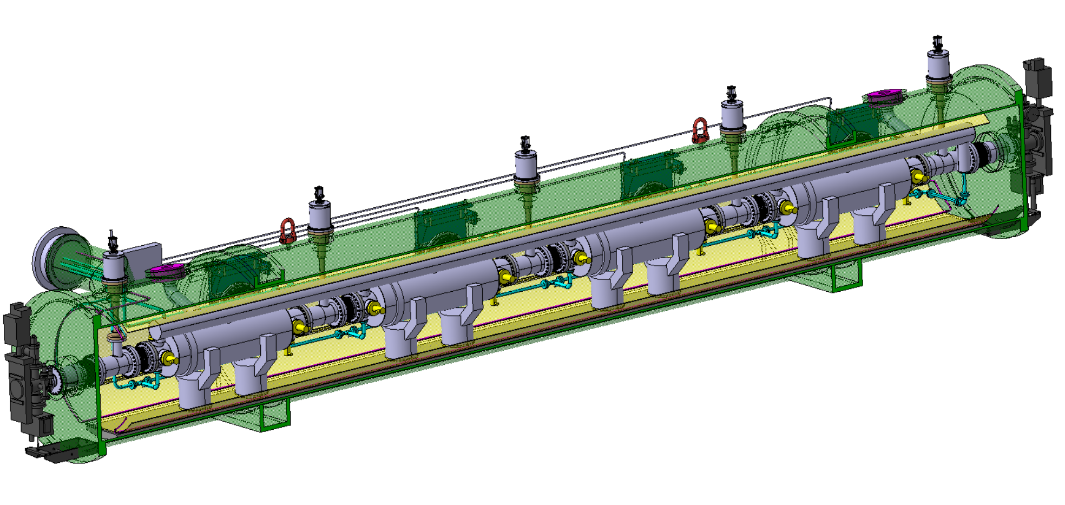

*A cell is one resonant section of the cavity where acceleration occurs (half a wavelength long = 38 cm for 400 MHz)
$$η=\frac{P_{RF out}}{P_{beam}}$$
FCC-ee — SRF
*
Superconducting RF system — key technology
Ref: arXiv:2505.00274
2-cell* 400 MHz SRF system for Z, W and ZH
Power source: 380 kW Klystron prototype built (HL-LHC) η* = 70% → two-stage Klystrons η = 86% → multibeam Tristrons η > 90% (R&D)
× 264
400 MHz superconducting cavity (6~10 MV/m), copper Nb coated, 1.5 m long
400 MHz Cryo-module
× 264
× 66
Higher gradient 6-cell 800 MHz SRF system for tt collider operation and booster at all energies
Klystron prototype
Compact 800 MHz cavity (~20 MV/m), 6-cell, bulk Nb, Nb₃Sn if R&D is successful
800 MHz Cryo-module
× (102 + 112 booster)
× 204 Tristons +
448 × 10-kW, 800-MHz solid-state RF amplifiers for the full-energy booster
× (408 + 448 booster)

Slide 14
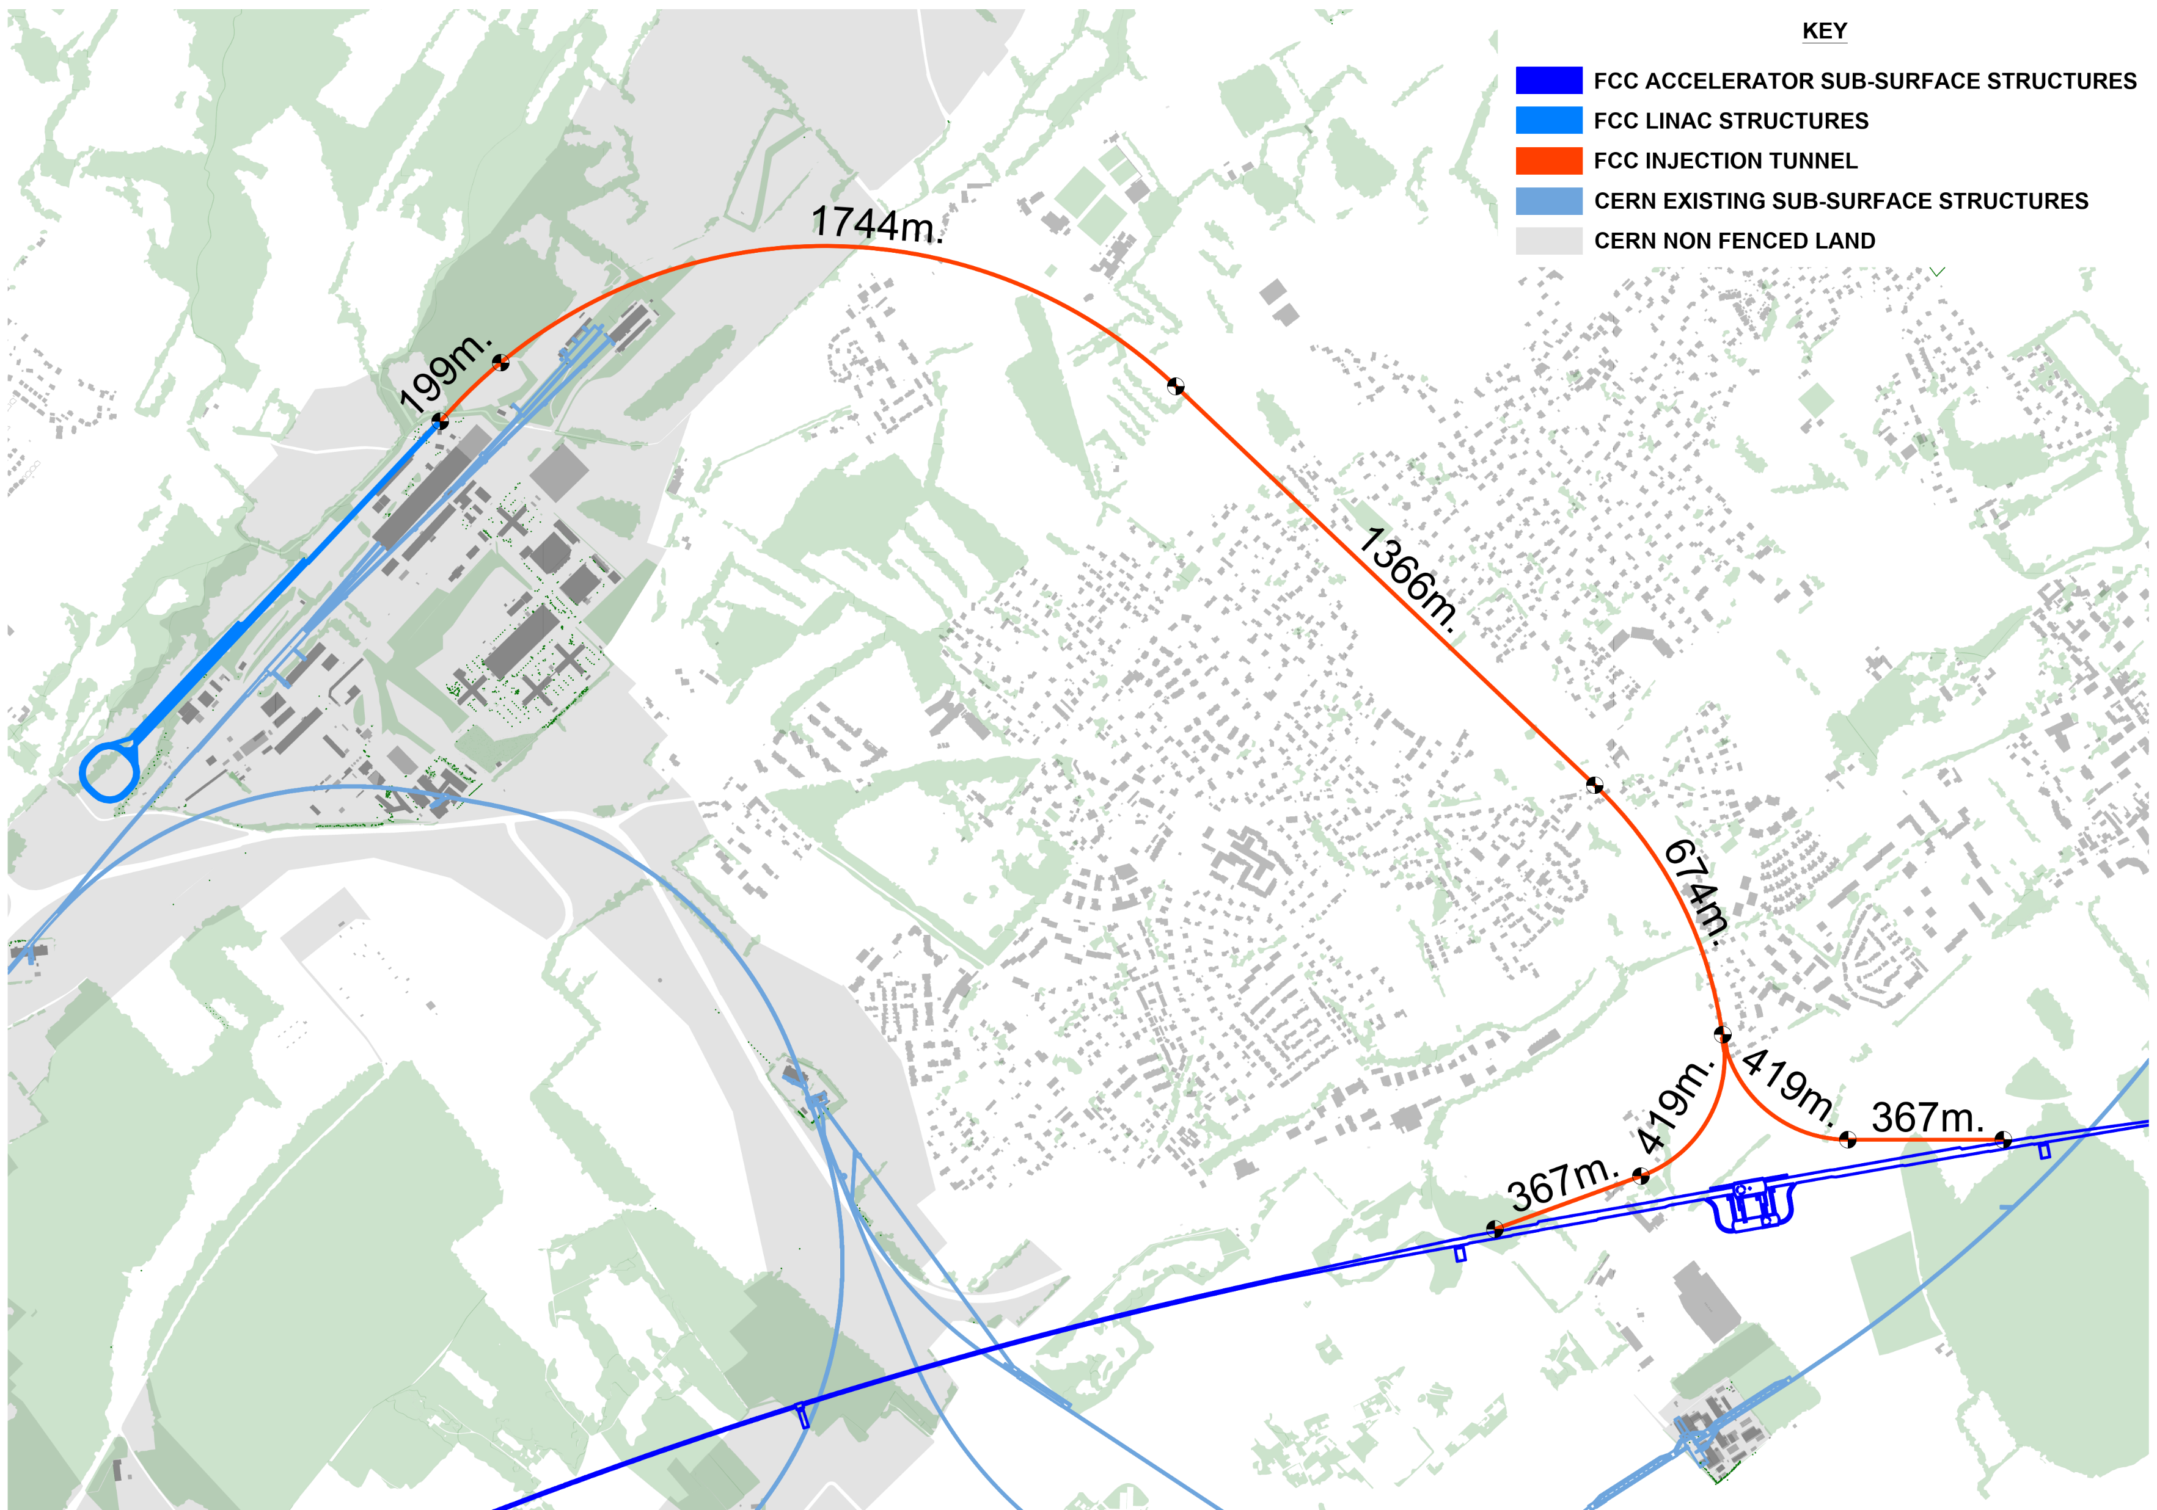
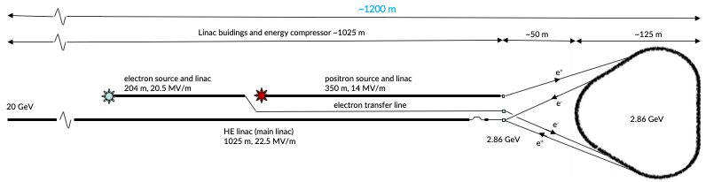
The FCC-ee injector continuously produces, conditions and accelerates e– and e⁺ bunches for top-up injection without interrupting collisions
FCC-ee – Injector
FCC-ee injector with high-energy linac
Located on CERN Prévessin site
Conventional positron source using tungsten target + capture linac, need: 1.1⨯10¹³ e⁺/s (SLC: ∼6 ⨯10¹² e⁺/s)
2.9 GeV wiggler damping ring reduces longitudinal & transverse beam emittance in ~100 ms. RF restores longitudinal momentum
Main linac ~1 km with 22.5 MV/m to accelerate e⁺ and e– to 20 GeV for injection into booster
Transfer line to FCC PA (LHC P8, LHCb), “cut and cover” construction
Total linac + damping ring length: 1.2 km
SPS
FCC
Damping ring

Slide 15
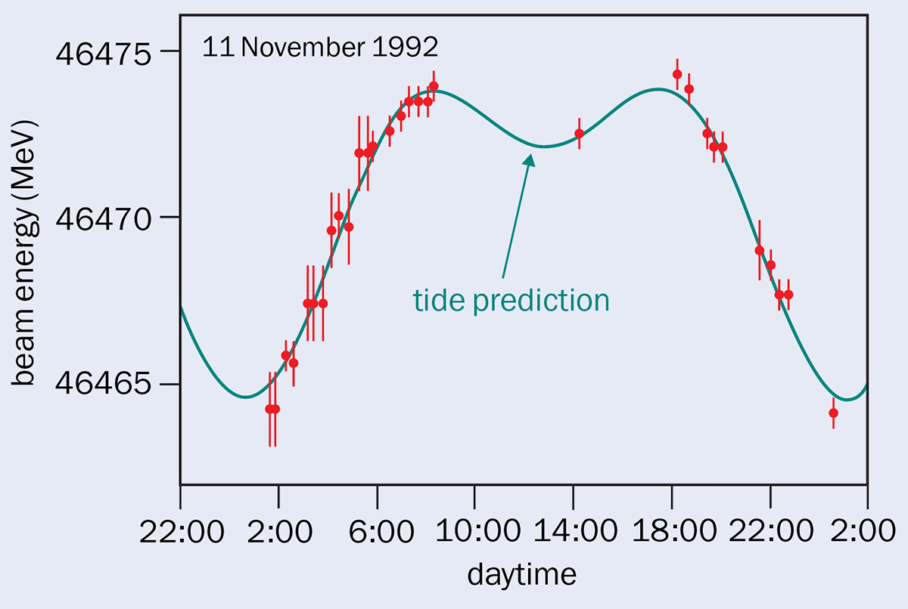
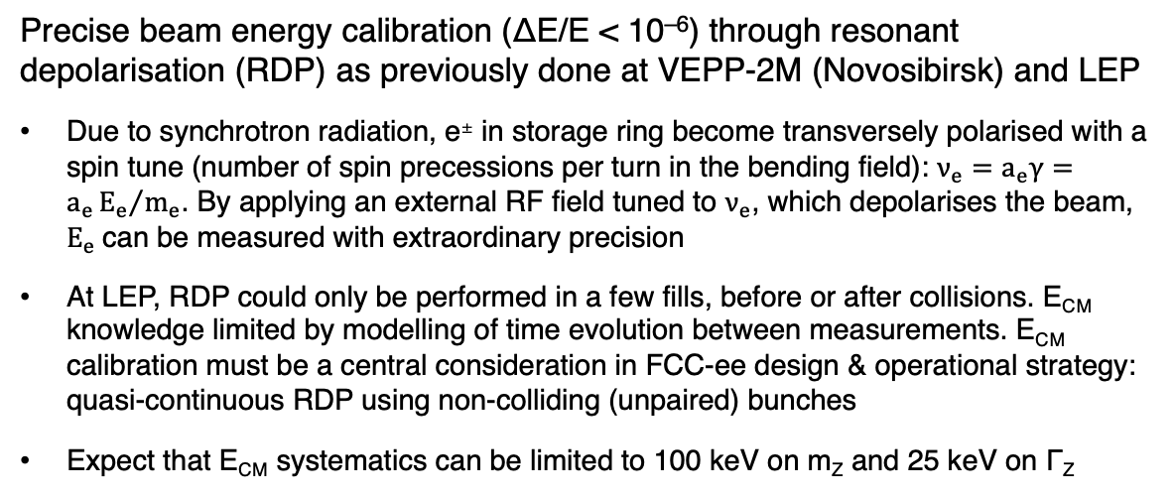
FCC-ee — beam energy
Precise knowledge of beam energy at Z pole crucial, meticulous work done at LEP to achieve
m_{Z} Γ_{Z}
LEP E_{CM} related syst. uncertainty: 1.7 MeV (1.9 × 10^{–5}) 1.2 MeV
FCC-ee statistical uncertainty: 4 keV (≪ 10^{–6}) 4 keV
Precise beam energy calibration (ΔE/E < 10^{–6}) through resonant depolarisation (RDP) as previously done at VEPP-2M (Novosibirsk) and LEP
Due to synchrotron radiation, e± in storage ring become transversely polarised with a spin tune (number of spin precessions per turn in the bending field): $ν_{e}=a_{e}γ=a_{e}{E_{e}}/{m_{e}}$. By applying an external RF field tuned to $ν_{e}$, which depolarises the beam, $E_{e}$can be measured with extraordinary precision
At LEP, RDP could only be performed in a few fills, before or after collisions. E_{CM} knowledge limited by modelling of time evolution between measurements. E_{CM} calibration must be a central consideration in FCC-ee design & operational strategy: quasi-continuous RDP using non-colliding (unpaired) bunches
Expect that E_{CM} systematics can be limited to 100 keV on m_{Z} and 25 keV on Γ_{Z}
See, eg, this CERN Courier article
~ 9 MeV
Beam energy variation at LEP from Earth tides

Slide 16
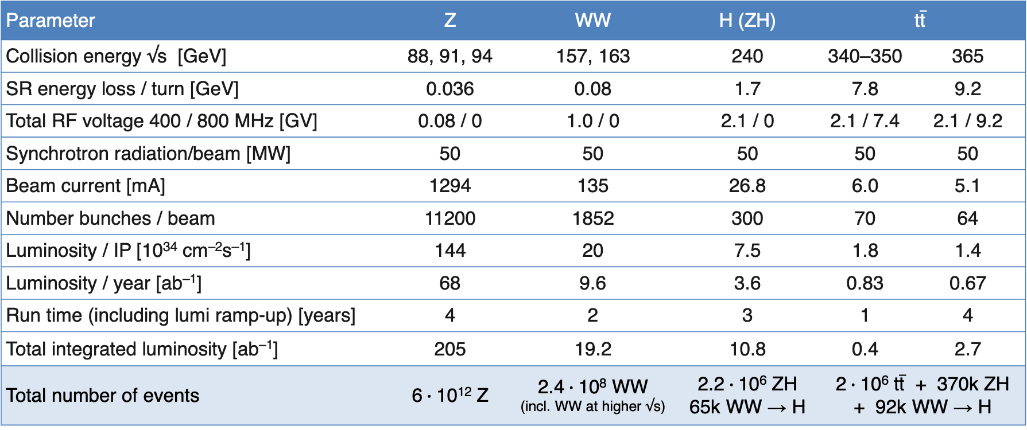

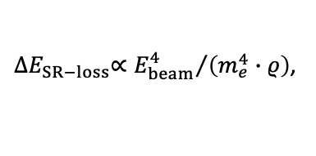
FCC-ee — parameters
${∆E}_{SR−loss}∝{E_{beam}^{4}}/{\left(m_{e}^{4}∙ρ\right)}$,
$$P_{SR}=U_{0}I, U_{0}∝E^{4}$$
FCC-ee main parameters (assuming 4 IPs / experiments)
Ref: arXiv:2505.00274
Parameter | Z | WW | H (ZH) | $$\text{t}\overline{\text{t}}$$
Collision energy √s [GeV] | 88, 91, 94 | 157, 163 | 240 | 340–350 | 365
SR energy loss / turn [GeV] | 0.036 | 0.08 | 1.7 | 7.8 | 9.2
Total RF voltage 400 / 800 MHz [GV] | 0.08 / 0 | 1.0 / 0 | 2.1 / 0 | 2.1 / 7.4 | 2.1 / 9.2
Synchrotron radiation/beam [MW] | 50 | 50 | 50 | 50 | 50
Beam current [mA] | 1294 | 135 | 26.8 | 6.0 | 5.1
Number bunches / beam | 11200 | 1852 | 300 | 70 | 64
Luminosity / IP [10³⁴ cm^{–2}s^{–1}] | 144 | 20 | 7.5 | 1.8 | 1.4
Luminosity / year [ab^{–1}] | 68 | 9.6 | 3.6 | 0.83 | 0.67
Run time (including lumi ramp-up) [years] | 4 | 2 | 3 | 1 | 4
Total integrated luminosity [ab^{–1}] | 205 | 19.2 | 10.8 | 0.4 | 2.7
Total number of events | 6$∙$10¹² Z | 2.4$∙$10⁸ WW (incl. WW at higher √s) | 2.2$∙$10⁶ ZH 65k WW → H | 2$∙$10⁶ $\text{t}\overline{\text{t}}$ + 370k ZH + 92k WW → H
~350,000 × LEP-1 (~6 years)
~26 × HL-LHC (~9 years)
~5,000 × LEP-2 (~5 years)
0.5% of HL-LHC (~9 years)
0.01% of HL-LHC (tt) (~9 years)

Slide 17
FCC-ee — parameters
${∆E}_{SR−loss}∝{E_{beam}^{4}}/{\left(m_{e}^{4}∙ρ\right)}$,
$$P_{SR}=U_{0}I, U_{0}∝E^{4}$$
FCC-ee main parameters (assuming 4 IPs / experiments)
Ref: arXiv:2505.00274
Parameter | Z | WW | H (ZH) | $$\text{t}\overline{\text{t}}$$
Collision energy √s [GeV] | 88, 91, 94 | 157, 163 | 240 | 340–350 | 365
SR energy loss / turn [GeV] | 0.036 | 0.08 | 1.7 | 7.8 | 9.2
Total RF voltage 400 / 800 MHz [GV] | 0.08 / 0 | 1.0 / 0 | 2.1 / 0 | 2.1 / 7.4 | 2.1 / 9.2
Synchrotron radiation/beam [MW] | 50 | 50 | 50 | 50 | 50
Beam current [mA] | 1294 | 135 | 26.8 | 6.0 | 5.1
Number bunches / beam | 11200 | 1852 | 300 | 70 | 64
Luminosity / IP [10³⁴ cm^{–2}s^{–1}] | 144 | 20 | 7.5 | 1.8 | 1.4
Luminosity / year [ab^{–1}] | 68 | 9.6 | 3.6 | 0.83 | 0.67
Run time (including lumi ramp-up) [years] | 4 | 2 | 3 | 1 | 4
Total integrated luminosity [ab^{–1}] | 205 | 19.2 | 10.8 | 0.4 | 2.7
Total number of events | 6$∙$10¹² Z | 2.4$∙$10⁸ WW (incl. WW at higher √s) | 2.2$∙$10⁶ ZH 65k WW → H | 2$∙$10⁶ $\text{t}\overline{\text{t}}$ + 370k ZH + 92k WW → H
Despite the constant synchrotron power, due to the larger RF voltage and system size (increased cryogenic system), RF efficiency losses, and other increasing accelerator demands, the electrical power consumption increases with CM energy:
FCC-ee elecrtical energy consumption | Z | W | H | top
Beam energy [GeV] | 45.6 | 80 | 120 | 182.5
Peak power during beam operation [MW] | 250 | 275 | 297 | 381
Total FCC-ee yearly consumption [TWh] | 1.2 | 1.3 | 1.4 | 1.85
LHC + injectors: ~ 200 MW peak power
Today CERN with LHC operating: ~1.3 TWh
Various R&D towards further reduction of electrical energy consumption

Slide 18
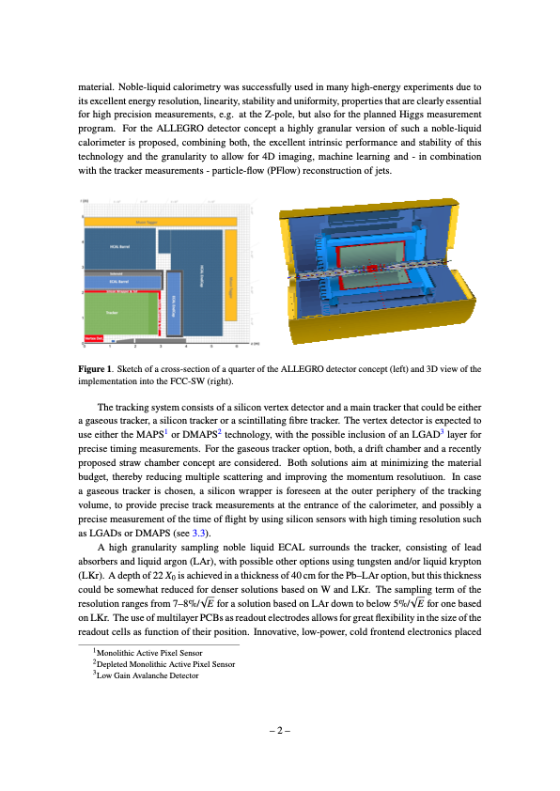
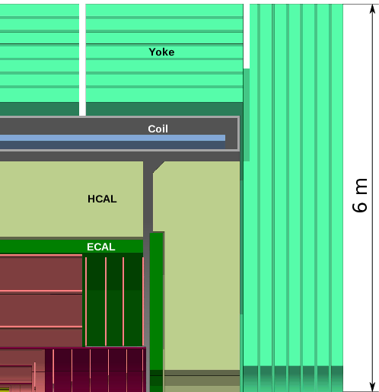
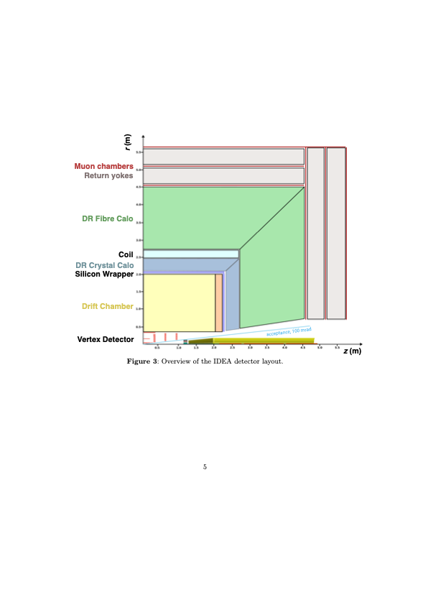
FCC-ee — detectors
*A too-strong detector solenoid (≥ 4 T) would distort the beam trajectories, induce transverse coupling, and blow up the vertical emittance — drastically reducing luminosity
Event rates and radiation are modest compared with HL-LHC, but Tera-Z precision imposes unprecedented stability and resolution demands: luminosity at 10^{–5} relative and 10^{–4} absolute precision, acceptance definition at 10^{–5}, etc. Ultimately, most measurements will be systematics- and theory-limited
Detector concepts are built around high-granularity particle-flow calorimetry, close-to-beam MAPS vertex detectors, large low-material central trackers, PID, a ~2 T solenoid, and muon tagging, with fields up to 3 T possible above the Z pole.
Dual-readout (DR) technique can in principle distinguish between EM and HAD responses in single CAL. Nevertheless, newest IDEA design proposes DR crystal ECAL and DR fibre HCAL
ALLEGRO detector concept around noble-liquid EM calorimeter [Ref]
CLD detector concept silicon-tungsten EM calorimeter and tracker [Ref]
IDEA detector concept around dual-readout (scintillation (all ionising charged particles) & Cherenkov (relativistic – e/𝛾 EM component) light) calorimeters [Ref]

Slide 19
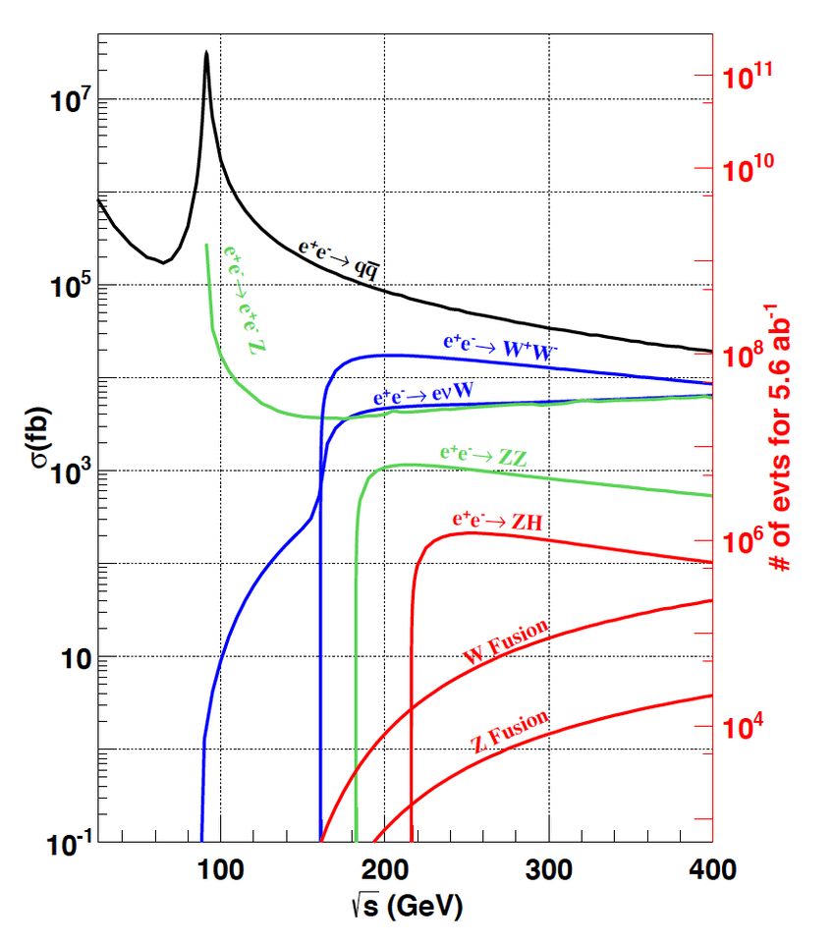
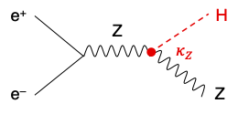
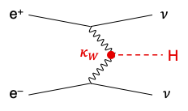
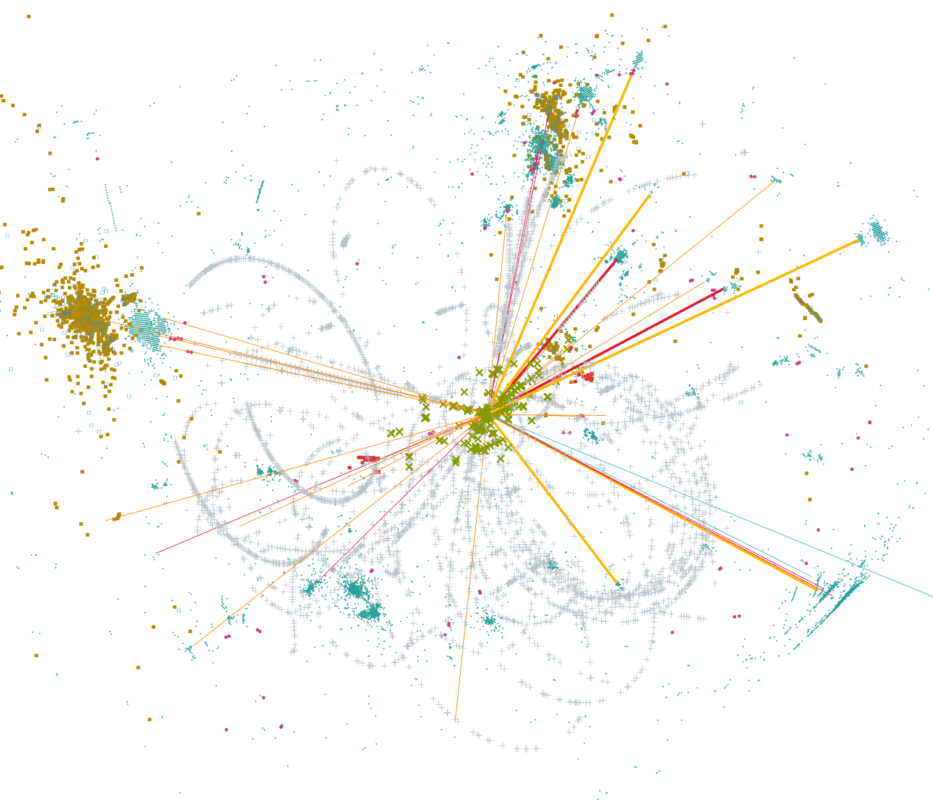
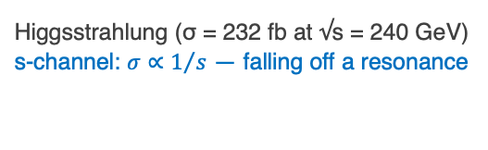
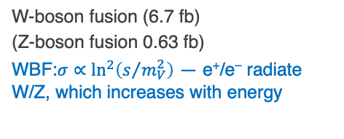
FCC-ee — Higgs Factory
e⁺e– → X cross sections versus CM energy
Primary goal: Higgs precision measurements
HZ factory
Higgsstrahlung (σ = 232 fb at √s = 240 GeV)
s-channel: $σ∝1/s$ — falling off a resonance
W-boson fusion (6.7 fb)
(Z-boson fusion 0.63 fb)
WBF:$σ∝\ln^{2}\left(s/{m_{V}^{2}}\right)$ — e⁺/e– radiate W/Z, which increases with energy
Simulated e⁺e– → ZH event at √s = 240 GeV in IDEA detector

Slide 20
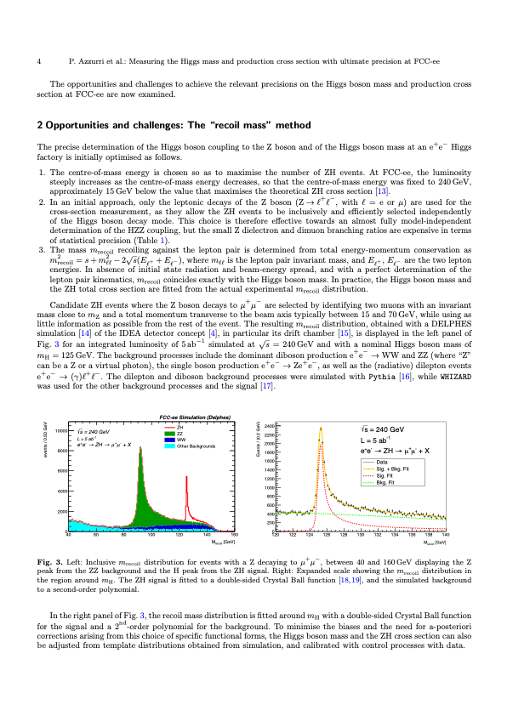




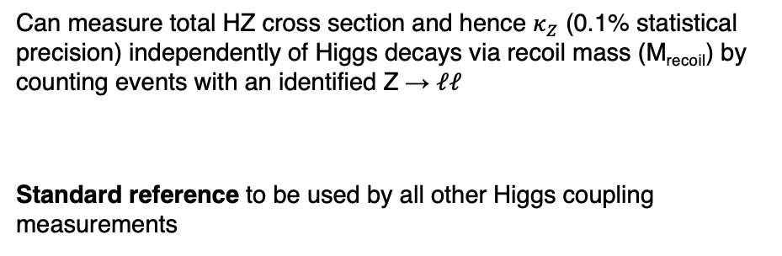
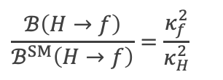
$$κ_{i}≡\frac{g_{Hi}}{g_{Hi}^{SM}}$$
$$\frac{σ_{i}}{σ_{i}^{SM}}≃κ_{i}^{2},$$
$$\frac{ℬ\left(H→f\right)}{ℬ^{SM}\left(H→f\right)}=\frac{κ_{f}^{2}}{κ_{H}^{2}}$$
FCC-ee — Higgs Factory
Higgs coupling modifiers: ➠
Absolute coupling strengths — difficult at LHC due to weak constraint on $Γ_{H}$ (current precision ~50%, HL-LHC < 25%)
Can measure total HZ cross section and hence $κ_{Z}$ (0.1% statistical precision) independently of Higgs decays via recoil mass (M_{recoil}) by counting events with an identified Z → 𝓁𝓁
Standard reference to be used by all other Higgs coupling measurements
$${σ(e}^{+}e^{−}→ZH)∝κ_{Z}^{2}$$
$$M_{recoil}^{2}={\left(\sqrt{s}−E_{ℓ^{+}}−E_{ℓ^{−}}\right)}^{2}−{\left|p_{ℓ^{+}}+p_{ℓ^{−}}\right|}^{2}$$
Higgsstrahlung (σ = 232 fb at √s = 240 GeV)
arXiv:2106.15438, see also arXiv:2512.21290
$${σ(e}^{+}e^{−}→ZH(→ZZ^{∗}))∝\frac{κ_{Z}^{4}}{Γ_{H}}$$
Combination with measurement of
allows to determine $Γ_{H}$ to 0.8% precision (30 × HL-LHC)

Slide 21
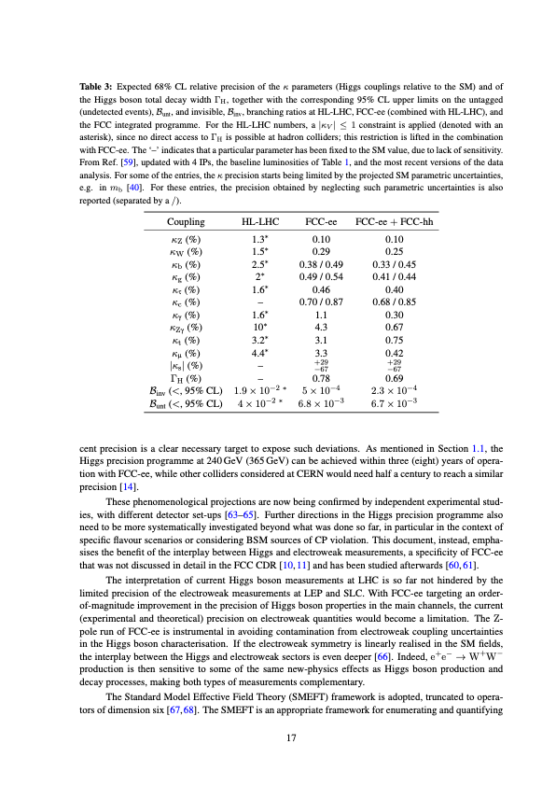


FCC-ee – the Higgs factory
Why “factory”? 2.2M Higgs (FCC-ee) vs 350M (HL-LHC), production through Higgsstrahlung rather than s-channel
→ e⁺e– collisions offer exceptionally clean Higgs reconstruction, unmatched precision on decays with large branching ratios
FCC-ee feasibility stydu (Vol 1): arXiv:2505.00272 (HL-LHC numbers updated)
Uncertainty
HL-LHC / FCC-ee
1.6
1.6
3.6
2.4
1.9
~ 40
1.8
6.8
3.4
3.0
–
< 25
0.025
0.04
16
5.5
7.3
4.4
4.1
~ 44
1.6
1.6
1.1
0.9
–
< 32
50
5.9
Most precise coupling, probes $f_{H} \sim 5.5 TeV$
*Incl. SM parametric uncertainties
*
Particularly large improvement over HL-LHC
Note: current uncertainties on Higgs branching fraction predictions O(1.5%)
BR(H → 4𝜈) = 10.6 $∙$ 10^{–4}
HL-LHC numbers updated from arXiv:2504.00672; they assume SM value for $Γ_{H}$, and incl. theoretical uncertainties (mostly dominant)

Slide 22
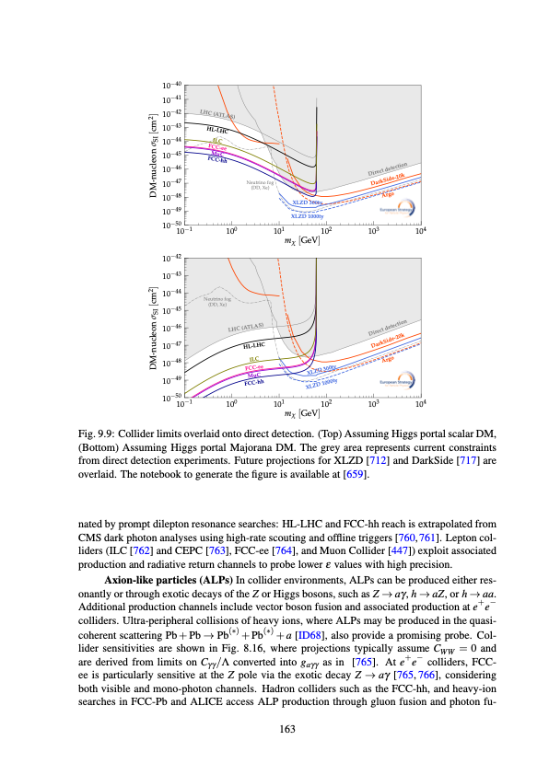
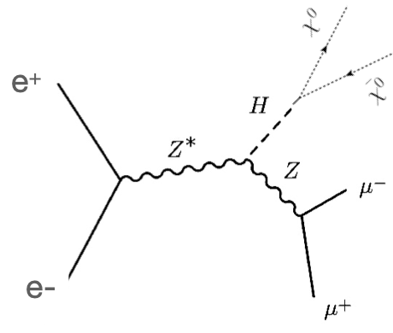
FCC-ee – the Higgs factory
Why “factory”? 2.2M Higgs (FCC-ee) vs 350M (HL-LHC), production through Higgsstrahlung rather than s-channel
→ e⁺e– collisions offer exceptionally clean Higgs reconstruction, unmatched precision on decays with large BR
FCC-ee feasibility stydu (Vol 1): arXiv:2505.00272
Uncertainty
HL-LHC / FCC-ee
1.6
1.6
3.6
2.4
1.9
~ 40
1.8
6.8
3.4
3.0
–
< 25
0.025
0.04
16
5.5
7.3
4.4
4.1
~ 44
1.6
1.6
1.1
0.9
–
< 32
50
5.9
*
Collider limits overlaid onto direct detection (Higgs portal assuming Majorana DM)
BR(H → 4𝜈) = 10.6 $∙$ 10^{–4}

Slide 23
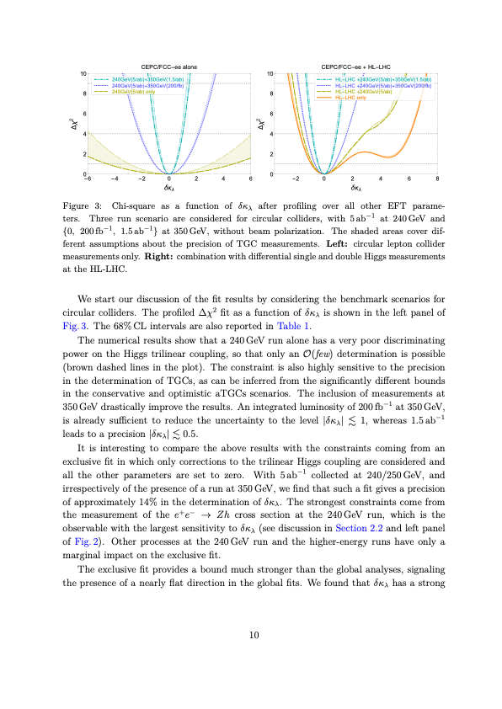
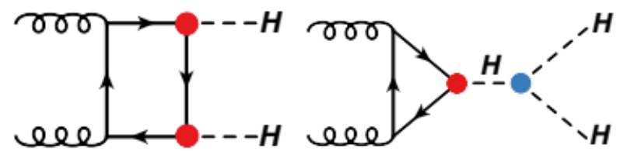
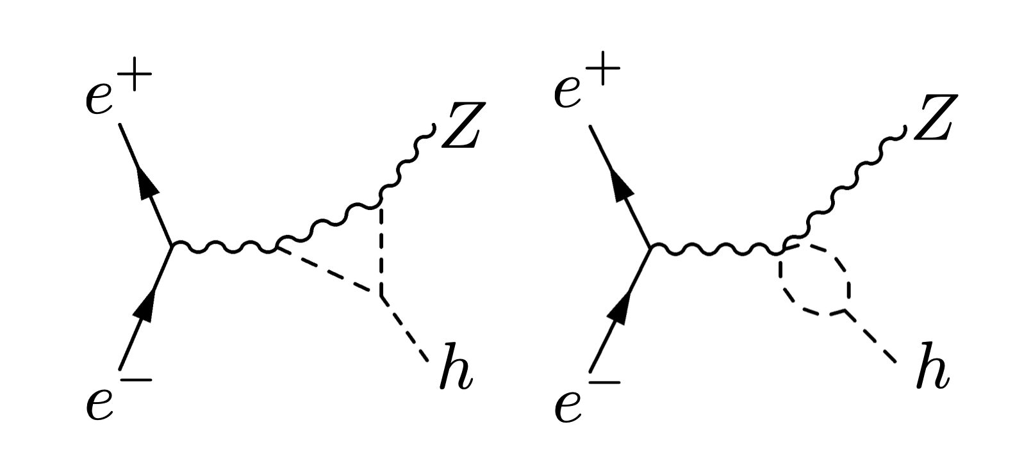







FCC-ee – the Higgs factory
Higgs self-coupling — can be determined via HH production, but e⁺e– → ZHH (m ~ 341 MeV) heavily suppressed even at E_{CM} = 365 GeV
Higgs potential:
$$V\left(φ\right)=−μ^{2}{\left|φ\right|}^{2}+λ{\left|φ\right|}^{4}$$
arXiv:1711.03978
t
$$∝6λυ=\frac{3m_{H}^{2}}{υ}$$
$$κ_{t}$$
FCC-ee has indirect sensitivity to $λ$ via H-H-H loops
$$κ_{Z}$$
$$κ_{Z}$$
H
$$κ_{λ}$$
H
H
H
H
H
NLO vertex corrections to Higgsstrahlung (similar for W-boson fusion)
Measuring σ(e⁺e– → ZH) and σ(e⁺e– → 𝜈𝜈H) at different √s improves precision on $κ_{λ}$ from 30% (HL-LHC) to 20% (or 40% standalone)

Slide 24
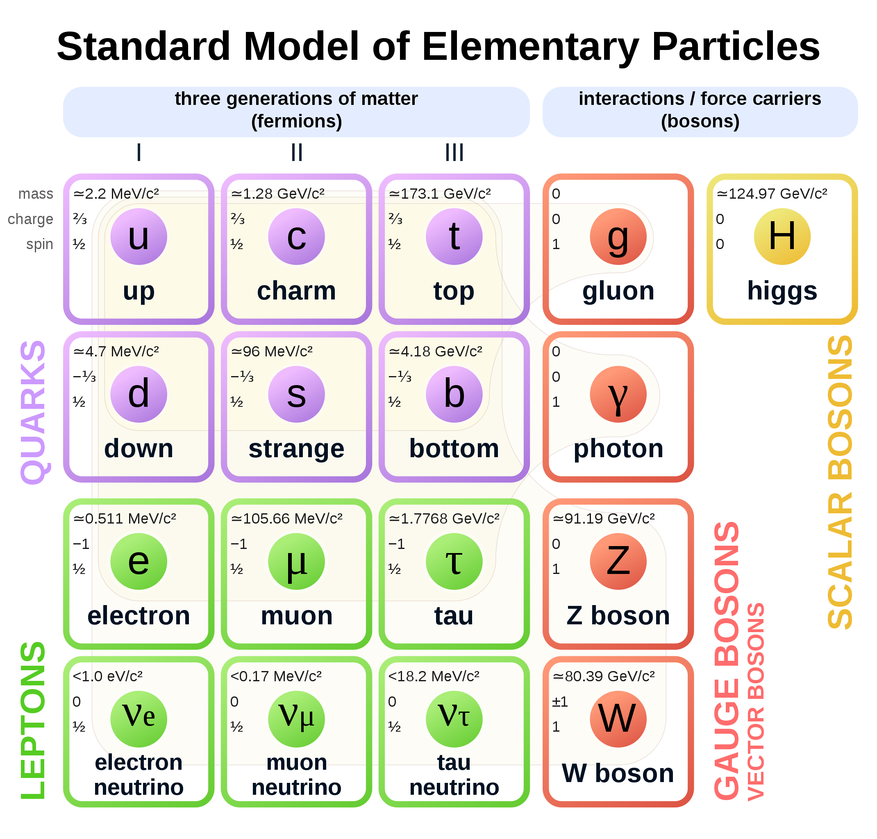

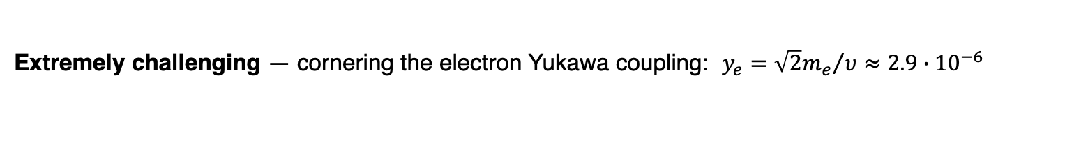
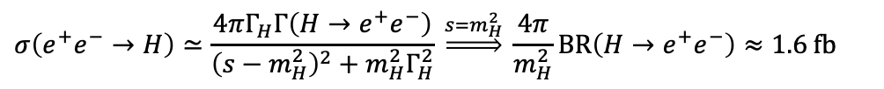
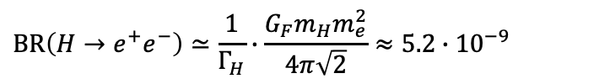
FCC-ee – the Higgs factory
Extremely challenging — cornering the electron Yukawa coupling: $y_{e}={\sqrt{2}m_{e}}/υ≈2.9∙{10}^{−6}$
Can we measure the decay? (recall: $Γ_{H}$ = 4.1 MeV)
$$BR\left(H→e^{+}e^{−}\right)≃\frac{1}{Γ_{H}}∙\frac{G_{F}m_{H}m_{e}^{2}}{4π\sqrt{2}}≈5.2∙{10}^{−9}$$
✅
✅
✅
✅
The entire HL-LHC may produce 2 such events!
e⁺
$$κ_{e}$$
At the FCC-ee, BW s-channel resonance:
H
✅
✅
✅
e–
$$σ\left(e^{+}e^{−}→H\right)≃\frac{4πΓ_{H}Γ\left(H→e^{+}e^{−}\right)}{{\left(s−m_{H}^{2}\right)}^{2}+m_{H}^{2}Γ_{H}^{2}} \underset{⇒}{s=m_{H}^{2}} \frac{4π}{m_{H}^{2}}BR\left(H→e^{+}e^{−}\right)≈1.6 fb$$
❓
✅
✅
✅
but ISR and √s spread will lead to smearing of BW peak, so that effective cross section is 0.3 fb (remember: L_{ZH} = 10.8 ab^{–1}). Can it be done?
✅
Almost all Higgs couplings to SM particles will have been measured at HL-LHC & FCC-ee

Slide 25
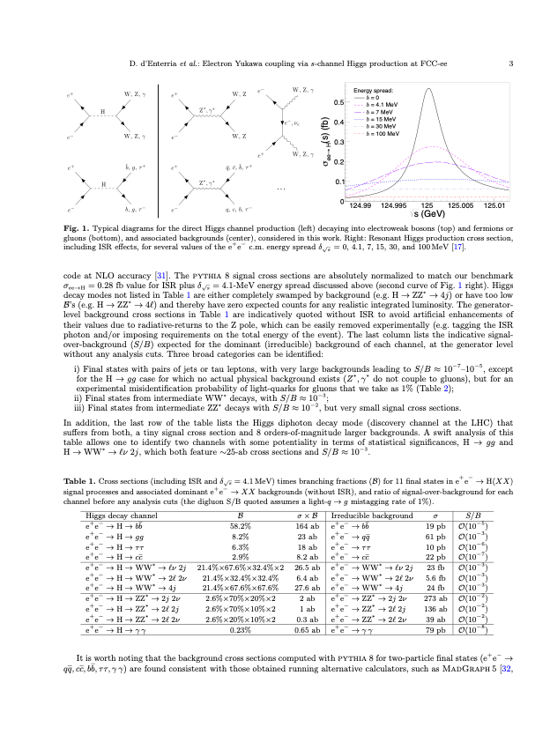
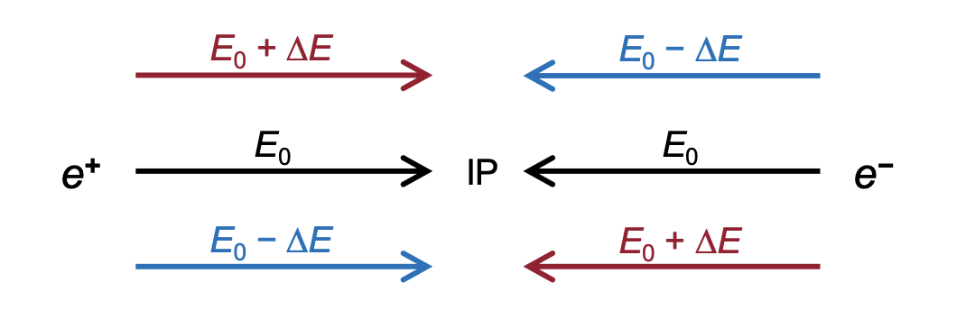
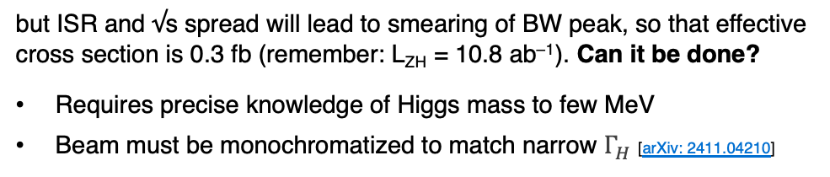
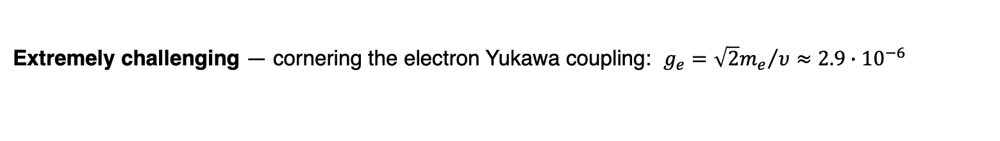
FCC-ee – the Higgs factory
Extremely challenging — cornering the electron Yukawa coupling: $g_{e}={\sqrt{2}m_{e}}/υ≈2.9∙{10}^{−6}$
Can we measure the decay? (recall: $Γ_{H}$ = 4.1 MeV)
arXiv:2107.02686
$$BR\left(H→e^{+}e^{−}\right)≃\frac{1}{Γ_{H}}∙\frac{G_{F}m_{H}m_{e}^{2}}{4π\sqrt{2}}≈5.2∙{10}^{−9}$$
The entire HL-LHC may produce 2 such events!
e⁺
$$κ_{e}$$
At the FCC-ee, BW s-channel resonance:
H
e–
$$σ\left(e^{+}e^{−}→H\right)≃\frac{4πΓ_{H}Γ\left(H→e^{+}e^{−}\right)}{{\left(s−m_{H}^{2}\right)}^{2}+m_{H}^{2}Γ_{H}^{2}} \underset{⇒}{s=m_{H}^{2}} \frac{4π}{m_{H}^{2}}BR\left(H→e^{+}e^{−}\right)≈1.6 fb$$
but ISR and √s spread will lead to smearing of BW peak, so that effective cross section is 0.3 fb (remember: L_{ZH} = 10.8 ab^{–1}). Can it be done?
Requires precise knowledge of Higgs mass to few MeV
Beam must be monochromatized to match narrow $Γ_{H}$ [arXiv: 2411.04210]
Correlate energy and transverse position so high-energy particles collide with low-energy ones (opposite beam dispersions at IP) — requires dedicated instruments: proposed for many e⁺e– colliders, but never implemented
Possible sensitivity to $g_{e}$ of ~0.5σ per year and IP

Slide 26

FCC-ee – also a Tera-Z, W and top factory
Extreme luminosity on Z pole: 140$∙$10³⁴ cm^{–2}s^{–1} / IP, 205 ab^{–1} & 6$∙$10¹² Z (4 IPs) — ultimate EW precision data
arXiv:2505.00272
Improvements up to × 300 over current knowledge
Input to global electroweak fit: requires significant improvements in theoretical predictions

Slide 27

FCC-ee – also a Tera-Z, W and top factory
Extreme luminosity on Z pole: 140$∙$10³⁴ cm^{–2}s^{–1} / IP, 205 ab^{–1} & 6$∙$10¹² Z (4 IPs) — ultimate EW precision data
arXiv:2505.00272
Improvements up to × 300 over current knowledge
Simulation of tt threshold scan with CLIC [arXiv:2503.24168]

Slide 28



FCC-ee – also a Tera-Z, W and top factory
Global electroweak fit expressed on top versus W mass
ESPPU 2025 Briefing Book and arXiv:2607.09861
Conservative theoretical uncertainty scenario

Slide 29





BR(Z → bb / cc) = 15% / 12%
Γ(Z → qq) ∝ ${(g}_{V}^{2}+g_{A}^{2})$
FCC-ee – also a flavour factory (on Z pole)
–
–
Large c and b-hadron statistics — combines strengths of Belle-II (e+e– → ϒ(4S) → BB) and LHCb (pp → bb + X)
The larger yield of B mesons than Belle II allows unmatched precision on B decays with neutrinos
arXiv:2505.00272
FCC-ee (×10⁹)
Yields for 6$∙$10¹² Z
Belle-II (×10⁹) 28 28 – – – 33 46
Yields for 50 ab^{–1}
Clean reconstruction due to boost and flavour tagging (> LHCb), excellent charm / 𝜏 separation (challenging at ϒ(4S))
Ultimate CKM angle precision (similar to LHCb)
Ultimate τ factory
B → 𝜏𝜈 allows 1% measurement of |V_{ub}| and running above WW threshold allows on-shell measurement of |V_{cb}| to ~1%
Current precision 3.5_{Vub} / 1.1_{Vcb}%, but discrepancies between exclusive and inclusive results of 17_{Vub} / 5_{Vcb}%, respectively

Slide 30
FCC-ee — projected construction cost
First stage incl. Z, WW and ZH working points. Upgrade to ttbar adds 1,260 MCHF
Domain | Cost [MCHF]
Civil engineering | 6,160
Technical infrastructures | 2,840
Injectors and transfer lines | 590
Booster and collider | 4,140
CERN contribution to four experiments | 290
FCC-ee total | 14,020
+ four experiments (non-CERN part) | 1,300
FCC-ee total incl. four experiments | 15,320
Note: First FCC-ee stage (up to ZH)
Over a period of 15 years
Human resources for construction estimated to 15,000 FTE-years

Slide 31

FCC-ee — projected construction cost
First stage incl. Z, WW and ZH working points. Upgrade to ttbar adds 1,260 MCHF
Socio-economic impact analysis (incl. investment, personnel, external effects, dismantling, …) estimates benefit–cost factor of 1.2 (net: 4.1 MCHF)
Domain | Cost [MCHF]
Civil engineering | 6,160
Technical infrastructures | 2,840
Injectors and transfer lines | 590
Booster and collider | 4,140
CERN contribution to four experiments | 290
FCC-ee total | 14,020
+ four experiments (non-CERN part) | 1,300
FCC-ee total incl. four experiments | 15,320
https://doi.org/10.5281/zenodo.10653395
Note: First FCC-ee stage (up to ZH)
Over a period of 15 years
Human resources for construction estimated to 15,000 FTE-years
90% CL lower limit

Slide 32

FCC — timeline of integrated programme
FCC-ee followed by FCC-hh
European strategy recommendation
Reference design phase
2033–2041 civil engineering construction work
2039–2043 technical infrastructure installation
2041–2045 accelerator installation

Slide 33



FCC — territorial dialogue & public participation
Public information and discussion meetings
First cycle of public information meetings between April 2024 – March 2025
11 sessions reached over 1,500 people in France & Switzerland
During 2025: Second cycle of public information meetings
Workshops with residents in municipalities potentially affected by surface sites; meetings with stakeholders of the territory
May/June – October 2026: Formal public participation process in France (Débat Public) and Switzerland (public concertation)
Workshops with residents in municipalities potentially affected by surface sites; meetings with stakeholders of the territory
Dialogue website:

Slide 34


FCC-ee — global collaboration
Increasing international collaboration is a prerequisite for success. Links with science, R&D, and high-tech industry will be essential to further advance and prepare the implementation of the FCC
38 Countries (162 Institutes)
Austria – Belgium – Brazil – Canada – CERN – Chile – Colombia – Czech Republic – Denmark – Estonia – Finland – France – Georgia – Germany – Greece – Hungary – India – Iran – Italy – Japan – Latvia – Malta – Mexico – Netherlands – Norway – Pakistan – Poland – Portugal – Republic of Korea – Romania – Serbia – Spain – Sweden – Switzerland – Thailand – Türkiye – Ukraine – United Kingdom – United States of America
FCC Week, 8–12 Jun 2026, Helsinki (609 in-person participants)
https://indico.cern.ch/event/1552126/

Slide 35

European Commission — moonshots
Recognition by the European Commission highlights the strategic value of the FCC, not only for fundamental research but also as a project fostering high-level collaboration in Europe
Link to document

Slide 36






Other e⁺e– collider options
CEPC — China
LEP3 — CERN
ILC, Main Linac — Japan
CLIC — CERN

Slide 37

CEPC — Circular (not Chinese !) Electron Positron Collider
Very similar to FCC-ee: baseline is 100 km tunnel, top-up, 30 MW / beam, 2 IPs, option for subsequent hadron collider
Parameter | Z | WW | H (ZH) | $$\text{t}\overline{\text{t}}$$
Inst. luminosity / IP [10³⁴ cm^{–2}s^{–1}] | 115 | 16 (160 GeV) | 5.0 (240 GeV) | 0.5 (360 GeV)
Integrated luminosity / year / IP [ab^{–1}] | 15 | 2.1 | 0.65 | 0.065
Run time [years] | 2 | 1 | 10 | 5
Total integrated luminosity [ab^{–1}, 2 IPs] | 60 | 4.2 | 13 | 0.65
Total number of events [2 IPs] | 2.5$∙$10¹² | 1.3$∙$10⁸ | 2.6$∙$10⁶ | 0.4$∙$10⁶
Inst. luminosity / IP [10³⁴ cm^{–2}s^{–1}] | 144 | 20 (157, 163 GeV) | 7.5 (240 GeV) | 1.8 (~350 GeV) | 1.4 (365 GeV)
Integrated luminosity / year / IP [ab^{–1}] | 17 | 2.4 | 0.9 | 0.21 | 0.17
Run time (including lumi ramp-up) [years] | 4 | 2 | 3 | 1 | 4
Total integrated luminosity [ab^{–1}, 4 IPs] | 205 | 19.2 | 10.8 | 0.4 | 2.7
Total number of events [4 IPs] | 6$∙$10¹² | 2.4$∙$10⁸ | 2.2$∙$10⁶ | 2$∙$10⁶
Collider w/o experiments:
CEPC
Total cost 4.6B USD
CEPC TDR: arXiv:2312.14363
Detector TDR: arXiv:2510.05260
FCC-ee
Total cost 13.7B + 1.3B_{tt} CHF
CEPC proposal was submitted to Chinese Academy of Science for inclusion in 15th 5-year plan in 2025, but not retained (STCF?)
CEPC plan: hope to retain funding, seek collaboration with FCC-ee, resubmit in 2030 if FCC-ee not approved by then
Also significant research on high-temperature superconducting (HTS) high-field magnets (iron based) for hadron collider

Slide 38

LEP3 — a Higgs and EW factory in the LHC tunnel
Backup if (preferred) FCC-ee cannot be realised with long-term goal of an energy-frontier hadron or muon collider: similar to FCC-ee with booster and collider rings, 2 beampipes, 50 MW / beam, 2 IPs
Parameter | Z | WW | H (ZH) | $$\text{t}\overline{\text{t}}$$
Inst. luminosity / IP [10³⁴ cm^{–2}s^{–1}] | 40 | 6.2 (160 GeV) | 1.6 (230 GeV) | –
SR energy loss / turn [GeV] | 0.13 | 1.3 | 5.4 | (~25 GeV)
Integrated luminosity / year / IP [ab^{–1}] | 4.8 | 0.7 | 0.19 | –
Run time [years] | 5 | 4 | 6 | –
Total integrated luminosity [ab^{–1}, 2 IPs] | 48 | 6.0 | 2.3 | –
Total number of events [2 IPs] | 1.4$∙$10¹² | 0.36$∙$10⁸ | 0.42$∙$10⁶ | –
Inst. luminosity / IP [10³⁴ cm^{–2}s^{–1}] | 144 | 20 (157, 163 GeV) | 7.5 (240 GeV) | 1.8 (~350 GeV) | 1.4 (365 GeV)
SR energy loss / turn [GeV] | 0.036 | 0.08 | 1.7 | 7.8 | 9.2
Integrated luminosity / year / IP [ab^{–1}] | 17 | 2.4 | 0.9 | 0.21 | 0.17
Run time (including lumi ramp-up) [years] | 4 | 2 | 3 | 1 | 4
Total integrated luminosity [ab^{–1}, 4 IPs] | 205 | 19.2 | 10.8 | 0.4 | 2.7
Total number of events [4 IPs] | 6$∙$10¹² | 2.4$∙$10⁸ | 2.2$∙$10⁶ | 2$∙$10⁶
Construction:
LEP3
Total cost 3.7B CHF
ESPPU input: arXiv:2504.00541
FCC-ee
Total cost 13.7B + 1.3B_{tt} CHF
FCC-ee SR loss reference
Challenges for LEP3 include design of IRs, large E-loss, need 6.0 GV RF power installed in 4 long straight sections (2 booster, 2 collider), crab-waist scheme requires large crossing angle and widening tunnel on either side of the experiments from ~4m to 7m diameter along 270 m
With LEP3 one must include a long-term energy-frontier plan

Slide 39

Linear Collider Facility (LCF) at CERN
Very similar to ILC: baseline is 33.5 km tunnel, 1.3 GHz niobium SRF cavities with an accelerating gradient of 31.5 MV/m, √s = 250 GeV upgradable to 550 GeV, 10 Hz repetition frequency, low/full-power (LP/FP) 1312/2625 bunches per pulse, power usage of 140–320 MW at 250–550 GeV, longitudinal polarisation (±80/30% for e–/e⁺, ~20% higher σ(ZH)), 2 IPs (sharing luminosity)
√s = 550 GeV allows access to tt+V/H, HH (~20%), increased WW fusion cross section, and extended reach for BSM searches
Conceptual view of the ILC / LCF
ESPPU input: arXiv:2503.19983
Undulator based polarised positron source

Slide 40

Linear Collider Facility (LCF) at CERN
Very similar to ILC: baseline is 33.5 km tunnel, SRF cavities with an accelerating gradient of 31.5 MV m⁻¹, √s = 250 GeV upgradable to 550 GeV, longitudinal polarisation (± 80/30% for e–/e⁺, ~20% higher σ(ZH)), 2 IPs (sharing luminosity)
Parameter | Z | WW | H (ZH) | above $\text{t}\overline{\text{t}}$
Inst. luminosity / IP [10³⁴ cm^{–2}s^{–1}] | 0.28 | – | 1.4_{LP} / 2.7_{FP} (250 GeV) | 3.9 (550 GeV)
Integrated luminosity / year / IP [ab^{–1}] | 30 | – | 0.19_{LP} + 0.64_{FP} | 2.3
Run time [years] | 1 | – | 5_{LP} + 3_{FP} | 10
Total integrated luminosity [ab^{–1}, 2 IPs*] | 0.07 | – | 1.0_{LP} + 1.9_{FP} | 8.3
Total number of events [2 IPs*] | 0.002$∙$10¹² | – | 0.8$∙$10⁶ | ~ 1.6 (H) / 3.9 (tt)$∙$10⁶
Inst. luminosity / IP [10³⁴ cm^{–2}s^{–1}] | 144 | 20 (157, 163 GeV) | 7.5 (240 GeV) | 1.8 (~350 GeV) | 1.4 (365 GeV)
Integrated luminosity / year / IP [ab^{–1}] | 17 | 2.4 | 0.9 | 0.21 | 0.17
Run time (including lumi ramp-up) [years] | 4 | 2 | 3 | 1 | 4
Total integrated luminosity [ab^{–1}, 4 IPs] | 205 | 19.2 | 10.8 | 0.4 | 2.7
Total number of events [4 IPs] | 6$∙$10¹² | 2.4$∙$10⁸ | 2.2$∙$10⁶ | 2$∙$10⁶
Construction:
LCF
Total cost:
8.5B CHF (250 GeV, LP)
9.3B CHF (250 GeV, FP)
14.8B CHF (550 GeV)
ESPPU input: arXiv:2503.19983
Total cost 15.3B CHF
FCC-ee
*LCF proposes to share luminosity among two interaction regions, ie, same integrated luminosity as for single IP
Challenges for for LCF include the positron source, final focus and nano-beam stability ($σ_{y}^{∗}$ ~ 6–8 nm, FCC-ee: 40 nm)
Options to increase energy beyond 550 GeV with development and installation of higher gradient accelerating technologies (see here for a discussion of options)

Slide 41


Other collider options for CERN
Compact Linear e⁺e– Collider (CLIC): √s = 380 GeV – 1.5 TeV, two-beam acceleration with high-current 12 GHz RF drive beam to reach up to 100 MV/m gradient in main-beam cavities, 100 Hz repetition rate, 0.5 ns bunch separation, 1.5–2 nm IP
Multiple test facilities were built at CERN, the latest, CTF3, demonstrated the drive-beam concept, but a larger-scale demonstrator is needed to fully validate the concept under realistic operating conditions → requires more R&D
Running at 1.5 TeV allows direct access to 𝜅_{λ} via ZHH and 𝜈𝜈HH (𝜅_{λ} = 1 , L = 2.5 ab^{–1} in 6 yr)
+0.11
–0.08
LC-550
CLIC-1.5
ESPPU input: arXiv:2503.24168
arXiv:1901.05897

Slide 42

Other collider options for CERN
Compact Linear e⁺e– Collider (CLIC): √s = 380 GeV – 1.5 TeV, two-beam acceleration with high-current 12 GHz RF drive beam to reach up to 100 MV/m gradient in main-beam cavities, 100 Hz repetition rate, 0.5 ns bunch separation, 1.5–2 nm IP
Multiple test facilities were built at CERN, the latest, CTF3, demonstrated the drive-beam concept, but a larger-scale demonstrator is needed to fully validate the concept under realistic operating conditions → requires more R&D
Running at 1.5 TeV allows direct access to 𝜅_{λ} via ZHH and 𝜈𝜈HH (𝜅_{λ} = 1 , L = 2.5 ab^{–1} in 6 yr)
+0.11
–0.08
LC-550
CLIC-1.5
ESPPU input: arXiv:2503.24168
arXiv:1901.05897
LHeC electron–proton/ion collider: 50 GeV e−beam (√s = 1.2 TeV) with 1 GW power from innovative multi-pass energy recovery linac (ERL), up to 1 ab^{–1} in 6 years (HERA: √s = 320 GeV, 2 × 0.5 fb^{–1}) [ESPPU input: arXiv:2503.17727, see also this nice talk]
ERL test facility PERLE under construction at IJCLab (start 2029), success of LHeC relies on ERL concept to work as planned
Excellent PDF and QCD precision, 200k H allow precise measurements of 𝜅_{c}, 𝜅_{b}, 𝜅_{W}, 𝜅_{Z} (but Higgs yield strongly dependent on achieved e–beam power)
(P2)

Slide 43

Assessment of proposed colliders by expert group
[Link to ESG WG2a report]
(1–9)
Muon Collider: Technologies in early phases of exploration, large R&D programme defined (300 MCHF, 1800 FTEy), demonstrator required
FCC-hh: Further R&D and industrialisation with cost reduction of high-field magnets (Nb₃Sn 15–20 y, HTS ?)
LEP3: No detailed lattice design & full-scale simulation, proposed baseline HTS nested quadrupoles/sextupoles has lowest TRL
LHeC: Performance relies on very high current Energy-Recovery Linac (ERL), large luminosity uncertainty, PERLE @ IJCLab required

Slide 44

Assessment of physics reach
[Link to ESG WG2b report]
BSM
SM
e⁺e– colliders only
pp (+ e⁺e–) collider
High-E e⁺e– collider
μμ (+ e⁺e–) collider

Slide 45
Conclusions
FCC-ee is Europe’s priority for CERN’s next collider project: a transformative instrument for exploring the Higgs boson, the electroweak sector, and the quantum structure of fundamental interactions with unprecedented precision
A detailed feasibility study has been released, and the project is now moving towards a reference design, with a possible CERN Council decision around 2028
FCC-ee is also the foundation for the future energy frontier, enabling a subsequent hadron collider in the same infrastructure — a highly synergistic and complementary programme that maximises the long-term physics reach

Slide 46
Extra slides …

Slide 47

FCC-ee — parameters
${∆E}_{SR−loss}∝{E_{beam}^{4}}/{\left(m_{e}^{4}∙ρ\right)}$,
$$P_{SR}=U_{0}I, U_{0}∝E^{4}$$
Global data-centre electricity use is projected to rise from 460 TWh in 2024 (1.5% of total electricity consumption) to 1,000 TWh (±25%) by 2030 and 1,300 (±40%) TWh by 2035 (~15% annual raise), driven mainly by the US and China. The AI share may grow from 10~20% today to 30~50% in 2035.
Reference: International Energy Agency,
see also this critical review of the modelling
Aerial view of Microsoft’s new AI datacenter in Mt Pleasant, Wisconsin, Sep 2025 [Link]
Despite the constant synchrotron power, due to the larger RF voltage and system size (increased cryogenic system), RF efficiency losses, and other increasing accelerator demands, the electrical power consumption increases with CM energy:
FCC-ee electrical energy consumption | Z | W | H | top
Beam energy [GeV] | 45.6 | 80 | 120 | 182.5
Peak power during beam operation [MW] | 250 | 275 | 297 | 381
Total FCC-ee yearly consumption [TWh] | 1.2 | 1.3 | 1.4 | 1.85
LHC + injectors: ~ 200 MW peak power
Today CERN with LHC operating: ~1.3 TWh
Various R&D towards further reduction of electrical energy consumption

Slide 48



High-energy frontier, longer term R&D projects
Significantly expanding the reach for new physics requires a new energy frontier, which are long-term R&D projects
FCC-hh: current baseline is 85 TeV based on 14 T Nb₃Sn high-field magnet technology, L = 30$∙$10³⁴ cm^{–2}s^{–1}, pileup 1000, 20 ab^{–1} / IP in 20 years of operation
Challenges: industrial production & cost control of magnets, beam screens (1200 kW synchrotron radiation vs 7.3 kW at HL-LHC), safety: 10 × stored energy of HL-LHC (6.5 vs 0.7 GJ), power consumption: 1.9 or 4.5 K helium cooling (2.5 vs 2.0 TWh annual)
Detector design: much of the SM physics (low Bjorken-x) peaks forward (Higgs produced up to rapidity of ~ 6.5 (0.3 deg) (up to 2.5 (9 deg) at LHC), Detector granularity will be critical: decay product of a Z at 10 TeV separated by Δ𝑅 ∼ 0.01
Superb BSM physics reach, Higgs & SM programme, incl. few % on 𝜅_{λ}
FCC-hh ESPPU input
H → 4𝓁 @ 100 TeV

Slide 49

High-energy frontier, longer term R&D projects
Significantly expanding the reach for new physics requires a new energy frontier, which are long-term R&D projects
Muon collider: best of all worlds? High energies (3–10 TeV), high luminosities with excellent luminosity per MW ratio, (relatively) clean lepton collision events
Challenges: muon production (MW-scale proton drivers, robust targets, ~20 T capture solenoids), ionisation cooling (longitudinal & transverse (6D) emittance reduction via absorbers + RF in strong B-fields), acceleration by series of high-energy rapid-cycling synchrotrons with fast rising magnets, collision — all within ~0.1 s, detector backgrounds, high neutrino flux (>3 TeV)
Demonstrator facility needed before full realisation
Superb BSM physics reach, Higgs & SM programme
Muon Collider ESPPU input
Conceptual layout of a muon collider

Slide 50

FCC-ee — projected acceptance
Does the average taxpayer in CERN’s member states support a new accelerator at CERN?
A public perception study assessed quantitative indicators for drivers as basis for evidence-based actions
How much of their taxes would citizens be willing to allocate to a new collider project at CERN?
Study based on accredited methodology, passed through an ethics committee and carried out with an independent, domain specific quality management certified support company.
Link to article: https://inspirehep.net/literature/3155013
In general, the offered amounts exceed significantly the actual contribution of a taxpayer to CERN
66% of respondents expressed their willingness to financially support a new collider at CERN with their annual taxes. 34% reported zero willingness to support
Positive opinions raised from 58% to 78%, negative fell from 18% to 2% after receiving specific CERN related information

Slide 51


HL-LHC Physics prospects — Higgs
Higgs coupling prospects | Coupling strength modifiers ($κ_{i}^{2}≡{σ_{i}}/{σ_{i}^{SM}}$, assuming SM $Γ_{H}$)
Prospects for Higgs width from off-shell measurement, invisible Higgs decays, Higgs sector extensions (2HDM)
Γ_{H} via μ_{off-shell} / μ_{on-shell} in H → 4𝓁 & 2𝓁2𝜈 with < 20% uncertainty
BR(H → invisible) < 2.5%
Discover or exclude MSSM two Higgs doublets scenario deep into TeV scale for tanβ > 6
In SILH 5.0% (1.6%) precision on $κ_{i}$ probes compositeness scale $f_{H} \sim$ 1.1 (1.9) TeV
Even with 2× better theory precision, theoretical uncertainties will be dominant
Unique sensitivity to rare decays and to top coupling
51

Slide 52






HL-LHC Physics prospects — Higgs
Higgs self-coupling via Higgs pair production: complex final states, eldorado for ML enthusiasts, strongest channels: HH → bb𝛾𝛾, bb𝜏𝜏, bbbb. Best sensitivity to $λ$ at low m(HH)
t
arXiv:2504.00672
$$∝6λυ=\frac{3m_{H}^{2}}{υ}$$
$$κ_{t}$$
$$V\left(φ\right)=−μ^{2}{\left|φ\right|}^{2}+λ{\left|φ\right|}^{4}$$
$$κ_{λ}≡{λ_{3}^{obs}}/{λ^{SM}}$$
For SM:
Expect HH observation > 7σ
$κ_{λ}$ precision better than 30%

Slide 53


FCC-ee – also a Tera-Z, W and top factory
Global electroweak fit: indirect constraints on new physics via “oblique parameters”
ESPPU 2025 Briefing Book and arXiv:2607.09861
Conservative theoretical uncertainty scenario

Slide 54

Power efficiency: next-generation e⁺e– collider
FCC-ee vs LEP: larger bending radius, more efficient superconducting RF, improved beam optics (higher beam-beam performance limits), ultra-low emittance magnet lattices, crab waist scheme, continuous top-up injection via booster (always near optimal luminosity), power-optimised from the start
Figure reference
FCC-ee delivers 10⁴ – 10⁵ × luminosity / electrical power of LEP

Slide 55
The big picture: next-generation collider projects for CERN
Project | Construction start | First beams | Peak lumi at Z per IP [10³⁴ cm^{–2}s^{–1}] | Peak lumi at HZ per IP [10³⁴ cm^{–2}s^{–1}] | Years of operation | Construction cost* [BCHF] | Next stage collider | Start of operation | Total construction cost* [BCHF]
FCC-ee | 2033 | 2046 | 144 | 7.5 | 14 | 15.3 | FCC-hh | 2079 | 34.7
LEP3 | 2037 | 2047 | 40 | 1.6 | 15 | 4.1 | FCC-hh | 2074 | 32.5
LCF 250 → 550 GeV | 2035 | 2045 | 0.28 | 1.4 – 2.7 | 19 | 9.4 + 5.4 = 14.8 | > 1 TeV collider? | – | –
CLIC 380 → 1500 GeV | 2035 | 2045 | – | 1.2_{380 GeV} | 20 | 7.5 + 7.1 = 14.6 | 3 TeV collider? | – | –
LHeC | 2037 | 2044 | – | 2.3 | 7 | 2.1 | FCC-hh | 2064 | 30.5
Similar start dates driven by HL-LHC running until 2041
*Construction costs include experiments

Slide 56

ESG recommendations
[Link to document, Karl’s talk]
General Recommendations

Slide 57

ESG recommendations
[Link to document, Karl’s talk]
The next CERN flagship collider project

Slide 58

ESG recommendations
[Link to document, Karl’s talk]
Technology

Slide 59

The European Strategy for Particle Physics – Update (ESPPU)
From Karl’s talk

Slide 60

Overall summary
[From Karl’s talk]
Physics: from WG2b: sum of precision/BSM physics
Phys vs CEPC: competitiveness, assuming CEPC is running in parallel
Tech readiness: from WG2a
Construction cost: from proponents + exp. (CERN part)

