Slide 1
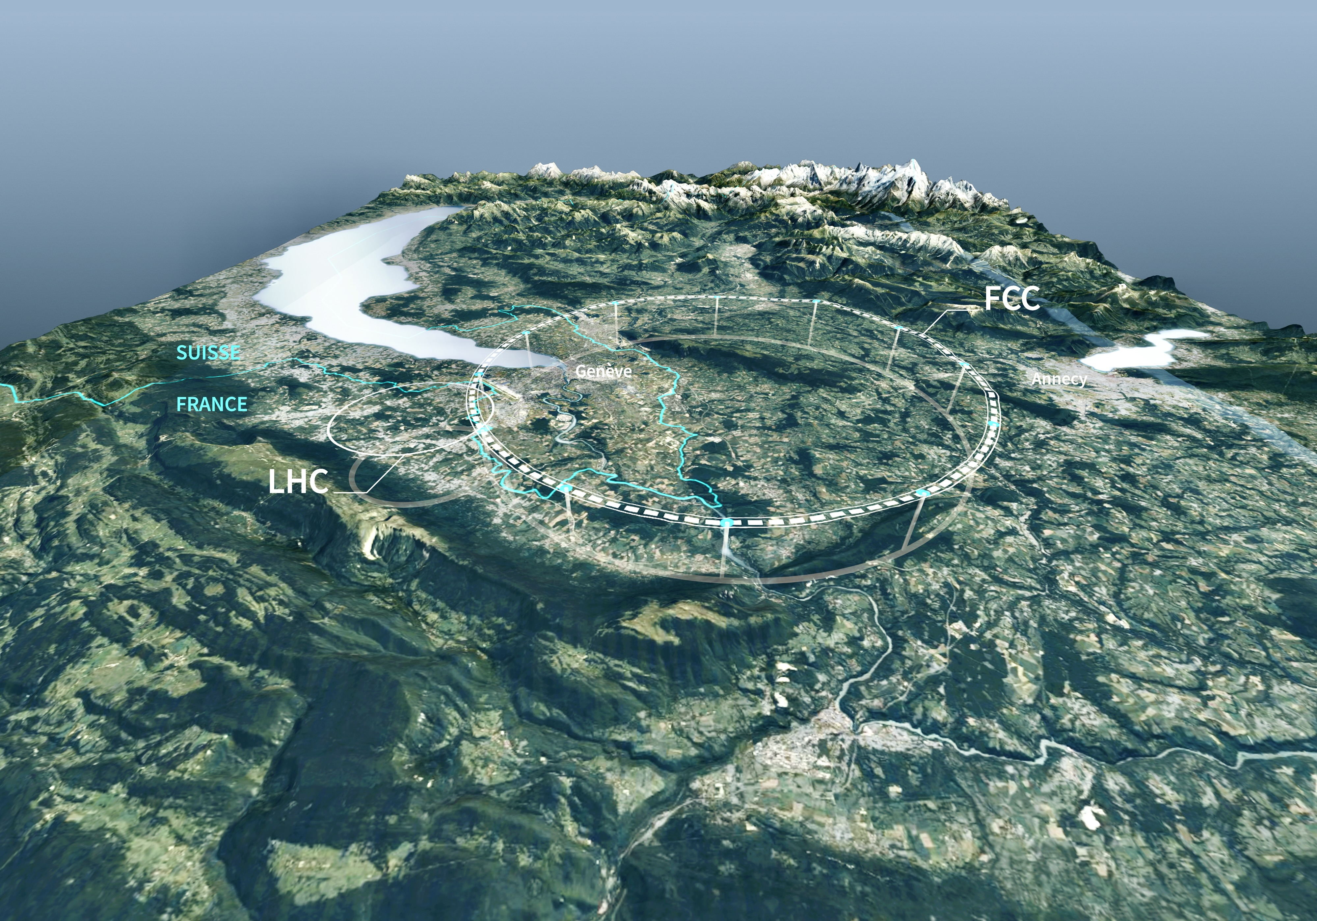
Future Circular Collider (FCC)
Europe’s Next-Generation Flagship Particle Physics Project at CERN
Andreas Hoecker (CERN), Les Rencontres de Noirmoutier, 3 June 2026

Slide 2
Future Circular Collider (FCC)
Europe’s Next-Generation Flagship Particle Physics Project at CERN
Andreas Hoecker (CERN), Les Rencontres de Noirmoutier, 3 June 2026
High-energy physics has an environmental footprint driven by high power demands, large-scale infrastructures, and specialised detector technologies
Unlike previous large-scale accelerator projects, sustainability considerations have been integrated into the FCC design from the outset
Sustainability involves environmental impact, economic viability, and societal benefit
In this talk, I will introduce the project and its scientific goals, while highlighting the associated environmental challenges along the way

Slide 3

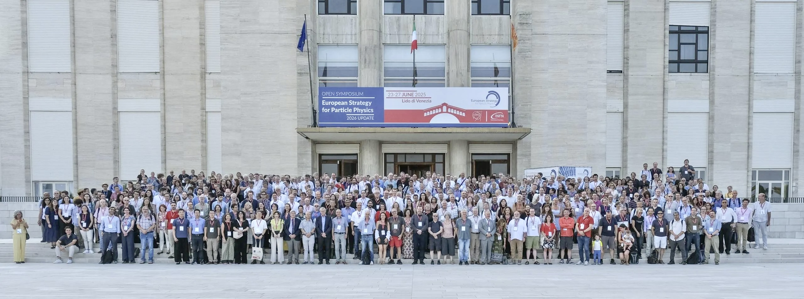
The European Strategy for Particle Physics
Open Symposium, European Strategy of Particle Physics, 23–27 Jun 2025, Venice Lido [Link]

Slide 4
The European Strategy for Particle Physics
Cornerstone of Europe’s decision-making process for the long-term future of the field
Mandated by CERN Council, the Strategy is formed through a broad consultation of the particle physics communities in Europe and worldwide (266 individual and national submissions, 2-year process)
In the Strategy process, recommendations are developed which are submitted to the CERN Council for an update of the Strategy
It is not a project approval process; projects are approved by the CERN Council through a separate decision process, taking the Strategy recommendations into account
Original Strategy (2006): LHC, mooting of luminosity upgrade of LHC, R&D in accelerator technologies, coordination with a potential ILC project
1st Update (2013): High Luminosity LHC, need for a post-LHC programme
2nd Update (2020): FCC feasibility study
3rd Update (2026): Recommendation for the next large-scale accelerator project at CERN

Slide 5
The European Strategy for Particle Physics
Main recommendations of the 2026 strategy update
The full exploitation of the physics potential of the LHC and the HL-LHC and the completion of the high-luminosity upgrade remain the highest priorities of European particle physics. Every effort must be made to complete the HL-LHC upgrade within the current schedule
The electron–positron Future Circular Collider (FCC-ee) is recommended as the preferred option for the next flagship collider at CERN
A descoped FCC-ee* is the preferred alternative option for the next flagship collider at CERN *No ttbar run: –1.26 BCHF, drop 2 / 4 experiments: –0.80 BCHF, decrease RF power from 50 → 30 MW (–0.35 BCHF)
The particle physics community should continue and intensify its efforts to develop and adopt sustainable solutions
…
Links: CERN Council resolution, Recommendations, Briefing book, All documents, More information, CERN Colloquium by Karl Jakobs

Slide 6
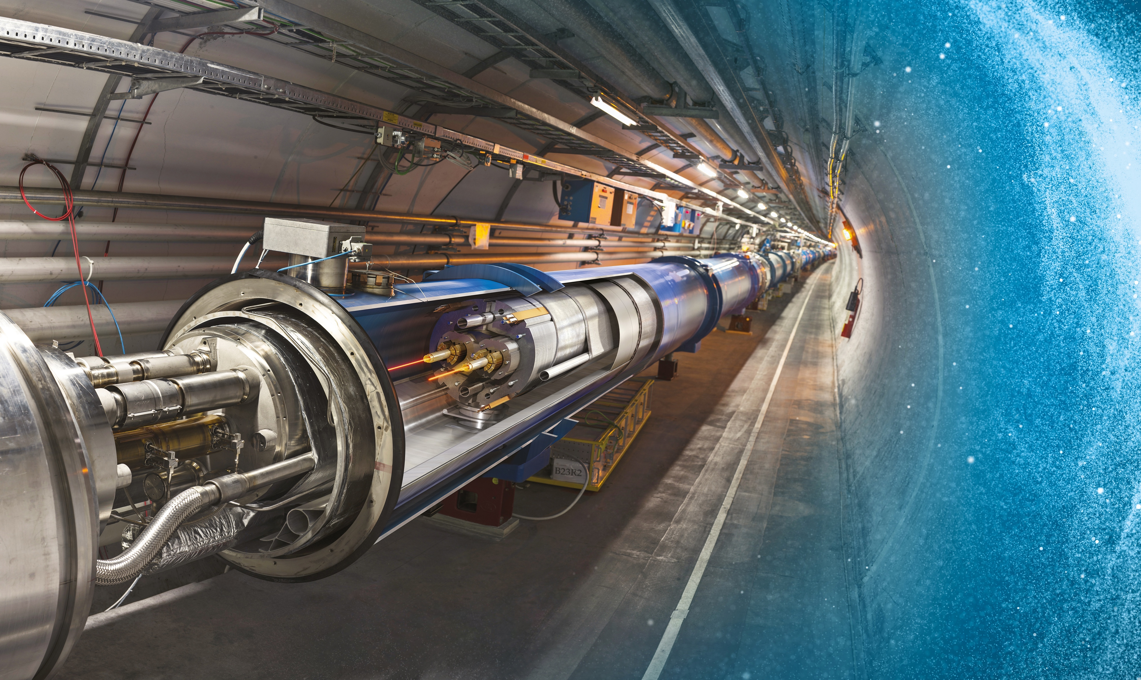
Large Hadron Collider (LHC) at CERN: the world’s largest accelerator reaching unprecedented energy and intensity
27 km underground accelerator and collider
Superconducting magnets (1.9 K = –271.3 °C) steer the particles around the ring
Proton and ions are accelerated to multi-TeV scale energies before they collide
6

Slide 7
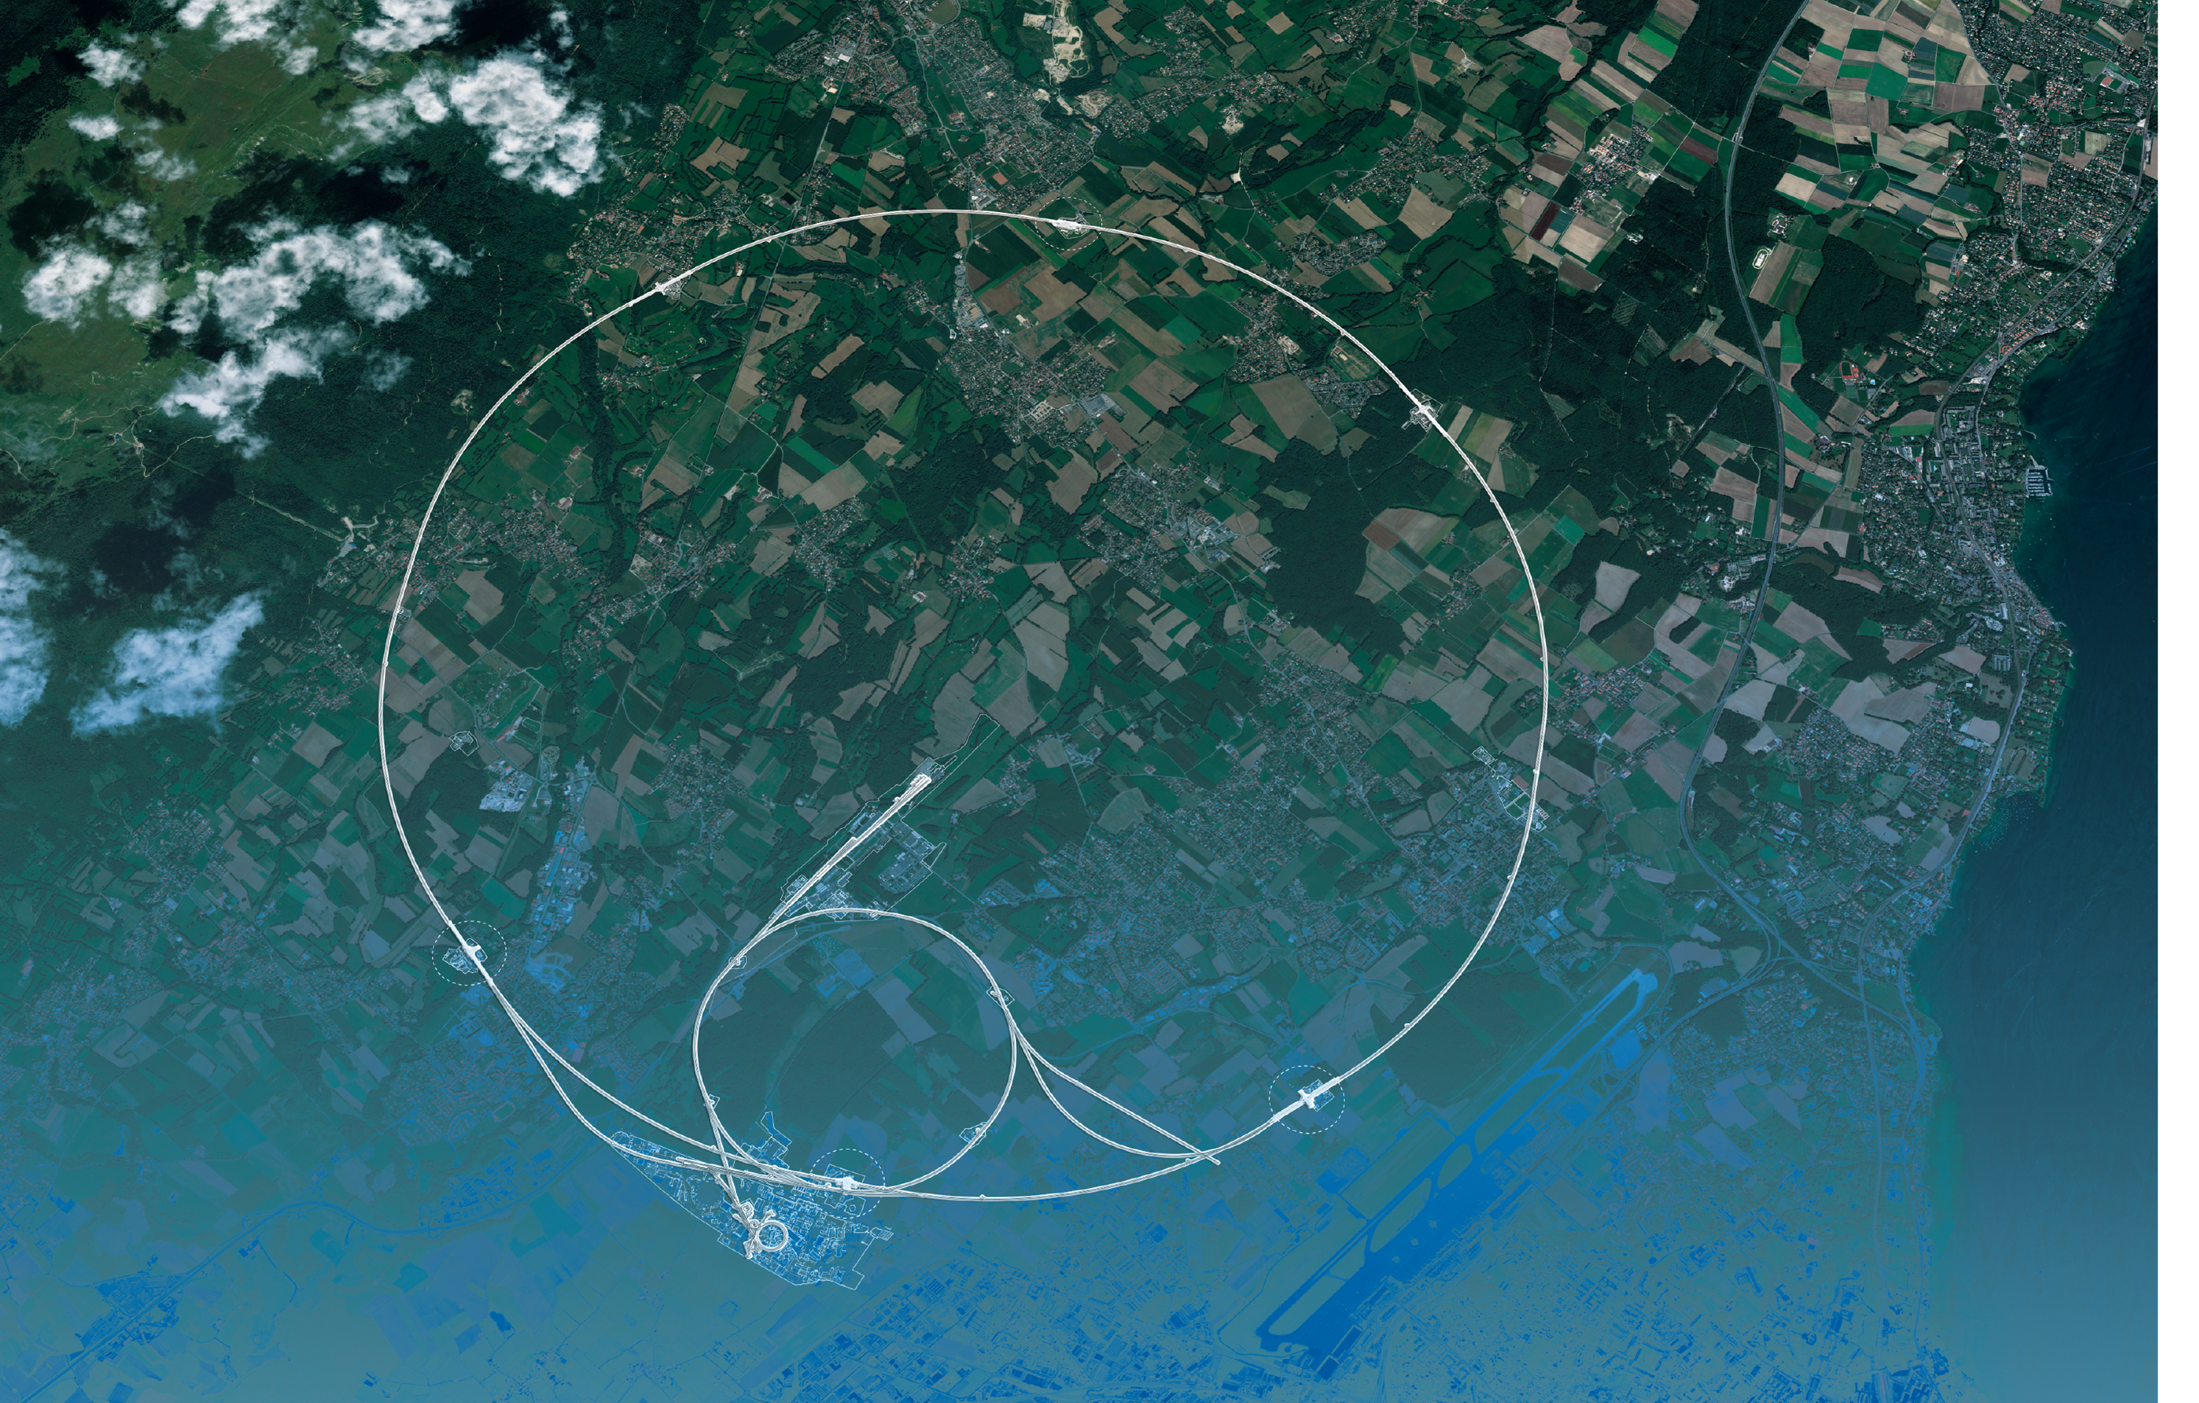
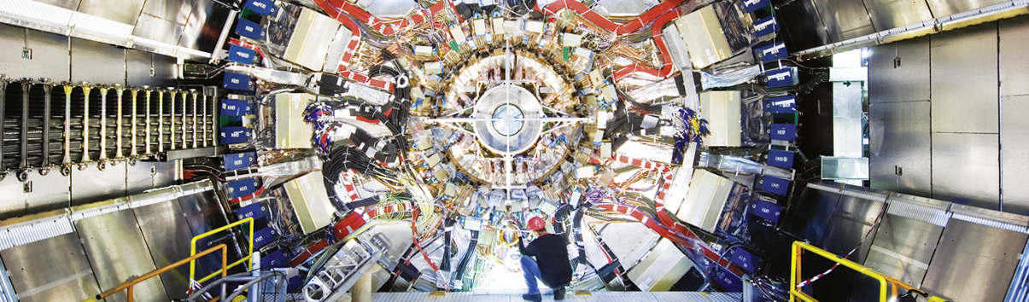
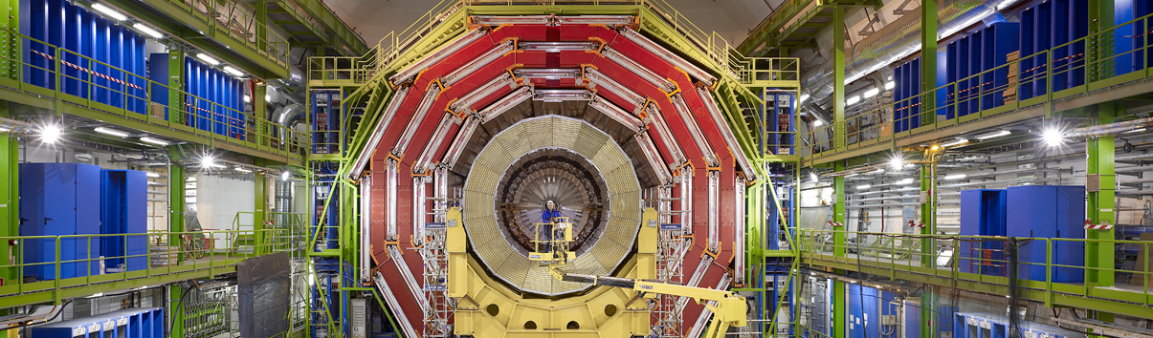
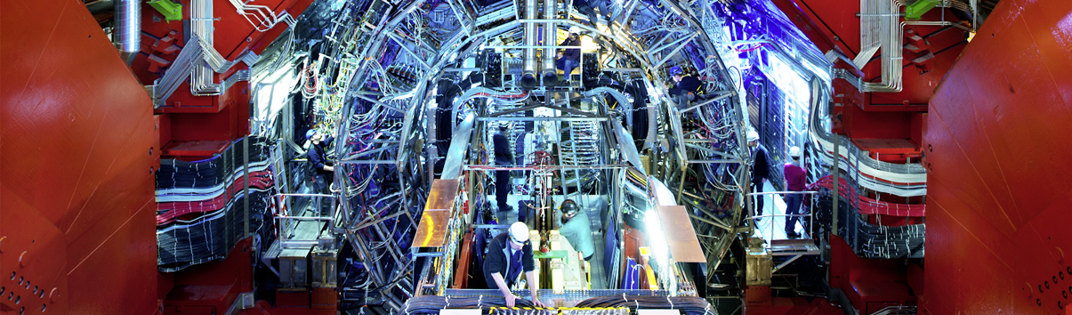
LHC and Experiments
CMS
ATLAS
LHC
CMS
ALICE
SPS
ALICE
LHCb
ATLAS
LHCb
PS
All experiments are global collaborations
Aerial view
Presentation

Slide 8
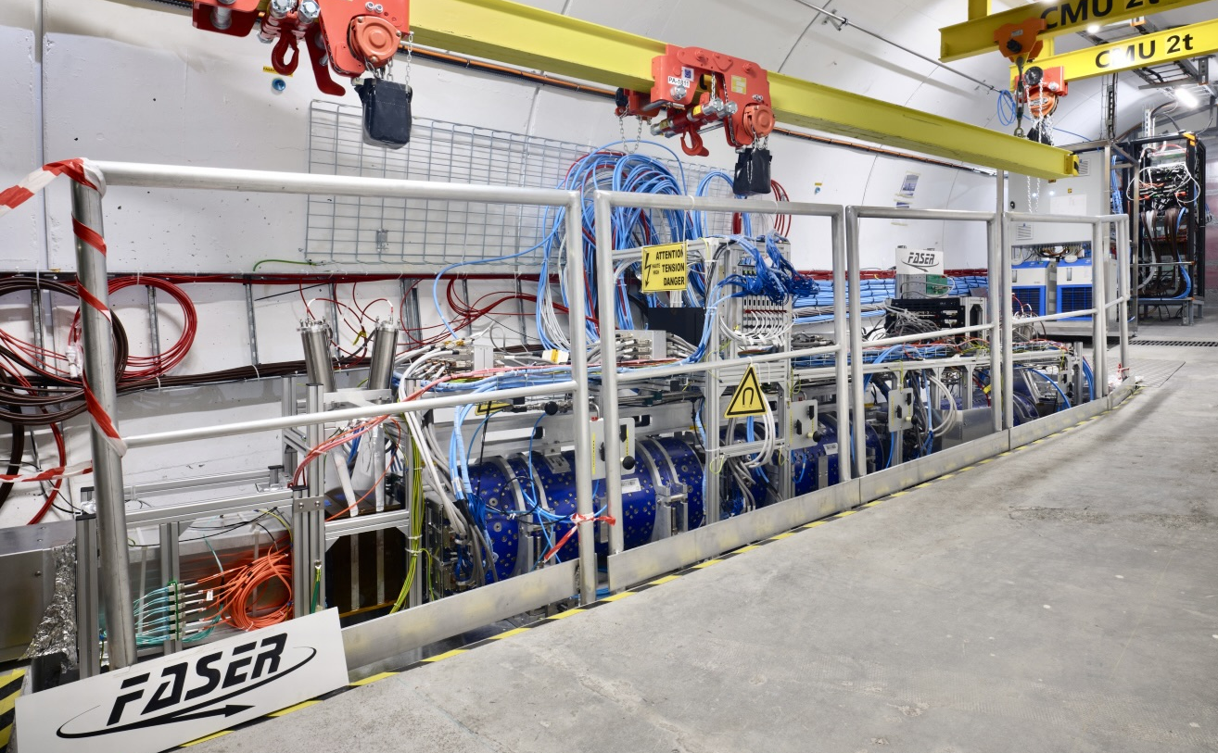
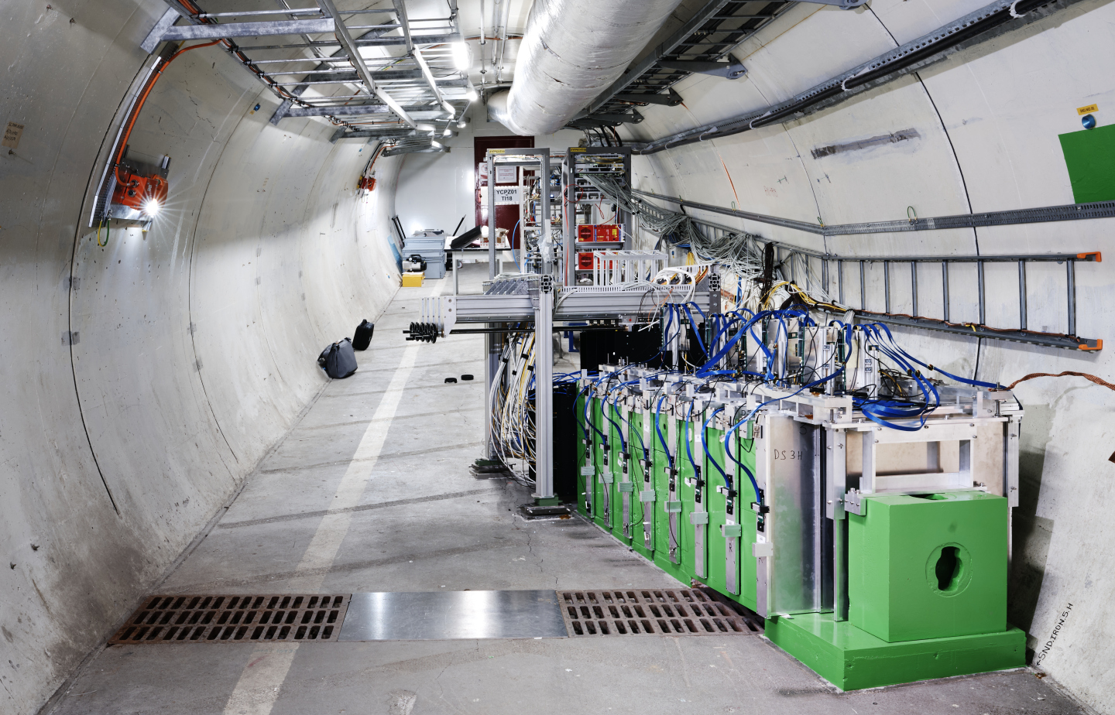
LHC and Experiments
CMS
MilliQan
FASER
LHC
SND@LHC
SPS
PRL 134 (2025) 21
ALICE
ATLAS
LHCf
LHCb
SND
FASER
MoEDAL
PS
Aerial view
Presentation

Slide 9
LHC and Experiments
CMS
MilliQan
LHC
LHC, experiments, software & computing, object reconstruction and physics analysis — all perform beyond design. Many new analyses ideas emerged that were not thought of during the design phase. ML now ubiquitous
SPS
PRL 134 (2025) 21
ALICE
ATLAS
LHCf
LHCb
SND
FASER
MoEDAL
PS
Aerial view
Presentation

Slide 10
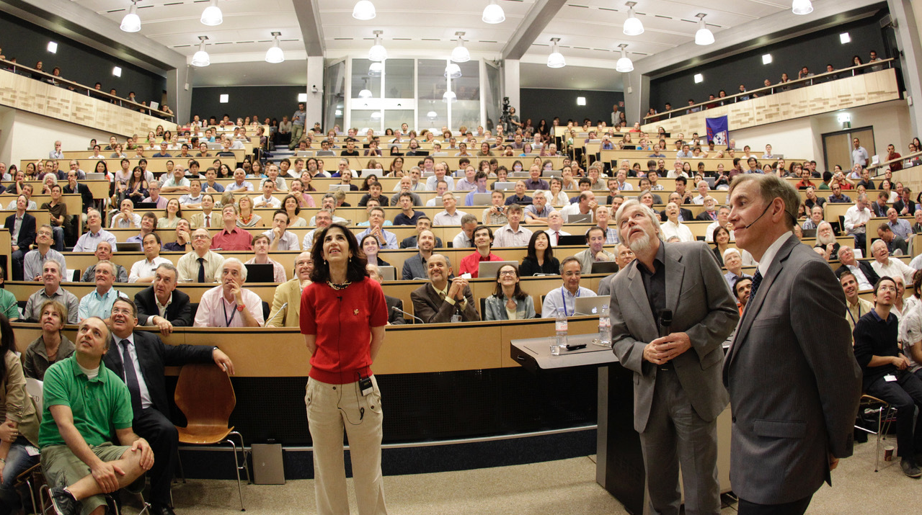
A monumental discovery
Presentation of Higgs boson discovery by ATLAS and CMS at CERN on 4 July 2012

Slide 11
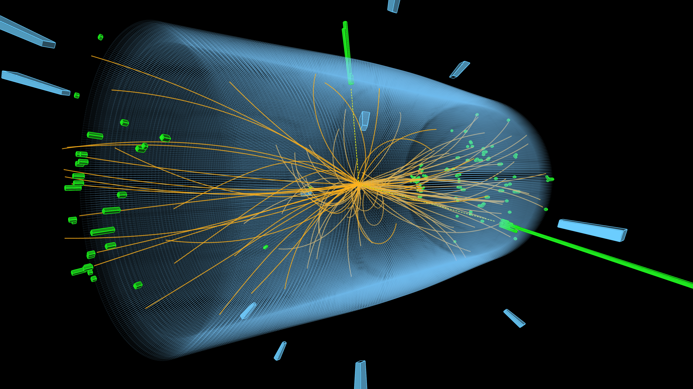
A monumental discovery
Presentation of Higgs boson discovery by ATLAS and CMS at CERN on 4 July 2012

Slide 12
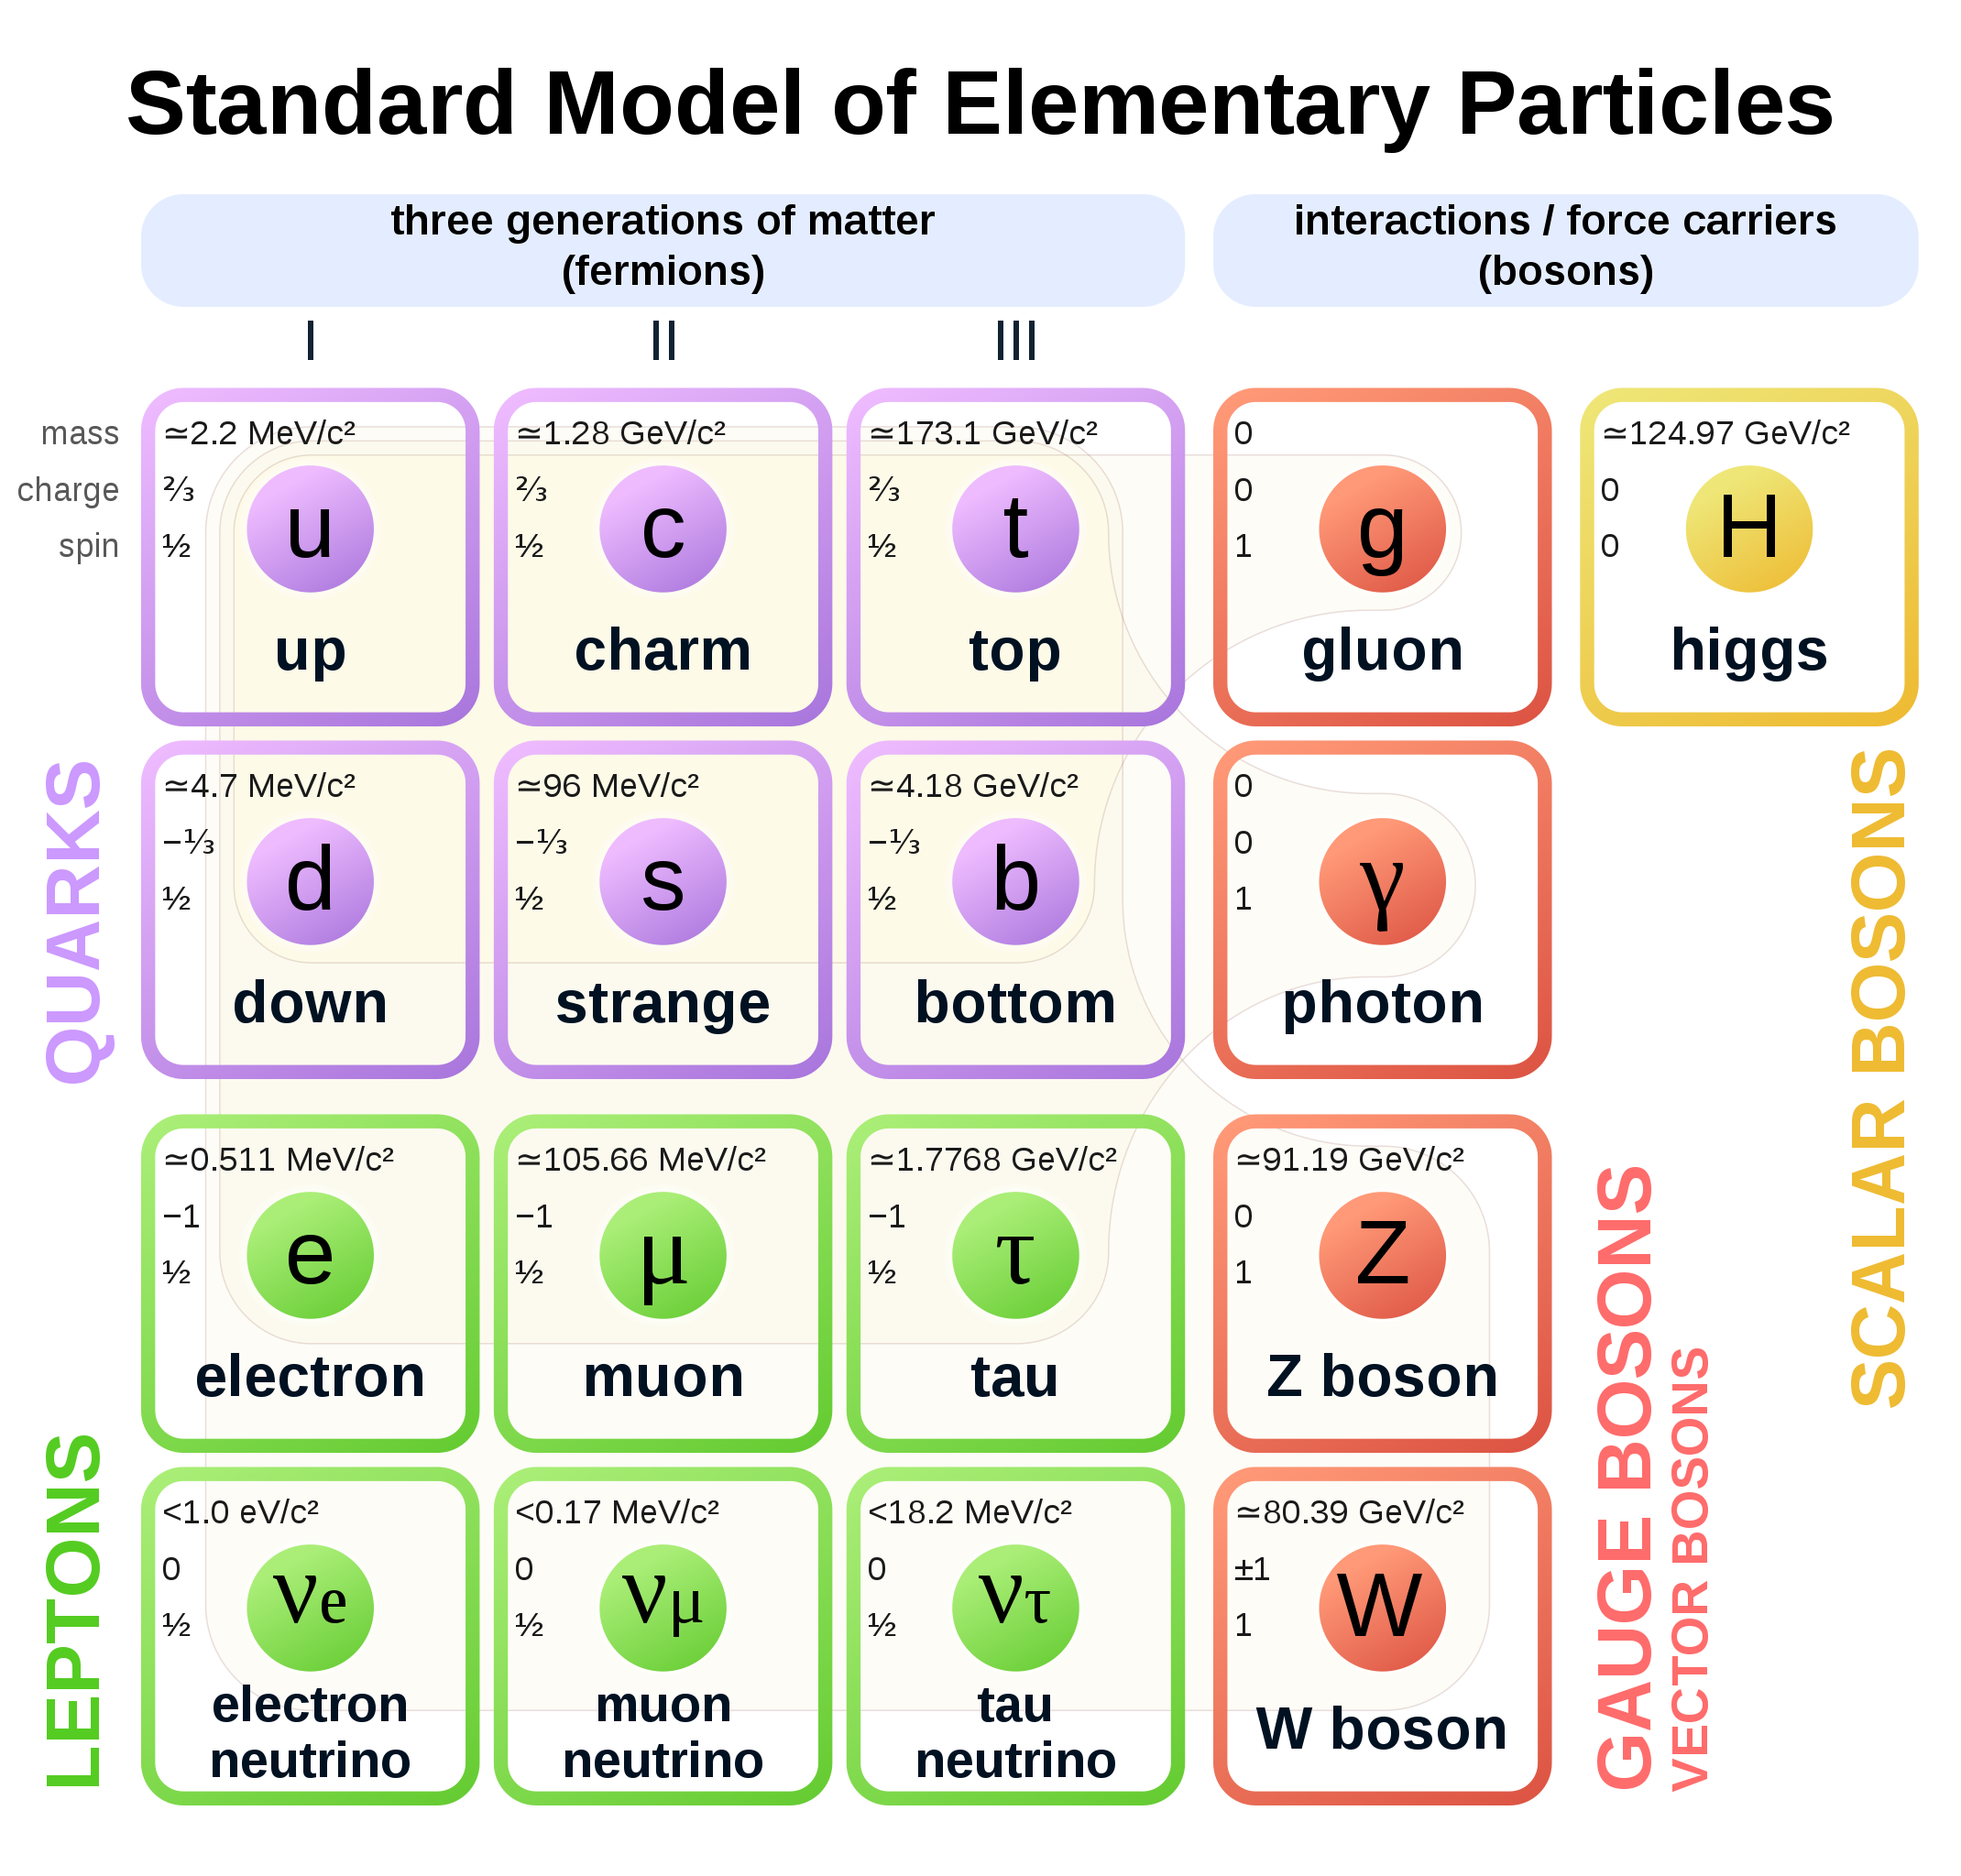
The fundamental universe is profoundly strange
The sub-atomic structure of matter and its interactions is described by the Standard Model (SM)
Spin 1/2

Slide 13
The fundamental universe is profoundly strange
The sub-atomic structure of matter and its interactions is described by the Standard Model (SM)
Particles discovered through decades of international, high-technology accelerator-based research
Spin 1/2
Spin 1
Spin 0

Slide 14
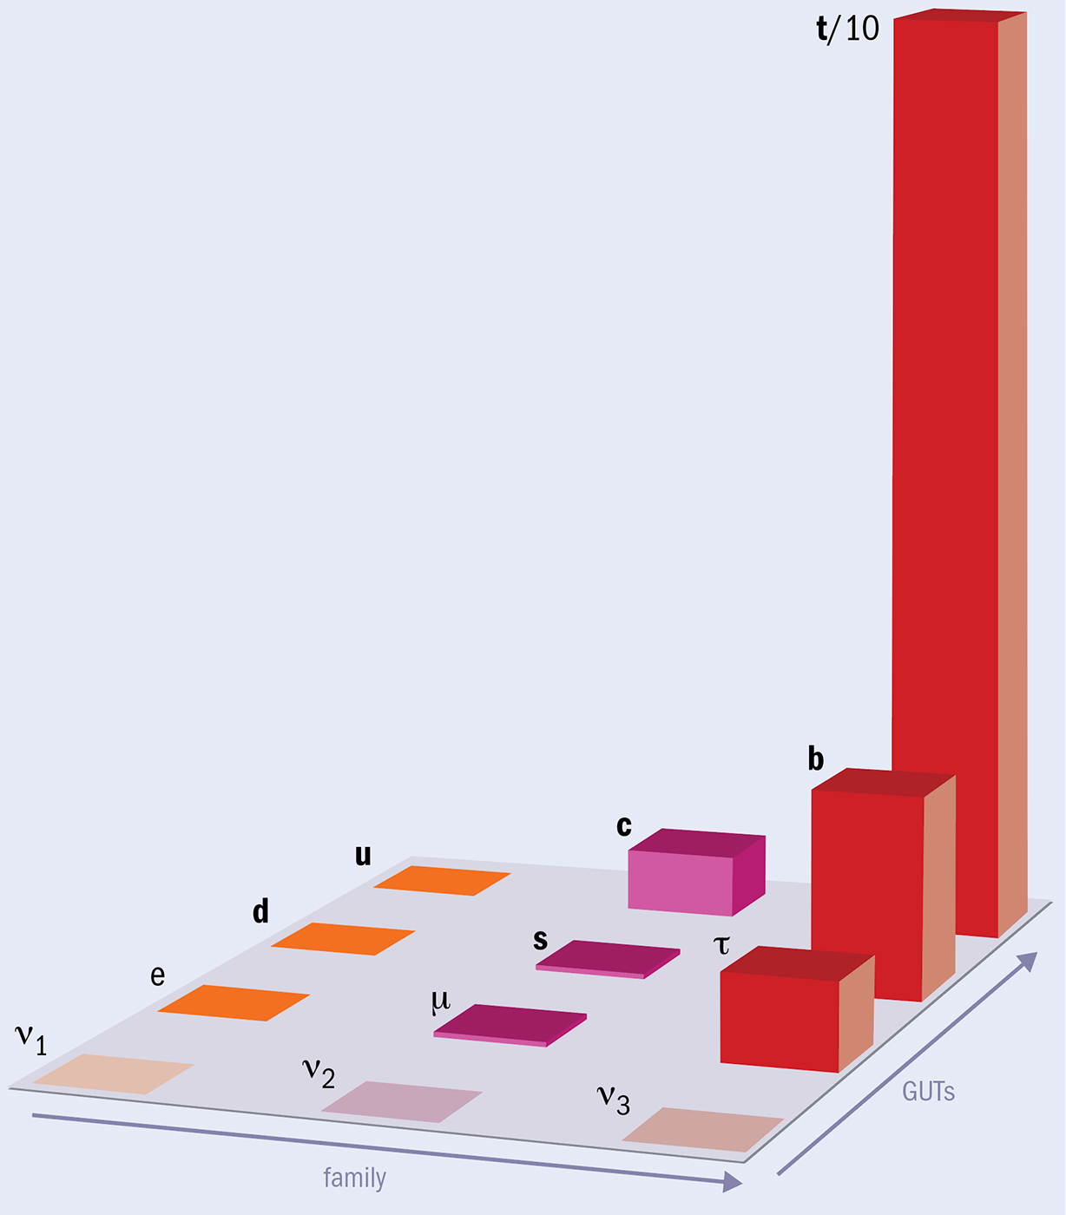
The fundamental universe is profoundly strange
The sub-atomic structure of matter and its interactions is described by the Standard Model (SM)
Fermion mass pattern (“flavour problerm”)
top quark 340,000 times heavier than electron
CERN Courier
Spin 1/2

Slide 15
The fundamental universe is profoundly strange
The sub-atomic structure of matter and its interactions is described by the Standard Model (SM)
Spin 1/2
Spin 1
Spin 0

Slide 16
The fundamental universe is profoundly strange
The sub-atomic structure of matter and its interactions is described by the Standard Model (SM)
New kind of interactions, unlike any known force
A manifestation of a vacuum field that gives elementary particles mass according to their coupling strength
The core conceptual challenges of the SM are tied to the Higgs sector (unstable mass)
The Higgs may also hold clues to dark matter, matter–antimatter asymmetry, and physics beyond the SM (eg, is the Higgs boson elementary? Does it have brothers and sisters? …)
Spin 1/2
Spin 1
Spin 0

Slide 17


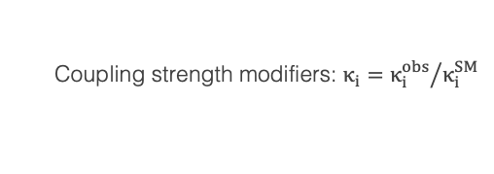




The LHC showed that the Brout-Englert-Higgs mechanism is real
Discovery of Higgs boson enables the direct study of electroweak symmetry breaking and the process of mass generation
ATLAS: ATLAS-CONF-2025-006, CMS: arXiv:2602.18611
$$κ_{f}$$
f
H
$$∝\frac{m_{f}}{υ}$$
f
$$κ_{λ}$$
H
H
$$∝\frac{3m_{H}^{2}}{υ}$$
+ ….
Unpleasant scalar sector (23 parameters, large hierarchy) — key to many mysteries
$$κ_{W/Z}$$
W/Z
H
$$∝\frac{2m_{W/Z}^{2}}{υ}$$
H
W/Z
Coupling strength modifiers: $κ_{i}={κ_{i}^{obs}}/{κ_{i}^{SM}}$

Slide 18
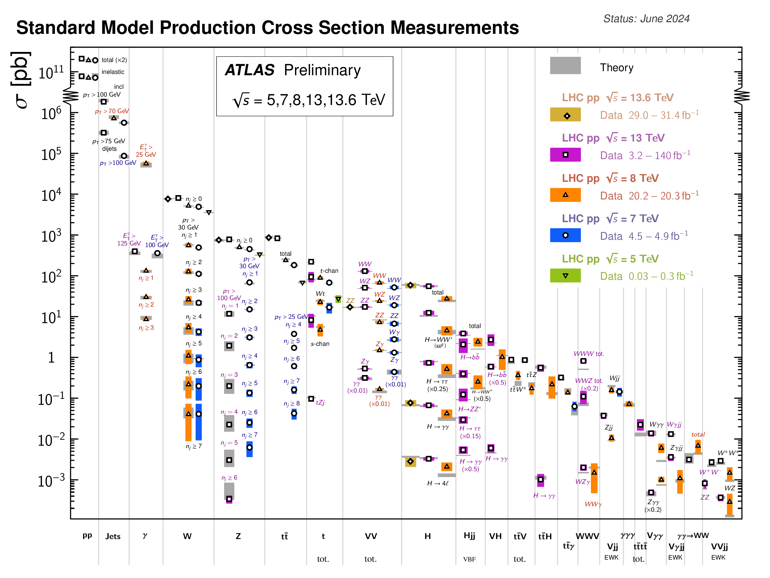
We have learned so much more at the LHC …
A plethora of measurements, some involving extremely rare and sensitive processes, others reaching very high precision, confirm the predictive power of the SM and deepen our understanding
82 new hadronic bound states discovered so far, 28 of which exotic, the heaviest being toponium
Heavy-ion collisions enabled unprecedented insights into the quark-gluon plasma
Searches for new phenomena have set tight constraints on some of the most popular SM extensions, thus completely changing the field of beyond the SM physics
PRD 105 (2022) 012010
Phys. Rep. 1116 (2025) 261

Slide 19
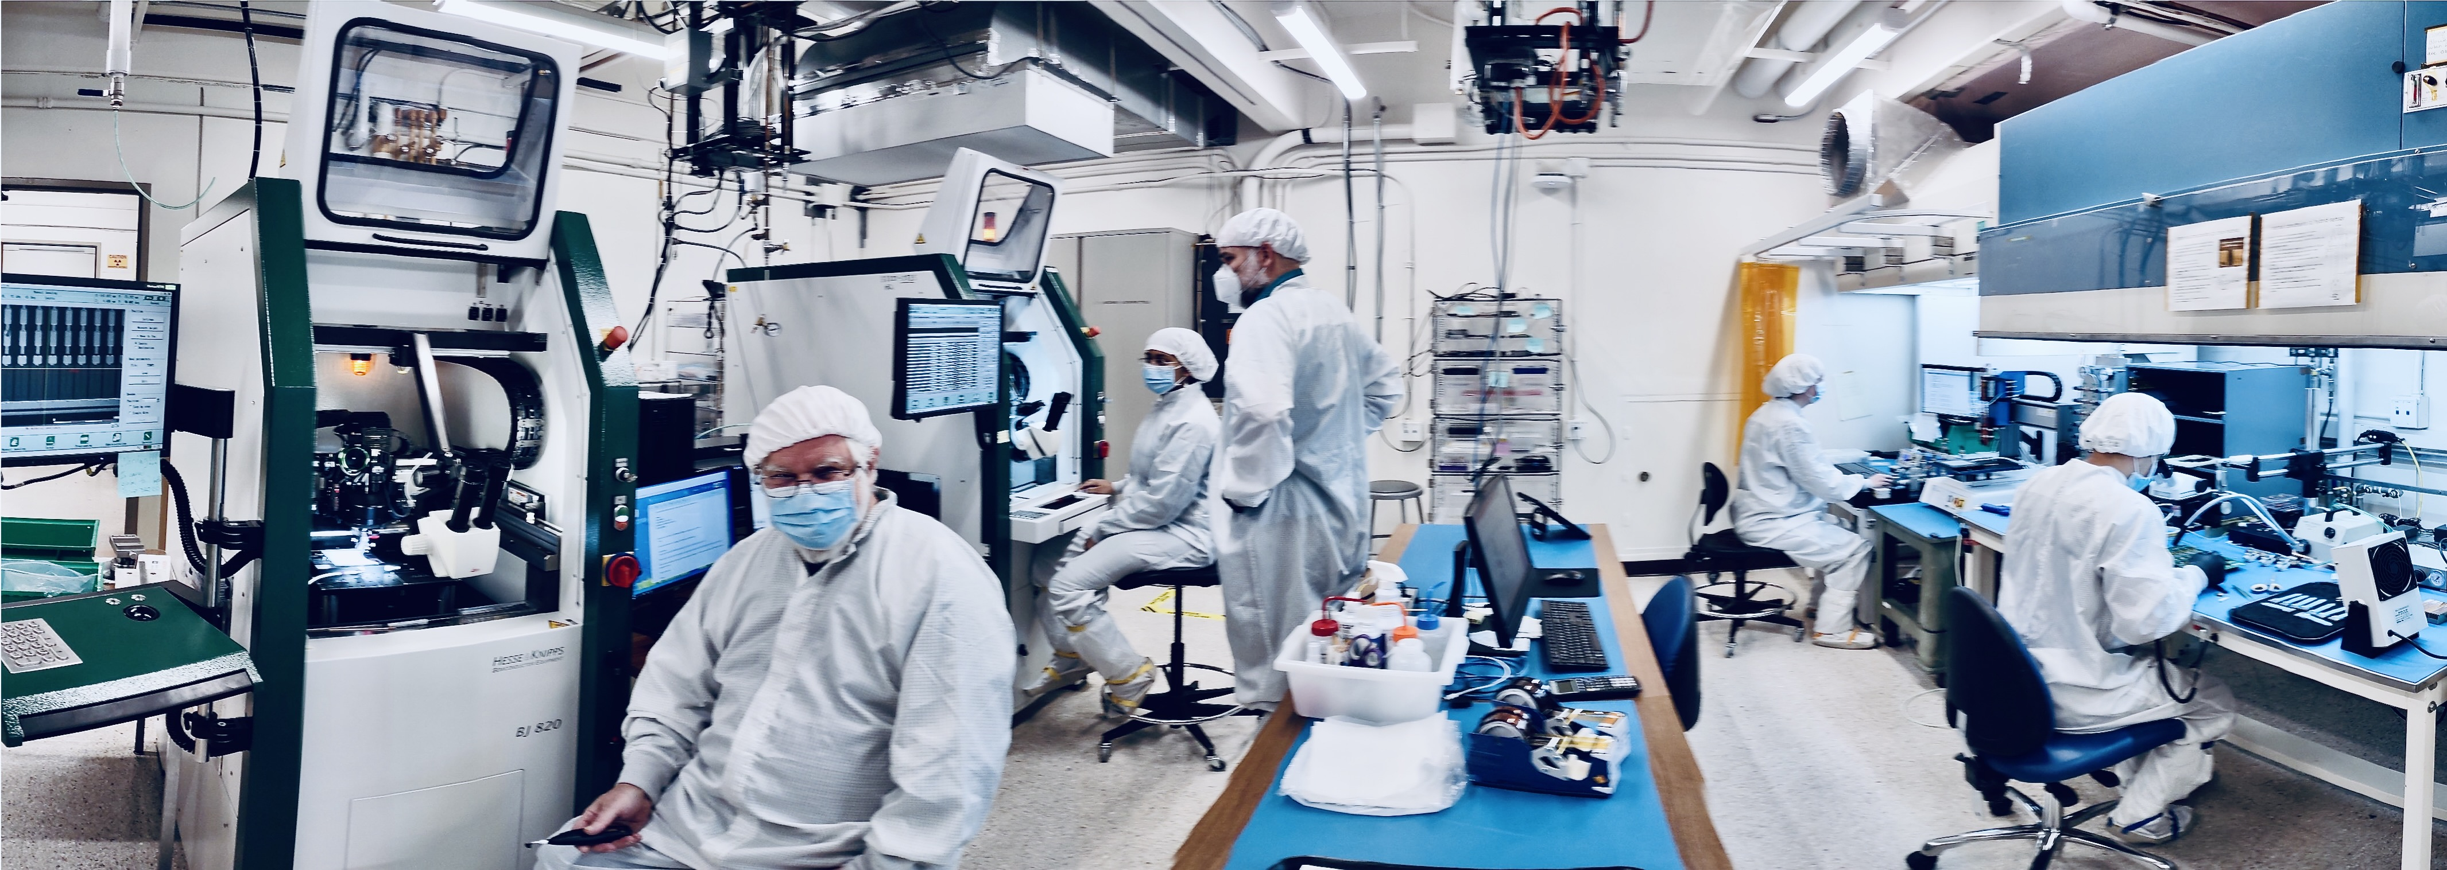
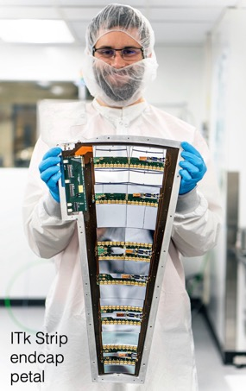
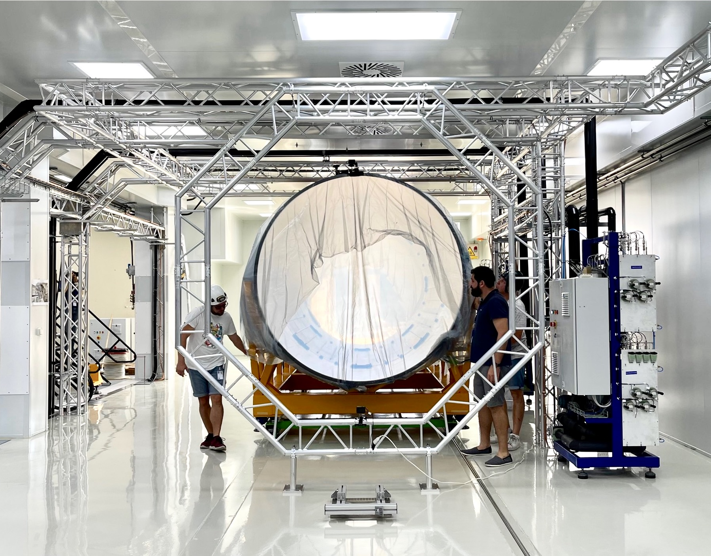
Upgrade to the
High-Luminosity LHC is under way
The HL-LHC will use new technologies to provide
6 times more collisions
than the LHC
Intensities require large-scale detector upgrades
Access to rare phenomena, greater precision and new discovery potential (350M H, 240k HH, 13B top, 720M WW, …)
It will start operating in 2030 and run until 2041
Complementary in many ways to the FCC-ee
Notes:
Additional information (OPTIONAL, TIME PERMITTING)
Key innovations in HL-LHC:
1) Powerful superconducting quadrupole magnets (12 Tesla) will be installed on either side of the ATLAS and CMS experiments to focus the particle bunches. These magnets will be made using niobium-tin (Nb₃Sn), used for the first time in an accelerator (instead of niobium-titanium)
2) Crab cavities for tilting the beams (16 in total) - give the head and tail of the particle bunches opposite-sign transverse momentum before they meet, enlarging the overlap area of the two bunches and thus increasing the probability of collisions.
3) One hundred new, more effective collimators will be installed: these devices absorb particles that stray from the beam trajectory and might otherwise damage the machine.
4) More compact and powerful bending magnets (11 Tesla), also made using the niobium-tin superconductor.
5) Innovative superconducting power lines will connect the power converters to the accelerator; will be able to carry currents of record intensities, up to 100 000 amps!

Slide 20
Environmental impact of LHC / HL-LHC operation
Source: CERN Environmental Report 2023–2024
CERN’s total annual power consumption is ~1.3 TWh dropping to ~0.4 TWh when LHC is not operating
Total of 350 kt CO₂e in 2024
Scope 1: direct emission of greenhouse gases*
Scope 2: indirect emission via purchased electricity
Scope 3: all other indirect emission (procurement, …)
*F-gas impact mainly from RPC losses and detector cooling; HL-LHC reductions from leak repairs, gas dilution, and new CO₂ cooling plants

Slide 21
Feasibility study: 3 volumes (physics & experiments, accelerator, civil engineering & sustainability) (March 2025), All documents
Future Circular Collider
90.7 km circumference tunnel facility to host an e⁺e– and a hadron collider

Slide 22
Proposed large-scale projects at CERN, ~ 2045

Slide 23
Assessment of proposed colliders by expert group
[Link to ESG WG2a report]
(1–9)
Muon Collider: Technologies in early phases of exploration, large R&D programme defined (300 MCHF, 1800 FTEy), demonstrator required
FCC-hh: Further R&D and industrialisation with cost reduction of high-field magnets (Nb₃Sn 15–20 y, HTS ?)
LEP3: No detailed lattice design & full-scale simulation, proposed baseline HTS nested quadrupoles/sextupoles has lowest TRL
LHeC: Performance relies on very high current Energy-Recovery Linac (ERL), large luminosity uncertainty, PERLE @ IJCLab required

Slide 24
Assessment of physics reach
[Link to ESG WG2b report]
BSM
SM
e⁺e– colliders only
pp (+ e⁺e–) collider
High-E e⁺e– collider
μμ (+ e⁺e–) collider

Slide 25
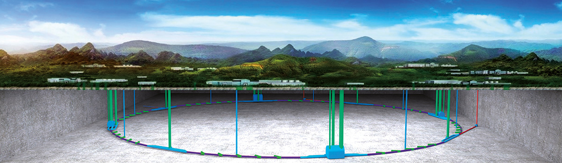
Total cost 4.6B USD
A remark on CEPC
CEPC TDR: arXiv:2312.14363
Detector TDR: arXiv:2510.05260
CEPC — Circular (not Chinese !) Electron Positron Collider
Very similar to FCC-ee: baseline is 100 km tunnel, top-up, 30 MW / beam, 2 IPs, option for subsequent hadron collider
CEPC proposal was submitted to Chinese Academy of Science for inclusion in 15th 5-year plan in 2025, but not retained (STCF preliminarily yes)
CEPC plan: hope to retain funding, seek collaboration with FCC-ee, resubmit in 2030 if FCC-ee not approved by then
CEPC — China

Slide 26
FCC-ee
Next-generation circular e⁺e– collider to deliver extremely high luminosities across multiple energies

Slide 27
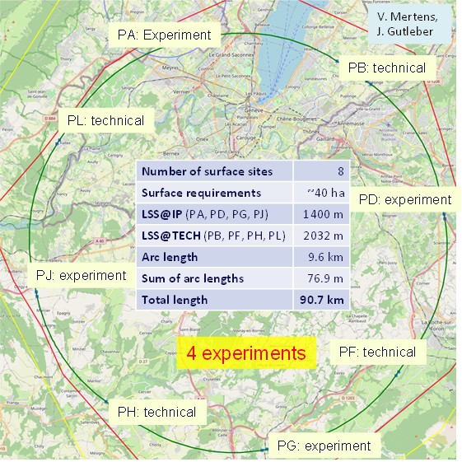
FCC-ee
Next-generation circular e⁺e– collider to deliver extremely high luminosities across multiple energies
Detailed feasibility study: layout selected from ~100 variants following the EU “Avoid–Reduce–Compensate” principle — 90.7 km ring, 8 surface sites (7 FR, 1 CH), 5.5 m tunnel diameter, 50–560 m depth

Slide 28
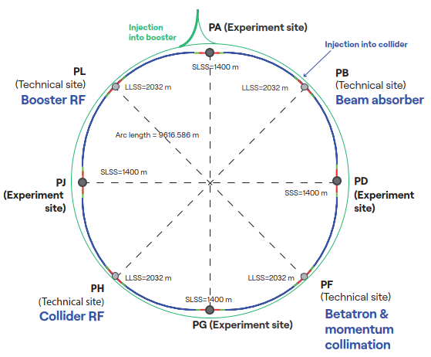
FCC-ee
Next-generation circular e⁺e– collider to deliver extremely high luminosities across multiple energies
Ring structure: 4 experiments, 1 RF-section / beam, 1 collimation section, 1 section for injection and dump
Booster is single-beam synchrotron which cycles within a few seconds between accelerating and top-up injecting e⁺ and e–

Slide 29
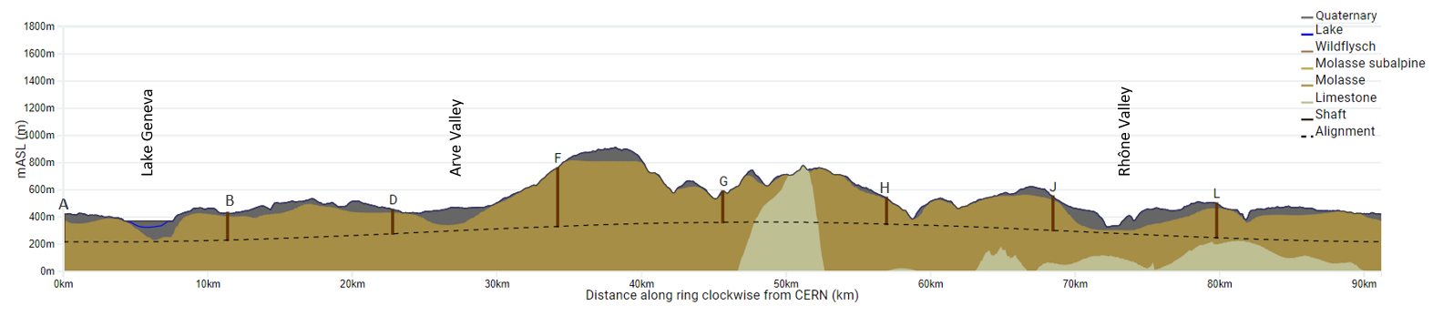
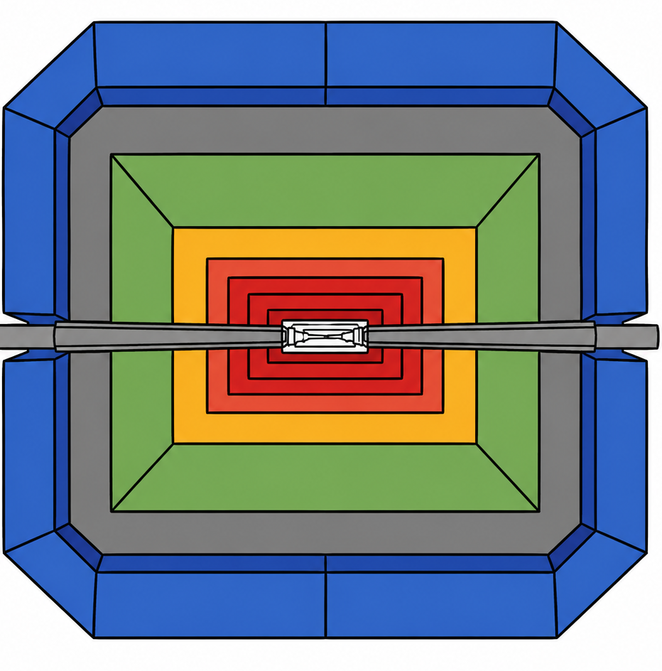
FCC-ee
Next-generation circular e⁺e– collider to deliver extremely high luminosities across multiple energies
Geology of FCC tunnel
FCC inclined at 0.5% gradient to minimise depth of point F
Limestone unavoidable between G–H
Tunneling mainly in molasse layer (soft rock), well suited for fast, low-risk construction, 6 million m³ excavated volume
→ 8.5 million m³ excavation material on surface (OpenSkyLab R&D project to study reuse), average shaft depths ~240 m
265’000 m³ concrete/year over 8 years (0.075% of annual EU production), use of low-carbon concrete under study
Total civil engineering construction carbon footprint estimate: 530,000 – 1,184,000 tCO₂(eq)
Assessed according to European Norms (EN 17472, EN15804+A2)
= 1.5 – 3.4 × CERN with LHC operation per year

Slide 30
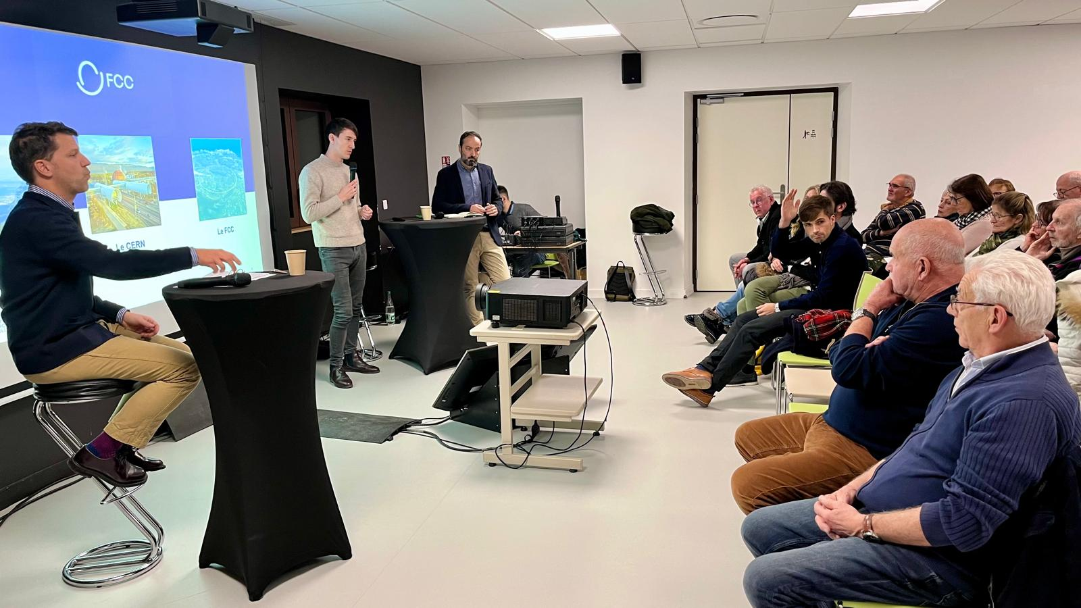
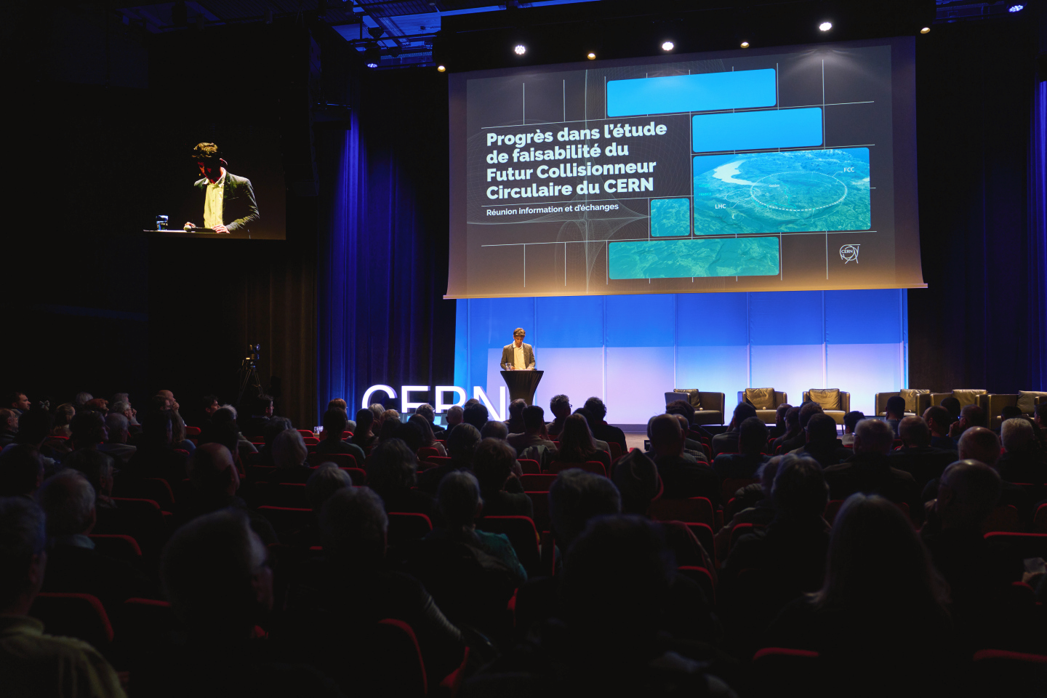
FCC-ee — territorial dialogue & public participation
Public information and discussion meetings
First cycle of public information meetings between April 2024 – March 2025
11 sessions reached over 1,500 people in France & Switzerland
During 2025: Second cycle of public information meetings
Workshops with residents in municipalities potentially affected by surface sites; meetings with stakeholders of the territory
May/June – October 2026: Formal public participation process in France (Débat Public) and Switzerland (public concertation)
Workshops with residents in municipalities potentially affected by surface sites; meetings with stakeholders of the territory
Dialogue website:

Slide 31
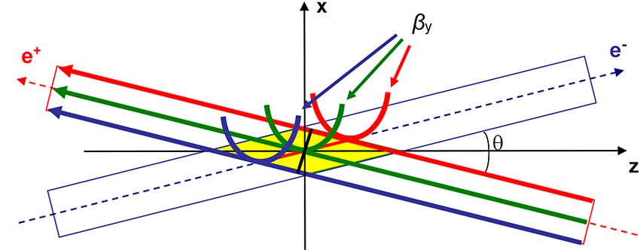
FCC-ee — maximum luminosity
FCC-ee collider concept for maximum luminosity
Double ring collider: many bunches, high current, like LHC and B factories, different from LEP (CERN)
Top-up injection (requiring booster) during collisions: needed due to short luminosity lifetime (~10–20 min, radiative Bhabhas), standard at light sources and used at PEP-II, KEKB, BEPCII. Booster intensity ~1% of collider; full RF voltage as in collider
Superconducting RF: LEP-proven Nb/Cu 400 MHz cavities; bulk Nb 800 MHz cavities as in ESS/EuXFEL; efficient RF sources and simplified energy-switching scheme
Crab-waist collisions: successfully demonstrated at DAΦNE and SuperKEKB
Numbers assume 4 experiments
~350,000 × LEP-1
~5,000 × LEP-2
Crab waist scheme: sextupoles near IP rotate vertical waist along the opposing beam’s path (and suppresses beam-beam resonances)

Slide 32
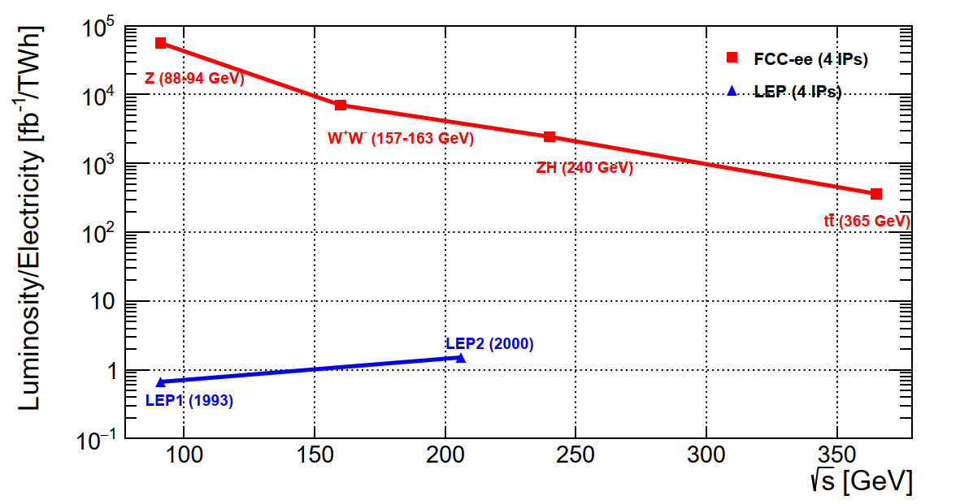
FCC-ee — maximum luminosity
FCC-ee collider concept for maximum luminosity
Combining all these concepts results in a giant efficiency step: 10⁴ – 10⁵ × luminosity / electrical power of LEP
Double ring collider: many bunches, high current, like LHC and B factories, different from LEP (CERN)
Top-up injection (requiring booster) during collisions: needed due to short luminosity lifetime (~10–20 min, radiative Bhabhas), standard at light sources and used at PEP-II, KEKB, BEPCII. Booster intensity ~1% of collider; full RF voltage as in collider
Superconducting RF: LEP-proven Nb/Cu 400 MHz cavities; bulk Nb 800 MHz cavities as in ESS/EuXFEL; efficient RF sources and simplified energy-switching scheme
Crab-waist collisions: successfully demonstrated at DAΦNE and SuperKEKB
Crab waist scheme: sextupoles near IP rotate vertical waist along the opposing beam’s path (and suppresses beam-beam resonances)

Slide 33
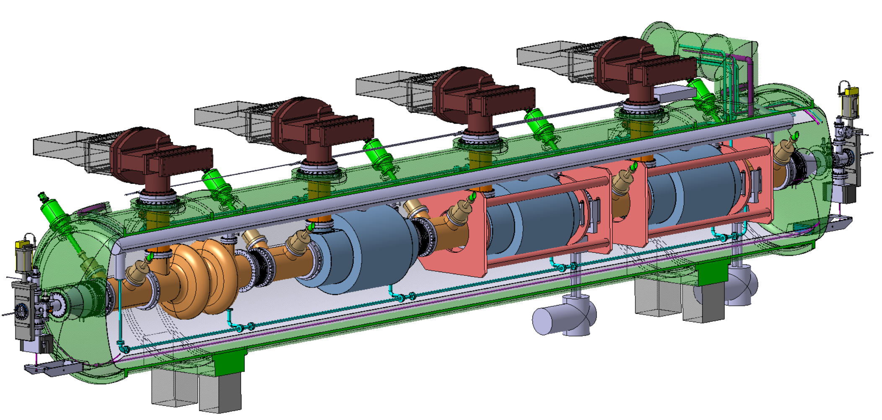
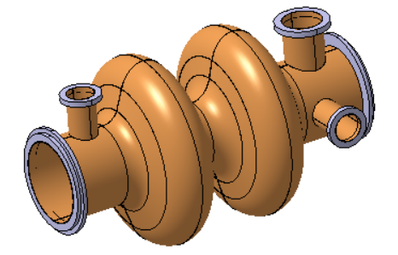
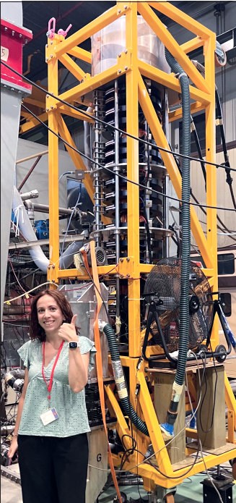
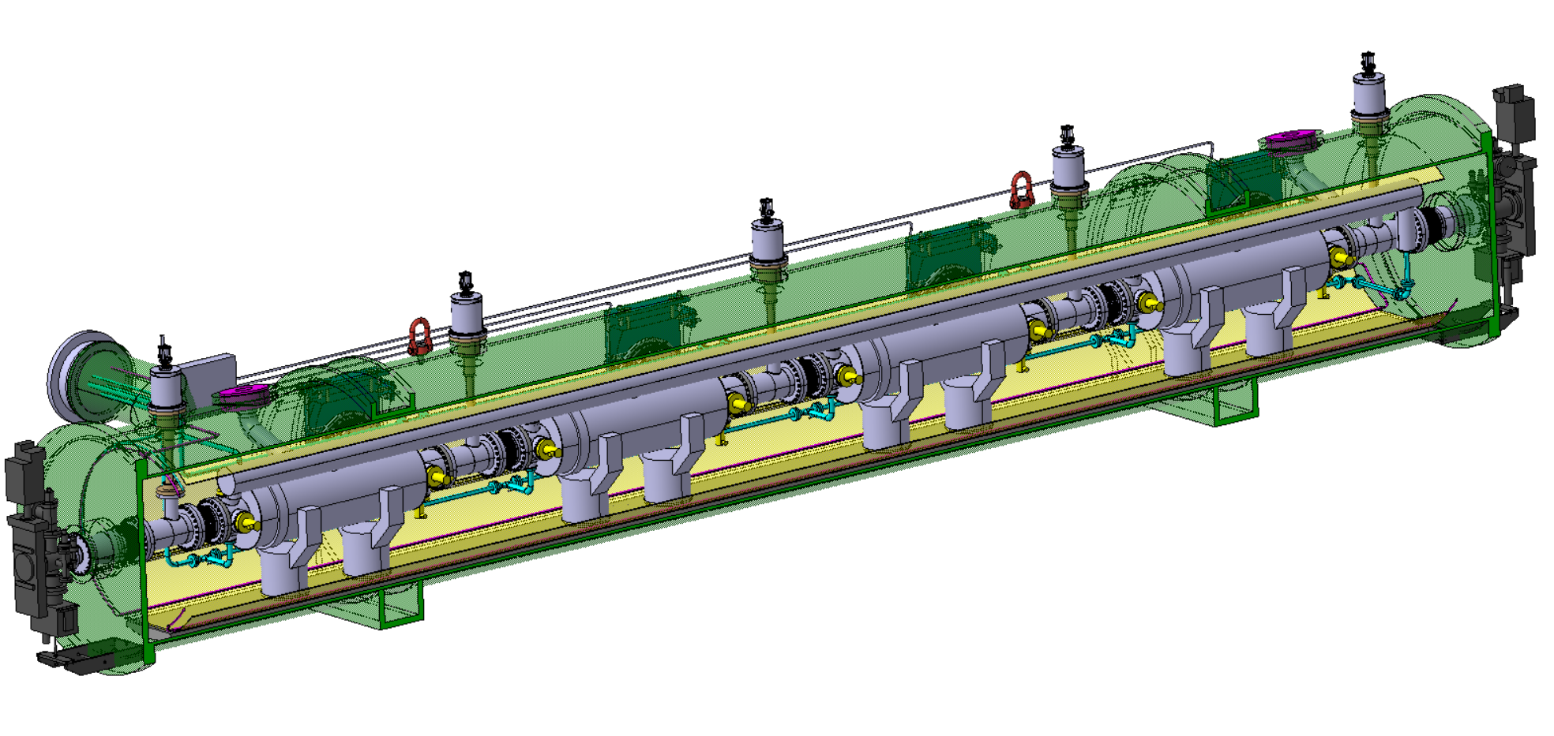

*A cell is one resonant section of the cavity where acceleration occurs (half a wavelength long = 38 cm for 400 MHz)
$$η=\frac{P_{RF out}}{P_{beam}}$$
FCC-ee — SRF
*
Superconducting RF system — key technology
Ref: arXiv:2505.00274
2-cell* 400 MHz SRF system for Z, W and ZH
Power source: 380 kW Klystron prototype built (HL-LHC) η* = 70% → two-stage Klystrons η = 86% → multibeam Tristrons η > 90% (R&D)
× 264
400 MHz superconducting cavity (6~10 MV/m), copper Nb coated, 1.5 m long
400 MHz Cryo-module
× 264
× 66
Higher gradient 6-cell 800 MHz SRF system for tt collider operation and booster at all energies
Klystron prototype
Compact 800 MHz cavity (~20 MV/m), 6-cell, bulk Nb, Nb₃Sn if R&D is successful
800 MHz Cryo-module
× (102 + 112 booster)
× 204 Tristons +
448 × 10 kW SSA booster
× (408 + 448 booster)

Slide 34
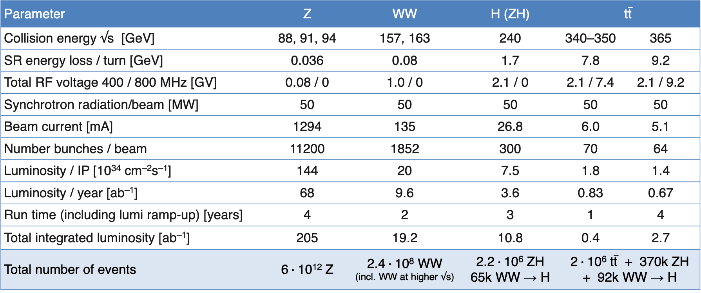

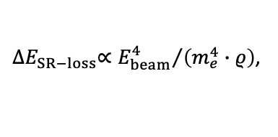
FCC-ee — parameters
${∆E}_{SR−loss}∝{E_{beam}^{4}}/{\left(m_{e}^{4}∙ρ\right)}$,
$$P_{SR}=U_{0}I, U_{0}∝E^{4}$$
FCC-ee main parameters (assuming 4 IPs / experiments)
Ref: arXiv:2505.00274
Parameter | Z | WW | H (ZH) | $$\text{t}\overline{\text{t}}$$
Collision energy √s [GeV] | 88, 91, 94 | 157, 163 | 240 | 340–350 | 365
SR energy loss / turn [GeV] | 0.036 | 0.08 | 1.7 | 7.8 | 9.2
Total RF voltage 400 / 800 MHz [GV] | 0.08 / 0 | 1.0 / 0 | 2.1 / 0 | 2.1 / 7.4 | 2.1 / 9.2
Synchrotron radiation/beam [MW] | 50 | 50 | 50 | 50 | 50
Beam current [mA] | 1294 | 135 | 26.8 | 6.0 | 5.1
Number bunches / beam | 11200 | 1852 | 300 | 70 | 64
Luminosity / IP [10³⁴ cm^{–2}s^{–1}] | 144 | 20 | 7.5 | 1.8 | 1.4
Luminosity / year [ab^{–1}] | 68 | 9.6 | 3.6 | 0.83 | 0.67
Run time (including lumi ramp-up) [years] | 4 | 2 | 3 | 1 | 4
Total integrated luminosity [ab^{–1}] | 205 | 19.2 | 10.8 | 0.4 | 2.7
Total number of events | 6$∙$10¹² Z | 2.4$∙$10⁸ WW (incl. WW at higher √s) | 2.2$∙$10⁶ ZH 65k WW → H | 2$∙$10⁶ $\text{t}\overline{\text{t}}$ + 370k ZH + 92k WW → H
~350,000 × LEP-1 (~6 years)
~26 × HL-LHC (~9 years)
~5,000 × LEP-2 (~5 years)
0.5% of HL-LHC (~9 years)
0.01% of HL-LHC (tt) (~9 years)

Slide 35
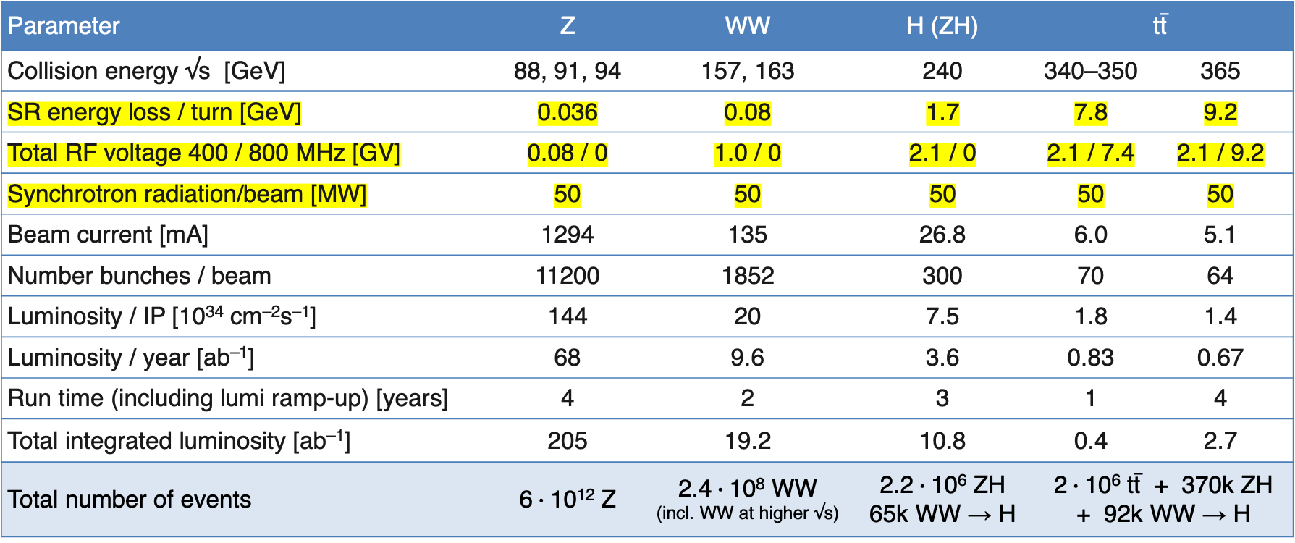
FCC-ee — parameters
${∆E}_{SR−loss}∝{E_{beam}^{4}}/{\left(m_{e}^{4}∙ρ\right)}$,
$$P_{SR}=U_{0}I, U_{0}∝E^{4}$$
FCC-ee main parameters (assuming 4 IPs / experiments)
Ref: arXiv:2505.00274
Parameter | Z | WW | H (ZH) | $$\text{t}\overline{\text{t}}$$
Collision energy √s [GeV] | 88, 91, 94 | 157, 163 | 240 | 340–350 | 365
SR energy loss / turn [GeV] | 0.036 | 0.08 | 1.7 | 7.8 | 9.2
Total RF voltage 400 / 800 MHz [GV] | 0.08 / 0 | 1.0 / 0 | 2.1 / 0 | 2.1 / 7.4 | 2.1 / 9.2
Synchrotron radiation/beam [MW] | 50 | 50 | 50 | 50 | 50
Beam current [mA] | 1294 | 135 | 26.8 | 6.0 | 5.1
Number bunches / beam | 11200 | 1852 | 300 | 70 | 64
Luminosity / IP [10³⁴ cm^{–2}s^{–1}] | 144 | 20 | 7.5 | 1.8 | 1.4
Luminosity / year [ab^{–1}] | 68 | 9.6 | 3.6 | 0.83 | 0.67
Run time (including lumi ramp-up) [years] | 4 | 2 | 3 | 1 | 4
Total integrated luminosity [ab^{–1}] | 205 | 19.2 | 10.8 | 0.4 | 2.7
Total number of events | 6$∙$10¹² Z | 2.4$∙$10⁸ WW (incl. WW at higher √s) | 2.2$∙$10⁶ ZH 65k WW → H | 2$∙$10⁶ $\text{t}\overline{\text{t}}$ + 370k ZH + 92k WW → H
Despite the constant synchrotron power, due to the larger RF voltage and system size (increased cryogenic system), RF efficiency losses, and other increasing accelerator demands, the electrical power consumption increases with CM energy:
FCC-ee elecrtical energy consumption | Z | W | H | top
Beam energy [GeV] | 45.6 | 80 | 120 | 182.5
Peak power during beam operation [MW] | 250 | 275 | 297 | 381
Total FCC-ee yearly consumption [TWh] | 1.2 | 1.3 | 1.4 | 1.85
LHC + injectors: ~ 200 MW peak power
Today CERN with LHC operating: ~1.3 TWh
Various R&D towards further reduction of electrical energy consumption

Slide 36
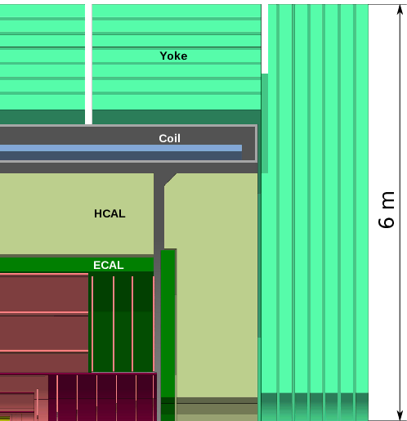
FCC-ee — detectors
*A too-strong detector solenoid (≥ 4 T) would distort the beam trajectories, induce transverse coupling, and blow up the vertical emittance — drastically reducing luminosity
Event rates and radiation are modest compared with HL-LHC, but Tera-Z precision imposes unprecedented stability and resolution demands: luminosity at 10^{–5} relative and 10^{–4} absolute precision, acceptance definition at 10^{–5}, etc. Ultimately, most measurements will be systematics- and theory-limited
Detector concepts are built around high-granularity particle-flow calorimetry, close-to-beam MAPS vertex detectors, large low-material central trackers, PID, a ~2 T solenoid, and muon tagging, with fields up to 3 T possible above the Z pole.
Dual-readout (DR) technique can in principle distinguish between EM and HAD responses in single CAL. Nevertheless, newest IDEA design proposes DR crystal ECAL and DR fibre HCAL
ALLEGRO detector concept around noble-liquid EM calorimeter [Ref]
CLD detector concept silicon-tungsten EM calorimeter and tracker [Ref]
IDEA detector concept around dual-readout (scintillation (all) & Cherenkov (relativistic – e/𝛾) light) fiber/Cu calorimeters [Ref]

Slide 37
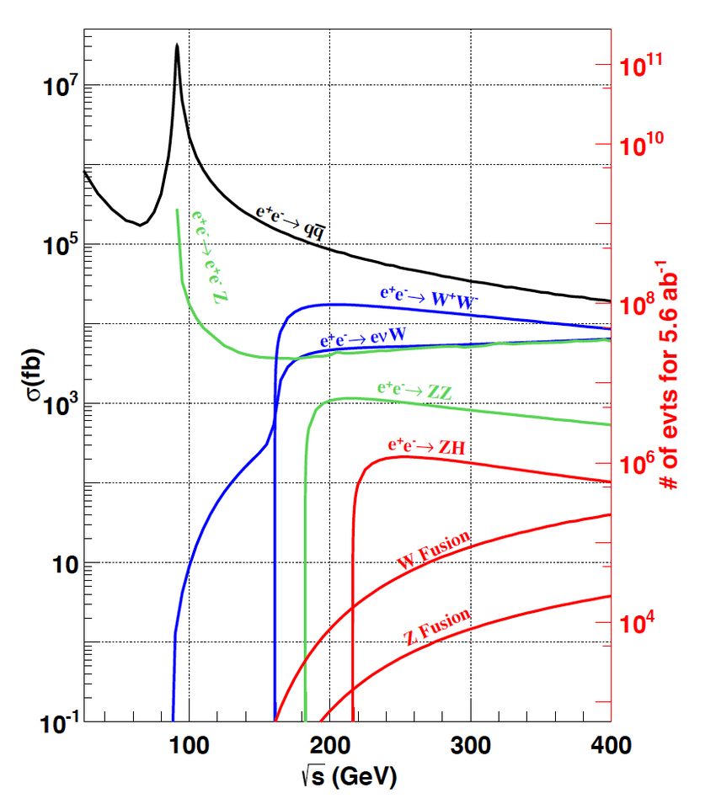
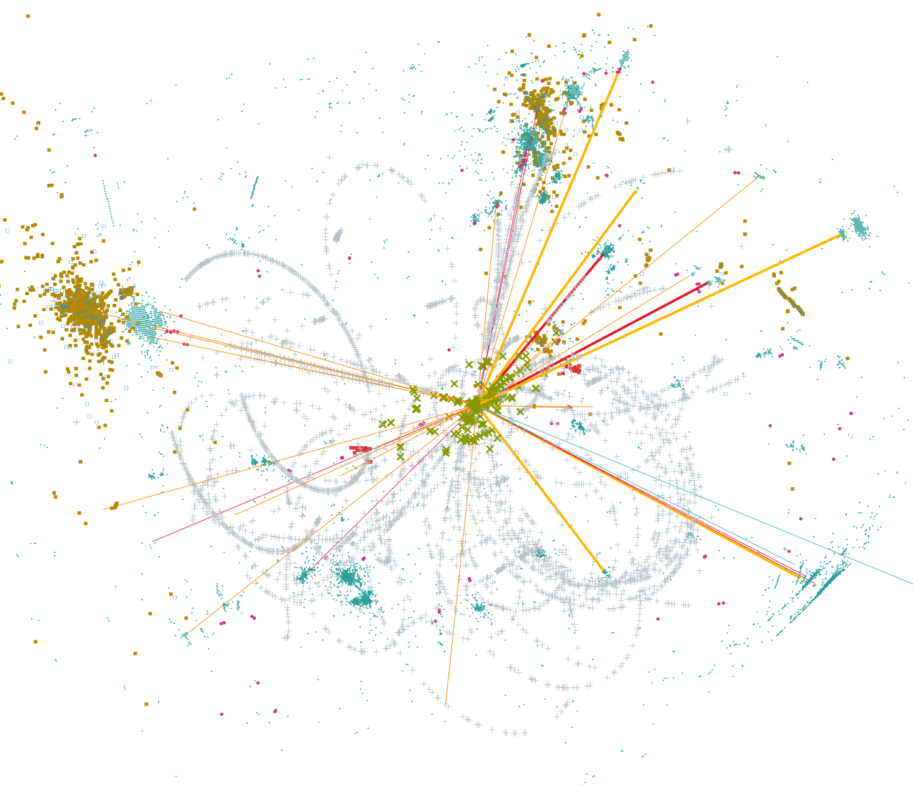
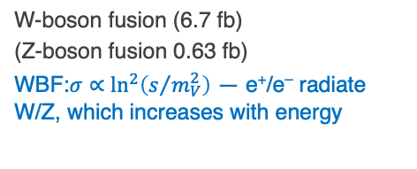
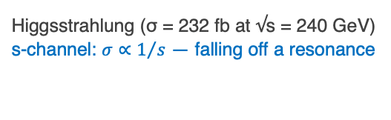
FCC-ee — Higgs Factory
e⁺e– → X cross sections versus CM energy
Primary goal: Higgs precision measurements
HZ factory
Higgsstrahlung (σ = 232 fb at √s = 240 GeV)
s-channel: $σ∝1/s$ — falling off a resonance
W-boson fusion (6.7 fb)
(Z-boson fusion 0.63 fb)
WBF:$σ∝\ln^{2}\left(s/{m_{V}^{2}}\right)$ — e⁺/e– radiate W/Z, which increases with energy
Simulated e⁺e– → ZH event at √s = 240 GeV in IDEA detector

Slide 38


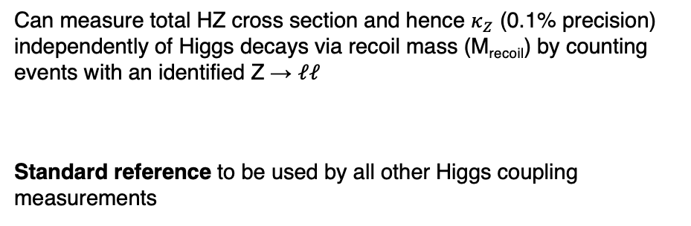
FCC-ee — Higgs Factory
Absolute coupling strengths — difficult at LHC due to weak constraint on $Γ_{H}$ (current precision ~50%, HL-LHC < 25%)
Can measure total HZ cross section and hence $κ_{Z}$ (0.1% precision) independently of Higgs decays via recoil mass (M_{recoil}) by counting events with an identified Z → 𝓁𝓁
Standard reference to be used by all other Higgs coupling measurements
$${σ(e}^{+}e^{−}→ZH)∝κ_{Z}^{2}$$
$$M_{recoil}^{2}={\left(\sqrt{s}−E_{ℓ^{+}}−E_{ℓ^{−}}\right)}^{2}−{\left|p_{ℓ^{+}}+p_{ℓ^{−}}\right|}^{2}$$
Higgsstrahlung (σ = 232 fb at √s = 240 GeV)
arXiv:2106.15438
$${σ(e}^{+}e^{−}→ZH(→ZZ^{∗}))∝\frac{κ_{Z}^{4}}{Γ_{H}}$$
Combination with measurement of
allows to determine $Γ_{H}$ to 0.8% precision (30 × HL-LHC)

Slide 39


FCC-ee – the Higgs factory
Why “factory”? 2.2M Higgs (FCC-ee) vs 350M (HL-LHC), production through Higgsstrahlung rather than s-channel
→ e⁺e– collisions offer exceptionally clean Higgs reconstruction, unmatched precision on decays with large branching ratios
FCC-ee feasibility stydu (Vol 1): arXiv:2505.00272
Uncertainty
HL-LHC / FCC-ee
1.6
1.6
3.6
2.4
1.9
~ 40
1.8
6.8
3.4
3.0
–
< 25
0.025
0.04
16
5.5
7.3
4.4
4.1
~ 44
1.6
1.6
1.1
0.9
–
< 32
50
5.9
Most precise coupling, probes $f_{H} \sim 8 TeV$
*Incl. SM parametric uncertainties
*
Particularly large improvement over HL-LHC
Note: current uncertainties on Higgs branching fraction predictions O(1.5%)
BR(H → 4𝜈) = 10.6 $∙$ 10^{–4}
HL-LHC numbers updated from arXiv:2504.00672; they assume SM value for $Γ_{H}$, and incl. theoretical uncertainties (mostly dominant)

Slide 40
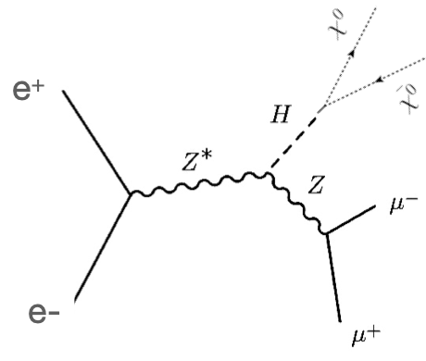
FCC-ee – the Higgs factory
Why “factory”? 2.2M Higgs (FCC-ee) vs 350M (HL-LHC), production through Higgsstrahlung rather than s-channel
→ e⁺e– collisions offer exceptionally clean Higgs reconstruction, unmatched precision on decays with large BR
FCC-ee feasibility stydu (Vol 1): arXiv:2505.00272
Uncertainty
HL-LHC / FCC-ee
1.6
1.6
3.6
2.4
1.9
~ 40
1.8
6.8
3.4
3.0
–
< 25
0.025
0.04
16
5.5
7.3
4.4
4.1
~ 44
1.6
1.6
1.1
0.9
–
< 32
50
5.9
*
Collider limits overlaid onto direct detection (Higgs portal assuming Majorana DM)
BR(H → 4𝜈) = 10.6 $∙$ 10^{–4}

Slide 41
FCC-ee – also a Tera-Z, W and top factory
Extreme luminosity on Z pole: 140$∙$10³⁴ cm^{–2}s^{–1} / IP, 205 ab^{–1} & 6$∙$10¹² Z (4 IPs) — ultimate EW precision data
arXiv:2505.00272
Improvements up to × 500 over current knowledge
Input to global electroweak fit: requires significant improvements in theoretical predictions

Slide 42

FCC-ee – also a Tera-Z, W and top factory
Global electroweak fit expressed on top versus W mass
ESPPU 2025 Briefing Book and R. Kogler at Moriond EW 2026
Conservative theoretical uncertainty scenario

Slide 43
FCC-ee – also a Tera-Z, W and top factory
Global electroweak fit: indirect constraints on new physics via “oblique parameters”
ESPPU 2025 Briefing Book and R. Kogler at Moriond EW 2026
Conservative theoretical uncertainty scenario

Slide 44
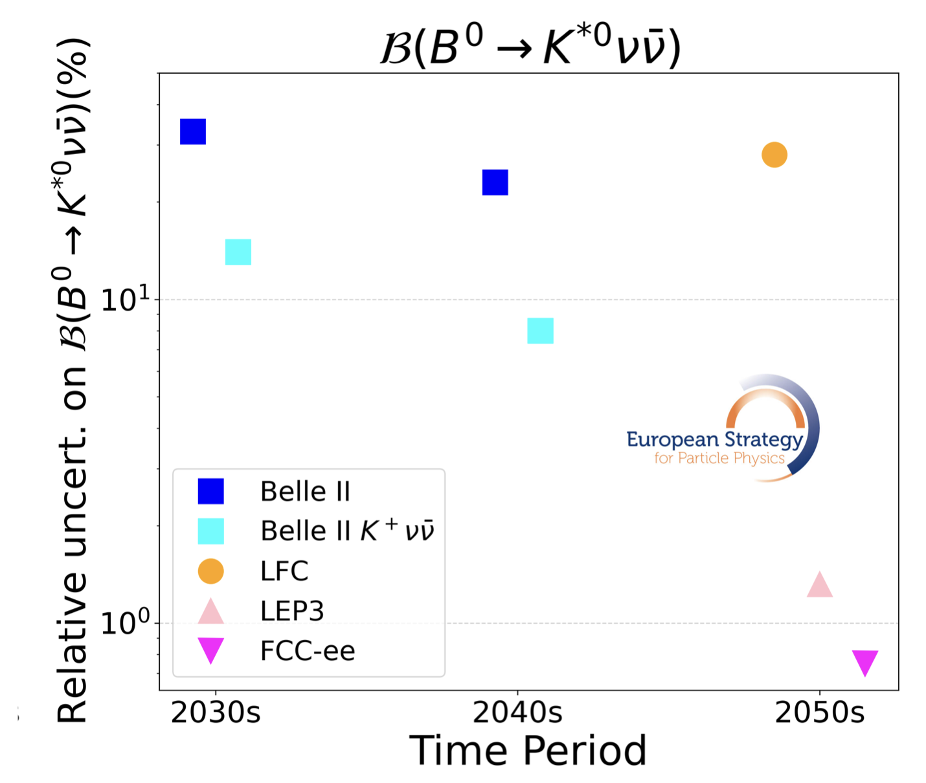


BR(Z → bb / cc) = 15% / 12%
Γ(Z → qq) ∝ ${(g}_{V}^{2}+g_{A}^{2})$
FCC-ee – also a flavour factory (on Z pole)
–
–
Large c and b-hadron statistics — combines strengths of Belle-II (e+e– → ϒ(4S) → BB) and LHCb (pp → bb + X)
The larger yield of B mesons than Belle II allows unmatched precision on B decays with neutrinos
arXiv:2505.00272
FCC-ee (×10⁹)
Yields for 6$∙$10¹² Z
Belle-II (×10⁹) 28 28 – – – 33 46
Yields for 50 ab^{–1}
Clean reconstruction due to boost and flavour tagging (> LHCb), excellent charm / 𝜏 separation (challenging at ϒ(4S))
Ultimate CKM angle precision (similar to LHCb)
Ultimate τ factory
B → 𝜏𝜈 allows 1% measurement of |V_{ub}| and running above WW threshold allows on-shell measurement of |V_{cb}| to ~1%
Current precision 3.5_{Vub} / 1.1_{Vcb}%, but discrepancies between exclusive and inclusive results of 17_{Vub} / 5_{Vcb}%, respectively

Slide 45
FCC-ee — projected construction cost
First stage incl. Z, WW and ZH working points. Upgrade to ttbar adds 1,260 MCHF
Domain | Cost [MCHF]
Civil engineering | 6,160
Technical infrastructures | 2,840
Injectors and transfer lines | 590
Booster and collider | 4,140
CERN contribution to four experiments | 290
FCC-ee total | 14,020
+ four experiments (non-CERN part) | 1,300
FCC-ee total incl. four experiments | 15,320
Note: First FCC-ee stage (up to ZH)
Over a period of 15 years
Human resources for construction estimated to 15,000 FTE-years

Slide 46
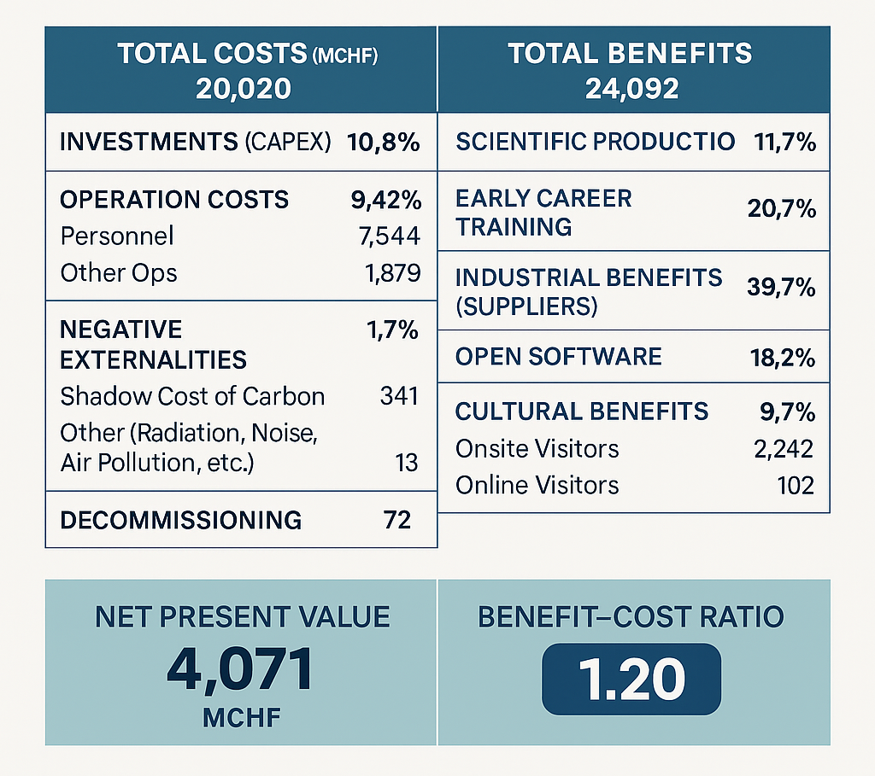
FCC-ee — projected construction cost
First stage incl. Z, WW and ZH working points. Upgrade to ttbar adds 1,260 MCHF
Socio-economic impact analysis (incl. investment, personnel, external effects, dismantling, …) estimates benefit–cost factor of 1.2 (net: 4.1 MCHF)
Domain | Cost [MCHF]
Civil engineering | 6,160
Technical infrastructures | 2,840
Injectors and transfer lines | 590
Booster and collider | 4,140
CERN contribution to four experiments | 290
FCC-ee total | 14,020
+ four experiments (non-CERN part) | 1,300
FCC-ee total incl. four experiments | 15,320
https://doi.org/10.5281/zenodo.10653395
Note: First FCC-ee stage (up to ZH)
Over a period of 15 years
Human resources for construction estimated to 15,000 FTE-years
90% CL lower limit

Slide 47
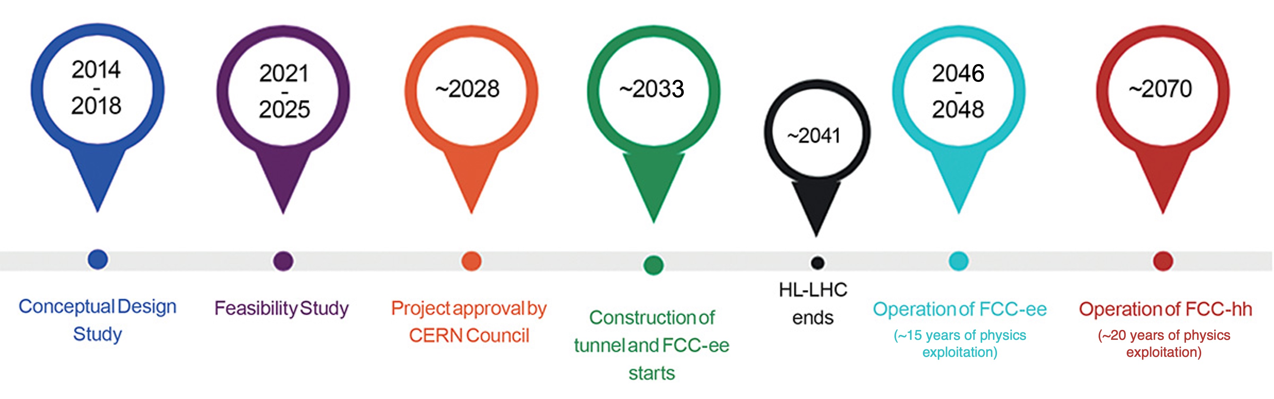
FCC — timeline of integrated programme
FCC-ee followed by FCC-hh
European strategy recommendation
Reference design phase
2033–2041 civil engineering construction work
2039–2043 technical infrastructure installation
2041–2045 accelerator installation

Slide 48
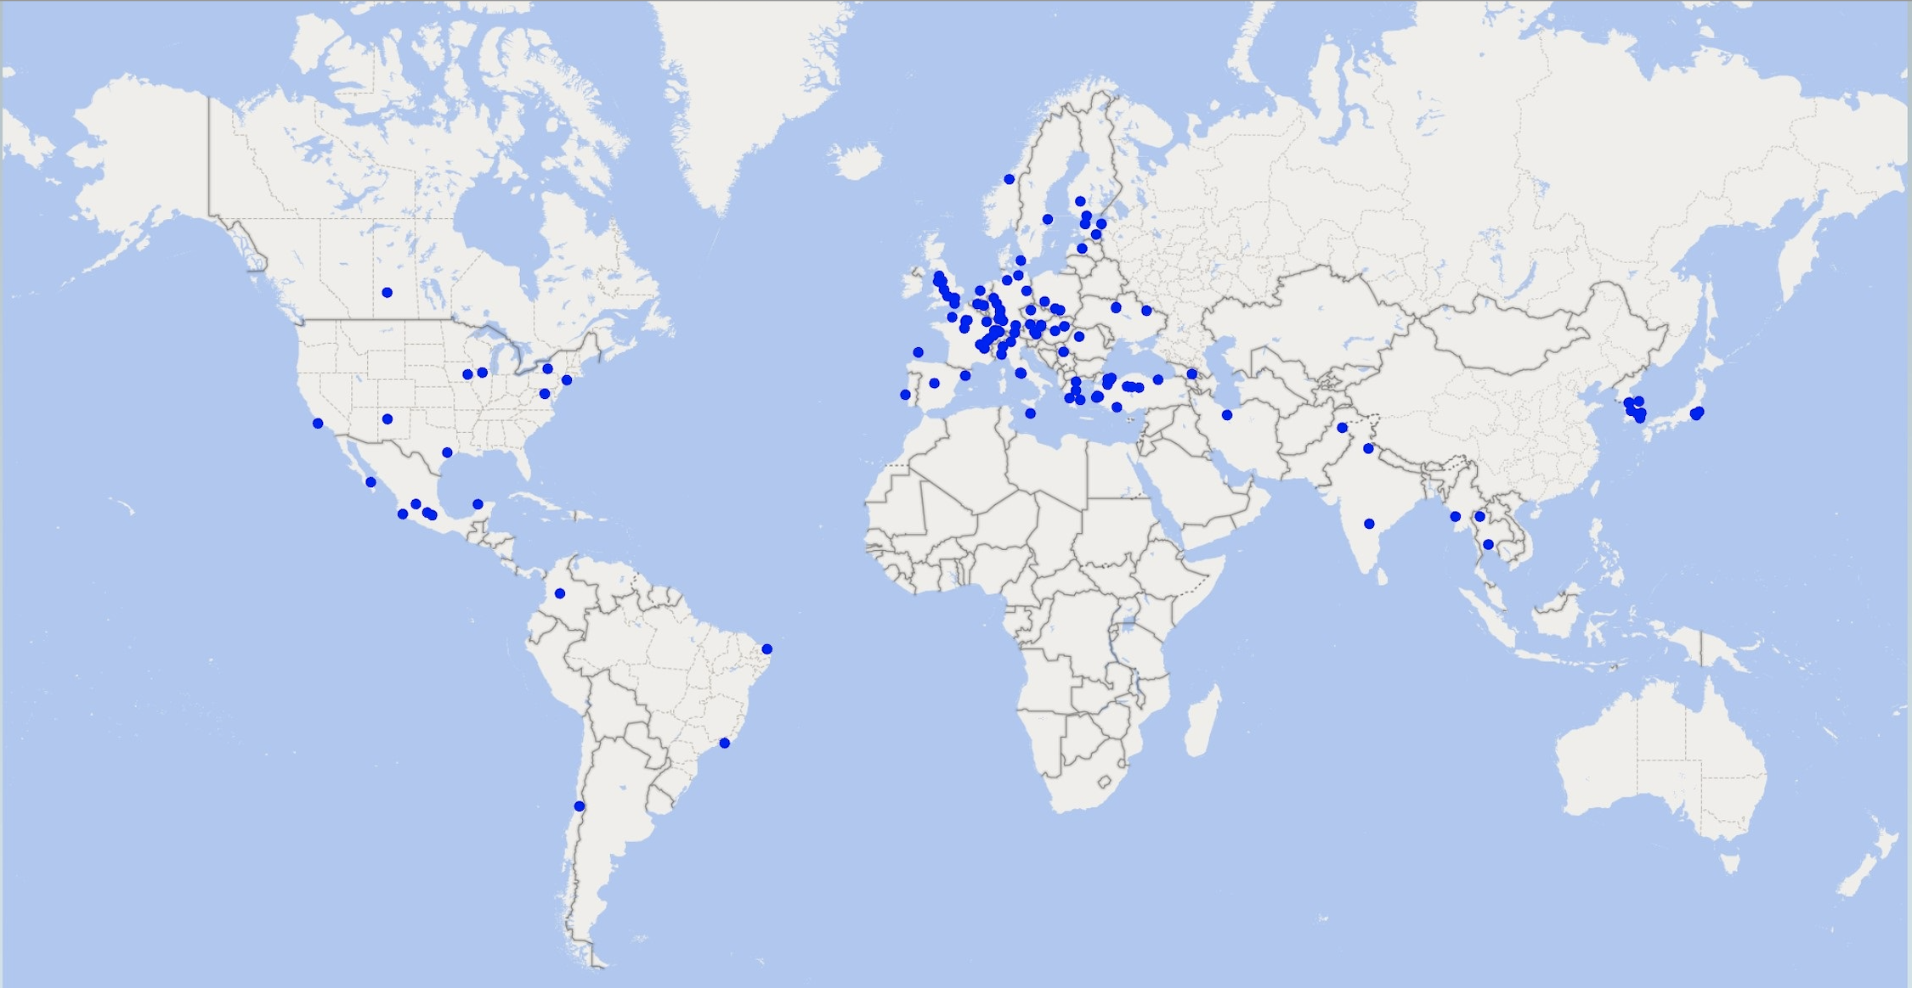

FCC-ee — global collaboration
Increasing international collaboration is a prerequisite for success. Links with science, R&D, and high-tech industry will be essential to further advance and prepare the implementation of the FCC
38 Countries (162 Institutes)
Austria – Belgium – Brazil – Canada – CERN – Chile – Colombia – Czech Republic – Denmark – Estonia – Finland – France – Georgia – Germany – Greece – Hungary – India – Iran – Italy – Japan – Latvia – Malta – Mexico – Netherlands – Norway – Pakistan – Poland – Portugal – Republic of Korea – Romania – Serbia – Spain – Sweden – Switzerland – Thailand – Türkiye – Ukraine – United Kingdom – United States of America

Slide 49
European Commission — moonshots
Recognition by the European Commission highlights the strategic value of the FCC, not only for fundamental research but also as a project fostering high-level collaboration in Europe
Link to document

Slide 50
Conclusions
FCC-ee is Europe’s priority for CERN’s next collider project: a transformative instrument for exploring the Higgs boson, the electroweak sector, and the quantum structure of fundamental interactions with unprecedented precision
A detailed feasibility study has been released, and the project is now moving toward the next design phase, with a possible CERN Council decision around 2028
FCC-ee is also the foundation for the future energy frontier, enabling a subsequent hadron collider in the same infrastructure — a highly synergistic and complementary programme that maximises the long-term physics reach
Sustainability is a design principle, not an afterthought, embedded in the FCC-ee study from the outset

Slide 51
Extra slides …

Slide 52
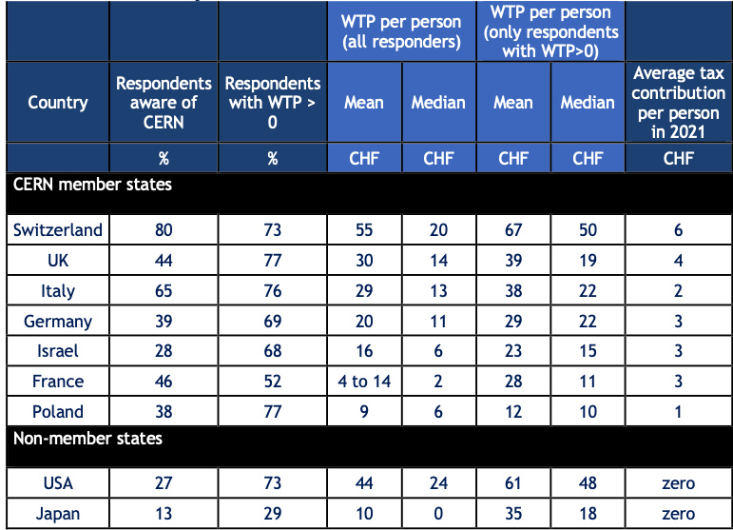
FCC-ee — projected acceptance
Does the average taxpayer in CERN’s member states support a new accelerator at CERN?
A public perception study assessed quantitative indicators for drivers as basis for evidence-based actions
How much of their taxes would citizens be willing to allocate to a new collider project at CERN?
Study based on accredited methodology, passed through an ethics committee and carried out with an independent, domain specific quality management certified support company.
Link to article: https://inspirehep.net/literature/3155013
In general, the offered amounts exceed significantly the actual contribution of a taxpayer to CERN
66% of respondents expressed their willingness to financially support a new collider at CERN with their annual taxes. 34% reported zero willingness to support
Positive opinions raised from 58% to 78%, negative fell from 18% to 2% after receiving specific CERN related information

Slide 53
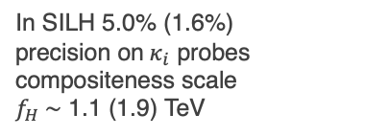
HL-LHC Physics prospects — Higgs
Higgs coupling prospects | Coupling strength modifiers ($κ_{i}^{2}≡{σ_{i}}/{σ_{i}^{SM}}$, assuming SM $Γ_{H}$)
Prospects for Higgs width from off-shell measurement, invisible Higgs decays, Higgs sector extensions (2HDM)
Γ_{H} via μ_{off-shell} / μ_{on-shell} in H → 4𝓁 & 2𝓁2𝜈 with < 20% uncertainty
BR(H → invisible) < 2.5%
Discover or exclude MSSM two Higgs doublets scenario deep into TeV scale for tanβ > 6
In SILH 5.0% (1.6%) precision on $κ_{i}$ probes compositeness scale $f_{H} \sim$ 1.1 (1.9) TeV
Even with 2× better theory precision, theoretical uncertainties will be dominant
Unique sensitivity to rare decays and to top coupling
53

Slide 54
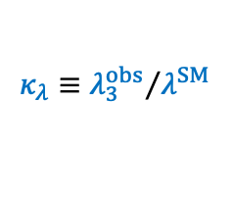
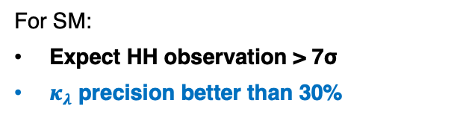


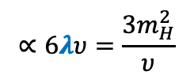
HL-LHC Physics prospects — Higgs
Higgs self-coupling via Higgs pair production: complex final states, eldorado for ML enthusiasts, strongest channels: HH → bb𝛾𝛾, bb𝜏𝜏, bbbb. Best sensitivity to $λ$ at low m(HH)
t
arXiv:2504.00672
$$∝6λυ=\frac{3m_{H}^{2}}{υ}$$
$$κ_{t}$$
$$V\left(φ\right)=−μ^{2}{\left|φ\right|}^{2}+λ{\left|φ\right|}^{4}$$
$$κ_{λ}≡{λ_{3}^{obs}}/{λ^{SM}}$$
For SM:
Expect HH observation > 7σ
$κ_{λ}$ precision better than 30%

Slide 55

FCC-ee – Injector
FCC-ee injector with high-energy linac
Located on CERN Prévessin site
Transfer line to FCC PA (LHC P8, LHCb), “cut and cover” construction
Conventional positron source using tungsten target + capture linac, need: 1.1⨯10¹³ e⁺/s (SLC: ∼6 ⨯10¹² e⁺/s)
2.9 GeV damping ring with wigglers (small synchrotron to reduce transverse and longitudinal beam emittance)
Main linac ~1 km with 22.5 MV/m to accelerate e⁺ and e– to 20 GeV for injection into booster
Total length about 1.2 km
SPS
FCC
Damping ring

Slide 56


FCC-ee — parameters
FCC-ee main parameters (assuming 4 IPs / experiments)
Global data-centre electricity use is projected to rise from 460 TWh in 2024 (1.5% of total electricity consumption) to 1,000 TWh (±25%) by 2030 and 1,300 (±40%) TWh by 2035 (~15% annual raise), driven mainly by the US and China. The AI share may grow from 10~20% today to 30~50% in 2035.
Ref: arXiv:2505.00274
Parameter | Z | WW | H (ZH) | $$\text{t}\overline{\text{t}}$$
Collision energy √s [GeV] | 88, 91, 94 | 157, 163 | 240 | 340–350 | 365
SR energy loss / turn [GeV] | 0.036 | 0.08 | 1.7 | 7.8 | 9.2
Total RF voltage 400 / 800 MHz [GV] | 0.08 / 0 | 1.0 / 0 | 2.1 / 0 | 2.1 / 7.4 | 2.1 / 9.2
Synchrotron radiation/beam [MW] | 50 | 50 | 50 | 50 | 50
Beam current [mA] | 1294 | 135 | 26.8 | 6.0 | 5.1
Number bunches / beam | 11200 | 1852 | 300 | 70 | 64
Luminosity / IP [10³⁴ cm^{–2}s^{–1}] | 144 | 20 | 7.5 | 1.8 | 1.4
Luminosity / year [ab^{–1}] | 68 | 9.6 | 3.6 | 0.83 | 0.67
Run time (including lumi ramp-up) [years] | 4 | 2 | 3 | 1 | 4
Total integrated luminosity [ab^{–1}] | 205 | 19.2 | 10.8 | 0.4 | 2.7
Total number of events | 6$∙$10¹² Z | 2.4$∙$10⁸ WW (incl. WW at higher √s) | 2.2$∙$10⁶ ZH 65k WW → H | 2$∙$10⁶ $\text{t}\overline{\text{t}}$ + 370k ZH + 92k WW → H
Reference: International Energy Agency,
see also this critical review of the modelling
Aerial view of Microsoft’s new AI datacenter in Mt Pleasant, Wisconsin, Sep 2025 [Link]
Despite the constant synchrotron power ($U_{0}∝{E^{4}}/ρ$, $P_{SR}=U_{0}I$), due to the larger RF voltage and system size (increased cryogenic system), RF efficiency losses, and other increasing accelerator demands, the electrical power consumption increases with CM energy:
FCC-ee electrical energy consumption | Z | W | H | top
Beam energy [GeV] | 45.6 | 80 | 120 | 182.5
Peak power during beam operation [MW] | 250 | 275 | 297 | 381
Total FCC-ee yearly consumption [TWh] | 1.2 | 1.3 | 1.4 | 1.85
LHC + injectors: ~ 200 MW peak power
Today with LHC operating: ~1.3 TWh
Various R&D towards further reduction of electrical energy consumption

Slide 57


FCC-ee — beam energy
Precise knowledge of beam energy at Z pole crucial, meticulous work done at LEP to achieve
m_{Z} Γ_{Z}
LEP E_{CM} related syst. uncertainty: 1.7 MeV (1.9 × 10^{–5}) 1.2 MeV
FCC-ee statistical uncertainty: 4 keV (≪ 10^{–6}) 4 keV
Precise beam energy calibration (ΔE/E < 10^{–6}) through resonant depolarisation (RDP) as previously done at VEPP-2M (Novosibirsk) and LEP
Due to synchrotron radiation, e± in storage ring become transversely polarised with a spin tune (number of spin precessions per turn in the bending field): $ν_{e}=a_{e}γ=a_{e}{E_{e}}/{m_{e}}$. By applying an external RF field tuned to $ν_{e}$, which depolarises the beam, $E_{e}$can be measured with extraordinary precision
At LEP, RDP could only be performed in a few fills, before or after collisions. E_{CM} knowledge limited by modelling of time evolution between measurements. E_{CM} calibration must be a central consideration in FCC-ee design & operational strategy: quasi-continuous RDP using non-colliding (unpaired) bunches
Expect that E_{CM} systematics can be limited to 100 keV on m_{Z} and 25 keV on Γ_{Z}
See, eg, this CERN Courier article
~ 9 MeV
Beam energy variation at LEP from Earth tides

Slide 58
FCC-ee – also a Tera-Z, W and top factory
Extreme luminosity on Z pole: 140$∙$10³⁴ cm^{–2}s^{–1} / IP, 205 ab^{–1} & 6$∙$10¹² Z (4 IPs) — ultimate EW precision data
arXiv:2505.00272
Improvements up to × 2000 over current knowledge
Simulation of tt threshold scan with CLIC [arXiv:2503.24168]

Slide 59



FCC-ee – the Higgs factory
Extremely challenging — cornering the electron Yukawa coupling: $g_{e}={\sqrt{2}m_{e}}/υ≈2.9∙{10}^{−6}$
Can we measure the decay? (recall: $Γ_{H}$ = 4.1 MeV)
$$BR\left(H→e^{+}e^{−}\right)≃\frac{1}{Γ_{H}}∙\frac{G_{F}m_{H}m_{e}^{2}}{4π\sqrt{2}}≈5.2∙{10}^{−9}$$
✅
✅
✅
✅
The entire HL-LHC may produce 2 such events!
At the FCC-ee, BW s-channel resonance:
✅
✅
✅
$$σ\left(e^{+}e^{−}→H\right)≃\frac{4πΓ_{H}Γ\left(H→e^{+}e^{−}\right)}{{\left(s−m_{H}^{2}\right)}^{2}+m_{H}^{2}Γ_{H}^{2}} \underset{⇒}{s=m_{H}^{2}} \frac{4π}{m_{H}^{2}}BR\left(H→e^{+}e^{−}\right)≈1.6 fb$$
❓
✅
✅
✅
but ISR and √s spread will lead to smearing of BW peak, so that effective cross section is 0.3 fb (remember: L_{ZH} = 10.8 ab^{–1}). Can it be done?
✅
Almost all Higgs couplings to SM particles will have been measured at HL-LHC & FCC-ee

Slide 60


FCC-ee – the Higgs factory
Extremely challenging — cornering the electron Yukawa coupling: $g_{e}={\sqrt{2}m_{e}}/υ≈2.9∙{10}^{−6}$
Can we measure the decay? (recall: $Γ_{H}$ = 4.1 MeV)
arXiv:2107.02686
$$BR\left(H→e^{+}e^{−}\right)≃\frac{1}{Γ_{H}}∙\frac{G_{F}m_{H}m_{e}^{2}}{4π\sqrt{2}}≈5.2∙{10}^{−9}$$
The entire HL-LHC may produce 2 such events!
At the FCC-ee, BW s-channel resonance:
$$σ\left(e^{+}e^{−}→H\right)≃\frac{4πΓ_{H}Γ\left(H→e^{+}e^{−}\right)}{{\left(s−m_{H}^{2}\right)}^{2}+m_{H}^{2}Γ_{H}^{2}} \underset{⇒}{s=m_{H}^{2}} \frac{4π}{m_{H}^{2}}BR\left(H→e^{+}e^{−}\right)≈1.6 fb$$
but ISR and √s spread will lead to smearing of BW peak, so that effective cross section is 0.3 fb (remember: L_{ZH} = 10.8 ab^{–1}). Can it be done?
Requires precise knowledge of Higgs mass to few MeV
Beam must be monochromatized to match narrow $Γ_{H}$ [arXiv: 2411.04210]
Correlate energy and transverse position so high-energy particles collide with low-energy ones (opposite beam dispersions at IP) — requires dedicated instruments: proposed for many e⁺e– colliders, but never implemented
Possible sensitivity to $g_{e}$ of ~0.5σ per year and IP

Slide 61





FCC-ee – the Higgs factory
Higgs self-coupling — no HH production at FCC-ee, sensitivity through H–H–H loops
$$κ_{Z}$$
$$κ_{Z}$$
FCC-ee+hh tightly constrains BSM models with 1st order EW phase transition
$$κ_{λ}$$
arXiv:2504.00672
NLO vertex corrections to Higgsstrahlung (similar for W-boson fusion)
arXiv:1711.03978
Measuring σ(e⁺e– → ZH) and σ(e⁺e– → 𝜈𝜈H) at different √s improves precision on $κ_{λ}$ from 30% (HL-LHC) to 20% (or 40% standalone) in EFT analysis

Slide 62
Power efficiency: next-generation e⁺e– collider
FCC-ee vs LEP: larger bending radius, more efficient superconducting RF, improved beam optics (higher beam-beam performance limits), ultra-low emittance magnet lattices, crab waist scheme, continuous top-up injection via booster (always near optimal luminosity), power-optimised from the start
Figure reference
FCC-ee delivers 10⁴ – 10⁵ × luminosity / electrical power of LEP

Slide 63
The big picture: next-generation collider projects for CERN
Project | Construction start | First beams | Peak lumi at Z per IP [10³⁴ cm^{–2}s^{–1}] | Peak lumi at HZ per IP [10³⁴ cm^{–2}s^{–1}] | Years of operation | Construction cost* [BCHF] | Next stage collider | Start of operation | Total construction cost* [BCHF]
FCC-ee | 2033 | 2046 | 144 | 7.5 | 14 | 15.3 | FCC-hh | 2079 | 34.7
LEP3 | 2037 | 2047 | 40 | 1.6 | 15 | 4.1 | FCC-hh | 2074 | 32.5
LCF 250 → 550 GeV | 2035 | 2045 | 0.28 | 1.4 – 2.7 | 19 | 9.4 + 5.4 = 14.8 | > 1 TeV collider? | – | –
CLIC 380 → 1500 GeV | 2035 | 2045 | – | 1.2_{380 GeV} | 20 | 7.5 + 7.1 = 14.6 | 3 TeV collider? | – | –
LHeC | 2037 | 2044 | – | 2.3 | 7 | 2.1 | FCC-hh | 2064 | 30.5
Similar start dates driven by HL-LHC running until 2041
*Construction costs include experiments

Slide 64
Intermediate conclusions by ESG
[Link to document]
FCC-ee is technically feasible and would deliver the broadest high-precision particle physics programme. It would also pave the way towards a hadron collider reusing the tunnel and much of the infrastructure
LEP3 and LHeC as alternative options with significantly lower construction cost (but no new tunnel for a possible hadron collider): not competitive with FCC-ee on breadth of physics programme, not flagship colliders
CLIC and LCF as alternative options: operation at 550 GeV or higher would offer competitive programmes in Higgs and top-quark physics, however, overall not competitive with FCC-ee. Both require a new tunnel of about 33 km to reach their ultimate energies. Path to 10 TeV pCM requires plasma wakefield acceleration, which is not yet a proven technology
Descoped FCC-ee to reduce cost by 15% (no ttbar run: –1.26 BCHF, drop 2 / 4 experiments: –0.80 BCHF, decrease RF power from 50 → 30 MW (–0.35 BCHF) significantly impacts breadth of the physics programme and precision, but still stronger than other options. Scenarios would be reversible
[ L(FCC-ee) × 3/5 × 2/4 × 1.2 = L(FCC-ee) × 0.36 → need to run 2.8 × longer for equivalent physics ]

Slide 65
ESG recommendations
[Link to document, Karl’s talk]
General Recommendations

Slide 66
ESG recommendations
[Link to document, Karl’s talk]
The next CERN flagship collider project

Slide 67
ESG recommendations
[Link to document, Karl’s talk]
Technology

Slide 68
The European Strategy for Particle Physics – Update (ESPPU)
From Karl’s talk

Slide 69
Overall summary
[From Karl’s talk]
Physics: from WG2b: sum of precision/BSM physics
Phys vs CEPC: competitiveness, assuming CEPC is running in parallel
Tech readiness: from WG2a
Construction cost: from proponents + exp. (CERN part)

Slide 70

LEP3 — a Higgs and EW factory in the LHC tunnel
Backup if (preferred) FCC-ee cannot be realised with long-term goal of an energy-frontier hadron or muon collider: similar to FCC-ee with booster and collider rings, 2 beampipes, 50 MW / beam, 2 IPs
Parameter | Z | WW | H (ZH) | $$\text{t}\overline{\text{t}}$$
Inst. luminosity / IP [10³⁴ cm^{–2}s^{–1}] | 40 | 6.2 (160 GeV) | 1.6 (230 GeV) | –
SR energy loss / turn [GeV] | 0.13 | 1.3 | 5.4 | (~25 GeV)
Integrated luminosity / year / IP [ab^{–1}] | 4.8 | 0.7 | 0.19 | –
Run time [years] | 5 | 4 | 6 | –
Total integrated luminosity [ab^{–1}, 2 IPs] | 48 | 6.0 | 2.3 | –
Total number of events [2 IPs] | 1.4$∙$10¹² | 0.36$∙$10⁸ | 0.42$∙$10⁶ | –
Inst. luminosity / IP [10³⁴ cm^{–2}s^{–1}] | 144 | 20 (157, 163 GeV) | 7.5 (240 GeV) | 1.8 (~350 GeV) | 1.4 (365 GeV)
SR energy loss / turn [GeV] | 0.036 | 0.08 | 1.7 | 7.8 | 9.2
Integrated luminosity / year / IP [ab^{–1}] | 17 | 2.4 | 0.9 | 0.21 | 0.17
Run time (including lumi ramp-up) [years] | 4 | 2 | 3 | 1 | 4
Total integrated luminosity [ab^{–1}, 4 IPs] | 205 | 19.2 | 10.8 | 0.4 | 2.7
Total number of events [4 IPs] | 6$∙$10¹² | 2.4$∙$10⁸ | 2.2$∙$10⁶ | 2$∙$10⁶
Construction:
LEP3
Total cost 3.7B CHF
ESPPU input: arXiv:2504.00541
FCC-ee
Total cost 13.7B + 1.3B_{tt} CHF
FCC-ee SR loss reference
Challenges for LEP3 include design of IRs, large E-loss, need 6.0 GV RF power installed in 4 long straight sections (2 booster, 2 collider), crab-waist scheme requires large crossing angle and widening tunnel on either side of the experiments from ~4m to 7m diameter along 270 m

Slide 71

Linear Collider Facility (LCF) at CERN
Very similar to ILC: baseline is 33.5 km tunnel, SRF cavities with an accelerating gradient of 31.5 MV m⁻¹, √s = 250 GeV upgradable to 550 GeV, longitudinal polarisation (± 80/30% for e–/e⁺, ~20% higher σ(ZH)), 2 IPs (sharing luminosity)
Parameter | Z | WW | H (ZH) | above $\text{t}\overline{\text{t}}$
Inst. luminosity / IP [10³⁴ cm^{–2}s^{–1}] | 0.28 | – | 1.4_{LP} / 2.7_{FP} (250 GeV) | 3.9 (550 GeV)
Integrated luminosity / year / IP [ab^{–1}] | 30 | – | 0.19_{LP} + 0.64_{FP} | 2.3
Run time [years] | 1 | – | 5_{LP} + 3_{FP} | 10
Total integrated luminosity [ab^{–1}, 2 IPs*] | 0.07 | – | 1.0_{LP} + 1.9_{FP} | 8.3
Total number of events [2 IPs*] | 0.002$∙$10¹² | – | 0.8$∙$10⁶ | ~ 1.6 (H) / 3.9 (tt)$∙$10⁶
Inst. luminosity / IP [10³⁴ cm^{–2}s^{–1}] | 144 | 20 (157, 163 GeV) | 7.5 (240 GeV) | 1.8 (~350 GeV) | 1.4 (365 GeV)
Integrated luminosity / year / IP [ab^{–1}] | 17 | 2.4 | 0.9 | 0.21 | 0.17
Run time (including lumi ramp-up) [years] | 4 | 2 | 3 | 1 | 4
Total integrated luminosity [ab^{–1}, 4 IPs] | 205 | 19.2 | 10.8 | 0.4 | 2.7
Total number of events [4 IPs] | 6$∙$10¹² | 2.4$∙$10⁸ | 2.2$∙$10⁶ | 2$∙$10⁶
Construction:
LCF
Total cost:
8.5B CHF (250 GeV, LP)
9.3B CHF (250 GeV, FP)
14.8B CHF (550 GeV)
ESPPU input: arXiv:2503.19983
Total cost 15.3B CHF
FCC-ee
*LCF proposes to share luminosity among two interaction regions, ie, same integrated luminosity as for single IP
Challenges for for LCF include the positron source, final focus and nano-beam stability ($σ_{y}^{∗}$ ~ 6–8 nm, FCC-ee: 40 nm)
Options to increase energy beyond 550 GeV with development and installation of higher gradient accelerating technologies (see here for a discussion of options)

