Slide 1
Experimental Physics at the LHC (1)
Andreas Hoecker (CERN)
57. Herbstschule HEP
1–11 September 2026, Bad Honnef, Germany

Slide 2
Today’s lecture:
A brief conceptual introduction — certainly overlap with other lectures, but hopefully highlighting different perspectives
Historical collider milestones
Introduction to the LHC
Next lectures:
Particle detection at the LHC
Data reconstruction and analysis
Selected physics topics
Upgrade to the High-Luminosity LHC
New physics opportunities

Slide 3
A big apology for showing more ATLAS examples in this lecture, simply because I know better how to find them
In all cases, there exist equivalent CMS examples
I further apologise for focusing more on the high-p_{T} LHC experiments, assuming many of the LHCb results are featured in the dedicated flavour lecture

Slide 4
The time will come when diligent research over long periods will bring to light things which now lie hidden. A single lifetime, even though entirely devoted to the sky, would not be enough for the investigation of so vast a subject ...
And so this knowledge will be unfolded only through long successive ages. There will come a time when our descendants will be amazed that we did not know things that are so plain to them …
Many discoveries are reserved for ages still to come, when memory of us will have been effaced. Our universe is a sorry little affair, unless it has in it something for every age to investigate. Nature does not reveal her mysteries once and for all.

Slide 5
The time will come when diligent research over long periods will bring to light things which now lie hidden. A single lifetime, even though entirely devoted to the sky, would not be enough for the investigation of so vast a subject ...
And so this knowledge will be unfolded only through long successive ages. There will come a time when our descendants will be amazed that we did not know things that are so plain to them …
Many discoveries are reserved for ages still to come, when memory of us will have been effaced. Our universe is a sorry little affair, unless it has in it something for every age to investigate. Nature does not reveal her mysteries once and for all.
Seneca the Younger (Stoic philosopher of Ancient Rome) in Naturales Quaestiones, 1st century AD

Slide 6
Steven Weinberg’s four golden lessons: start before you feel ready; tackle the messy problems; accept wasting time*; know your field’s history**
https://www.nature.com/articles/426389a (2003)
* ”If you want to be creative, then you will have to get used to spending most of your time not being creative”
** ”The best antidote to the philosophy of science is a knowledge of the history of science”, “Science is civilizing work, of which scientists are able to feel proud”

Slide 7
No single insight in this search is sacred,
only the searching
Paraphrased from Ann Druyan’s introduction to Carl Sagan’s The Varieties of Scientific Experience

Slide 8
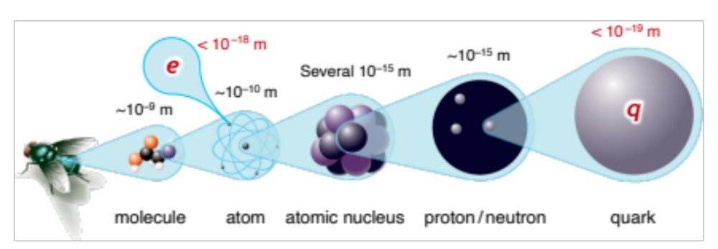
It’s all made of a handful of particles and forces
The sub-atomic structure of matter and its interactions are elegantly simple (a very simplified picture)
The universe is a strange place
Elementary particles are point-like — with no spatial extent at all
Without some remarkable mechanism at play, elementary particles would have no mass (except for spin-zero particles)
Bare fermion masses are forbidden by the chiral structure of weak interaction

Slide 9
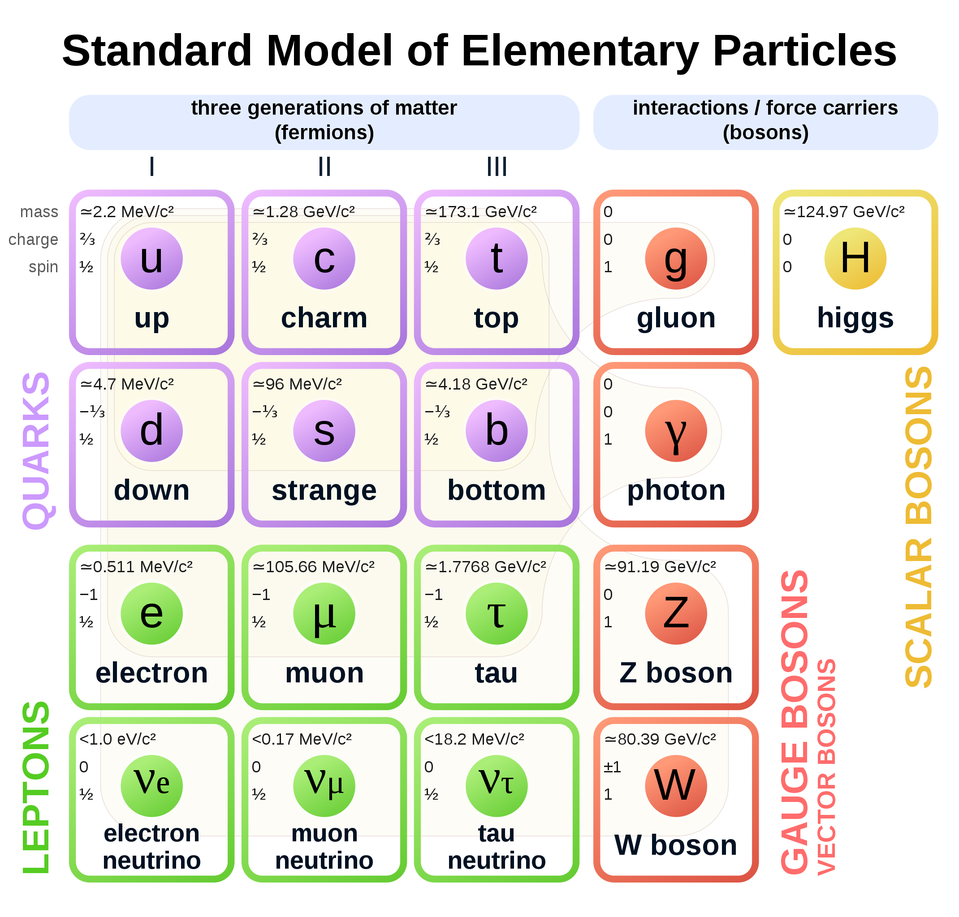
It’s all made of a handful of particles and forces
The sub-atomic structure of matter and its interactions are described by the Standard Model
Completely new type of force, very different from the other known forces
In mathematical terms, particles are local excitations of quantum fields. There are matter fields (fermions) and force fields (bosons)
Spin 1/2
Spin 1
Spin 0

Slide 10
It’s all made of a handful of particles and forces
The sub-atomic structure of matter and its interactions are described by the Standard Model
Decades of international high-technology accelerator-based research gave us these insights
Spin 1/2
Spin 1
Spin 0

Slide 11
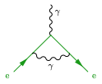
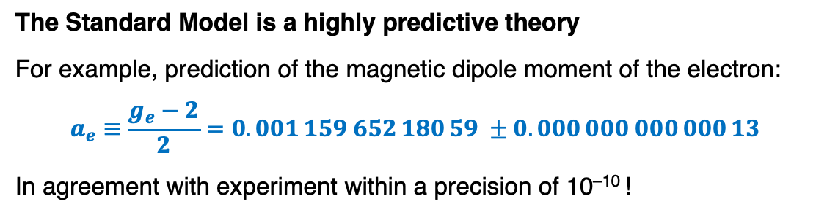

It’s all made of a handful of particles and forces
The sub-atomic structure of matter and its interactions are described by the Standard Model
The Standard Model is a highly predictive theory
For example, prediction of the magnetic dipole moment of the electron:
$$a_{e}≡\frac{g_{e}−2}{2}=0.001 159 652 180 59 ±0.000 000 000 000 13$$
In agreement with experiment within a precision of 10^{–10} !
“Schwinger” term:
$$a_{e}=α/(2π)$$
Spin 1/2
Spin 1
Spin 0

Slide 12
It’s all made of a handful of particles and forces
The sub-atomic structure of matter and its interactions are described by the Standard Model
The strong force is particular, the world is made of non-perturbative objects: hadrons. How do we know that hadrons obey the laws of QCD?
Spin 1/2
Spin 1
Spin 0

Slide 13
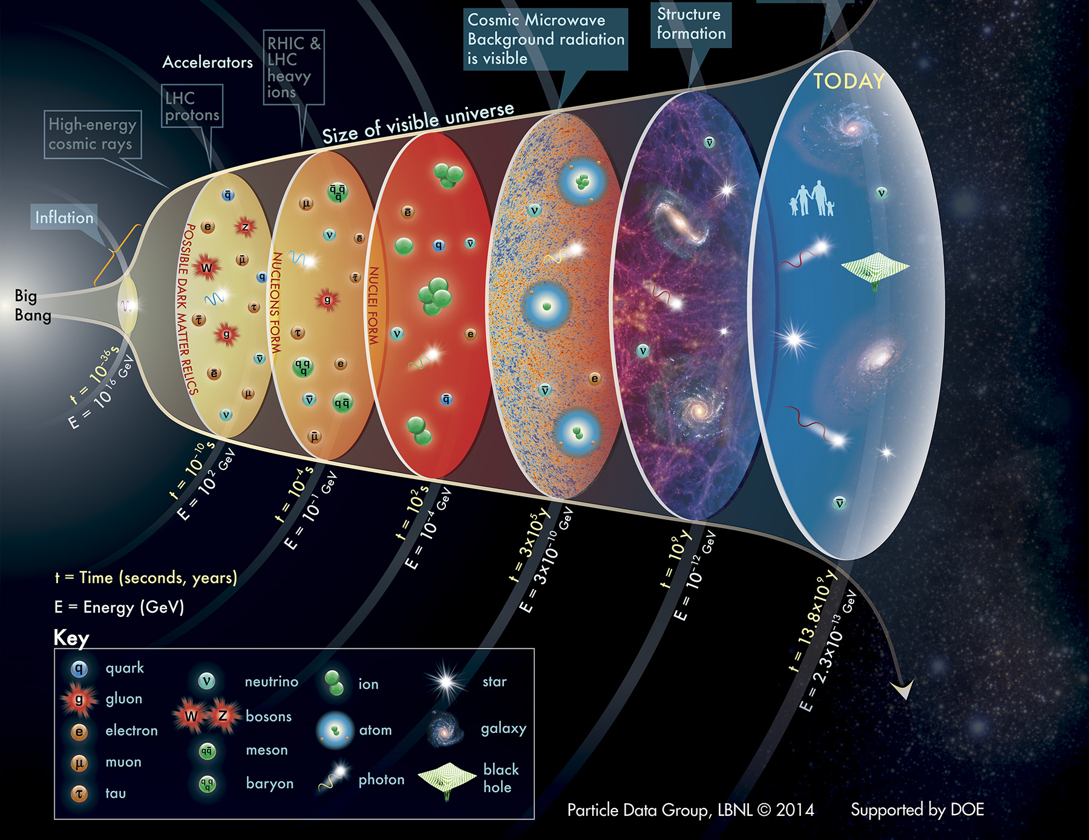
The Standard Model
… should not only work today, but also describe the history of the universe since the Big Bang 13.8 billion years ago
–12
T = 10¹⁵ K
T = 10¹² K
T = 10⁹ K
T = 4000 K
T = 60 K
T = 2.7 K

Slide 14
The Standard Model
… should not only work today, but also describe the history of the universe since the Big Bang 13.8 billion years ago
matter ~ antimatter
→ annihilation
(very little) matter
But why is there (only) matter left in the universe?
–12
T = 10¹⁵ K
T = 10¹² K
T = 10⁹ K
T = 4000 K
T = 60 K
T = 2.7 K

Slide 15
The Standard Model
… should not only work today, but also describe the history of the universe since the Big Bang 13.8 billion years ago
matter ~ antimatter
→ annihilation
(very little) matter
But why is there (only) matter left in the universe?
And what is the origin of the huge quantity of dark matter (5 times more than the baryonic matter)?
–12
invisible “dark” matter
T = 10¹⁵ K
T = 10¹² K
T = 10⁹ K
T = 4000 K
T = 60 K
T = 2.7 K

Slide 16
The Standard Model
… should not only work today, but also describe the history of the universe since the Big Bang 13.8 billion years ago
matter ~ antimatter
→ annihilation
(very little) matter
But why is there (only) matter left in the universe?
And what is the origin of the huge quantity of dark matter (5 times more than the baryonic matter)?
–12
invisible “dark” matter
T = 10¹⁵ K
T = 10¹² K
T = 10⁹ K
T = 4000 K
T = 60 K
And why do elementary particles have mass at all? (Simply sticking masses onto particles breaks gauge symmetry)
T = 2.7 K

Slide 17
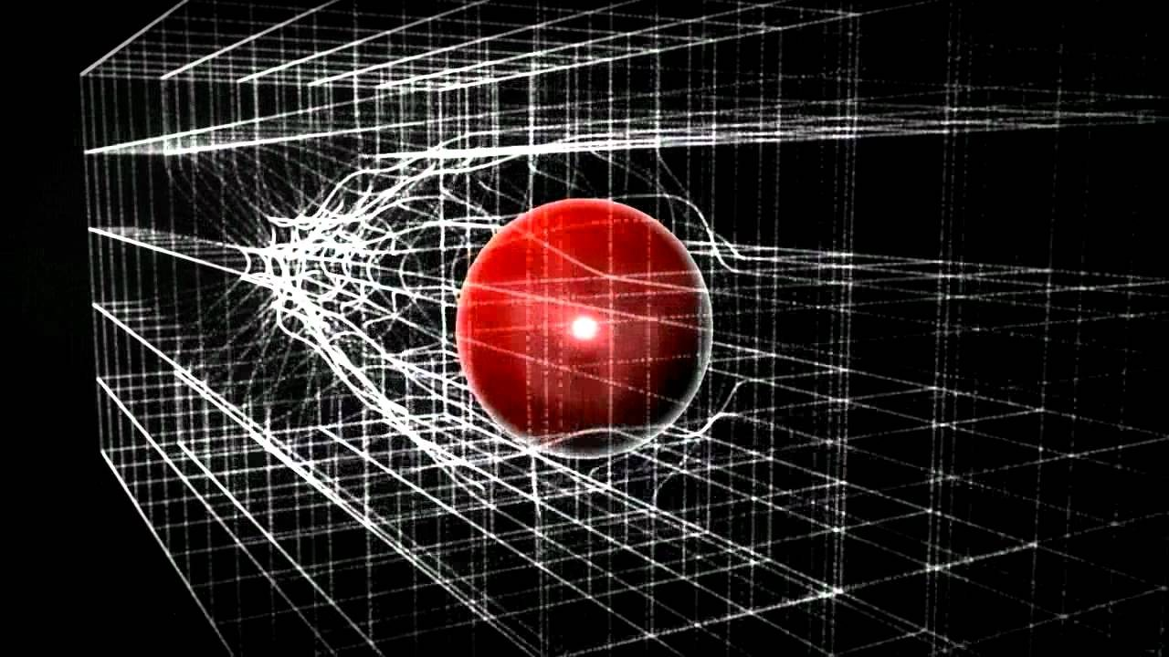
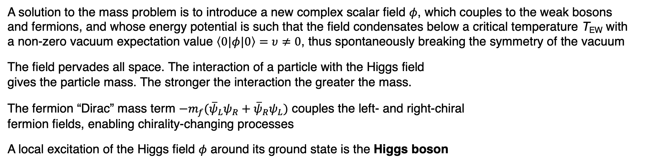
Gauge symmetry and the Brout-Englert-Higgs mechanism
A solution to the mass problem is to introduce a new complex scalar field $φ$, which couples to the weak bosons and fermions, and whose energy potential is such that the field condensates below a critical temperature T_{EW} with a non-zero vacuum expectation value $\left\langle 0|φ|0\right\rangle =υ≠0$, thus spontaneously breaking the symmetry of the vacuum
The field pervades all space. The interaction of a particle with the Higgs field gives the particle mass. The stronger the interaction the greater the mass.
The fermion “Dirac” mass term $−m_{f}{(\overline{ψ}}_{L}ψ_{R}+{\overline{ψ}}_{R}ψ_{L})$ couples the left- and right-chiral fermion fields, enabling chirality-changing processes
A local excitation of the Higgs field $φ$ around its ground state is the Higgs boson

Slide 18
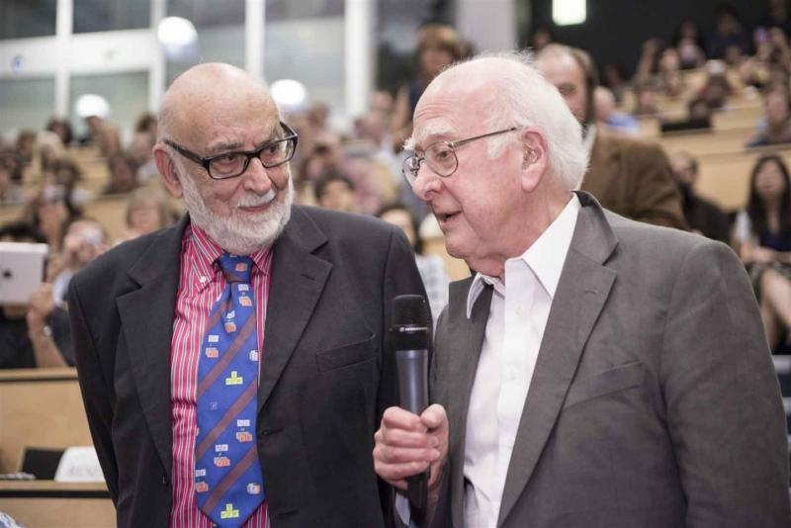
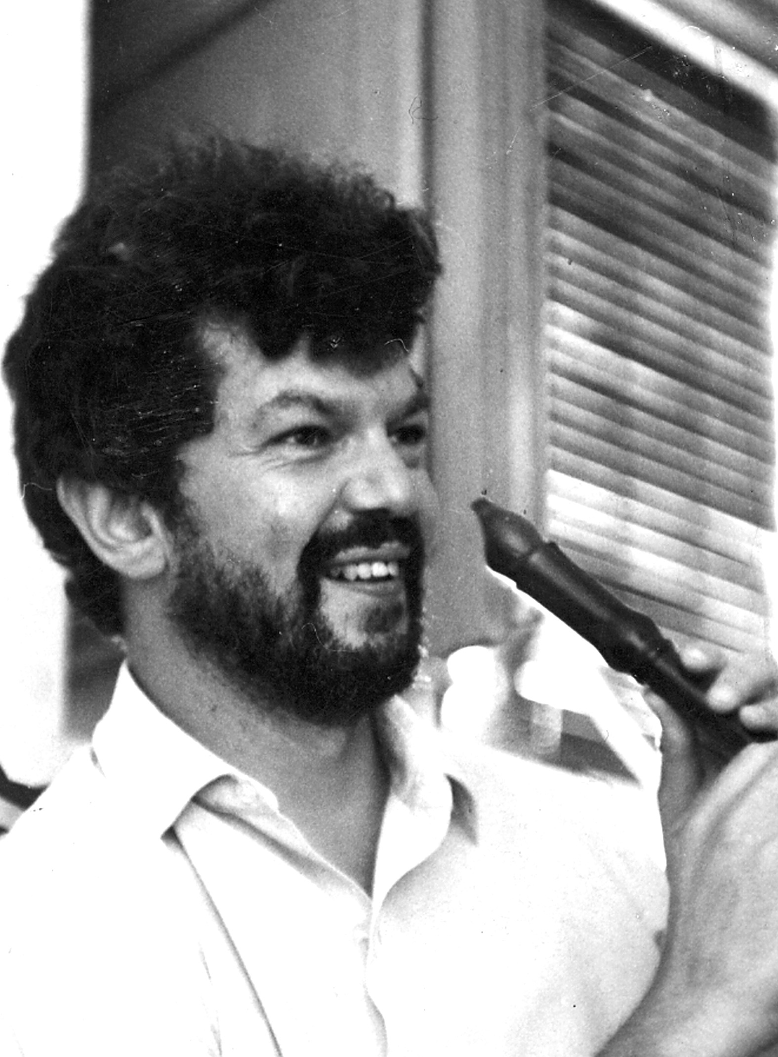
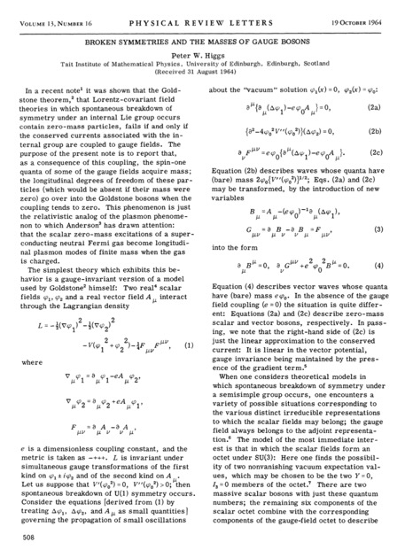
Gauge symmetry and the Brout-Englert-Higgs mechanism
A solution to the mass problem is to introduce a new complex scalar field $φ$, which couples to the weak bosons and fermions, and whose energy potential is such that the field condensates below a critical temperature T_{EW} with a non-zero vacuum expectation value $\left\langle 0|φ|0\right\rangle =υ≠0$, thus spontaneously breaking the symmetry of the vacuum
The field pervades all space. The interaction of a particle with the Higgs field gives the particle mass. The stronger the interaction the greater the mass.
The fermion “Dirac” mass term $−m_{f}{(\overline{ψ}}_{L}ψ_{R}+{\overline{ψ}}_{R}ψ_{L})$ couples the left- and right-chiral fermion fields, enabling chirality-changing processes
A local excitation of the Higgs field $φ$ around its ground state is the Higgs boson
Peter Ware Higgs (1929 – 2024)
François Englert (1932 – 2026)
Robert Brout (1928 – 2011)
Broken Symmetries and the Masses of Gauge Bosons, PRL 13, 508, (1964) –– or how to change the course of physics with a good idea on two pages — together with the other famous works from his colleagues in 1964
Superconductivity (BCS theory) was key in the development of the BEH mechanism [My life as a boson, 2010]
Broken Symmetry and the Mass of Gauge Vector Mesons, PRL 13, 321, (1964)
François Englert and Peter Higgs at CERN on 4 July 2012
Robert Brout

Slide 19
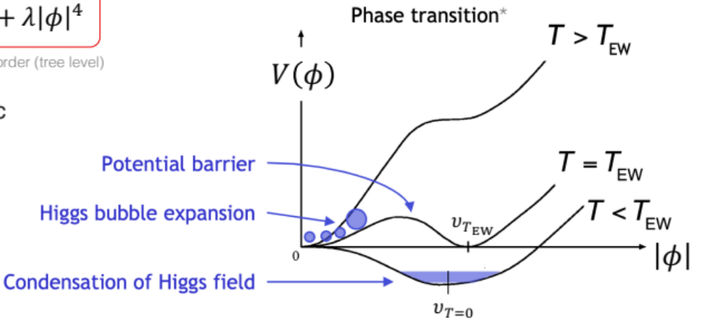


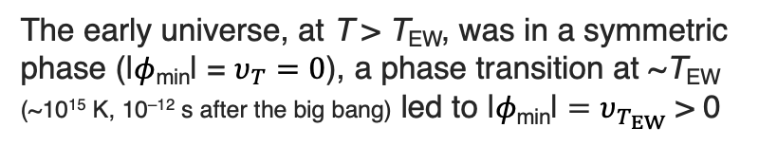
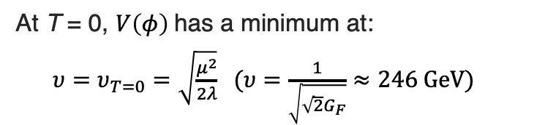
The Brout-Englert-Higgs (BEH) mechanism
*Note that in the SM, this phase transition is a smooth crossover, ie, of 2nd order with no Higgs bubble creation
The BEH potential energy:
$$V\left(φ\right)=−μ^{2}{\left|φ\right|}^{2}+λ{\left|φ\right|}^{4}$$
At lowest order (tree level)
The early universe, at T > T_{EW}, was in a symmetric phase (|$φ$_{min}| = $υ_{T}=0$), a phase transition at ~T_{EW} (~10¹⁵ K, 10^{–12} s after the big bang) led to ${\text{|}φ\text{min}\text{|}=υ}_{T_{EW}}$ > 0
At T = 0, $V\left(φ\right)$has a minimum at:
${υ=υ}_{T=0}=\sqrt{\frac{μ^{2}}{2λ}}$ $(υ=\frac{1}{\sqrt{\sqrt{2}G_{F}}}≈246 GeV)$
where was used: $g/m_{W}∝\sqrt{G_{F}}$

Slide 20
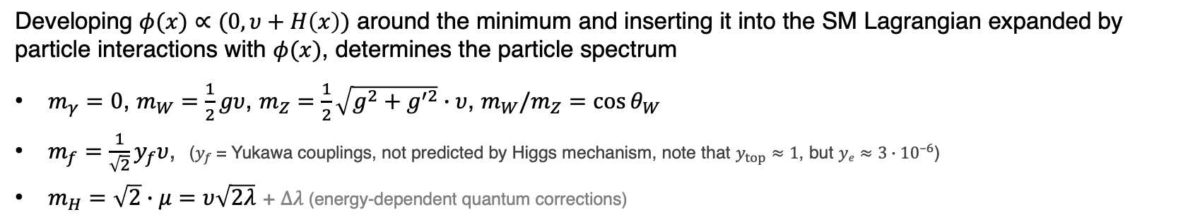
The Brout-Englert-Higgs (BEH) mechanism
*Note that in the SM, this phase transition is a smooth crossover, ie, of 2nd order with no Higgs bubble creation
The BEH potential energy:
$$V\left(φ\right)=−μ^{2}{\left|φ\right|}^{2}+λ{\left|φ\right|}^{4}$$
At lowest order (tree level)
The early universe, at T > T_{EW}, was in a symmetric phase (|$φ$_{min}| = $υ_{T}=0$), a phase transition at ~T_{EW} (~10¹⁵ K, 10^{–12} s after the big bang) led to ${\text{|}φ\text{min}\text{|}=υ}_{T_{EW}}$ > 0
At T = 0, $V\left(φ\right)$has a minimum at:
${υ=υ}_{T=0}=\sqrt{\frac{μ^{2}}{2λ}}$ $(υ=\frac{1}{\sqrt{\sqrt{2}G_{F}}}≈246 GeV)$
where was used: $g/m_{W}∝\sqrt{G_{F}}$
Developing $φ(x)∝(0, υ+H\left(x\right))$ around the minimum and inserting it into the SM Lagrangian expanded by particle interactions with $φ(x)$, determines the particle spectrum
$m_{γ}=0$, $m_{W}=\frac{1}{2}gυ$, $m_{Z}=\frac{1}{2}\sqrt{g^{2}+g^{′2}}∙υ$, $m_{W}/m_{Z}=\cos{θ_{W}}$
$m_{f}=\frac{1}{\sqrt{2}}y_{f}υ$, ($y_{f}$= Yukawa couplings, not predicted by Higgs mechanism, note that $y_{top}≈1$, but $ye≈3∙{10}^{–6}$)
$m_{H}=\sqrt{2}∙μ=υ\sqrt{2λ}$ + $Δλ$(energy-dependent quantum corrections)

Slide 21
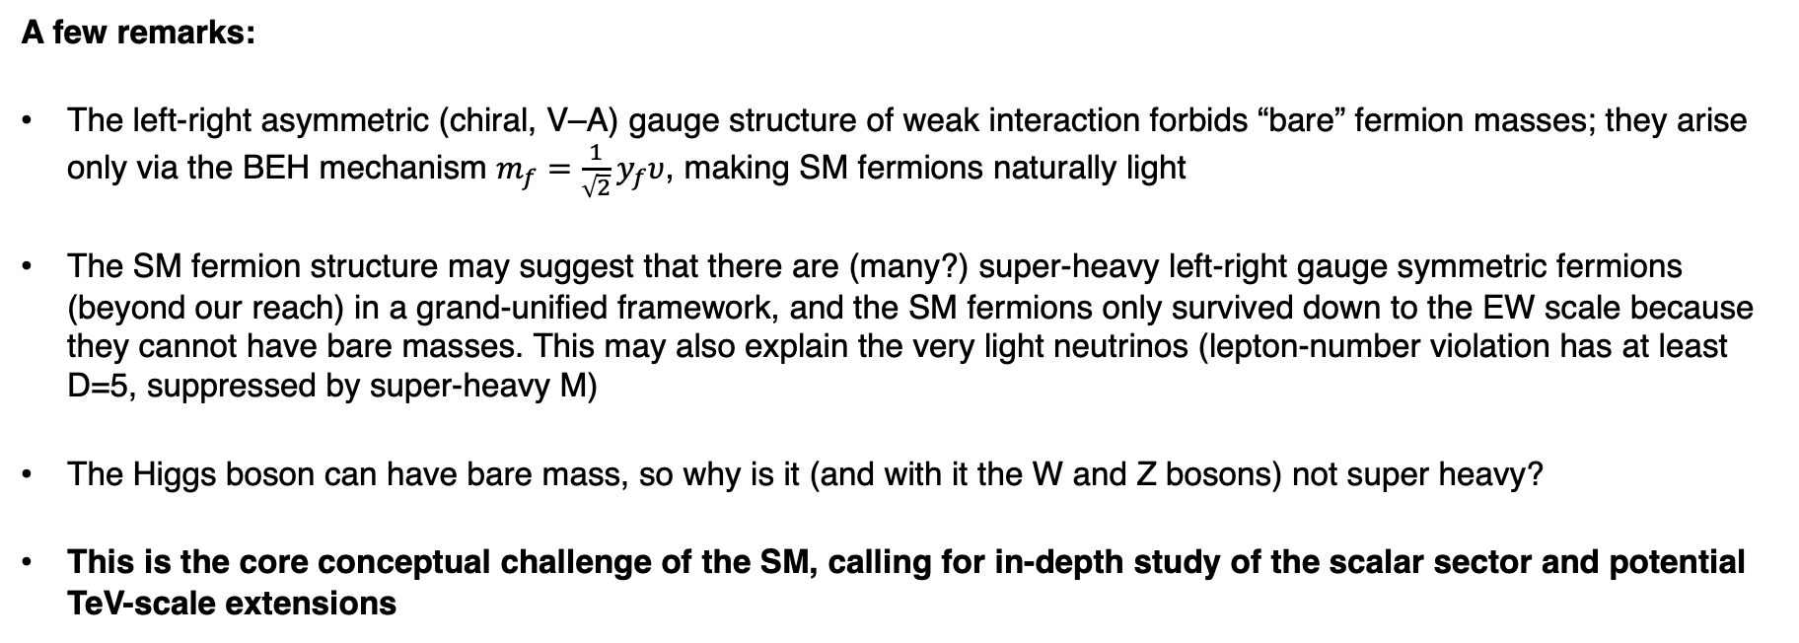
The Brout-Englert-Higgs mechanism
A few remarks:
The left-right asymmetric (chiral, V–A) gauge structure of weak interaction forbids “bare” fermion masses; they arise only via the BEH mechanism $m_{f}=\frac{1}{\sqrt{2}}y_{f}υ$, making SM fermions naturally light
The SM fermion structure may suggest that there are (many?) super-heavy left-right gauge symmetric fermions (beyond our reach) in a grand-unified framework, and the SM fermions only survived down to the EW scale because they cannot have bare masses. This may also explain the very light neutrinos (lepton-number violation has at least D=5, suppressed by super-heavy M)
The Higgs boson can have bare mass, so why is it (and with it the W and Z bosons) not super heavy?
This is the core conceptual challenge of the SM, calling for in-depth study of the scalar sector and potential TeV-scale extensions

Slide 22
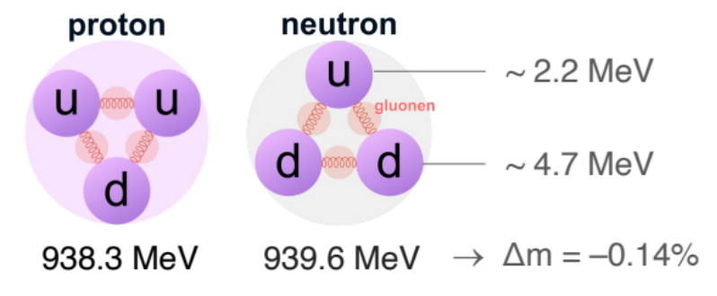
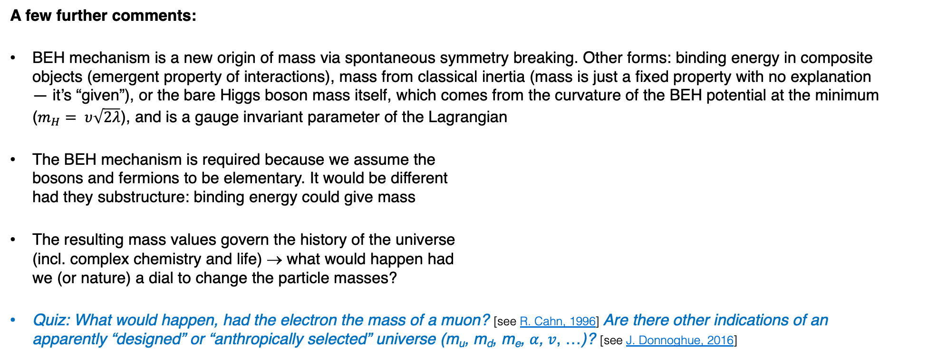
The Brout-Englert-Higgs mechanism
A few further comments:
BEH mechanism is a new origin of mass via spontaneous symmetry breaking. Other forms: binding energy in composite objects (emergent property of interactions), mass from classical inertia (mass is just a fixed property with no explanation — it’s “given”), or the bare Higgs boson mass itself, which comes from the curvature of the BEH potential at the minimum ($m_{H}= υ\sqrt{2λ}$), and is a gauge invariant parameter of the Lagrangian
The BEH mechanism is required because we assume the bosons and fermions to be elementary. It would be different had they substructure: binding energy could give mass
The resulting mass values govern the history of the universe (incl. complex chemistry and life) → what would happen had we (or nature) a dial to change the particle masses?
Quiz: What would happen, had the electron the mass of a muon? [see R. Cahn, 1996] Are there other indications of an apparently “designed” or “anthropically selected” universe (m_{u}, m_{d}, m_{e}, 𝛼, 𝑣, …)? [see J. Donnoghue, 2016]

Slide 23
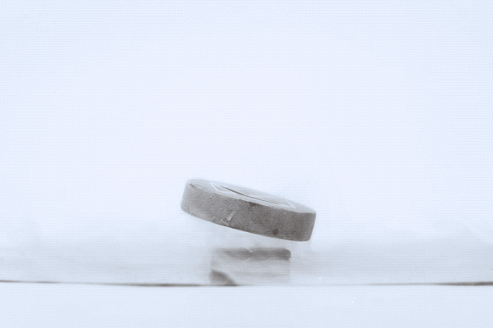
A remarkable analogy — Superconductivity
The universe as a superconductor for weak interactions
SC (BCS*) theory Higgs mechanism
Cooper pair Bose condensate Higgs VEV (condensed Higgs field)
Condensate charge (–2e) Higgs doublet carries weak charge
Effective photon mass W & Z bosons acquire mass
T_{crit} ~ mK to several tens of K EW crossover: T_{crit} = T_{EW} ~ 10¹⁵ K
A superconductor is locked mid-air in different orientations above a permanent magnet — superconductive levitation due to the expulsion of the static magnetic field (Meissner effect) [Source]
In response to an externally applied magnetic field, perpetual eddy currents circulate in the superconductor, producing an internal magnetic field that exactly cancels the externally applied one
*Bardeen, Cooper, Schrieffer theory – mid 1950s
Further reading, eg: L. Dixon, “From superconductors to supercolliders”, 1996

Slide 24
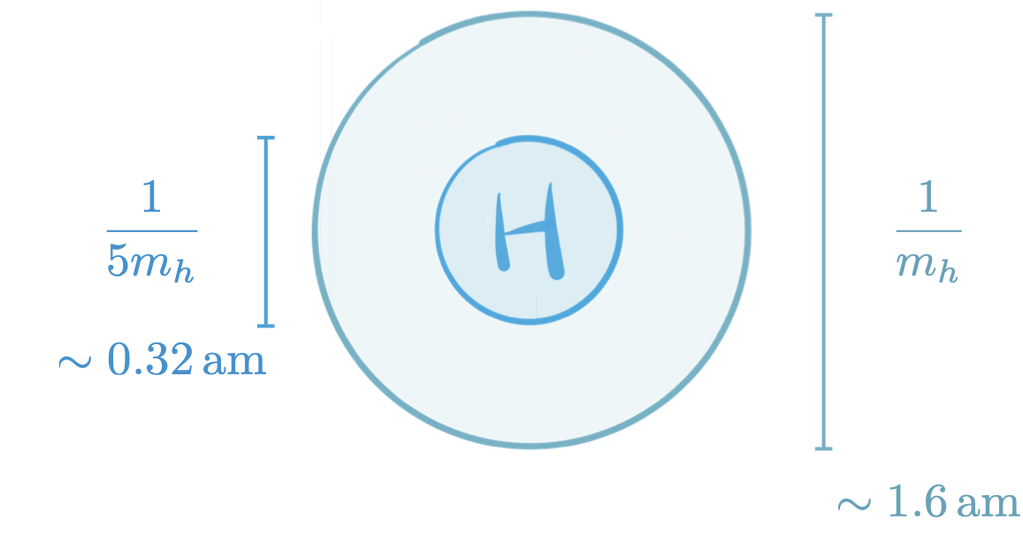
A remarkable analogy — Superconductivity
The universe as a superconductor for weak interactions
SC (BCS*) theory Higgs mechanism
Cooper pair Bose condensate Higgs VEV (condensed Higgs field)
Condensate charge (–2e) Higgs doublet carries weak charge
Effective photon mass W & Z bosons acquire mass
T_{crit} ~ mK to several tens of K EW crossover: T_{crit} = T_{EW} ~ 10¹⁵ K
→ Is the Higgs boson elementary or composite?
A superconductor is locked mid-air in different orientations above a permanent magnet — superconductive levitation due to the expulsion of the static magnetic field (Meissner effect) [Source]
In response to an externally applied magnetic field, perpetual eddy currents circulate in the superconductor, producing an internal magnetic field that exactly cancels the externally applied one
*Bardeen, Cooper, Schrieffer theory – mid 1950s
Further reading, eg: L. Dixon, “From superconductors to supercolliders”, 1996

Slide 25
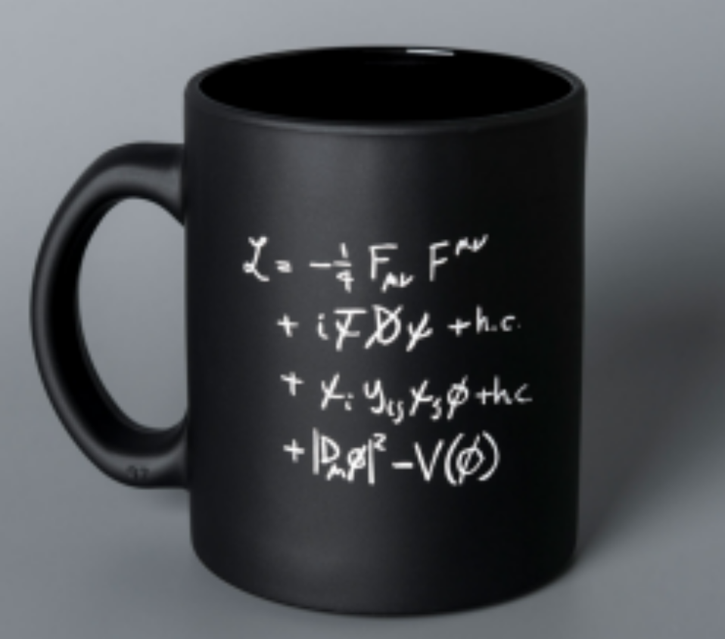

Completing the Standard Model
The scalar Higgs sector completes the Standard Model
These terms describe interactions among force particles (top) and among matter and force particles (bottom)
The SM Lagrangian
Beauty: interactions governed by gauge symmetries with only 3 (EW) and 2 (QCD, θ_{strong} tiny → strong CP problem) parameters
This term is related to the Higgs sector
$$+ …$$
Key to many mysteries
Unpleasant: not governed by symmetries, 23 free parameters*, large hierarchy among masses
*Assuming neutrinos are Majorana particles (total of 9 neutrino related parameteres)

Slide 26
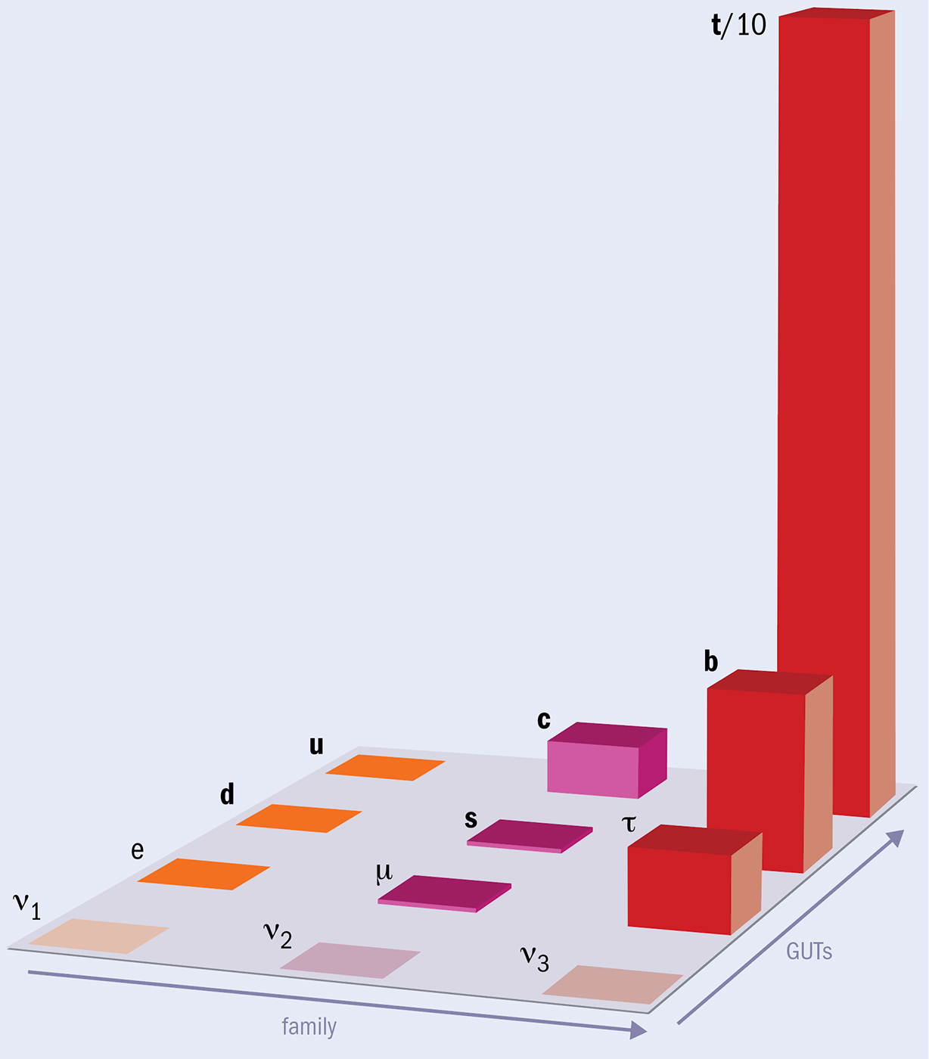
Completing the Standard Model
The scalar Higgs sector completes the Standard Model
Fermion mass pattern (“flavour problerm”)
These terms describe interactions among force particles (top) and among matter and force particles (bottom)
Order one interaction strength to Higgs boson
The SM Lagrangian
CERN Courier
Beauty: interactions governed by gauge symmetries with only 3 (EW) and 2 (QCD, θ_{strong} tiny → strong CP problem) parameters
Very small interaction strengths
This term is related to the Higgs sector
$$+ …$$
Key to many mysteries
Unpleasant: not governed by symmetries, 23 free parameters*, large hierarchy among masses
*Assuming neutrinos are Majorana particles (total of 9 neutrino related parameteres)

Slide 27
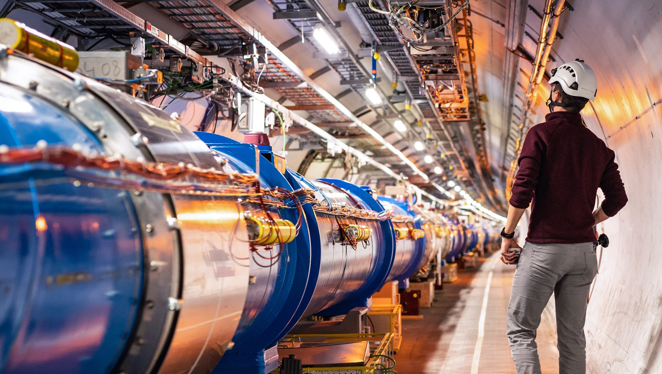
Producing the Higgs boson and pushing the boundaries of our understanding requires a huge accelerator
tt → eµ + jets candidate event in 2016 8.16 TeV p-Pb collisions
This accelerator has been built at CERN

Slide 28

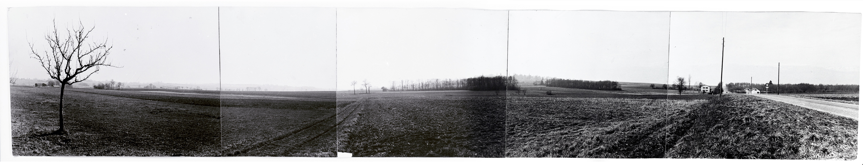
CERN — Science for peace
Objective: Creation of a powerful and competitive infrastructure for fundamental research in nuclear / particle physics in Europe
1952: Creation of a Council: "Conseil Européen pour la Recherche Nucléaire“
  Belgium, Denmark, France, West Germany, Greece, Italy, The Netherlands, Norway, Sweden, Switzerland, United Kingdom, Yugoslavia
Coming into force of the convention on 29 September 1954: Foundation as "Organisation Européenne pour la Recherche Nucléaire“
“Panorama” photograph taken around 1954 of the site that would become the CERN laboratory
Find more on CERN’s history here: https://timeline.web.cern.ch/timeline-header/89

Slide 29
CERN — Science for peace
Objective: Creation of a powerful and competitive infrastructure for fundamental research in nuclear / particle physics in Europe
1952: Creation of a Council: "Conseil Européen pour la Recherche Nucléaire“
  Belgium, Denmark, France, West Germany, Greece, Italy, The Netherlands, Norway, Sweden, Switzerland, United Kingdom, Yugoslavia
Coming into force of the convention on 29 September 1954: Foundation as "Organisation Européenne pour la Recherche Nucléaire“
The first steps towards CERN’s creation were taken in the United States between 1947 and 1949. François de Rose, a French diplomat who was involved in that process, remembers Robert Oppenheimer saying to him: “We have learnt all we know in Europe. But in the future, fundamental physics research is going to require substantial resources which will be beyond the means of individual European countries. You will need to pool your efforts to build these big machines that are going to be needed. It would be unhealthy if the Europeans were obliged to go the United States or the Soviet Union to conduct their fundamental research.”
Source: https://home.cern/news/series/cern70/cern70-foundations-european-science
“Panorama” photograph taken around 1954 of the site that would become the CERN laboratory
Find more on CERN’s history here: https://timeline.web.cern.ch/timeline-header/89

Slide 30
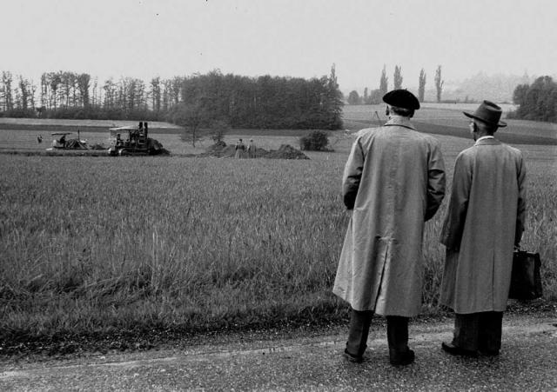
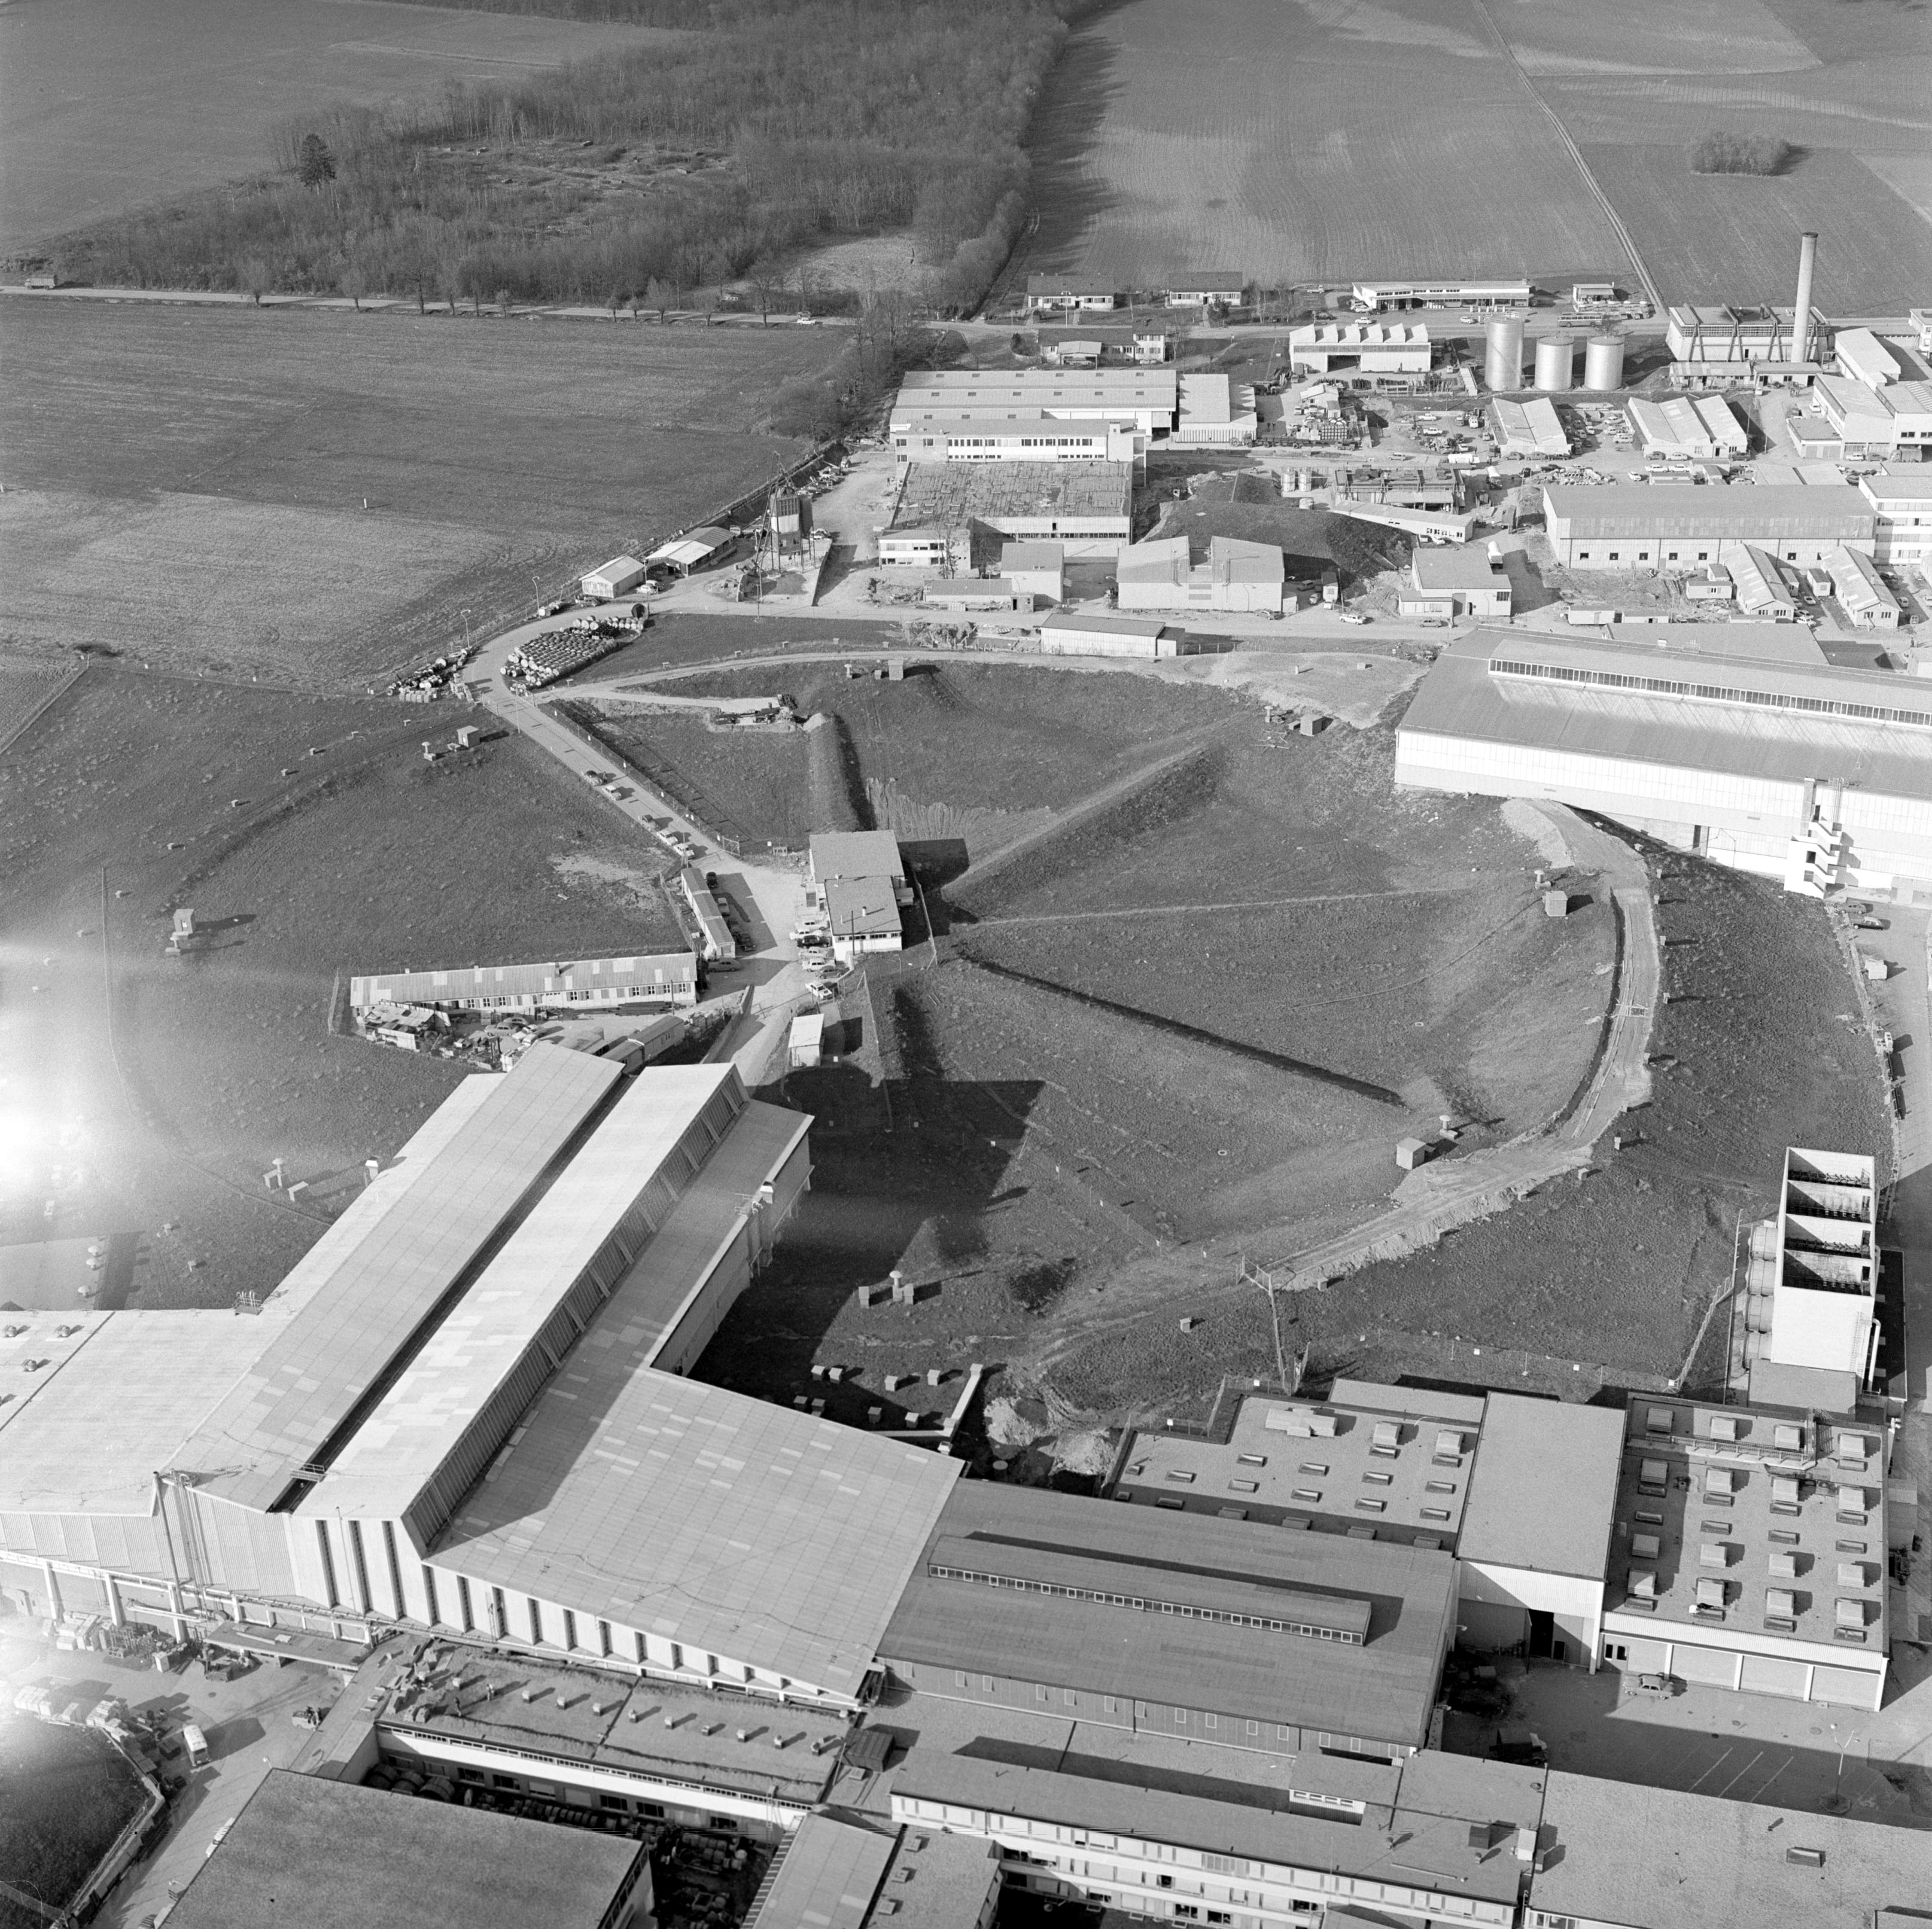
On 17 May 1954, the first shovel of earth was dug on the Meyrin site in Switzerland under the eyes of Geneva officials and members of CERN staff
Aerial view of the 25 GeV Protron Synchrotron at CERN in 1965

Slide 31
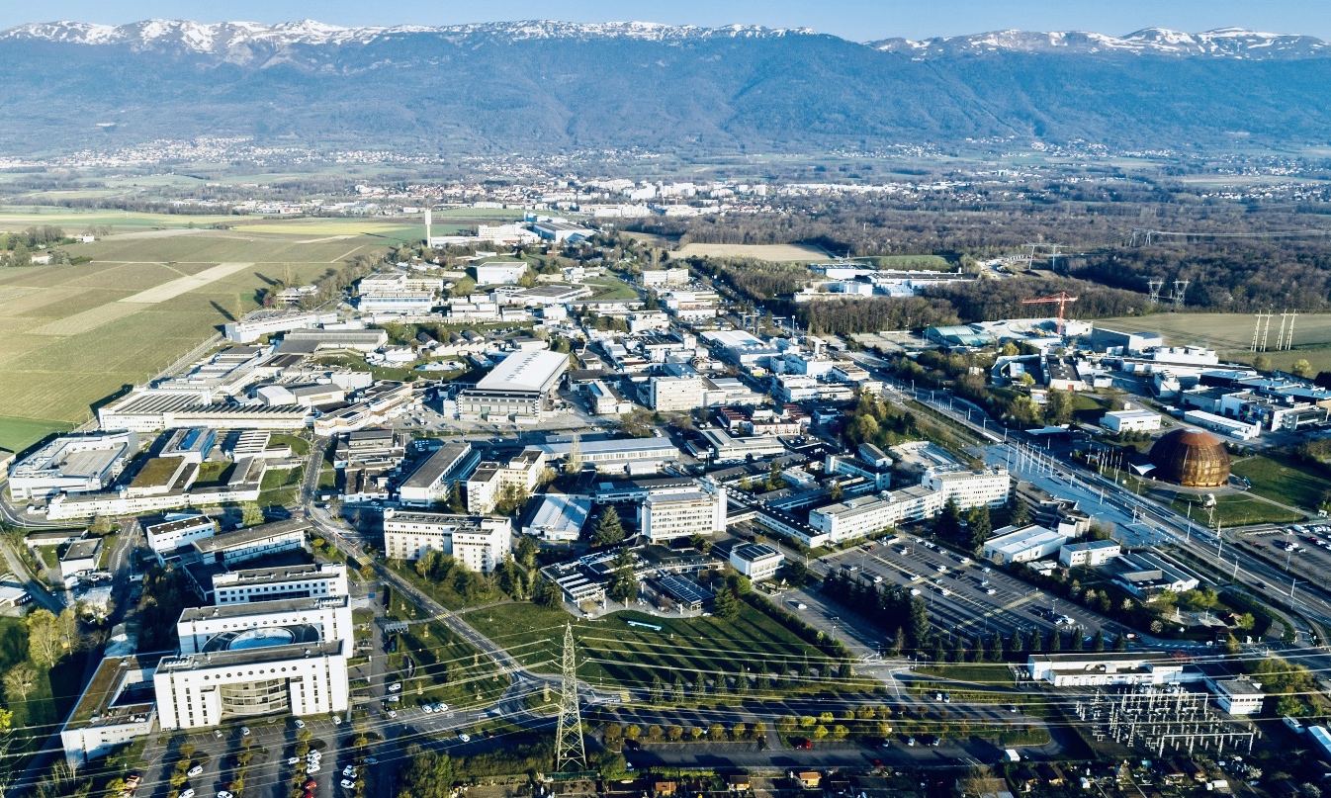
CERN today — the world’s largest centre for particle physics
CERN – Meyrin Campus next to Geneva, Switzerland

Slide 32
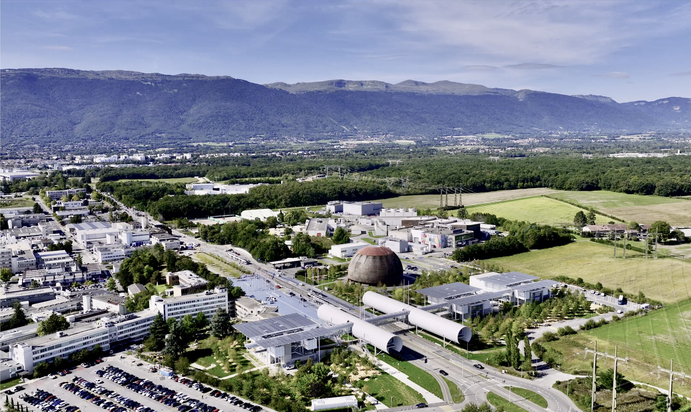
CERN today
ATLAS Experiment

Slide 33


CERN today: 25 Member States
A laboratory for people around the world
CERN members:
2’700 staff
1’200 graduates and fellows
13’000 users (3’000 Ph.D. students)
25 Member States
Austria – Belgium – Bulgaria – Czech Republic
Denmark – Estonia – Finland – France – Germany
Greece – Hungary – Israel – Italy – Netherlands
Norway – Poland – Portugal – Romania – Serbia
Slovakia – Slovenia – Spain – Sweden – Switzerland
United Kingdom
10 Associate Member States
Brazil – Croatia – Cyprus – India – Ireland – Latvia Lithuania – Pakistan – Türkiye – Ukraine
4 Observers
Japan – USA – European Union – UNESCO
~ 50 Cooperation Agreements
Albania – Algeria – Argentina – Armenia – Australia – Azerbaijan – Bahrain
Bangladesh – Bolivia – Bosnia and Herzegovina – Canada – Chile – Colombia
Costa Rica – Ecuador – Egypt – Georgia – Guatemala – Honduras – Iceland
Iran – Jordan – Kazakhstan – Lebanon – Malta – Mexico – Mongolia – Montenegro
Morocco – Nepal – New Zealand – North Macedonia – Paraguay – Palestine
People's Republic of China – Peru – Philippines – Qatar – Saudi Arabia
South Africa – Sri Lanka – Thailand – Republic of Korea – Tunisia
United Arab Emirates – Uruguay – Vietnam
Education & training is one of CERN’s core mission
Data as of 31 December 2024
33

Slide 34
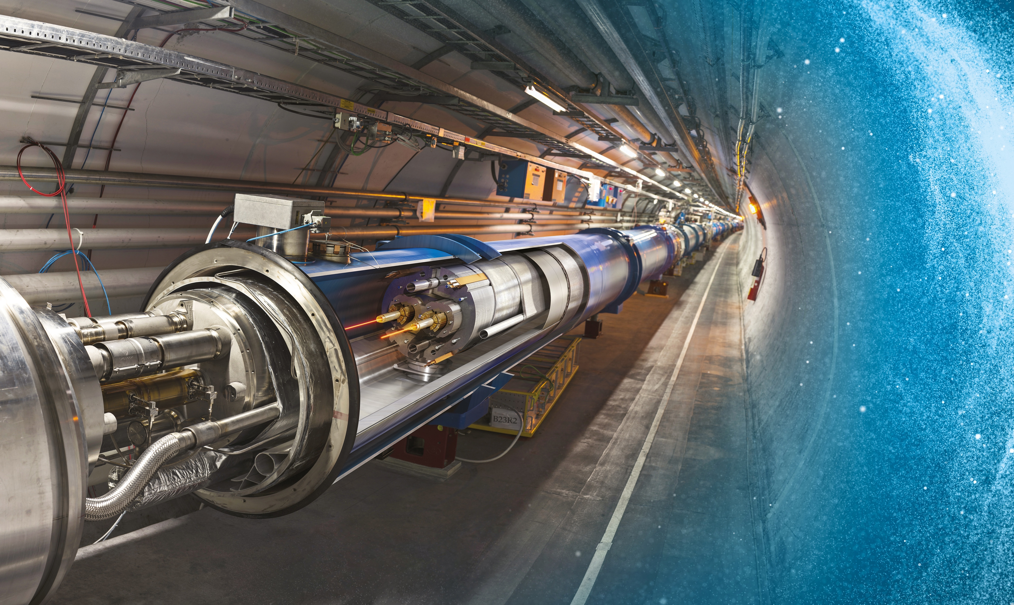
Large Hadron Collider (LHC) — the world’s largest accelerator reaching unprecedented energies
27 km underground accelerator and collider
Superconducting magnets (1.9 K = –271.3 °C) steer the particles around the ring
Proton and ions are accelerated to multi-TeV scale energies before they collide
34

Slide 35
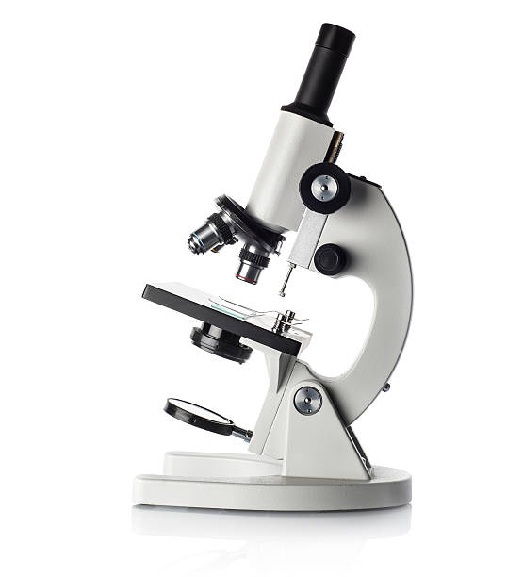
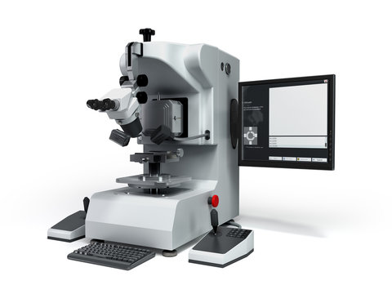

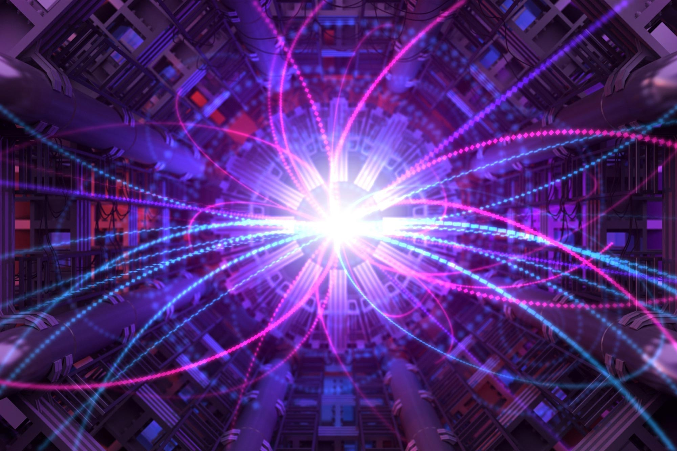
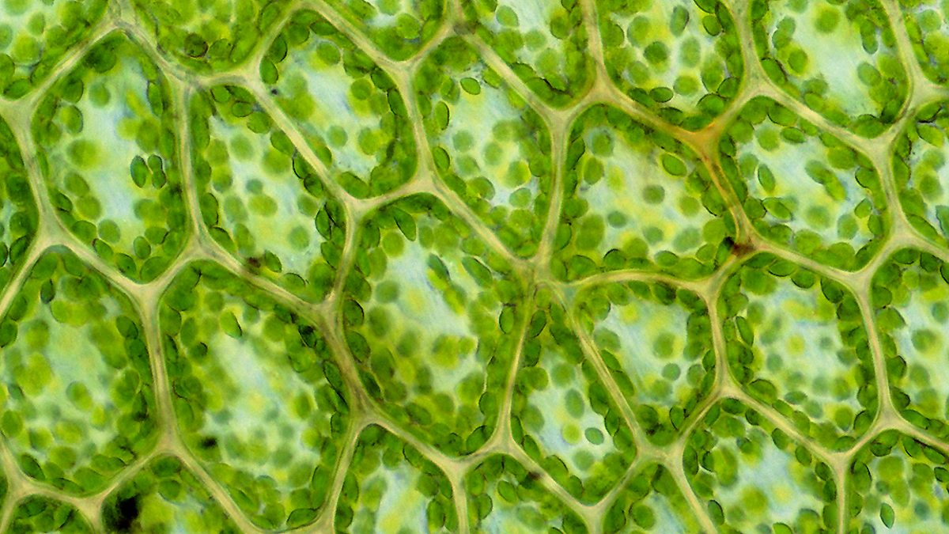
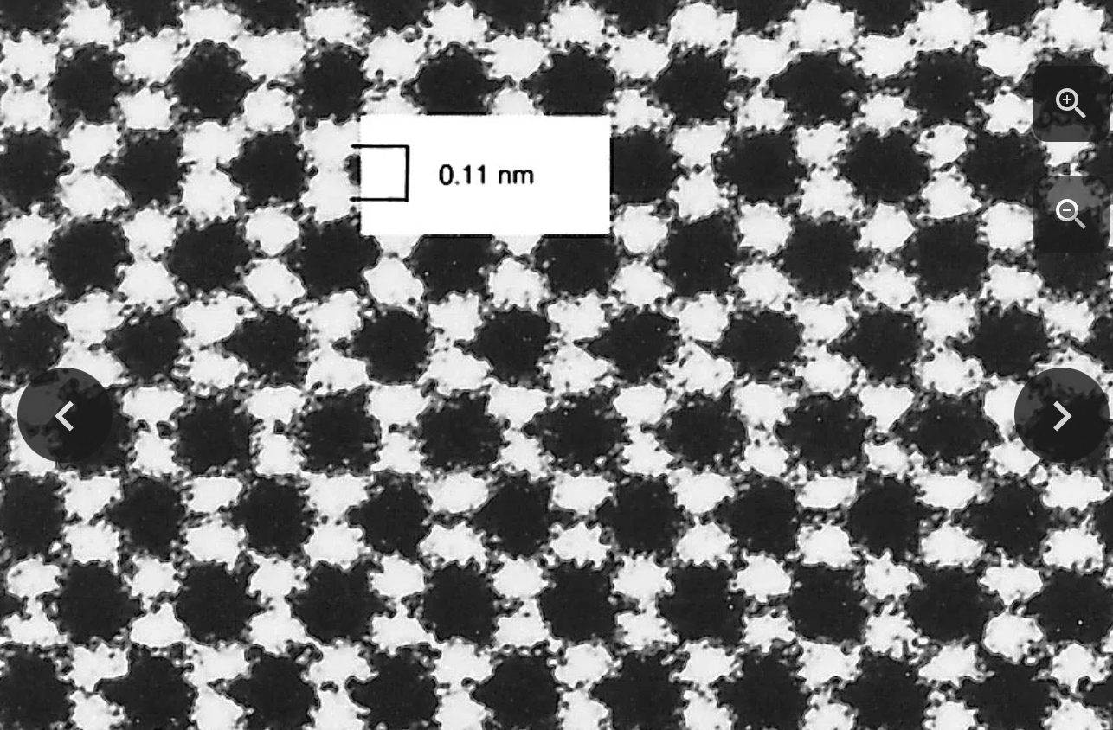

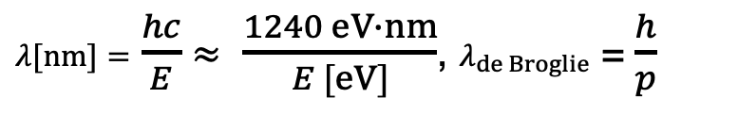


A few accelerator and collider basics (example: LHC)
A particle collider can create new particles, higher energy → heavier particles: $E=mc^{2}$
It is (also) a microscope, higher energy → better space resolution:
$λ[nm]=$ $\frac{hc}{E}$ $≈$ $\frac{1240 eV∙nm}{E [eV]}$, $λ_{de Broglie}$ =$\frac{h}{p}$
Visible light miscrosope
Electron micsroscopes
LHC
$λ_{de B.} \sim 2∙{10}^{−19}$ m (at 10 TeV)
$$λ≈400–700 nm$$
$$λ<0.1 nm$$
Atomic structure of diamond surface

Slide 36
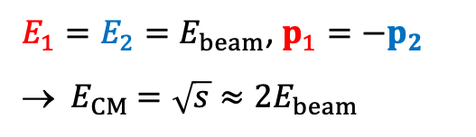
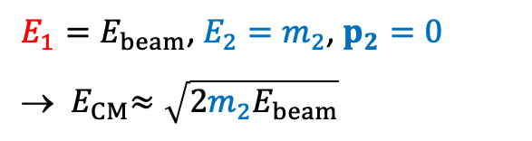
Particle collider versus fixed target
Central collisions vs. hitting a stationary (“fixed”) target? $E_{CM}^{2}= s={\left(p_{1}+p_{2}\right)}^{2}=m_{1}^{2}+m_{2}^{2}+{2E}_{1}E_{2}−2p_{1}p_{2}$
$E_{1}=E_{2}{=E}_{beam}$, $p_{1}{=−p}_{2}$
→ ${ E}_{CM} =\sqrt{s}≈2E_{beam}$
$E_{1}=E_{beam}$, $E_{2}=m_{2}$, $p_{2}=0$
→ ${ E}_{CM}≈\sqrt{2{m_{2}E}_{beam}}$
Huge advantage of colliders over fixed target; for protons: $E_{CM}=1.4\sqrt{GeV}\sqrt{E_{beam}}$
→ $E_{CM}=14 TeV$ would require a 100’000 TeV = 100 PeV beam in fixed target mode
Collider reaches much higher${ E}_{CM}$, so why are fixed target collisions still useful?

Slide 37
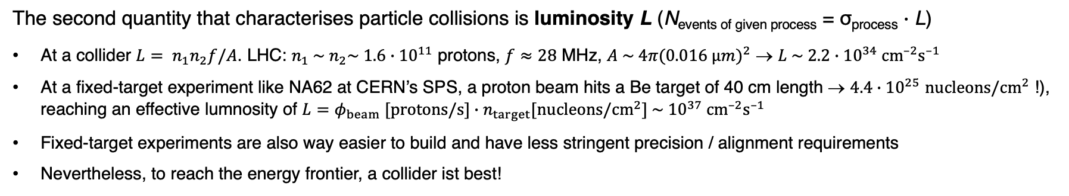

Particle collider versus fixed target
Central collisions vs. hitting a stationary (“fixed”) target? $E_{CM}^{2}= s={\left(p_{1}+p_{2}\right)}^{2}=m_{1}^{2}+m_{2}^{2}+{2E}_{1}E_{2}−2p_{1}p_{2}$
$E_{1}=E_{2}{=E}_{beam}$, $p_{1}{=−p}_{2}$
→ ${ E}_{CM} =\sqrt{s}≈2E_{beam}$
$E_{1}=E_{beam}$, $E_{2}=m_{2}$, $p_{2}=0$
→ ${ E}_{CM}≈\sqrt{2{m_{2}E}_{beam}}$
The second quantity that characterises particle collisions is luminosity L (N_{events of given process} = σ_{process} $∙$ L)
At a collider ${L= n}_{1}n_{2}f/A$. LHC: $n_{1} \sim { n}_{2}\sim 1.6∙{10}^{11}$ protons, $f≈28$ MHz, $A \sim 4π(0.016 µm)^{2}$ → $L \sim 2.2∙{10}^{34} {cm}^{–2}s^{–1}$
At a fixed-target experiment like NA62 at CERN’s SPS, a proton beam hits a Be target of 40 cm length → $4.4∙{10}^{25}$ $nucleons/{cm}^{2}$ !), reaching an effective lumnosity of $L=φ_{beam}$ $[protons/s]∙n_{target}[nucleons/{cm}^{2}]$ $\sim {10}^{37} {cm}^{–2}s^{–1}$
Fixed-target experiments are also way easier to build and have less stringent precision / alignment requirements
Nevertheless, to reach the energy frontier, a collider ist best!

Slide 38
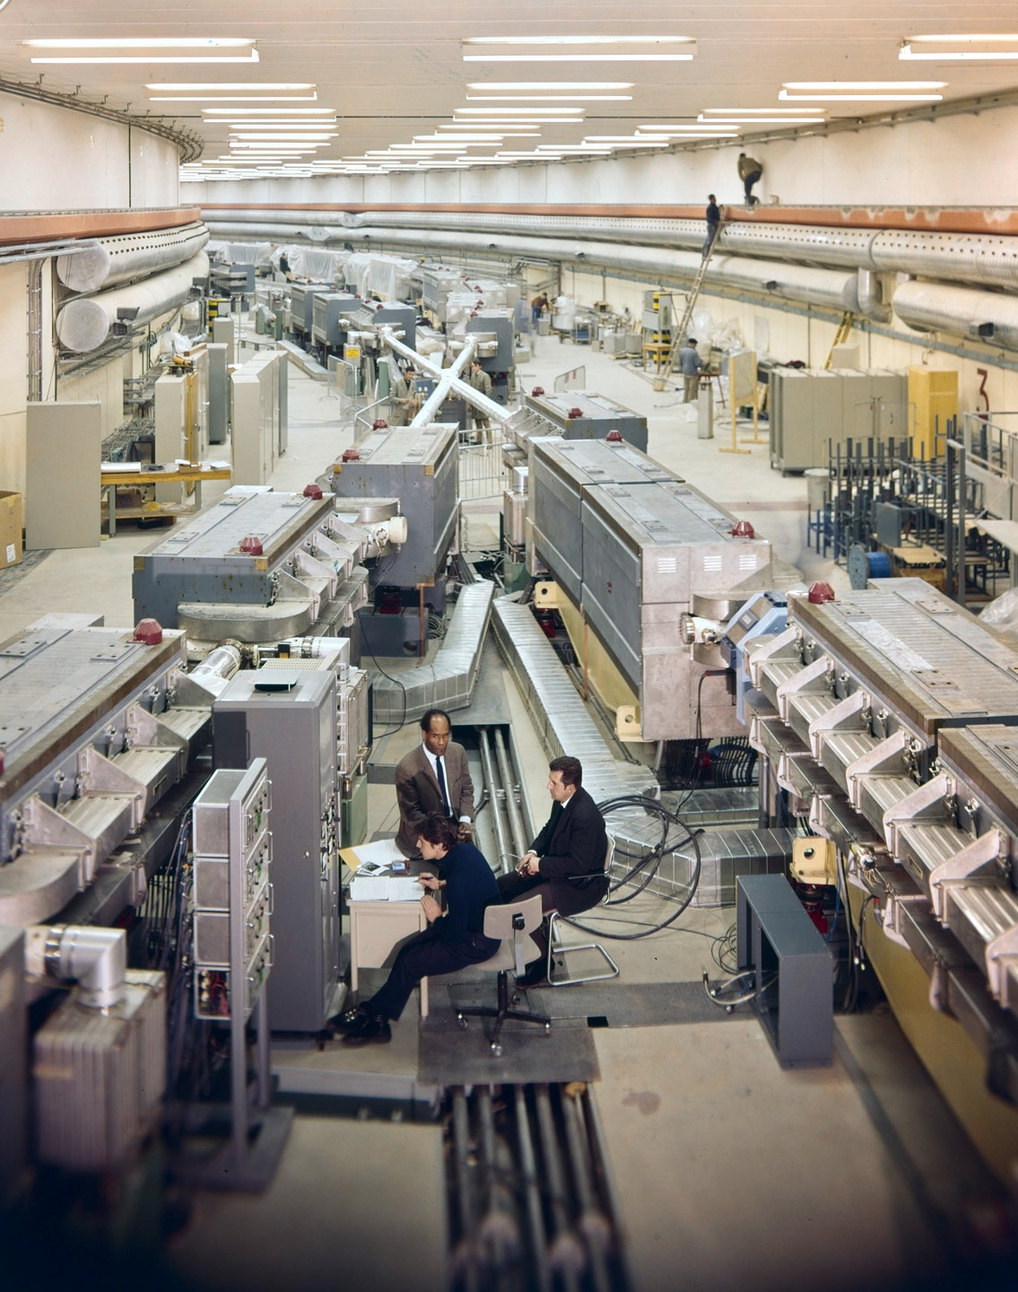
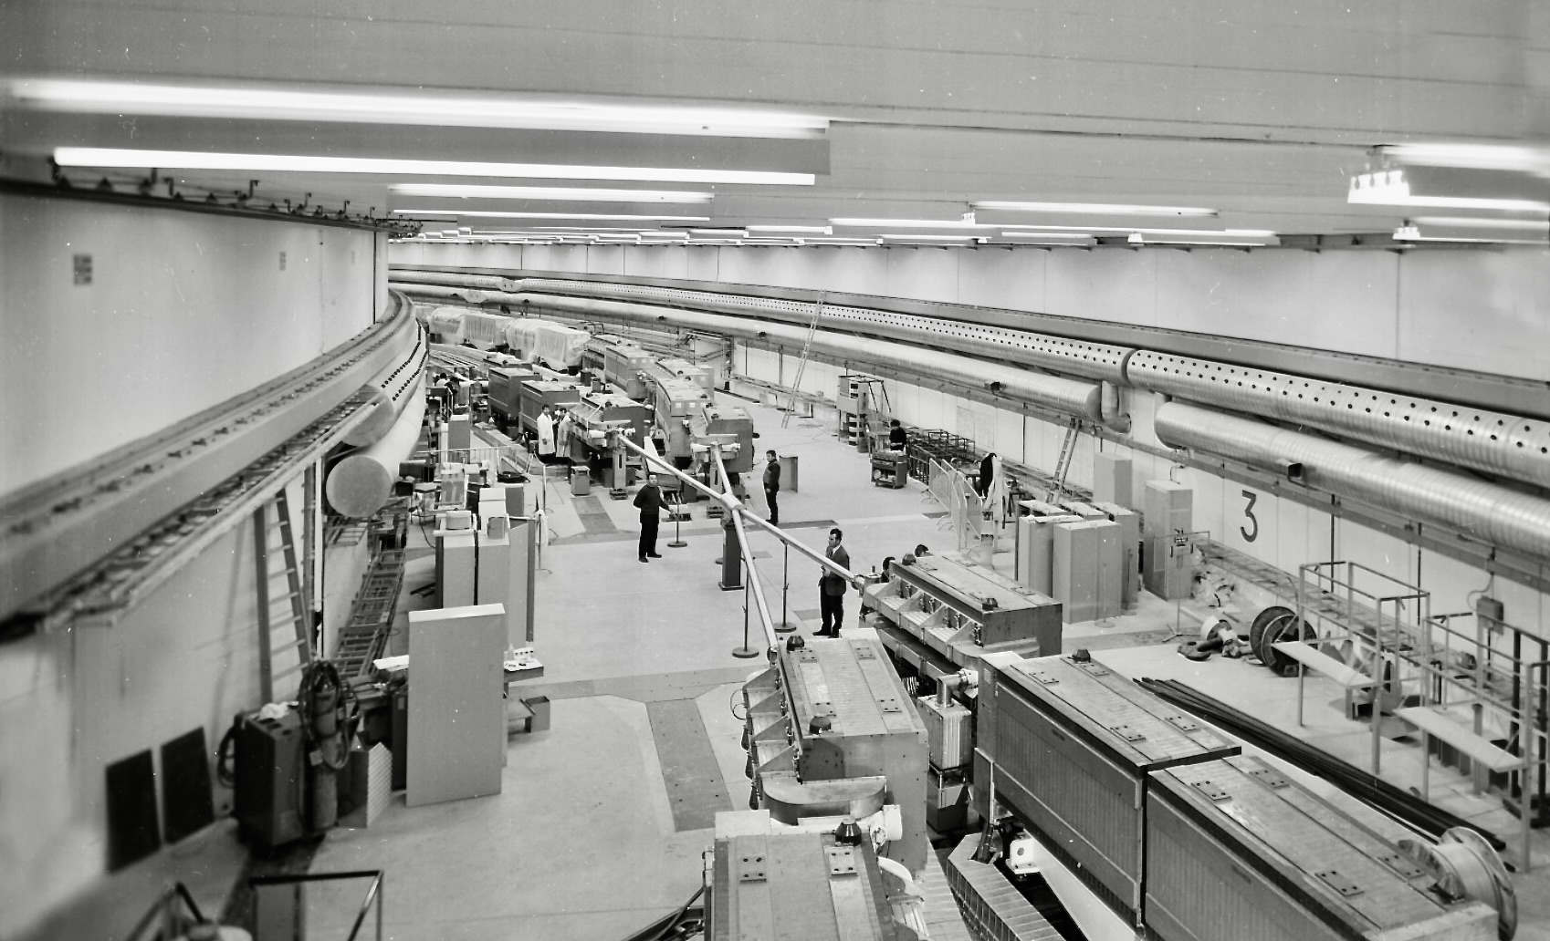
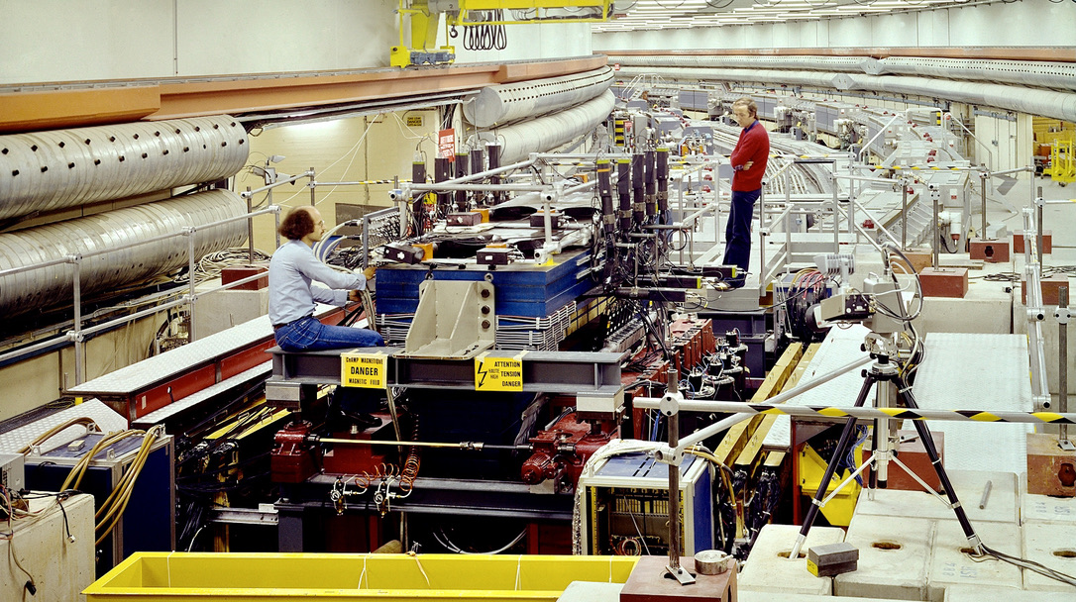
IP5
1971 — the first Hadron-Collider
Intersecting Storage Rings at CERN operated as a proton, proton–antiproton and ion collider for physics between 1971 and 1983. 943 m circumference, 1.3 T dipole field, CM energy up to 63 GeV, holding luminosity record for hadron colliders until 2004
IP7: R702 in 1977

Slide 39
IP5
1971 — the first Hadron-Collider
Intersecting Storage Rings at CERN operated as a proton, proton–antiproton and ion collider for physics between 1971 and 1983. 943 m circumference, 1.3 T dipole field, CM energy up to 63 GeV, holding luminosity record for hadron machines until 2004
The ISR missed the 1974 ‘November revolution’ and also the bottom quark discovery in 1977 because of an initial lack of low-mass triggers, slow DAQ, and insufficient acceptance. However, its legacy enabled the next generation collider experiments: proton stacking, space charge compensation, beam diagnostics, stochastic cooling, van-der-Meer luminosity scans, importance of efficient triggers and large-angle coverage, jets, etc.
IP7: R702 in 1977

Slide 40
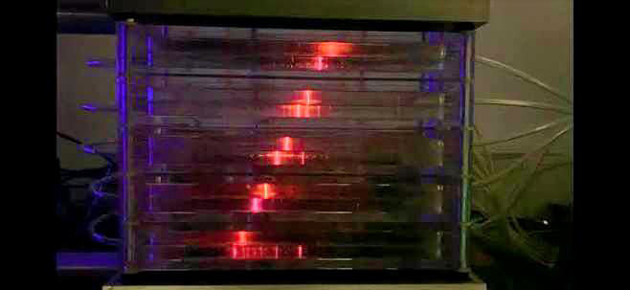
IP5
1971 — the first Hadron-Collider
Intersecting Storage Rings at CERN operated as a proton, proton–antiproton and ion collider for physics between 1971 and 1983. 943 m circumference, 1.3 T dipole field, CM energy up to 63 GeV, holding luminosity record for hadron machines until 2004
Particle detectors also went through revolutions from the low-rate visual (eg, cloud chambers) and high-rate counting devices (eg, scintillators with PMTs) in the late 1950s, early 1960s, to spark chambers in the 1960s, allowing to visualise charged tracks at relatively high rate
Cylindrical spark chambers were at the heart of the SLAC-LBL Magnetic Detector (Mark-I) at SPEAR enabling the November 1974 revolution (charm), and also the discovery of 𝜓’, open charm, tau-lepton, quark spin, …)
IP7: R702 in 1977

Slide 41
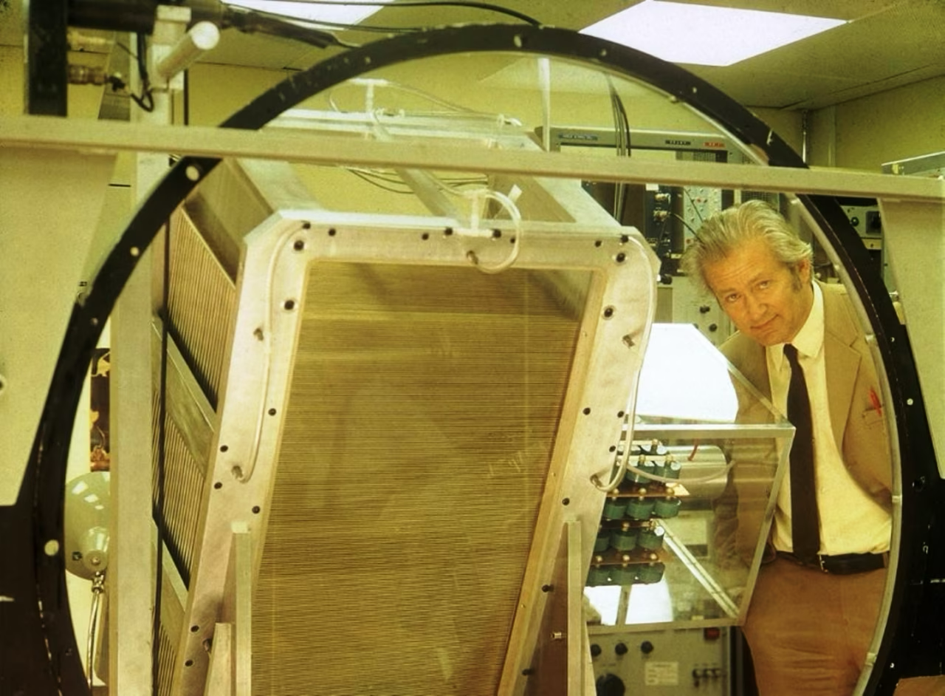
IP5
1971 — the first Hadron-Collider
Intersecting Storage Rings at CERN operated as a proton, proton–antiproton and ion collider for physics between 1971 and 1983. 943 m circumference, 1.3 T dipole field, CM energy up to 63 GeV, holding luminosity record for hadron machines until 2004
Particle detectors also went through revolutions from the low-rate visual (eg, cloud chambers) and high-rate counting devices (eg, scintillators with PMTs) in the late 1950s, early 1960s, to spark chambers in the 1960s, allowing to visualise charged tracks at relatively high rate
Cylindrical spark chambers were at the heart of the SLAC-LBL Magnetic Detector (Mark-I) at SPEAR enabling the November 1974 revolution (charm), and also the discovery of 𝜓’, open charm, tau-lepton, quark spin, …)
The development of MWPC in 1968 by G. Charpak rapidly superseded spark chambers during the 1970s, …
IP7: R702 in 1977

Slide 42
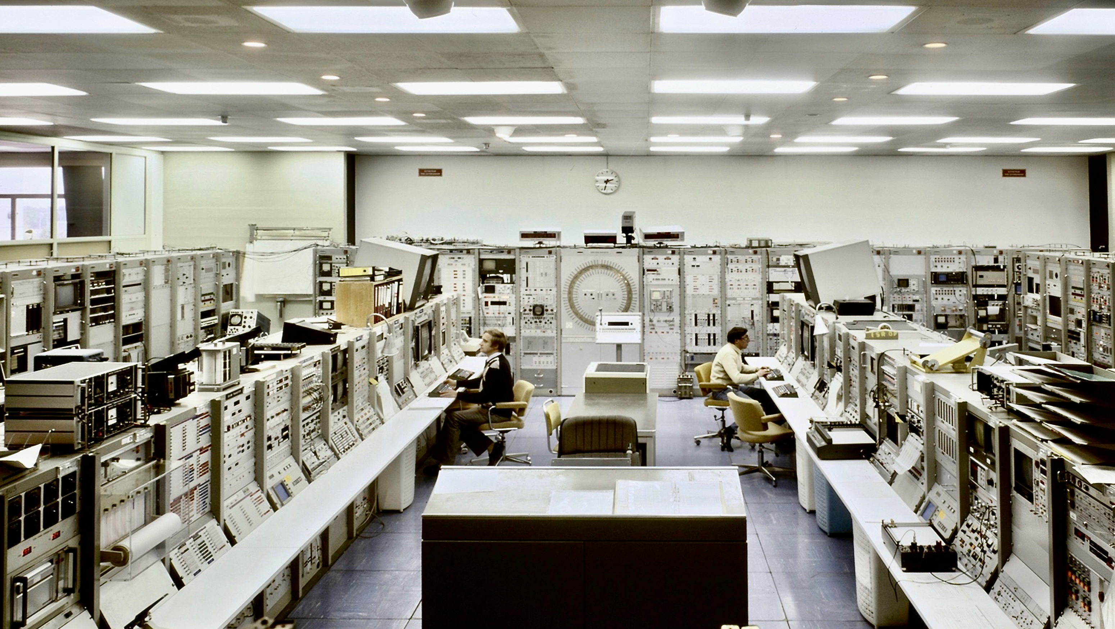
ISR Control Room (early 70s)

Slide 43
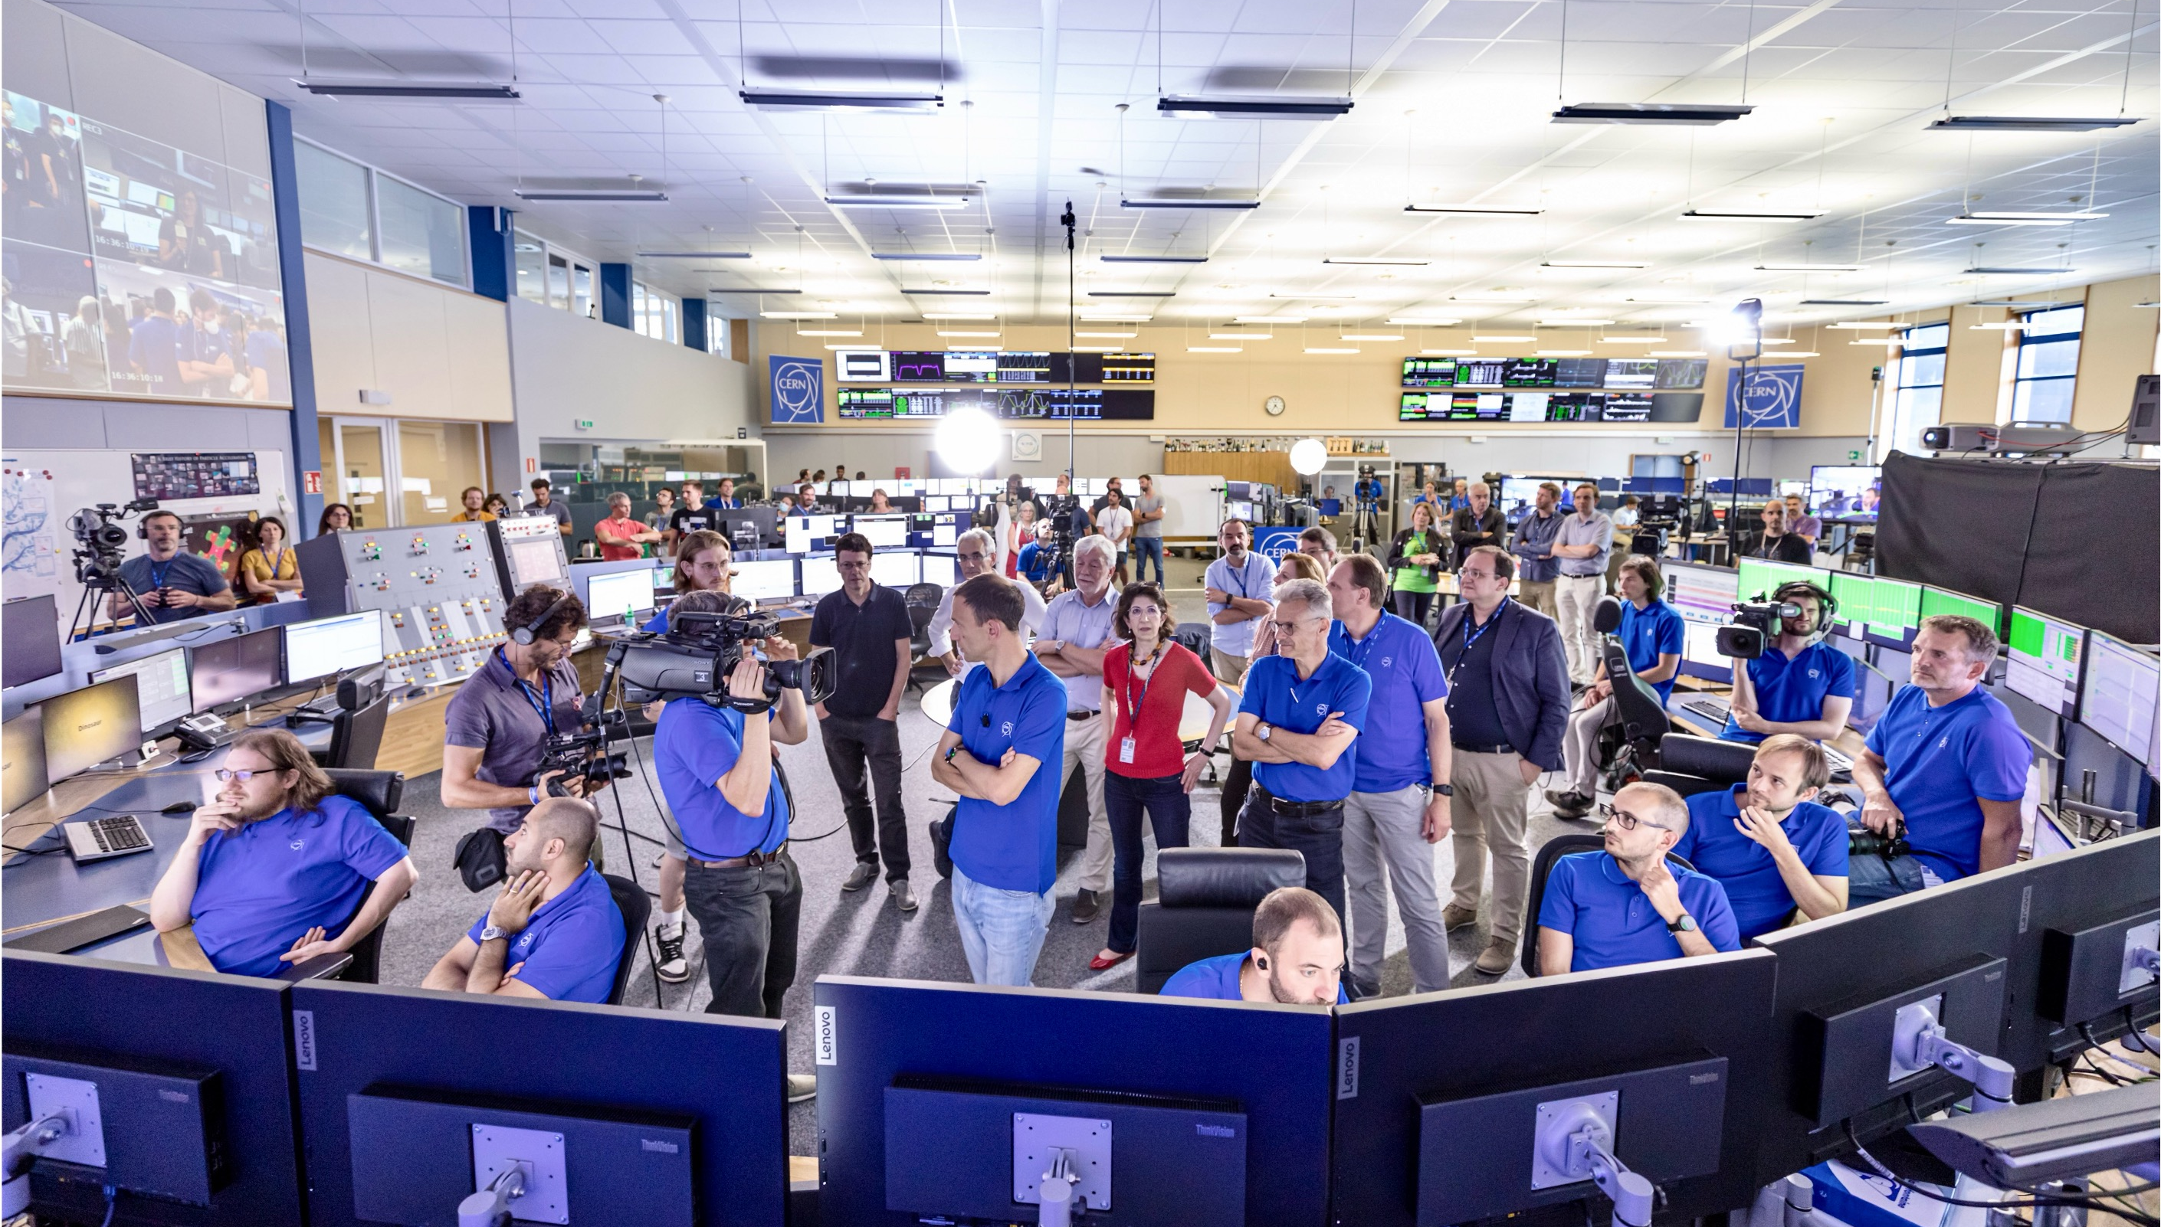
LHC Control Room (July 2022)

Slide 44
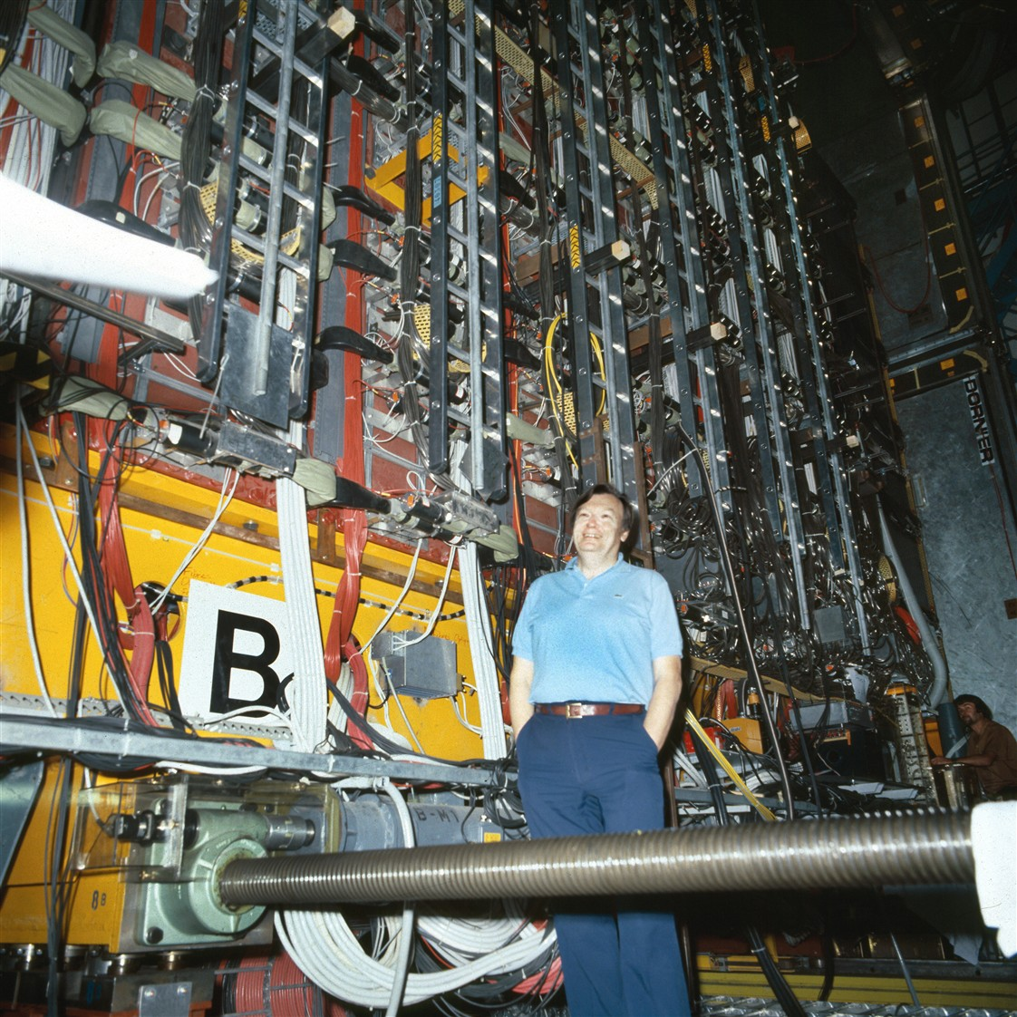
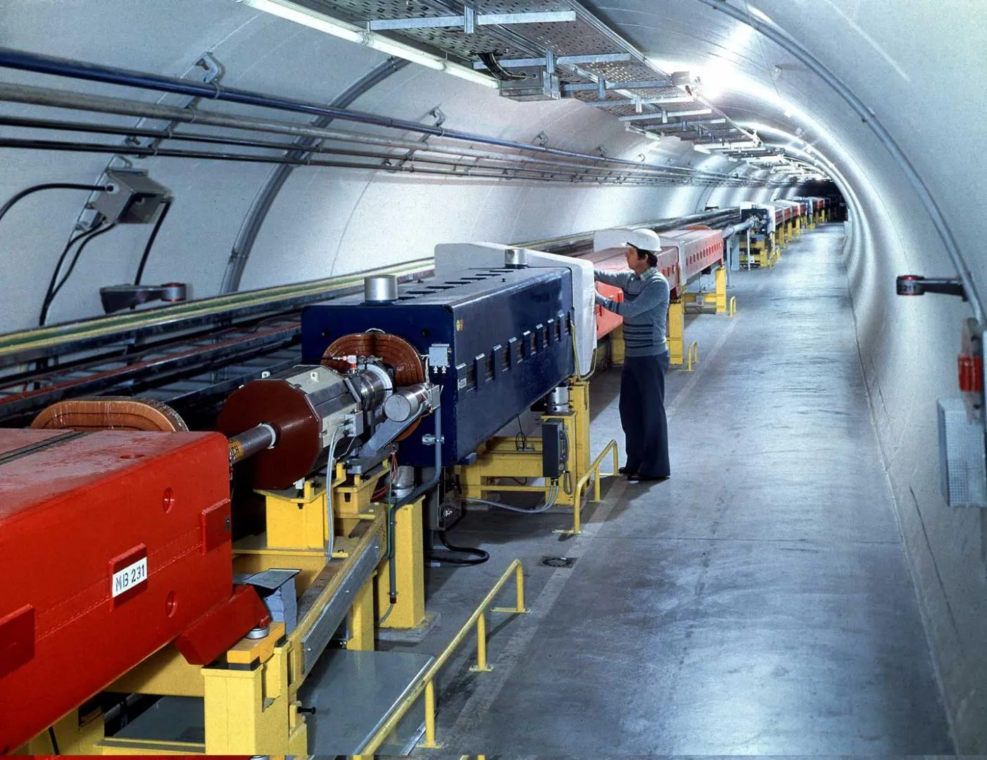
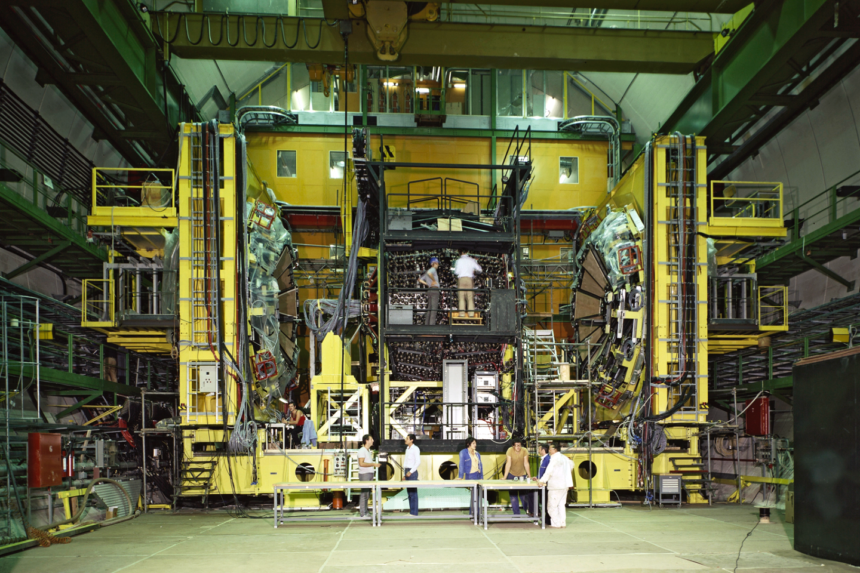
SPS: 6.9-km proton synchrotron and ppbar collider, (900 GeV) with UA1 and UA2 detectors
Both experiments were approved in 1978, first data taking in 1981

Slide 45
Discovery of the W and Z bosons by UA1 and UA2 at CERN’s SPS collider in 1983
Neutrino (missing E_{T})
Electron
Positron
Electron
Displays show W (left) and Z (right) boson candidates from proton–antiproton collisions measured in the UA1 detector (1982/83)
Nobel Prize 1984 to Carlo Rubbia and Simon van der Meer for their decisive contributions to the large project, which led to the discovery of the field particles W and Z, communicators of weak interaction [Link]

Slide 46
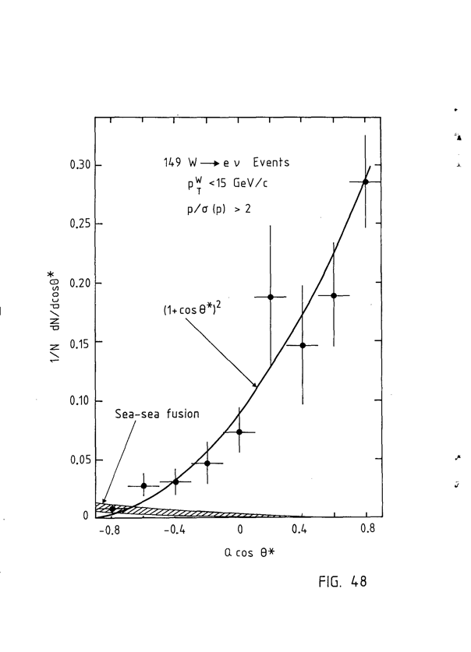
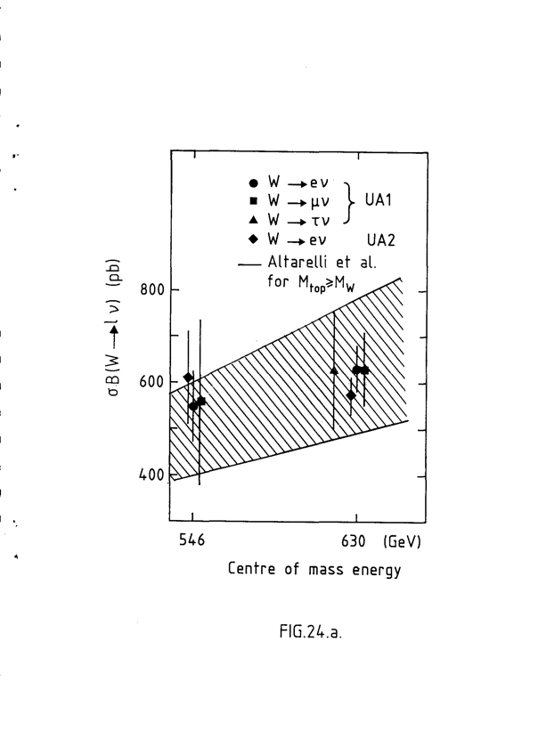
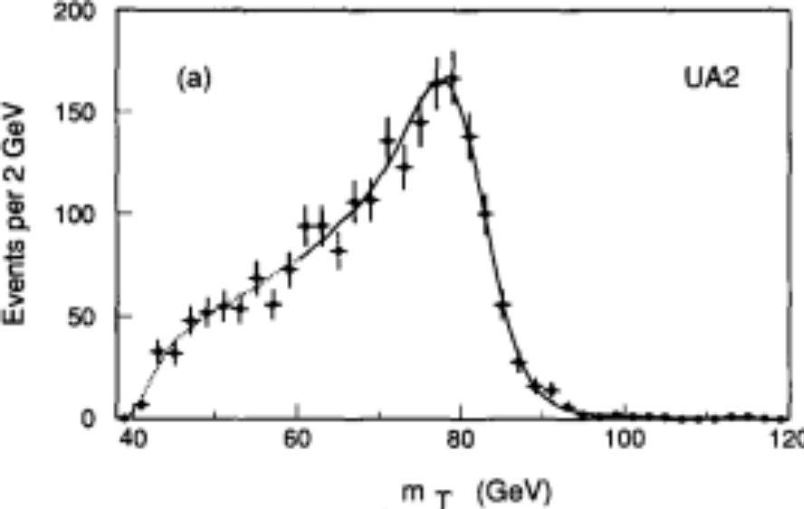


Discovery of the W and Z bosons by UA1 and UA2 at CERN’s SPS collider in 1983
UA2, Phys. Lett. B 276 (1992) 354
UA1, Z. Phys. C 44 (1989) 15
UA1, Z. Phys. C 44 (1989) 15
Transverse mass with full UA2 dataset (1992):
$mW$ = 80.84 ± 0.22 ± 0.81 (calibration) GeV
Together with Z-mass measurement allowed to determine the weak mixing angle and to test the “custodial” symmetry relation:
$$ρ≡{m_{W}^{2}}/{{(m}_{Z}^{2}∙\cos^{2}θ_{W}) ≈ 1}$$
Charge asymmetry in the W → e𝜈 decay: W production polarised along anti-p beam due to V–A coupling
Universality of weak currents

Slide 47



A new Circular Collider at CERN
The birth of LEP and the LHC: a 26.7 km tunnel facility

Slide 48

The Large Electron–Positron Collider
LEP was formally approved in 1981, tunnel construction 1983–1988, first beam on 14 July 1989
LEP tunnel before installation of bending magnets
OPAL logbook entry on 13 Aug 1989 with the first Z-boson candidate

Slide 49







With LEP and SLC, the Standard Model entered the precision era
Huge amount of experimental and theoretical developments during LEP and SLC (SLAC) years, pioneering era of high-precision physics in HEP, constraints on yet unseen heavy particles through quantum loops
There are 3 light neutrino families
The top quark is heavy
The Higgs boson is light, but > m_{Z}
m_{Z} measured to 2.1 MeV (0.0023%) precision via beam-energy calibration
Per-mil tests of lepton universality, QCD, and tau-lepton properties
$$∝m_{t}^{2}/m_{W}^{2}$$
$$∝log(m_{H}^{2}/m_{W}^{2})$$

Slide 50

Late 1980s: the Tevatron at Fermilab climbed at the energy frontier
Thanks to 4.4 T superconducting dipole magnets, the 6.3-km circumference Tevatron reached 1.8 TeV proton–antiproton collision energy (later up to 1.98 TeV) and quickly overtook the SppS after physics operation started in 1987 (the antiproton cooling was based on Gersh Budker’s electron cooling method during Run 2) and ended in 2011
CDF
D0
Aerial view of Fermilab's proton--antiproton accelerator and collider complex in 2011. The Main Injector and Recycler ring is seen in front and the 6.3-kilometre circumference Tevatron collider ring in the background. On the left the iconic Wilson Hall, Fermilab's central laboratory building. Close-by are the proton source and the Booster. Tevatron's main detectors CDF and D0 are placed to the left and right along the ring, respectively.
Tevatron collider
Main Injector

Slide 51


Late 1980s: the Tevatron at Fermilab climbed at the energy frontier
Among the Tevatron legacies:
Top-quark discovery by CDF & D0 in 1995
Final combined CDF & D0 Higgs boson search result (2012)
CDF
High-precision top and W mass measurements, σ(m_{top}) = 0.65 GeV (0.4%), σ(m_{W}) = 16 MeV (0.02%)
Also: first observation of neutral B_{s} oscillation by CDF in 2006

Slide 52

The Large Hadron Collider

Slide 53
The LHC and its experiments are projects of superlatives
Factors of 7 larger energy and 50 larger luminosity, almost twice larger dipole fields, 16 times narrower bunch spacing than the Tevatron
Compact two-in-one accelerating scheme
Detectors as technological masterpieces designed and optimised from scratch using detailed simulation
Their physics performance exceeds the design expectations
Experimental collaborations counting several thousand scientists and spanning entire careers between proposal and exploitation
World-wide distributed computing organised as its own collaboration

Slide 54






CERN’s Accelerator Complex (> 50 km beam lines)
SPS (450 GeV)
LHC (6.8 TeV)
PS (26 GeV)
Booster (2.0 GeV)
LINAC5 (160 MeV H–, charge-exchange (stripping) injection into Booster)

Slide 55




Accelerating protons in the LHC
Oscillating microwave fields accelerate the protons in the LHC
16 400 MHz superconducting RF cavities (8 per beam in 4 cryomodules) each provide up to 2 MV (16 MV per beam). During energy ramp, only a small phase component of this voltage accelerates the protons; most provides longitudinal focusing and keeps the bunches stable
Each cavity is driven by a high-power klystron, a tube containing electron beams, intensity-modulated to a frequency of 400.8 MHz
Acceleration rate is limited by synchronous ramping of dipole fields with the beam momentum
What limits their energy?
Bending power of dipole magnets for given bending radius: $E_{beam}\left[TeV\right]≈0.3∙B\left[T\right]∙ρ\left[km\right]≈0.3∙8.3 T∙2.8 km$ $≈7 TeV$
High-field magnets are key for hadron colliders
to contain beam
Bunching
LHC: multifilament NbTi alloy superconducting wire (“strand”, 0.85 mm) surrounded by copper stabiliser, 11,800 A
Electron gun
Fast deceleration
Operating principle of a klystron (at LHC: 3–4 m height, power efficiency ~62%, becoming 70% at HL-LHC)
Waveguide to RF cavity

Slide 56


Cross section and luminosity
Cross section and luminosity drive the number of events produced of a given process
B
B
B
?
H
tt
H
tt
$$N_{events}^{obs}=cross section × acceptance × \int{L∙dt}$$
t
Z
W
B
“Cross section” given by Nature
“Acceptance” of detection optimised by experimentalist
Integrated luminosity delivered by LHC
LHC
Particle factory
The cross section, σ, measures the probability of a particle reaction. It can be pictured as the effective target area presented by one particle to another: the larger the cross-section, the more frequently the reaction occurs
Cross-sections have units of area. Particle physicists use the barn: $1 barn={10}^{−24} {cm}^{2}=100{ fm}^{2}$

Slide 57


Cross section and luminosity
Cross section and luminosity drive the number of events produced of a given process
pp / pp cross sections
B
B
B
?
H
tt
H
tt
$$N_{events}^{obs}=cross section × acceptance × \int{L∙dt}$$
t
Z
W
B
“Cross section” given by Nature
“Acceptance” of detection optimised by experimentalist
Integrated luminosity delivered by LHC
LHC
Particle factory
Cross sections at LHC (13 TeV) [N_{events} in 140 fb^{–1} at √s = 13 TeV — Run 2]
Total: 100 mb, inelastic: 80 mb (remaining diffractive)
b-quarks: 400 μb, jets with E_{T} > 100 GeV: 3 μb
W and Z: 200 / 60 nb | [26 / 8 B events] (→ 𝓁𝜈 / 𝓁𝓁: 20 / 2 nb [2.8 / 0.27 B] per flavour)
WW / ZZ / WWW: 125 / 28 pb / 0.5 pb [17.5 / 3.9 M / 70 k ]
Top quark pair: 830 pb [116 M]
H: 56 pb [7.8 M]
HH: 33 fb [4.6 k]

Slide 58




Cross section and luminosity
Cross section and luminosity drive the number of events produced of a given process
$$N_{events}^{obs}=cross section × acceptance × \int{L∙dt}$$
L_{peak} ~ 2.2 × 10³⁴ s^{–1}cm^{–2}
Interaction rate: R = L_{peak} σ ~ 1.8 GHz
$$\left[L\right]=\frac{1}{s∙{cm}^{2}}=\frac{{10}^{−33}}{s∙nb}$$
Luminosity is a function of the LHC beam parameters
18 nb^{–1} was the dataset used by UA1 for the W discovery (run of Nov/Dec 1982) → 0.8 seconds at the LHC
$$L=\frac{f_{r}n_{bunch}N_{p}^{2}}{4πσ_{x}σ_{y}}∙R\left(θ_{c},ε,β^{∗},σ_{z}\right)$$
  f_{r} = 11245.5 Hz is the bunch revolution frequency
  n_{bunch} ~ 2500 is the number of bunches in the machine
  N_{p} ~ 1.6 × 10¹¹ is the number of protons per bunch (“bunch intensity”)
  σ_{x/y} ~ 16 μm is the transverse beam width characterising beam optics of the final focusing system (60-m long “inner triplet” assembly)
Piwinski angle
Reduction factor R
Crossing angle (0.3 mrad, to avoid parasitic collisions) and small “hourglass effect” (σ_{z} ~ 4–6 cm, β* varies along z)
Crossing angle (approx. factor $1/{\sqrt{1+{\left({θ_{c}σ_{z}}/{2σ_{x}}\right)}^{2}}}=1/{\sqrt{1+φ^{2}}}≈0.82$)
Hourglass (varying $β^{∗}$along IP in z, factor decreases with increasing ${σ_{z}}/{β^{∗}}$)

Slide 59







Maximising luminosity
High luminosity requires: many protons per bunch, many bunches, low transverse beam emittance, strong focusing
What limits the luminosity?
Beam intensity limited by available cooling to mitigate heat load from synchrotron radiation & beam coupling impedance*: ${∆E}_{loss}∝{E_{p}^{4}}/{\left(m_{p}^{4}∙ρ\right)}\sim 18 keV$ / turn, or a power of 6 kW / beam / turn, intercepted by beamscreen at higher temperature (5–20 K) to evacuate heat
Beam focusing: beamspot $σ=\sqrt{{εβ^{∗}}/γ}$, LHC: $ε \sim 2.5 µm$, $β^{∗} \sim 30 cm,$limited by strength and aperture (available clearance) of focusing quadrupole magnets in inner triplet
High peak luminosity also challenges experiments due to simultaneous pp collisions, pileup background, affecting trigger and event reconstruction
Helium cooled LHC beamscreen within beampipe
$$μ=\frac{σ_{inel}∙L}{n_{b}∙f_{r}}≈\frac{80 mb∙2.2∙{10}^{34}{cm}^{−2}s^{−1}}{2448∙11,246 Hz}$$
$$≈\frac{1.76 GHz}{2448∙11,246 Hz}$$
$≈$ 64
Inner triplets
~100 pileup pp interactions in CMS detector
Horizontal beam envelopes around IP1 of 5 and 10 σ for the 2018 optics with a β∗ of 25 cm
[ *Impedance: beam induces EM fields in surroundings (cavities, vacuum chamber walls, collimators, etc) quantified by “impedance” ]

Slide 60





Cross-section measurements require precise luminosity value
Any detector with a linear luminosity response can be used to measure the luminosity. Its “visible cross section” is calibrated in situ using van der Meer beam-separation scans.
Very challenging to achieve sub-percent precision (Tevatron exps: ~6%)
Peak visible interaction rate per bunch crossing
Convolved beam sizes
$σ_{vis}=μ_{vis}^{max}\frac{2πΣ_{x}Σ_{y}}{n_{1}n_{2}}$ and then: $L_{b}={μ_{vis}f_{r}}/{σ_{vis}}$
Bunch intensities
←
Table from: ATLAS: arXiv:2212.09379, See also: CMS: arXiv:2606.26832

Slide 61



A typical LHC fill during Run 3
Luminosity profile during a 15h28 fill (13h07 in stable beams), 2 Oct 2025
Luminosity profile of a typical run (6 September 2024)
Luminosity: 2.2×10³⁴ cm^{–2}s^{–1}
Pileup: μ = 64
Intensity: 1.7 × 10¹¹ p / bunch
θ (μrad)
Crossing angle levelling: 160 → 120 μrad
β* (m)
β* levelling 120 → 60 / 18 cm (shown is average)
Delivered integrated luminosity in this fill: 947 pb^{–1}
ATLAS recorded luminosity : 917 pb^{–1} (96.9%)

Slide 62

Delivered luminosity
Superb LHC performance in 2024 through 2026 — Run 2+3 > 3 × Run 2; > 450 fb^{–1} good physics data at 13 & 13.6 TeV
Total delivered luminosity (ATLAS, CMS): 548 fb^{–1}
LHC design value per experiment 300 fb^{–1}

Slide 63

Some conclusions from today’s lecture
  The universe is a strange place
  The gauge sector is tightly constrained by symmetry, new physics effects are typically suppressed by ${υ^{2}}/{Λ^{2}}$
  The Yukawa sector is far less constrained: gauge symmetry permits the Yukawa couplings but does not explain their values, hierarchy, flavour structure, or CP phases. Many BSM scenarios therefore predict modified Yukawa interactions
  The Higgs is the only elementary scalar in the SM. It is subject to large radiative corrections, making it particularly susceptible to heavy new degrees of freedom — the essence of the hierarchy or naturalness problem
  High-energy and luminosity colliders are essential: they are the telescopes of particle physics
  At a hadron collider, the collision energy is limited by the ring circumference and the strength of the bending magnets, while the luminosity is driven by the beam intensity and the focusing strength

Slide 64
Extra slides

Slide 65




(Digression) Gauge anomaly cancellation and GUT
A chiral gauge theory is consistent only if all gauge anomalies cancel
In the SM, quark and lepton contributions cancel precisely, generation by generation — by design?
SM is chiral: left- and right-handed fermions carry different electroweak quantum numbers
Fermion triangle diagrams can make gauge currents non-conserved
Chiral gauge anomalies cancel when summing all SM contributions
Quantum contributions from chiral quarks and leptons cancel
$$\begin{matrix}\text{LH }\text{Field}\text{s} & {\left(SU{\left(3\right)}_{C},SU{\left(2\right)}_{L}\right)}_{Y} \\ Q_{L} & {\left(3,2\right)}_{+1/6} \\ u_{R}^{c} & {\left(\overline{3},1\right)}_{−2/3} \\ d_{R}^{c} & {\left(\overline{3},1\right)}_{+1/3} \\ L_{L} & {\left(1,2\right)}_{−1/2} \\ e_{R}^{c} & {\left(1,1\right)}_{+1}\end{matrix}$$
$U{\left(1\right)}_{Y}^{3}$ anomaly: $\sum_{ψ_{L}}{Y^{3}}=6{\left(\frac{1}{6}\right)}^{3}+3{\left(−\frac{2}{3}\right)}^{3}+3{\left(\frac{1}{3}\right)}^{3}+2{\left(−\frac{1}{2}\right)}^{3}+1^{3}=0$
$SU{\left(3\right)}_{C}^{3}$ anomaly: cancels because $Q_{L}$ balanced by $u_{R}^{c}$ and $d_{R}^{c}$
$SU{\left(2\right)}_{L}^{2}U{\left(1\right)}_{Y}$ anomaly: $3Y_{Q_{L}}+Y_{L_{L}}=3\left(\frac{1}{6}\right)−\frac{1}{2}=0$
$SU{\left(3\right)}_{C}^{2}U{\left(1\right)}_{Y}$ anomaly: $2Y_{Q_{L}}+Y_{u_{R}^{c}}+Y_{d_{R}^{c}}=2\left(\frac{1}{6}\right)−\frac{2}{3}+\frac{1}{3}=0$
Gauge anomaly cancellation hints at grand unification (GUT)
$SU\left(5\right)⟶SU{\left(3\right)}_{C} × SU{\left(2\right)}_{L} × U{\left(1\right)}_{Y}$, with fermion multiplets for each generation: ${\overline{5}}_{F}⊕{10}_{F}$ with $A\left(10\right)+A\left(\overline{5}\right)=1−1=0$
$SO\left(10\right)⟶…⟶SU{\left(3\right)}_{C} × SU{\left(2\right)}_{L} × U{\left(1\right)}_{Y}$, with ${16}_{F}=Q_{L}+u_{R}^{c}+d_{R}^{c}+L_{L}+e_{R}^{c}+ν_{R}^{c}$, single multiplet, built-in anomaly cancellation
GUTs unify quarks and leptons, explaining anomaly cancellation and quantising hypercharge, but it is not a prove for GUT!
GUT scalar sector is tricky: coloured Higgs partners must be superheavy to suppress proton decay; GUT-scale states destabilise Higgs mass (μ); and breaking the GUT to exactly the SM often requires large scalar multiplets with carefully aligned VEVs
Gauge anomaly references: S. Adler, Phys Rev, 177, 2426 (1969), J.S. Bell, R. Jackiw, Il Nuovo Cim. A, 60, 47 (1969), D.J. Gross, R. Jackiw, PRD, 6, 477 (1972), C. Bouchiat, J. Iliopoulos,, Ph. Meyer, PLB, 38, 519 (1972)

Slide 66





(Digression) Vacuum energy: where QFT meets gravity
Quantum field theory describes the fabric of empty space
In QFT, the vacuum is not an empty void but a dynamic and structured entity with quantum fluctuations, zero-point energy (Nullpunktsenergie)
Zero-point energy: quantum fields have vacuum energy even in absence of real particles
(ρ_{QFT} ∝ M⁴_{Pl} ~ (2 $∙$10¹⁸ GeV)⁴ → 10¹¹⁰ eV⁴ ≫ ρ_{Λ} ~ (2×10^{–3} eV)⁴ ~ 10^{–11} eV⁴)
Electroweak theory and Brout-Englert-Higgs mechanism
Higgs field has vacuum expectation value $\left\langle 0|φ|0\right\rangle =υ≈246 GeV$
(|Δρ_{EW}| ~ V($υ$) – V(0) = m_{H}² $υ2$ / 8 ~ 10⁴⁴ eV⁴)
QCD vacuum
The quark condensate signals spontaneous chiral-symmetry breaking; quark and gluon condensates contribute to the nonperturbative QCD vacuum energy
(|Δρ_{QCD}| ~ $Λ_{QCD}^{4}$ ~ 10³² eV⁴)
General relativity
In General Relativity, the cosmological constant (Λ) which can be interpreted as a form of (dark) vacuum energy, drives the accelerated expansion of the universe
➠ $ρ_{Λ}^{obs}={Λ/{8πG}=ρ}_{bare}+ρ_{QFT}^{ren.}+{Δρ}_{EW}+{Δρ}_{QCD}+…≃{\left(2.3 meV\right)}^{4}≃2.8∙{10}^{−11} {eV}^{4}$
Casimir force: an observable quantum-field boundary effect, sensitive to energy differences, not absolute vacuum energy
Non-zero ground state of the Higgs field (1D slice)
$$υ$$
Phase diagram of hadronic matter
Why is this renormalised sum extraordinarily small and radiatively stable?

Slide 67

Delivered luminosity
Superb LHC performance in 2024 through 2026 — Run 2+3 > 3 × Run 2; > 450 fb^{–1} good physics data at 13 & 13.6 TeV

