Slide 1
Experimental Physics at the LHC (2)
Andreas Hoecker (CERN)
57. Herbstschule HEP
1–11 September 2026, Bad Honnef, Germany

Slide 2
Today’s lecture:
Particle detection at the LHC
Data reconstruction and analysis
Next lectures:
Selected physics topics
Upgrade to the High-Luminosity LHC
New physics opportunities

Slide 3
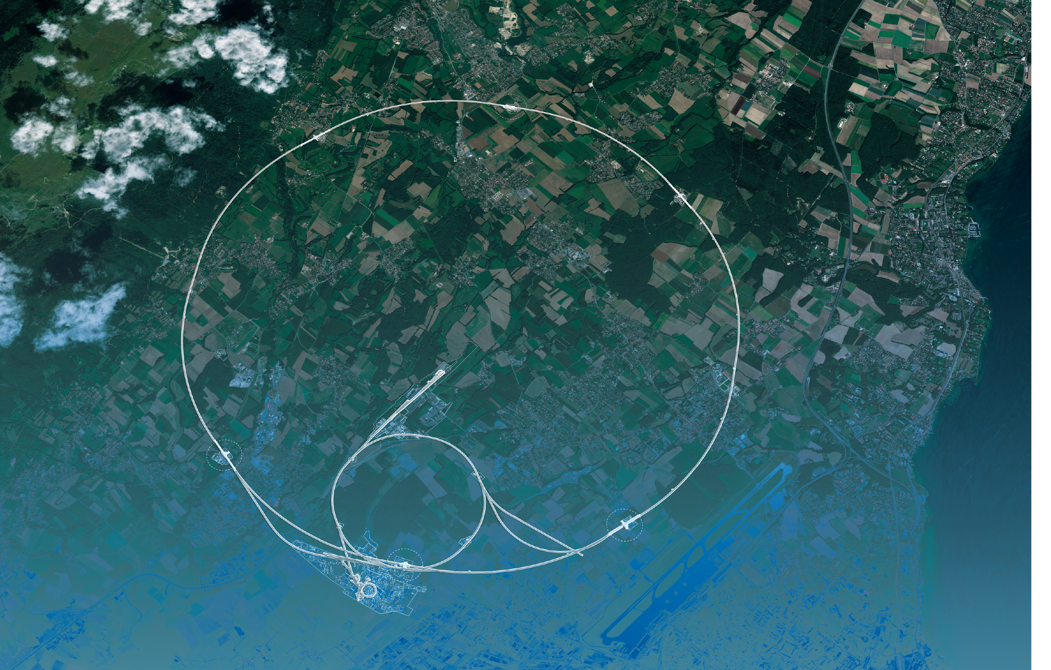
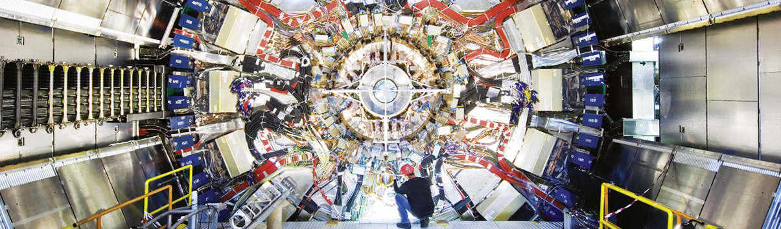
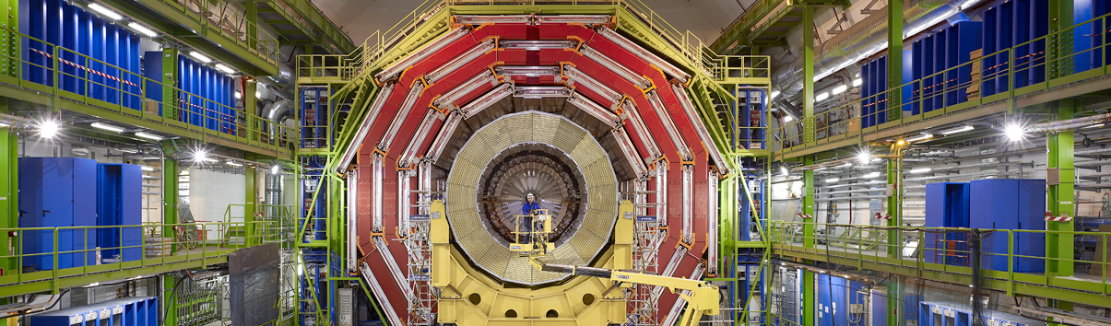
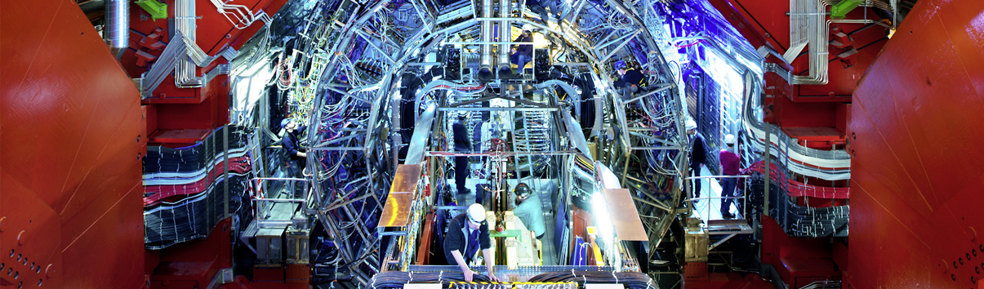
LHC Experiments
CMS
ATLAS
LHC
CMS
ALICE
SPS
ALICE
LHCb
ATLAS
LHCb
PS
Areal view
Presentation

Slide 4
LHC Experiments
CMS
FACET / PREFACE ?
MATHUSLA ?
MilliQan
SHIFT
(gaseous target)
LHC
NA62, NA64, SHiP (BDF)
SPS
ALICE
ATLAS
FPF ?
ANUBIS
SND
LHCb
FASER
MoEDAL / MoEDAL-MAPP-1/2 ?
CODEX-b/β ?
Areal view
Presentation

Slide 5
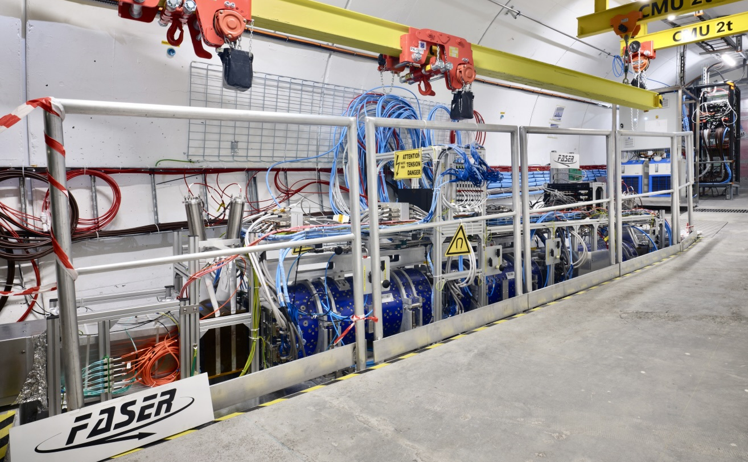
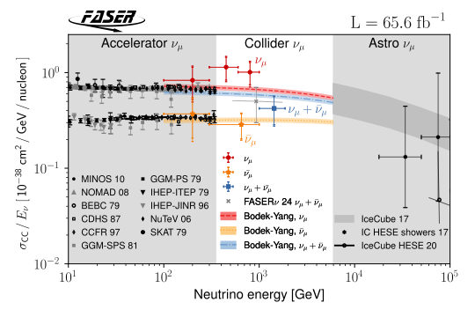
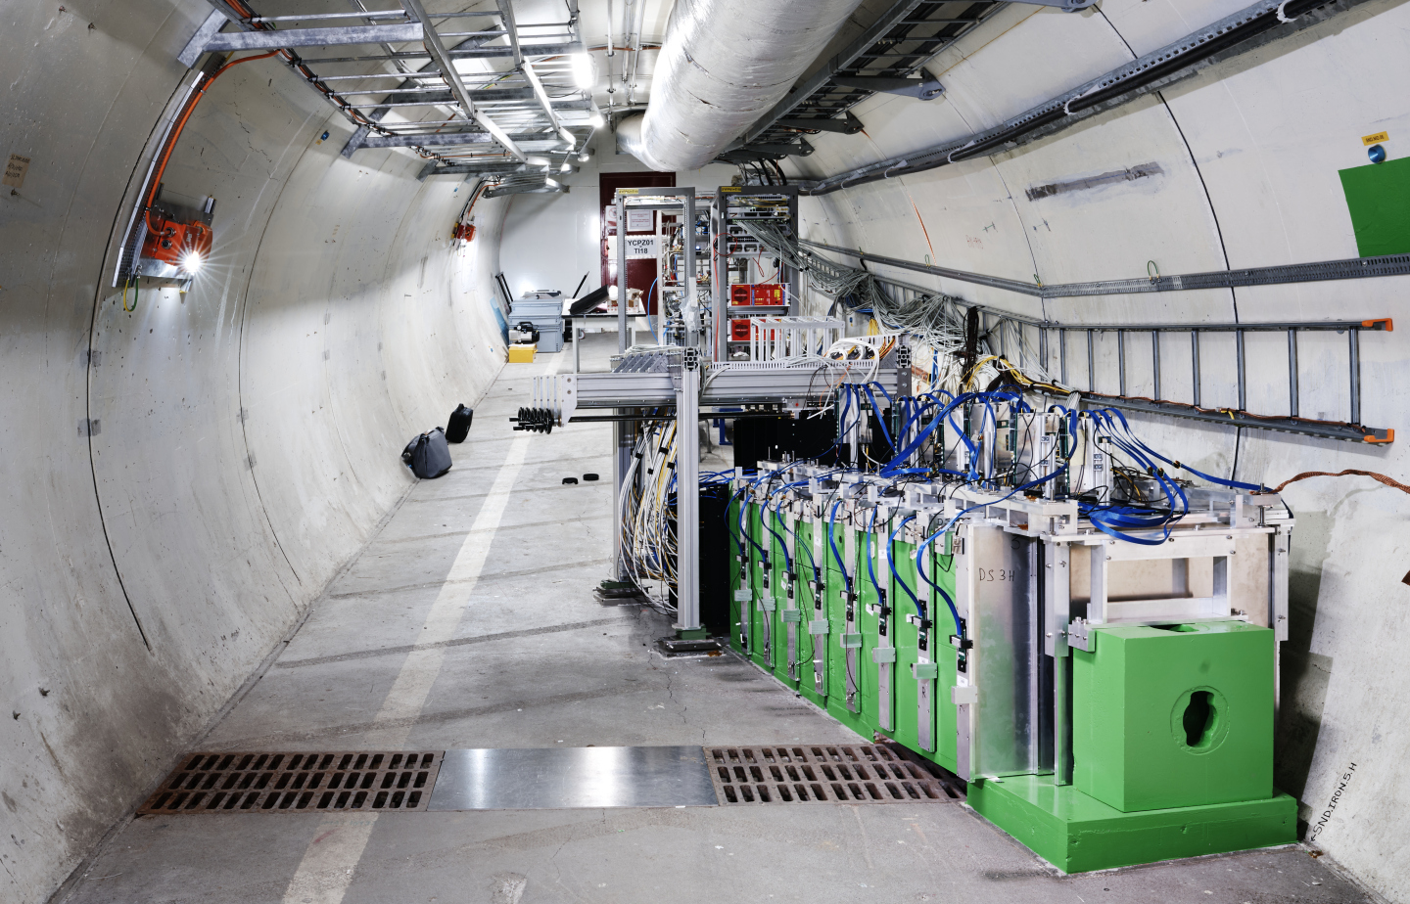
LHC Experiments
CMS
FACET / PREFACE ?
MATHUSLA ?
MilliQan
SHIFT
(gaseous target)
FASER
LHC
SND@LHC
NA62, NA64, SHiP (BDF)
SPS
arXiv:2412.03186
ALICE
ATLAS
FPF ?
ANUBIS
SND
LHCb
FASER
MoEDAL / MoEDAL-MAPP-1/2 ?
CODEX-b/β ?
Areal view
Presentation

Slide 6
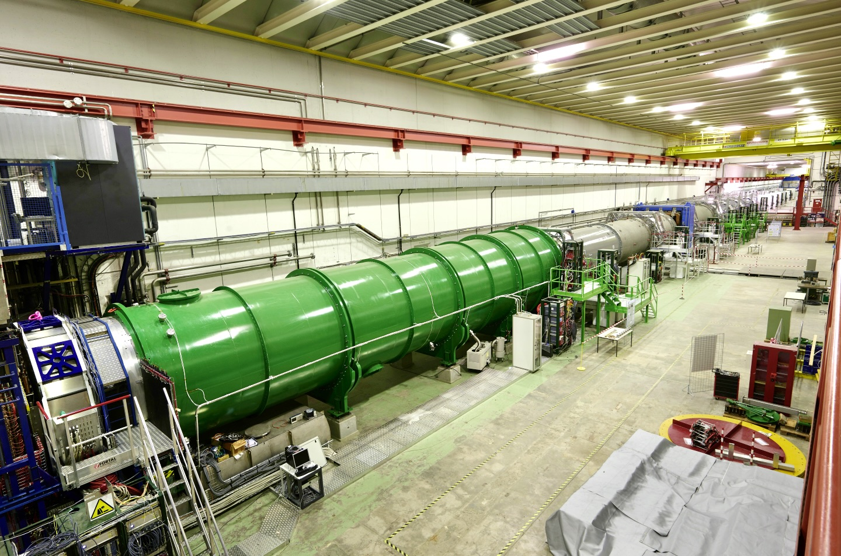
LHC Experiments
CMS
FACET / PREFACE ?
MATHUSLA ?
MilliQan
SHIFT
(gaseous target)
NA62
Rare kaon decay experiment
NA62, NA64, SHiP (BDF)
SPS
ALICE
ATLAS
FPF ?
ANUBIS
SND
LHCb
FASER
MoEDAL / MoEDAL-MAPP-1/2 ?
CODEX-b/β ?
Areal view
Presentation

Slide 7
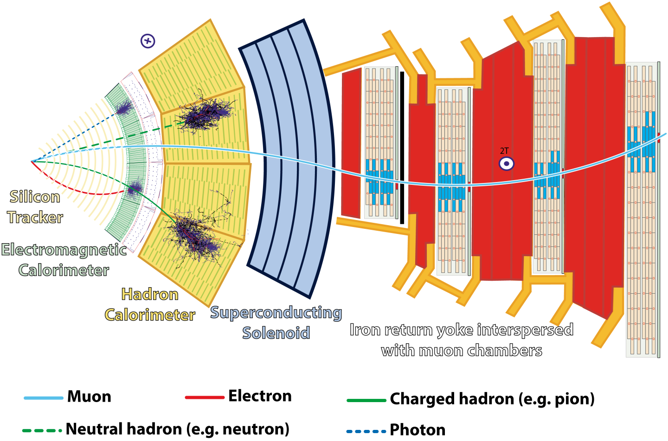
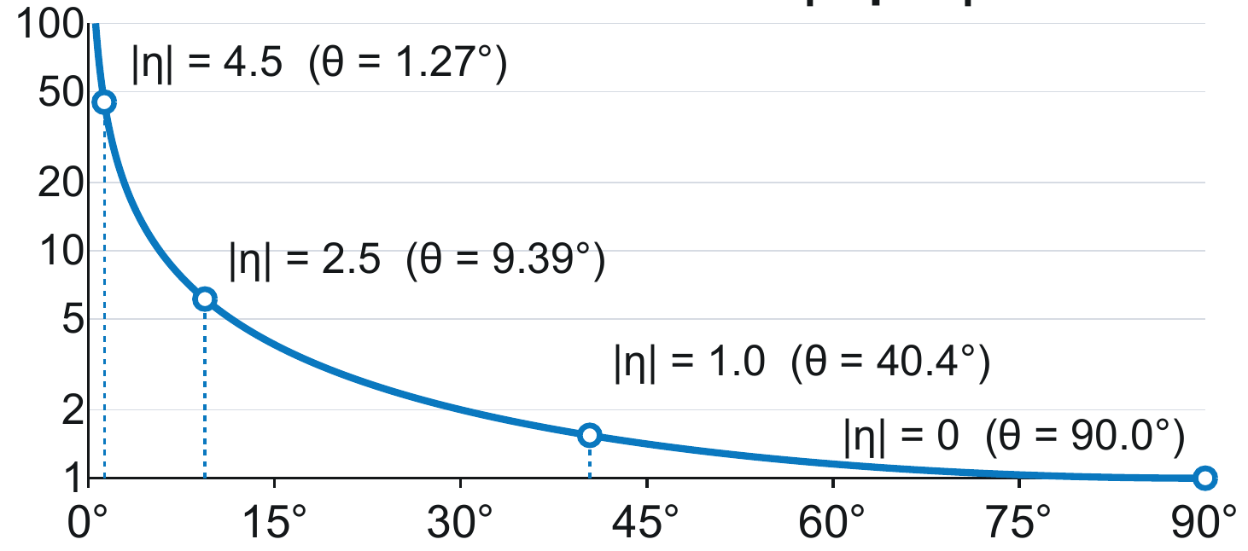
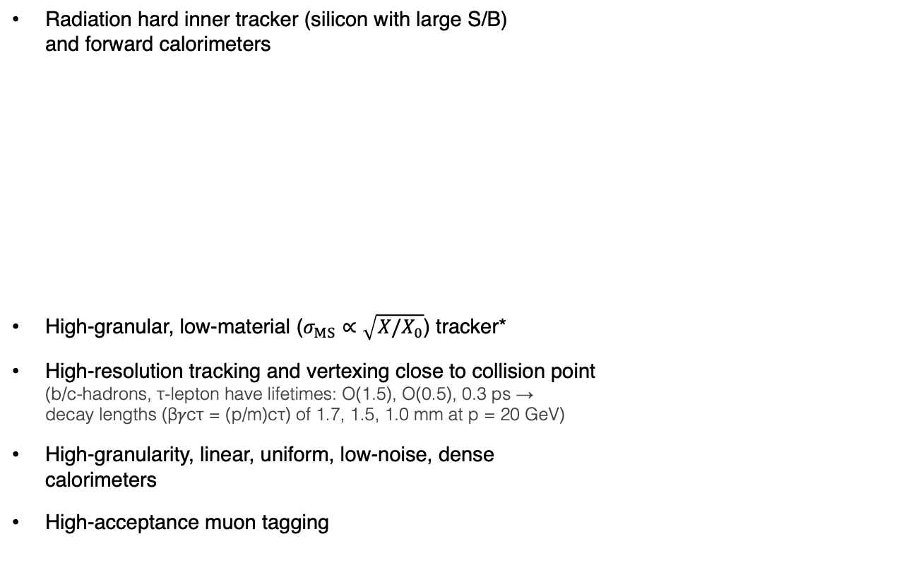


Particle detector basics
Requirements (up to 40 MHz bunch crossing rate, 64 pileup collisions — 2.5 × original design!)
Radiation hard inner tracker (silicon with large S/B) and forward calorimeters
High-granular, low-material ($σ_{MS}∝\sqrt{X/X_{0}}$) tracker*
High-resolution tracking and vertexing close to collision point (b/c-hadrons, τ-lepton have lifetimes: O(1.5), O(0.5), 0.3 ps → decay lengths (β𝛾cτ = (p/m)cτ) of 1.7, 1.5, 1.0 mm at p = 20 GeV)
High-granularity, linear, uniform, low-noise, dense calorimeters
High-acceptance muon tagging
$$η=−\ln{​}\left[\tan\left(\frac{θ}{2}\right)\right]$$
$$\frac{dN}{dθ}\sim \left|\frac{dN}{dθ}\right|=\frac{1}{sinθ}$$
Relative particle density
Polar angle θ [degrees]
Slice showing CMS sub-detectors and how particles interact with them
*Radiation length X₀ : mean distance a high-E electron travels before losing 1/e of its energy by bremsstrahlung

Slide 8
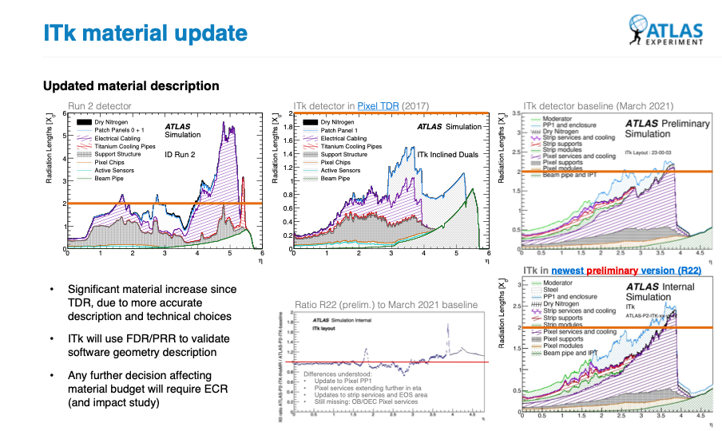
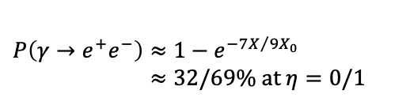
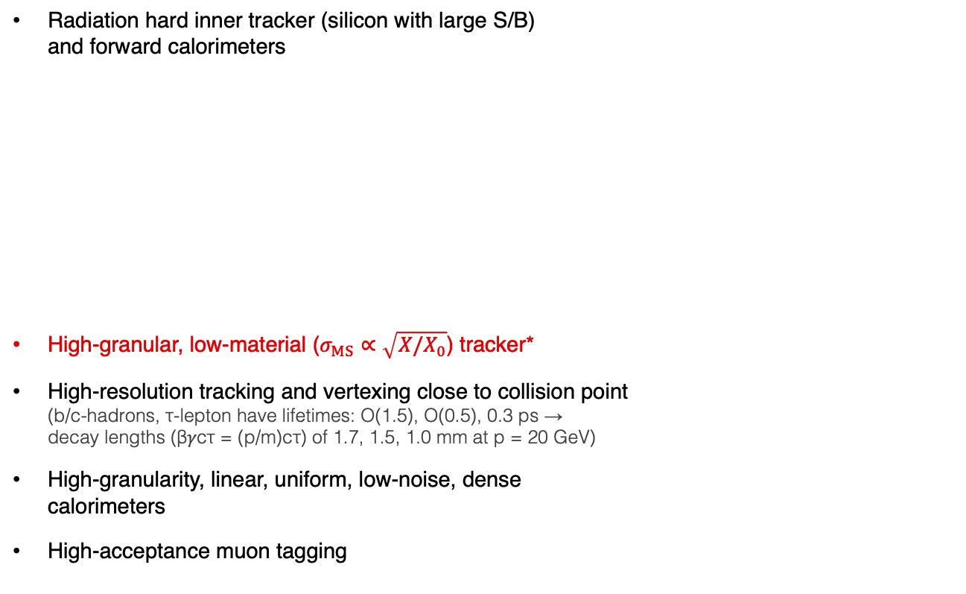
Particle detector basics
Requirements (up to 40 MHz bunch crossing rate, 64 pileup collisions — 2.5 × original design!)
Radiation hard inner tracker (silicon with large S/B) and forward calorimeters
High-granular, low-material ($σ_{MS}∝\sqrt{X/X_{0}}$) tracker*
High-resolution tracking and vertexing close to collision point (b/c-hadrons, τ-lepton have lifetimes: O(1.5), O(0.5), 0.3 ps → decay lengths (β𝛾cτ = (p/m)cτ) of 1.7, 1.5, 1.0 mm at p = 20 GeV)
High-granularity, linear, uniform, low-noise, dense calorimeters
High-acceptance muon tagging
$$η=−\ln{​}\left[\tan\left(\frac{θ}{2}\right)\right]$$
$$\frac{dN}{dθ}\sim \left|\frac{dN}{dθ}\right|=\frac{1}{sinθ}$$
Relative particle density
Polar angle θ [degrees]
Material leads to multiple scattering, nuclear interactions, bremsstrahlung, photon conversion
$$P\left(γ→e^{+}e^{−}\right)≈1−e^{{−7X}/{9X_{0}}}$$
$≈32/69\% at η=0/1$
*Radiation length X₀ : mean distance a high-E electron travels before losing 1/e of its energy by bremsstrahlung

Slide 9
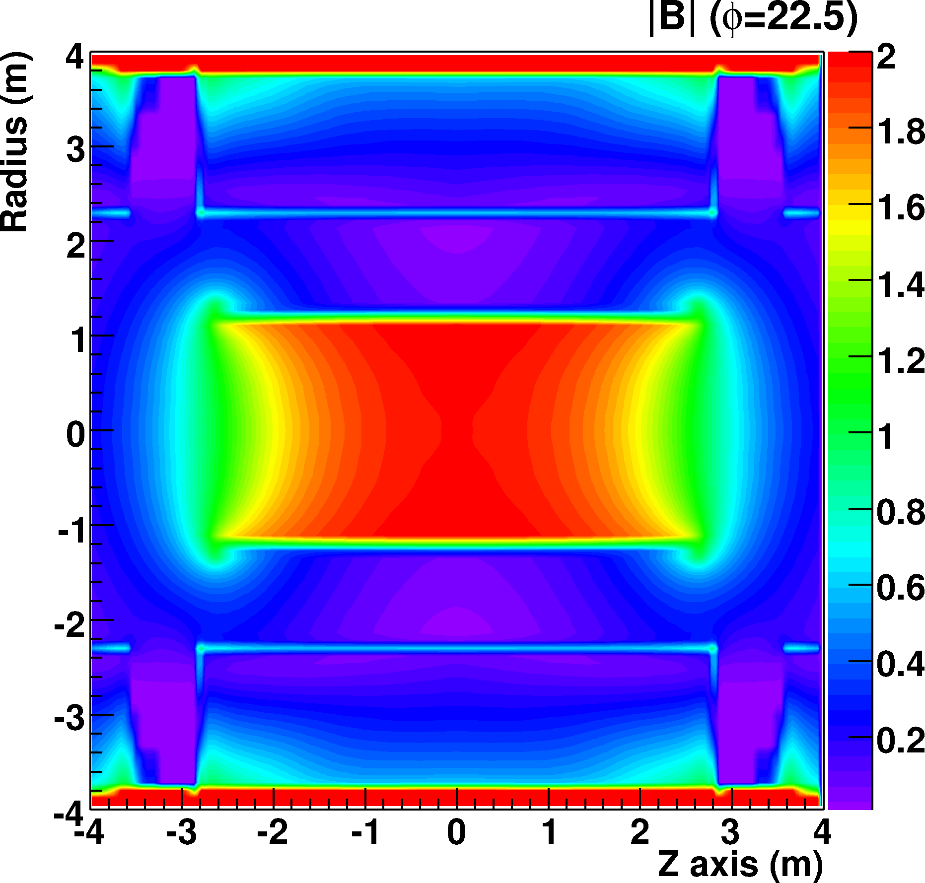

Particle detector basics — Solenoid magnets
Superconducting solenoid magnets: homogenous B field simplifies tracking
Flux return
Had Cal
EM Cal
B-field inhomogeneities
Solenoid
(4.5 cm thick)
Active tracker area
Beam axis
Solenoid
EM Cal
Had Cal
Flux return

Slide 10

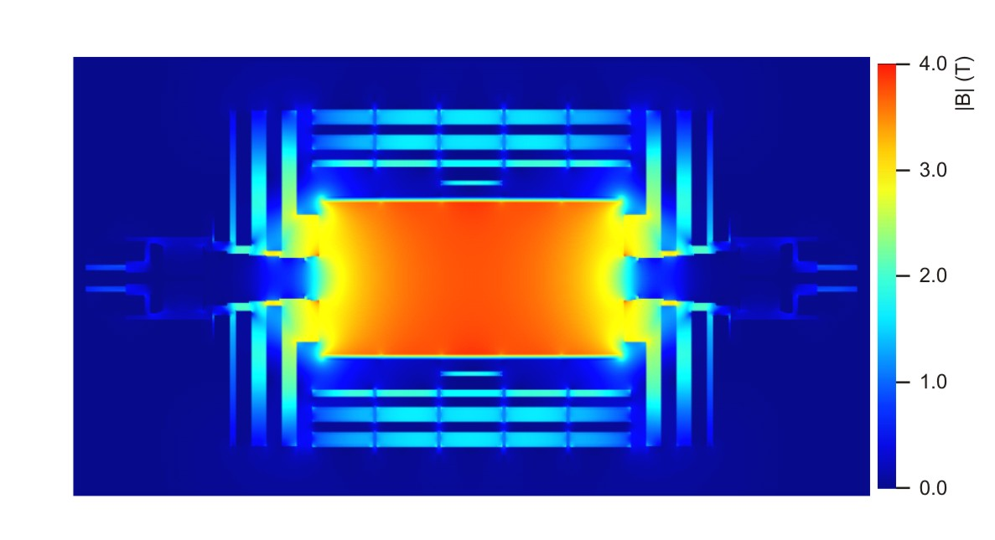
Particle detector basics — Solenoid magnets
Superconducting solenoid magnets: homogenous B field simplifies tracking
3.8T field map
Flux return
Solenoid (31 cm thick)
3.0 m
Active tracker area
0
Beam axis
–3.0 m
Solenoid
Flux return
–6.3 m
0
6.3 m

Slide 11
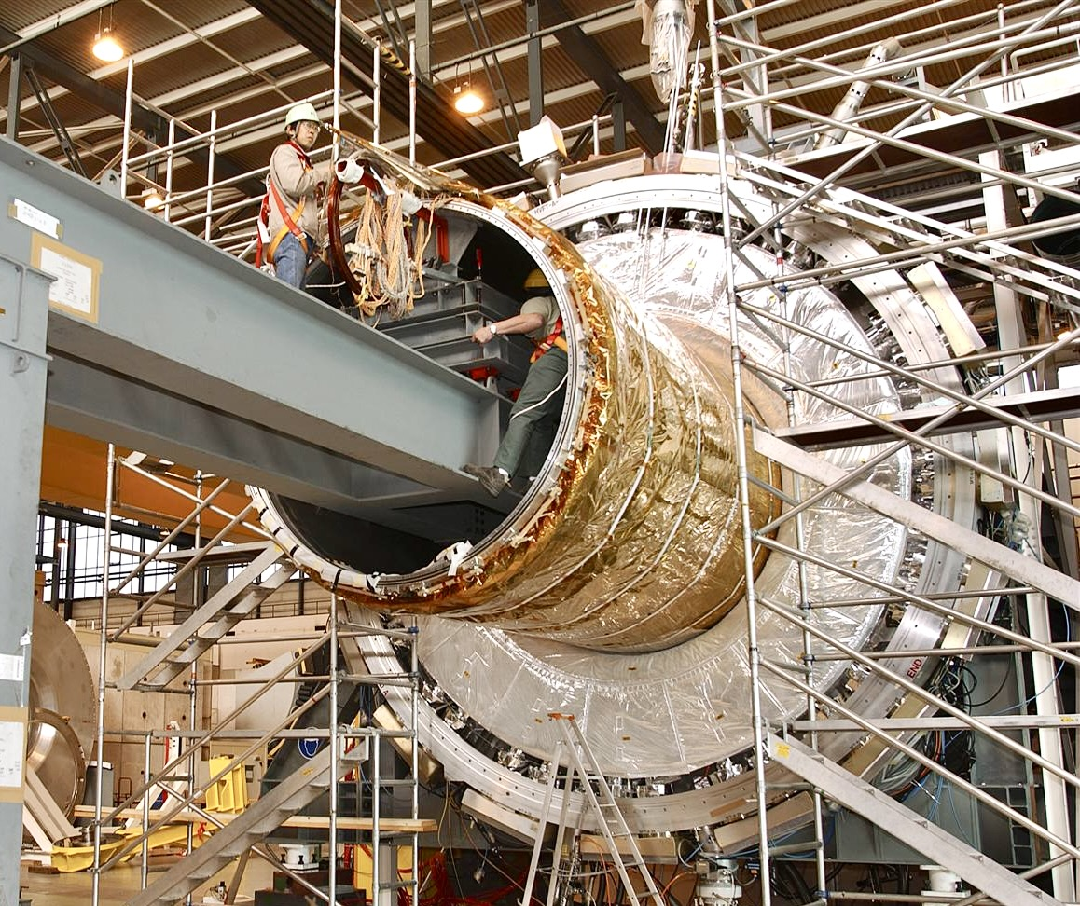
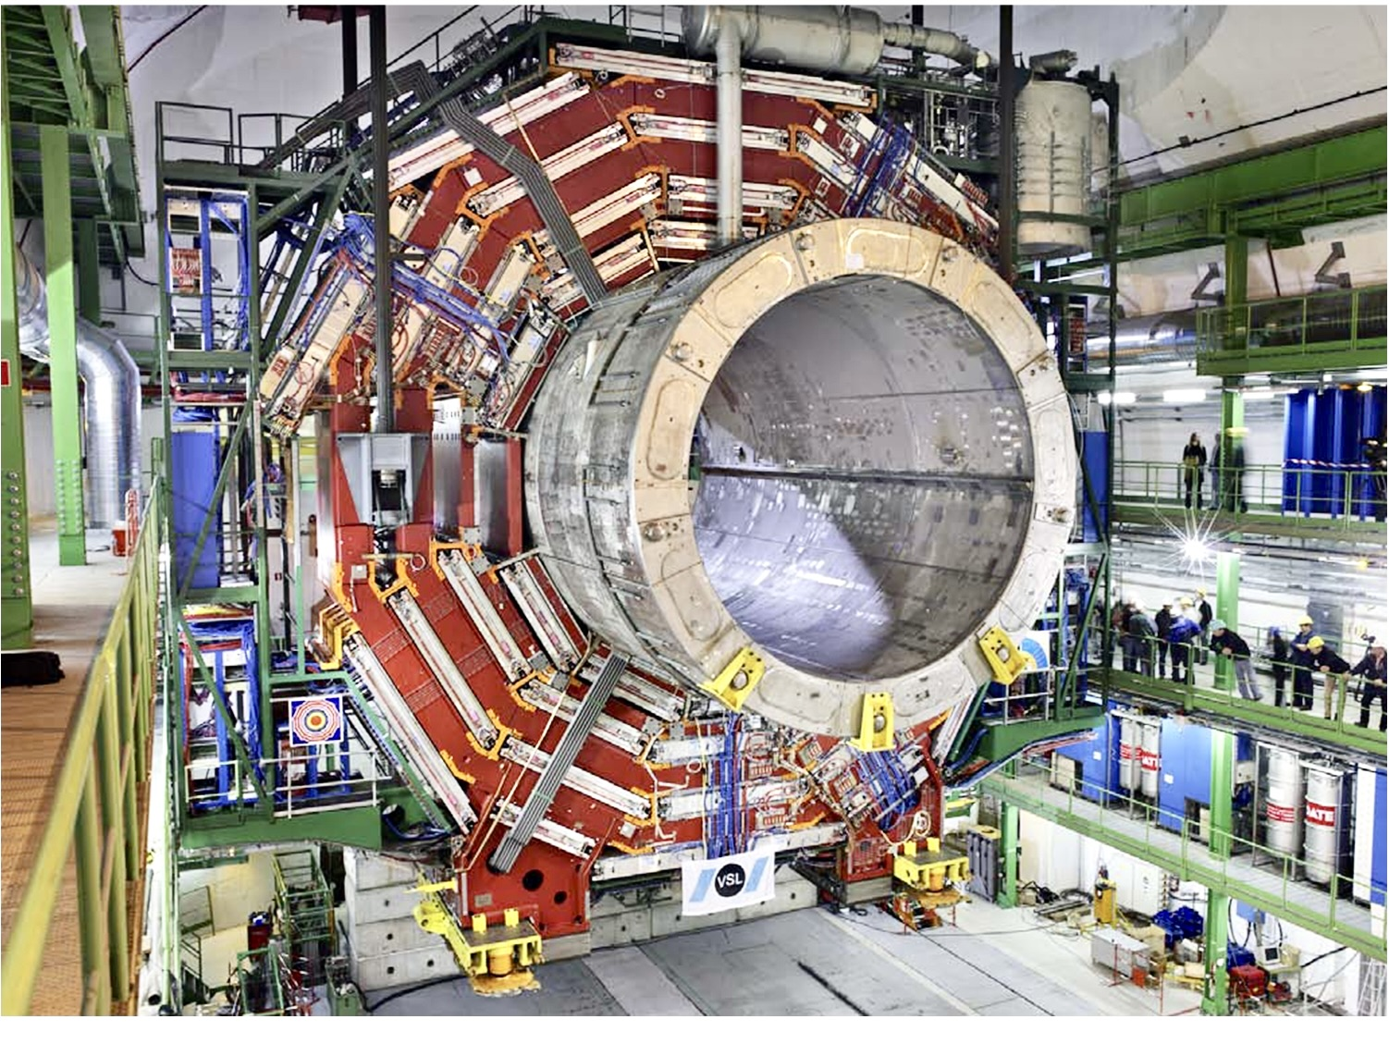
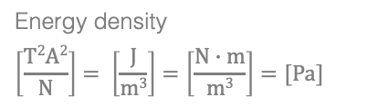
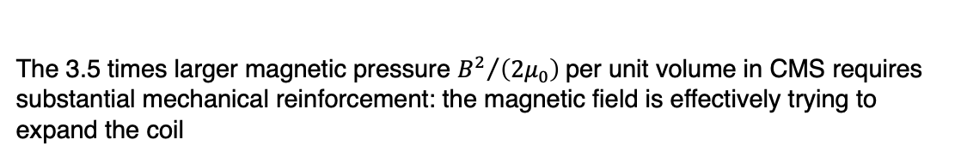
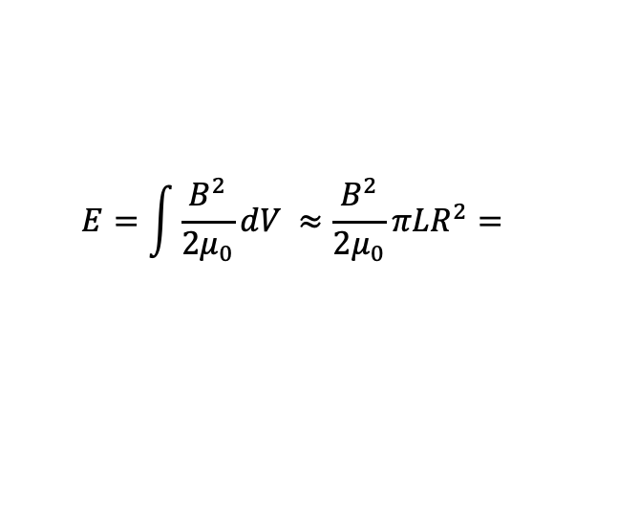
Particle detector basics — Solenoid magnets
Superconducting solenoid magnets — stored energies
Insertion of ATLAS and CMS solenoids
For homogeneous cylindrical solenoid:
38 MJ for ATLAS (B = 2 T, I = 7.7 kA, V ~ 24 m³)
Extra-thin magnet (before calorimeter, 0.66 X₀), single winding, weight : 5.5 tons
$$E=\int{\frac{B^{2}}{2μ_{0}}dV} ≈\frac{B^{2}}{2μ_{0}}πLR^{2}=$$
2’400 MJ for CMS (B = 3.8 T, I = 18.2 kA, V ~ 353 m³)
Thicker, stabilised magnet, four windings (3.9 X₀), weight: 220 tons (40 × ATLAS solenoid)
Energy density
$$\left[\frac{T2A2}{N}\right]= \left[\frac{J}{m3}\right]=\left[\frac{N∙m}{m3}\right]=[Pa]$$
The 3.5 times larger magnetic pressure ${B^{2}}/{\left(2μ_{0}\right)}$per unit volume in CMS requires substantial mechanical reinforcement: the magnetic field is effectively trying to expand the coil
$μ_{0}≈1.26∙{10}^{−6} N/A^{2}$ is the vacuum permeability

Slide 12
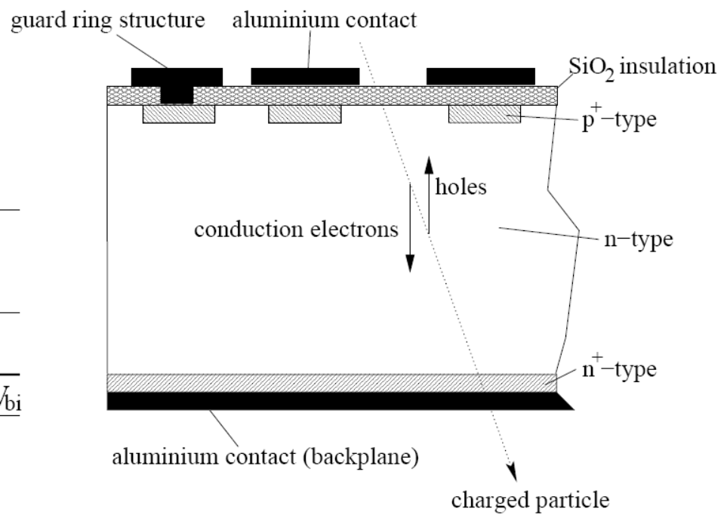
Particle detector basics — Charged particle measurement
Tracking (inner tracker & muon system, exploiting ionization signal)
p⁺ type
p⁺-in-n type
(HL-LHC: n⁺-in-p type)
Holes
O(300
μm)
Electrons
n type bulk
Depleted Si: electric field separates and collects e–hole pairs (Q_{col})
n⁺ type
+
Charged particle
Reverse bias (V_{bias} < 500 V)
Full depletion when V_{bias} > V_{dep} (depletion voltage)
  High Si density and low e–hole creation energy (3.6 eV vs ~36 eV in gas) enable thin detectors with sufficient signal
  High mobility of charge carriers in Si allows fast charge collection (~5 ns for e–)
  Leakage current (I_{leak}) from thermally generated carriers suppressed by cooling

Slide 13
Particle detector basics — Charged particle measurement
Tracking (inner tracker & muon system, exploiting ionization signal)
p⁺ type
p⁺-in-n type
(HL-LHC: n⁺-in-p type)
Holes
After irradiation
O(300
μm)
Electrons
n type bulk
V_{dep} ↑
Q_{col} ↓
I_{leak} ↑
Depleted Si: electric field separates and collects e–hole pairs (Q_{col})
(effective doping changes)
(carrier trapping)
(thermal carrier generation at radiation defects)
n⁺ type
+
Bias recovery is limited by leakage current power (P = I_{leak} · V_{bias}), which can cause thermal runaway*
Charged particle
!
Reverse bias (V_{bias} < 500 V)
Full depletion when V_{bias} > V_{dep} (depletion voltage)
  High Si density and low e–hole creation energy (3.6 eV vs ~36 eV in gas) enable thin detectors with sufficient signal
  High mobility of charge carriers in Si allows fast charge collection (~5 ns for e–)
  Leakage current (I_{leak}) from thermally generated carriers suppressed by cooling
*Thermal runaway: sensor heating increases leakage current and power dissipation, causing still more heating unless sufficient cooling stabilises the system

Slide 14
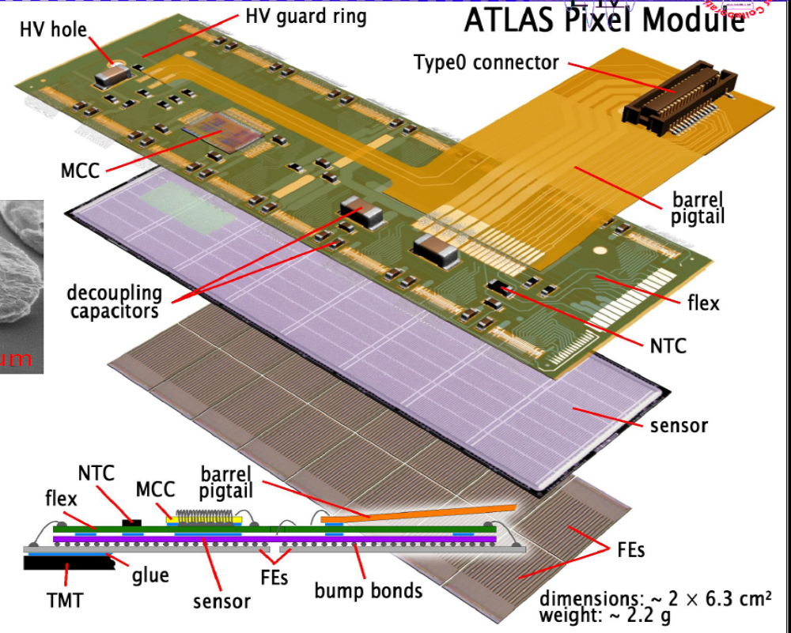
Particle detector basics — Charged particle measurement
Tracking (inner tracker & muon system, exploiting ionization signal)
Example: ATLAS silicon pixel module (16 FE chips, 2880 channels / chip) (“hybrid” technology: separate FE chips and sensor bump-bonded together)
p⁺ type
p⁺-in-n type
(HL-LHC: n⁺-in-p type)
Holes
O(300
μm)
Electrons
n type bulk
Depleted Si: electric field separates and collects e–hole pairs (Q_{col})
n⁺ type
+
Charged particle
Reverse bias (V_{bias} < 500 V)
Full depletion when V_{bias} > V_{dep} (depletion voltage)
  High Si density and low e–hole creation energy (3.6 eV vs ~36 eV in gas) enable thin detectors with sufficient signal
  High mobility of charge carriers in Si allows fast charge collection (~5 ns for e–)
  Leakage current (I_{leak}) from thermally generated carriers suppressed by cooling

Slide 15
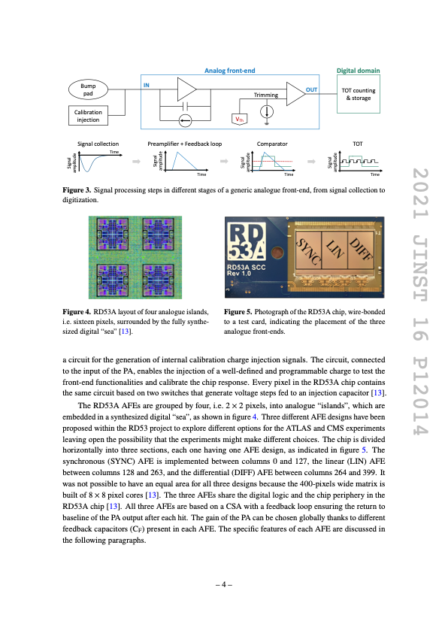
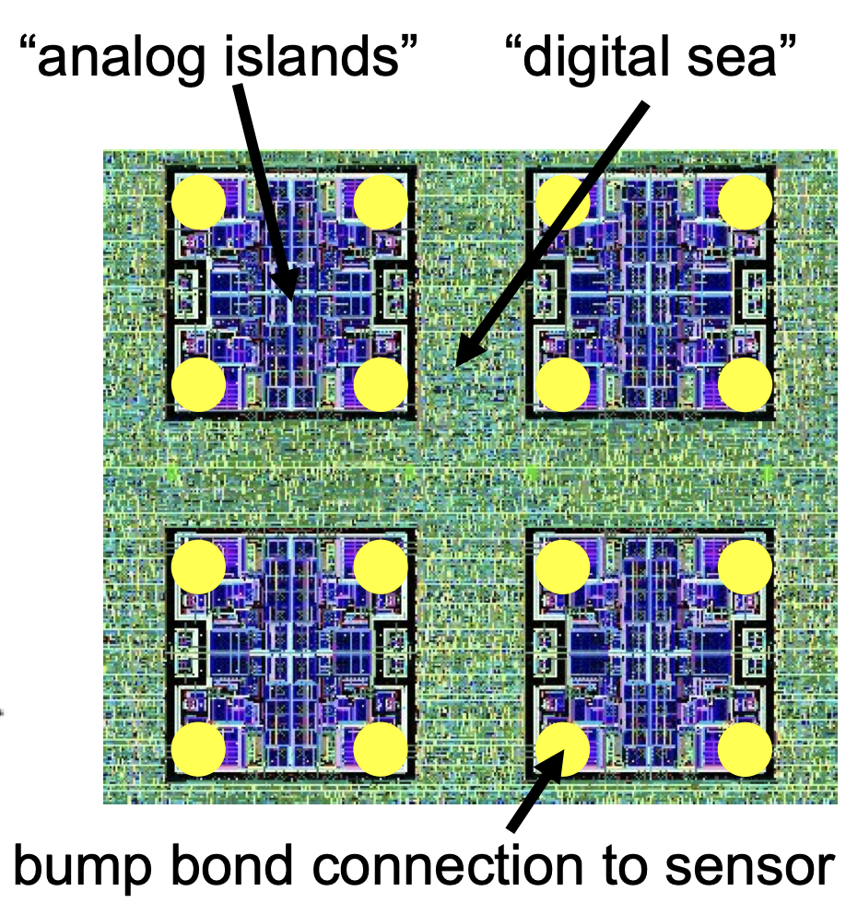
Particle detector basics — Charged particle measurement
Tracking (inner tracker & muon system, exploiting ionization signal)
Example: ATLAS silicon pixel module (16 FE chips, 2880 channels / chip) (“hybrid” technology: separate FE chips and sensor bump-bonded together)
–
p⁺ type
Holes
Conduction electrons
n type bulk
O(300
μm)
Depleted Si: electric field separates and collects e–hole pairs (Q_{col})
n⁺ type
Readout ASIC combines an analog front-end (charge-sensitive preamplifier, feedback, discriminator, threshold tuning and calibration injection) that converts the tiny sensor charge into a digital hit signal, followed by digital logic for TOT digitization, time stamping, buffering, triggering and data readout [link to figure, RD53 chip]
+
Charged particle
Reverse bias (V_{bias} < 500 V)
Full depletion when V_{bias} > V_{dep} (depletion voltage)
  High Si density and low e–hole creation energy (3.6 eV vs ~36 eV in gas) enable thin detectors with sufficient signal
  High mobility of charge carriers in Si allows fast charge collection (~5 ns for e–)
  Leakage current (I_{leak}) from thermally generated carriers suppressed by cooling

Slide 16
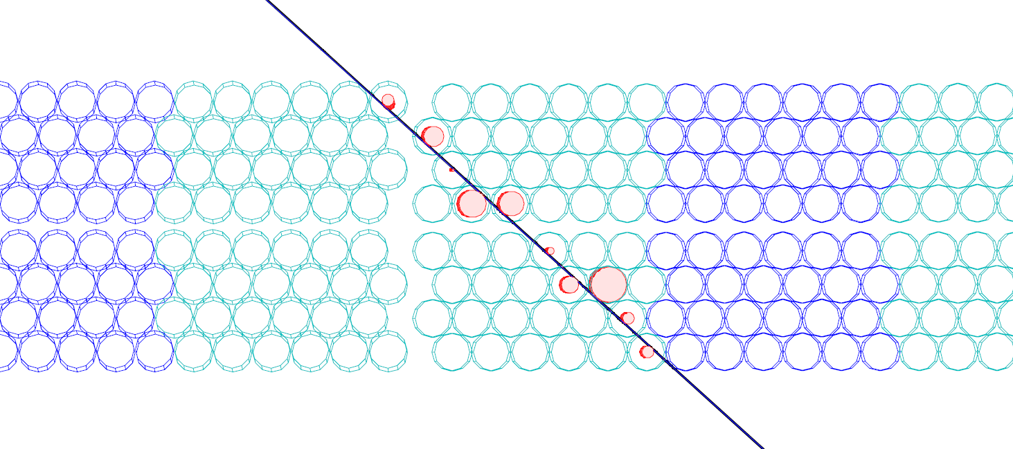

Particle detector basics — Charged particle measurement
Tracking (inner tracker & muon system, exploiting ionization signal)
Charged particle
Ionised electrons drift to wire
Cathode (HV–)
p⁺ type
p⁺-in-n type
(HL-LHC: n⁺-in-p type)
r_{drift}
Anode wire (HV+)
Holes
Drift circle
O(300
μm)
n type bulk
Ions drift to cathode
Electrons
Depleted Si: electric field separates and collects e–hole pairs (Q_{col})
Noble Gas
n⁺ type
$$σ_{DT} \sim 80 μm$$
+
Example: simulated muon in MDTs
Charged particle
Reverse bias (V_{bias} < 500 V)
Full depletion when V_{bias} > V_{dep} (depletion voltage)
  High Si density and low e–hole creation energy (3.6 eV vs ~36 eV in gas) enable thin detectors with sufficient signal
  High mobility of charge carriers in Si allows fast charge collection (~5 ns for e–)
  Leakage current (I_{leak}) from thermally generated carriers suppressed by cooling
Alignment needs to be better than 35 μm

Slide 17
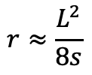
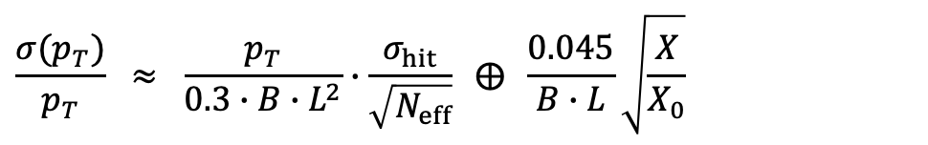


Particle detector basics — Charged particle measurement
Momentum reconstruction of a charged track in a magnetic field (B)
Si clusters / drift circles
track fit
Obtain r and p_{T} from measurement of sagitta:
$$r≈\frac{L^{2}}{8s}$$
(if $s≪L$) ➠
$$p_{T}[GeV] ≈0.3∙r[m]∙B[T]$$
s
Momentum resolution:
L
r
$$\frac{σ(p_{T})}{p_{T}} ≈ \frac{p_{T}}{0.3∙B∙L^{2}}∙\frac{σ_{hit}}{\sqrt{N_{eff}}} ⨁ \frac{0.045}{B∙L}\sqrt{\frac{X}{X_{0}}}$$
Multiple scattering term (central tracks, β = 1)
r
Track fitting in LHC environment is very challenging
Several thousand tracks per proton-bunch collision, up to 20k tracks for a central PbPb collision
Must handle ambiguities, hit overlaps, multiple scattering, bremsstrahlung, multiple vertices, …
Track fitters take Gaussian noise (e.g., Kalman filter) and non-Gaussian noise (e.g., Gaussian sum filter) into account
Fitter must be fast, used in high-level trigger

Slide 18
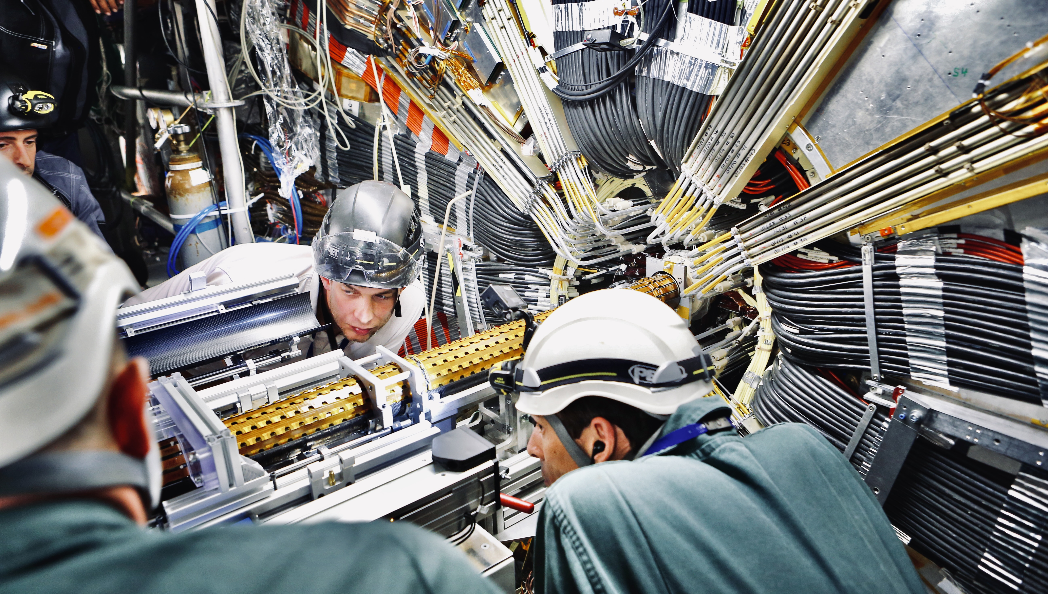
Installation of ATLAS Insertable B-layer on 15 May 2014

Slide 19
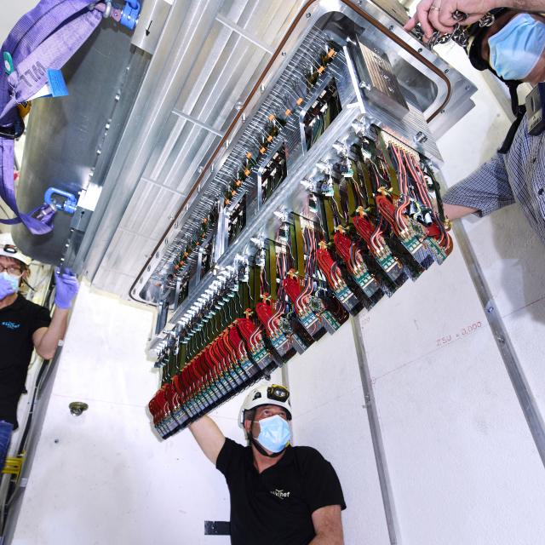
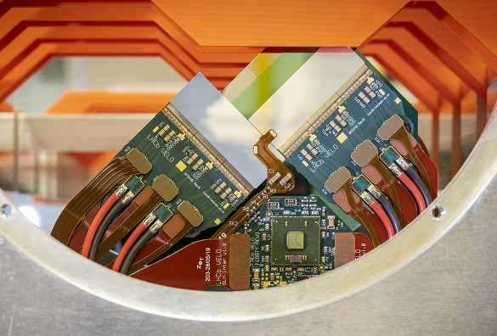
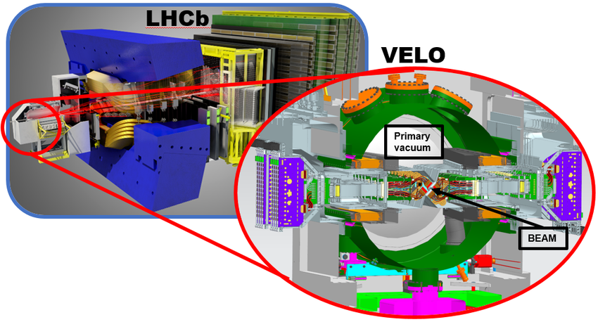
Closest active pixel edge: 5.1 mm from beam axis
RF box/foil separating the detector and beam vacua: ~3.5 mm from beam
LHCb’s VELO (Vertex Locator) Detector

Slide 20
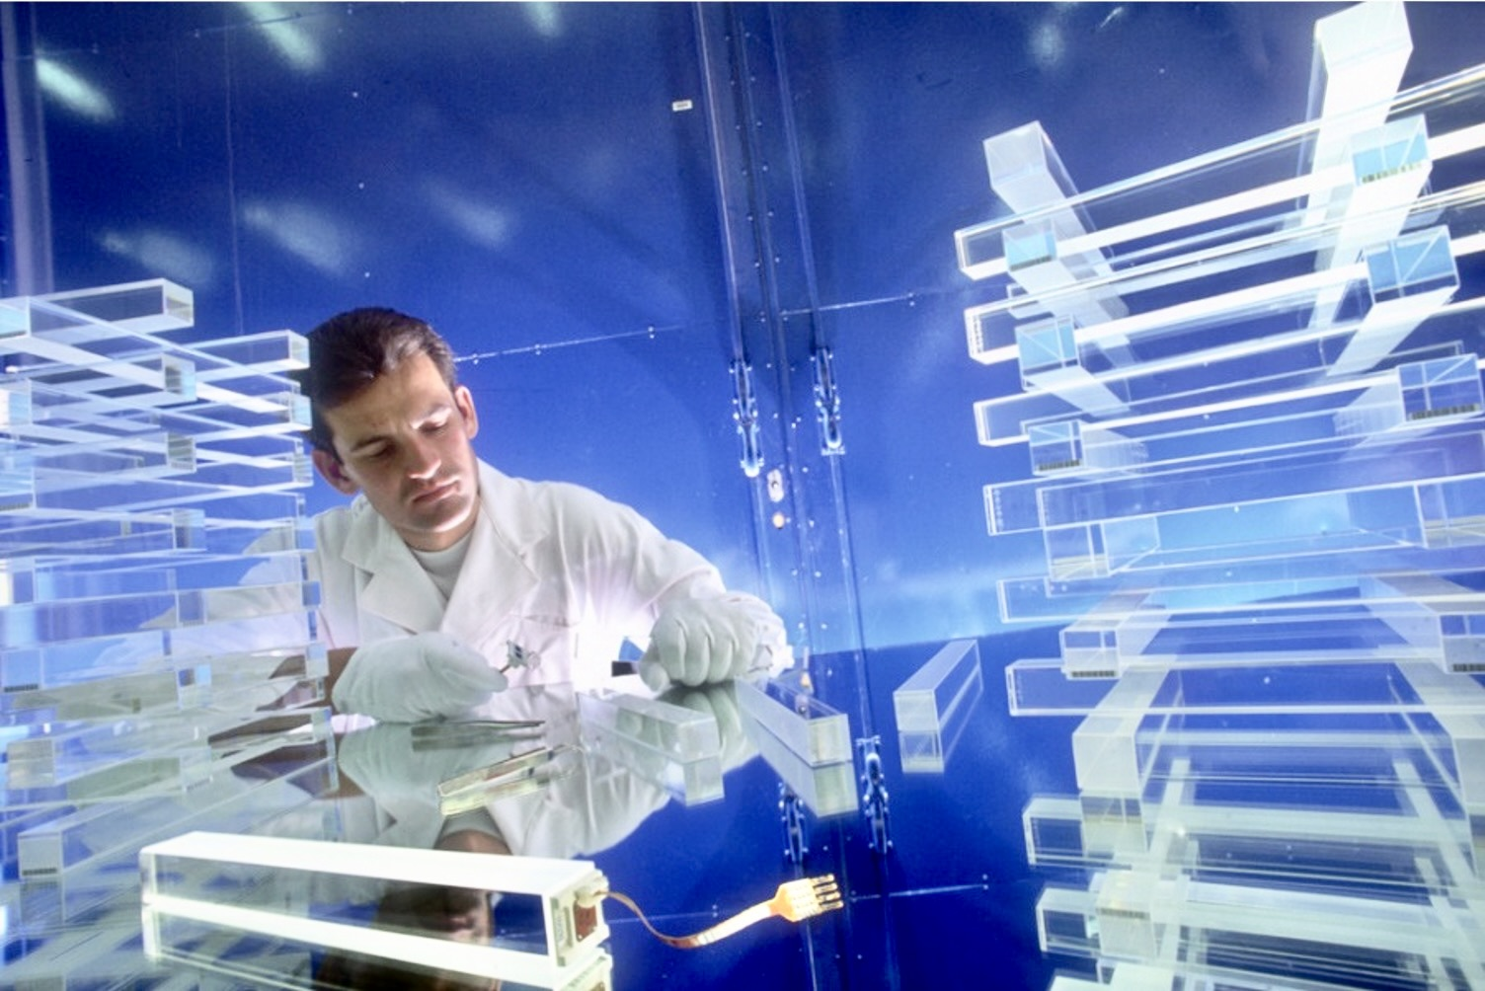
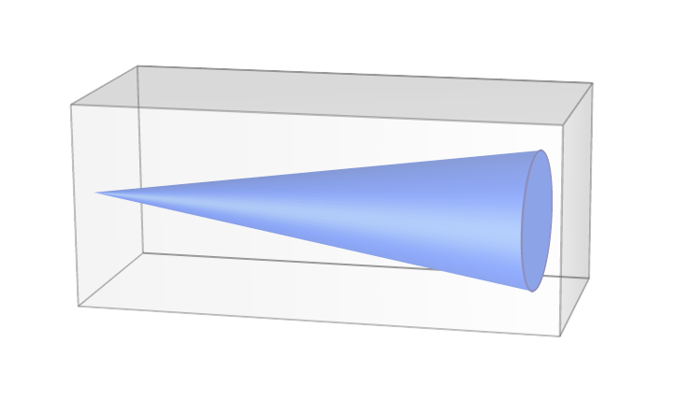
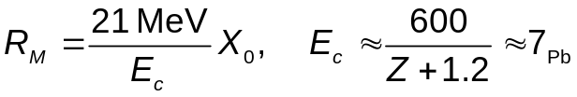

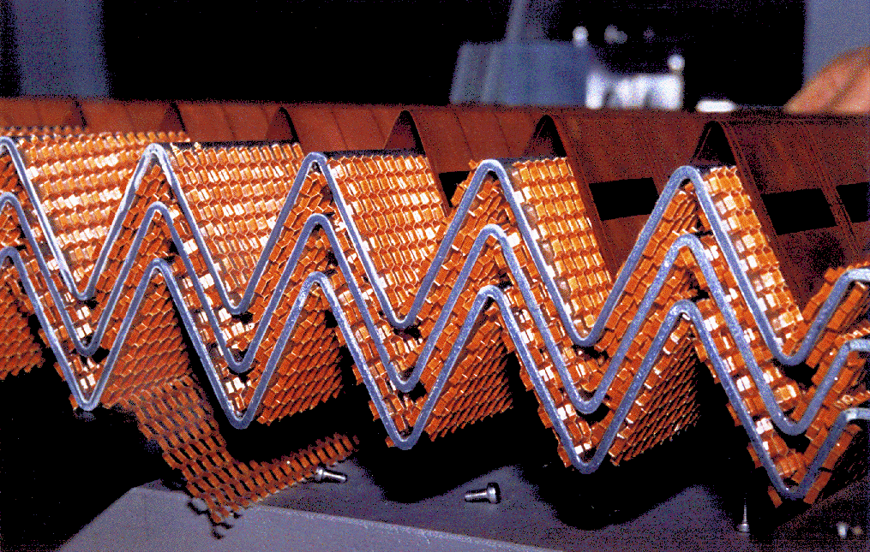
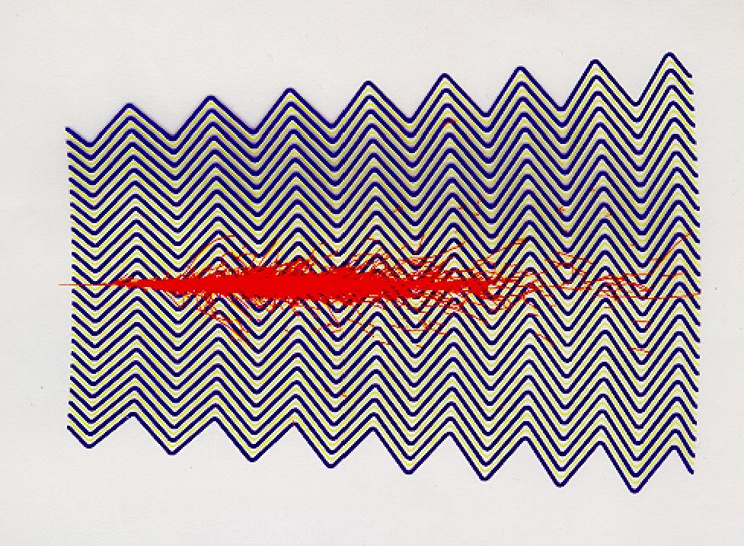
Particle detector basics — EM Calorimeters
Calorimeters (high-energy particle incident on absorber initiates EM cascades and, if hadron, nuclear interactions)
EM: bremsstrahlung and pair production generate lower energy electrons and photons, transverse size given by Molière radius:
MeV
~ 2 X₀
Calorimeters aim at large X/X₀ ~ (20 – 30)
X₀(Pb, PbWO4) ≈ 5.6, 8.9 mm
~ 22 X₀
CMS: PbWO₄ scintillation crystal calorimeter
Entire shower in active detector material, no particles lost in passive absorber, high granularity and resolution, light yield sensitive to radiation
No longitudinal segmentation
ATLAS: LAr sampling calorimeter (cryogenic T at 87 K)
Passive Pb absorber (1.1–1.5 mm thick [barrel]) inter-leaved with active detector material (liquid argon), high granularity, linearity, uniformity, radiation hard, medium resolution
Longitudinal segmentation (3 layers)

Slide 21
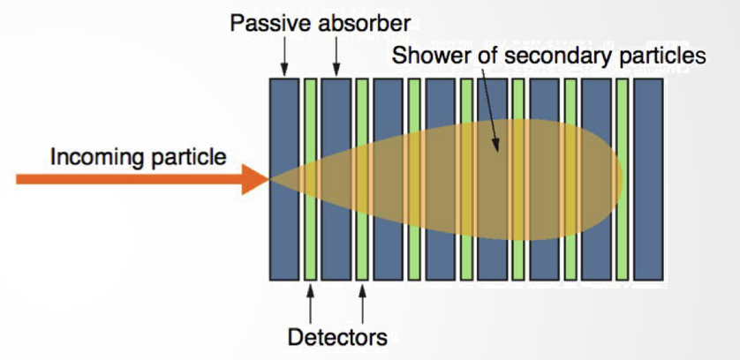
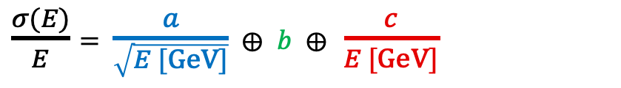
Particle detector basics — EM Calorimeters
A calorimeter converts a particle shower into a signal proportional to energy. Since the number of shower particles $N∝E$, counting fluctuations give $σ(E)/E ∝ 1/√E$.
$\frac{σ(E)}{E}$ $=$ $\frac{a}{\sqrt{E [GeV]}}$ $⨁$ $b$ $⨁$ $\frac{c}{E [GeV]}$
Stochastic term
Constant term
Noise term
a/√E
b
c/E
Sampling calorimeter
Only the active layers record energy; thinner absorber layers and a larger active fraction reduce the stochastic term
Shower and sampling fluctuations
Dominates at intermediate energy
Calibration, non-uniformity and leakage
Dominates at high energy
Electronics and pileup noise
Dominates at low energy
Representative EM performance:
ATLAS Pb/LAr sampling: 10~12% / √E ⊕ 0.2–0.35%
CMS PbWO₄ crystals: 3~5.5% / √E ⊕ 0.5%
Takeaway: precision improves as $1/√E$ until calibration, uniformity and leakage set a constant-term floor

Slide 22
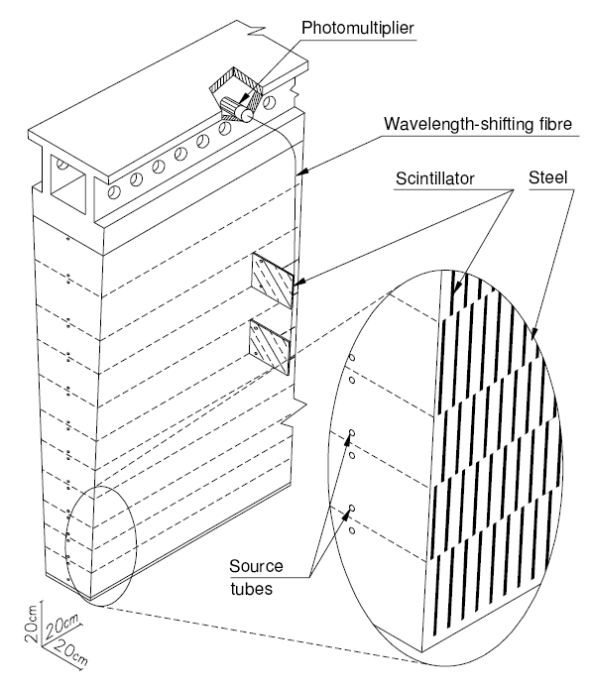
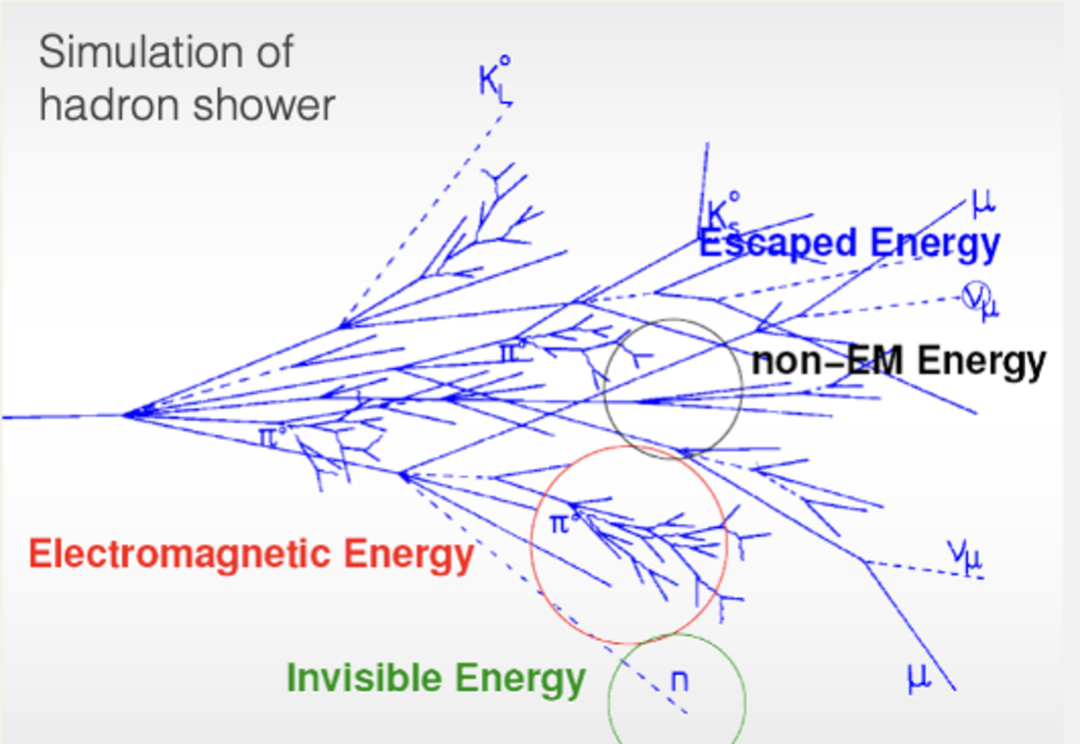
Particle detector basics — Hadron Calorimeters
HAD: Hadronic calorimeters need to fully absorb hadronic showers (initiated by interaction with nuclei)
Nuclear interaction length λ: mean free path of hadrons between strong collisions (λ > X[X₀] → HAD showers are later than EM ones, eg, λ_{Fe/brass} ~ 17 cm, need λ > 10)
Where the incident energy goes
EM component (~50%): π⁰, η → γγ; average fraction grows with energy
Visible non-EM (~25%): ionisation and excitation by charged hadrons
Invisible (~25%): nuclear breakup and binding energy; slow neutrons
Escaped (~2%): neutrinos and particles leaving the instrumented volume
Larger fluctuations and invisible energy causes worse energy resolution for HAD showers
ATLAS / CMS
λ = 9.7–13.0 / 7.2–11.0
3 / 1 sampling layers (barrel)
Pions: stochastic: ~55 / 70%, constant: 2.3 / 8.0%, noise: small
Significant improvement in CMS through particle flow (less so for ATLAS)
Sketch of ATLAS Tile Hadronic Calorimeter (steel / scintillator, three radial layers — CMS 1 layer)

Slide 23
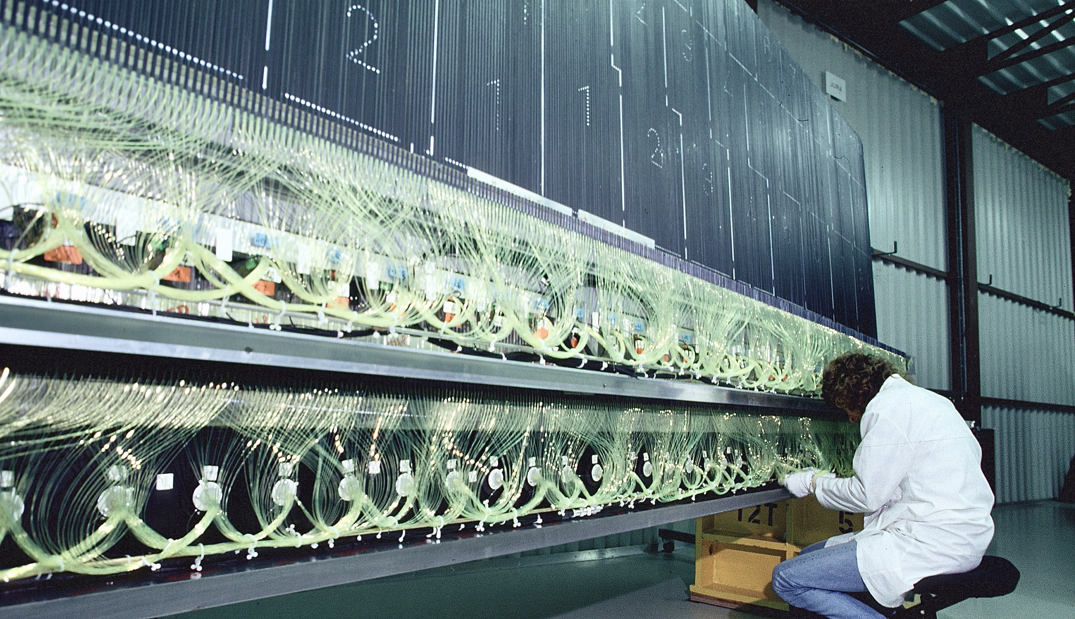
A complete ATLAS tile calorimeter module covering 1/64 of the full azimuth

Slide 24
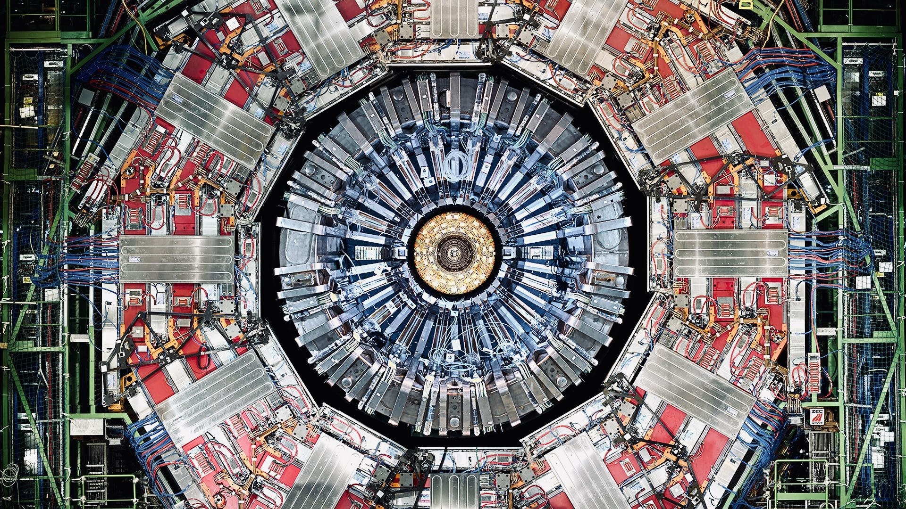
Transverse slice of the CMS detector

Slide 25
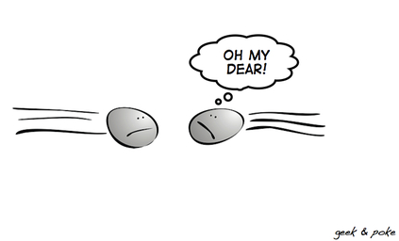
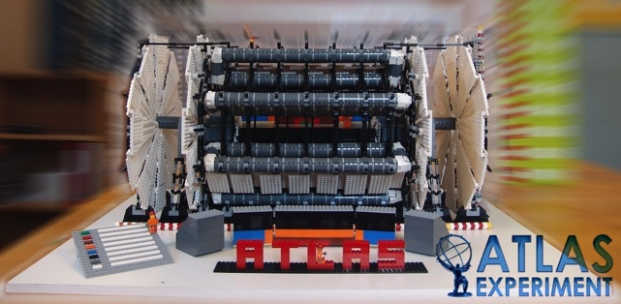
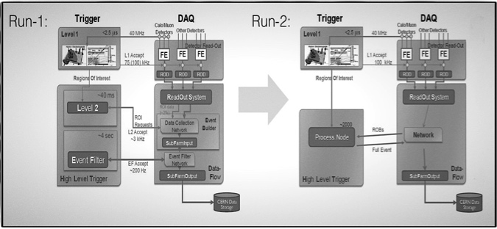
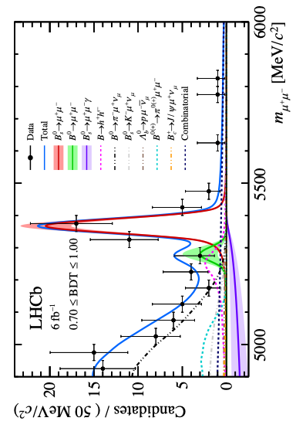
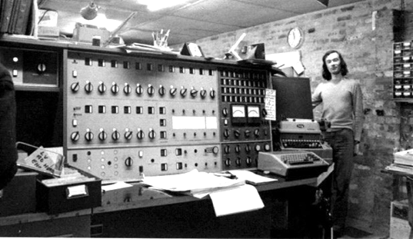
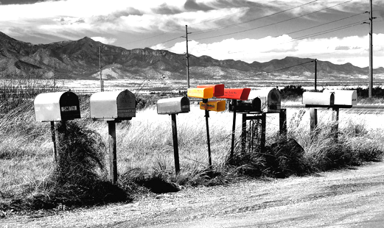
The data path in a nut-shell
Large Hadron Collider
LHC Detector
Trigger & Online monitoring
25 ns bunch distance
L_{max} ~ 2.2 ×10³⁴ cm^{–2} s^{–1}
L1 (HW, up to 100 kHz) + HLT (SW, ~3 kHz)
Challenge: low-threshold triggers to keep physics efficiency high, use combined / topological signature information
Calibration & Reconstruction
Distributed computing
Physics analysis
48h calibration & data quality processing, then prompt reconstruction of data in Tier-0
Production of standardised derived datasets for physics and performance analysis
Also: MC production — O(100 billion) 13 TeV events produced per experiment
Performance analysis provides standard physics objects with calibrations and uncertainties, unified in analysis release
Physics analyses build upon this groundwork

Slide 26
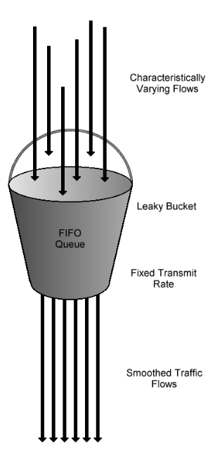

Particle detector basics — Online event filter
Trigger: ~ 1 / 10’000 events kept, necessarily cutting into physics, mostly driven by Level-1 (~100 kHz, driven by readout time)
L1 trigger must deliver a decision every BC, despite a latency much longer than the BC period. Achieved by pipelining: the processing is split into steps, each done within one BC, with parallel logic handling different operations. The fixed latency is set by the number of steps plus data transfer times. Input data are fanned out to several processing elements, with data volume decreasing down the pipeline.
Dead-time (1)
[ depends on size of readout frame ]
4 BC dead-time upon L1Accept
Dead-time = 100 kHz × 4 × 25 ns = 1%
“Simple deadtime”
(prevent overlapping readout time-frames for some FE systems)
2. Signals
(every 25 ns)
DERANDOMISER
(buffer memory placed right after FE pipeline and before readout links, converts random time arrival into steady rate determined by bandwidth — “leaky bucket” algorithm )
(Digitiser)
Register
…
Register
Register
…
Register
1. BC clock
(every 25 ns)
Accept
Dead-time (2)
[ depends on size of derandomiser and drain speed ]
Require dead-time
< 1% at 75 kHz
(< 6% at 100 kHz)
Reject
“Complex deadtime”
(prevent derandomisers of some FE systems to overflow)
FE PIPELINE MEMORY (Length (~ 100 BC) matches L1 latency of ~2.5 μs)
3. L1 trigger
(every 25 ns)
Readout

Slide 27

Particle detector basics — Online event filter
Trigger: ~ 1 / 10’000 events kept, necessarily cutting into physics, mostly driven by Level-1 (~100 kHz, driven by readout time)
L1 trigger must deliver a decision every BC, despite a latency much longer than the BC period. Achieved by pipelining: the processing is split into steps, each done within one BC, with parallel logic handling different operations. The fixed latency is set by the number of steps plus data transfer times. Input data are fanned out to several processing elements, with data volume decreasing down the pipeline.
Dead-time (1)
[ depends on size of readout frame ]
4 BC dead-time upon L1Accept
Dead-time = 100 kHz × 4 × 25 ns = 1%
“Simple deadtime”
(prevent overlapping readout time-frames for some FE systems)
2. Signals
(every 25 ns)
DERANDOMISER
(buffer memory placed right after FE pipeline and before readout links, converts random time arrival into steady rate determined by bandwidth — “leaky bucket” algorithm )
(Digitiser)
Register
…
Register
Register
…
Register
Accept
Dead-time (2)
[ depends on size of derandomiser and drain speed ]
Require dead-time
< 1% at 75 kHz
(< 6% at 100 kHz)
Reject
“Complex deadtime”
(prevent derandomisers of some FE systems to overflow)
Move towards more and more powerful global FPGA-based triggers and deeper pipelines, need to watch the latency of the algorithms!
Readout

Slide 28

Monte Carlo simulation is key for analysis
Simulation chain:
Event generation
Detector simulation
Digitization
Reconstruction
Hard process, parton shower, hadronization, underlying event
Particle transport and interactions in material — Geant4 (slow) and fast simulation
Signals, electronics, noise, detector conditions, pileup overlay
Same algorithms as data → tracks, clusters, jets, leptons, missing p_{T}
Event generation (defining the MC truth record)
Parton shower
Hard process: PDFs ⊗ matrix elements describe the short-distance scattering
QCD radiation: parton shower plus matching / merging with matrix-element jets
Hard scattering
Hadronization
Soft activity: multiple-parton interactions and underlying event
Hadronization: formation of hadrons followed by unstable-particle decays
proton
proton
MC is not a single prediction: alternative generators, scales, PDFs, and tunes used to quantify modelling uncertainties
Underlying event
Sketch of proton–proton scattering in LHC [Link]
Generator modelling is often a leading systematic uncertainty

Slide 29

Particle (object) reconstruction, identification, and calibration
pp → ttH(→ bb) candidate event [link]

Slide 30


Precision objects enable precision measurements — Vertexing
Tracks can be fitted to common vertices (constrained fit taking into account measurement uncertainties)
The hard-scatter primary vertex identifies the pp collision of interest among pileup interactions ($max⁡\sum_{tracks}{p_{T}^{2}}$)
Displaced secondary and tertiary vertices reveal decays of long-lived b- and c-hadrons or tau-leptons
Photon conversions and hadronic interactions create material vertices, identified from their topology and location in the detector
Secondary vertices
LHC beamspot width in Run 3 (pp) at start of run (Gaussian profile):
σ_{x/y} ≈ 9 μm
σ_{z} ≈ 4 cm
Primary vertex of hard scatter
Pileup vertices

Slide 31



Precision objects enable precision measurements — Electron / 𝛾
Electron: isolated track matched to EM shower, energy measurement in EM calorimeter more accurate, calibrated in-situ with Z, ϒ, J/𝜓 → ee (“tag & probe”), and E/p. Note: large bremsstrahlung losses $P∝1/{m^{2}}$, ${∆E}/{E≈1−e^{{−X}/{X_{0}}}}≈40/70\%$ in inner detector at $η \sim 0/1$, corrected in tracking
Photon: no track, isolated EM shower, calibrated with Z → ee(𝛾), π⁰ / η → 𝛾𝛾 (low energy). Note: large conversion rate: mean free path: $λ_{γ→e^{+}e^{−}}≈9/7{∙X}_{0} →P\left(γ→e^{+}e^{−}\right)≈1−exp\left({−X}/{λ_{γ→e^{+}e^{−}}}\right)=1−exp({−7X}/{9X_{0}})≈32/69\%$ at $η \sim 0/1$
Detailed photon energy calibration enables precise Higgs mass measurement with H → 𝛾𝛾 (0.09%)
arXiv:2308.07216, arXiv:2308.04775, arXiv:2309.05471
arXiv:2309.05471

Slide 32



Precision objects enable precision measurements — Muon
Muon: isolated track in inner detector and muon system, combined momentum reconstruction (despite MIP, looses ~3–5 GeV in calorimeter through $dE/dx$), calibrated with Z, ϒ, J/𝜓 → μμ, requires accurate detector alignment
Detailed muon momentum calibration (and much more!) enables precise W mass measurement (10 MeV (0.012%) precision, also find agreement with LEP Z mass within 4.8 MeV precision)
arXiv:2412.13872
η^{μ}

Slide 33





Precision objects enable precision measurements — Jet
A Jet is an experimentally defined, collimated spray of hadrons initiated by an energetic quark or gluon
QCD radiation builds the shower; colour confinement turns it into hadrons; a jet algorithm makes it measurable
1. Hard process
2. Parton shower
3. Hadronisation
4. Jet clustering
q / g
q→qg, g→gg, g→qq̄
Q₀ ~ Λ_{QCD}
R
A coloured parton is produced at a hard scale Q
Repeated emissions evolve from Q down to Q₀ ≈ 1 GeV
Confinement converts partons into colour-singlet hadrons
Anti-kₜ clusters particles in η – φ:
$∆R=\sqrt{{(∆η)}^{2}+{(∆φ)}^{2}}$ (typically R = 0.4)
Soft–collinear enhancement of gluon emission
Why the measured cross section remains finite
$$dP≈C_{i}\frac{α_{S}}{π}∙\frac{dE}{E}∙\frac{dθ^{2}}{θ^{2}}$$
For infrared- and collinear-safe jet algorithms, unresolved real emissions do not change the jet; their divergences cancel against virtual corrections. Repeated emissions generate Sudakov suppression
soft gluon: $E→0$
collinear gluon: $θ→0$
Jets are not fundamental particles: they are IRC-safe, algorithm-dependent representations of a hadronic final state

Slide 34


Precision objects enable precision measurements — Jet
Jet energy scale (JES) is calibrated to “particle level” using di-/multi-jet, 𝛾 + jet, Z + jet, 𝜏 → 𝜋𝜈 , t → W → qq events
Eur. Phys. J. C 85 (2025) 927
New JES calibration method using calorimeter response to single particles (test-beam, E/p from 𝜏→𝜋𝜈), combined with p_{T} balance techniques for the most precise JES to date
Total JES uncertainty of 3.8 / 0.3 / 0.6% at 20 / 300 / 4000 GeV
(uncertainty at low p_{T} dominated by pileup)

Slide 35



Precision objects enable precision measurements — Jet
Jet energy scale (JES) is calibrated to “particle level” using di-/multi-jet, 𝛾 + jet, Z + jet, 𝜏 → 𝜋𝜈 , t → W → qq events
Precise jet energy calibration using in-situ processes enables, among others, high-precision top mass measurement (0.2%)
arXiv:2402.08713
~100 pileup pp interactions in CMS detector
Pileup: mitigated / corrected through vertex association of tracks, area-based subtractions using soft event activity, particle flow candidate weight based on local activity and vertex (PUPPI, CMS)

Slide 36



Opening angle $θ \sim {2γ}^{−1}=2m/{p_{T}}$, $∆R=\sqrt{{∆η}^{2}+{∆φ}^{2}}≈θ$
Lorentz boost and jet substructure
At p_{T} ≫ m, the hadronic decay products of W, Z, H and top become collimated and may merge into one reconstructed jet
$$∆R≈{2m}/{p_{T}}$$
Two-body, symmetric decay; p_{T} ≫ m
Resolved
Boosted
3 small-R jets
1 large-R jet with 3-prong substructure
From a ‘fat’ jet to a physics object
Capture
Cluster all decay products with a large radius, typically R = 1.0
When do standard R = 0.4 jets merge?
$$p_{T}≳{2m}/R$$
Groom
Remove pileup and soft wide-angle radiation, stabilise the jet mass
W/Z
≈ 400–450 GeV
2 prongs
Resolve prongs
Use jet mass, 2-/3-prong structure and b-tagged subjets
H
≈ 630 GeV
2 prongs + flavour
top
≈ 870 GeV
3 prongs + b
Modern low-level taggers learn these patterns directly from tracks and calorimeter/particle-flow constituents
Rule of thumb: exact containment depends on decay kinematics, radiation and the jet algorithm
Boosted-object reconstruction converts lost angular separation into measurable internal jet structure

Slide 37


Jet + Higgs (→ bb) candidate event [reference]
Boosted hadronic ttbar candidate event [reference]

Slide 38


Particle flow: measure each particle with the best detector
Particle flow: a jet typically deposits ~65% of its visible energy via charged hadrons, 25% photons (mainly π⁰), 10% neutral hadrons (n, K_{L}, …)
Measured about 1/3 in ECAL and 2/3 in the HCAL (poorer resolution, limiting jet energy resolution)
Idea: replace energy of individual charged hadrons by track momenta (energy flow), so that ideally only 10% of energy stems from HCAL, leading to improved jet energy resolution for E_{jet} ≲ 150 GeV
Generalisation to “particle flow” with aim to reconstruct individual particles not just energy deposits (ALEPH, ILC, CMS, ATLAS, FCC, …)
Many ideas for end-to-end particle flow involving machine learning
arXiv:1703.10485
Particle flow solves the inverse problem of detector simulation → particles [link to figure]
Idealised examples of particle flow algorithm handling different cases

Slide 39

Particle flow: measure each particle with the best detector
Next-generation energy-frontier detectors are designed around particle flow (here: CLIC detector design (CLICdet), silicon–tungsten ECAL & steel–scintillator HCAL)

Slide 40


Flavour reconstruction / tagging — eldorado for modern ML
Tau: → e/μ + 𝜈𝜈 (35%), → π/K + 𝜈 (11.5%), π/K+π⁰ + 𝜈 (26%), …, isolated hadrons reconstructed in tracker and calorimeter (narrow cones) using particle flow and ML, calibrated with Z → 𝜏𝜏
b/c quarks: “tagged” through decay into b/c hadron, jet with massive secondary (b → c tertiary) vertex, non-isolated soft lepton(s), combined through ML, calibrated with jets containing muons, ttbar events
𝜏
Illustration of ALTAS GN2 flavour tagging algorithm [arXiv:2505.19689]
3. A Transformer (attention network) followed by a network produce track representations that incorporate information from other tracks inside the jet
2. Combined GNN feature vectors are fed into a per-track initialisation network
1. Jet features are copied for each track associated with the jet
4. Jet representation and output track embeddings are inputs to three task-specific networks
Jet/track features → Per-track embeddings → Transformer builds context across tracks → 3 heads deliver (i) jet flavour, (ii) track origins, and (iii) explicit displaced-vertex structure

Slide 41





Flavour reconstruction / tagging — eldorado for modern ML
Impressive flavour tagging and further ML based performance and analysis improvements enhance physics reach
Public plots, arXiv:2505.19689
$$\left|κ_{c}\right|<3.5 (2.7 exp)$$
Strongest constraint to date
A new kid in town
CMS ttH(cc/bb) analysis used ParticleNet for jet flavour identification and ParticleTransformer for event classification
arXiv:2509.22535

Slide 42

Flavour reconstruction / tagging — eldorado for modern ML
Impressive flavour tagging and further ML based performance and analysis improvements enhance physics reach
ATL-SOFT-PUB-2026-002
Large language models (LLMs) have demonstrated that scaling, driven by compute, can yield dramatic improvements in performance, with current state-of-the-art systems reaching up to one trillion parameters. In contrast, state-of-the-art jet flavour classifiers in HEP remain in the tens of millions of parameters. Scaling laws offer a framework for predicting how much HEP models benefit from systematic increases in capacity and training data.
Public plots, arXiv:2505.19689
Scaling behaviour of transformers — how far can it go?
Expect further gains as training data and model sizes increase

Slide 43


Precision objects enable precision measurements — Missing p_{T}
Missing p_{T}: negative vector sum of momenta of all reconstructed objects and a “soft term” from isolated tracks / clusters
Precise missing p_{T} reconstruction allows to detect invisible particles
arXiv:2107.13021
Monojet candidate event

Slide 44

Cross section, backgrounds, likelihood fits, systematic effects
A H →𝛾𝛾 candidate event in CMS

Slide 45



From event counts to a physical cross section
Cross section is obtained by subtracting backgrounds, correcting detector effects, and normalising to integrated luminosity
$$σ_{pp→X→decay}^{fid}=\frac{N_{obs}−N_{bkg}}{L_{int}∙C_{X}}$$
$$σ_{pp→X}^{tot}=\frac{σ_{pp→X→decay}^{fid}}{A_{X}∙B_{X→decay}}$$
Measurement recipe
Uncertainty budget
Statistics: finite event counts
Observed
data
Subtract
background
Correct detector
response
Divide by
exposure
Fiducial
cross section
Background: normalisation and shape
N _{obs}
− N _{bkg}
÷ C
÷ L_{int}
σ^{fid}
Detector: calibration, efficiency, migrations
Luminosity: exposure scale
$C_{X}={N_{reco,selected}}/{N_{gen,fid}}$ — efficiency & resolution correction (from MC)
$A_{X}={N_{gen,fid}}/{N_{gen,tot}}$ — acceptance factor (from MC / theory)
$B_{X→decay}$ — branching fraction (from theory)
Signal model: acceptance and unfolding dependence
Differential results: invert a response matrix; regularisation trades variance against bias
Fiducial cross sections minimise extrapolation and are usually the most reusable result

Slide 46


Backgrounds are constrained with data whenever possible
All LHC analyses must estimate backgrounds and their uncertainties: sensitivity of a BSM search often governed by the uncertainty on the background prediction — not only by its expected yield
Example of sensitive regions in high-tail BSM search:
3 complementary strategies:
Simulation / theory: predicts normalisation and shape; limited by modelling and MC statistics in extreme tails
events / bin
CONTROL REGION
VALIDATION
SIGNAL REGION
Control-region fit: data constrain background normalisations; simulation transfers them to signal region
Data-driven extrapolation: ABCD, sidebands or fake-factor methods reduce dependence on absolute simulation
ABCD example:
C
x fail y pass
A
x pass y pass
$$N_{A}^{pred}=κ∙\frac{N_{B}N_{C}}{N_{D}}$$
y more signal-like →
$κ$ corrects residual correlations; subtract non-target backgrounds and test signal leakage
D
x fail y fail
B
x pass y fail
Fit the control region, test the extrapolation in validation regions, then predict the signal region
more signal-like →
x more signal-like →
Background yields and uncertainties are fitted, correlated quantities — not a fixed subtraction

Slide 47

Profile likelihood fit
Estimate the parameter of interest μ while the data constrain backgrounds and systematic uncertainties through nuisance parameters θ
1
Build the likelihood
2
Profile the nuisance parameters
Simple counting experiment
For each tested μ, choose the θ values that maximise L
$$L(n | μ, θ) = Pois(n | μS + θB) × G(θ; 1, σθ)$$
Fix μ
Maximise over θ
Lₚ(μ)
μ signal strength
parameter of interest
θ background scale
nuisance parameter
$$Lₚ(μ) = L(μ, \hat{θ}(μ))$$
$$λ\left(μ\right)= L(μ,\hat{θ}\left(μ\right)) / L(\hat{μ},\hat{θ}); q(μ) = −2 ln⁡λ(μ)$$
n observed events | S expected signal | B nominal background
G(θ; 1, σ_{θ}) is an auxiliary constraint from calibration or control data
θ̂(μ): conditional best fit | (μ̂, θ̂): global best fit | q(μ): test statistic
In a realistic LHC analysis
Combined model
Control regions
Correlations
Product over bins, regions, channels, categories and processes
Constrain background yields and nuisance parameters directly from data
Shared nuisance parameters propagate systematic effects across the fit
The profile-likelihood ratio provides confidence intervals, significances and upper limits

Slide 48


Profile likelihood fit
  ATLAS $H→γγ$ likelihood model used in fit
In a realistic LHC analysis
Combined model
Control regions
Correlations
Product over bins, regions, channels, categories and processes
Constrain background yields and nuisance parameters directly from data
Shared nuisance parameters propagate systematic effects across the fit
The profile-likelihood ratio provides confidence intervals, significances and upper limits

Slide 49


Systematic uncertainties
They quantify how imperfect knowledge can impact the inferred physics result
Statistical: finite event counts; usually decreases as $1/{\sqrt{N}}$
Systematic: imperfect knowledge; may persist, but can be constrained by data (introducing a $1/{\sqrt{N}}$component)
Common sources
Treatment in a robust analysis
Detector response and calibration
1
Identify and parameterise
E and p_{T} scales, efficiencies, resolutions, alignment
Represent each relevant effect by a nuisance parameter θᵢ
Backgrounds and event modelling
2
Constrain with data
Normalisations, shapes, data-driven transfer factors
Use calibrations, auxiliary measurements and control regions
Theory and simulation
3
Propagate shifts and correlations
Missing higher orders, PDFs, parton shower, hadronization
Carry rate and shape variations consistently through the likelihood
Data-taking conditions
4
Validate and report
Luminosity, pileup, time dependent conditions, detector stability
Perform closure and stress tests; rank impacts and document assumptions
Goal: calibrated coverage, transparent assumptions, correct correlations — right, not over or under-conservative
Theory uncertainties: state the variation prescription explicitly; a Gaussian “1σ” interpretation is not always justified

Slide 50
Summary of today’s lecture
  A large facility, such as the LHC and its injectors, offers a diverse research programme, flagship experiments and much more
  The experimental environment of a hadron collider is especially demanding for detectors, event reconstruction, and their simulation. It is also a driver for innovation
  The groundwork invested into these areas is key for the successful physics exploitation
  Physics analysis relies on sophisticated statistical methods correlating as much as possible all contributions and their uncertainties
  There seems to be no limit to further improvement!

Slide 51
Extra slides

Slide 52



Proton–proton collisions
Proton–proton collisions correspond to a convolution of Parton Density Functions (PDF) with parton–parton scattering matrix element
Parton distribution functions
Represent structure of proton, extracted using experimental data and QCD properties

Slide 53




Proton–proton collisions
Proton–proton collisions correspond to a convolution of Parton Density Functions (PDF) with parton–parton scattering matrix element
Parton distribution functions
Hard scatter parton cross section
Higher order pQCD correction; accompanying radiation, jets, …
p
$$q^{2}=m_{X}^{2}$$
X = jets, W, Z, top, Higgs, ?, …
p
Underlying event
CM energy-squared of parton collision:
Gluon and sea-quark PDFs rise dramatically towards low x:
Higher cross section at higher proton−proton collision energy
More luminosity also leads to higher achievable energy
Low-x regime (eg, Higgs production) dominated by gluon−gluon collisions: “gluon collider”

Slide 54
LHCb’s dipole magnet at 2018 detector opening

Slide 55

LHCb’s dipole magnet at 2018 detector opening
Refurbished Time Projection Chamber (TPC) lowered into the ALICE cavern and installed in the experiment during LS2

Slide 56

Particle detector basics — Data sizes
Reference

Slide 57



Detector simulation and generative ML
ATLAS simulation of a Higgs boson event
Detector simulation is traditionally performed by Geant4 (G4)
Geant4 simulates particle transport by stepping particles through the detector geometry, applying stochastic physics processes at each step, and recording energy deposits in sensitive volumes. These “hits” are then digitized into detector-like signals, so experiments can run reconstruction on them as if they were real data
arXiv:2404.06335
arXiv:2109.02551, arXiv:2404.06335
Despite significant improvements, the detailed simulation necessarily makes G4 slow
CPU dominated by calorimeters
≈ 120 s/ev*
≈ 150 s/ev*
≈ 210 s/ev*
*assuming 15 HS23 / core
Fast simulation using generative ML algorithm trained with G4
ATLAS developed a generative NN (FastCaloGAN) to simulate EM and HAD showers leading to an overall speed-up by 5 compared to G4

Slide 58







Precision objects enable precision measurements — Tracking
Charged particles deflection in magnetic field
Lorentz force ⊥ to B-field and to particle direction
Particle trajectory projected onto plane ⊥ to B-field is circle with radius:
  ➠ For $pT$ = 10 … 1000 GeV → $r$ = 17 … 1700 m (cf, $rID$ ~ 1 m)
Obtain r and p_{T} from measurement of sagitta
$$r[m]≈\frac{p_{T}[GeV]}{0.3∙B[T]}$$
$$r≈\frac{L^{2}}{8s}$$
$$p_{T}∝\frac{1}{s}$$
$$\frac{σ(p_{T})}{p_{T}}=\frac{σ(s)}{s}∝p_{T}$$
(if $s≪L$) ➠ and
Track fitting in LHC environment challenging
Several thousand tracks per proton-bunch collision, up to 20k tracks for a central PbPb collision
Must handle ambiguities, hit overlaps, multiple scattering, bremsstrahlung, multiple vertices, …
Track fitters take Gaussian noise (e.g., Kalman filter) and non-Gaussian noise (e.g., Gaussian sum filter) into account
Fitter must be fast, used in high-level trigger
Multiple scattering (diffusion) of light passing through a wetter and wetter windscreen (left to right)

Slide 59

Opening angle $θ \sim {2γ}^{−1}=2m/{p_{T}}$, $∆R=\sqrt{{∆η}^{2}+{∆φ}^{2}}≈θ$
Lorentz boost and jet substructure
At p_{T} ≫ m, the hadronic decay products of W, Z, H and top become collimated and may merge into one reconstructed jet
$$∆R≈{2m}/{p_{T}}$$
arXiv:2407.20127
Two-body, symmetric decay; p_{T} ≫ m
Area of creative and powerful ML applications
Modelling uncertainty of constituent-based (except hlDNN) top taggers versus background rejection. Another prominent field of GNN applications in HEP
Detailed detector simulation is required to evaluate these taggers
ParticleNet: constituent based GNN, EFN: Energy-Flow Network, DeepSet structure, lower weights for low-p_{T} constituents, PFN: Particle Flow Network, as EFN, but without p_{T} weights, ResNet50: imaging CNN, DNN: densely connected NN with zero padding for variable structure, hlDNN: as DNN but with 15 high-level variables (subjettiness, splitting scales, thrust, etc)

Slide 60








Precision objects enable precision measurements — Jet
Jet: soft and collinear QCD radiation generates a parton shower, which hadronizes through colour confinement and is reconstructed as one or more jets
Leading order:
No parton emission
One real emission (NLO):
Propagator:
$$\frac{1}{{(p+q)}^{2}}≈\frac{1}{2p∙q}=\frac{1}{{2E}_{p}E_{q}(1−cosθ)}=\frac{1}{{4E}_{p}E_{q}\sin^{2}\frac{θ}{2}}$$
$$p$$
$$θ$$
$$q$$
Explodes if $E_{p}→0$ (soft divergence) or $θ→0$ (collinear divergence)
$$dσ ∝ α_{S}\int_{θ_{min}}^{R}{\int_{E_{min}}^{E_{max}}{\frac{dθ}{θ}\frac{dE}{E}}} \sim α_{S} lnR lnE$$
Differential cross section:
$$→$$
$$≫$$
Double-log enhanced real-emission probability
Jets are experimentally defined using an infrared- and collinear-safe R-dependent algorithm, usually anti-k_{t} at the LHC

