Slide 1
Experimental Physics at the LHC (3)
Andreas Hoecker (CERN)
57. Herbstschule HEP
1–11 September 2026, Bad Honnef, Germany

Slide 2
Today’s lecture:
Selected physics topics
Next lectures:
Upgrade to the High-Luminosity LHC (HL-LHC)
New physics opportunities

Slide 3
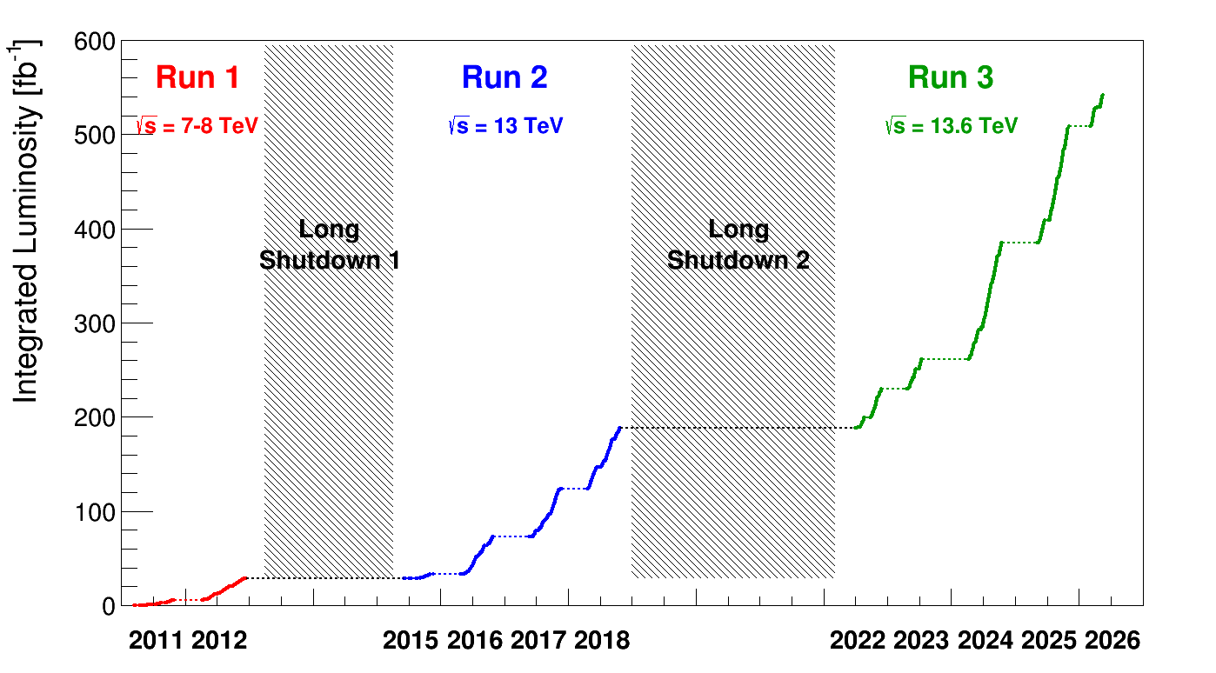
Delivered luminosity
Superb LHC performance in 2024 through 2026 — Run 2+3 > 3 × Run 2; > 450 fb^{–1} good physics data at 13 & 13.6 TeV
Total delivered luminosity (ATLAS, CMS): 548 fb^{–1}
LHC design value per experiment 300 fb^{–1}

Slide 4
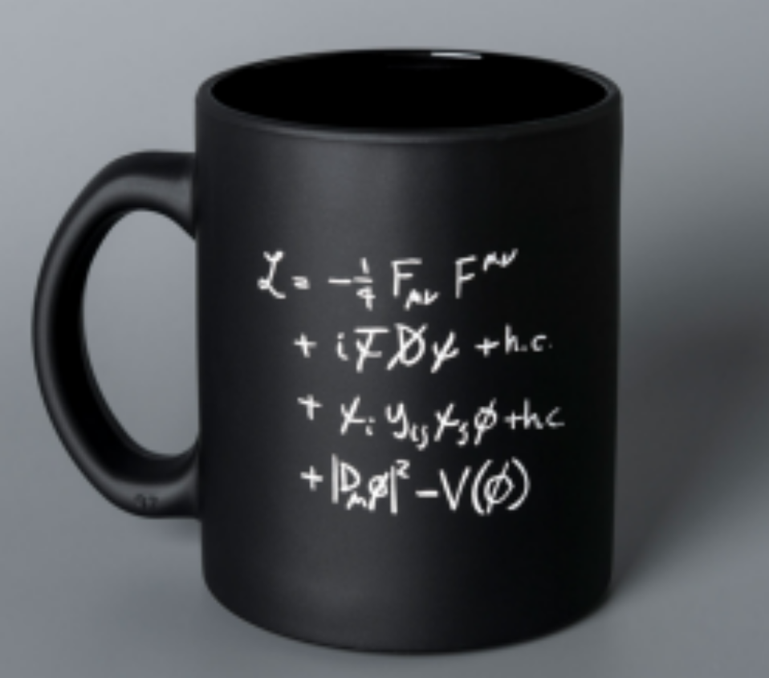




Higgs physics
Sensitive tests of the SM by measuring the Higgs to boson and fermion couplings, and its self-coupling
f
H
$$∝N_{C}\frac{m_{f}}{υ}$$
f
W/Z
$$∝\frac{2m_{W/Z}^{2}}{υ}$$
H
W/Z
This term is related
to the Higgs sector
H
$$+ …$$
Key to many mysteries
$$∝\frac{3m_{H}^{2}}{υ}$$
Unpleasant: not governed by symmetries, 23 free parameters*, large hierarchy among masses
H
H
*Assuming neutrinos are Majorana particles (total of 9 neutrino related parameteres)

Slide 5

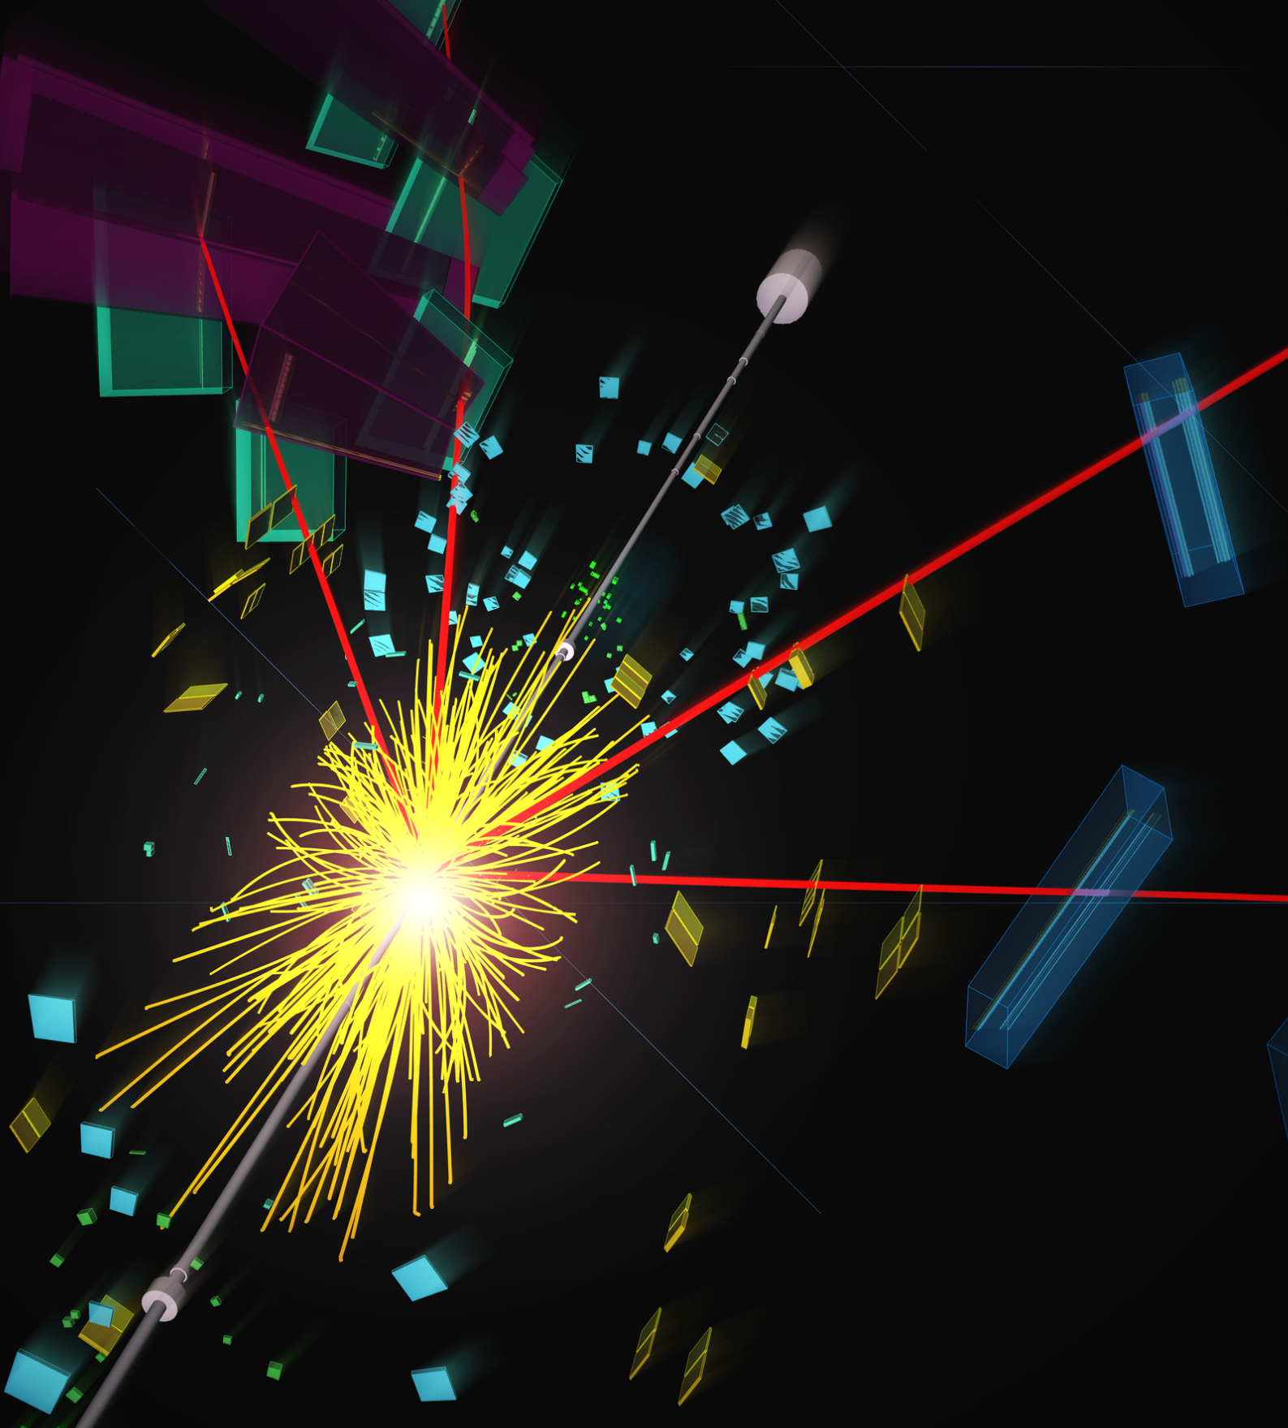


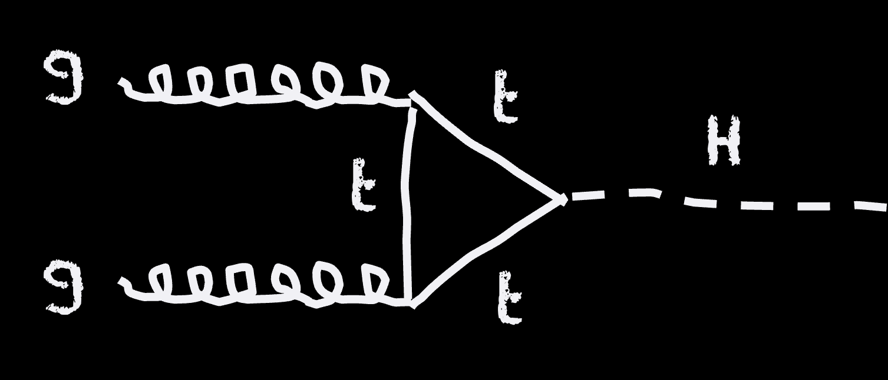
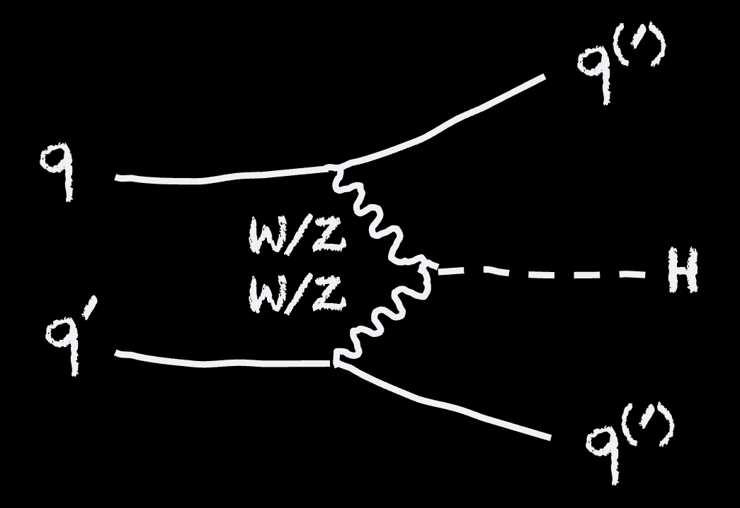
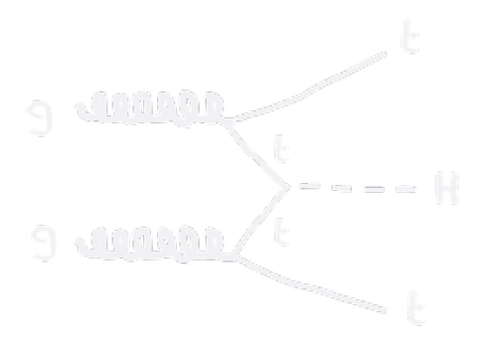

Higgs boson production at the LHC
About one Higgs boson per second, about 28 million produced so far in each ATLAS and CMS
tt → eµ + jets candidate event in 2016 8.16 TeV p-Pb collisions
(88% of H production)
Sensitivity to heavy new particles
(7%)
(0.9%)
(4%)
Parton collision:
Total pp → H cross section: 55.7 pb (13 TeV), 59.9 pb (13.6 TeV)

Slide 6
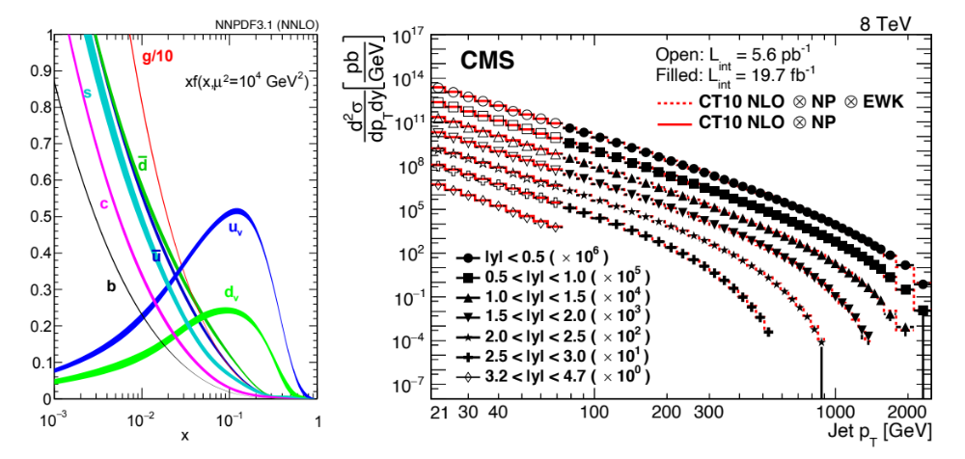

Higgs boson production at the LHC
About one Higgs boson per second, about 28 million produced so far in each ATLAS and CMS
tt → eµ + jets candidate event in 2016 8.16 TeV p-Pb collisions
Parton distribution functions
(88% of H production)
Sensitivity to heavy new particles
(7%)
(0.9%)
Higgs (central prod.)
(4%)
Bjorken x
Parton collision:
Total pp → H cross section: 55.7 pb (13 TeV), 59.9 pb (13.6 TeV)

Slide 7
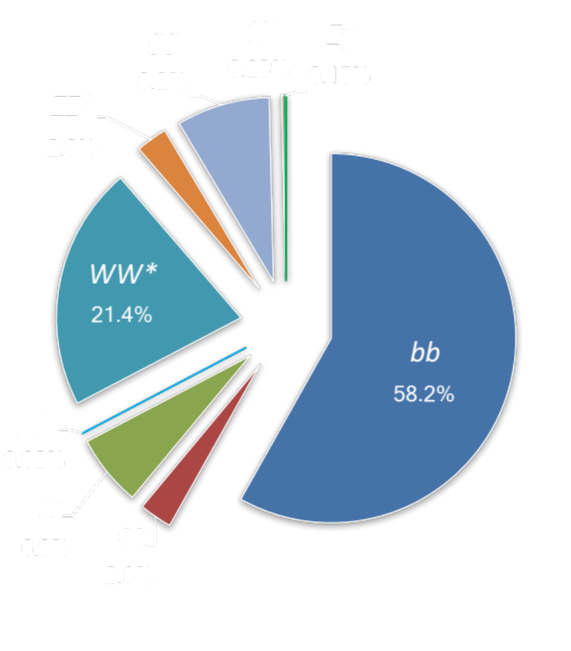

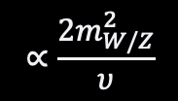

Higgs boson production at the LHC
About one Higgs boson per second, about 28 million produced so far in each ATLAS and CMS
It decays within 10^{–22} s
0.010% (e,µ)
f
0.012% (e,µ)
H
$$∝N_{C}\frac{m_{f}}{υ}$$
f
1.1% (e,µ)
W/Z
H
$$∝\frac{2m_{W/Z}^{2}}{υ}$$
W/Z
H → 𝛾𝛾, Z𝛾 occur through virtual top or W loops (no direct Higgs coupling to massless particles)

Slide 8
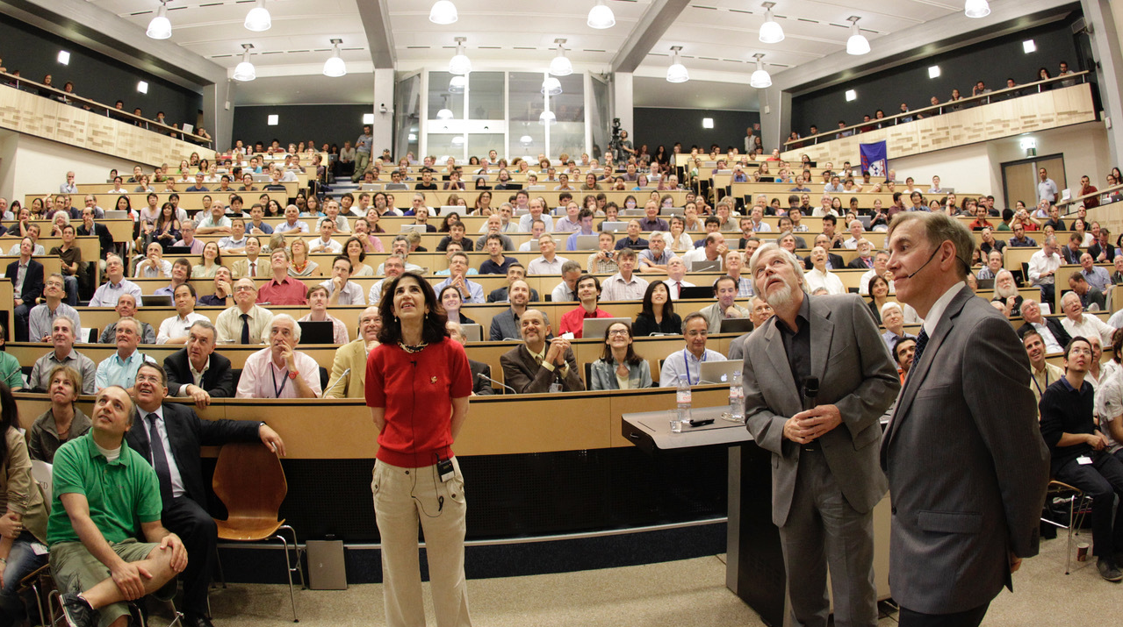
The Higgs boson discovery
Presentation of Higgs boson discovery by ATLAS and CMS at CERN on 4 July 2012

Slide 9
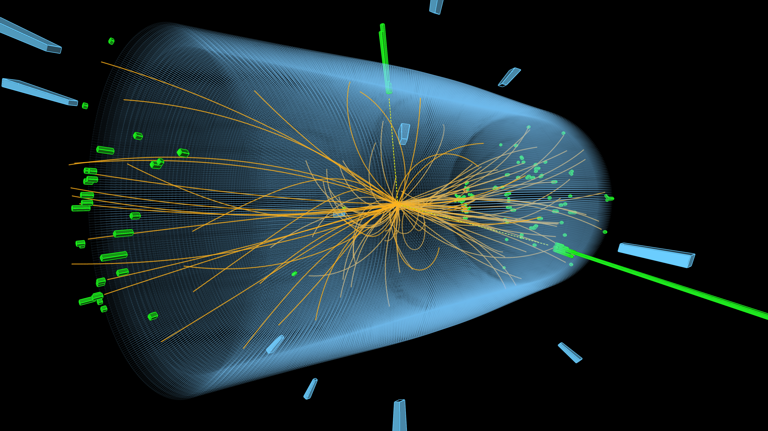
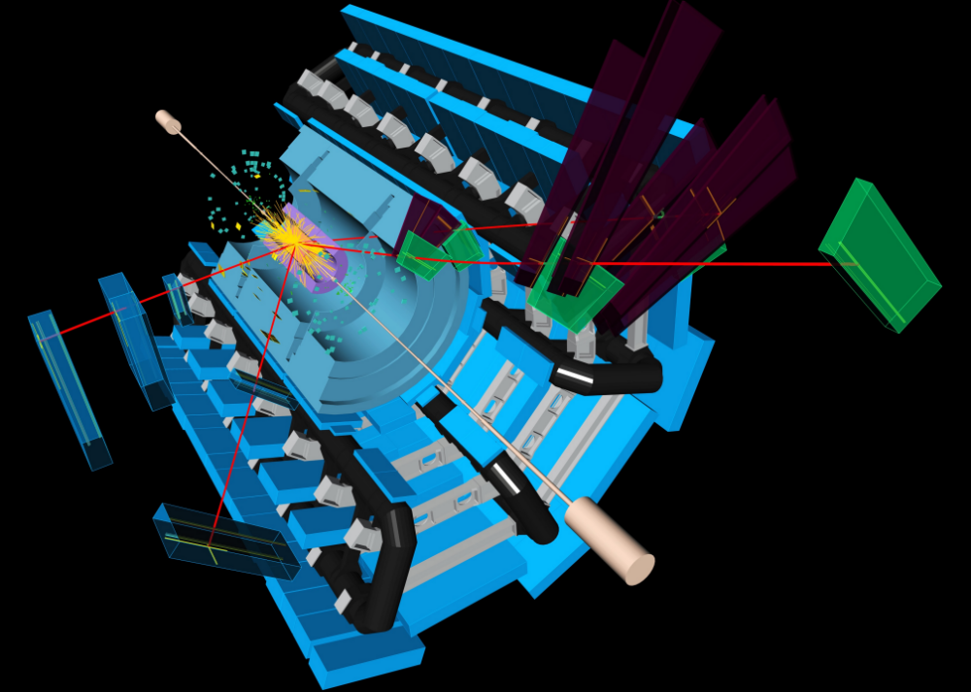

The Higgs boson discovery
Presentation of Higgs boson discovery by ATLAS and CMS at CERN on 4 July 2012

Slide 10

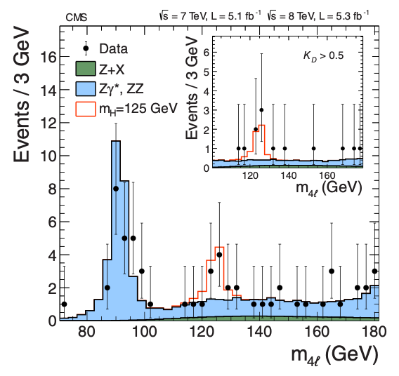
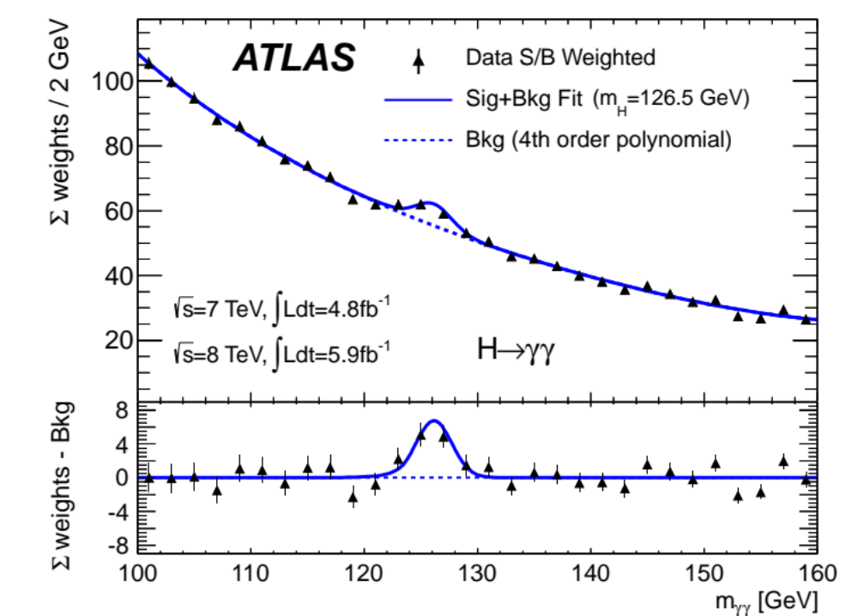
The Higgs boson discovery
2012
Phys. Lett. B 716 (2012) 1-29 [17’600 citations]
H → 𝛾𝛾
H → ZZ* → 4𝓁
Phys. Lett. B 716 (2012) 30 [17’000 citations]
Presentation of Higgs boson discovery by ATLAS and CMS at CERN on 4 July 2012

Slide 11

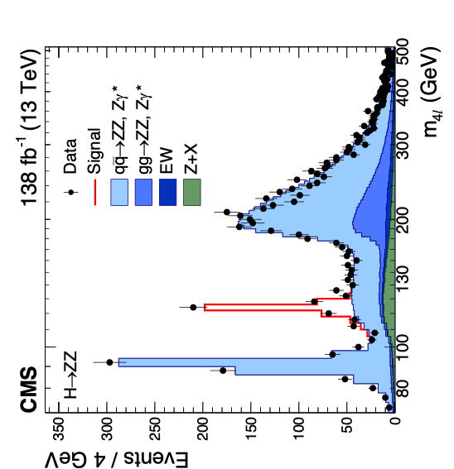
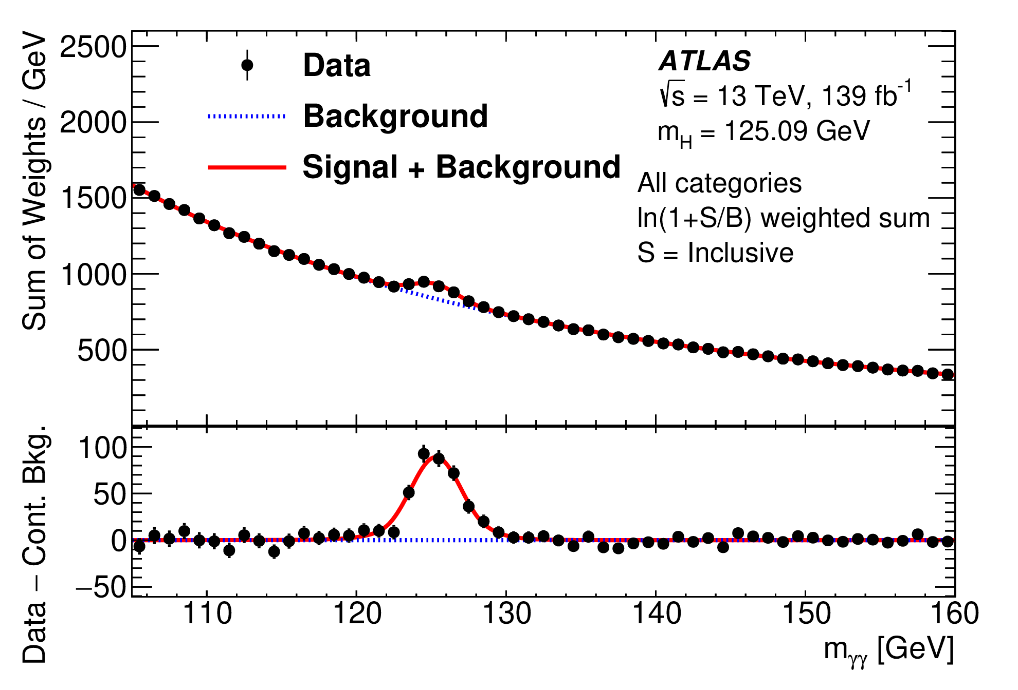
The Higgs boson after Run 2
2020
JHEP 07 (2023) 088
Nature 607 (2022) 60-68
H → ZZ*
→ 4𝓁
H → 𝛾𝛾

Slide 12
The Higgs boson after Run 2
2020
JHEP 07 (2023) 088
Nature 607 (2022) 60-68
H → ZZ*
→ 4𝓁
H → 𝛾𝛾
m_{H} = 125.11 ± 0.11 GeV (0.09%)
ATLAS: PRL 131 (2023) 251802
CMS: arXiv:2607.28396

Slide 13
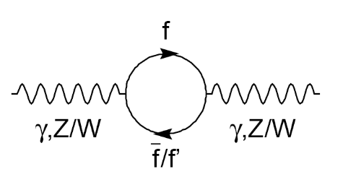
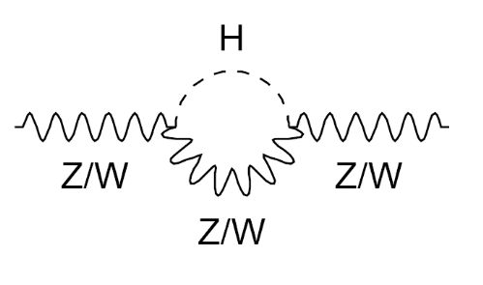
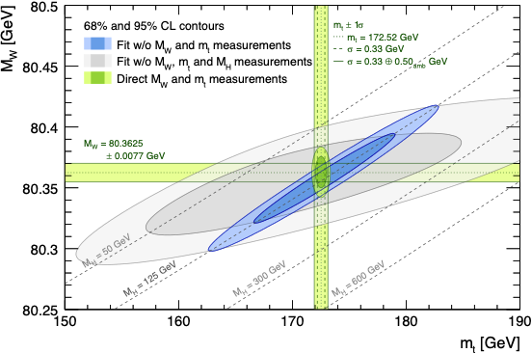
Higgs boson mass
Radiative corections sensitive to heavy particles in loop
The Higgs mass is peculiar
It is consistent with the global electroweak fit
Gfitter Group: arXiv:2607.09861

Slide 14
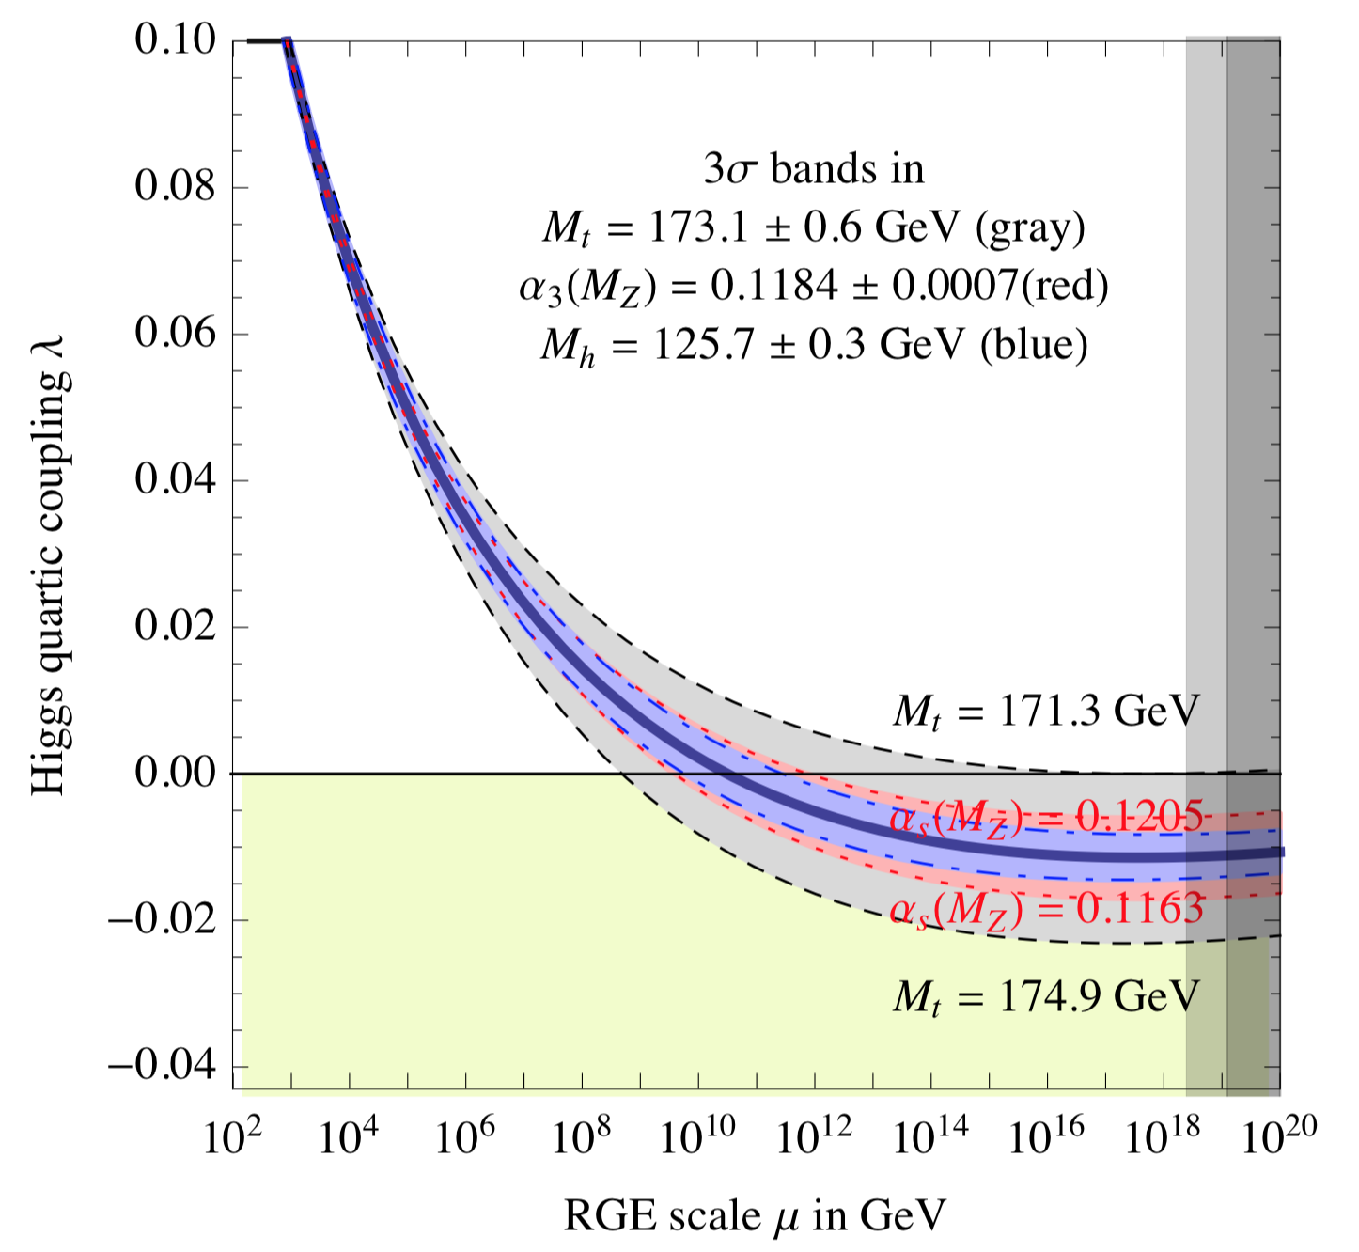


Higgs boson mass
$$\frac{dλ}{d lnμ}≈−\frac{3y_{t}^{4}}{8π^{2}}≈−\frac{3}{2π^{2}}{\left(\frac{m_{t}}{υ}\right)}^{4}\left[1−\frac{16α_{s}}{3π}\right]$$
Larger m_{t} increases y_{t} driving 𝜆 downwards more strongly
Larger 𝛼_{s} reduces y_{t} thus stabilising 𝜆
Evolution of the Higgs quartic coupling, assuming SM (only)
The Higgs mass is peculiar
It is consistent with the global electroweak fit
But the electroweak vacuum seems to be metastable
$$V\left(φ\right)=−μ^{2}{\left|φ\right|}^{2}+λ{\left|φ\right|}^{4}$$
arXiv:1205.6497

Slide 15
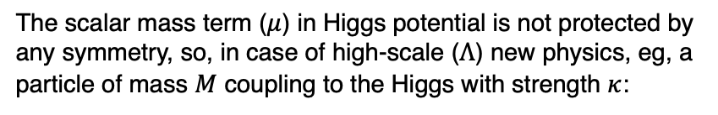
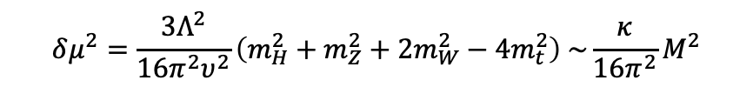
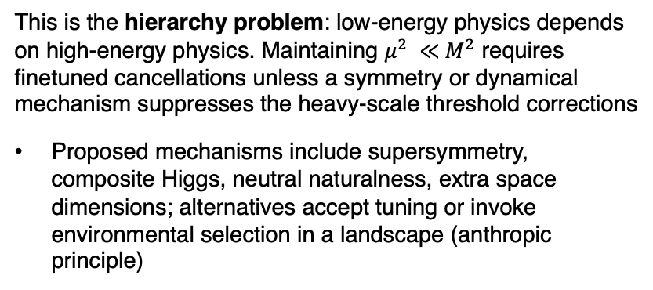
Higgs boson mass
M. Veltman, Acta Phys. Pol. B 12, 437 (1981)
The scalar mass term ($μ$) in Higgs potential is not protected by any symmetry, so, in case of high-scale ($Λ$) new physics, eg, a particle of mass $M$ coupling to the Higgs with strength $κ$:
$$μ^{2}=μ_{bare}^{2}+δμ^{2}$$
$$δμ^{2}=\frac{{3Λ}^{2}}{16π^{2}υ^{2}}\left(m_{H}^{2}+m_{Z}^{2}+{2m}_{W}^{2}−{4m}_{t}^{2}\right) \sim \frac{κ}{16π^{2}}M^{2}$$
The Higgs mass is peculiar
It is consistent with the global electroweak fit
But the electroweak vacuum seems to be metastable
And in case of new high-scale physics, the Higgs mass appears to be highly fine-tuned
This is the hierarchy problem: low-energy physics depends on high-energy physics. Maintaining $μ^{2} ≪$ $M^{2}$ requires finetuned cancellations unless a symmetry or dynamical mechanism suppresses the heavy-scale threshold corrections
Proposed mechanisms include supersymmetry, composite Higgs, neutral naturalness, extra space dimensions; alternatives accept tuning or invoke environmental selection in a landscape (anthropic principle)

Slide 16
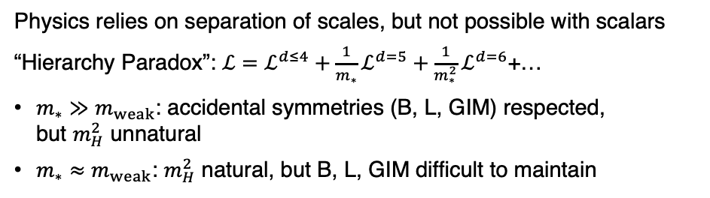
Higgs boson mass
M. Veltman, Acta Phys. Pol. B 12, 437 (1981)
The scalar mass term ($μ$) in Higgs potential is not protected by any symmetry, so, in case of high-scale ($Λ$) new physics, eg, a particle of mass $M$ coupling to the Higgs with strength $κ$:
$$μ^{2}=μ_{bare}^{2}+δμ^{2}$$
$$δμ^{2}=\frac{{3Λ}^{2}}{16π^{2}υ^{2}}\left(m_{H}^{2}+m_{Z}^{2}+{2m}_{W}^{2}−{4m}_{t}^{2}\right) \sim \frac{κ}{16π^{2}}M^{2}$$
Riccardo Rattazzi at EPS-HEP, 2025
This is the hierarchy problem: low-energy physics depends on high-energy physics. Maintaining $μ^{2} ≪$ $M^{2}$ requires finetuned cancellations unless a symmetry or dynamical mechanism suppresses the heavy-scale threshold corrections
Proposed mechanisms include supersymmetry, composite Higgs, neutral naturalness, extra space dimensions; alternatives accept tuning or invoke environmental selection in a landscape (anthropic principle)
Physics relies on separation of scales, but not possible with scalars
“Hierarchy Paradox”: $ℒ=ℒ^{d≤4}+{\frac{1}{m_{∗}}ℒ}^{d=5}+{\frac{1}{m_{∗}^{2}}ℒ}^{d=6}$+…
$m_{∗}≫m_{weak}$: accidental symmetries (B, L, GIM) respected, but $m_{H}^{2}$ unnatural
$m_{∗}≈m_{weak}$: $m_{H}^{2}$ natural, but B, L, GIM difficult to maintain
Clash between simplicity and naturalness

Slide 17
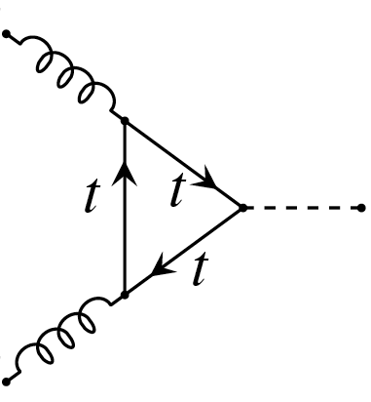

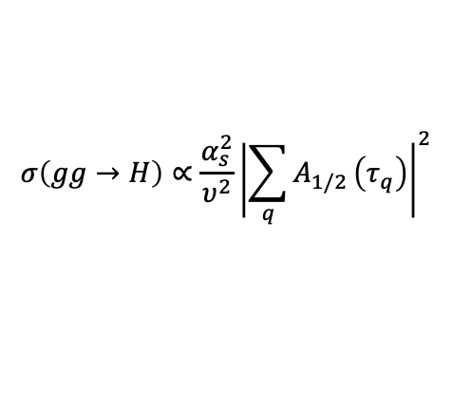
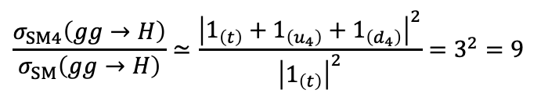


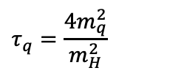
Higgs boson cross section
Gluon fusion production of Higgs boson, heavy quarks do not decouple if u₄, d₄ obtain their masses from Higgs VEV
g
u₄, d₄ ?
$$y_{Q}∝\frac{m_{Q}}{υ},\text{loop}∝\frac{1}{m_{Q}}⇒ℳ_{Q}∝\frac{1}{υ}$$
H
Powerful constraint on SM-like (chiral) 4th generation
g
$$σ\left(gg→H\right)∝\frac{α_{s}^{2}}{υ^{2}}{\left|\sum_{q}{A_{1/2}}\left(τ_{q}\right)\right|}^{2}$$
$$τ_{q}=\frac{4m_{q}^{2}}{m_{H}^{2}}$$
, where
$$A_{1/2}\left(τ_{q}\right)⟶1$$
$$m_{q}≫m_{H}/2$$
Heavy quarks dominate:
for
$$\frac{σ_{SM4}\left(gg→H\right)}{σ_{SM}\left(gg→H\right)}≃\frac{{\left|1_{\left(t\right)}+1_{\left(u_{4}\right)}+1_{\left(d_{4}\right)}\right|}^{2}}{{\left|1_{\left(t\right)}\right|}^{2}}=3^{2}=9$$
SM-like Higgs cross section measurement excludes a chiral fourth generation

Slide 18
Testing the Brout-Englert-Higgs mechanism
Huge experimental programme, some channels suffer from large backgrounds, big improvements from smart analysis techniques and machine learning
Channel categories |  | BR | ggF | VBF | VH | ttH
Cross Section (13 TeV) |  |  | 48.6 pb | 3.8 pb | 2.3 pb | 0.5 pb
γγ | 0.2 % | 0.2 % | ✓ | ✓ | ✓ | ✓
ZZ | 2.6% | 3% | ✓ | ✓ | ✓ | ✓
WW | 21% | 22% | ✓ | ✓ | ✓ | ✓
ττ | 6.3 % | 6.3 % | ✓ | ✓ | ✓ | ✓
bb | 58% | 55% | ✓ | ✓ | ✓ | ✓
Zγ (& γγ∗) | 0.2 % | 0.2 % | ✓ | ✓ | ✓ | ✓
μμ | 0.02 % | 0.02 % | ✓ | ✓ | ✓ | ✓
The Higgs boson couplings to the SM particles are experimentally determined by measuring cross-sections of all accessible Higgs boson production and decay modes, and by performing a combined fit to all measurements
Careful detector and reconstruction calibration, and Machine Learning have led to substantial improvements
In grey: evidence for decays, but not observed yet

Slide 19
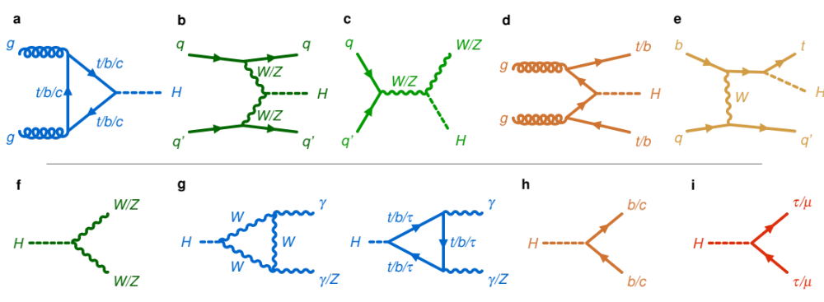
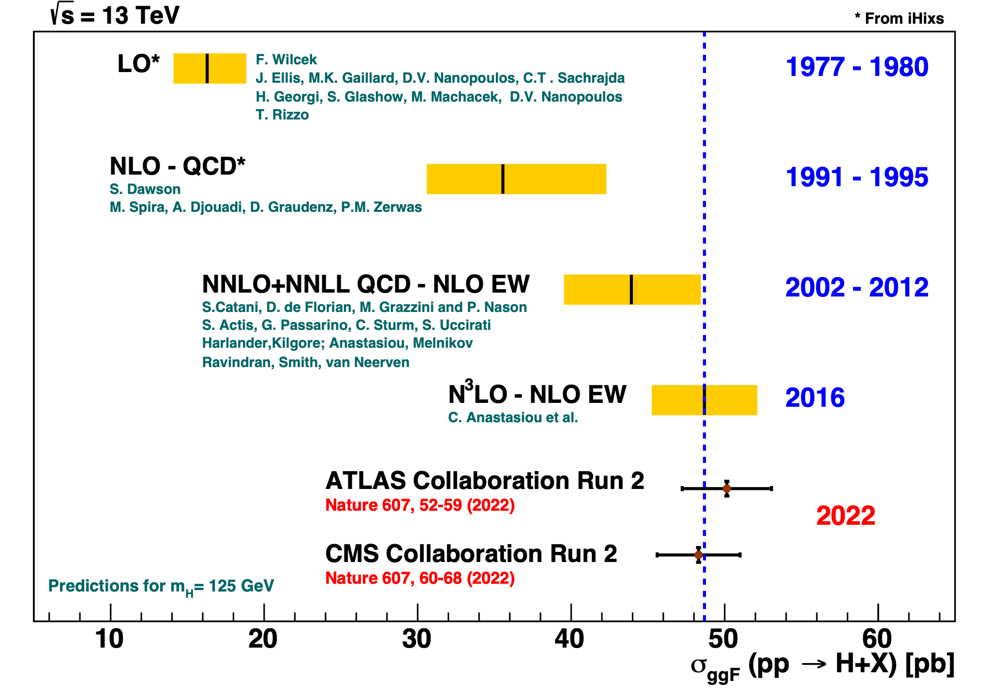
Theory predictions
Calculations of Higgs boson production via gluon fusion versus time
Predictions at hadron colliders are extremely complex and require several levels of modelling and calculations (higher order hard processes, parton fragmentation, hadronization, parton distribution functions, etc…)
The interpretability of our results relies on our ability to compute accurate and precise predictions
Marumi Kado

Slide 20
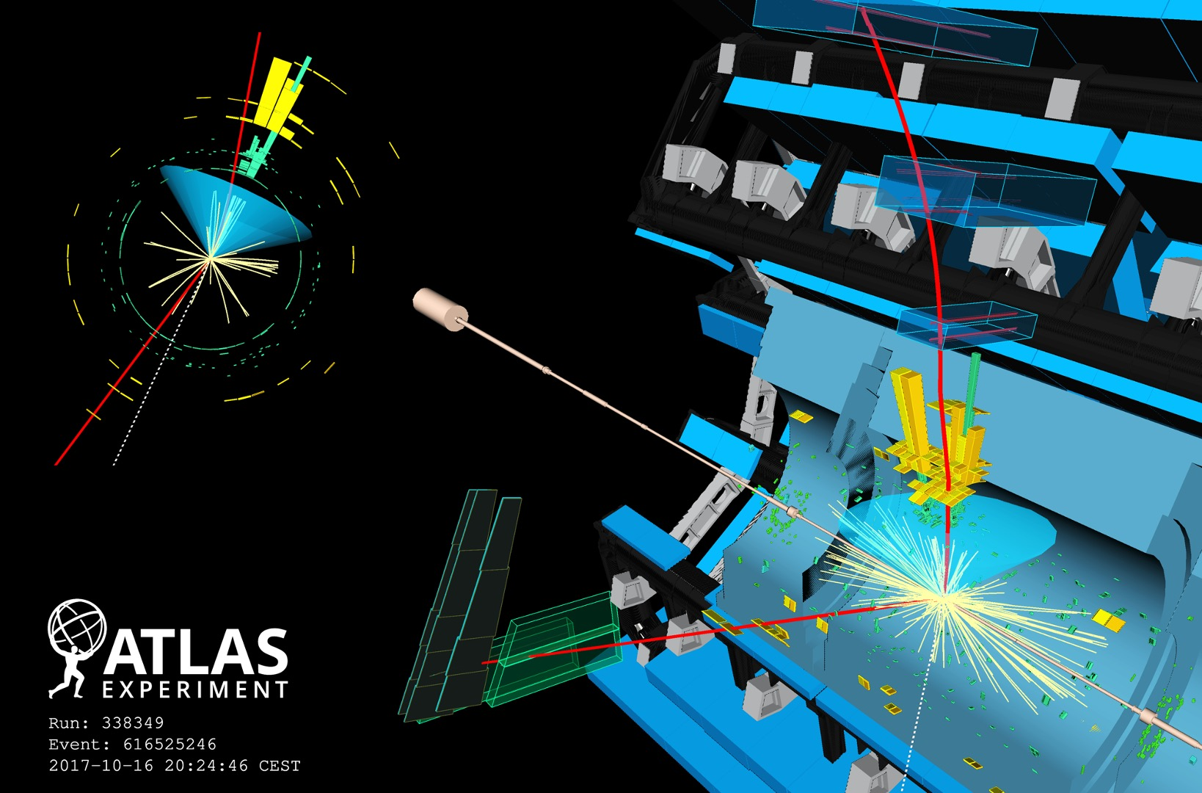
H → bb

Slide 21
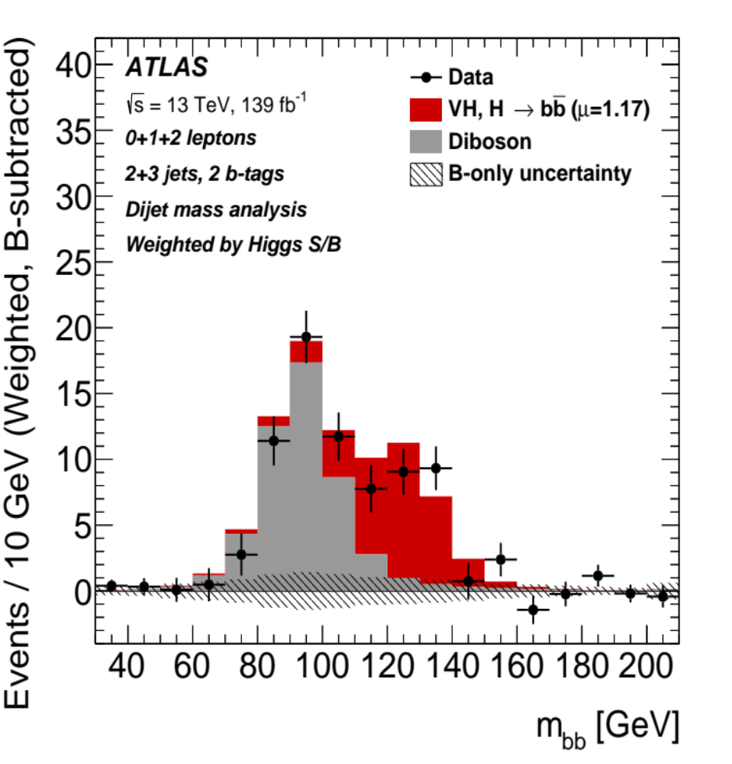
H → bb
arXiv:2007.02873
Z → bb
H → bb

Slide 22
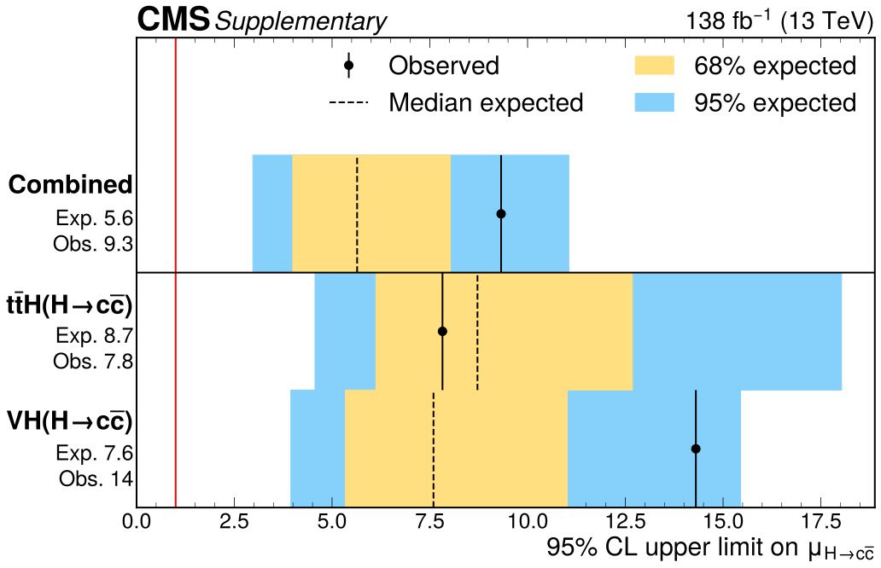
H → cc
Rate of H → cc is 20 × smaller than H → bb due to lighter charm quark, challenging to isolate experimentally
Best constraints so far from VH(→ cc) production: μ_{VH × H → cc} < 11.5_{obs} (10.6_{exp}) / 14_{obs} (7.6_{exp}) (ATLAS / CMS) [JHEP 04 (2025) 075 / JHEP 03 (2020) 131]
Strong recent result from CMS using ttH production and simultaneously measuring H → bb, cc (as also done in VH)
arXiv:2509.22535
Strongest constraint to date
A new kid in town

Slide 23
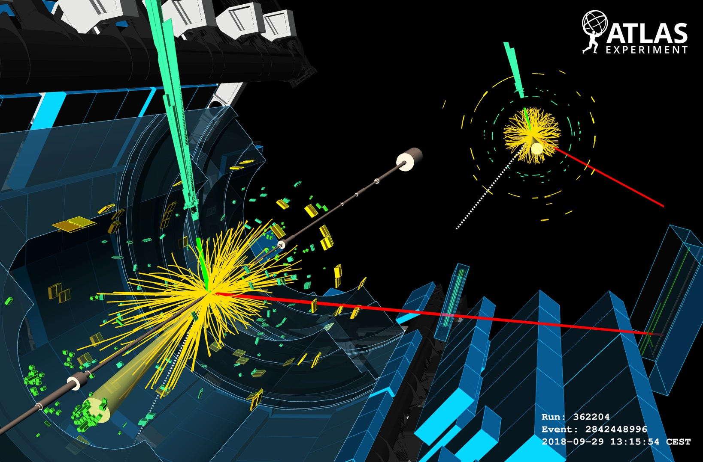
H → WW* (→ eµ+2𝜈)

Slide 24
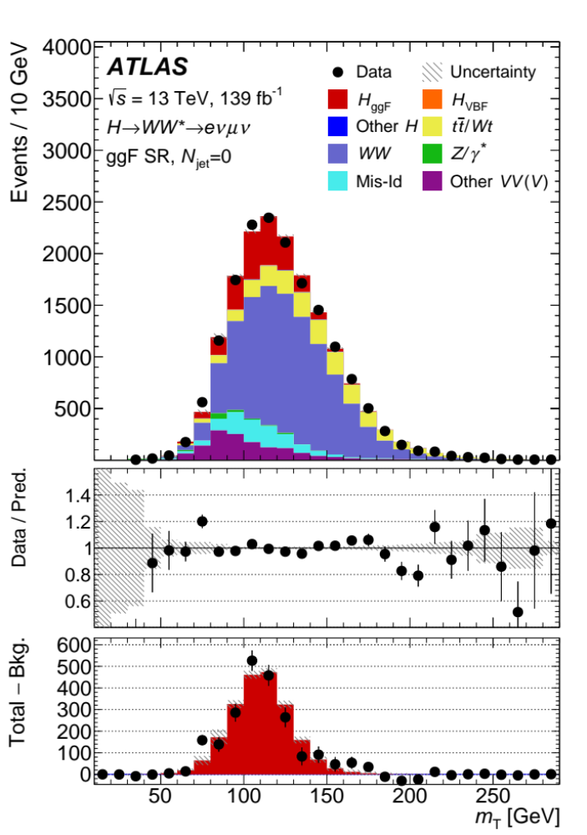
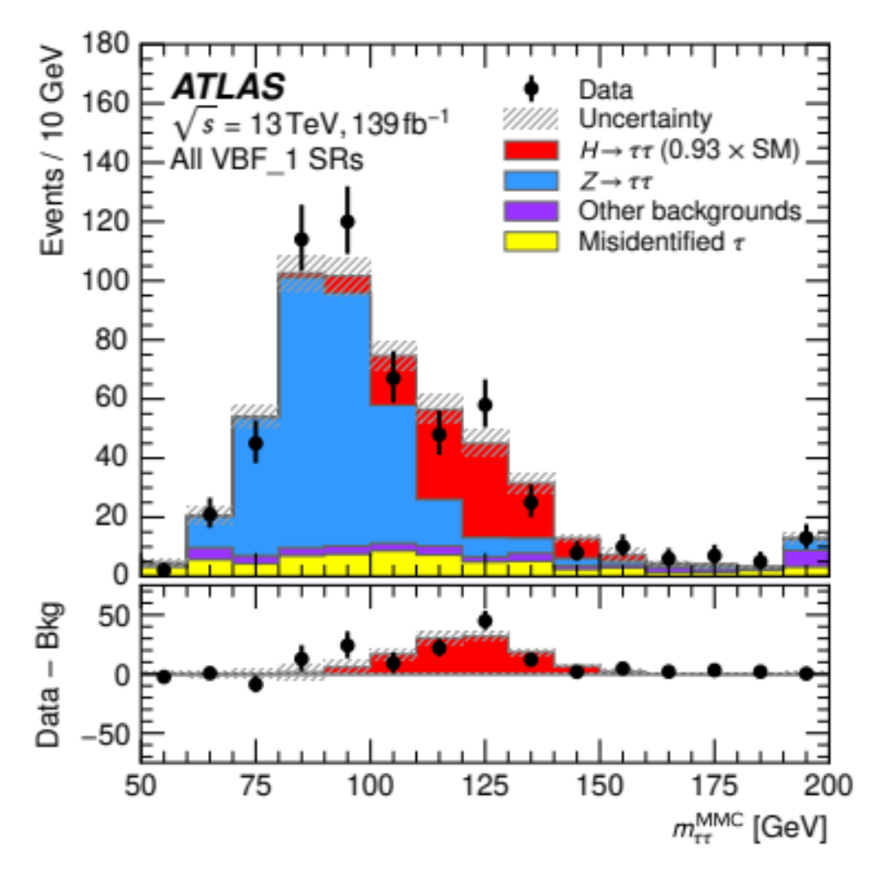

H → WW* (→ eµ+2𝜈)
arXiv:2207.00338
arXiv:2201.08269
H → WW* → 2𝓁2𝜈
H → 𝜏𝜏

Slide 25
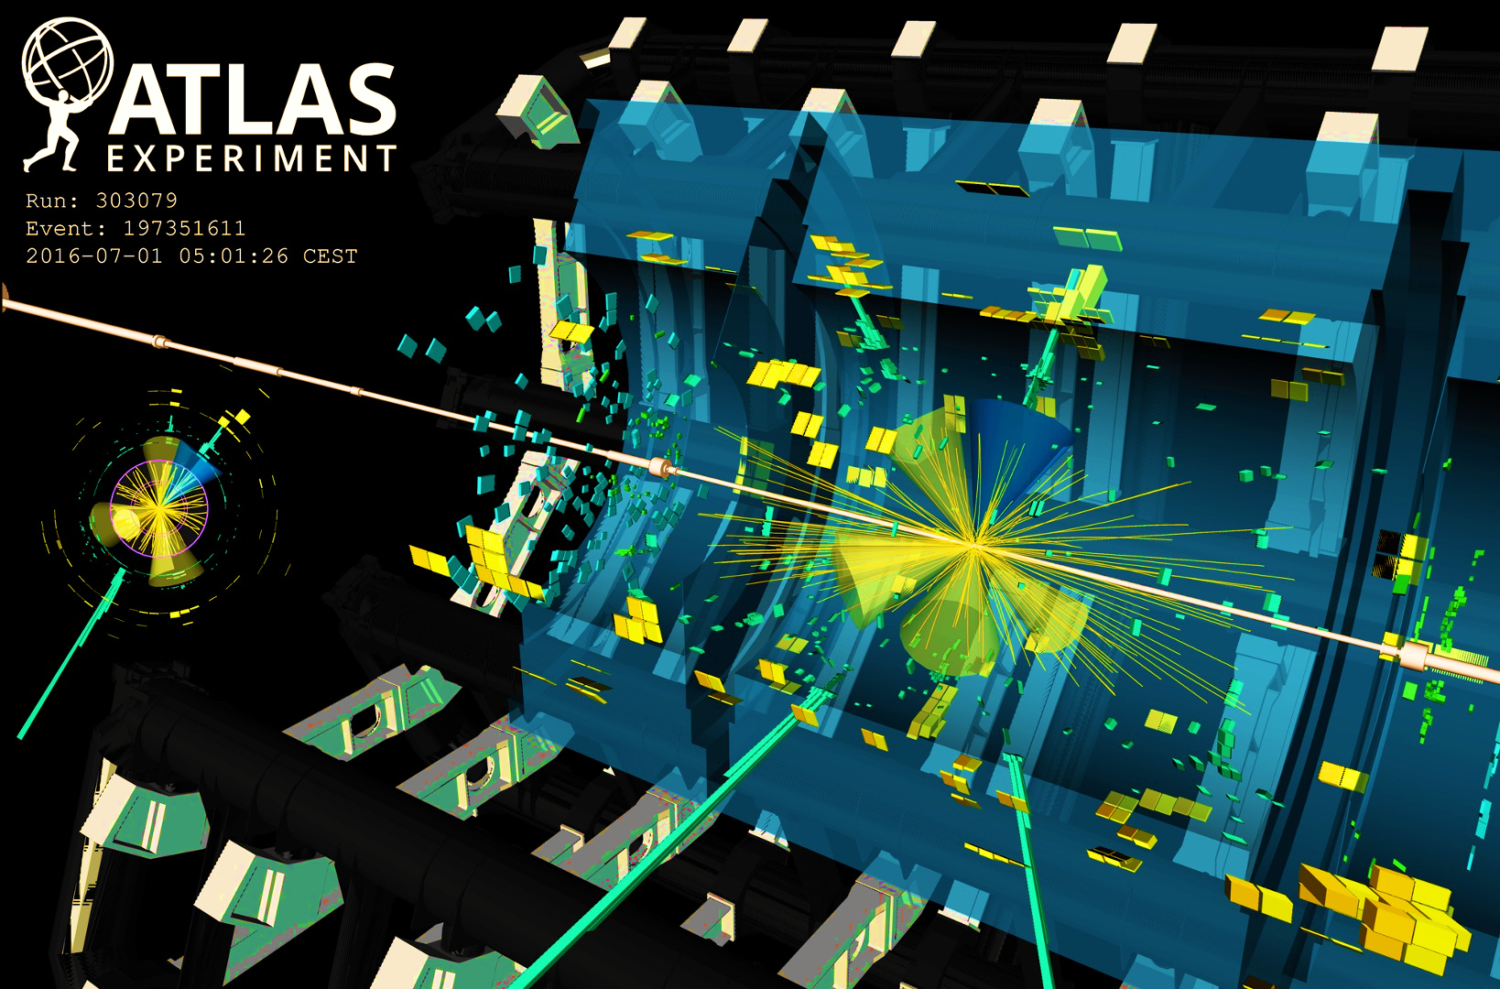
ttH production
A ttH → 6 jets + 𝛾𝛾 candidate event

Slide 26
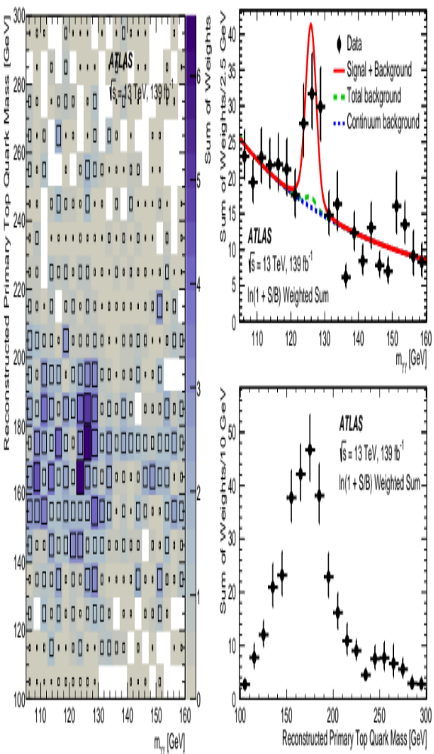
ttH production
ttH production features rich events, H → 𝛾𝛾 channel most powerful
arXiv:2004.04545
A ttH → 6 jets + 𝛾𝛾 candidate event

Slide 27
Rare Higgs boson decays
A Higgs boson to µµ candidate event

Slide 28
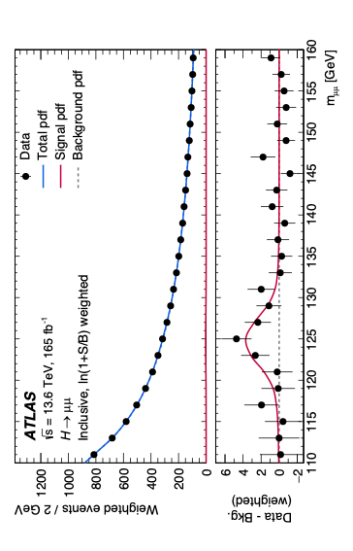
Using 305 fb^{–1} of Run-2 + 3 (2022–2024) data, ATLAS reported evidence for rare 2nd generation H → μμ (first seen by CMS)
PRL 135 (2025) 231802
Rare Higgs boson decays
H → μμ (BR ~ 0.02%)
Significance: 3.4σ (2.5σ exp), σ_{exp} / σ_{SM} = 1.4 ± 0.4
CMS (Run 2): μ = 1.19 ± 0.43 (3.0σ) [JHEP 01 (2021) 148]

Slide 29
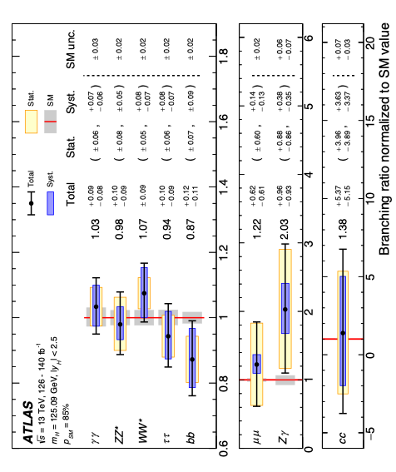
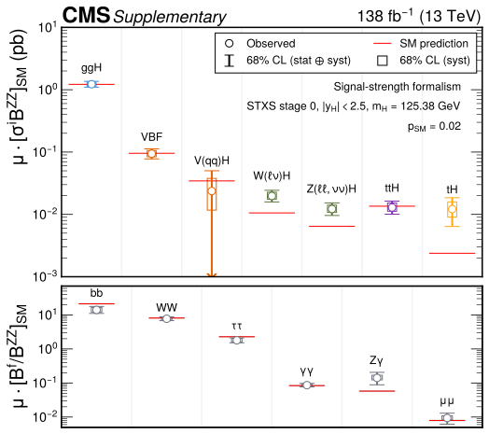
Higgs cross sections and branching fractions
Combination of Higgs production and decay measurements using Run-2 13 TeV pp data
arXiv:2608.07332
Among the many results:
Detailed fiducial and differential cross section measurements
Overall agreement with SM Combined production & decay mode p-values: ATLAS / CMS = 0.85 / 0.006 (all categories)
Rep. Prog. Phys. 89 (2026) 087801
Cross section measurements assume SM Higgs branching fractions and vice versa
Up to O(100) cross sections measured simultaneously in ~1k categories, O(10k) parameters, including background “nuisance” parameters
tH comes out high, see also recent ATLAS tH(bb) result; μ_{tH} = 8.1 ± 3.3 [JHEP 10 (2025) 093]

Slide 30
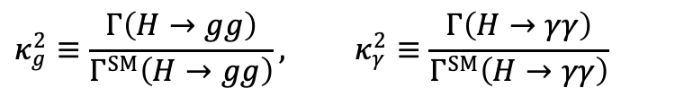
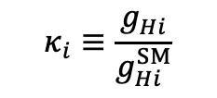
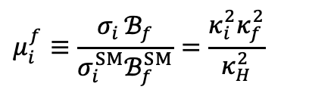
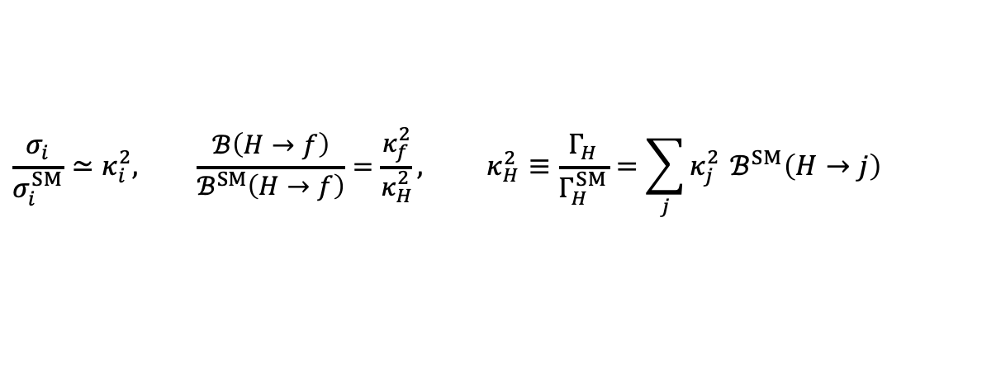
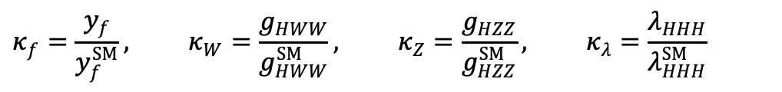
Higgs couplings — “kappa framework”
Extraction of Higgs boson coupling strengths modifiers from signal-strength measurements
In the Higgs coupling-modifier $κ$ framework, each Higgs coupling is rescaled relative to its SM value:
$$κ_{i}≡\frac{g_{Hi}}{g_{Hi}^{SM}}$$
$$κ_{f}=\frac{y_{f}}{y_{f}^{SM}}, κ_{W}=\frac{g_{HWW}}{g_{HWW}^{SM}}, κ_{Z}=\frac{g_{HZZ}}{g_{HZZ}^{SM}}, κ_{λ}=\frac{λ_{HHH}}{λ_{HHH}^{SM}}$$
For example:
$$\frac{σ_{i}}{σ_{i}^{SM}}≃κ_{i}^{2}, \frac{ℬ\left(H→f\right)}{ℬ^{SM}\left(H→f\right)}=\frac{κ_{f}^{2}}{κ_{H}^{2}}, κ_{H}^{2}≡\frac{Γ_{H}}{Γ_{H}^{SM}}=\sum_{j}{κ_{j}^{2}} ℬ^{SM}\left(H→j\right)$$
Assuming unchanged interaction structures:
$$μ_{i}^{f}≡\frac{σ_{i} ℬ_{f}}{σ_{i}^{SM}ℬ_{f}^{SM}}=\frac{κ_{i}^{2}κ_{f}^{2}}{κ_{H}^{2}}$$
If no non-SM Higgs decays!
The signal strength for production mode $i$ and decay $f$ is therefore:
For loop-induced interactions (eg, gg → H, H → 𝛾𝛾), one can either resolve the loop assuming SM, or define effective modifiers:
$$κ_{g}^{2}≡\frac{Γ\left(H→gg\right)}{Γ^{SM}\left(H→gg\right)}, κ_{γ}^{2}≡\frac{Γ\left(H→γγ\right)}{Γ^{SM}\left(H→γγ\right)}$$
The “kappa framework” assumes one narrow Higgs with SM Lorentz structures and constant coupling rescalings. It is a useful phenomenologically, but not a general gauge-invariant Effective Field Theory (EFT)

Slide 31
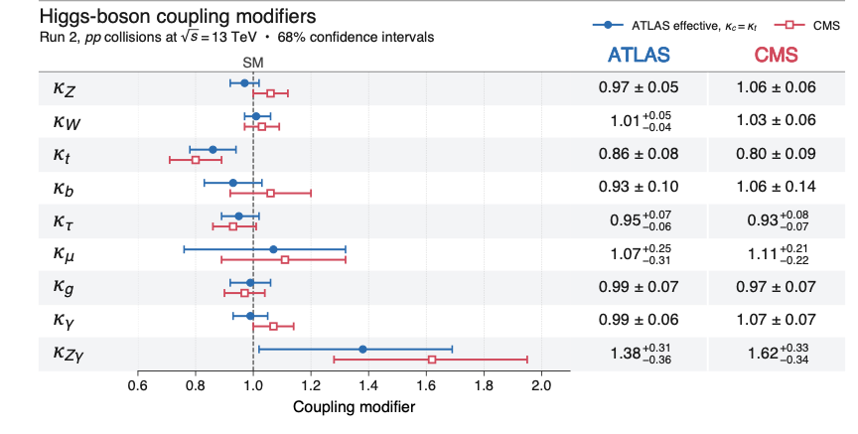
Higgs couplings
ATLAS: arXiv:2608.07332, CMS: Rep. Prog. Phys. 89 (2026) 087801
Extraction of Higgs boson coupling strengths modifiers from Run-2 signal-strength combination
Fit assume: Γ_{H→inv/und} = 0, 𝜅_{c} = 𝜅_{t}, and effective parametrisation

Slide 32
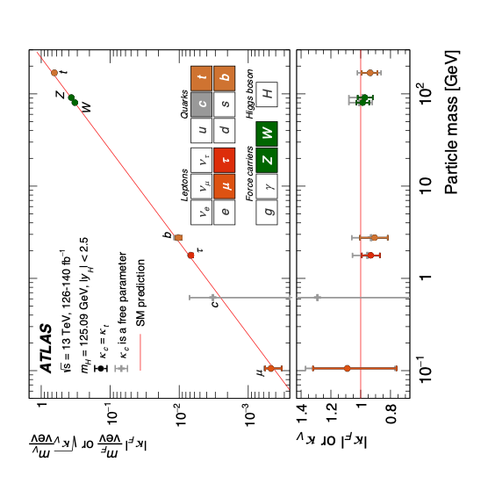
Higgs couplings
ATLAS: arXiv:2608.07332, CMS: Rep. Prog. Phys. 89 (2026) 087801
The Brout-Englert-Higgs mechanism is real
The measurements by ATLAS and CMS have confirmed the non-universal, mass-dependent coupling strengths of the Higgs boson to the SM particles

Slide 33
Higgs couplings
ATLAS: arXiv:2608.07332, CMS: Rep. Prog. Phys. 89 (2026) 087801
The Higgs boson relates to many open questions in particle physics and cosmology
Why is the Higgs boson so light?
Is the Higgs boson elementary or composite ?
Do Higgs interactions violate CP symmetry?
Is the Higgs boson unique?
Does the Higgs boson couple to dark matter?
What is the origin of the large mass hierarchy of the fermions in the Standard Model?
Is the vacuum metastable?
Is the Higgs field connected with cosmic inflation?
Why is the dark energy in the universe so much smaller than the Higgs vacuum energy?

Slide 34
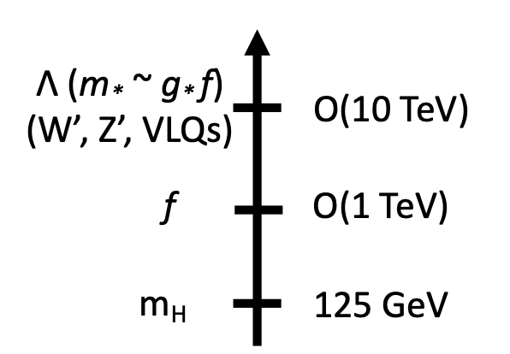
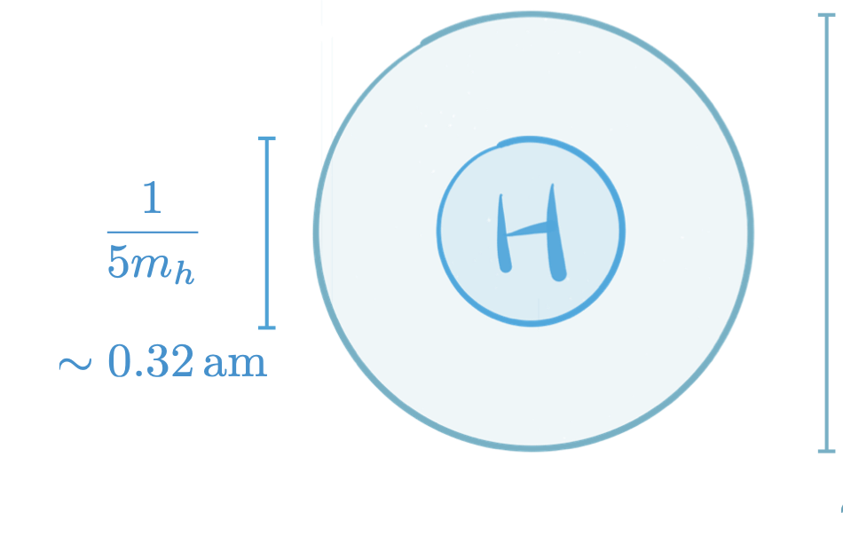






Higgs couplings — probing composite Higgs doublet
JHEP 0706:045 (2007), arXiv:1412.6356
The Higgs doublet may not be elementary but a composite pNGB multiplet of a new strong sector, with global symmetry broken at $f_{H}$ and resonances at $m_{∗}∼g_{∗}f_{H}$, with coupling $1≲g_{∗}≲4π$. SM gauge and top-sector couplings explicitly break this symmetry, generating the Higgs potential and Higgs mass through loops
Analogously, QCD chiral symmetry breaks at $f_{π}$, producing pions as pNGBs and resonances at $m_{ρ}∼g_{ρ}f_{π}$. Quark masses explicitly break the symmetry and generate $m_{π}$
Composite-Higgs scales
The pNGB nature of the Higgs modifies its interactions by terms of order $ξ≡{υ^{2}}/{f_{H}^{2}}$
In minimal composite-Higgs models, the couplings to W and Z bosons are universally suppressed:
$λ_{H}\sim \frac{1}{m_{∗}}$
$λ_{C}\sim \frac{1}{m_{H}}\sim 1.6 am$
H
$$κ_{V}≡\frac{g_{hVV}}{g_{hVV}^{SM}}=\sqrt{1−ξ}≃1−\frac{ξ}{2} (V=W,Z)$$
Fermion coupling also shift by $O(ξ)$, but model-dependently. Precision Higgs-coupling measurements therefore probe the compositeness scale
1 ≲ g* ≲ 4π
for a strongly coupled sector
5.0 (0.1)% precision on $κ_{i}$ probes $f_{H} \sim$ 0.8 (5.5) TeV
The best measured coupling probes Higgs compositness best

Slide 35


Higgs width
The Higgs boson is a narrow resonance: Γ_{H}(SM) = 4.1 MeV
For comparison:
Γ_{W} = 2.1 GeV
Γ_{Z} = 2.5 GeV
Γ_{top} = 1.3 GeV
?
Invisible dark matter?
Even small Higgs couplings to new light states (a small new partial width) can measurably alter its branching fractions
Γ_{H} = 4.1 MeV

Slide 36









Higgs width
Access to the Higgs boson decay width by comparing the high-mass off-shell Higgs production rate of H* → ZZ, WW (insensitive to Γ_{H}) to the on-shell (125 GeV) one (dependent on Γ_{H})
+ …
gg → H matrix element:
$$ℳ_{H}\left(gg→H^{∗}→VV\right)=ℳ_{ggH} D_{H}\left(\overset{ˆ}{s}\right) ℳ_{HVV}$$
Nat. Phys. 18 (2022) 1329
$${\overset{ˆ}{σ}}_{H}\left(\overset{ˆ}{s}\right)∝g_{ggH}^{2}g_{HVV}^{2} {\left|D_{H}\left(\overset{ˆ}{s}\right)\right|}^{2}$$
$${\left|D_{H}\left(\overset{ˆ}{s}\right)\right|}^{2}=\frac{1}{{\left(\overset{ˆ}{s}−m_{H}^{2}\right)}^{2}+m_{H}^{2}Γ_{H}^{2}}$$
so that with
For the full gg → VV process:
$${\left|ℳ\right|}^{2}={\left|ℳ_{H}\right|}^{2}+{\left|ℳ_{box}\right|}^{2}+2 Re​\left(ℳ_{H}ℳ_{box}^{∗}\right)$$
$$μ_{on}=\frac{κ_{i}^{2}κ_{f}^{2}}{Γ_{H}/Γ_{H}^{SM}}$$
Negative far off-shell: Higgs sector preserves consistency of longitudinal weak-boson scattering amplitudes!
On-shell:
Destructive interference of continuum gg → ZZ and gg → H → ZZ amplitudes, qq → ZZ added incoherently
Far off-shell:
$$μ_{off}\left(\overset{ˆ}{s}\right)≃κ_{i}^{2}\left(\overset{ˆ}{s}\right)κ_{f}^{2}\left(\overset{ˆ}{s}\right)$$
So that under the assumption $κ_{i,f}^{off}=κ_{i,f}^{on}$:
$$\frac{Γ_{H}}{Γ_{H}^{SM}}=\frac{μ_{off}}{μ_{on}}$$

Slide 37


Higgs width
Access to the Higgs boson decay width by comparing the high-mass off-shell Higgs production rate of H* → ZZ, WW (insensitive to Γ_{H}) to the on-shell (125 GeV) one (dependent on Γ_{H})
PLB 846 (2023) 138223
Rep. Prog. Phys. 88 (2025) 057803,
Evidence for off-shell Higgs production
+ 2.1
– 1.6
arXiv:2608.07332
(ZZ & WW)
ATLAS:
➠ Γ_{H} = 3.6 MeV
+ 2.0
– 1.8
arXiv:2607.23352
(ZZ & WW)
CMS:
➠ Γ_{H} = 5.1 MeV
First use of neural simulation-based inference technique at LHC [Link] to exploit the complete multidimensional event kinematics (similar to Matrix Element method, but simulation based)

Slide 38




Invisible Higgs decays
The Higgs boson may invisibly decay to dark matter, if kinematically allowed
Detect through missing E_{T} generated by recoil against visible particles, e.g, in weak boson fusion
JHEP 08 (2022) 104, PLB 842 (2023) 137963
Minimal Higgs-portal interpretation: $m_{χ}<m_{H}/2$, $ℬ_{inv}=ℬ\left(H→χχ\right)$, pure scalar SM Higgs exchange and scalar-nucleon form factor $f_{N}=0.308±0.018$ ($g_{HNN}={f_{N}m_{N}}/υ$)
(Vector limits are UV-model dependent)
➠ BR(H → invisible) < 0.107 (0.077) at 95% CL

Slide 39



Higgs self-coupling via Higgs pair production
$$V\left(φ\right)=−μ^{2}{\left|φ\right|}^{2}+λ{\left|φ\right|}^{4}$$
Mainly HL-LHC physics
→ tomorrow’s lecture

Slide 40

LHC physics is incredibly rich
Huge harvest of results delivering (i) high precision measurements of fundamental SM parameters, (ii) improving our understanding of process dynamics, and (iii) looking for ripple effects from new physics

Slide 41






Observing rare processes
Rare high-energy processes expose interaction vertices that do not occur in abundant reactions — examples
+ t-channel W exchange
σSM ~ 136 fb at √s = 13 TeV
σSM ~ 13 fb at 13 TeV (60,000 rarer than tt)
σ^{SM, fid} ~ 3 fb
EPJ C 83 (2023) 496, CMS: PLB 847 (2023) 138290
PLB 816 (2021) 136190
PRL 136 (2026) 081802

Slide 42

Observing rare processes
Rare high-energy processes expose interaction vertices that do not occur in abundant reactions — examples
+ t-channel W exchange
σSM ~ 136 fb at √s = 13 TeV
σSM ~ 13 fb at 13 TeV (60,000 rarer than tt)
σ^{SM, fid} ~ 3 fb
EPJ C 83 (2023) 496, CMS: PLB 847 (2023) 138290
PLB 816 (2021) 136190
PRL 136 (2026) 081802
Directly probes four-top-quark D = 6 contact operators such as $({\overline{t}}_{R}γ_{μ}t_{R})({\overline{t}}_{R}γ^{μ}t_{R})$, which otherwise only enter through loops / indirectly
Four-top production is effectively a top–top scattering experiment embedded inside a proton collision
Directly probes D = 8 anomalous quartic gauge couplings (QGCs), which can change QGCs without modifying triple-gauge couplings (TGCs), so ordinary diboson production may be insensitive

Slide 43



Probing the top-Z coupling
Measurement of the rare ttZ process provides clean access to the top-Z coupling. The large luminosity of Runs 2 and 3 allow detailed studies of this process for the first time
Clean multi-lepton signature, inclusive cross section: σ(ttZ) = 0.86 ± 0.04 ± 0.04 pb (SM: 0.86 ± 0.08 pb)
EPJ C 81 (2021) 737, JHEP 07 (2024) 163, JHEP 02 (2025) 177

Slide 44





Longitudinal vector boson scattering
*M.S. Chanowitz, M.K. Gaillard, NP B 261, 379 (1985)
At E ≫ m_{W}, longitudinal W and Z bosons behave like the Goldstone modes absorbed during symmetry breaking
Goldstone boson equivalence theorem: at E $≫$ m_{V}, amplitude of V_{L}V_{L} → V_{L}V_{L} ~ GG → GG
Unitarity: W_{L}W_{L} scattering violates unitarity for gauge diagrams, quartic (WWWW) interaction plus 𝛾Z exchange
Higgs boson exchange restores unitarity of total amplitude:
A_{tot}
H
H
m_{H} must not be too large (which is fulfilled)
Why this is an exceptional probe?
The longitudinal modes are the physical imprint of the symmetry-breaking field
Their high-energy scattering tests the Higgs–vector coupling and gauge self-interactions in the same amplitude
Longitudinal VV scattering tests whether the observed Higgs boson really completes the electroweak theory
A failed cancellation could reveal extra scalars, TeV-scale resonances or higher-dimensional interactions

Slide 45





Longitudinal vector boson scattering
Look for VBS scattering in high dijet invariant mass distributions — extremely rare processes requiring extraction of longitudinal polarisation
PRL 135 (2025) 111802
QGC vertex
EW VBS production
Non-VBS production
Strong production
ATLAS recently reported first ensemble evidence for at least one longitudinally polarised W boson in W±W± → W±W± VBS
[3.3σ_{obs} (4.0σ_{exp})]
Light Higgs and W±W± VBS consistent with SM suggests weakly coupled Higgs dynamics, but strongly coupled resonances may still appear in the TeV regime!
*M.S. Chanowitz, M.K. Gaillard, NP B 261, 379 (1985)

Slide 46





EPJ. C 76, 6, 336 (2016)
Testing QCD to large scales
By measuring inclusive jet p_{T} or dijet mass spectra (or …), the LHC tests perturbative QCD across an enormous energy range, constrains the proton’s parton structure and 𝛼_{S}, and probes new physics in the highest-energy tail
EPJ. C 85, 72 (2025)
x – Q² phase space covered by collider sand fixed target experiments
$$m_{jj}^{2}=x_{1}x_{2}s$$
$$x_{1,2}=\frac{m_{jj}}{\sqrt{s}}exp\left(±\frac{|y_{1}+y_{2}|}{2}\right)$$
Combined fit of m_{jj} differential dijet cross section data to NNLO QCD and HERA deep-inelastic ep cross section data allows simultaneous extraction of PDFs and the strong coupling strength:
𝛼_{S}(m_{Z}) = 0.1179 ± 0.0019
[ Fit uncertainty: 0.0015, scale: 0.0008, PDF model: 0.0008 ]
m_{jj} (GeV)

Slide 47



Top–antitop production at threshold
Near production threshold, repeated gluon exchange attracts a colour-singlet top–antitop pair through the Coulombic potential $V^{[1]}\left(r\right)≃{{−C}_{F}α_{s}}/r$ ($C_{F}=4/3$ colour factor), producing a quarkonium-like correlation with $Γ_{tt}≈2Γ_{t}≈2.8 GeV$
Unlike ordinary quarkonium, toponium decays through its constituent tops ($τ_{t}≈5∙{10}^{−25} s$), allowing only a brief correlation
Finite top width smears the would-be 1S pole into a broad quasi-bound threshold enhancement
At LHC, toponium is dominantly pseudoscalar: $η_{t}=$ ¹$S_{0}^{[1]}$ (where: ^{2S+1}$L_{J}^{[colour]}$)
Spin singlet: S = 0 (antiparallel tt spins); S wave: L = 0 → J = 0, colour singlet: [1]
For neutral quark–antiquark state: P = (–1)^{L+1}, C = (–1)^{L+S} → J^{PC} = 0^{–+}
Gluon-fusion at LHC favours the attractive ¹$S_{0}^{[1]}$ state: ³$S_{0}^{[1]}$ via gluons is forbidden, P-waves are velocity-suppressed, and the colour-octet $gg→$ ³$S_{0}^{[8]}$and $qq→$³$S_{1}^{[8]}$ channels feel the repulsive $V^{[8]}\left(r\right)≃{+α_{s}}/{(6r)}$
Non-relativistic QCD (NRQCD) exploits $υ≃\sqrt{\left|E\right|/m_{t}}≪1$ near threshold, factorising hard tt production from non-relativistic evolution, and resumming enhanced terms ${\left(α_{s}/υ\right)}^{n}$ from repeated gluon exchange using colour-dependent QCD potentials
EPJ C60 (2009) 375
dσ / dM_{tt} (pb/GeV)
M_{tt} (GeV)
attractive [1]: threshold enhancement
repulsive [8]: continuum

Slide 48



Top–antitop production at threshold
Toponium was thought not to be resolvable at the LHC, but with smart analysis using dilepton tt decays CMS reported the observation of a pseudoscalar “toponium” enhancement near production threshold — observation confirmed by ATLAS
Rep. Prog. Phys. 89 (2026) 057801
ATLAS used NRQCD model for threshold contribution (also alternative models studied)
Observed significance > 8σ for a cross section of 9.3 ±1.4 pb
(With CMS signal model ATLAS finds: 13.2 ±1.8 pb)
Rep. Prog. Phys, 88 (2025) 087801
(> 5.0σ)
Elusive attraction among top-quarks at threshold

Slide 49
Top–antitop production at threshold
Toponium was thought not to be resolvable at the LHC, but with smart analysis using dilepton tt decays CMS reported the observation of a pseudoscalar “toponium” enhancement near production threshold — observation confirmed by ATLAS
Rep. Prog. Phys. 89 (2026) 057801
ATLAS used NRQCD model for threshold contribution (also alternative models studied)
Observed significance > 8σ for a cross section of 9.3 ±1.4 pb
(With CMS signal model ATLAS finds: 13.2 ±1.8 pb)
Rep. Prog. Phys, 88 (2025) 087801
Extremely challenging measurement of a subtle signal in a difficult modelling environment. This observation will spur further theoretical and experimental progress at the tt threshold
–
(> 5.0σ)
Elusive attraction among top-quarks at threshold

Slide 50



High-precision measurements of fundamental SM parameters
The LHC is both a high-E+Lumi discovery machine and a facility for extraordinarily precise measurements
CMS
Nature 652, 321–327 (2026)
All references in arXiv:2607.09861
LHCTopWG (May 2026)
World / LHC+Tevatron averages:
LEP & SLD: 0.23153 ± 0.00016
$$m_{W}|_{excl.. CDF} = 80.3625 ± 0.0077 GeV \sin^{2}θ_{eff}^{ℓ}|_{Had Coll}=0.23149 ±0.00021 m_{top}=172.52 ±0.33 GeV$$
SM (global EW fit): $80.3558 ±0.0061 GeV 0.23149±0.00006 173.6±1.5 GeV$

Slide 51








Flavour physics — dedicated lecture, so only a few highlights here
Extremely rare channels such as B_{s} → μμ (left) and K⁺ → π⁺𝜈𝜈 (right) occur as predicted
NA62
Possible new physics contributions to B_{s} → μμ
SM contributions to K⁺ → π⁺𝜈𝜈
PRD 105 (2022) 012010
JHEP 02 (2025) 191
+ 3.3
– 3.0
B(B_{s} → μμ) = 3.1 ± 0.5 $∙$ 10^{–9}
SM: 3.6 ± 0.1 $∙$ 10^{–9}
B(K⁺ → π⁺𝜈𝜈) = 13.0 $∙$ 10^{–11}
SM: 8.4 ± 1.0 $∙$ 10^{–11}
Similar precision by CMS [PLB 842 (2023) 137955, 140 fb^{–1}]

Slide 52





Flavour physics — CP violation
High-precision CKM angle measurements overconstrain CKM matrix and probe new physics
Mixing-induced time-dependent CP violation measurements in J/𝜓𝜙 (and similar)
LHCb:
𝛾 = 64.6 ± 2.8 deg
sin2ß = 0.717 ± 0.015 (more precise than B-factory combination)
in agreement with CKM fit
HFLAV reference
LHCb-CONF-2024-004
PRL 132 (2024) 021801
$${φ_{a}^{c\overline{\overline{c}}s}=−2β}_{s}=−0.052±0.013 rad{ , β}_{s}≡\arg{​}\left[−\frac{V_{ts}V_{tb}^{∗}}{V_{cs}V_{cb}^{∗}}\right]$$
$$β≡\arg{​}\left[−\frac{V_{cd}V_{cb}^{∗}}{V_{td}V_{tb}^{∗}}\right],$$
$$γ≡\arg{​}\left[−\frac{V_{ud}V_{ub}^{∗}}{V_{cd}V_{cb}^{∗}}\right]$$
with
SM: –0.0376 ± 0.0006 rad

Slide 53
Flavour physics — CP violation
High-precision CKM angle measurements overconstrain CKM matrix and probe new physics
Mixing-induced time-dependent CP violation measurements in J/𝜓𝜙 (and similar)
LHCb:
𝛾 = 64.6 ± 2.8 deg
sin2ß = 0.717 ± 0.015 (more precise than B-factory combination)
in agreement with CKM fit
HFLAV reference
LHCb-CONF-2024-004
PRL 132 (2024) 021801
Interestingly: CP violation in Standard Model far too small to generate observed baryon asymmetry — so what is its “purpose” (if there is such thing like a purpose …)?
$${φ_{a}^{c\overline{\overline{c}}s}=−2β}_{s}=−0.052±0.013 rad{ , β}_{s}≡\arg{​}\left[−\frac{V_{ts}V_{tb}^{∗}}{V_{cs}V_{cb}^{∗}}\right]$$
$$β≡\arg{​}\left[−\frac{V_{cd}V_{cb}^{∗}}{V_{td}V_{tb}^{∗}}\right],$$
$$γ≡\arg{​}\left[−\frac{V_{ud}V_{ub}^{∗}}{V_{cd}V_{cb}^{∗}}\right]$$
with
SM: –0.0376 ± 0.0006 rad

Slide 54







Flavour physics — Anomalies?
Flavour physics probes Yukawa sector of the Standard Model with high sensitivity to new physics — explaining the considerable attention given to even statistically not-yet-significant deviations
Among the remaining “anomalies”
HFLAV, ICHEP 2026
PRL 137, 021802 (2026)
PRD 109, 112006 (2024)
2D compatibility with SM: 2.0σ
$P_{5}^{′}$
$$R\left(D^{\left(∗\right)}\right)=\frac{ℬ(B→D^{\left(∗\right)}τν)}{ℬ(B→D^{\left(∗\right)}ℓν)}$$
$P_{5}^{′}$ is an angular observable in $B^{0}→K^{∗}μμ$ $(q^{2}=m_{μμ}^{2})$, which probes the underlying short-distance $b→sℓℓ$ interaction with reduced form-factor uncertainties
probing the charged current transition: $b→cℓν$
+ subleading W-box

Slide 55




Flavour physics — Anomalies?
A lesson from penguins…
4.0σ discrepancy between penguin and charmonium averages in 2004 – new physics?

Slide 56

Searches for new phenomena

Slide 57






Searches for physics beyond the Standard Model
Direct searches have not yet revealed signs of high- or low-scale new physics, dark matter, or an extended scalar or flavour sector; no signs of Supersymmetry yet (neither in sparticle no extended Higgs searches)
Phys. Rep. 1116 (2025) 261
JHEP 07 (2023) 073
MSSM 2HDM
~
t
t
SUSY features 2 Higgs doublets, $H_{u}$, $H_{d}$ with VEVs $υ^{2}=υ_{u}^{2}+υ_{d}^{2}$
Top squark searches
“Heavy” light Higgs (h) requires heavy stops and/or large mixing
$$\tan{β}≡\frac{υ_{u}}{υ_{d}}, y_{t/b}=\frac{\sqrt{2} m_{t/b}}{υsin/cos{β}}$$
Five Higgs bosons after EWSB: $h, H, A, H^{+}, H^{−}$

Slide 58

The evolution of BSM searches at the LHC
A few general BSM search tendencies since the start of the LHC and into the future
Search paradigm | Targeted, model-specific | → | Broader scenarios (eg, dark sectors, hidden phenomena, FIPs, …), more model-agnostic, diffuse, data-driven (anomaly detection, …)
Search reach | Direct production at accessible mass scales | → | Addition of indirect sensitivity via precision, rare processes, EFT
Kinematic range | Focus on high mass and momenta | → | All regions, incl. very low masses and soft particles, small couplings
Object topology | Clean, prompt, isolated leptons/jets | → | Complex, boosted, merged, displaced, non-pointing
Trigger approach | Rigid thresholds, fixed menus | → | Real-time ML, scouting/TLA/PEB, use of turn-ons and prescaled triggers, dedicated per-analysis triggers
Analysis approach | Cut-based, simple ML | → | Advanced ML: GNNs, transformers, unsupervised learning

Slide 59
Summary of today’s lecture
  The Higgs mechanism is real
  The LHC allows for the first time to directly probe interactions of the Higgs boson with the other particles, thereby deeply probing the SM
  Rare Higgs boson couplings and Higgs self coupling are relatively unexplored yet
  The study of rare electroweak processes provides qualitatively new information
  The LHC performs precision QCD and top-quark physics across unprecedented scales, observing new phenomena
  Precision electroweak and flavour measurements have made huge progress, and reveal no decisive inconsistency yet
  No direct new-physics signal has yet emerged, but the search programme has expanded dramatically

Slide 60
Extra slides

Slide 61

Z(→ μμ) + H(→ eeμμ) candidate event

Slide 62

Searches for Dark Matter

Slide 63













Observation of Z_{L}Z_{L} production
ATLAS: arXiv:2607.12879
The existence of longitudinally polarised weak bosons is a consequence of the BEH mechanism (it requires the weak bosons to be massive)
Inclusive production is dominated by: $q\overline{q}→Z_{L}Z_{L}$
Small EW $Z_{L}Z_{L}jj$ contribution included but not isolated (ie, not a measurement of $Z_{L}Z_{L}→Z_{L}Z_{L})$. Gluon fusion $gg→ZZ$ is subtracted
Connection through EWSB: at high energy
$$ℳ\left(q\overline{q}→Z_{L}Z_{L}\right)≃ℳ\left(q\overline{q}→G^{0}G^{0}\right)+𝒪​\left(\frac{m_{Z}}{E}\right)$$
Ordinary t/u-channel quark-exchange Zqq contributions are gauge suppressed $∝{m_{Z}}/{E_{z}}$
$G^{0}$ is neutral Goldstone boson
Tiny $G^{0}$–light quark Yukawa couplings suppress high-energy $Z_{L}Z_{L}$ production, so $f_{LL}$ falls with $m_{ZZ}$, a prediction of EWSB
Observation of $Z_{L}Z_{L}$ production with 6.5σ
q²-dependnet results (consistent with SM predictions):
$$f_{LL}=0.080±0.017$$
($f_{LL}^{SM}=0.061±0.002$)
$$f_{LL}\left(180<m_{4ℓ}<240 GeV\right)=0.108±0.028$$
$$f_{LL}\left(m_{4ℓ}>240 GeV\right)=0.011±0.017$$

Slide 64





High precision 𝛼_{S} measurement using Drell-Yan data
EPJ C 84 (2024) 315, arXiv:2309.12986
The low p_{T,Z} Drell-Yan spectrum is shaped by soft and collinear QCD radiation and is therefore highly sensitive to 𝛼_{S.} N³LO predictions matched to resummation of large logarithms at approximate N⁴LL accuracy, enable a sub-percent determination of the strong coupling
Precise extraction (incl. PDF profiling):
𝛼_{S}(m_{Z}) = 0.1183 ± 0.0009
[ Dominated by PDF and QCD scale uncertainties ]
soft collinear gluons → large $\ln^{m}⁡({m_{Z}^{2}}/{p_{T,Z}^{2}})$

Slide 65



Understanding top–antitop production – LHC as a top factory
Good description of inclusive cross sections, but precise modelling of differential distributions remains challenging
Measured top–antitop cross section versus pp energy compared to NNLO QCD calculation complemented with NNLL resummation
High-precision top–antitop diff. cross section measurement in the e–μ channel
Powheg+MiNNLO: differential NNLO+PS (tt + 1 jet NLO) accuracy + small-q_{T} resummation
LHCTopWG (May 2026)
arXiv:2509.15066

Slide 66







Deep test of Electroweak Standard Model
Gfitter, 2607.09861
Confronting Z-pole observables, W, top, and Higgs masses with SM predictions probes quantum-loop effects
$$O({m_{t}^{2}}/{m_{W}^{2}})$$
$$O(ln({m_{H}^{2}}/{m_{W}^{2}}))$$
Excellent consistency of measurements with electroweak Standard Model
$$O({|V_{tb}|m}_{t}^{2})$$

Slide 67

Deep test of Electroweak Standard Model
Gfitter, 2607.09861
Confronting Z-pole observables, W, top, and Higgs masses with SM predictions probes quantum-loop effects
Probe BSM physics in loops (“oblique (= indirect) parameters”)
S: momentum dependence of neutral-current self-energies
T: custodial-symmetry breaking between neutral and charged current self-energies
Excellent consistency of measurements with electroweak Standard Model

Slide 68



Hadron spectroscopy
CMS revealed family of 3 all-charm X resonances in J/ψJ/ψ → 4μ mass spectrum [Nature 648 (2025) 58]
CMS
Also seen by ATLAS & LHCb
Tightly bound tetraquark in same confinement volume ?
Since J/ψ does not couple to light quarks, X unlikely hadronic molecules bound by light meson exchange, but too heavy to be cccc ground state
Angular analysis prefers J^{PC} = 2⁺⁺, suggesting tightly bound tetraquarks
(On the contrary, narrow-width P_{cc} appear to be Σ_{c}D⁽*⁾ or Ξ_{c}D molecule)
X(6600)
X(6900)
X(7100)
Molecule, like a deuteron (molecular hexaquark)?
Run-3 provides much larger sample thanks to improved triggers and parking stream

Slide 69


Hadron spectroscopy
Several 4- and 5-valence quark states found, majority by LHCb, and certainly not the end of the story…
Resonances with heavy quarks reduce the amount of open decay channels and thus have smaller width → easier to discover if enough energy, luminosity, and momentum resolution
–
–
Who finds the T_{bb} (bbud) first ?
Attraction between two heavy quarks $∝α_{s}^{2}m_{q}$→ large negative binding energy, so expected to have mass below BB threshold and thus weakly decaying (contrary to T_{cc}(3875)⁺, which has less binding energy and decays strongly)
See this instructive CERN Courier article by Marek Karliner and Jonathan Rosner (Jonathan sadly passed away just recently)
Several other states discovered in e⁺e– collisions (not included in figure), e.g., Z_{c}(3900)⁺ and Z_{b}(10610)⁺ cc/bbud states discovered by Belle

Slide 70

A 𝛾𝛾 → WW → eµ + 2𝜈 candidate event

Slide 71
A 𝛾𝛾 → WW → eµ + 2𝜈 candidate event
Rare processes are not automatically more sensitive to new physics merely because they are rare. The strength of these processes comes from a particularly favourable combination of
Small amplitude + High energy + Unique external particles
A new contribution can therefore be a large fraction of the SM rate, and some interactions can only contribute directly when the rare final state is present

Slide 72

Studies of physics in extreme electromagnetic fields
$$∝α^{4}$$

Slide 73

And a detailed mapping of the properties of the quark-gluon plasma with soft and hard probes
In collisions of heavy ions, the LHC creates for a very brief moment a quark-gluon plasma of up to 6 trillion degrees, almost half a million times hotter than the core of the sun

Slide 74



Searches for physics beyond the Standard Model
Compressed electroweak SUSY spectrum featuring degenerate neutralinos / charginos (higgsinos) — hard to tackle, experiments pushing the limits of reconstruction
Soft di-electron
Soft µ+track
Isolated soft track
Low-momentum isolated tracks, electrons calibrated down to 1 GeV!
Comprehensive set of analyses targeting ultra-compressed spectra
Disappearing track → up to 900 GeV exclusion
…
CMS-PAS-SUS-24-003

Slide 75

Indirect detection — thermal wino / higgsino
Space observations can also provide hints for new physics (as is the case for Dark Matter!) — and set competitive constraints on dark matter models [arXiv:2511.03883]
Pure wino*
Pure higgsino*
Thermal wino ruled out by HESS and negative Ferm-LATi gamma-ray data
*Majorana fermion triplet
*Dirac fermion doublet

