Slide 1
Experimental Physics at the LHC (4)
Andreas Hoecker (CERN)
57. Herbstschule HEP
1–11 September 2026, Bad Honnef, Germany

Slide 2
Today’s lecture:
Upgrade to the High-Luminosity LHC (HL-LHC)
Physics opportunities

Slide 3
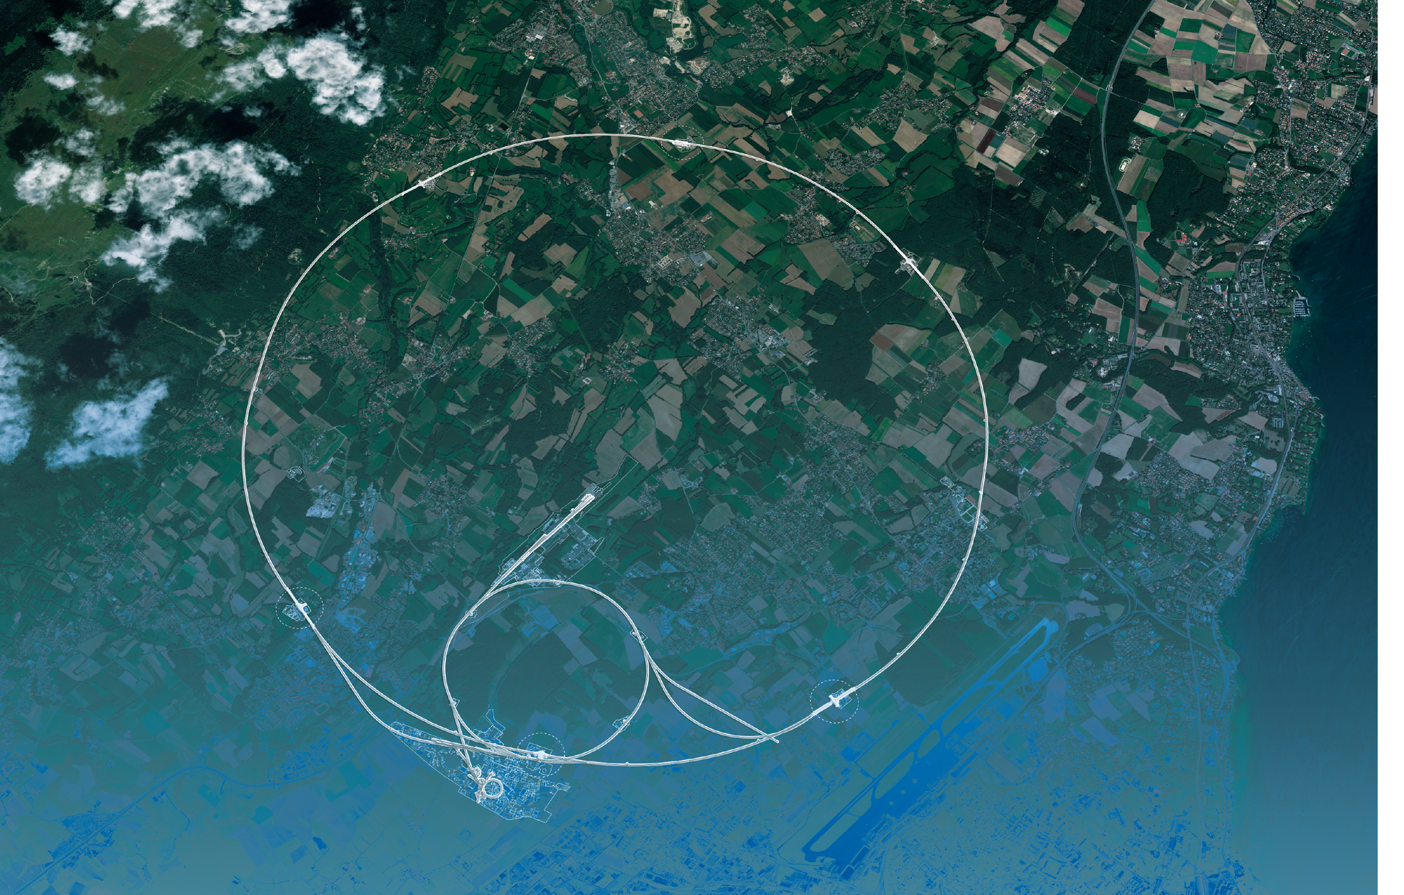
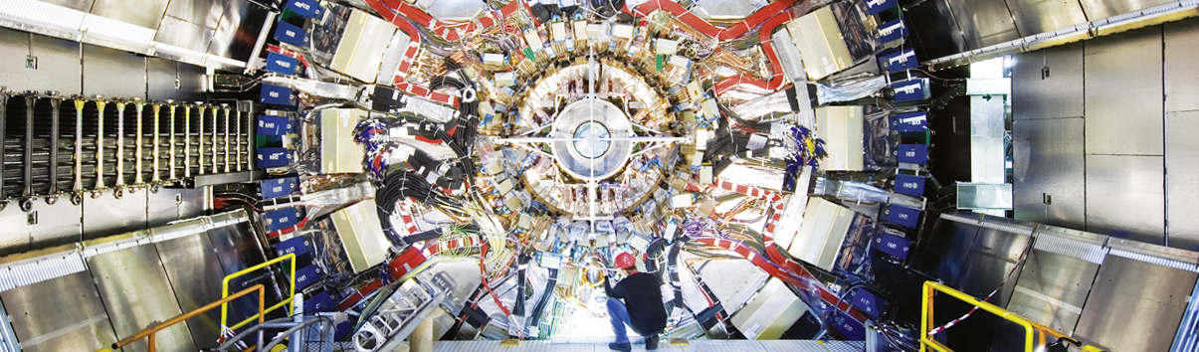
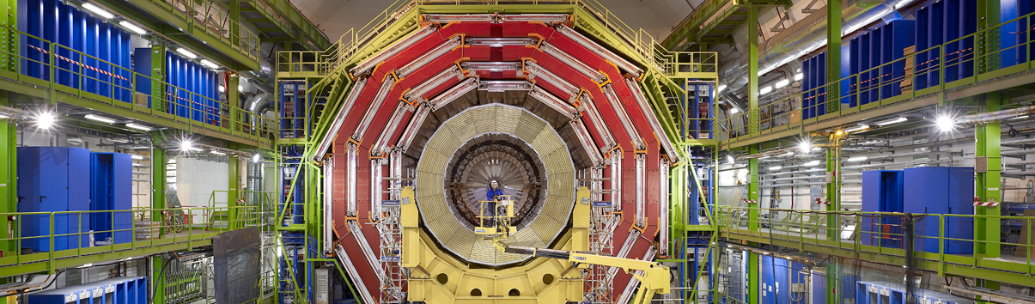
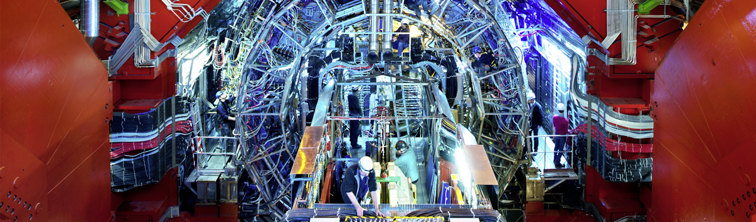
CMS
ATLAS
LHC
CMS
LHC: the next phase
ALICE
SPS
ALICE
LHCb
ATLAS
LHCb
PS
Not shown: additional smaller experiments
Areal view
Presentation

Slide 4
High-Luminosity LHC
New underground LHC service gallery at Point 5 (CMS) to accommodate higher radiation levels, Increased power consumption, complex electronics, cooling, and cryogenic systems

Slide 5
High-Luminosity LHC
312 fb^{–1}
Run 3
Run 2
R1
140 fb^{–1}
25 fb^{–1}
HL-LHC
3000 fb^{–1}
Brian Moser (Freiburg), 2026
New underground LHC service gallery at Point 5 (CMS) to accommodate higher radiation levels, Increased power consumption, complex electronics, cooling, and cryogenic systems

Slide 6
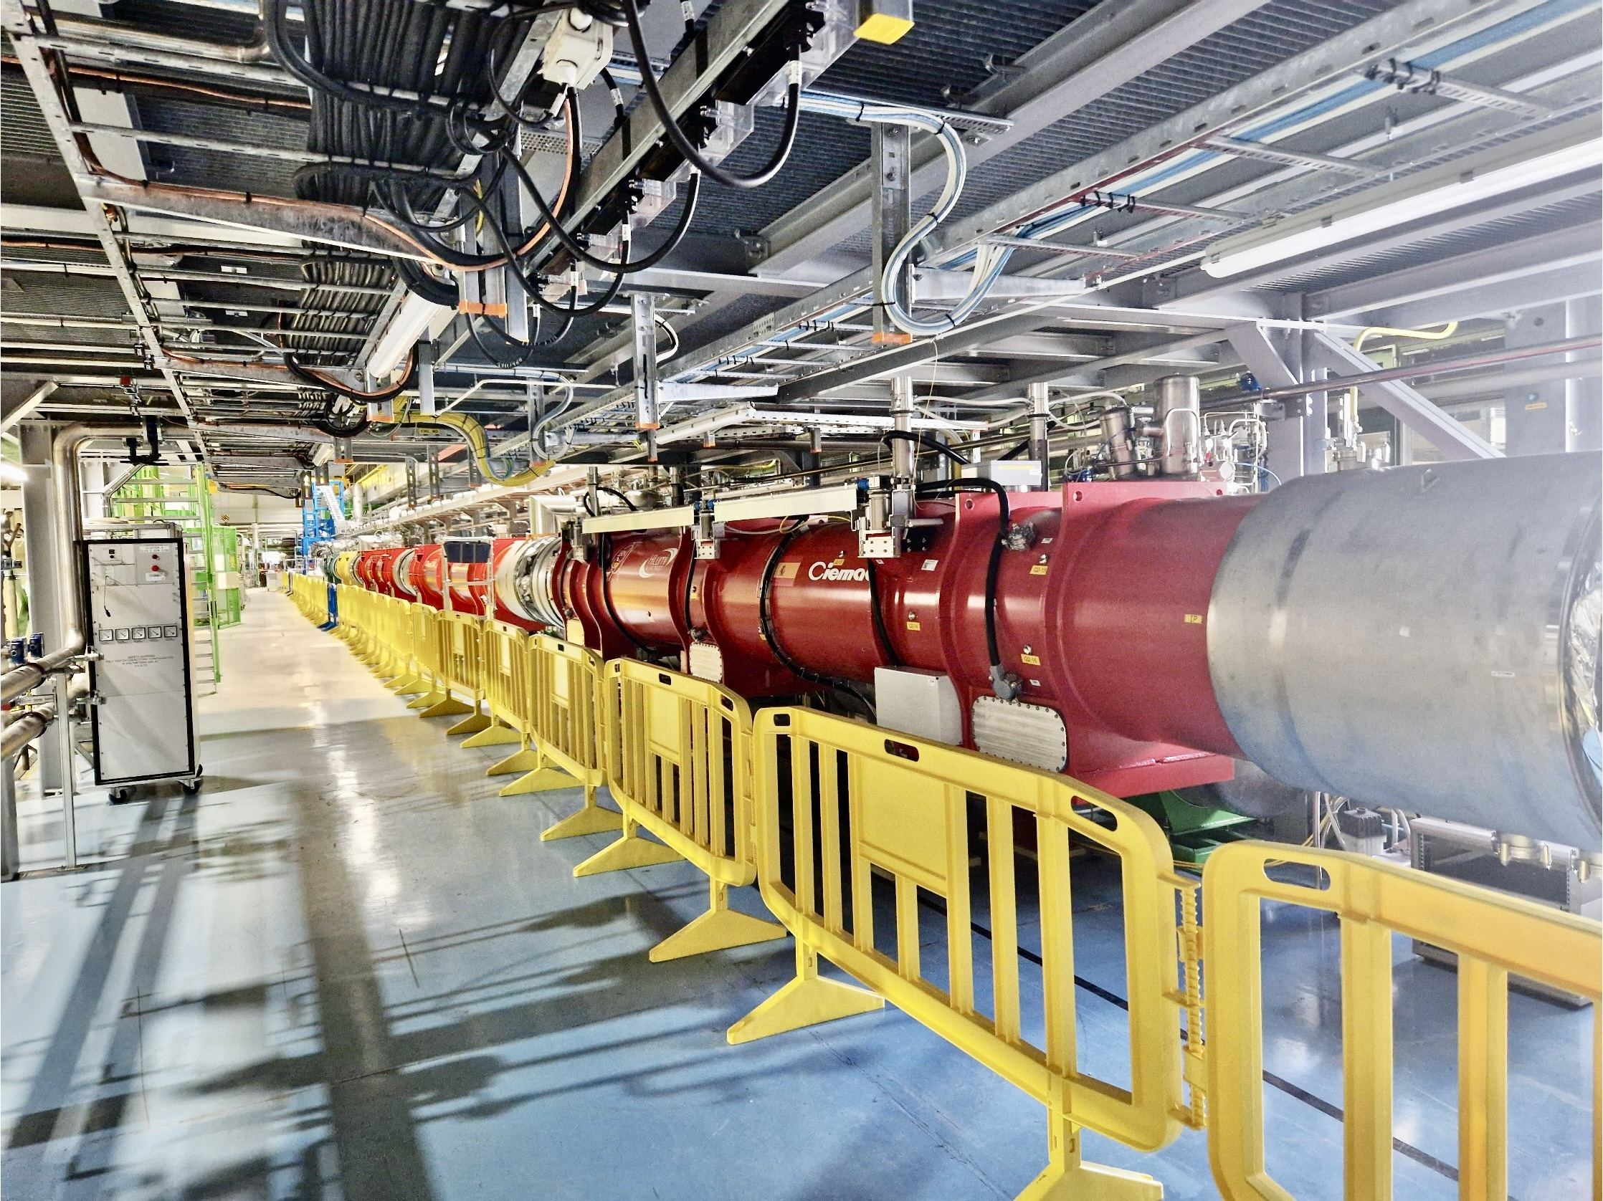
Upgrade to the
High-Luminosity LHC is under way
The HL-LHC will use new technologies to provide up to 6 times more luminosity
than the LHC
The detectors are also being upgraded
It will give access to rare phenomena, greater precision and discovery potential (350M H, 240k HH, 13B top, 720M WW, …)
It is scheduled to start operating in 2030 and run until 2041
Largest construction project at CERN for almost 20 years
Fully realistic inner triplet string test facility at CERN
Notes:
Additional information (OPTIONAL, TIME PERMITTING)
Key innovations in HL-LHC:
1) Powerful superconducting quadrupole magnets (12 Tesla) will be installed on either side of the ATLAS and CMS experiments to focus the particle bunches. These magnets will be made using niobium-tin (Nb₃Sn), used for the first time in an accelerator (instead of niobium-titanium)
2) Crab cavities for tilting the beams (16 in total) - give the head and tail of the particle bunches opposite-sign transverse momentum before they meet, enlarging the overlap area of the two bunches and thus increasing the probability of collisions.
3) One hundred new, more effective collimators will be installed: these devices absorb particles that stray from the beam trajectory and might otherwise damage the machine.
4) More compact and powerful bending magnets (11 Tesla), also made using the niobium-tin superconductor.
5) Innovative superconducting power lines will connect the power converters to the accelerator; will be able to carry currents of record intensities, up to 100 000 amps!

Slide 7
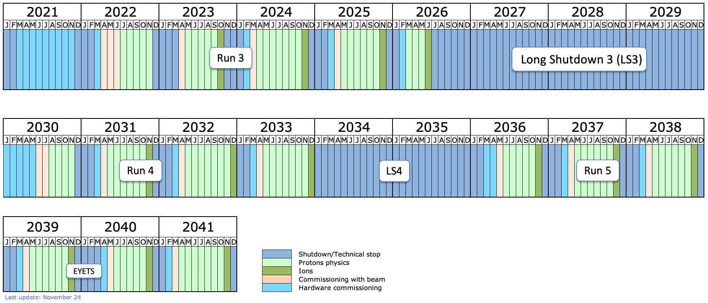
LHC and High-Luminosity-LHC (HL-LHC) project timeline
HL-LHC and experiment upgrades
Large-scale ATLAS & CMS upgrades under construction for Run 4, ALICE & LHCb plan significant upgrades for Run 5
548 fb^{–1} pp delivered →
We are here
ATLAS & CMS upgrades
HL-LHC →
ALICE & LHCb upgrades
3000 fb^{–1} pp
Power of HL-LHC together with upgraded detectors & AI/ML: huge scientific opportunity for our field — complementary in many ways to a future e⁺e– collider

Slide 8
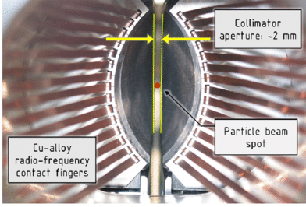
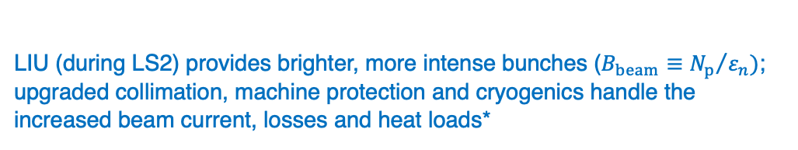
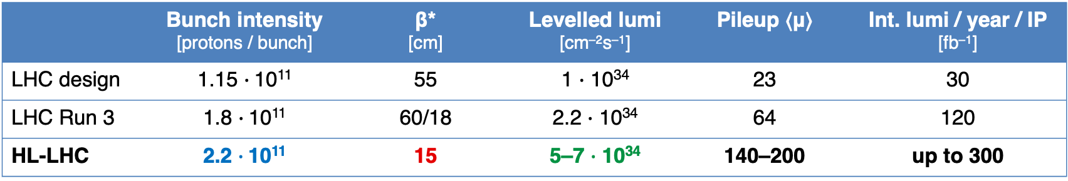
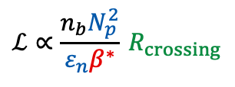
HL-LHC — Brighter beams and stronger focusing to deliver 3 ab^{–1}
Ambitious goal: L_{int} > 2500 fb^{–1} in 9 years of operation (for a total delivered luminosity of 3 ab^{–1})
Expect no increase in pp collision energy beyond current 13.6 TeV for Run 4; and later?
$$ℒ∝\frac{n_{b}N_{p}^{2}}{ε_{n}β^{∗}} R_{crossing}$$
 | Bunch intensity [protons / bunch] | β* [cm] | Levelled lumi [cm^{–2}s^{–1}] | Pileup ⟨μ⟩ | Int. lumi / year / IP [fb^{–1}]
LHC design | 1.15 $∙$10¹¹ | 55 | 1 $∙$ 10³⁴ | 23 | 30
LHC Run 3 | 1.8 $∙$10¹¹ | 60/18 | 2.2 $∙$ 10³⁴ | 64 | 120
HL-LHC | 2.2 $∙$10¹¹ | 15 | 5–7 $∙$ 10³⁴ | 140–200 | up to 300
LIU (during LS2) provides brighter, more intense bunches ($B_{beam}≡{N_{p}}/{ε_{n}})$; upgraded collimation, machine protection and cryogenics handle the increased beam current, losses and heat loads*
RF fingers provide continuous, low-impedance electrical path through mechanical gaps and moving joints (suppress beam-coupling impedance and localized RF heating or electrical discharges)
*New shafts, caverns and 300-m power-converter galleries at Points 1 and 5 house power converters, cryogenics and services
Front-view of an LHC collimator showing the size of jaw aperture in operation

Slide 9
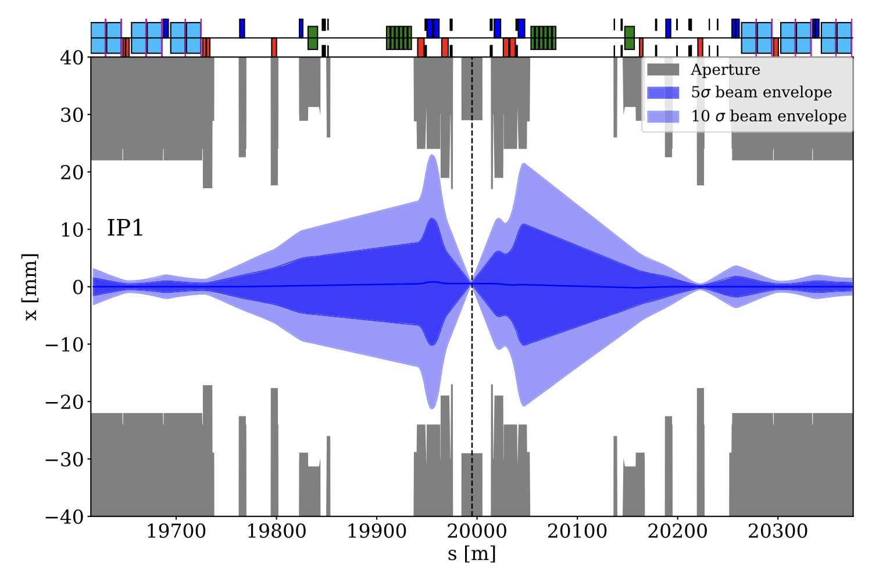

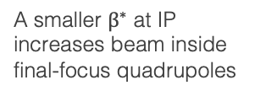

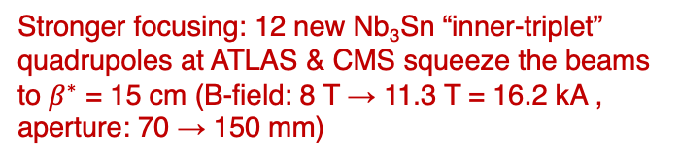
HL-LHC — Brighter beams and stronger focusing to deliver 3 ab^{–1}
Ambitious goal: L_{int} > 2500 fb^{–1} in 9 years of operation (for a total delivered luminosity of 3 ab^{–1})
Expect no increase in pp collision energy beyond current 13.6 TeV for Run 4; and later?
$$ℒ∝\frac{n_{b}N_{p}^{2}}{ε_{n}β^{∗}} R_{crossing}$$
 | Bunch intensity [protons / bunch] | β* [cm] | Levelled lumi [cm^{–2}s^{–1}] | Pileup ⟨μ⟩ | Int. lumi / year / IP [fb^{–1}]
LHC design | 1.15 $∙$10¹¹ | 55 | 1 $∙$ 10³⁴ | 23 | 30
LHC Run 3 | 1.8 $∙$10¹¹ | 60/18 | 2.2 $∙$ 10³⁴ | 64 | 120
HL-LHC | 2.2 $∙$10¹¹ | 15 | 5–7 $∙$ 10³⁴ | 140–200 | up to 300
Stronger focusing: 12 new Nb₃Sn “inner-triplet” quadrupoles at ATLAS & CMS squeeze the beams to $β^{∗}$ = 15 cm (B-field: 8 T → 11.3 T = 16.2 kA , aperture: 70 → 150 mm)
Rapid growth of the beam envelope away from IP:
$$β\left(s\right)≃β^{∗}+\frac{s^{2}}{β^{∗}}$$
A smaller $β^{∗}$ at IP increases beam inside final-focus quadrupoles
Note: beam size is: $σ\left(s\right)=\sqrt{ε β\left(s\right)}$

Slide 10
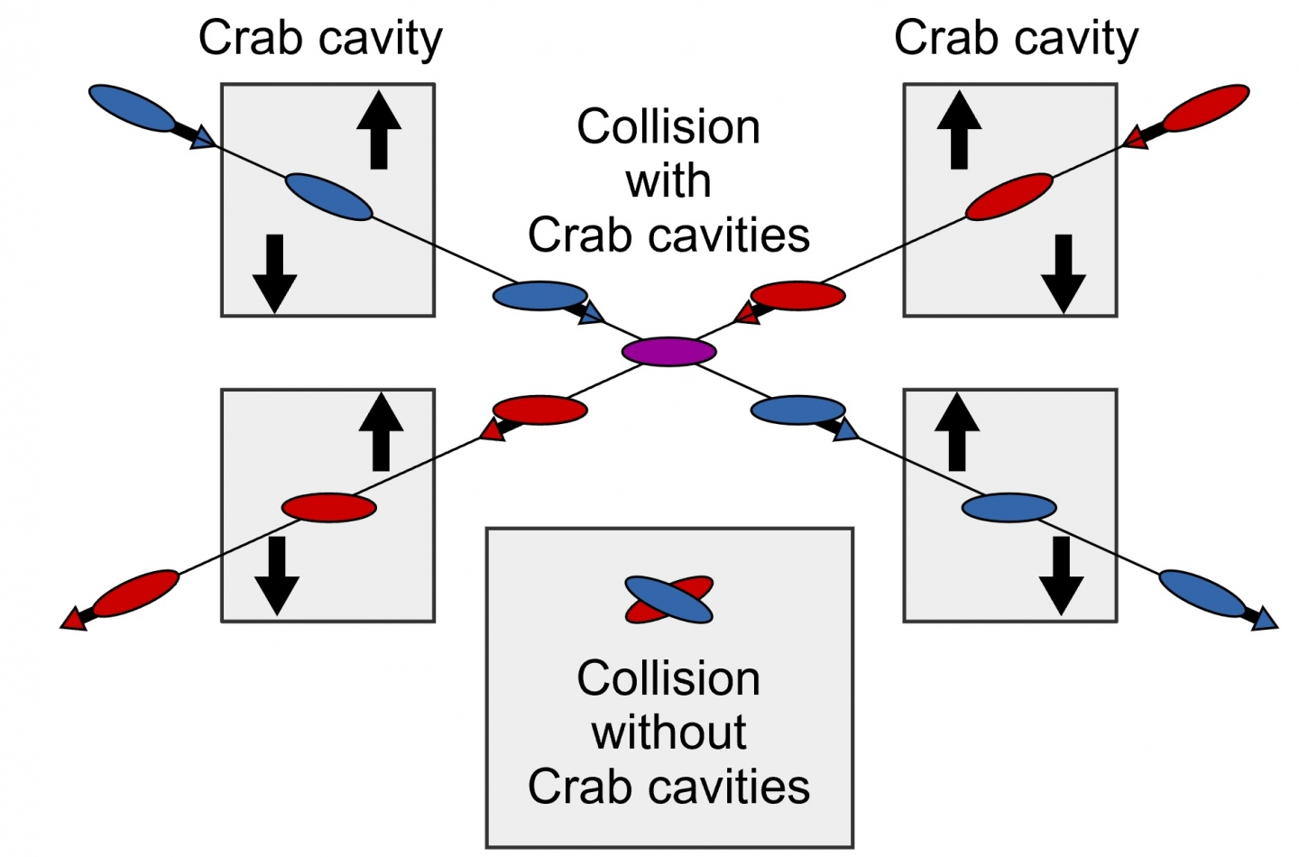
HL-LHC — Brighter beams and stronger focusing to deliver 3 ab^{–1}
Ambitious goal: L_{int} > 2500 fb^{–1} in 9 years of operation (for a total delivered luminosity of 3 ab^{–1})
Expect no increase in pp collision energy beyond current 13.6 TeV for Run 4; and later?
$$ℒ∝\frac{n_{b}N_{p}^{2}}{ε_{n}β^{∗}} R_{crossing}$$
 | Bunch intensity [protons / bunch] | β* [cm] | Levelled lumi [cm^{–2}s^{–1}] | Pileup ⟨μ⟩ | Int. lumi / year / IP [fb^{–1}]
LHC design | 1.15 $∙$10¹¹ | 55 | 1 $∙$ 10³⁴ | 23 | 30
LHC Run 3 | 1.8 $∙$10¹¹ | 60/18 | 2.2 $∙$ 10³⁴ | 64 | 120
HL-LHC | 2.2 $∙$10¹¹ | 15 | 5–7 $∙$ 10³⁴ | 140–200 | up to 300
RF crab cavities tilt the bunches via time-dependent transverse kicks, restoring their overlap despite the larger crossing angle
16 (8 around ATLAS/CMS) superconducting RF cavities tilt proton bunches through application of a time-dependent transverse voltage (3.4 MV/cavity) across the bunch such that they effectively collide head-on despite the crossing angle (uncorrected: luminosity loss of up to 30% at HL-LHC)
Leading (trailing) edge of the bunch gets a kick in one (opposite) direction → rotation of the bunch in the transverse plane
Already successfully used at SuperKEKB, but never at hadron colliders

Slide 11
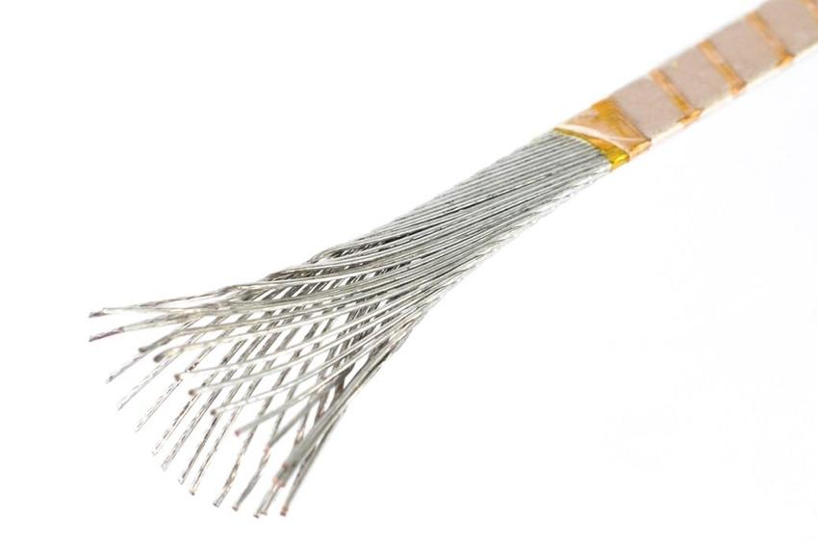

HL-LHC — Stronger focusing
HL-LHC final focus: large-aperture Nb₃Sn quadrupoles
NbTi (known since 1962) is a ductile (malleable) alloy, while Nb₃Sn (1954!) is a brittle intermetallic compound, which cannot be bent or plastically deformed once formed
This requires a “wind-and-react” process:
  Cable: Nb and Sn precursor filaments in a copper-stabilised Rutherford cable
  Wind: form the coil while the precursor remains ductile
  React: heat-treat at 650–700 °C to form brittle Nb₃Sn (entire coil must survive high-temperature treatment without distortion or contamination, any mismatch in thermal expansion can induce stress or cracking)
  Support: vacuum-impregnate with epoxy and apply precise mechanical preload
Small conductor movements can initiate quenches; Nb₃Sn magnets may require more training quenches than NbTi to reach nominal field, and they could show de-training after thermal cycling [or possibly not, see this article from July 21, 2026]
NbTi: T_{c} ~ 9.2 K, B_{c} ~ 10–11 T (0 K), B_{practical} ~ 8– 9 T (4.2 K)
Nb₃Sn: T_{c} ~ 18 K, B_{c} ~ 25–30 T (0 K), B_{practical} ~ 15–20 T (4.2 K)
Nb₃Sn cable with single strands and glass-fibre insulation (partially unwrapped). Winding of magnet coil with glass-fibre insulated cables made of multi-filamentary wires that contain Nb and Sn precursors in a Cu matrix. Heat treatment of coil so that precursor elements react chemically and form the desired Nb₃Sn superconducting phase. To protect the then extremely fragile coil, a polymer is injected, which fills the interstitial spaces among cables, and is subsequently cured to become a matrix of hardened plastic providing cohesion and support to the cables

Slide 12
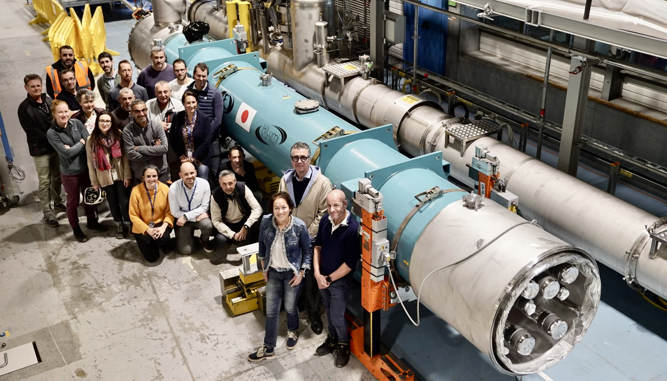
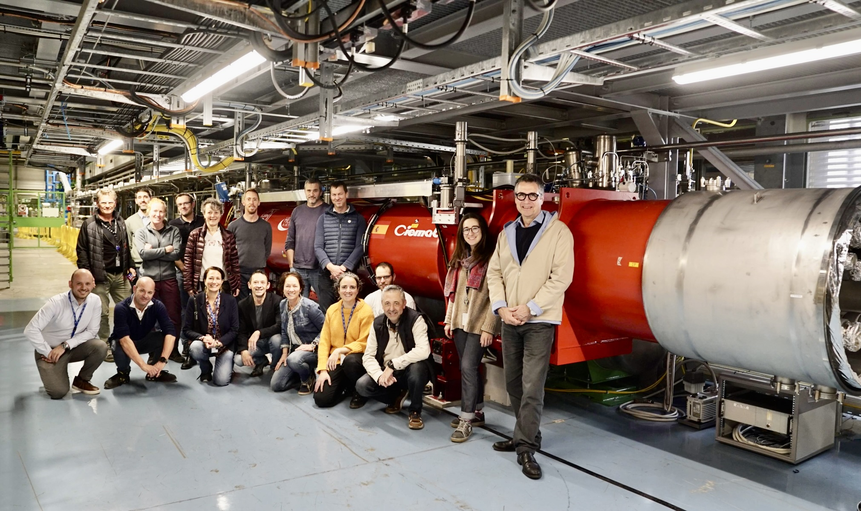
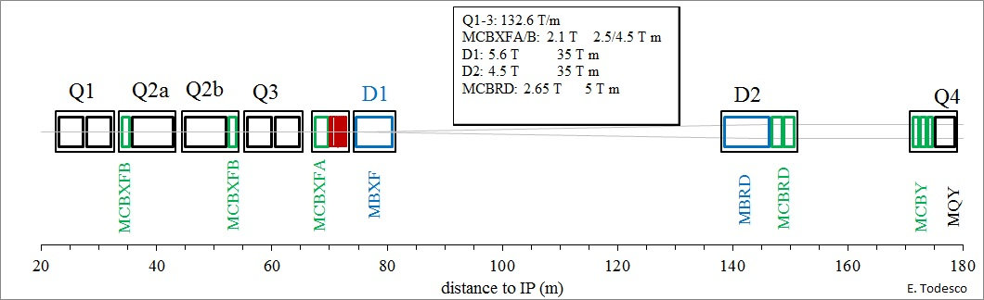
HL-LHC — Stronger focusing
New Nb₃Sn “inner triplet” quadrupoles
Fully realistic inner triplet string test facility at CERN, from left to right: installation of superconducting link, installation of D1 and Q2a cryo-assemblies, tests to start in Oct 2025
USA
KEK, Japan
(separator)
Genova, Italy
(recombiner)
CEA, France
(shaping/matching)
Nb₃Sn technology for new high-field superconducting quadrupole magnets successfully demonstrated for HL-LHC!
CERN
Corrector magnets by CIEMAT (Spain)
Orbit corrector IHEP (China)

Slide 13
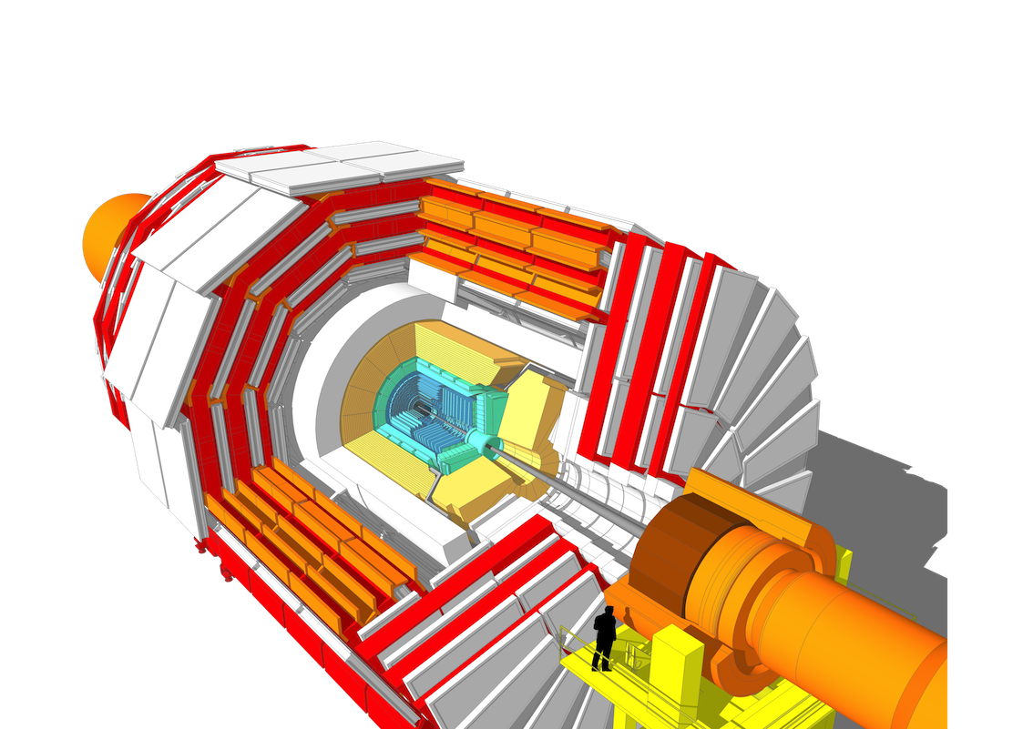
HL-LHC (aka Phase-2) upgrades of ATLAS and CMS
HL-LHC’s high luminosity (pileup → 200) requires unprecedented detector and computing technologies, realised through very ambitious and challenging upgrades
→ Top priority for ATLAS & CMS
New muon detectors in barrel and endcap
Electronics upgrades:
calorimeters & muon system
New timing detectors adding a 4th coordinate to tracking (30~50 ps resolution, cf: current ATLAS-LAr: 200 ps)
New silicon pixel and strip inner trackers with increased granularity and forward acceptance to |η| ~ 4
New high-granularity endcap calorimeter (CMS)
Upgraded trigger and data acquisition systems (new trigger requirements (increased latency) drive most of the electronics upgrades)
Extensive software (incl. ML) developments in trigger, reconstruction, and analysis needed to fully exploit the new capabilities

Slide 14
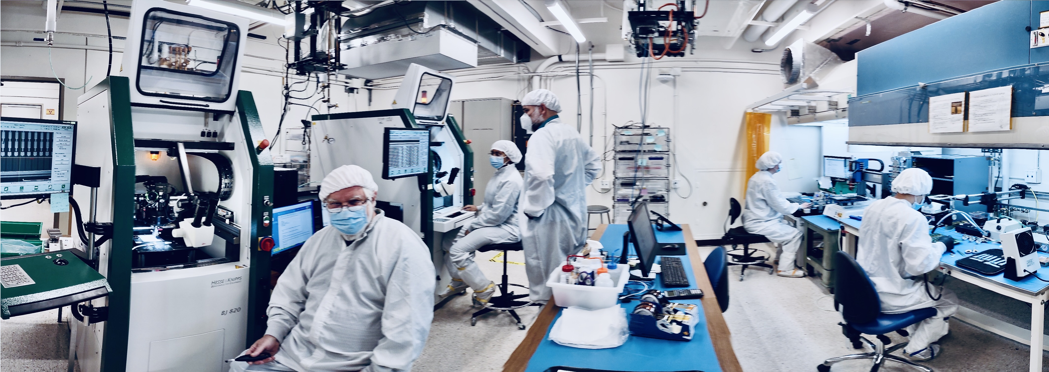
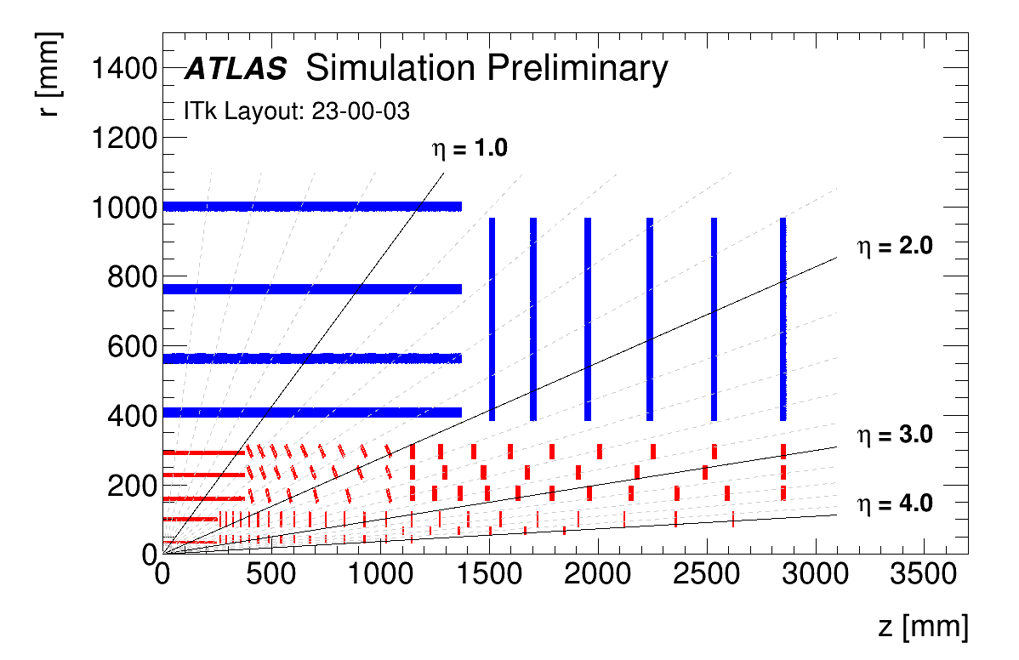
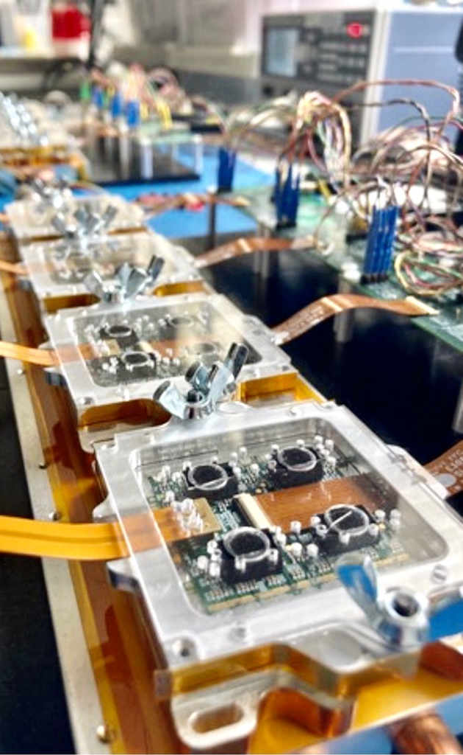
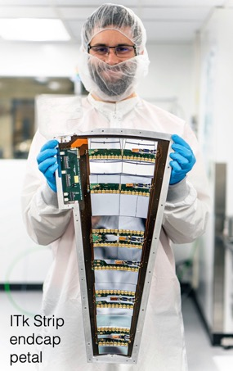
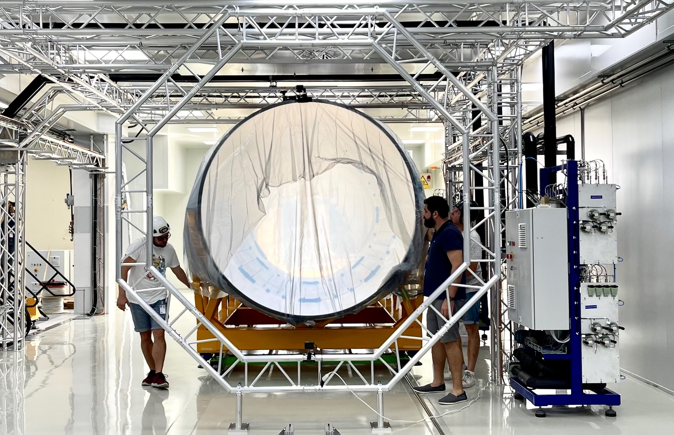
New ATLAS Inner Tracker (ITk)
New ATLAS silicon pixel and strip tracker (5B channels, |η| ≤ 4: e.g. in VBF, 30 GeV central-jet veto efficiency rises from 26% to 82% owing to better pileup mitigation)
Pixel sensor size (z–ϕ)
Outer layers:
ITk Pixel
Current Pixel
Innermost barrel layer:
ITk Pixel (L0)
Current IBL
Current SCT active layers
[4,088 modules → 17,888 (ITk)]
[61 m² silicon → 165 m² (ITk)]
Current Pixel active layers
[2,024 modules → 8,372 (ITk)]
[1.7 m² silicon → 13 m² (ITk)]
New Inner Tracking Detector (ITk)
All silicon, up to |η| = 4
ITk: ~13 hits in barrel (incl. 2 hits per Strip module), minimum ~9 Pixel hits in forward region

Slide 15
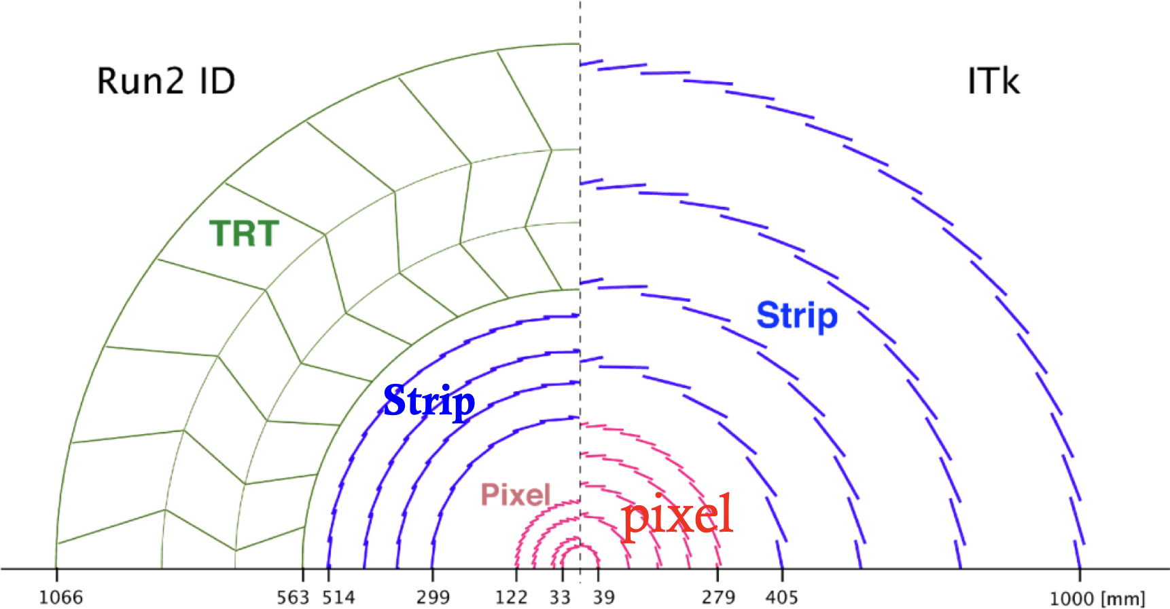
New ATLAS Inner Tracker (ITk)
New ATLAS silicon pixel and strip tracker (5B channels, |η| ≤ 4: e.g. in VBF, 30 GeV central-jet veto efficiency rises from 26% to 82% owing to better pileup mitigation)
ITk: ~13 hits in barrel (incl. 2 hits per Strip module), minimum ~9 Pixel hits in forward region

Slide 16
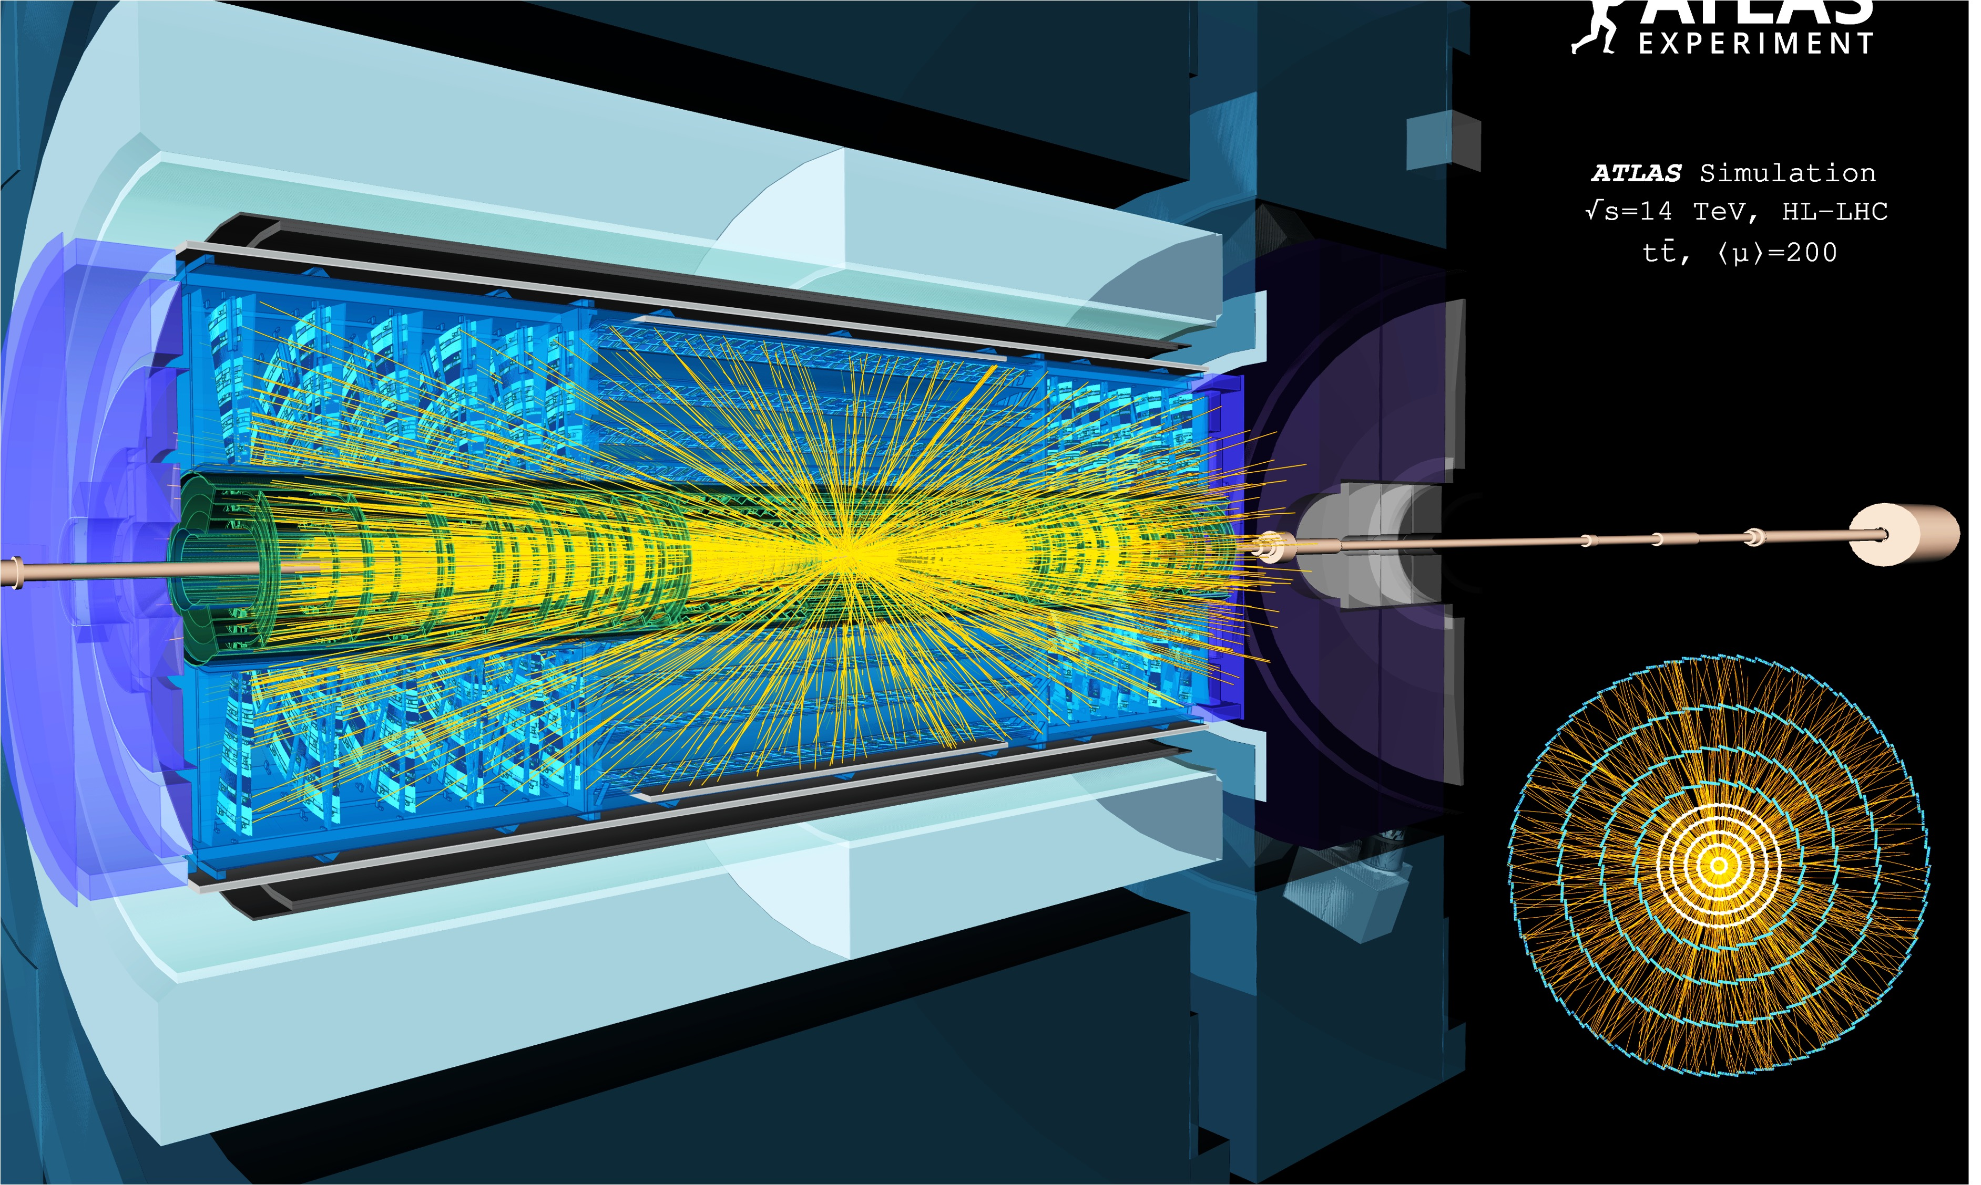

Display of a simulated top–antitop event with µ = 200 (1600 tracks) in the ATLAS ITk

Slide 17
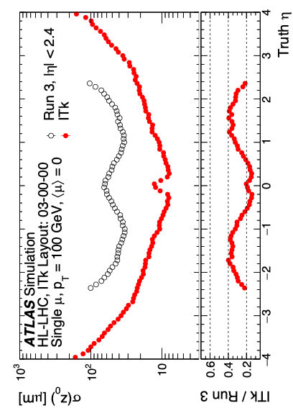
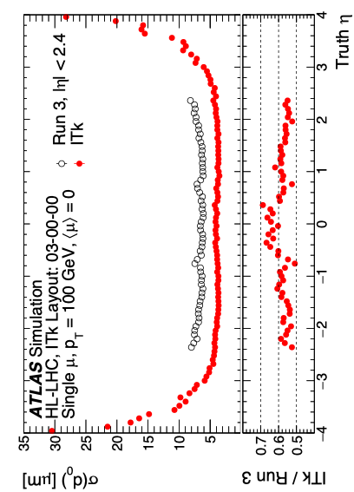
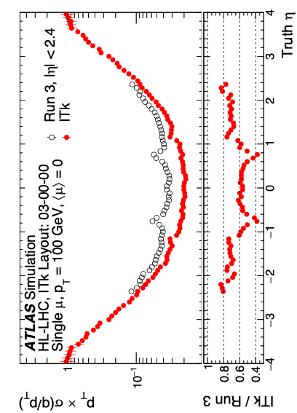
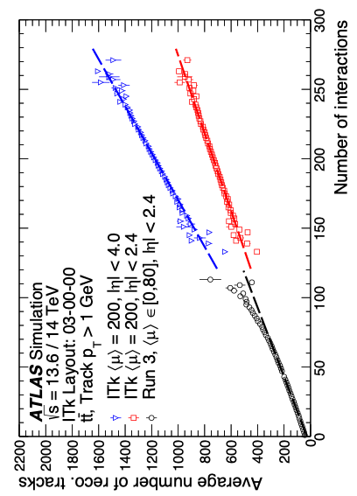
Performance of ATLAS ITk
JINST 20 (2025) P02018
For 100 GeV muons, z₀ resolution improves by up to ×5, enhancing pileup rejection; d₀ and p_{T} resolutions also improve, benefiting flavour tagging and H → μμ (smaller gains at low p_{T} due to multiple scattering)
Quasi-linear scaling of track multiplicity with pile-up

Slide 18
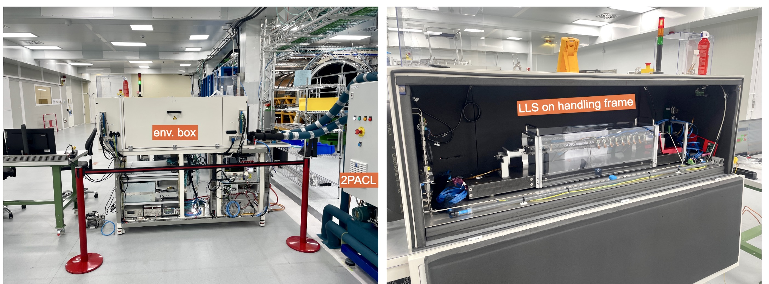
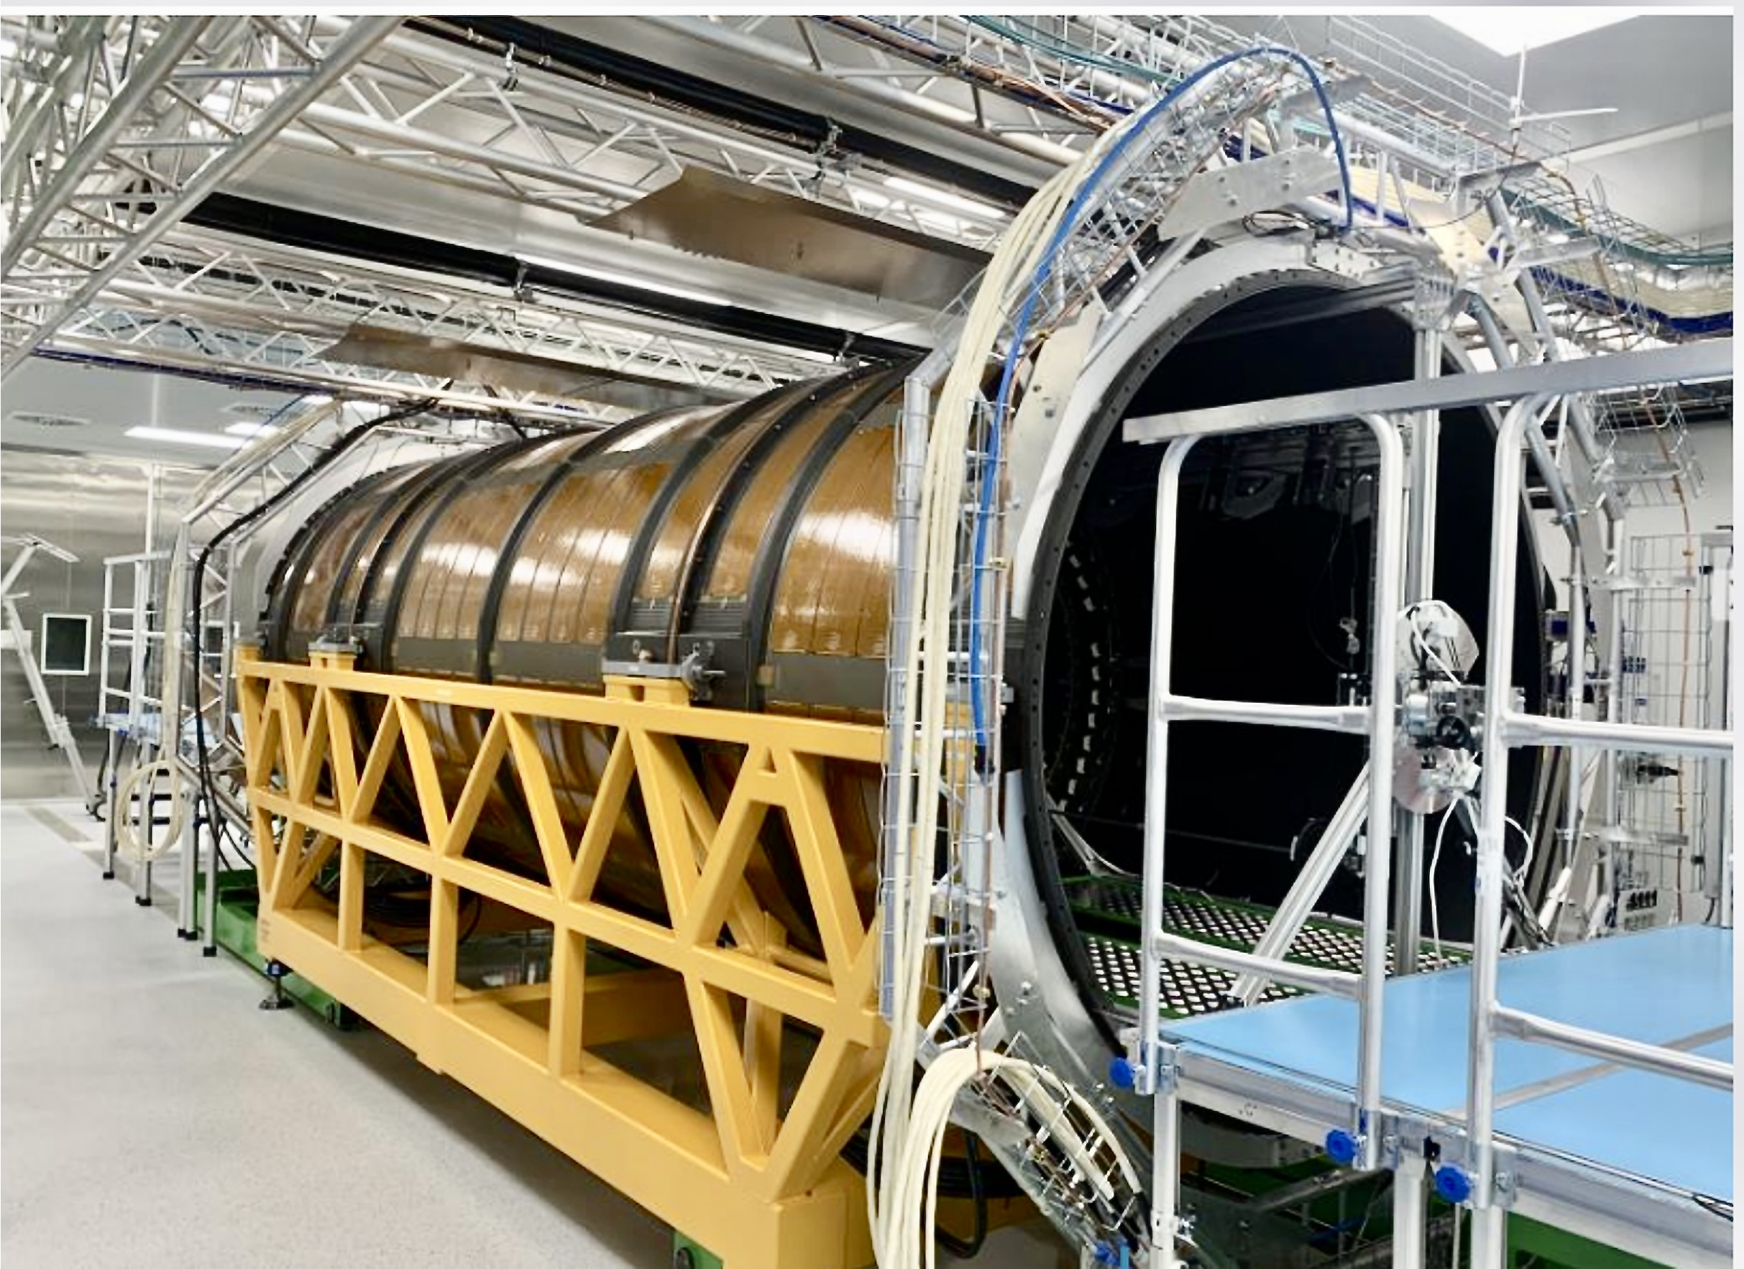
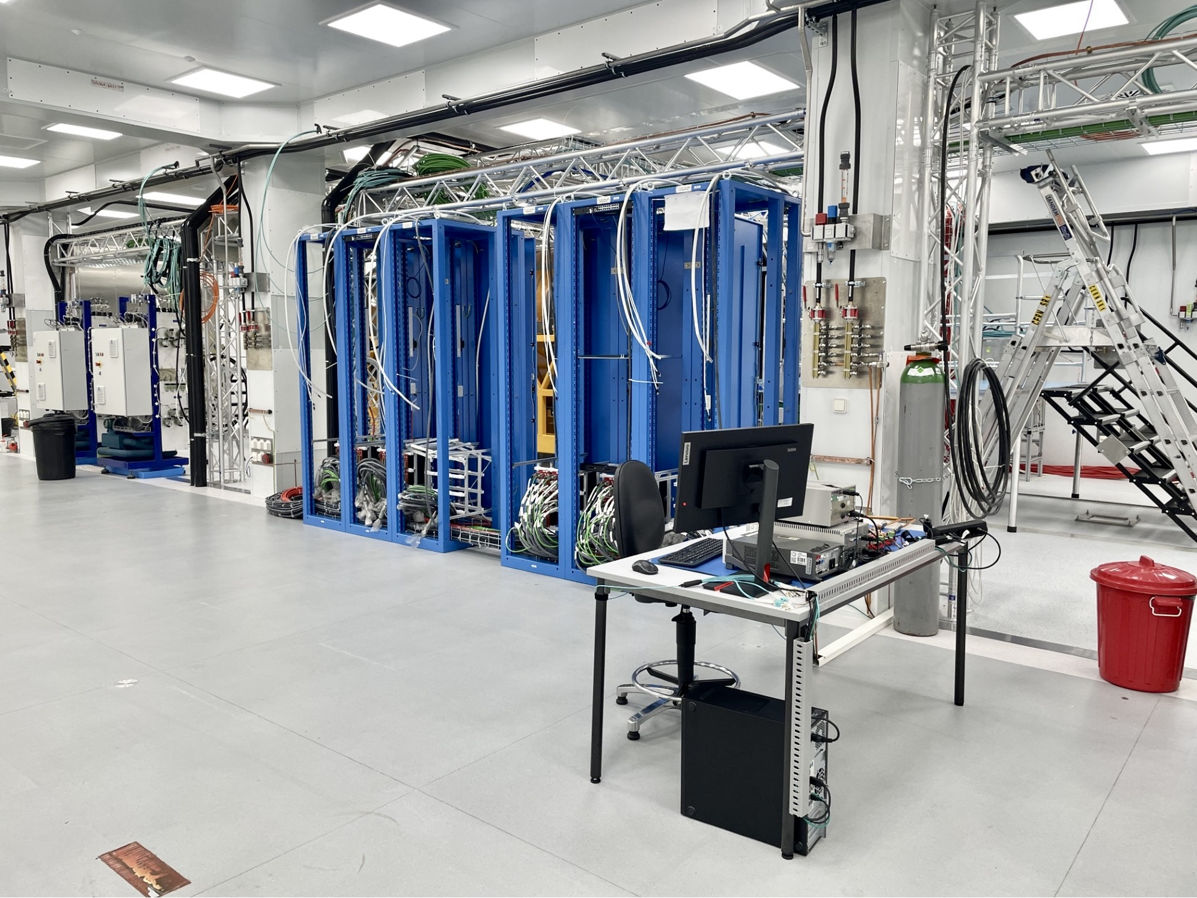
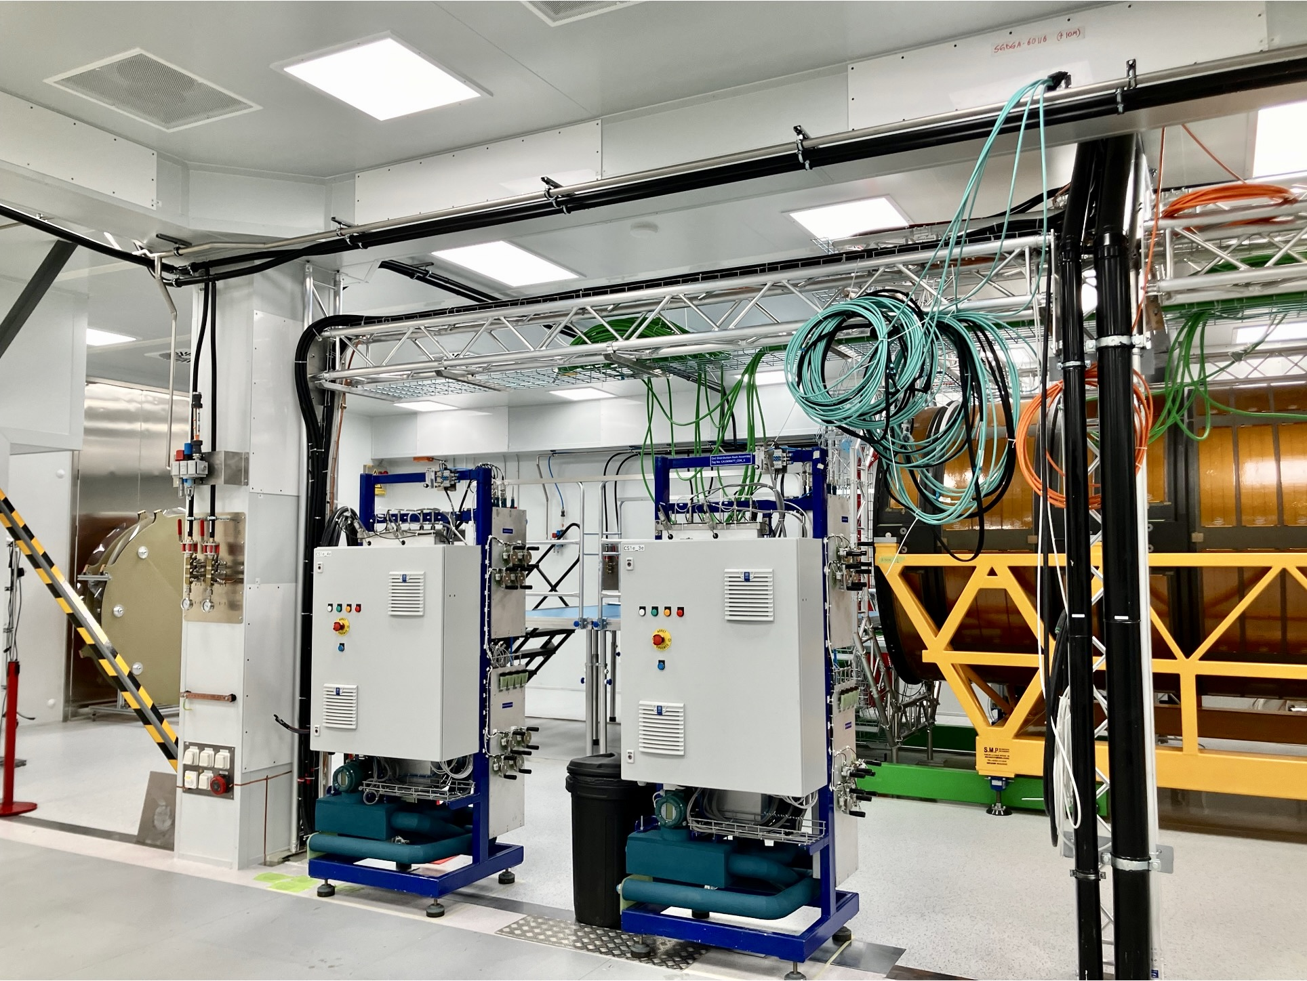
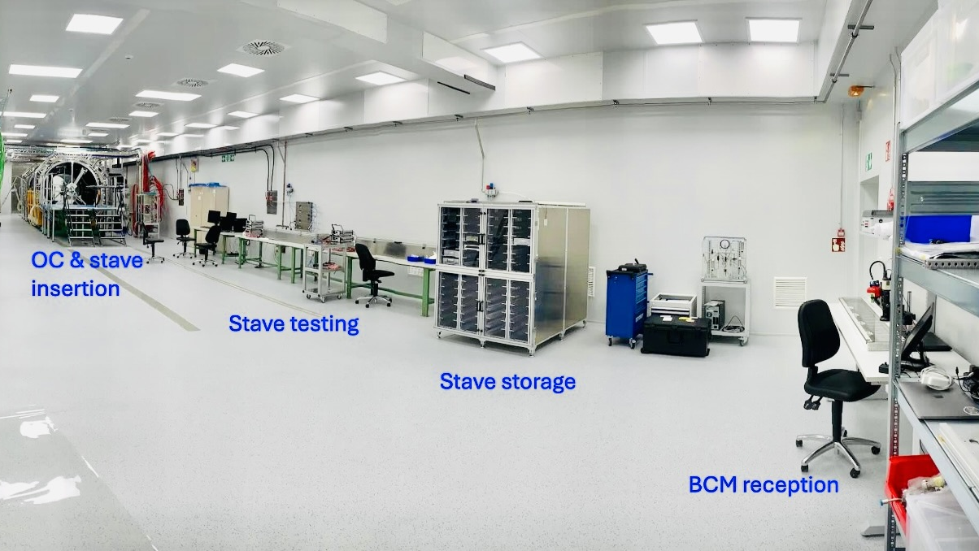
SR1 at Point 1: cleanroom for ITk Pixel and Strip integration
Top: ITk Outer Cylinder
Outer Barrel loaded local support reception test stand
Outer Barrel integration area
Bottom: ITk Strip integration area

Slide 19
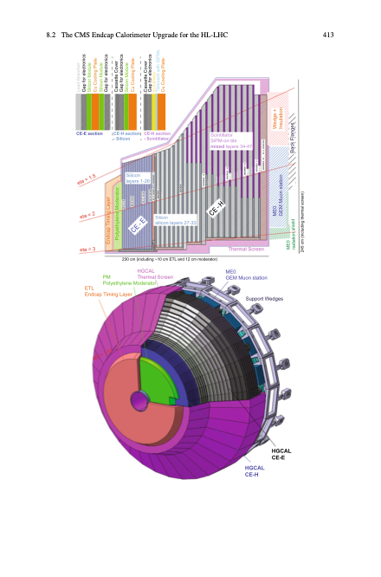
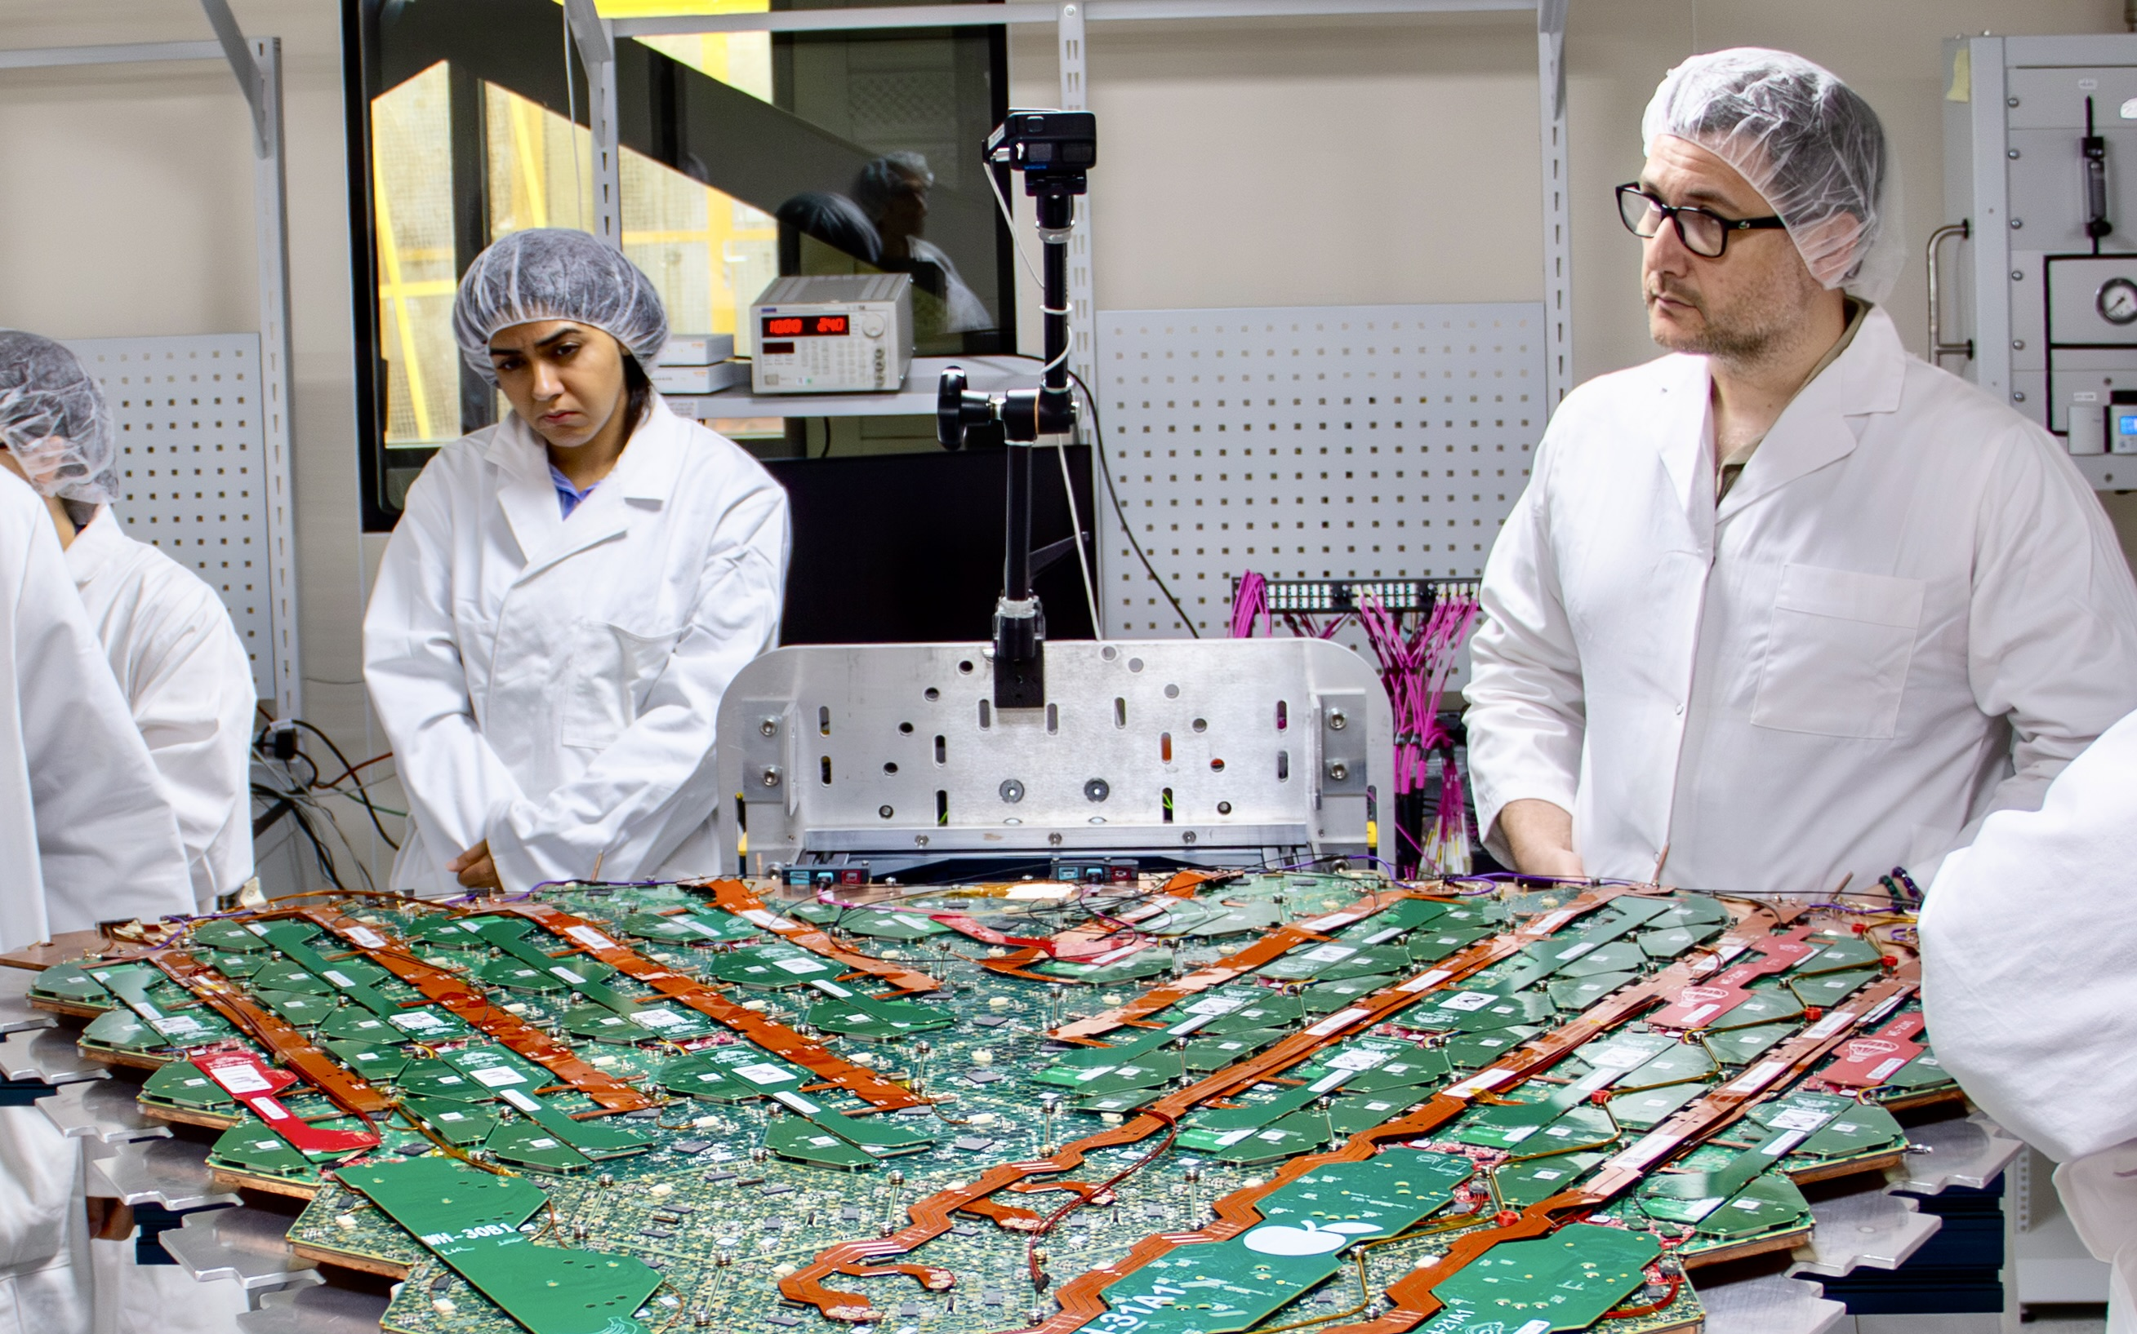
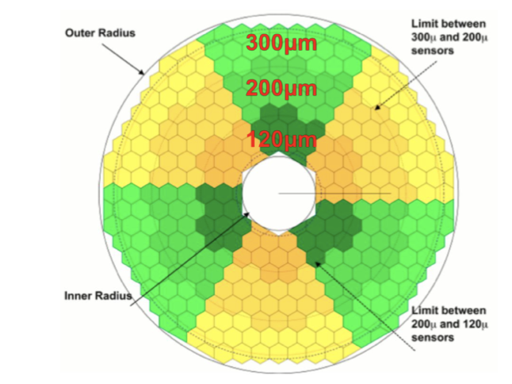
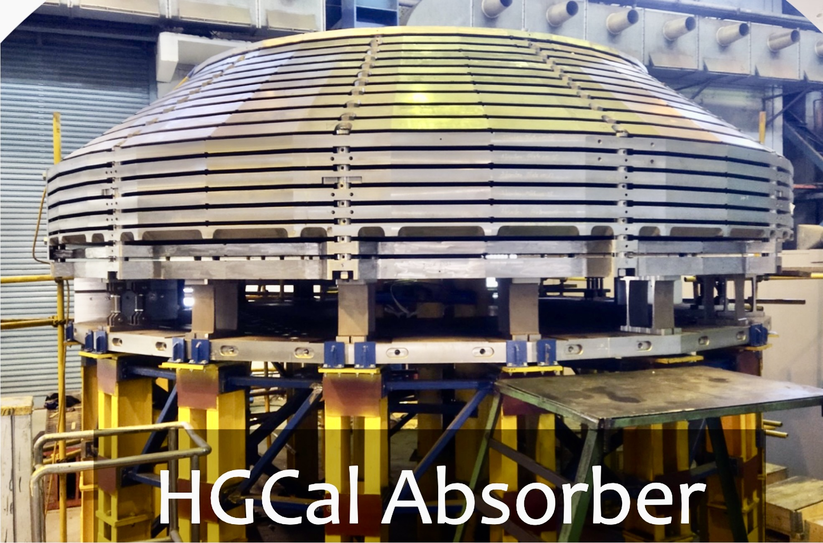
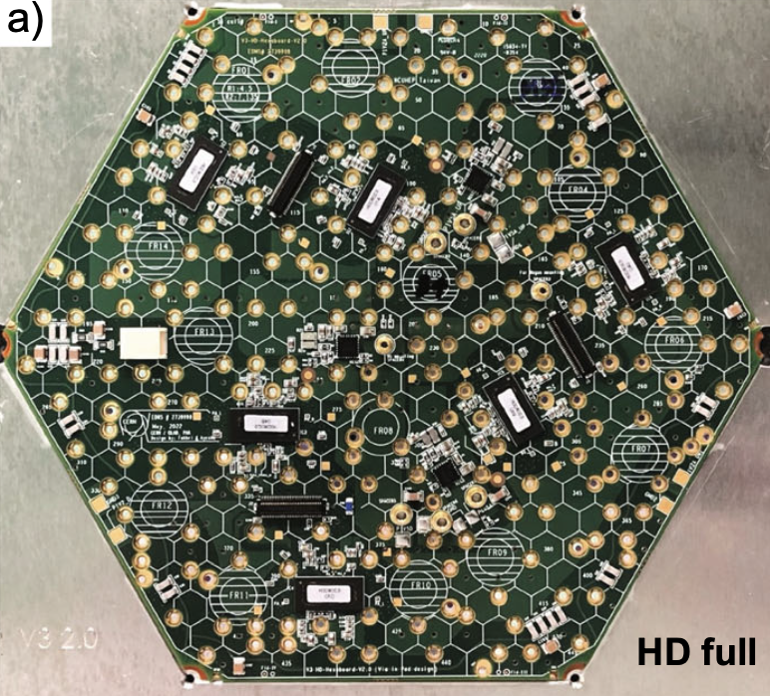
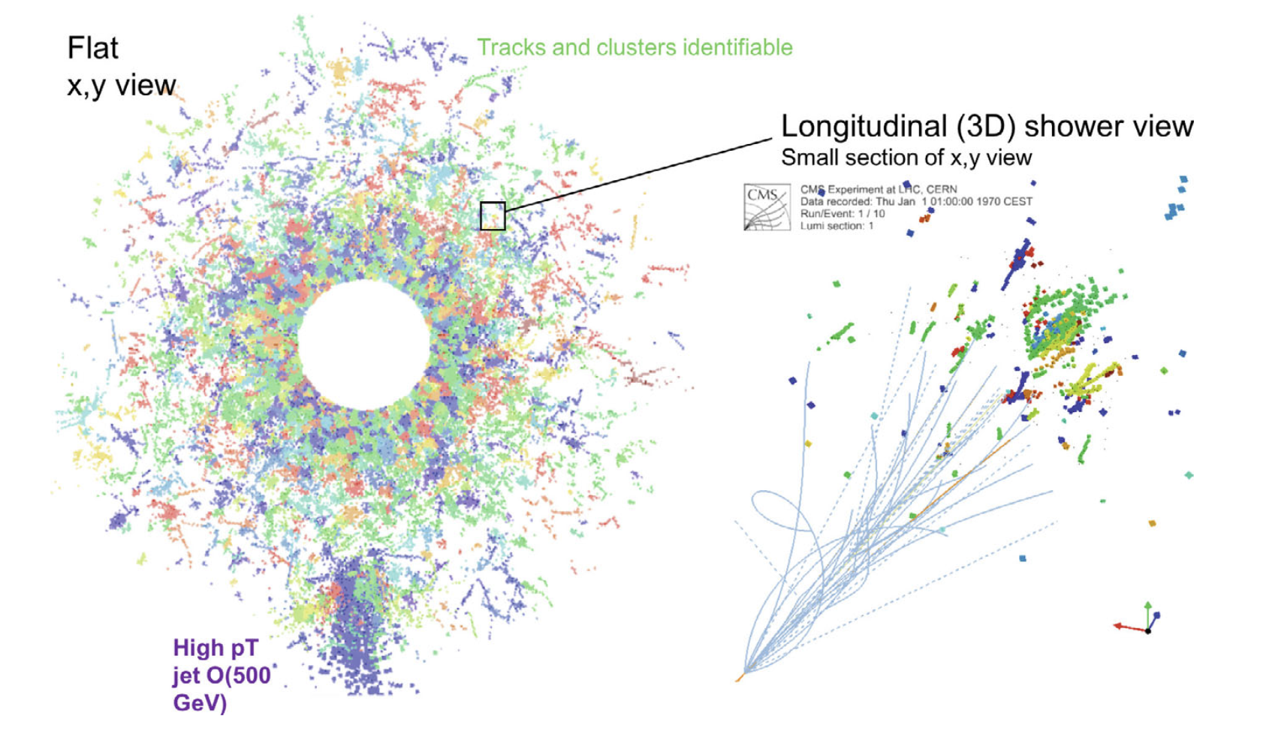
New High-Granularity Silicon CMS Endcap Calorimeter
New CMS endcap calorimeter (HGCAL, 1.5 < η < 3) — highly segmented, 5D imaging sampling calorimeter with 26 Si + Pb/CuW/Cu layers in EM section (CE-E), and 7 Si plus 14 scintillator + steel/Cu layers in HAD section (CE-H), to provide precise energy, position, and timing measurements in high-radiation forward region, 6M channels, 27k Si modules, 620 m² of silicon (ATLAS tracker: 180 m²)
Reference
HGCAL cassette prototype

Slide 20
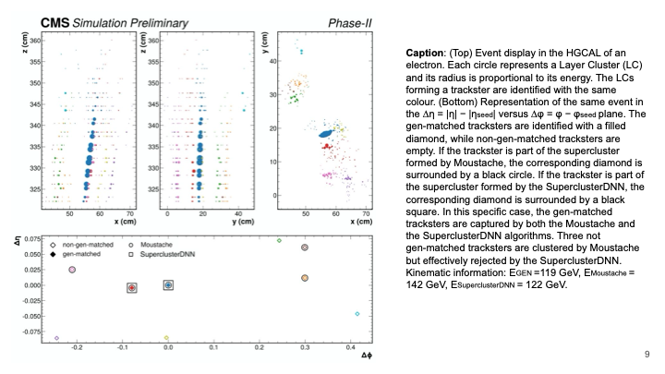
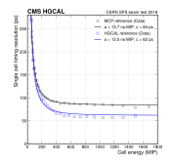
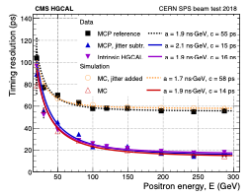
New High-Granularity Silicon CMS Endcap Calorimeter
New CMS endcap calorimeter (HGCAL, 1.5 < η < 3) — highly segmented, 3D imaging sampling calorimeter with 26 Si + Pb/CuW/Cu layers in EM section (CE-E), and 7 Si plus 14 scintillator + steel/Cu layers in HAD section (CE-H), to provide precise energy, position, and timing measurements in high-radiation forward region, 6M channels, 27k Si modules, 620 m² of silicon (ATLAS tracker: 180 m²)
CMS DP -2024/124
arXiv:2312.14622
Event display in the HGCAL of an electron. Each circle represents a Layer Cluster (LC) and its radius is proportional to its energy. The LCs forming a trackster* are identified with the same colour
Timing results from 2018 positron beam tests of an HGCAL prototype. If sufficient energy, reaching 60 ps single channel and 20 ps full shower resolution
*trackster is reconstructed 3D representation of a particle shower (or shower fragment) in HGCAL

Slide 21
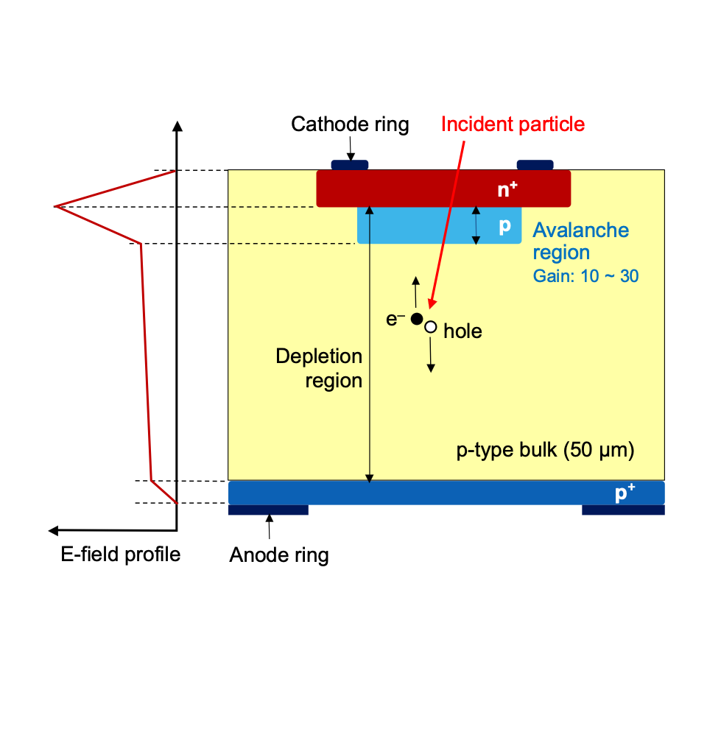
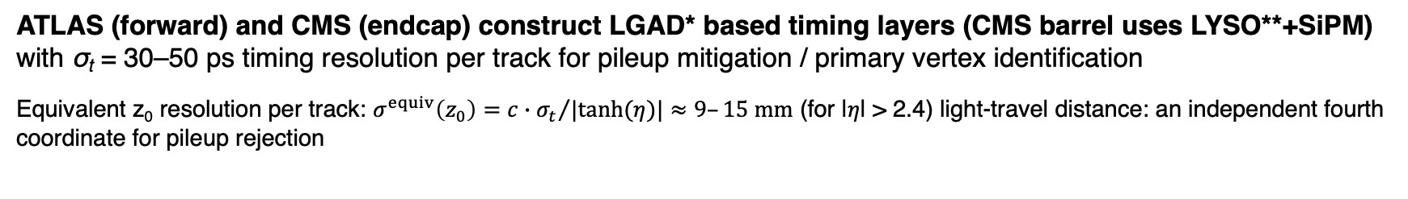
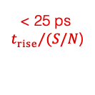
A 4th tracking coordinate: precision timing
*LGAD = Low-Gain Avalanche Detector
LYSO** is a fast rad hard scintillating crystal
ATLAS (forward) and CMS (endcap) construct LGAD* based timing layers (CMS barrel uses LYSO**+SiPM) with σ_{t} = 30–50 ps timing resolution per track for pileup mitigation / primary vertex identification
Equivalent z₀ resolution per track: $σ^{equiv}\left(z_{0}\right)={c∙σ_{t}}/{|tanh(η)|}≈9–15 mm$ (for |𝜂| > 2.4) light-travel distance: an independent fourth coordinate for pileup rejection
ATLAS HGTD at a glance
Geometry:
Two double-sided disks per endcap at z ≈ ±3.5 m; 2.4 < |η| < 4.0; 2–3 hits per track
Granularity:
50 μm sensors; 1.3 × 1.3 mm² pads; 3.6 M channels in 8'032 modules
High E-field peak in narrow n⁺/p avalanche junction
Readout:
ASIC measures time of arrival and time over threshold; ToT corrects timewalk
Reconstruction:
Time-of-flight correction + calibrated offsets → track time; associated tracks determine vertex t (primary vertex t₀ required → barrel timing layer (CMS) helpful)
Lifetime:
~30 ps/track initially → ~50 ps at 2.5 × 10¹⁵ n_{eq}/cm²
–V_{bias} (~100–550 V)
What sets the time resolution
$$σ_{t}^{total} = σ_{t}^{Landau} ⨁{ σ}_{t}^{jitter} ⨁{ σ}_{t}^{timewalk} ⨁{ σ}_{t}^{TDC} ⨁{ σ}_{t}^{clock}$$
Mechanism: Gain layer → fast rise time; thin sensor → fast charge collection, less fluctuations; together: precision timing
Rad-mitigation: Engineered gain layer, active cooling, higher V_{bias}
< 25 ps
thin sensor
< 25 ps
${t_{rise}}/{(S/N}$)
< 10 ps
ToT correction
< 10 ps
digitisation
< 10 ps
distribution

Slide 22
Impact of radiation on silicon detectors
φ_{eq} = 1 MeV neutron-equivalent fluence
1 MGy = 1 MJ per kg absorbed energy
Detectors face harsh radiation fields varying with radial distance and pseudorapidity. Exposure is quantified by Non-Ionizing Energy Loss (NIEL fluence φ_{eq}) [unit: 1 MeV n_{eq}/cm²] and Total Ionizing Dose (TID) [MGy]
Impact on silicon
Maximum doses (4 ab^{–1})
BULK · NIEL
Displacement defects in silicon lattice → p-type carrier generation (I_{leak} ↑), trapping ↑ (Q_{col} ↓), space-charge changes (V_{dep} ↑)
DETECTOR REGION
φ_{eq} [n_{eq} /cm²]
TID
ATLAS/CMS Inner Pixels
2 × 10¹⁶
10 MGy
SURFACE · TID
Oxide / interface charge builds up → surface leakage (I_{leak} ↑), insulation, ASIC transistor threshold voltage shifts
CMS HGCAL silicon
1 × 10¹⁶
6 MGy
ATLAS HGTD (sensor)
2.5 × 10¹⁵
2 MGy
LGAD
Gain-layer acceptors are removed → multiplication gain ↓, timing jitter ↑
ATLAS ITk Strips
1.5 × 10¹⁵
0.75 MGy
RADIATION LOAD
ELECTRICAL DAMAGE
SIGNAL QUALITY
MEASUREMENT
φ_{eq} ↑ and TID ↑
I_{leak} ↑ V_{dep} ↑
trapping ↑ LGAD gain ↓
Q_{col} ↓ shot noise ↑
S/N and timing degrade
Hit efficiency falls; tracking, timing and calorimeter response worsen
Recover charge collection during operation
But bias has a ceiling (limiting det. lifetime)
V_{bias} ↑ → deeper depletion + stronger field + faster drift → Q_{col} and efficiency recover
Sensor breakdown and HV insulation limits, thermal runaway, excessive shot noise, LGAD single-event burnout SEB (< 550 V)
Cold operation (−35 °C CO₂ set point) suppresses I_{leak} and prevents thermal runaway

Slide 23
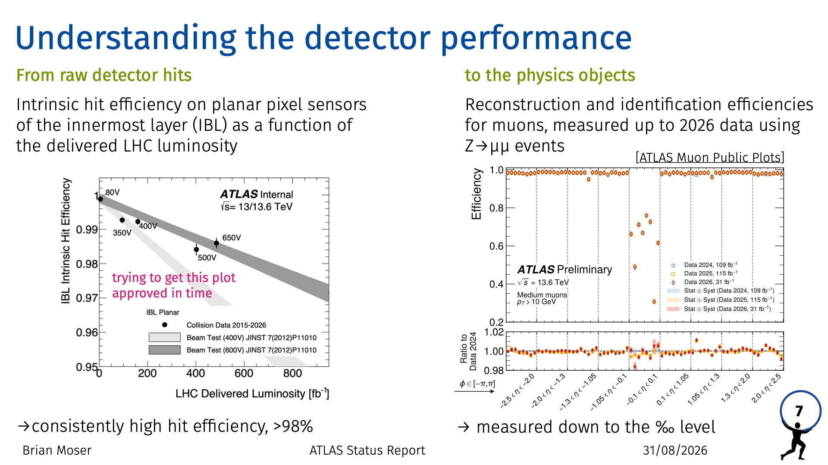
Impact of radiation on silicon detectors
φ_{eq} = 1 MeV neutron-equivalent fluence
1 MGy = 1 MJ per kg absorbed energy
Detectors face harsh radiation fields varying with radial distance and pseudorapidity. Exposure is quantified by Non-Ionizing Energy Loss (NIEL fluence φ_{eq}) [unit: 1 MeV n_{eq}/cm²] and Total Ionizing Dose (TID) [MGy]
Impact on silicon
Maximum doses (4 ab^{–1})
BULK · NIEL
Displacement defects in silicon lattice → p-type carrier generation (I_{leak} ↑), trapping ↑ (Q_{col} ↓), space-charge changes (V_{dep} ↑)
DETECTOR REGION
φ_{eq} [n_{eq} /cm²]
TID
ATLAS/CMS Inner Pixels
2 × 10¹⁶
10 MGy
SURFACE · TID
Oxide / interface charge builds up → surface leakage (I_{leak} ↑), insulation, ASIC transistor threshold voltage shifts
CMS HGCAL silicon
1 × 10¹⁶
6 MGy
ATLAS HGTD (sensor)
2.5 × 10¹⁵
2 MGy
LGAD
Gain-layer acceptors are removed → multiplication gain ↓, timing jitter ↑
ATLAS ITk Strips
1.5 × 10¹⁵
0.75 MGy
RADIATION LOAD
ELECTRICAL DAMAGE
SIGNAL QUALITY
MEASUREMENT
φ_{eq} ↑ and TID ↑
I_{leak} ↑ V_{dep} ↑
trapping ↑ LGAD gain ↓
Q_{col} ↓ shot noise ↑
S/N and timing degrade
Hit efficiency falls; tracking, timing and calorimeter response worsen
Recover charge collection during operation
But bias has a ceiling (limiting det. lifetime)
V_{bias} ↑ → deeper depletion + stronger field + faster drift → Q_{col} and efficiency recover
Sensor breakdown and HV insulation limits, thermal runaway, excessive shot noise, LGAD single-event burnout SEB (< 550 V)
Cold operation (−35 °C CO₂ set point) suppresses I_{leak} and prevents thermal runaway

Slide 24
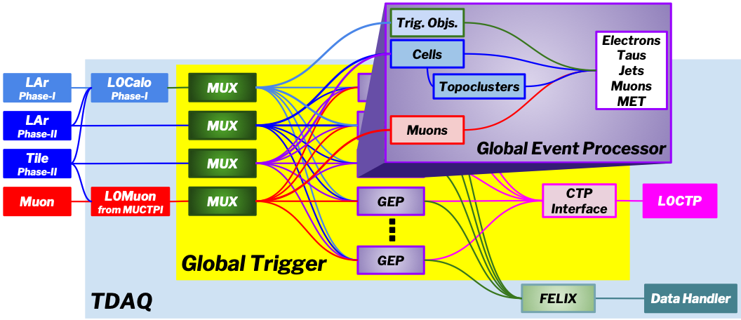
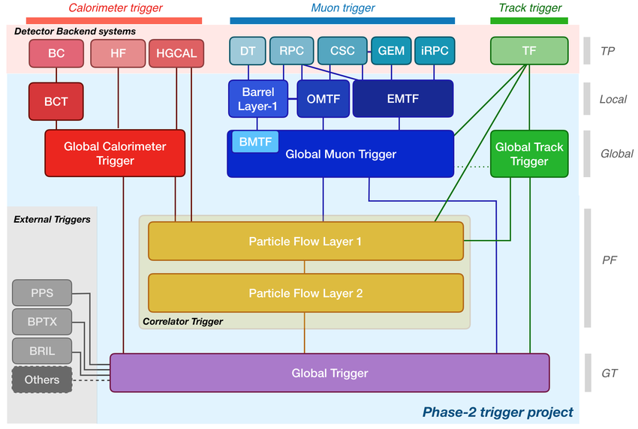

ATLAS and CMS Trigger and Data Acquisition Upgrade
Significantly improved TDAQ especially for the first hardware level: throughput of 1 MHz (ATLAS), 750 kHz (CMS), much more detailed object-level, topological, and global event selection capabilities, including ML, based on powerful FPGAs
Aim: keep and improve over Run-2 selections (low thresholds) in much harder HL-LHC environment, and offer new opportunities
New ATLAS L0 Global Trigger: offline-quality reconstruction using input from calorimeters and muon systems built upon digital improvements realised during Phase-I upgrade
New CMS L1 trigger design: the Global Muon Trigger matches muons to tracks built from outer tracker stubs in the Track Finder, the Global Track Trigger reconstructs the primary vertex, the Correlator Trigger performs particle-flow, and the Global Trigger makes the final decision
ATLAS Global Common Module prototype (v3)

Slide 25

ATLAS and CMS Trigger and Data Acquisition Upgrade
Significantly improved TDAQ especially for the first hardware level: throughput of 1 MHz (ATLAS), 750 kHz (CMS), much more detailed object-level, topological, and global event selection capabilities, including ML, based on powerful FPGAs
Aim: keep and improve over Run-2 selections (low thresholds) in much harder HL-LHC environment, and offer new opportunities
New ATLAS L0 Global Trigger: offline-quality reconstruction using input from calorimeters and muon systems built upon digital improvements realised during Phase-I upgrade
CMS Outer Tracker paired sensors discard low-p_{T} pileup locally, while fast FPGAs combine the surviving stubs into tracks that make the hardware trigger vertex-aware and far more selective
New CMS L1 trigger design: the Global Muon Trigger matches muons to tracks built from outer tracker stubs in the Track Finder, the Global Track Trigger reconstructs the primary vertex, the Correlator Trigger performs particle-flow, and the Global Trigger makes the final decision
ATLAS Global Common Module prototype (v3)

Slide 26




Ambitious LHCb Upgrade II and ALICE 3 for Run 5 (2036–2041)
LHCb Upgrade II [LHCb Upgrade II scoping document]
Goal: enable operating at L_{inst} = 1.5 × 10³⁴ cm^{–2}s^{–1} (currently 0.23 × 10³⁴ cm^{–2}s^{–1}), for L_{int} > 300 fb^{–1}
Challenge: pileup of 42 (current: ~6) → efficient tracking and vertexing, excellent PID, precise timing
ALICE upgrades during LS3
New ITS3 (MAPS) and forward calorimeter
ALICE 3 [ALICE 3 scoping document]
Key goals: early-stage temperature with dielectrons, properties and hadronisation of QGP with heavy flavour hadrons, low-p_{T} hadron reconstruction required
Compact low-mass all-silicon tracker, excellent vertex reconstruction, wide acceptance |η|< 4, PID in wide p_{T} range, high readout rate in A-A and pp
Shielding
During stable beams
ALICE3 detector model
Retractable silicon vertex detector at 5 mm (15 mm during injection) from beam, giving < 10 µm pointing resolution for p_{T} > 200 MeV in high-multiplicity environment at ALICE3
During injection

Slide 27



Environmental impact of LHC / HL-LHC operation
Source: CERN Environmental Report 2023–2024
CERN’s total annual power consumption is ~1.3 TWh dropping to ~0.4 TWh when LHC is not operating
Total of 350 kt CO₂e in 2024
Scope 1: direct emission of greenhouse gases*
Scope 2: indirect emission via purchased electricity
Scope 3: all other indirect emission (procurement, …)
*F-gas impact mainly from RPC losses and detector cooling; HL-LHC reductions from leak repairs, gas dilution, and new CO₂ cooling plants

Slide 28



New opportunities at the HL-LHC
20 times more luminosity than Run 2 and better detectors offer significantly enhanced physics reach
Sensitivity increase by up to 2 TeV for searches
http://collider-reach.cern.ch
3000 fb^{–1} at 13.6 TeV
3000 fb^{–1} at 14.0 TeV
Proton–proton collisions correspond to a convolution of Parton Density Functions (PDF) with parton–parton scattering matrix element
CM energy-squared of parton collision:
More luminosity allows to explore the high-x tails of the PDFs and thus reach higher parton collision energies

Slide 29
New opportunities at the HL-LHC
20 times more luminosity than Run 2 and better detectors offer significantly enhanced physics reach
Sensitivity increase by up to 2 TeV for searches
√L or better sensitivity increase to new physics with weak or suppressed couplings (eg, EW SUSY, WIMPs, or feebly interacting particles)
Sensitivity to new SM processes, extended phase space, and improved precision in Higgs, multiboson, top, flavour, … probes
arXiv:2402.07985
Evolution of the expected significance in CMS 4 top search, and what really happened

Slide 30


New opportunities at the HL-LHC
20 times more luminosity than Run 2 and better detectors offer significantly enhanced physics reach
Sensitivity increase by up to 2 TeV for searches
√L or better sensitivity increase to new physics with weak or suppressed couplings (eg, EW SUSY, WIMPs, or feebly interacting particles)
Sensitivity to new SM processes, extended phase space, and improved precision in Higgs, multiboson, top, flavour, … probes
Increased trigger acceptance and selection capabilities for low-mass, soft, unconventional signatures
With the expected backgrounds
CMS-DP-2025-058
L1 data scouting prospects for low-mass μμ resonance search (eg, dark photon), excellent resolution owing to track trigger

Slide 31

New opportunities at the HL-LHC
20 times more luminosity than Run 2 and better detectors offer significantly enhanced physics reach
Sensitivity increase by up to 2 TeV for searches
√L or better sensitivity increase to new physics with weak or suppressed couplings (eg, EW SUSY, WIMPs, or feebly interacting particles)
Sensitivity to new SM processes, extended phase space, and improved precision in Higgs, multiboson, top, flavour, … probes
Increased trigger acceptance and selection capabilities for low-mass, soft, unconventional signatures, and AD
Increased forward acceptance of trackers allows improved reconstruction of VBF/VBS topologies, constraints on PDFs, and control of pileup
New timing detectors with 30 ~ 50 ps resolution help mitigate pileup and improve the detection of long-lived particles
Vector boson scattering diagramme

Slide 32

New opportunities at the HL-LHC
20 times more luminosity than Run 2 and better detectors offer significantly enhanced physics reach
Sensitivity increase by up to 2 TeV for searches
√L or better sensitivity increase to new physics with weak or suppressed couplings (eg, EW SUSY, WIMPs, or feebly interacting particles)
Sensitivity to new SM processes, extended phase space, and improved precision in Higgs, multiboson, top, flavour, … probes
Increased trigger acceptance and selection capabilities for low-mass, soft, unconventional signatures, and AD
Increased forward acceptance of trackers allows improved reconstruction of VBF/VBS topologies, constraints on PDFs, and control of pileup
New timing detectors with 30 ~ 50 ps resolution help mitigate pileup and improve the detection of long-lived particles
Machine learning and AI will continue to boost detector, reconstruction, and analysis performance, as well as our work efficiency
ATL-SOFT-PUB-2026-002

Slide 33





HL-LHC Physics prospects — Higgs
Higgs physics is one of the science drivers of the HL-LHC
Huge experimental programme. Some channels suffer from large backgrounds, big improvements from smart analysis techniques and machine learning
Channel categories |  | BR | ggF | VBF | VH | ttH
Cross Section (13 TeV) |  |  | 48.6 pb | 3.8 pb | 2.3 pb | 0.5 pb
γγ | 0.2 % | 0.2 % | ✓ | ✓ | ✓ | ✓
ZZ | 2.6% | 3% | ✓ | ✓ | ✓ | ✓
WW | 21% | 22% | ✓ | ✓ | ✓ | ✓
ττ | 6.3 % | 6.3 % | ✓ | ✓ | ✓ | ✓
bb | 58% | 55% | ✓ | ✓ | ✓ | ✓
Zγ (& γγ∗) | 0.2 % | 0.2 % | ✓ | ✓ | ✓ | ✓
μμ | 0.02 % | 0.02 % | ✓ | ✓ | ✓ | ✓
f
$$∝N_{C}\frac{m_{f}}{υ}$$
f
H
$$∝\frac{2m_{W/Z}^{2}}{υ}$$
+ ….
Key to many mysteries
$$∝\frac{3m_{H}^{2}}{υ}$$
H
H

Slide 34




Higgs couplings
Higgs coupling prospects
Coupling strength modifiers ($κ_{i}^{2}≡{σ_{i}}/{σ_{i}^{SM}}$, assuming SM $Γ_{H}$)
arXiv:2504.00672
Remember: the best measured coupling probes compositness of the Higgs boson
Current status:
Coupling modifier | ATLAS (Γ_{H→inv/und} = 0, 𝜅_{c} = 𝜅_{t}) [arXiv:2608.07332] | CMS (Γ_{H→inv/und},= 0 𝜅_{c} = 𝜅_{t}) [arXiv:2602.18611]
𝜅_{Z} | 0.97 ± 0.05 | 1.06 ± 0.06
𝜅_{W} | 1.01 | 1.03 ± 0.06
𝜅_{𝛾} (effective) | 0.99 ± 0.06 | 1.07 ± 0.07
𝜅_{τ} | 0.95 | 0.93
𝜅_{t} | 0.86 ± 0.08 | 0.80 ± 0.09
probes $f_{H} \sim$ 1.9 TeV
+ 0.05
– 0.04
+ 0.07
– 0.06
+ 0.08
– 0.07
Assuming SM value for $Γ_{H}$
5.0 (0.1)% precision on $κ_{i}$ probes $f_{H} \sim$ 0.8 (5.5) TeV
Coupling strength modifiers: $κ_{i}^{2}≡{σ_{i}}/{σ_{i}^{SM}}$ or $κ_{i}^{2}≡{Γ_{i}}/{Γ_{i}^{SM}}$

Slide 35
Higgs couplings
Higgs coupling prospects
Coupling strength modifiers ($κ_{i}^{2}≡{σ_{i}}/{σ_{i}^{SM}}$, assuming SM $Γ_{H}$)
arXiv:2504.00672
Remember: the best measured coupling probes compositness of the Higgs boson
Current status:
Coupling modifier | ATLAS (Γ_{H→inv/und} = 0, 𝜅_{c} = 𝜅_{t}) [arXiv:2608.07332] | CMS (Γ_{H→inv/und},= 0 𝜅_{c} = 𝜅_{t}) [arXiv:2602.18611]
𝜅_{Z} | 0.97 ± 0.05 | 1.06 ± 0.06
𝜅_{W} | 1.01 | 1.03 ± 0.06
𝜅_{𝛾} (effective) | 0.99 ± 0.06 | 1.07 ± 0.07
𝜅_{τ} | 0.95 | 0.93
𝜅_{t} | 0.86 ± 0.08 | 0.80 ± 0.09
+ 0.05
– 0.04
Unique sensitivity to top coupling and rare decays
+ 0.07
– 0.06
+ 0.08
– 0.07
5.0 (0.1)% precision on $κ_{i}$ probes $f_{H} \sim$ 0.8 (5.5) TeV
Coupling strength modifiers: $κ_{i}^{2}≡{σ_{i}}/{σ_{i}^{SM}}$ or $κ_{i}^{2}≡{Γ_{i}}/{Γ_{i}^{SM}}$

Slide 36
Higgs couplings
Higgs coupling prospects
Coupling strength modifiers ($κ_{i}^{2}≡{σ_{i}}/{σ_{i}^{SM}}$, assuming SM $Γ_{H}$)
arXiv:2504.00672
Remember: the best measured coupling probes compositness of the Higgs boson
Current status:
Coupling modifier | ATLAS (Γ_{H→inv/und} = 0, 𝜅_{c} = 𝜅_{t}) [arXiv:2608.07332] | CMS (Γ_{H→inv/und},= 0 𝜅_{c} = 𝜅_{t}) [arXiv:2602.18611]
𝜅_{Z} | 0.97 ± 0.05 | 1.06 ± 0.06
𝜅_{W} | 1.01 | 1.03 ± 0.06
𝜅_{𝛾} (effective) | 0.99 ± 0.06 | 1.07 ± 0.07
𝜅_{τ} | 0.95 | 0.93
𝜅_{t} | 0.86 ± 0.08 | 0.80 ± 0.09
Even with 2× better theory precision, its uncertainties remain dominant
+ 0.05
– 0.04
+ 0.07
– 0.06
+ 0.08
– 0.07
5.0 (0.1)% precision on $κ_{i}$ probes $f_{H} \sim$ 0.8 (5.5) TeV
Coupling strength modifiers: $κ_{i}^{2}≡{σ_{i}}/{σ_{i}^{SM}}$ or $κ_{i}^{2}≡{Γ_{i}}/{Γ_{i}^{SM}}$

Slide 37



BSM Higgs
Higgs width from off-shell measurement and invisible decays, Higgs sector extensions (2HDM)
Γ_{H} via μ_{off-shell} / μ_{on-shell} in H → 4𝓁 & 2𝓁2𝜈 with < 20% uncertainty
BR(H → invisible) < 2.5%
Discover or exclude MSSM two Higgs doublets scenario deep into TeV scale for tanβ > 6
ATLAS & CMS Snowmass White Paper
2 Higgs doublets, $H_{u}$, $H_{d}$ with VEVs $υ^{2}=υ_{u}^{2}+υ_{d}^{2}$
$$\tan{β}≡\frac{υ_{u}}{υ_{d}}, y_{t/b}=\frac{\sqrt{2} m_{t/b}}{υsin/cos{β}}$$
Five Higgs bosons after EWSB: $h, H, A, H^{+}, H^{−}$

Slide 38













Higgs self-coupling
Higgs self-coupling via Higgs pair production: complex final states, eldorado for ML enthusiasts, strongest channels: HH → bb𝛾𝛾 (0.27%), bb𝜏𝜏 (7.3%), bbbb (34%); best sensitivity to $λ$ at low $m_{HH}$
Higgs potential:
$$V\left(φ\right)=−μ^{2}{\left|φ\right|}^{2}+λ{\left|φ\right|}^{4}$$
Reference
After expansion around minimum:
$$V(H)=\frac{1}{2}m_{H}^{2}H^{2}+λ_{3}υH^{3}+\frac{1}{4}λ_{4}H^{4}$$
where: $λ_{3}^{SM}=λ_{4}^{SM}=λ^{SM}$ and: $κ_{λ}≡{λ_{3}^{obs}}/{λ^{SM}}$
HH production via gluon fusion and triple-Higgs coupling
Minimum HH cross section at $κ_{λ}≃2.4​$
t
$$∝6λ_{3}υ=\frac{3m_{H}^{2}}{υ}$$
Dominates near $m_{HH}$ threshold
$$κ_{t}$$
Destructive interferes with box diagram:
t
$$κ_{t}$$
Dominates at large $m_{HH}$
t
$$κ_{t}$$
leads to small HH SM cross section of 32.5 (36) fb at 13 (13.6) TeV
Minimum HH cross section at $κ_{λ}≈2.3$

Slide 39

Higgs self-coupling
Higgs self-coupling via Higgs pair production: complex final states, eldorado for ML enthusiasts, strongest channels: HH → bb𝛾𝛾 (0.27%), bb𝜏𝜏 (7.3%), bbbb (34%); best sensitivity to $λ$ at low $m_{HH}$
Higgs potential:
$$V\left(φ\right)=−μ^{2}{\left|φ\right|}^{2}+λ{\left|φ\right|}^{4}$$
After expansion around minimum:
$$V(H)=\frac{1}{2}m_{H}^{2}H^{2}+λ_{3}υH^{3}+\frac{1}{4}λ_{4}H^{4}$$
where: $λ_{3}^{SM}=λ_{4}^{SM}=λ^{SM}$ and: $κ_{λ}≡{λ_{3}^{obs}}/{λ^{SM}}$
HH production via gluon fusion and triple-Higgs coupling
t
$$∝6λ_{3}υ=\frac{3m_{H}^{2}}{υ}$$
$$κ_{t}$$
Destructive interferes with box diagram:
t
$$κ_{t}$$
t
$$κ_{t}$$
A HH → 𝛾𝛾bb candidate event
leads to small HH SM cross section of 32.5 (36) fb at 13 (13.6) TeV
Minimum HH cross section at $κ_{λ}≈2.3$

Slide 40





Higgs self-coupling
First ATLAS & CMS combination of HH production using Run-2 datasets
arXiv:2602.23991
SM
CMS
ATLAS
$–0.7< κ_{λ}<6.1$ $(95\% CL)$
$$μ_{HH}={0.8}_{−0.7}^{+0.9}$$
SM
Combined
95% CL upper limit on HH signal strength $μ_{HH}=σ_{HH}^{obs}/σ_{HH}^{SM}$
$κ_{λ}=λ^{obs}/λ^{SM}$ $(λ_{SM} \sim 0.13)$

Slide 41




Higgs self-coupling
PLB 876 (2026) 140280
New ATLAS result on HH → bbγγ with 308 fb^{–1} (Run 2 + 2022–2024 of Run 3 data)
Improvements: more data (50%), better b-tagging (20%), analysis optimisation (15%)
$$μ_{HH}={0.9}_{−1.1}^{+1.4}$$
SM
$–1.6< κ_{λ}<6.6$ $(95\% CL)$
Single channel as sensitive as ATLAS’ full Run-2 combination

Slide 42



Higgs self-coupling
arXiv:2607.26879, Physics briefing
New ATLAS result on HH → bbττ with 196 fb^{–1} (Run 2 + 2022–2023 of Run 3 data)
Improvements: additional triggers, improved b-tagging, 𝜏-id, and ML-based event classification → 40% better than expected luminosity scaling
Post-fit log₁₀(S/B) profile likelihood ratio
$$–3.4< κ_{λ}<1.6 or 5.5< κ_{λ}<10.1 (95\% CL)$$
$$μ_{HH}={2.6}_{−1.0}^{+1.4} (2.6σ)$$
SM

Slide 43




Higgs self-coupling
CMS-PAS-HIG-25-008
New CMS result on HH → bbττ with 310 fb^{–1} (Run 2 + 2022–2024 of Run 3 data)
Improvements: improved triggering, recovery of boosted 𝜏𝜏 events, ggHH / VBF classifiers, better fake-τ modelling → 20% > luminosity scaling
Post-fit log₁₀(S/B) profile likelihood ratio
SM
SM
$$–2.5< κ_{λ}<9.4 (95\% CL)$$
$$μ_{HH}={0.9}_{−1.4}^{+1.6}$$

Slide 44

A HH → bb𝜏𝜏 candidate event

Slide 45








Higgs self-coupling
ATLAS: arXiv:2608.07332, CMS: Rep. Prog. Phys. 89 (2026) 087801
Precise single Higgs production measurements can constrain $κ_{λ}$ through loops
Results varying only $κ_{λ}$ (blue) or varying $κ_{λ}$, $κ_{F}$, $κ_{V}$ (orange)
SM
$–3.3< κ_{λ}<9.9$ $(95\% CL)$
$$No constraint (95\% CL)$$
Loop diagrams involving Higgs self-coupling.
From left to right ggF, VBF, HV, ttH, Higgs self energy

Slide 46







Higgs self-coupling — HL-LHC prospects
Combination of expected ATLAS and CMS yields for 3 ab^{–1}
Note: prospects tend to be conservative as future analysis improvements not included
t
$$∝6λυ=\frac{3m_{H}^{2}}{υ}$$
arXiv:2504.00672
$$κ_{t}$$
$$V\left(φ\right)=−μ^{2}{\left|φ\right|}^{2}+λ{\left|φ\right|}^{4}$$
$$κ_{λ}≡{λ_{3}^{obs}}/{λ^{SM}}$$
$$0.74< κ_{λ}<1.29$$
$$(95\% CL, expected for SM)$$
For SM:
Expect HH observation > 7σ
$κ_{λ}$ precision better than 30%

Slide 47




HL-LHC Physics prospects — vector boson scattering
Longitudinal VV scattering tests whether the observed Higgs boson really completes the electroweak theory
Status so far:
Using Run-2 dataset, ATLAS reported first 3.3σ evidence for at least one longitudinally polarised W boson in W±W± scattering
Using Run 2 plus part of Run-3 dataset, ATLAS reported observation with 6.5σ of electroweak Z_{L}Z_{L} production
Extrapolation
to HL-LHC
H
m_{H} must not be too large (which is fulfilled)
H
ATLAS & CMS expect to observe with > 5σ and measure W_{L}W_{L} jj at the HL-LHC with a precision better than 20%
arXiv:2504.00672, see also: CMS PAS FTR-21-001

Slide 48






SUSY stop search
Top squark searches
Remember: m_{h} = 125 GeV requires large radiative corrections, putting strong constraints on stop mass $M_{S}=\sqrt{m_{{\tilde{t}}_{1}}m_{{\tilde{t}}_{2}}}$ and left-right mixing parameter $X_{t}=A_{t}−μ\cot{β}$
~
t
t
$${\left(Δm_{h}^{2}\right)}_{O\left(α_{t}\right)}≈\frac{3 m_{t}^{4}}{4π^{2}υ^{2}}\left[\ln\left(\frac{M_{S}^{2}}{m_{t}^{2}}\right)+\frac{X_{t}^{2}}{M_{S}^{2}}−\frac{X_{t}^{4}}{12 M_{S}^{4}}\right]$$
ATL-PHYS-PUB-2022-018
For $m_{{\tilde{t}}_{1,2}}=\sqrt{M_{S}^{2}+m_{t}^{2}∓m_{t}|X_{t}|}$, $MS = 2 TeV$and maximum LR mixing: ${Δm}_{{\tilde{t}}_{1,2}}\sim 0.4 TeV$
arXiv:2012.15629

Slide 49


HL-LHC Physics prospects — flavour
LHCb Upgrade II scoping document
Huge opportunities in flavour sector with LHCb Upgrade II
> ×5 Run 3/4 instantaneous luminosity, integrated luminosity of 300 fb^{–1}
Assuming improved Lattice QCD calculations
LHCb Upgrade II scoping document, see also arXiv:1808.08865

Slide 50


HL-LHC Physics prospects — flavour
Huge opportunities in flavour sector with LHCb Upgrade II
> ×5 Run 3/4 instantaneous luminosity, integrated luminosity of 300 fb^{–1}
CMS projection: expect to observe $B_{d}^{0}→μ^{+}μ^{−}$decay with > 5σ (LHCb with Upgrade II should be even better)
CMS-PAS-FTR-18-013
LHCb Upgrade II scoping document, see also arXiv:1808.08865

Slide 51

Robert the Robot toy produced by the Ideal Toy Corporation in the 1950s (NOT an AI picture!)
“The composition captures mid-century retro-futuristic optimism, reflecting how post-war popular culture and early science fiction imagined the dawn of the robotic age” (Google AI)

Slide 52
WE ARE IN A (TECHNICAL & INTELLECTUAL?) REVOLUTION
→ Jan Kieseler’s talk on ML in HEP
LLMs are already permeating every aspect of our work and research, and today's models are only the weakest we will ever get to use
We are clearly ‘learning by doing’, at the minimum, AI will accelerate our work (and publications)
We must uphold our scientific principles and integrity during this learning process!
Use AI transparently and critically: acknowledge its use, document reproducible workflows, independently verify outputs and possible hallucinations, retain human accountability, and avoid undue vendor dependence

Slide 53
Lecture summary
The LHC is the greatest fundamental science machine ever built. Its accelerator and experiments are unique marvels of engineering, made to advance physics and technology
It is the result of the vision and talent of thousands of people from across the world who have worked together for decades towards this common goal
Today, we are privileged to exploit and further improve the LHC and its detectors, while we operate and exploit many other experiments worldwide, and design ambitious new projects — to answer the deep questions in our field, we need more experiments, not less
You are part of this adventure. Stay curious, question boldly, and aim high — compelling ideas attract collaborators and support

Slide 54

Extra slides

Slide 55








The LHC showed that the Brout-Englert-Higgs mechanism is real
Discovery of Higgs boson enables the direct study of electroweak symmetry breaking and the process of mass generation
ATLAS: arXiv:2608.07332, CMS: arXiv:2602.18611
$$κ_{f}$$
f
H
$$∝\frac{m_{f}}{υ}$$
f
$$κ_{λ}$$
H
H
$$∝\frac{3m_{H}^{2}}{υ}$$
+ ….
Unpleasant scalar sector (23 parameters, large hierarchy) — key to many mysteries
$$κ_{W/Z}$$
W/Z
H
$$∝\frac{2m_{W/Z}^{2}}{υ}$$
H
W/Z
Coupling strength modifiers: $κ_{i}={κ_{i}^{obs}}/{κ_{i}^{SM}}$

Slide 56




We have learned so much more at the LHC …
A plethora of measurements, some involving extremely rare and sensitive processes, others reaching very high precision, deepen our understanding and confirm the predictive power of the SM
82 new hadronic bound states discovered so far, 28 of which exotic, the heaviest being the quasi-bound state toponium
Heavy-ion collisions enabled unprecedented insights into the properties of the quark-gluon plasma
Searches for new phenomena have set tight constraints on some of the most popular SM extensions, thus completely changing the field of beyond the SM physics
PRD 105 (2022) 012010
Phys. Rep. 1116 (2025) 261

Slide 57



What are the next goals in collider physics?
Higgs potential
Scalar sector and EWBS
Higgs coupling measurements from 10% → % → ‰ level to test BEH mechanism
Establish second (and first?) generation Yukawa couplings; probe width, CP, and rare/exotic decays
Begin mapping the Higgs potential through the trilinear self-coupling $λ_{3}$
Establish longitudinal VBS and probe extended or composite Higgs sectors
Precision SM and QCD
Push the precision of electroweak, top, flavour, and Higgs observables
Deepen understanding of SM dynamics, pert. and nonpert. QCD, hadron structure, and spectroscopy
Probe high scales indirectly through precision observables and energetic tails
Match experimental precision with higher-order calculations and improved event generators
Discovery frontier
Search directly for new particles and interactions across masses and coupling strengths
Explore dark sectors, LLPs, FIPs, HNLs, and exotic Higgs decays
Test possible origins of dark matter, neutrino mass, baryogenesis, and electroweak hierarchy
Heavy ion collisions
Determine QGP transport properties and temperature evolution
Study jets, heavy flavour, quarkonia and electromagnetic radiation in QGP
Probe small-x nuclear dynamics and map the accessible QCD phase structure
Flavour consistency
QGP thermometer

Slide 58


HL-LHC — Higher peak luminosity
Crab cavities at ATLAS and CMS
16 (8 around ATLAS/CMS) superconducting RF cavities tilt proton bunches through application of a time-dependent transverse voltage (3.4 MV/cavity) across the bunch such that they effectively collide head-on despite the crossing angle (uncorrected: luminosity loss of up to 30% at HL-LHC)
Leading (trailing) edge of the bunch gets a kick in one (opposite) direction → rotation of the bunch in the transverse plane
Already successfully used at SuperKEKB, but never at hadron colliders
Right: cryomodule designs for crab cavity chain at ATLAS (top, RFD — RF Dipole) and CMS (bottom, DQW — Double Quarter-Wave)

Slide 59


New ATLAS Inner Tracker (ITk)
JINST 20 (2025) P02018
New ATLAS silicon pixel and strip
BARREL
FULL DETECTOR

Slide 60


LS3 installation schedule — Example ATLAS, overseen by ATLAS Technical Coordination
Detector in UX15 (Point 1 cavern) — Schedule includes > 7,500 tasks
ID decommissioning
Muon barrel C
HGTD C
ITk services at PP2
Contingency
ITk insertion
Closing
Muon endcap
Opening
Muon barrel A
LAr, Tile, Muon BIS, HGTD co-activity
Muon barrel completion A & C
HGTD A
2026
2027
2028
2029
2030
Services in UX15 — 6 teams working in parallel

Slide 61



Infrastructure upgrades advanced already during Run-3 YETS
2PACL installation (March 2025)

Slide 62

Ambitious LHCb Upgrade II and ALICE 3 for Run 5 (2036–2041)
LHCb Upgrade II [LHCb Upgrade II scoping document]
Goal: enable operating at L_{inst} = 1.0 × 10³⁴ cm^{–2}s^{–1} (currently 0.23 × 10³⁴ cm^{–2}s^{–1}), for L_{int} ~ 300 fb^{–1}
Challenge: pileup of 30 (current: ~6) → efficient tracking and vertexing, excellent PID, precise timing
A new vertex detector (VELO) including timing
Primary vacuum
Shielding
Secondary vacuum
Readout
Modules
RF foil
Run-3 VELO, closest active pixel sensor: 5.1 mm from beam, 55 µm pixel pitch
Move VELO to O(7 mm), to limit fluence (~ 10¹⁶ n_{eq} /cm²), offset by finer pixels (45~50 μm), a 75-μm RF foil (250 μm in Run 3) and less material
Fast 3D sensors with 28-nm ToT/ToA “PicoPix” ASIC (current VeloPix: 130 nm) target ~50 ps/hit and ~20 ps/track resolution from 6–8 hits

Slide 63

Ambitious LHCb Upgrade II and ALICE 3 for Run 5 (2036–2041)
LHCb Upgrade II [LHCb Upgrade II scoping document]
Goal: enable operating at L_{inst} = 1.0 × 10³⁴ cm^{–2}s^{–1} (currently 0.23 × 10³⁴ cm^{–2}s^{–1}), for L_{int} ~ 300 fb^{–1}
Challenge: pileup of 30 (current: ~6) → efficient tracking and vertexing, excellent PID, precise timing
A new high-granularity 4D calorimeter replacing ECAL: PicoCal
Shielding
High granularity and time resolution of O(20 ps) per EM object
SpaCal-W, tungsten absorber with radiation-hard crystal fibres
SpaCal, lead absorber with plastic scintillating fibres
Upgraded Shashlik, alternating lead and plastic-scintillator plates with faster wavelength-shifting fibres

Slide 64
Ambitious LHCb Upgrade II and ALICE 3 for Run 5 (2036–2041)
ALICE upgrades during LS3
New ITS3 (MAPS) and forward calorimeter
Among the new systems, new MAPS detectors
3-layer ITS3 uses ultra-thin, wafer-scale Monolithic Active Pixel Sensors (MAPS) bent into cylinders, integrating sensor and readout electronics on one CMOS wafer, without bump bonding
“Stitching” joins multiple lithographic fields into one O(25 cm)-long wafer-scale sensor
After fabrication, sensors are thinned to O(50 μm) and bent
ALICE 3 [ALICE 3 scoping document]
Physics: QGP temperature from dielectrons; heavy-flavour transport and hadronisation in QGP; low-p_{T} hadron reconstruction required
Compact compact, low-mass all-silicon tracker with precision vertexing, broad PID and high-rate readout
ALICE 3 detector model
During stable beams
Retractable silicon vertex detector at 5 mm (15 mm during injection) from beam, giving < 10 μm pointing resolution for p_{T} > 200 MeV in high-multiplicity environment at ALICE3
During injection

Slide 65

New opportunities at the HL-LHC
20 times more luminosity than Run 2 and better detectors offer significantly enhanced physics reach
Sensitivity increase by up to 2 TeV for searches
√L or better sensitivity increase to new physics with weak or suppressed couplings (eg, EW SUSY, WIMPs, or feebly interacting particles)
Sensitivity to new SM processes, extended phase space, and improved precision in Higgs, multiboson, top, flavour, … probes
Increased trigger acceptance and selection capabilities for low-mass, soft, unconventional signatures, and AD
Increased forward acceptance of trackers allows improved reconstruction of VBF/VBS topologies, constraints on PDFs, and control of pileup
New timing detectors with 30 ~ 50 ps resolution help mitigate pileup and improve the detection of long-lived particles
Machine learning (and AI?) will continue to boost detector, reconstruction, and analysis performance
The higher luminosity (LHCb) and increased low-p_{T} acceptance (ALICE) will improve sensitivity in direct searches for feebly interacting particles
arXiv:2203.05939
ALICE 3 sensitivity to ALPs from light-by-light scattering extending significantly to low masses. PbPb collisions also offer unmatched sensitivity to some magnetic monopole processes
( ALICE 3 constraints estimated in two scenarios of 5% and 100% photon reconstruction eﬃciency corresponding to photons registered via conversions or in an ideal calorimeter )

Slide 66

New opportunities at the HL-LHC
20 times more luminosity than Run 2 and better detectors offer significantly enhanced physics reach
Sensitivity increase by up to 2 TeV for searches
√L or better sensitivity increase to new physics with weak or suppressed couplings (eg, EW SUSY, WIMPs, or feebly interacting particles)
Sensitivity to new SM processes, extended phase space, and improved precision in Higgs, multiboson, top, flavour, … probes
Increased trigger acceptance and selection capabilities for low-mass, soft, unconventional signatures, and AD
Increased forward acceptance of trackers allows improved reconstruction of VBF/VBS topologies, constraints on PDFs, and control of pileup
New timing detectors with 30 ~ 50 ps resolution help mitigate pileup and improve the detection of long-lived particles
Machine learning (and AI?) will continue to boost detector, reconstruction, and analysis performance
The higher luminosity (LHCb) and increased low-p_{T} acceptance (ALICE) will improve sensitivity in direct searches for feebly interacting particles
And, of course, the next generation HNL/FIP experiments at the LHC will significantly extend the sensitivity in coupling and mass
ESPPU 2025 Briefing Book
Projection of future searches for dark scalars (sin²θ sets the mixing strength between the SM Higgs and S)

Slide 67


Higgs self-coupling — HL-LHC prospects
Combination of expected ATLAS and CMS yields for 3 ab^{–1}
Note: prospects tend to be conservative as future analysis improvements not included
arXiv:2504.00672
t
$$∝6λυ=\frac{3m_{H}^{2}}{υ}$$
$$κ_{t}$$
$$V\left(φ\right)=−μ^{2}{\left|φ\right|}^{2}+λ{\left|φ\right|}^{4}$$
$$κ_{λ}≡{λ_{3}^{obs}}/{λ^{SM}}$$
The measurement of $λ$ allows to constrain SM extensions that produce a 1st order electroweak phase transition to allow possible EW baryogenesis (SM: 2nd order = continuous)

