Slide 1
Feedback on future collider strategy
Andreas Hoecker, Bad Honnef, 14 Nov 2019
Introduction
What will the HL-LHC achieve
Which CM energy for an e⁺e– Higgs factory
Precision and flavour
A few personal remarks
Discussion assumes no hint for new physics at the LHC. This question is not settled yet!

Slide 2
German input to European Strategy Update
The German input to European process is extremely important
Biggest contributor to CERN
Large and diverse particle physics community with a strong national lab, research institutions and universities
Did anything change since 2018 German input to process? Yes!
HL-LHC Yellow Books (2 volumes) released with much more realistic extrapolations using newest Run-2 analyses
FCC and CEPC Conceptual Design Reports released
New Giga-Z study for ILC
160 written contributions to ESPP Update
Granada Meeting
Physics Briefing Book and accompanying studies released by Physics Preparatory Group (PPG) to ESPP Update
Five scenarios identified by PPG and submitted for discussion with request for feedback to European Study Group (ESG)
Many thanks to KET for having this discussion and for reassessing the German input to the European strategy

Slide 3
High-Luminosity LHC: 2026~2037, L_{peak} up to 7×10³⁴ cm^{–2}s^{–1} (up to 200 pileup events), 3–4 ab^{–1}
HL-LHC
Higgs factory (400M Higgs bosons produced) for precise Higgs coupling ratio measurements and increased rare & new physics sensitivity
Large-scale detector upgrades required for improved robustness against pileup and radiation
Main expected Higgs results (and much more than Higgs physics!)
HL-LHC excellent for rare and high-q² Higgs processes
Differential cross section and angular measurements
Expect observation of H → µµ and H → Zγ
Precise top-Higgs coupling measurement
Access to di-Higgs production
Huge challenge
However, extrapolations are not scientific results. The data are still to be produced and collected, the HL-LHC is not a reality yet
Operation, Analysis and Upgrade of experiments require our strong and sustained support

Slide 4
Long term future of the energy frontier
Progress in particle physics requires experiments at the energy frontier
→ A high-luminosity 100 TeV hadron collider such as the FCC-hh offers a huge physics potential
Event numbers compared to HL-LHC
FCC-hh — the ultimate Higgs factory
Among the FCC-hh physics highlights
5σ discovery potential for new phenomena: q* up to 40 TeV, Z’_{SSM} up to 43 TeV, gluino / stop up to 16 / 10 TeV, …
Precision probes of Higgs self coupling and rare Higgs processes (incl. H → invisible down to 10^{–4})
Studies of SM processes such high-mass longitudinal vector boson scattering (3%), Drell-Yan up to 15 TeV mass (10%)
WIMP dark matter sensitivity between 1 and 3 TeV
Heavy-ion physics program with √s_{NN} = 39 TeV for PbPb and 63 TeV for pPb
It is important to optimise the combined scientific reach of future collider projects:
→ Results of an e⁺e– collider should be complementary to a future hadron collider, and not be superseded by it

Slide 5
e⁺e– : complementarity with hadron colliders is key
Highest luminosity for best precision and to probe rare and forbidden phenomena: physics the FCC-hh cannot do as well
Jenny List
FCC-ee (14 years of operation)
All numbers assume 2 experiments
> 10⁵ × LEP
Stable beam time assumed:
FCC-ee: 1.08 ×10⁷ s
ILC: 1.6 ×10⁷ s
CLIC: 1.2 ×10⁷ s
Compare:
SLD: < 1.0 ×10⁷ s
Belle: < 1.2 ×10⁷ s
LHC: < 0.7 ×10⁷ s
ILC (22~24 years of operation)
Giga-Z: 0.1 ab^{–1} in 1~3 years
250 GeV: 2.0 ab^{–1} in 11.5 years
350 GeV: 0.1 ab^{–1} in 1 year
500 GeV: 4.0 ab^{–1} in 8.5 years
CLIC (> 20 years of operation)
Giga-Z: ?
380 GeV: 1.0 ab^{–1} in 8 years
Upgrade to > 1 TeV in > 15 years
Another important consideration is one vs. two running experiments!

Slide 6
The 500 GeV question
The question whether or not an e⁺e– collider should be upgradable to at least 500 GeV depends on the expected HL-LHC and FCC-hh potential
Main considerations:
  Top-Higgs coupling measurement
  Higgs self-coupling
γ
κ_{t}
γ
Top-Higgs coupling: expectation at HL-LHC: σ(κ_{t}) = 3.4% (from mostly ttH(→ γγ), 3.7M ttH produced in total)
  FCC-hh: 1.0% (systematics limited)
  ILC-500 (4 ab^{–1}, 8.5 years): 6.3% (~9k ttH produced) Note: strong cross-section rise for > 500 GeV (2% precision at 600 GeV)
ATLAS H → γγ signal with Run-2 data (139 fb^{–1})
Alone providing already 13% measurement of κ_{t}
ATLAS-CONF-2019-004

Slide 7
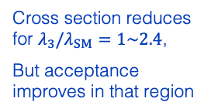

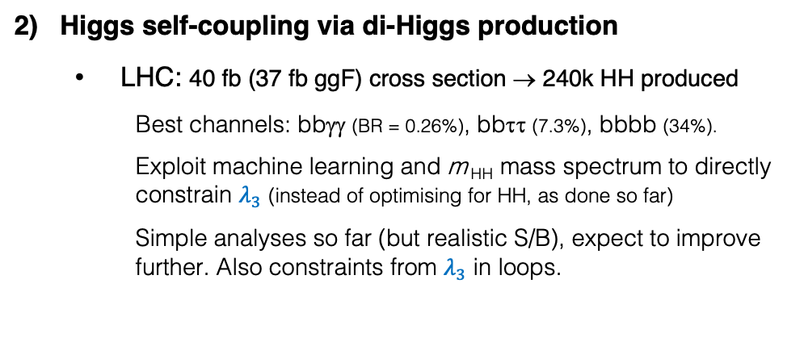


The 500 GeV question (continued)
Higgs self-coupling via di-Higgs production
  LHC: 40 fb (37 fb ggF) cross section → 240k HH produced
    Best channels: bbγγ (BR = 0.26%), bbττ (7.3%), bbbb (34%).
    Exploit machine learning and m _{HH} mass spectrum to directly constrain $λ_{3}$ (instead of optimising for HH, as done so far)
    Simple analyses so far (but realistic S/B), expect to improve further. Also constraints from $λ_{3}$ in loops.
$$λ_{3}=\frac{m_{H}^{2}}{2υ^{2}}\sim 0.13$$
LO diagrams contributing with negative interference
Box diagram dominates inclusive production
Sensitivity to H self-coupling rises at low m _{HH}
Second minimum constrained at low m_{HH} mainly from bbγγ
Extrapolated HL-LHC sensitivity
Cross section reduces for $λ_{3}/λ_{SM}=1\sim 2.4$,
But acceptance improves in that region
$$−0.52<\frac{λ_{3}}{λ_{3}^{SM}}<1.50$$
1902.00134
But no dedicated analysis optimisation on $λ_{3}$ yet

Slide 8
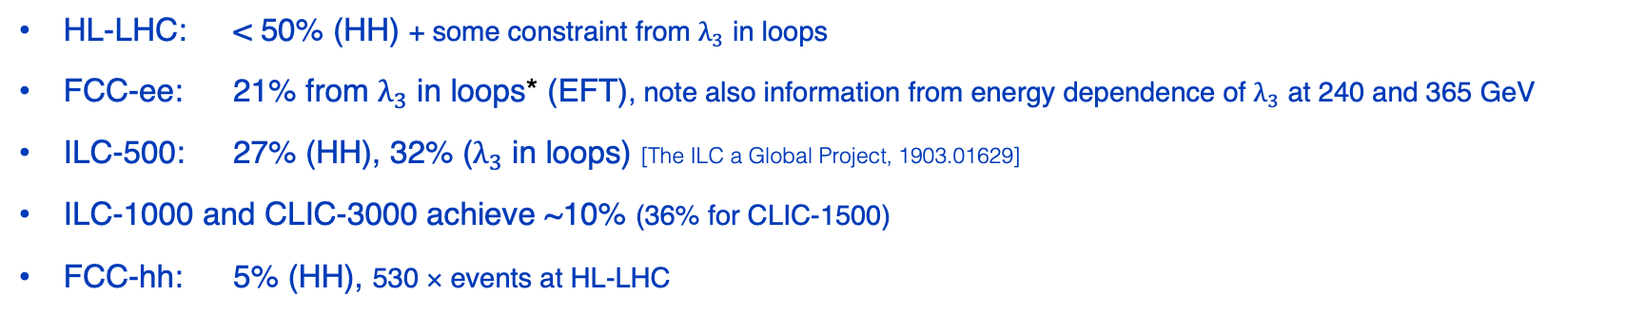
The 500 GeV question (continued)
Higgs self-coupling: expected precision on $λ_{3}$
HL-LHC: < 50% (HH) + some constraint from $λ_{3}$ in loops
FCC-ee: 21% from $λ_{3}$ in loops* (EFT), note also information from energy dependence of $λ_{3}$ at 240 and 365 GeV
ILC-500: 27% (HH), 32% ($λ_{3}$ in loops) [The ILC a Global Project, 1903.01629]
ILC-1000 and CLIC-3000 achieve ~10% (36% for CLIC-1500)
FCC-hh: 5% (HH), 530 × events at HL-LHC
A precise measurement of the Higgs self-coupling at the few percent level can only be provided by the combination of an e⁺e– collider and FCC-hh.
*

Slide 9
Electroweak precision and rare phenomena physics
FCC-ee is an electroweak and flavour factory
> 5 times better precision on S, T oblique parameters [1905.03764]
3–4 orders of magnitude improved sensitivity to LFV in Z decays
Flavour: 2×10¹¹ tau decays, B_{s} → ττ and B → K*ττ in 2×10¹² bb events
Searches for weakly coupled particles
LHC + ILC-250
LHC + CLIC-380
LHC + FCC-ee
LHC + ILC-250+GZ
LHC + CLIC-380+GZ
LHC + CEPC
Figures: Jorge de Blas private communications

Slide 10
Feedback to the European Strategy Group, a few personal remarks
As a community we should promote the projects with the largest scientific reach and lowest technical risk, not (or not primarily) the ones we believe the policy makers may accept (or like). If we are not convinced and united, we will convince no one else. If we are convinced to have the best scientific projects, we can move mountains!
There seems to be consensus that the next collider should be an e⁺e– “Higgs factory”. Given the arguments I tried to convey, I would wish the German community emphasised the importance of such a machine as next step, w/o prioritising a concrete project.
If Japan moves forward with the ILC, a decision is taken. Since, so far, this has not been the case we should not close the door to an FCC-ee at CERN. Its advantages (highest luminosity ≤ HZ, at least two experiments, lowest technical risk) counterbalance the shortcomings (inefficient > tt). The FCC-ee is a phenomenal machine.
I believe that the long term goal of a O(100 TeV) hadron collider for discovery physics should be emphasised. While it is essential that particle physics remains diverse and supports collider as well as non-collider projects, the flagship projects provide the largest scientific return.
CERN, as the European Laboratory of Particle Physics, is predestined to host such a hadron collider. The way towards it could be realised via a circular e⁺e– collider with its own complementary physics potential.
Finally, I believe it is important that the German community re-emphasises its long-term support for the High-Luminosity LHC. Although approved, it is not a reality yet: operation, analysis and upgrade of experiments and accelerator require our strong and lasting engagement.

Slide 11
Extra slide 1 — Higgs self-coupling
Graphical overview of constraints on Higgs self-coupling expected for future colliders
Figure from 1905.03764:
Sensitivity at 68% probability on the Higgs cubic self-coupling at the various FCs. All values reported correspond to a simplified combination of the considered collider with HL-LHC. Only numbers for Method (1), i.e. "di-H excl.", corresponding to the results given by the future collider collaborations, and for Method (4), i.e. "single-H glob." are shown (the results for Method (3) are reported in parenthesis). For Method (4) we report the results computed by the Higgs@FC working group. For the leptonic colliders, the runs are considered in sequence. For the colliders with √s < 400 GeV, Method (1) cannot be used, hence the dash signs. Due to the lack of results available for the ep cross section in SMEFT, we do not present any result for LHeC nor HE-LHeC, and only results with Method (1) for FCC-eh.

Slide 12
Extra slide 2 — Power consumption
Jenny List
Jenny List
HZ factory
HZ factory

Slide 13
Extra slide 2 — e⁺e– → H+X cross sections
HZ factory

